Slide 1
Coupling of UrQMD 3.4 and SMM models for simulation of neutron and nuclear fragment productions in nucleus-nucleus interactions
T.Q.T. Le^{1, 2}, A. Galoyan², V. Uzhinsky²
Institute of Research and Development, Duy Tan University, Da Nang, 550000, Vietnam
Joint Institute for Nuclear Research, Dubna, Russia

Slide 2
Outline
Description of experimental data of the NA61/SHINE collaboration on $π^{±},K^{±},p,\overline{p}$ production in Ar+Sc interactions at 13, 19, 30, 40, 75, 150 A*GeV using UrQMD model version 3.4
Study of neutron production in P + A interactions in the frame of UrQMD model version 3.4 .
Coupling of UrQMD 3.4 model with the Statistical Multifragmentation Model (SMM) by Botvina.
Analysis of neutron spectra in UrQMD+SMM model.
Description of fragment production in nucleus-nucleus interactions by UrQMD+SMM model.
Conclusion

Slide 3
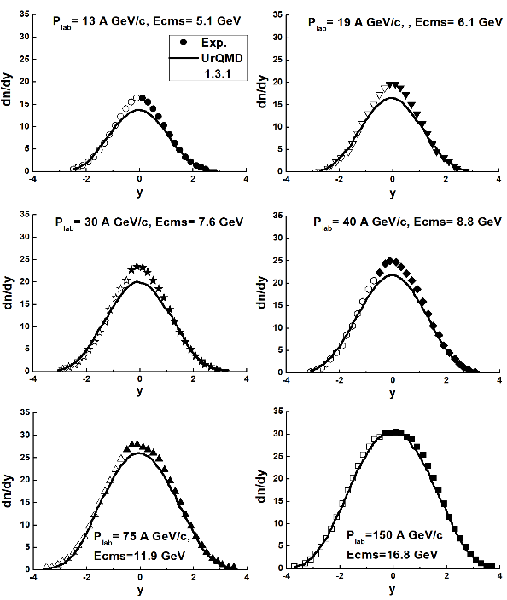
Pi-meson production in UrQMD model 1.3
UrQMD model is used to simulate hadron-nucleus and nucleus-nucleus interactions at high energies.
It represents a Monte-Carlo solution of a large set of equations:
Parameterization of cross-section of various meson-meson, meson-baryon, and baryon-baryon interactions.
String fragmentation and formation time of particles.
Epx. Data: Ar + Sc-> $π^{−}$+ X,
NA61/SHINE Collaboration, Eur. Phys. J. C 81 (2021) 397

Slide 4
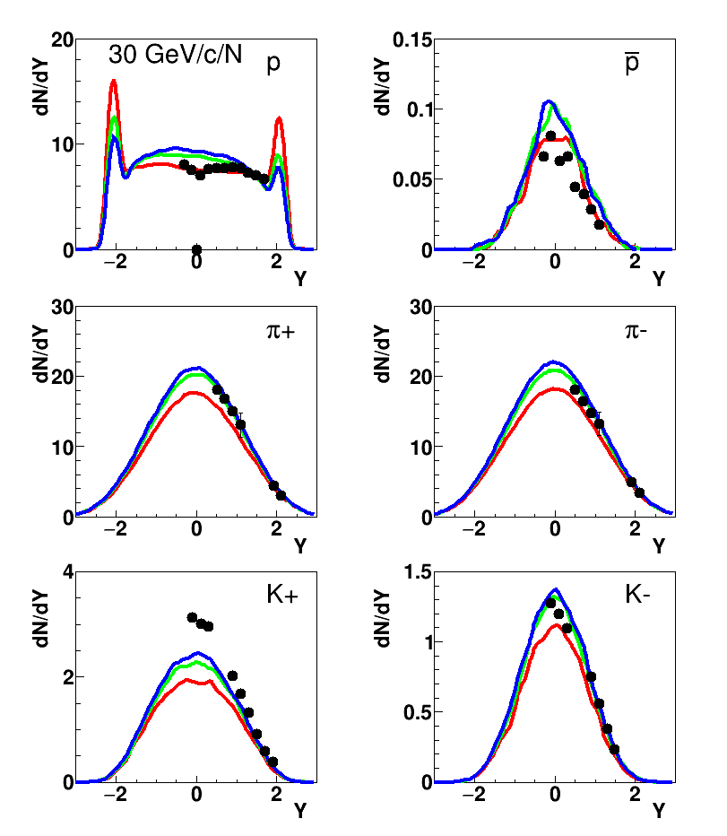
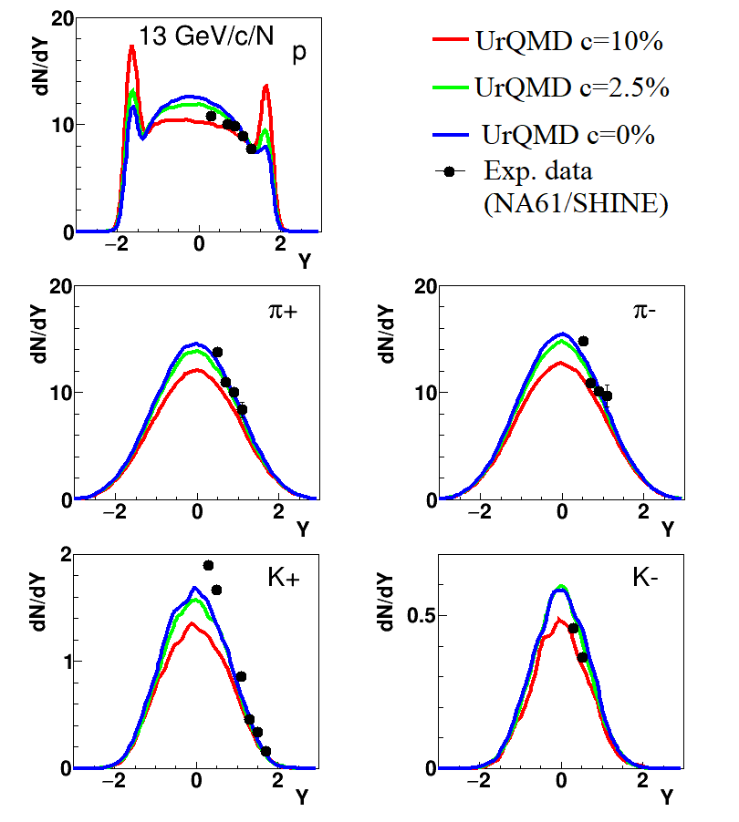
$π^{±},K^{±},p,\overline{p}$ production in Ar+Sc interactions according to UrQMD model version 3.4 . (Exp. Data: NA61/SHINE, 2024)
We installed UrQMD 3.4 at HybriLIT cluster at JINR. All given calculations are performed at HybriLIT
$$σ^{exp.}=c × σ^{inel.}$$
$$=πB_{max}^{2}$$
$$c=10\%$$
$$→ B_{max}=2.87 fm$$
$$c=2.5\%$$
$$→ B_{max}=1.44 fm$$
$$c=0\%$$
$$→ B_{max}0.0 fm$$
NA61/SHINE Collaboration., Adhikary, H., Adrich, P. et al.
Eur. Phys. J. C 84, 416 (2024)
At $P_{lab}$=19 GeV/c, we obtained the similar results with 13GeV/c

Slide 5
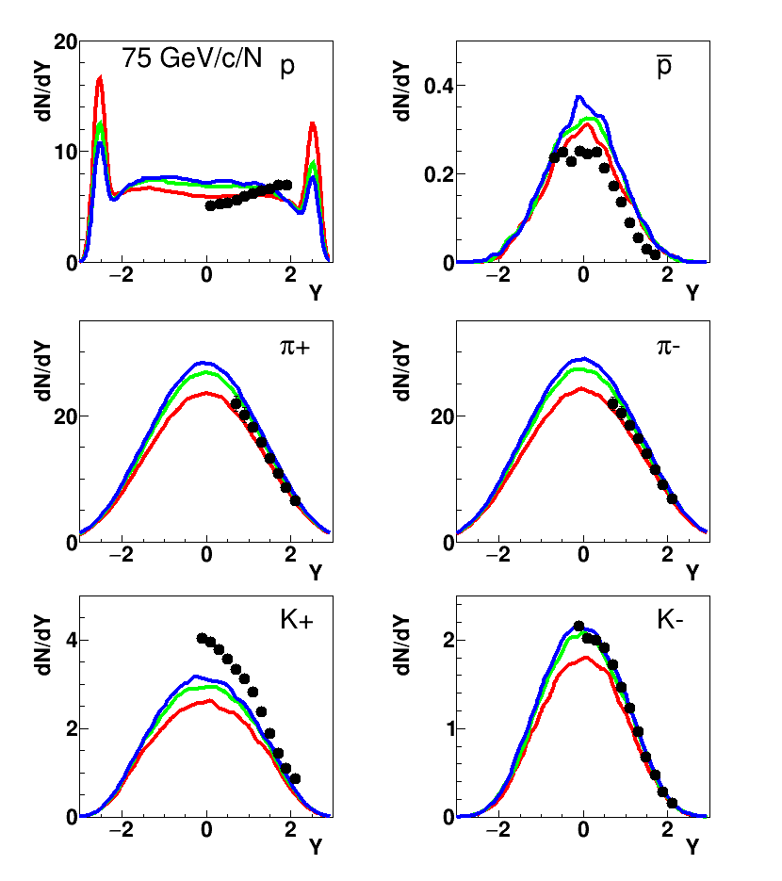
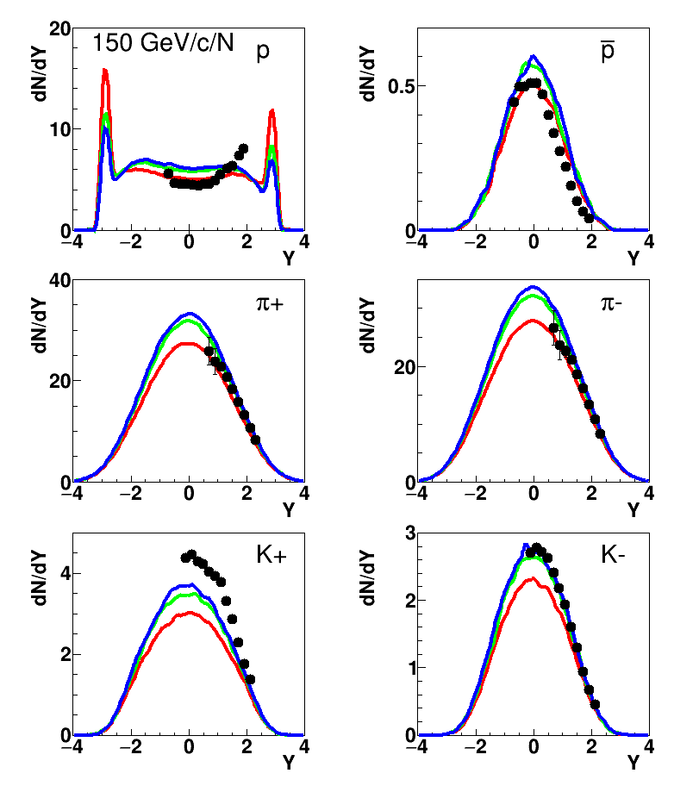
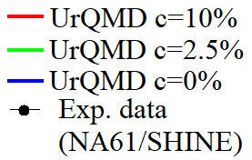
$π^{±},K^{±},p,\overline{p}$ production in Ar+Sc interaction at higher energies according to UrQMD model (Exp. Data: NA61/SHINE)
At c=2.5%,
$π^{±}$ are well described
For proton spectra are described better at 10%.
At $P_{lab}$=40 GeV/c, we obtained the similar results with 75GeV/c

Slide 6
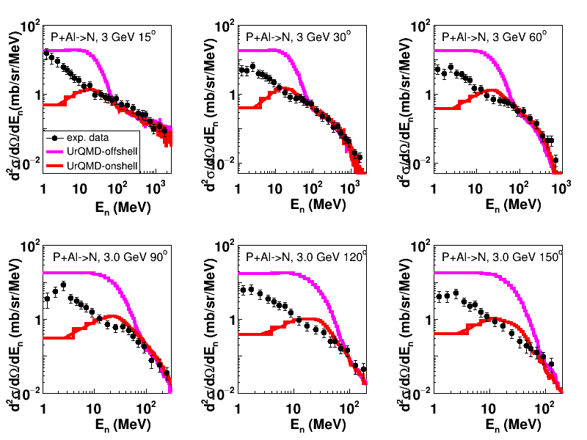
Neutron production using UrQMD model in p+Al interactions
(Exp. Data: K. Ishibashi et al., J.Nucl. Sci. Tech., Vol.34, N6 (1997) P. 529)
Large $E_{n}$: Normal UrQMD model works well!
Low $E_{n}$:
offshell or onshell neutrons have to be included?

Slide 7
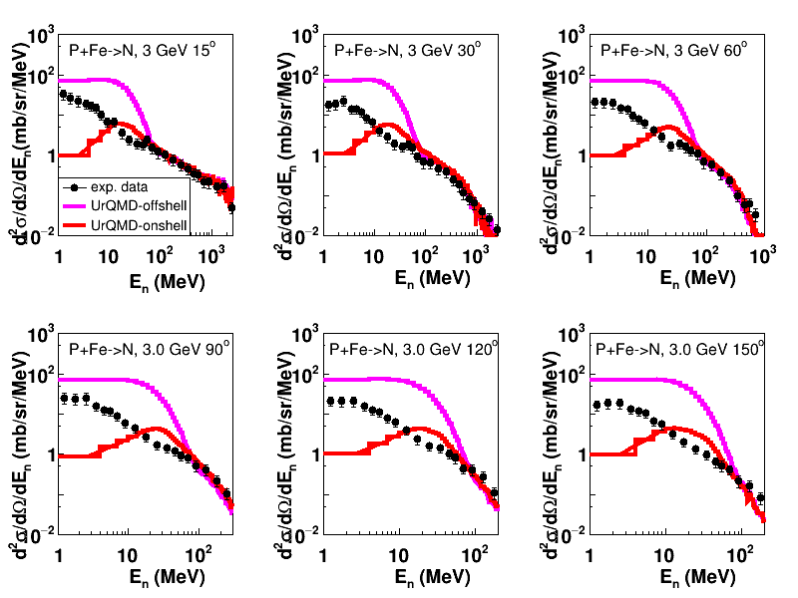
Neutron production using UrQMD model in p+Fe interactions
(Exp. Data: K. Ishibashi et al., J.Nucl. Sci. Tech., Vol.34, N6 (1997) P. 529)
Similar results are obtained for p+Fe interactions

Slide 8
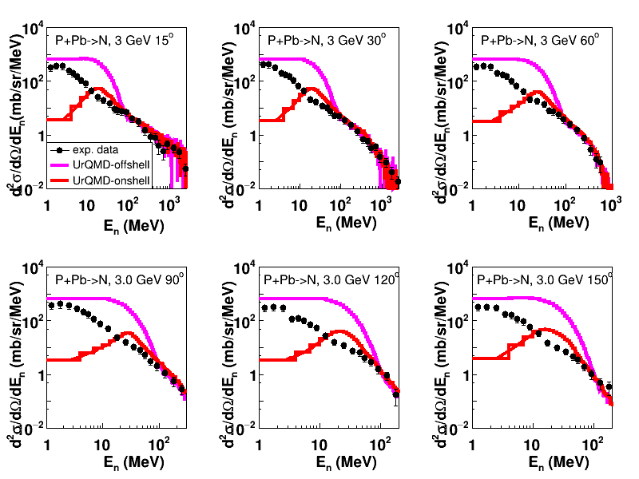
Neutron production using UrQMD model in proton interactions with heavy target.
(Exp. Data: K. Ishibashi et al., J.Nucl. Sci. Tech., Vol.34, N6 (1997) P. 529)
And for p+Pb interactions
Solution →
It is needed to couple UrQMD with Statistical Multifragmentation Model (SMM) by Botvina

Slide 9
Coupling of UrQMD and SMM models
UrQMD 3.4
(Original)
Cluster
(use neutrons, protons)
Botfra
Fragments
(n, p, frags)
Mesons, gamma, electron, etc.
For calculation by UrQMD+SMM model, potential mode of UrQMD is used (Option: eos=1 Skyrm energy; Coulomb energy).
The next parameters are imported in calculation by modified UrQMD+SMM model:
Evaluation time t =100 fm
radius of clusterization r = 3.0 fm (We also tested r = 2 and 4 fm.)
Excitation energy: $E_{excit}=\left(E_{potential}+E_{kinetic}\right)−E_{ground state}$

Slide 10
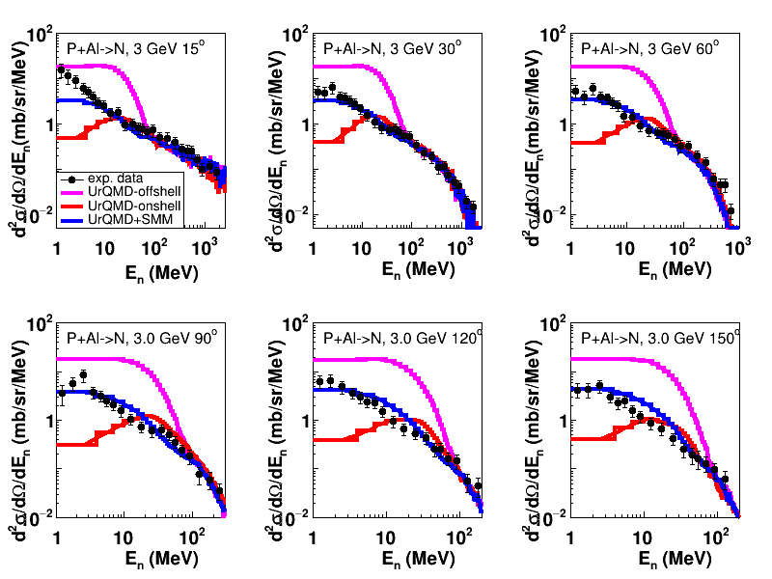
Coupling UrQMD and SMM models. Results for neutron production in p+Al interactions
(Exp. Data: K. Ishibashi et al., J.Nucl. Sci. Tech., Vol.34, N6 (1997) P. 529)
Neutron emission angle from 30-150 degrees, there is a good agreement between the modified model and exp. data.
At smaller angle + small kinetic energies, UrQMD+SMM underestimate the neutron spectra.

Slide 11
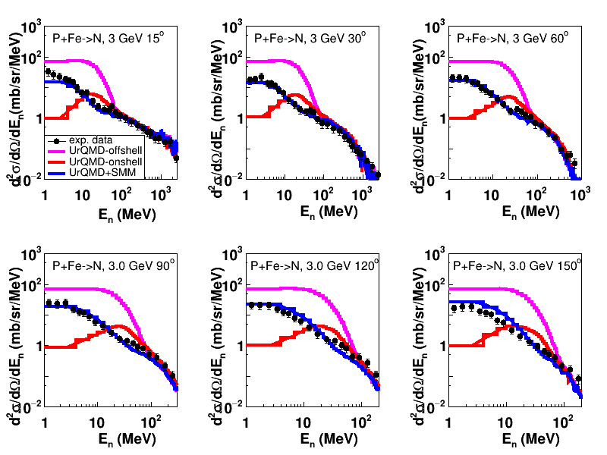
Coupling UrQMD and SMM models. Results for neutron production in p+Fe interactions
(Exp. Data: K. Ishibashi et al., J.Nucl. Sci. Tech., Vol.34, N6 (1997) P. 529)
UrQMD+SMM works well for all angles for intermediate nuclei.

Slide 12
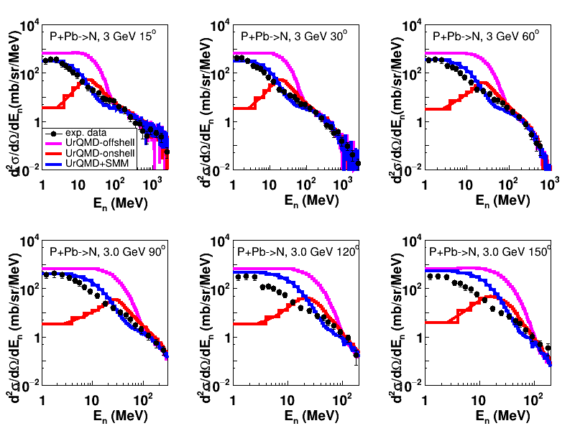
Coupling UrQMD and SMM models Results for neutron production in proton interactions with heavy nuclei
(Exp. Data: K. Ishibashi et al., J.Nucl. Sci. Tech., Vol.34, N6 (1997) P. 529)
UrQMD+SMM works well for describing forward angles neutron spectra.
Problem with description of backward emitted neutron spectra.

Slide 13
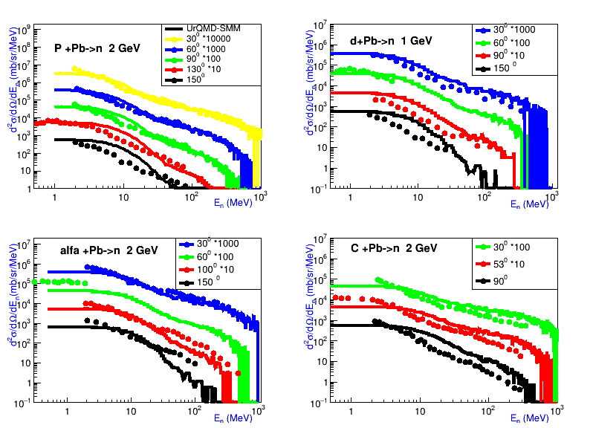
Coupling UrQMD and SMM models for studying neutron production in A+Pb interactions at various angles
(Exp. Data: V. I. Yurevich, R.M. Yakovlev, V. G. Lyapin (JINR)
Physics of Atomic Nuclei, 2006, Vol. 69, No. 9, P. 1496)
Description of forward neutron spectra is reasonably well.
Problems with description of backward emitted neutron spectra.

Slide 14
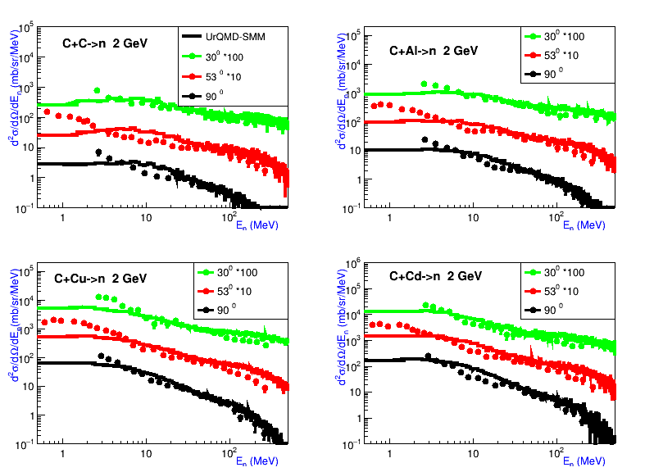
Coupling UrQMD and SMM models for studying neutron production in C+A interactions
(Exp. Data: V. I. Yurevich, R.M. Yakovlev, V. G. Lyapin (JINR)
Physics of Atomic Nuclei, 2006, Vol. 69, No. 9, P. 1496)
Good description of neutron production in interactions of C with various nuclei
(C, Al, Cu, Cd) at energy 2 GeV

Slide 15
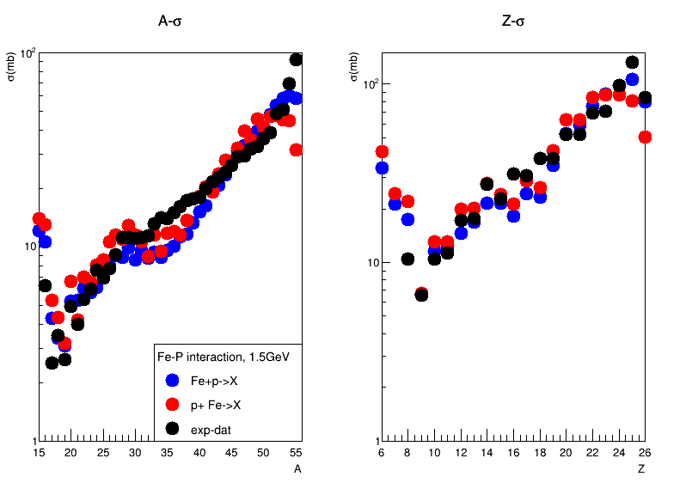
Mass and charge distributions of fragments produced in
Fe+p interactions according to UrQMD+SMM model. (Exp. Data: C. Villagrasa-Canton et al. Phys. Rev. C 75, 044603 – Published 13 April 2007)
There is observed a symmetry between calculations of Fe+P and P+Fe interactions by UrQMD+SMM model.

Slide 16
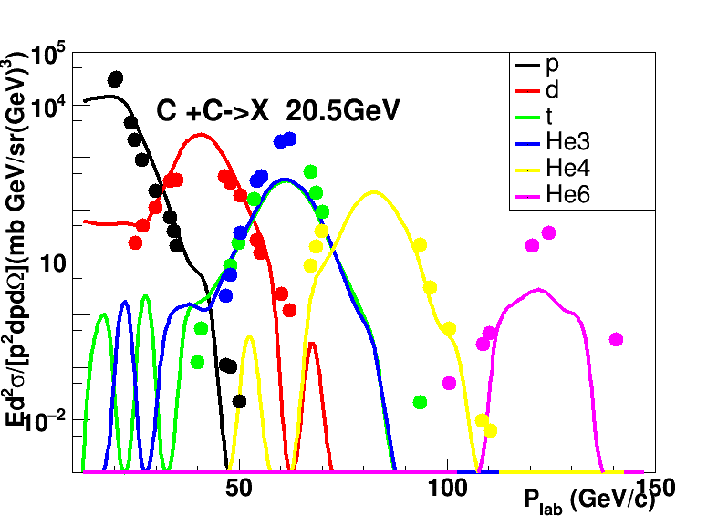
Momentum distributions of fragments produced in C+C interactions at energy 20.5 GeV according to UrQMD+SMM model (Exp. Data: Afonin, A. G., et al. Nuclear Physics A 997 (2020): 121718.)
Spectra of
p, d, He4 are described well by UrQMD+SMM
Problems with t, He3, He6 momentum distributions.

Slide 17
Conclusion and outlook
Conclusion:
The UrQMD model 3.4 describes sufficiently well the spectra of $π^{±},K^{−},p,\overline{p}$ in nucleus-nucleus interactions by NA61/SHINE Collaboration at various initial energies. There is a problem with reproducing of $K^{+}$ spectra in the model.
UrQMD model can not well describe neutron yield in proton-nuclei interactions at small neutron energies.
The UrQMD model has been coupled with SMM model. On the whole,
UrQMD+SMM model describes well neutron and fragment productions in proton –
nucleus and nucleus - nucleus interactions.
Outlook:
Applying UrQMD+SMM model for the MPD/NICA experiment.
Studies of neutron and fragments production are experimentally foreseen in BM@N experiment at JINR.

Slide 18
Thank you so much for your listening!

Slide 19
Ultrarelativistic Quantum Molecular Dynamics (UrQMD)
Monte Carlo model used to simulate nucleus-nucleus interactions at high energies by solving a large set of equations:
Where f(x,p) are phase space densities of particle species.
Consideration of cross-section of various meson-meson, meson-baryon, and baryon-baryon interactions.
Potential interaction between particles: Yukawa, Coulomb, Pauli potential.

Slide 20
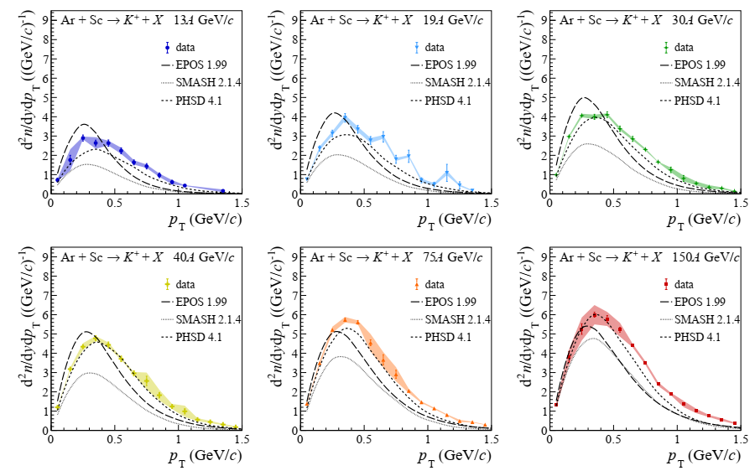
Appendix: K-meson production in different simulation model

