Slide 1
Memberships of the PACs
Acad. Grigory V. Trubnikov

Slide 2
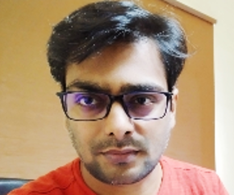
PAC for Particle Physics
Dr. Amaresh Jaiswal (National Institute of Science Education and Research — NISER, Bhubaneshwar, Odisha, India) as a new member of the PAC for Particle Physics for a term of three years.
Honourable Mention in Rahul Basu Memorial Award for Best Ph.D. Thesis in High Energy Physics (2014); INSPIRE Faculty Award from Department of Science & Technology, India (2017); Young Achiever Award, DAE Symposium on Nuclear Physics (2022); Life member of the Indian Physics Association from 2024.
2014 – 2017: Post-doctoral Fellow, Theory Division, GSI Helmholtzzentrum für Schwerionenforschung, Darmstadt, Germany.
2017 – present: Associate Professor, School of Physical Sciences, NISER, India.
Areas of Research: relativistic dissipative fluid dynamics with spin; theoretical formulation of causal relativistic dissipative fluid dynamics from kinetic theory; thermal and blast wave model study of relativistic heavy-ion collisions; phenomenology of heavy quarkonia in relativistic heavy-ion collisions. Cosmology and nuclear astrophysics.
Scientific Reviewer of Physics Letters B, Physical Review C, D, E, Journal of Physics G, European Physical Journal A, Scientific Reports – Nature, Advances in High Energy Physics.
Member of Programme Committee “India-JINR Workshop on Elementary Particle and Nuclear Physics, and Condensed Matter Research”, Dubna, 2023; Organizer “2nd Workshop on Dynamics of QCD Matter, NISER, October 07–09, 2023.

Slide 3
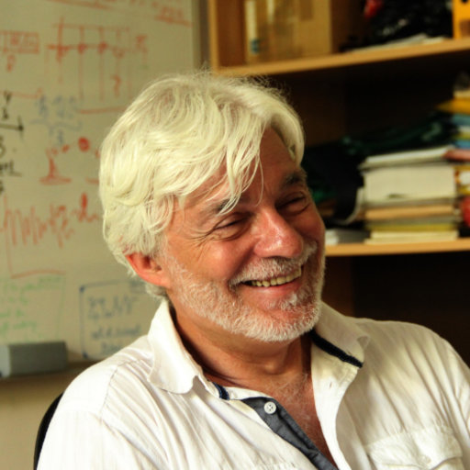
PAC for Particle Physics
Prof. Leandar Litov (Sofia University “St. Kliment Ohridski”, Bulgaria) as a new
member of the PAC for Particle Physics for a term of three years.
Professor in Particle Physics, Head of the Atomic Physics Department,
Faculty of physics, University of Sofia “St. Kliment Ohridski”.
Worked for 11 years at JINR (1979–1990) and 14 years at CERN.
Outstanding scientist in the field of experimental and theoretical particle physics.
Fields of research: Elementary particle physics; Design and construction of
experimental equipment; Monte Carlo simulation and data analysis;
Theoretical research in the field of quantum physics; Computer drug design.
Science-management experience: Establishing of the Particle Physics Group at the University of Sofia, its supervision and management (including both material and human resources).
Organization of Bulgarian participation in particle physics experiments (CMS, NA48, NA49, NA62).
Organization of conferences and workshops.
Membership: Bulgarian National Commission for collaboration with CERN (1999–2000 and since 2006).
CMS RDMS (Russia and Dubna Member States) Collaboration Board (since 1995).
CMS Collaboration Board (since 1993).
European Commission for Future Accelerators (ECFA) (since 1999).
Bulgarian National Commission on HEP (since 2002).
NA62 Steering Committee (since 2006).

Slide 4
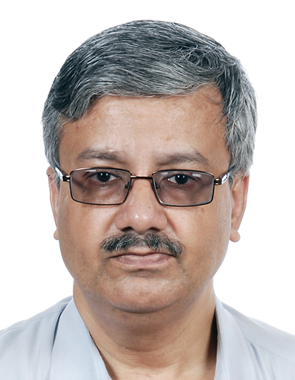
PAC for Particle Physics
Prof. Gobinda Majumder (Tata Institute of Fundamental Research (TIFR), Mumbai, India) as a new member of the PAC for Particle Physics for a term of three years.
Prof. Gobinda Majumder is a Senior Professor at the Department of High Energy Physics of the TIFR.
Expertise in Elementary Particle Physics, Neutrino physics. Significantly contributed to many experiments within India and worldwide:
L3 experiment at CERN.
CLEO experiment at Cornell University (USA.
proposed BTeV experiment at FNAL.
BELLE experiment at KEK (Japan).
CMS experiment at CERN.
India-based Neutrino Observatory (INO) at TIFR.
At present, Prof. Gobinda’s primary focus is the detector development for the future collider experiments, particularly calorimeters using quantum sensors.
Due to his significant contributions to the scientific community, he was elected fellow of all three science academies of India and part of the many national/international organization, an important one was the Fermilab (US) Long Baseline Neutrino Committee (LBNC).

Slide 5
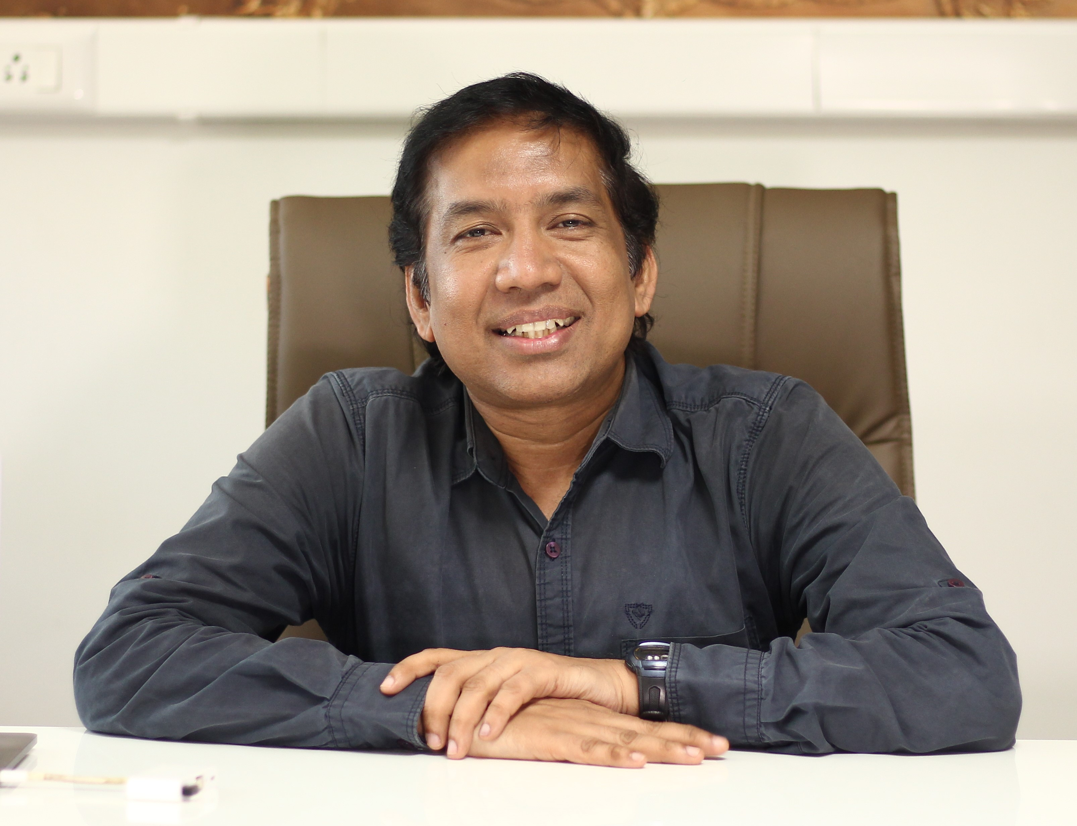
PAC for Condensed Matter Physics
Prof. Ravi Kumar N V (Indian Institute of Technology Madras, Chennai, India) as a new member of the PAC for Condensed Matter Physics for a term of three years.
Ravi Kumar is a Professor at the Department of Metallurgical and Materials Engineering, IIT Madras, Head of the Central X-ray Diffraction Laboratory.
Research expertise: development of novel non-metallic & inorganic materials whose properties can be tuned on an atomistic scale which includes thermal management, catalysis and energy development of novel ceramic materials, their testing techniques and fabrication methods.
Collaborates with a large number of national and international institutions and organizations (in Russia, Serbia, France, Germany, Japan, USA, and multilateral collaboration within BRICS).
Member of the editorial board of numerous journals on Materials Science.
Membership of professional bodies: American Ceramic Society, ASM International, Serbian Ceramic Society, Indian Institute of Metals, Indian Ceramic Society, etc.
Entrepreneurship: Professor Ravi Kumar has incubated two start-ups in the IIT Madras Research Park.

Slide 6
The JINR Directorate asks the Scientific Council
to approve these proposals

