Slide 1
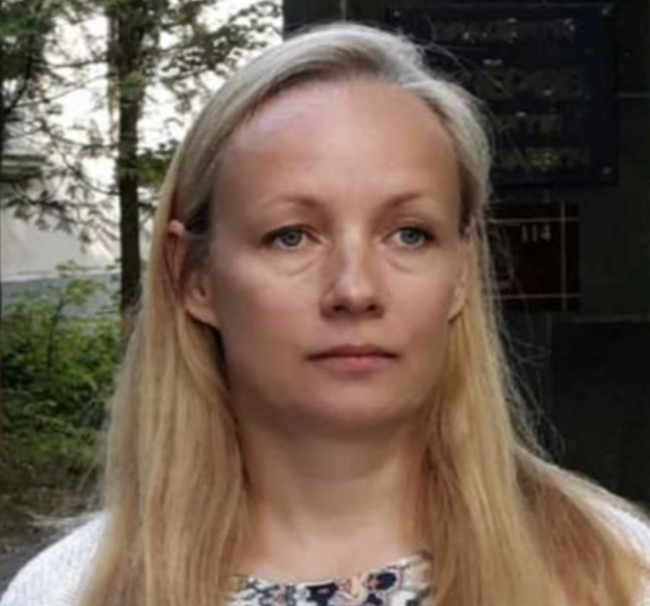
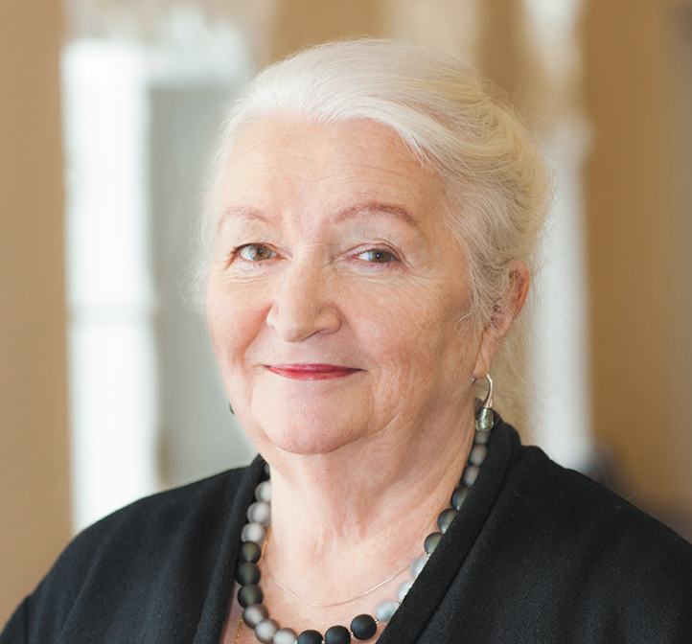
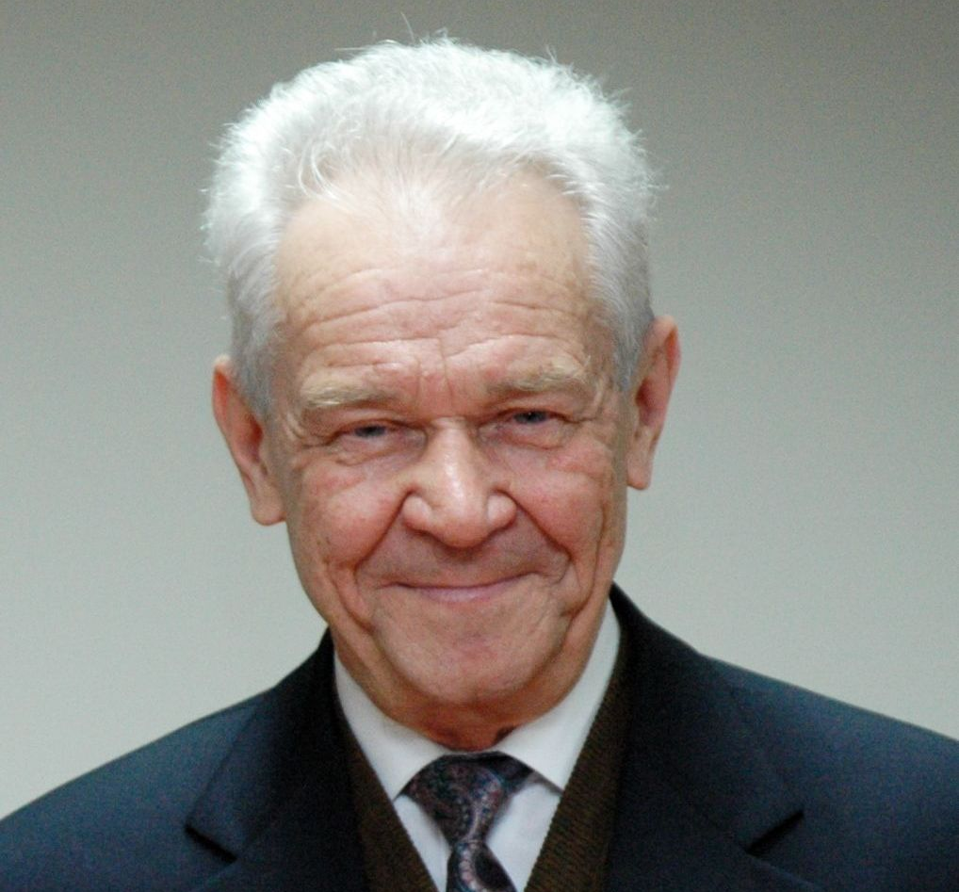
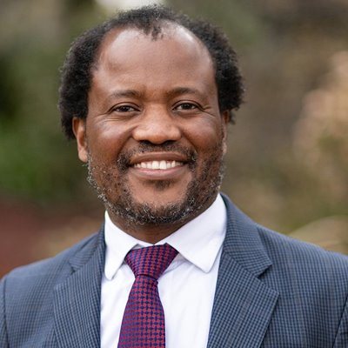
The OGANESSON Prize Winners in 2024
Dr. Aliya NURMUKHANBETOVA
Dr. Galina KNYAZHEVA
Prof. Tatiana CHERNIGOVSKAYA
Academician Yuri ZOLOTOV
Prof. Zeblon Zenzele
VILAKAZI
Nazarbayev University, Kazakhstan
Flerov Laboratory of Nuclear Reactions of the Joint Institute for Nuclear Research
Director of the Institute of Cognitive Research, St Petersburg University, Honored Worker of Higher Education and Honored Scientist of the Russian Federation
Russian Academy of Sciences
Vice-Chancellor and Principal of Wits University
For the development and implementation of a new programme for the study of the lightest nuclei at the low-energy ion accelerator (DC–60)
For pioneering work on the observation and study of the quasi-fission process of the heaviest nuclei
For her outstanding contribution to the popularization of scientific knowledge and the development of interdisciplinary research at the intersection of neuroscience, linguistics, and psychology
For outstanding scientific work in the field of analytical chemistry, for his enormous personal contribution to the training of young scientists, specialists and highly qualified personnel
For his significant contribution to the development of scientific cooperation between South Africa and JINR in the field of nuclear reactions, accelerator technologies, and relativistic nuclear physics

