Slide 1
Programme Advisory Committee for Condensed Matter Physics
59th meeting, 24-25 June 2024
Dénes Lajos Nagy
136th Session of the JINR Scientific Council, 12-13 September 2024

Slide 2
Agenda of the 59th PAC meeting
25 June 2024
26 June 2024

Slide 3
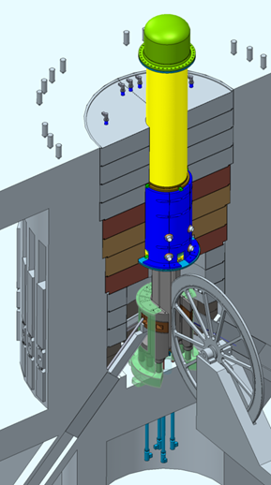
Current status of work on the new neutron source
The PAC took note of the information on the development of the new neutron source, presented by Egor Lychagin. The PAC endorsed the main directions of activities, including work to outline the suite of necessary instruments of the facility, develop models of reactor dynamics, and study the heating of the modulator elements and the reactor vessel.
In further work on the project of the new reactor facility, the most pressing tasks for the near future are research into the mechanisms of power feedback formation and the development of mathematical models describing the processes leading to fluctuations in pulse energy on the basis of the IBR-2 operation experience.

Slide 4
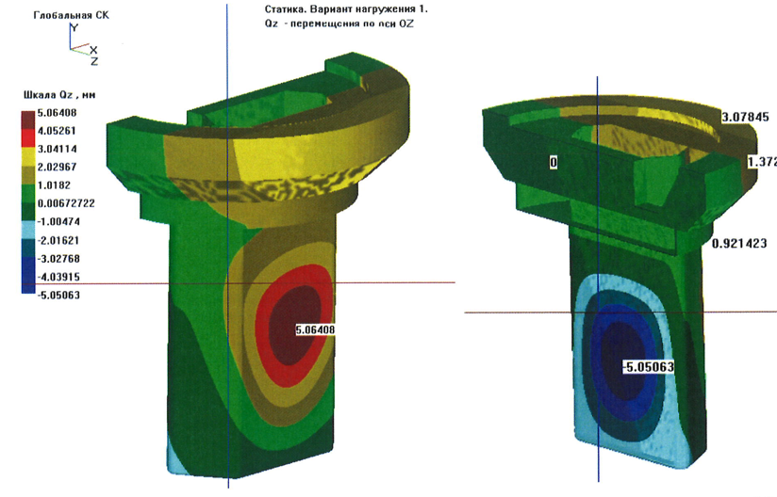
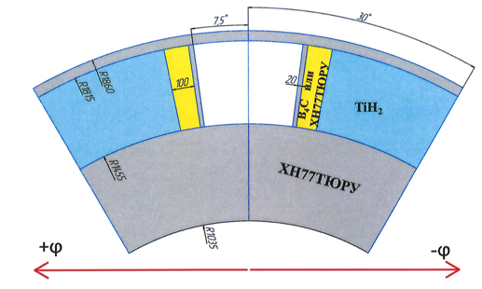
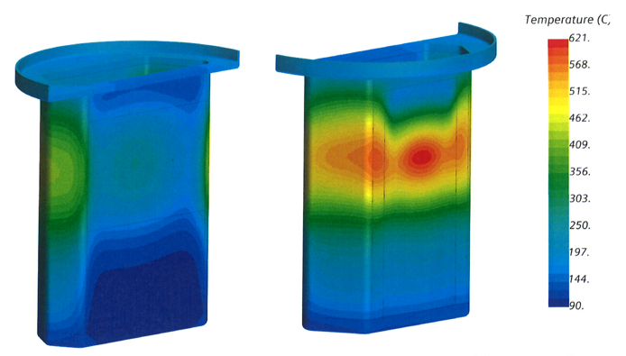
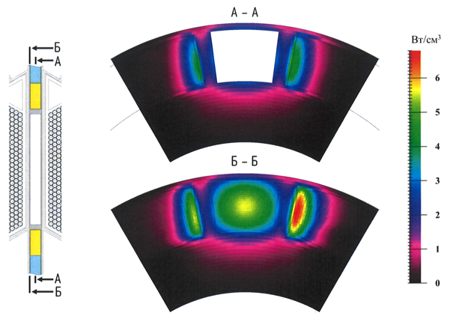
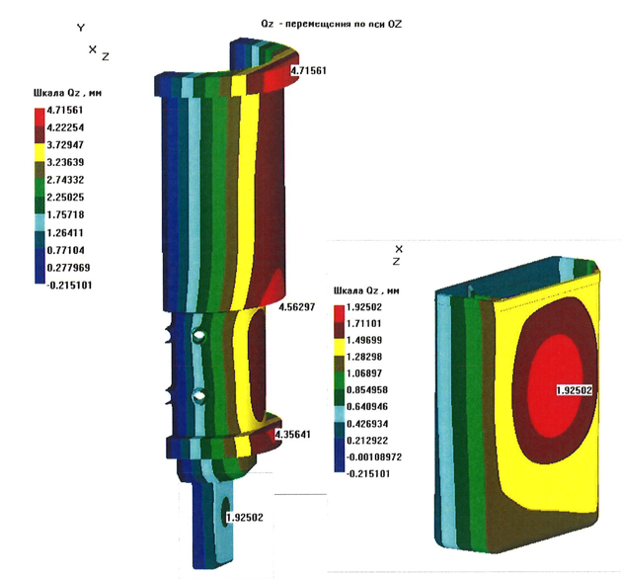
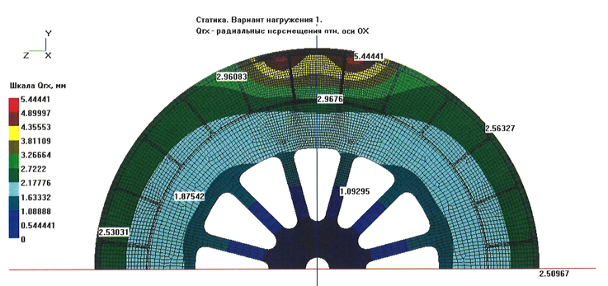
Current status of work on the new neutron source
Thermal-hydraulic calculations of the reactivity modulator, core, housing and safety housing were performed by NIKIET in 2023-2024. The calculations were performed for two variants of the reactor body design for the single fuel rod load of the core:
- with reactivity modulator without a jacket;
- with reactivity modulator in a cooling jacket.
2023-2024
Deformations
Temperature
“It was shown that in both cases, at a power of 15 MW, the permissible temperature of the modulator is not provided, and the resulting deformations of the jacket are unacceptable.
Possible technical solutions to these problems may lead to deterioration in the reactor characteristics below the specified limits.”
Deformations
Temperature
Deformations
FLNP physicists continue to check these conclusions.
Next step: determine the facility parameters at which permissible deviations are achieved. This is a labor-intensive and expensive task.

Slide 5
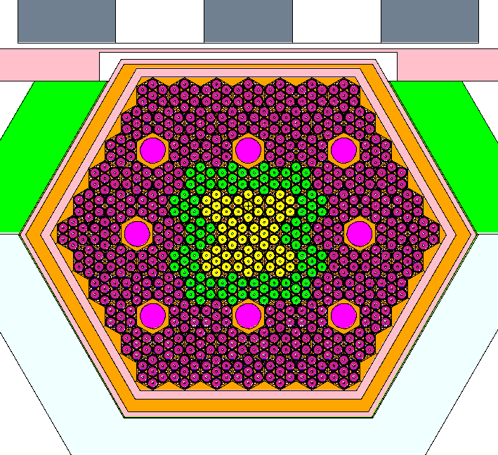
Current status of work on the new neutron source
Another concept of the reactor from FLNP (2020-2024):
fuel as in IBR-2;
existing PO-3 modulator of reactivity for IBR-2
vessel is practically the same as the MBIR vessel;
new core design.
AM of CPS
Rotated
plug
Parameter | value
Average power, MW | 4
Coolant | Sodium
Repetition rate, 1/s | 10
Fuel | PuO₂
Core volume, l | ~23,4
Thermal neutron flux density, 10¹³ n/cm² ∙s | up to 12*
Vessel
Coolant exit
Core
102 fuel assemblies,
86 fuel assemblies with plutonium dioxide,
8 control rods with enriched boron,
8 fuel assemblies – simulator cassettes to compensate for burnout,
13 fuel assemblies with tungsten inserts 6 cm long in the center of each fuel element.
Entrance
Water
moderators
AMR
BMR
* depending on the thermal neutron pulse width.
Pepelyshev Yu. N. et al.
Preliminary Computations for the Pulsed Reactor IBR-4.
Basic Composition. JINR Preprint P13-2024-7
This concept has not been discussed with the Chief Designer yet.

Slide 6
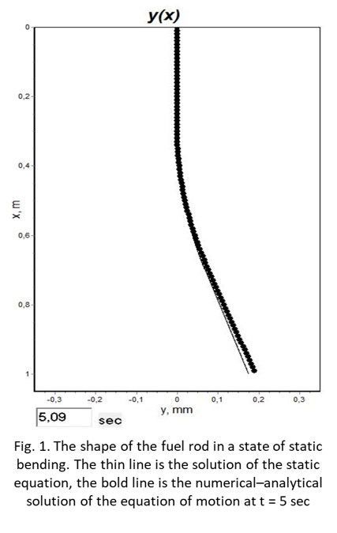
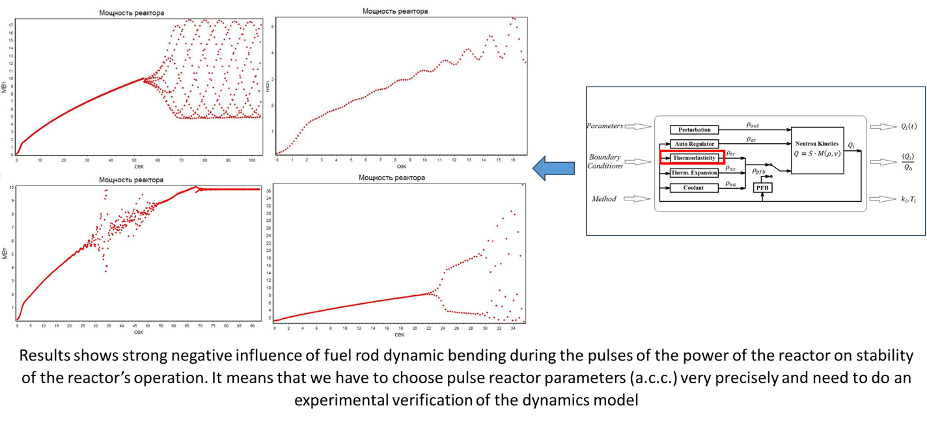
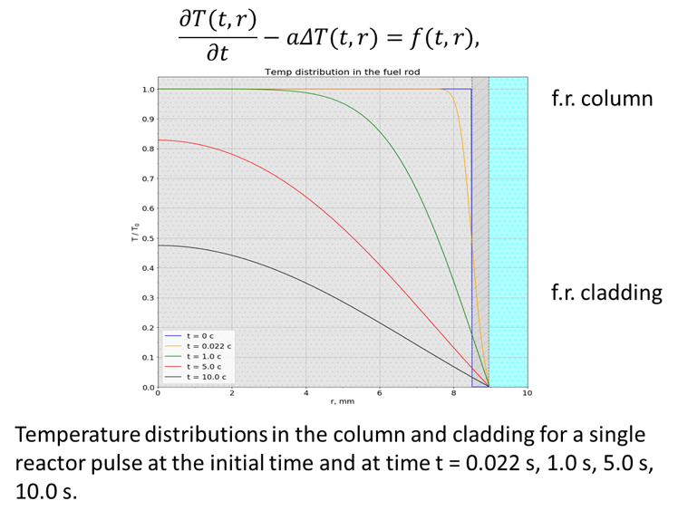
Current status of work on the new neutron source
Key issues for any new pulsed reactor include the prediction of pulse energy fluctuations to keep them within acceptable limits, and the determination of reactor stability limits. The IBR-2 exploitation experience shows a strong dependence of fluctuations on the core configuration and its power.
Increasing the power of new facilities requires the creation of an adequate theory/model for predicting these characteristics. The model can be tested at low energies only on IBR-2.
Our physicists have been working on this problem for a long time. The problem of dynamic bending was found and partially studied, which is significant for single fuel rod loading into the core.
The results were presented in the 55th and-57th meetings of the PAC for Condensed Matter Physics :
We plan to continue this work theoretically and in experiments together with VNIITF.

Slide 7
Current status of work on the new neutron source
Recommendation
The PAC recommended continuing work on the project to develop the new neutron source.
The PAC agreed with the proposal of the FLNP Directorate that at this stage of work, activities should be focused on the following issues:
Development of the concept of the new source;
Development of mathematical models describing processes leading to fluctuations in pulse energy on the basis of the IBR-2 operation experience;
Continuation of work on developing a scientific program for the new reactor with a concept of the instrument base;
Continuation of work on developing the concept of a system for fast changing the working material in the chamber of the cryogenic moderator of the reactor, and extending activities on determining the optimal configuration of the cryogenic moderator chamber of the new neutron source with a working substance based on hydrogen-containing materials.
Schematic of the large-aperture backscattering detector.

Slide 8
Current plans to resume operation of the IBR-2 reactor and preparations
for the restart of the FLNP User Programme
The PAC took note of the information on the progress of obtaining a license to operate the IBR-2 nuclear research facility and on the preparatory work to replace the air heat exchangers of the reactor’s secondary cooling circuit, presented by Bagdaulet Mukhametuly. At the moment, the FLNP Directorate plans to resume the operation of the reactor in the fall of this year.
Assembling of
a tower crane
on-site.
Removing the
insulation of air
heat exchanger.
Preparing the air
heat exchanger
for dismantling.
The heat
exchanger drain
manifold is
prepared for
cutting.
Tower crane
near the
reactor.

Slide 9
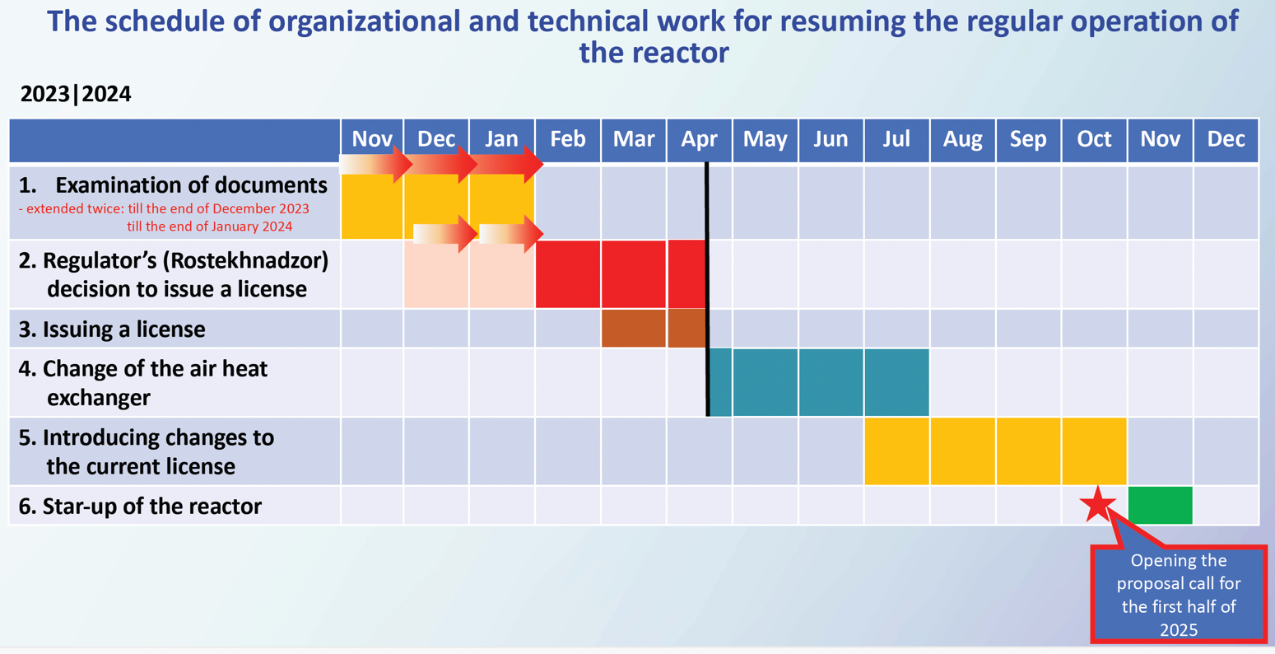
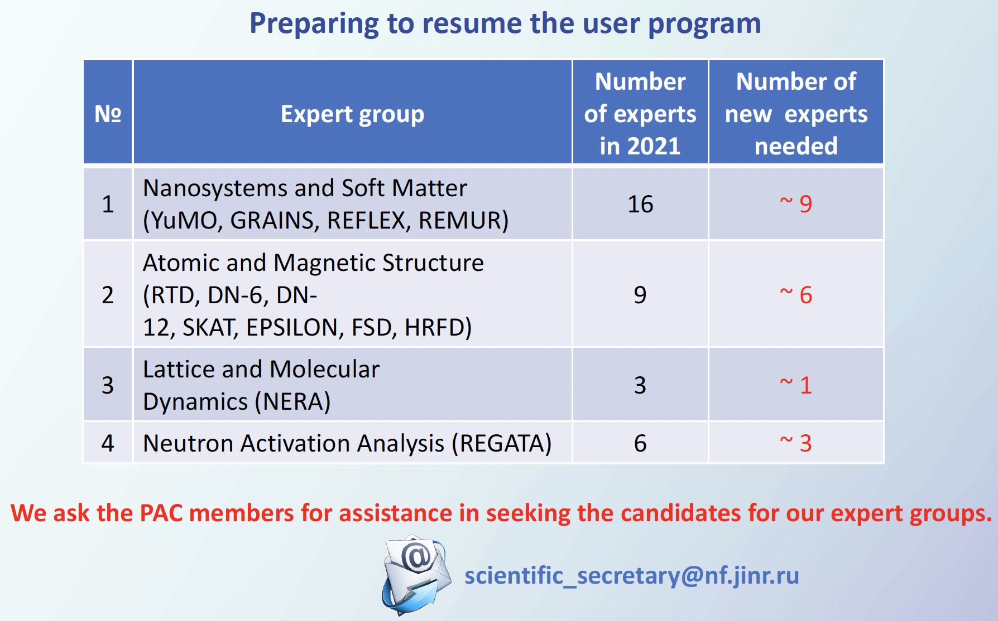
Current plans to resume operation of the IBR-2 reactor and preparations
for the restart of the FLNP User Programme
Recommendation. The PAC highly appreciated and supported FLNP’s plans and efforts to restart the operation of the IBR-2 nuclear research facility in 2024–2025 and resume the FLNP User Programme in 2025. The PAC noted the need to attract a sufficient number of experts to review projects.

Slide 10
Status reports on the upgrade of FLNP instruments
The PAC was informed about the status and progress of instrument modernization at the IBR-2 reactor, presented by Viktor Bodnarchuk.
The PAC noted that active preparations are underway at the IBR-2 spectrometers for the reactor start-up at the end of 2024.
All important elements of the spectrometers are being tested and adjusted for correct operation. The detector systems of the spectrometers are undergoing routine testing to ensure their readiness for the reactor start-up.
Two new scintillation detectors (ASTRA-M, BSD) have been installed on the IBR-2 beamlines and are ready for test measurements after the IBR-2 reactor starts its operation. Most of the choppers with their control electronics have already been tested and are ready for operation. At present, implementation of the BJN project and activity on the SANSARA instrument are in progress.

Slide 11
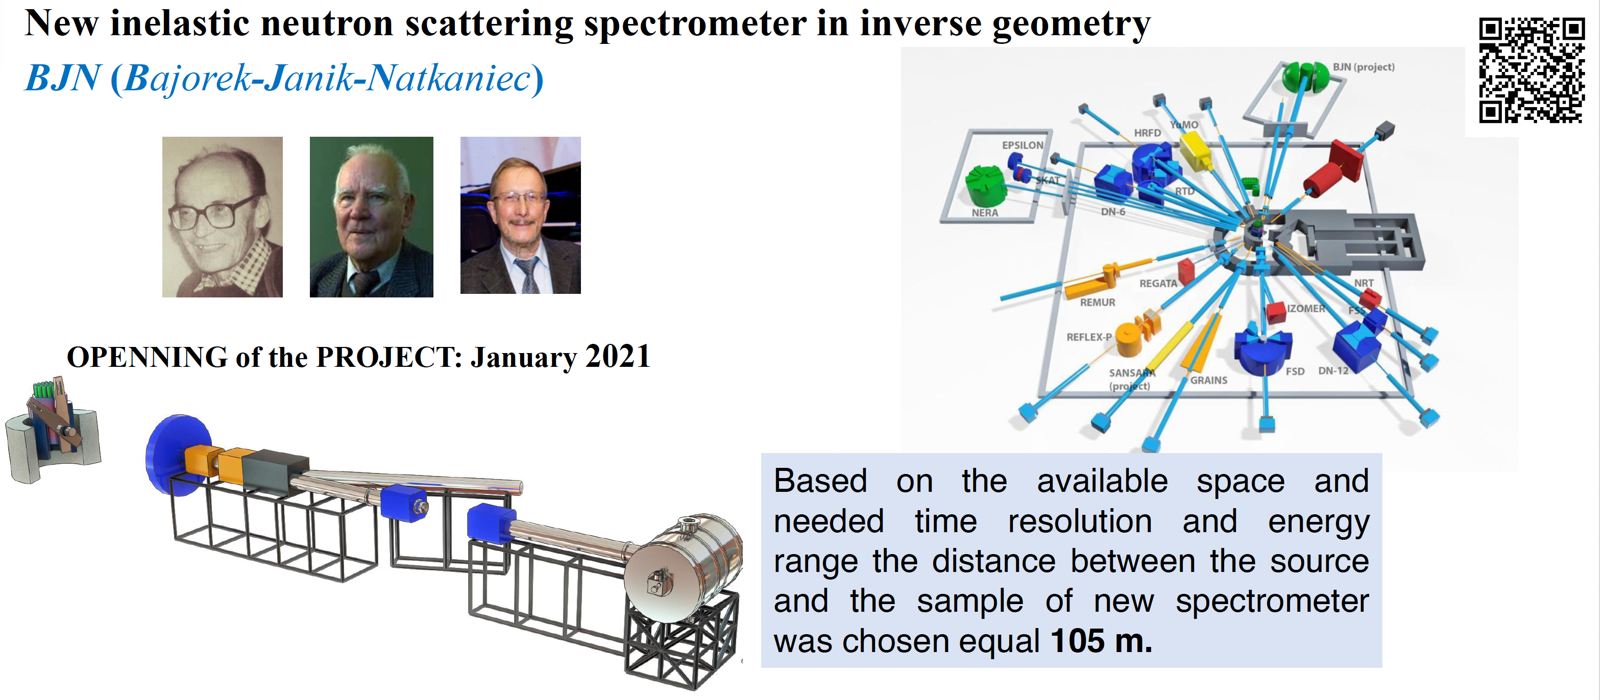
Status reports on the upgrade of FLNP instruments
The PAC supported overall progress in preparing spectrometers and equipment for the reactor start-up. In particular, the PAC supported activities on the development of the new BJN spectrometer.

Slide 12
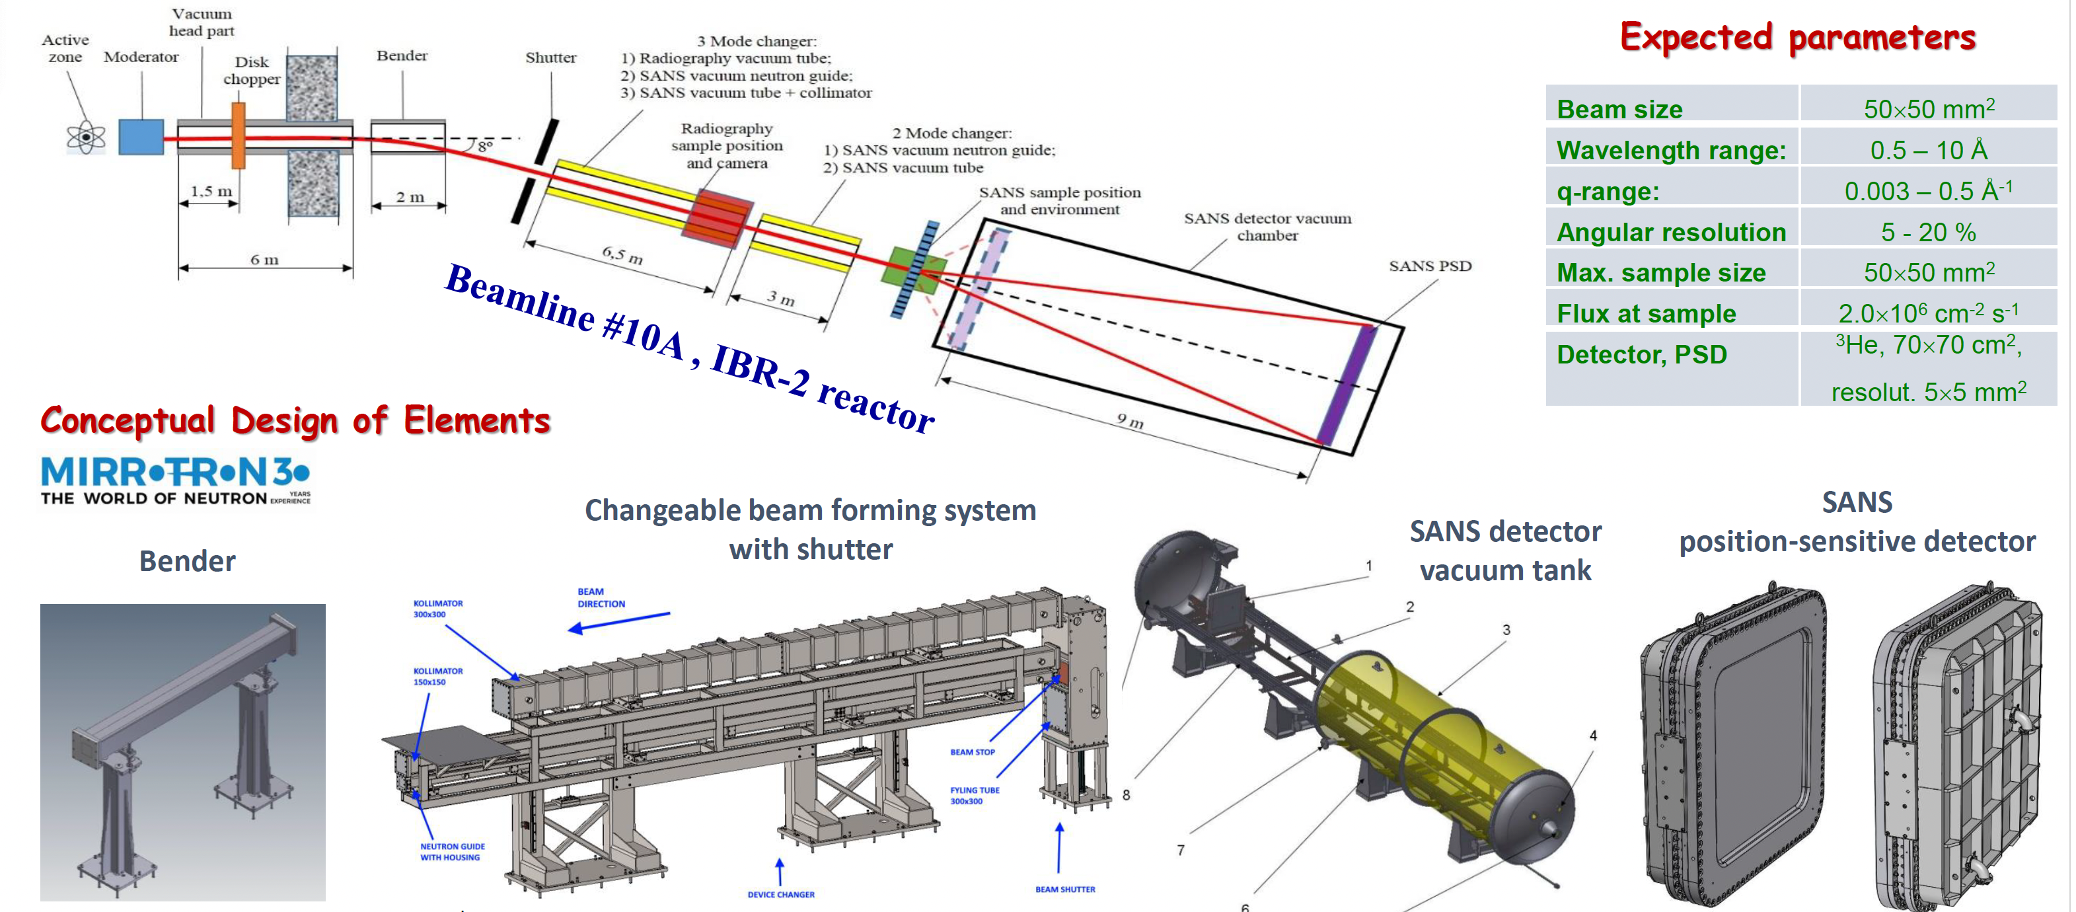
SANSARA Spectrometer
SANS/ Neutron Tomography
The PAC heard a report on the status of the SANSARA instrument and noted the progress in its creation within the instrument development programme of the project “Investigations of functional materials and nanosystems using neutron scattering”.

Slide 13
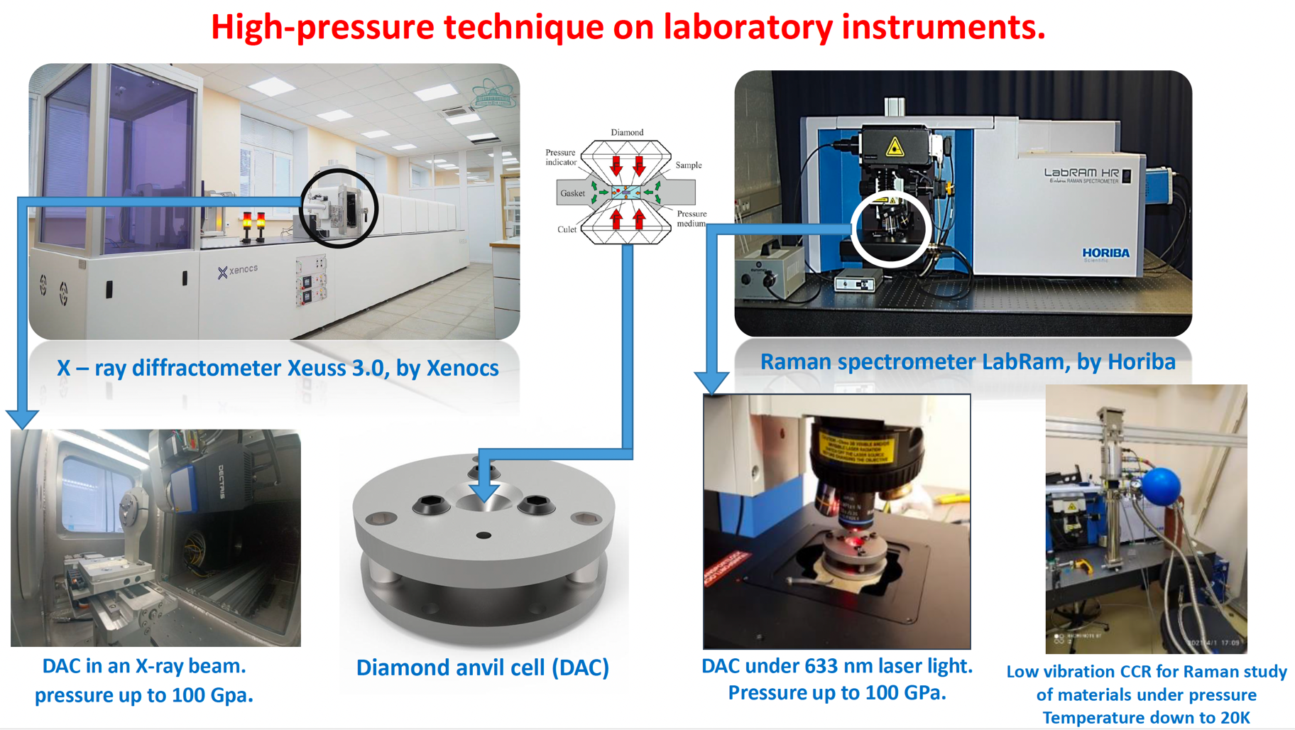
DN-6 diffractometer
The PAC heard the report on the current state of the DN-6 diffractometer for the study of materials at ultrahigh pressures, presented by Evgeny Lukin. The PAC noted a significant modernization of the instrument, which makes it possible to increase the incident neutron flux density onto the sample and improve the quality of experimental data.
Recommendation. Considering that the DN-6 diffractometer is one of the most advanced facilities in the world for neutron scattering studies of materials under extreme conditions, the PAC supported the further development of this diffractometer.

Slide 14
Reports on projects
The PAC took note of the proposal to open a new project, “High-sensitivity sensors based on molecular recognition for virus detection”, presented by Alexander Nechaev.
Recommendation. The PAC recommended opening this project for its implementation in 2025–2029 within the theme “Radiation Materials Science, Nanotechnological and Biomedical Investigations with Heavy-Ion Beams”.
The PAC took note of the progress report on the project “Protection against physical and chemical stresses with tardigrade proteins (TARDISS)”, presented by Mikhail Zarubin.
Recommendation. The PAC welcomed the ongoing activities within the project TARDISS and recommended its further continuation within the theme “Study of Molecular Genetic Mechanisms of Adaptations of Extremophilic Organisms”.

Slide 15
Scientific reports
The PAC heard with interest the scientific reports
“Functional renormalization group approach to some problems of condensed matter physics ” (by Georgii Kalagov)
“Study of phase transitions in cathode materials for sodium-ion batteries” (by Natalia Samoylova)
The PAC thanked the speaker for the excellent reports.

Slide 16
Virtual presentations by young scientists
The PAC reviewed 19 virtual presentations made by young scientists in the field of condensed matter physics and related fields. The virtual poster presentation “Pressure effect on crystal, magnetic structure and vibrational properties of van der Waals materials” made by Olga Lis was selected as the best presentation of the session.
The PAC also noted two more virtual poster presentations of a high level: “Convolutional neural networks for reconstruction of three-dimensional neutron tomography models from incomplete data” by Bulat Bakirov and “The effect of calcium ions on the structure and morphology of lipid membranes in the presence of amyloid-beta peptide” by Sergei Kurakin.
Recommendation. The PAC recommended the poster “Pressure effect on crystal, magnetic structure and vibrational properties of van der Waals materials” to be presented at this session of the JINR Scientific Council.

Slide 17
Thank you for your attention

