Slide 1
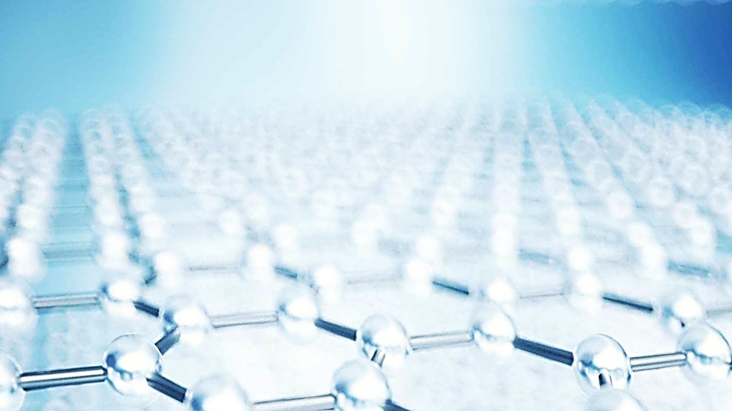
Pressure effect on crystal, magnetic structure and vibrational properties of van der Waals materials
O.N. Lis, D.P. Kozlenko, S.E. Kichanov, E.V. Lukin, I. Yu. Zel

Slide 2
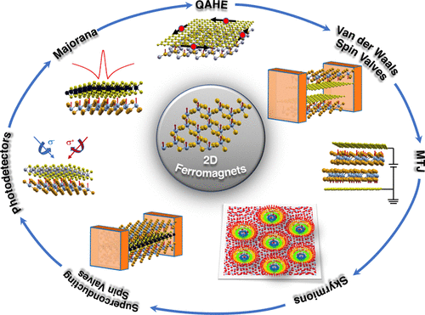
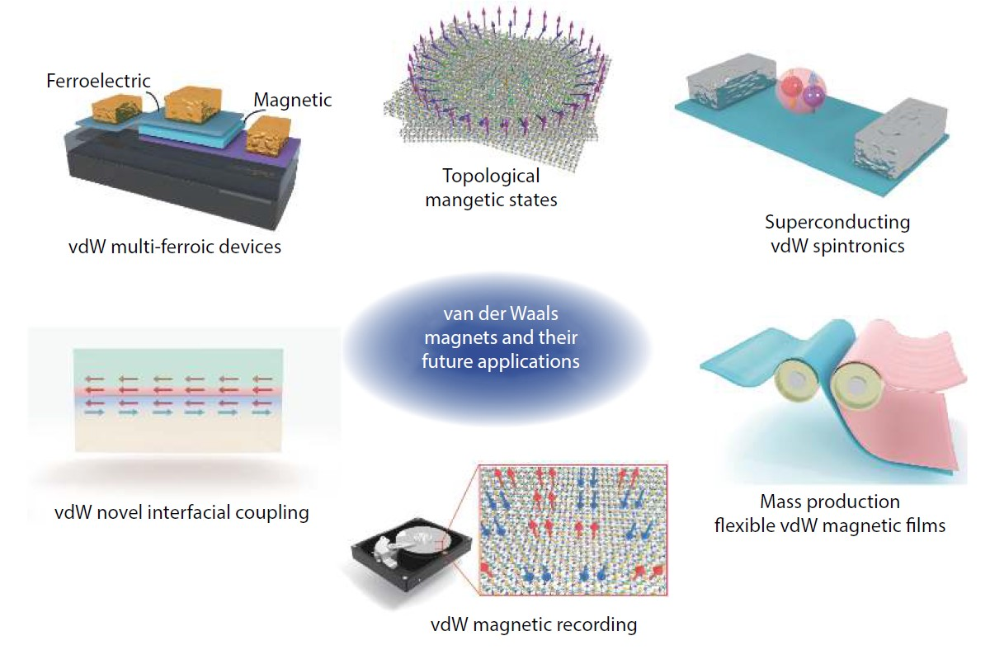
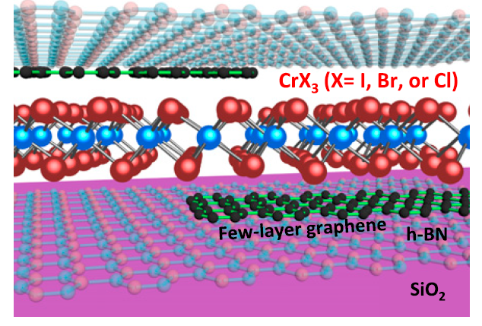
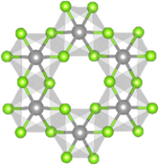
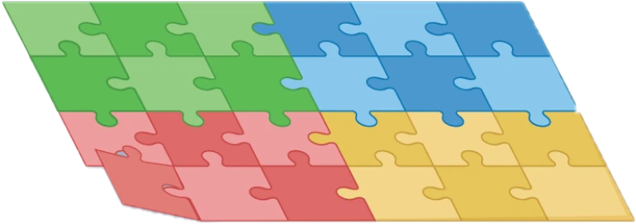
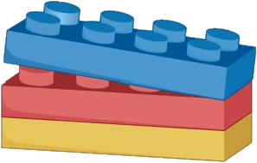
Motivation
Applications of 2D ferromagnets in van der Waals heterostructures and twisted lattices
(!) Recent studies of two-dimensional forms of van der Waals magnets have shown that the magnetic ordering in them can be maintained at sufficiently high temperatures up to the limit of the atomic monolayer.
Future – the search and creation of various heterostructures with potential use in spintronics and other related fields

Slide 3
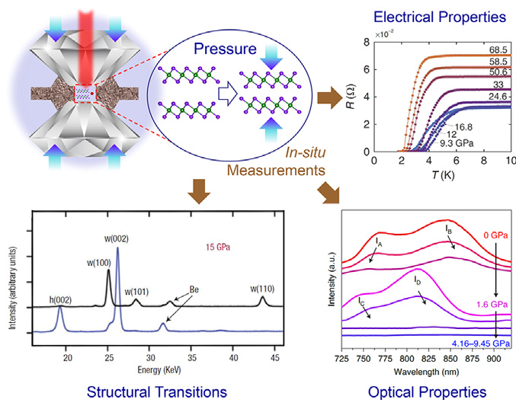
Introduction
VdW CrI₃ at high pressures
The effect of high pressure on the electrical, optical and structural properties of van der Waals compounds
Pressure-induced changes in the layer stacking order is found to result in new magnetic ground states in two-dimensional insulating CrI₃.
(!) A significant advantage of 2D materials is that their physical properties are highly tunable by means of external control parameters that include temperature, electrostatic doping, pressure, strain

Slide 4
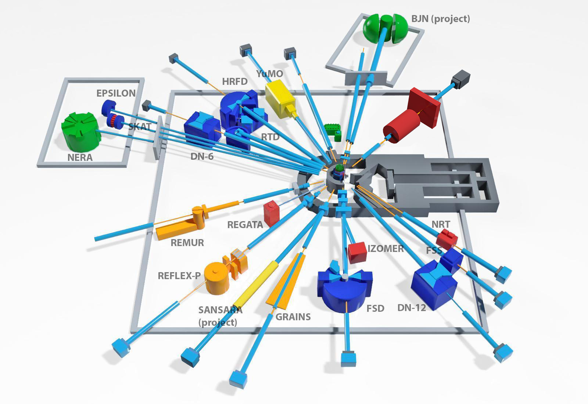
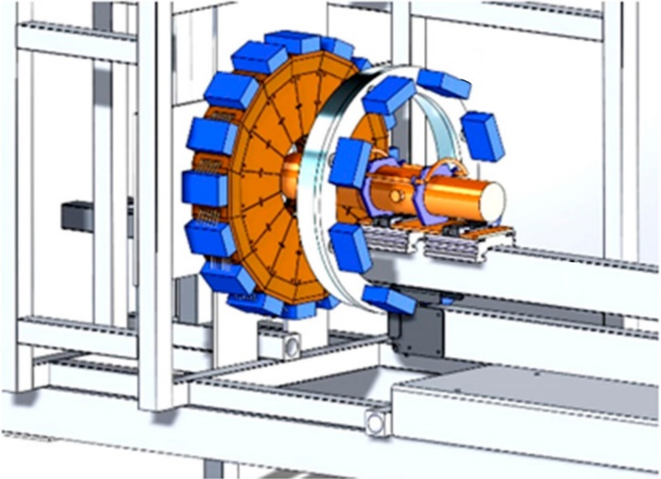
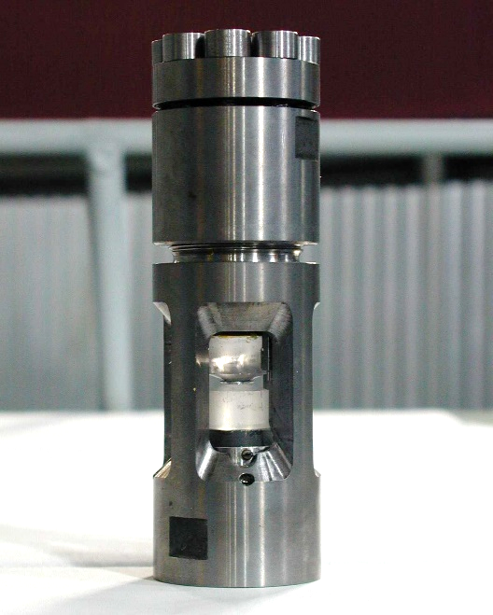
Experimental methods: neutron diffractometer DN-6
Experimental hall of the IBR-2 reactor with 14 neutron output channels and the layout of the DN-6 diffractometer
High-pressure cell with sapphire anvils
Notes:
Carry out such experiment under high pressure is difficult issue. This problem resolved in JINR. Therefore all experiments were performed in new diffractometer for investigation microsamples under high pressure DN-6 of pulse high-flux reactor IBR-2 in Dubna. High pressure on the sample created by using the high pressure cells with sapphire anvils.

Slide 5
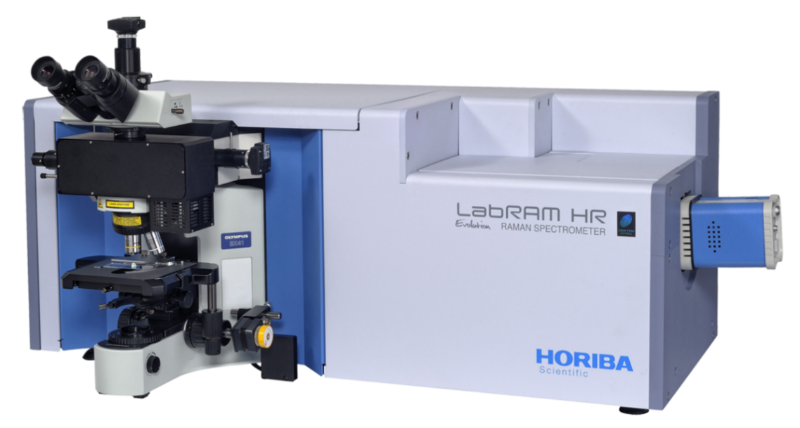
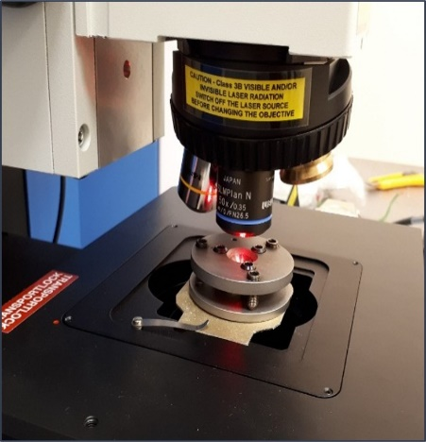
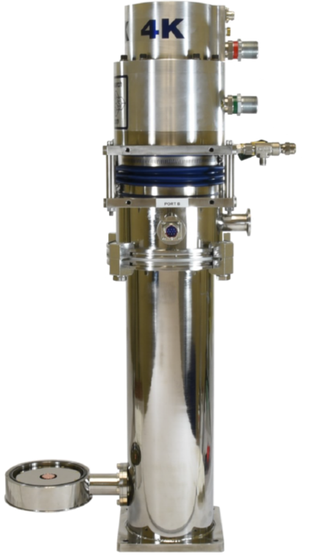
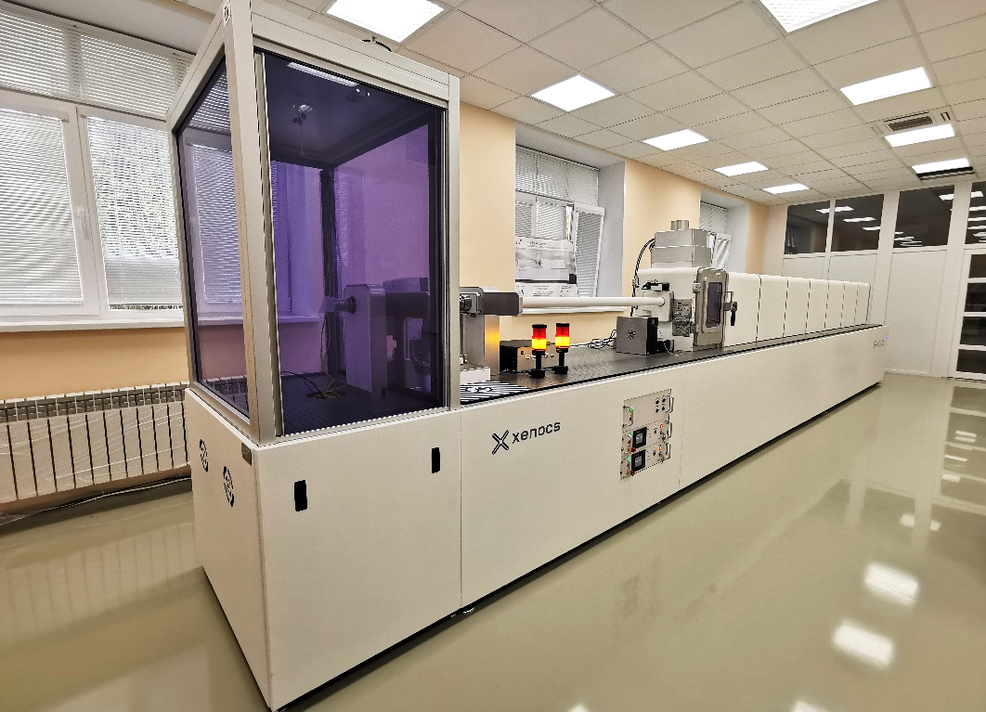
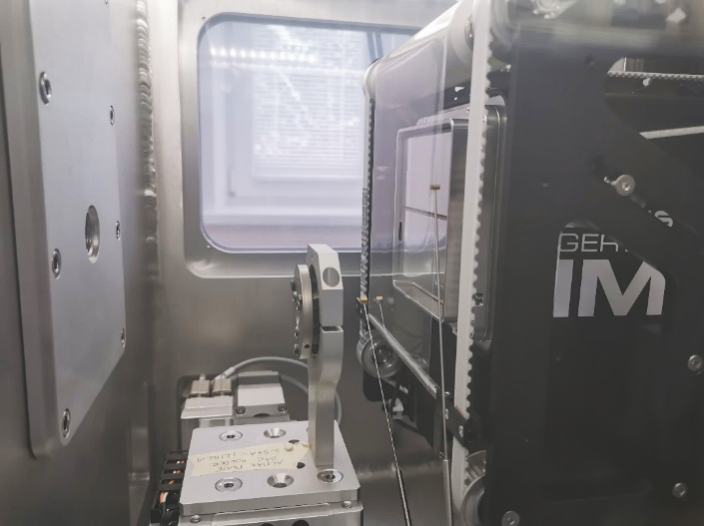
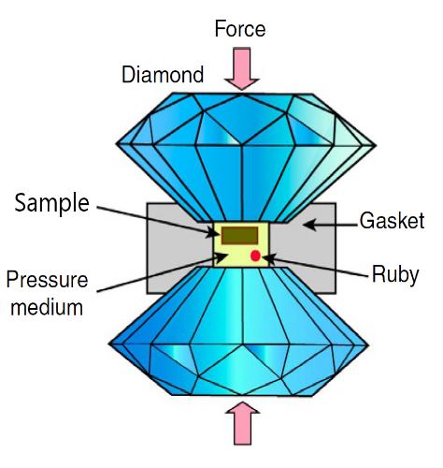
Experimental methods : X-ray diffraction and Raman spectroscopy
LabRAM HR Evolution Wavelength excitation of 632.8 nm emitted from He–Ne laser. The low-temperature Raman measurements were carried out using low vibration helium refrigerator in temperature range 19–300 K.
Xeuss 3.0
Cu radiation (λ = 1.54184 Å) Mo radiation (λ = 0.71078 Å)
High-pressure cell with diamond anvils
P = 1 GPa ~ 10 000 atm.

Slide 6
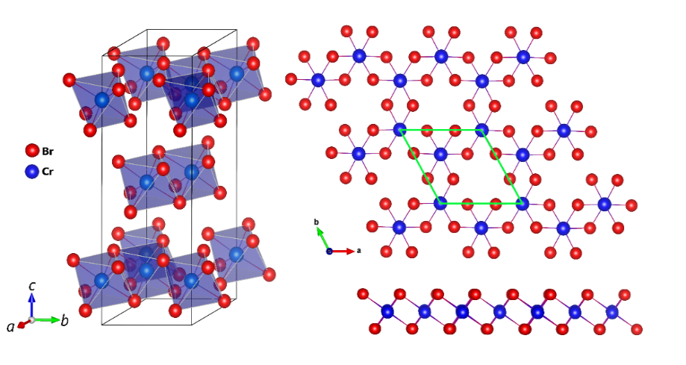
Neutron diffraction of CrBr₃ at low temperature
- The thermal expansion of CrBr₃ lattice is strongly anisotropic with the pronounced variation of the c lattice parameter.
- The interatomic intralayer and interlayer Cr–Cr distances decrease slightly on cooling in the temperature range above T_{C} and they also demonstrate opposite increasing trend for T < T_{C}
The temperature dependences of the lattice parameters and volume obtained from neutron and X-ray diffraction measurements
Kozlenko, D.P., Lis, O.N., Kichanov, S.E. et al. npj Quantum Mater. 6, 19 (2021)

Slide 7
Neutron diffraction of CrBr₃ at high pressure and low temperature
P = 1 GPa ~ 10 000 atm.
The negative volume thermal expansion in CrBr₃ persists even with the application of high pressure
Neutron diffraction patterns of CrBr₃ measured at selected pressures, room and low temperatures.
O.N. Lis, D.P. Kozlenko, S.E. Kichanov, E.V. Lukin, et al. Materials – 2023. – 16(1). – 454

Slide 8
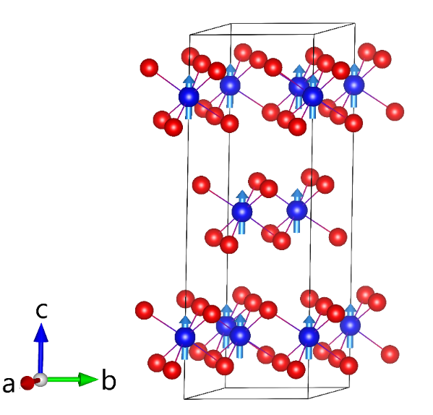
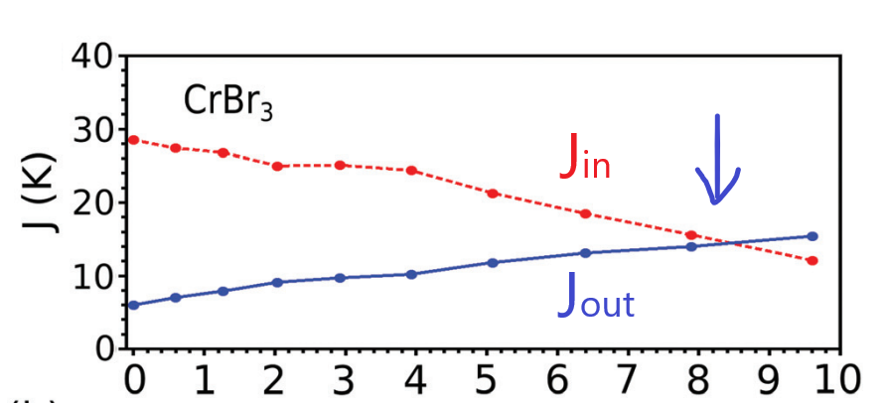
Neutron diffraction of CrBr₃ at high pressure and low temperature
P_{Tr} ~ 8.4 GPa
P (GPa)
The obtained temperature dependences of the Cr magnetic moment of ferromagnetic FM phase at different pressures
The Curie temperatures of the CrBr₃ as a function of the pressure
Values of the exchange constants for CrBr₃. The out-of-plane coupling becomes larger as pressure is applied
A. O. Fumega, et.al. J. Mater. Chem. C, 2020,8, 13582-13589
O.N. Lis, D.P. Kozlenko, S.E. Kichanov, E.V. Lukin, et al. Materials – 2023. – 16(1). – 454

Slide 9
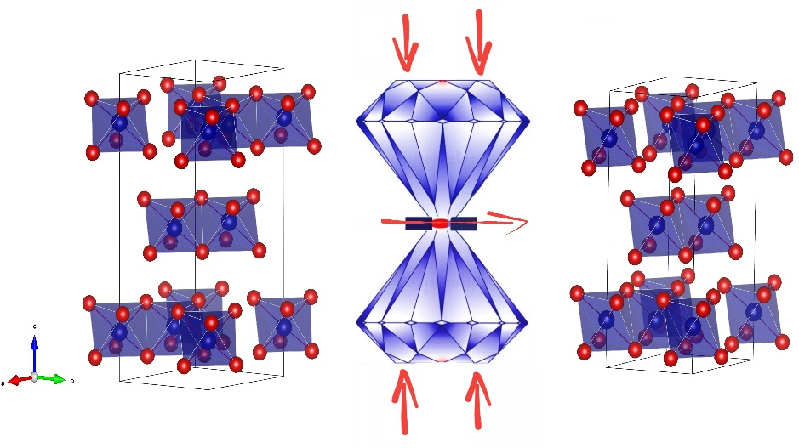
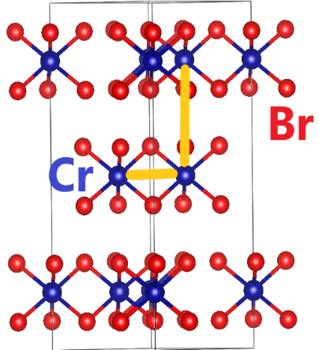
X-ray diffraction of CrBr₃ at high pressure
XRD spectra of CrBr₃, which retains the initial rhombohedral structure up to 38 GPa. Upon compression it is observed a significant decrease in the distance between the layers, interatomic distance and angles above 5 GPa

Slide 10
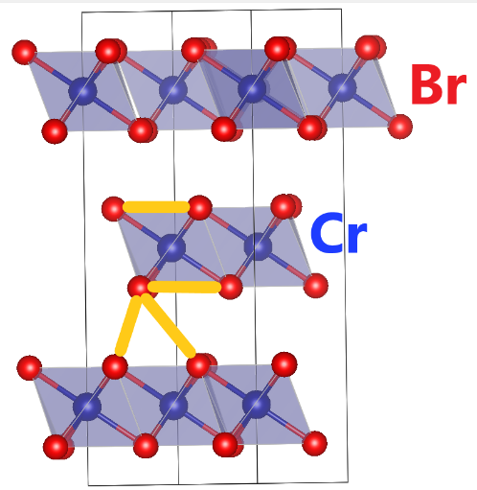
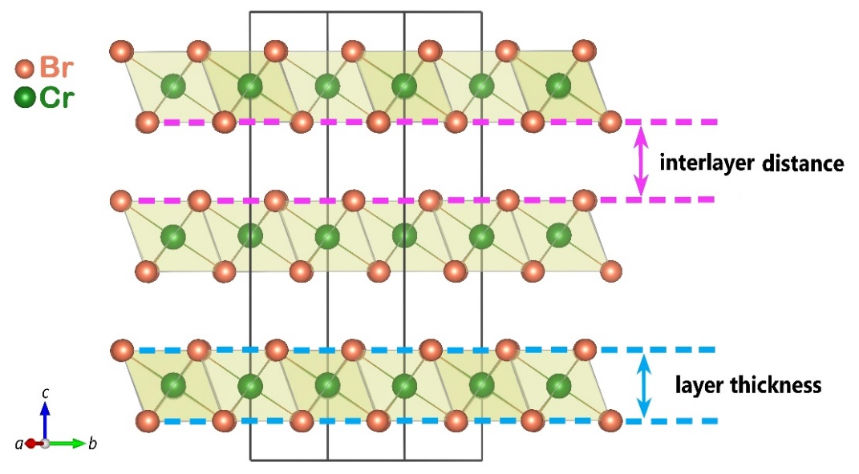
X-ray diffraction of CrBr₃ at high pressure
A strong decrease in interatomic bonds along the c-axis indicates the transformation of CrBr₃ under high pressure from a quasi-two-dimensional structure to a three-dimensional one.
Notes:
Under the high pressure, the Br-Br bond length along the c-axis becomes significantly smaller than in the (ab) plane, as well as the corresponding distance between the layers in comparison with the layer thickness. This indicates the transformation of CrBr₃ under high pressure from a quasi-two-dimensional structure to a three-dimensional one.

Slide 11
Raman spectroscopy of CrBr₃ at high pressure
1. The structural crossover is accompanies by anomalies in pressure behavior of several vibrational modes in pressure range 2.5 - 12 GPa
2. Transition to metallic state above 26 GPa

Slide 12
X-ray diffraction and Raman spectroscopy of CrCl₃
At 6 GPa, anomalies are also observed in the Raman spectra and baric dependences of the frequencies of vibrational modes.
X-ray diffraction revealed a structural transition from the initial monoclinic to rhombohedral phase above 1 GPa. Up to ∼6 GPa, the coexistence of two phases is observed.

Slide 13
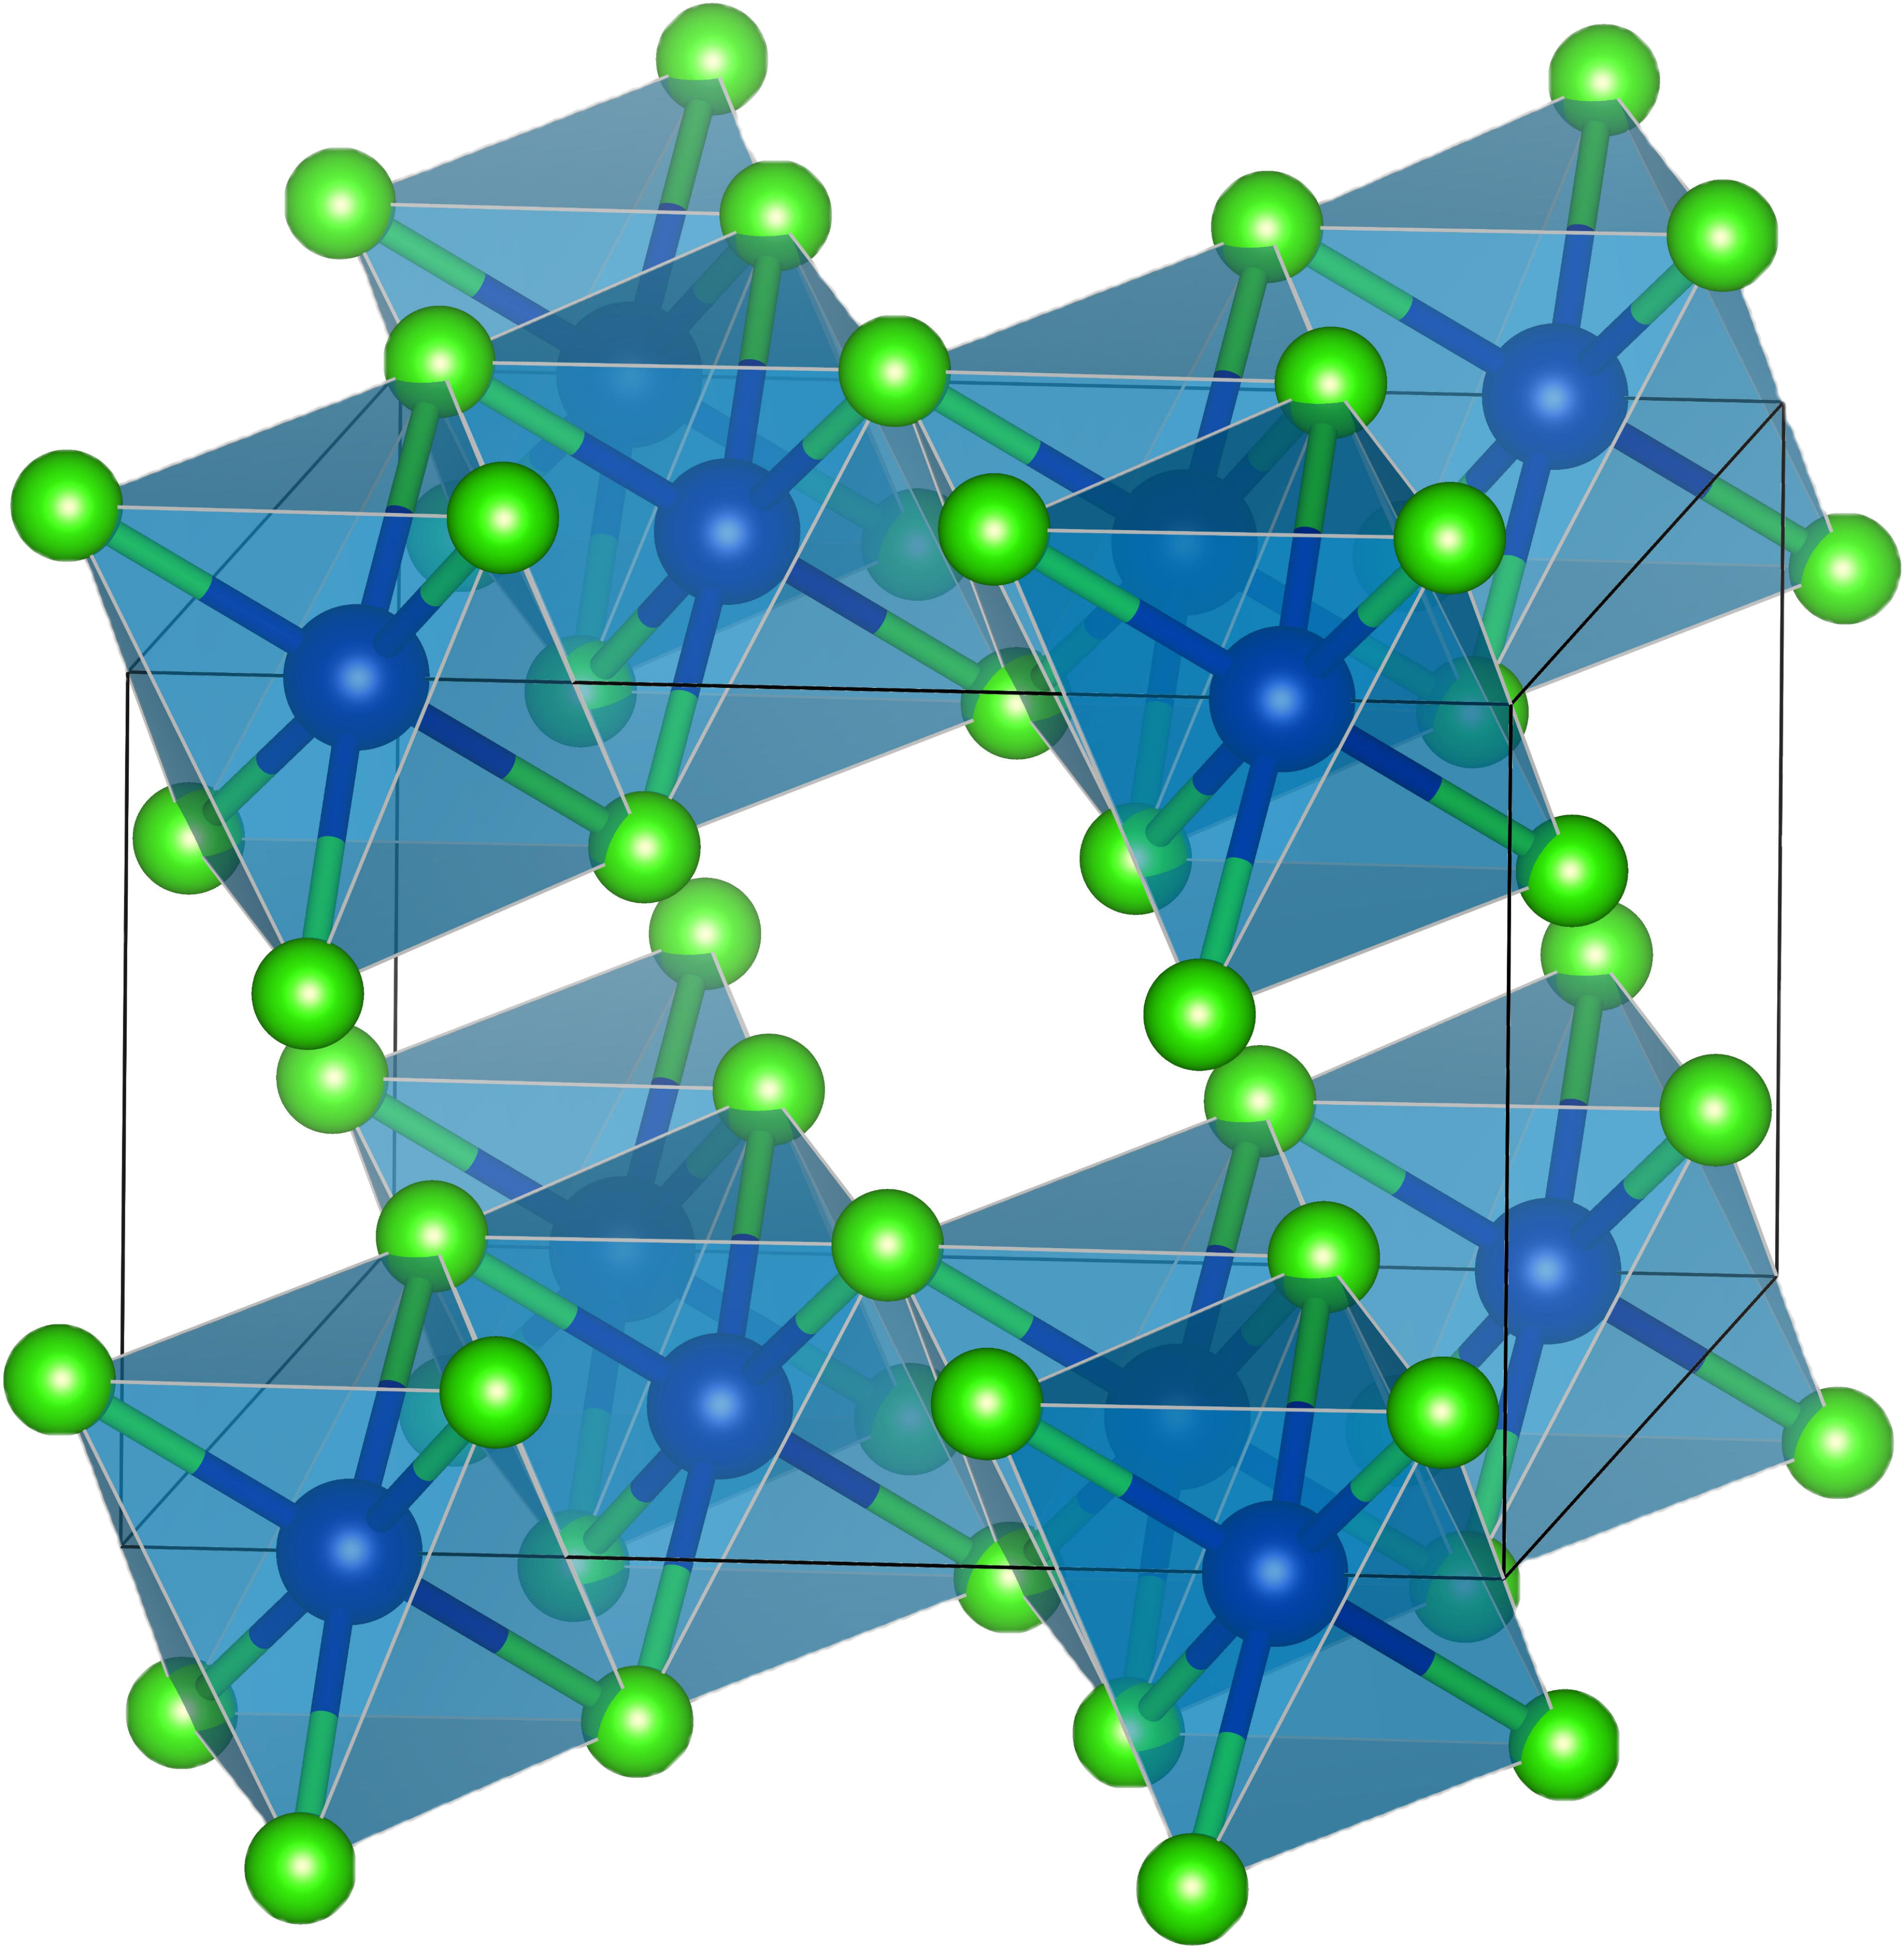
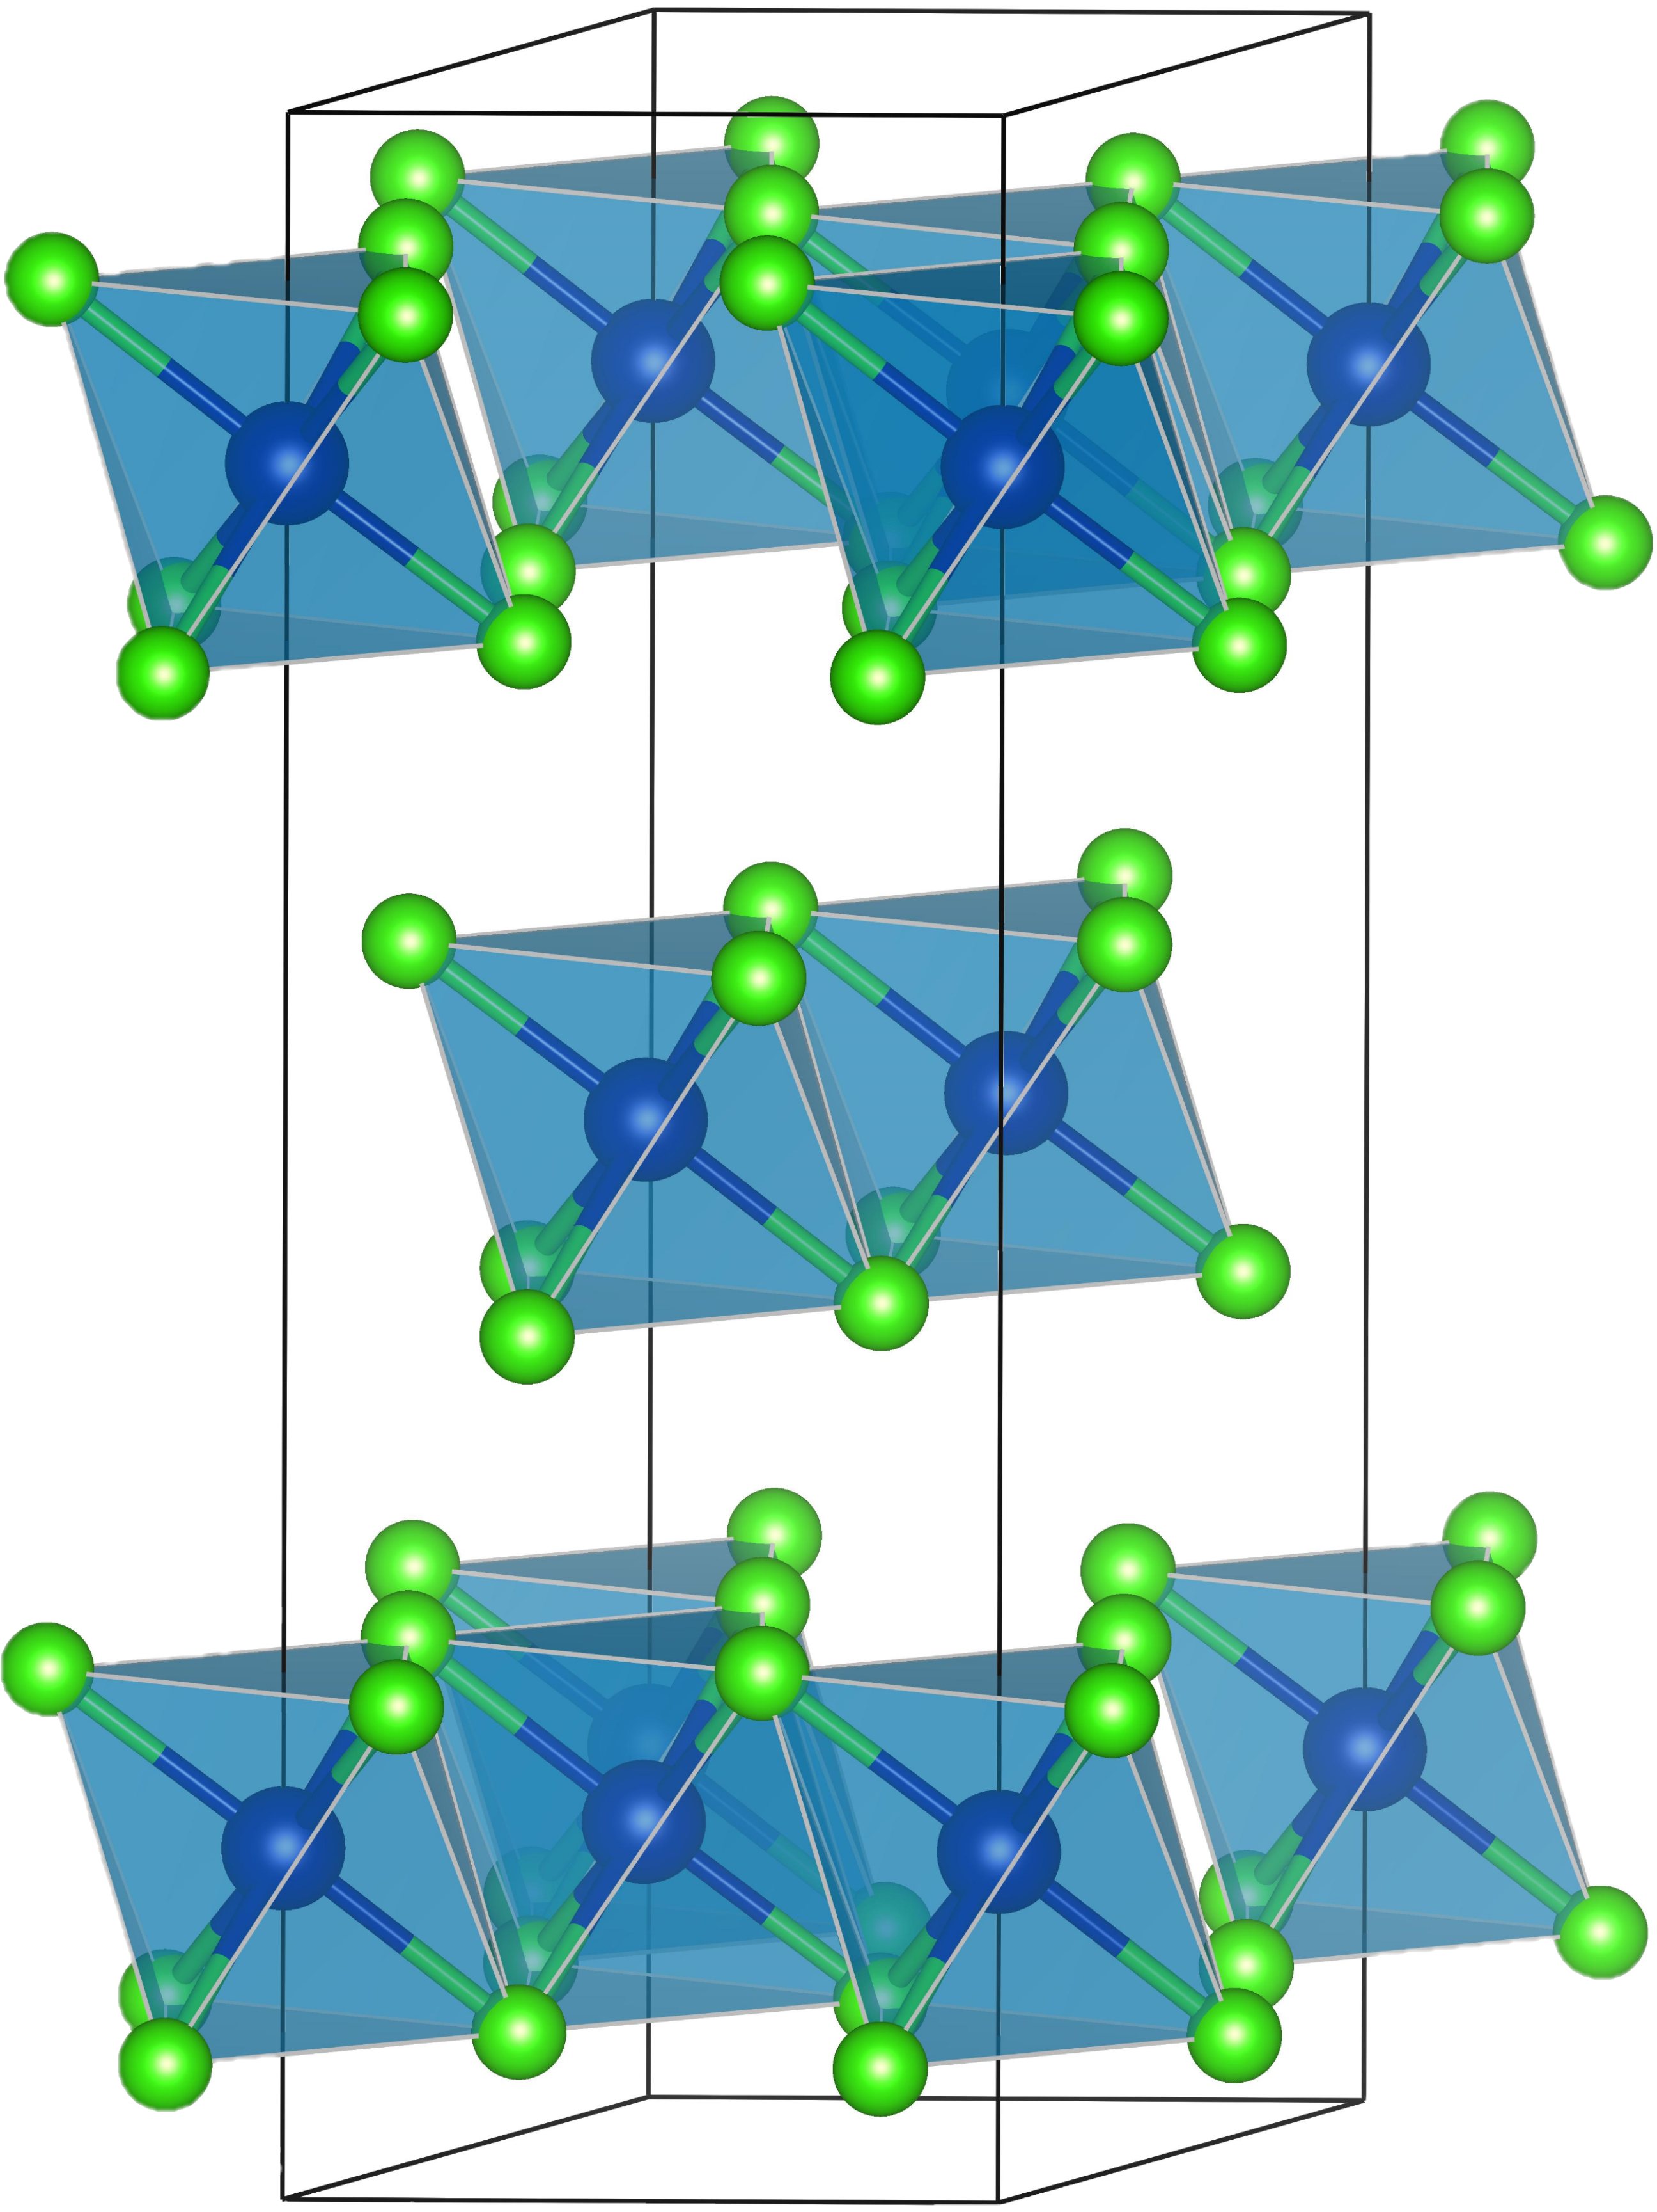
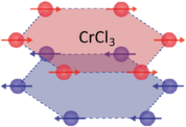
Neutron diffraction of CrCl₃ at low temperature and high pressure
T<200 K
T_{N}≈16K
At 1 GPa, there is no observed contribution from antiferromagnetic ordering, however, a contribution to the nuclear peak (1 1 0), which indicates a possible transition to a ferromagnetic state. At 2 GPa, the contribution becomes implicit.
At about 200 K, a phase transition from the initial monoclinic to the rhombohedral phase is observed

Slide 14
Summary
The negative volume thermal expansion was observed below the Curie temperature in CrBr₃, as well as obvious anomalies in the interatomic distances, Raman shifts and corresponding full-width at half-maximum (FWHM) dependences, which is due to a complex interplay between spin and lattice degree of freedom.
The Curie temperature of CrBr₃ is reduced rapidly, implying instability of the initial FM order. A full suppression of the FM state and a magnetic transition to either AFM state or into a magnetically disordered one is expected at P ~ 8.4 GPa.
The pressure induced structural crossover from a quasi-two-dimensional structure to a three-dimensional one in CrBr₃ is observed above P ~ 5 GPa. This is also accompanied by anomalous behavior of several vibrational modes.
It is observed the structural phase transition in CrCl₃ from the initial monoclinic to rhombohedral phase at low temperatures and also at high pressures.
Under high pressure, an additional contribution to the intensity of the nuclear peak CrCl₃ is weakly observed, which may be due to the magnetic transition from the AFM ordering to the FM mode.

Slide 15
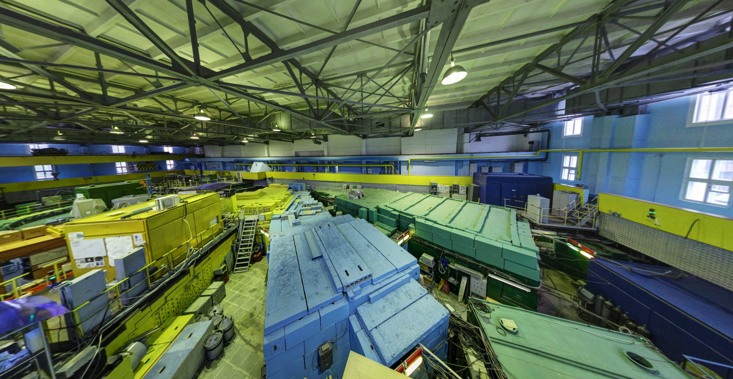
Thank you for your attention!

Slide 16
Raman spectroscopy of CrBr₃ at low temperature
Br
Cr
The FWHM of all the observed phonon modes demonstrate anomalous reversal broadening in the T < T_{C} range. These effects reveal a presence of the strong spin–phonon coupling in CrBr₃.
Kozlenko, D.P., Lis, O.N., Kichanov, S.E. et al. npj Quantum Mater. 6, 19 (2021)

