Slide 1
Jury’s recommendation on the awarding of the Venedikt Dzhelepov Prize for 2024
N. Russakovich
136th session of the Scientific Council
12-13 September 2024

Slide 2
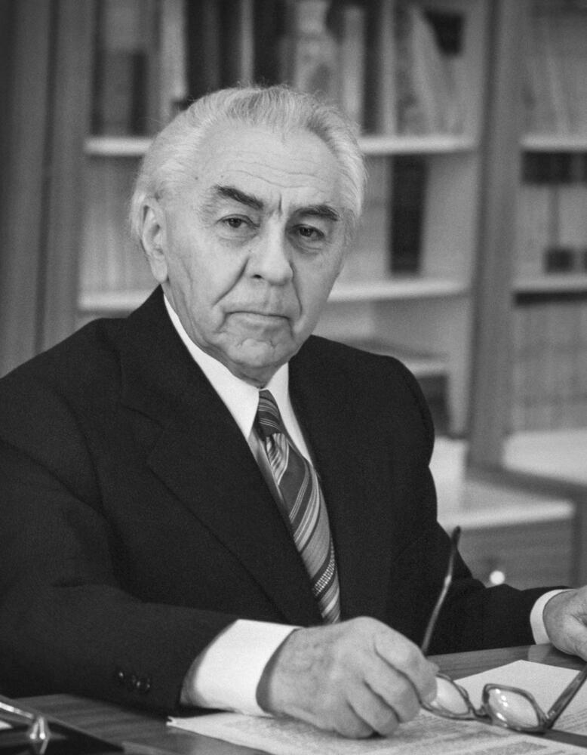
The Venedikt Dzhelepov Prize is awarded for outstanding achievements in the field of experimental and theoretical research addressing applied problems with the use of nuclear physics methods
The Jury composition:
N. Russakovich (Chair)
E. Yakushev
S. Dmitriev
L. Kostov
E. Lychagin

Slide 3
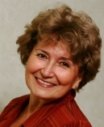
UNECE International Cooperative Program (ICP) Vegetation in the framework of the United Nations Convention on Long-Range Transboundary Air Pollution was developed with the aim to identify the main polluted areas of Europe, produce regional maps and further develop the understanding of the long-range transboundary pollution.
Dr. Marina Frontasyeva contributed significantly to the development of the program by the assessment of heavy metals deposition in JINR member and no-member countries using neutron activation analysis and moss biomonitors.
Dr. Marina V. Frontasyeva

Slide 4
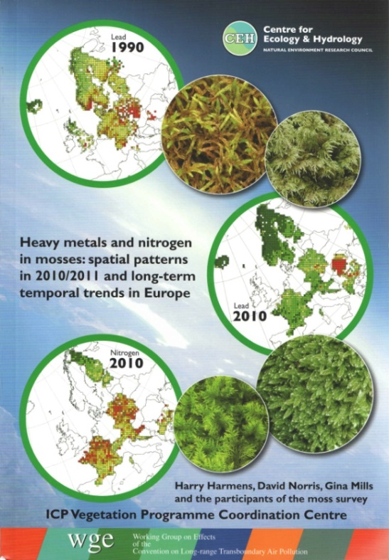
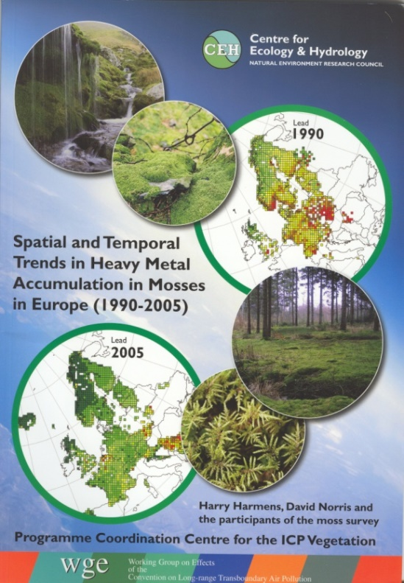
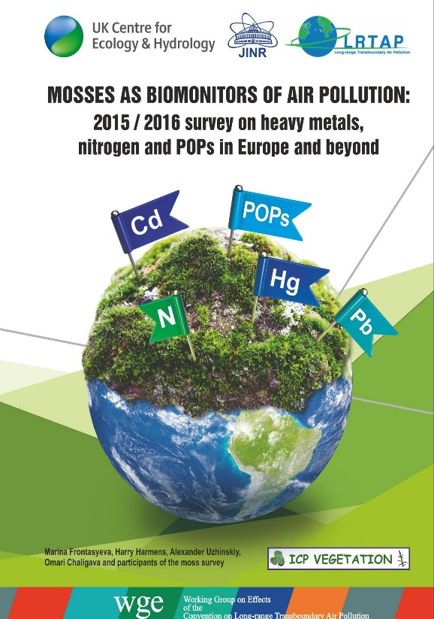
Being the Coordinator of the United Nations air programme Dr. Marina Frontasyeva, has significantly expanded the geography of countries participating in the programme.
Some representative publications by M. Frontasyeva:
1. M. Frontasyeva, et al. (2020). Mosses as biomonitors of air pollution: 2015/2016 survey on heavy metals, nitrogen and POPs in Europe and beyond. Report of the ICP Vegetation Moss Survey Coordination Centre, Joint Institute for Nuclear Research, Dubna, Russian Federation, 136 pp. ISBN 978-5-9530-0508-1.
2. H. Harmens, ...., M. Frontasyeva, et al. (2010) Mosses as biomonitors of atmospheric heavy metal deposition: Spatial patterns and temporal trends in Europe, Environmental Pollution, 158 (10), 2010.
3. Frontasyeva, M.V. Neutron activation analysis in the life sciences. (2011) Phys. Part. Nuclei 42, 332–378.

Slide 5
The above Jury has unanimously recommended as follows:
To award Dr. Marina V. Frontasyeva with the Venedikt Dzhelepov Prize
for her significant contribution to the development of international programme on the assessment of air quality using neutron activation analysis
I am now asking the Council to approve the Jury’s recommendation.

