Slide 1
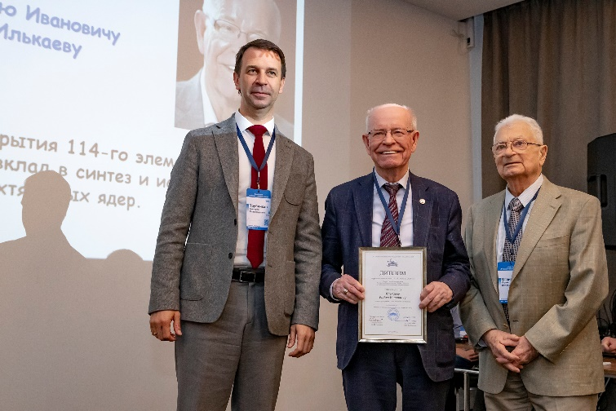
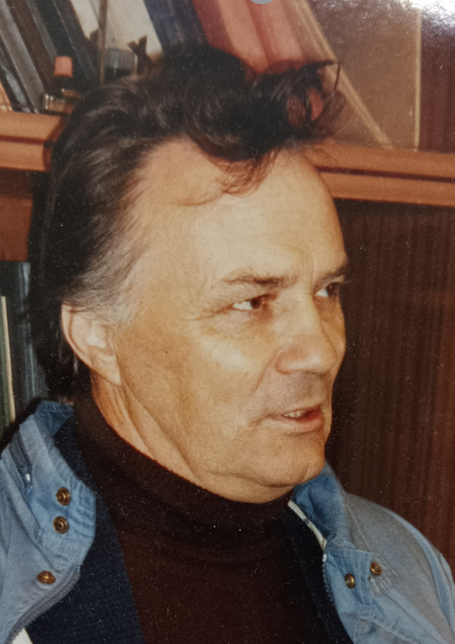
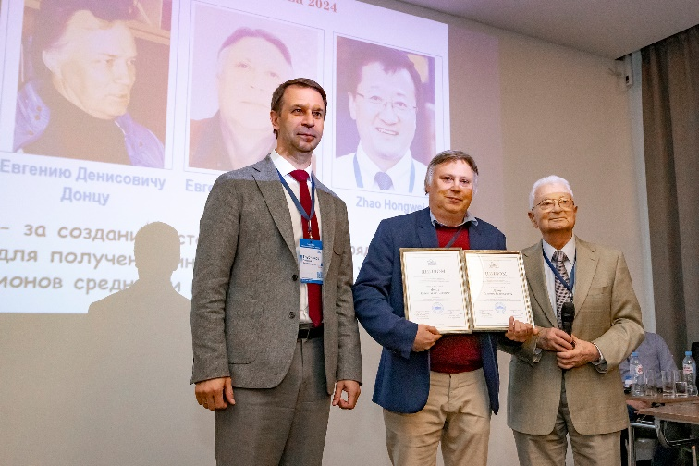
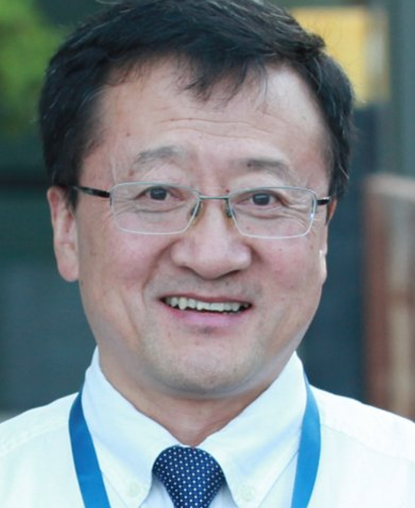
G.N. Flerov Prize 2024 Laureates
Prof. R. I. Il’kaev
for his great contribution to the synthesis
and study of the properties of
superheavy nuclei
for development of sources of highly charged ions
to produce intense accelerated beams of medium and high energies
Dr. E. D. Donets
Dr. E. E. Donets
Prof. Zhao Hongwei

Slide 2
