Slide 1
2024 OGANESSON Prize
FOUNDERS
Yuri Oganessian and JINR
Established in 2023 at the suggestion and funds transferred to the Joint Institute for Nuclear Research by Academician of the Russian Academy of Sciences Yuri OGANESSIAN
AWARDED ANNUALLY
FOR SIGNIFICANT ACHIEVEMENTS in theoretical and experimental research in the fields of physics, chemistry, biology, and applied research.
FOR CREATIVE ACTIVITIES in the field of education and science popularisation.
Who may participate in the COMPETITION for the prize: individual scientific, engineering, and technical specialists or groups of authors (no more than 3 people) whose contribution was decisive in solving scientific problems and in popularisation of projects.
AUTHORS of scientific papers, published lecture courses, articles as well as popular science and fiction works aimed at science popularisation.

Slide 2
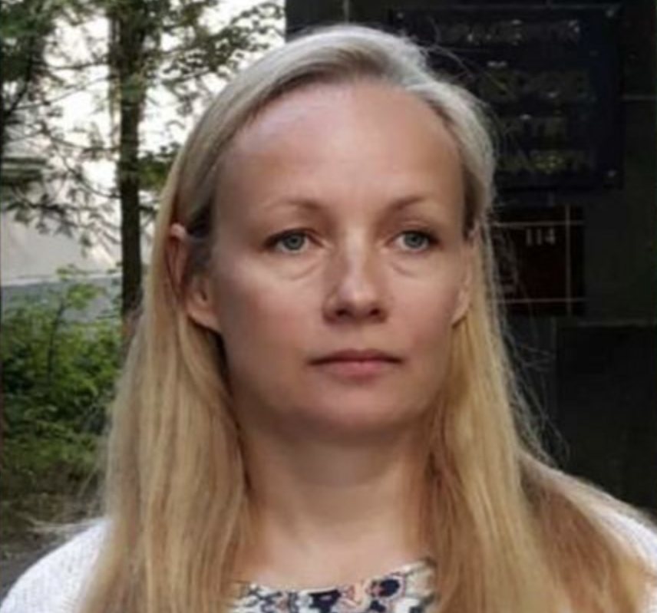
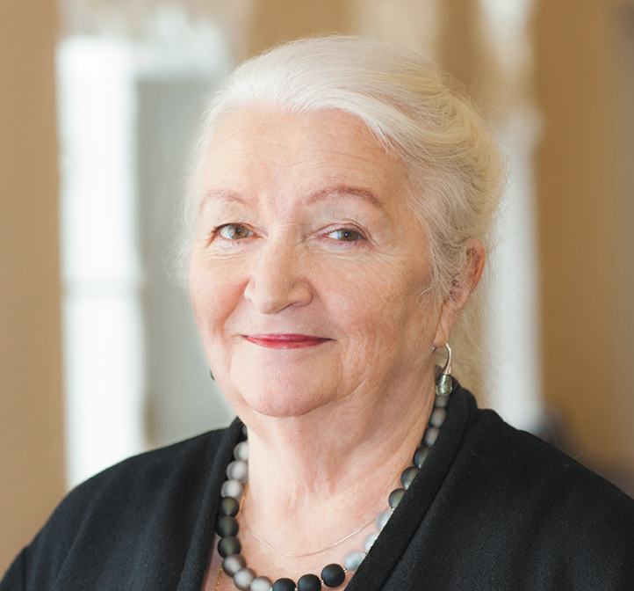
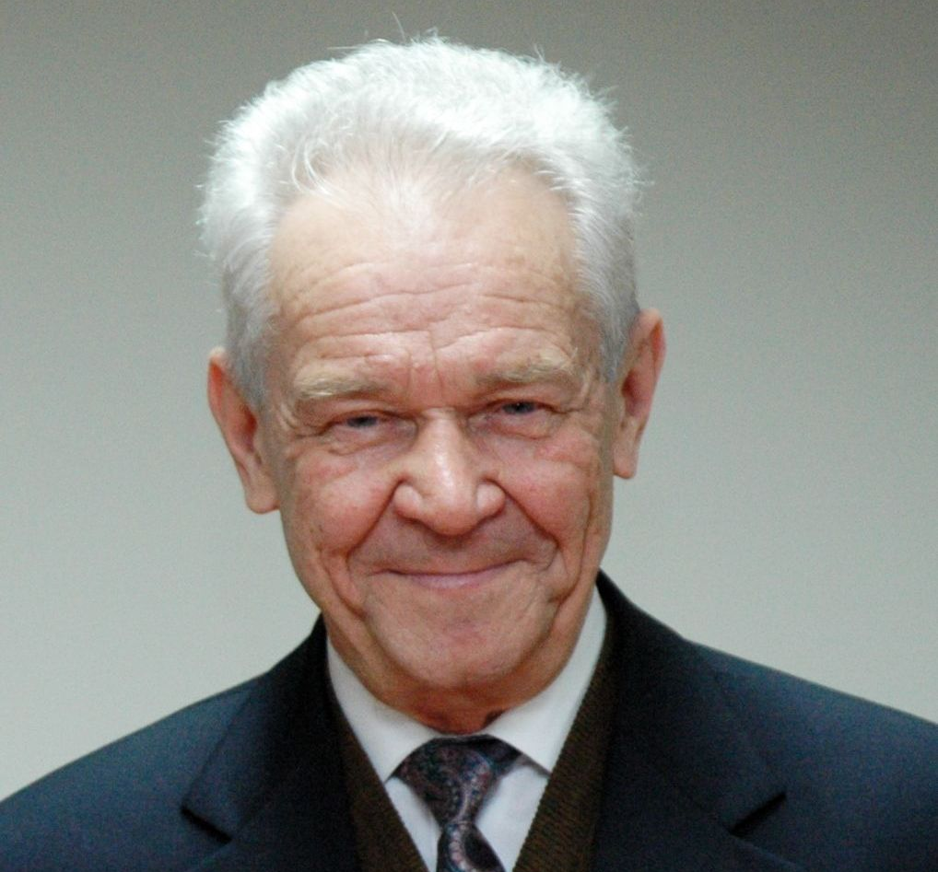
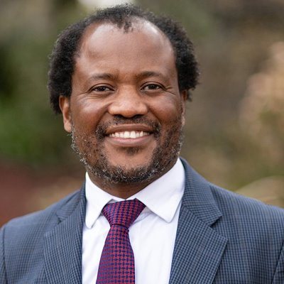
The OGANESSON Prize Winners in 2024
Dr. Aliya NURMUKHANBETOVA
Dr. Galina KNYAZHEVA
Prof. Tatiana CHERNIGOVSKAYA
Academician Yuri ZOLOTOV
Prof. Zeblon Zenzele
VILAKAZI
Nazarbayev University, the Republic of Kazakhstan
Flerov Laboratory of Nuclear Reactions at the Joint Institute for Nuclear Research
Director of the Institute of Cognitive Research at St. Petersburg University, Honoured Worker of Higher Education and Honoured Scientist of the Russian Federation
Russian Academy of Sciences
Vice-Chancellor and Principal of Wits University
For the development and implementation of a new programme for the study of the lightest nuclei at the low-energy ion accelerator (DC–60)
For pioneering work on the observation and study of the quasi-fission process of the heaviest nuclei
For outstanding contribution to the popularisation of scientific knowledge and the development of interdisciplinary research at the intersection of neuroscience, linguistics, and psychology
For outstanding scientific work in analytical chemistry, for significant personal contribution to the training of young scientists, specialists, and highly qualified personnel
For significant contribution to the development of scientific cooperation between South Africa and JINR in nuclear reactions, accelerator technologies, and relativistic nuclear physics

