Slide 1
Primary Vertex Analysis and Restrictions on Histograms
16/07/2024
Students:
Adrian Lara Tlaxcala
Francisco Reyes
Supervisors:
Dr. Vadim Kolesnikov
Dr. Ivonne Alicia Maldonado Cervantes
Dr. Viktar Kireyeu
1

Slide 2
Cuts on Histograms
For all Histograms a cut on Number of MC Tracks were made, on which NumMCTracks > 308 = 124 + 184
For Pt Resolution Profiles, number of hits > 3 and cuts on impact parameter < 13 were made.
This was made to remove the perimetral particles

Slide 3
$$∆p_{T}=\frac{\left|p_{T}^{reco}−p_{T}^{mc}\right|}{p_{T}^{mc}}$$
Resolution equations
$$∆Zvertex=\frac{\left|{Zvertex}^{reco}−{Zvertex}^{mc}\right|}{{Zvertex}^{mc}}$$
Equation were also used for pT an Z-Vertex resolution
3

Slide 4
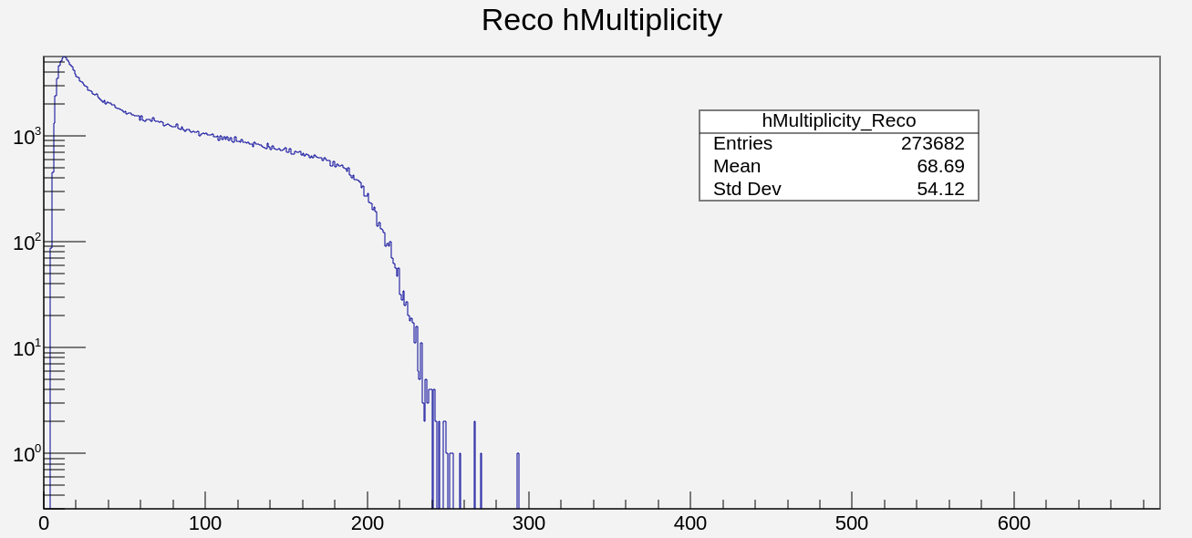
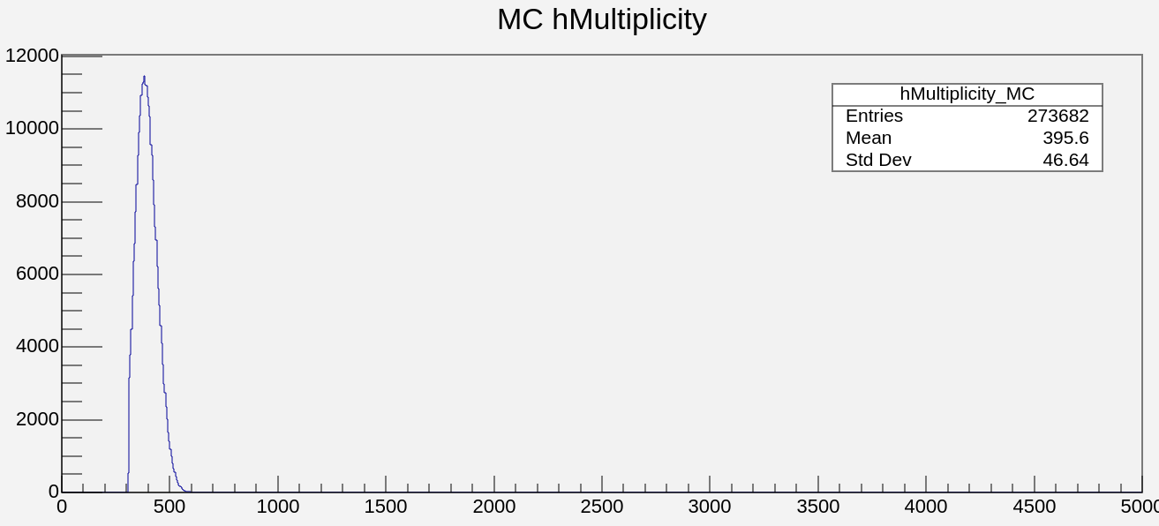
Multiplicity Reco and MC
Here again we have multiplicities as reference for some following histograms
4

Slide 5
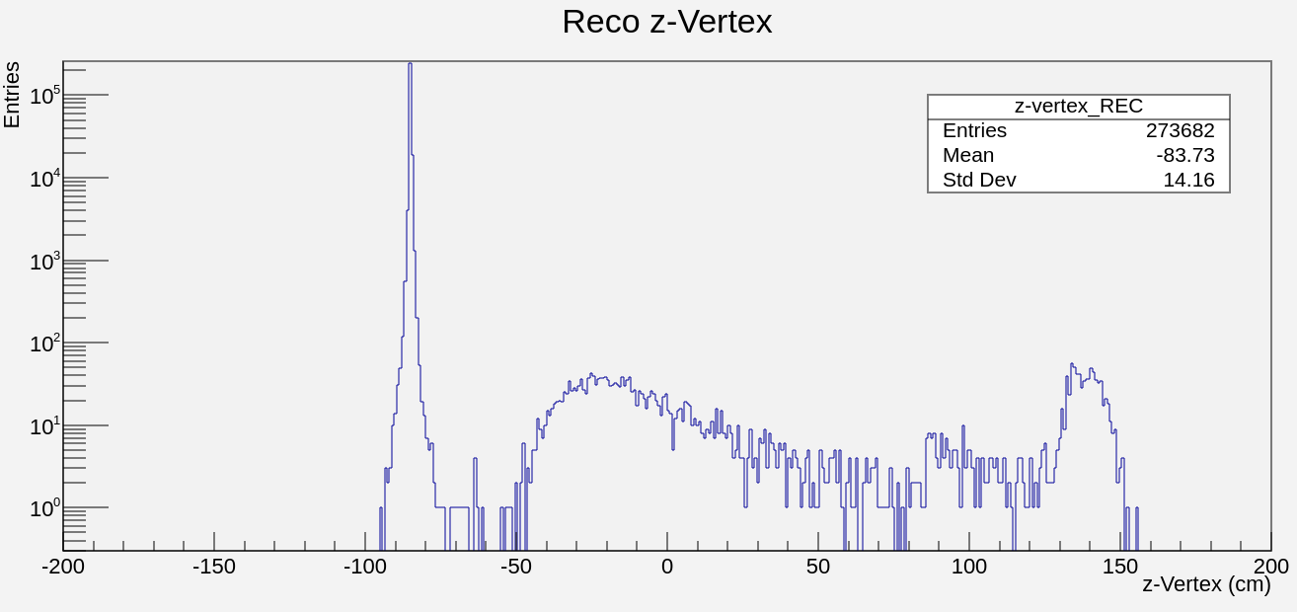
ZvertexREC
And distribution of Zvertex

Slide 6
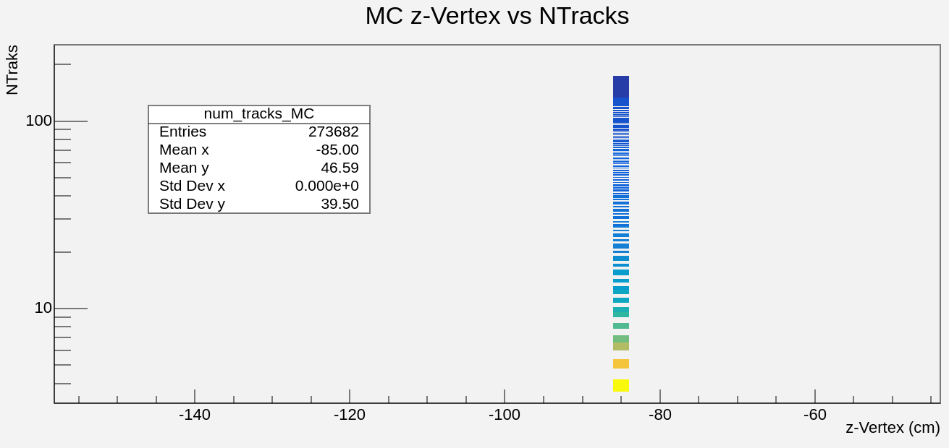
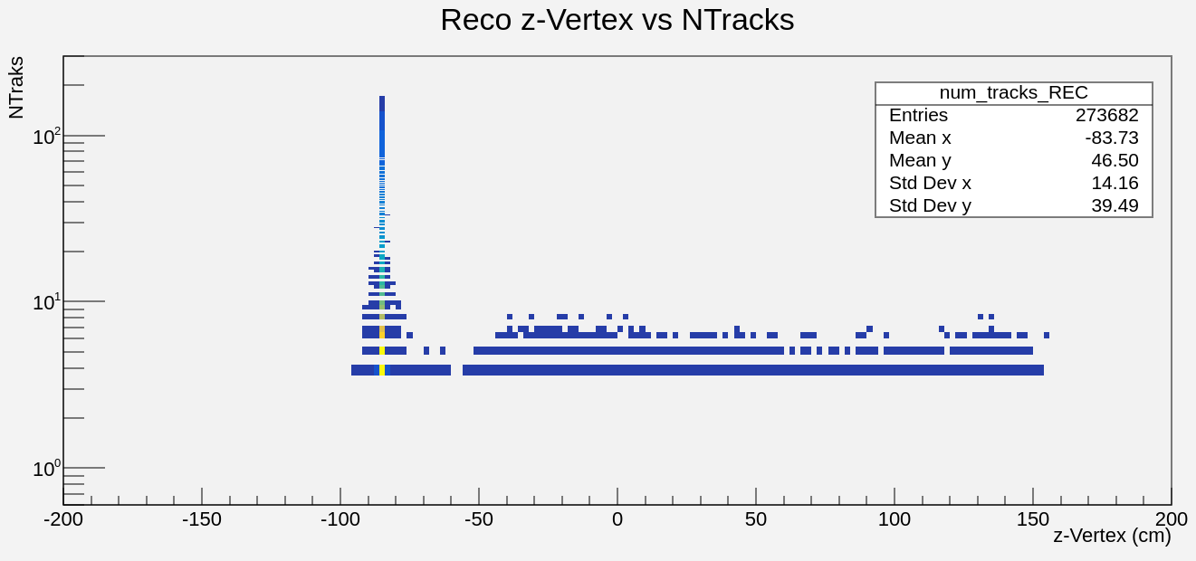
Ntracks
A number of events with <3 tracks were used for distribution
Track counts were used to remove peripheral particles

Slide 7
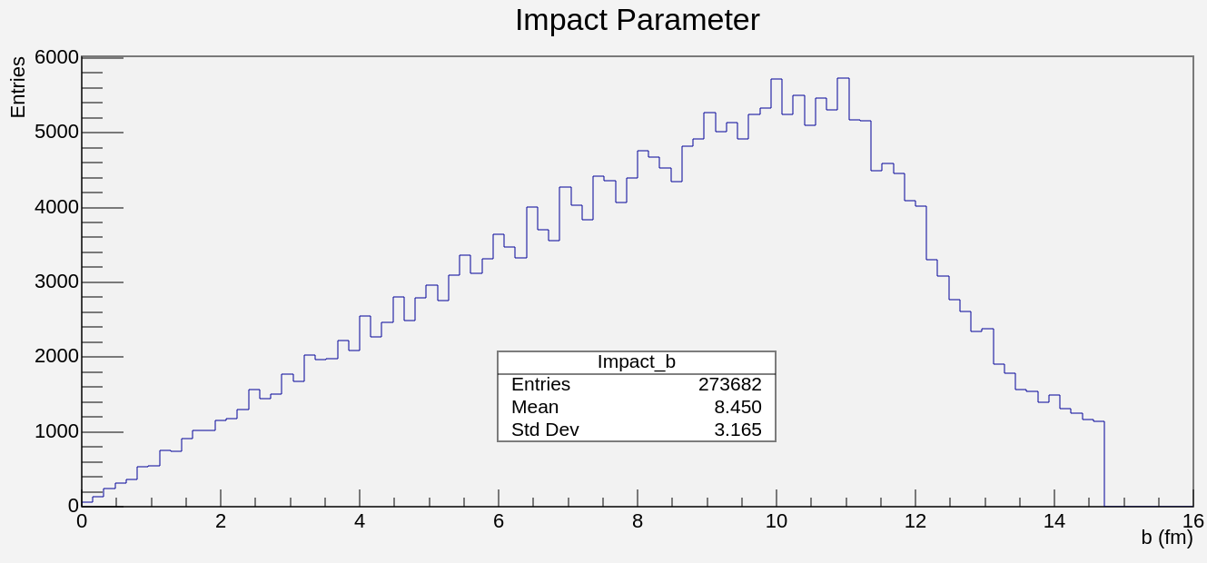
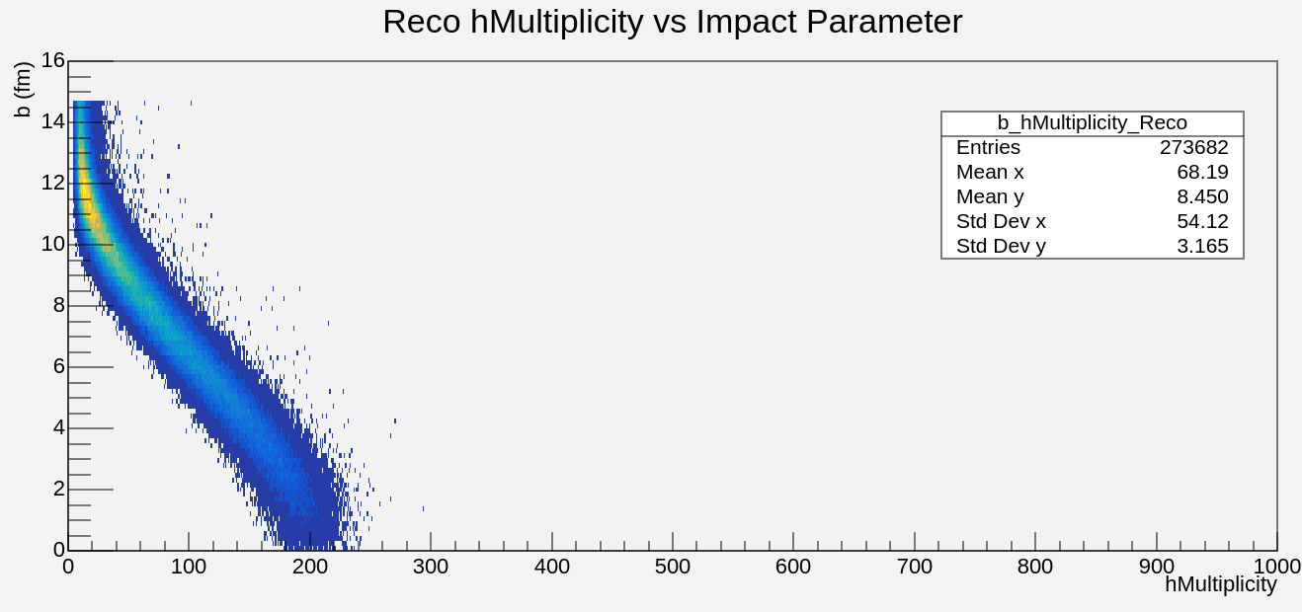
Impact Parameter and multiplicity
Cuts were also made in the impact parameter greater than 13 to clean and have better distibution
7

Slide 8
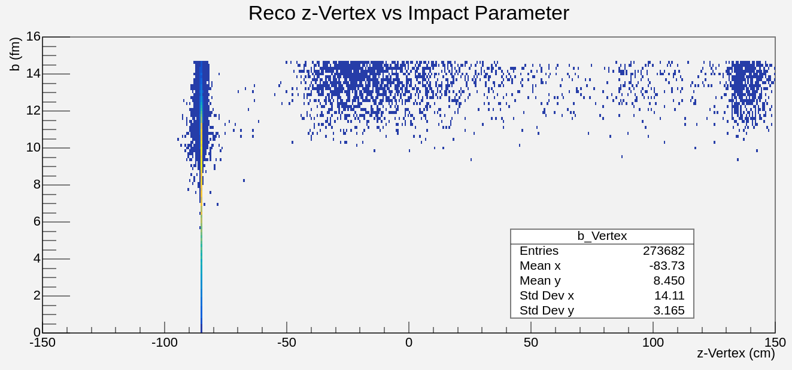
Zvertex in funcion the impact parameter
8

Slide 9
$$χ^{2}$$

Slide 10
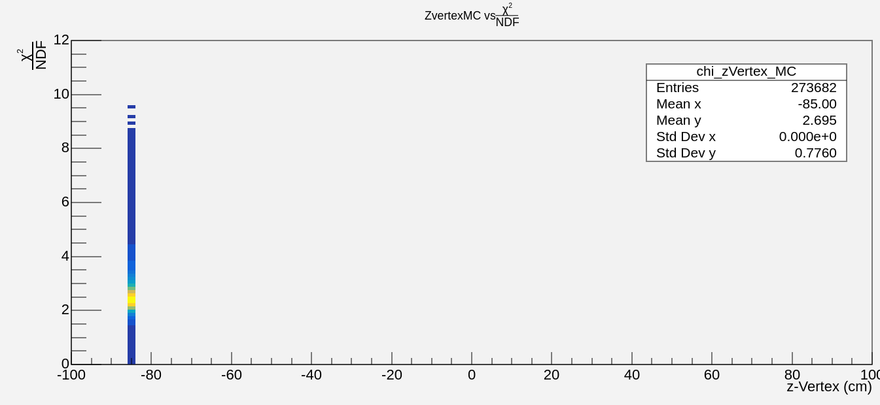
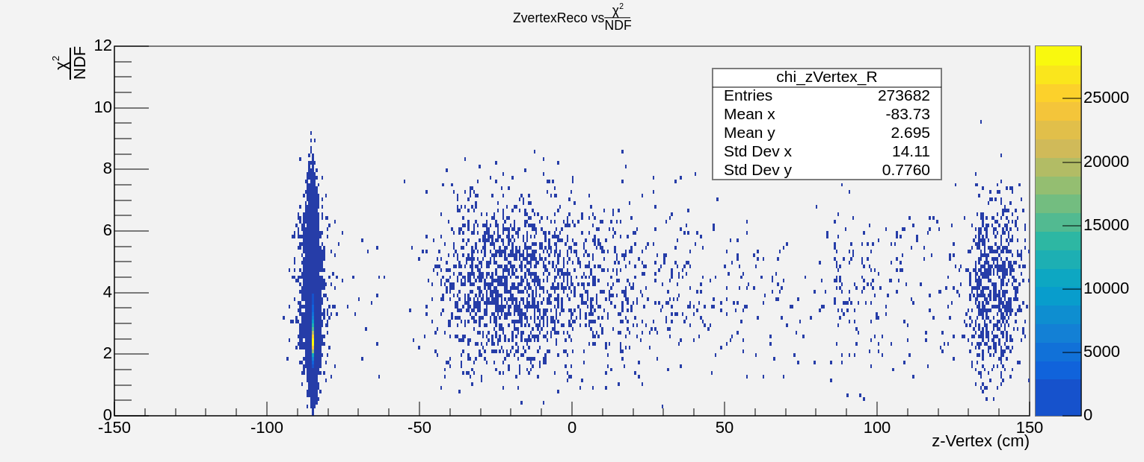
$$χ^{2}and ZVertex$$

Slide 11
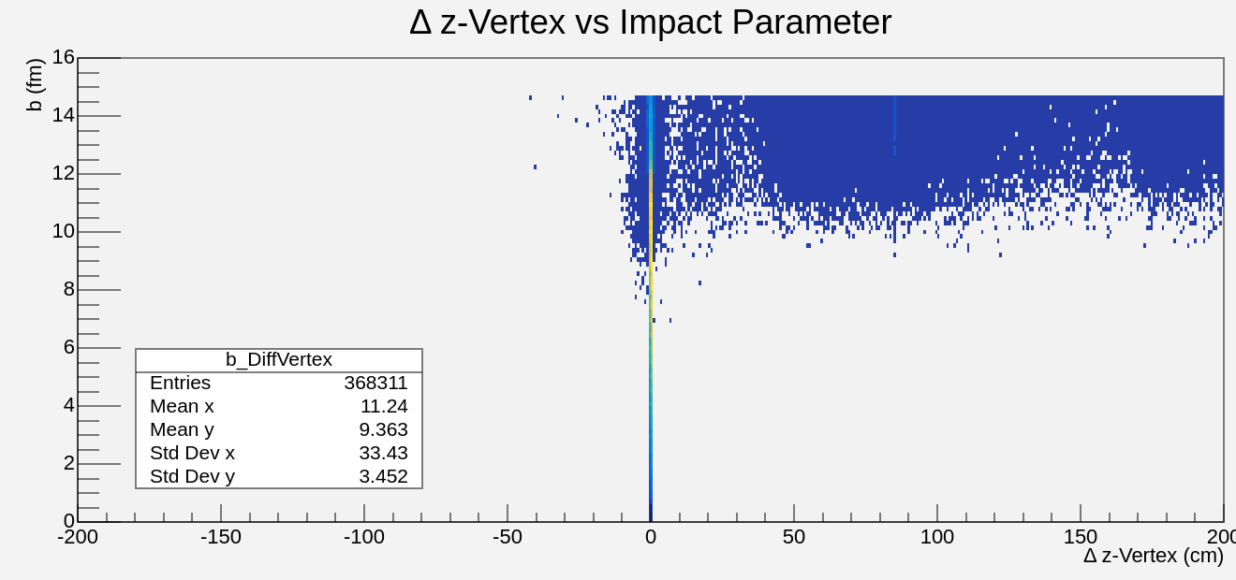
Resolution Zvertez in the funcion the impact parameter
A number of events with <3 tracks were used for distribution

Slide 12
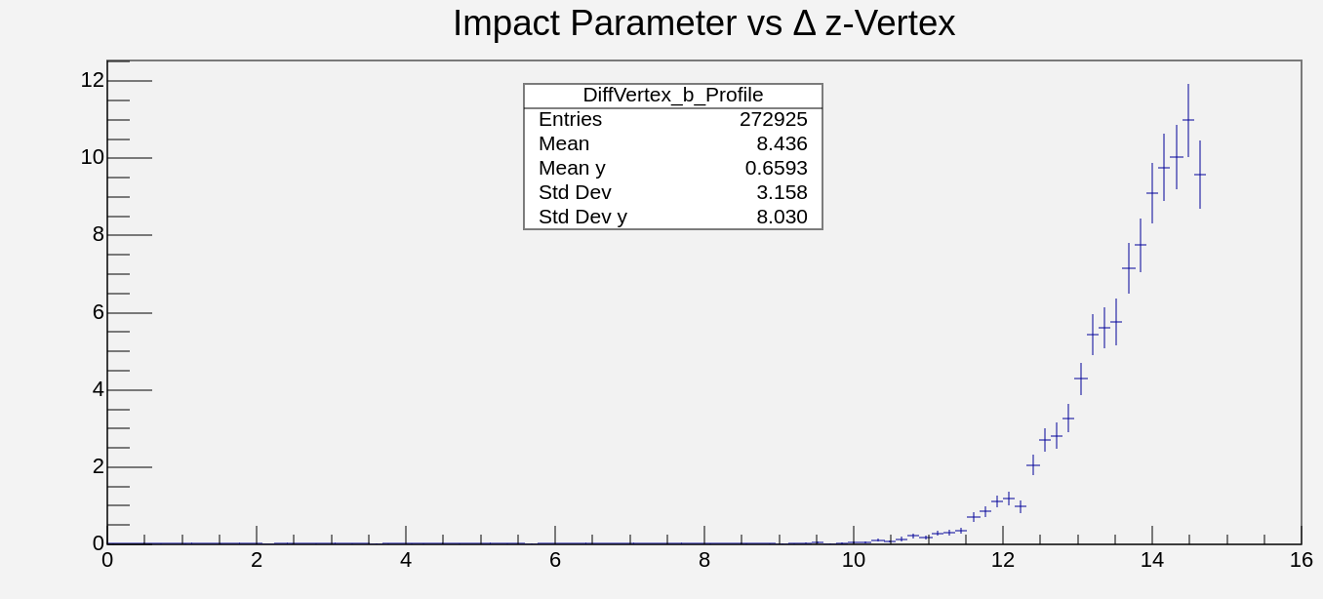
Resolution and Impact parameter
z-Vertex(cm)
b(fm)

Slide 13
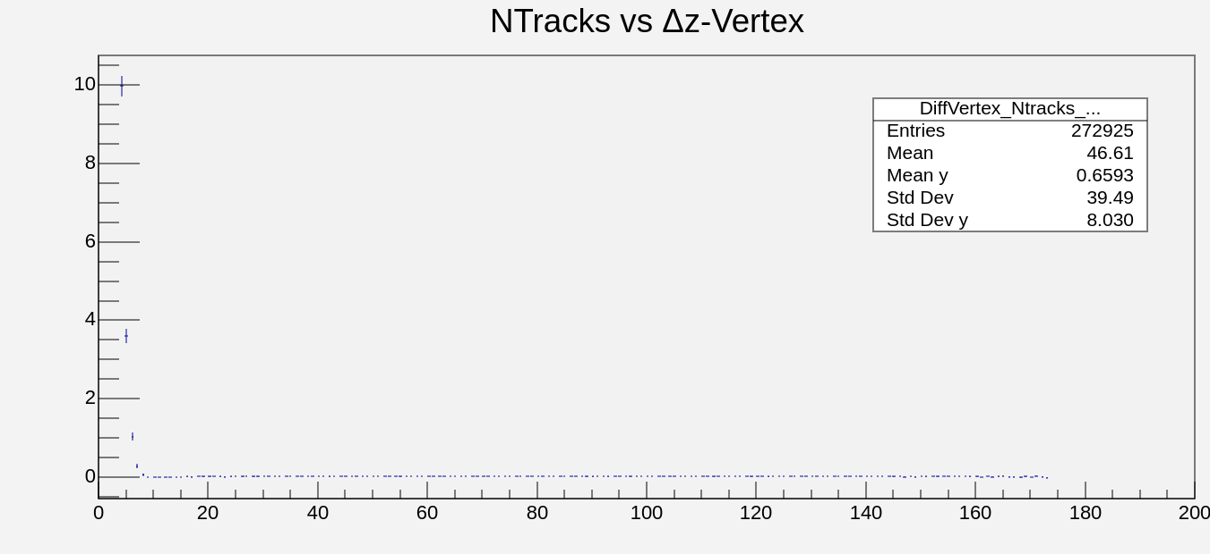
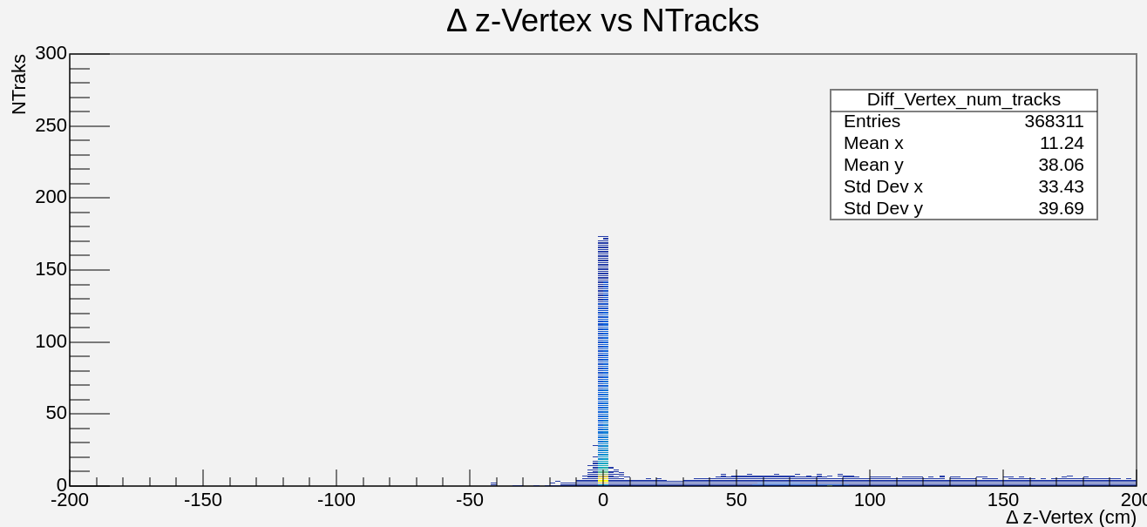
Resolution and NTracks
NTracks
z-Vertex(cm)

Slide 14
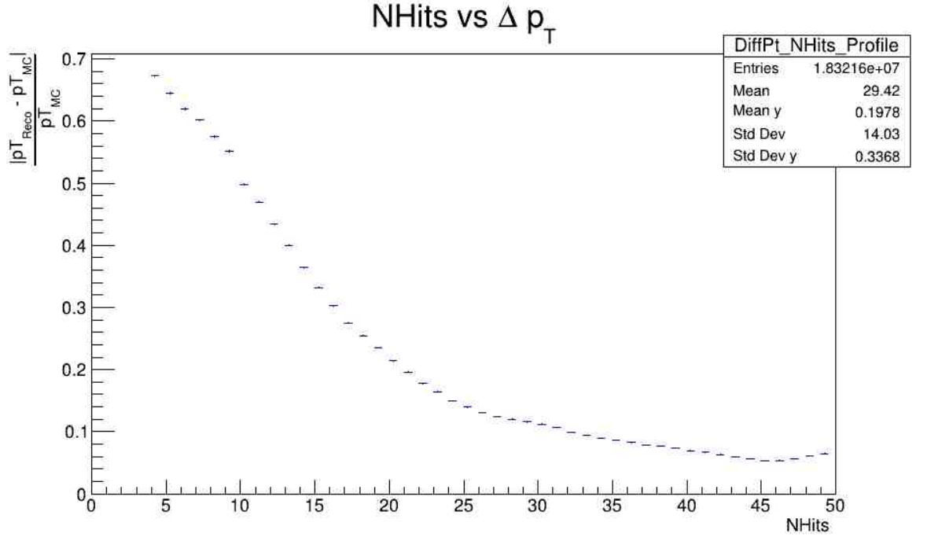
Nhits vs Pt Resolution
14

Slide 15
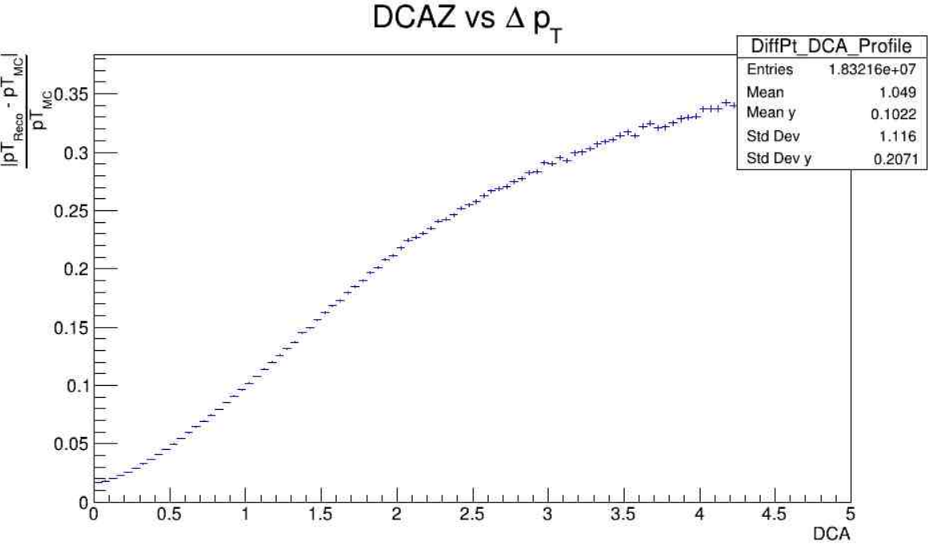
DCA vs Pt Resolution
15

Slide 16
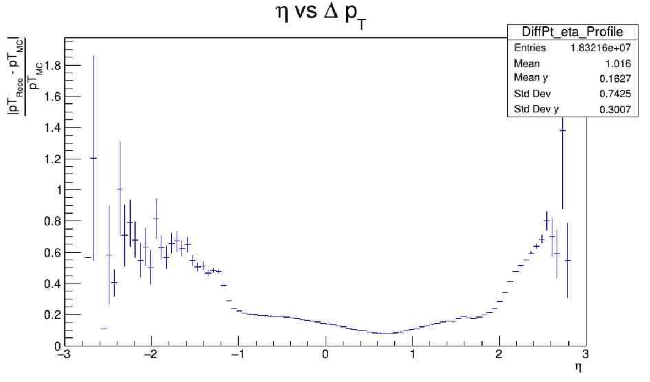
Pseudorapidity vs Pt Resolution
16

Slide 17
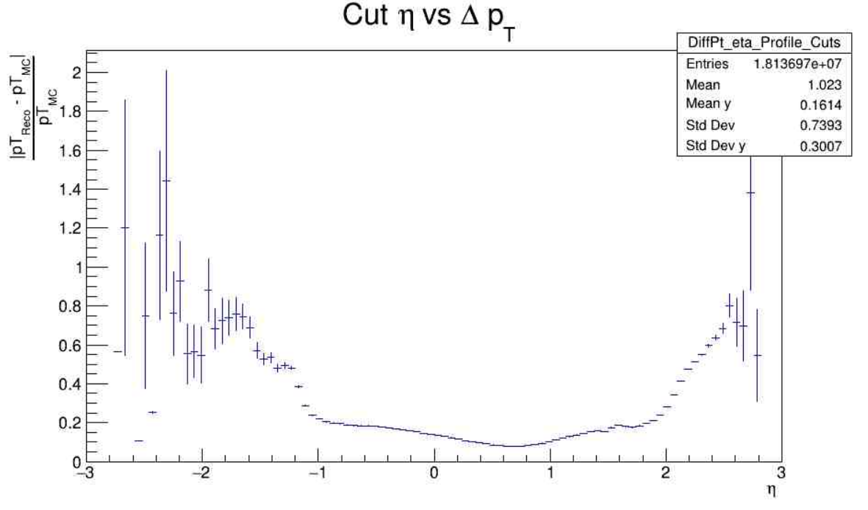
Cut Eta vs Pt Resolution
Cuts in:
b < 13
hits > 3

Slide 18
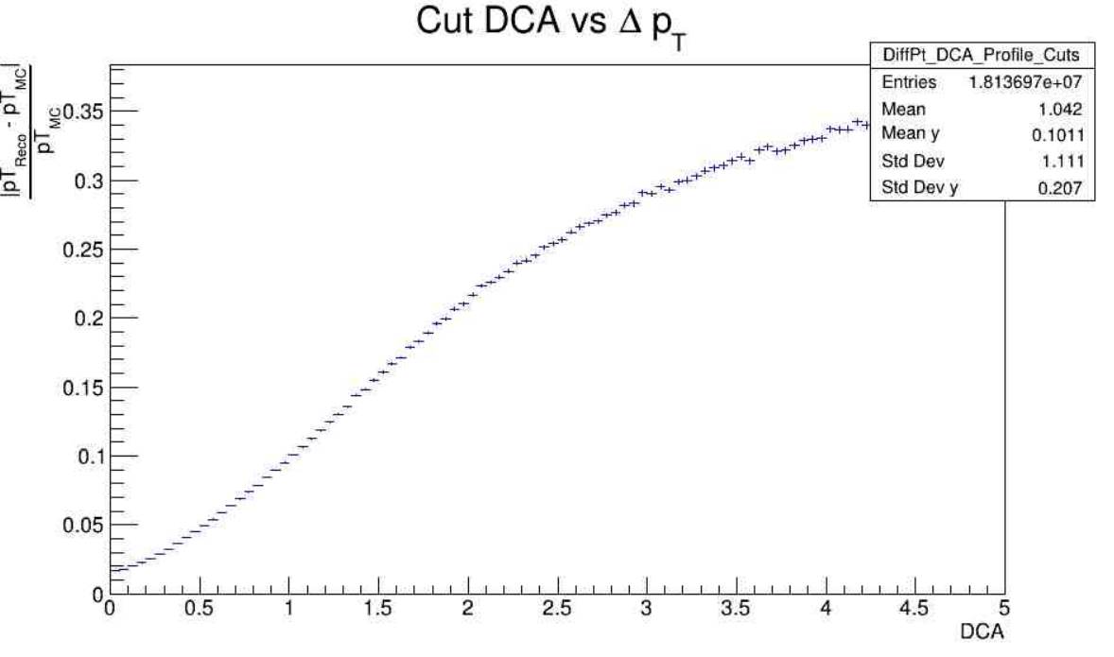
Cut DCA vs Pt Resolution
Cuts in:
b < 13
hits > 3

Slide 19
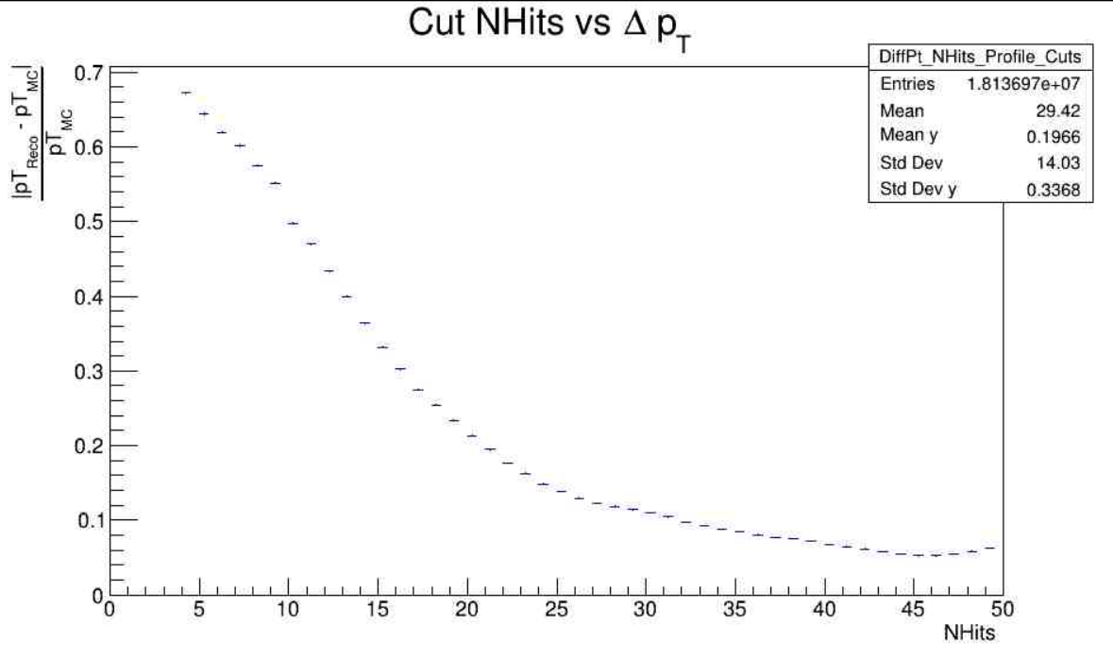
Cut Nhits vs Pt Resolution
Cuts in:
b < 13
hits > 3

Slide 20
Implementation of Centrality class
Work in Progress
It will be used the Centrality Framework:
https://github.com/FlowNICA/CentralityFramework/tree/master
It has two methods:
MC Glauber
Inverse Bayesian Method (Gamma Fit)

Slide 21
MCGlauber Necessary Information
Wolfram
Xenon
Radius of Nucleus: 5.373 +- 0.01
Skin thickness: 0.523
Radius of Nucleus: 4.763 +- 0.01
Skin thickness: 0.523
Inelastic cross section:
$$σ_{tot}=48+0.522{(ln{p_{lab}})}^{2}−4.51\ln{(p_{lab}})$$
$$σ_{el}=11.9+26.9\ln{({p_{lab}}^{−1.21})}+0.169{(ln{p_{lab}})}^{2}−185\ln{(p_{lab}})$$
$${σ_{inel}=σ}_{tot}−σ_{el}$$

Slide 22
Deduction of Energy on CM using Kinetic Energy of 2.5
$$p_{1}=(E_{1}{,p}_{1})$$
$$p_{2}=(m_{2},0)$$
$p_{μ}p^{μ}={\left(p_{1}+p_{2}\right)}^{2}=m_{1}^{2}+m_{2}^{2}+2E_{1}$ $m_{2}$ $≡s$
$$E_{cm}=2.88Gev \sim 2.9Gev$$

Slide 23
Deduction of Lab Mommentum
$$E_{1}=E_{proy}$$
$$E_{1}^{2}=m_{1}^{2}{+ p}_{1}^{2}$$
$$p_{1}=\sqrt{E_{1}^{2}−m_{1}^{2}}=p_{lab}$$
23

Slide 24
Cross section total and elastic
$$σ_{tot}$$
$$σ_{tot}=48+0.522{(ln{p_{lab}})}^{2}−4.51\ln{(p_{lab}})=43.3595$$
$$σ_{el}=11.9+26.9\ln{({p_{lab}}^{−1.21})}+0.169{(ln{p_{lab}})}^{2}−185\ln{(p_{lab}})$$
$$=16.41915$$
$${σ_{inel}=σ}_{tot}−σ_{el}=26.94035$$
24

Slide 25
Thanks
25

Slide 26
References
Xenon: https://materials.springer.com/googlecdn/assets/sm_lbs/885/sm_lbs_978-3-540-45555-4_56/sm_lbs_978-3-540-45555-4_56.pdf?trackRequired=true&originUrl=/lb/docs/sm_lbs_978-3-540-45555-4_56&componentId=Download%20Chapter
Wolfram: https://materials.springer.com/googlecdn/assets/sm_lbs/947/sm_lbs_978-3-540-45555-4_76/sm_lbs_978-3-540-45555-4_76.pdf?trackRequired=true&originUrl=/lb/docs/sm_lbs_978-3-540-45555-4_76&componentId=Download%20Chapter
Cross section info: O. Buss, T. Gaitanos, K. Gallmeister, H. van Hees,
M. Kaskulov, O. Lalakulich, A. B. Larionov, T. Leitner, J. Weil, and U. Mosel, Phys. Rept. 512, 1 (2012),
arXiv:1106.1344 [hep-ph].

