Slide 1
Readout Electronics Design for ITS of MPD in NICA
NICA-MPD ITS Seminar
Lei Zhao, Changqing Feng, Zhe Cao, Jiajun Qin
USTC
2023-7-23

Slide 2

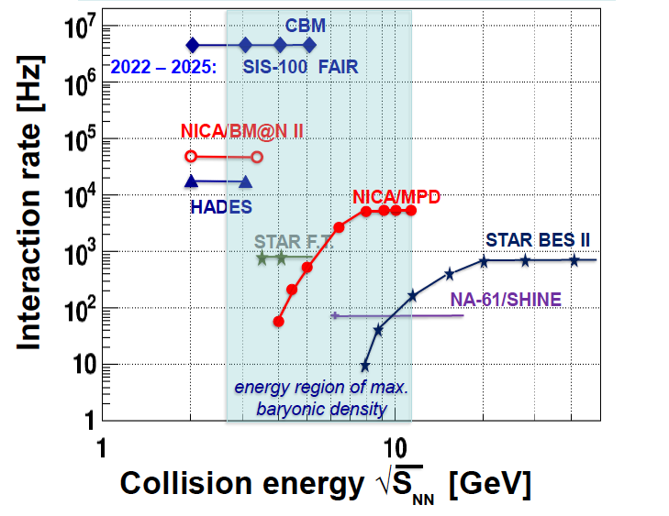

Background
Main targets:
study of hot and dense baryonic matter at the energy range of max net baryonic density
construction of collider to collide

Slide 3
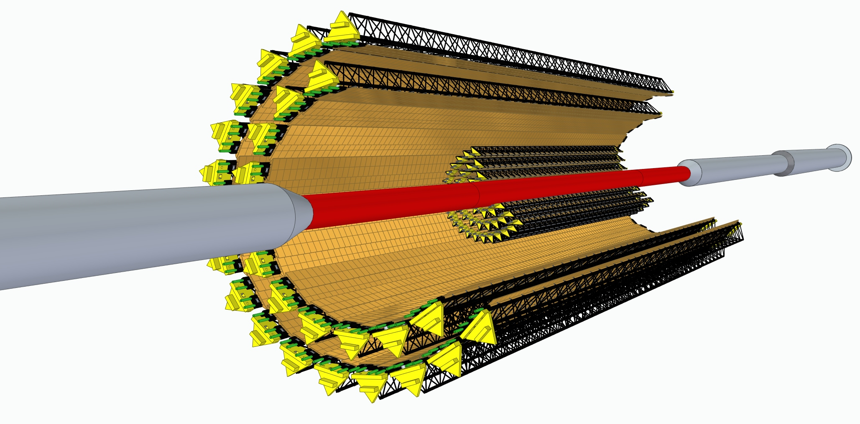
Background
Inner Tracker Detector
  2 barrels (IB,OB)
  5 cylinder layers
Outer Barrel
  ALTAI ASIC based
  Pixel sensor (CCNU)
Readout Electronics for ITS OB in MPD of NICA
Readout Unit (RU) System Scale:
  42 RU modules
  Each RU controls/reads out 196 MAPS chips (from 14 modules)
  Power Unit (PU) System Scale:
  42 PB → 84 PU
  Challenges:
  1. High speed data transmission and real-time pre-processing
  2. High reliability in radioactive environments

Slide 4
Content
R&D progress of Readout Unit
R&D progress of Power Unit
R&D progress of NICA_ROC ASIC
Notes:
这是我报告的提纲

Slide 5
Content
R&D progress of Readout Unit
R&D progress of Power Unit
R&D progress of NICA_ROC ASIC
Notes:
这是我报告的提纲

Slide 6
FPGA based RU
Control and read out the data from 14 modules (14 ALTAI chips/module)
SRAM-FPGA receives control/trigger signals and delivers packed data to CRU
GBT function integrated into the SRAM-FPGA
A Flash-FPGA to monitor and protect the SRAM-FPGA from SEU based on scrubbing

Slide 7
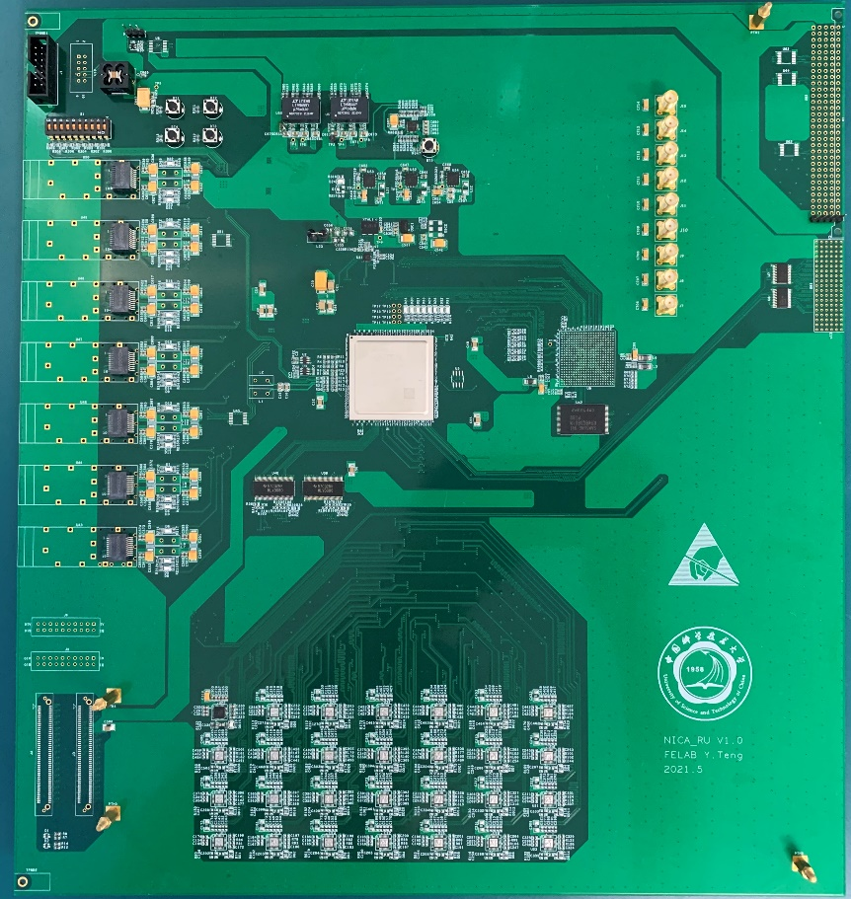
RU prototype Version 0
Transfer data and control signals from/to ALTAI staves
FPGA implemented GBT protocol
Protection from SEU based on logic scrubbing, with a flash based FPGA
Power supply from VME backplane
I2C interface is reserved on the front panel as an alternative path to communicate with PU
8 SFPs for output data transmission

Slide 8
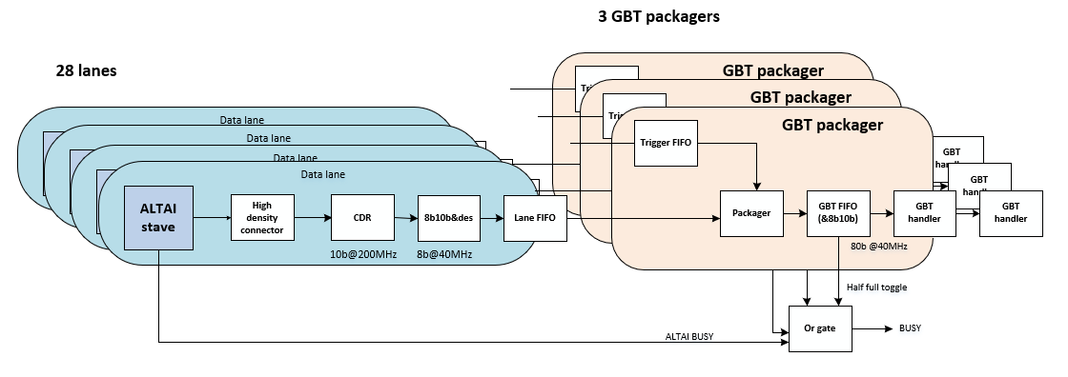
Data flow overview
Data flow in RU:
  Read data from stave
  CDR outputs data and clock
  The main FPGA decodes and deserializes the 8b/10b data
  Combining data and trigger signals
  8b/10b encoding (optional)
  Deliver data to GBT Logic/GBTx
  GBT FIFO half full status will be use as data process busy
FPGA

Slide 9
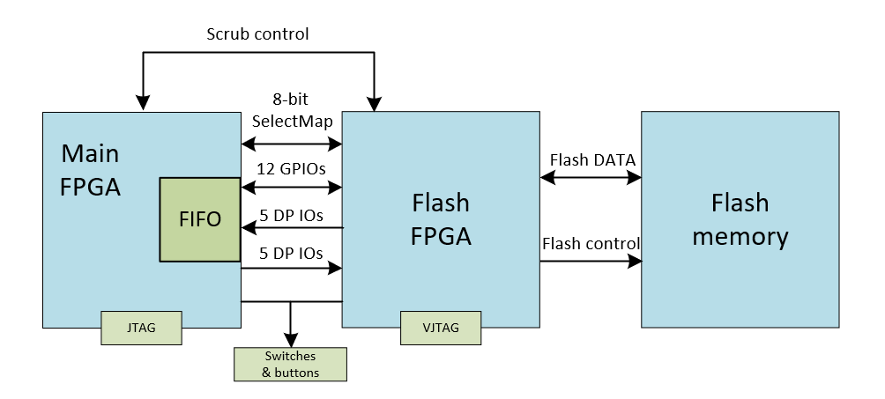
Radiation protection design
A SEM core is employed in the main FPGA to monitor the SEU error
Corresponding logic file will be refreshed by the Flash FPGA once error detected
Key configure logics are protected by TMR(Triple Modular Redundancy) design
The firmware files are stored in the flash memory
Notes:
RU will be exposed in radioactive environment

Slide 10
RU V0 Test
FPGA is used to simulate the MAPS：
  ALTAI data transfer
  control management
10

Slide 11
RU V0 Test: Input data check
Simulate the MAPS data stream (400 Mbps)
clock
data
Simulated ALTAI input vs. internal FPGA waveform
Simulation data
Received test data
Primary para data
11

Slide 12
RU V0 Test: Control and Status
Partial timing diagrams of control management captured by chipscope
Read addr
Write addr
V0 temporarily uses SiTCP protocol to verify the data path
Computer sends commands to FPGA registers
FPGA encodes register status and sends them to ALTAI simulator
Data is collected and returned to PC for readout
12

Slide 13
RU V0 Test: Data rate and BER
The data rate is measured for both front-end and back-end circuit
  400 Mbps for serial data link (front-end)
  5 Gbps for optic fiber path (back-end)
    Indirect measurement: data band width x parallel clock frequency
BER
  b = -ln(1-C)/R
  9.21×10¹² bits data are tested for both data links
  < 10⁻¹²
  99.99% condidence level
13
Notes:
Ten to the power of 12

Slide 14
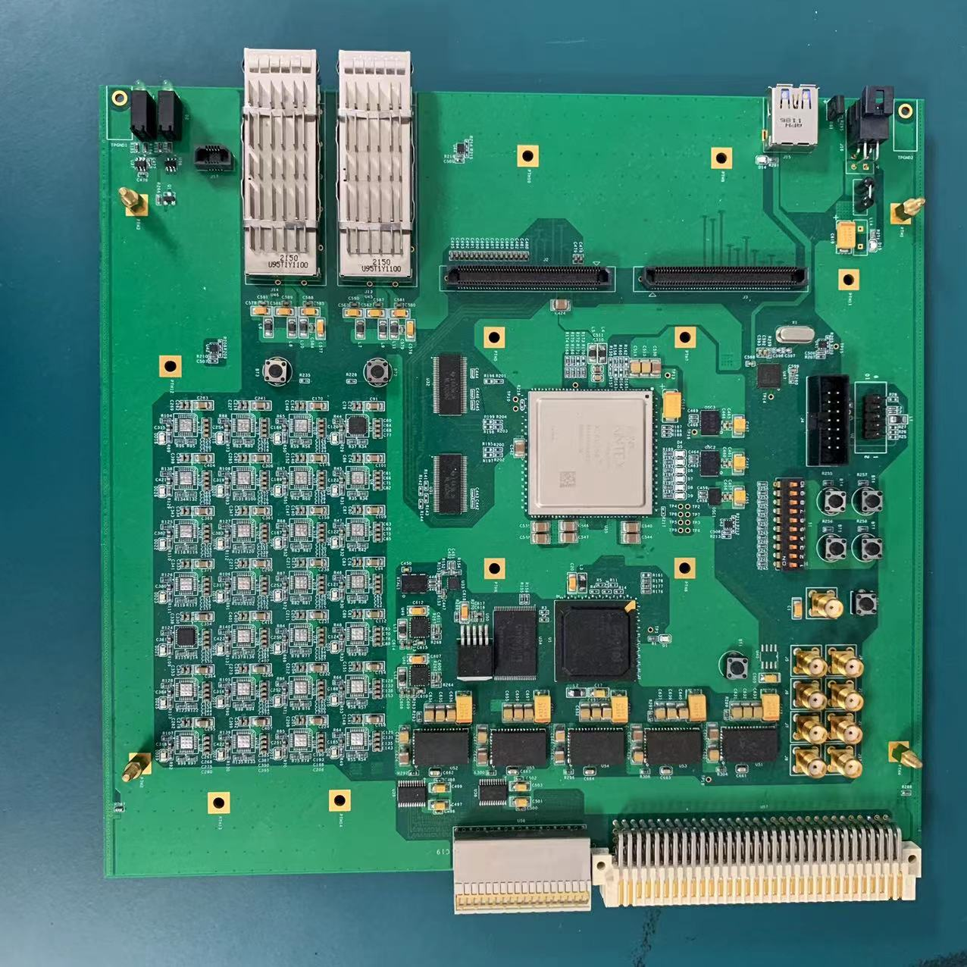
RU V1 Hardware Design
Some Changes:
  Dimensional adjustment to a wider 6U (220 mm x 233 mm)
  Change to CAEN power supply
  Modify the power supply circuit to suit strong magnetic environments
  QSFP+ fiber interface
14

Slide 15
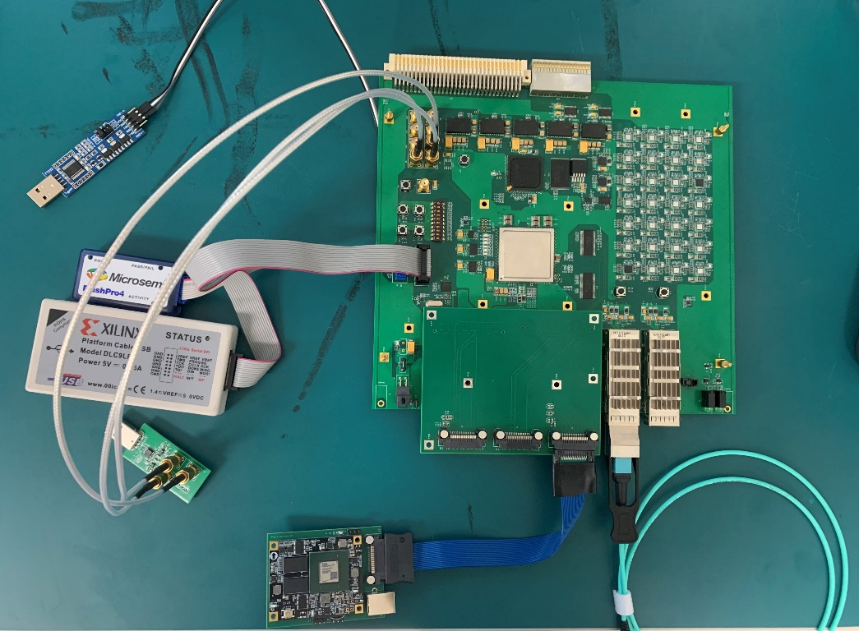
RU V1 test
Aux FPGA UART
RU
Adaptor board
Main FPGA UART
ALTAI sim board
QSFP+
Aux FPGA UART
  Load the bitstream files
  Microprocessor control
Main FPGA UART
  Error inject
Bitstream file load test passed
Partial reconfiguration test passed
Error injection test passed
SelectMAP test passed
co-test passed

Slide 16
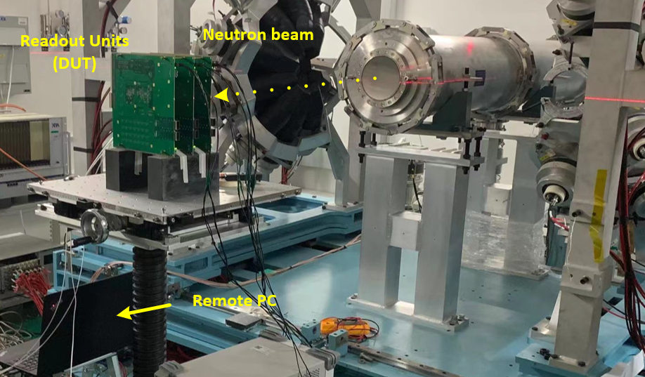
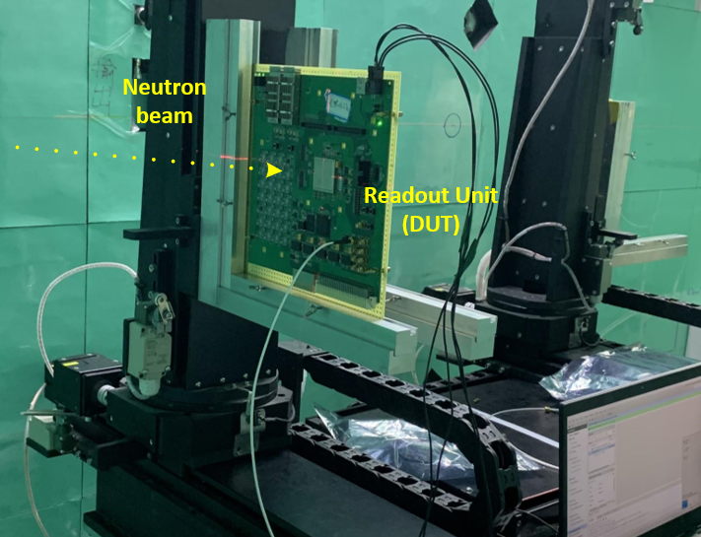
Neutron beam test platform setup
RU V1 test in CSNS
Beam line
DUT FPGA
Test platform setup. Back-n (left), ANIS (right).
CSNS: Chinese Spallation Neutron Source
Back-n: reverse-angle white light source
ANIS: Atmospheric Neutron Irradiation Spectrometer

Slide 17
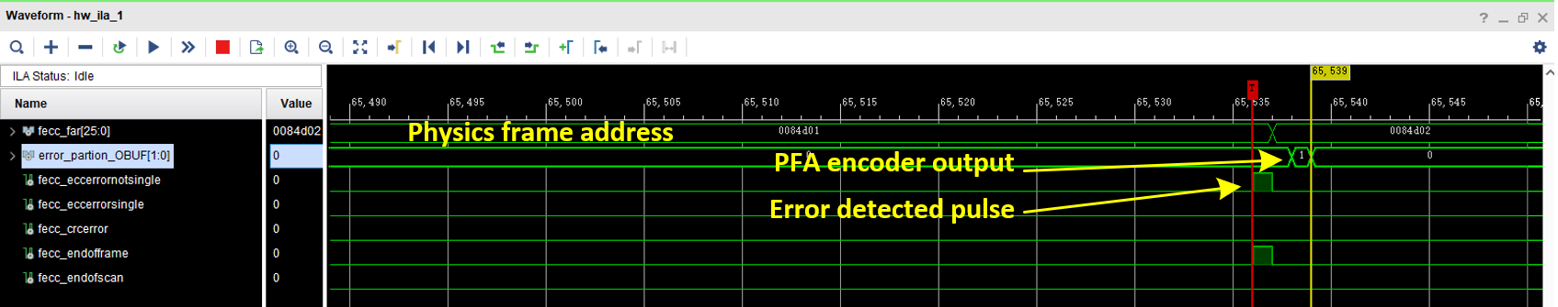
Validation for error detection
RU V1 test in CSNS
Detection of the SEU event
The error detected signal assert at the pos-edge of the end of the frame signal
Record the frame address for classification
We performed SEU tests at Back-n and ANIS, respectively
The system can always detect the soft error and do self-recover (424 SEE errors are detected in total, which are all recovered.)

Slide 18
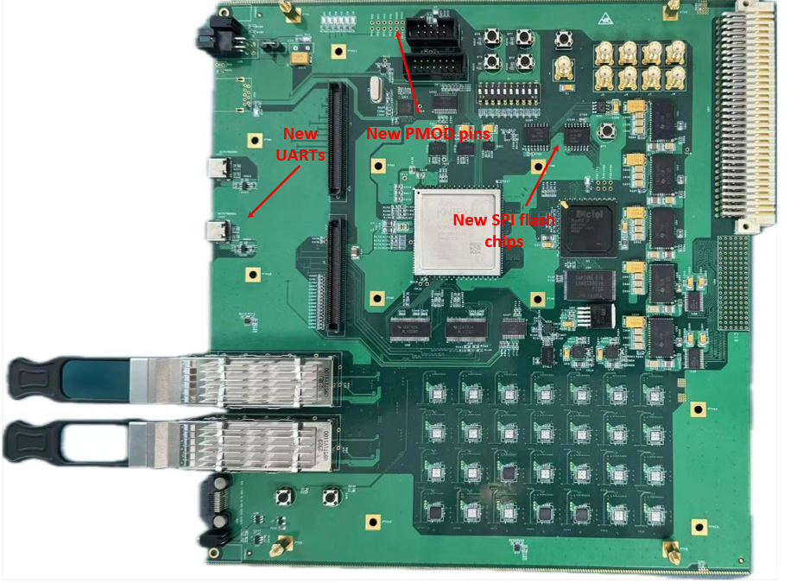
RU V2 Hardware Design
Added two SPI flash chip for both FPGAs
Added two USB-UART chip for both FPGAs
Added more Pmod pins for both FPGAs
Changed the connector to PU
18

Slide 19
Content
R&D progress of Readout Unit
R&D progress of Power Unit
R&D progress of NICA_ROC ASIC
Notes:
这是我报告的提纲

Slide 20
PU in NICA
Purpose: to power the staves of ITS in MPD of NICA
Powered by CAEN power system
Controlled and monitored by RU

Slide 21
Design of PU
A PB consists of two independent PUs (PUR and PUL), which have almost identical main functions
Each PU contains 8 channels of analogue output (1.8V/250mA) and 8 channels of digital output (1.8V/1.5A)
The PU operation mode (for OB or IB) can be selected via a switch
A flash FPGA on PUR controls both PUR and PUL and is responsible for communication with RU

Slide 22
Functions in PU
  Monitoring of voltages and currents and over-current protection with adjustable threshold on each supply channel
  Monitoring of temperature and over-temperature protection
  Individual adjustment of supply voltages
  Individual enabling of supply voltages
  Communication with RU

Slide 23
Communication with RU
Communication Protocol between PU and RU: UART
  Uplink: upload the status of PUs and staves
  Downlink: download a set of commands
Uplink
Downlink
Parameter | Size[bits] | Channel
Analogue Voltage | 12 | 16
Analogue Current | 12 | 16
Digital Voltage | 12 | 16
Digital Current | 12 | 16
Bias Voltage | 12 | 2
Bias Current | 12 | 2
Temperature | 15 | 6
PUR Status | 16 | 1
PUL Status | 16 | 1
Command | Code[Hex]
General Reset | 00
Parameter Upload Start | 01
PUR Digital Voltage Set | 02
PUR Analogue Voltage Set | 03
PUL Digital Voltage Set | 04
PUL Analogue Voltage Set | 05
PUR Bias Voltage Set | 06
PUL Bias Voltage Set | 07
Limit Set | 08
Bias output enabling | 09

Slide 24
Design of PUR
ADC: monitoring of voltages and currents
RTD to digital converter: monitoring of temperature of both PU and stave
Digital potentiometer: individual adjustment of supply voltages
FPGA: individually enabling of supply channels and communication with RU

Slide 25
Layout of PU
PUs are 6U VME boards (220mm depth, 233mm height)
All connectors are designed to be compatible with the CAEN power system and the breakout board

Slide 26
Cooling plate design
Cooling plate is needed for cooling PU in VME crate
Cooling plate of PU is located between PUL and PUR
Cooling pipes go through the main high-power components: LDOs

Slide 27
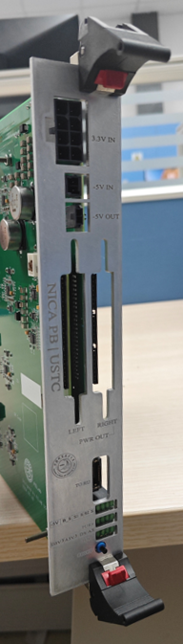
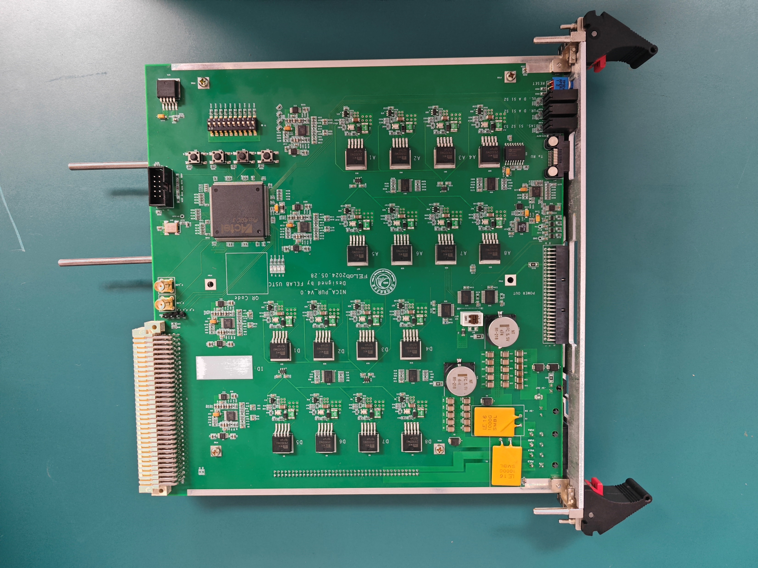
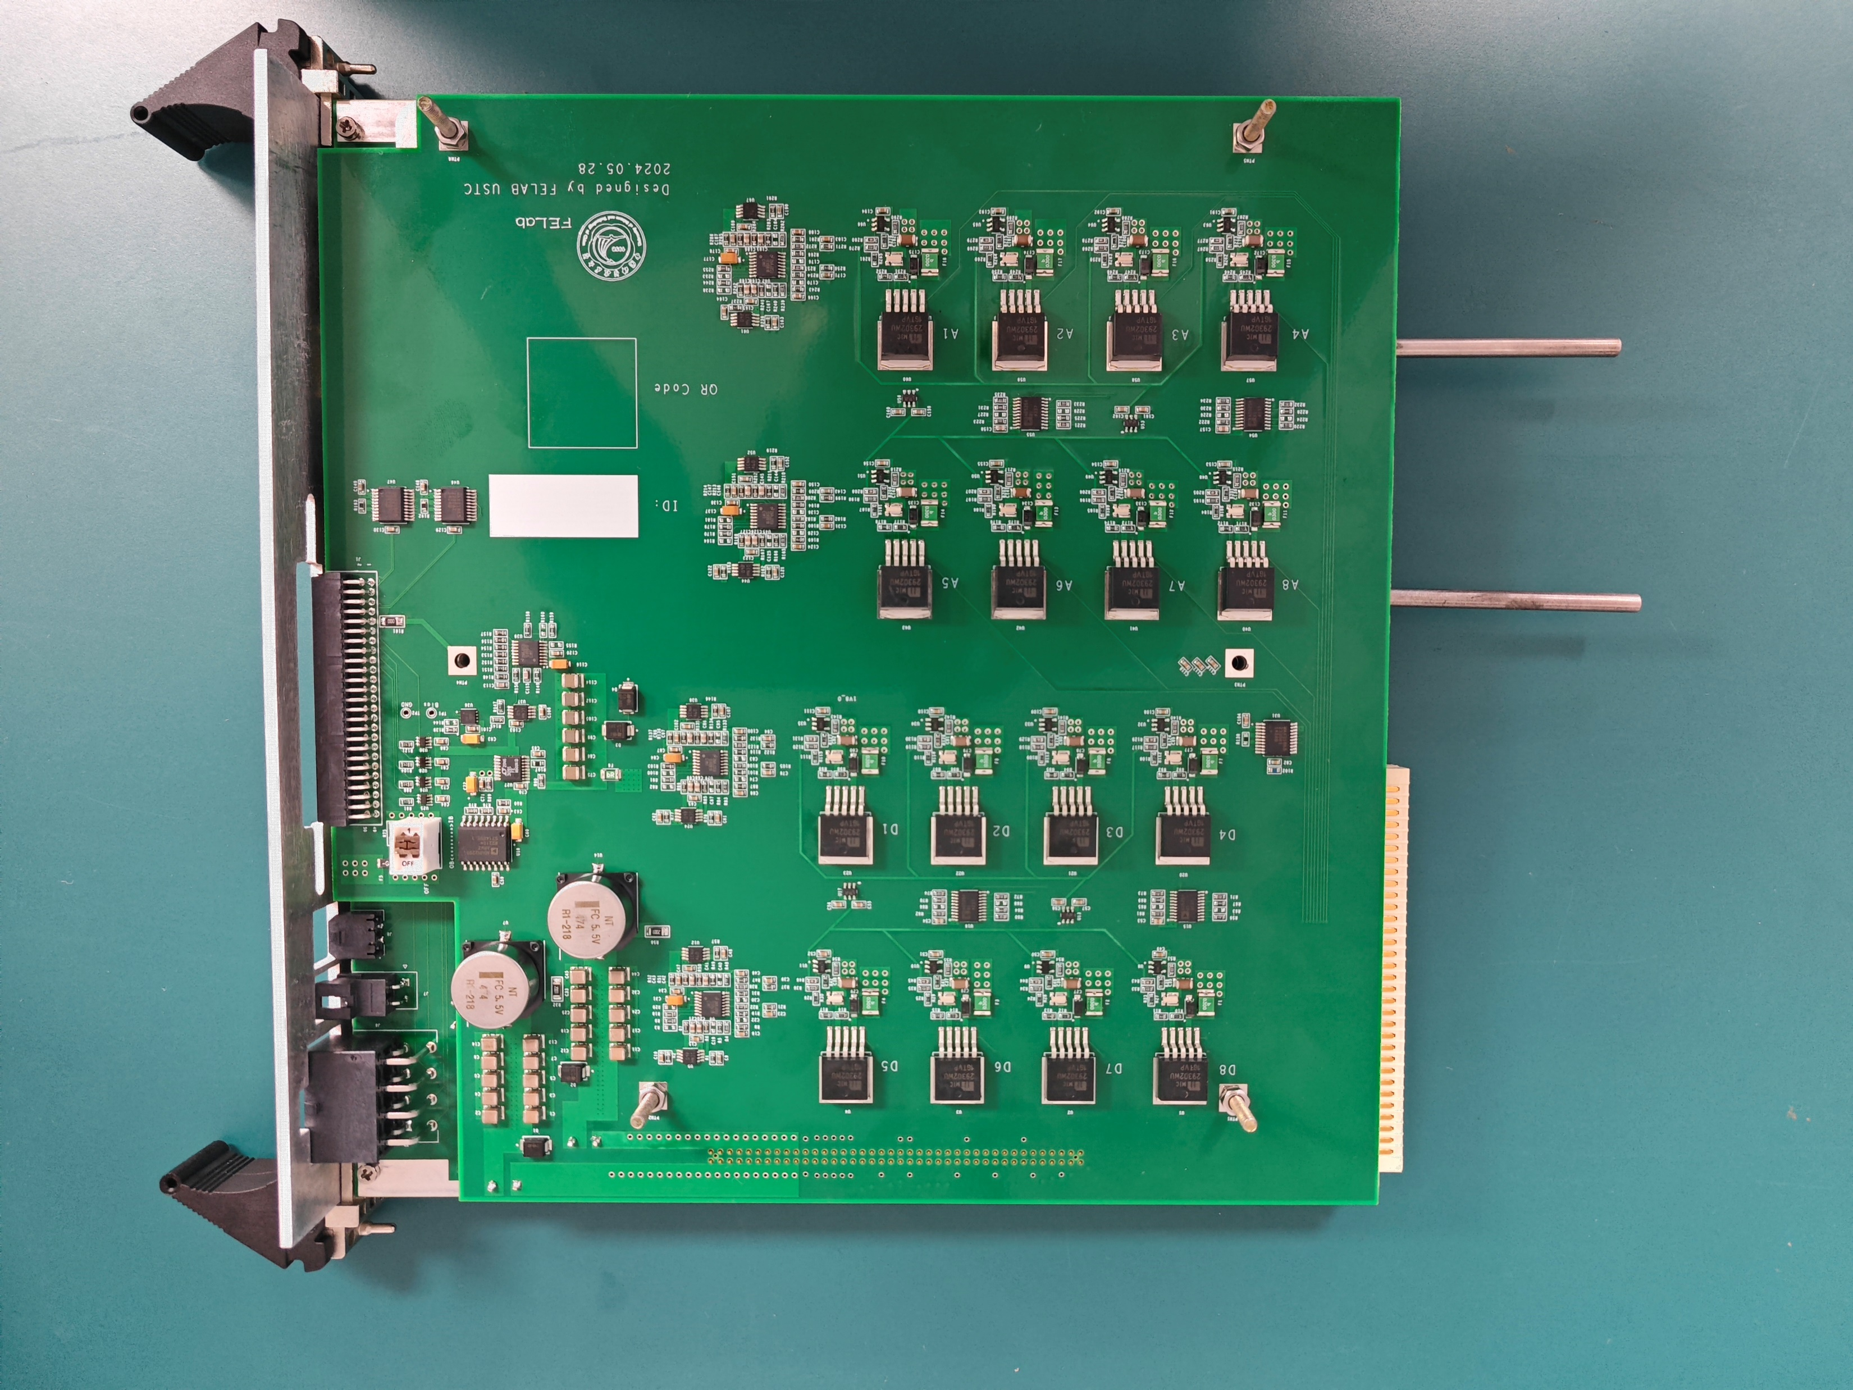
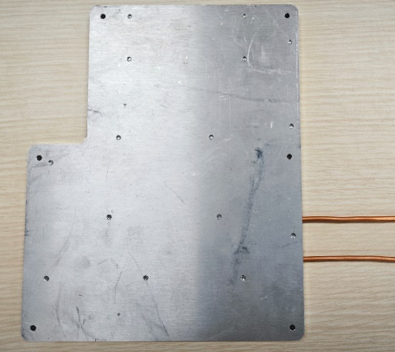
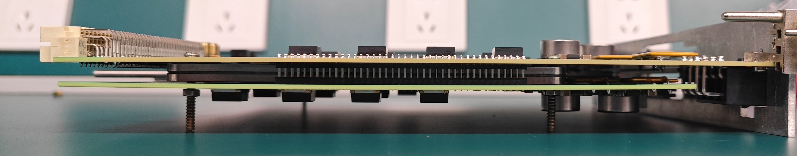
Prototype of PB
All functions of the PB have been tested successfully
All mechanical parts have been fabricated
  Cooling plate
  Front panel
Front panel
PUR
PUL
Cooling plate

Slide 28
Voltage drop in power cable
Load resistance(Ω) | Voltage at PU(V) | Voltage at load(V) | Current(A) | Voltage drop(V) | Resistance between PU and load(Ω)
1.2 | 1.805 | 1.313 | 1.094 | 0.492 | 0.450
1.8 | 1.802 | 1.442 | 0.801 | 0.360 | 0.449
4 | 1.798 | 1.617 | 0.404 | 0.181 | 0.448
5 | 1.798 | 1.649 | 0.330 | 0.149 | 0.452
7.5 | 1.798 | 1.696 | 0.226 | 0.102 | 0.451
Voltage drop in power cable (10m) can not be ignored
Resistance of the round trip is essentially a constant, approximately 0.45Ω
  Resistance of the power cable is around 0.38Ω (2×0.19), 84.4%
  Resistance of other parts is around 0.07Ω, 15.6%

Slide 29
Voltage compensation
ADC
  Obtain output current information
  Conversion takes at least 48.8ms
FPGA
  Resistance between PU and load is stabilized at 0.45 ohm
  Voltage loss can be calculated from current information and resistance information
Digital potentiometer
  Control output voltage
  Compensating for the voltage loss calculated by the FPGA
Real-time voltage compensation can be completed in approximately 50ms
Notes:
Because there is a current monitor circuit on the board, we can get the current value in real time. And the resistance of the power cable we can calibrate in advance. Then adjust the output voltage accordingly.

Slide 30
Test of voltage compensation
Load resistance(Ω) | Voltage at PU(V) | Voltage at load(V)
1.2 | 2.483 | 1.808
1.8 | 2.261 | 1.810
4 | 2.015 | 1.812
5 | 1.967 | 1.806
7.5 | 1.912 | 1.804
The voltage compensation algorithm is capable of addressing the issue of voltage drop loss across power cable
Notes:
The load side voltage can be maintained at 1.8V at different load resistances.

Slide 31
Content
R&D progress of Readout Unit
R&D progress of Power Unit
R&D progress of NICA_ROC ASIC
Notes:
这是我报告的提纲

Slide 32
NICA ROC ASIC
Replace the function of FPGA，readout and control the MAPS chips;
NICA_ROC and NICA_GBT form the complete data link and control link;
Acts assembler, buffer, aggregator, and data packet processor for the pixel detectors;
NICA_ROC essentially optimizes the bandwidth utilization and reduces the number of required data links.
At present, two versions of the chip have been completed

Slide 33
NICA ROC_V0 ASIC
Data link:
  Input: 400 Mbps/8 channels/
      LVDS
  Output: 400 Mbps /8 channels/
      LVDS
Trigger : 40 Mbps/LVDS
Clock: 40 MHz
Design based on a self-defined interface and data format；
Provides the control, trigger and clock information for the ALTAI chips;
Allows flexible mapping configuration between input and output channels；
Notes:
This slide shows the architecture of the NICA_ROC, it is consists of the following parts: Data Capture, cross-bar, Sub_ROC capture, configure and Clock/Trigger/control module.

Slide 34
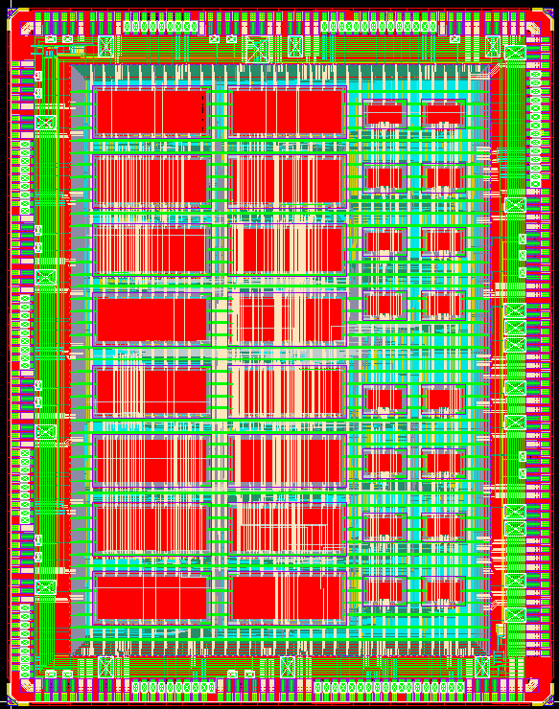
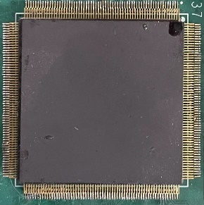
NICA ROC ASIC
NICA_ROC V0
MAPS Link:
  Data link: 400 Mbps / 8 channels
  Cfg link: 40 Mbps / Bi-directional
  Clock : 40 MHz
GBT Link:
  Data link: 400 Mbps / 1/2/4/8 channels
  Cfg link: 80 Mbps
  Trigger link :160 Mbps
  Clock : 40 MHz
Power：0.702 W
Provides Control, Trigger and Clock information for the detector chip
Realize the function of data reorganization
    Area：5.7 mm×4.5 mm
    Pins：247
    Package：CQFP256
34

Slide 35
Test result of data link
Collection Mode: 8 input channels to 4 output channels

Slide 36
Test result of data link
Collection Mode: 8 input channels to 1 output channel

Slide 37
NICA_ROC V1 ASIC Design
CDR schematic
Integrated CDR block and PLL into the chip
Input data rate up to 1.2 Gbps/SLVS
Integrated UART、SPI and other control interfaces

Slide 38
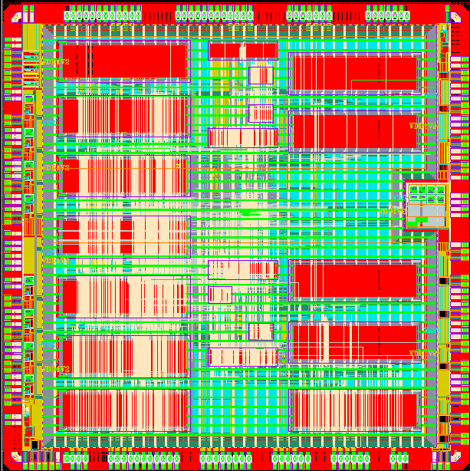
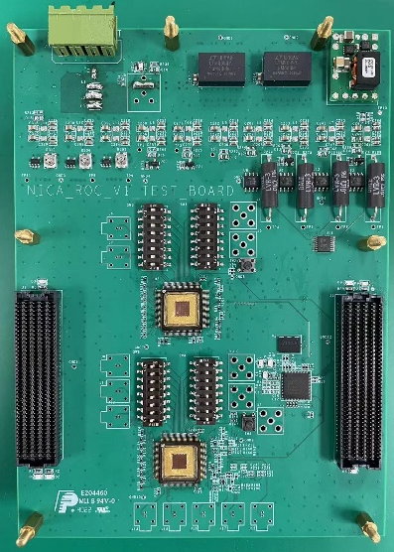
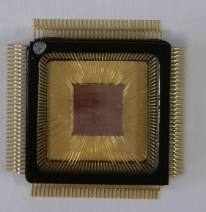
NICA_ROC V1 layout
Areas:5 mm × 5 mm Package:QFP128 8 channels
Test board

Slide 39
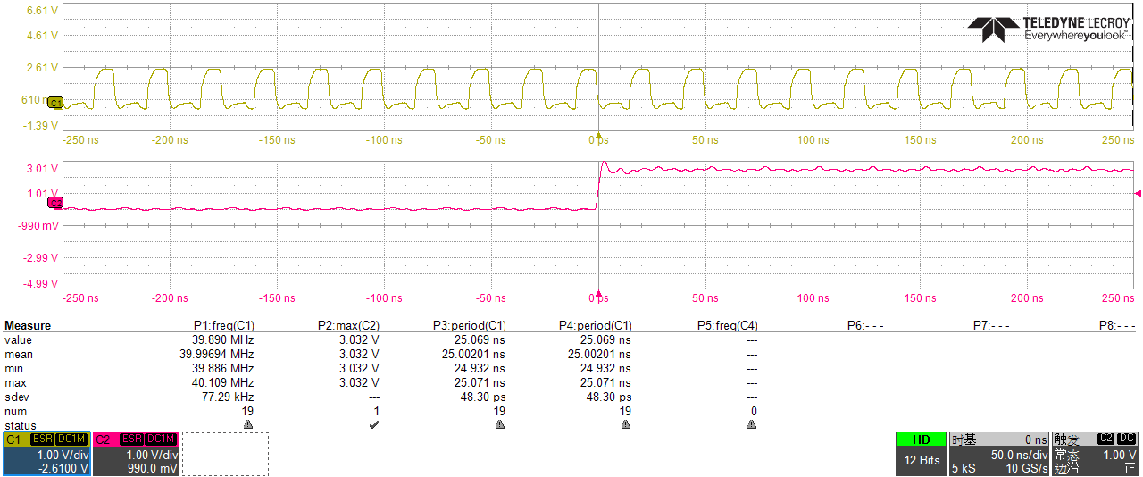
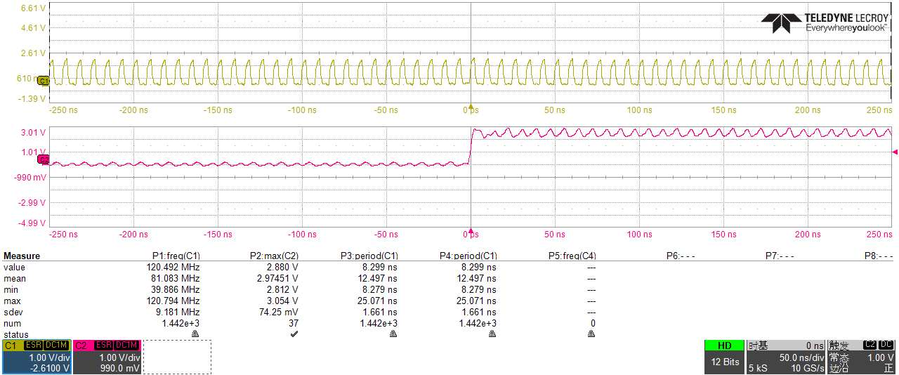
Test result of CDR
The following figure shows the clock signal recovered by CDR at different input data frequencies
400 Mbps data
1.2 Gbps data

Slide 40
Thanks

Slide 41
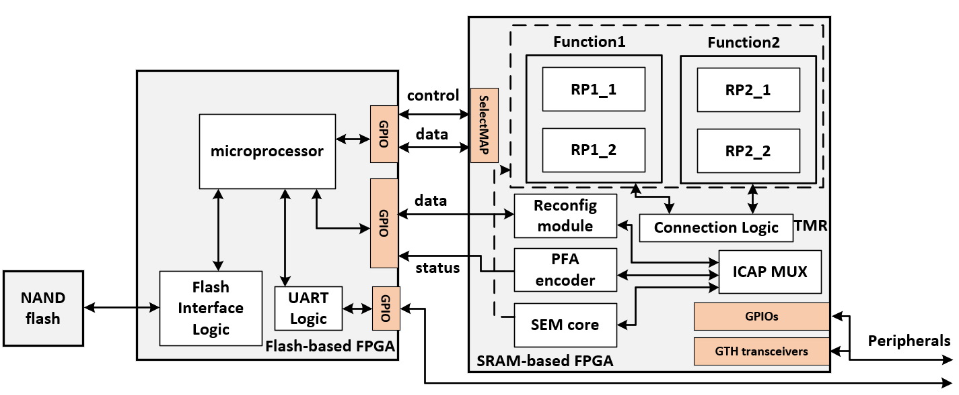
Scrubber design overview
Primary config
Dynamic reconfig
SEM core is employed to monitor the configuration memory
Fast logic recovery by method of hot backups
Every function module has a reconfiguration partition (PR) backup
Connection logic is protected by TMR technology
Physics frame address (PFA) encoder is used to calculate the partition that soft error occured
The microprocessor is used to control the read and write of the configuration port and the flash port
41

Slide 42
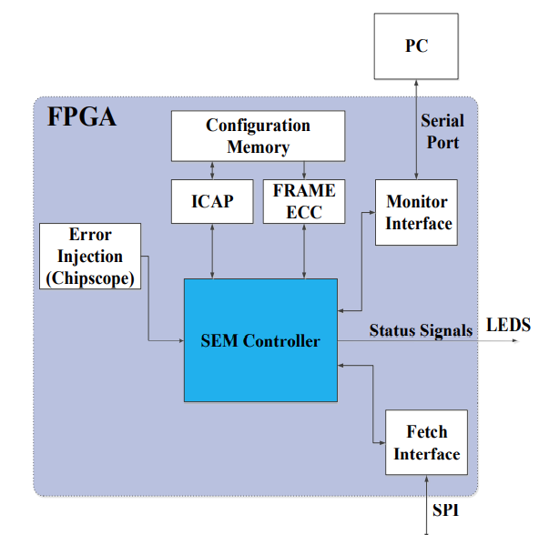
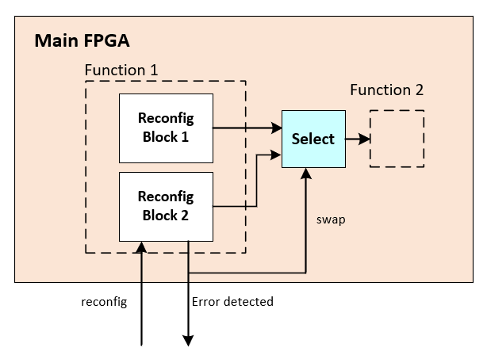
Main FPGA desin for scrubber
SEM IP
  provides the ability to detect and correct soft errors in the configuration memory
  Generate the error detected signal to microprocessor
Partial reconfiguration
  Increase solution flexibility by time-multiplexing design functionality
  Reduce dynamic power consumption by loading functions on-demand
  Significantly reduces system dead time

Slide 43
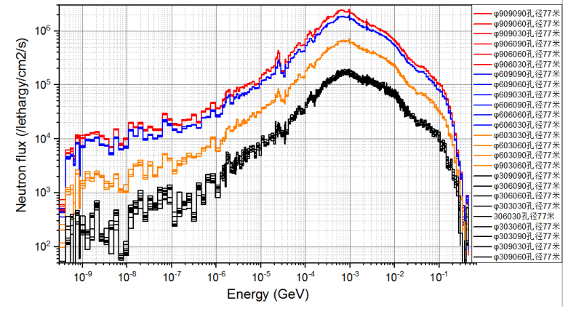
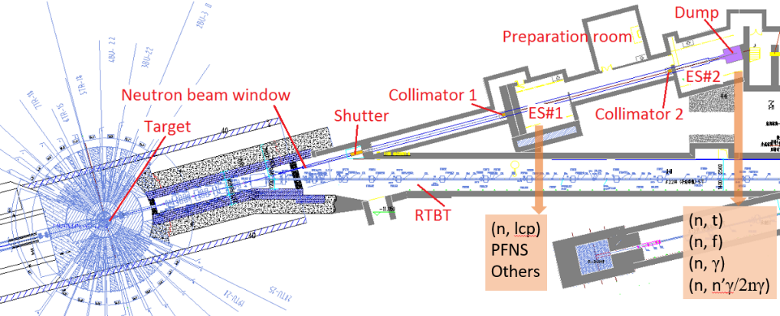
V1 test in CSNS
The CSNS reverse-angle white light source (Back-n) is an experimental device built on the Chinese spallation neutron source (CSNS). The neutron physics, especially the neutron nucleus, is carried out by using the anti-angular white neutron beam generated by the proton spallation target. Data measurement studies and research and applications such as detector calibration, neutron beam irradiation effects, and neutron photography.

Slide 44
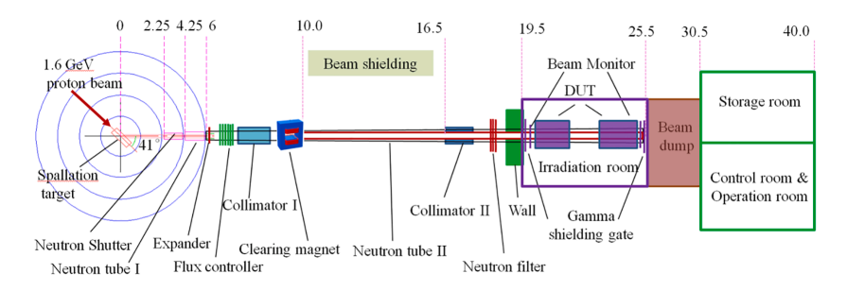
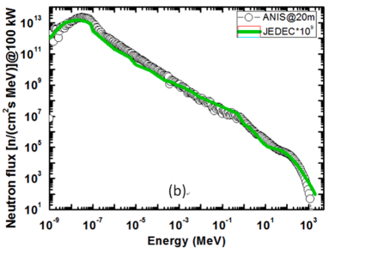
V1 test in CSNS
An Atmospheric Neutron Irradiation Spectrometer (ANIS) with a neutron spectrum resembling that of atmospheric neutrons was physically designed at CSNS. Simulation results indicate that ANIS is a world-class neutron irradiation facility based on proton accelerator, with very distinctive neutron beam quality and wide range adjustment capability. It will supply a powerful platform for the accelerated Single Event Effect (SEE) test that is used in aviation and terrestrial electronics.

Slide 45
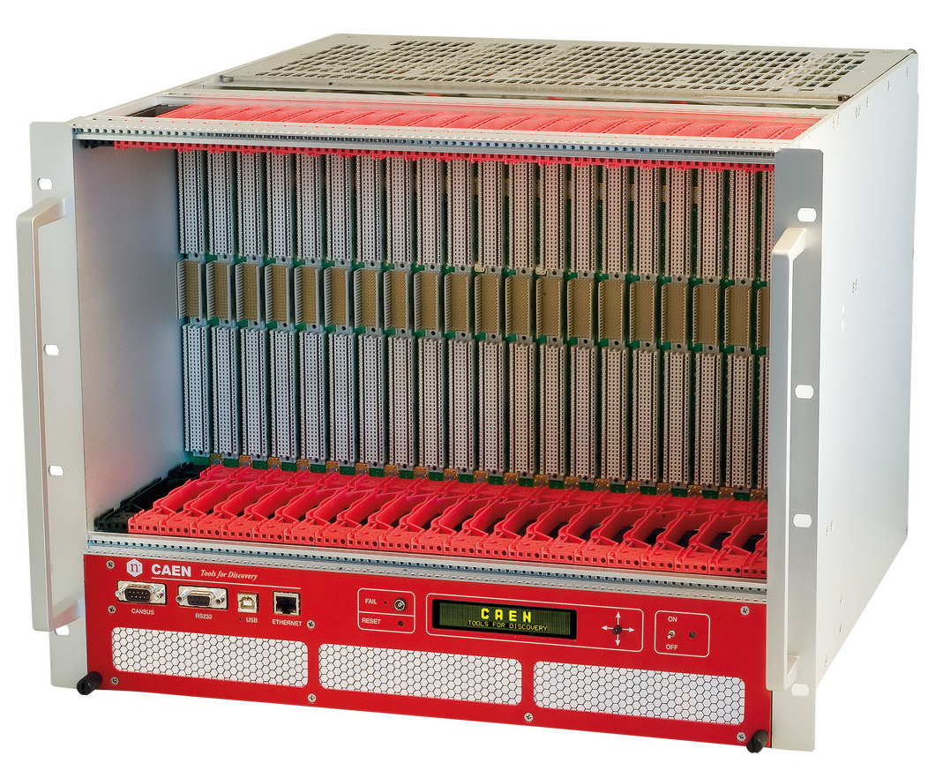
VME crate
PB and RU are installed in a 21-slot VME crate: VME8100
  OB: A group contains one PB and one RU, allowing for the power supply and readout of one stave
  IB: A group contains one PB and two RU, allowing for the power supply and readout of two staves

