Slide 1
Modules and supermodules assembly readiness at JINR
Sheremetev Aleksei
JINR LHEP

Slide 2
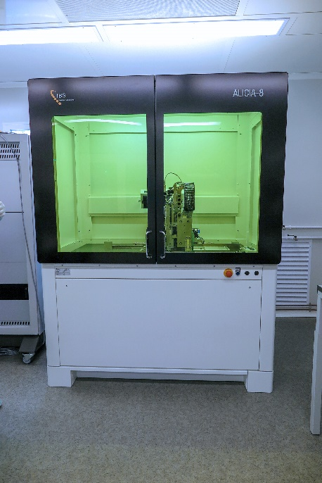
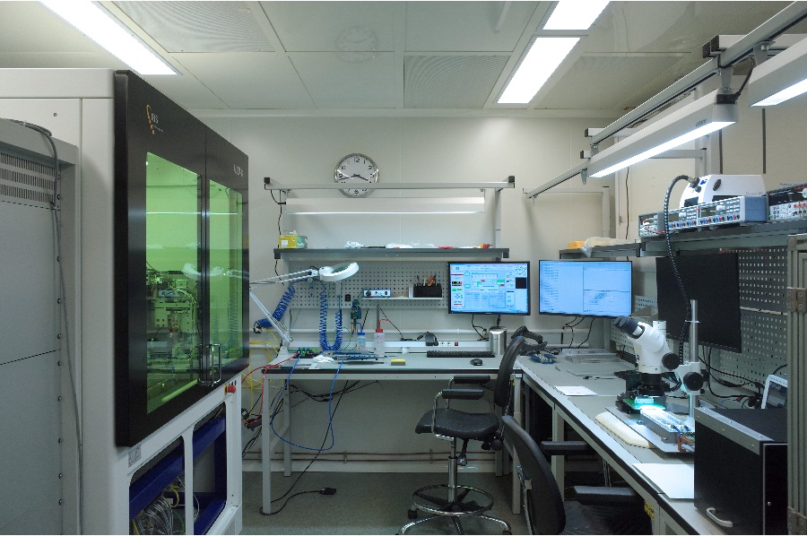
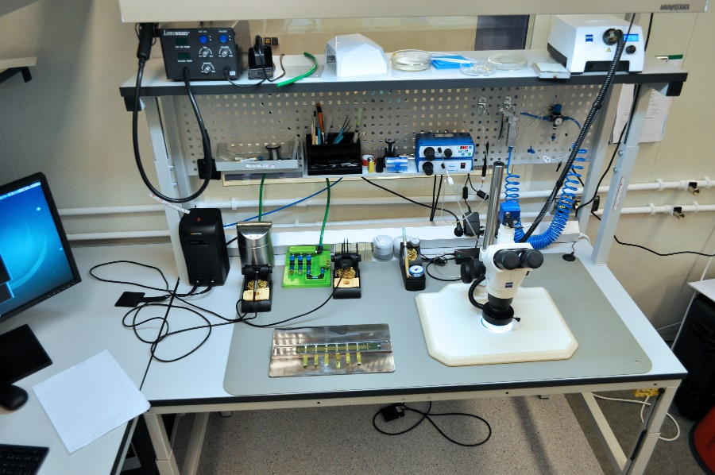
Infrastructure and preparation at JINR LHEP
Production line for assembly of Hybrid Integrated Circuits (HIC):
Clean room ISO6 ~50 m² (ready);
Pick and Place machine ALICIA-8 has been installed and configured for assembly and transfer data for LIT data server (need to adjust gripper part of machine);
F&K Delvotec G5 ultrasonic wire bonding has been configured for bonding HIC (ready).

Slide 3
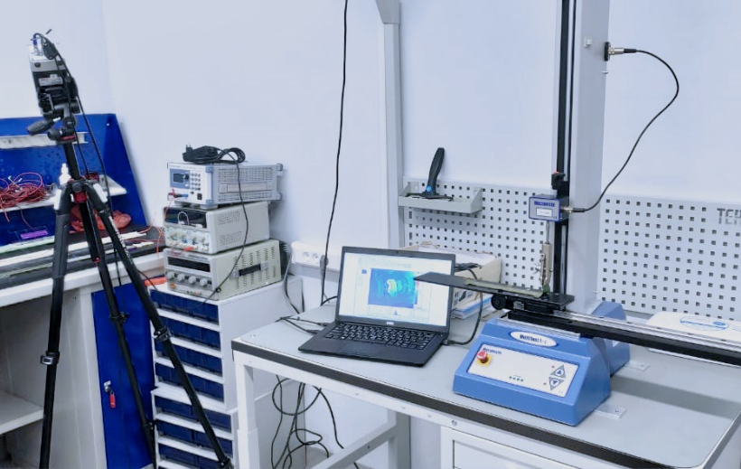
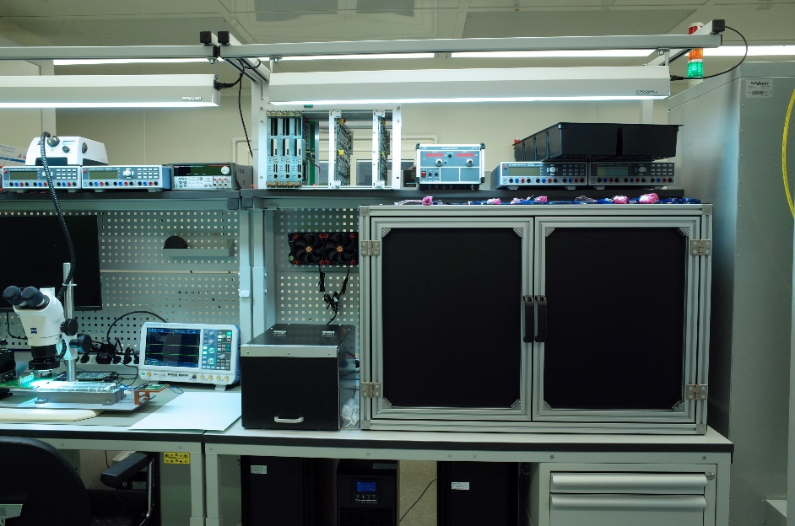
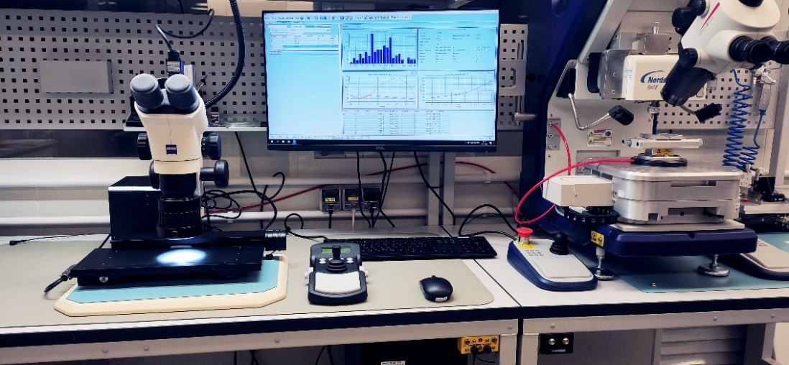
Infrastructure and preparation at JINR LHEP
Production line for testing of Hybrid Integrated Circuits (HIC):
Soldering and assembly Flexible Printed Circuit (FPC) (ready)
Qualification/endurance test setups:
Pull tester DAGE4000+ (ready)
Peel force tester Multitest i1 (ready)

Slide 4
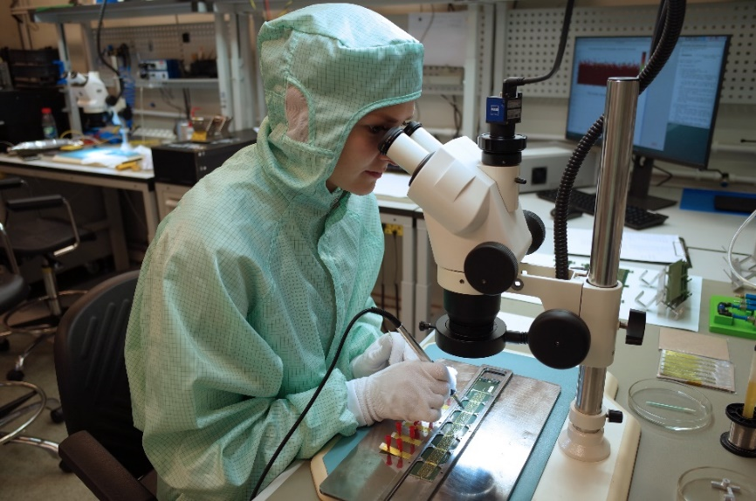
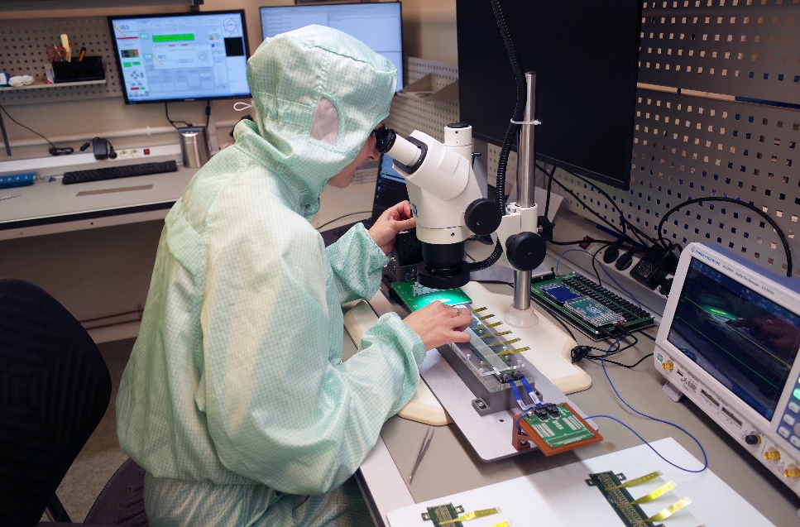
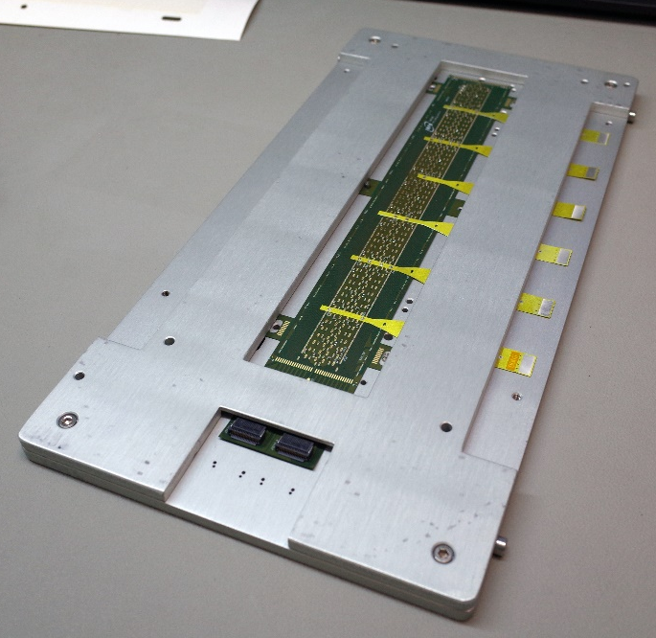
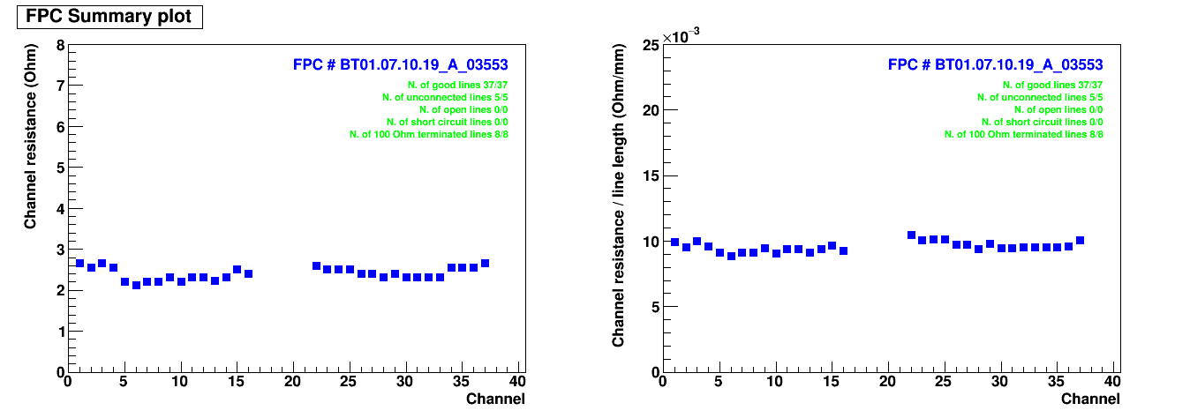
Assembly stages for ITS detectors parts
Workflow of preparing the FPC:
Soldering Cross cable to FPC
Cleaning the FPC in an ultrasonic bath
Electrical test of FPC (impedance)
Storage to carrier plates
90 FPC has been ready
for assembly

Slide 5
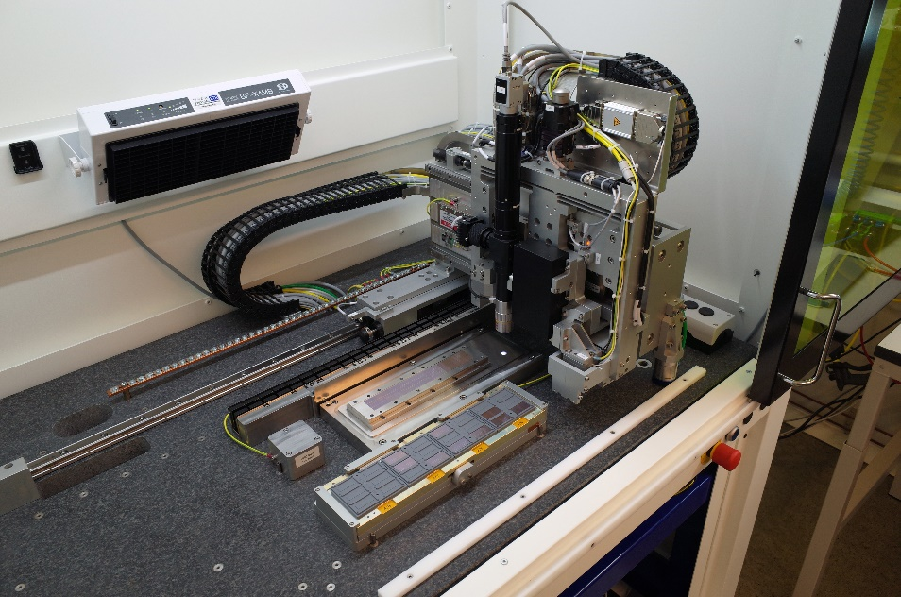
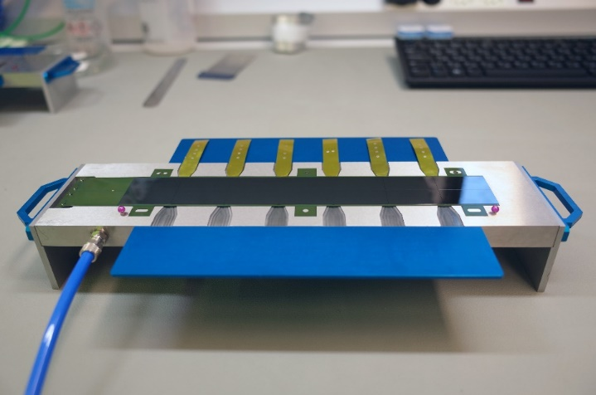
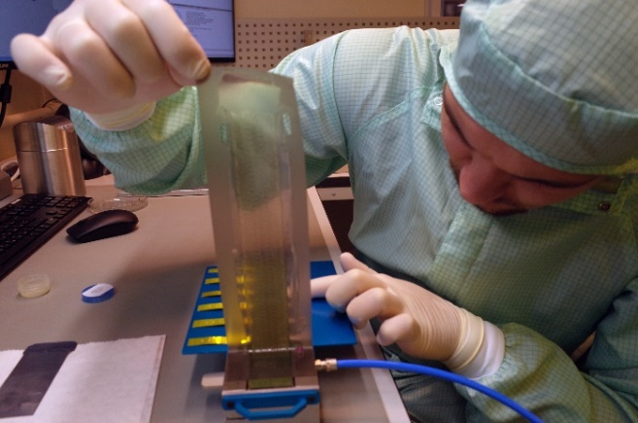
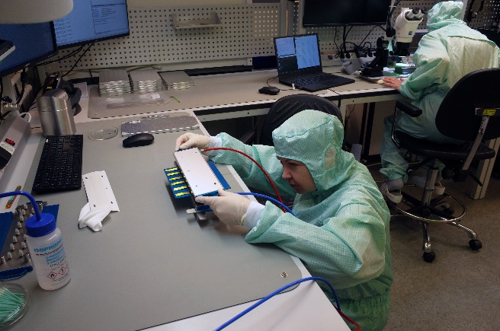
Assembly stages for ITS detectors parts
Workflow of assembly MICA chip to FPC:
Alignment MICA chips in ALICIA-8
Glue chips to FPC
Wire bonding on Delvotec G5
Pull test some HIC
Peel test of wire bonding on HIC

Slide 6
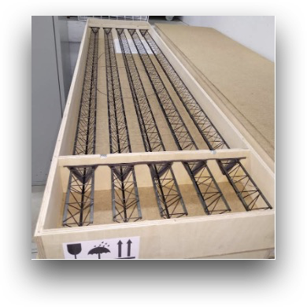
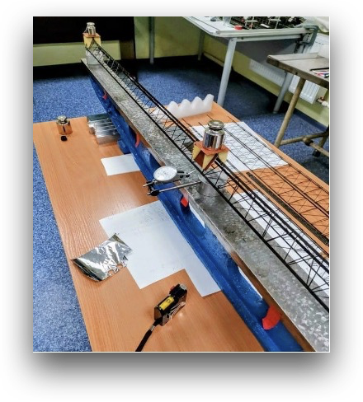
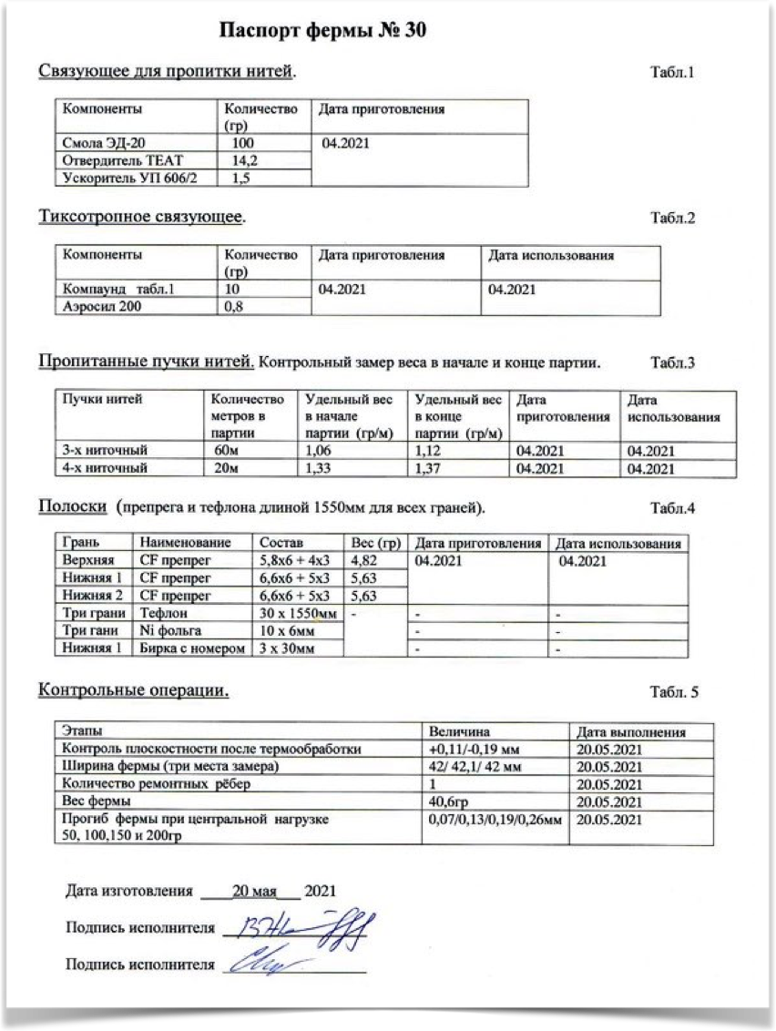
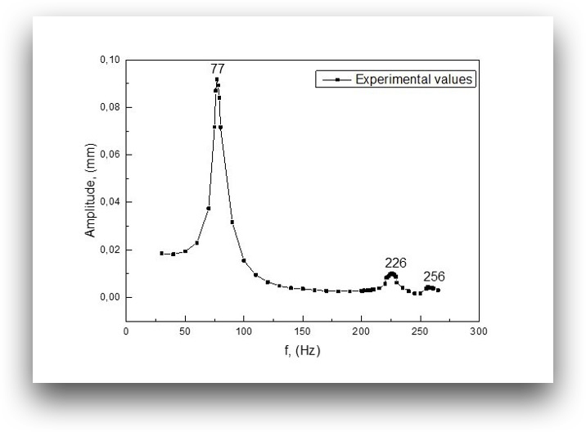
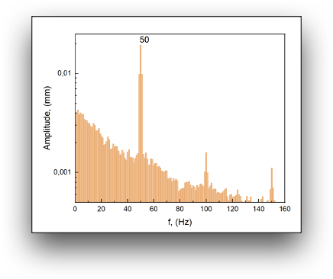
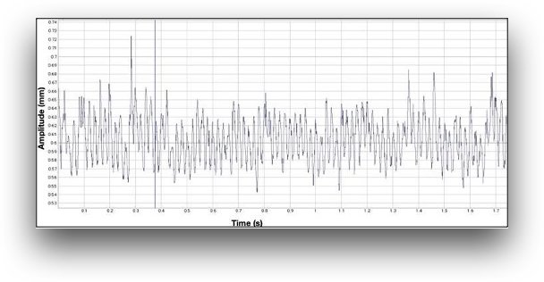
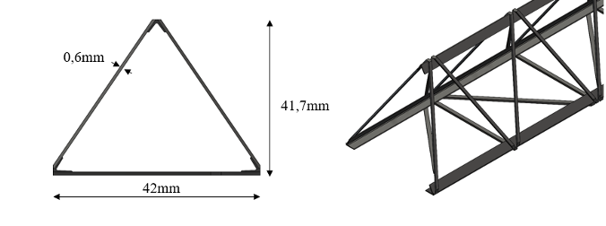
QA test of mechanical degradation of irradiated STAVE
Mechanical test
Maribel Herrera
Tuyana Lygdenova
Determination of the 1st natural frequency before and after
the irradiation at IBR-2M reactor
FT
f_{n} = 77 ± 0.55 Hz

Slide 7
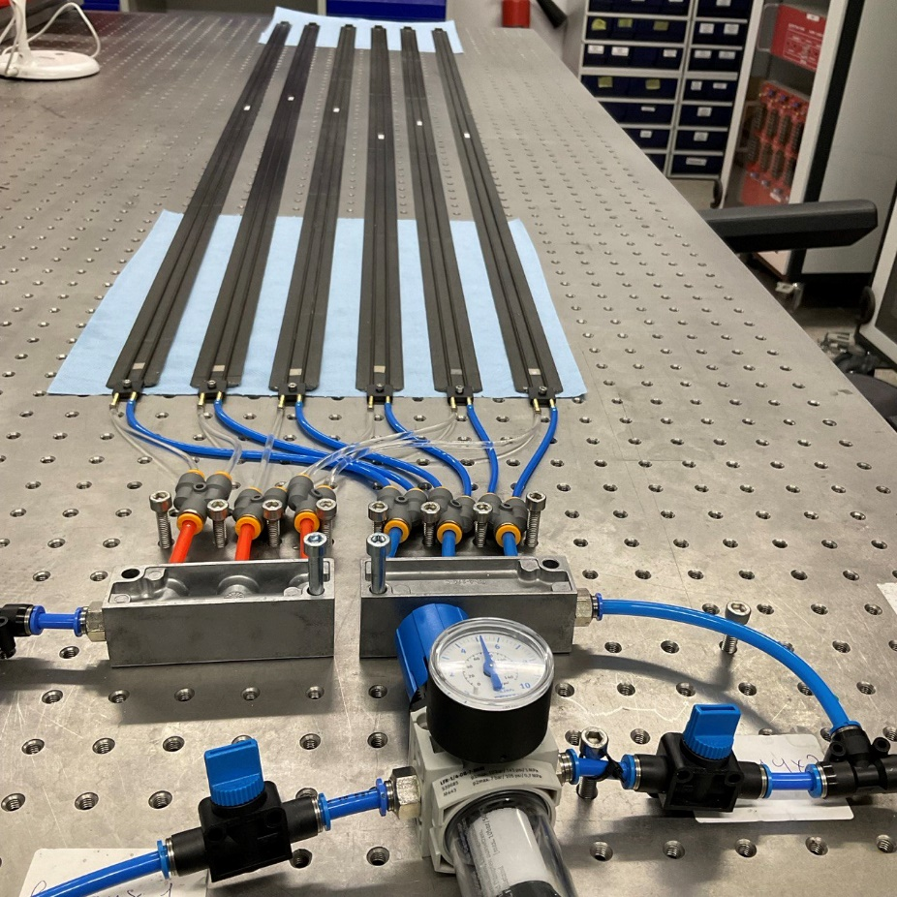
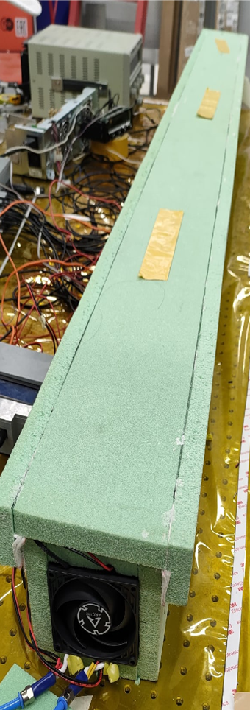
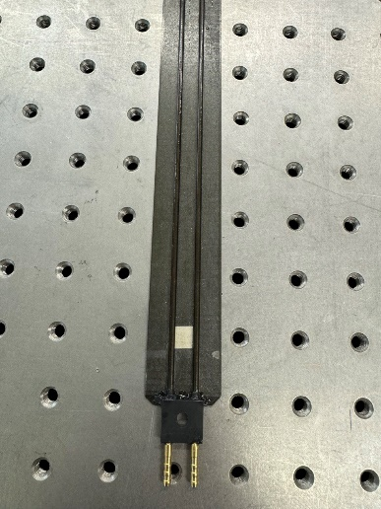
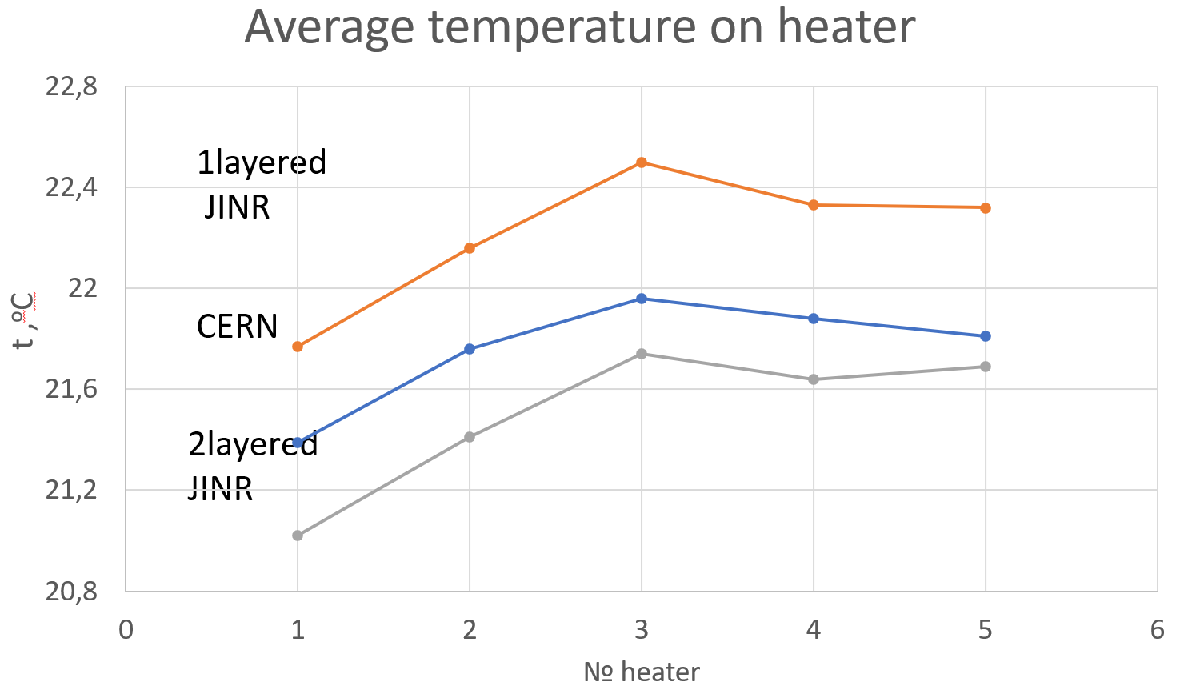
QA test of carbone part for STAVE
Cooling test
Thermal test
Heat imitators

Slide 8
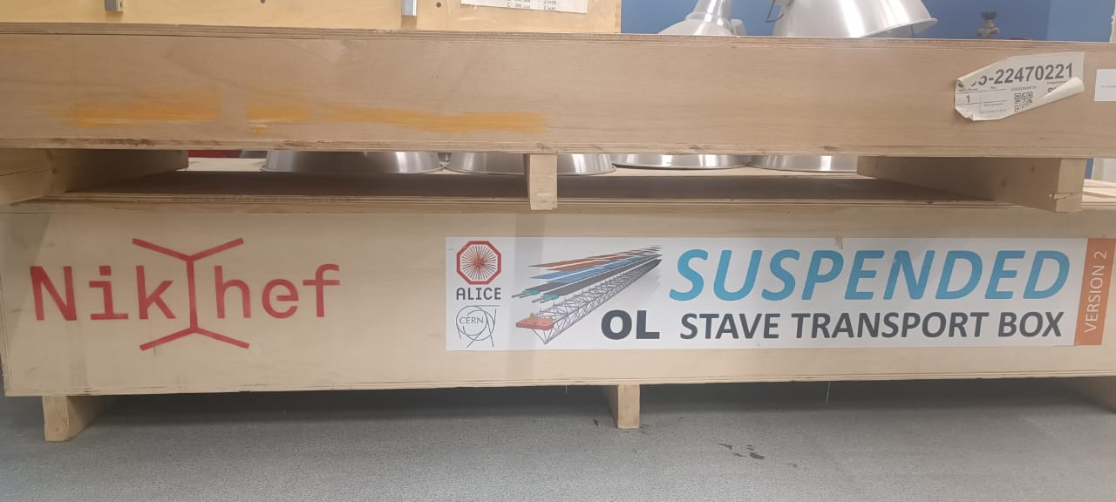
Infrastructure for STAVE assembly
Workflow of assembly STAVE:
Clean room for assembly STAVE (not ready);
Mitutoyo Machine (on storage);
Set of jig (on storage);
Functional test equipment (on storage);

Slide 9
Conclusions
Infrastructure for assembly HICs will be ready for production provided the gripper of ALICIA 8 will be replaced
Test bench of Electrical test for HIC are scheduled to be ready
Technical staff trained in HIC assembly stages
Benches of QA test for carbon part of STAVE has been ready
Sets of jig for the HIC and STAVE production on storage
Infrastructure for assembly STAVE not yet ready

Slide 10
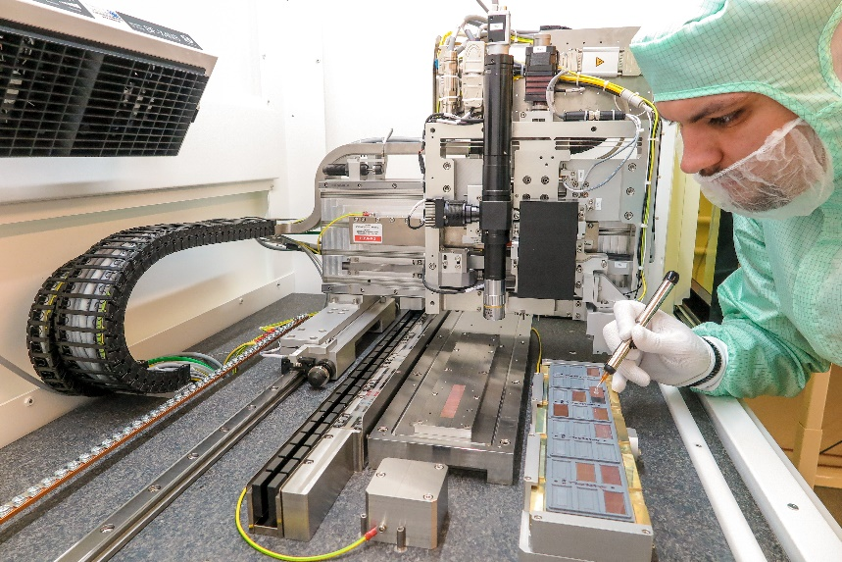
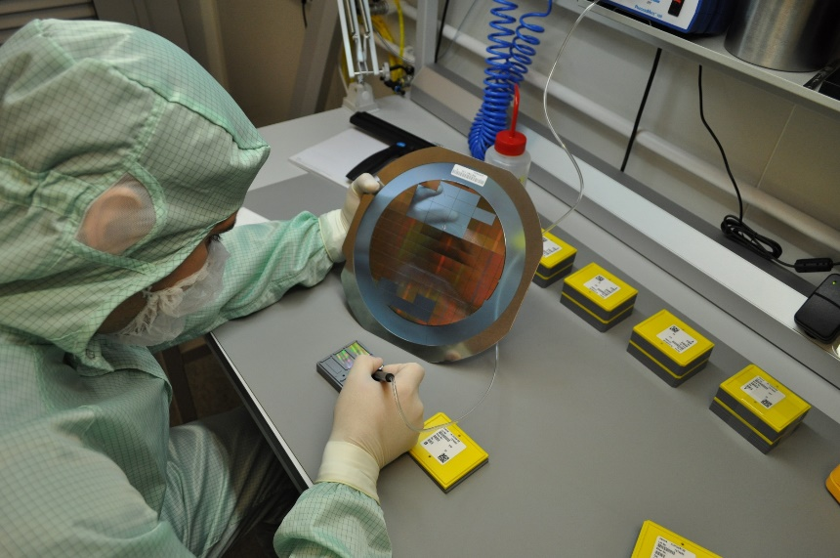
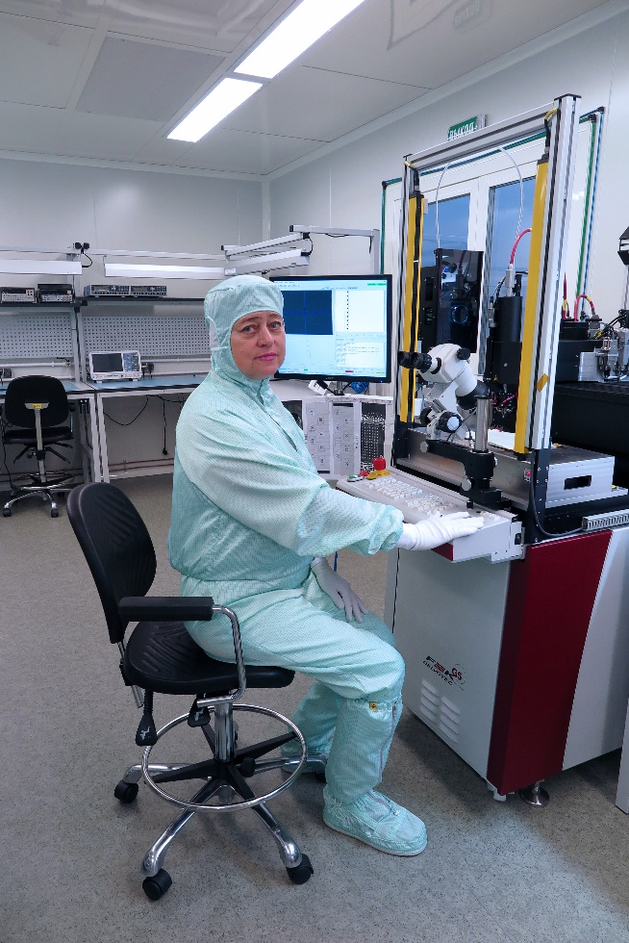
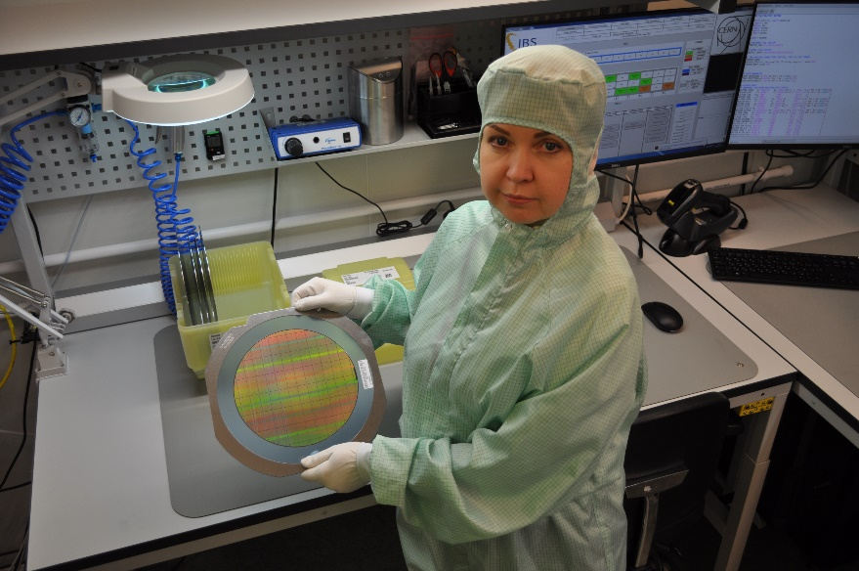
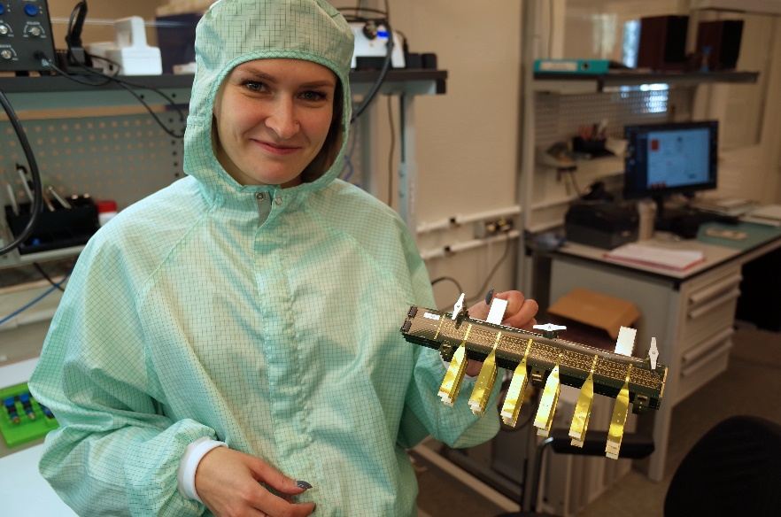
Thank you for the attention !

