Slide 1
Cuts for centrality FrameWork
23/07/2024
Supervisors:
Dr. Vadim Kolesnikov
Dr. Ivonne Alicia Maldonado Cervantes
Dr. Viktar Kireyeu
Students:
Adrian Lara Tlaxcala
Francisco Reyes

Slide 2
Summary of Primary Vertex

Slide 3
Difference z-Vertex vs NTracks
From here we made a cut on Number of
Reco Tracks > 3

Slide 4
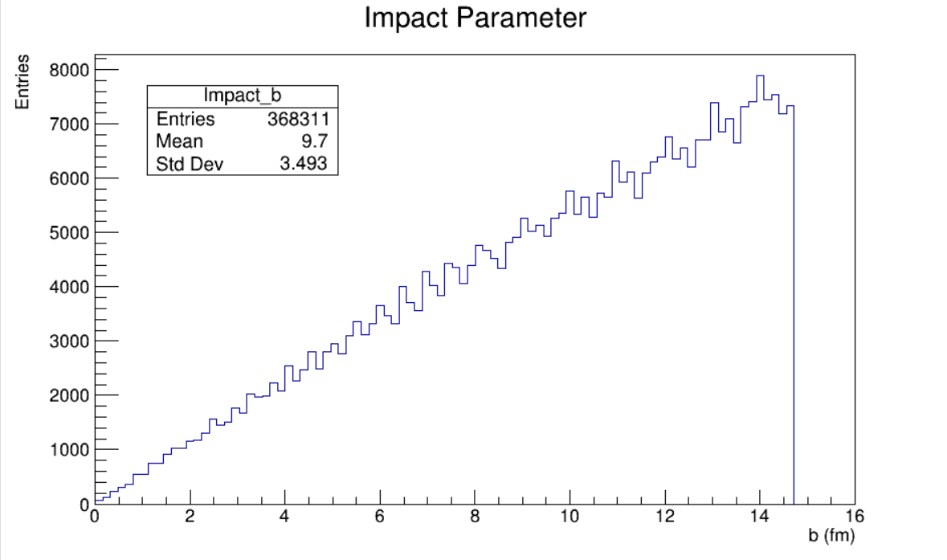
Impact Parameter
Number of MC Tracks > 308 = 124 (Xe) + 184 (W)
From here we got a cut on b < 13

Slide 5
Z-Vertex Histogram
Cuts:
MCTracks > 304
RecoTracks > 3
Percentage of events on [-100 cm , -70 cm]: 98.95 %
$\frac{\int_{−100}^{−70}{Histogram}}{\int_{−200}^{200}{Histogram}}∗100=98.95$

Slide 6
Previously
Histograms of Hits, DCA and Nhits with primary and secondary particles.
Change the air inside of the pipe to vacuum.

Slide 7
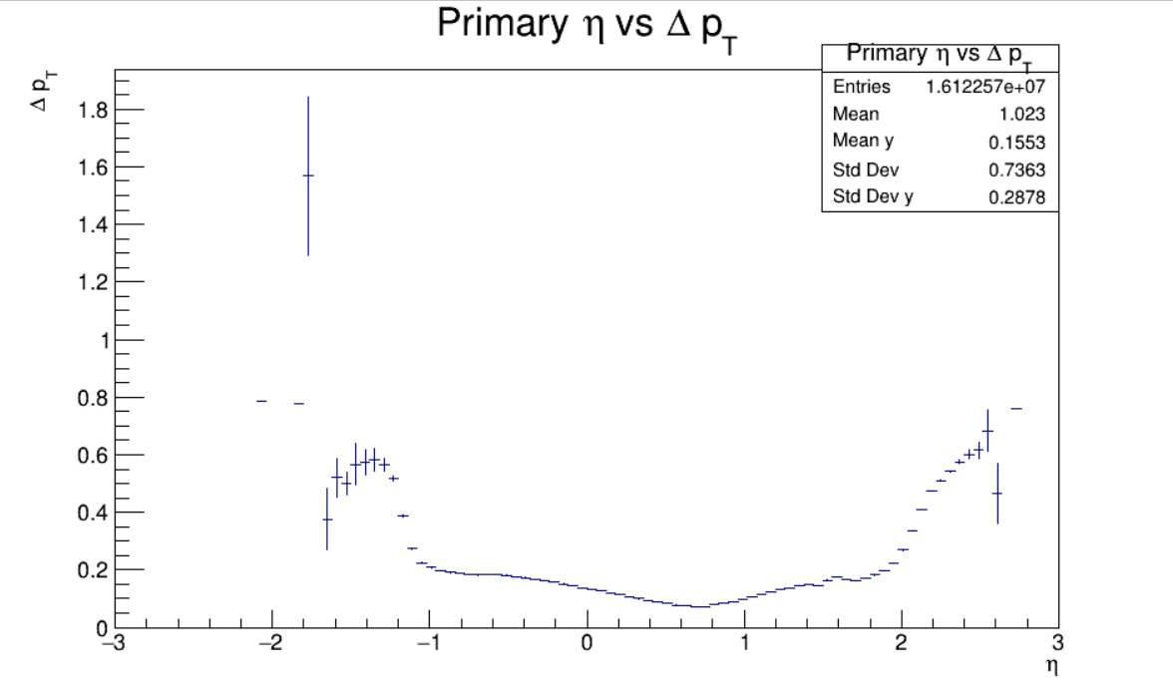
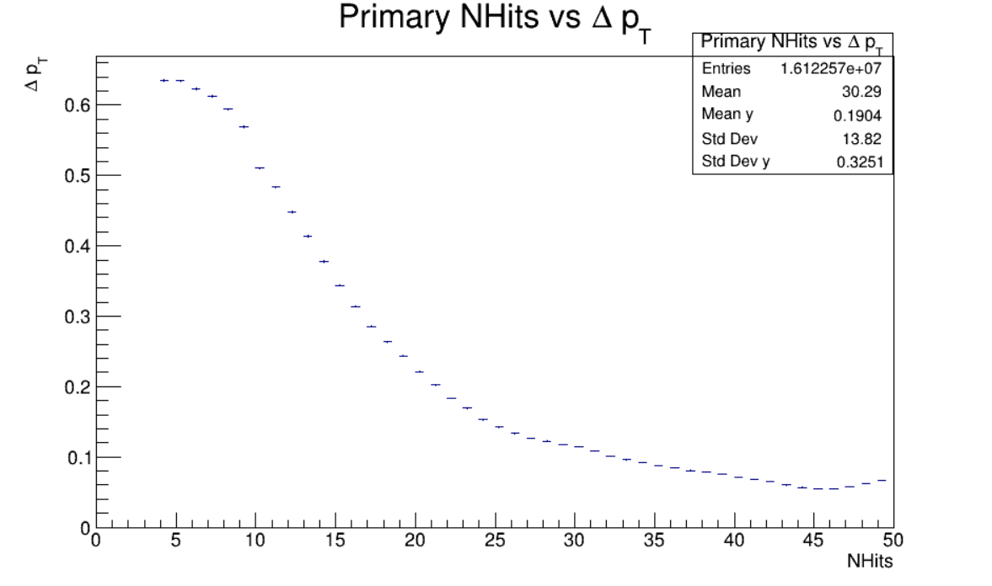
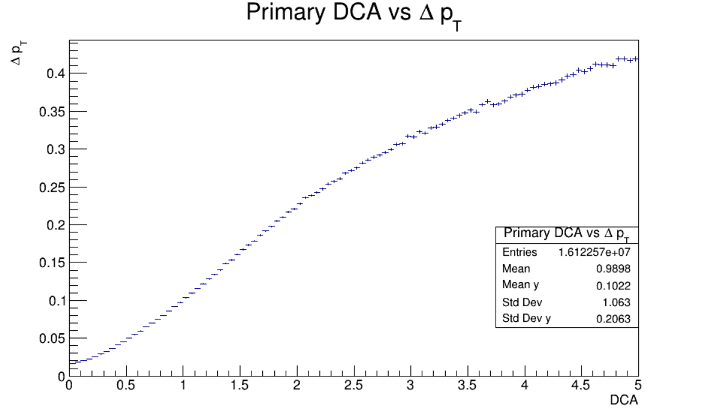
Primary eta,Nhits,DCA vs Resolution Pt
Cuts:
MCTracks > 304
RecoTracks > 3

Slide 8
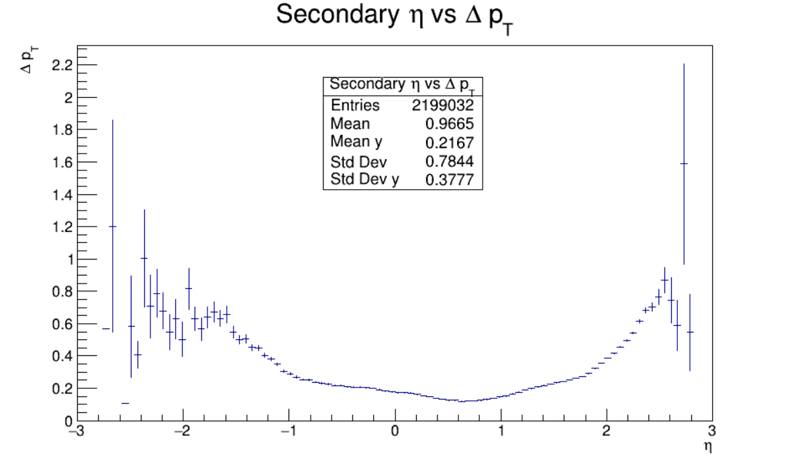
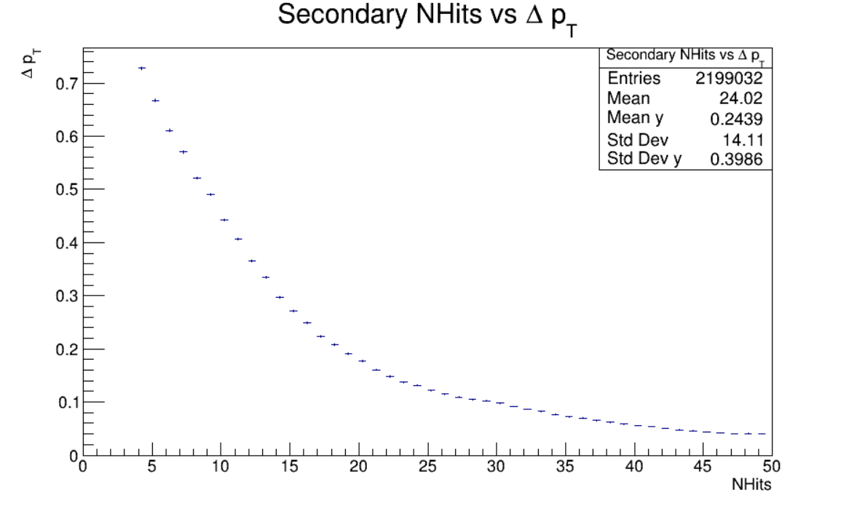
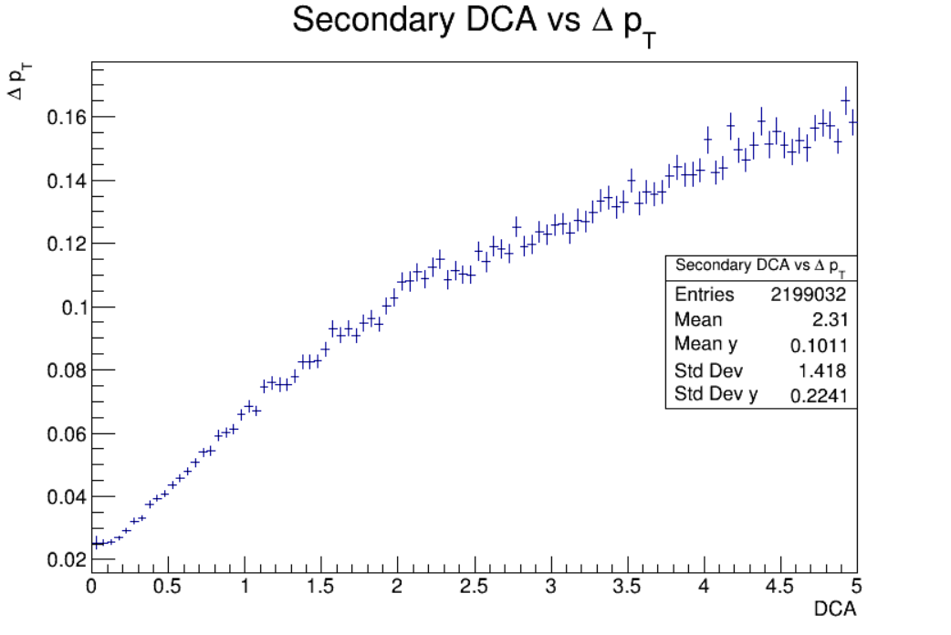
Secondary eta,Nhits,DCA vs Resolution Pt
Cuts:
MCTracks > 304
RecoTracks > 3

Slide 9
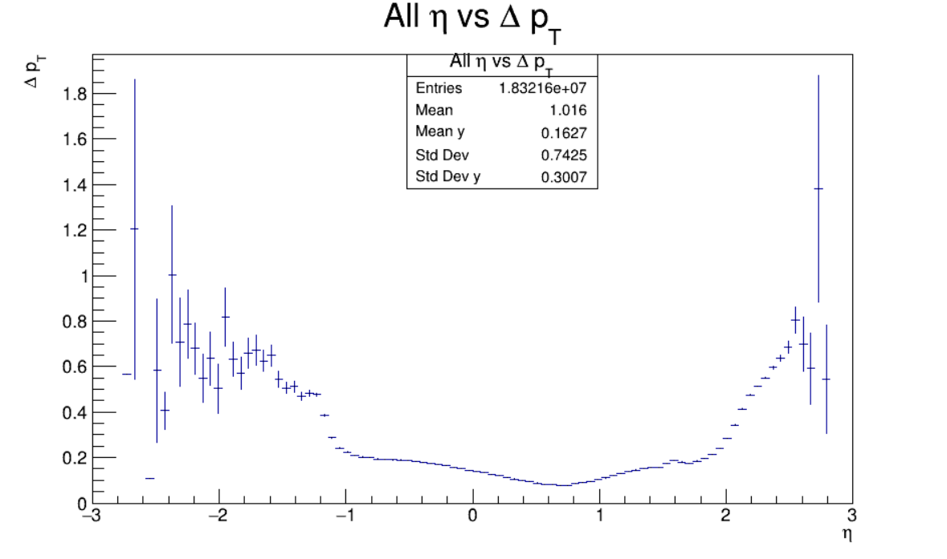
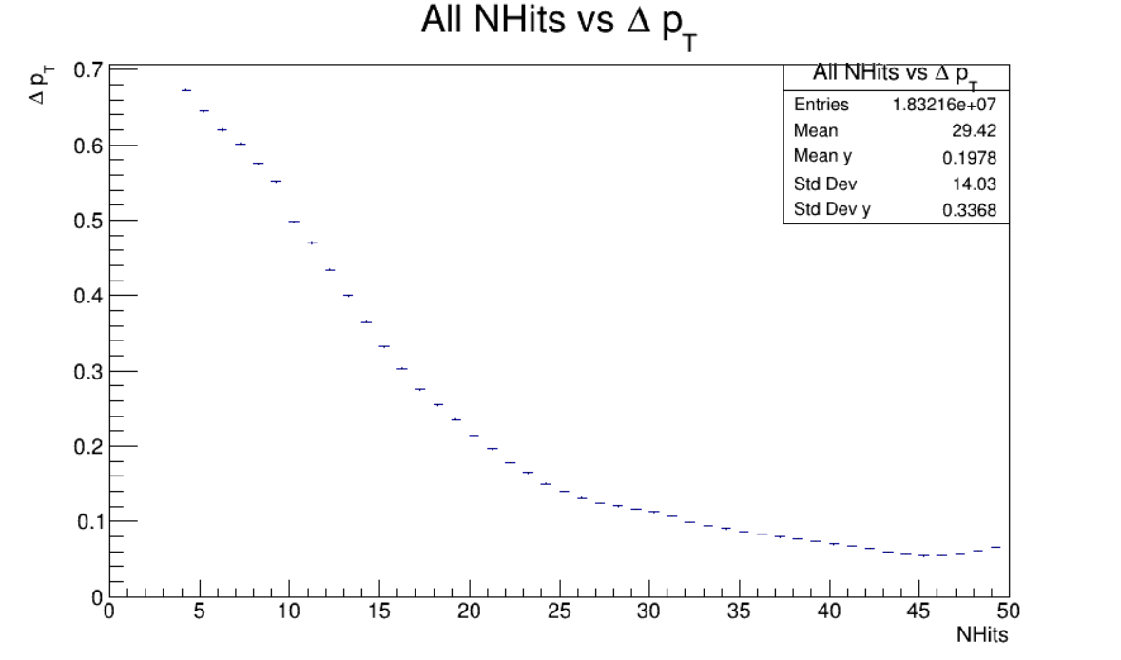
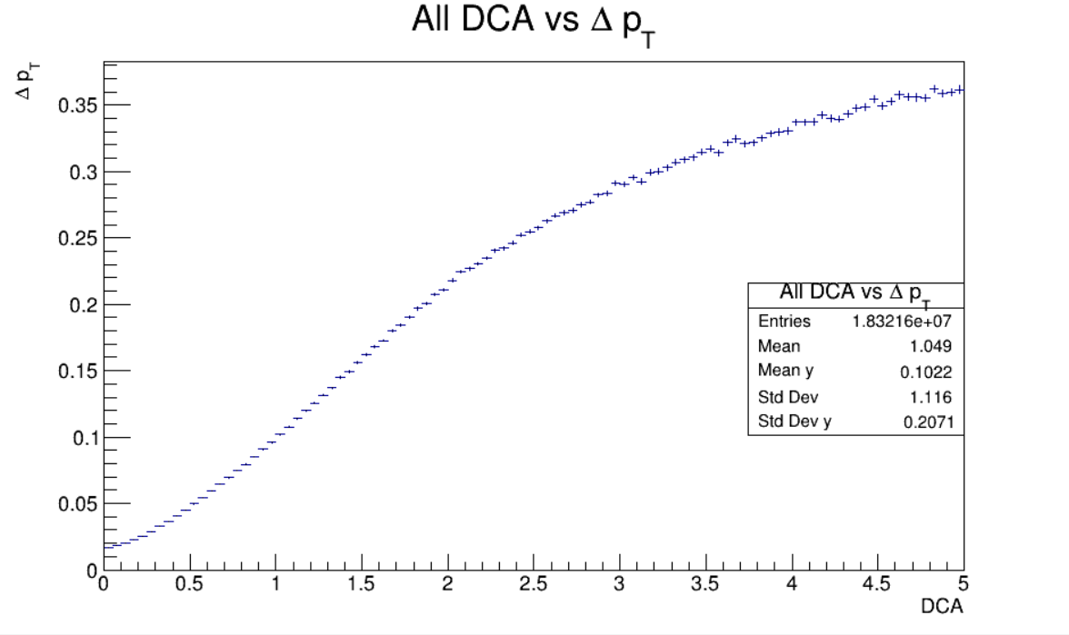
All Particles eta,Nhits,DCA vs Resolution Pt
Cuts:
MCTracks > 304
RecoTracks > 3

Slide 10
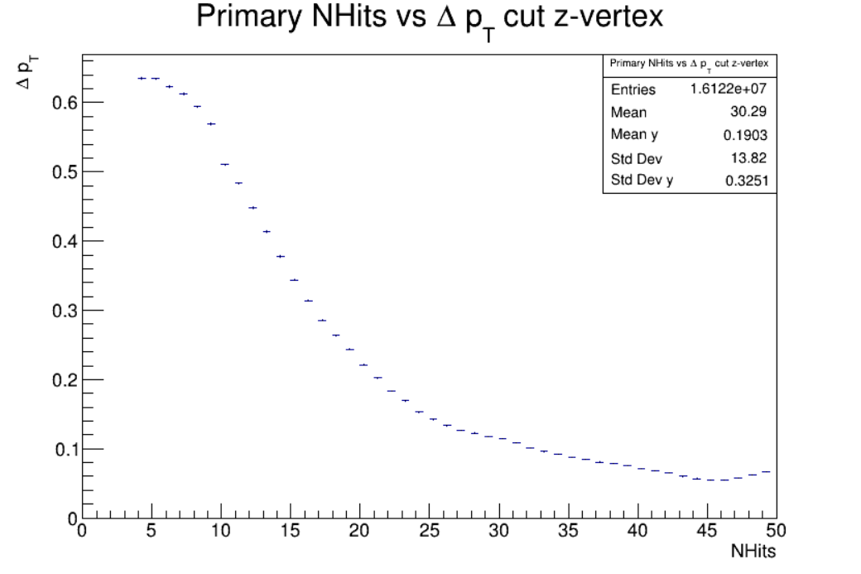
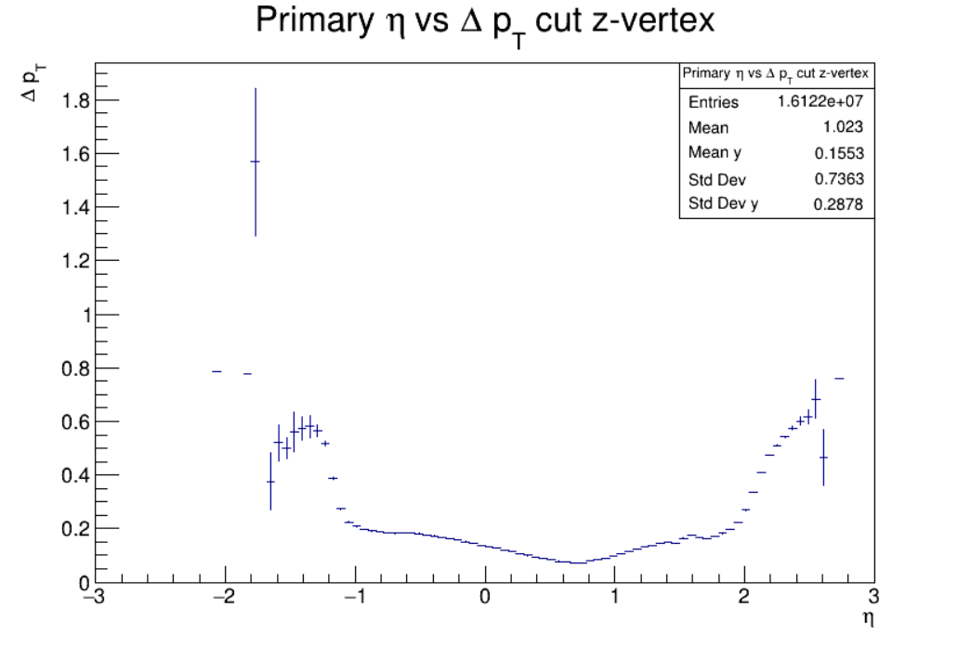
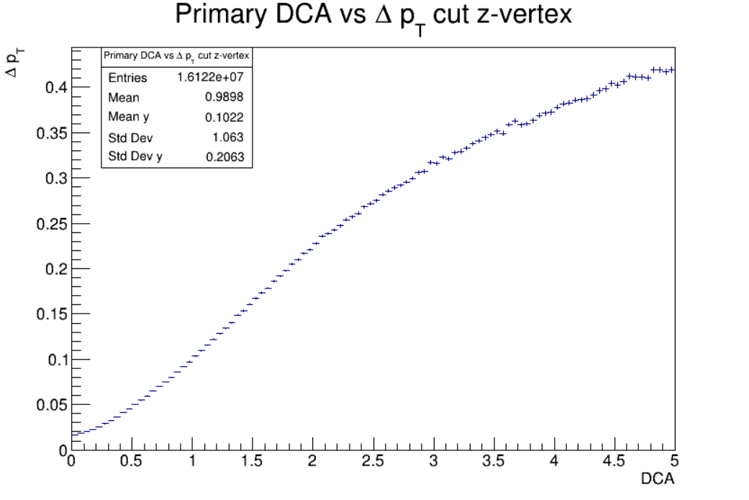
Primary eta,Nhits,DCA vs Resolution Pt z-Vertex Cut
Cuts:
MCTracks > 304
RecoTracks > 3
z-Vertex in [-100,-70]

Slide 11
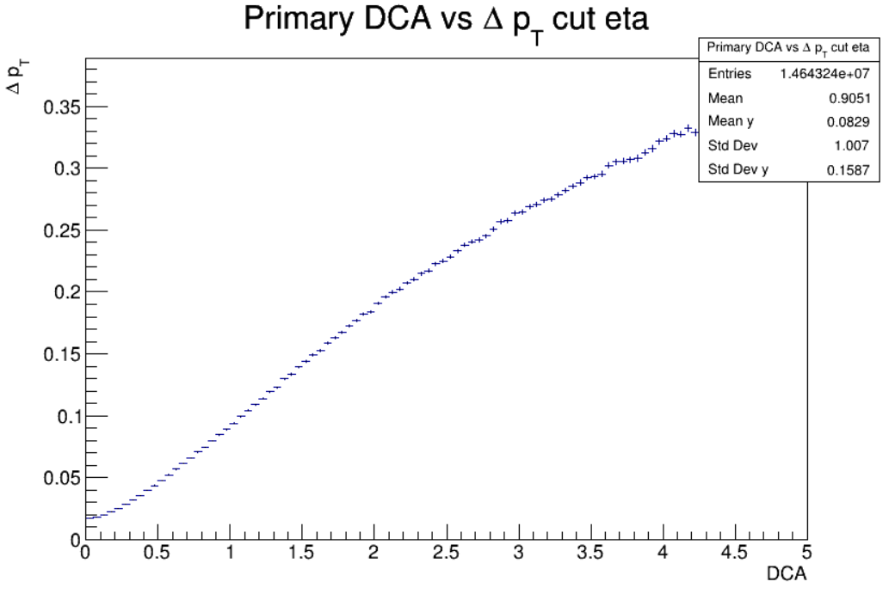
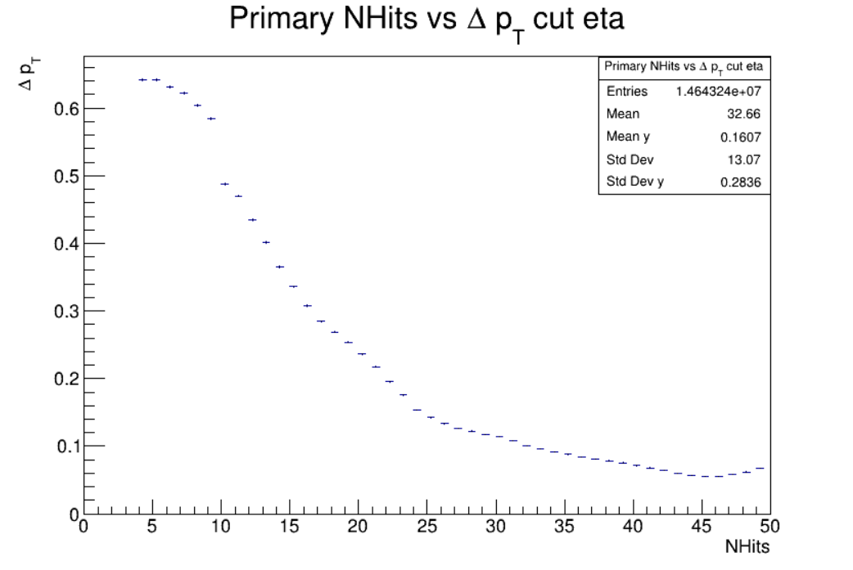
Primary Nhits,DCA vs Resolution Pt Eta Cuts
Cuts:
MCTracks > 304
RecoTracks > 3
z-Vertex in [-100,-70]
Eta in [-1,2]

Slide 12
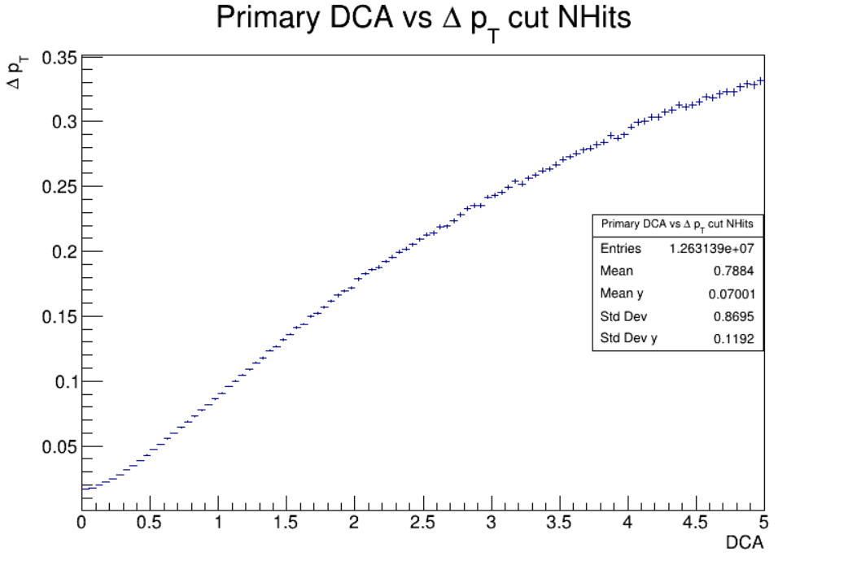
Primary Nhits,DCA vs Resolution Pt Nhits Cuts
Cuts:
MCTracks > 304
RecoTracks > 3
z-Vertex in [-100,-70]
Eta in [-1,2]
Nhits >= 20

Slide 13
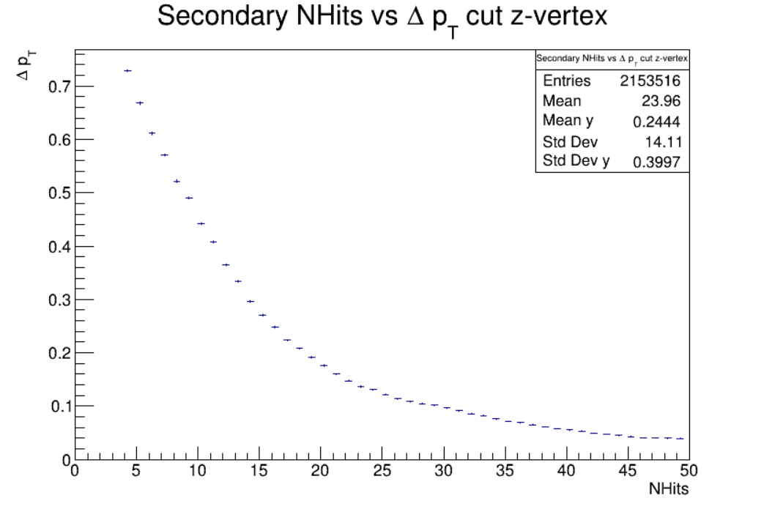
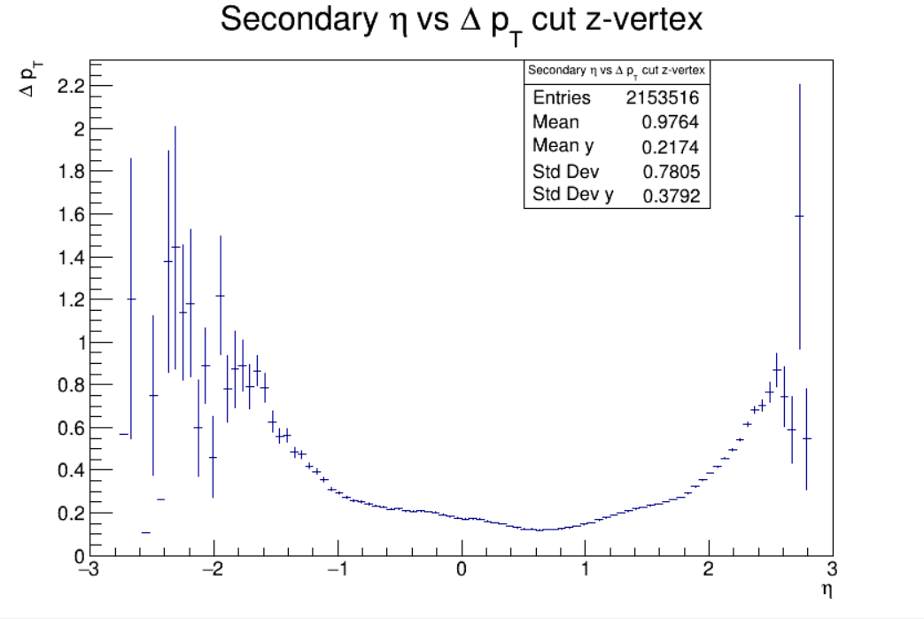
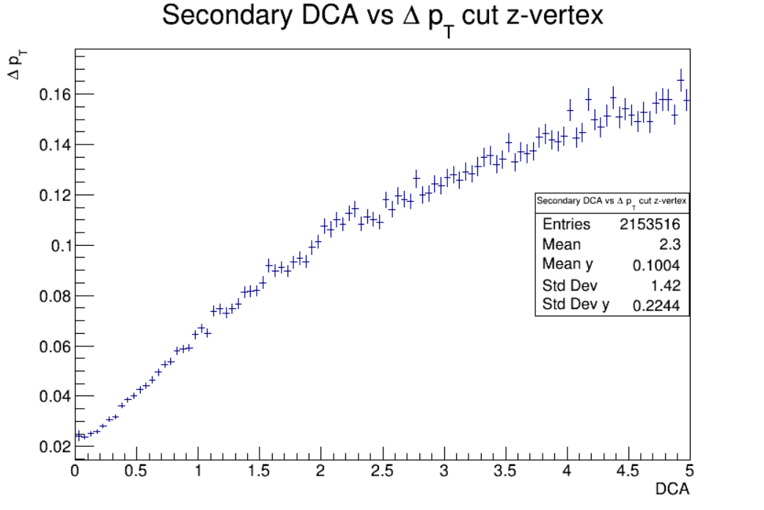
Secondary eta,Nhits,DCA vs Resolution Pt z-Vertex Cut
Cuts:
MCTracks > 304
RecoTracks > 3
z-Vertex in [-100,-70]

Slide 14
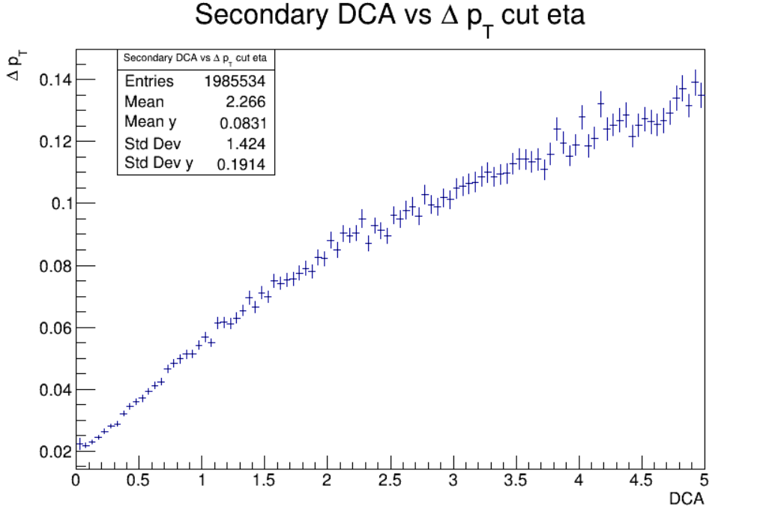
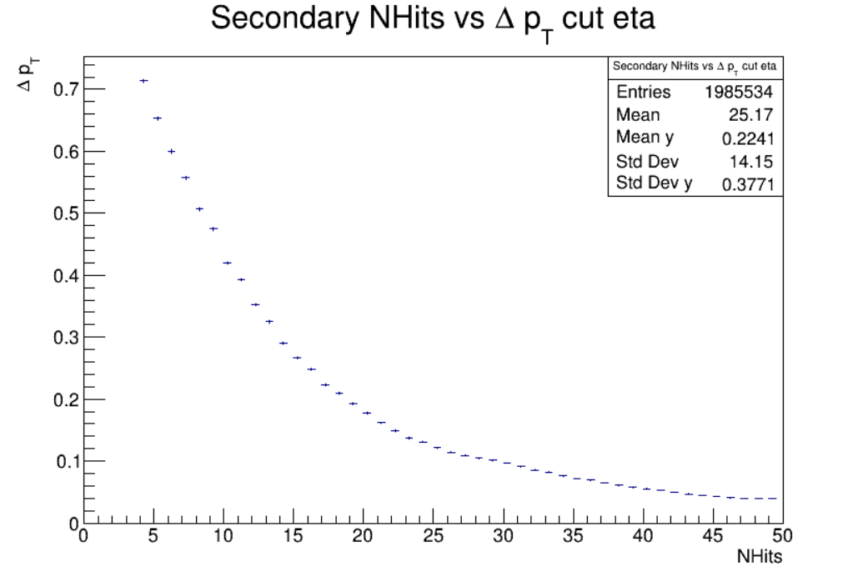
Primary Nhits,DCA vs Resolution Pt Eta Cuts
Cuts:
MCTracks > 304
RecoTracks > 3
z-Vertex in [-100,-70]
Eta in [-1,2]

Slide 15
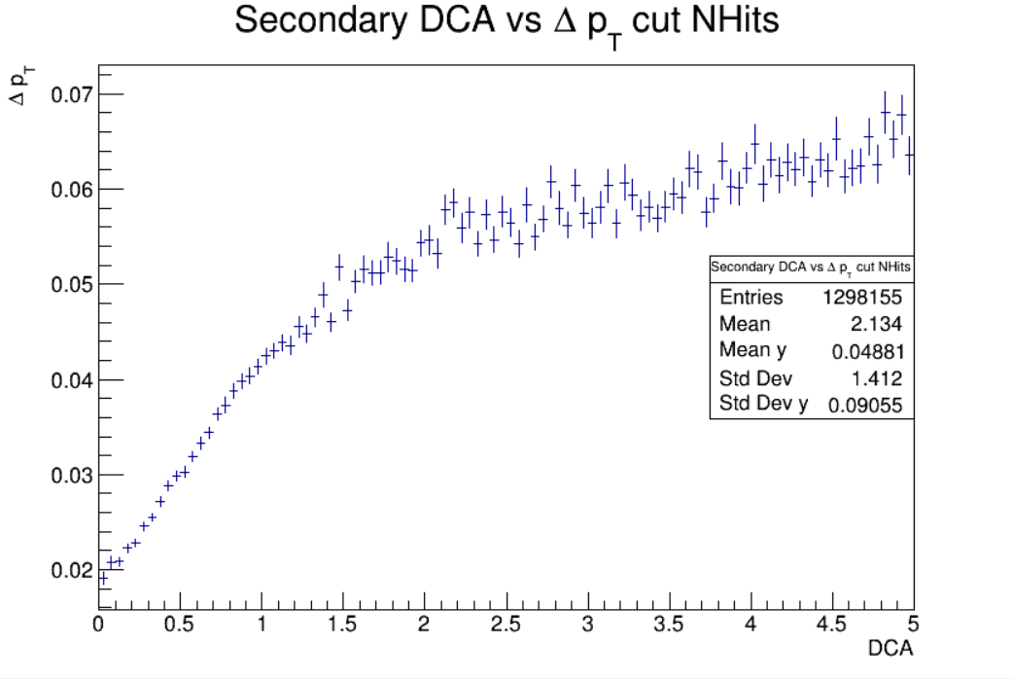
Primary DCA vs Resolution Pt Nhits Cuts
Cuts:
MCTracks > 304
RecoTracks > 3
z-Vertex in [-100,-70]
Eta in [-1,2]
Nhits >= 20

Slide 16
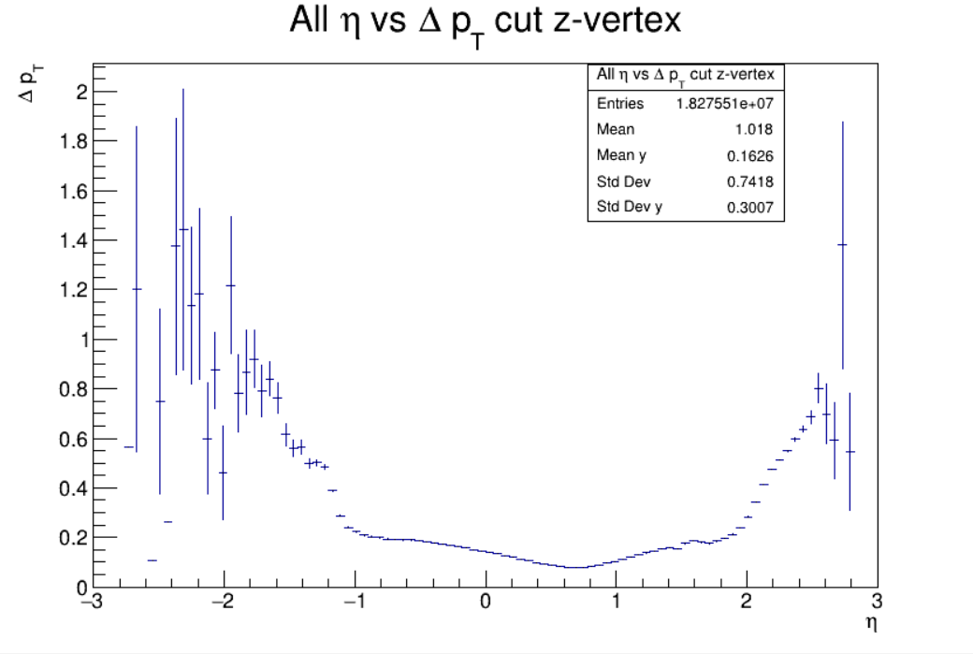
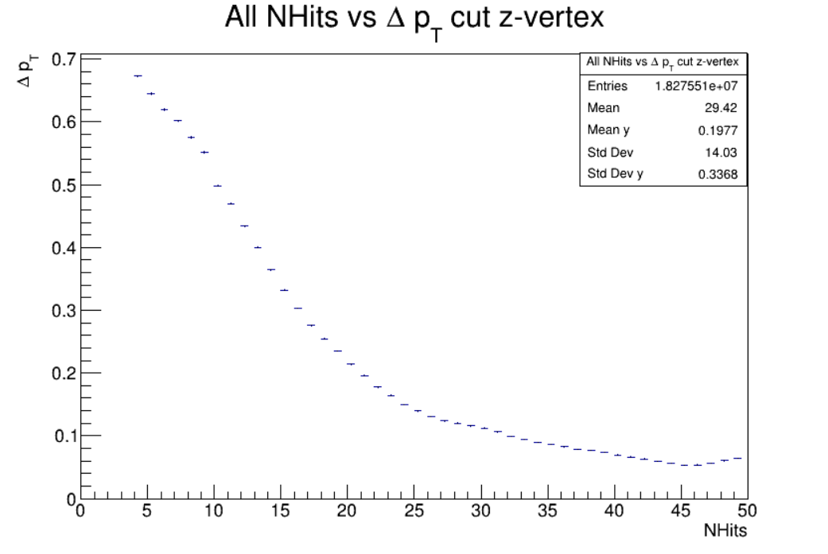
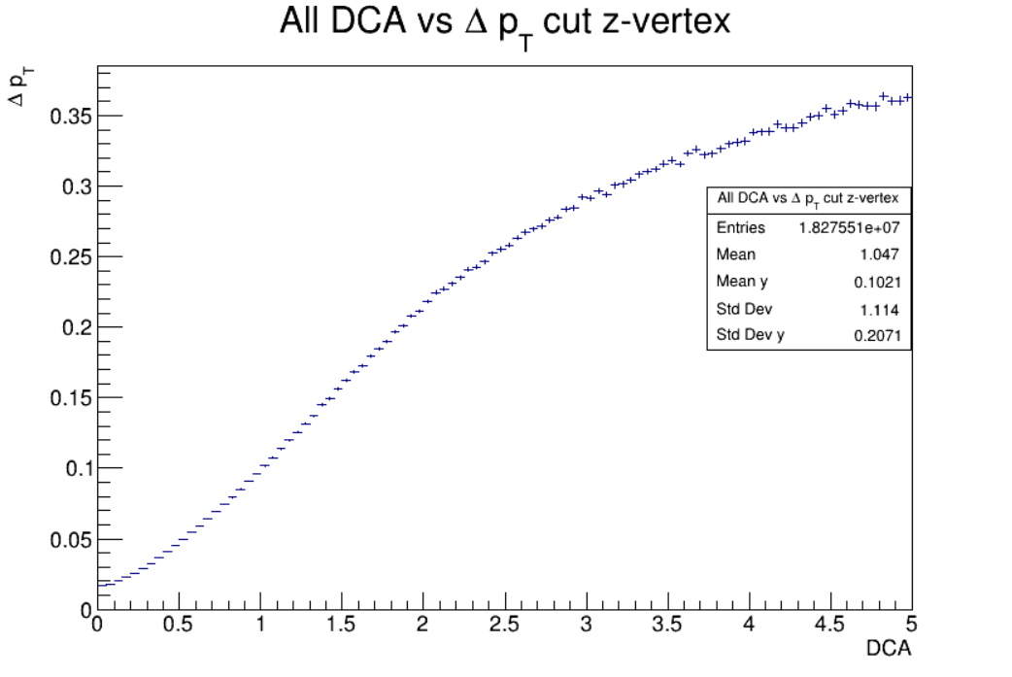
All Particles eta,Nhits,DCA vs Resolution Pt z-Vertex Cut
Cuts:
MCTracks > 304
RecoTracks > 3
z-Vertex in [-100,-70]

Slide 17
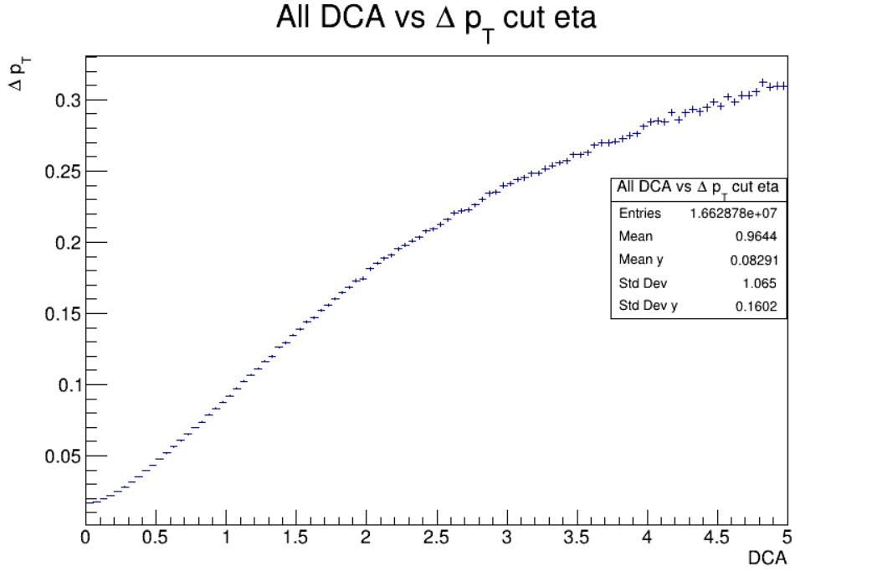
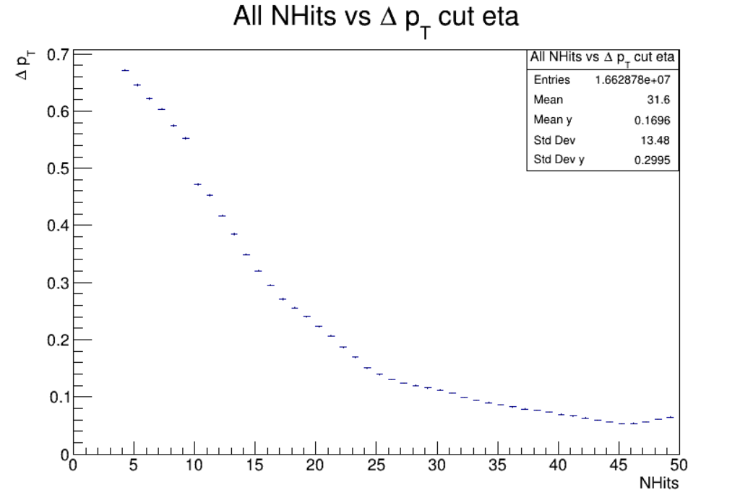
All Particles Nhits,DCA vs Resolution Pt Eta Cuts
Cuts:
MCTracks > 304
RecoTracks > 3
z-Vertex in [-100,-70]
Eta in [-1,2]

Slide 18
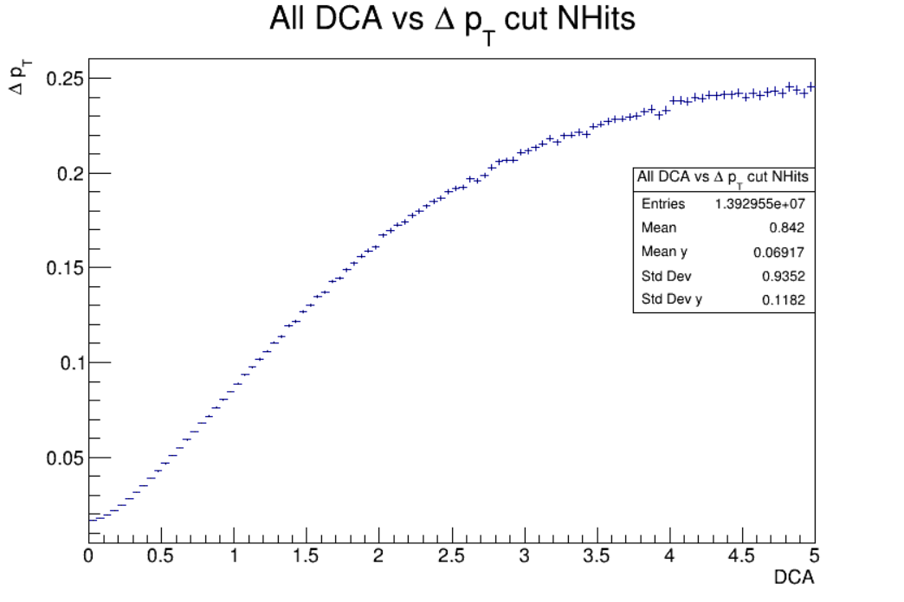
All Particles DCA vs Resolution Pt Nhits Cuts
Cuts:
MCTracks > 304
RecoTracks > 3
z-Vertex in [-100,-70]
Eta in [-1,2]
Nhits >= 20

Slide 19
Cuts
With the infomation on the Histograms, we took the 20% resolution pT as a limit and we got cuts on Eta, DCA and NHits
Cuts
eta in [-1,2]
DCA <= 2
Nhits >= 20

Slide 20
MUltiplicity
Without cuts on eta,dca,nhits
Cuts:
MCTracks > 304
RecoTracks > 3

Slide 21
Multiplicity cuts
Cuts:
MCTracks > 304
RecoTracks > 3
eta in [-1,2]
DCA <= 2
Nhits >= 20

Slide 22
Multiplicity vs B
Without cuts on eta,dca,nhits
Cuts:
MCTracks > 304
RecoTracks > 3

Slide 23
Multiplicity vs B cuts
Cuts:
MCTracks > 304
RecoTracks > 3
eta in [-1,2]
DCA <= 2
Nhits >= 20

Slide 24
Air and Vacuum comparison

Slide 25
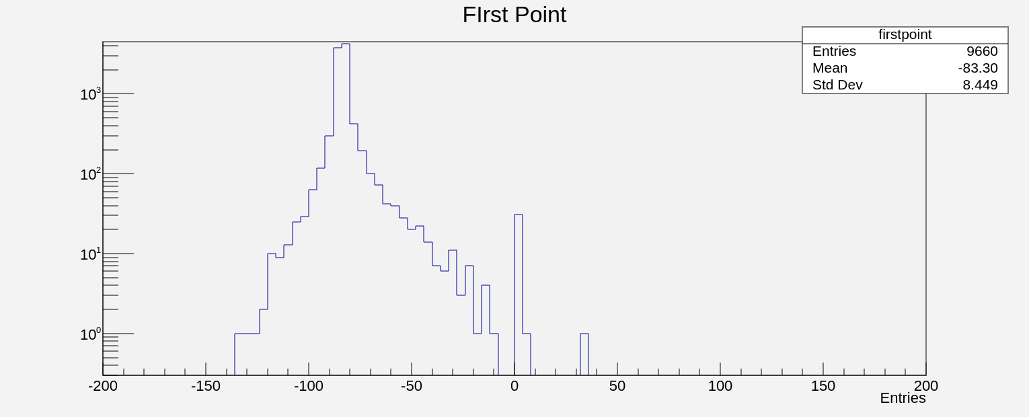
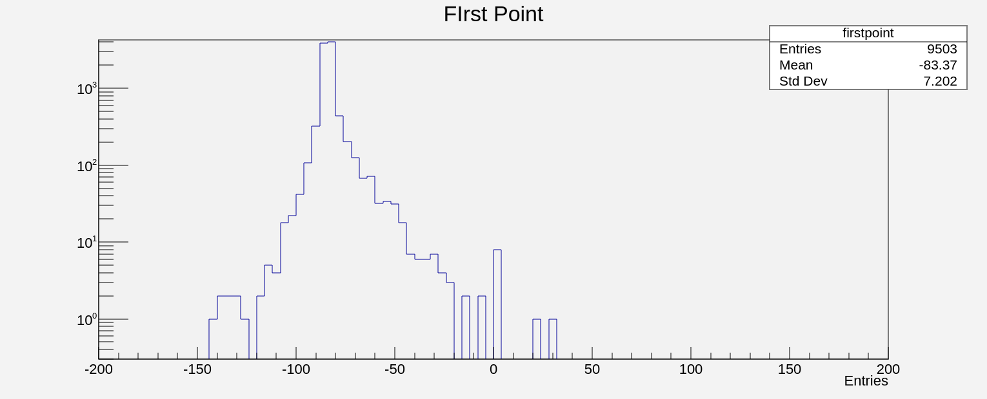
Geometries with air and vacuum
vaccum
The geometry of the detector was changed by changing air to vacuum to see the difference and possibly remove some of the feedback for the histogram of Zvertex Reco
air

Slide 26
Centrality

Slide 27
Necessary Information For MCGlauber
Xenon [1]
Radius of Nucleus: 4.763 +- 0.01
Skin thickness: 0.523
Inelastic Cross Section [3]
$$σ_{inel}=26.94035$$
Wolfram [2]
Radius of Nucleus: 5.373 +- 0.01
Skin thickness: 0.523

Slide 28
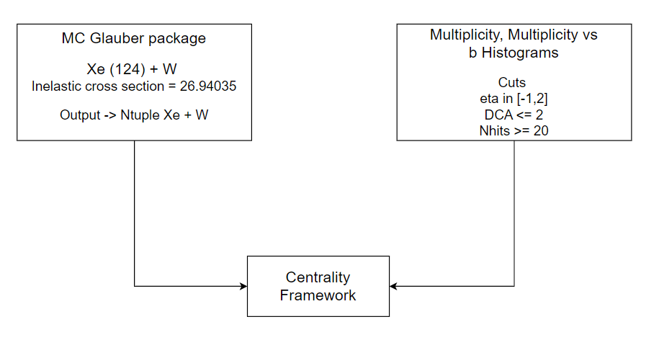
MCGlauber Procedure

Slide 29
GammaFit
the gamma fit method is used to extract centrality from a multiplicity input file, setting up the effective section of the collision in the macro, and by placing restrictions on their input parameters, these cuts will be closely guided from the cuts we presented earlier, from the multiplicity an adjustment is made and the impact parameter is extrapolated, after which the centrality with the impact parameter can be found

Slide 30
Multiplicity
Using the macro "MpdDstReader. C " we analyzed the data of req25 for multiplicity using the GammaFit method

Slide 31
Multiplicity fit
From the input that is the multiplicity of data the req25 makes a fit and you can compare how good it was

Slide 32
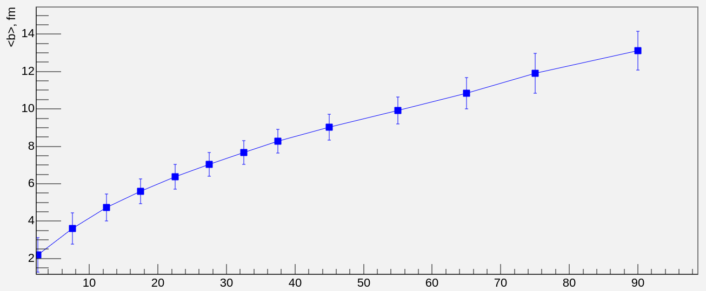
IMPACT Parameter
The impact parameter is extracted

Slide 33
IMPACT PARAMETER IN FUNCION THE CENTRALITY
The impact parameter is extracted as centrality function

Slide 34
B comparation
The results of the study are

Slide 35
REferences
[1] Xenon: https://materials.springer.com/googlecdn/assets/sm_lbs/885/sm_lbs_978-3-540-45555-4_56/sm_lbs_978-3-540-45555-4_56.pdf?trackRequired=true&originUrl=/lb/docs/sm_lbs_978-3-540-45555-4_56&componentId=Download%20Chapter
[2] Wolfram: https://materials.springer.com/googlecdn/assets/sm_lbs/947/sm_lbs_978-3-540-45555-4_76/sm_lbs_978-3-540-45555-4_76.pdf?trackRequired=true&originUrl=/lb/docs/sm_lbs_978-3-540-45555-4_76&componentId=Download%20Chapter
[3] Cross section info: O. Buss, T. Gaitanos, K. Gallmeister, H. van Hees, M. Kaskulov, O. Lalakulich, A. B. Larionov, T. Leitner, J. Weil, and U. Mosel, Phys. Rept. 512, 1 (2012),arXiv:1106.1344 [hep-ph].

Slide 36
Thank you

