Slide 1
Magnetic field measurement of MPD detector magnet
XIV Collaboration Meeting of the MPD Experiment at the NICA Facility
E. Antokhin, BINP, Novosibirsk.
14-16 October, 2024
Dubna, Russia.

Slide 2
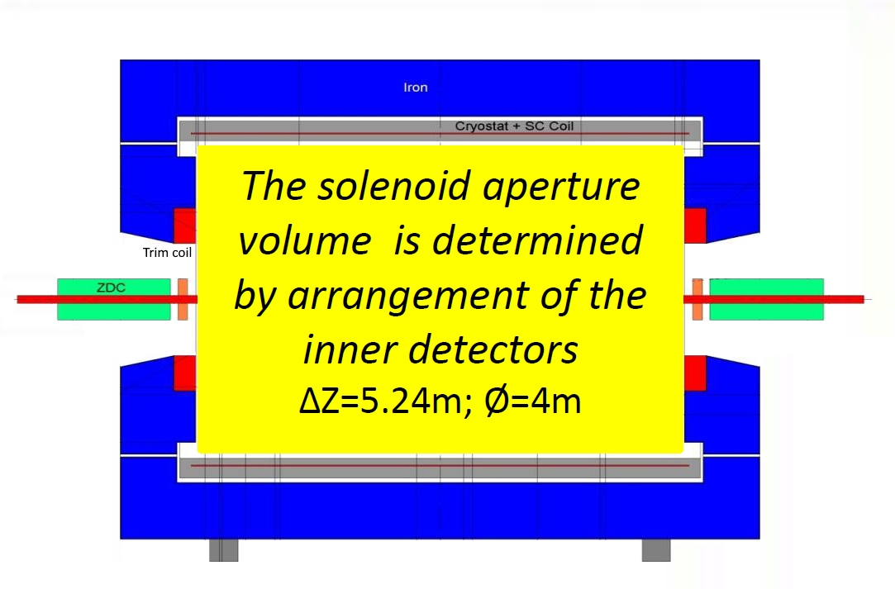
Magnet MPD
Magnetic field: 0.2 - 0.56 Т
Superconducting coil: (current 1800 А)
Two trim coil: (current 2800 А).
Good field region 1:
Z=±2.6 м, R=2.2 м.
Good field region 2: (ТРС):
Z=±1.7 м, R=1.2 м.
Field uniformity: ± 2×10⁻⁴.

Slide 3
Specification for mapping system
Using one 3D Hall sensor (HE444).
Covering all area inside TPC region.
Accuracy 0.3 Gauss.
Measuring positions in X, Y, Z with laser tracker.
Measuring inclination angle of carriage respect to solenoid axis with laser tracker.
Measuring time 1 sec for one point.
Possibility to reconstruct the field inside internal volume of cylinder from data measured at cylindrical surface.
.

Slide 4
Magnetic field uniformity

Slide 5
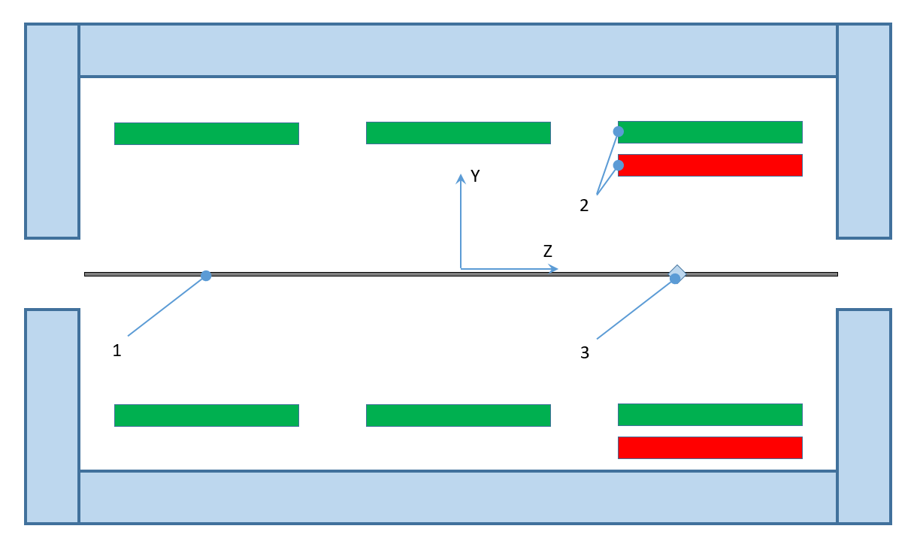
Magnetic field uniformity change due to SC central coil shift 5 mm
Acceptable shift of coil section is 5 mm

Slide 6
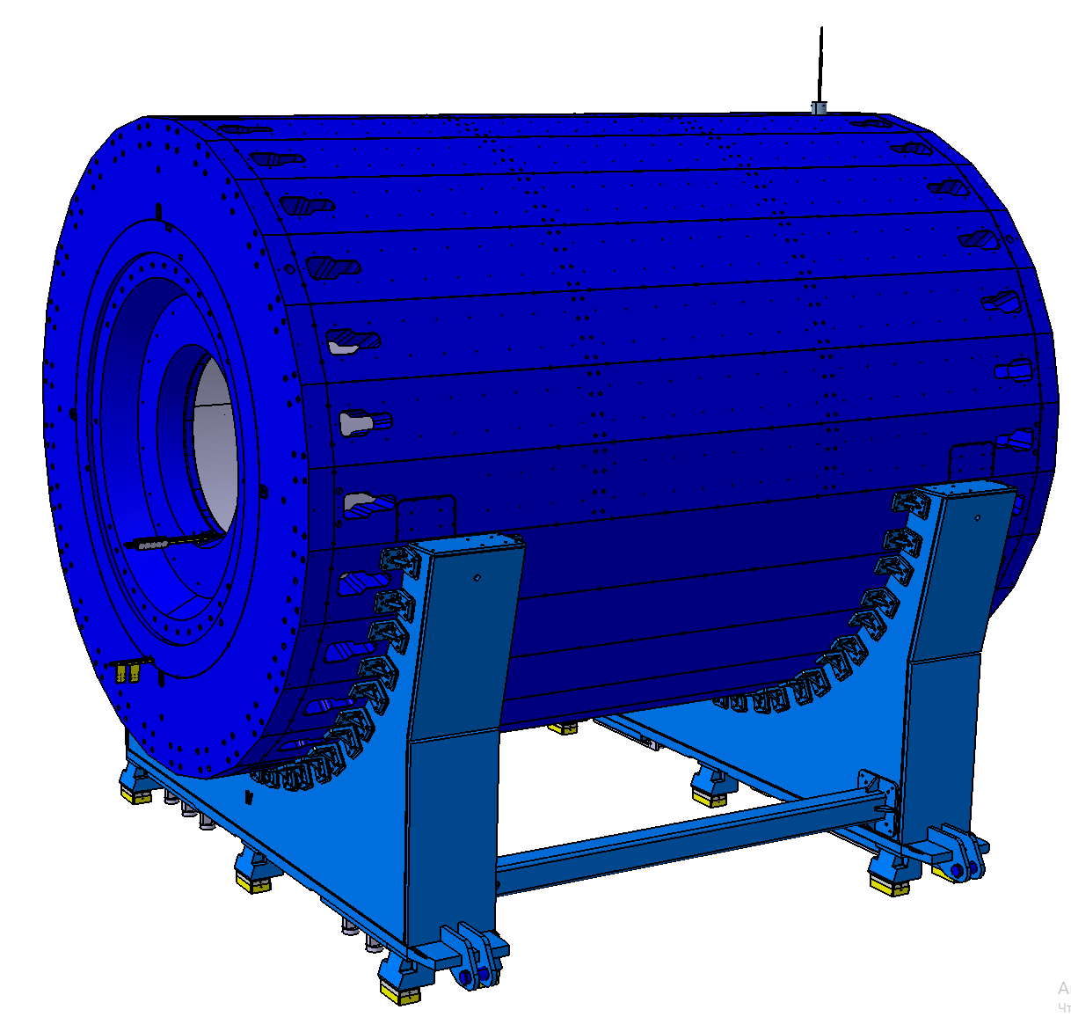
Free holes of the magnetic yoke at the time of magnetic field measurement

Slide 7
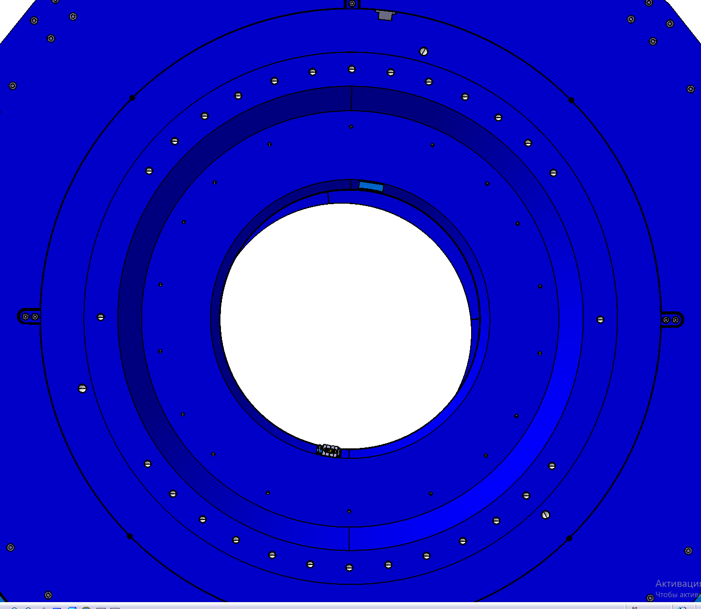
Very precise vertical flange
Accuracy of manufacturing and assembly of the magnetic yoke about 0.2 mm.
We must take advantage of this!

Slide 8
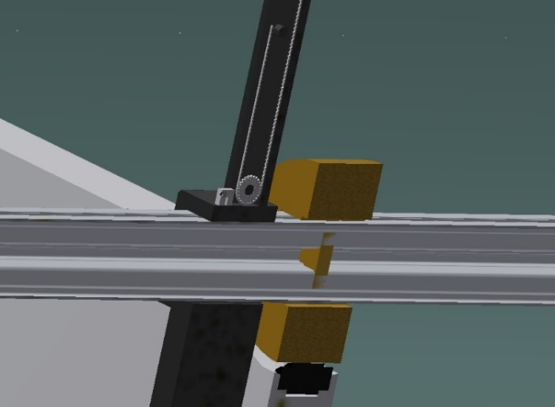
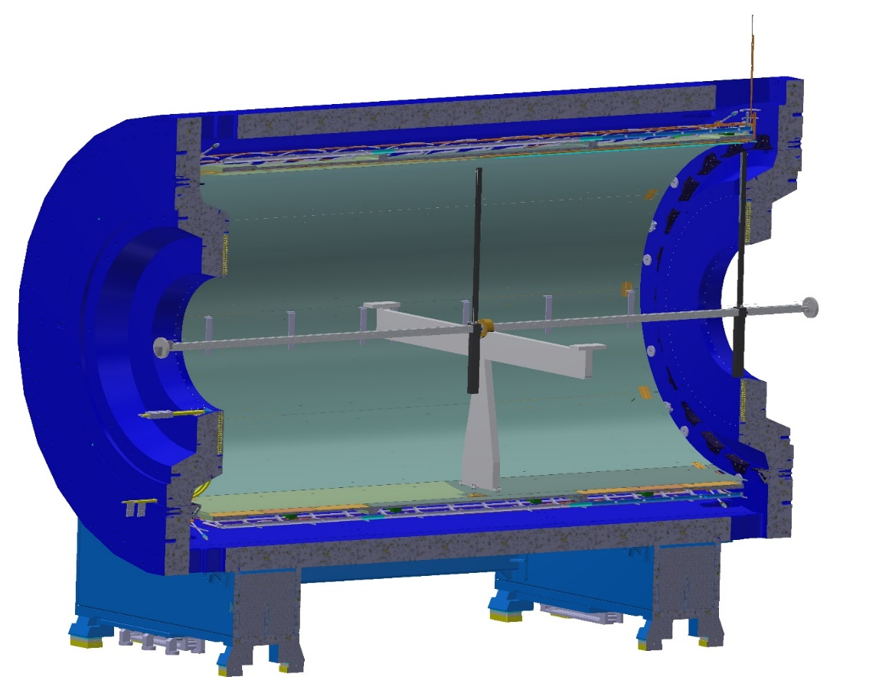
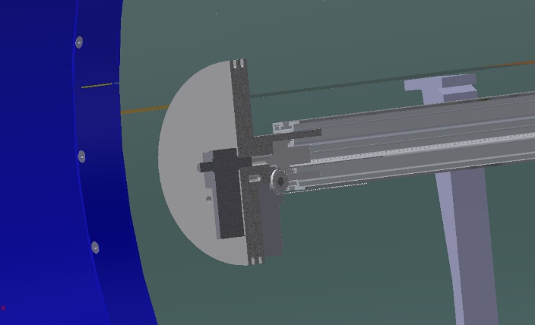
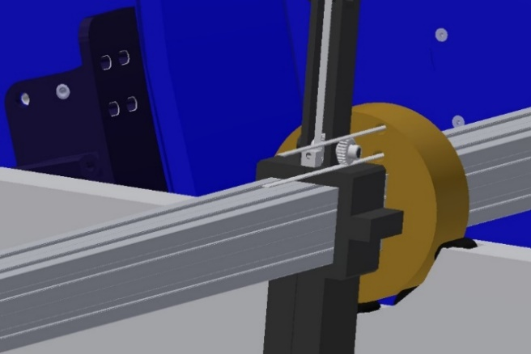
Our proposal for MPD magnet
.

Slide 9
Our proposal for MPD magnet. Measurement procedure.
The field map will be built in a Cartesian system, while the measurement results are issued in cylindrical coordinate system.
The direction of the Z axis of the local system obviously coincides with the Z axis of the laboratory system.
The control code uses a procedure that first moves through all the values ​​of the azimuth angle at the same position in Z at the minimum radius, then rotates back 360°, then steps along the radius, with rotation in azimuth at each radius, and reaching the maximum radius.
It is necessary to determine the coordinates of the 3D Hall sensor at each measurement point. To do this, one need to use a laser tracker with a set of reflectors and mirrors.
It is necessary to measure the inclination of the rod with the measuring block of the Hall sensor as a function of the length of the solenoid Z in advance and make correction table. The output file shall be as: N X Y Z Bx By Bz
.

Slide 10
Our proposal for MPD magnet. Mapper specification.
Parameter | Value
Length of movement for Z | 9 m (2 × 4.5 m)
Length of movement for R | 0.1 – 2.2 m
Rotation of measurement block | 360 deg.
Accuracy of movement for Z | 50 microns
Accuracy of movement for R | 50 microns
Accuracy of rotation | 0.2 deg.
Hall 3D sensor | НЕ444, HE Hoeben Electronix,
Hall 3D sensor accuracy | 0.1 Gs
Hall 3D sensor accuracy total (with accuracy of laser tracker and temperature correction) | 0.3 Gs
Sag of guide line | 4 mm
Weight of mapper | 60 kg
Reading time per one measurement | 1 sec
.

Slide 11
Carbon plastic carriage
20 kg.
2,1 m
9 m
Carbon plastic guide line
40 kg.
Bearing
Bearing
Servo transmission
Cross section of guide line
□150
The weight of the carriage is symmetrical about the axis of the guide
Young's modulus for carbon plastic 180 Gpa
The servo drive will be a belt drive. On the servo shaft and on the guide. there will be toothed pulleys.
The carriage is in the furthest position from the servo for calculation of torque
Through hole
4
We have to refuse from carbon plastic and change to Al guide line.

Slide 12
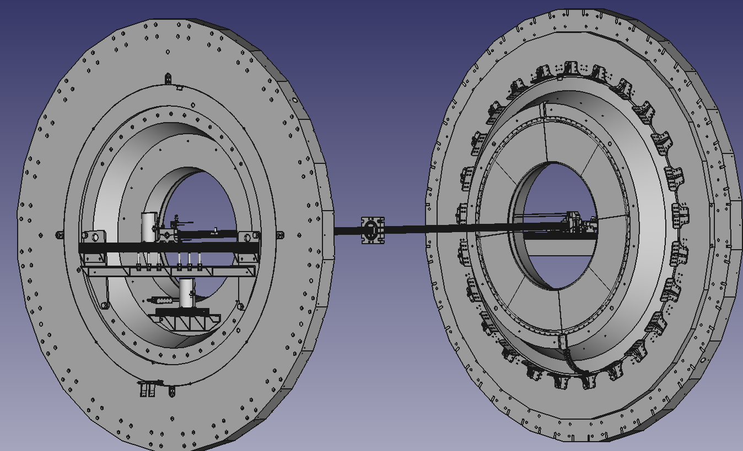
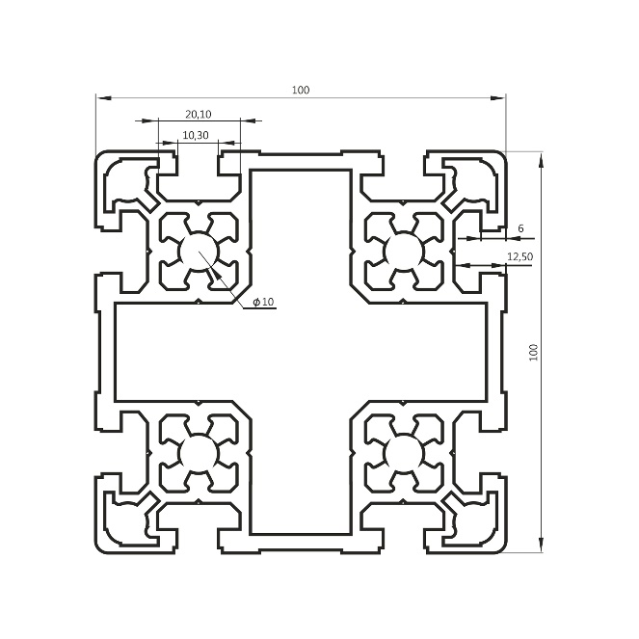
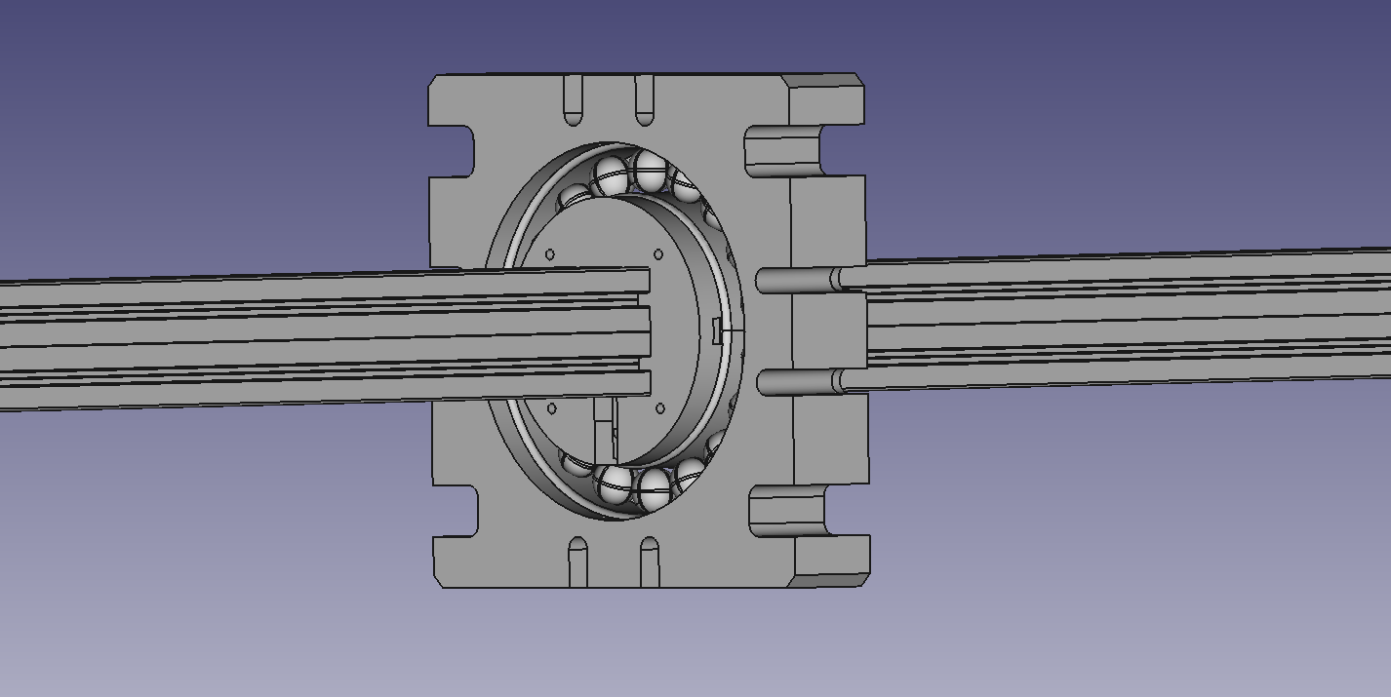
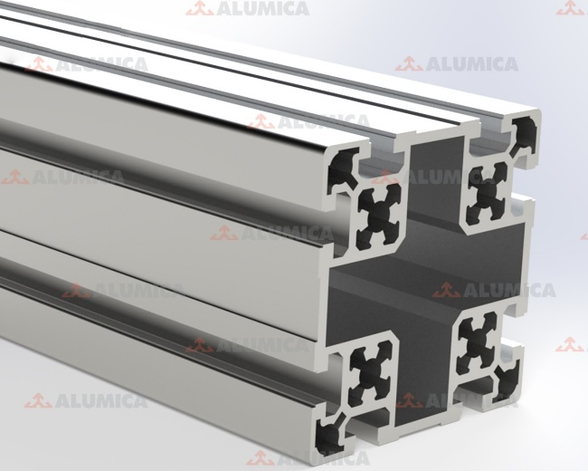
Mapper design with 9 m carbon plastic guide line had been changed to two 4.5 m Aluminum guide lines.
.

Slide 13
Design of moved parts with Hall sensor are some changed for using Al and polyamide materials
Polyamide
Aluminum
.

Slide 14
Status of project
The 3D STEP model and 2D drawings done for carbon plastic design. But had redesigned for Al and polyamide.
Servomotors, driving belts, pulleys had got and tested.
Preparation of test facility for simulating the attachment of the mapper to the MPD magnet and testing the mapper on the Earth's field (at the BINP side).
Control software had developed and under testing.
Control unit electronic blocks had been purchased.
Mechanical parts are in process of manufacturing, the main are fiberglass radial guide line, aluminum moved box and polyamide central bearing.

Slide 15
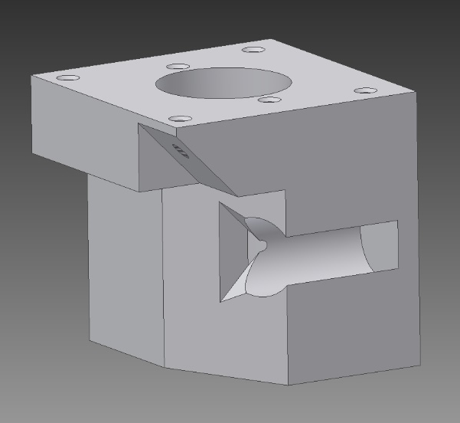
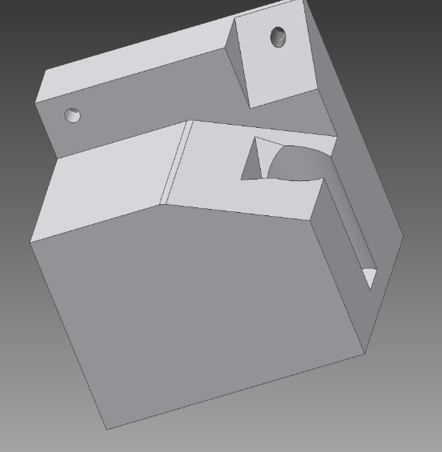
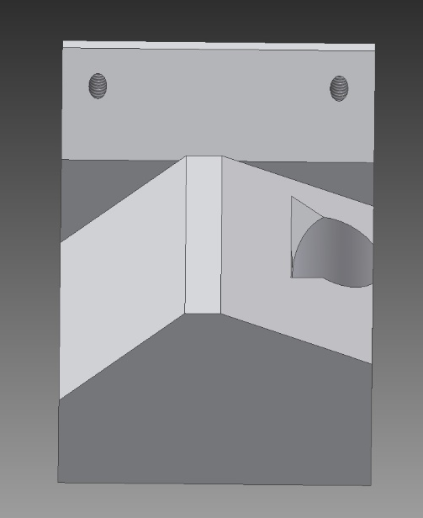
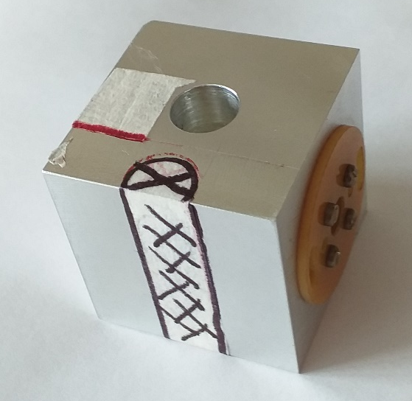
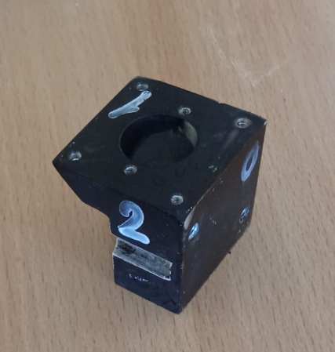
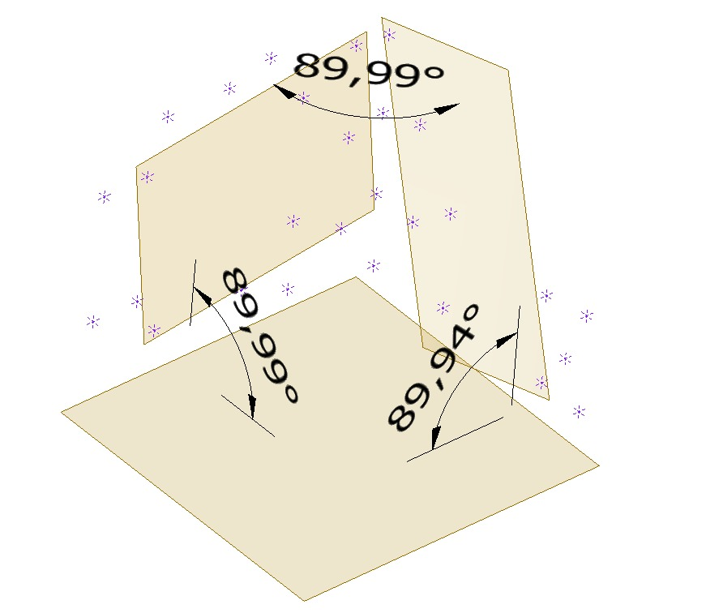
Status of project. Examples of measuring block

Slide 16
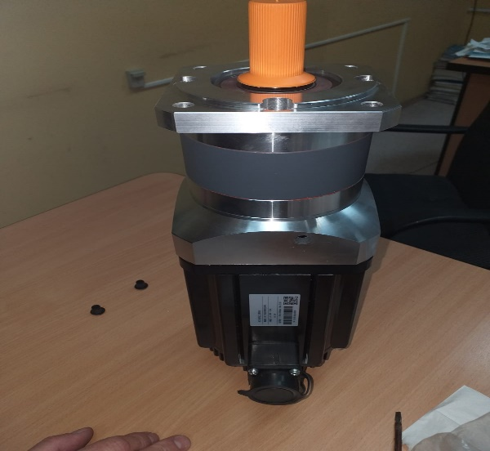
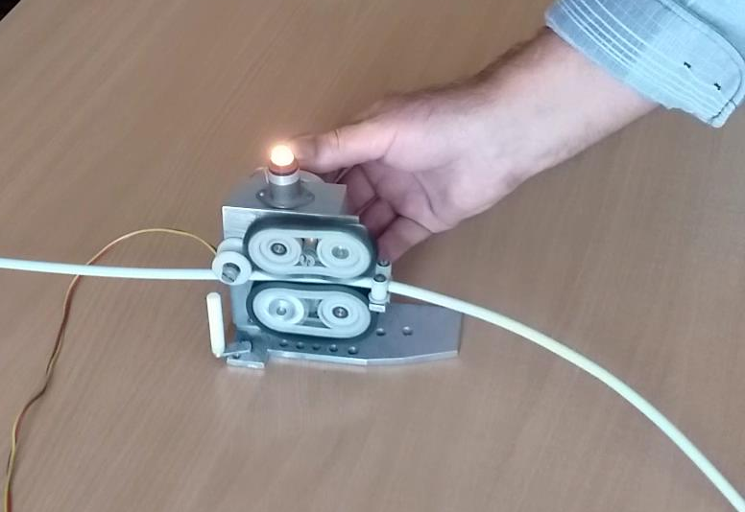
Status of project
Examples
Device for winding up wire
Servomotor with reducer

Slide 17
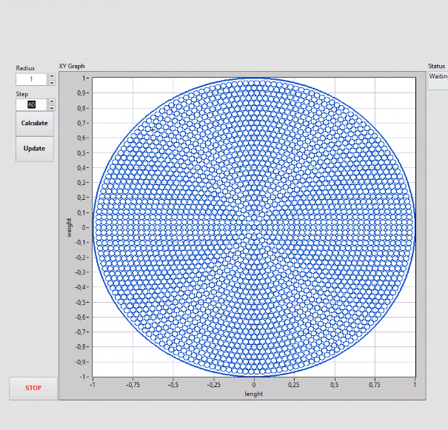
Status of project. Example of control software testing

Slide 18
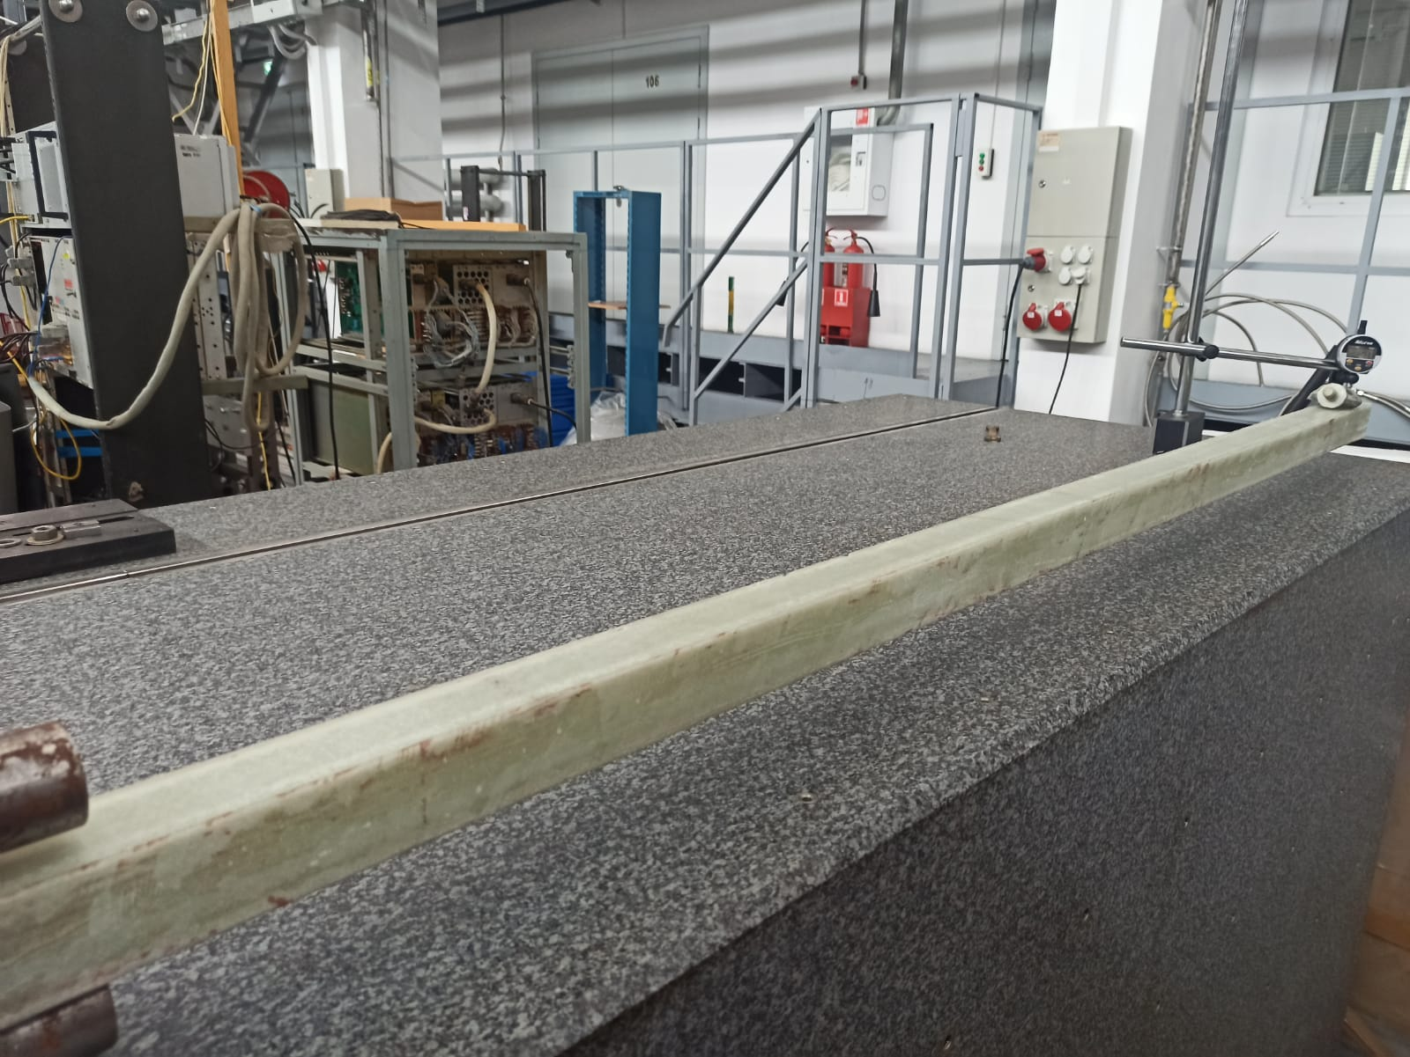
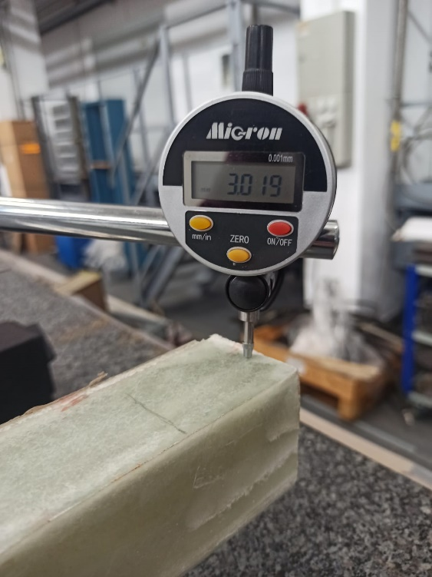
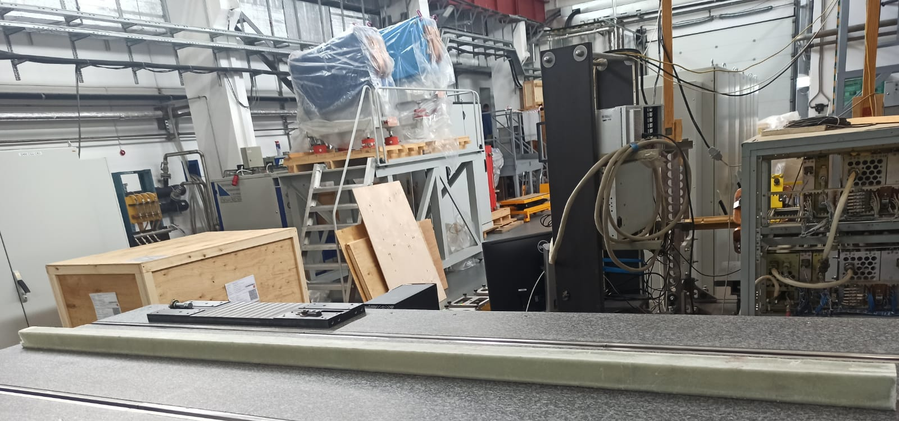
Status of project. Radial guide line
High flatness
Sag is less than 3 mm with Hall sensor carriage loading
Time of calm after excitation of oscillations is 0.8 sec.

Slide 19
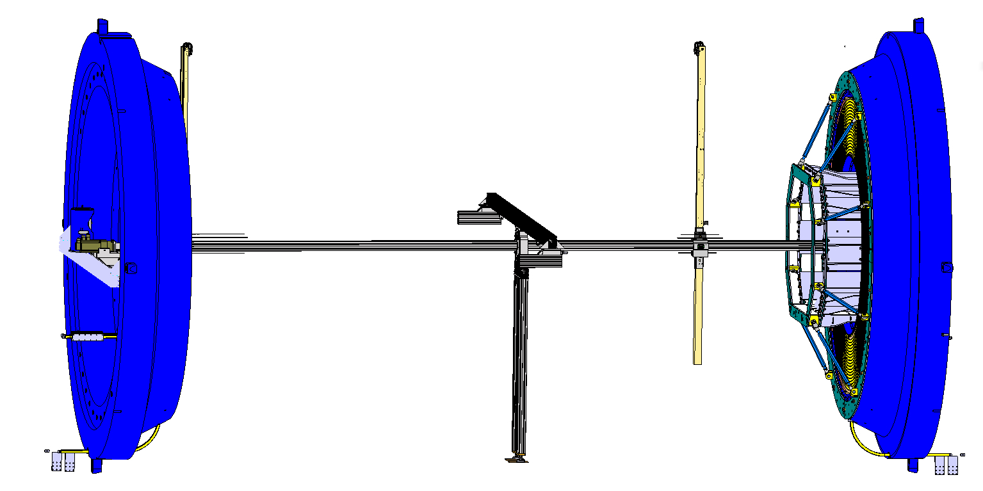
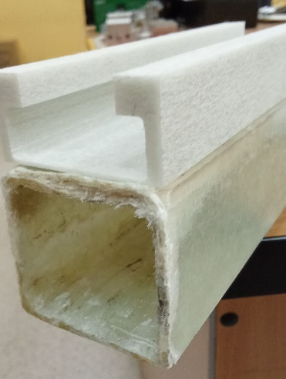
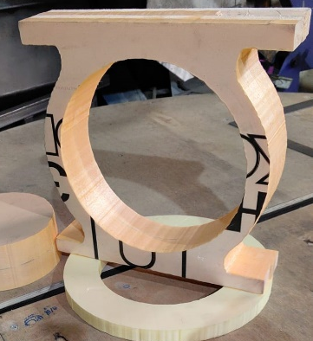
Status of project. Assembly issues
Fiberglass guide line is under
manufacturing
at side company together
with BINP
Bearing is under
manufacturing
at side company
Base is under manufacturing
at side company

Slide 20
Time schedule
Time, month | October | November | December
Aluminum guide line, carriage. and polyamide box
Control code testing
Servomotors and related parts (belts, bearings) | done
Mechanical parts (bearings and soon)
Assembling of mapper on testing facility at BINP.
Test with Earth field at BINP
Assembling of mapper at JINR
Measurements and correction of magnetic field in JINR.
Works

Slide 21
Time schedule
Time, weeks Works | 1 (works from 07.10.24) | 2 | 3 | 4 | 5 | 6 | 7 | 8 | 9 | 10 | 11 | 12
Fiberglass guide line
Control software (testing)
Control unit bloks purchasing (nanovoltmeter, commutator) | done
Hall sensor calibration
Servomotors and their accessories | done
Mechanics– platform for Hall sensor and fastener parts
Mechanics – aluminum box
Mechanics – central bearing
Mechanics – measurement cub for Hall sensor | ready
Test of mapper in BINP
Shipmnet to JINR
Assembly of mapper in JINR
Magnetic fired measurement and adjustment

Slide 22
Thank you for attention

