Slide 1
PWG1 Summary
PWG1 conveners: Petr Parfenov (JINR), Grigory Feofilov (SPbSU)
With big help from Andrey Moshkin (VBLHEP JINR) and Dmitry Podgainy (MLIT JINR)
XIV MPD Collaboration Meeting, Dubna, Russia, 14-16 October 2024

Slide 2
Outline
PWG1 activity
Selected results since previous meeting
Summary

Slide 3
PWG1 activity
There were 6 reports at MPD Cross-PWG since the previous meeting:
T.Q.T. Le, A. Galoyan, V. Uzhinsky, Coupling of UrQMD 3.4 and SMM models for simulation of neutron and nuclear fragment productions in nucleus-nucleus interactions, 9 Jul 2024
V. Riabov, MPD-FXT performance with Xe-beam and W-target, 9 Jul 2024
V. Riabov, Beam pipe and luminosity detector at startup, 20 Aug 2024
D. Flusova, N. Bikmetov, First results on centrality determination in Xe+W and Xe+Xe collisions at E_{kin}= 2.5 AGeV in MPD-FXT, 8 Oct 2024
E. Andronov, Status of p_{T} vs. multiplicity correlations analysis, 8 Oct 2024
N. Kolomoyets, Light hadron spectra obtained with MPDRoot, 8 Oct 2024

Slide 4
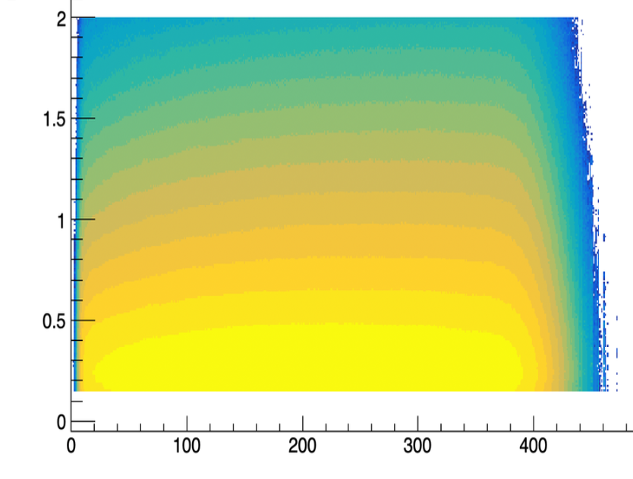
p_{T}-N_{ch} correlations
UrQMD, Bi+Bi, $\sqrt{s_{NN}}$=9.2 GeV
p_{T}, GeV/c
Analysis wagon for unidentified p_{T} spectrum and moments of p_{T} as a function of multiplicity (N_{ch}) is in preparation: MpdFluctPt
Such studies have a long history of measurements for broad energy range and for different colliding systems
It might help to constrain models
However only recently HI experiments started to publish full p_{T} spectrum as a function of multiplicity so one can have a look not only on the mean p_{T} but on the higher moments as well
It is used to study collectivity in p-p, p-A and A-A collisions
First results for production 25 and 26 (Bi+Bi, $\sqrt{s_{NN}}$=9.2 GeV) are ready
See E. Andronov talk at the MPD Cross-PWG Meeting (08.10.2024)
N_{ch}
<p_{T}>, GeV/c
𝜎(p_{T}), GeV/c
N_{ch}
N_{ch}

Slide 5
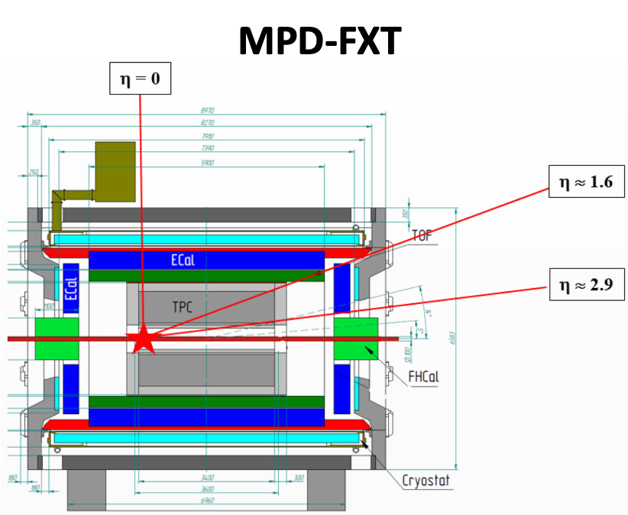
MPD in Fixed-Target Mode (MPD-FXT)
Model used: UrQMD mean-field
Bi+Bi, E_{kin}=1.45 AGeV (√s_{NN} =2.5 GeV)
Bi+Bi, E_{kin}=2.92 AGeV (√s_{NN} =3.0 GeV)
Bi+Bi, E_{kin}=4.65 AGeV (√s_{NN}=3.5 GeV)
Xe+W, E_{kin}=2.5 AGeV (√s_{NN} =2.87 GeV)
Xe+Xe, E_{kin}=2.5 AGeV (√s_{NN} =2.87 GeV)
Point-like target:
Bi+Bi: z = -115 cm
Xe+W, Xe+Xe: z = -85 cm
GEANT4 transport
Multiplicity-based centrality determination
Centrality Framework software:
https://github.com/FlowNICA/CentralityFramework/

Slide 6
FFD, FHCal, TOF: trigger efficiency in Xe+W at MPD-FXT
Most probably FFD will be the main trigger detector
To reject background from the photo-production and EMD, FFD and FHCal trigger decisions should be in coincidence with TOF
Trigger performance:
Both T=2.5 and 4.0 GeV/n can be used in physics runs
T=0.5 GeV/n shows bad performance - suitable only for performance study and technical runs
See V. Riabov talk at the MPD Cross-PWG Meeting (09.07.2024)
FFD
FHCal
TOF

Slide 7
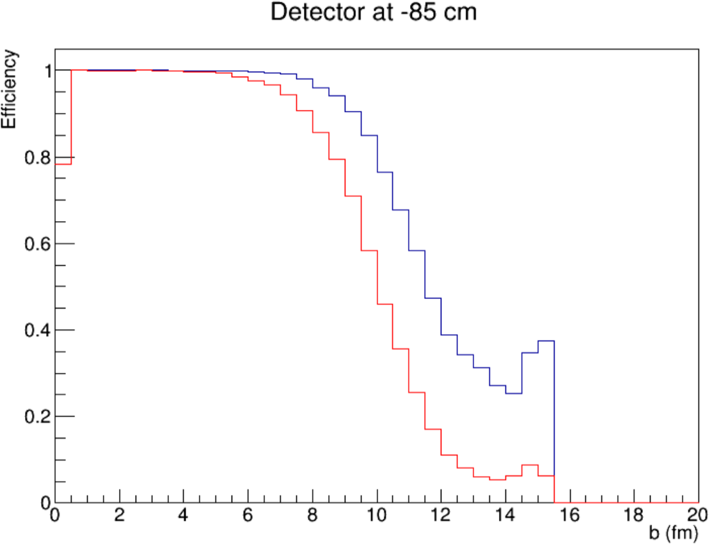
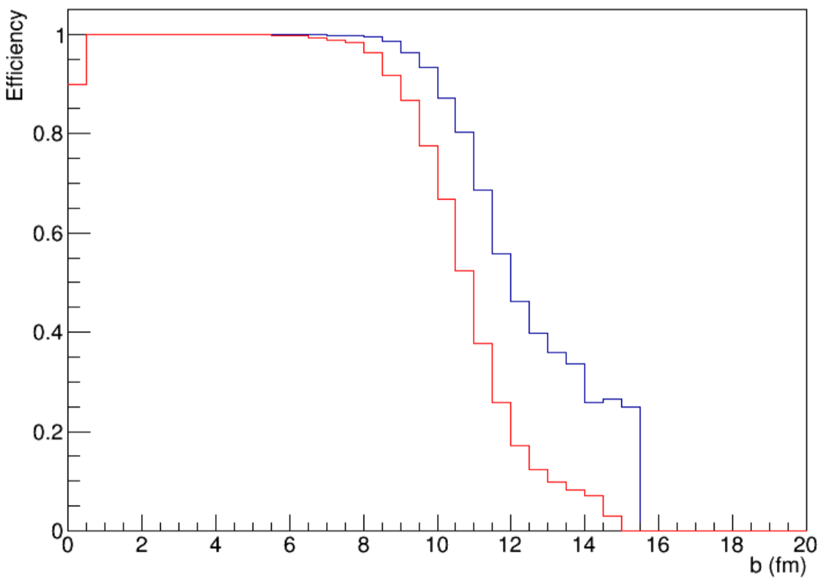
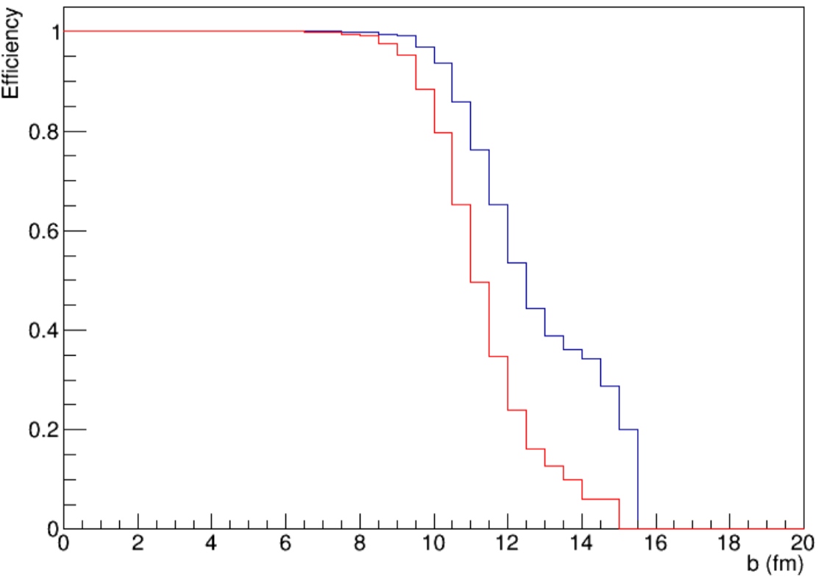
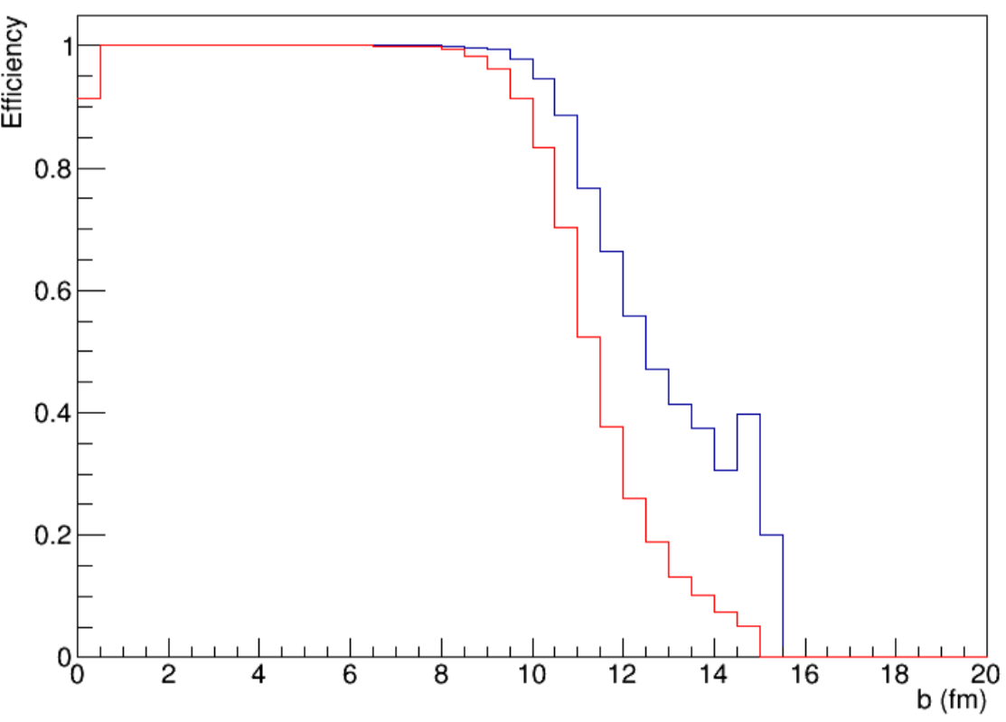
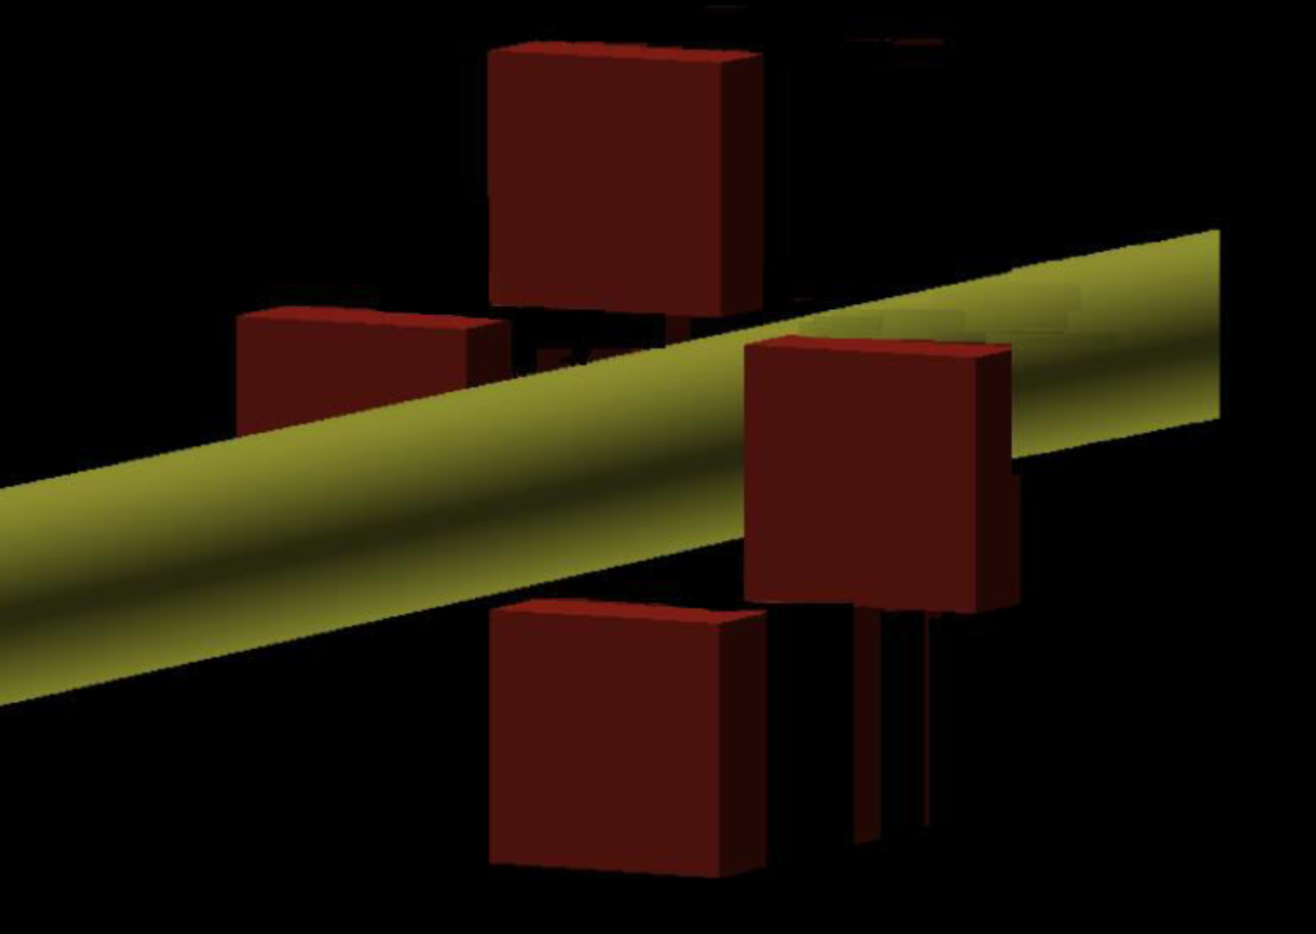
Luminosity detector: trigger efficiency in Xe+W at MPD-FXT
0.5A GeV
1.0A GeV
2.5A GeV
4.0A GeV
97.6874%
91.8781%
99.3471% 97.1304%
99.8317% 99.1449%
99.8697% 99.3465%
Setup with simplified geometry was used for GEANT4:
stainless steel beam pipe (diameter = 80 mm, width = 1 mm)
luminosity detector – 4 scintillator blocks of 10 x 10 cm2 at different locations along z-axis: -85, -40, 60, 160, 260 cm.
collision vertex is at -85 cm, Xe¹²⁴+W
DCM-QGSM-SMM event generator
Efficiency is higher for higher beam energies
It is preferrable for luminosity detector to be placed closer to the target wire
See V. Riabov talk at the MPD Cross-PWG Meeting (20.08.2024)

Slide 8
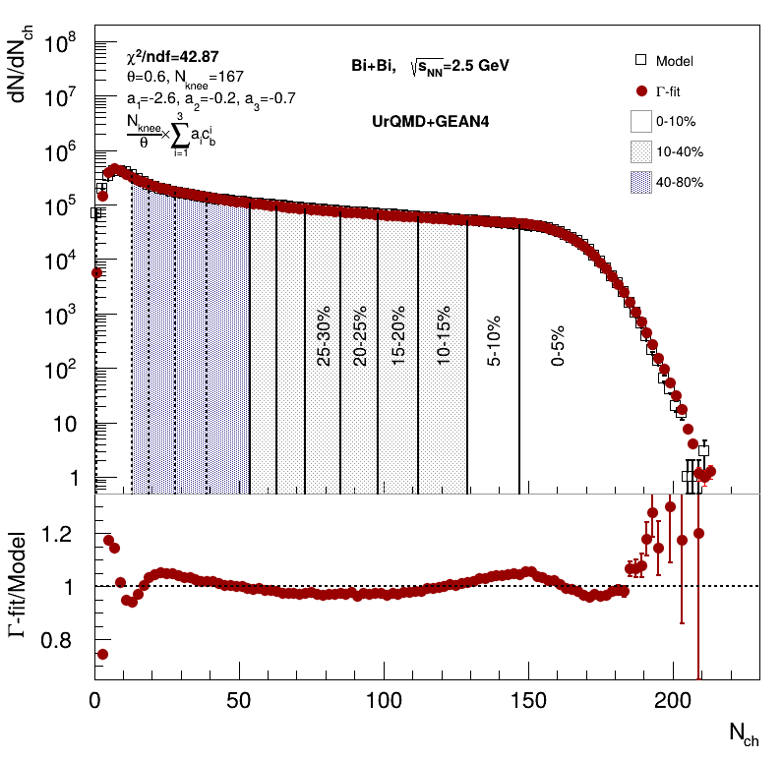
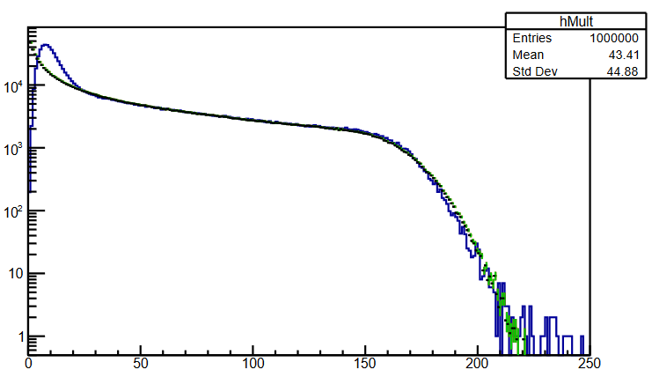
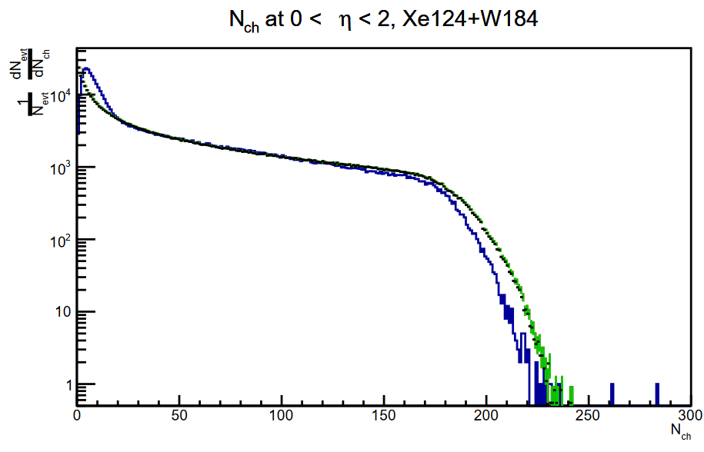
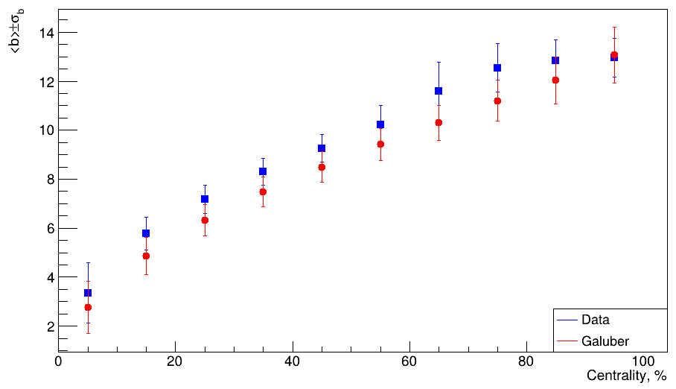
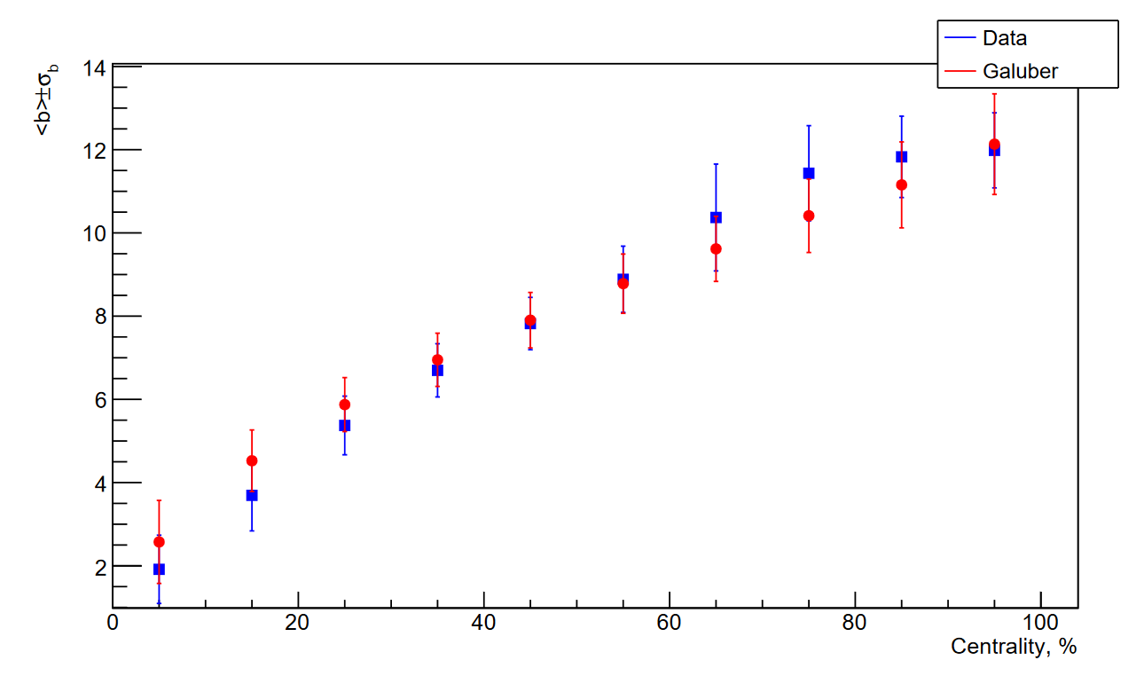
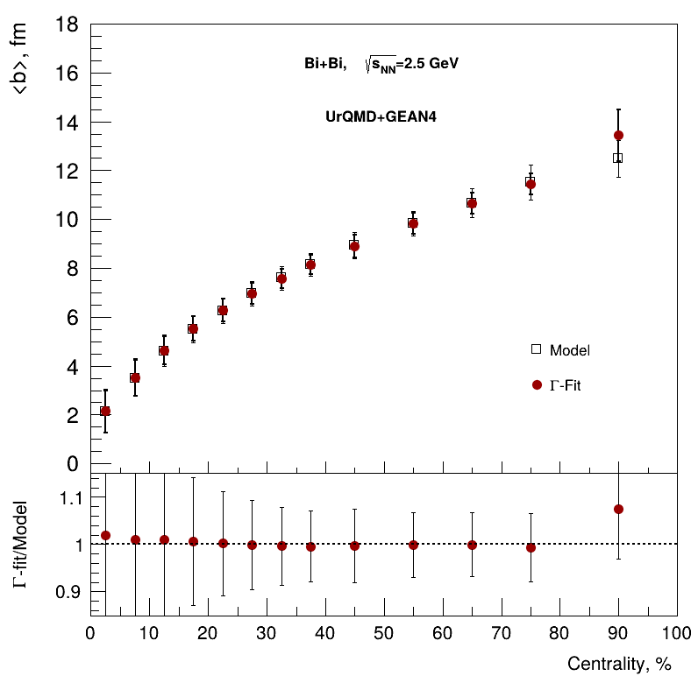
Centrality determination in MPD-FXT
Xe+W, $\sqrt{s_{NN}}$=2.87 GeV
Xe+Xe, $\sqrt{s_{NN}}$=2.87 GeV
Data
Fit (MC-Glauber)
<b>, fm
Both MC-Glauber and 𝛤-fit approaches work with MPD-FTX detector configuration
Centrality provided by 𝛤-fit method was used in flow measurements for Bi+Bi, $\sqrt{s_{NN}}$=2.5, 3, 3.5 GeV
Further study is in progress - see D. Flusova and N. Bikmetov talk at CrossPWG 8.10.2024
Centrality, %

Slide 9
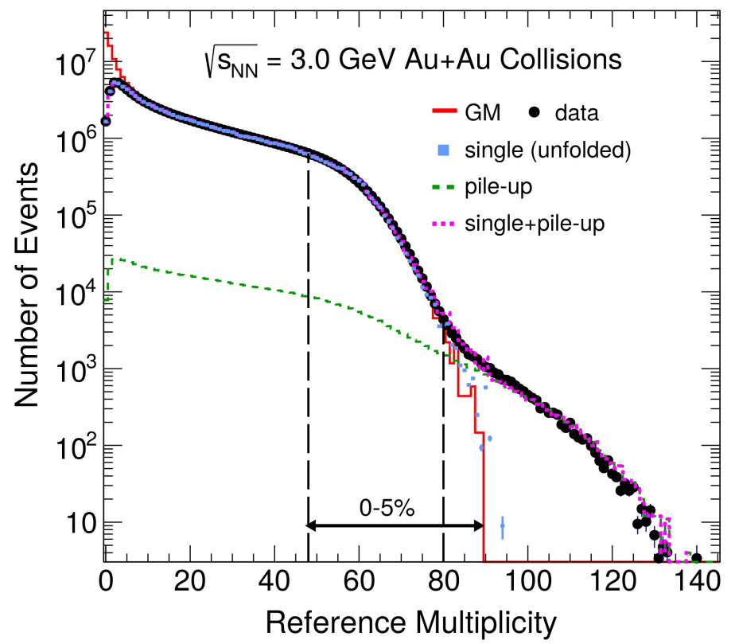
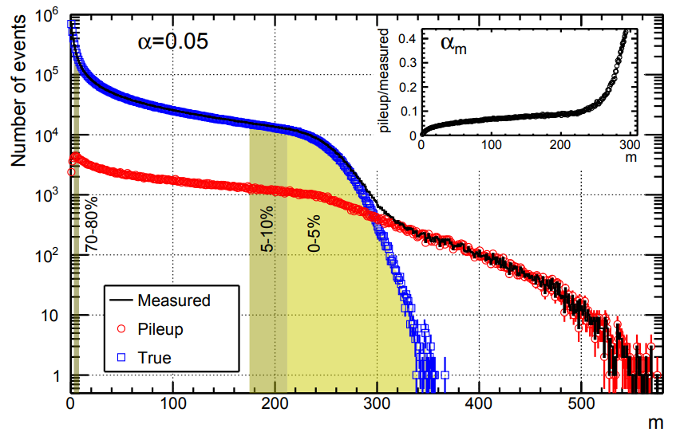
Implementation of “pileup” in the centrality determination procedure
https://arxiv.org/abs/2112.00240
Pileup events occur with the probability α_{m} at the m multiplicity bin.
The probability to find N particles of interest at multiplicity m with the pileup effects is given by:
P_{m}(N) = (1 − α_{m})P_{m}^{single}(N) + α_{m}P_{m}^{pileup}(N)
https://arxiv.org/abs/2006.15809
Simple toy model for pileup event generation is available: https://github.com/FlowNICA/McPileUp
Pileup events were implemented in the centrality determination framework: https://github.com/FlowNICA/CentralityFramework

Slide 10
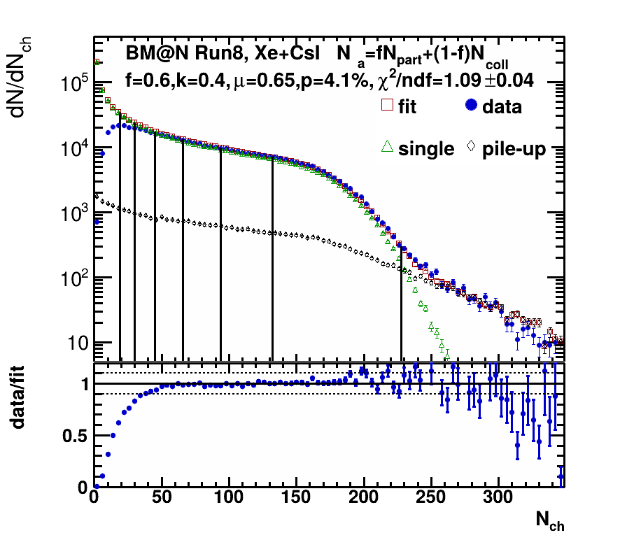
Testing centrality determination framework in BM@N
RunId: 8120-8170
Multiplicity Cuts:
CCT2
N_{vtxTr}>1
(Sts digi vs N_{tr}) cut
V_{r} <1 cm
V_{z} < 0.1 cm
Pileup event sampling is implemented in the framework similar to STAR-like approach¹
Generalized NBD parametrization is built in the framework. Fit parameters now are consistent with Kharzeev-Nardi² approach
Good agreement with experimental data
¹arXiv:2006.15809 (2020)
²Phys.Lett. B507 (2001) 121-128

Slide 11
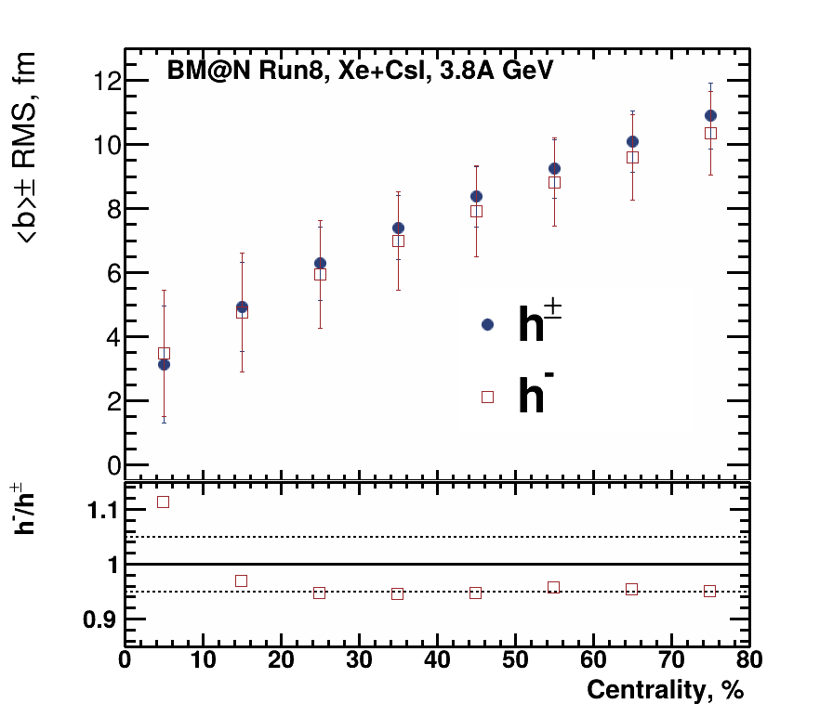
Testing centrality determination framework in BM@N
Difference in the most central class is due to pile-up:
Cut on maximum multiplicity differs – expected to improve with optimized pileup rejection
The difference in the mid-central region is within 5%
The possible effect from spectators in the case of h± multiplicity seems to be small

Slide 12
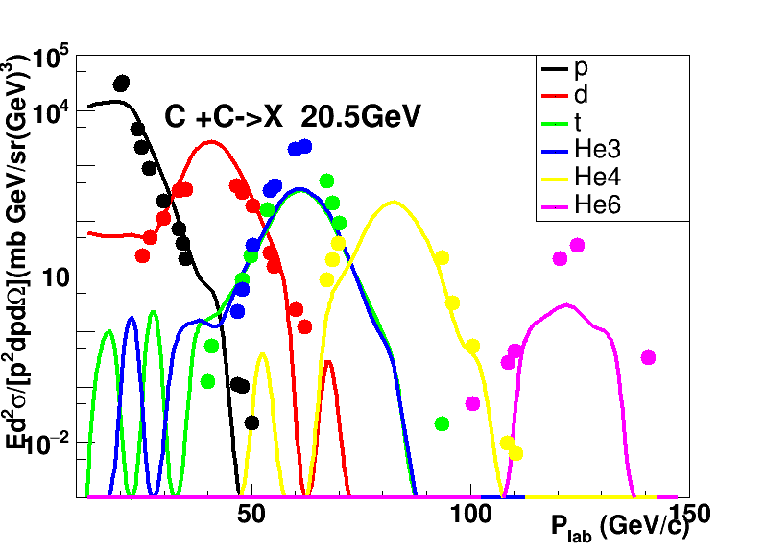
Coupling of UrQMD and SMM models
K. Ishibashi et al., J.Nucl. Sci. Tech., Vol.34, N6 (1997) P. 529
UrQMD 3.4
(Original)
Cluster
(use neutrons, protons)
Botfra
(SMM)
Mesons, gamma, electron, etc.
Fragments
(n, p, frags)
Exp. Data: Afonin, A. G., et al. Nuclear Physics A 997 (2020):121718
Realistic heavy-ion model at NICA energies needs to have:
Implemented EoS with mean-field approach
Fragmentation model for forward/backward spectator region
UrQMD+SMM satisfy such requirements:
UrQMD describes well spectra of ($π^{±},K^{−},p,\overline{p}$), $v_{n}$ of protons, etc.
SMM provides realistic fragmentation
See T.Q.T. Le talk at the MPD Cross-PWG Meeting (09.07.2024)

Slide 13
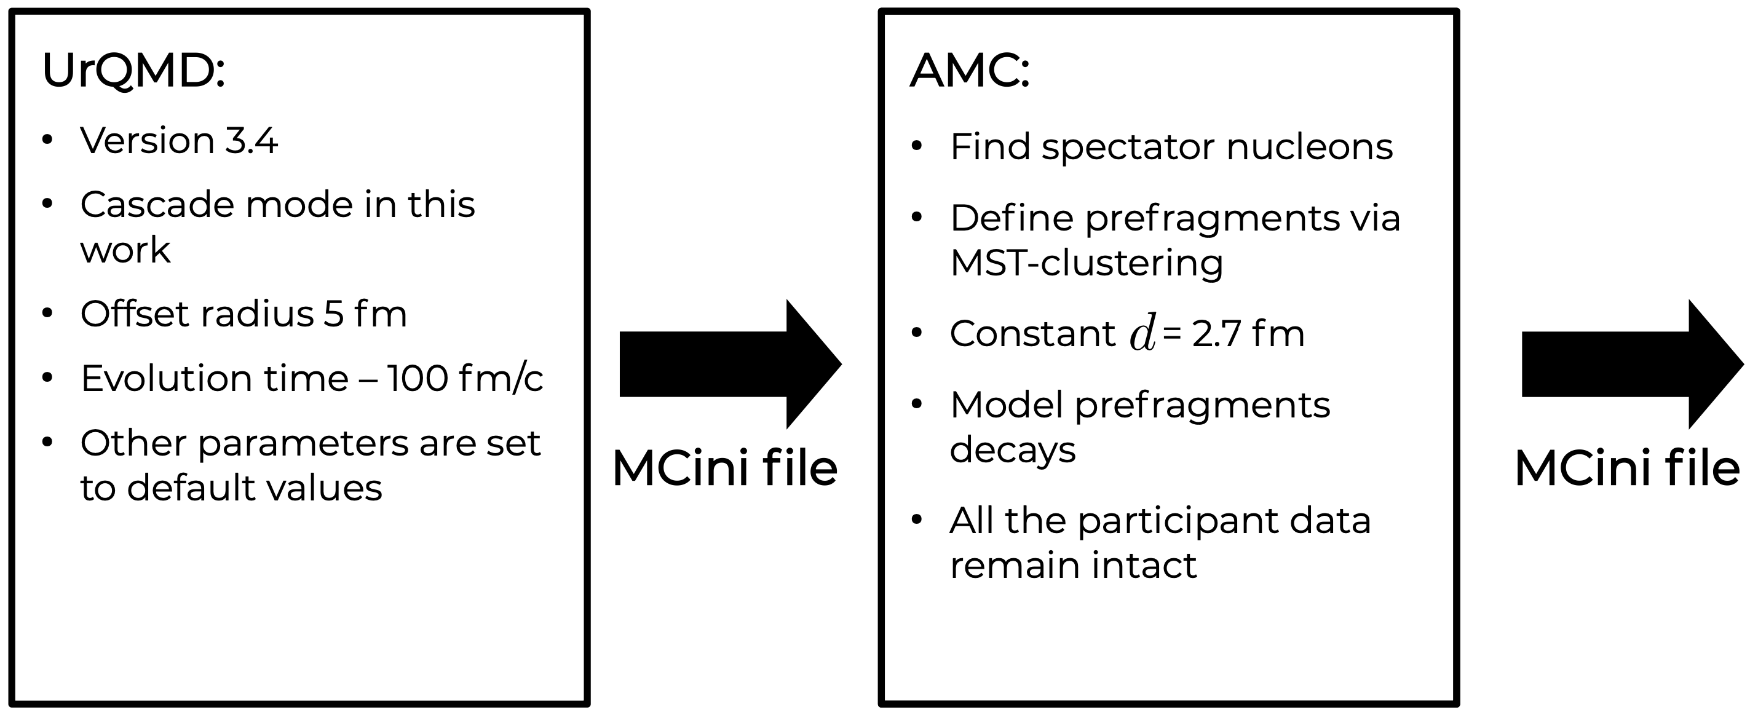
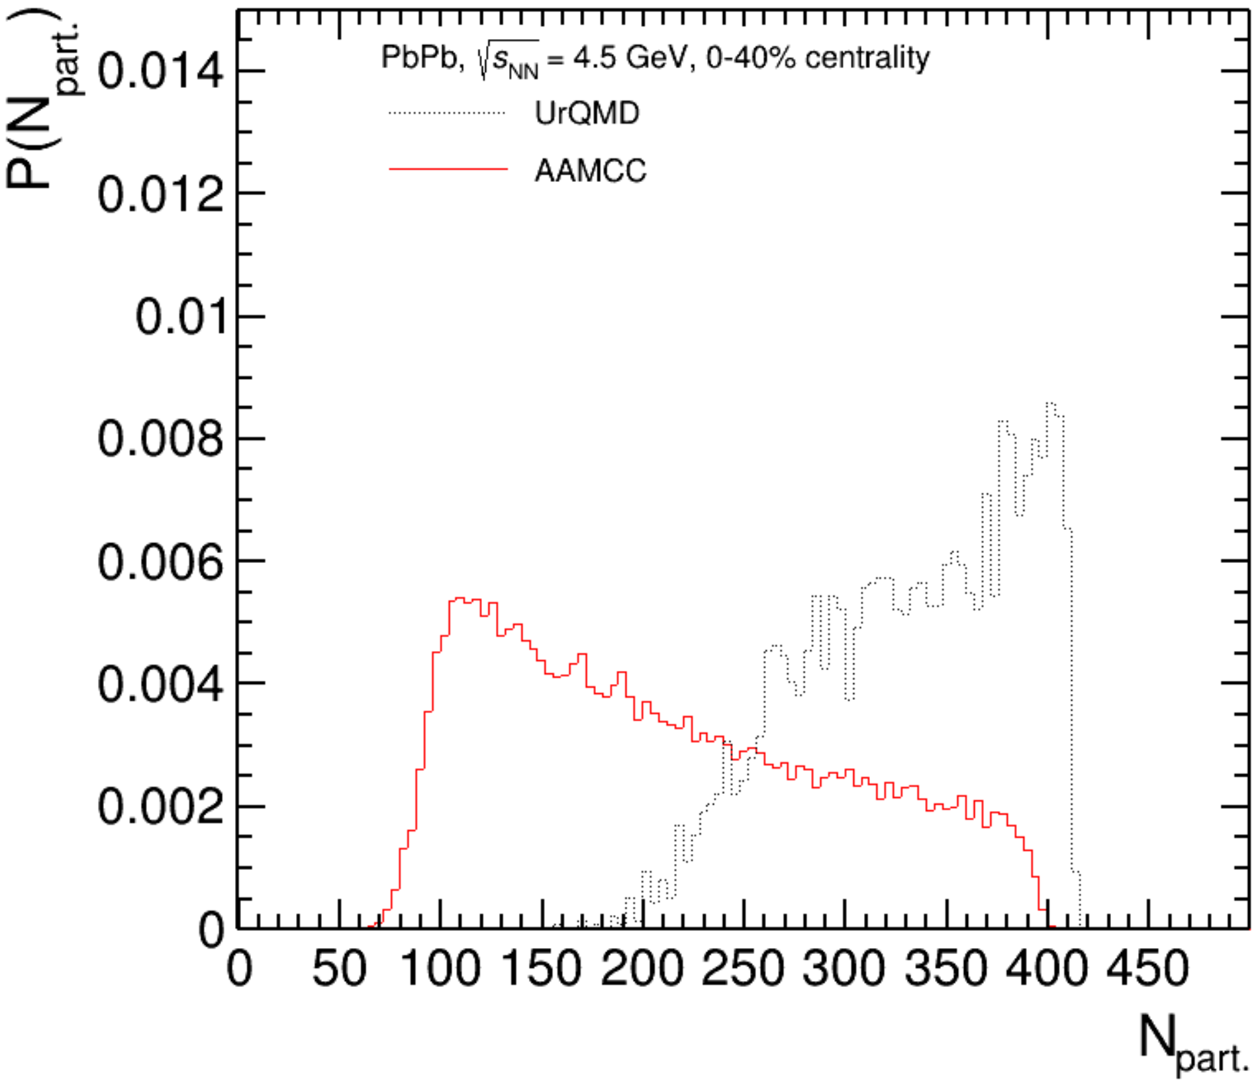
Coupling of UrQMD and AAMCC models
UrQMD-AMC allows to have mean-field mode (UrQMD) while having realistic fragmentation with (AAMCC)
UrQMD-AMC was developed and is ready for use in MPD framework
Further work is in progress (participant-spectator separation criteria in UrQMD, calculation of the FHCal response, etc.)
See A. Svetlichnyi talk at the MPD Cross-PWG Meeting (14.11.2023)

Slide 14
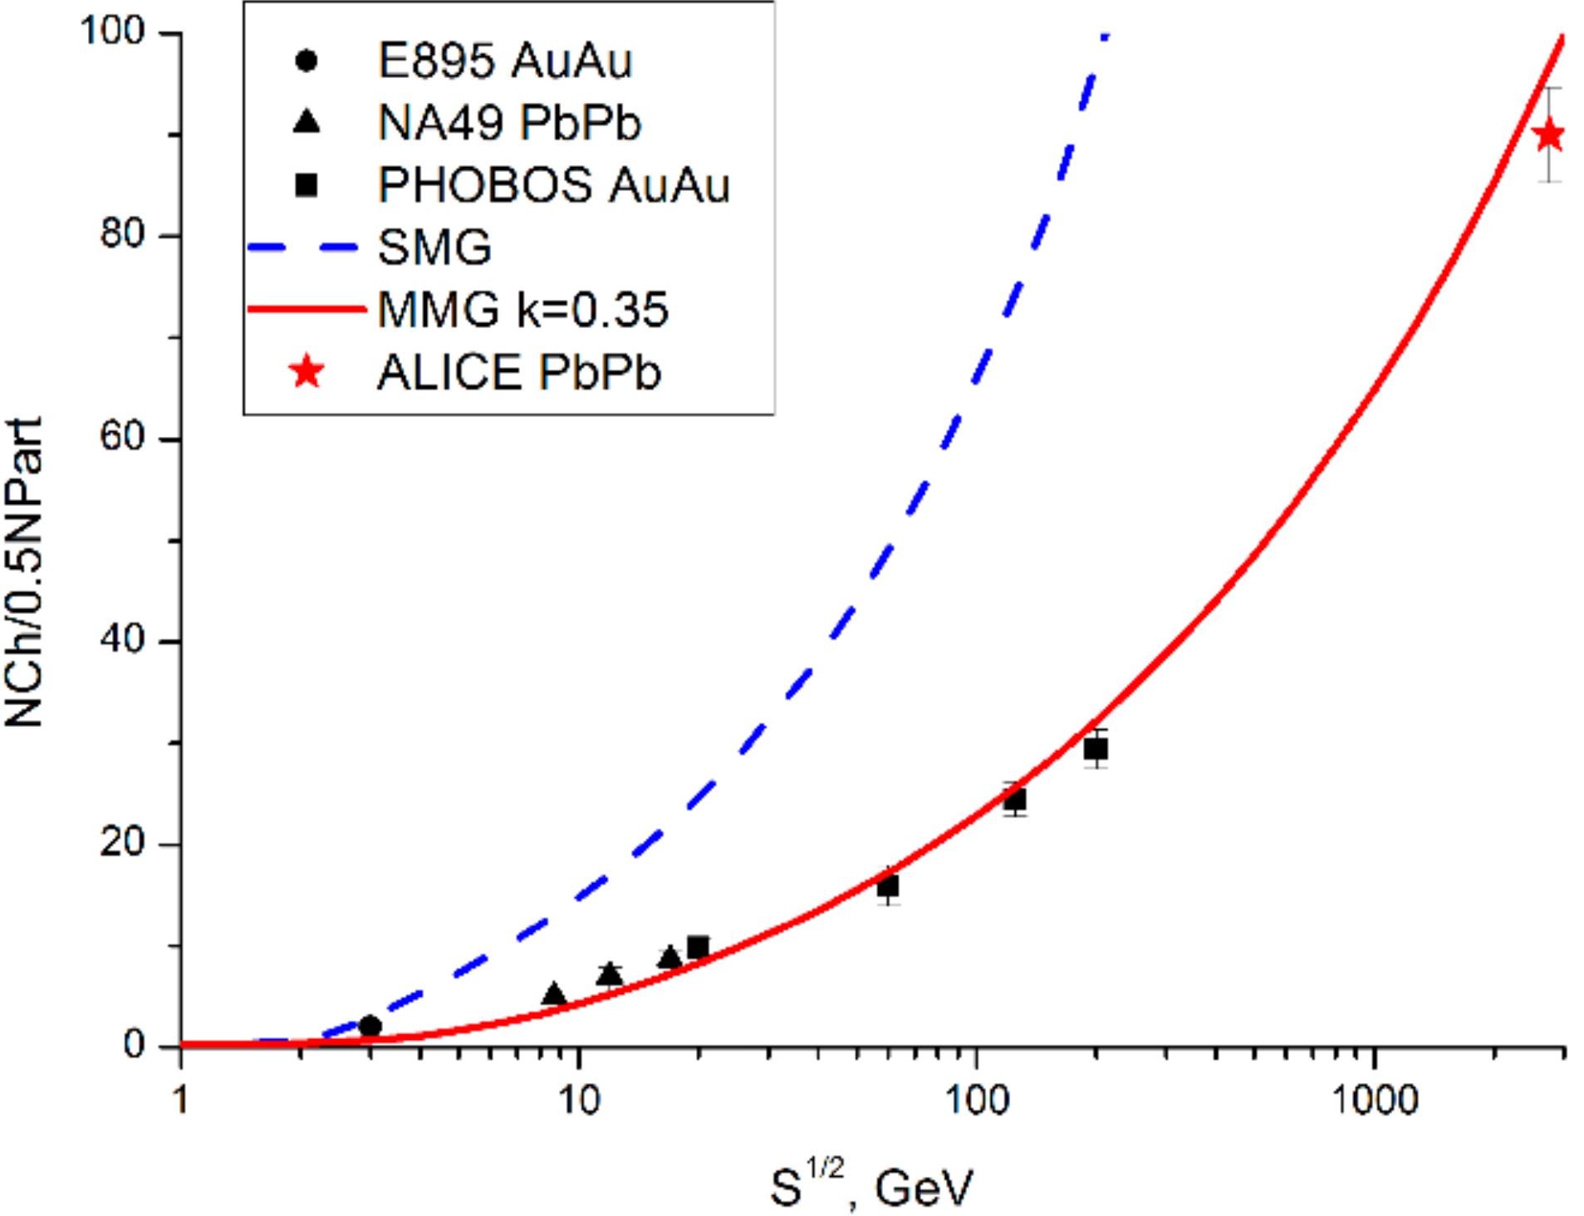
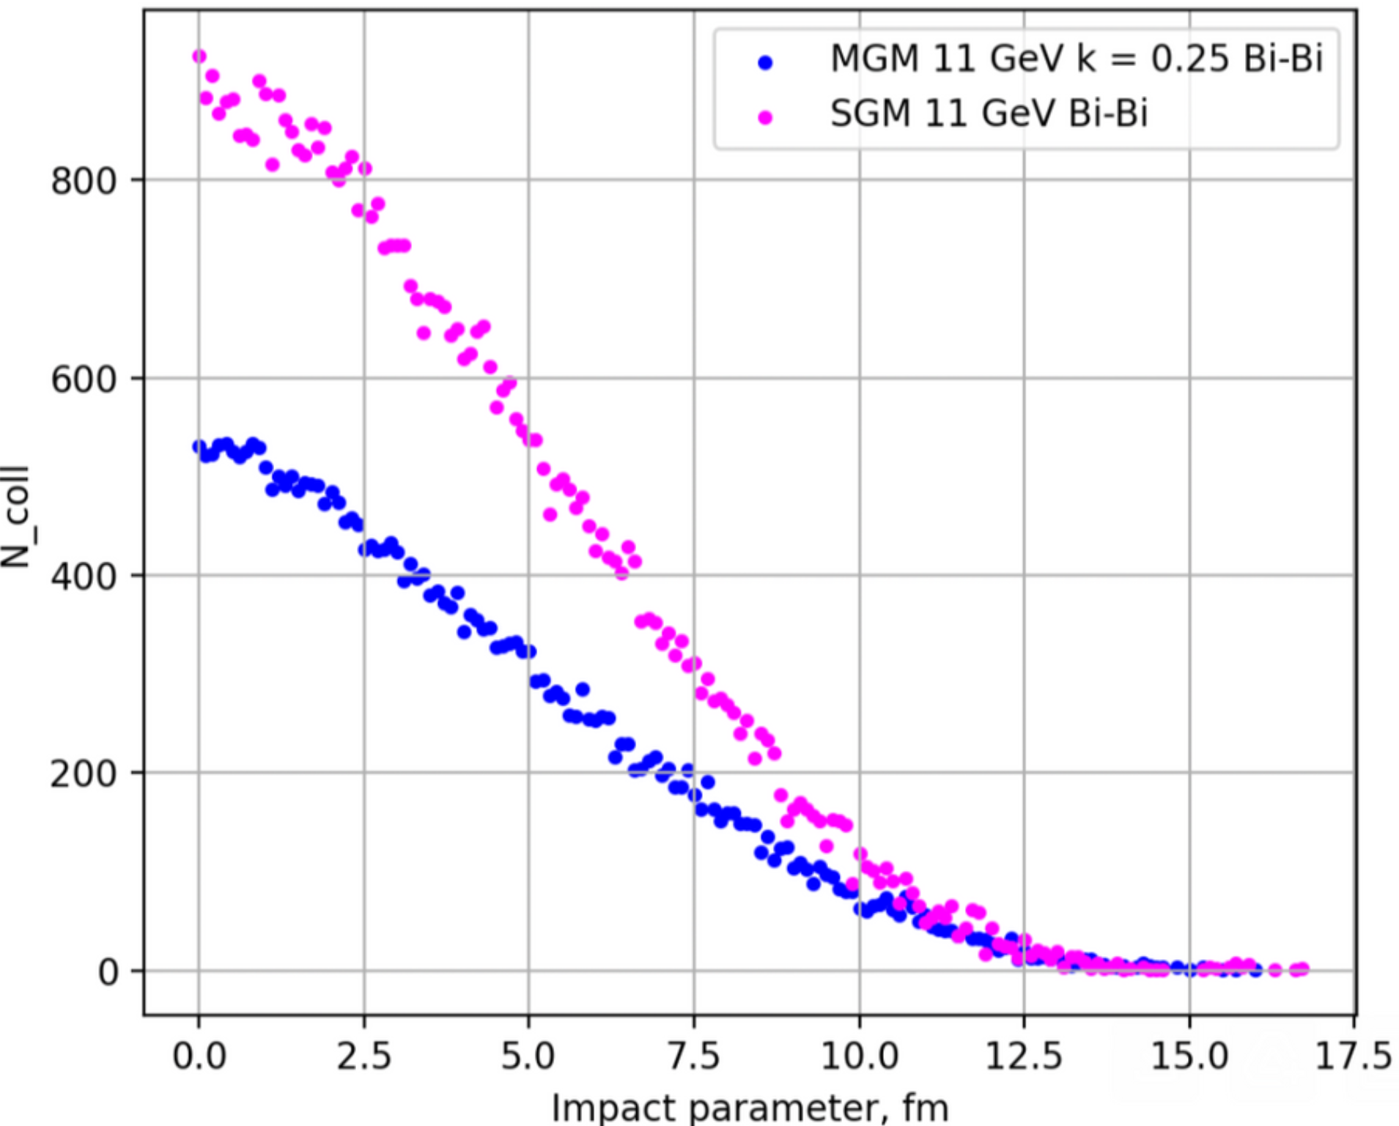
Modified MC-Glauber
A. Seryakov, G. Feofilov, AIP Conference Proceedings 1701(1):070001
Standard MC-Glauber model (SGM):
$σ_{NN}^{inel},d=const;$ $E_{tot},P_{tot}≠const$;
Modified MC-Glauber model (MGM):
$σ_{NN}^{inel}=const;d≠const; E_{tot},P_{tot}=const$;
New parameter k – mean fraction of momentum loss
MGM takes into account NN collisions with energy loss
Notable difference between SGM and MGM is observed – might be important at NICA energies
Work is ongoing:
See S. Simak talk at the MPD Cross-PWG Meeting (20.04.2024)

Slide 15
Summary
MPD-FXT now the focus of feasibility studies
Xe¹²⁴+W general purpose production was generated with target at z=-85 cm and Xe beam at E_{kin}=2.5A GeV
Study with simplified beam pipe and luminosity detector shows trigger efficiency Eff_{trig}>99% for E_{kin}=2.5A GeV
Centrality determination in MPD-FXT
Both MC-Glauber and 𝛤-fit approaches can be used in the fixed target configuration. 𝛤-fit requires further investigation in case of asymmetric collisions
BM@N Xe+CsI run provides excellent opportunity to test analysis frameworks on real experimental data
Centrality determination framework can describe multiplicity distribution in Xe+CsI data
Pileup event sampling was implemented in the MC-Glauber approach with the additional fit parameter
Generalization of NBD was built in the framework. That allows to obtain fit parameter consistant with the Kharzeev-Nardi approach
Development of the HI models
UrQMD+SMM and UrQMD-AMC can simultaneously realistically describe particle spectra, flow, etc. (mean-field UrQMD) and spectator fragments
Modification for MC-Glauber to take into account NN collisions with energy loss – might be important at NICA energies
Thank you for your attention!

Slide 16
Backup

Slide 17
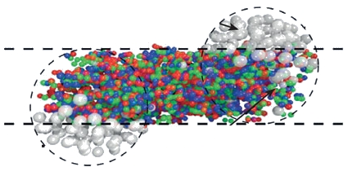
Motivation for centrality determination
Evolution of matter produced in heavy-ion collisions depends on its initial geometry
Goal of centrality determination: map (on average) the collision geometry parameters to experimental observables (centrality estimators)
Centrality class S₁-S₂: group of events corresponding to a given fraction (in %) of the total cross section:
(projectile)
spectators
participants
(target)
spectators

Slide 18
Overview of centrality determination methods
Method type | MC-Glauber based | Model independent (e.g. Г-fit method) | Based on ML
Used in | STAR, ALICE, HADES, CBM, MPD, etc. | ALICE, CMS, ATLAS J. Y. Ollitrault et al. Phys.Rev. C 98 (2018) 024902 | Becoming popular Fupeng L. et al. J.Phys.G 47 (2020) 11, 115104
Advantages | Commonly used, well established procedure | Universality due to model independence | The most modern and fast methods
Disadvantages | MC-Glauber model provides non-realistic N_{part} simulations at low energies M. O. Kuttan et al. e-Print: 2303.07919 [hep-ph] | In strong connection with σ_{inel} which dependence on energy is not well studied at low energies (same problem for MC-Glauber based methods) | There no way to control the physicality of the methods

Slide 19
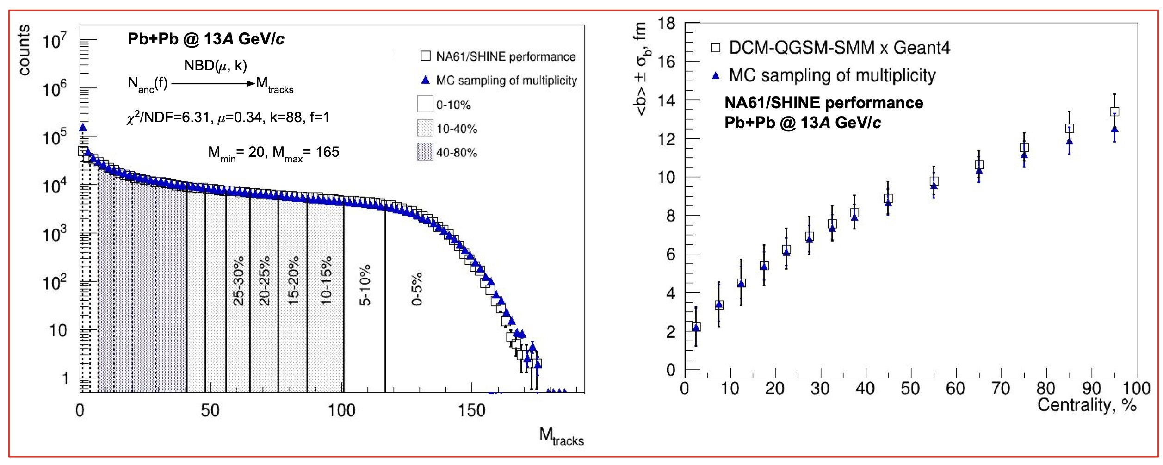
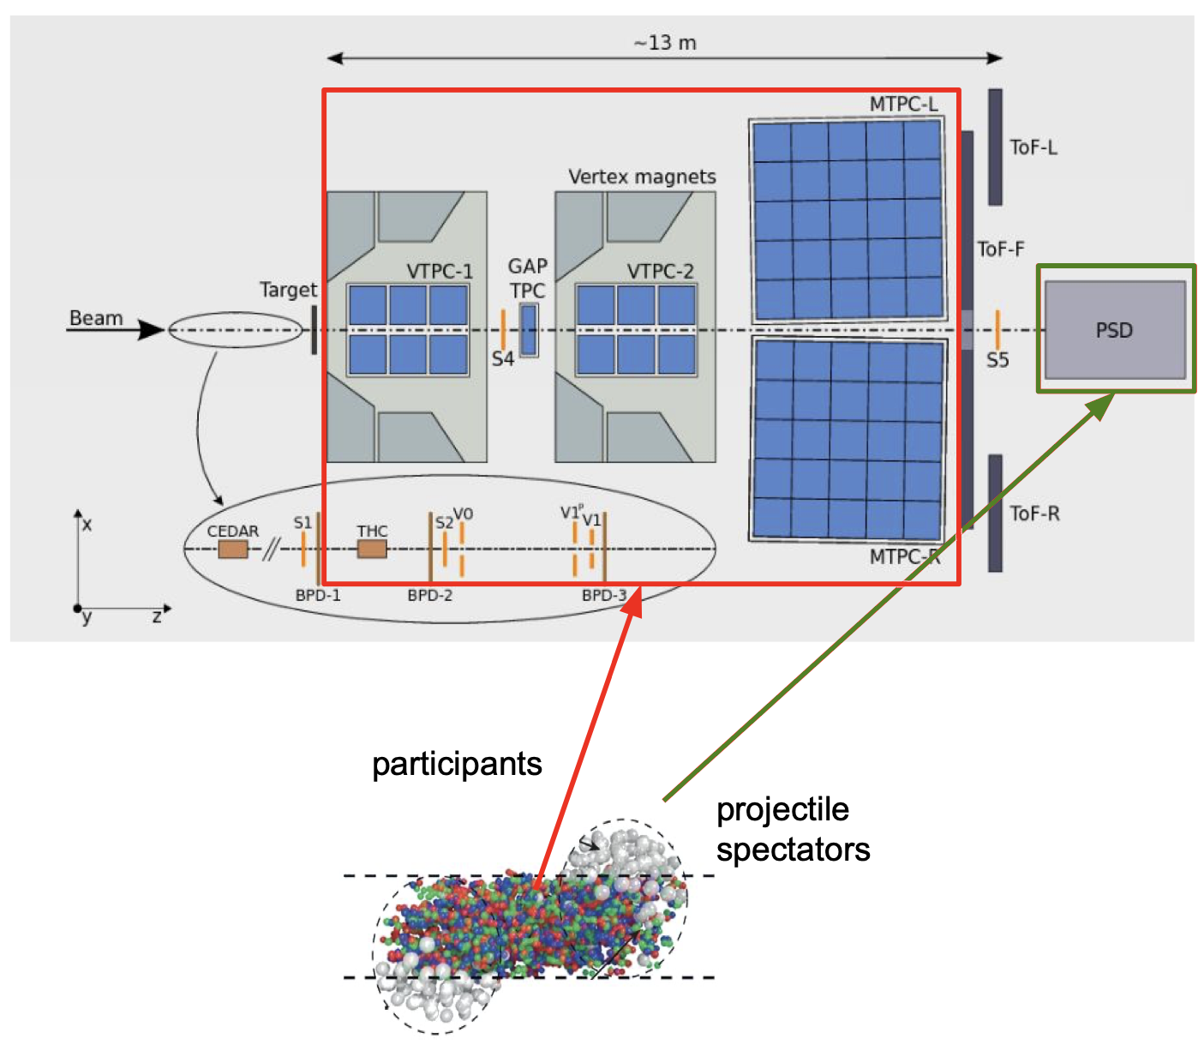
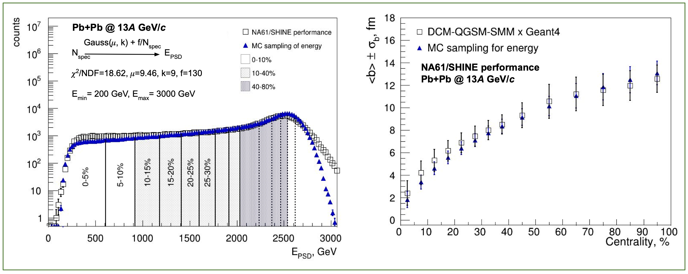
Centrality determination in NA61/SHINE using MC-Glauber
NA61/SHINE setup
Simplified procedure for spectator energy is developed and tested on NA61/SHINE data
Possible improvements are under investigation

Slide 20
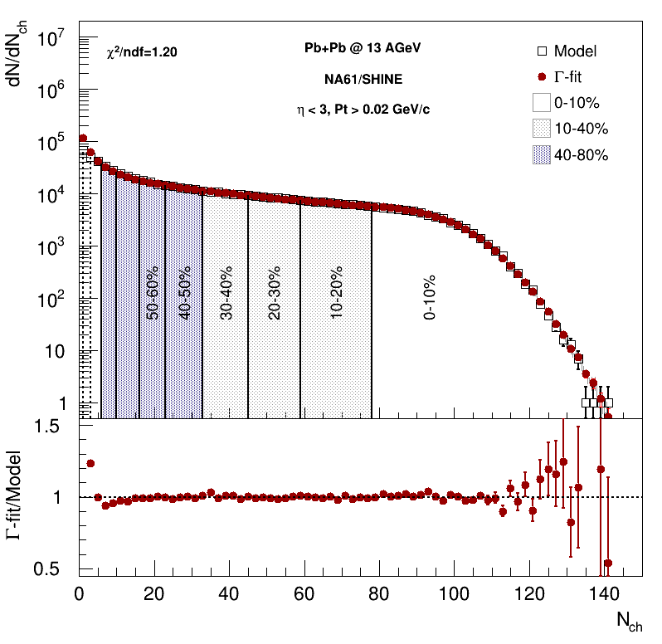
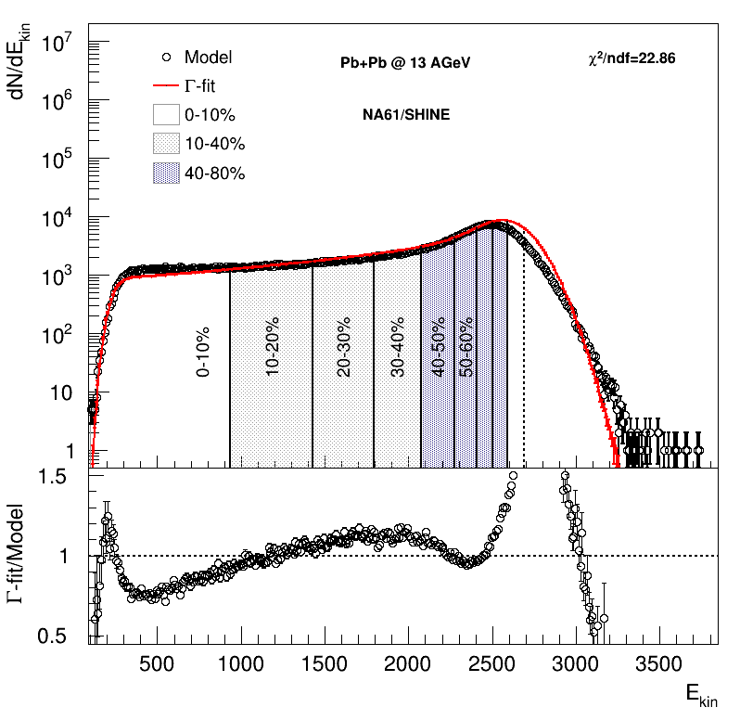
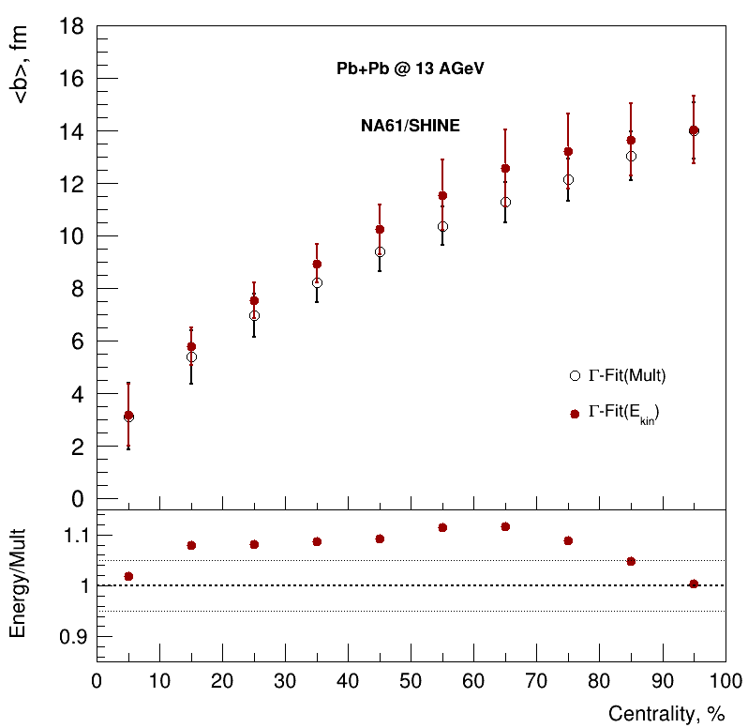
Centrality determination in NA61/SHINE using 𝛤-fit
Centrality determination based on spectator energy using inverse Bayes approach is being developed and tested on model (UrQMD, DCM-QGSM-SMM) and NA61/SHINE data
Application of centrality determination based on spectator energy using MC-Glauber and inverse Bayes approaches is in progress
Possible improvements are under investigation

Slide 21
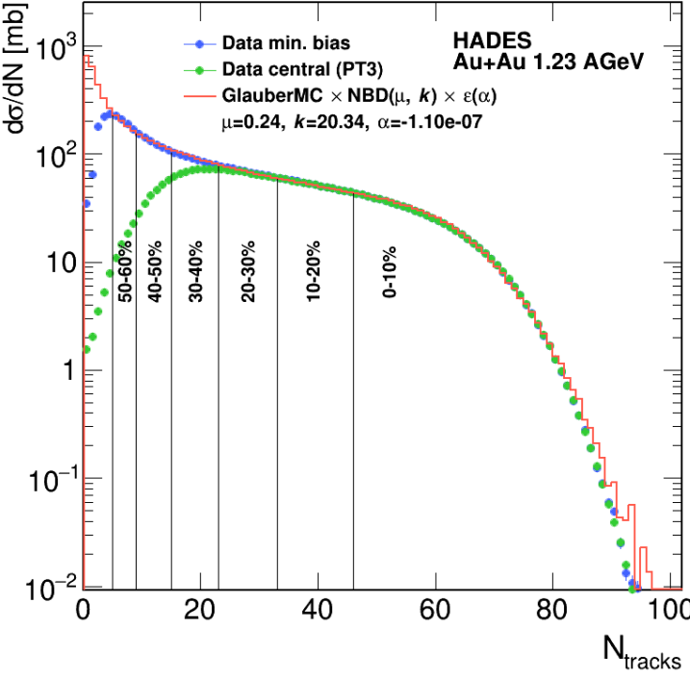
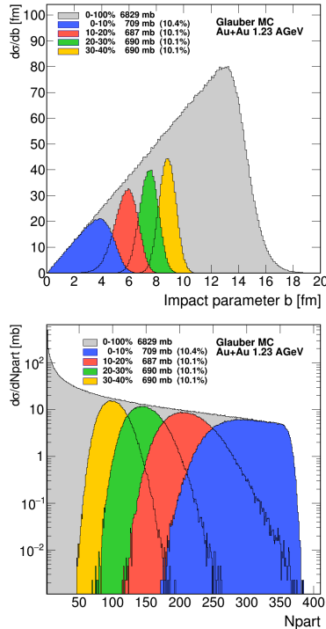
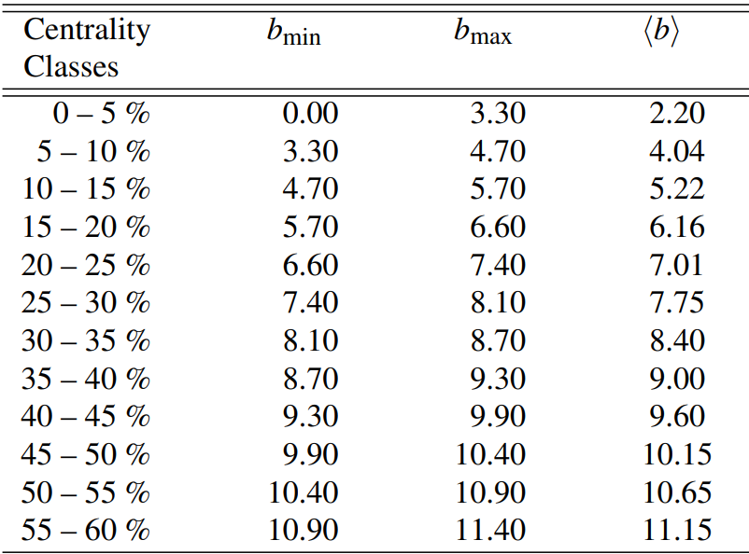
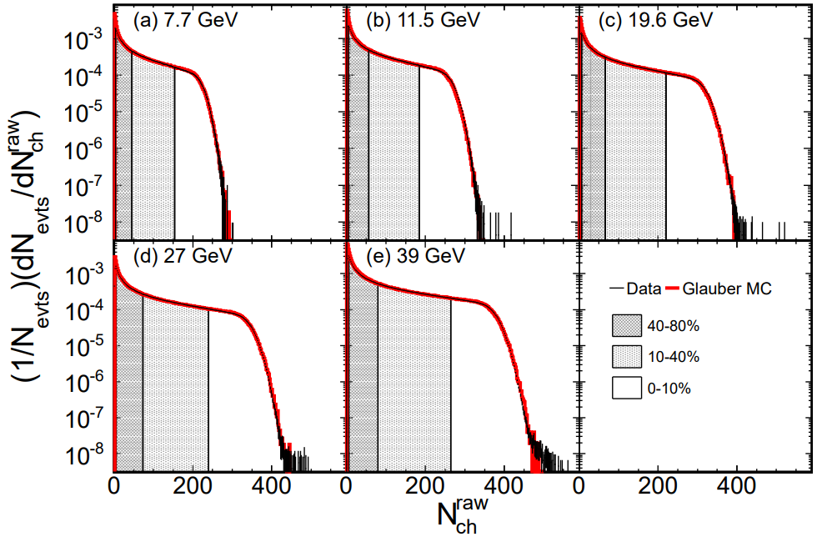
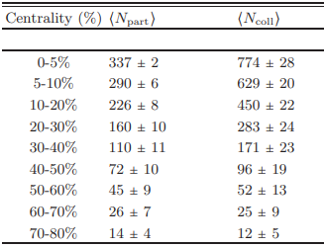
Centrality determination in HADES, STAR
HADES, Au+Au 1.23A GeV
Eur. Phys. J. A (2018) 54: 85
STAR, Au+Au, BES
Centrality determination based on multiplicity provides with:
impact parameter (b)
number of participating nucleons (N_{part})
Similar centrality estimator is needed for comparisons with STAR, HADES, etc.
Phys. Rev. C 86, 054908 (2012)
Notes:
Сверху представлены результаты по определению центральности в эксперименте HADES
Слева на картинке представлена множественность частицы и ее фит, и результат разбиения по центральности. Правее представлено распределение импакт параметра и Npart в получившихся бинах центральности
Снизу - это пример определения центральности в эксперименте стар.
Определение центральности на основе множественности обеспечивается импак параметром и Npart
Для сравнения с разными экспериментами нам необходима аналогичные эстиматоры

Slide 22
Centrality determination based on Monte-Carlo Glauber sampling
For multiplicity
of produced particles
used in HADES, CBM, BM@N, NA61/SHINE
For any spectators based observable
used in CBM, BM@N
For spectators energy from hadron calorimeters
used in NA61/SHINE
MC-Glauber
distribution
Full Monte-Carlo (real data) distribution
Get (N_{part}, N_{coll}) from MC-Glauber
Get (N_{spec}, b) from MC-Glauber
Calculate N_{a}=fN_{part}+(1-f)N_{coll}
Calculate
(A_{tot} ) - at t=∞
Sample hadron calorimeter response (S_{i}) N_{spec} times from
Gauss(μ, k)
Evaluate χ²
between dN/dE_{MC/data} and dN/dE_{Gl}
Sample (A_{frag},N_{Afrag})
for (A_{tot}, N_{spec}, b)
Scan phase space of parameters to find their values for minimum of χ²
Sample multiplicity of produced particles (S_{i}) N_{a} times from NBD (μ, k)
Sample (E_{frag},y_{frag})
for (A_{frag})
Sample S_{frag} for (E_{frag},y_{frag})
Result: total S_{tot}
Extract relation between geometry parameters and centrality estimator
Centrality can be estimated based on multiplicity of produced charged particles or spectator energy

Slide 23
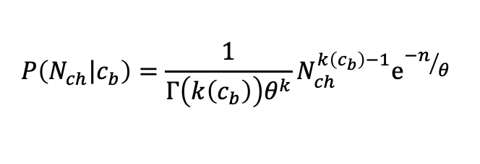
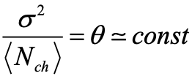
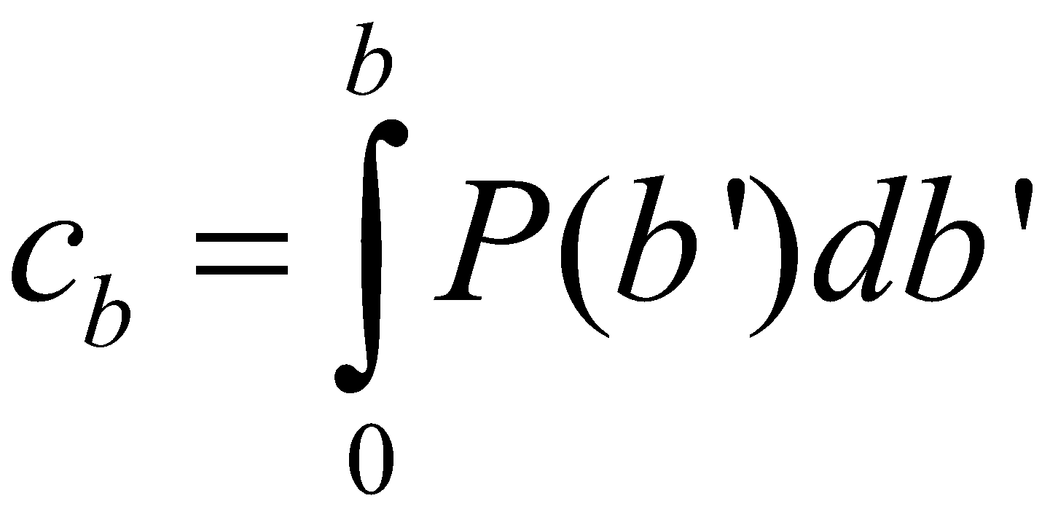
The Bayesian inversion method (Γ-fit): multiplicity
Relation between multiplicity N_{ch} and impact parameter b is defined by the fluctuation kernel:
2 main steps of the method:
Fit experimental (model) distribution with P(N)
– centrality based on impact parameter
Mean multiplicity as a function of c_{b} can be defined as follows:
Construct P(b|E) using Bayes’ theorem:
P(b|N) = P(b)P(N|b)/P(N)
- 5 parameters
Fit function for N_{ch} distribution:
b-distribution for a given N_{ch} range:
Notes:
the ratio of the fluctuation to the average value is equal to a constant
In the ehd

Slide 24
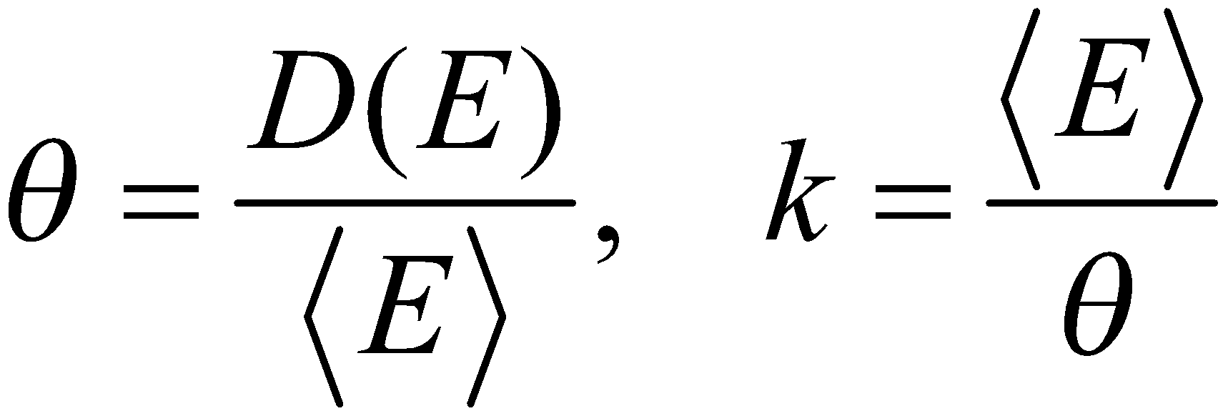
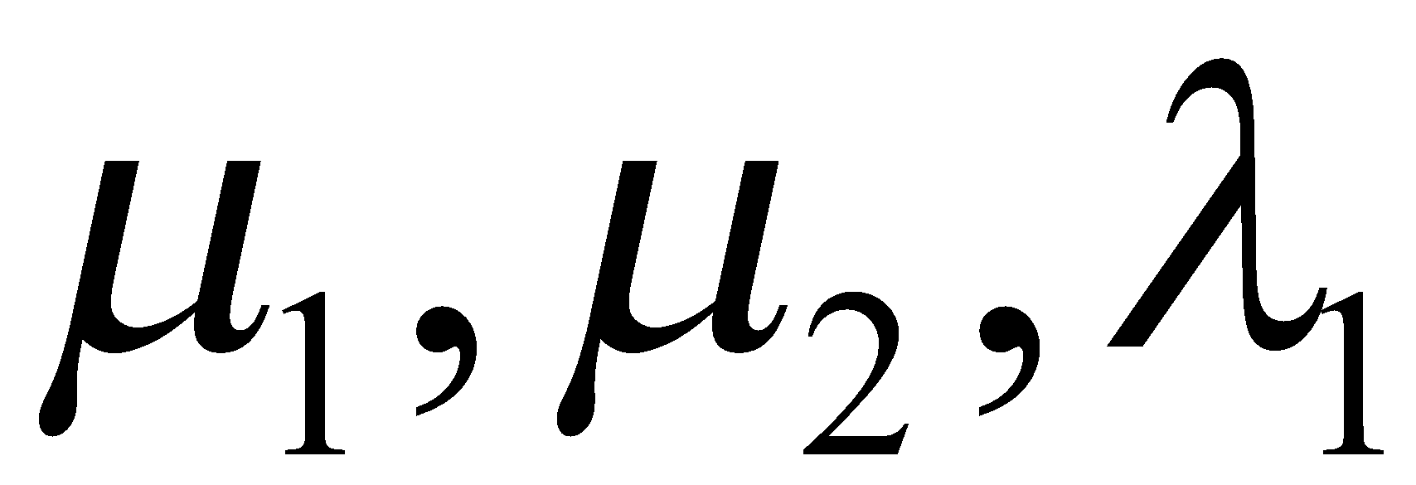
The Bayesian inversion method (Γ-fit): forward energy
Relation between multiplicity N_{ch} and impact parameter b is defined by the fluctuation kernel:
2 main steps of the method:
Fit experimental (model) distribution with P(E)
– centrality based on impact parameter
– average value and variance of energy
Three fit parameters
Construct P(b|E) using Bayes’ theorem:
P(b|E) = P(b)P(E|b)/P(E)
– average value and variance of energy from the model
These quantities can be approximated by polynomials
Notes:
the ratio of the fluctuation to the average value is equal to a constant
In the ehd

Slide 25
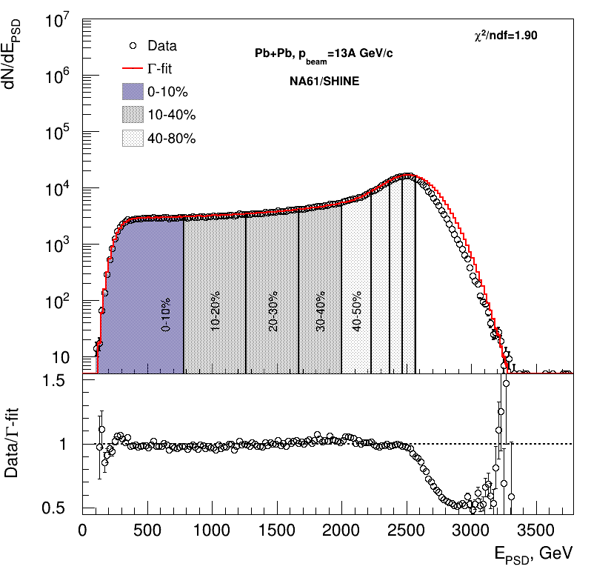
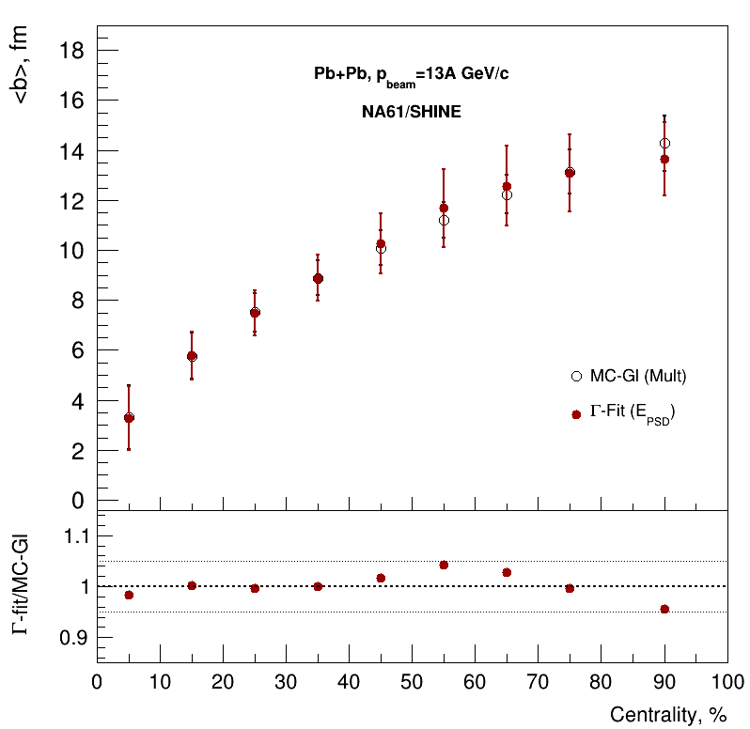
Comparison with MC-Glauber fit
For more details see D.Idrisov’s talk on Cross-PWG 19.09.2023
Good agreement between fit and data.
There is agreement within 5%.

Slide 26
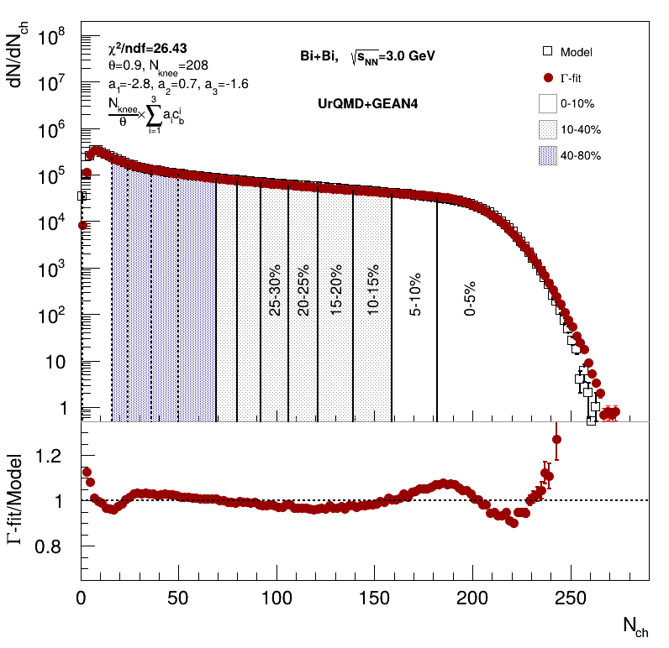
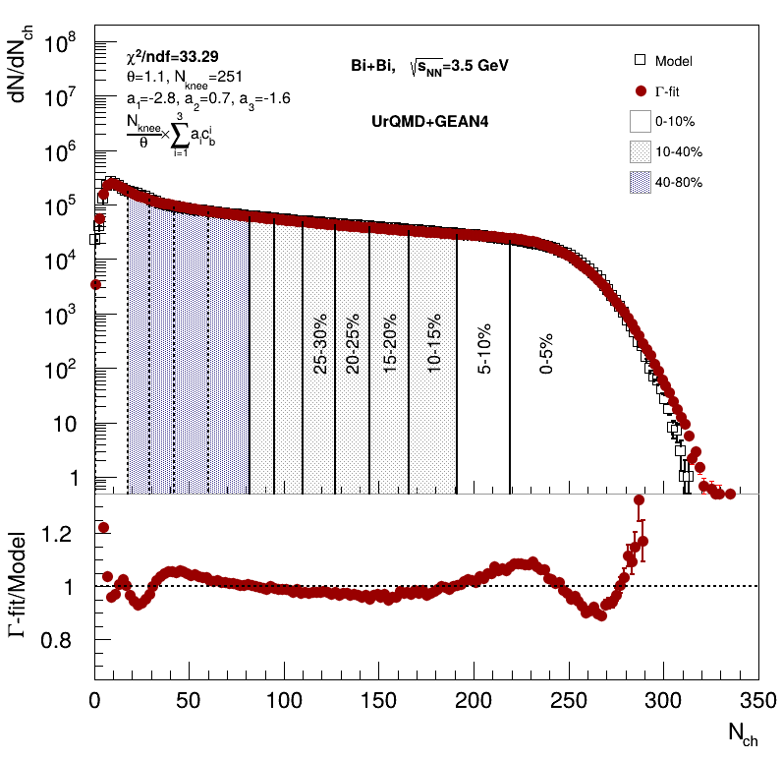
Centrality determination in Bi+Bi: multiplicity fit
Cuts on tracks:
Nhits>16
0 < η < 2
Multiplicity-based centrality determination using inverse Bayes was used in the flow studies
Good agreement between fit and data

Slide 27
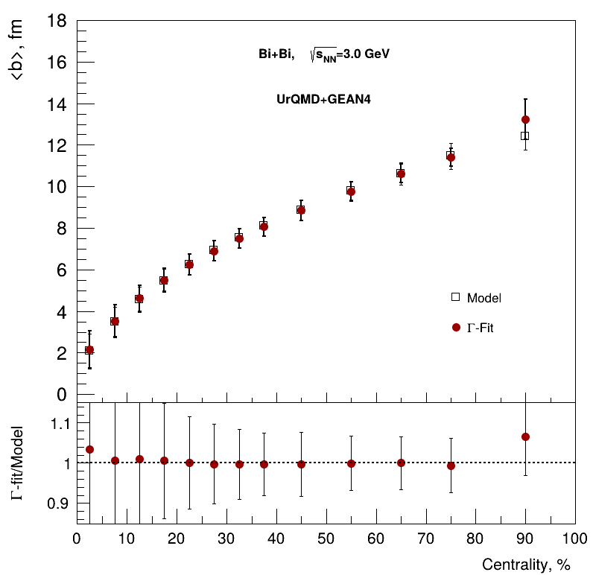
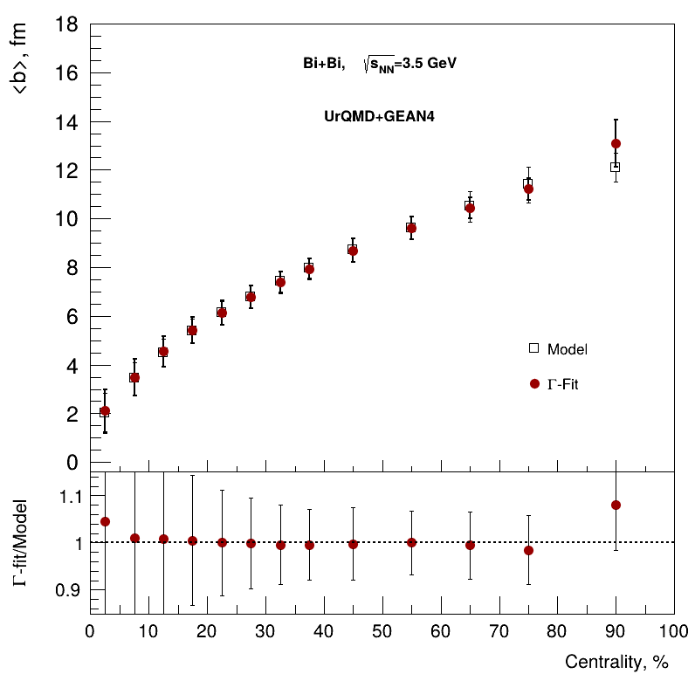
Centrality determination in Bi+Bi : <b> vs Centrality
Cuts on tracks:
Nhits>16
0 < η < 2
Multiplicity-based centrality determination using inverse Bayes was used in the flow studies
Good agreement between fit and data

Slide 28
Centrality determination in Xe+W: MC-Glauber approach
See D. Flusova and N. Bikmetov talk at CrossPWG 8.10.2024
Fit parameters:
$μ=0.62$, $f=0.8$, $k=53$, $χ^{2}=2.815±0.115$
Cuts: 0 < η < 2; Charge ≠ 0;
Overall reasonable agreement with model data
There is still no full agreement with data for most central collisions

Slide 29
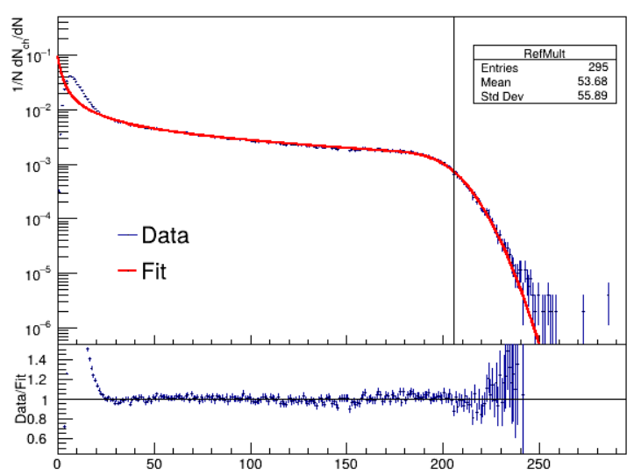
Centrality determination in Xe+W: 𝛤-fit approach
See D. Flusova and N. Bikmetov talk at CrossPWG 8.10.2024
Fit parameters:
$θ$ = 0.75; $N_{knee}$ = 205.38; $a_{1}$ = -3.33; $a_{2}$ = 0.08; $a_{3}$ = -2.80; $χ^{2}$= 1.16
Cuts: 0 < η < 2; Charge ≠ 0;
𝛤-fit provides better fit but worse <b> estimation than MC-Glauber approach
Inverse Bayes approach needs to be modified for asymmetrical collisions

Slide 30
Centrality determination in Xe+Xe: MC-Glauber approach
See D. Flusova and N. Bikmetov talk at CrossPWG 8.10.2024
Fit parameters:
$μ=0.73$, $f=0.9$, $k=60$,$χ^{2}=3.212±0.115$
Cuts: 0 < η < 2; Charge ≠ 0;
Overall good agreement with model data for both multiplicity fit and <b> estimation
Good agreement: further optimizations are in progress

Slide 31
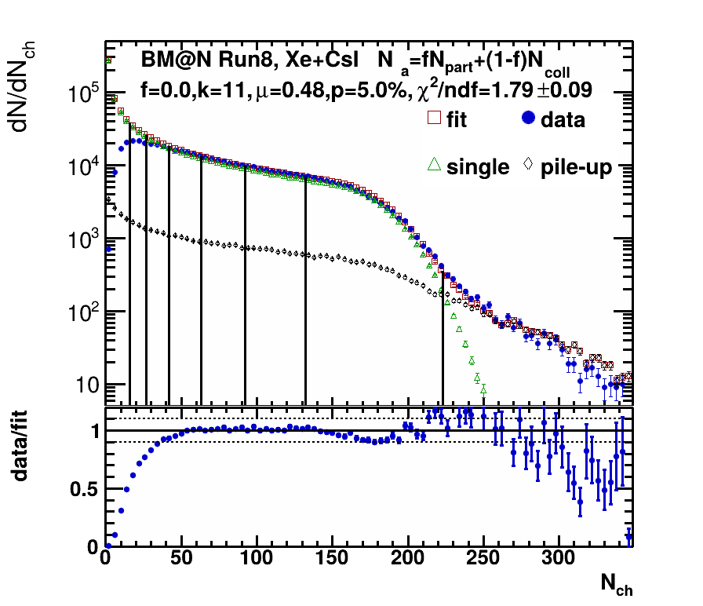
Main problem with centrality based on MC-Glauber at low energies
Fit suggests unphysical results
f=0 - means that hard processes are dominating
hard to fit pion multiplicity (or small systems)
Maybe our parametrization of multiplicity is not working at low energies?

Slide 32
Multiplicity in pp/nn/np collisions
Generally NBD is used to define multiplicity N_{ch} in such collisions:
Mean: μ
Variance: μ/k⋅(μ+k)
It works at high energies where μ>1, k>1.
However at lower energies we likely have situation where μ<1, k<1. NBD cannot be applicable in that case. We have to use generalized function - gamma distribution (GD):
Mean: μ
Variance: μ/k⋅(μ+k)

Slide 33
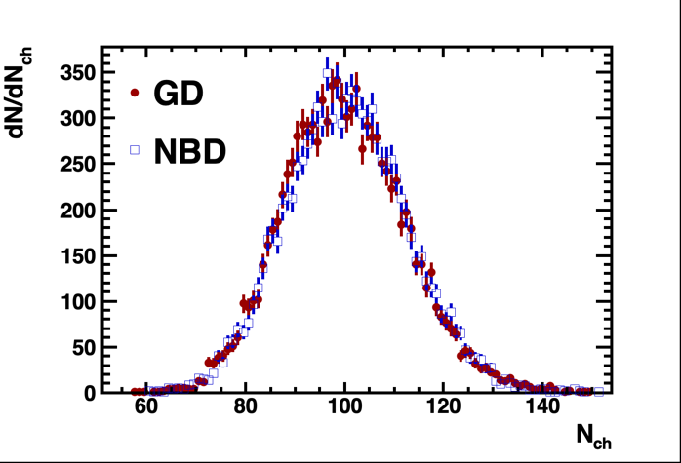
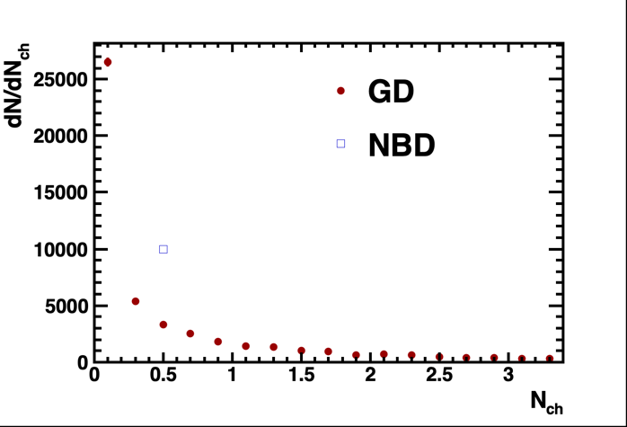
Multiplicity in pp/nn/np collisions
Case 1
μ=100, k=200
Case 1: k>1, μ~σ²=μ/k⋅(μ+k). The mean multiplicity is generally on the same level as its variation.
Case 2: k<1, μ<σ²=μ/k⋅(μ+k). The mean multiplicity might be smaller than its variation.
Case 1 can be defined with both NBD and GD.
Case 2 can be defined with GD only!
Case 2 can be more feasible at lower energies, where we have smaller multiplicities and relation between μ and σ² might vary greatly
What do we get if we implement it into our centrality procedure?
Case 2
μ=0.7, k=0.5

Slide 34
Multiplicity fit & centrality classes: h±
RunId: 8120-8170
Multiplicity Cuts:
CCT2
N_{vtxTr}>1
(Sts digi vs N_{tr}) cut
V_{r} <1 cm
V_{z} < 0.1 cm
Fit suggests f=0.6 - means that soft processes are dominating at E_{kin}=3.8A GeV
In agreement with Kharzeev-Nardi approach
Good agreement with experimental data
Phys.Lett. B507 (2001) 121-128

Slide 35
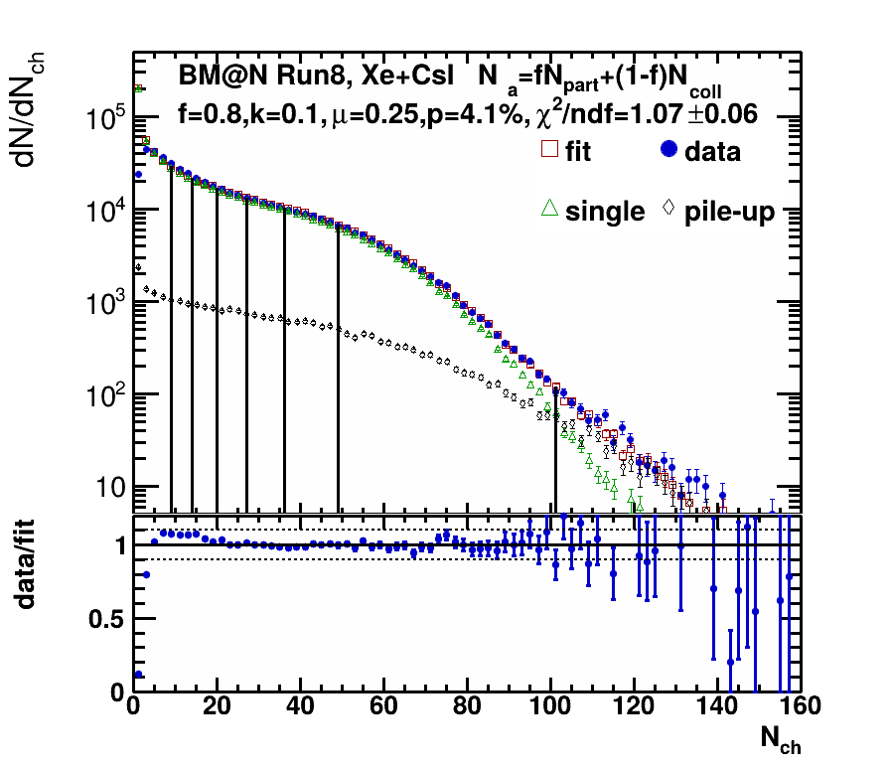
Multiplicity fit & centrality classes: h⁻
RunId: 8120-8170
Multiplicity Cuts:
CCT2
N_{vtxTr}>1
(Sts digi vs N_{tr}) cut
V_{r} <1 cm
V_{z} < 0.1 cm
Negative charge only
New parametrization (GB) can describe multiplicity of negatively charged tracks (mostly 𝜋⁻)
Good agreement with experimental data

Slide 36
MC Glauber model
MC Glauber model provides a description of the initial state of a heavy-ion collision
Independent straight line trajectories of the nucleons
A-A collision is treated as a sequence of independent binary NN collisions
Monte-Carlo sampling of nucleons position for individual collisions
Main model parameters
- Colliding nuclei
- Inelastic nucleon-nucleon cross section ( σ^{NN}_{inel} ) (depends on collision energy)
- Nuclear charge densities (Wood-Saxon distribution)
Geometry parameters
b – impact parameter
N_{part} – number of nucleons participating in the collision
N_{spec} – number of spectator nucleons in the collision
N_{coll} – number of binary NN collisions
Glauber Modeling in High Energy Nuclear Collisions: ARNPS57:205-243,2007

Slide 37
Model dependence of b, N_{part}
Eur. Phys. J. C 83, 792 (2023)
Use MC Glauber for centrality determination
The MC Glauber non-realistic N_{part} simulations at low energies
Differences in of number of participant nucleons (N_{part}) distributions from UrQMD and MC
The impact parameter (b) - model independent centrality estimator
Notes:
Среднее и стандартное отклонение импакт-параметра в зависимости от класса центральности.
Пунктирная зеленая кривая (Глаубер, Ur-b) изображает <b> и <s>, взятые из UrQMD для ячеек Nch-центральности, определенных из распределения Глаубера.
Среднее и стандартное отклонение числа участников в зависимости от класса центральности.
Сплошная черная кривая на верхней панели показывает прицельные параметры для различных центральностей, заданные упрощенной аппроксимацией ядер черным диском.
Прицельный параметр b и количество заряженных частиц с другой стороны, они гораздо более коррелированы и дают почти независимую от модели оценку центральности

