Slide 2
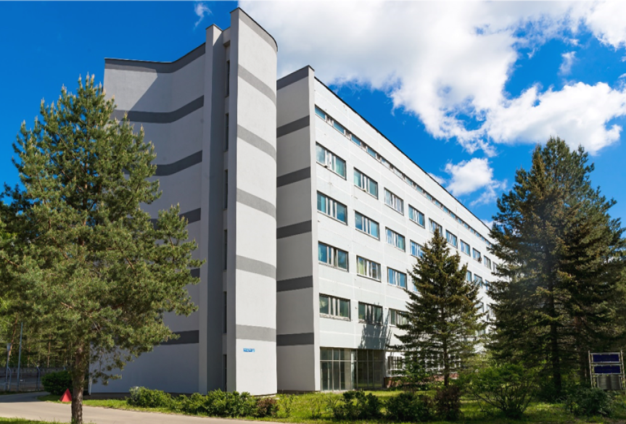
MLIT resources and services for the MPD experiment
MPD 14th collaboration meeting
Igor Pelevanyuk
Mescheryakov Laboratory of Information Technologies

Slide 3
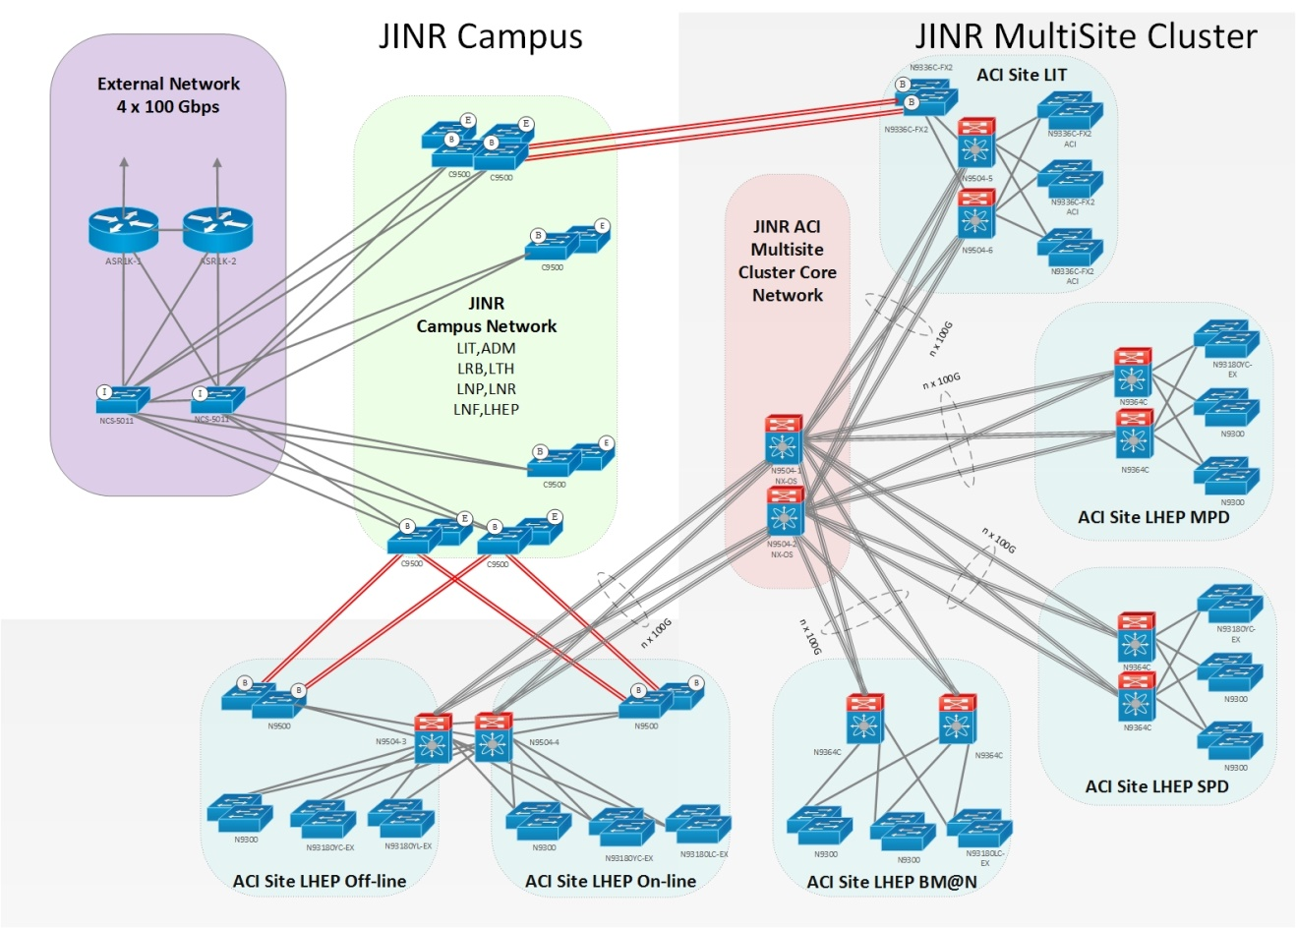
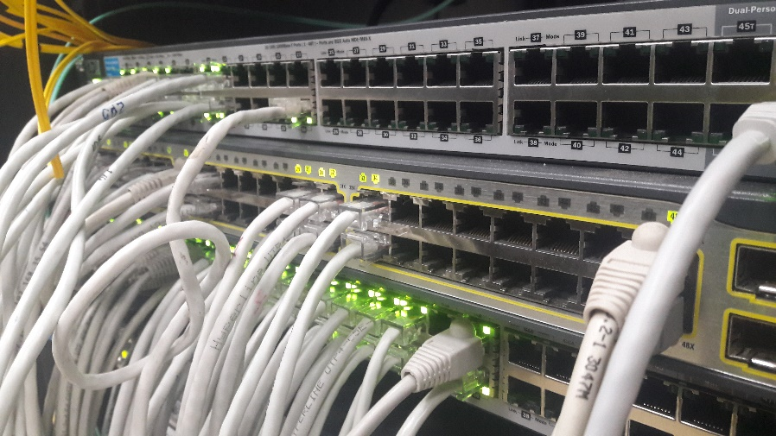
Network in JINR
JINR-Moscow 3x100 Gbit/s
JINR-CERN - 100 Gbit/s and JINR-Amsterdam 100 Gbit/s for LHCOPN, LHCONE, GEANT networks
Direct channels up to 100 Gbit/s for communication using RU-VRF technology with the collaboration of RUHEP research centers and with Runnet, ReTN networks
The multi-site cluster network with a bandwidth 4x100 Gbit/s between VBLHEP and MLIT
The JINR LAN comprises:
9291 network elements
18044 IP-addresses
6355 users registered within the network
4477 *.jinr.ru service users
1455 digital library users
837 remote VPN
111 EDUROAM users

Slide 4
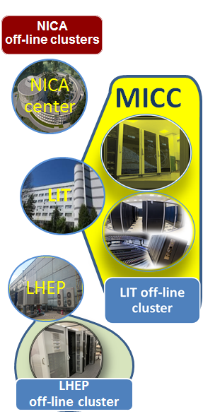
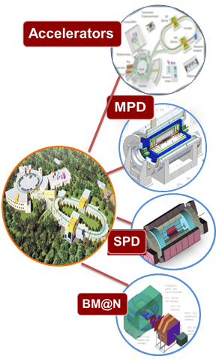
NICA network
Worldwide NICA Collaboration
400 Gbps
400 Gbps
400 Gbps
400 Gbps
400 Gbps
400 Gbps
400 Gbps
Lattice QCD calculations
Simulation of nuclear reactions
Event reconstruction
Physics analysis

Slide 5
Multifunctional Information and Computing Complex
4 advanced software and hardware components:
Tier1 grid site
Tier2 grid site
Govorun supercomputer
Cloud infrastructure
Distributed multi-layer data storage system
Disks
Robotized tape library
Engineering infrastructure
Power
Cooling
Network
Wide Area Network
Local Area Network
We ensure multifunctionality, scalability, high performance, reliability and availability in 24x7x365 mode for different user groups that carry out scientific studies within the JINR Topical Plan

Slide 6
MICC storage systems
Disks
43 PB
Tapes
100 PB
Disks are the main storage that allows processing of experimental and Monte-Carlo data
Tapes are primarily used for data backups
Enstore
EOS storage is used by all experiments on NICA collider. dCache is used by CMS experiment.
Enstore is the original system that may work with dCache to provide access to tapes. CTA is a CERN archival solution, it is rather new system which was adopted by many experiments.
MPD statistics on MLIT EOS:
Physical space occupied – 2.04 PB
Physical space free – 0.36 PB
MPD space on EOS may be expanded (to some extent) by request.
CTA is proposed to be used as an archival storage for MPD. That is ongoing work by MPD members from MLIT.

Slide 7
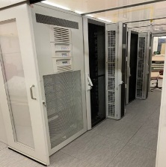
DIRAC in JINR
LHEP resources
MLIT MICC basic facility
DDC cluster
NICA cluster
MLIT EOS
DAQ computing
farm
MLIT CTA
Other/Collaboration resources
JINR Cloud
Tier-1
Tier-2
Govorun
UNAM
MEPHI
Lustre
Ultra-fast storage
Clouds
INP
MSC
Polytech
IMDT
NOSU
ASRT
IPANAS
PRUE
INP
SU
INRNE
INP

Slide 8
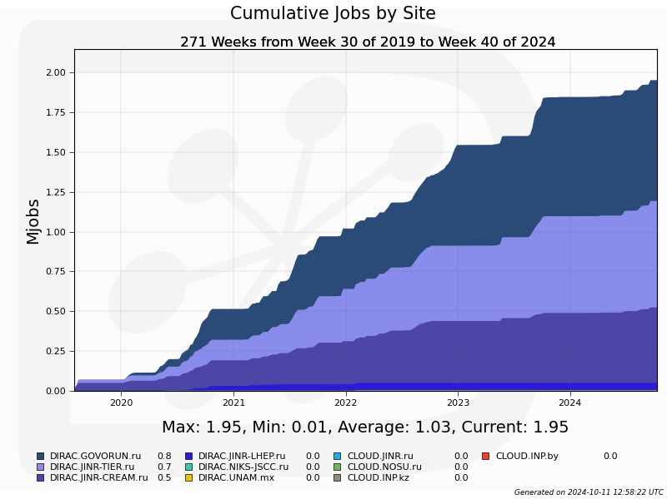
Successful MPD Jobs executed
1.95 M
jobs completed

Slide 9
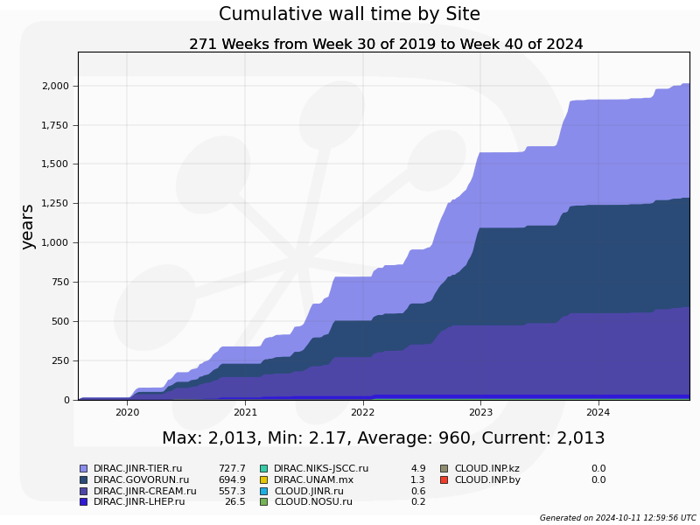
Successful MPD Jobs walltime
2013
total computation time (years)

Slide 10
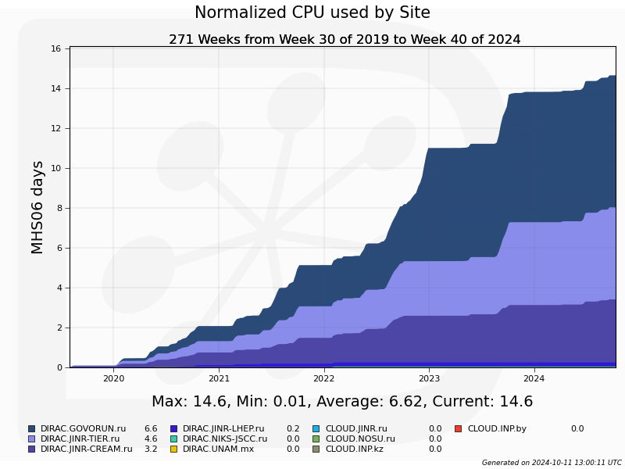
Successful MPD Jobs normalized time
40k
HEPSpec06 Years

Slide 11
MPD in numbers
36
data generation campaigns
1.412 B
events generated
568
events reconstructed
1.95 M
jobs completed
2013
total computation time(years)
1.6 PB
MPD data produced
10
data analysis campaigns
500 M
events analyzed

Slide 12
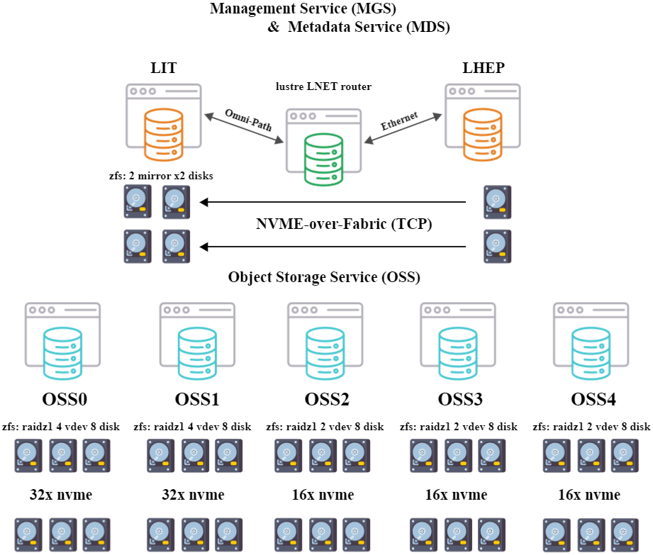
Distributed Lustre Govorun/NCX
The task is to simplify data transfers between Govorun supercomputer and NCX cluster
Distributed Lustre file system consists from two parts. One on NCX cluster and one on Govorun supercomputer.
Tests done with DIRAC demonstrated good performance of distributed Lustre file system which was similar to local HDD performance.

Slide 13
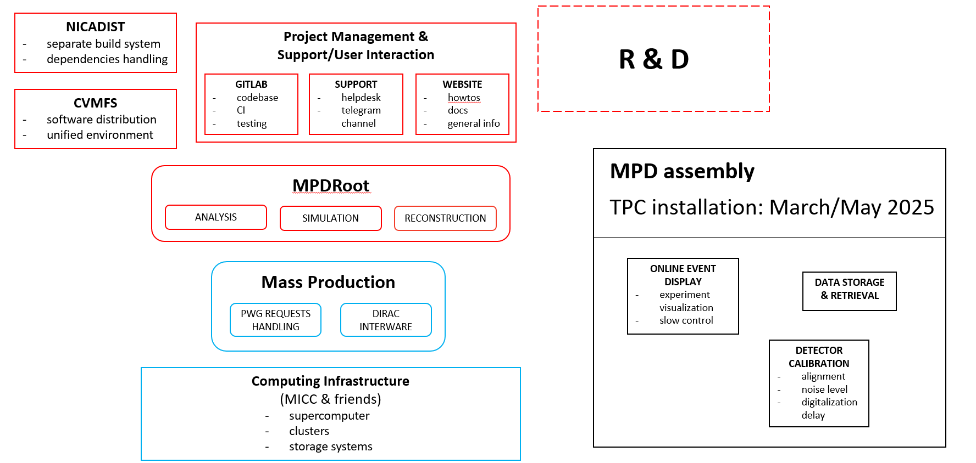
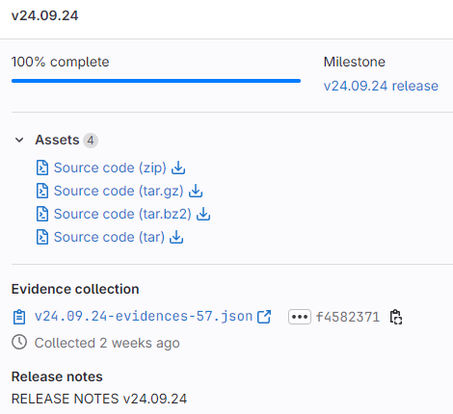
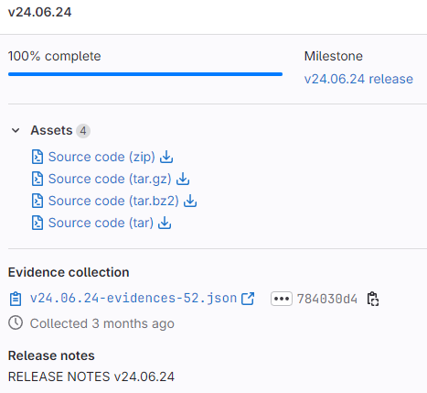
MPDRoot Developments
MLIT is responsible for applying modern development and integration techniques for mpdroot software. New releases are published regularly.
Automatic tests and deployment is done using GitLab and CVMFS.
New features
Analysis updates (physicists)
LUSI detector
Global QA histograms
ACTS vertexing
ACTS v36 port
git.jinr.ru/nica/mpdroot/-/releases
Latest dependencies
ROOT ……… 6.32.06
GCC ………….13.2.0
Boost ……….1.83.0
FairRoot .… 18.6.10
GEANT4 .… 11.2.1
Python …... 3.12.4
GSL ………….2.8
Fedora 40, Ubuntu 24.04 LTS
More detailed info will be presented today by Slavomir Hnatic:
https://indico.jinr.ru/event/4806/contributions/27982/

Slide 14
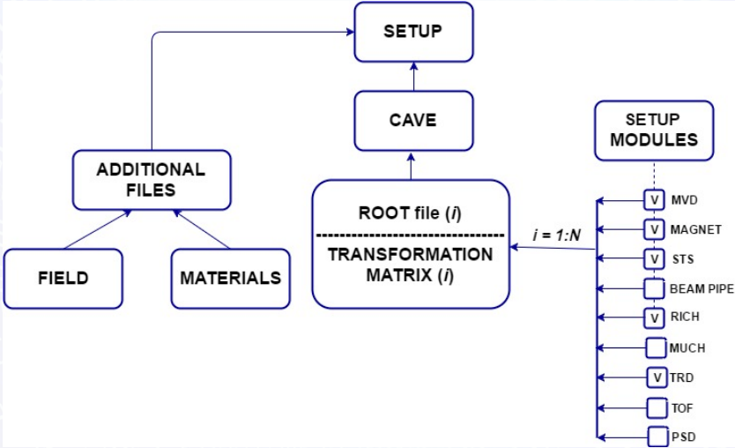
MPD databases
There are two databases that are in development now and crucial for successful MPD operations: Geometry DB and Conditions DB.
Team in MLIT develops their structure and study a way to improve performance of these databases.
The prototype of the Condition database, at the request of users, was created in 2023. For this purpose, the state database created for BM@N was used. It was adapted for the MPD experiment. At the moment, it is being transferred from the HybriLIT to a special machine.

Slide 15
Central Database Service
What we have now
The need to host and support a number of databases leads to the need for some sort of Central Database Service.
An establishing meeting was organized with representatives from MPD experiment to discuss requirements and usage models of this service.
GeometryDB
PostgreSQL 17
CentOS 7
Members List
PostgreSQL 16
Ubuntu 22.04
WebSiteDB
Mysql 7
AlmaLinux
ConditionsDB
MariaDB 10
AlmaLinux
Where we go
This approach should:
Free developers from administration
Simplify OS and DB updates
Automate backup procedures
Improve security
Boost DB performance
GeometryDB
WebSiteDB
Member List
ConditionsDB
AlmaLinux 9.4
PostgreSQL 17
MariaDB 10
In development

Slide 16
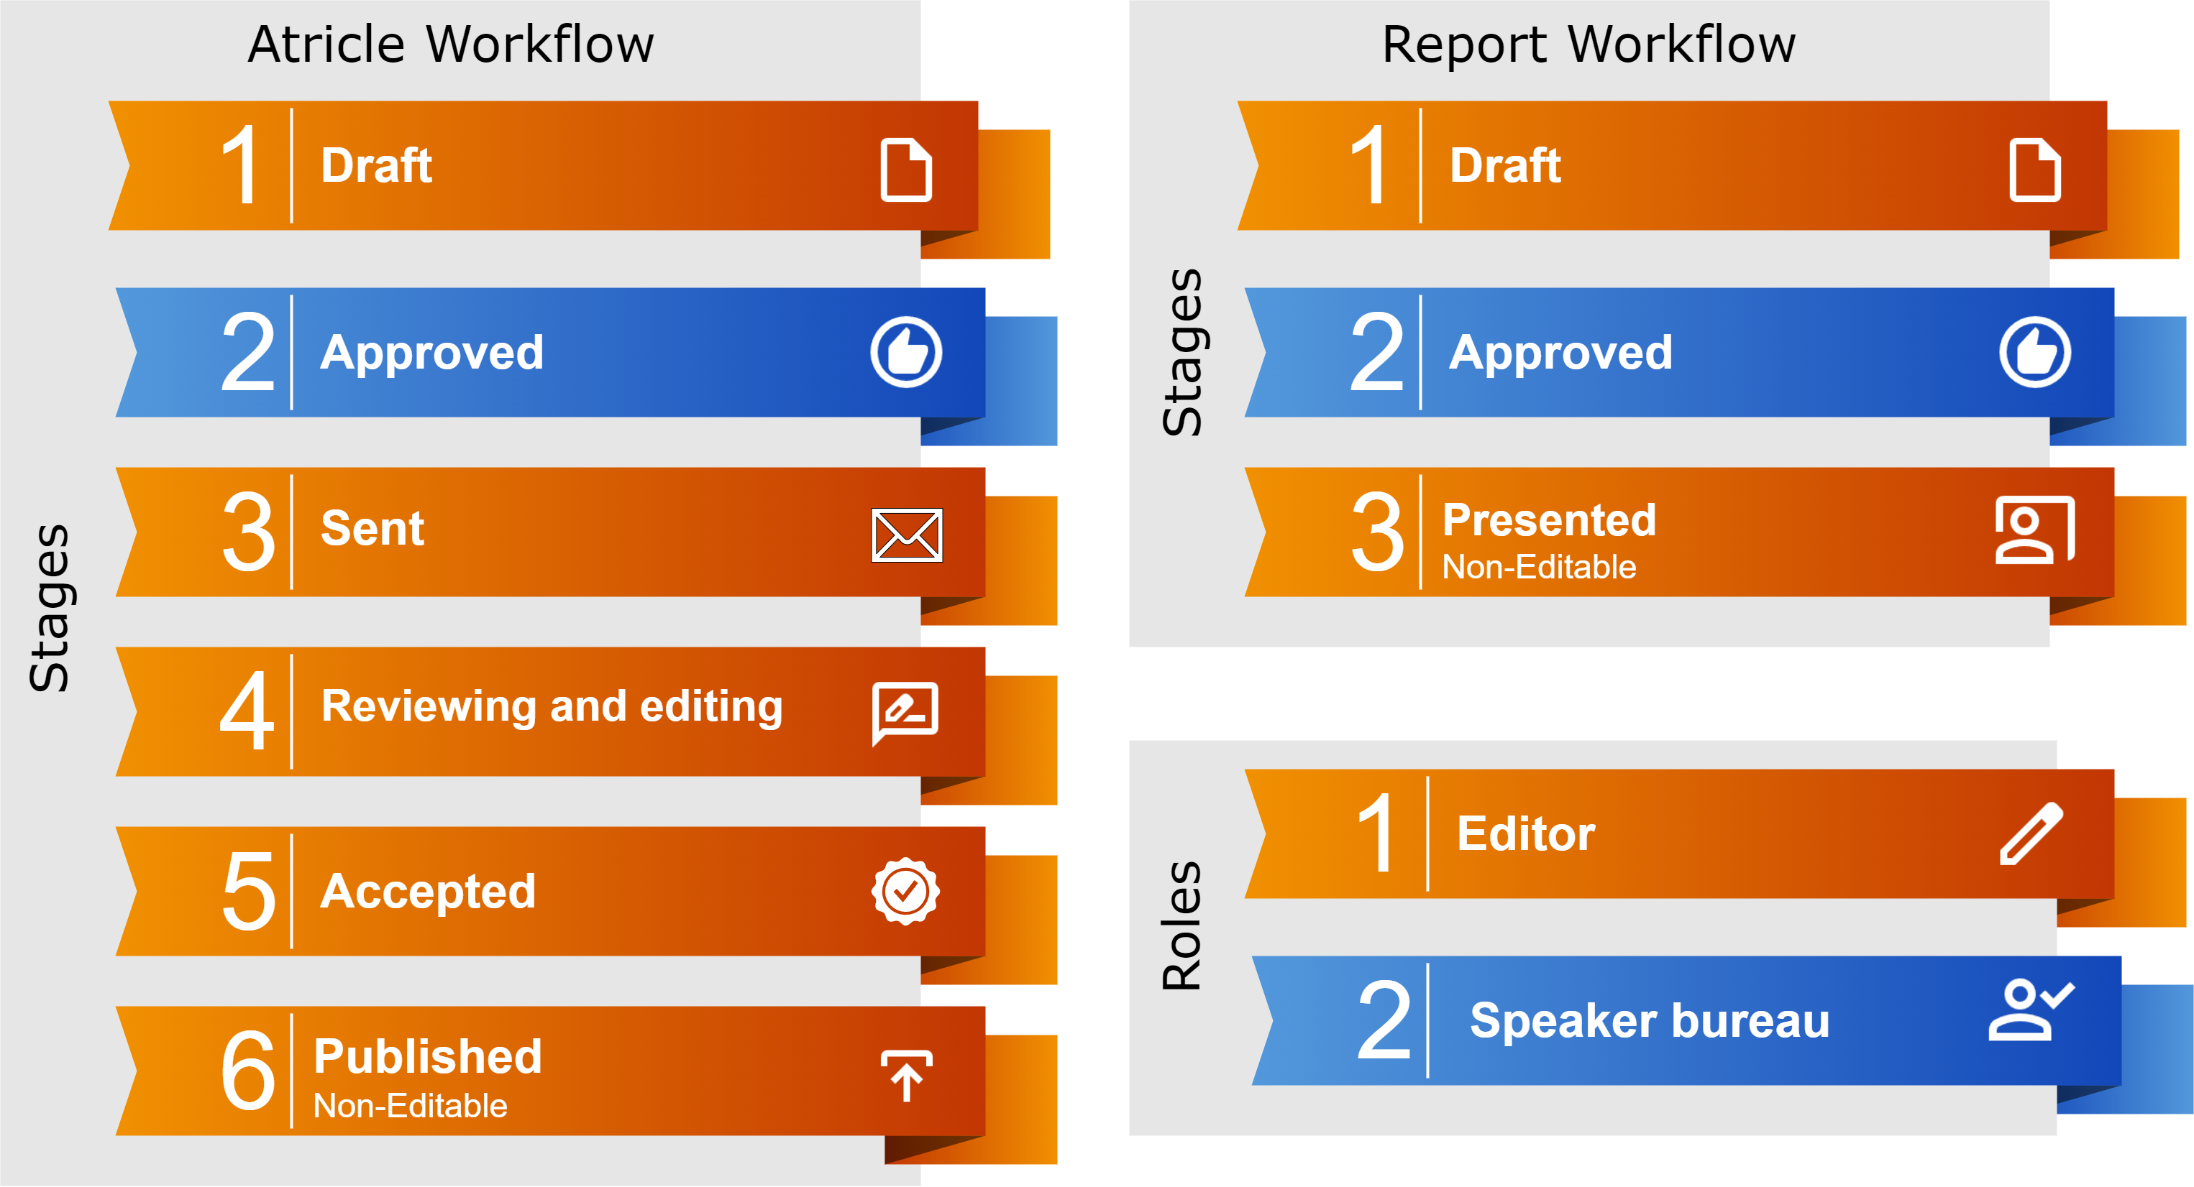
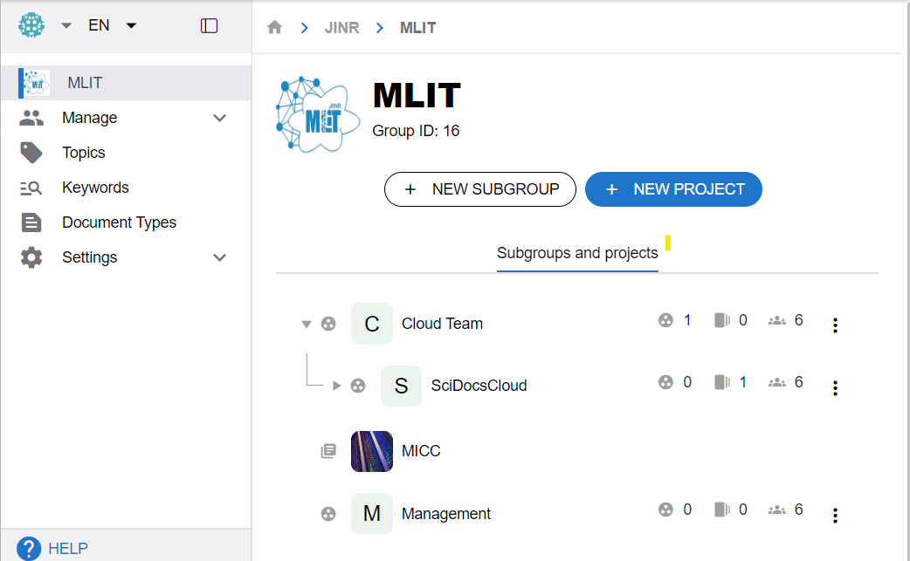
Storage Service for Scientific Documentation
Scientific groups collaborate on various types of documents:
Articles
Abstracts
Presentations
Reports, etc
Common challenges of collaborative work:
Organizing safe and structure documents storage
Tracking changes to documents
Restricting access to documents
Sharing of documents
The service is available for use: https://docs.jinr.ru
In development
Event
Calendar
Document
Visibility
Levels
Subscribe/
notification
system
Data
Migrations
Workflows

Slide 17
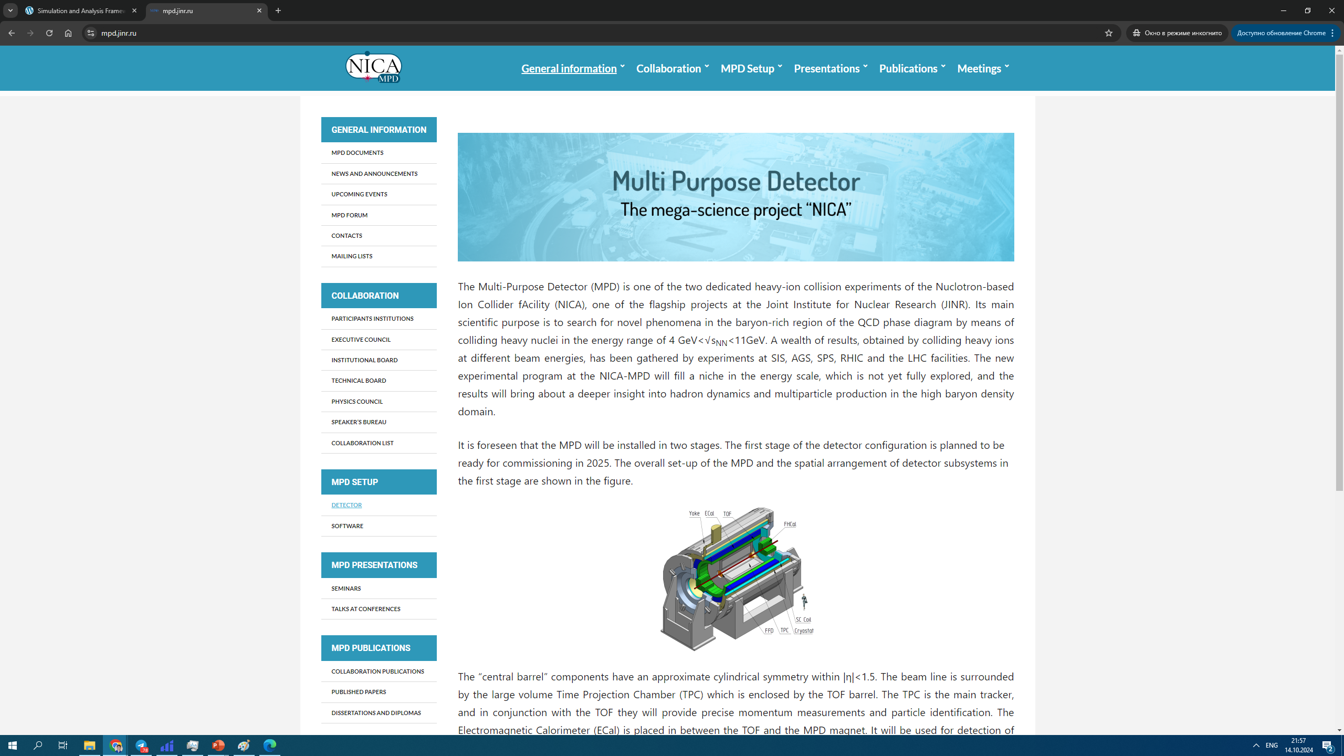
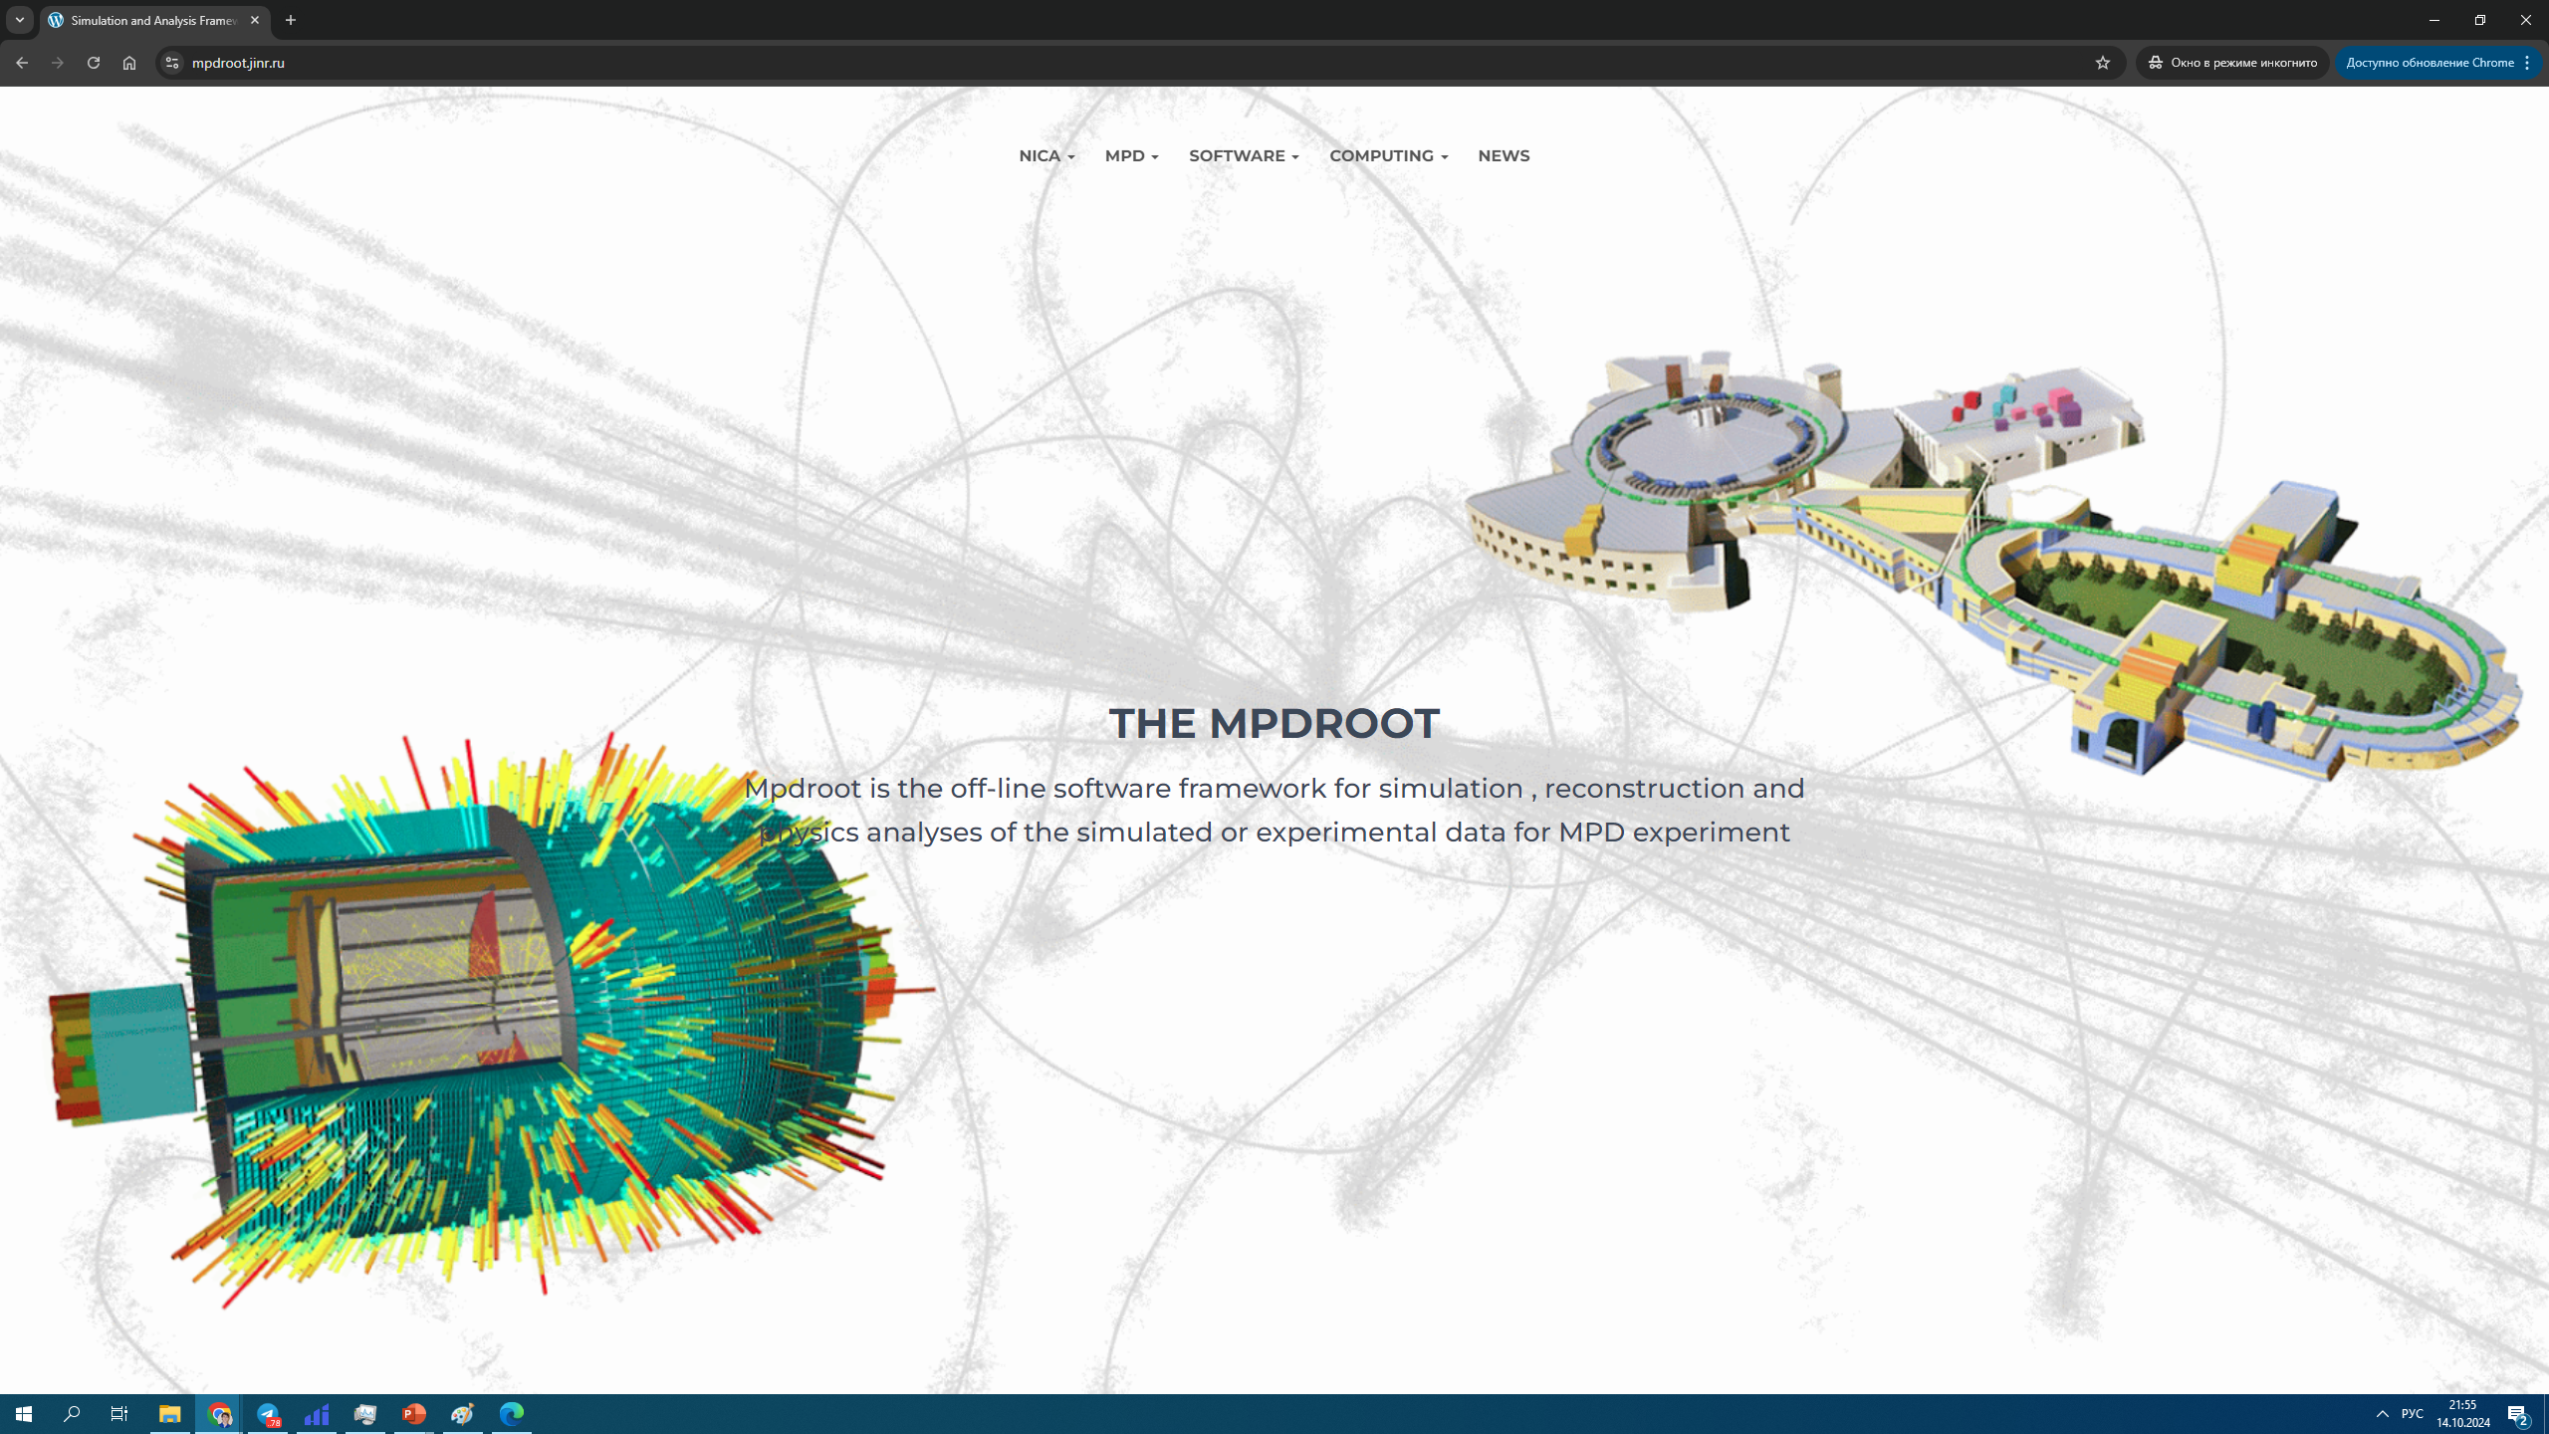
MPD collaboration websites
MLIT is hosting some of the MPD Collaboration websites. Some participants from MLIT were taking participation is websites developments.
https://mpd.jinr.ru/
MPD collaboration website
https://mpdroot.jinr.ru/
MPD root website

Slide 18
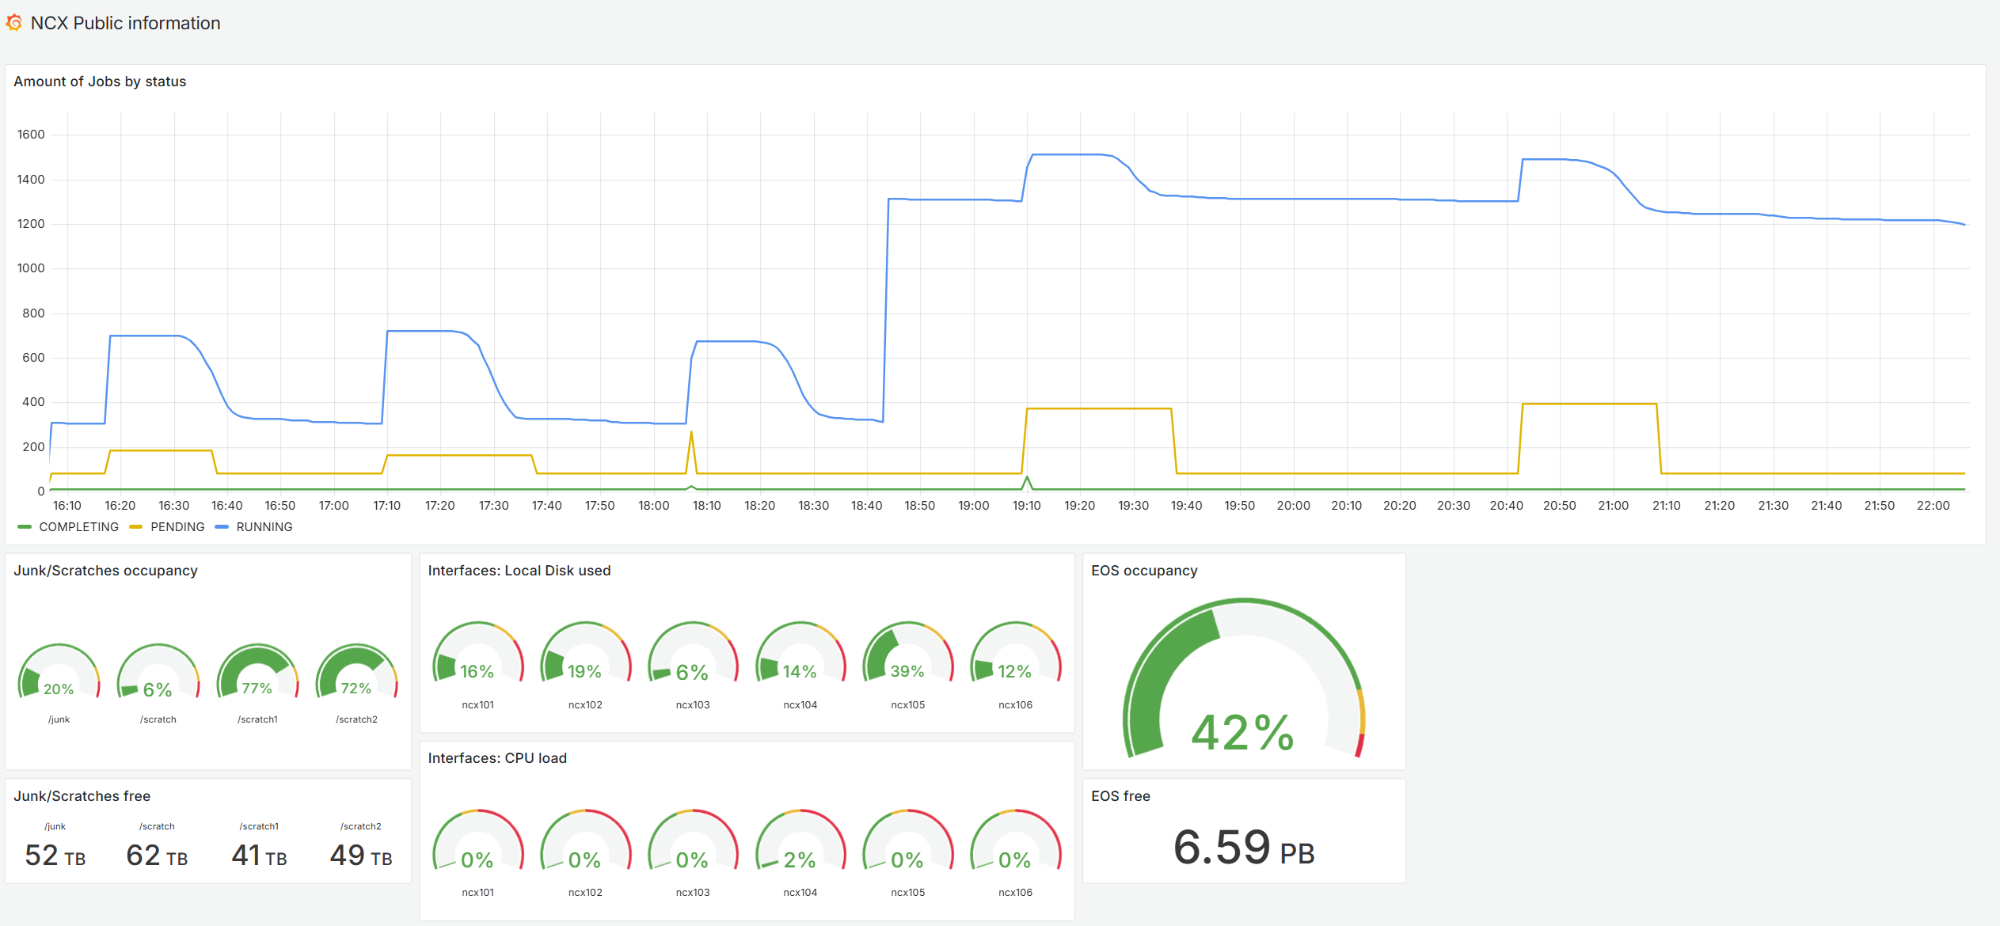
Works related to NCX cluster
MLIT team was working in collaboration with NCX team to perform migration from SGE to Slurm which is a modern cluster workload management system.
Together with Ivan Slepov a monitoring system with public access was developed and presented to users of NCX cluster.
It allows users to be aware of current load on the NCX cluster and reminds them about local storage occupation.

Slide 19
MLIT in MPD IT infrastructure
Participants from MLIT
Aleksandr Kokorev
Anastasia Anikina
Andrey Dolbilov
Balashov Nikita
Dmirty Belyakov
Dmitry Podgainy
Evgeny Aleksandrov
Igor Aleksandrov
Igor Pelevanyuk
Irina Filozova
Jan Busha Jr.
Maria Lubimova
Maxim Zuev
Natalia Gromova
Oksana Streltsova
Sergei Shmatov
Slavomir Hnatic
Tatyana Strizh
Valeriy Mitsin
Vladimir Korenkov
Vladimir Trofimov
Vladimir Uzhinsky
Govorun
Supercomputer
Mescheryakov Laboratory of Information Technologies take active participation in MPD collaboration wide range of works related to both development and support of IT services and providing computing, storage and network resources.
Network
Websites
Databases

Slide 20
Conclusion
MLIT provides a wide range of IT different services and resources:
GitLab, CVMFS, Slurm, DIRAC
Govorun, Tier1, Tier2, EOS, CTA
Network, hosting, security
MLIT also directly participates in MPD collaboration activity:
Develop new services and setting up new systems.
Participate in development of applied software.
Develop new approaches to solve appearing problems.
Govorun
Supercomputer
Thank you for attention
Network
Websites
Databases

