Slide 1


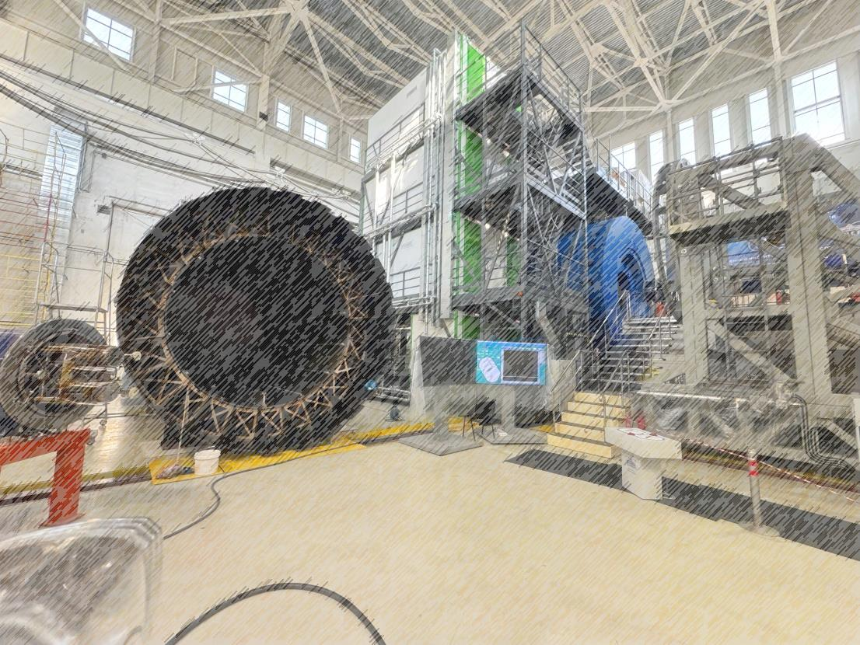
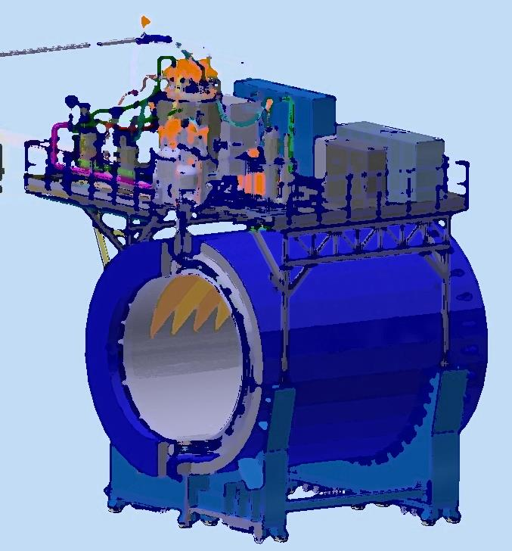
Status of the solenoid assembling
NICA Days and XIV Collaboration Meeting of the MPD Experiment at NICA
14-16/10/2024
From drawing
to facility
Speaker: K. Mukhin
JINR, LHEP 2024

Slide 2
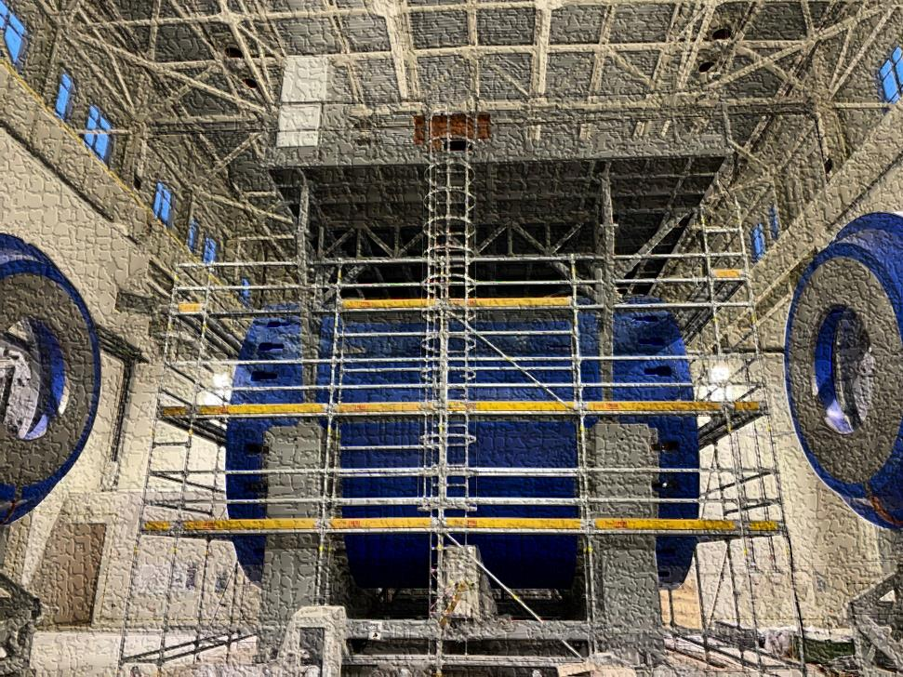
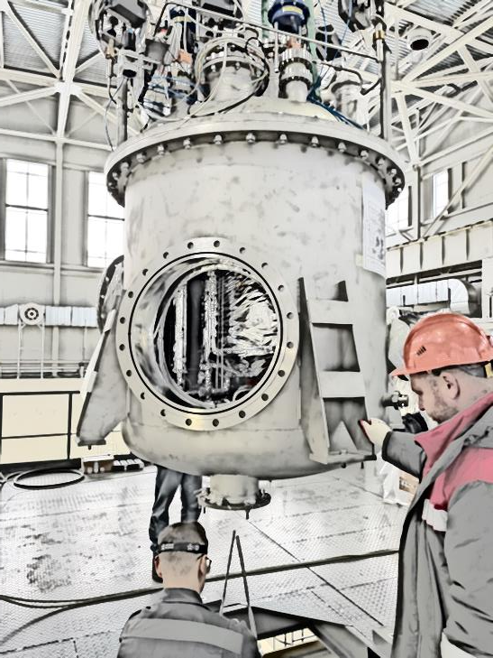
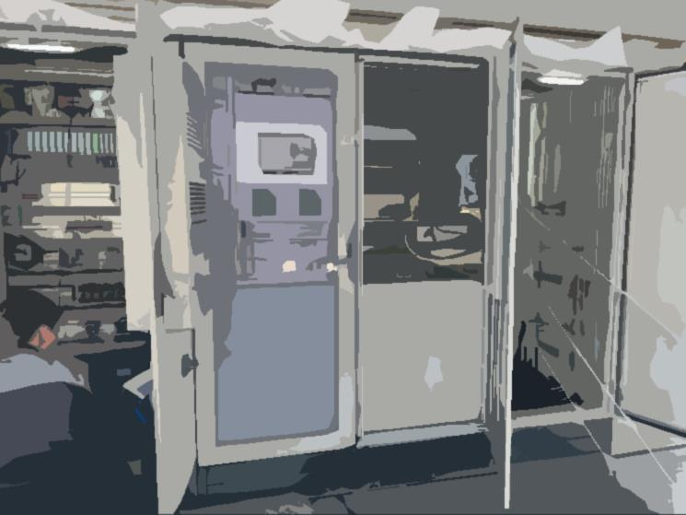
Plan of talk
Magnet construction and some parameters
Cryogenic infrastructure
- The first cooling by 72K and next steps
Engineering systems of the detector MPD
- Power supply system
- Water cooling system
- Control and protection systems
Timeline

Slide 3
Chapter 1
Magnet construction and parameters

Slide 4
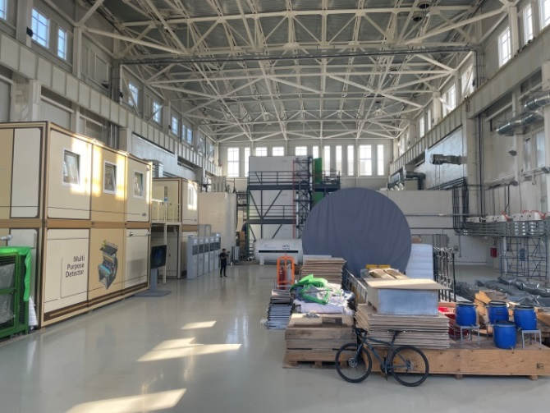
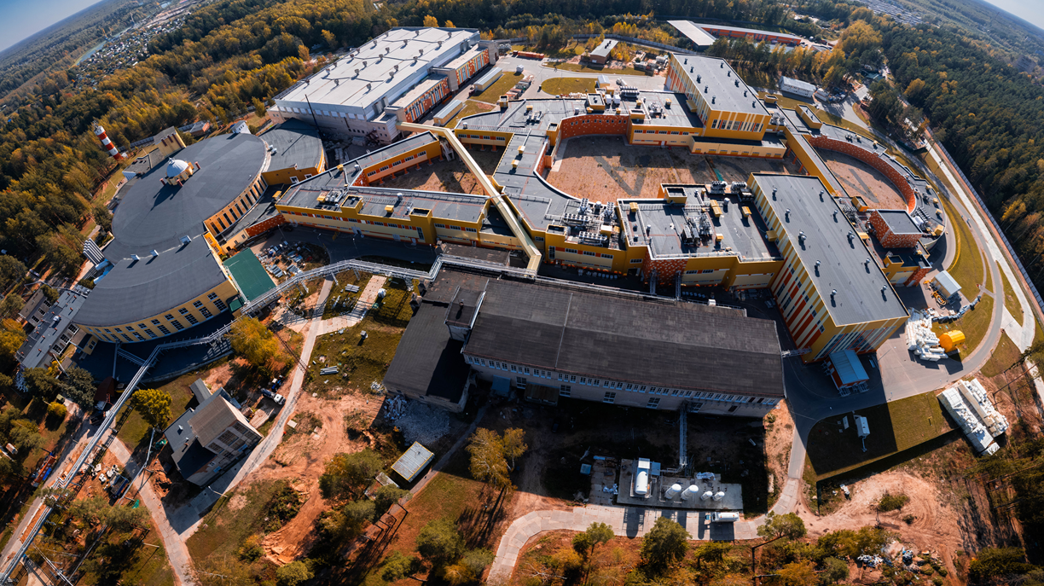
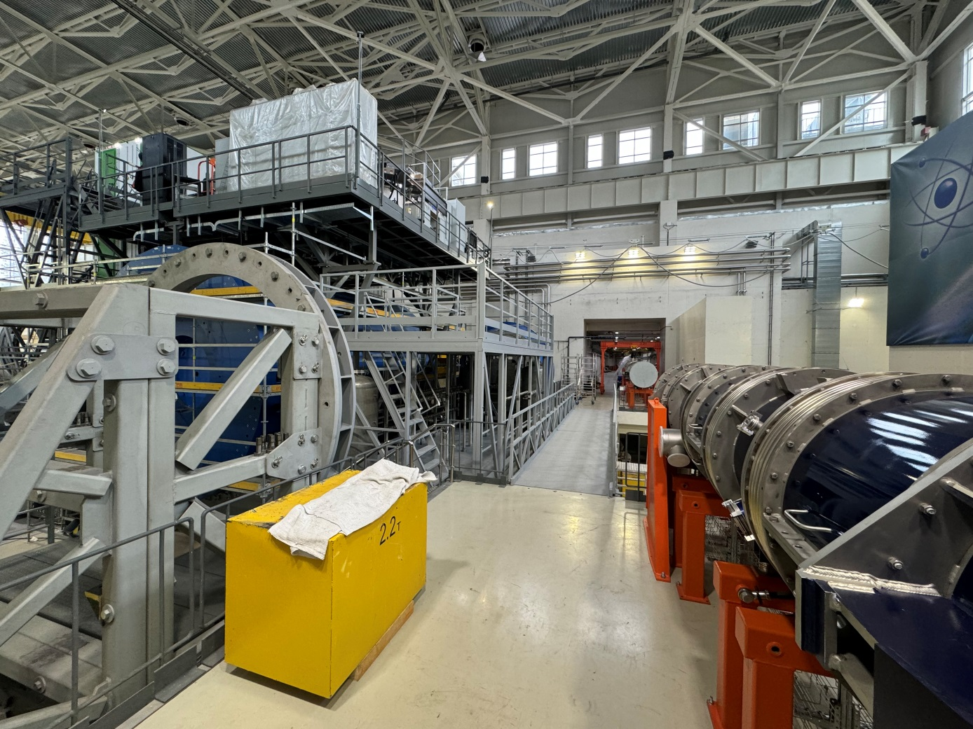
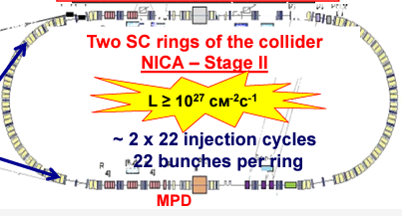
MPD in NICA complex
BM@N
SPD
Booster
Nuclotron
N I C A
MPD

Slide 5
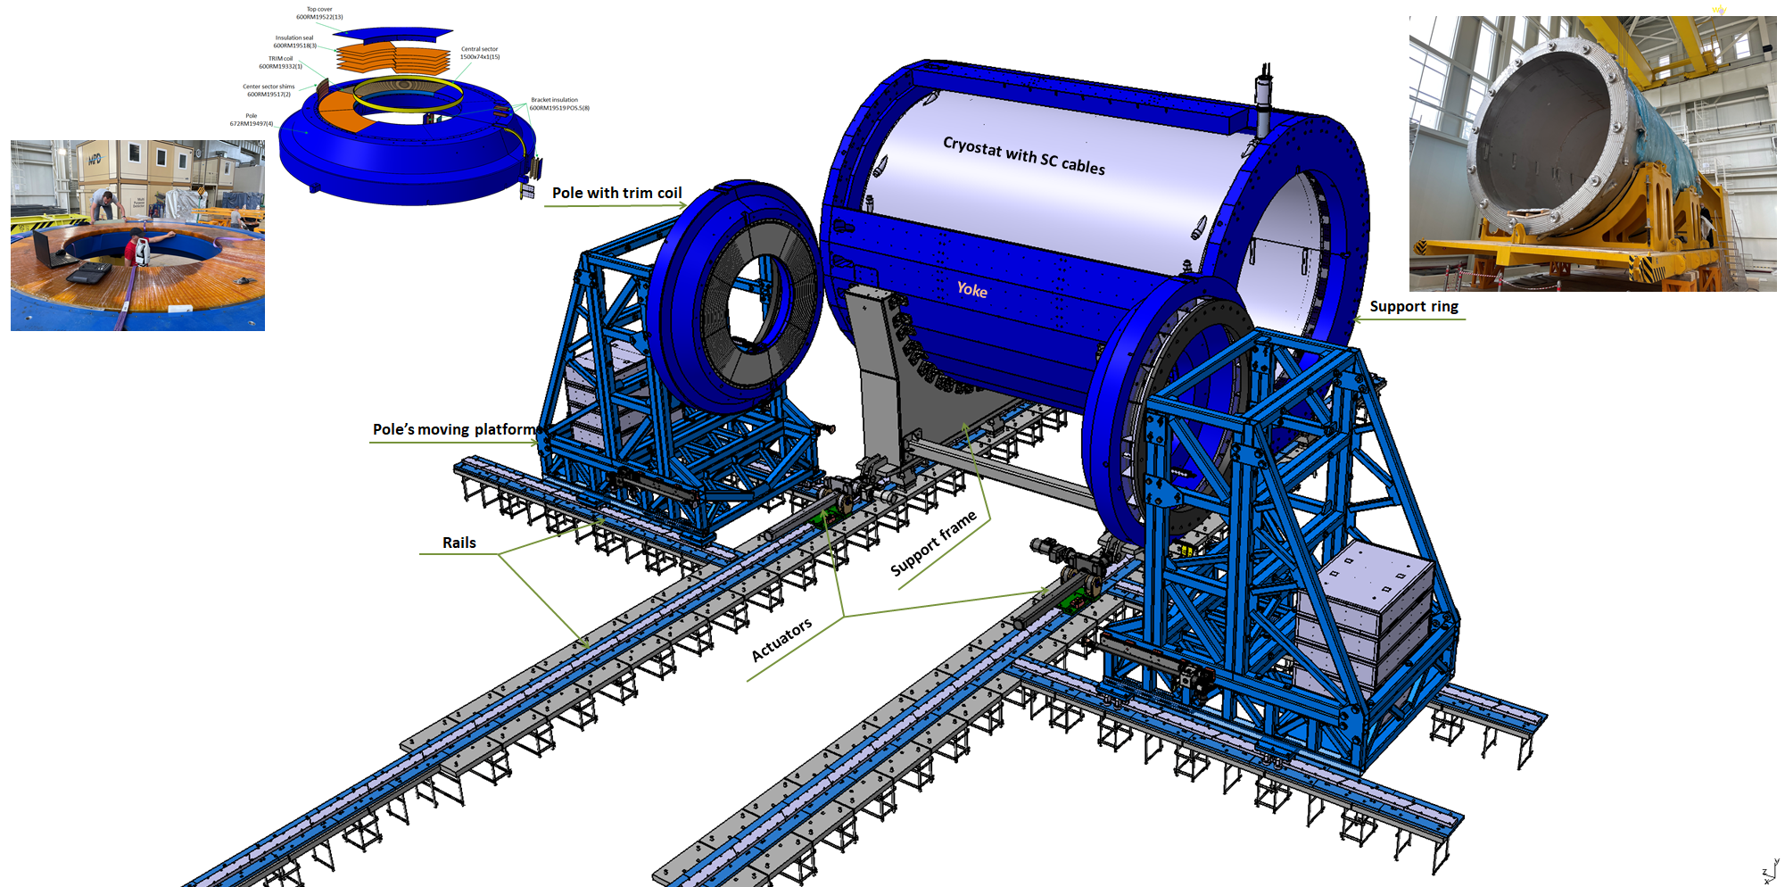
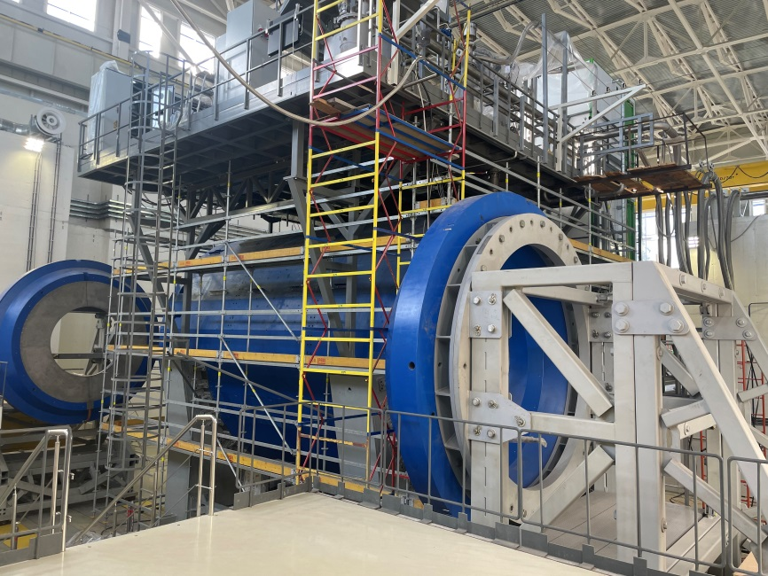
MPD magnet construction
Parameters of the magnet
Magnetic field | 0,57 T
Cryostat weight and size (diameter/length) mm | 66 tons 5443/7910
Yoke weight and size (diameter/length) mm | 630 tons 6583/8970
Current Voltage | 1790 A 10V
Each pole weight | 45 tons
Total weight with support equipment | 800 tons

Slide 6
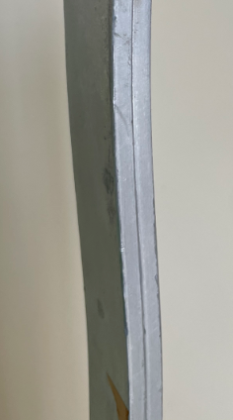
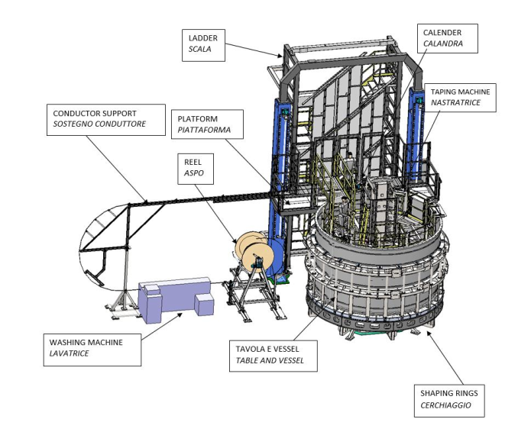
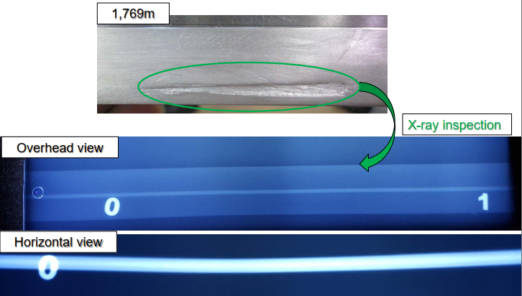
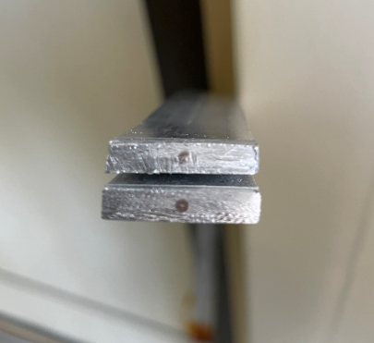
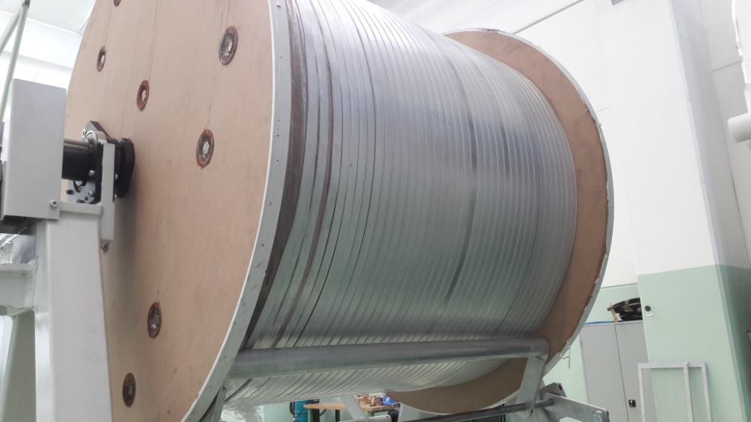
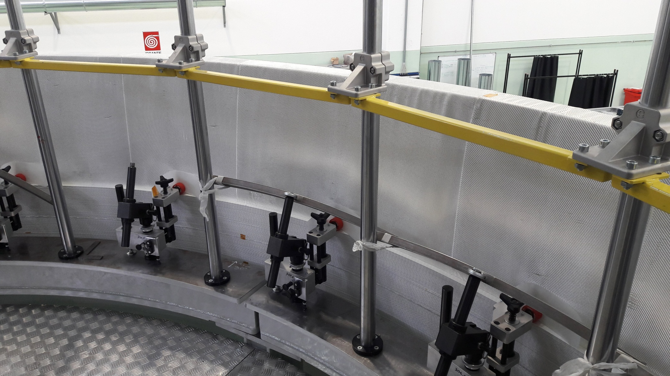
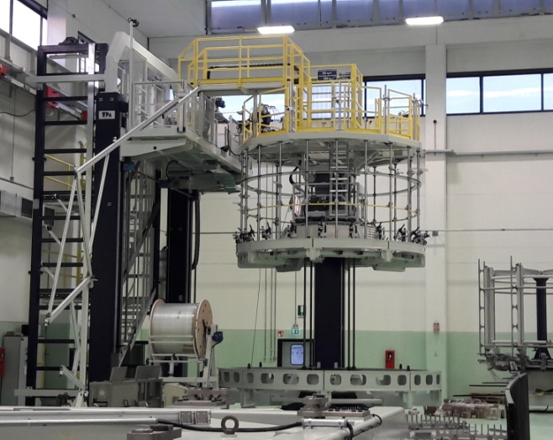
Superconductor cable
Original SC cables for MPD
Winding and tests of SC cable in ASG
SC cables parameters
SC Materials – NbTi/Cu.
Cable composition is pure aluminum matrix (4,1 x 20 mm) and inside string of Cu/SC ratio 0,9/1 (d – 1,5 mm).
Insulation – kapton tape, glass tape and epoxy resin.
Critical current (1,2 T, 4,5 K) – 6,9 kA
Cable length - 27 km.
Cable weight – 6,3 tons

Slide 7
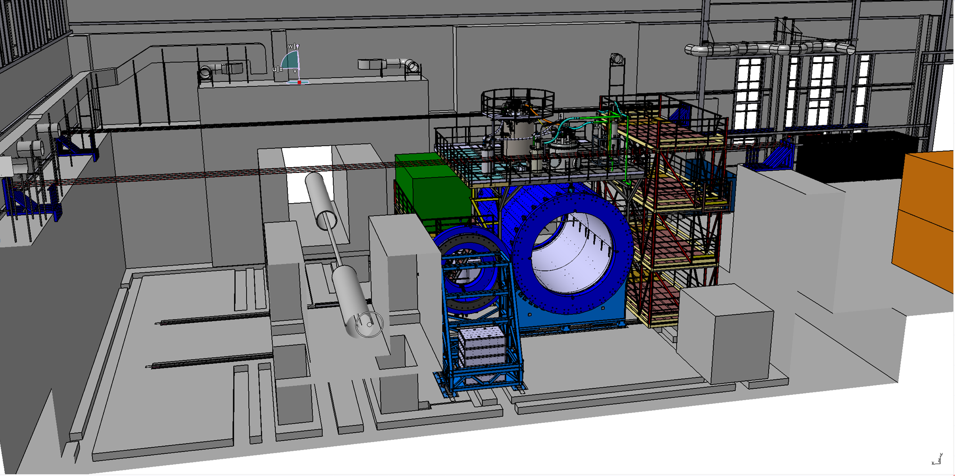
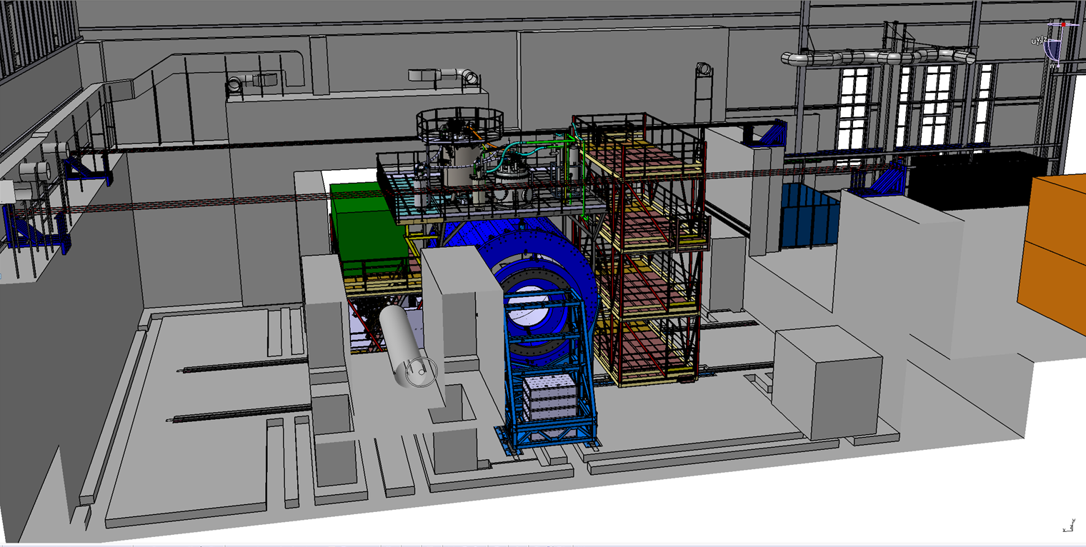
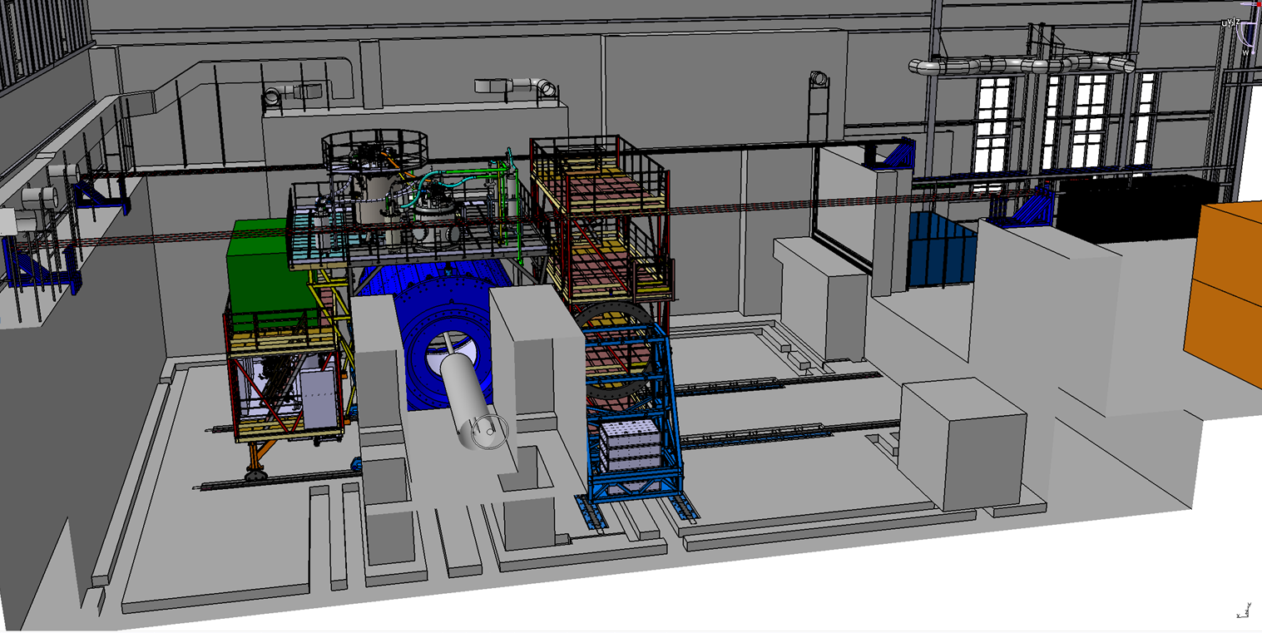
Possibility of magnet moving
Three main position
Assembling position
Trim coils installation position
Beam position
Distance – 12 m
Moving time about 5 hours
Speed 2 – 3 mm/s (for the final step 0,4-0,5 mm/s)

Slide 8
Chapter 2
Cryogenic infrastructure.
The first cooling by 72K and next steps.

Slide 9
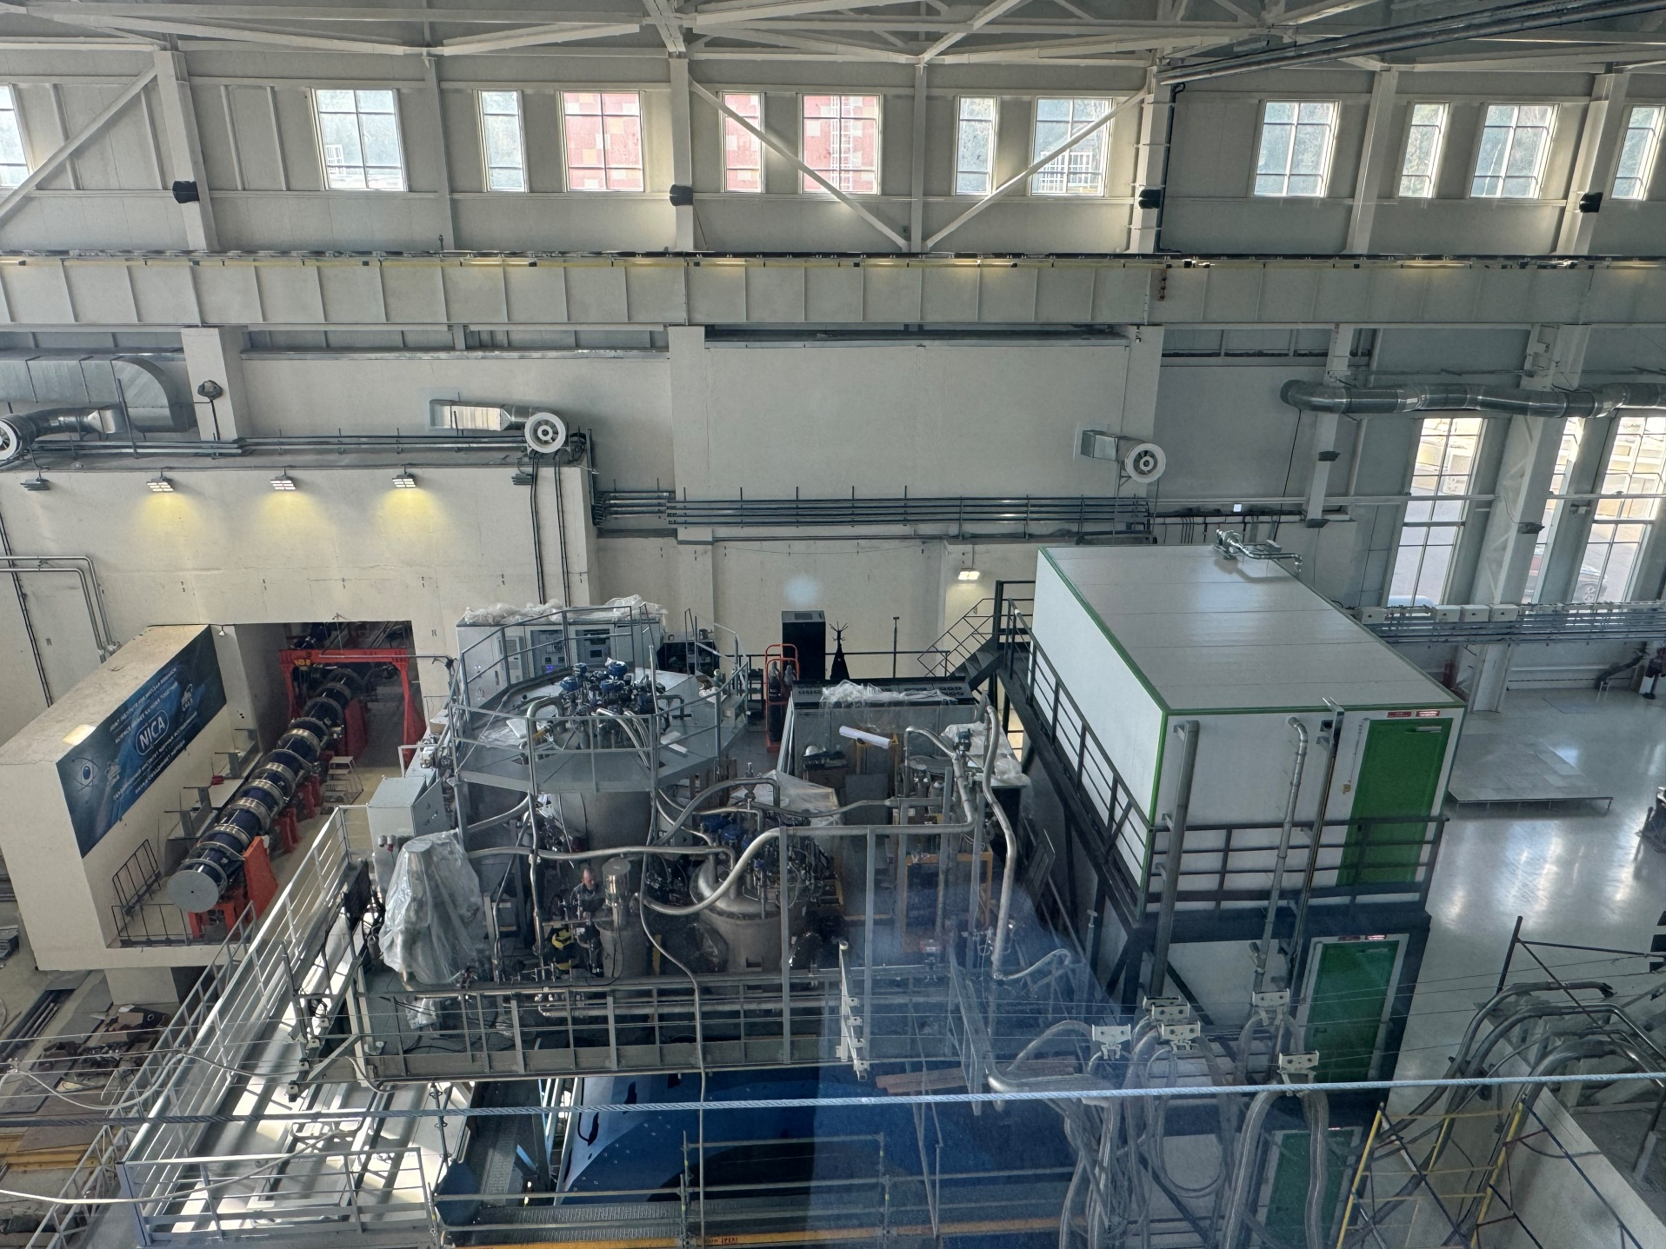
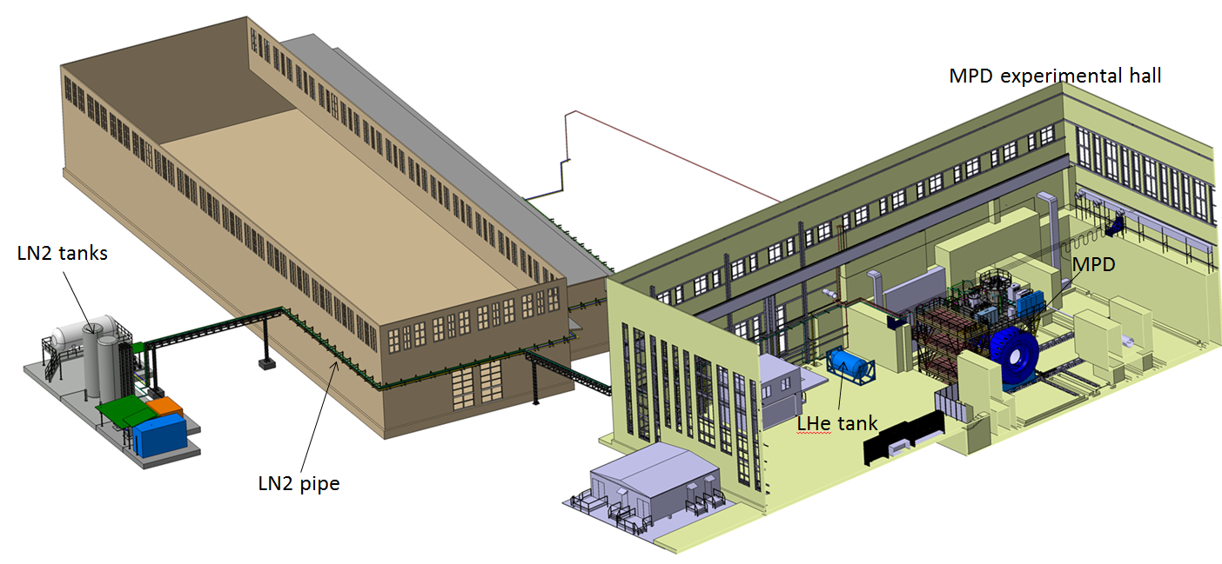
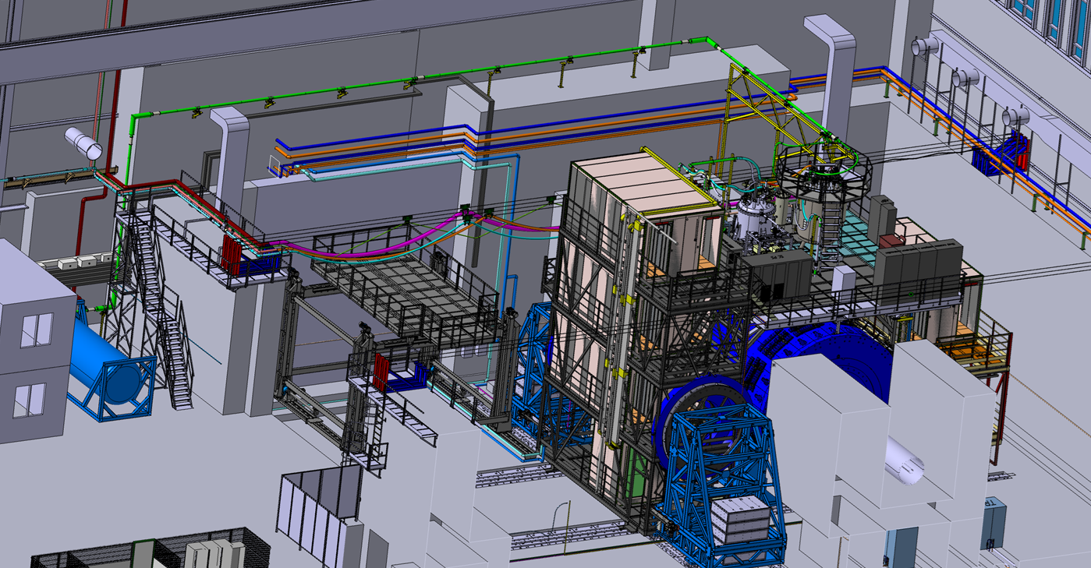
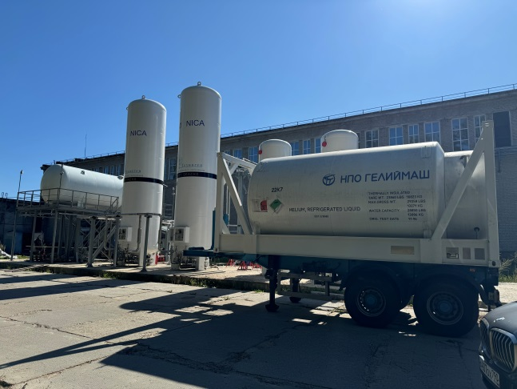
Cryogenic infrastructure
Control Dewar
Refrigerator
NTCS (Nitrogen temperature correction system)
LN2 and LHe heaters
LHe pipe (delivery is delay)
Cryogenic flexible connection pipes
LN2 Tanks (2 pc)
LHe Tanks (2 pc)
LN2 transfer pipe 120 m
Warm pipes for He, N2 and instrumentation Air
Flexible warm pipes
Support system for flexible pipes
Temporary pipes for cooling by temporary scheme

Slide 10
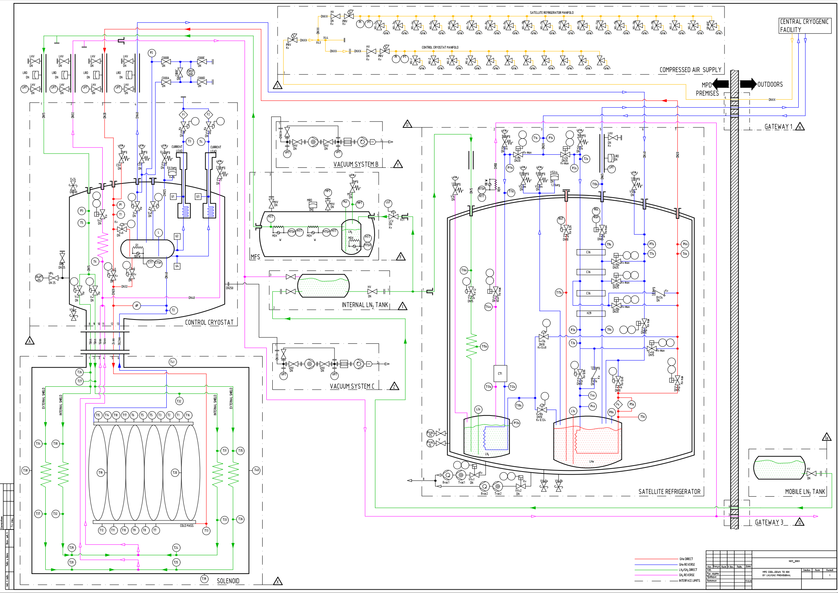
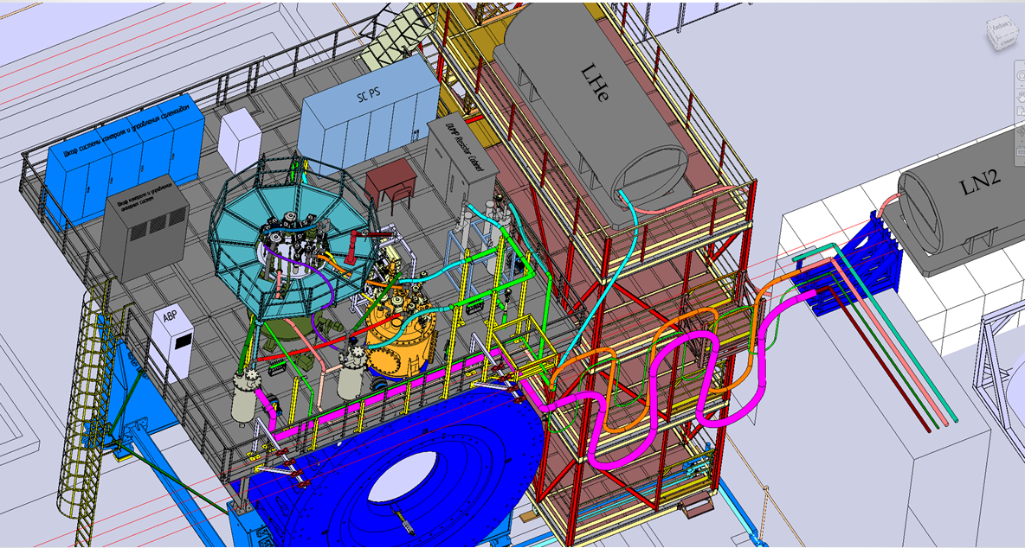
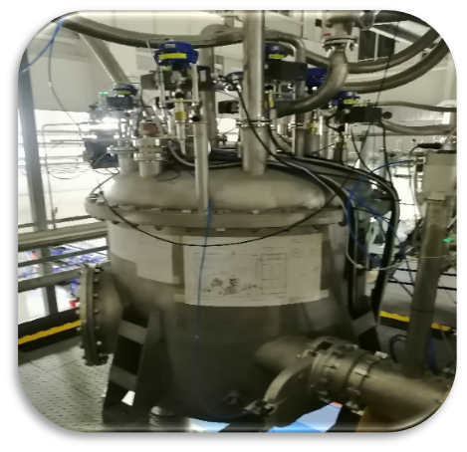
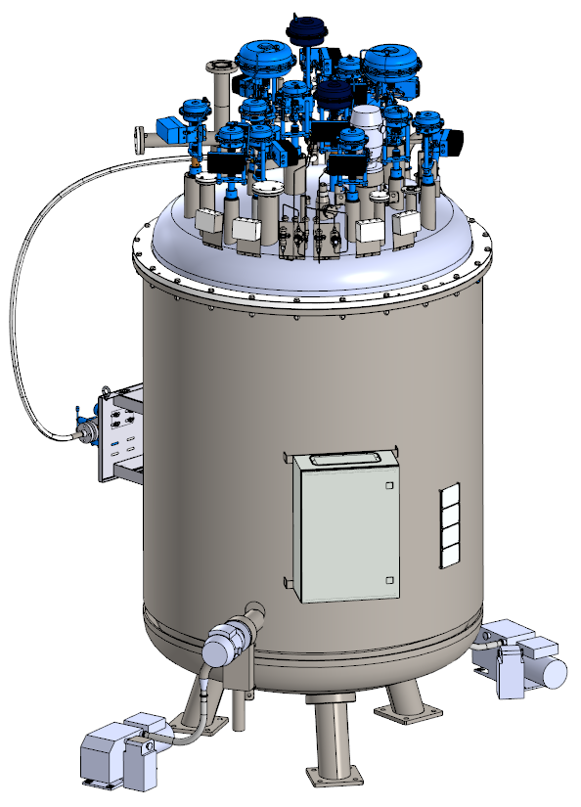
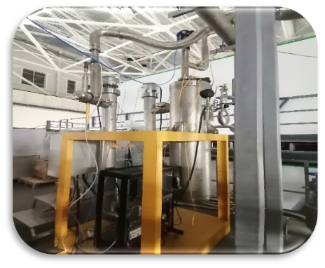
Temporary scheme of cooling at 80 K (February – March 2024)

Slide 11
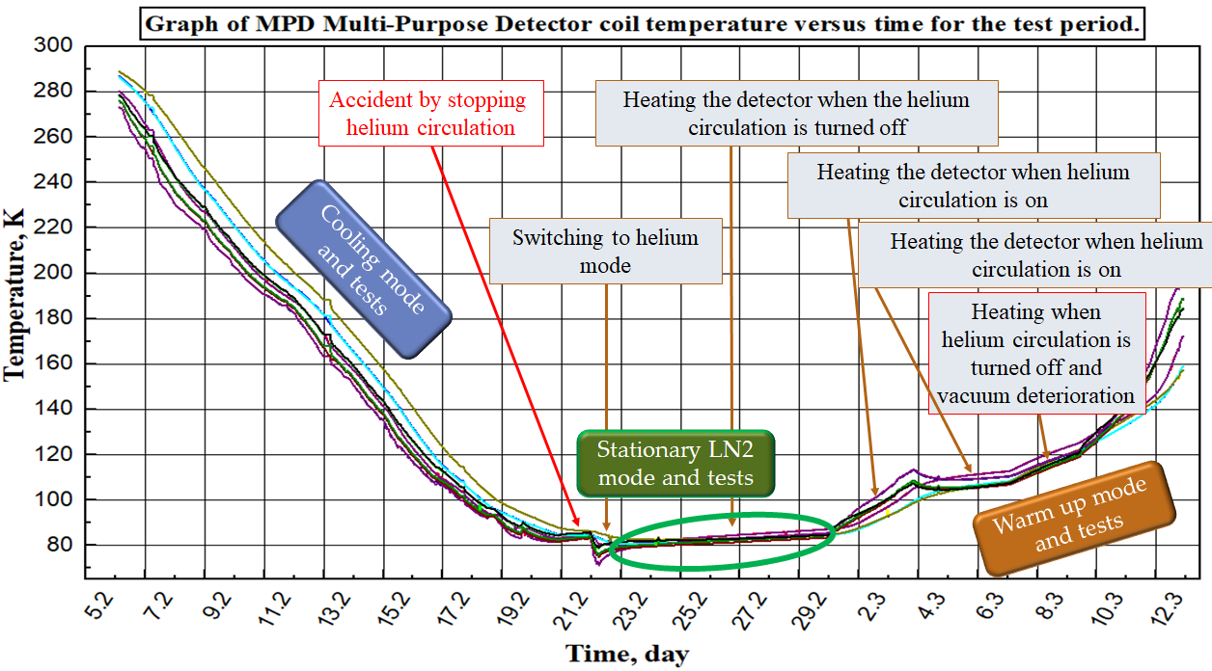
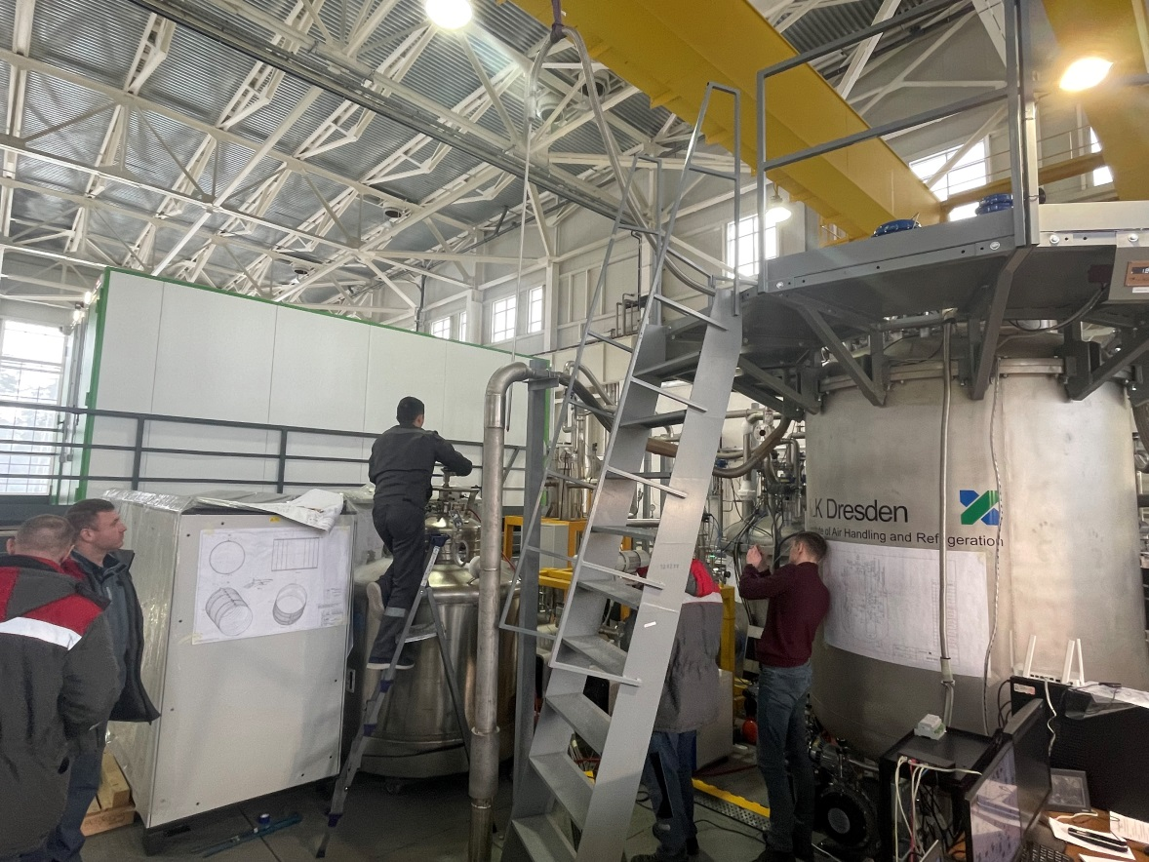
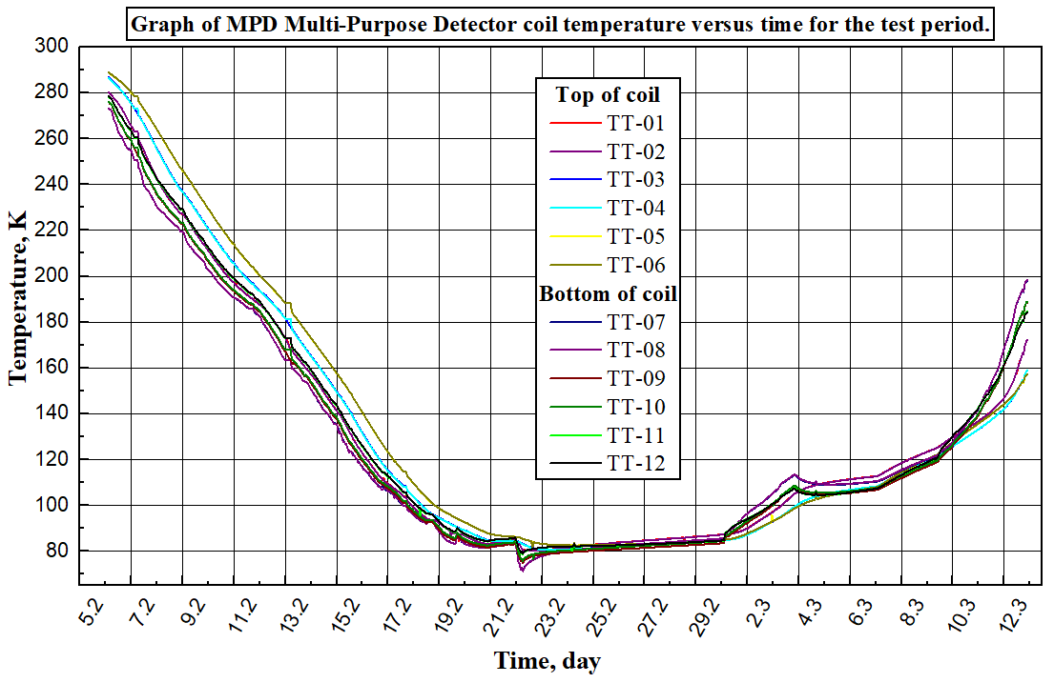
The first cooling by 72K
Tasks of the first cooling
Cooling the superconducting coil to nitrogen temperatures (78 K).
Check leak by cold model.
Test of maintaining a multi-purpose detector cooling rate of 1 Kelvin per hour.
Cooling of heat shields in automation mode.
Investigation of heat loads at the cooling stage and at 78K mode (stationary).
Cooling the superconducting coil with liquid helium.
Determination of heat inflow when vacuum deteriorates (heating mode).
Test cooling by nitrogen shield without helium circulation.
Maintaining a multi-purpose detector warming rate of 1 Kelvin per hour by warm mode.

Slide 12
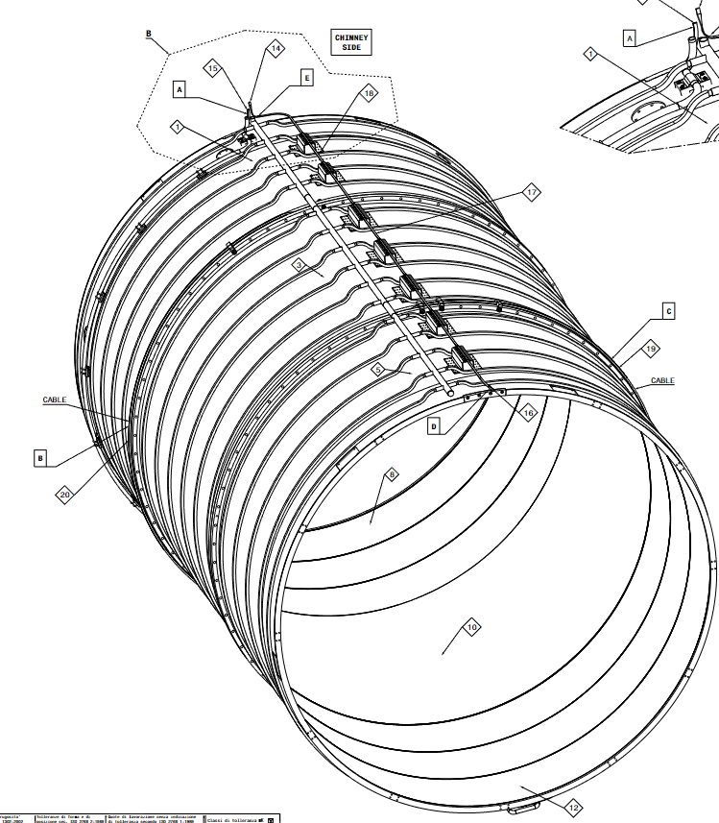
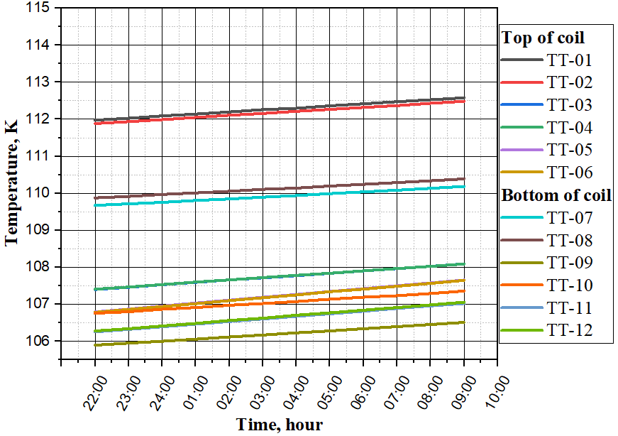
Dependence of the temperature of the coil (MPD detector) when cooling the thermal screens and switching off by helium circulation
Uniform temperature rise 0.5 K by 11 hours

Slide 13
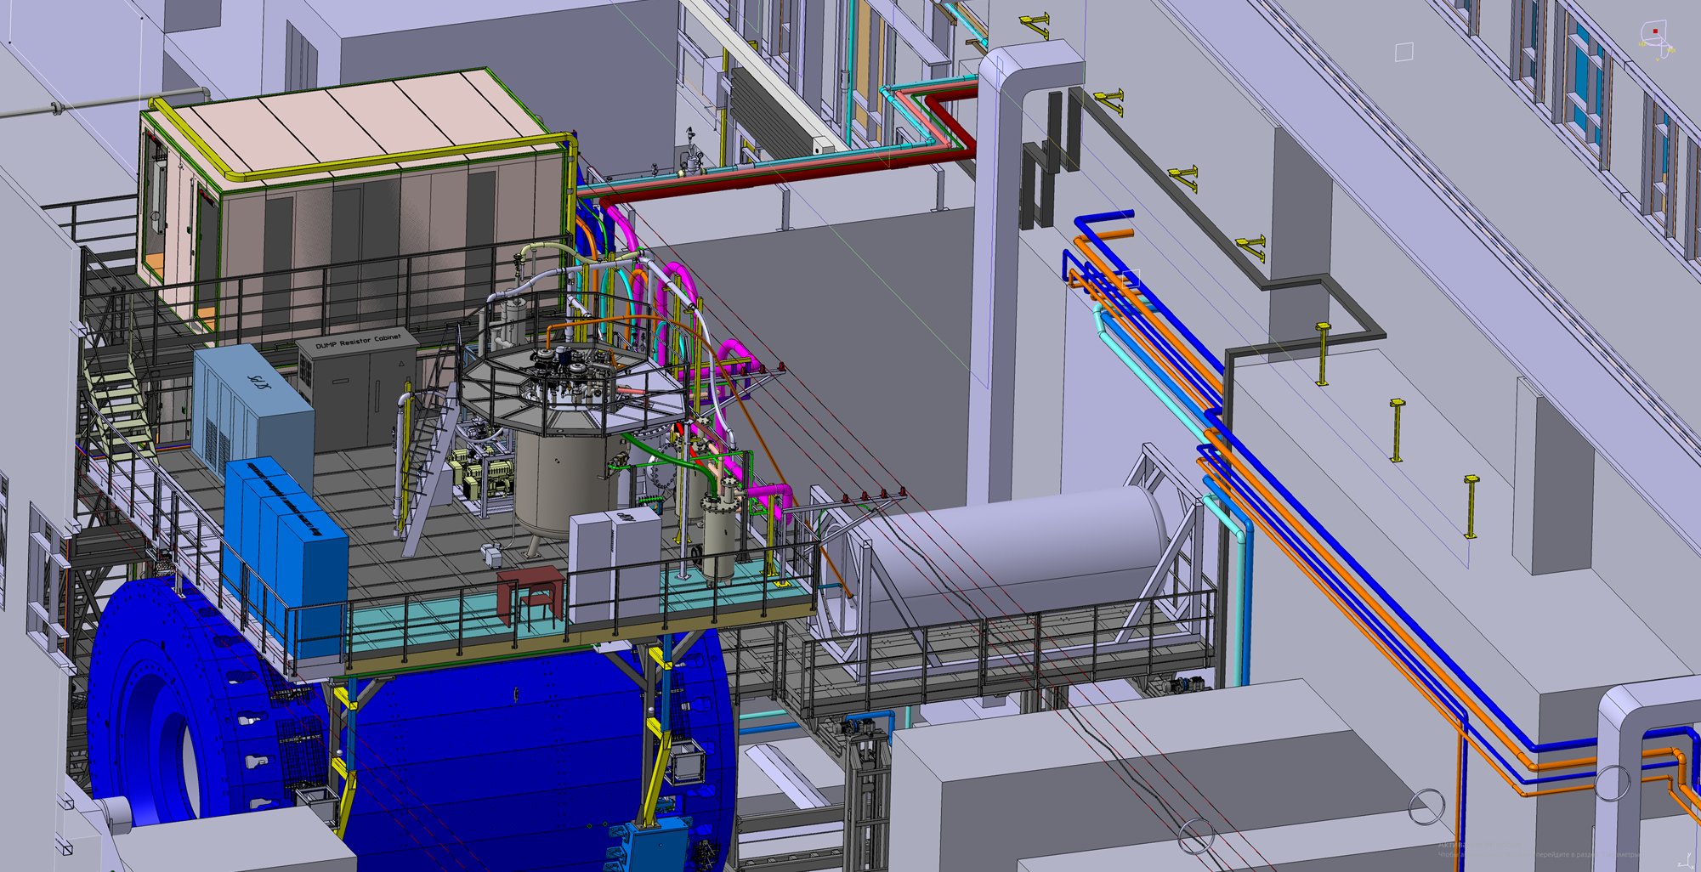
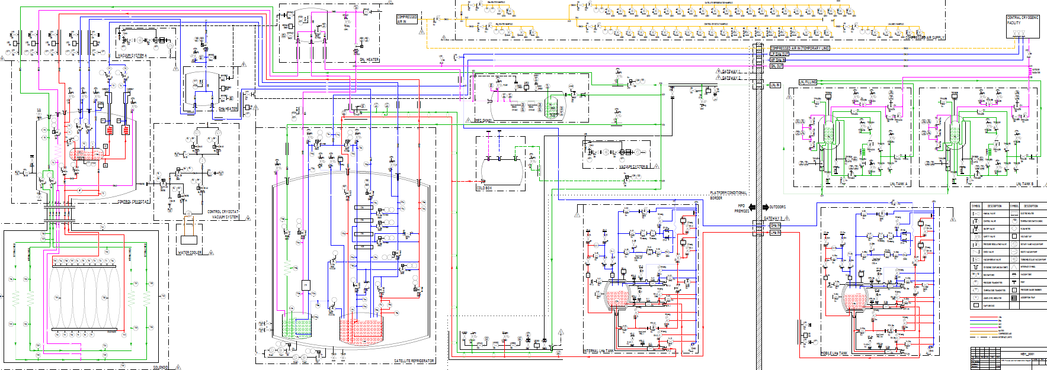
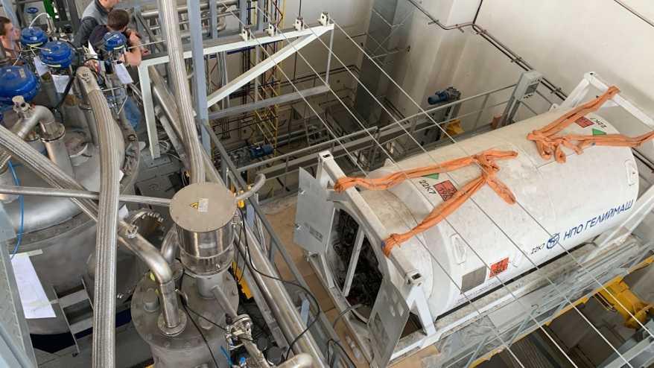
Cooling to 4,5 K start from end of October 2024

Slide 14
Conclusions of first cooling and next steps
Successful cooling solenoid by 72 K.
No cold leak in thermal shield and LHe circle.
Obtained cooling parameters of cryogenic equipment can be accept and are consistent with a manual (1 - 1,5K/h).
Heat load into solenoid are consistent by passport and low then 100 W.
Cooling time from room temperature to 80 K take’s about 13 days (need optimization, temperature difference need less then 30 K).
Successful test of hold 80 K temperature solenoid by LN2 shield without helium circulation (not actuators, no risks let us hold solenoid by 80 K all time It is extend a life time of solenoid).
Successful a warm mode test
Developed a new software of the refrigerator
Update solenoid software
Installed additional temperature sensors
Start of cooling at 4,5 K at end of October

Slide 15
Chapter 3
Engineering system of the detector MPD
Power supply system
Water cooling system
Control and protection systems

Slide 16
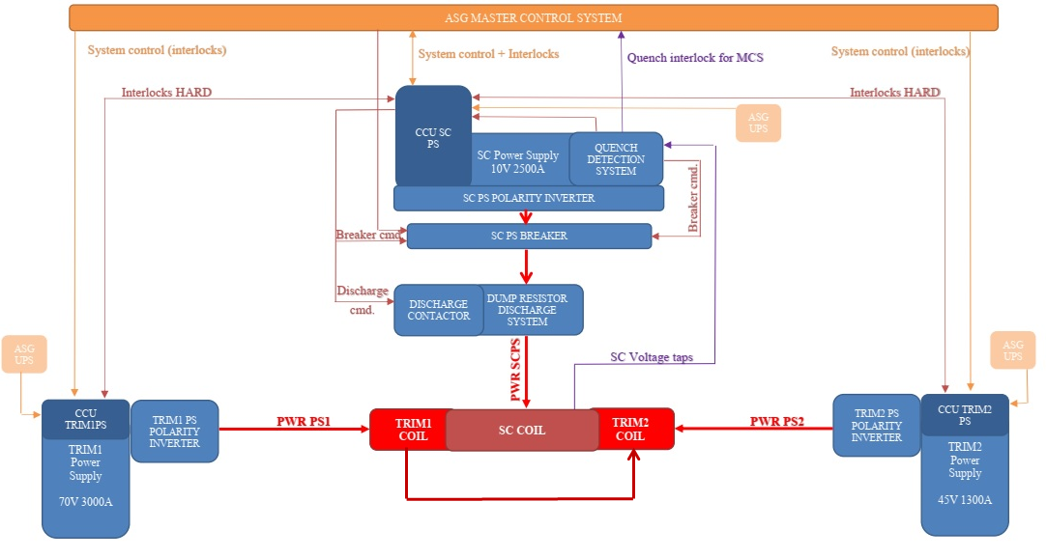
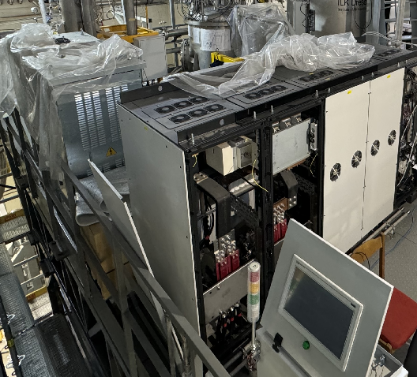
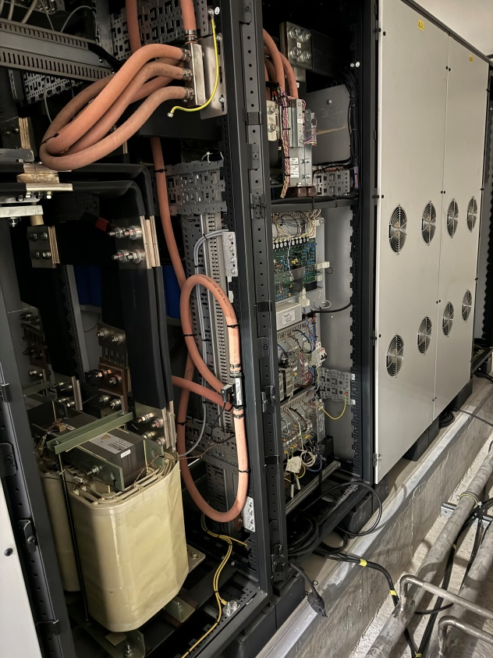
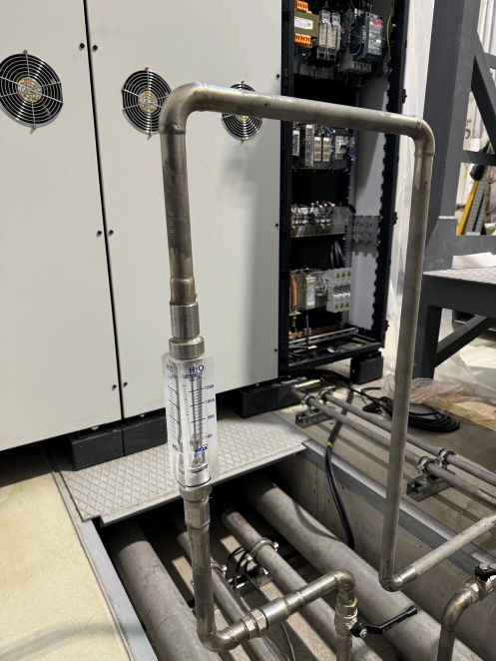
Power supply system

Slide 17
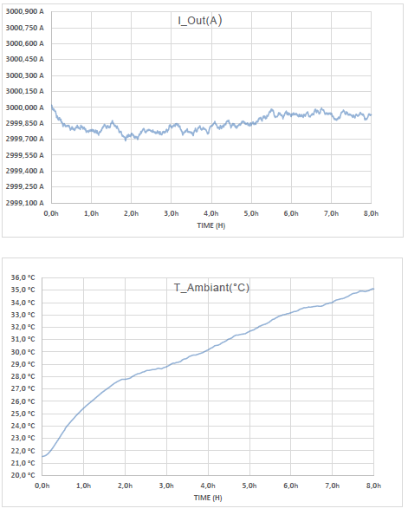
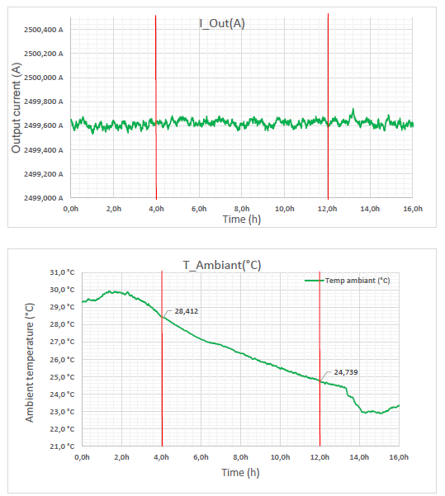
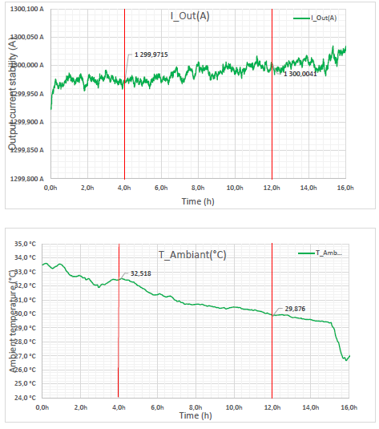
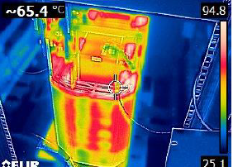
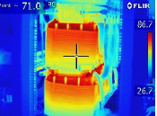
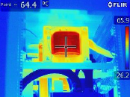
Factory test of power supplies
Power supply of TRIM1
I = 3000A V= 70V
Power supply of solenoid I = 2500A V= 10V
Power supply of TRIM2
I = 1300A V= 45V

Slide 18
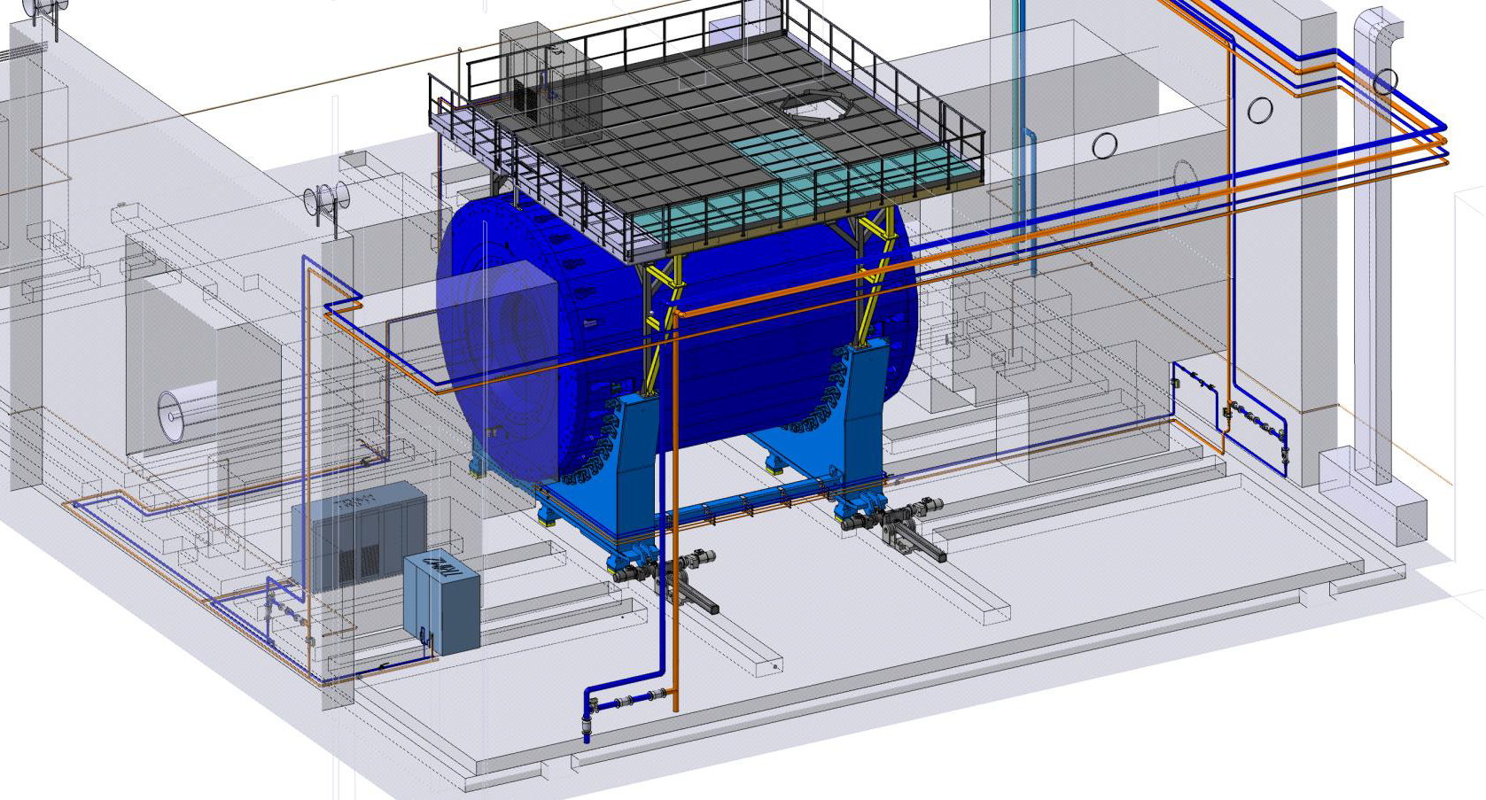
Water cooling system
Cooled equipment
TRIM COIL 1
1076 l/h water in 25⁰C out 55⁰C
TRIM COIL 2
2210 l/h water in 25⁰C out 55⁰C
POWER SUPPLY of SOLENOID
1800 l/h water in 25⁰C out 35⁰C
POWER SUPPLY of TRIM 1
720 l/h water in 25⁰C out 35⁰C
POWER SUPPLY of TRIM2
720 l/h water in 25⁰C out 35⁰C

Slide 19
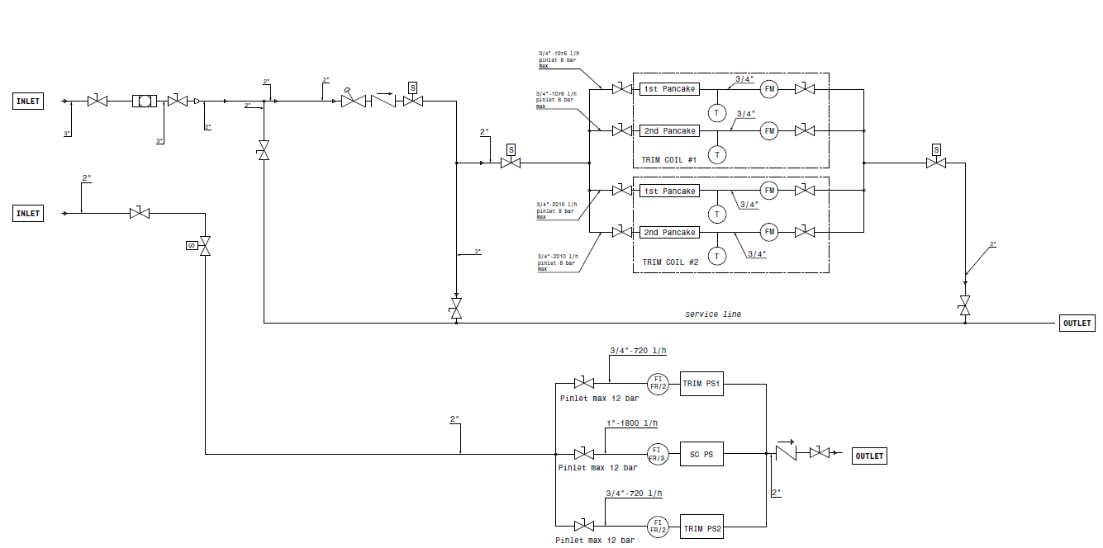



Cold water system scheme
Controlled parameters
Temperature of TRIM coils
Flow rate of TRIM coils
Flow rate of Power supplies

Slide 20




Control and protection systems
All signals from solenoid engineering system connect to control system
Valves position in different operation and alarm modes
Failure list and feedback on CS
Main control parameters
Temperature of CS cables (we add 6 sensors to chimney area and current leads)
Temperature of thermal shield
Volume of LHe in control Dewar vessel
Voltage taps (drop current at CS, current leads)
Pressure inside vacuum vessel
Tie rods (stress sensors, position of cold mass)
Water flow and temperature
Refrigerator failure (by LHe level)

Slide 21



Test of solenoid protection system (voltage taps)
Nominal current - 1790 A
Nominal volts - 10 V
Induction – 0,5 T
For the safety of SC cables and previously shout down power system, provide QD and voltage taps.
Voltage taps located in to welding points of SC cables, warm and cold part of current leads.
Signals from voltage taps transfer to Yokogawa, converted and gives a control signal to QD.
Safety parameters is +/- 1 V.
Test parameters 1,2A, 10V

Slide 22
Timeline
October 2024 – February 2025 – Solenoid at temperature 4,5 K
November 2024 – prepare a program and test stand for Power supply system, quench detection system and energy evacuation system by 10% - 20%.
All activities below will be delayed until the water cooling is turned on from an outer source.
December 2024 – tests power supply and energy evacuation system by nominal current. Risk is no cooling water from outer supplier.
December 2024 – Shipment all components of magnetic field measurement device from INP (Novosibirsk) and start assembling it in the solenoid.
December 2024 – February 2025 – measurement of magnetic field. Risk is no cooling water from outer supplier.
March 2024 – Start assembling subdetectors inside solenoid. Risk is no cooling water from outer supplier.

Slide 23

Thank you for attention

