Slide 1


ECal Status
14,10,2024
Dubna
I.Tyapkin

Slide 2
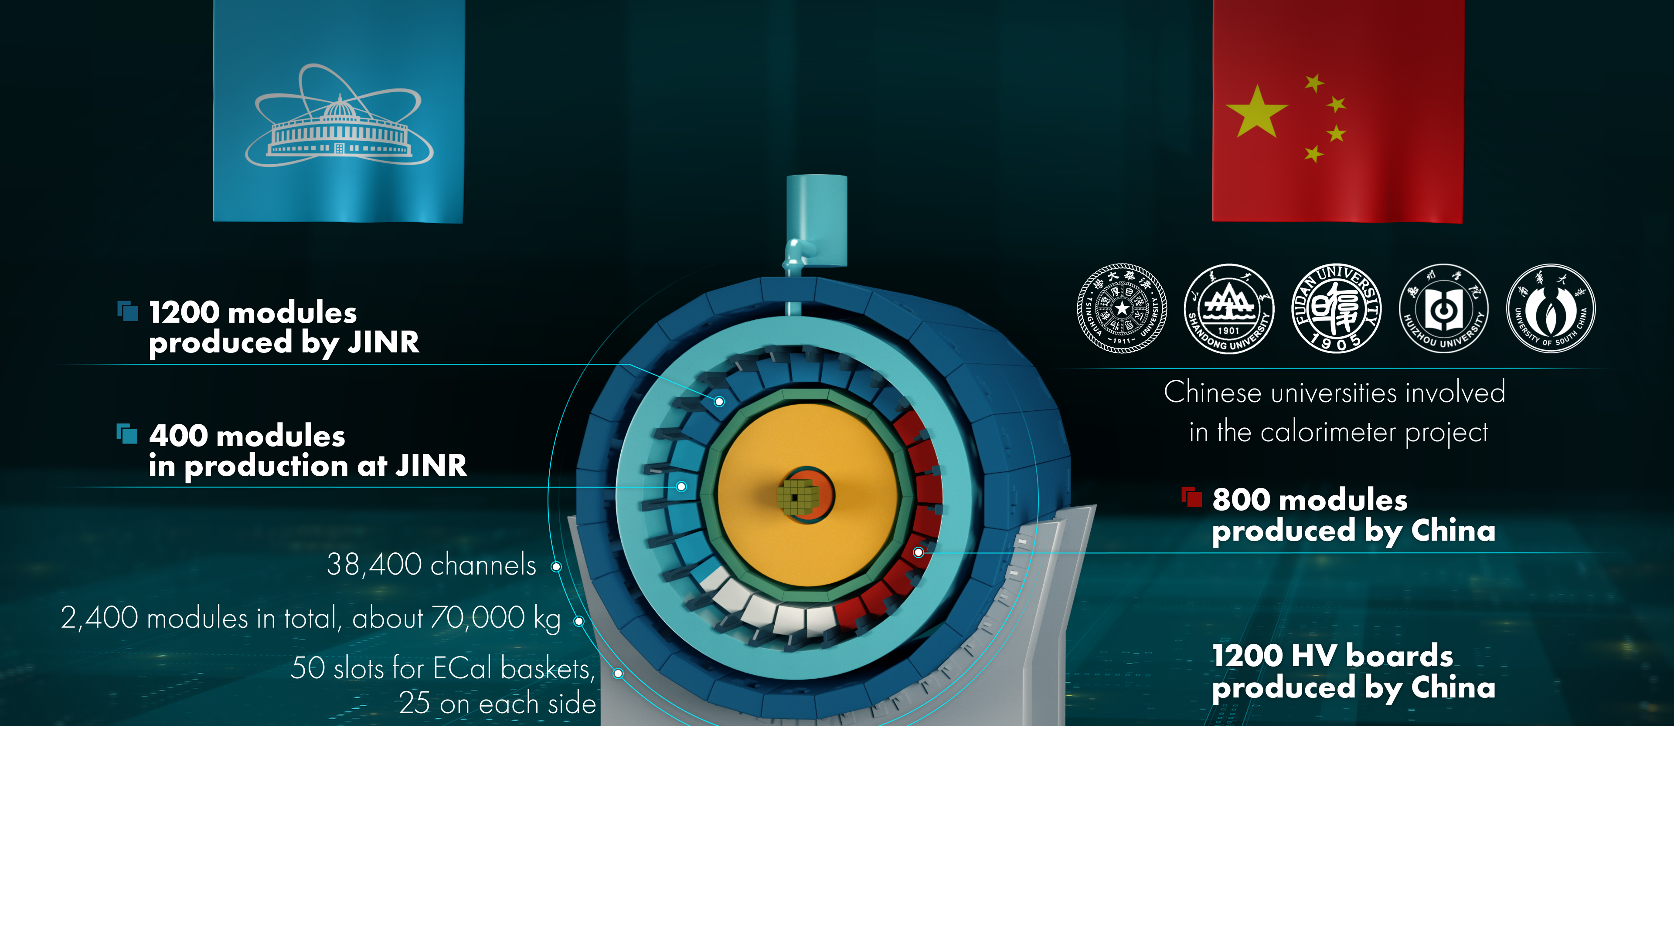

Slide 3
To complete barrel calorimeter
200 modules in the final stage of production.
Will be finished in Desember 2024
(80% of ECal)
230 still have to be ordered

Slide 4
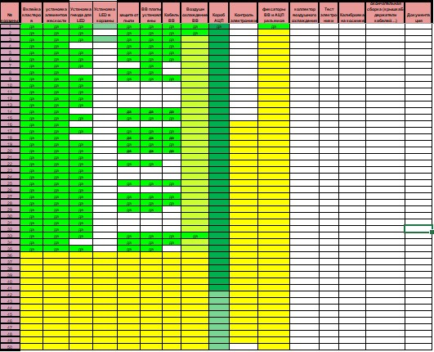

40
50

Slide 5
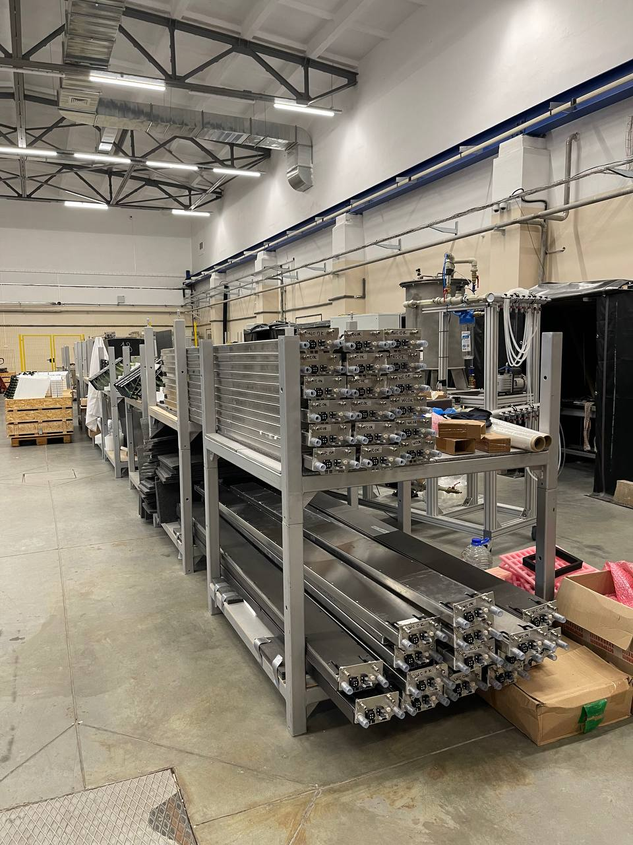
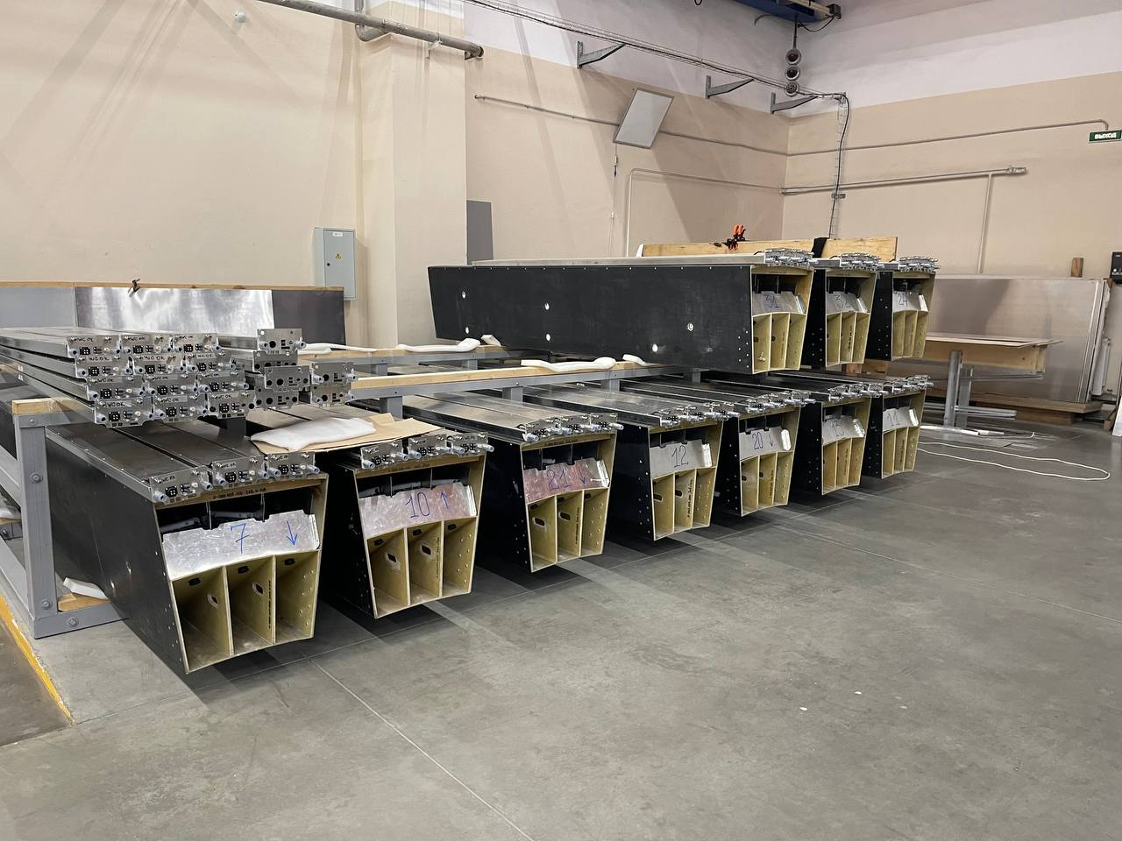
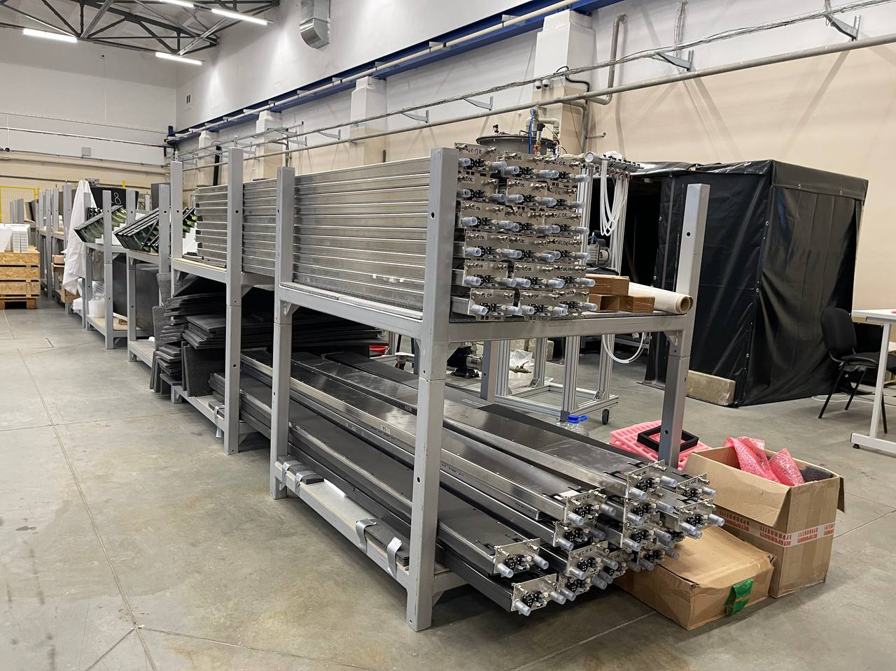

Slide 6
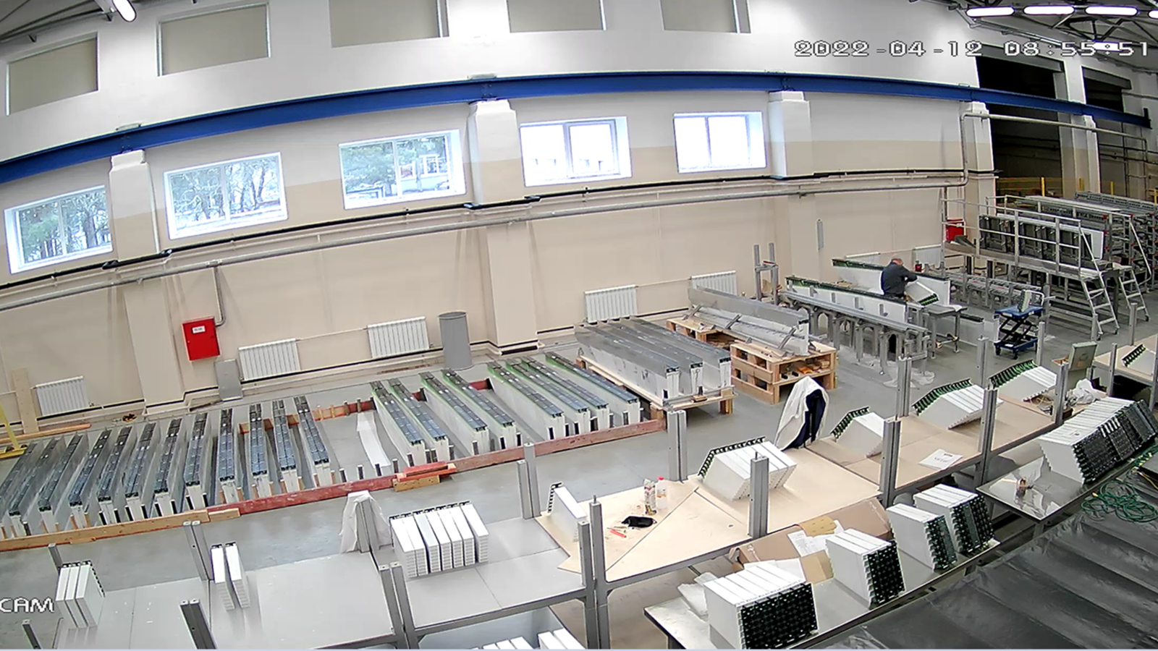

Slide 7
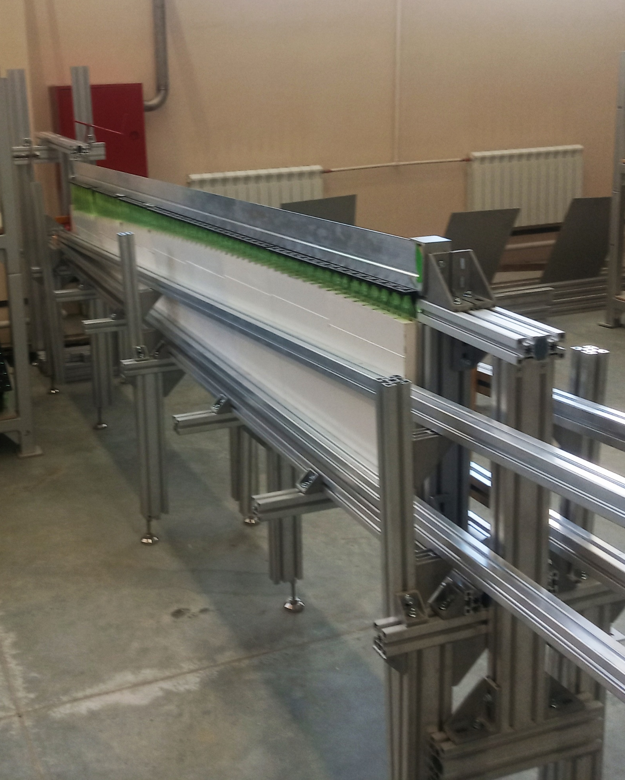
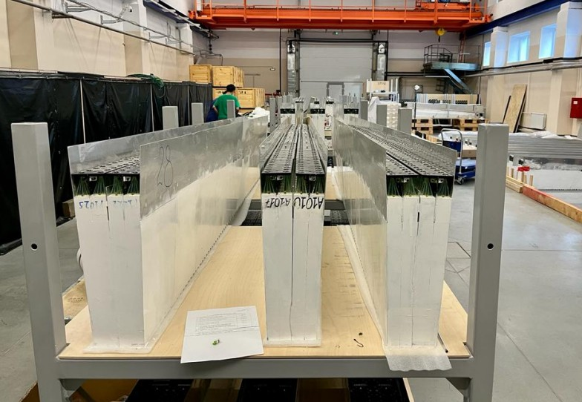
Specially designed slipway used to assembly 16 modules of 8 types in one cluster.
100 clusters are already produced

Slide 8
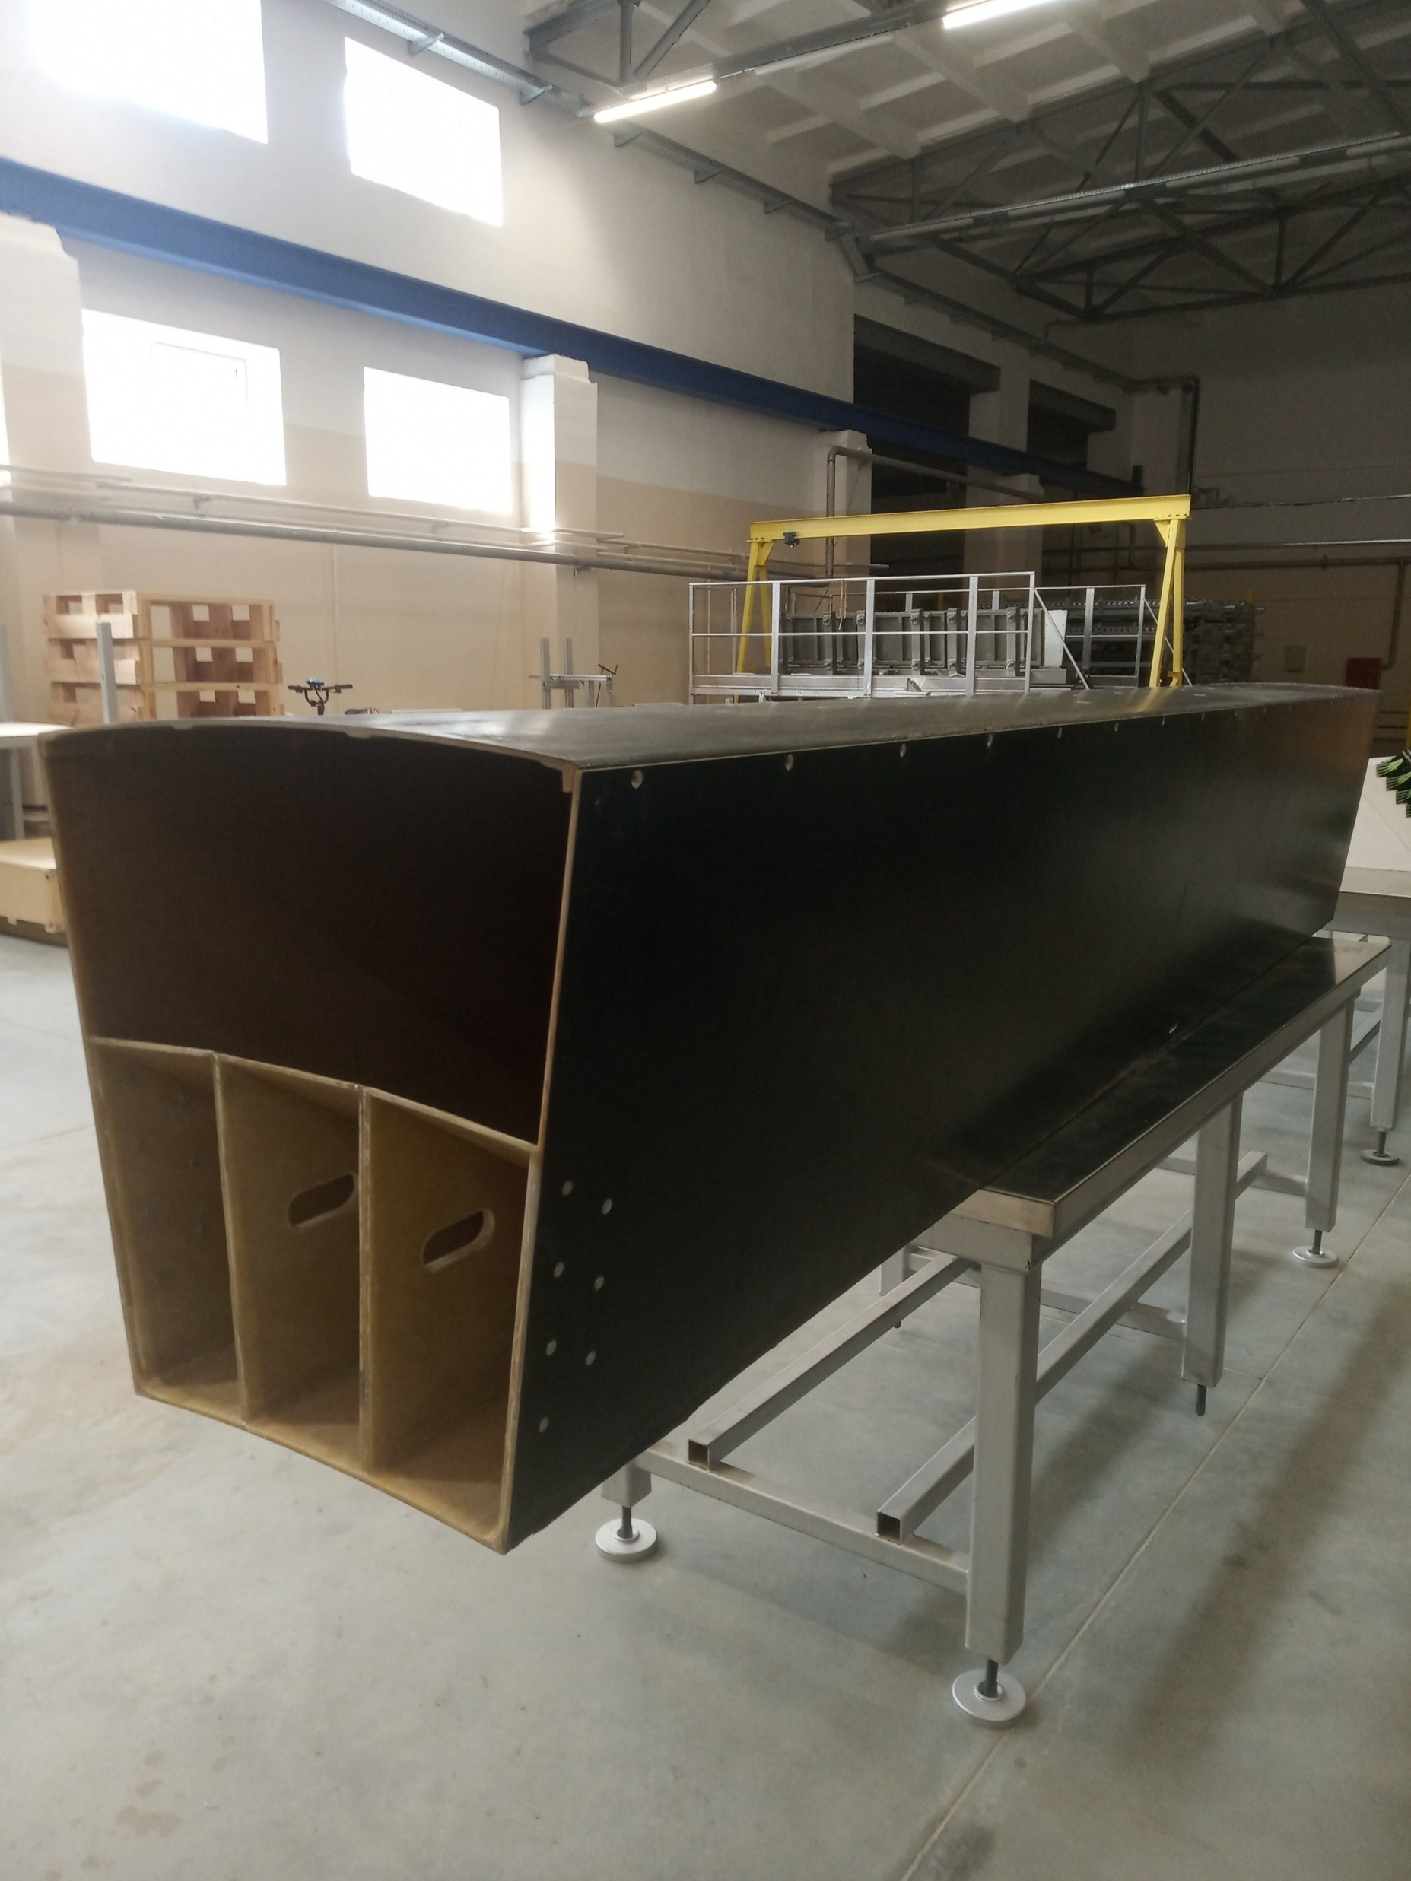
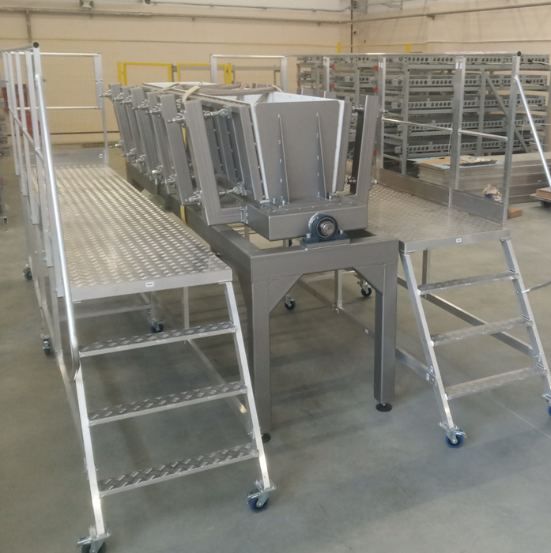
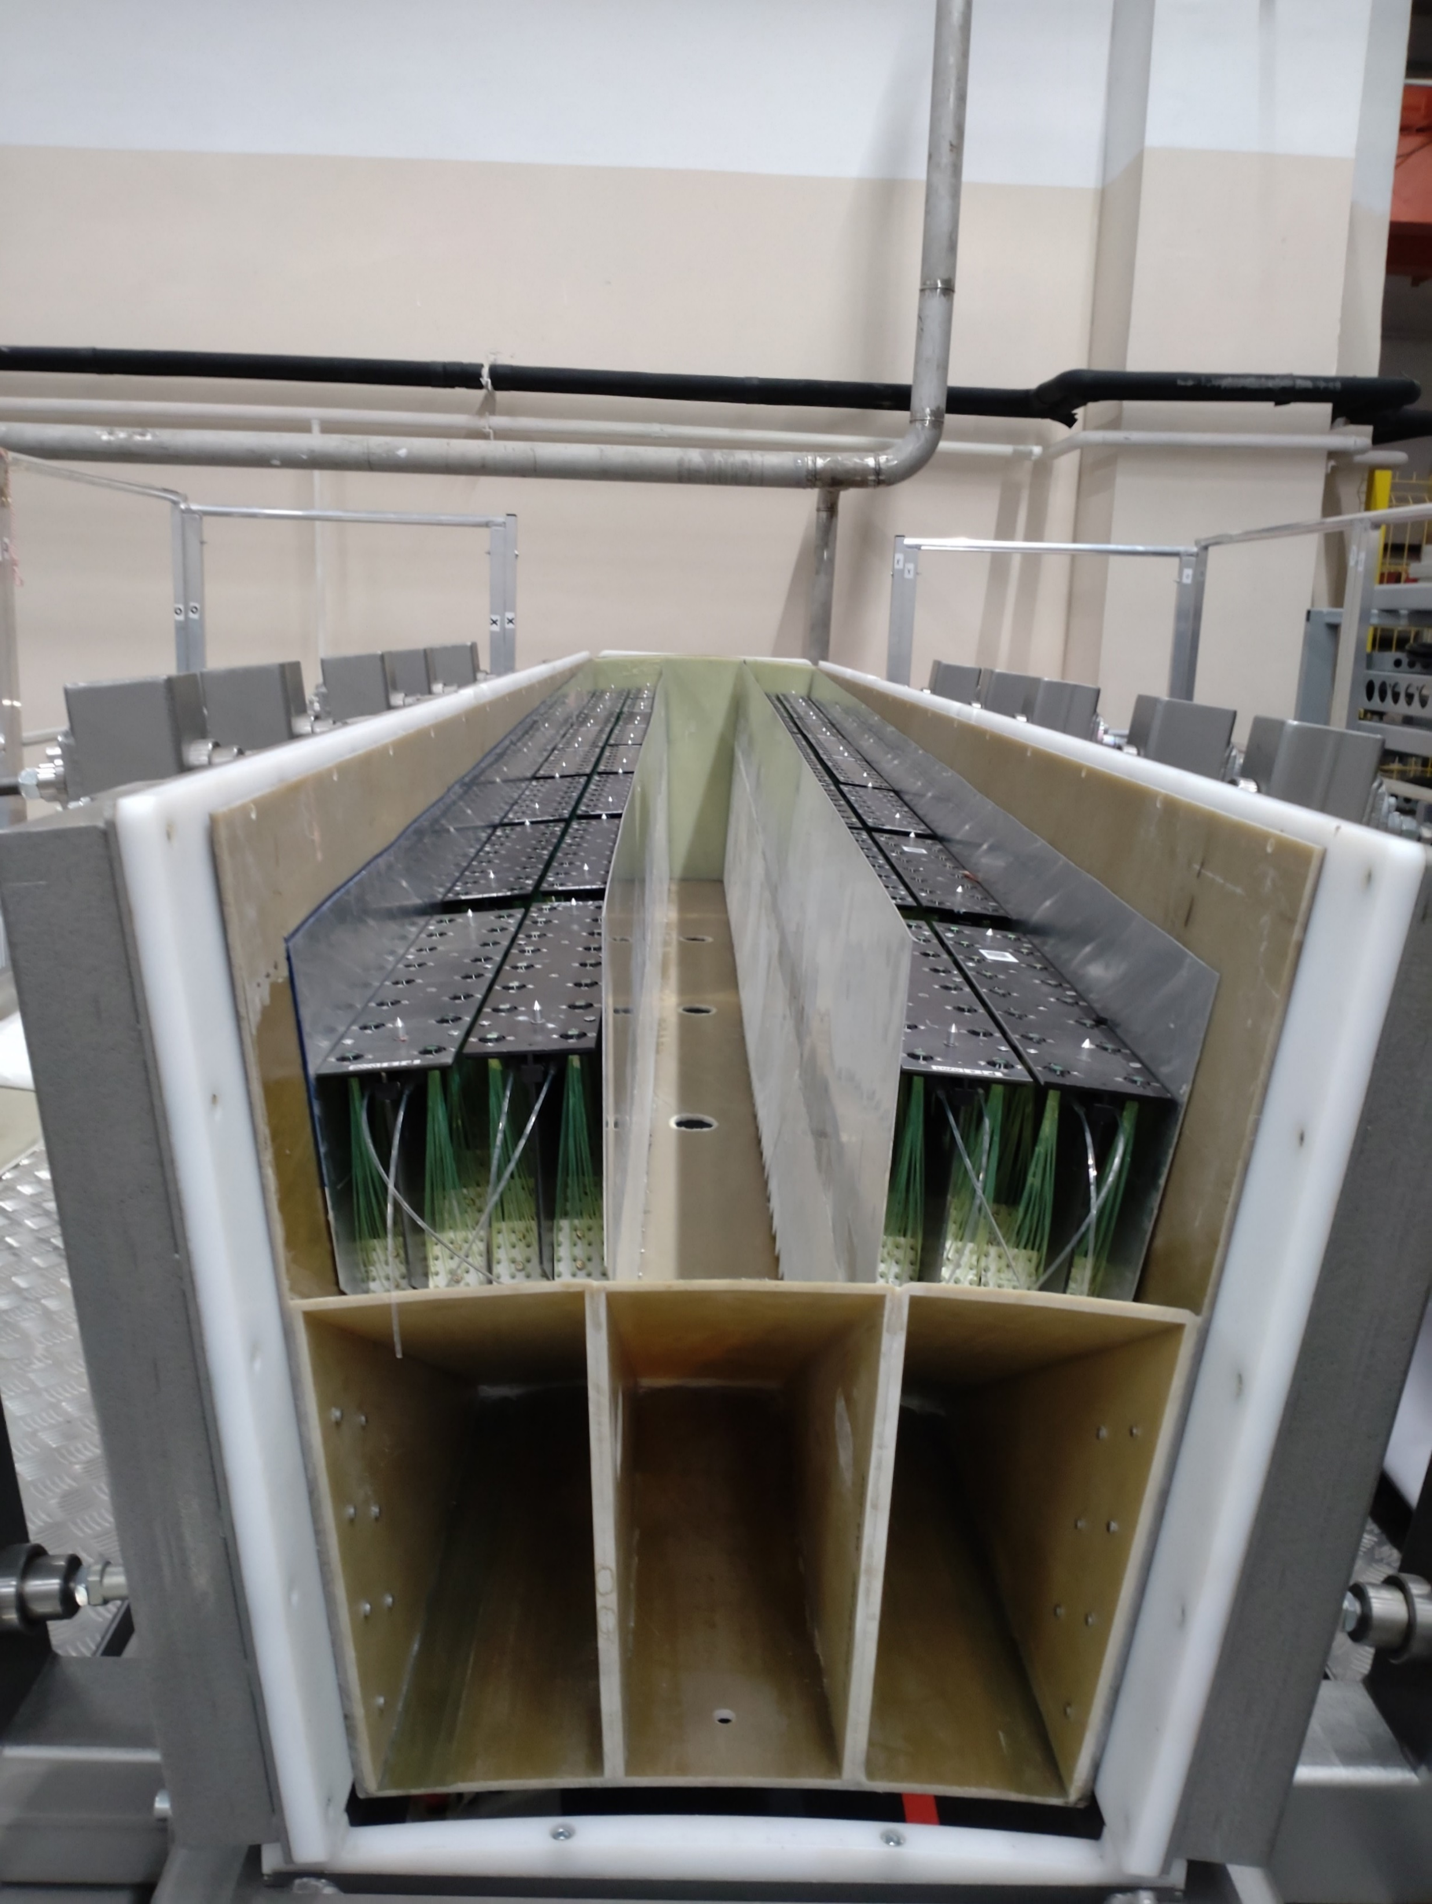
Each half sector basket consist of three clusters.
To fill basket by the clusters one more slipway designed and produced.
The main feature of this slipway is a very strong walls on the side
to keep basket in the size limits of slots dedicated in the MPD.
32 baskets are assembled and ready for the final step of
assembling procedure - installation of electronics.

Slide 9
In summarizing –
In the beginning of 2025 250 new modules
may be installed in the 40 half sector baskets and
will be ready to be inserted in the MPD in June 2024.
It will form 80% of full calorimeter.

Slide 11
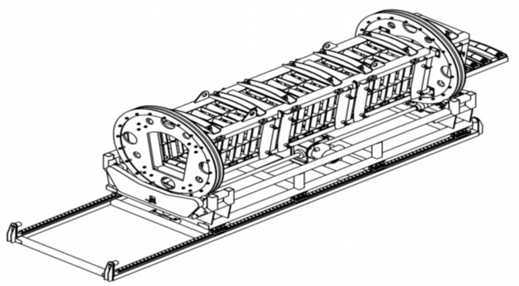

Slide 12
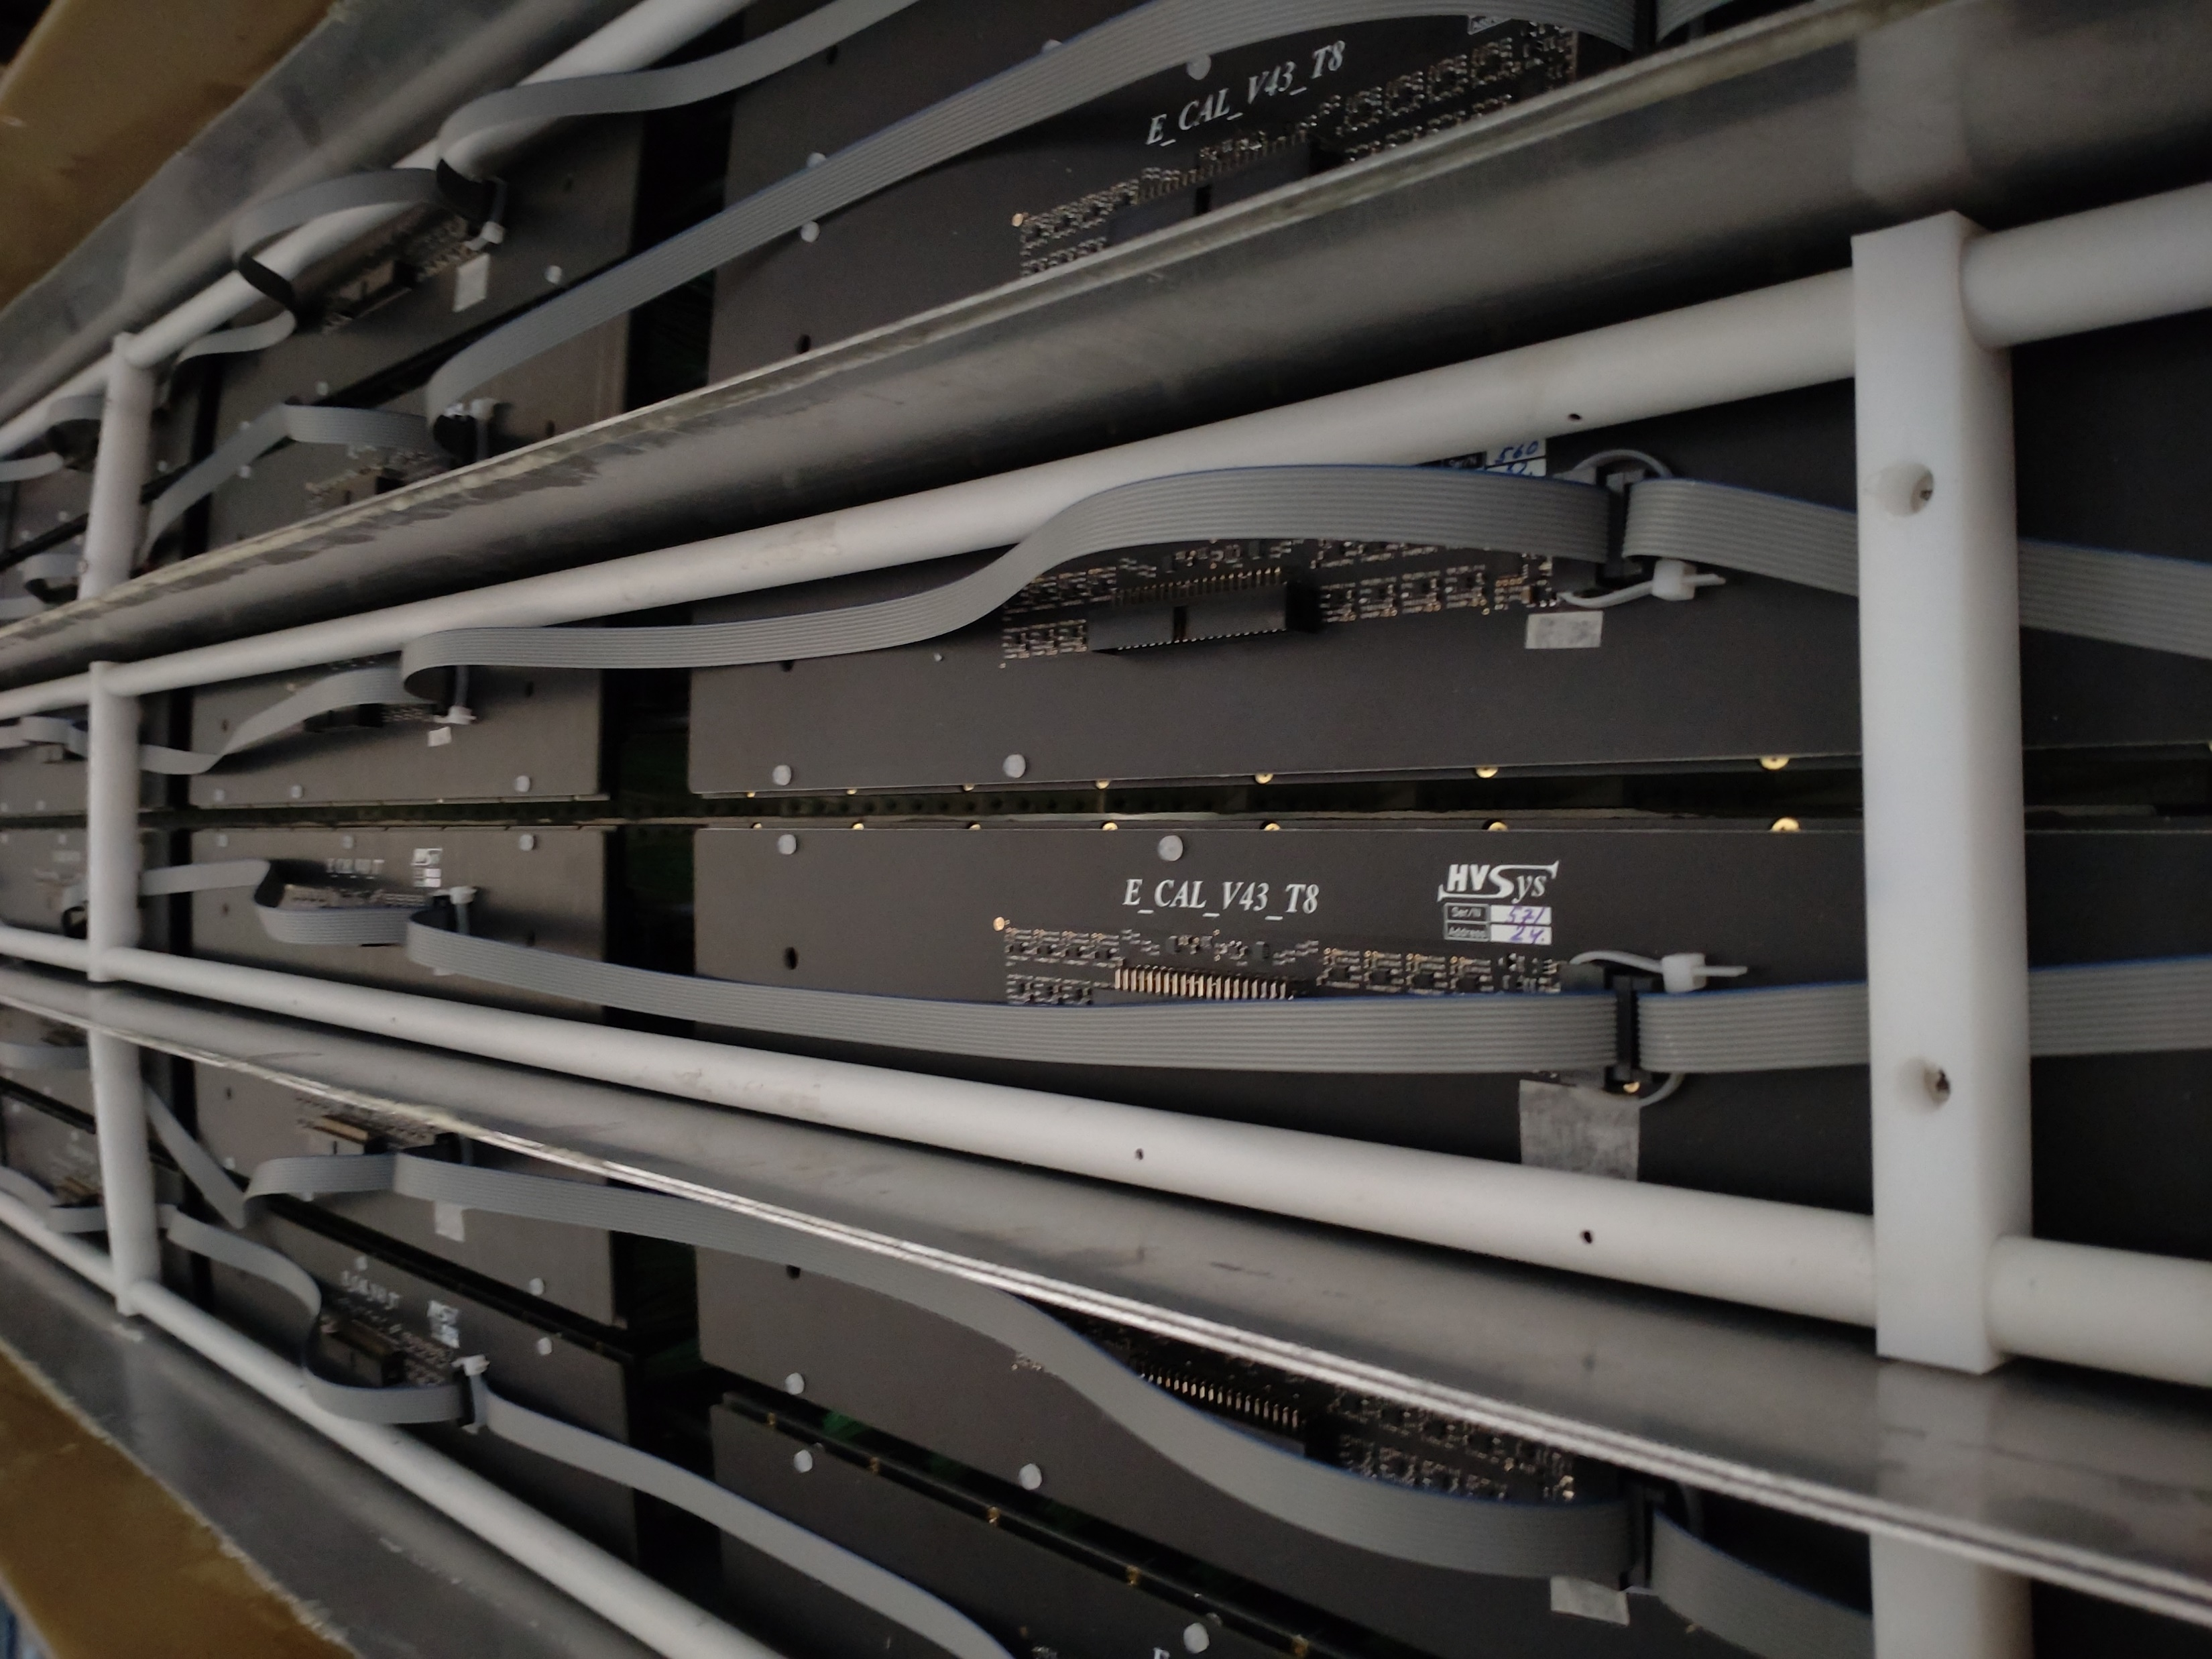
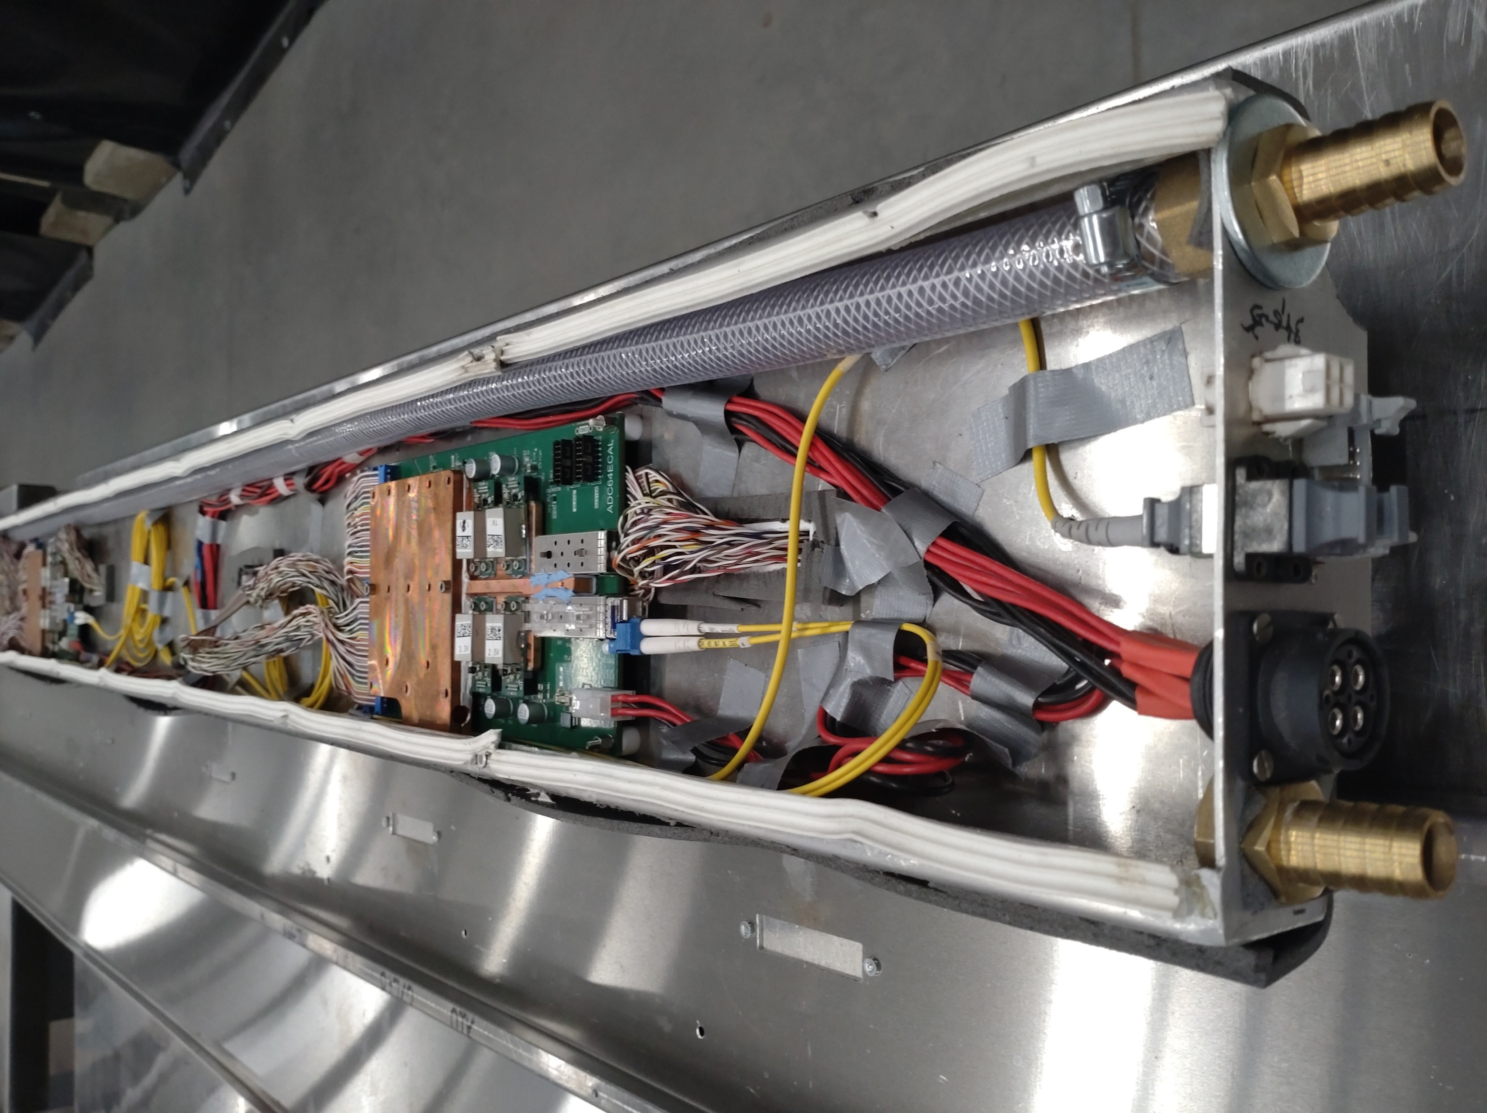
Electronics mounted in the basket consist
of HV+Slow Control boards mounted directly
on each module and ADC boards in the
cooling box.
Due to the rathe high power dissipation
in the ADC boards they are separated
from the detector volume in the cooling box.
Two half sector baskets are fully assembled
with electronics and stay under stability test
during last few months.
In September electronics mass assembling
was started.
All materials and electronics components
are in stock.
32 half sectors can be equipped with electronics
and installed on the tests in few months.

Slide 13
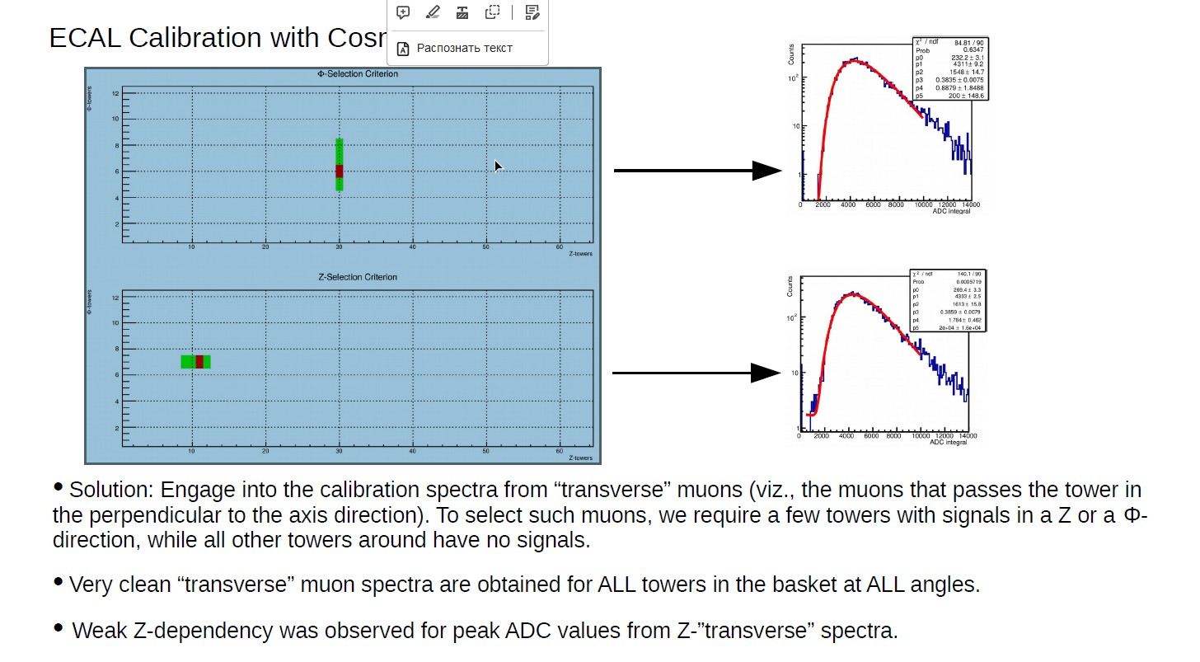

Slide 14
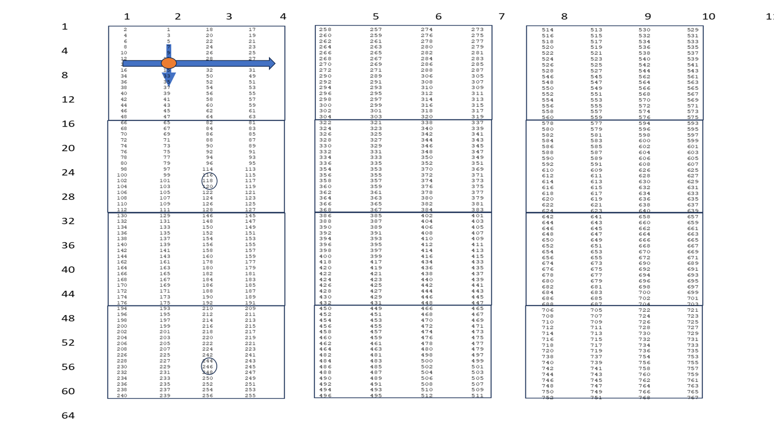
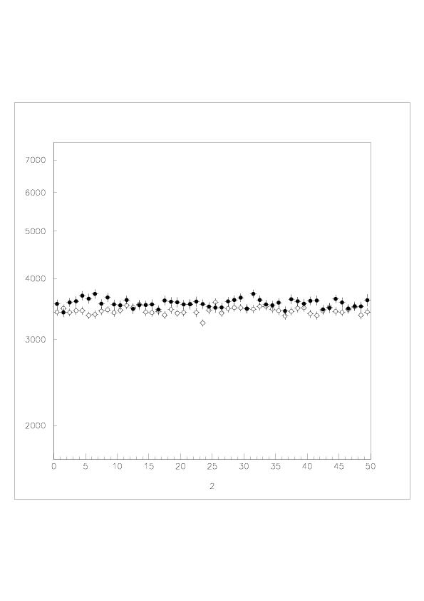
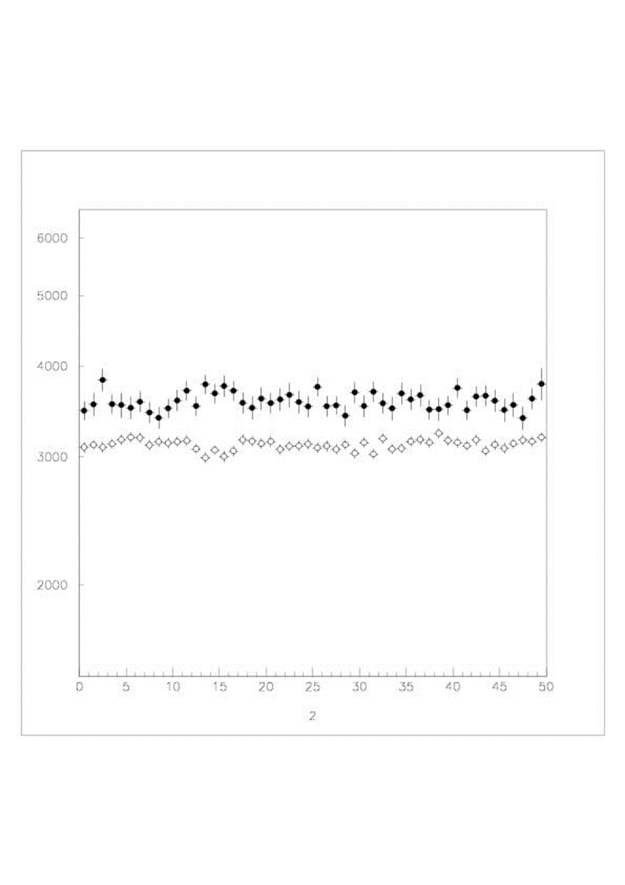
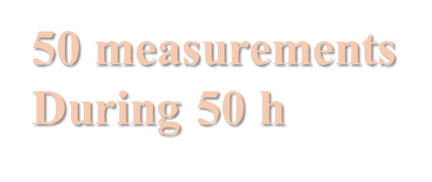
A (ADC counts)
Time (hours)

Slide 15
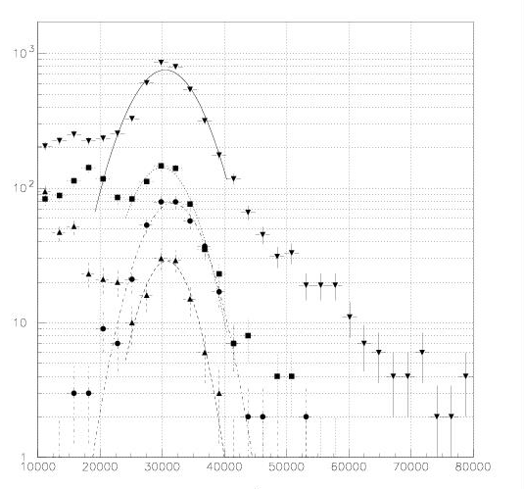

Slide 16
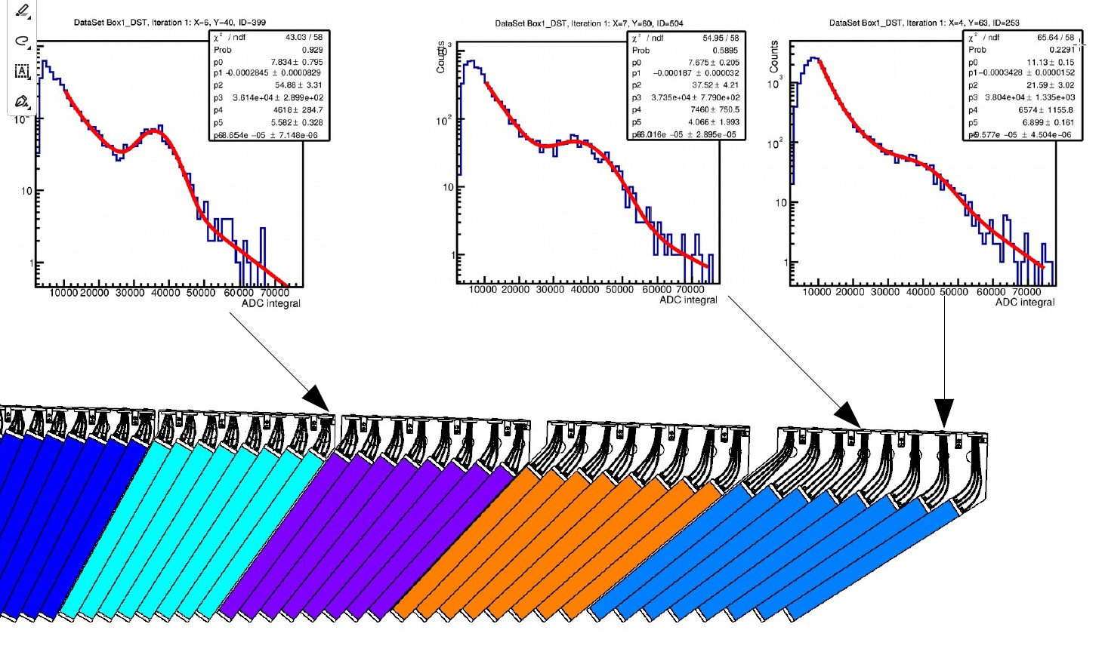
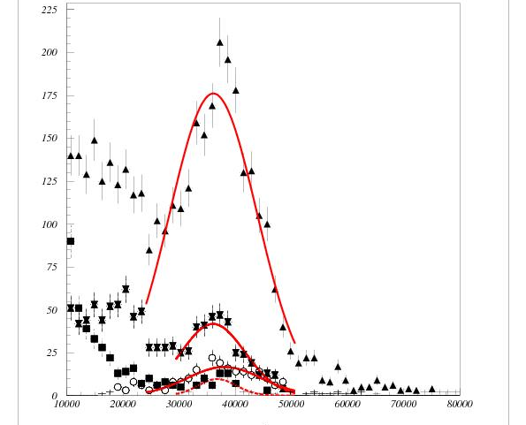
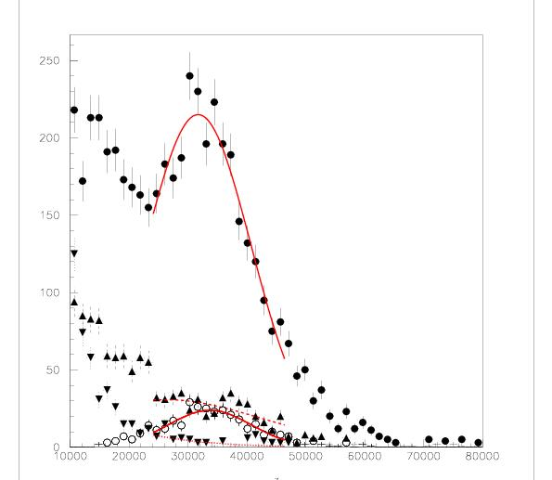
36140 ± 28990
36120 ± 226
36797 ± 493
36060 ± 465
38242 ± 692
38004 ± 1300
31757 ± 344
36797 ±610
35770 ± 1226

Slide 17
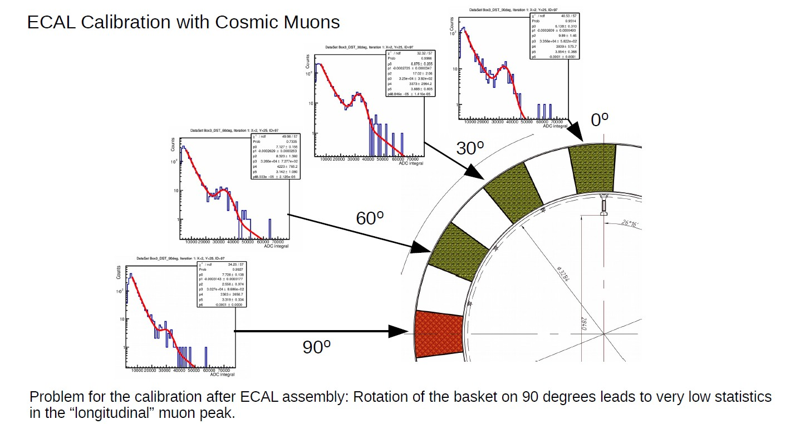

Slide 18

Conclusions:
First stage (64%) of ECal assembling is going well and will be completed in time (June 2024).
Work is started to build 400 more modules increasing ECal coverage in the barrel region up to 82%.
First assembled half sector is under long term tests. Stability of ECal operation demonstrated on the level of few % for 768 channels.
Possibility to use cosmic muons for the calibration of the assembled ECal is demonstrated.
ECal Slow Control and Stability Control software is under tests using assembled half sectors.

