Slide 1
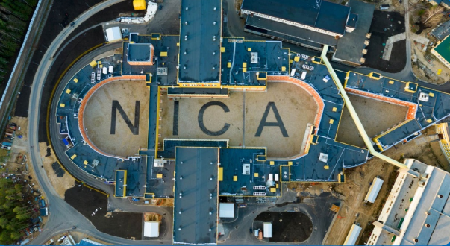


Anisotropic flow at high-baryon density
Arkadiy Taranenko
(NRNU MEPhI, JINR)
14th Collaboration Meeting of the MPD Experiment at NICA
14-16 October 2024, JINR
The work has been supported by the Ministry of Science and Higher Education of the Russian Federation, Project "Fundamental and applied research at the NICA megascience experimental complex" № FSWU-2024-0024

Slide 2
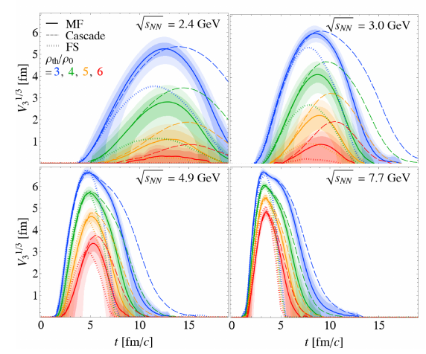
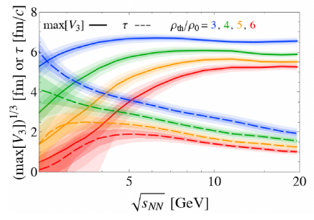

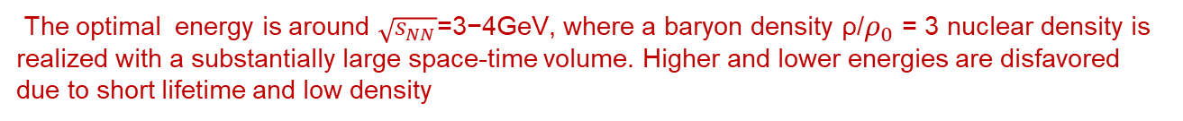
Optimal collision energy for realizing high baryon-density matter
H. Taya, A. Jinno, M. Kitazawa, Y. Nara https://arxiv.org/abs/2409.07685
Dense region disappears more quickly for larger $\sqrt{s_{NN}}$
$\sqrt{s_{NN}}$dependence of the maximum volume max[V3] (solid) and the lifetime τ (dashed)
The optimal energy is around $\sqrt{s_{NN}}$=3−4GeV, where a baryon density ρ/$ρ_{0}$ = 3 nuclear density is realized with a substantially large space-time volume. Higher and lower energies are disfavored due to short lifetime and low density

Slide 3
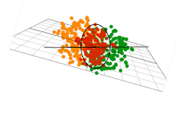
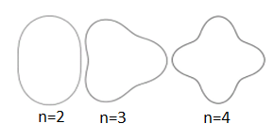

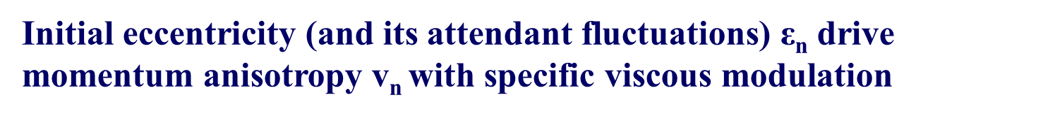
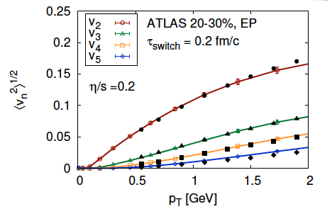
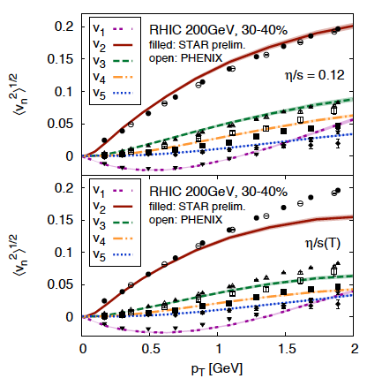
Anisotropic Flow at RHIC-LHC
Gale, Jeon, et al., Phys. Rev. Lett. 110, 012302
STAR, Phys. Rev. Lett. 122 (2019) 172301
3

Slide 4
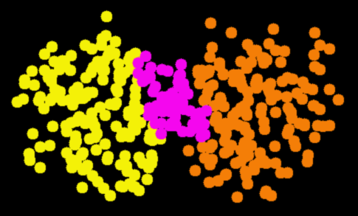
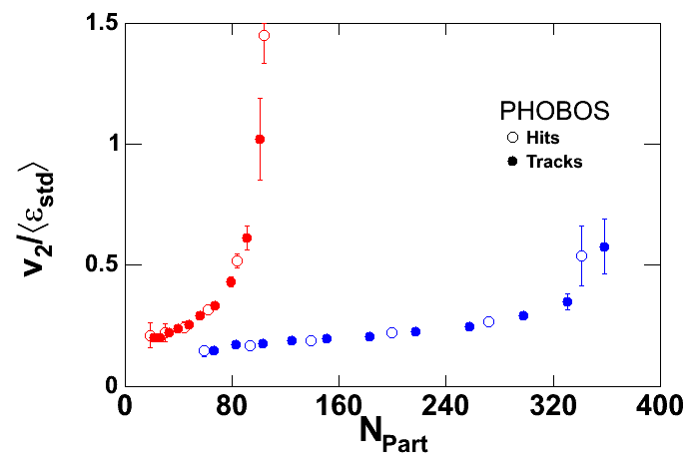

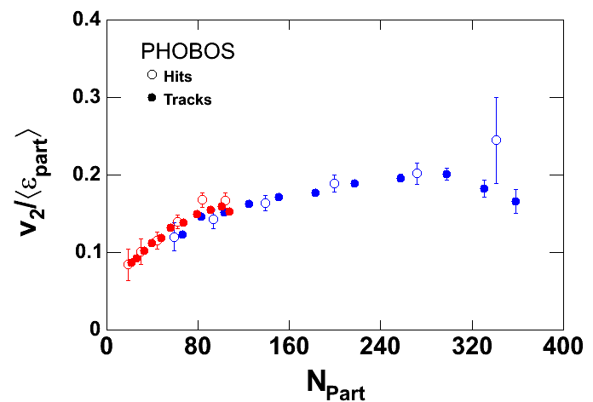
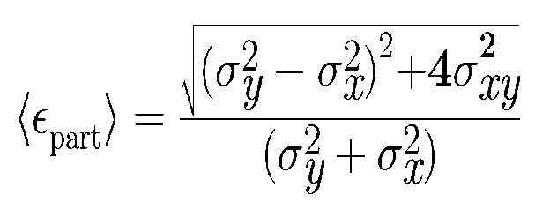
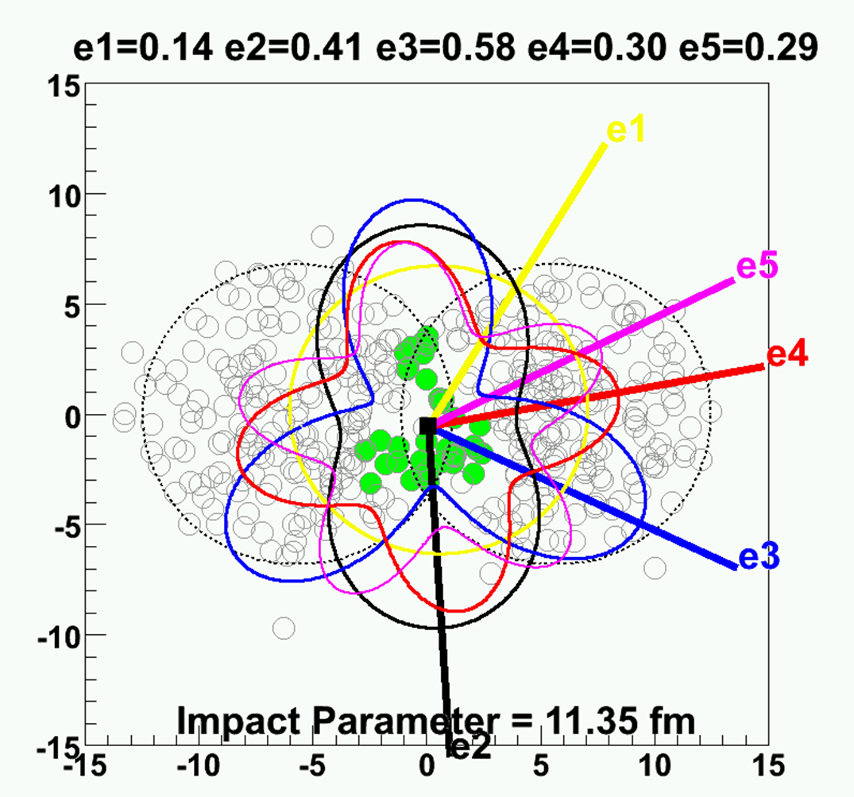
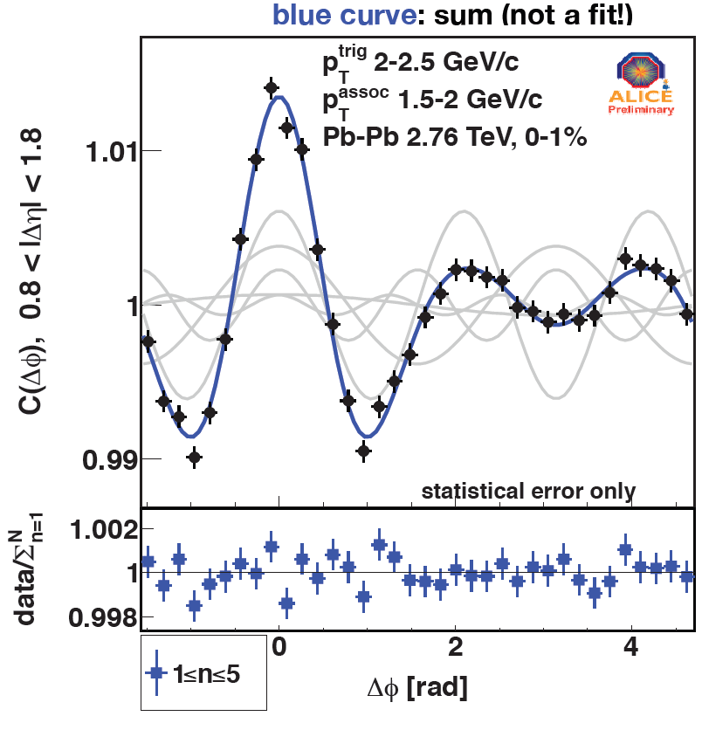
System size scan at top RHIC energy
Au+Au
200 GeV
2001-2005
Ψ₀
Ψ₀
2005-2011
2011-2012
Odd harmonics ≠ 0
4

Slide 5
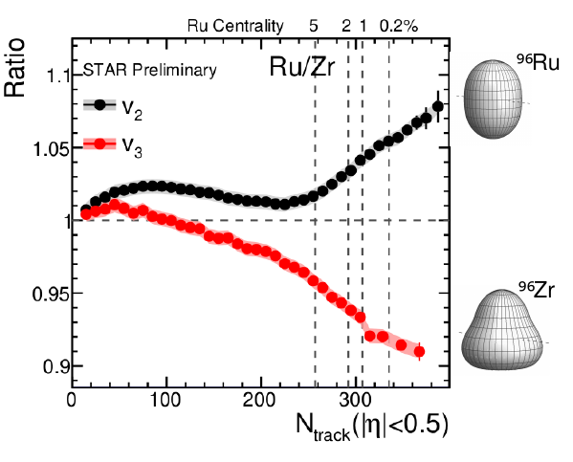
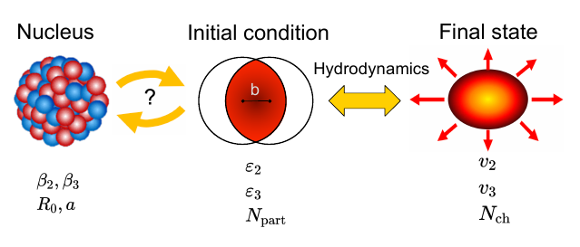
System size scan at top RHIC energy
2011-2020
Nucleon substructure matters
2020-2024
5

Slide 6
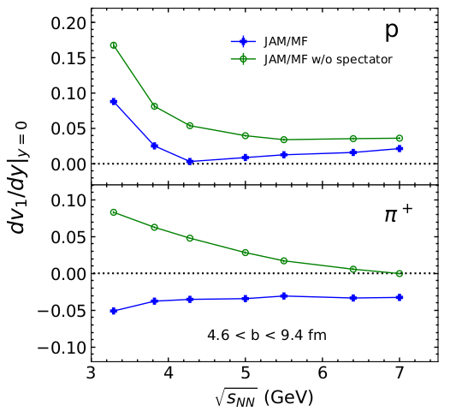
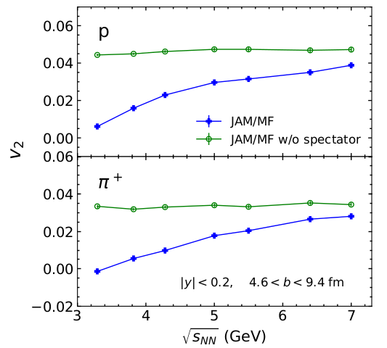
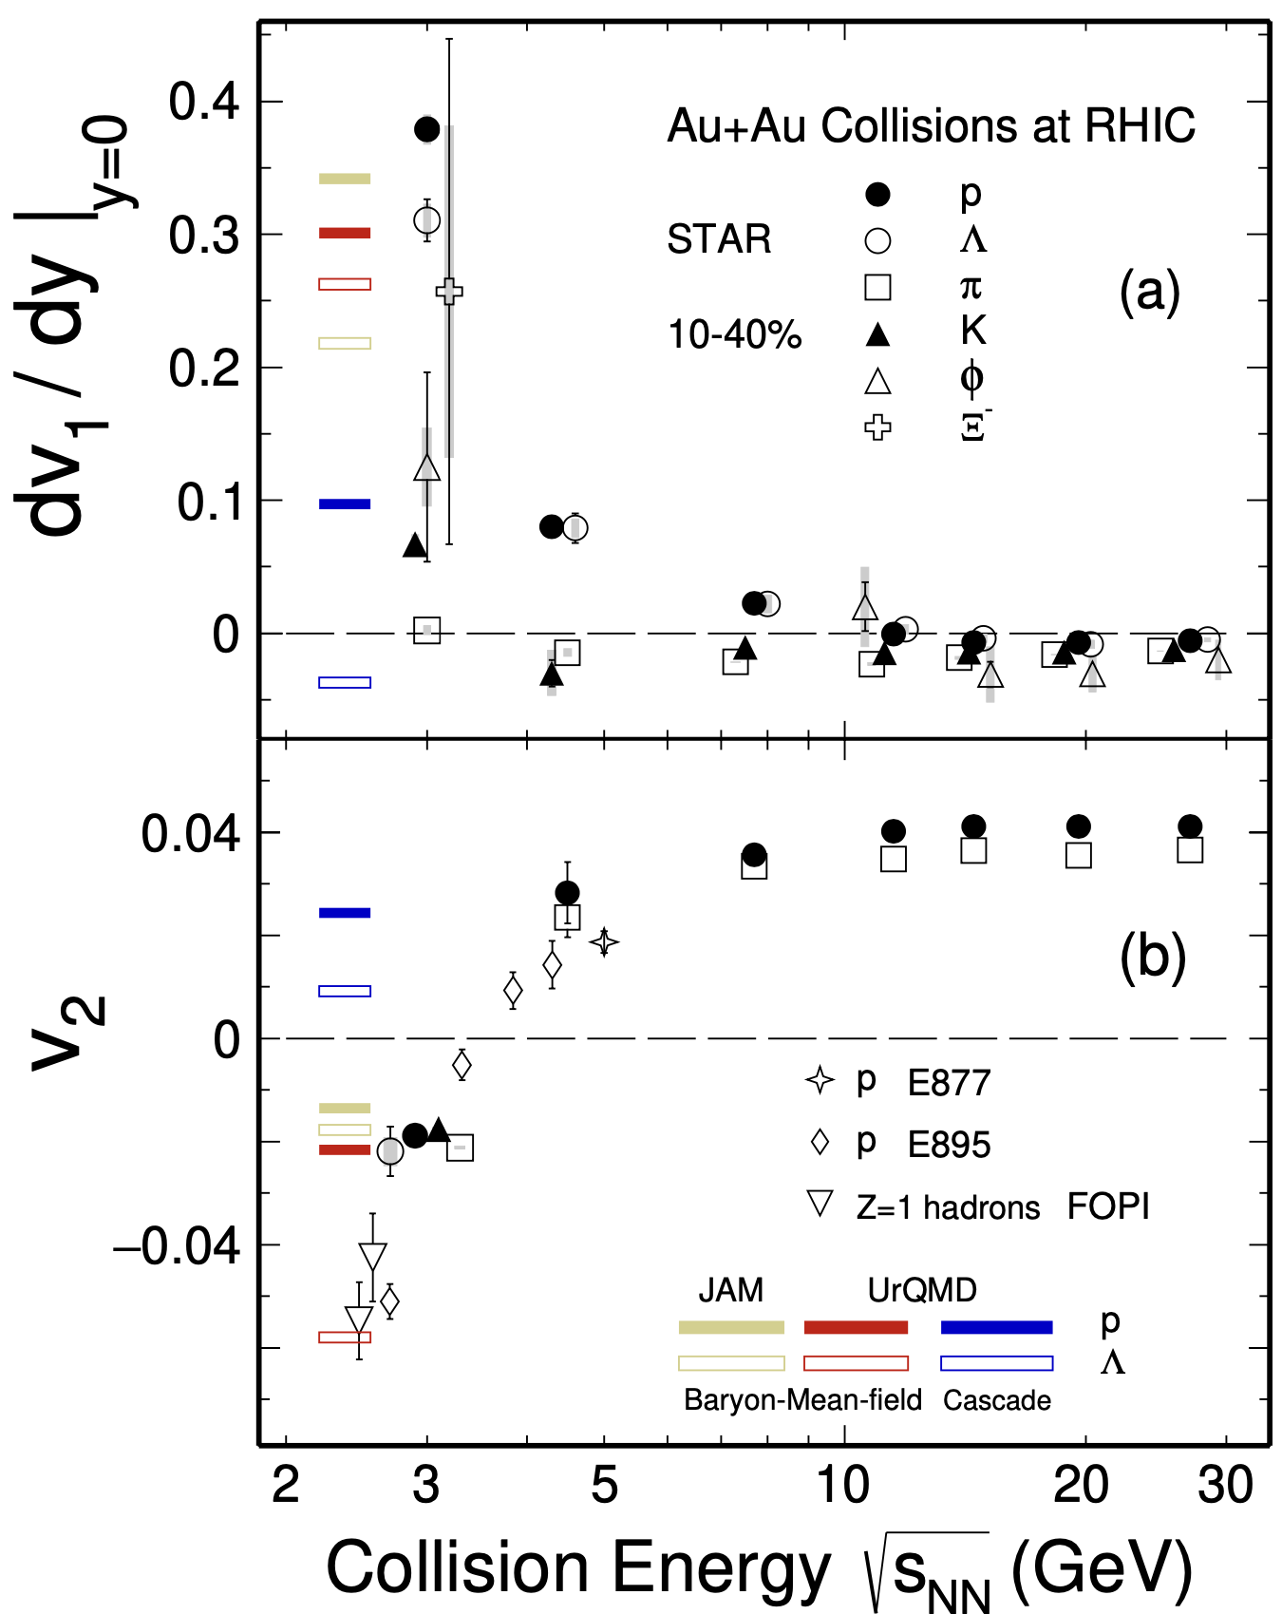

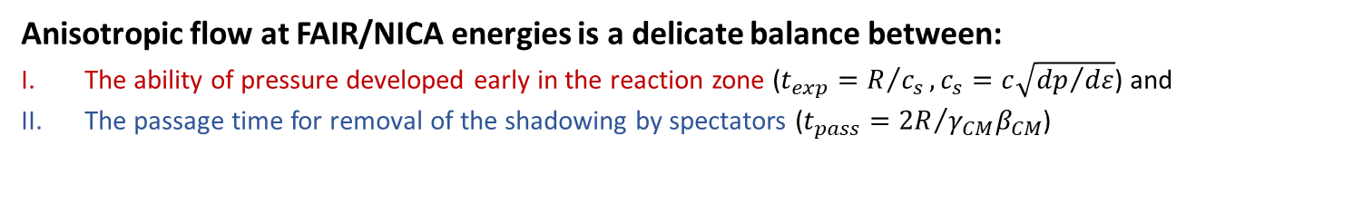
Anisotropic flow in heavy-ion collisions at high baryon density
M. Abdallah et al. STAR, Phys. Lett. B 827, 137003 (2022)
n]
BM@N
CBM
MPD
Anisotropic flow at FAIR/NICA energies is a delicate balance between:
The ability of pressure developed early in the reaction zone ($t_{exp}=R/{c_{s}}, c_{s}=c\sqrt{{dp}/{dε}}$) and
The passage time for removal of the shadowing by spectators ($t_{pass}={2R}/{γ_{CM}β_{CM}}$)

Slide 7
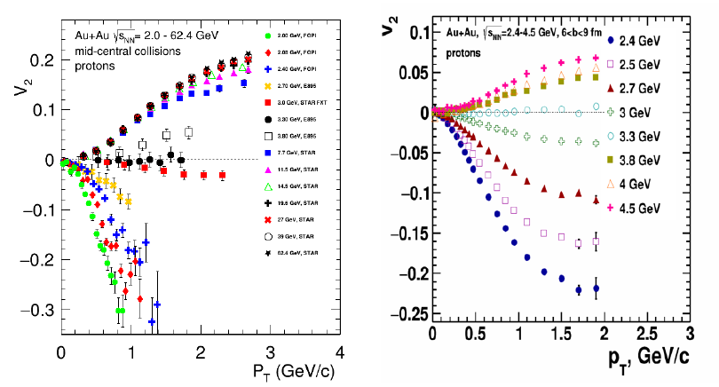
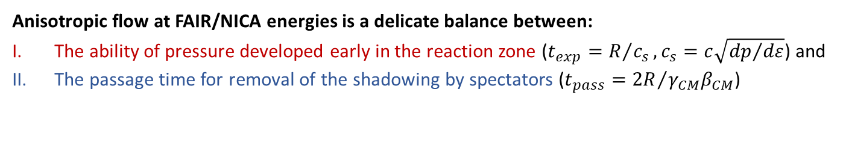
Anisotropic flow in Au+Au collisions at Nuclotron-NICA energies
M. Mamaev, Particles 6 (2023) 2, 622-637
Anisotropic flow at FAIR/NICA energies is a delicate balance between:
The ability of pressure developed early in the reaction zone ($t_{exp}=R/{c_{s}}, c_{s}=c\sqrt{{dp}/{dε}}$) and
The passage time for removal of the shadowing by spectators ($t_{pass}={2R}/{γ_{CM}β_{CM}}$)

Slide 8
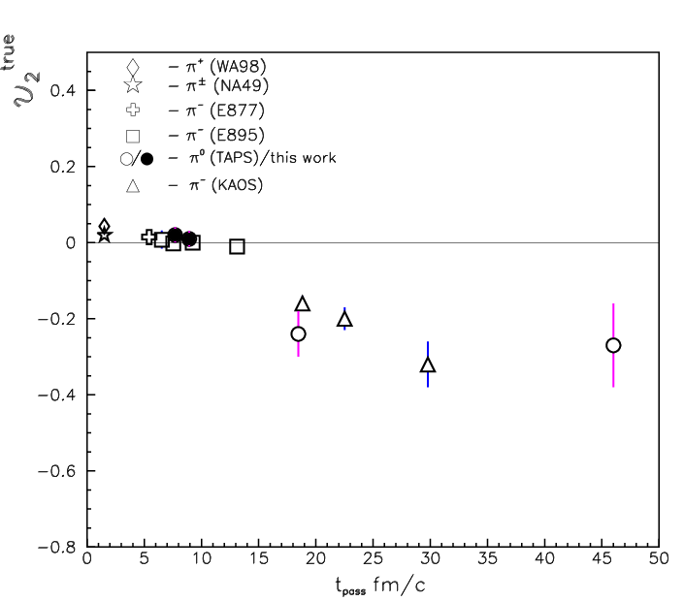
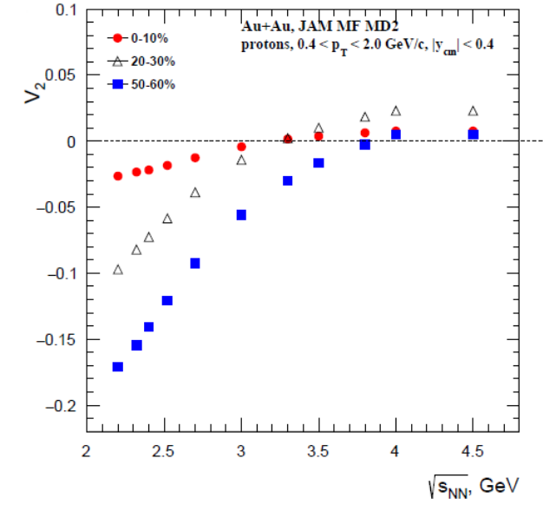
Elliptic flow: transition from out-of-plane to in-plane: geometry
P. Parfenov, Particles 5 (2022) 4, 561-579
A.T Czech.J.Phys. 50S4 (2000) 139-166
Au+Au
Ni+Ni, Ca+Ca

Slide 9
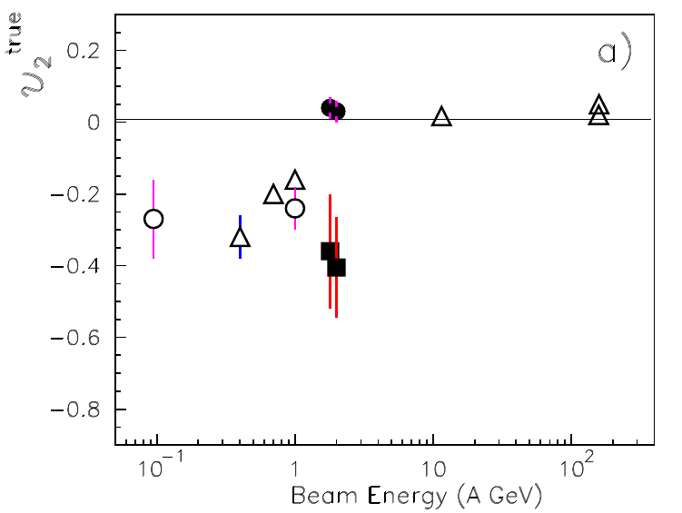
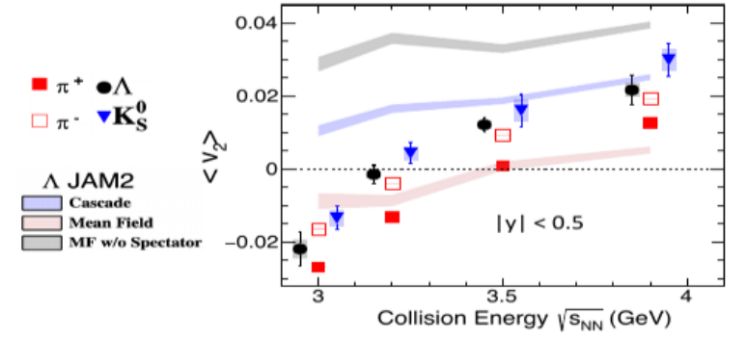
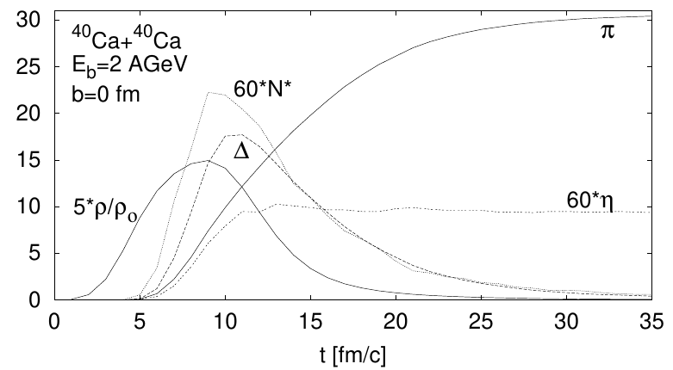

Elliptic flow: transition from out-of-plane to in-plane: PID
Li-Ke Liu (CCNU), STAR Collaboration, CPOD 2024
A.T Czech.J.Phys. 50S4 (2000) 139-166
$$π^{0}$$
η

Slide 10
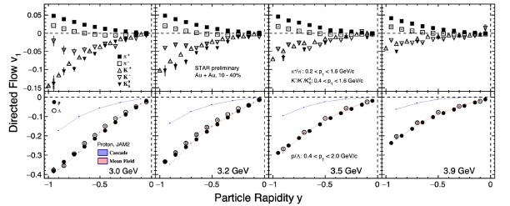
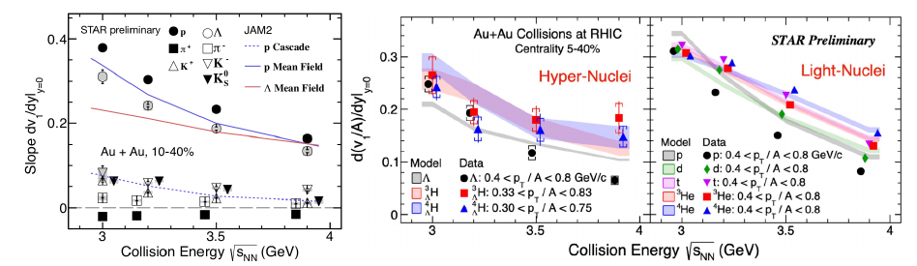
STAR preliminary results from BES – II program – directed flow

Slide 11
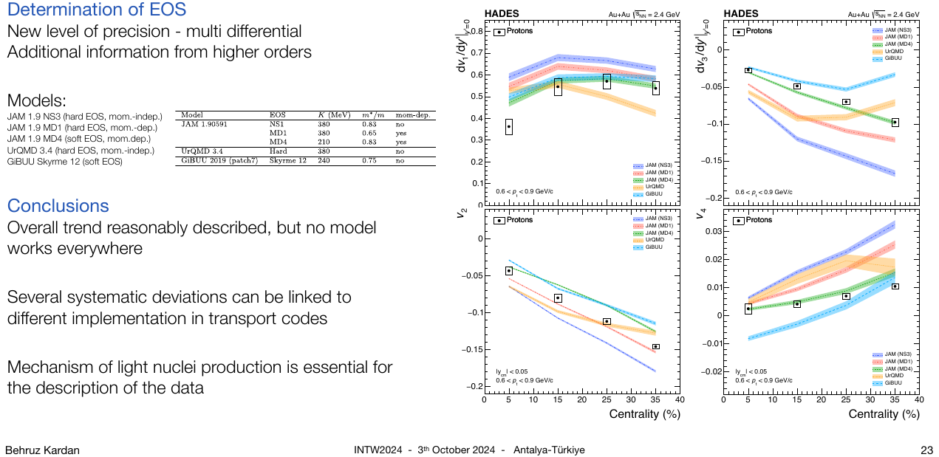
Vn of protons in Au+Au collisions at 2.4 GeV - HADES

Slide 12
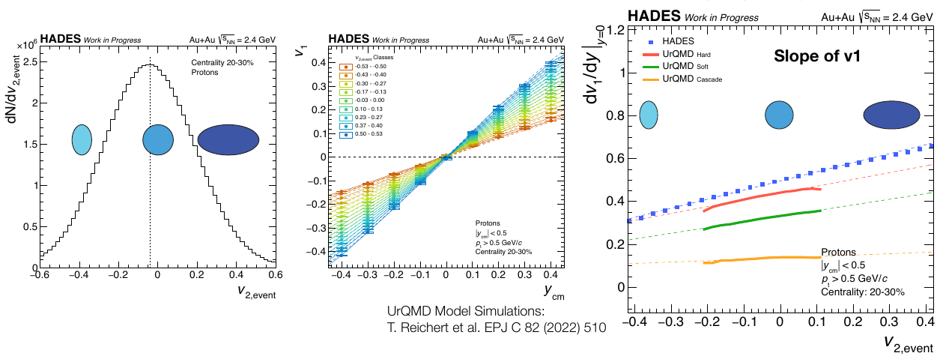
New HADES results on flow correlations

Slide 13
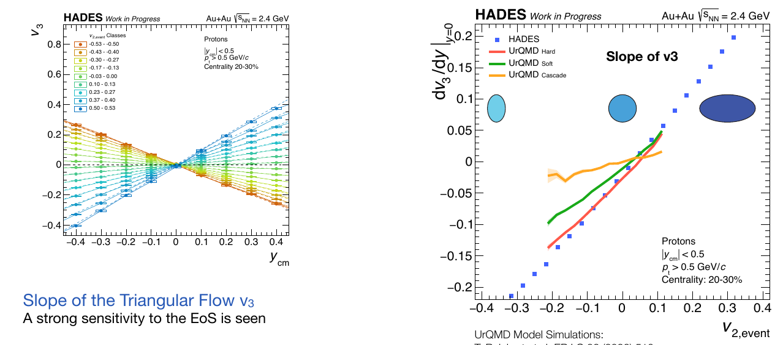
New HADES results on flow correlations

Slide 14
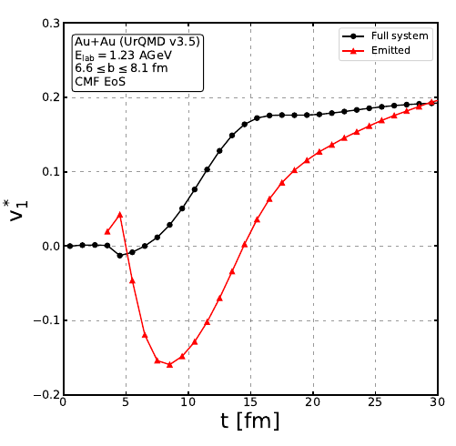
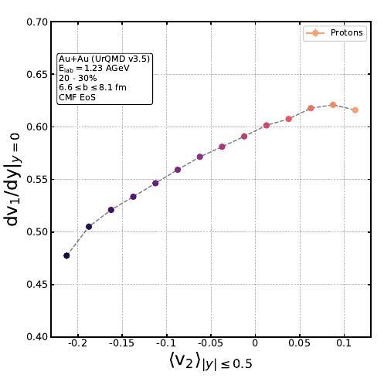
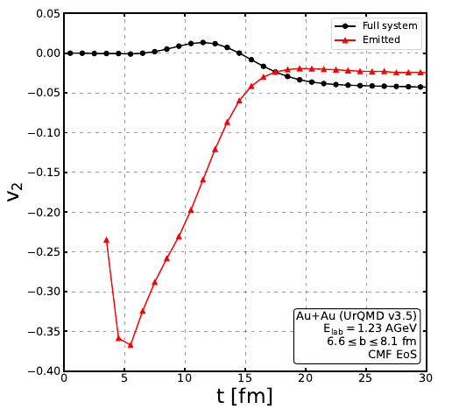
Decoding the flow evolution using hadron ${ V}_{1}$- $V_{2}$ correlations and dileptons
Tom Reichert et al., Phys.Lett.B 841 (2023) 137947
The elliptic flow is initially positive (v2 > 0) due to the early pressure gradient. This positive v2 transfers its momentum to the spectators, which creates the directed flow v1.
In turn, the spectator shadowing of the in-plane expansion results in a negative v2 for the observable final state hadrons. propose a measurement of v1−v2 flow to pin down this evolution pattern.

Slide 15
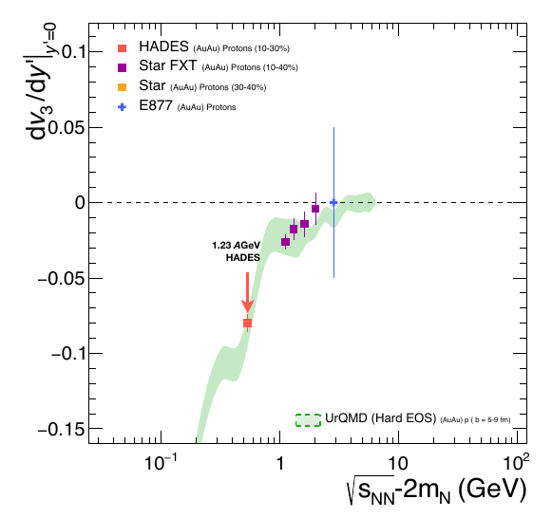
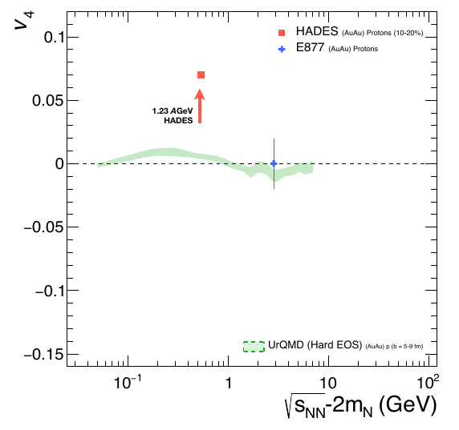
Collision energy dependence of v3 and v4

Slide 16
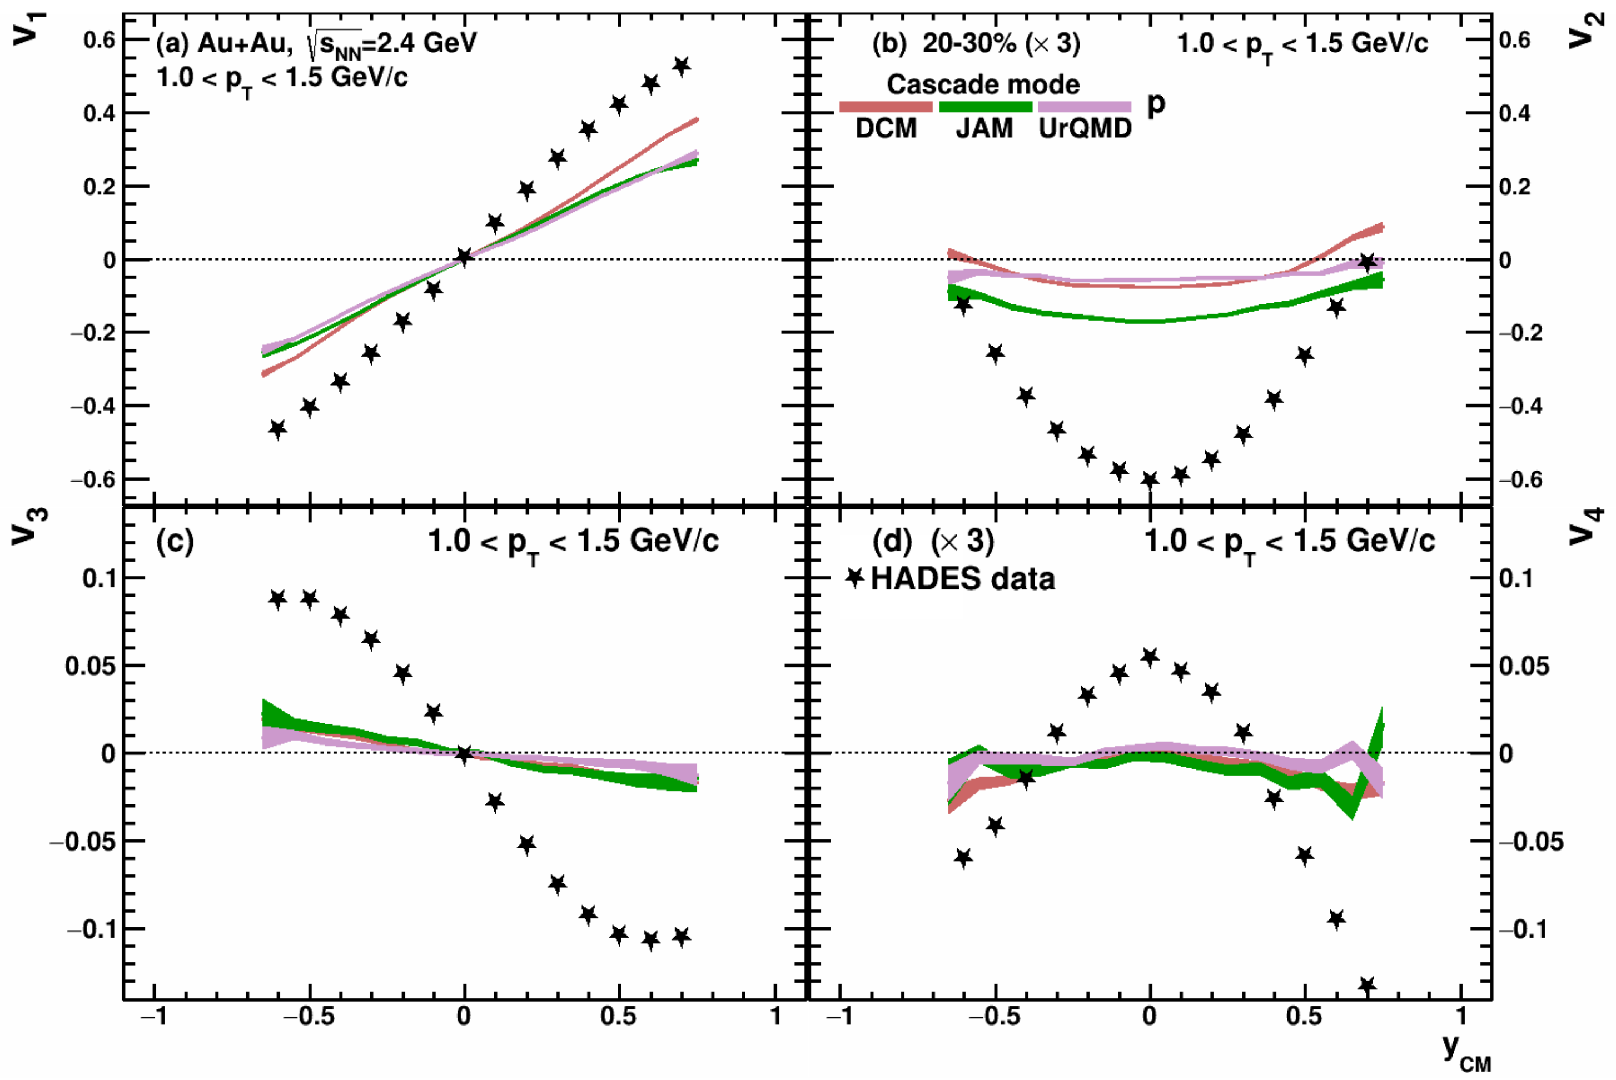
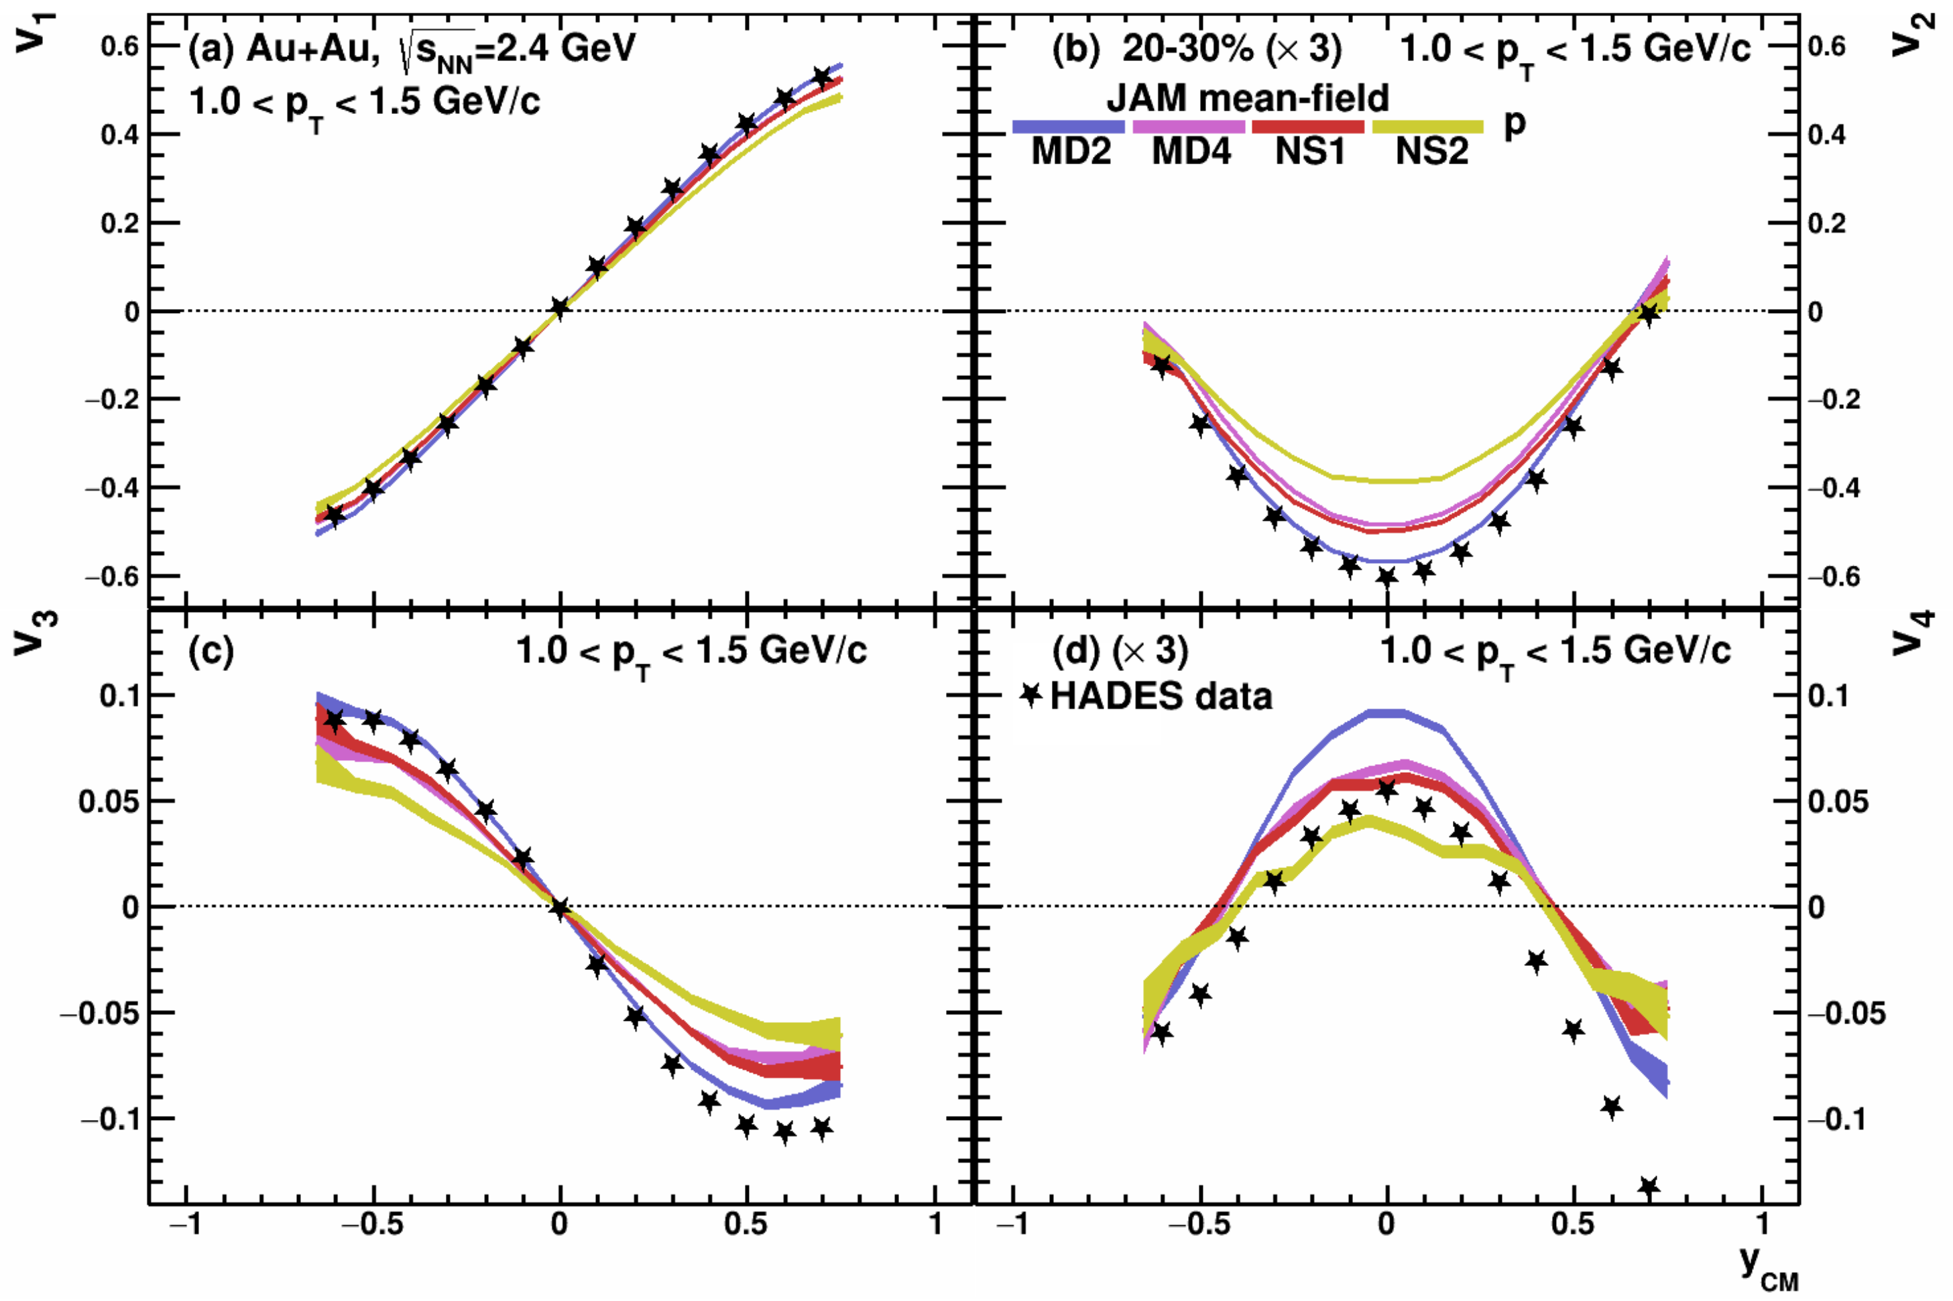
Flow of protons - models vs data
P. Parfenov, Particles 5 (2022) 4, 561-579

Slide 17
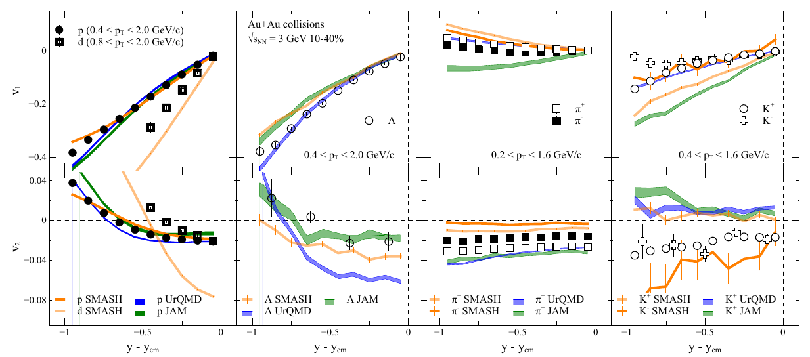
Describing proton flow is not enough
Prog.Part.Nucl.Phys. 134 (2024) 104080
Strange baryons are not well described
— the results may depend on:
• nucleon-hyperon and hyperon-hyperon
interactions
• in-medium modifications of interactions
Pions and kaons NOT described!
Not very surprising: UrQMD, JAM, and SMASH
don’t have mean-fields for mesons

Slide 18
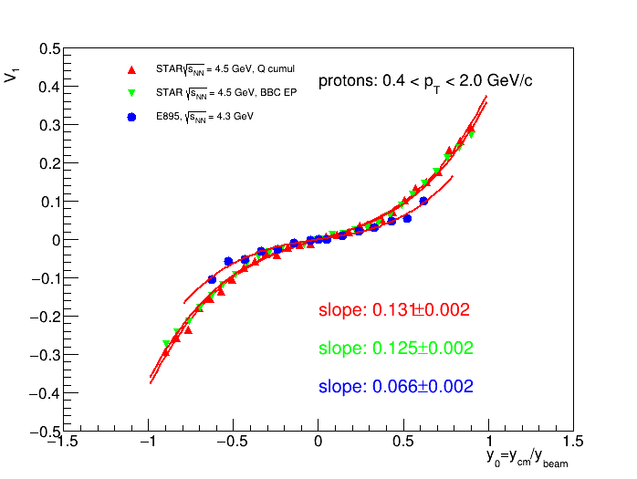
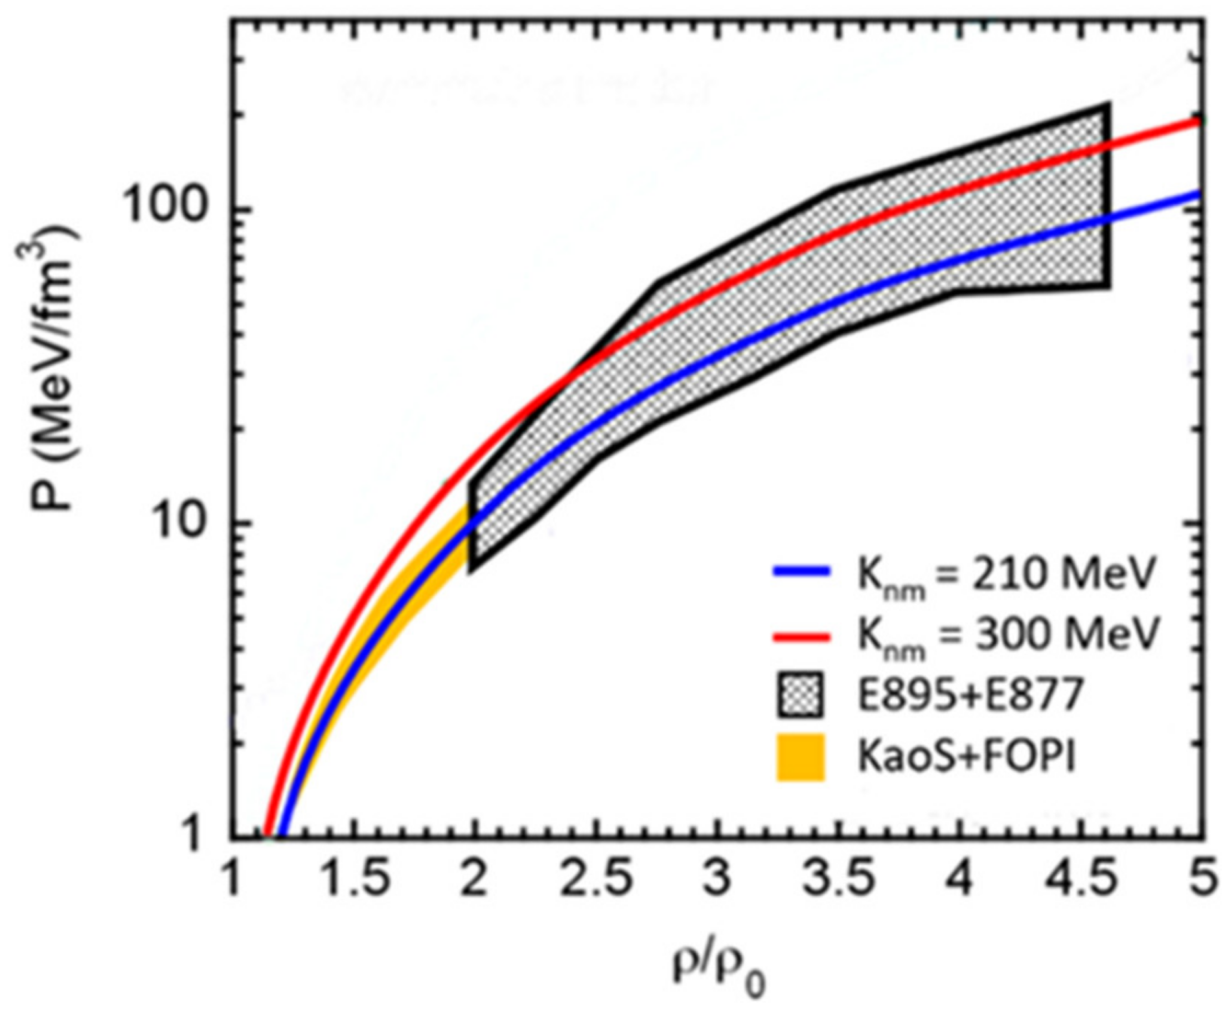
The main source of existing systematic errors in $v_{n}$ measurements
The main source of existing systematic errors in $v_{n}$ measurements is the difference between results from different experiments (for example, FOPI and HADES, E895 and STAR)

Slide 19
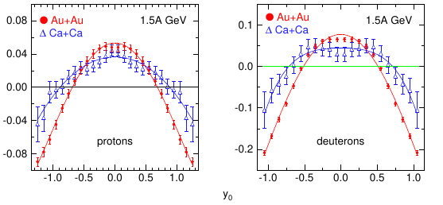
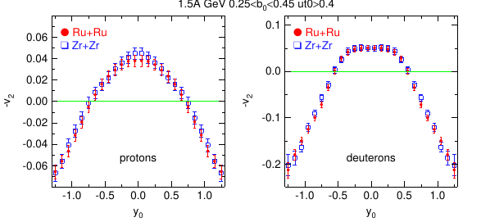
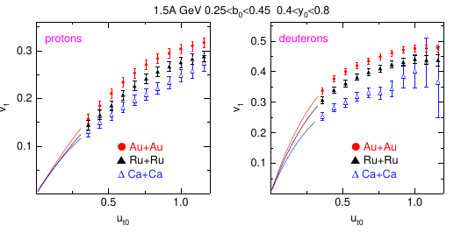
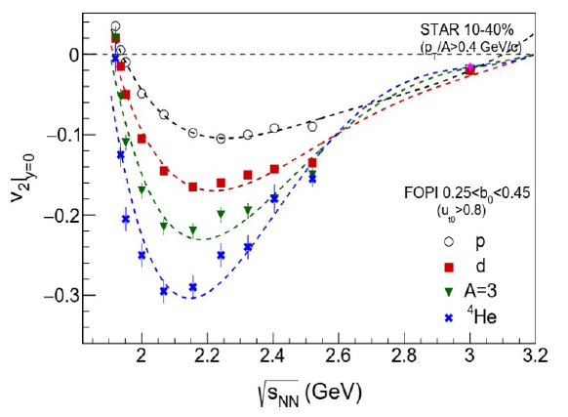
FOPI Ion-Ion collisions at 1.5 AGeV

Slide 20
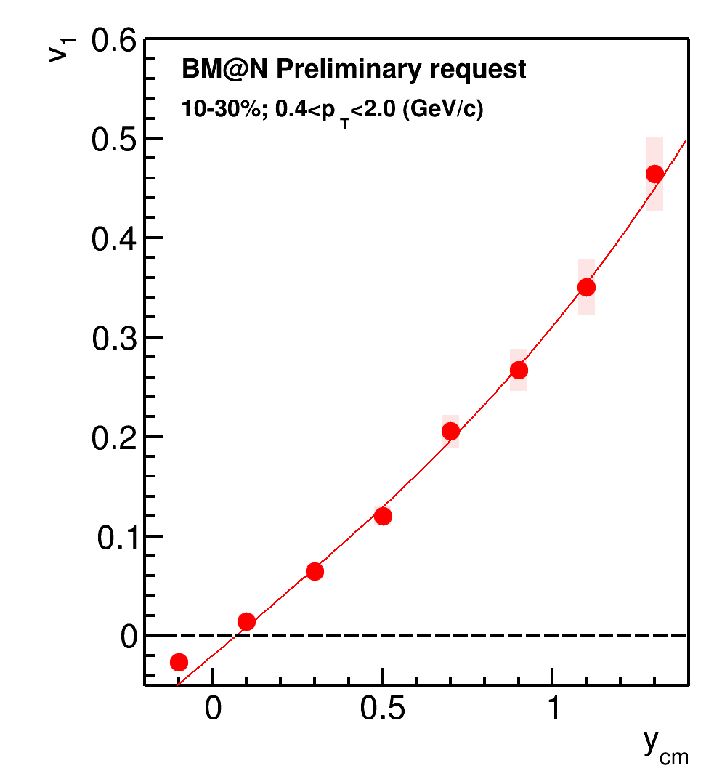
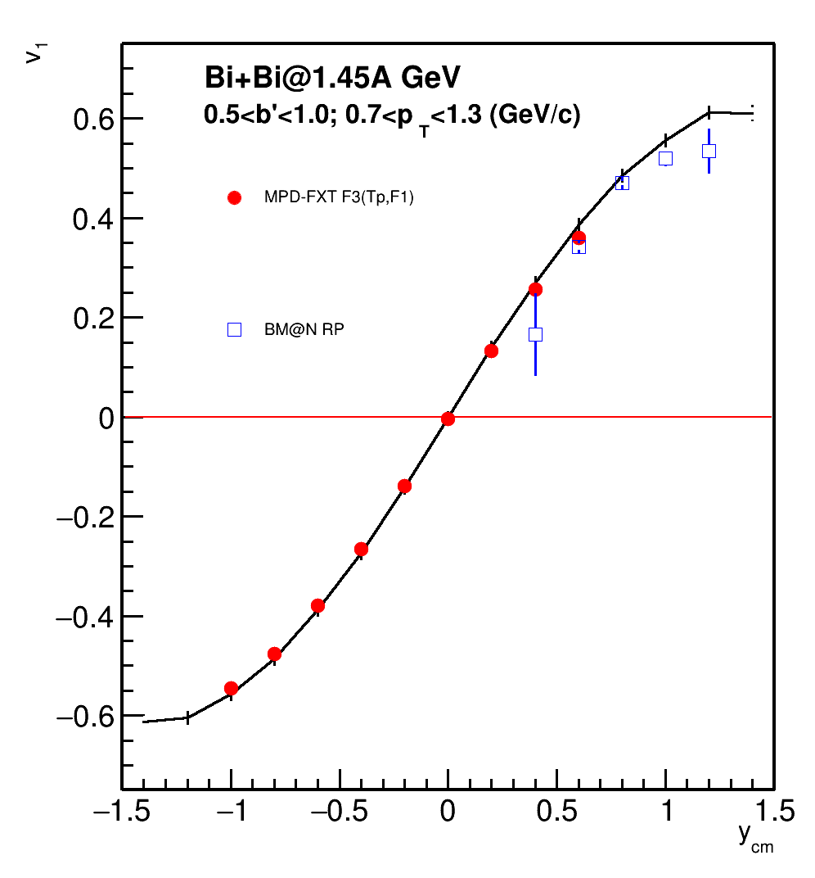
Directed flow of protons: BM@N – MD FXT

Slide 21
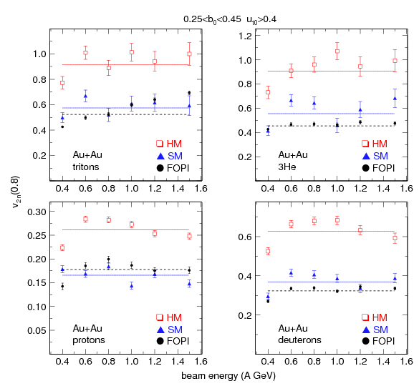

Rapidity dependence of v2 and EOS
FOPI data : Nucl. Phys. A 876 (2012) 1
IQMD : Nucl Phys. A 945 (2016)
HM – stiff momentum dependent with K=376 MeV
SM – soft momentum dependent with K=200 MeV
V2n=|V20|+|V22|
Fit: V2(y0)=V20+V22*Y0^2
Large rapidity coverage is important for flow measurements

Slide 22
Summary and outlook
Measurements of anisotropic flow, flow fluctuations, correlations between flow of different harmonics are sensitive to many details of the initial conditions and the system evolution. It may provides access to the transport properties of the medium: EOS, sound speed (cs ), viscosity, etc.
v_{n} at energies 2.5-11 GeV (SIS, STAR BESII, NICA, FAIR) shows strong energy dependence: possible transition between hadronic and partonic matter.
System size scan is very important in order to understand the effect of spectators on the experimental observables
Large rapidity coverage is important for flow measurements
22
Notes:
22
22
22
22
22
22
22
22

Slide 23

Backup

Slide 24




v₂ Flow at SIS-AGS: scaling relations
(KAOS – Z. Phys. A355 (1996);
(E895) - PRL 83 (1999) 1295
FOPI: v₂ of protons from
Elab=0.09 to 1.49 GeV
Phys.Lett. B612 (2005) 173-180

Slide 25


Vn of protons in Au+Au collisions at 2.4 GeV - HADES

Slide 26
Describing proton flow is not enough
Prog.Part.Nucl.Phys. 134 (2024) 104080
Strange baryons are not well described
— the results may depend on:
• nucleon-hyperon and hyperon-hyperon
interactions
• in-medium modifications of interactions
Pions and kaons NOT described!
Not very surprising: UrQMD, JAM, and SMASH
don’t have mean-fields for mesons

