Slide 1
Prototype ASIC development for
NICA SPD Time of Flight detector.
E.Usenko
INR RAS – NICA SPD (JINR).

Slide 2
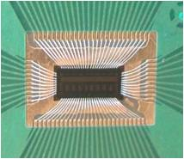
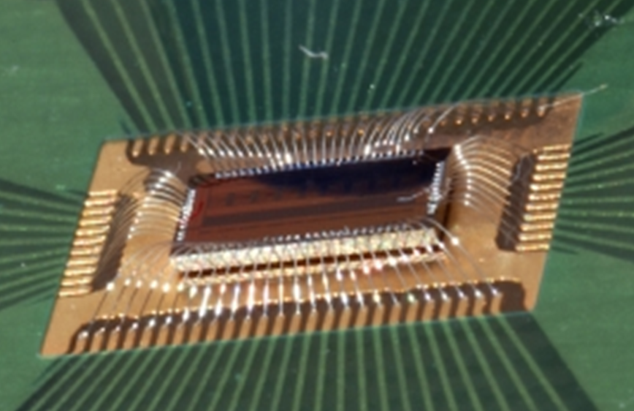
NINO ASIC – bounding to PCB.
Estimated time for end of ASIC prototype production is December 2023.
First step – is design test PCB for ASIC bounding like NINO ASIC.

Slide 3
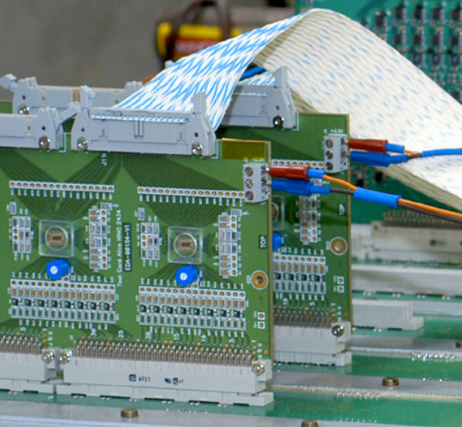
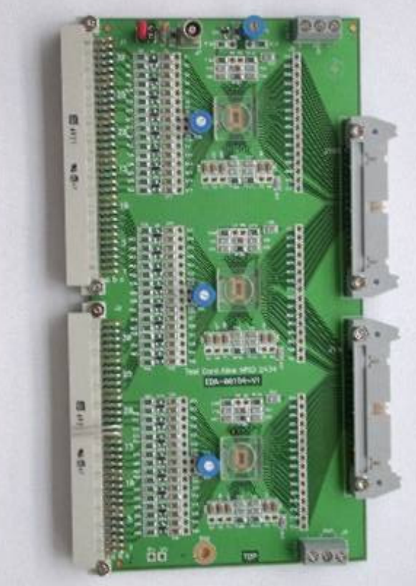
NINO ASIC – test board.
ALICE NINO ASIC 24-channel test board.
Include especial design for parametric measurements and first conceptual beam test.

Slide 4
NINO ASIC – test board schematic and structure.

Slide 5
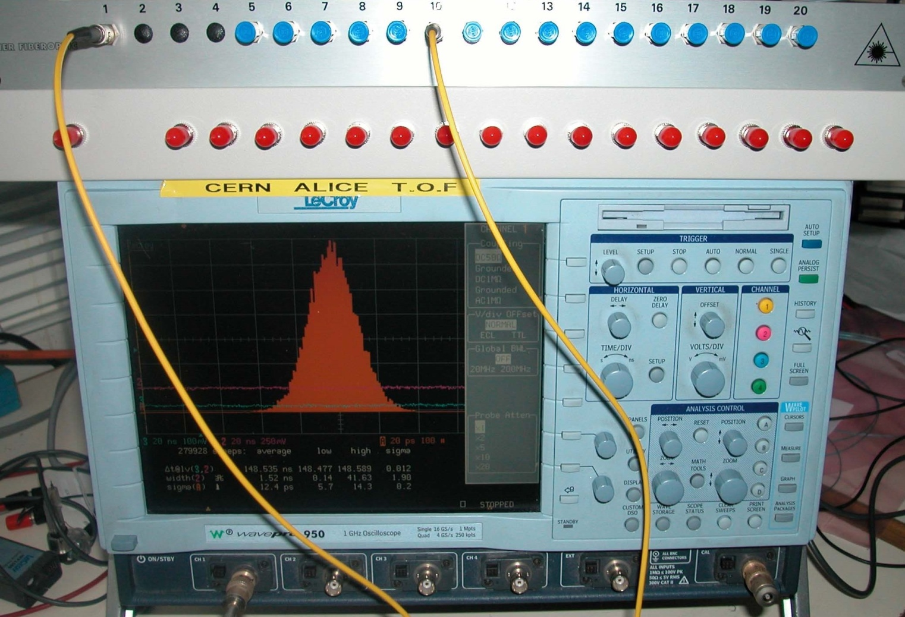
NINO ASIC – time resolution and cross talk measurements.

Slide 6
Time of Flight SPD ASIC – first prototype testing.
To start testing the first prototype of the time-of-flight SPD ASIC, there is a complete understanding of what and how to do, experience and qualifications.
There is no equipment and a clean room.
The issue of a clean room is currently being resolved in the leadership of the INR RAS.
The application for the equipment was made through JINR in December 2022.
To start testing the first prototype of the time-of-flight SPD ASIC, there is a complete understanding of what and how to do, experience and qualifications.
There is no equipment and a clean room.
The issue of a clean room is currently being resolved in the leadership of the INR RAS.
The application for the equipment was made through JINR in December 2022.

