Slide 1
SPD ECAL Status Report in September of 2024
Oleg Gavrishuk, Laboratory of High Energy Physics, Dubna
Matrix Form for new scintillator production (40x40x1.5 mm³) - ready
Scintillator tiles production (Vladimir, Uniplast) – 160000 – plates 40x40x0.5 mm³ - ready
Stamp Form for Lead :
  Design and documentation is read
  Production began in August 2024
Scintillator tiles delivered in Dubna
  Test and paint edges in LVHE – in progress
  Test and paint edges in LNP – in progress
  Modules assembling in LVHE & LNP - in progress
WLS Tver - purchase 200 m, (8.75USD/m) 1750 USD – Selunin, Ribnikov at all.
  Test was done in LNP – Results: Baranov V. report - not better of Kuraray
  MC – Zimin Iliya – WLS att. length influence on EC Resolution
Lead absorber 0.5 mm Ccu (Pb 99.4% + Sb 0.5% + 0.1% metals):
  Manufacturing plates for Modules 80x80 (4 cells) – in progress in LVHE
    Using milling machine – Vitaliy Azorsky – 400 plates should be ready soon
  Manufacturing plates for stamp – 85x168x0.5 mm 40.000 should be done in September-October 2024
WLS Fiber preparation – Not solved – polishing – painted
ADC and Frontend electronic – status not defined yet – responsibility – Anfimov
11/5/2024
Oleg Gavrishuk, JINR, Dubna , Russia
1

Slide 2
Cost of 2024:
Matrix form for Scintillator - 2600000 Rub – 26000 USD
Stamp for Lead - 180000 – 18000
Lead Ordered 450 kg – 4000
Material and tools – 5000
WLS - ordered in Tver – 1750
Lead - need to bye – 800 kg (8 USD/kg) – 12000 USD
Production – 14 Rub/plate - 560000 Rub – 6000 USD
Total – 56550
Numbers for 2024
Scintillator plates: 160000 ps – ordered already
Cells: Ncells=Nsc/200=800 ps – possible assembling in JINR
Modules: Nmod=Ncells/4=200 ps – possible assembling in JINR
Lead plates 80x80: Nlead=Nsc/4=40000 ps – will be stamped in Vladimir
  One Modules Lead Weight ( 200 pl *32 gr)=6.4.kg
  For 200 Modules – 6.4*200=1200 kg of Lead
Led: Exist 450 kg - 399960 Rub (889 Rub/kg – ordered already)

Slide 3
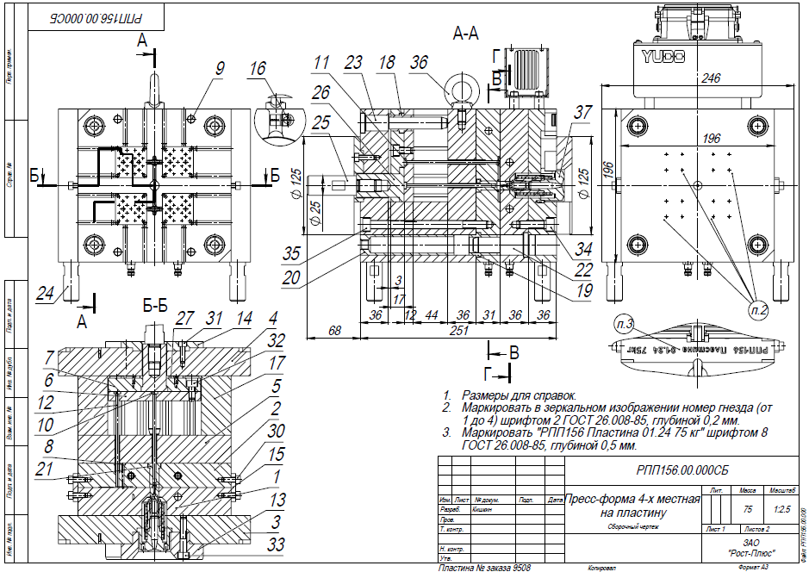
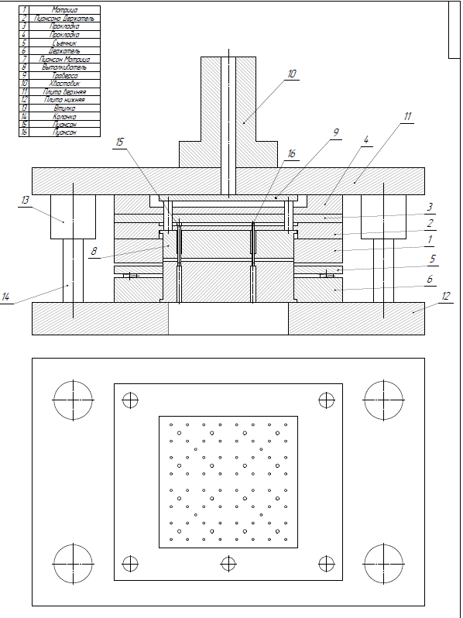
Matrix form for scintillator production (40x40x1.5 mm³)
Stamp for plate 80x80x0.5 mm³

Slide 4
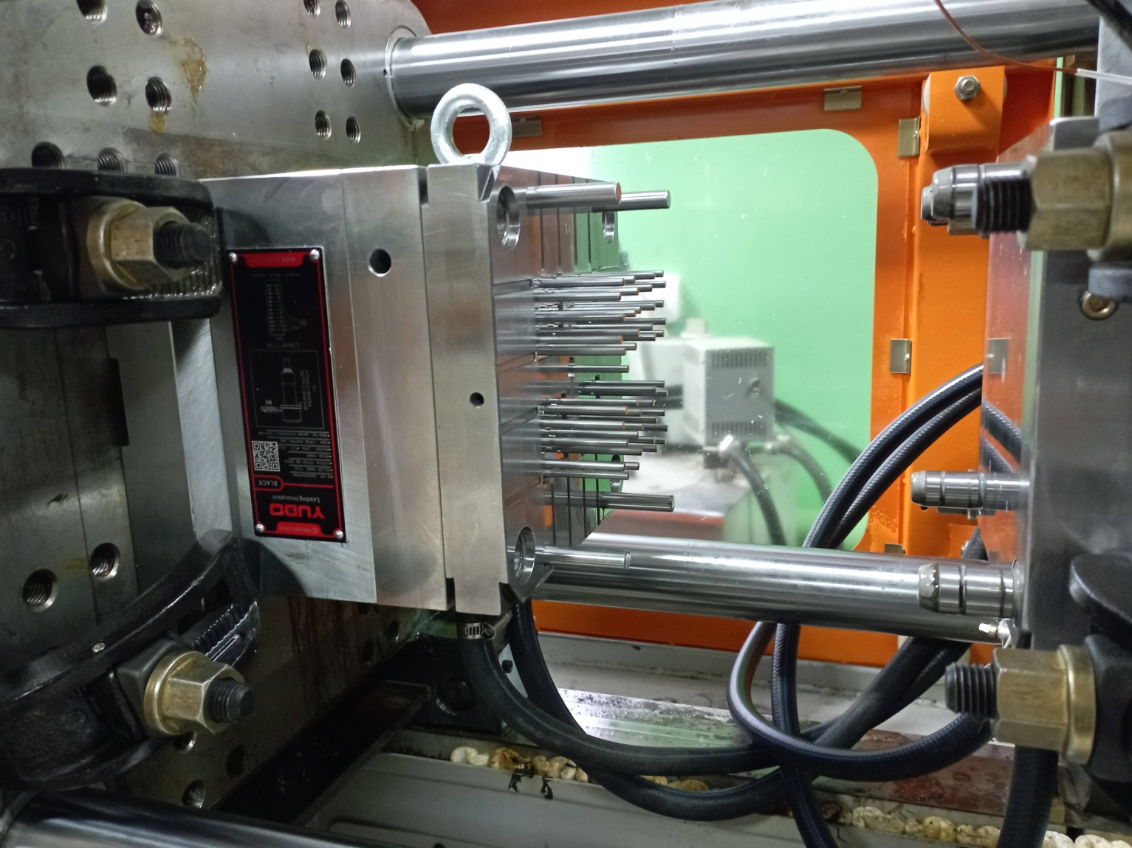
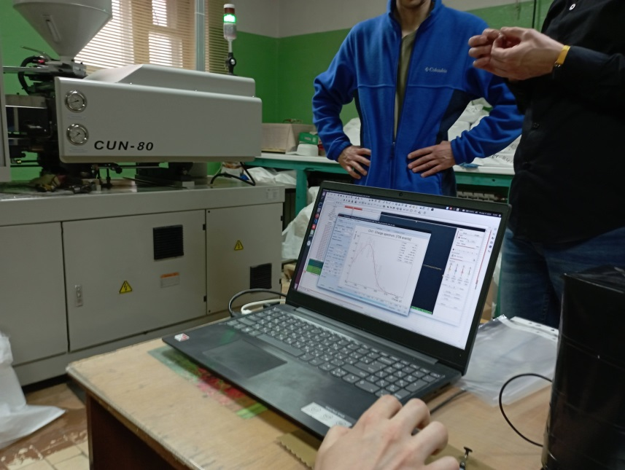
Matrix form for new scintillator production (40x40x1.5 mm³)
Injection molding machine with new
Matrix form for
Scintillator production
Quality test of scintillators.
Vladimir-UNIPLAST
February of 2024

Slide 5
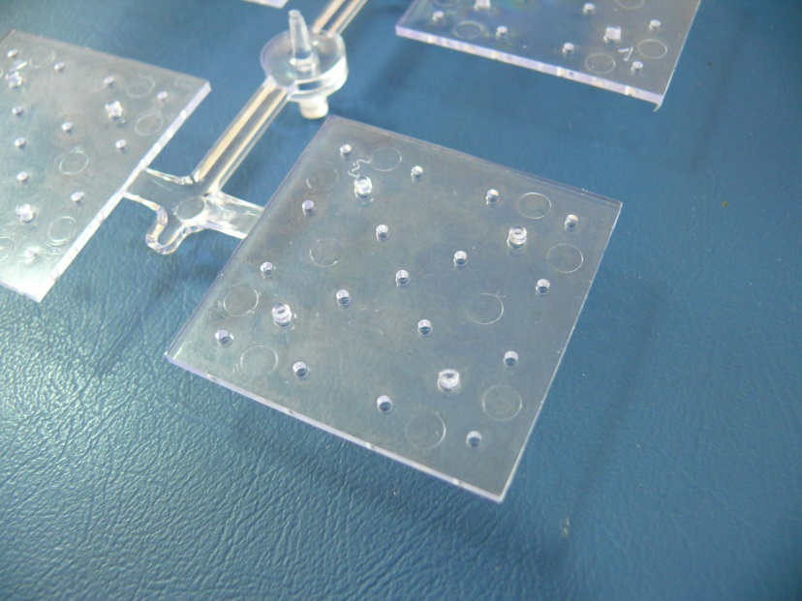
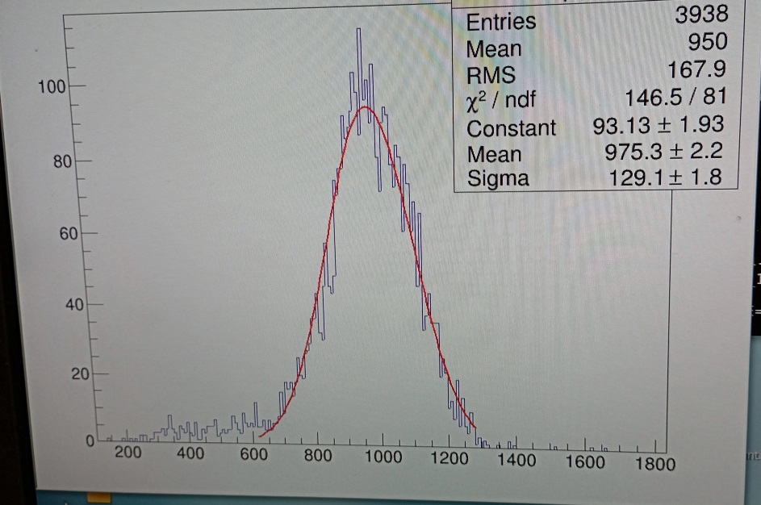
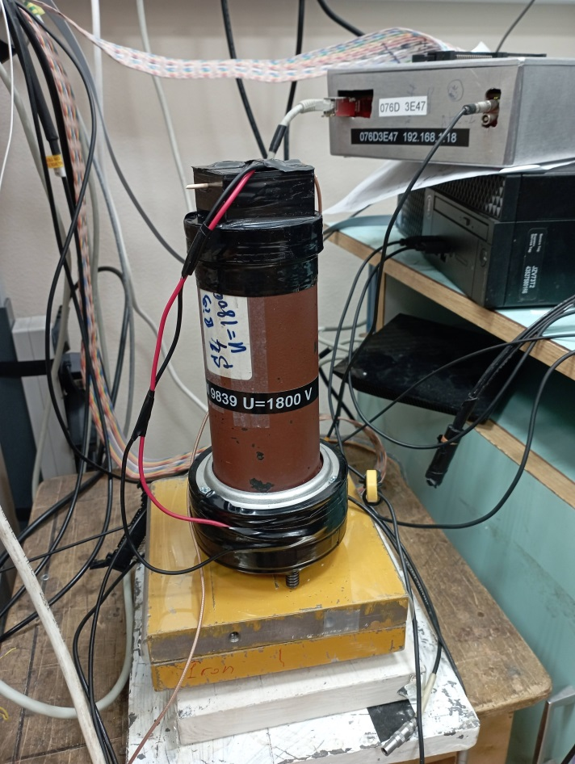
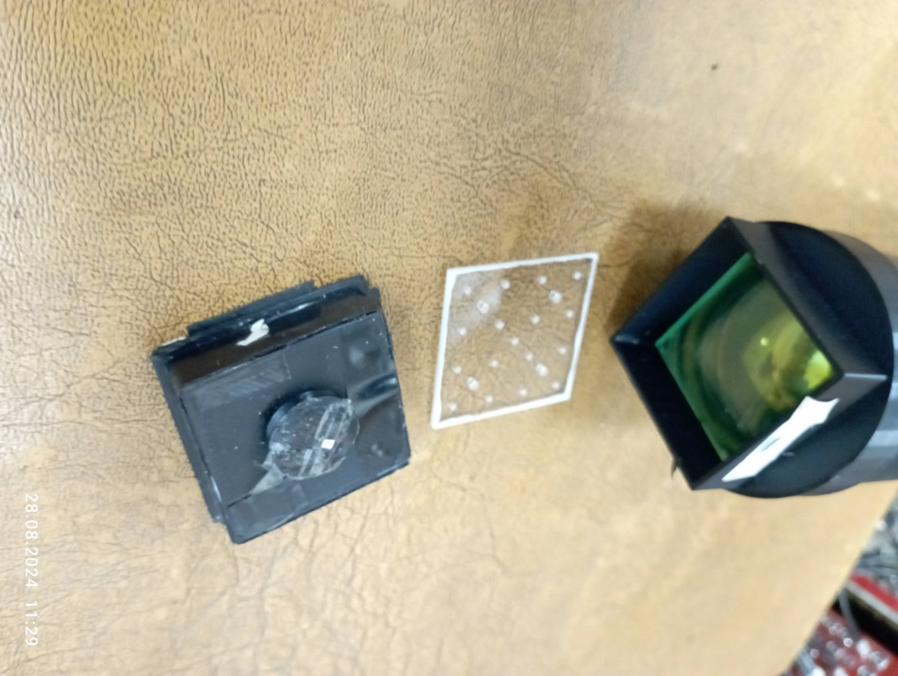
New Cells 160000
produced I Vladimir at February 2024
Spectra from
α-source
4 scintillators plates after injection molding machine
Scintillator plate:
40x40 mm² , t=1.5 mm
WLS and PM
Setup for scintillators test

Slide 6
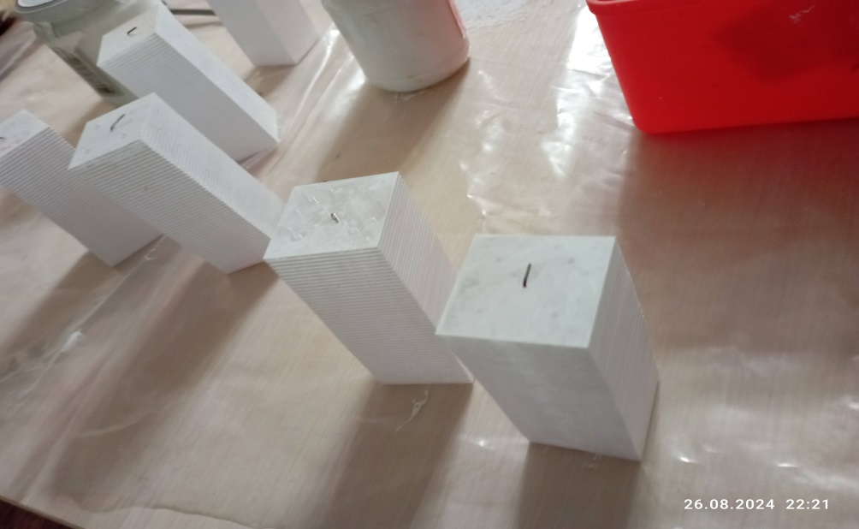
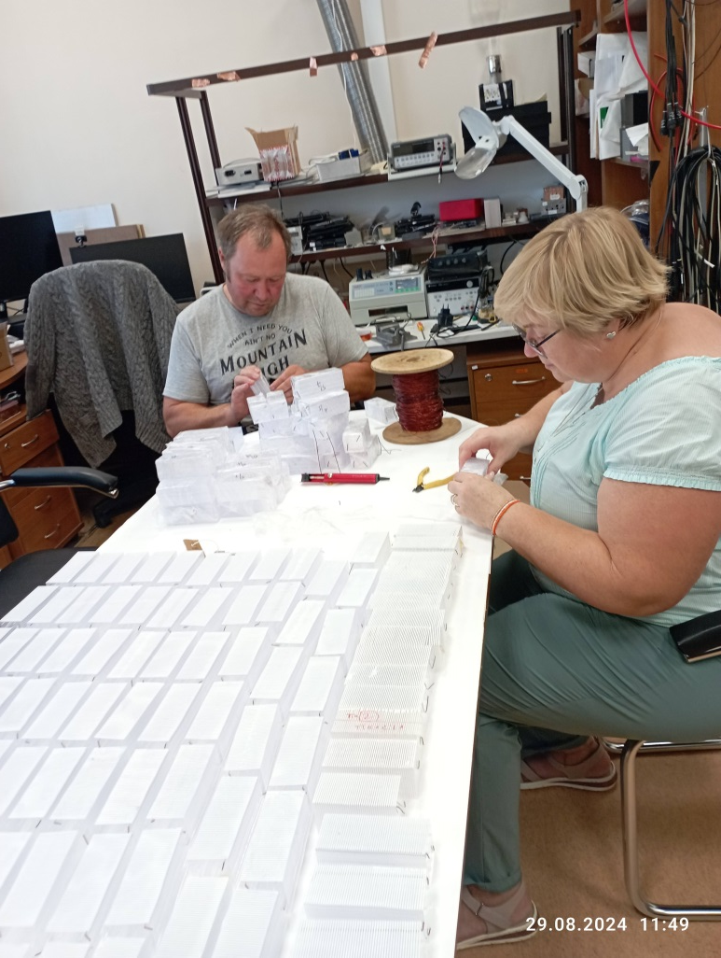
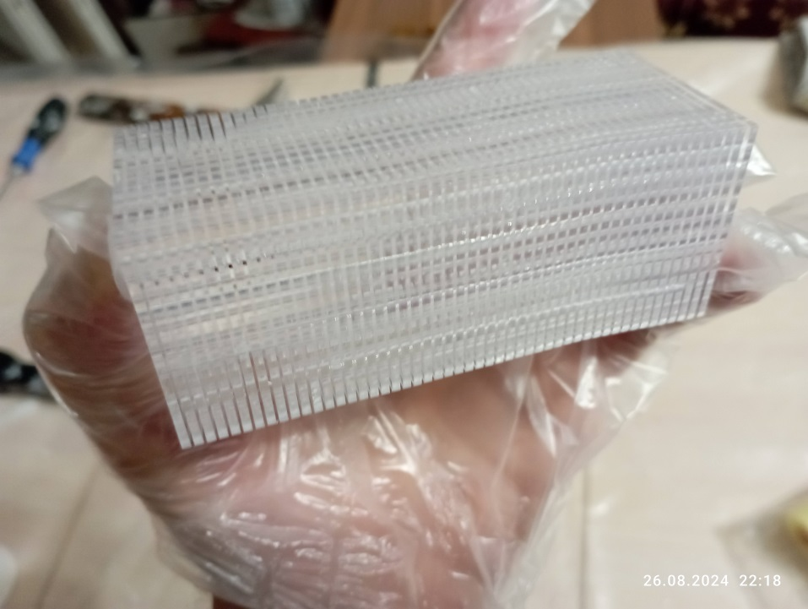
Scintillators painting
Ready for drying
Preparation for painting scintillator plates
Not painted scintillator plates

Slide 7
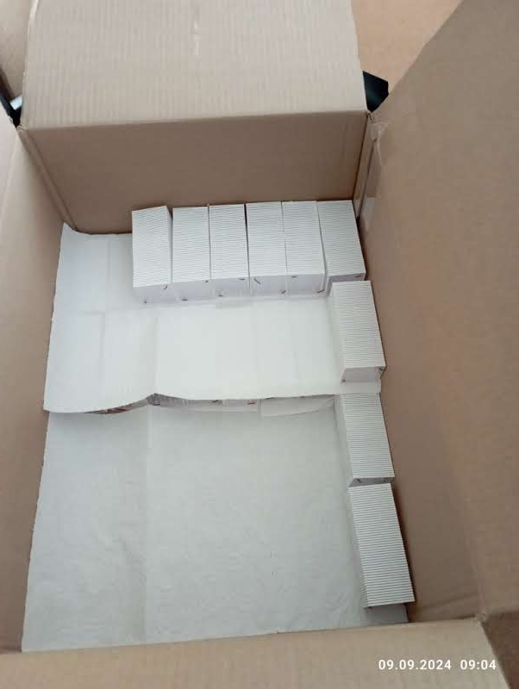
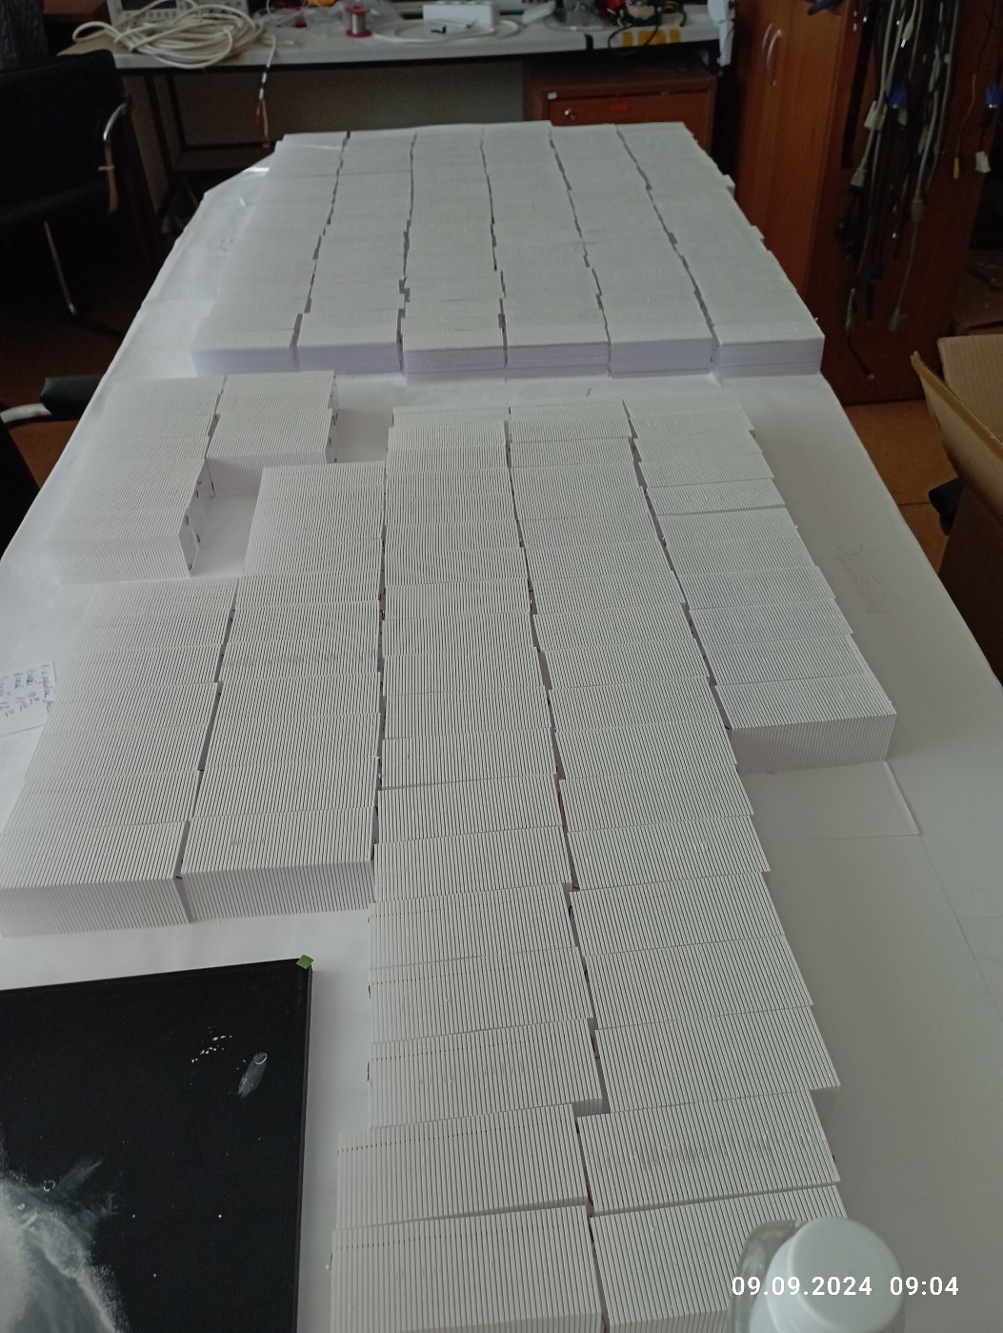
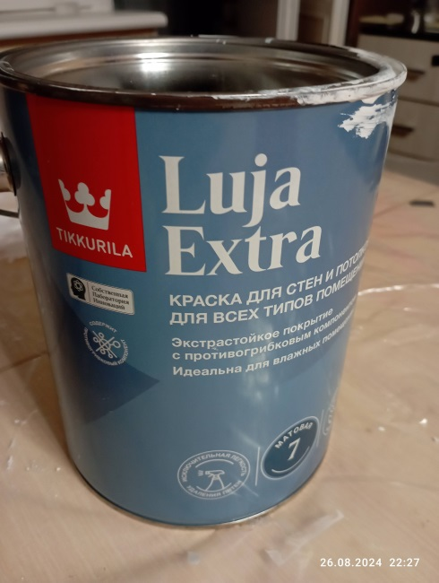
Scintillators painted and stored
Packaging of painted scintillator plates
Drying of painted scintillator plates
Painting video file:
https://photos.app.goo.gl/7yyTLzvsX6r7J8qF7

Slide 8
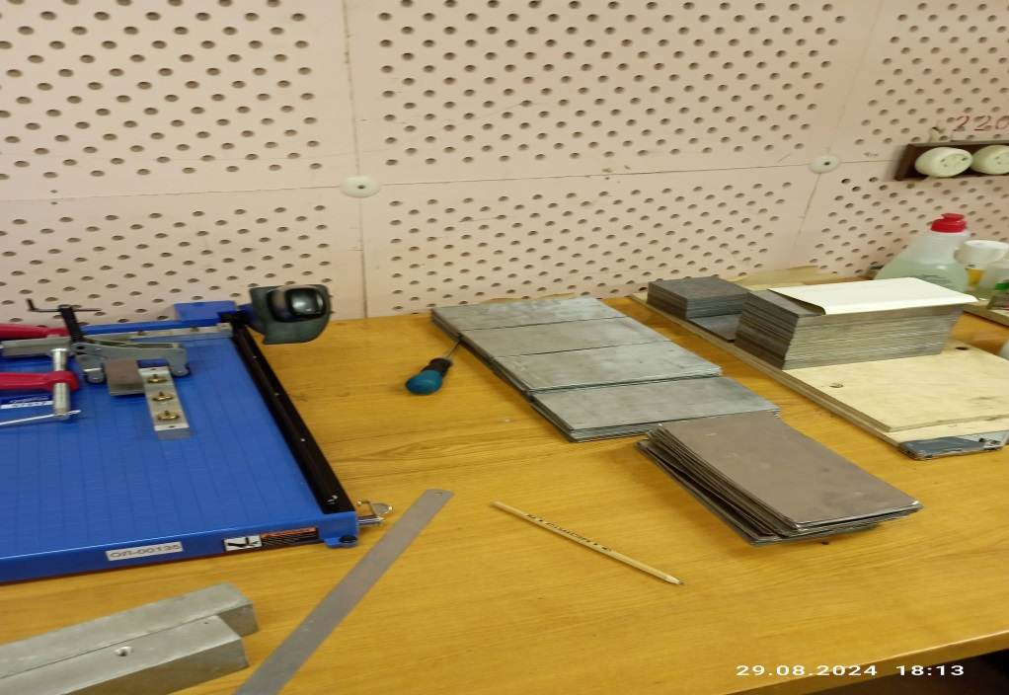
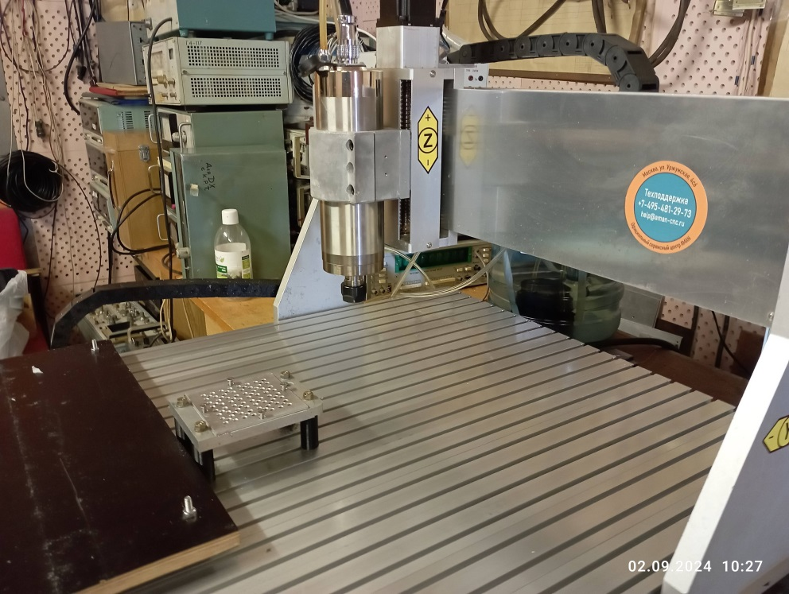
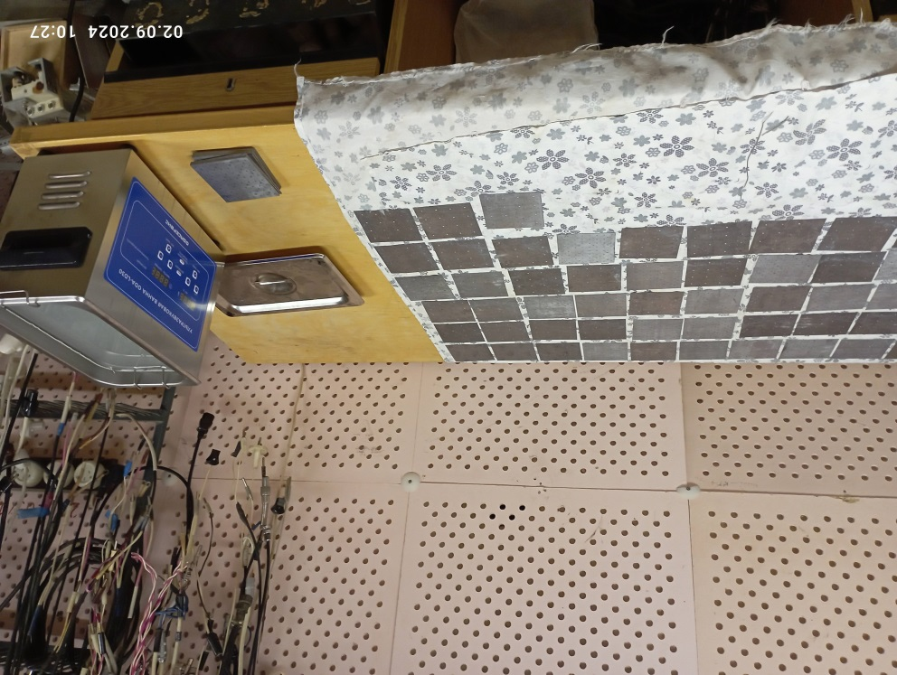
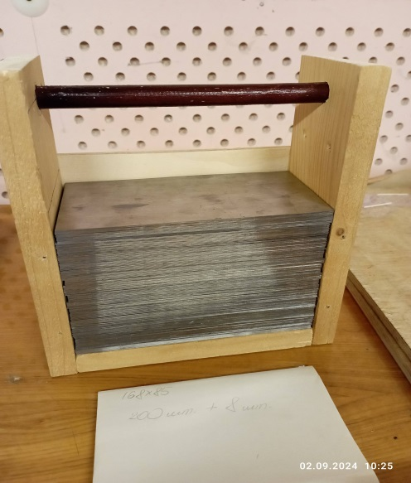
Lead preparation
Lead cutting Setup
Drilling holes in a 80x80 mm² plate on a milling machine
Box for 200 plates of 85x168 mm² – it is
blanks for the press
Has a weight ~20 kg
Washing of lead plates

Slide 9
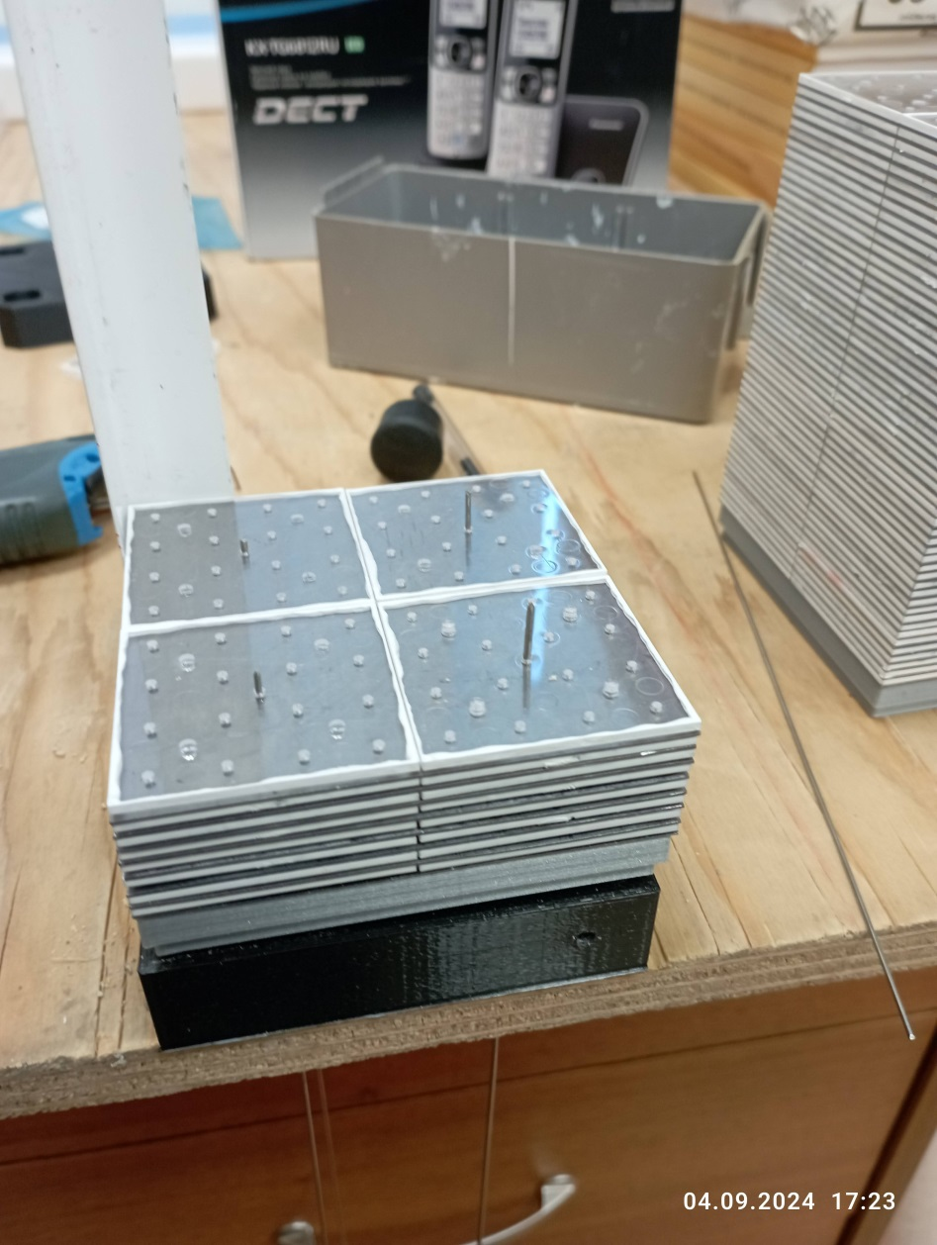
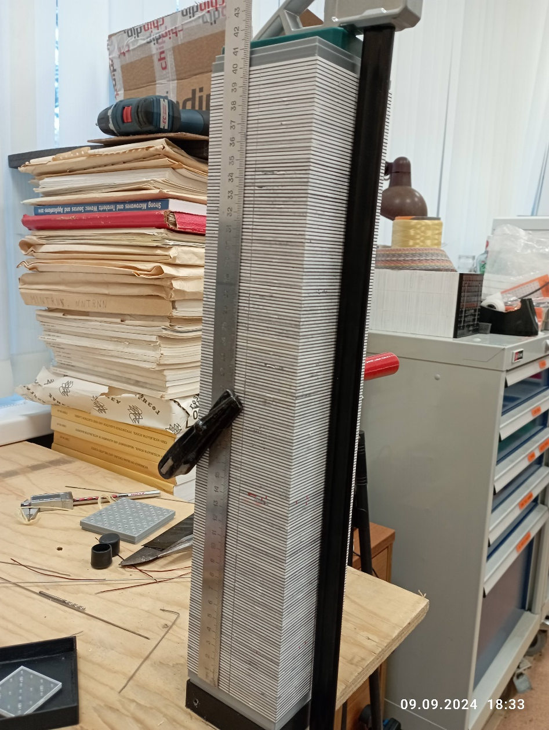
Module assembling – test setup
4-cells module assembling - in beginning starting
Final stage of module stacking with 200 layers of 1.5+0.5 mm scintillators
And Led plates

Slide 10
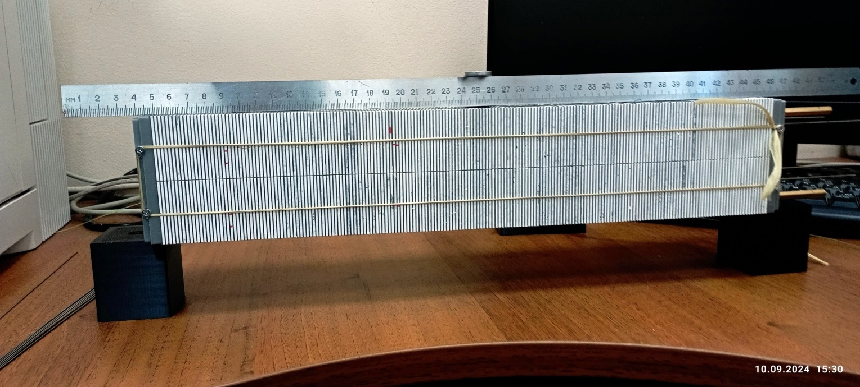
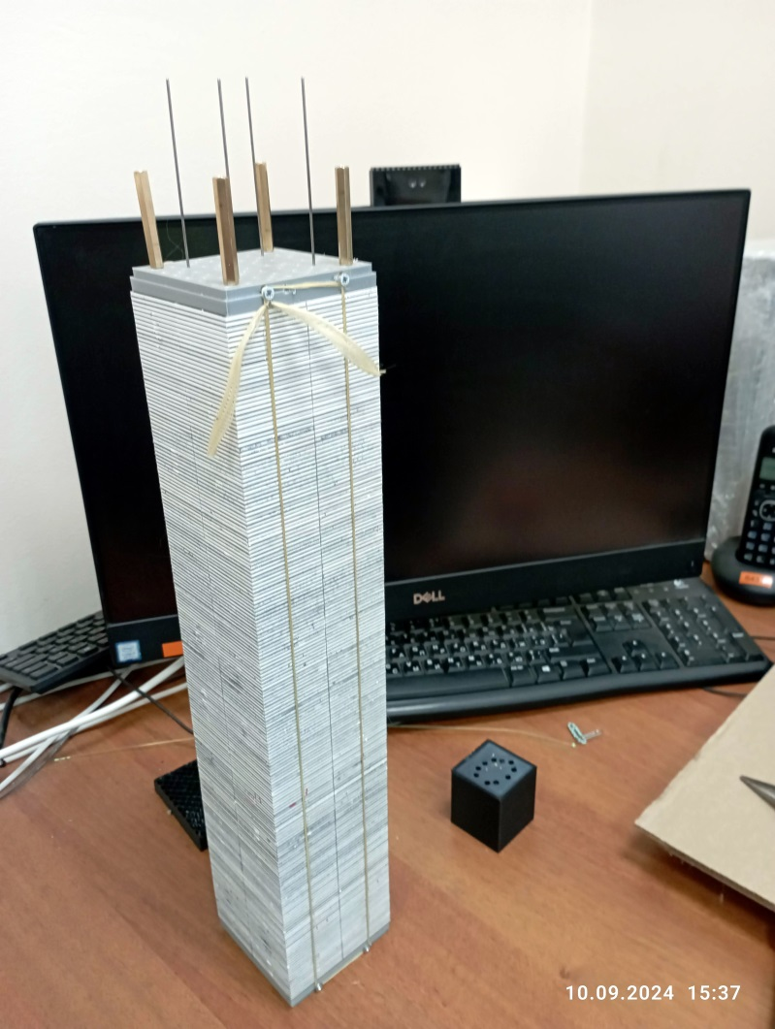
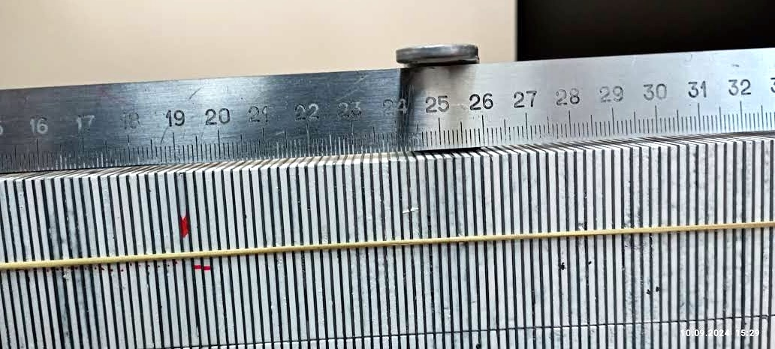
Module assembling and stress test setup
Stress test setup
4-cells module assembled and tied with a Kevlar rope
Center part Zoom

Slide 11
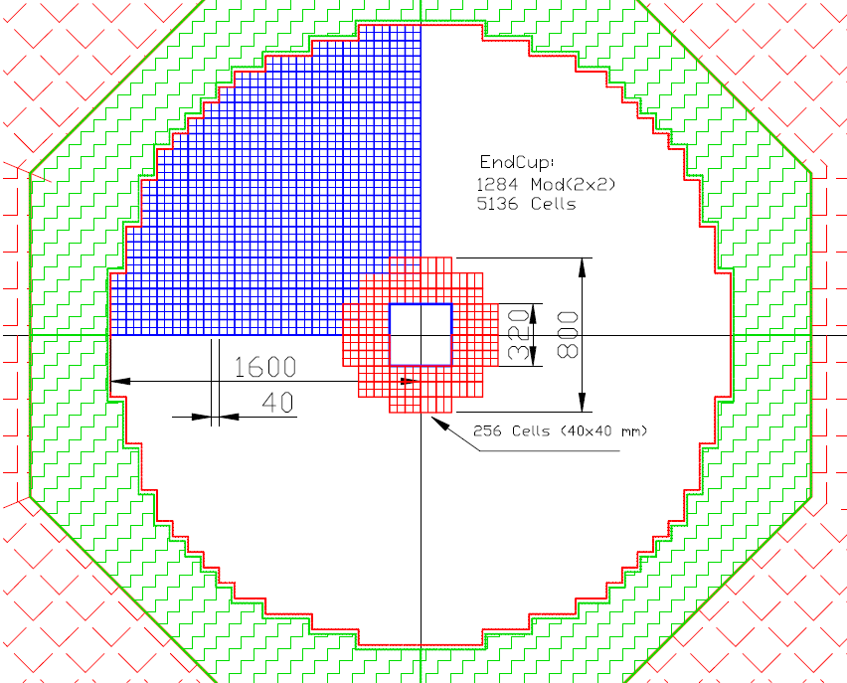
End Cup for SPD with new scintillator to be produced in 2024 via 256 cells of 40x40 mm²
This Figure shows in red 64 modules, consisting of 4 cells each (256 cells). The weight of this assembly is 597 kg. This will require 130 kg of polystyrene, 465 kg of lead, as well as additives: 1.95 kg of P-terphenyl and 65 g. POPOP, and 2000 meters WLS fiber type Y-11.
To read this setup, we need four ADC64 - 64-channel amplitude encoders, as well as 16 boards of 16-channel amplifiers and bias voltage regulators.
Possible central part assembling a little more with 200 modules

Slide 12
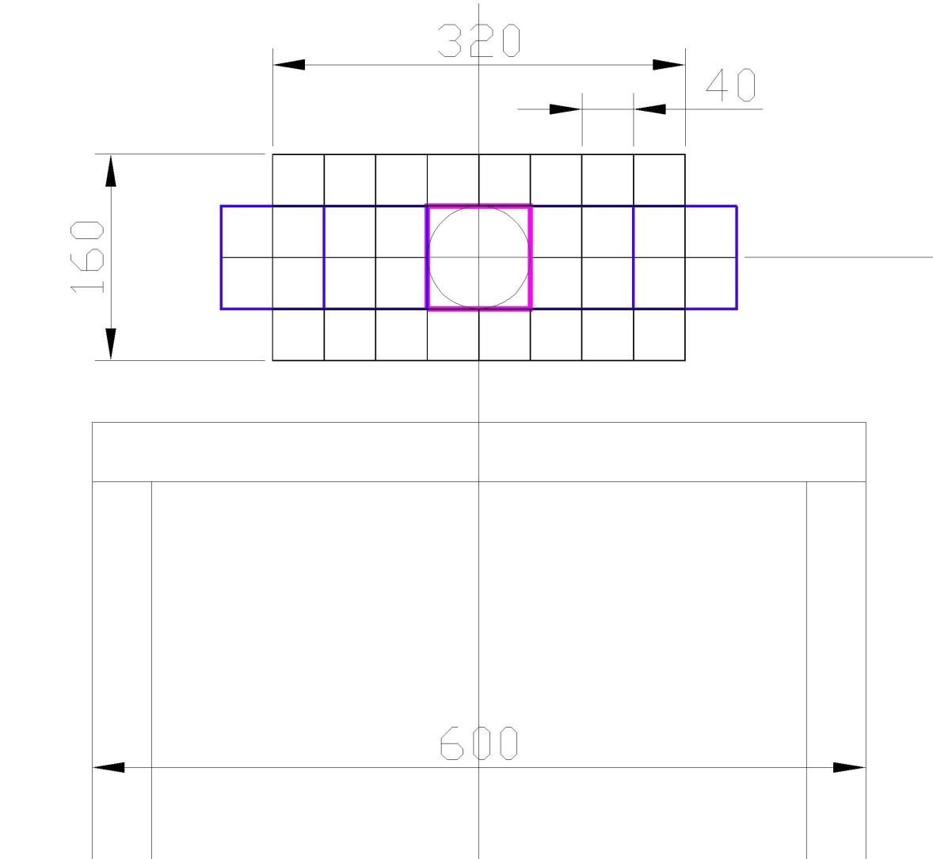
ECAL setup in SPD
Phase_0
ECAL
ЕС - прототип в количестве 64-128 каналов (ячеек 40х40).
Нужно ~220 вольт 5 А для подключения:
1. Крейт NIM (CAMAC)
2. ADC64 – 2 шт
2. Блоки питания SiPm
3. Ethernet - HUB для подключения и управления (1,2)
4. Место порядка 1 м**³ (60x80 cm².)
Possible central part assembling a little bit with 128 cells (32 modules)

Slide 13
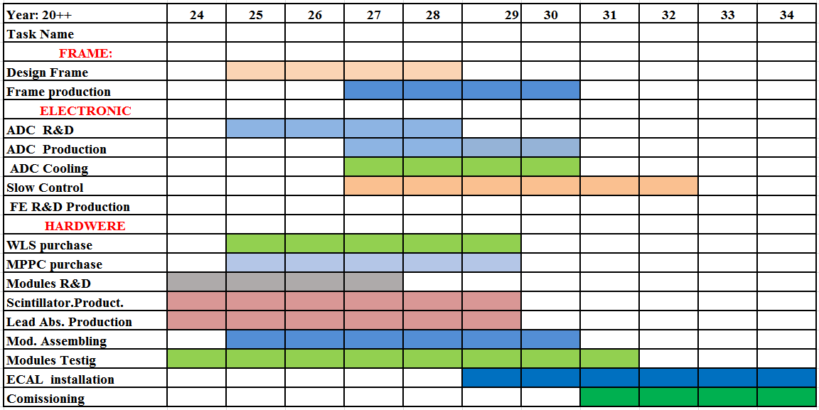
ECAL plan up to 2024

Slide 14
End of Report
Thanks for attention to All
11/5/2024
Oleg Gavrishuk, JINR, Dubna , Russia
14

