Slide 1

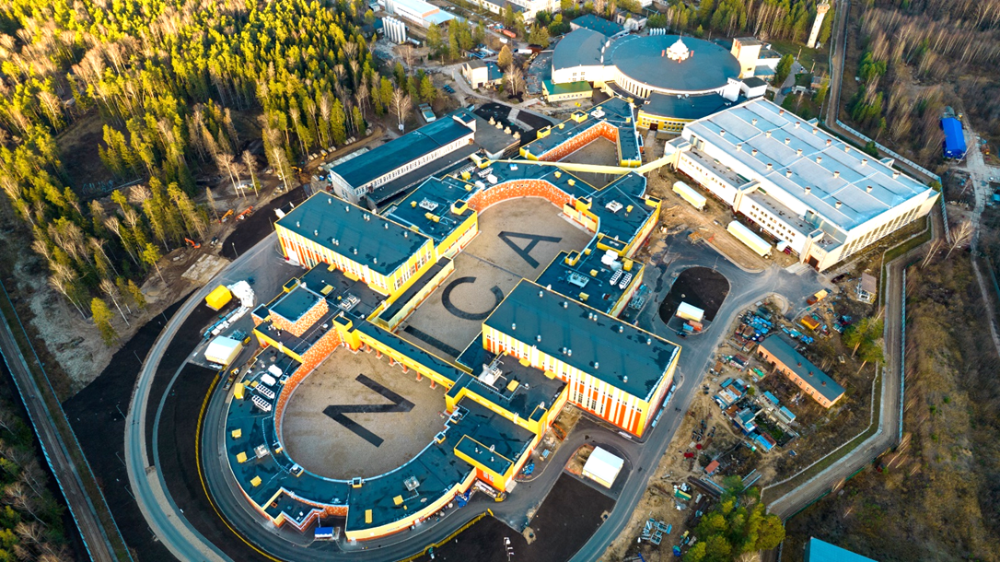
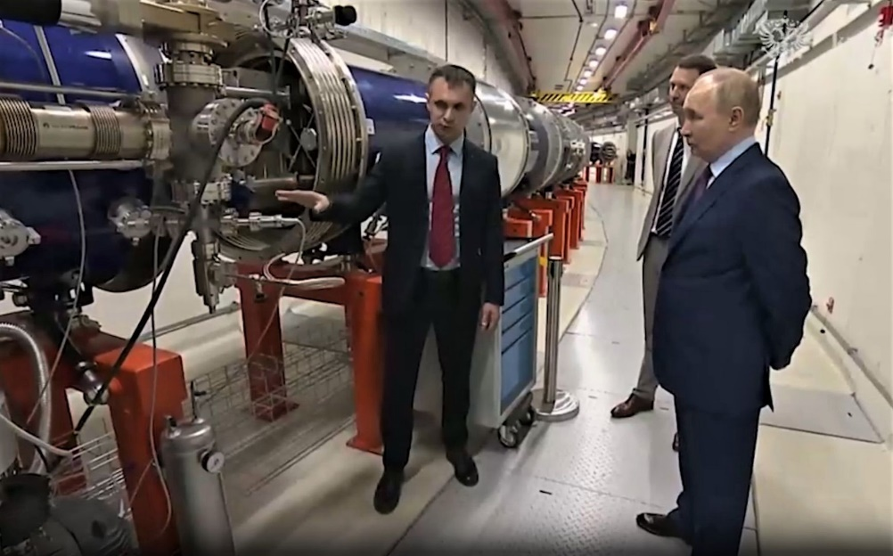
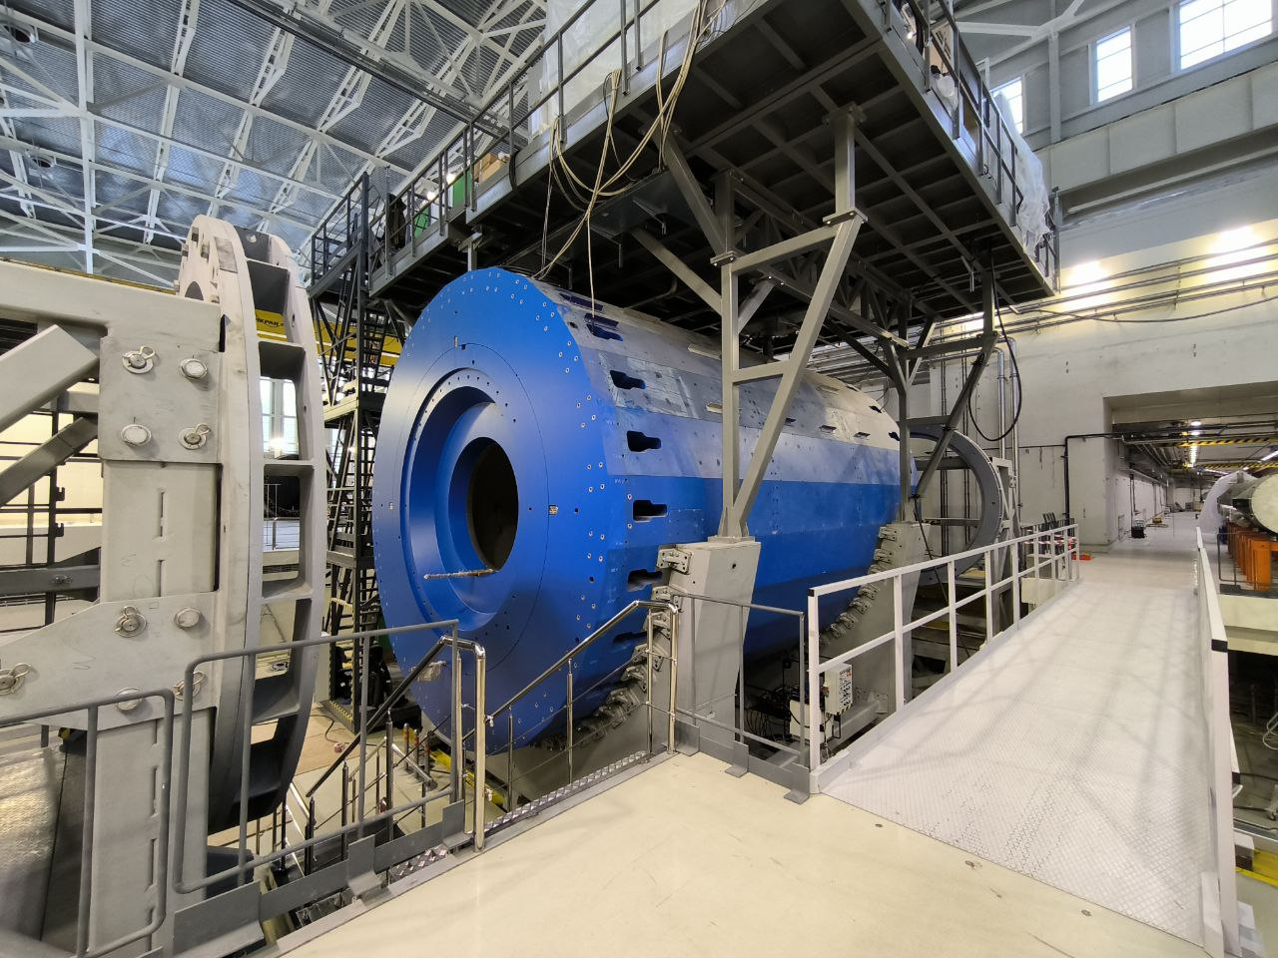
Collider NICA complex status
E. Syresin and V. Lebedev on behalf of Accelerator division
NICA: Nuclotron based Ion Collider fAcility

Slide 2
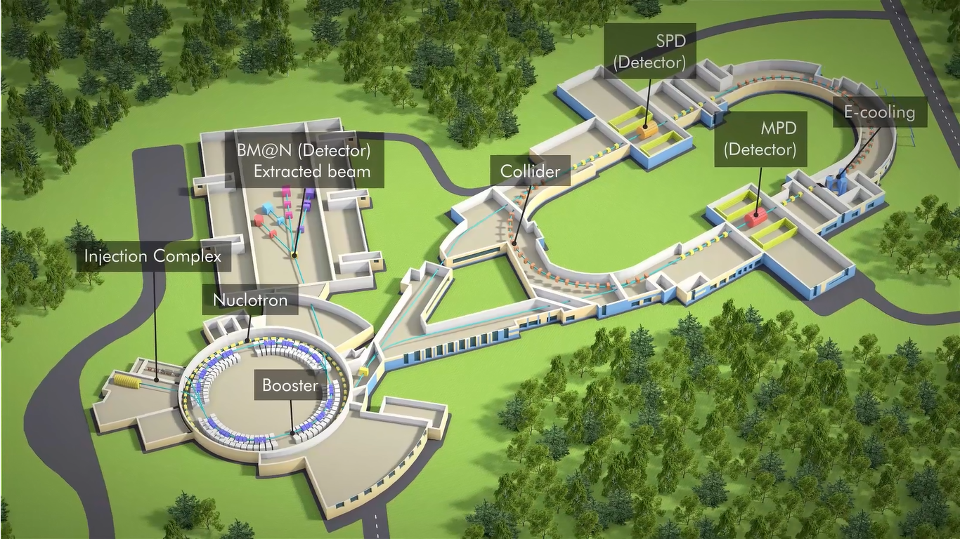


NICA Layout
3. Инжекция в
коллайдер
4. Магнитная система коллайдера
5. MPD
2. Каналы в
коллайдер
3. Инжекция в
коллайдер
1. Вывод из
Нуклотрона

Slide 3

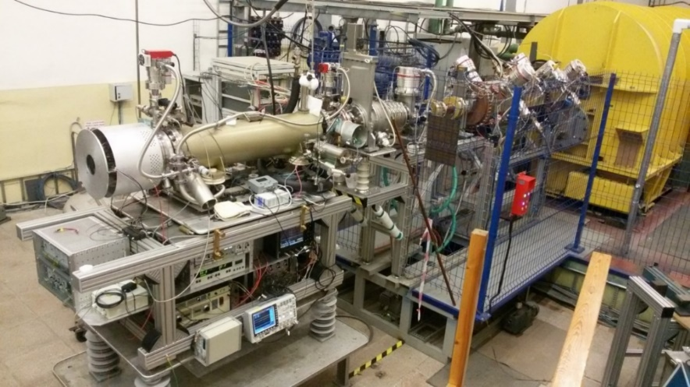
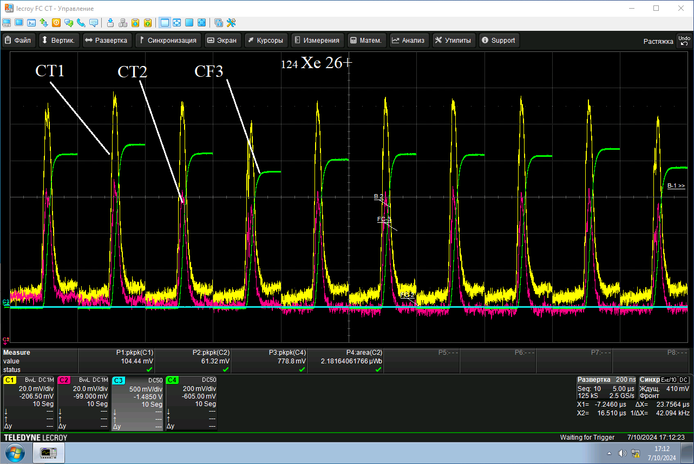
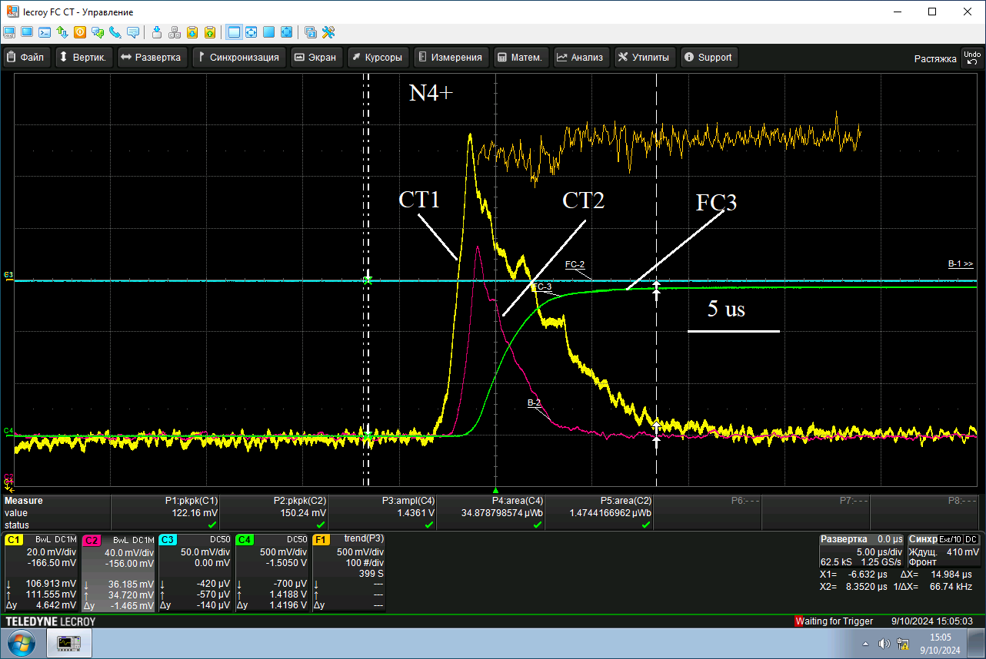
Ion source KRION-6Т
I [A]
Xe ion charge distribution at KRION exit
Project ion intensity 2·10⁹ Bi³⁵⁺ per pulse
Further development and upgrade of KRION-6T
during Apr.-May and Sep.-Oct. 2024 beam runs with D, N, Kr, Xe ions
at injection rate of 10 Hz and
pulse duration approaching required 4μs.
Achieved values:
Аr¹⁶⁺ - 5·10⁸ ions per pulse
Xe²⁸⁺ - 2·10⁸ ions per pulse
Bi³⁵⁺ - 2·10⁸ ions per pulse
First Collider beam runs are
planed with Xe²⁸⁺ & later Bi³⁵⁺ ions

Slide 4

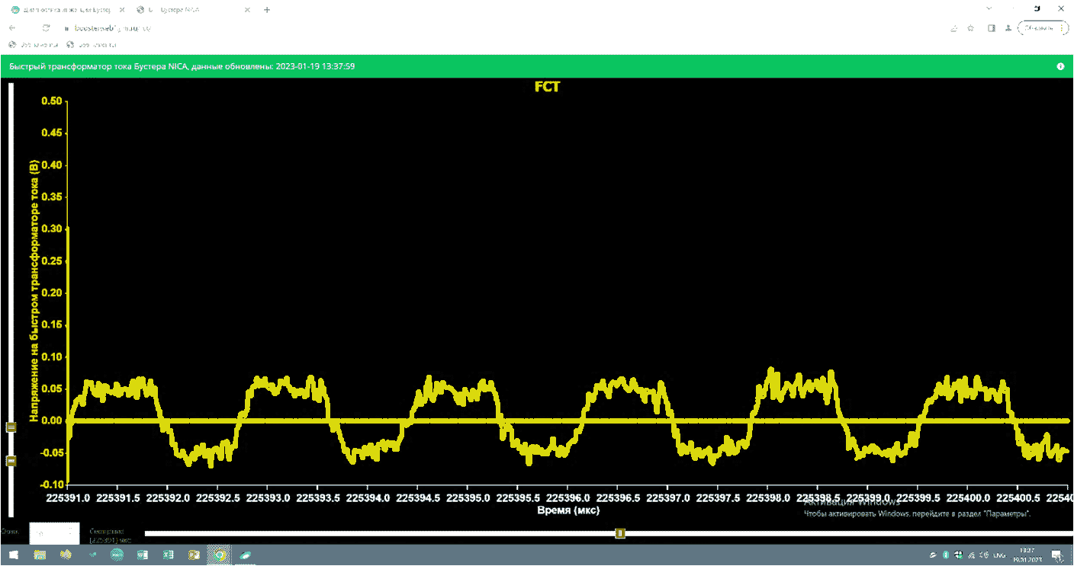
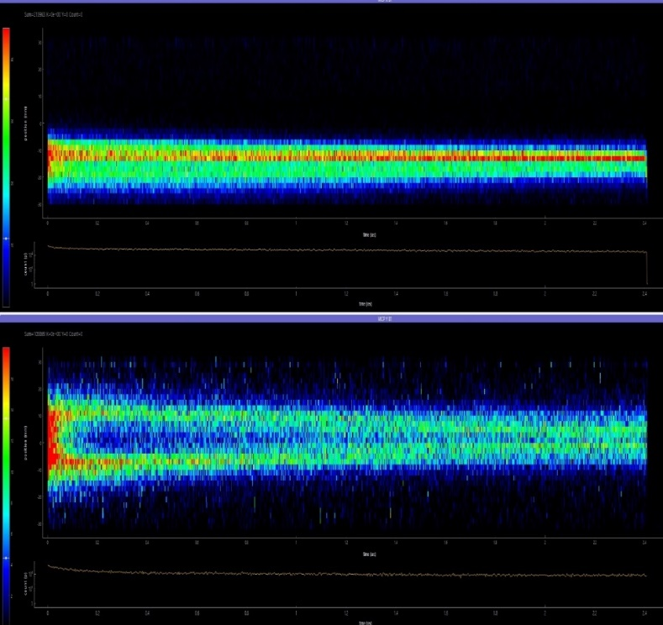
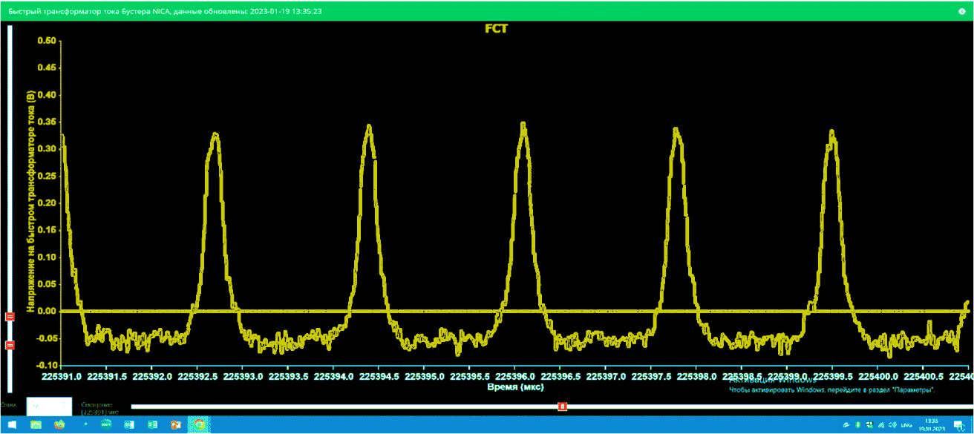


Electron cooling of Xe beam
¹²⁴Хе ²⁸⁺ at injection energy
Longitudinal electron cooling
Transverse cooling
Electron energy 1,93 keV
Electron current 150 mА
Bunch length
measured with FCT
Without cooling .
MCP monitor
With cooling .
Signals from Ionization profile monitors during beam circulation

Slide 5
Priorities for the Accelerator Complex
1. Most of NICA commissioning will proceed in heavy ion mode
  “Real” luminosity is expected in 2.5 – 3 years
  - after we will get cooling systems operational
Operation with slow extracted beams
  All modes of operations are anticipated
    Heavy ion mode is straightforward – it will not require significant efforts (Xe is at the beginning)
    Light unpolarized ions will be a backup for heavy ion mode in the case of problems with KRION (Acceleration in Booster)
    Polarized ions
    (Acceleration in Nuclotron, LU-20 has to be operational)
    Medium mass ions from laser source are anticipated
    They will require additional ion source (laser source?)
        Operation in 2-4 years

Slide 6
Plans for Acceleration of Polarized Ions
Delivery of LILAC (Light ions linac) is postponed to unknown time
  LU-20 is the only available possibility for near future
    LU-20 “switching-on” slowly proceeds
        Looks like the problem with beam loss is found
        Consequences of recent accident are addressed
        I expect LU-20 operations to be resumed by the year end
Increase of LU-20 acceleration efficiency from ~10% to ~30% will trigger displacement of the polarized ion source to LU-20
  Nuclotron injection energy - 5 MeV/n
  Particle number will be limited by betatron tune shift at E_{inj} to ~2.5∙10¹⁰ for H and ~5∙10¹⁰ for D (ε_{RMS}=3 μm, 2.5σ_{max}=16 mm, Δν=0.2)
I would not exclude short runs with acceleration of polarized D in the 2nd half of 2025
  2026 looks more realistic
If LU-20 will be out of operation we still can inject polarized D through HILAC and Booster – such operation was recently tested
  It will require new line connecting the Ion source and HILAC

Slide 7
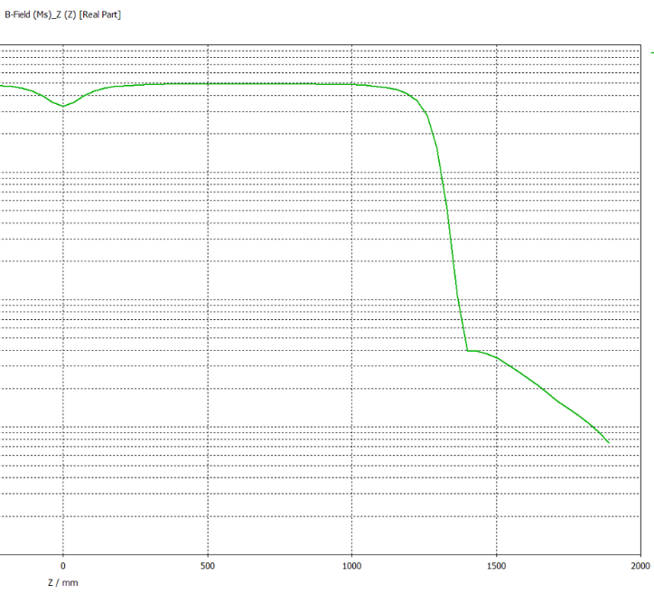
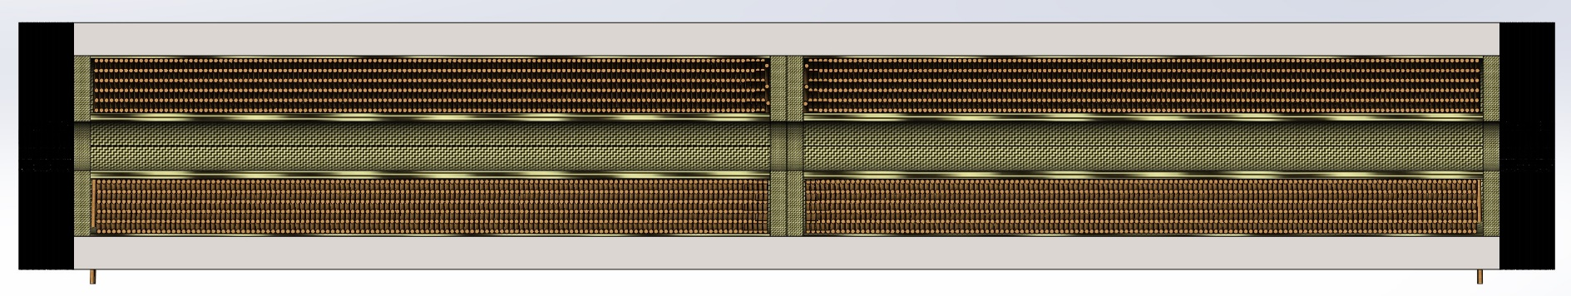
Acceleration of Protons in Nuclotron
We plan to install SC solenoid into Nuclotron to support proton beam acceleration without loss of polarization
Presently, two Nuclotron straights are taken by RF cavities
In the future we want to replace these cavities by SC
solenoid and new RF cavities which are identical
to the Booster RF
  The SC solenoid of ~2*12 T m is in advanced
  stage of design
  BINP will be ready to start work on new
  RF system in the 2nd half of 2025
Solenoid
  Current – 6.9 kA
  B_{max} - 5 T
  Stored energy - 640 kJ

Slide 8
Commissioning plan
Presented at coordination committee meeting Oct. 24, 2024
Starts: 25.12.2024
 | 2024 Дек. | Январь | Февр. | Март | Апрель | Май | Июнь | Июль | Август | Сент.
Комплексные испытания систем коллайдера:
Охл. западной арки
Охл. восточной арки
Охлаждение Бустера
Пучки в Бустере
Охлаждение Нуклотрона
Пучки в Нуклотроне
Настройка каналов в Колл.
Инжекция в Колл. (CCW)
Ускорение в Колл.
Начало работы MPD мишень

Slide 9
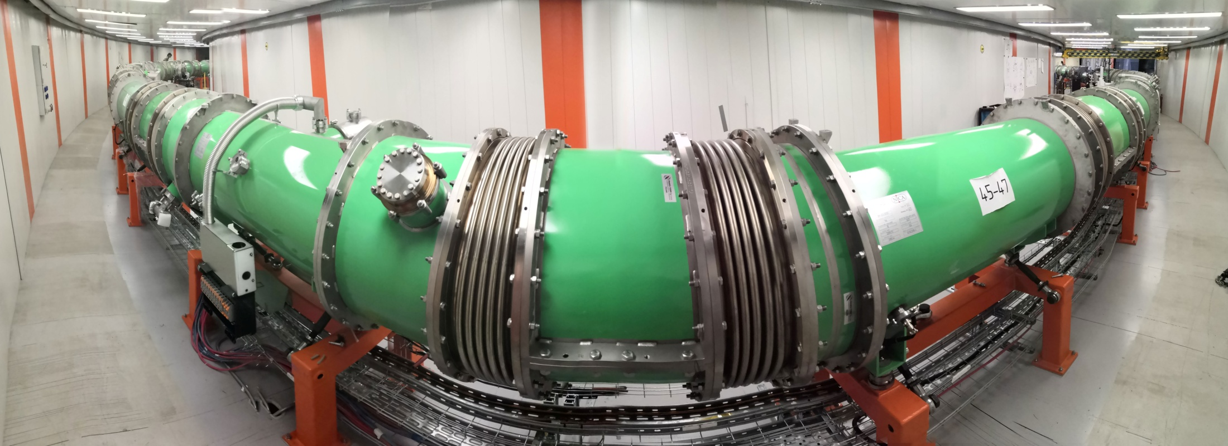
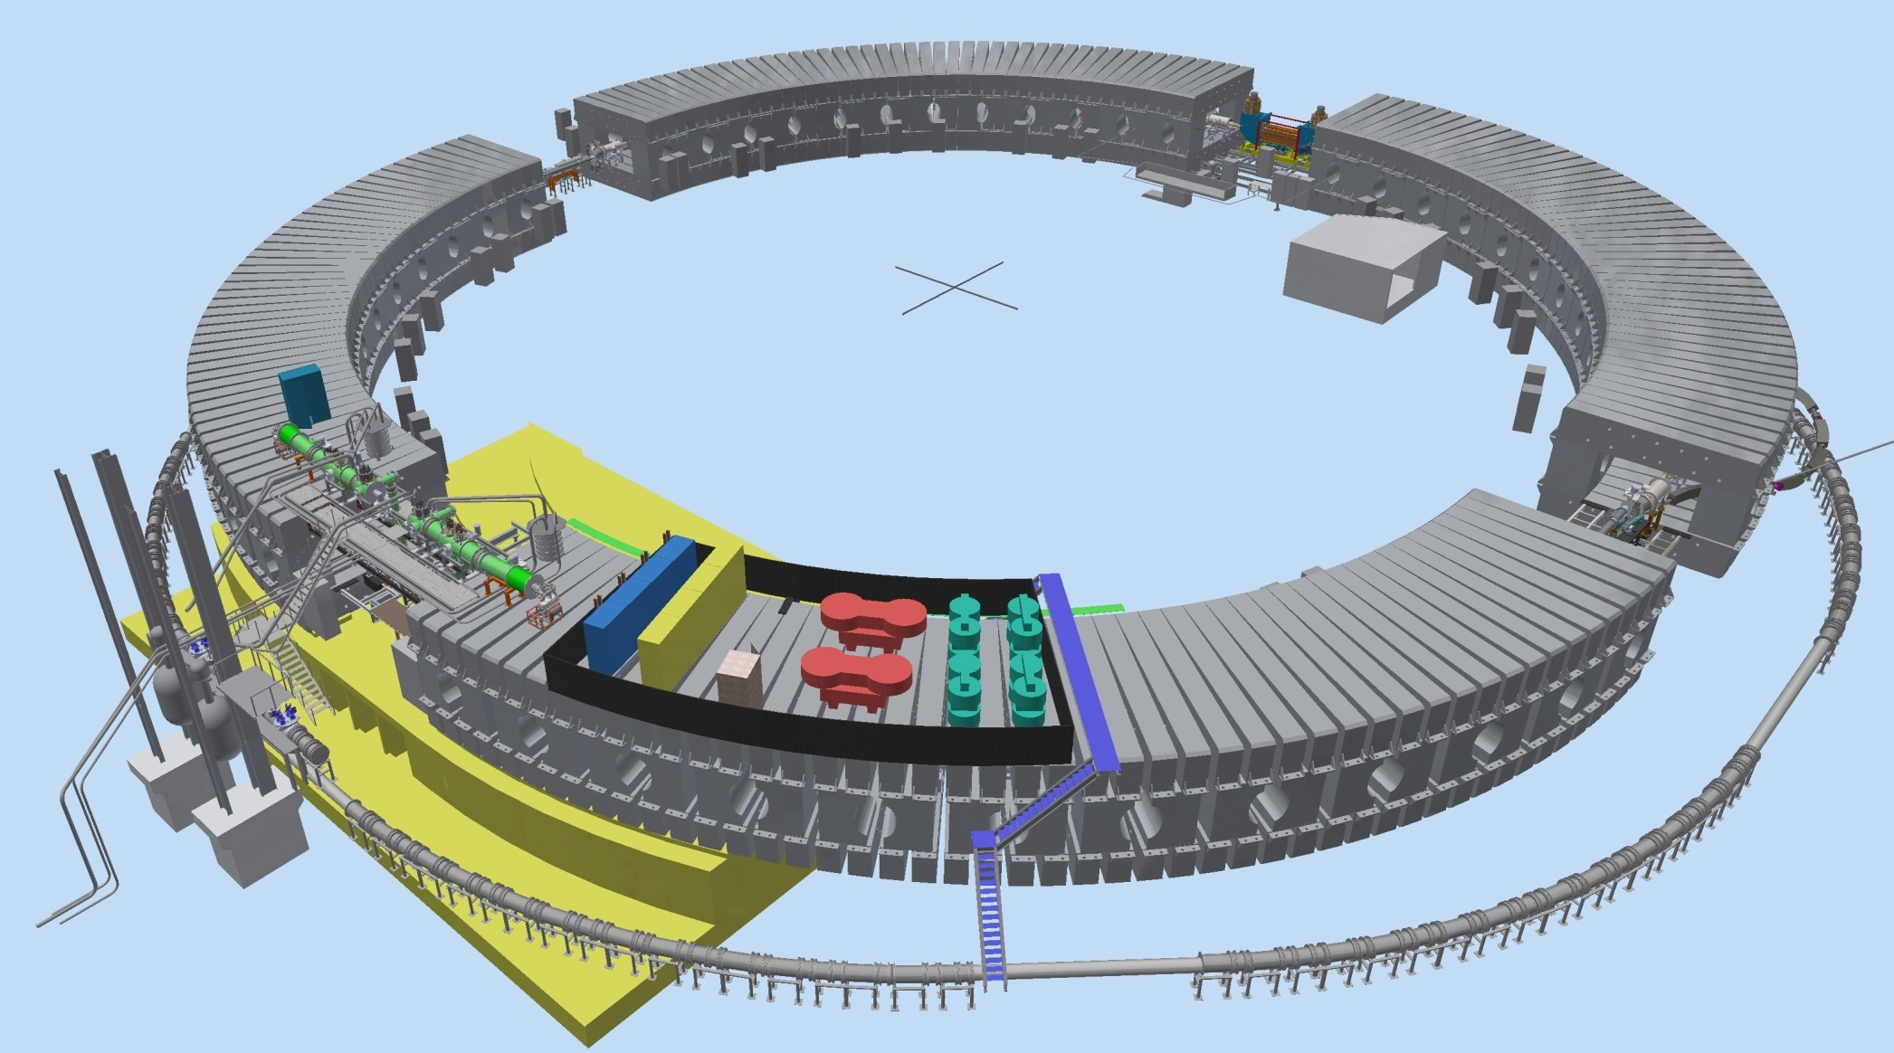
Booster Run
– January 2025
Injection system
E-cooling system
Synchrophasotron iron yoke
Parameter | Value
Circumference, m | 210.96
Lattice type | DFO
Injection energy, MeV/u | 3.2
Maximum energy, MeV/u | 578
Magnetic rigidity at injection, Т∙m | 1.6
Maximum magnetic rigidity, Т∙m | 25.0
Ions species (project) | ¹²⁴Xe²⁸⁺
Fast Extraction system
RF system
Reference magnets section
Power supply & energy evacuation
Nuclotron ring

Slide 10
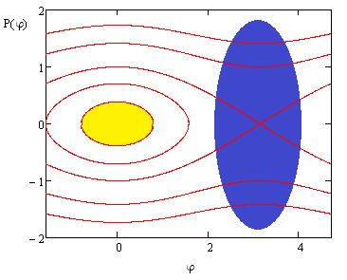
Beam Accumulation with Electron Cooling
Beam accumulation happens in the
longitudinal plane at Booster injection
  4 μs bunch – 8 μs revolution time
Each new injection happens after the
previous one is cooled to the core
  Expected injection rate – 10 Hz
  10 – 15 injections will be required
  Total cycle duration ~5 s
The permanently present 1st RF harmonic
weakly affects large amplitude particles
For small amplitude particles the cooling
force will be intentionally reduced to
avoid overcooling
To avoid anti-coolig we need to match well
the injection magnetic field and e-beam energy
  It happens since for large Δp/p, dF/dt changes sign after reaching the peak
An increase of ion accumulation intensity by a factor of 5 is planned. However, the intensity is restricted by ion bunch space charge at the level of (1-2)⋅10⁹ ions of Bi³⁵⁺
The run of KRION-6T - HILAC - Booster will be with Xe ions with the goal of commissioning of multi cycle injection and accumulation supported by electron cooling. The run will proceed in Jan.-Apr. of 2025

Slide 11
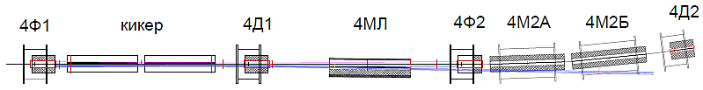

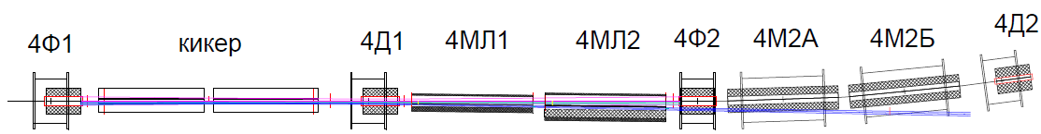
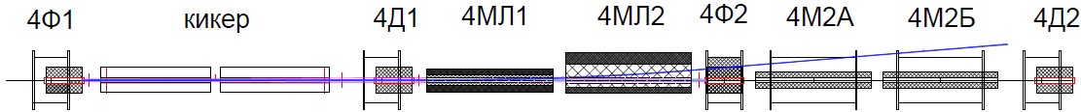
Nuclotron Extraction System
Start configuration (magnetic rigidity up to 29 T·m)
Full configuration (magnetic rigidity up to 38.5 T·m)
Application of one extraction Lambertson magnet permits to reach the maximal kinetic ion energy 2.5 GeV/n in first Collider beam runs
Nuclotron run –April 2025

Slide 12
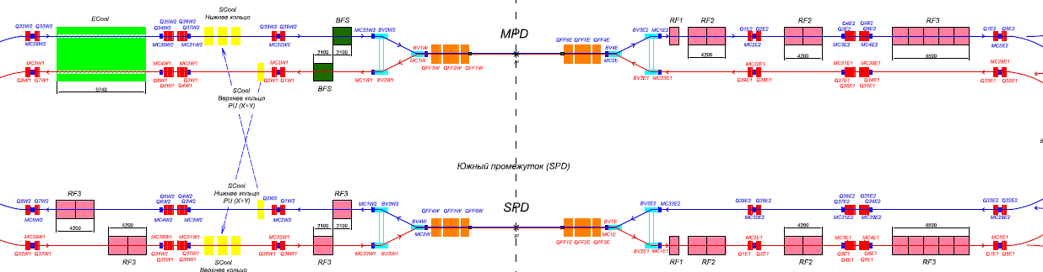
NICA Stage II-A (basic configuration)
Collider equipped with
RF-1 (barrier voltage system) for ion storage
RF-2 : 4 cavities per ring instead (100 kV RF amplitude)
Longitudinal S-cooling - 1 out of 4 channels for each ring
Commissioning start - Winter 2025
Technological run at cryomagnetic system testing
West arc W– February 2025
East arc E- March 2025
First beam run – Summer of 2025
Result: 22 bunches of the length σ ∼ 2 m per collider ring that 2e25 cm⁻²⋅s⁻¹,
ion kinetic energy E=2.5 GeV/n

Slide 13


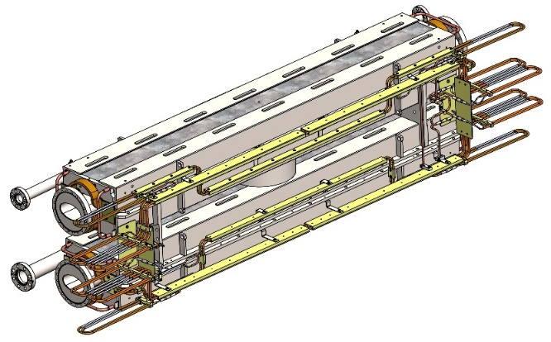
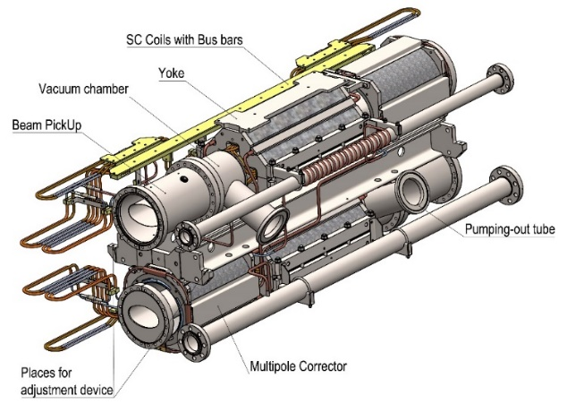
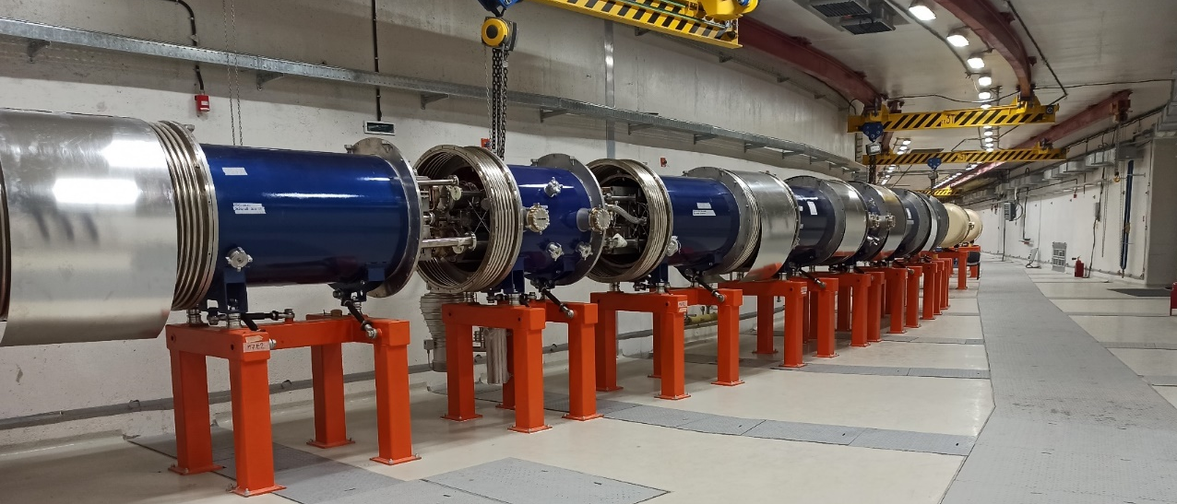
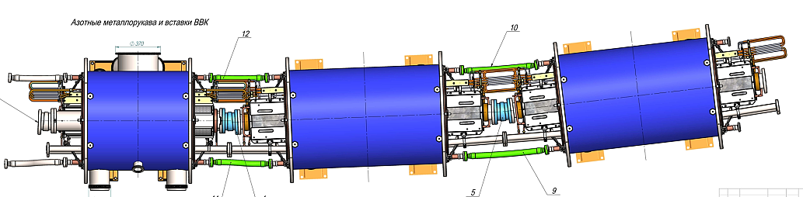
The Magnetic System: Regular Period
Parameter | Dipole | Lens
Number of magnets (units) | 80 | 46
Max. magnetic field (gradient) | 1.8 T | 23.1 T/m
Effective magnetic length, m | 1.94 | 0.47
Beam pipe aperture (h/v), mm | 120 / 70
Distance between beams, mm | 320
Overall weight, kg | 1670 | 240
Dipole unit
Quadrupole unit
Dipole unit
13
Comissioning W arc-December 2024, commisiong of E arc –February 2025
13

Slide 14
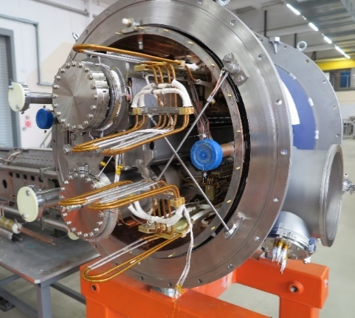
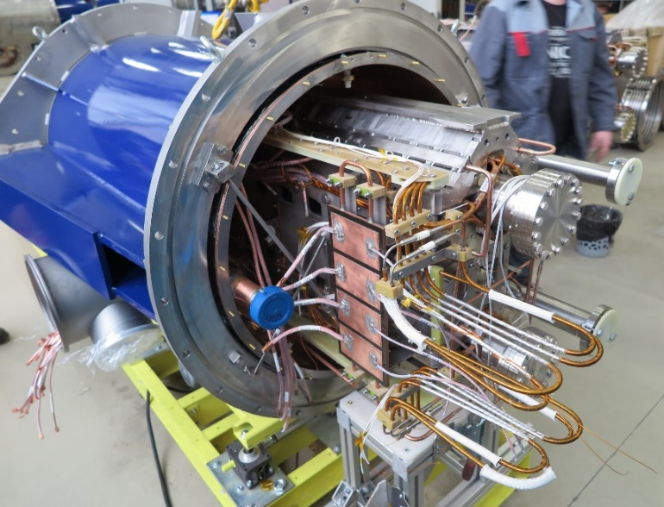
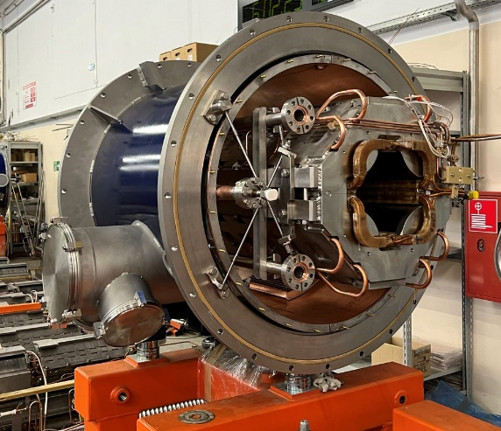
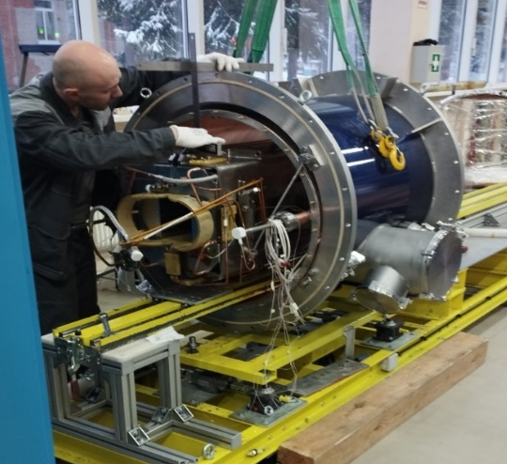
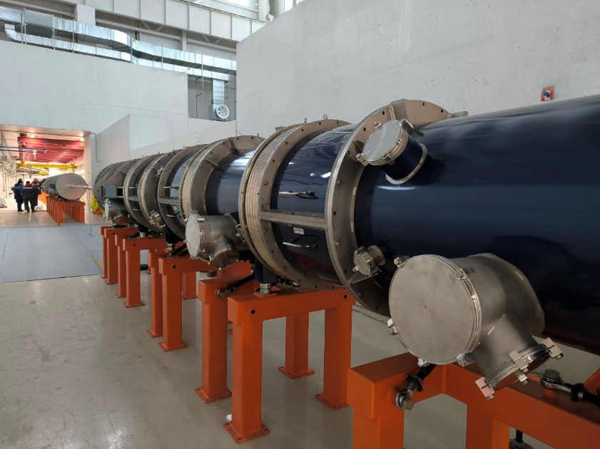
NICA Commissioning. The magnetic system: magnets
Quadrupole units
4х Quadrupole units
14
Final focusing quadrupoles
BI vertical 1х dipole units

Slide 15
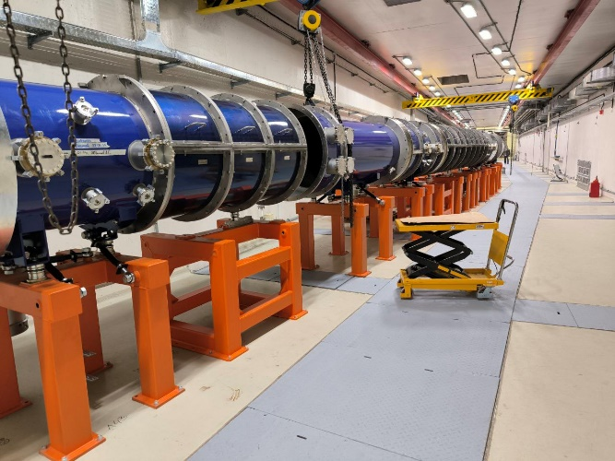
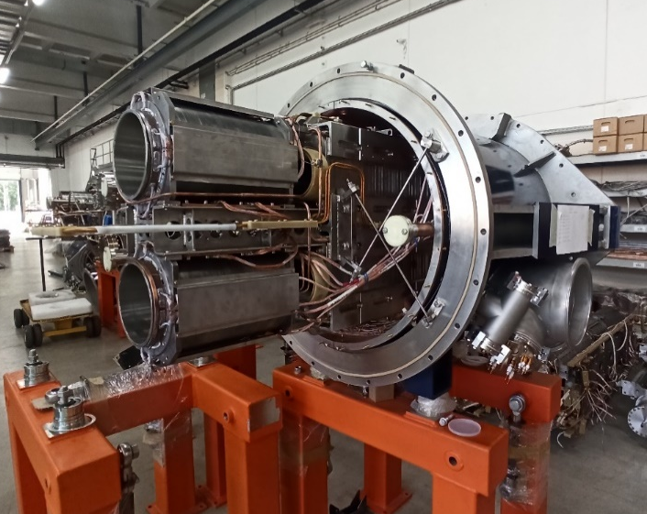

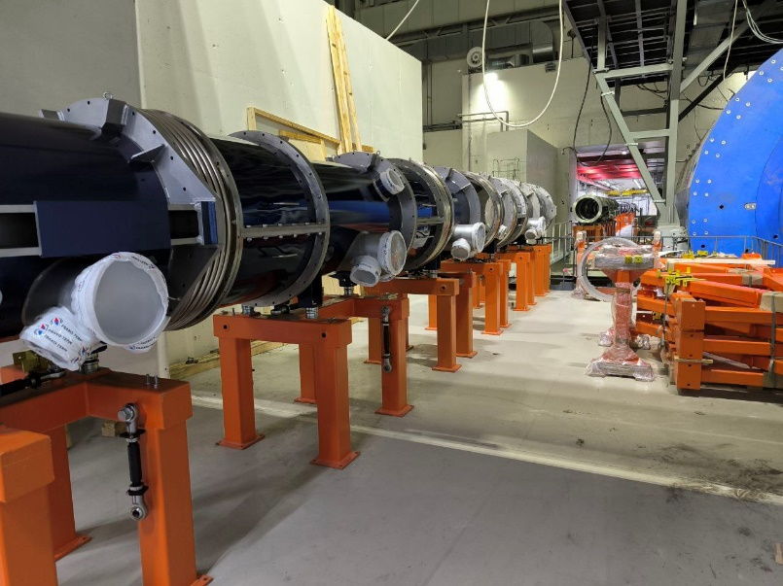

Straight Sections: Magnets
Final focuse lense
Straight section
Q1
Vertical magnets
Q2
Q3
BV1
ВВК Y
BV2
15
Straight section lenses
Straight sections and MPD final focus

Slide 16
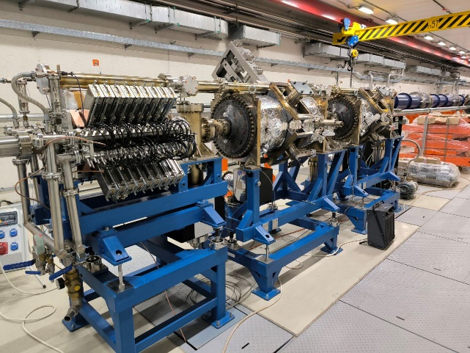
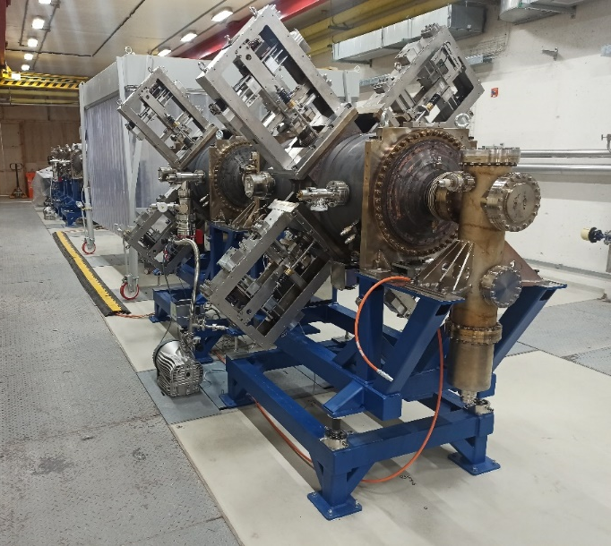
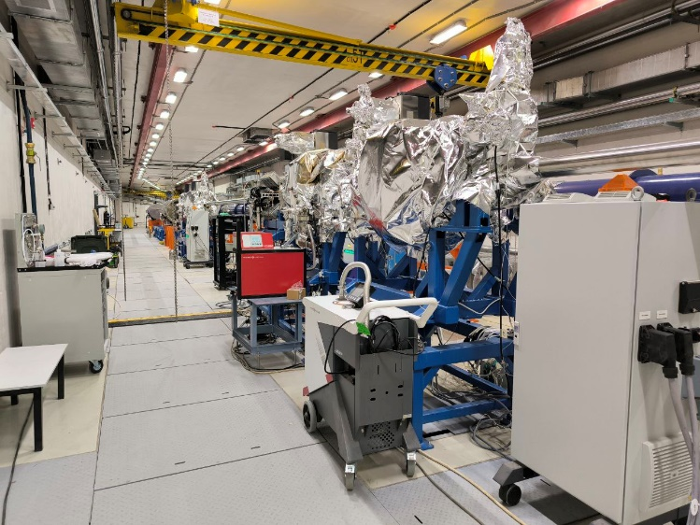
RF system: status RF1 and RF2
RF2
RF1 and RF2 in tunnel
RF1
RF2
RF2
All RF1 and RF2 cavity in JINR.
Two RF1 and eight RF2 cavities were installed.
Commissioning of E-arc- February 2025
16

Slide 17
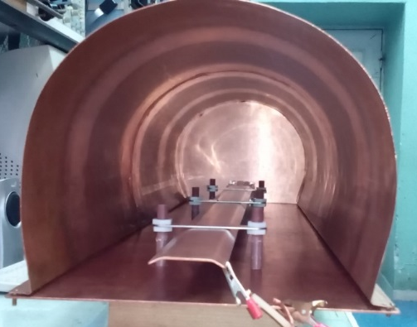
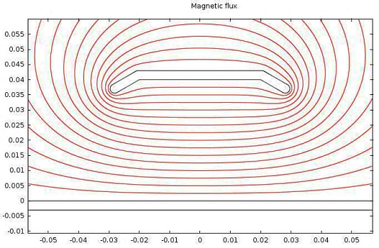
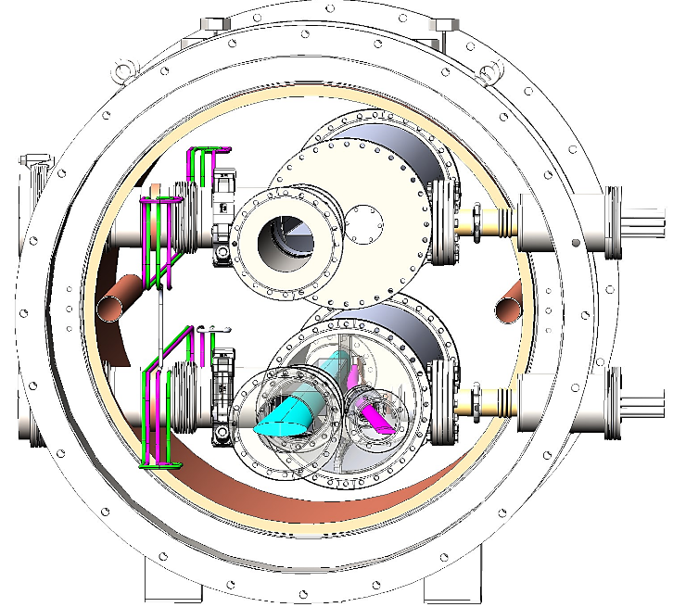
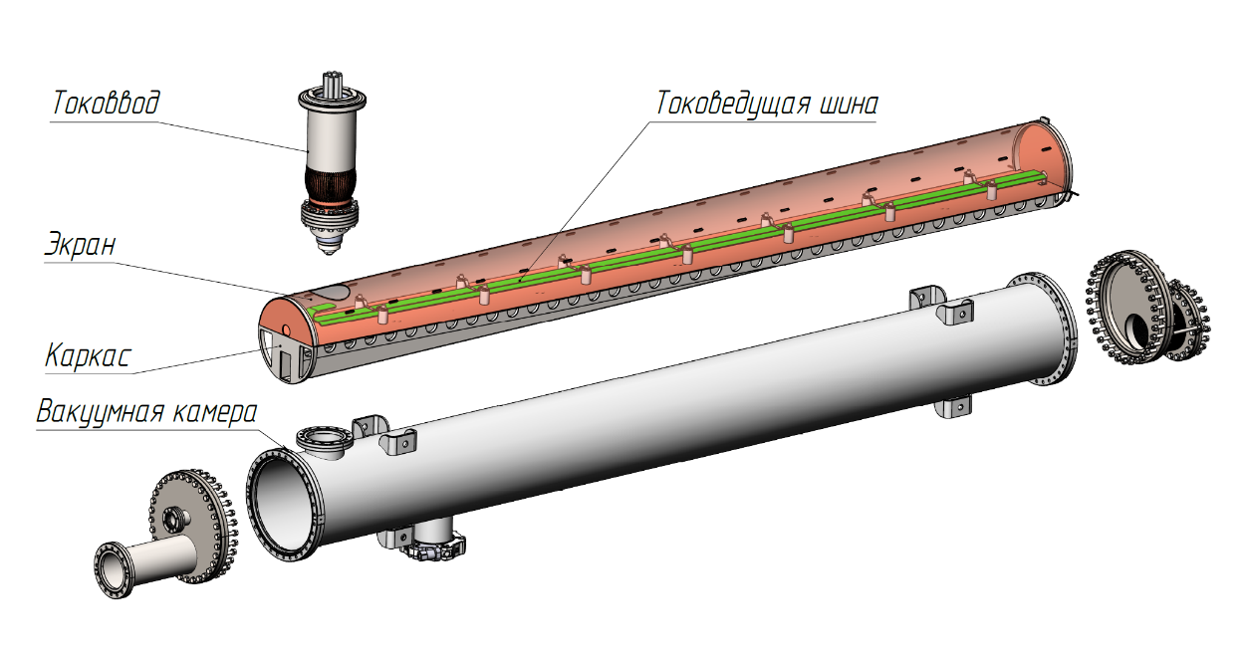
Collider Beam Injection Septa
Effective length, m | 2.5
Max. magnetic field, T | 0.42
Bending angle, mrad | 24
Gap, mm | 30
Septum thickness, mm | 3
Current, кA | 50
Pulse duration, µs | 10
Septum’s internal chamber with feedthrough
Septum cryostat module
17
Commissioning of Collider injection system –February 2025

Slide 18
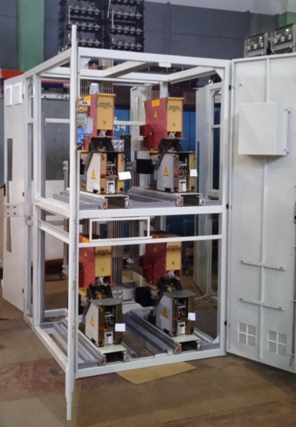
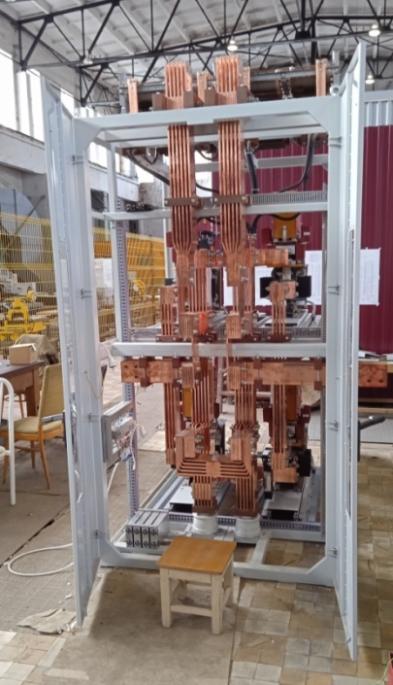
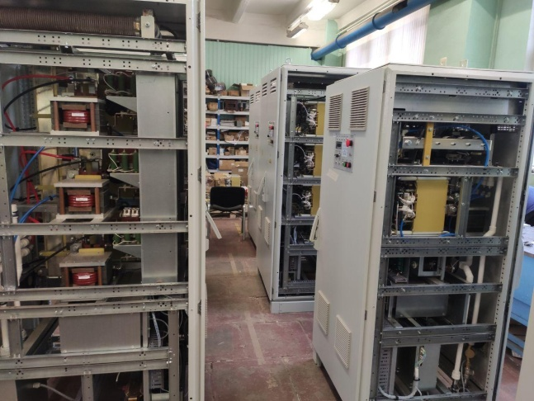
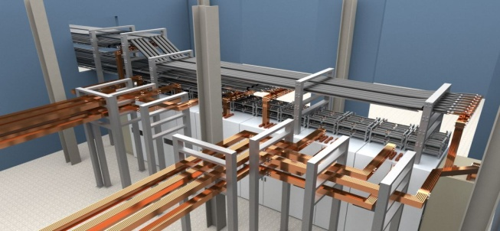
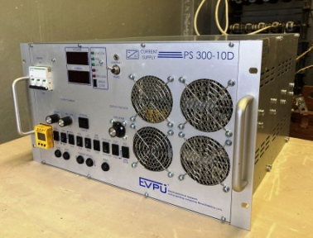
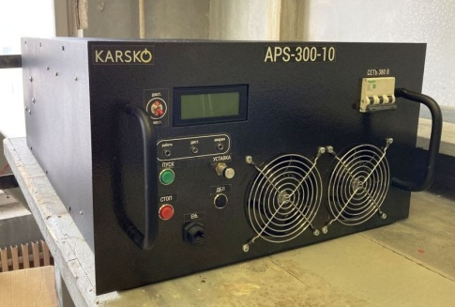
Collider Power Supply System
Each collider ring has its own power supply system based on 3 main current sources
2 sets of main PS for both collider rings are manufactured by NPP "LM Inverter"
and delivered to JINR.
12 energy evacuation keys
were built and tested
Busbars system model in b.17
68 Additional power supplies (10В х 300А)
First operation of PS and magnets- February 2025

Slide 19

Technological run of cryomagnetic system testing
West arc W– February 2025
East arc E- March 2025
I. Collider cryo-magnetic tests:
Tests of Power supplies on an equivalent load
Tests of energy evacuation switchers
Vacuum of isolation volume
High vacuum of beam chamber
Operation of control system
Magnet system cryogenic cooling
Thermometry tests
Operation of quench protection and evacuation system
Formation of magnetic cycle, power supplies tuning
Corrector system tuning
Serious situation with infrastructure of Bld.17:
Power distribution, Water cooling, Ventilation and air-conditioning

Slide 20
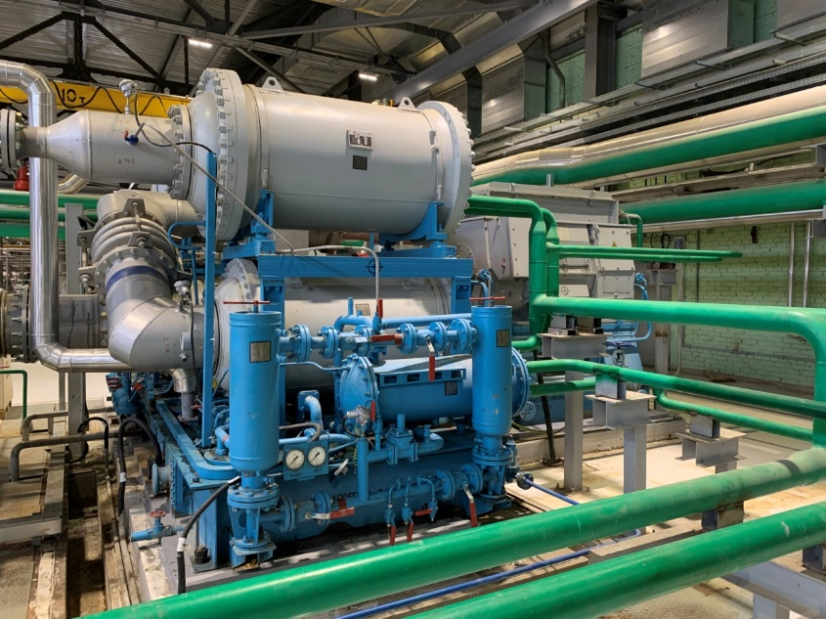
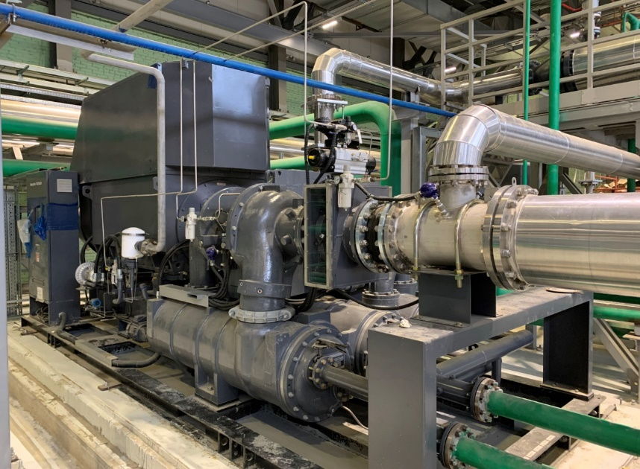
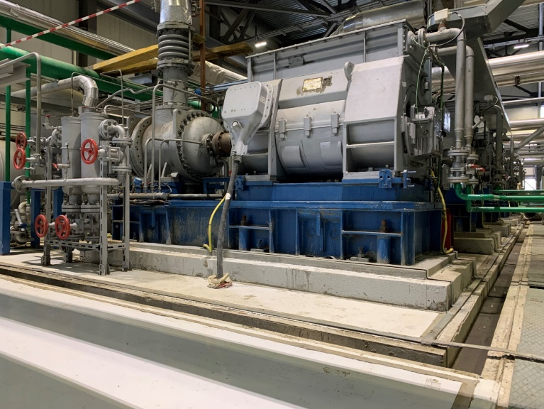
Status of cryogenic compressor station
Hanwha Techwin SM5000
Аerocom - 2 179/18
Commissioning and tests of nitrogen centrifugal compressor Aerocom - 2 179/18 and two nitrogen centrifugal compressors Hanwha Techwin SM5000 were done. Compressors passed through tests in air medium and ready for testing in NICA cryogenic nitrogen system.
Commissioning and tests of two spiral helium compressors «Каskad- 110/30» was performed by Heliomash company which will provide repairs of this system.
Spiral helium compressor

Slide 21
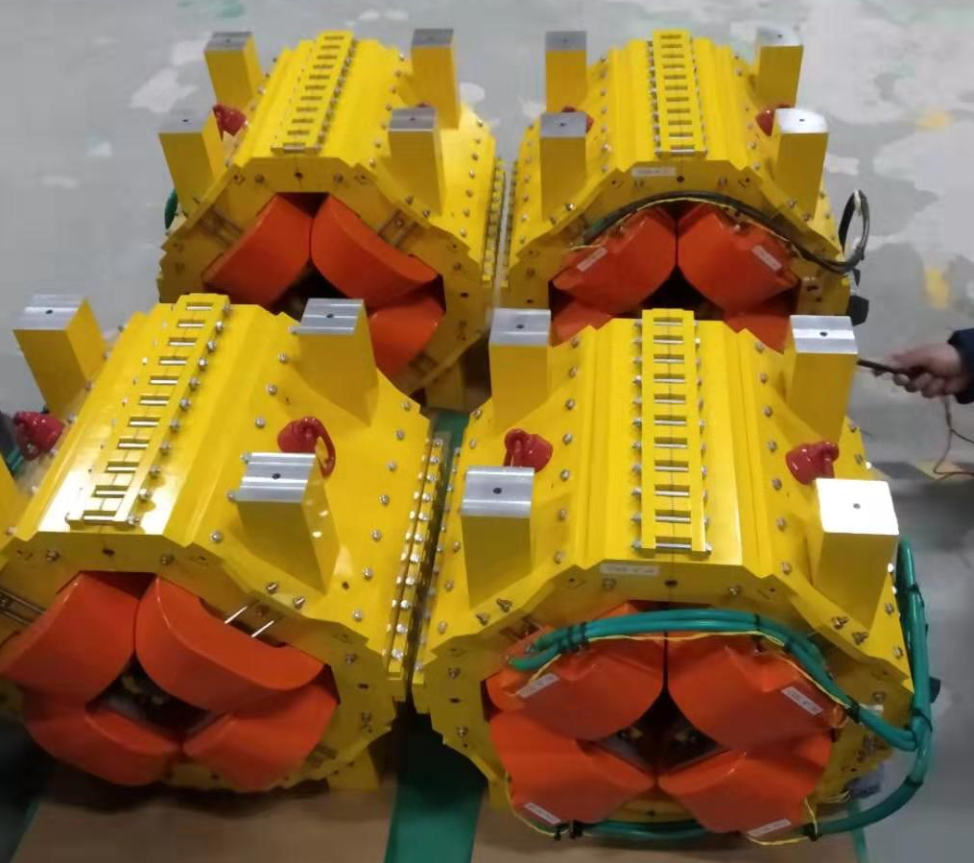
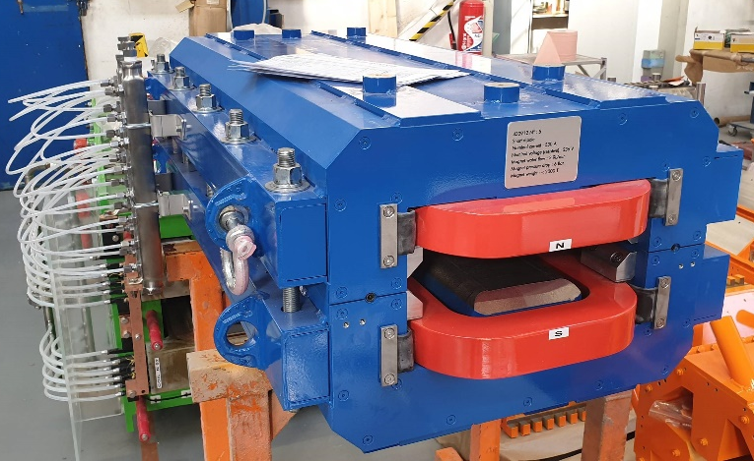
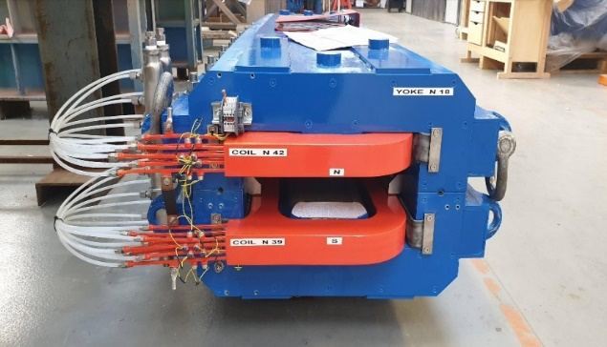

Nuclotron-Collider Beam Transport Channel
Parameters of pulsed magnet elements
Magnetic element | Number | Effective length, m | Max. magnetic field (gradient), T (T/m)
Long dipole | 21 | 2 | 1.5
Short dipole | 6 | 1.2 | 1.5
Quadrupole Q10 | 22 | 0.353 | 31
Quadrupole Q15 | 6 | 0.519 | 31
Dipole correctors (BINP) | 33 | 0.466 | 0.114
Nuclotron-Collider transfer line was contracted with French company Sigma Phi
Magnets delivery in JINR in February 2021
JINR could not receive some parts of already built equipment: power supplies, beam diagnostics, dipole correctors, vacuum chambers and support stands.
JINR restarted design and production of this equipment in Summer 2023.
We plan to produce and install this equipment before Summer 2025.
First beam tests – July 2025
Critical point is the construction of pulsed power supplies for magnets.

Slide 22

The first Collider Run with Beam
NICA Stage II-a (basic configuration): starts at April 2025
Collision of bunch to bunch
N=2E8
1. Injector chain: KRION => Booster => BTL BN => Nuclotron
2. BTL Nuclotron => Collider
3. Collider equipped with
RF-1 - (barrier voltage system) for ion storage
RF-2 - 4 cavities per ring (100 kV RF amplitude)
4. Date for MPD roll-in is not set (earliest the end of summer 2025)
Result: 22 bunches of the length σ ∼ 2 m per collider ring that 2e25 cm⁻²⋅s⁻¹. Maximum kinetic ion energy 2.5 GeV/n
 | Booster |  | Nuclotron |  | Collider
 | Injection | Extraction | Injection | Extraction
E | 3,2 МeV/u | 530 МeV/u | 523 МeV/u | 1,5-2,5 GeV/u | 1,5-2,5 GeV/u
N | 5⋅10⁸ | 3.5*10⁸ | 2.5*10⁸ | 2*10⁸ | Injection - 2*10⁸ Accumulation in RF1 - 4*10⁹ Formation of 22 bunches by RF2)
В_{d}, Тл | 0,1 | 1,6 | 0,4 | <1,2 | <1.2
Dependence of luminosity on number ions per bunch
at different energies (1) 4.5 GeV/u (2) 3GeV/u,
(3) 2 GeV/u, (4) 1 GeV/u.
22

Slide 23

Thank you for your attention

Slide 24
Backup slides

Slide 25




NICA – collisions for Heavy ion mode
2018
2025
2020
Operation 2016.
Linac HILac (3.2MeV/u)
ESIS KRION
Booster (2021)
(25 Tm, 211 m)
~10 one-turn injections Xe²⁸⁺ ,
storage up to 1×10⁹ ions
with electron cooling,
Acceleration to 550 MeV/u
Later transition to ²⁰⁹Bi³⁵⁺
Linac LU-20 (5MeV/u)
Ion sources
Baryonic Matter @ Nuclotron
BM@N: NICA – Stage I
(was realized in 2023)
Area of Fixed Target Experiments
Stripping (80%) ²⁰⁹Bi³⁵⁺ =>²⁰⁹Bi⁸³⁺
√s = 2.3 – 3.6 GeV/u (Au × Au)
Nuclotron
(38.5 Tm, 251.5 m)
injection of one bunch
of 0.8∙10⁹ ions,
acceleration up to
1 - 3.85 GeV/u
Two SC rings of the collider by 503 m
NICA – Stage II, E=1 - 4.5 GeV/u
L ≥ 10²⁷см⁻²с⁻¹ @ ~4.5 GeV/n
~ 2 x 22 injection cycles
22 bunches per ring
MPD
25

Slide 26


HILac status
HILAc status
Stable and safe HILAC operation during with Ar¹³⁺ and Xe ²⁸⁺ beams
Project HILAC intensity ²⁰⁹Bi³⁵⁺ at energy 3,2 МeV/n is about 1.8×10⁹ per pulse.
=> Further development
I.e. realization of multi cycle injection with electron cooling and upgrade of KRION-6T
Yellow line - at RFQ exit I=100 μΑ (). Redish line - at HILAC exit I=65 μΑ.
Ιon pulse duration 22 μs, about 70% at this pulse of target ions ¹²⁴Xe²⁸⁺.
Number of ions accelerated in HILAC at energy 3,2 МeV/n is about 1×10⁸.
4

