Slide 1
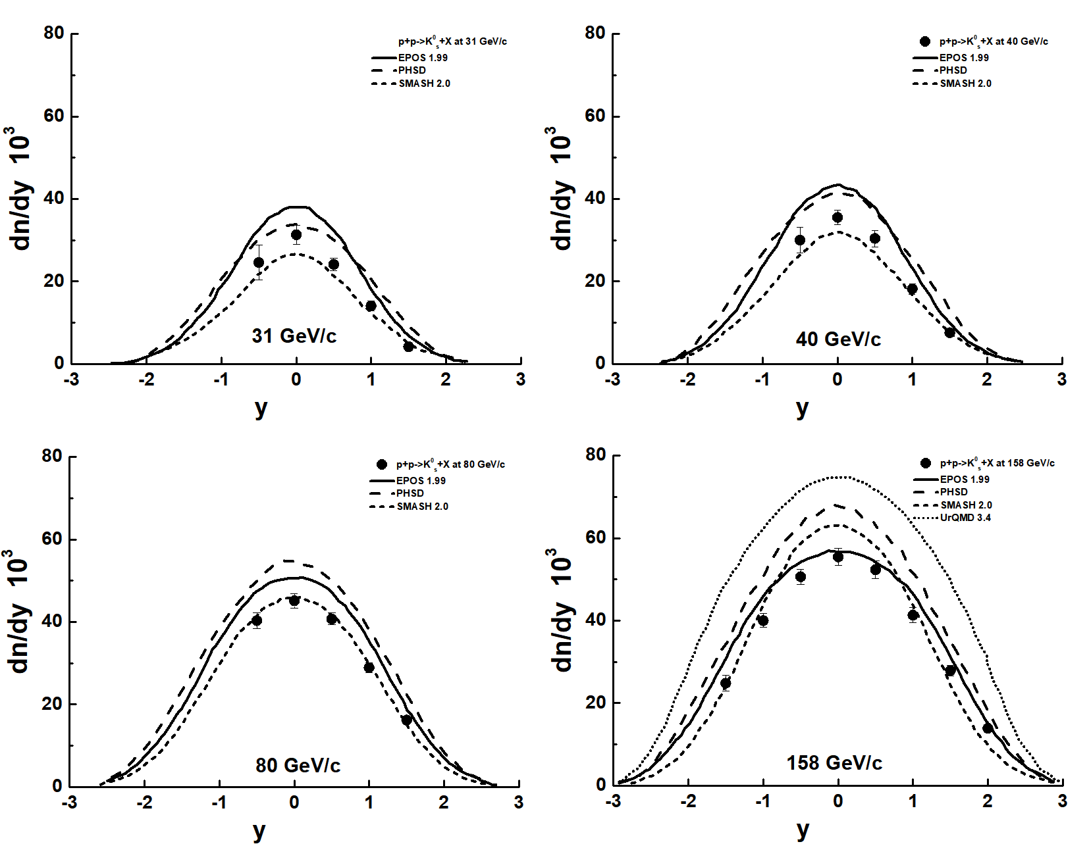
Two particle correlations of K⁰_{s} mesons with hadrons in proton-proton and deuteron-deuteron interactions
A. Galoyan, V. Uzhinsky 08.11.2024
NA61/SHINE Collaboration arXiv:2402.17025v1 [hep-ex] 26 Feb 2024
K0s meson production in inelastic p+p interactions at 31, 40 and 80 GeV/c beam momentum measured by NA61/SHINE at the CERN SPS
NA61/SHINE Collaboration (A. Acharya et al.), Eur. Phys. J. C82 (2022)
SMASH is O.K at 80 GeV/c, EPOS O.K. at 158 GeV/c, PHSD - ???
1

Slide 2

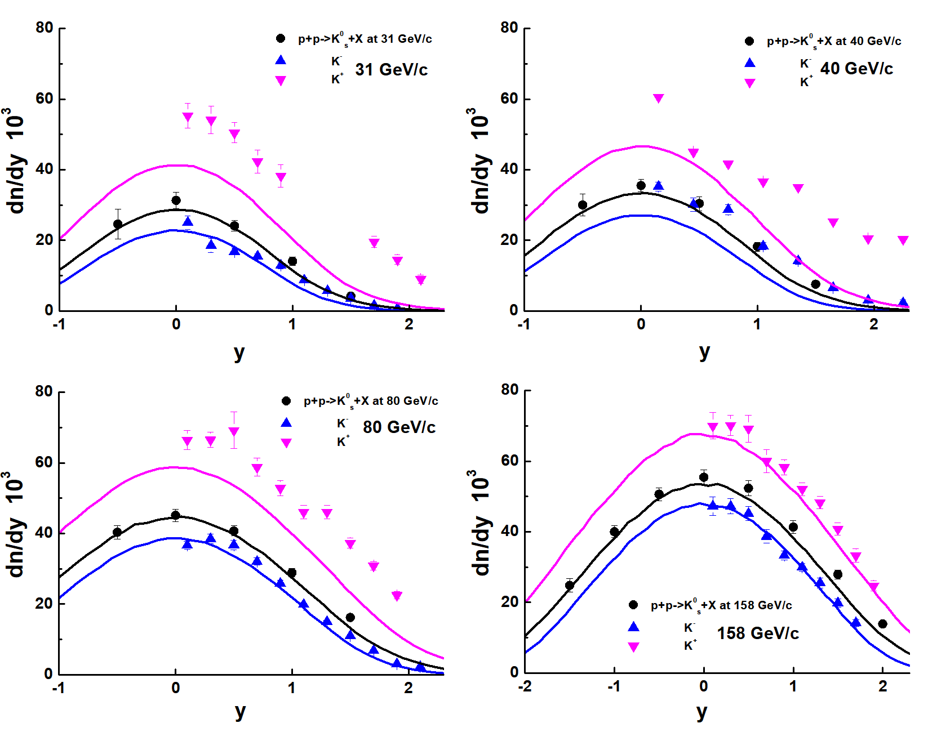
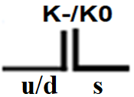


K⁺, K⁻ and K⁰_{s} in FTF model
The Schwinger model of quark’ pair
production from the vacuum in a strong color field.
Ps-sbar =12 %
Ps-sbar = 0.12*
[1 – (Mth/Mstr)^{2.5} ]
Dependence of Ps-sbar
on a string mass ?
exp. data:Pi+-,K+-,P,antiP, PP at Plab 20 - 158 GeV/c Eur. Phys. J. 77 C (2017) 671
Tuning the Geant4 FTF Model Using Experimental Data of the NA61/SHINE Collaboration
A.Galoyan, V Uzhinaky, Phys. Part. Nucl V. 55, (2024) 4 P. 962
2
All O.K. with K0s. K- ~ O.K. There is exp. problem with K+!

Slide 3
Study of 2-particles transverse momentum correlations of K⁰_{s} –mesons with hadrons in proton-proton interactions
V.Abramov et al, Possible studies at the first stage of the NICA collider operation with polarized and unpolarized proton and deuteron beams, arXiv:2102.08477
Phys.Part.Nucl. 52 (2021) 6, 1044-1119
Spin effects in elastic scattering and hyperon production, study of multiquark correlation, dibaryon resonances, exclusive reactions, open charm and charmonia near threshold. Minimal bias interactions will be studied also at SPD.
2-particles transverse momentum correlations of Λ –hyperons in PP and DD interactions can be studied at SPD.
A. Galoyan, A. Ribon, V. Uzhinsky
MDPI Physics 5 (2023) 3, 823-831
1. The method of study of 2-particle Pt-correlations
2. 2-particle Pt correlations of K⁰_{s} -mesons in PP-interactions in Geant4/FTF model
3. The Pt correlations of K⁰_{s} -mesons in PP-interactions in Pythia model and comparison with FTF ones.
4. The Pt correlations of K⁰_{s} -mesons in DD-interactions in FTF model and comparison with Pt correlations of K⁰_{s} -mesons in PP-interactions
5. Conclusion
3

Slide 4
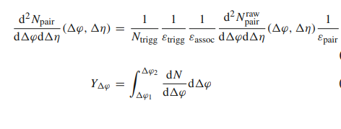
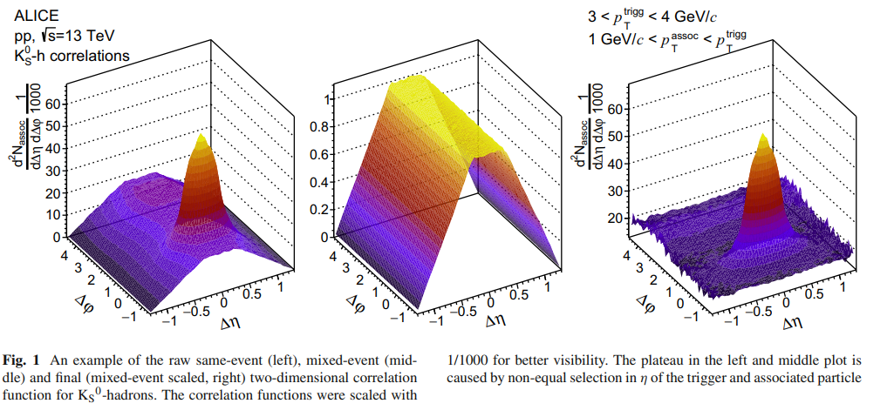
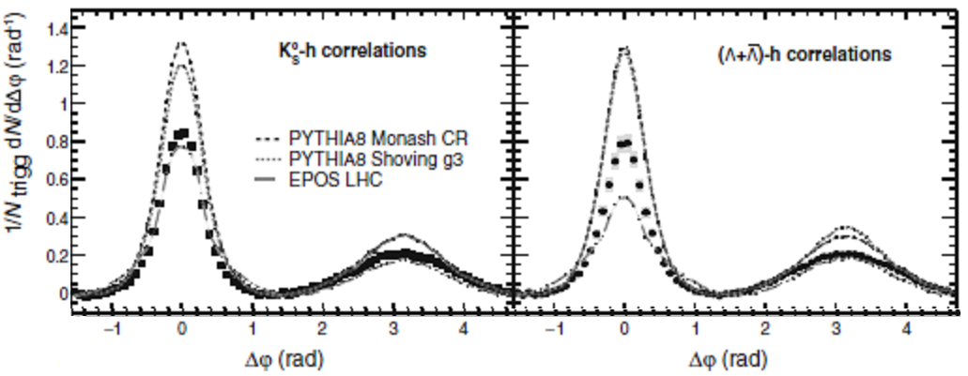
Eur. Phys. J. C (2021) 81:945
K_{S}⁰- (Λ or anti-Λ)- hadron correlations in pp collisions at √s = 13 TeV
ALICE Collaboration
Exp. data on K_{S}⁰-and (Λ anti-Λ)
- hadron correlations were
compared with predictions of
Pythia, EPOS models.
4

Slide 5
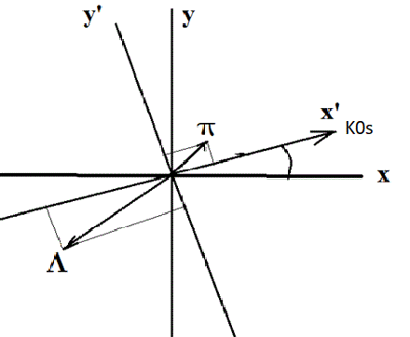


2-Particle Pt Correlations
There are 3 independent variables with
accounting the azimuthal symmetry –
|P_{T,triger}|, P_{x,track} and P_{y, track}
The correlations are connected
with Schwinger mechanism of
particle production
5

Slide 6
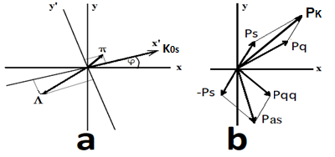
Method of study 2 particle’s Pt-correlations
1. We calculated 10^6 proton-proton interactions at √S=10 GeV using FTF and Pythia 6 generators, and 10^6 deuteron-deuteron interactions using FTF in SPDRoot version 4.1.6.1
2. We selected events with production of
K⁰_{s} -mesons, and calculated:
Cos(φ_ K⁰_{s} ) = Px_ K⁰_{s} / Pt_ K⁰_{s}
Sin( φ_ K⁰_{s} ) = Py_ K⁰_{s} / Pt_ K⁰_{s}
3. For these events we transformed Px and Py momenta of
particles associated with K⁰_{s} in the new rotated coordinate system:
Px’ = Px * Cos(φ_ K⁰_{s} ) + Py * Sin(φ_ K⁰_{s}
Py’ = - Px * Sin(φ_ K⁰_{s} ) + Py * Cos(φ_ K⁰_{s} )
(It is obviously, that for K0s Px’=Pt; Py’=0)
4. We performed analysis of transformed Px’ and Py’² of particles
produced with K⁰_{s} - mesons.
6

Slide 7
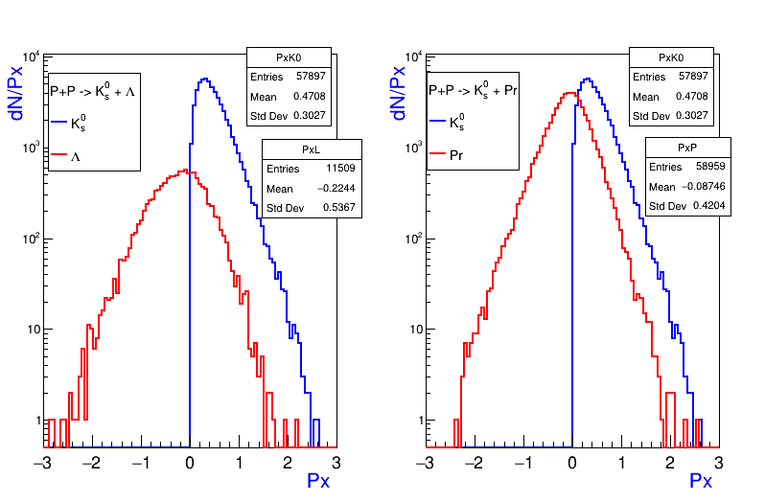
Comparison of Px’ of Λ-hyperons and protons associated with K⁰_{s} - mesons in PP- events calculated by FTF model
<Px’_ K⁰_{s} > = 470.8 MeV/с, N_ K⁰_{s} = 57897
<Px’_Λ > = - 224 MeV/с, N_ Λ = 11509
<Px’_Pr> = - 87.5 MeV/с, N_Pr = 58959
7

Slide 8
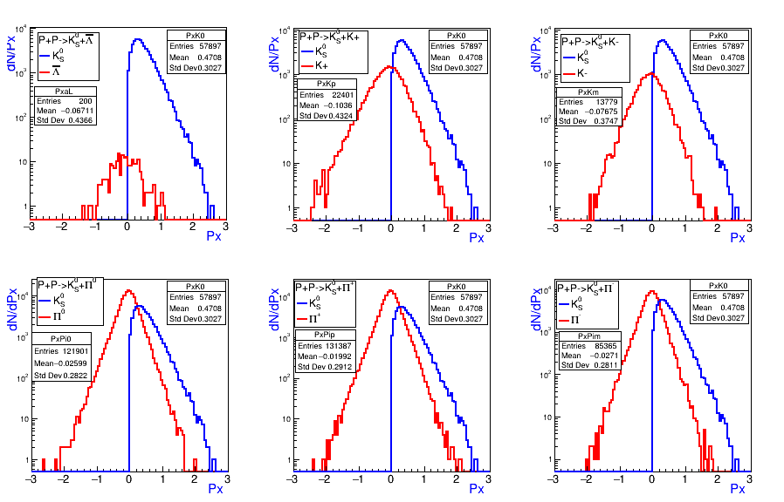
Px’ of particles associated with K⁰_{s} – meson
in PP-events calculated by FTF generator
<Px’_K⁰_{s} > = 470.8 MeV/c
<Px’_Λbar> = -67.1 MeV/с , <Px’_K⁺>=-103.6 MeV/с, <Px’_K⁻ > = -78.8 MeV/с
<Px’_π⁰> = -26 MeV/с, <Px’_π⁺>=-20 MeV/с, <Px’_π⁻ > = -27 MeV/с
8

Slide 9
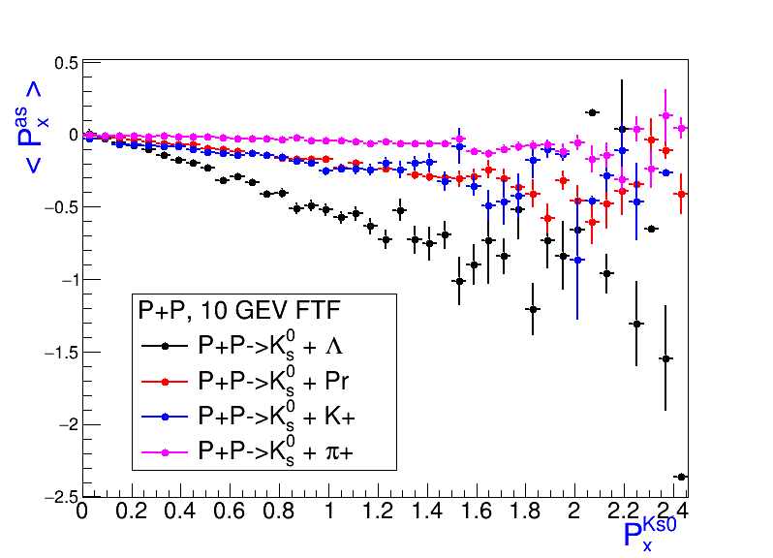
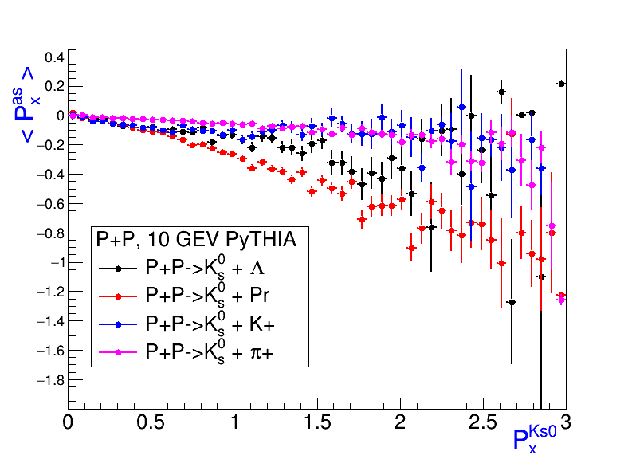
Correlations of mean Px’ of Λ-hyperons, K+, protons and π- mesons with K⁰_{s} – meson Px’ in PP-events calculated by FTF and PyTHIA
FTF
<Px’_Λ >= -224 MeV/с
<Px’_K+>=-103.6 MeV/с
<Px’Pr>= -87.5 MeV/с
<Px’_π+>= -20 MeV/с
PyTHIA
<Px’_Pr > = -128 MeV/с
<Px’_Λ> = -87.8 MeV/с
<Px’_K+> = -74.8 MeV/с
<Px’_π+> = - 31 MeV/с
9

Slide 10
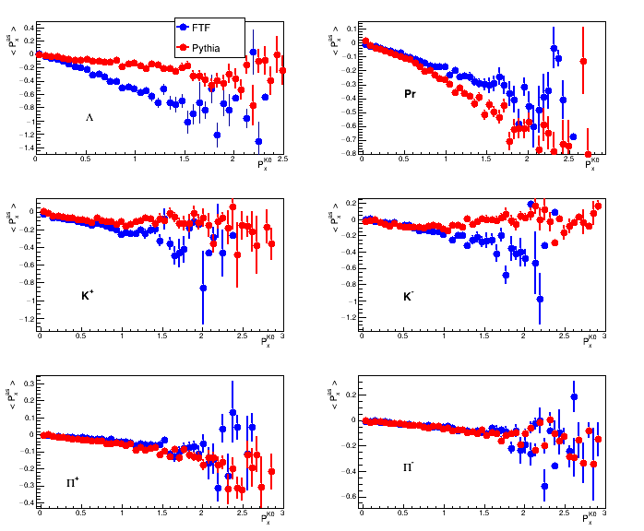
Comparison of correlations of mean Px’ of Λ hyperons, protons,
K-mesons and π-mesons with K⁰_{s} – meson Px’ in PP-events calculated by PYTHIA and FTF
FTF
PyTHIA
Beam reamnant
fragmentation
Where is
truth?
10

Slide 11
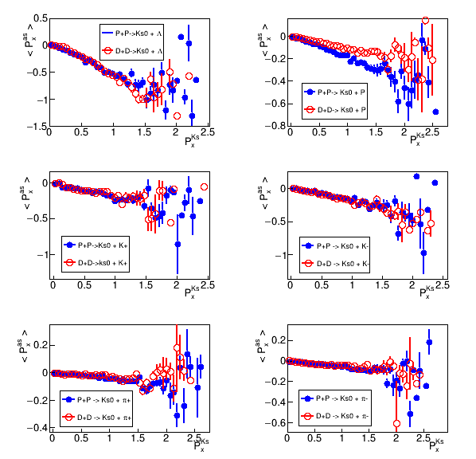
Comparison of correlations of mean Px’ of Λ hyperons, protons,
K-mesons and π-mesons with K⁰_{s} – meson Px’ in DD-events and PP-events calculated by FTF
FTF
Correlations of mean Px’ of Λ hyperons, K-mesons and π-mesons with K⁰_{s} – meson Px’ in DD-events and PP-events are close. Only the correlations between Px’ protons and K⁰_{s} – mesons in PP-interactions stronger than in DD-interactions.
11

Slide 12
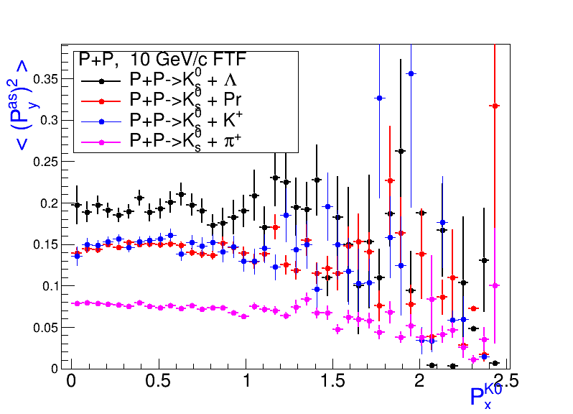
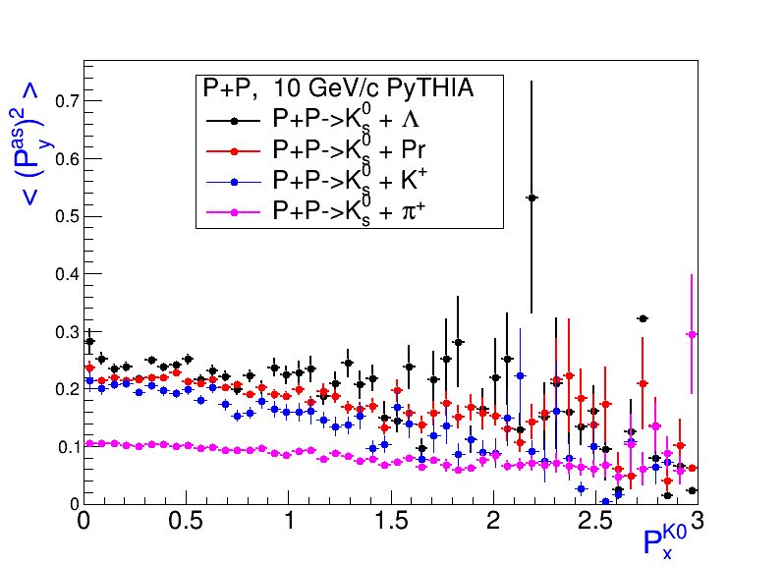
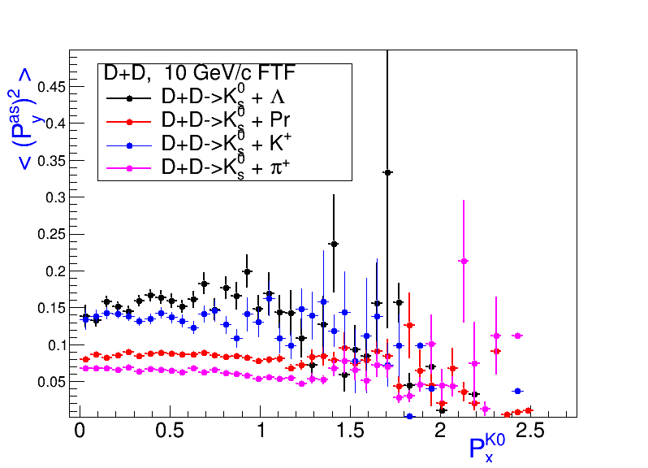
Correlations of mean Py’² of Λ- hyperons, protons K and π mesons with K⁰_{s} – meson Px’ in PP-events calculated by FTF and PyTHIA, and in DD-events.
FTF – PP events
<Py’² Λ>= 193 (MeV/c)²
< Py’² K⁺>= 151 (MeV/c)²
<Py’² Pr>= 147(MeV/c)²
< Py’² π⁺>= 75 (MeV/c)²
PyTHIA – PP events
<Py’² Λ>= 232 (MeV/c)²
< Py’² Pr>= 211 (MeV/c)²
<Py’² K⁺>= 188 (MeV/c)²
< Py’² π⁺>= 98 (MeV/c)²
FTF – DD events
<Py’² Λ>= 156 (MeV/c)²
< Py’² K⁺>= 137 (MeV/c)²
<Py’² Pr>= 86 (MeV/c)²
< Py’² π⁺>= 65 (MeV/c)²
12

Slide 13
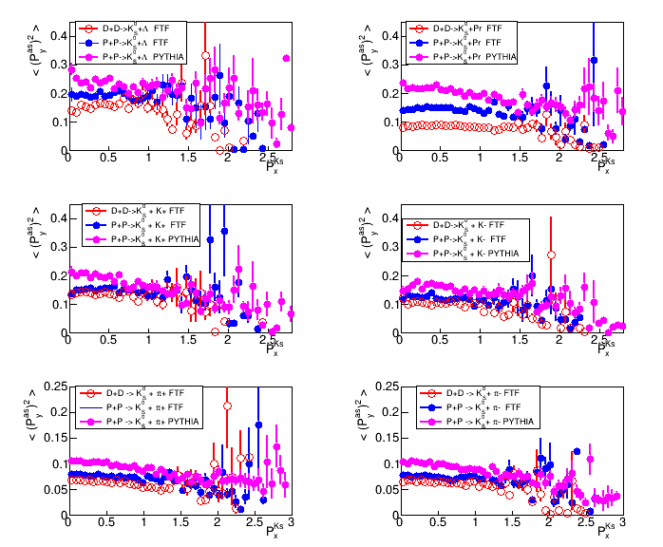
Comparison of correlations of mean Py’² of Λ hyperons, protons, K- and
π-mesons with K⁰_{s}–meson Px’ in PP-events calculated by FTF and PYTHIA, and in DD-events, calculated by FTF
Mt scaling
13

Slide 14
Table of Numbers and mean values of Px’ (MeV/c) and Py’² (MeV/c)² of
particles associated with K⁰_{s} – meson in PP-events at √S = 10 GeV
PP | К_{s}⁰ | Λ | Λbar | K ⁺ | K⁻ | π⁺ | π⁻ | π⁰ | P | Pbar
FTF | N 57897 | N 11509 | N 200 | N 22401 | N 13779 | N 131387 | N 86365 | N 121901 | N 58959 | N 276
Pythia | N 78850 | N 28219 | N 573 | N 29466 | N 20857 | N 201812 | N 129411 | N 182025 | N 74571 | N 1150
FTF | <P_{x}> 471 | <P_{x}> -224 | <P_{x}> -67 | <P_{x}> -104 | <P_{x}> -77 | <P_{x}> -30 | <P_{x}> -27 | <P_{x}> -26 | <P_{x}> -87 | <P_{x}> -48
Pythia | <P_{x}> 523 | <P_{x}> -88 | <P_{x}> -77 | <P_{x}> -75 | <P_{x}> -63 | <P_{x}> -31 | <P_{x}> -33 | <P_{x}> -34 | <P_{x}> -128 | <P_{x}> -75
FTF | <P_{y}²> 0 | <P_{y}²> 193 | <P_{y}²> 202 | <P_{y}²> 151 | <P_{y}²> 122 | <P_{y}²> 75 | <P_{y}²> 73 | <P_{y}²> 72 | <P_{y}²> 147 | <P_{y}²> 163
Pythia | <P_{y}²> 0 | <P_{y}²> 232 | <P_{y}²> 222 | <P_{y}²> 188 | <P_{y}²> 158 | <P_{y}²> 98 | <P_{y}²> 97 | <P_{y}²> 91 | <P_{y}²> 211 | <P_{y}²> 188
Table of Numbers and mean values of Px’ (MeV/c) and Py’² (MeV/c)² of
particles associated with K⁰_{s} – meson in DD-events at √S = 10 GeV
DD | К_{s}⁰ | Λ | Λbar | K ⁺ | K⁻ | π⁺ | π⁻ | π⁰ | P | Pbar
FTF | N 49323 | N 11171 | N | N 13308 | N 11399 | N 93683 | N 86796 | N 102010 | N 89367 | N 67
FTF | <P_{x}> 441 | <P_{x}> -175 | <P_{x}> -156 | <P_{x}> -91 | <P_{x}> -82 | <P_{x}> -15 | <P_{x}> -25 | <P_{x}> -20 | <P_{x}> -49 | <P_{x}> 49
FTF | <P_{y}²> 0 | <P_{y}²> 156 | <P_{y}²> 141 | <P_{y}²> 137 | <P_{y}²> 103 | <P_{y}²> 65 | <P_{y}²> 65 | <P_{y}²> 63 | <P_{y}²> 86 | <P_{y}²> 122
14

Slide 15
Summary
We observe strong 2-particle Pt correlations between K⁰_{s} mesons and
strange particles in PP - interactions according to Geant4 FTF model.
2. Event generators – Pythia and Geant4 FTF give
different predictions for these correlations. FTF model predicts
stronger correlations between strange particles than Pythia model.
3. According to Pythia generator, Pt correlations between K⁰_{s} mesons
and protons stronger than in FTF generator.
4. According to FTF model, correlations of mean Px’ of associated particles
with Px’ of K⁰_{s} mesons in DD-events and PP-events are approximately close to
each other.
5 . For PP-interactions, FTF predicts lower values of mean Py’² of particles associated with K ⁰_{s} mesons, than Pythia generator. For DD-interactions, mean Py’² of associated particles lower than for PP-interactions, according to FTF model calculations.
The Pt correlations are connected with main assumptions of various string models used in Pythia and Geant4 FTF. Study of the correlations allows tuning and calibration of the main simulation generators - Pythia and Geant4 in high energy physics!
15

Slide 16
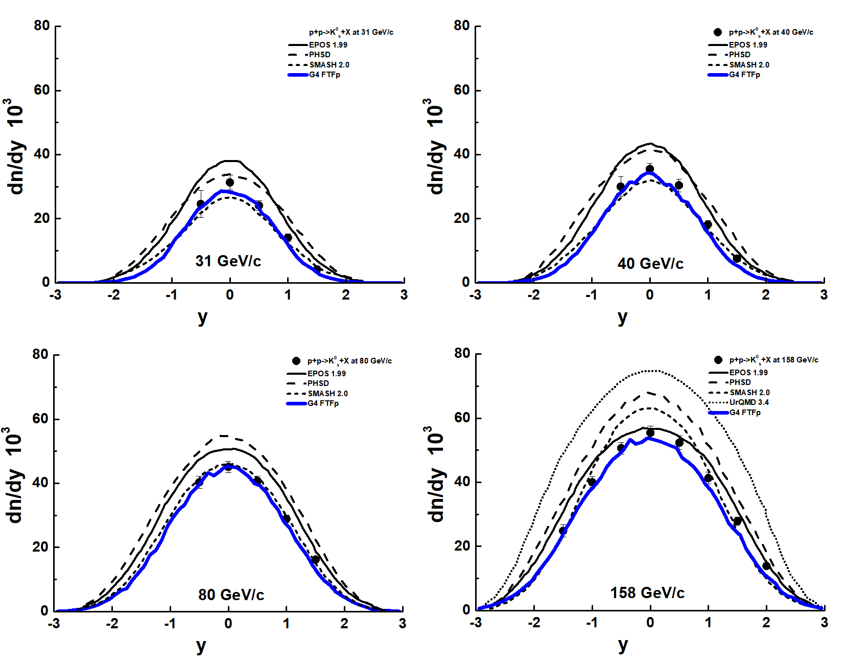
Experimental data and models + FTF
FTF is the best!
3

Slide 17
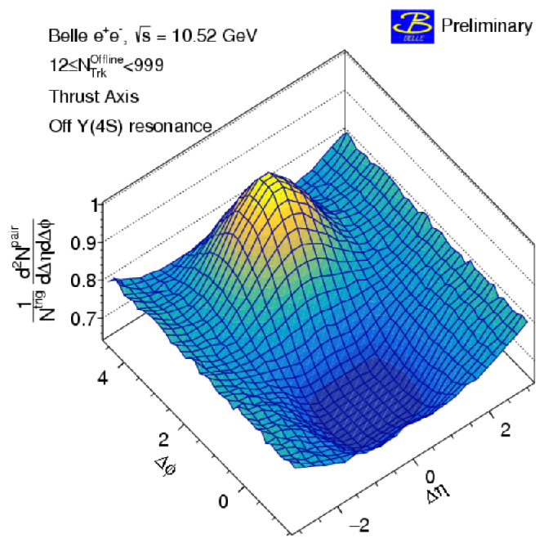
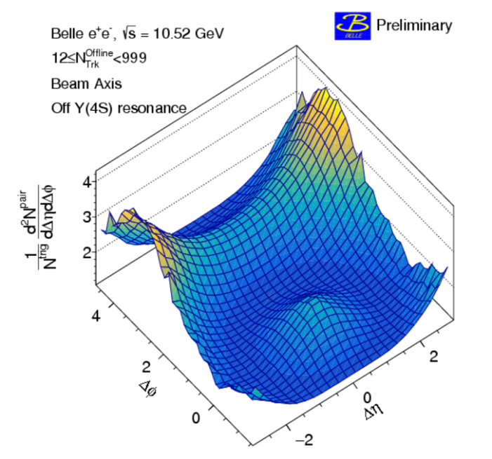
Towards Study of 2-Particle Pt Correlations
PHYSICS REPORTS 107 (1984) 59
e+e- PHYSICS AT PETRA –
THE FIRST FIVE YEARS,
Sau Lan WU and DESY.
Jets in High
Energy Physics
Two-particle correlation functions
for beam (left) and thrust (right)
axis analyses with offline multiplicity Noffline Trk ≥ 12.
What to do at lower energies when jets are not produced?
5

