Slide 1

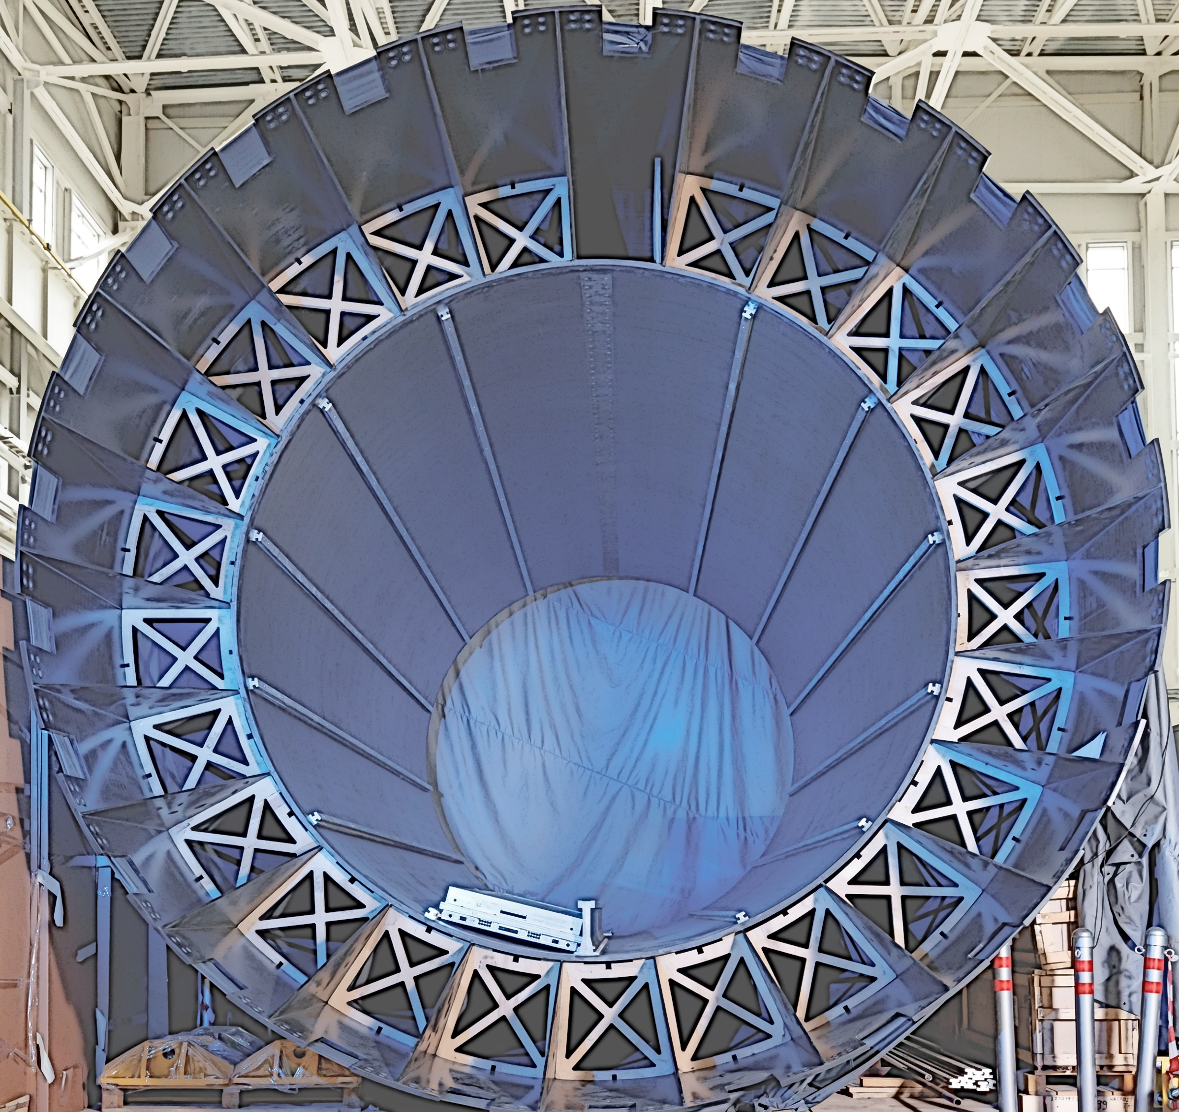

ECal Status

Slide 2
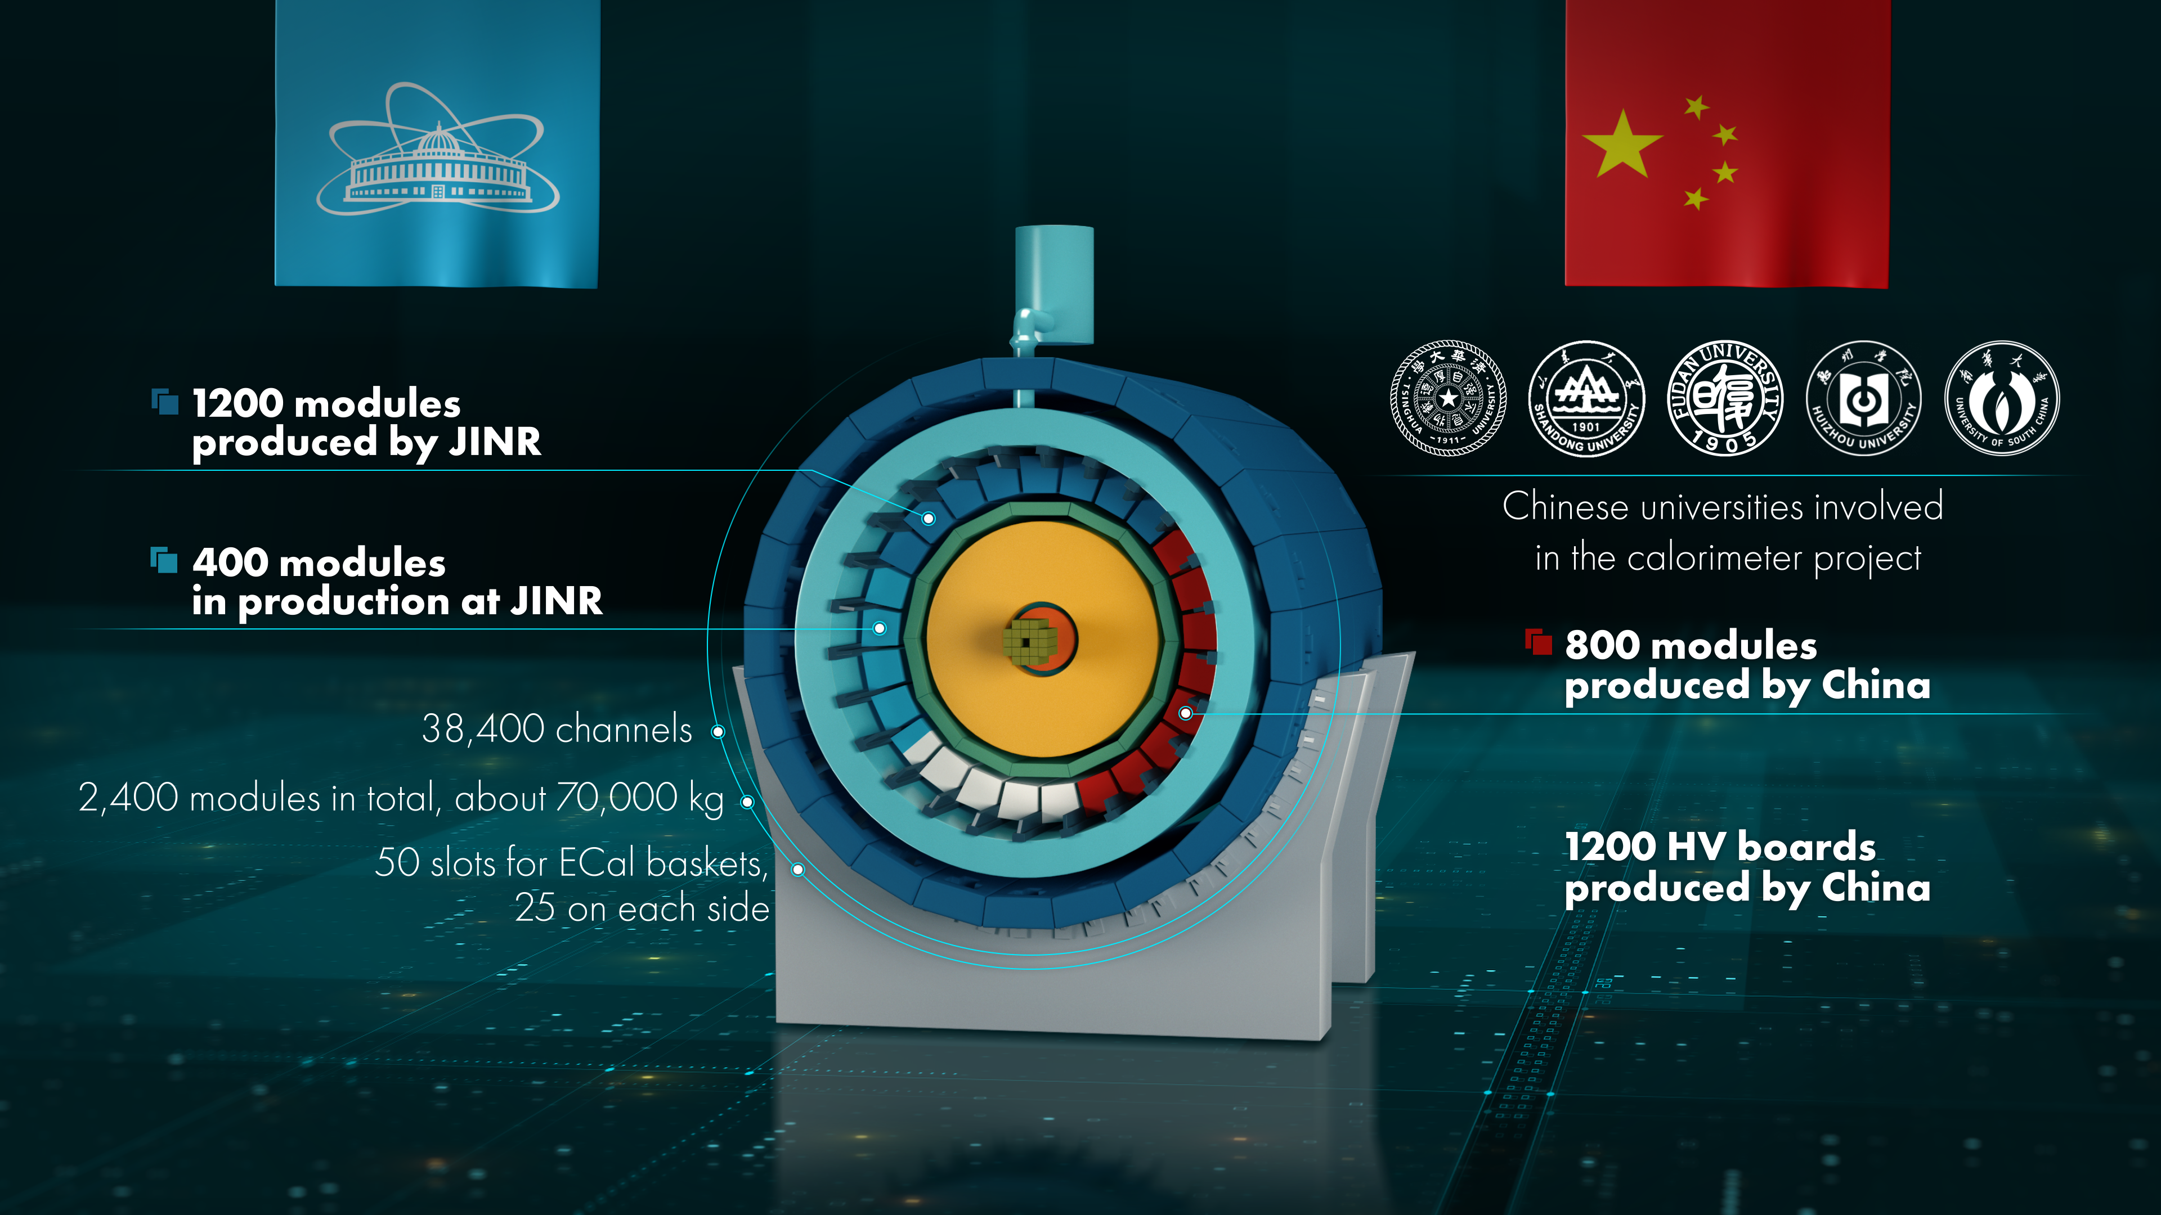

Slide 3
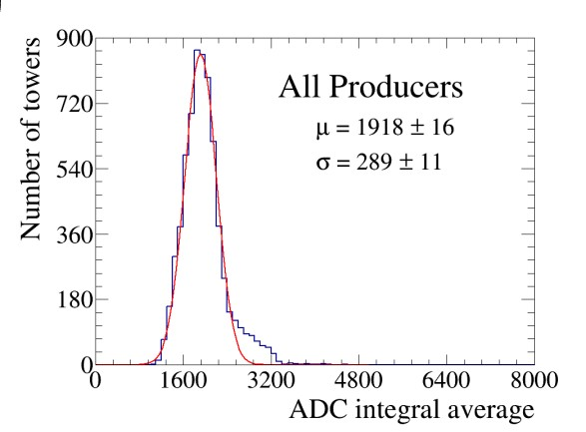
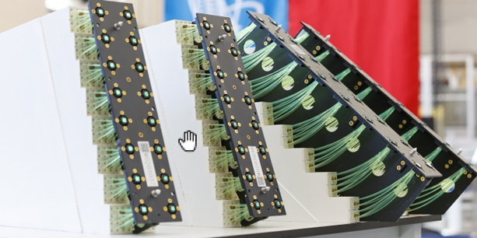
Main advantage and in the same time
main construction complication of our
ECal is it's projective geometry
In total 1600 modules produced
in Russia and China
All modules are already tested
by means of cosmic muons and none
of modules was rejected due to the
bad results of these tests.
γ¹
γ²
γ³
+ Better energy and space resolution
- Many detector types with complicated shape

Slide 4
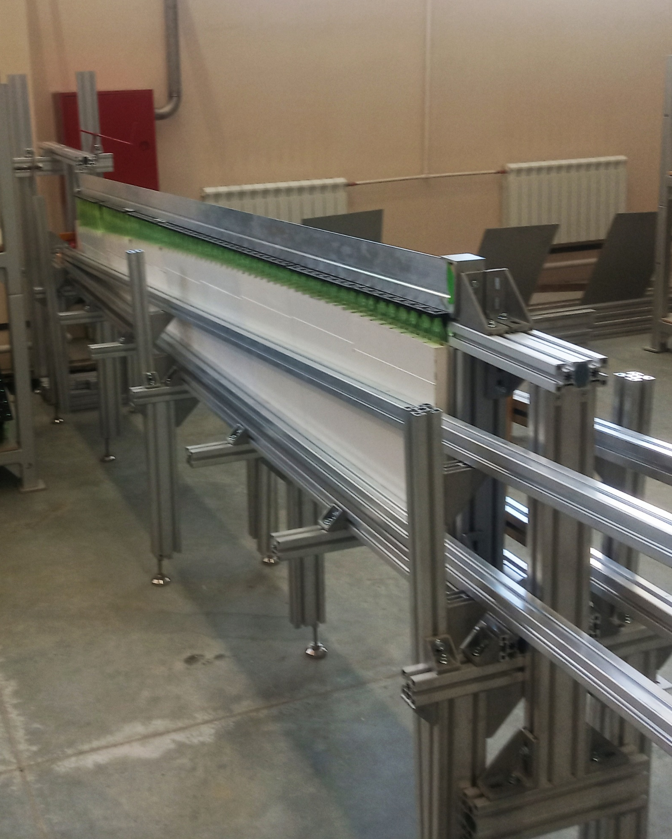
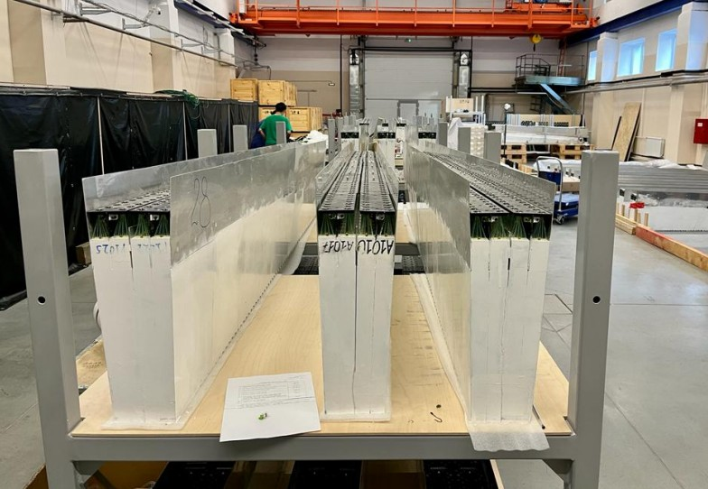
Specially designed slipway used to assembly 16 modules of 8 types in one cluster.
100 clusters are already produced

Slide 5
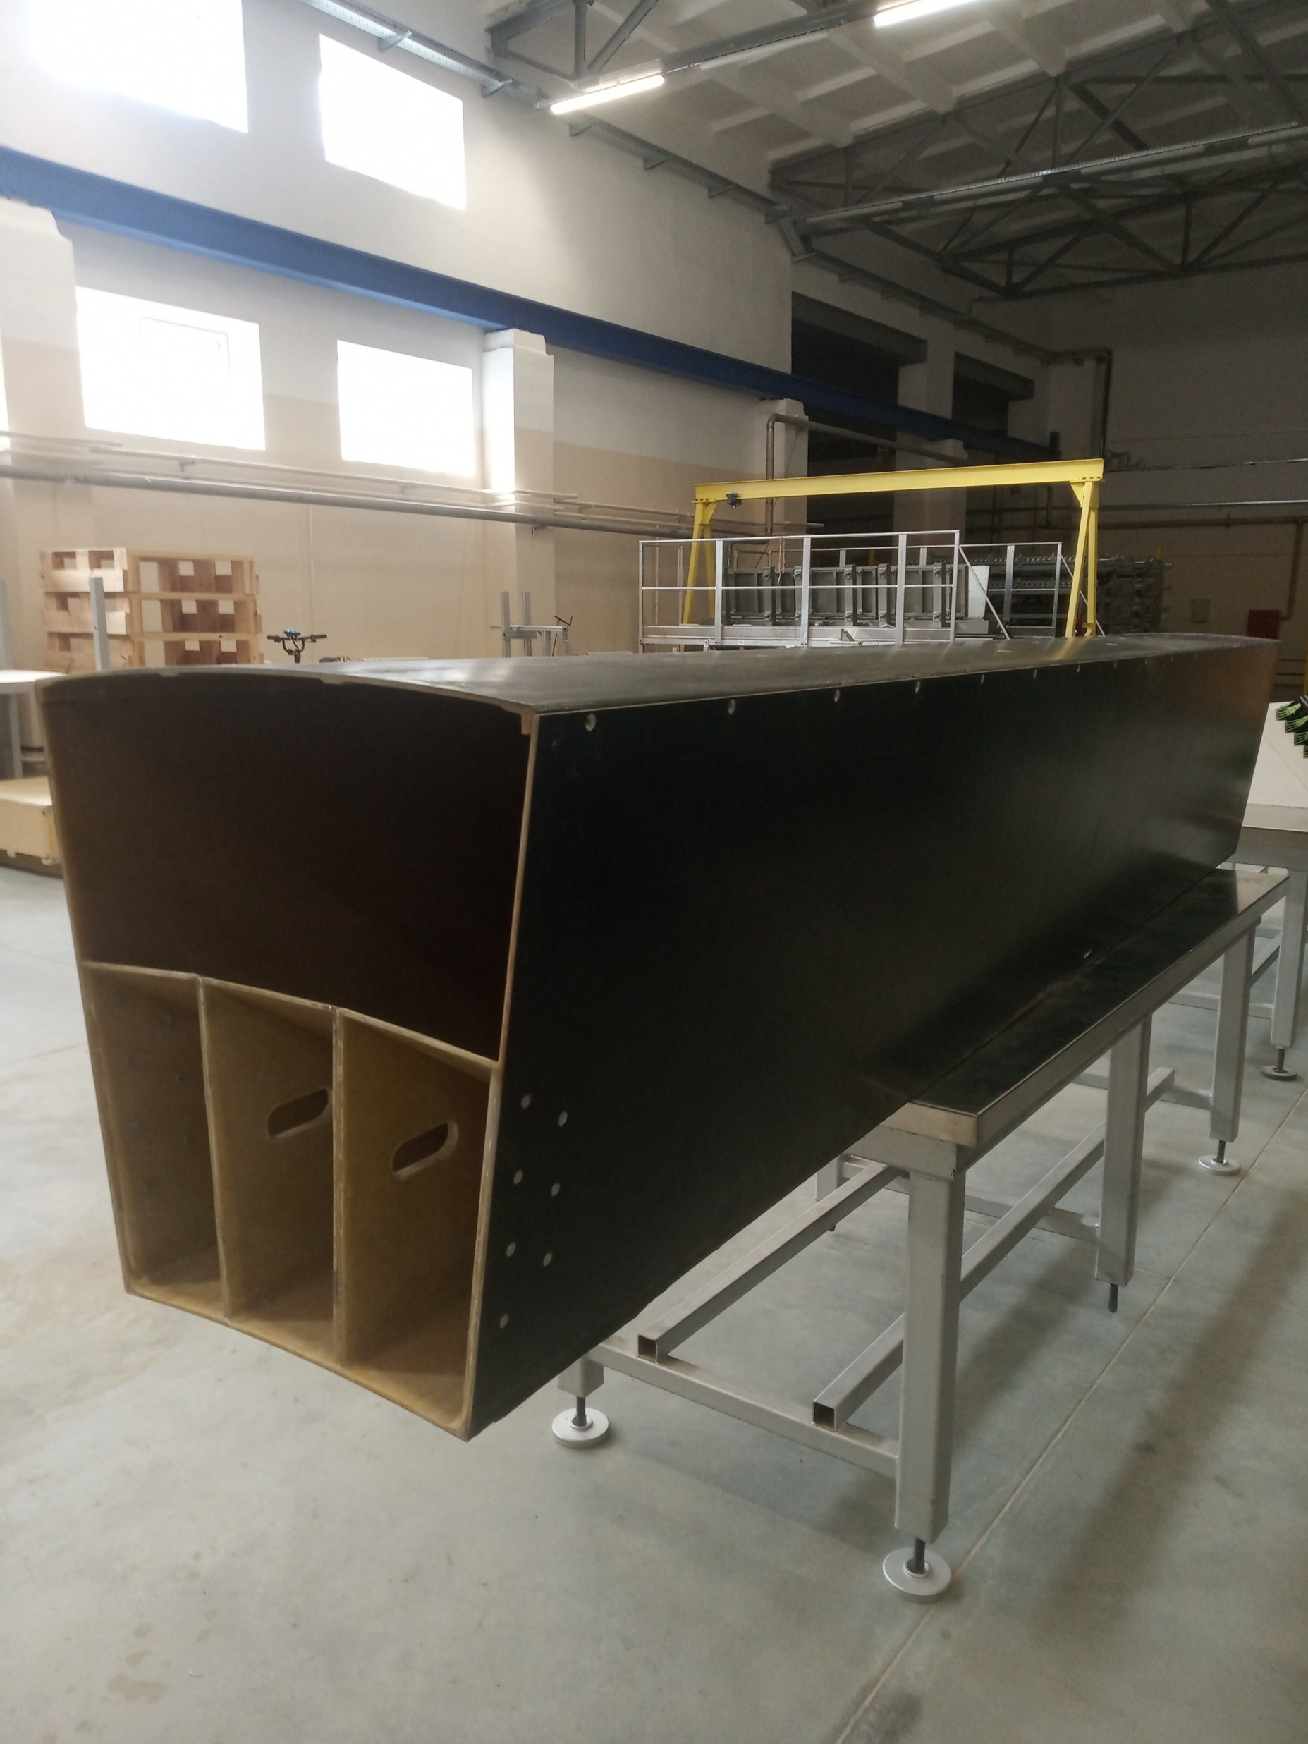
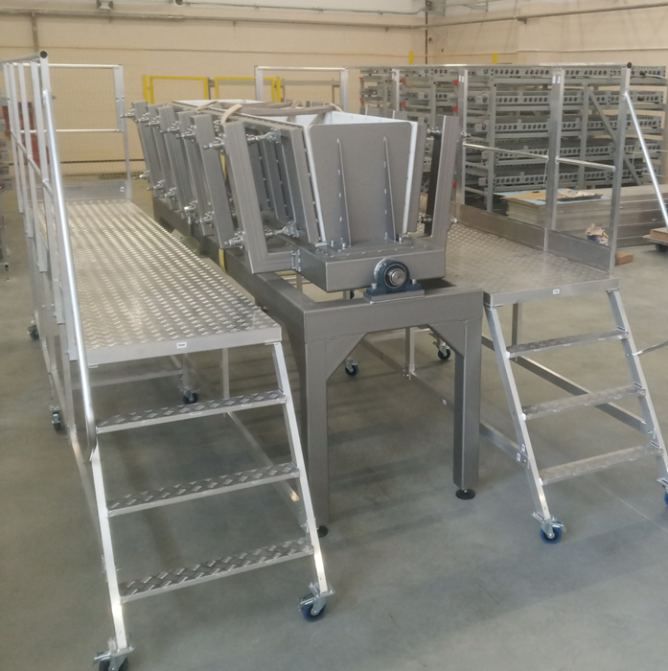
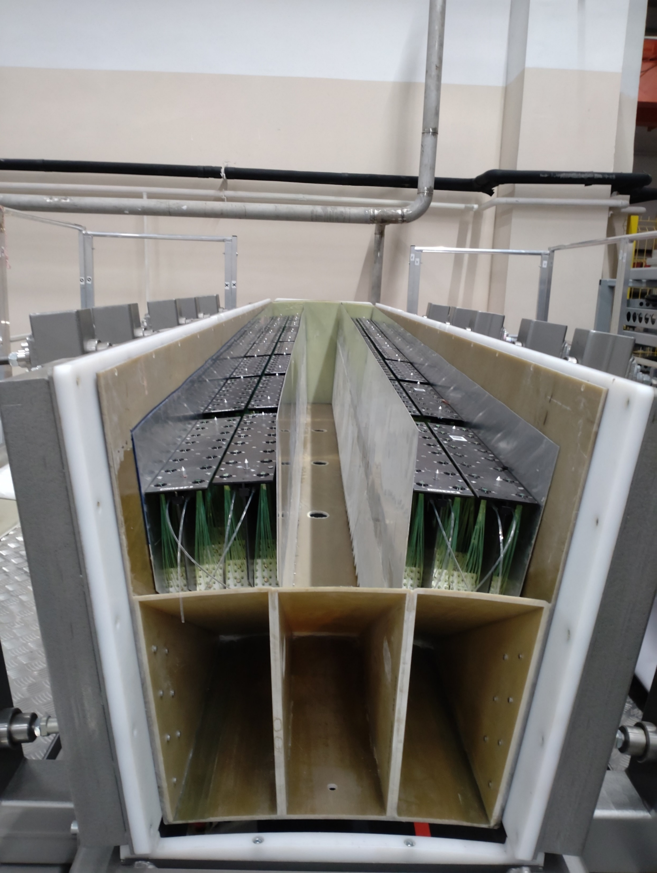
Each half sector basket consist of three clusters.
To fill basket by the clusters one more slipway designed and produced.
The main feature of this slipway is a very strong walls on the side
to keep basket in the size limits of slots dedicated in the MPD.
32 baskets are assembled and ready for the final step of
assembling procedure - installation of electronics.

Slide 6
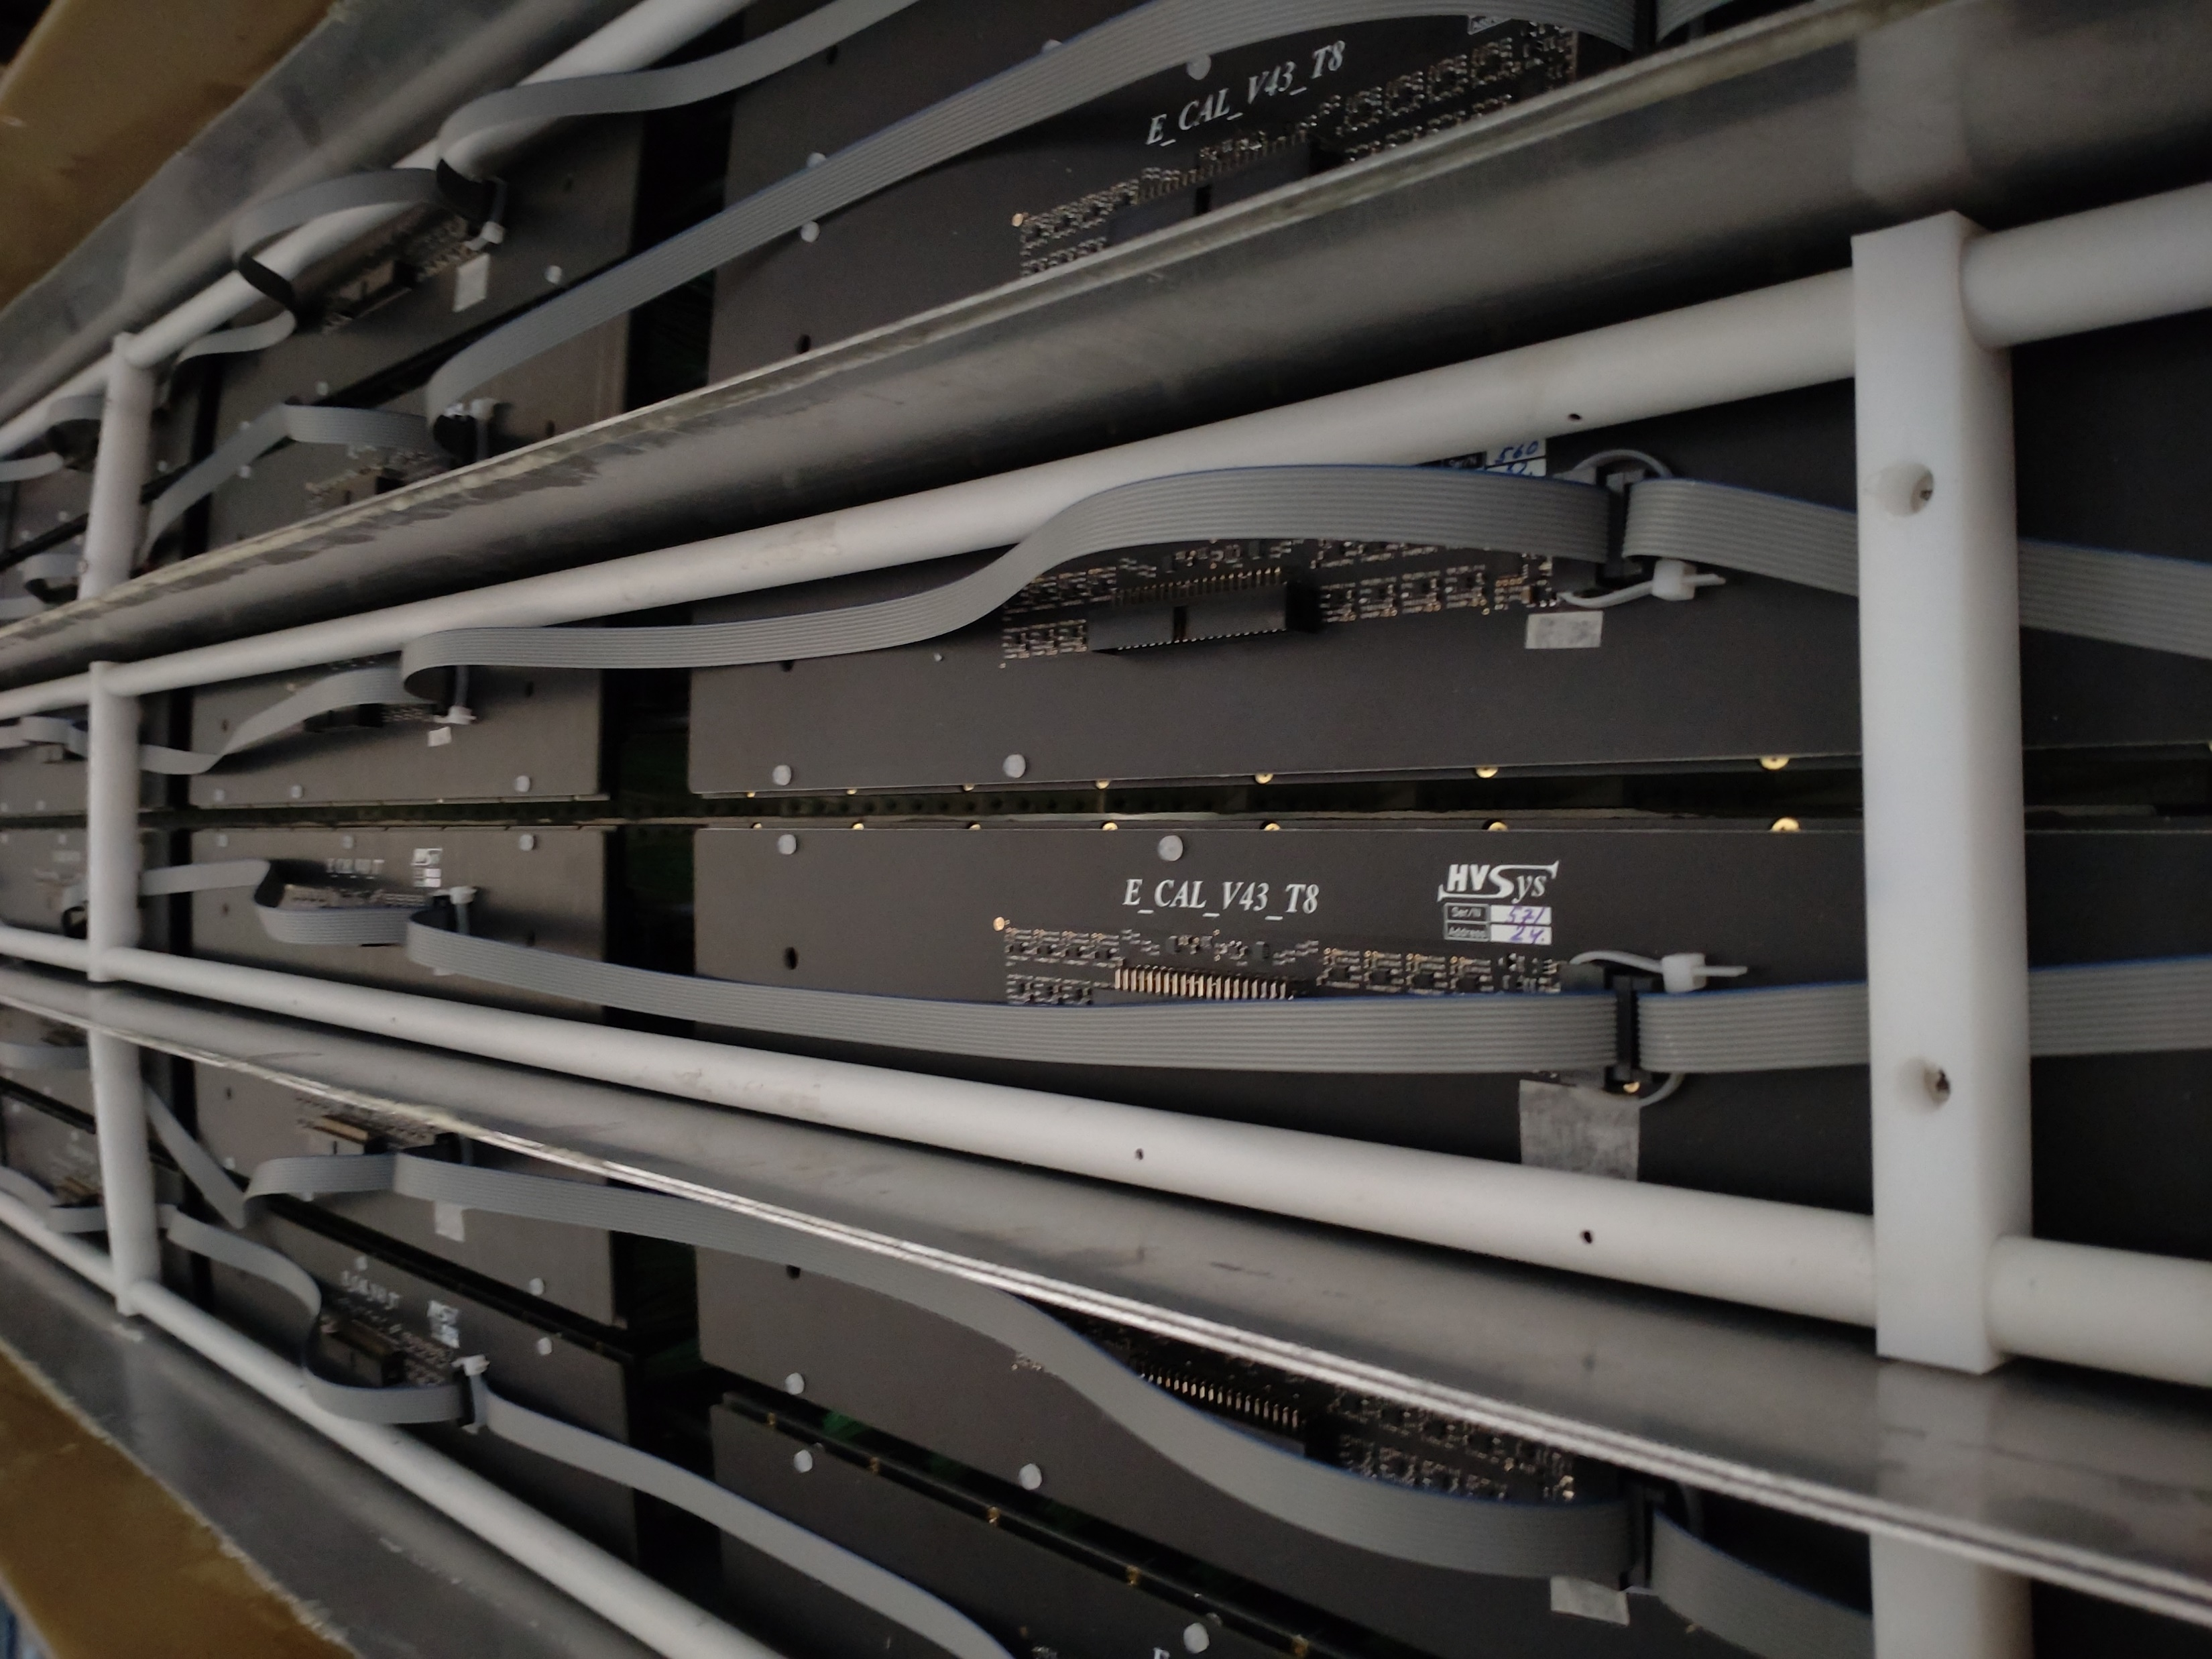
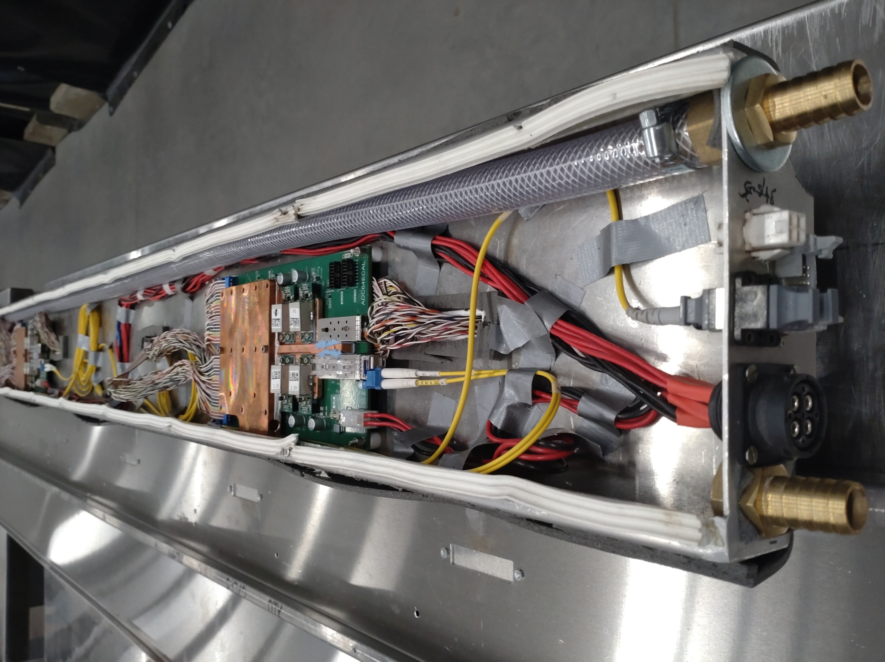
Electronics mounted in the basket consist
of HV+Slow Control boards mounted directly
on each module and ADC boards in the
cooling box.
Due to the rather high power dissipation
in the ADC boards they are separated
from the detector volume in the cooling box.
One half sector basket is fully assembled
with electronics and stay under stability test
during last few months.
In September electronics mass assembling
was started.
All materials and electronics components
are in stock.
32 half sectors already equipped with electronics
and will be installed on the tests.

Slide 7
In summarizing –
In the beginning of 2024 all produced modules
has been installed in the 32 half sector baskets and
Baskets are ready to be inserted in the MPD in June 2024.
It is already counts for 64% of full calorimeter.
Next few slides will be dedicated to the possibility of the
ECal coverage increase

Slide 8
One of the key elements of calorimeter construction is WLS fiber from the KURARAY (Japan).
We can not get it any more
Solution

Slide 9
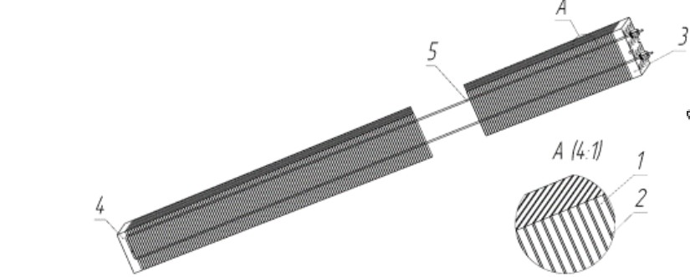
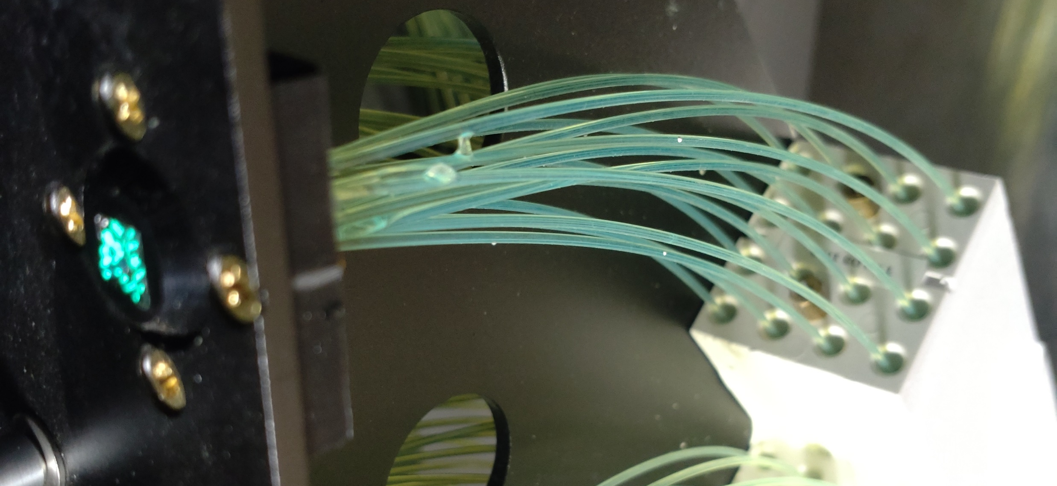
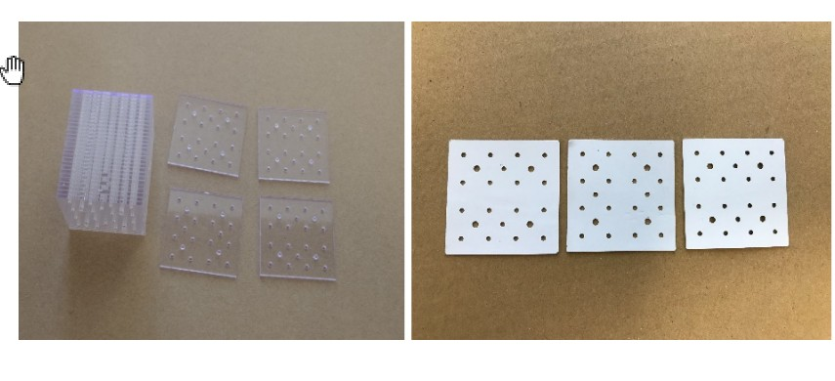
1600 ECal modules out of 2400 have been already manufactured
800 more modules are needed to complete ECal building
All materials, equipment and competencies are in our hands to build the rest of 800 modules.
WLS fibers are most crucial element of module construction.

Slide 10
The only well known producer of WLS fibers, used
in the high energy physics detectors, is KURARAY from Japan.
Number of serious barriers is appear now obstructing
for us to use this provider –
1. Sanctions
2. Factory is closed right now for one year for modernization
3. Slow production rate
To find WLS producer a search was made in Russia

Slide 11
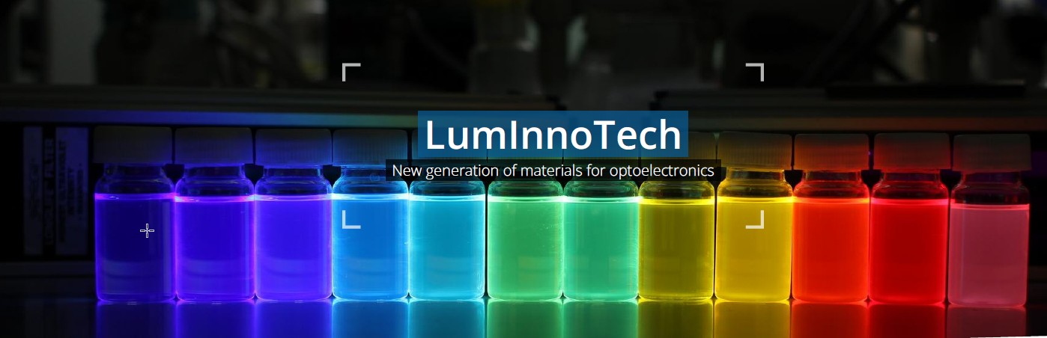
Moscow
Luminescent Innovative Technologies
Moscow,
The main goal of LumInnoTech LLC is research and development of novel functional materials for applications in high energy physics (plastic scintillators, wave lengths shifters) and organic optoelectronics (organic light-emitting diodes, solar cells, photodetectors).

Slide 12
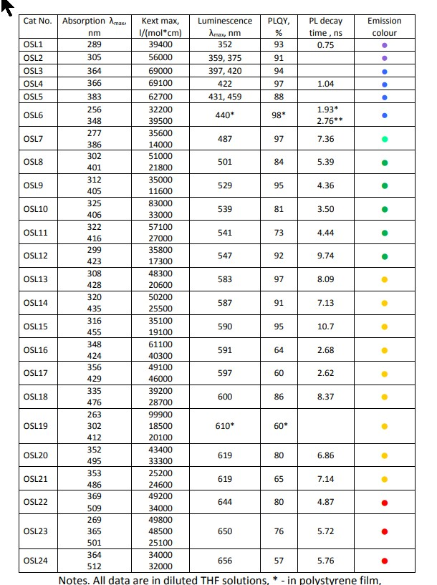
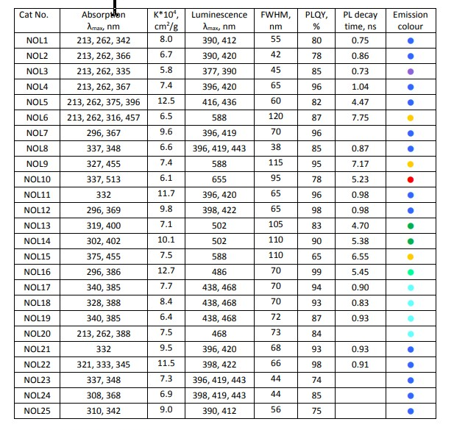
OrganoSilicon
Luminofores OSL
Nanostructured Organosilicon
Luminofores NOL

Slide 13
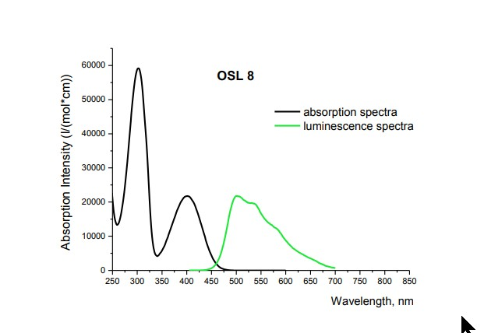
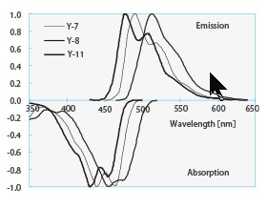
KURARAY

Slide 14

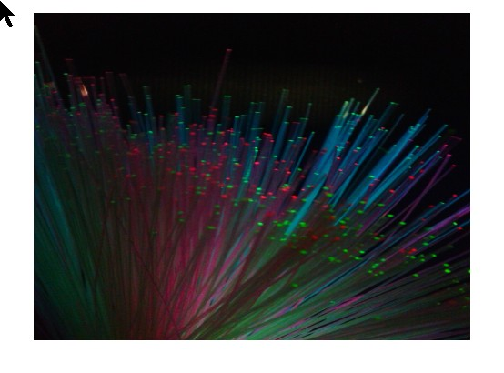
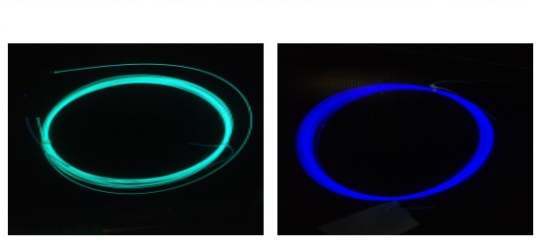
Tver’
Technologycal center
of polymer optical fiber
Polymer optical fiber (0.15-3.0 mm)
Optical fiber cable
Multi-core optical bundles
Side glow fiber
Scintillating fiber
WLS fiber
.....
WLS fibers

Slide 15
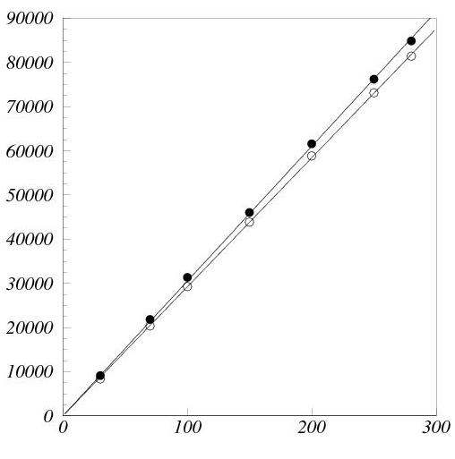
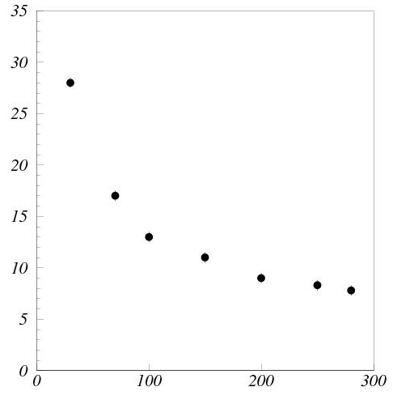
Module with OSL8 fibers
has been manufactured
Test has been done in Troitsk.
Electron beam
KURARAY
OSL8
σ_{A}/A (%)
A (ADC counts)
OSL8
E_{el} (MeV)
E_{el} (MeV)

Slide 16
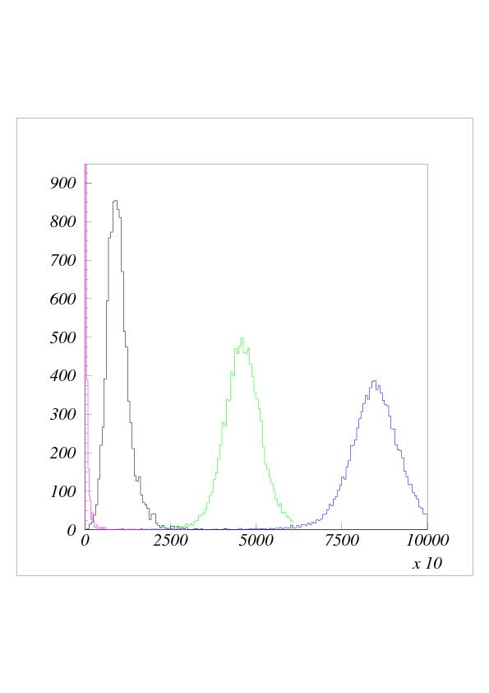
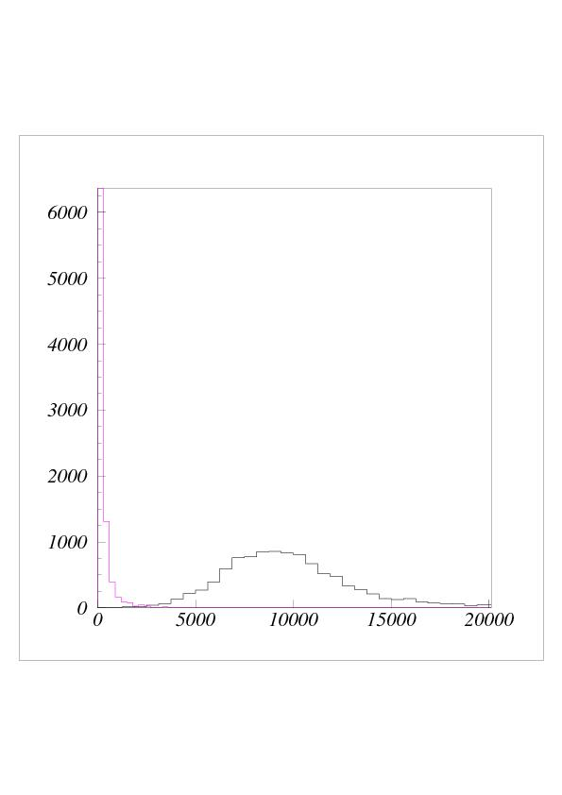
N
noise
N
e⁻ 30MeV
e⁻ 150MeV
e⁻ 280MeV
noise
e⁻ 30MeV
A (ADC counts)
A (ADC counts)
Tests of new modules equipped by the OSL8 WLS demonstrated good results very similar to the modules with KURARAY WLS fibers.
Production of 400 modules with SOL8 fibers started

Slide 17
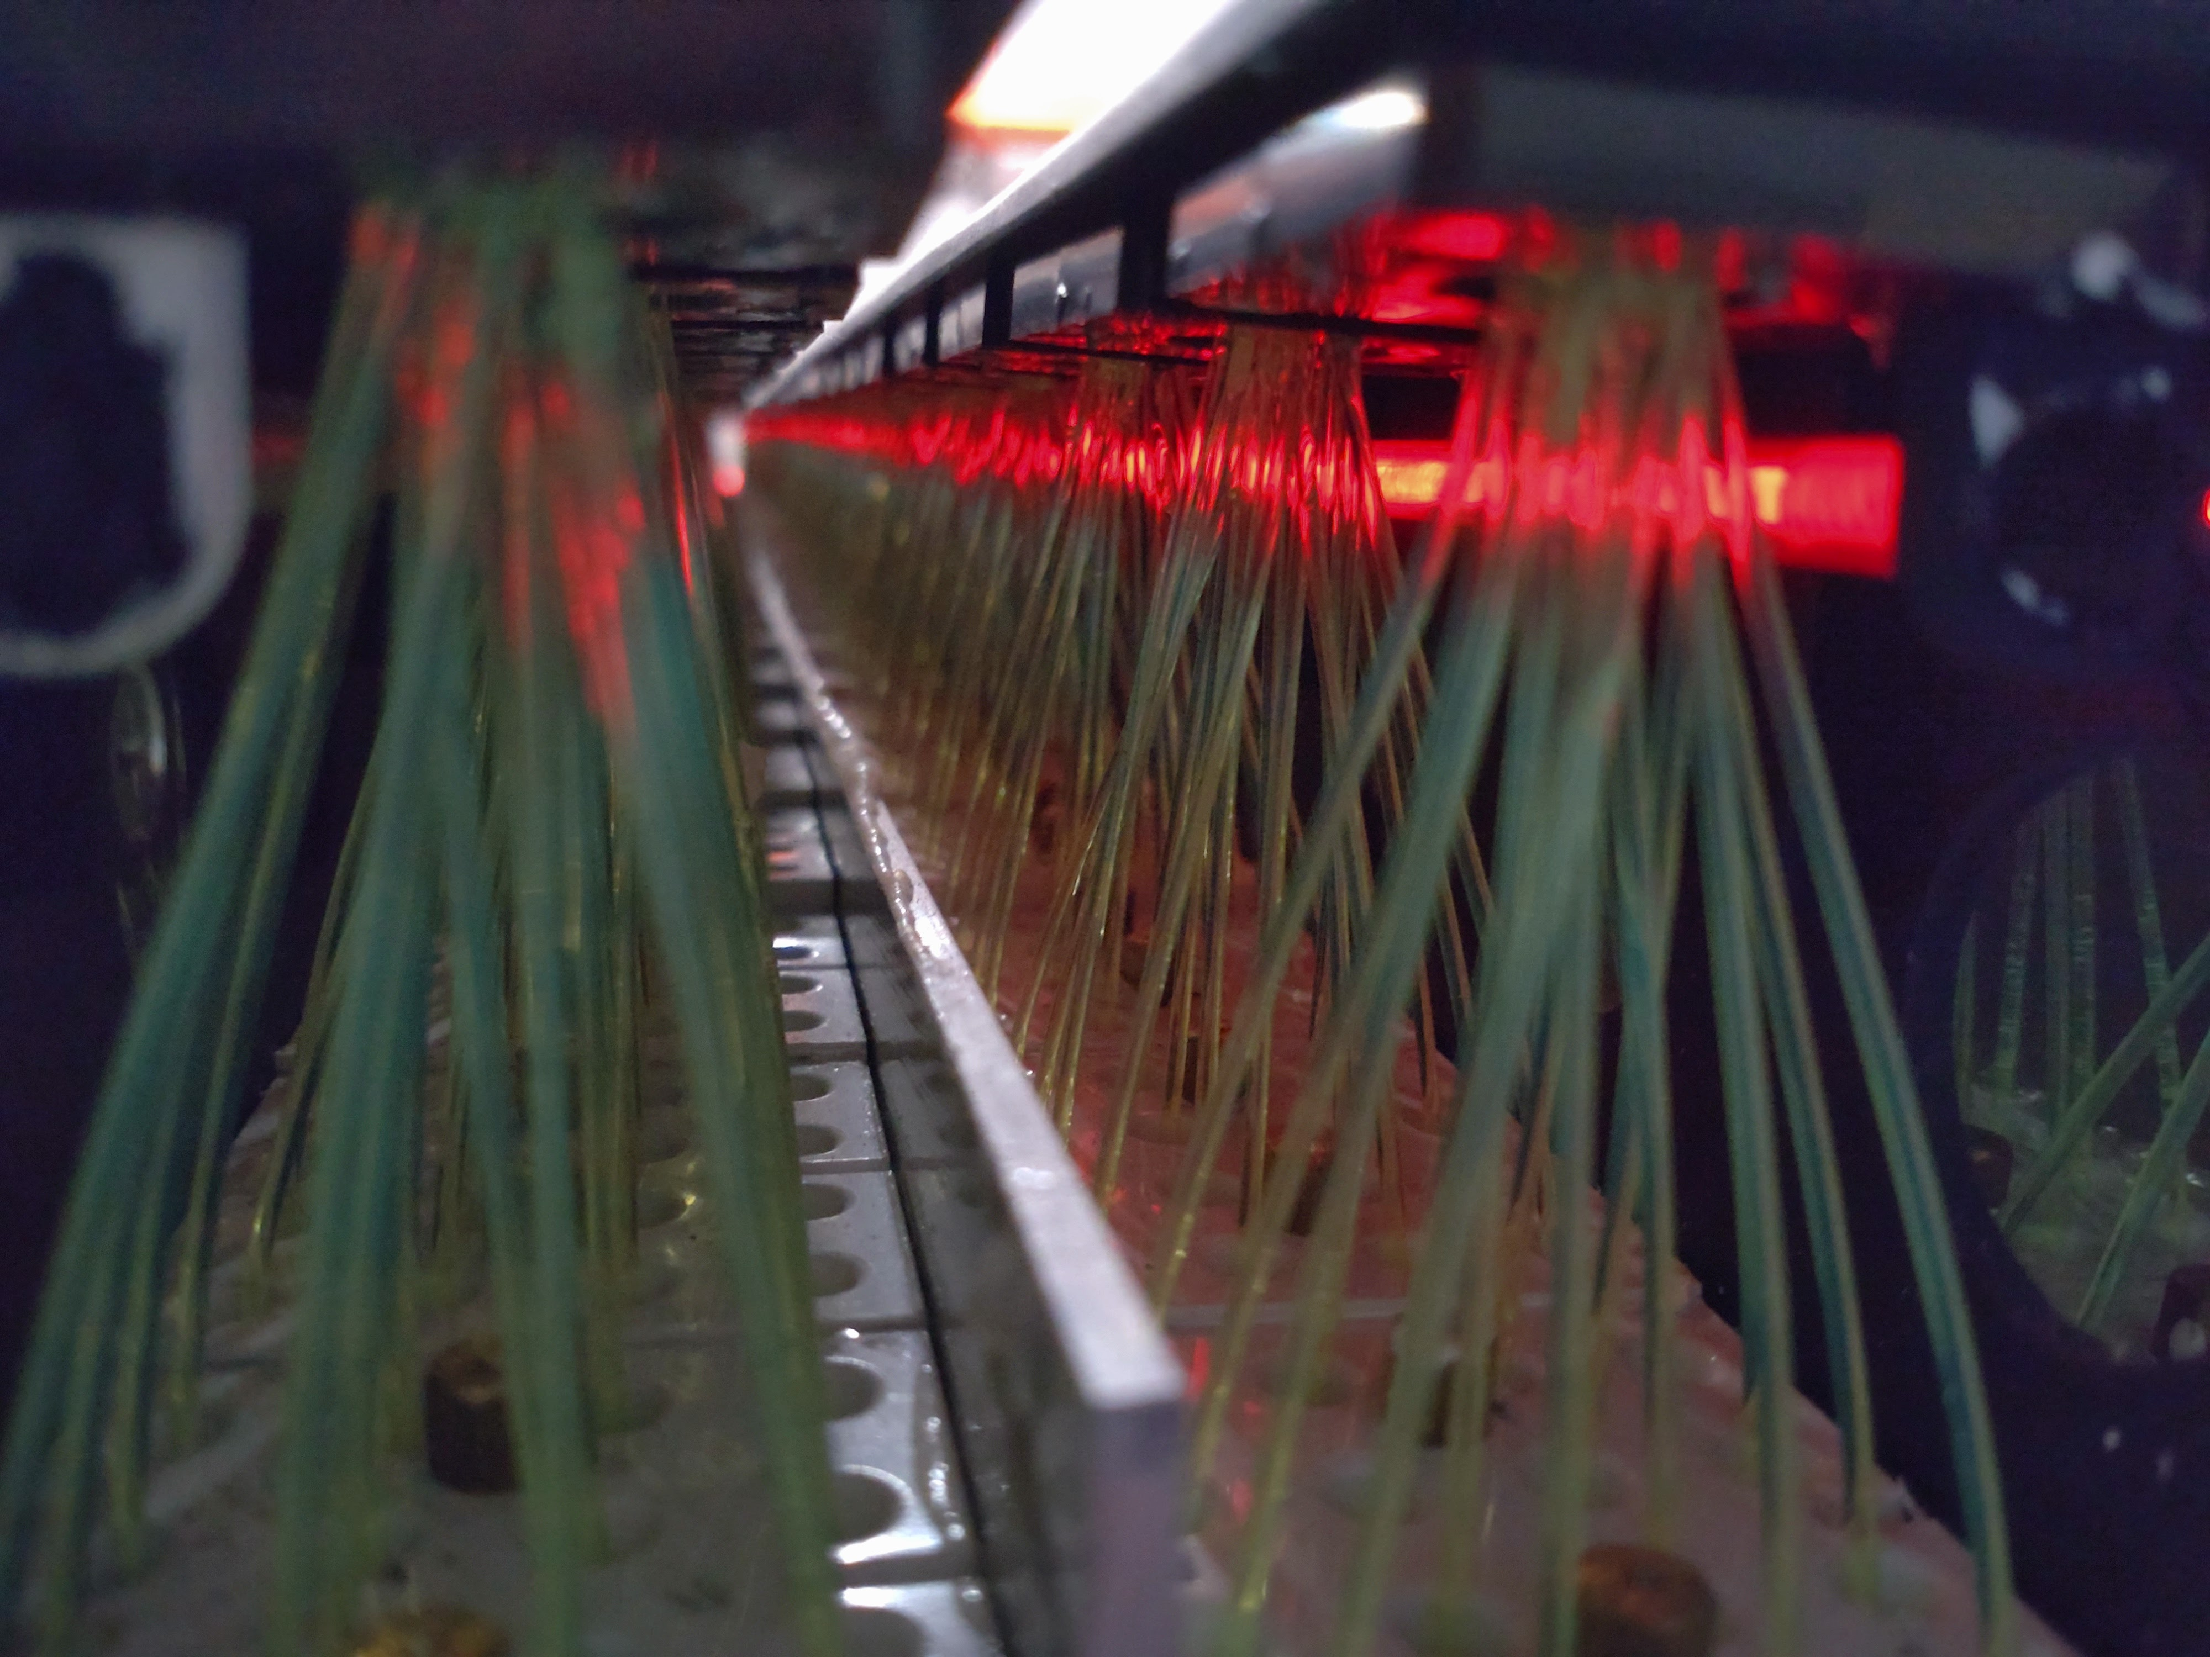
Tests
Cosmic muons tests
Operation Stability tests with LED
One half sector (768 channels) studied on the operation stability
by LED illuminating the WLS fibers through side glow fiber
Signals deviation from the reference values was analyzed vs time

Slide 18
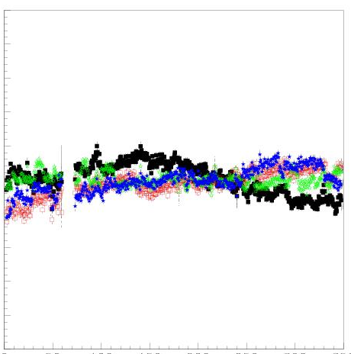
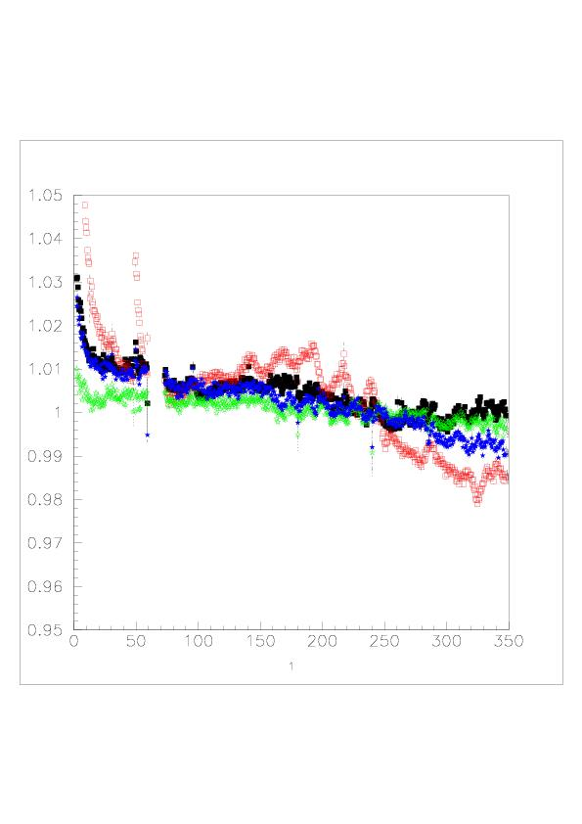
A_{i}/A_{i}^{reference}
A_{i}/A_{i}^{reference}
1.05
1.05
“bad” channels
“good” channels
1.03
1.03
1.02
1.02
1.01
1.01
1.00
1.00
0.99
0.99
0.98
0.98
0.97
0.97
0.95
0.95
0 100 200 300
0 100 200 300
Time (h)
Time (h)

Slide 19
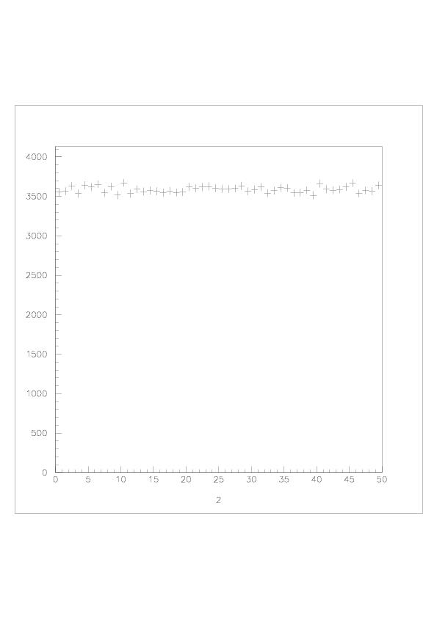

Slide 20
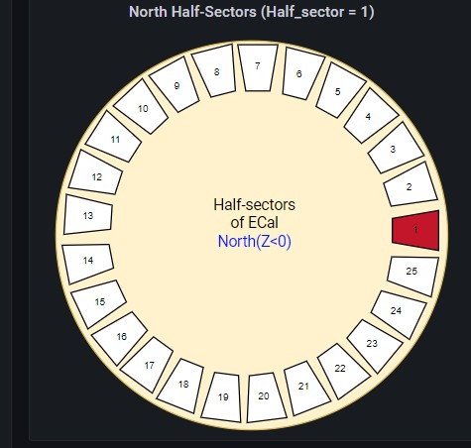
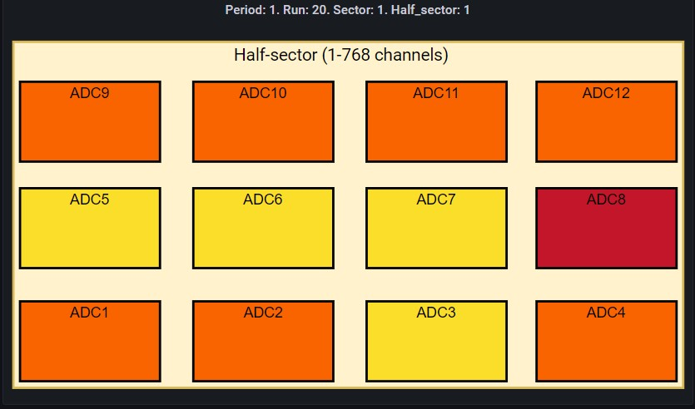
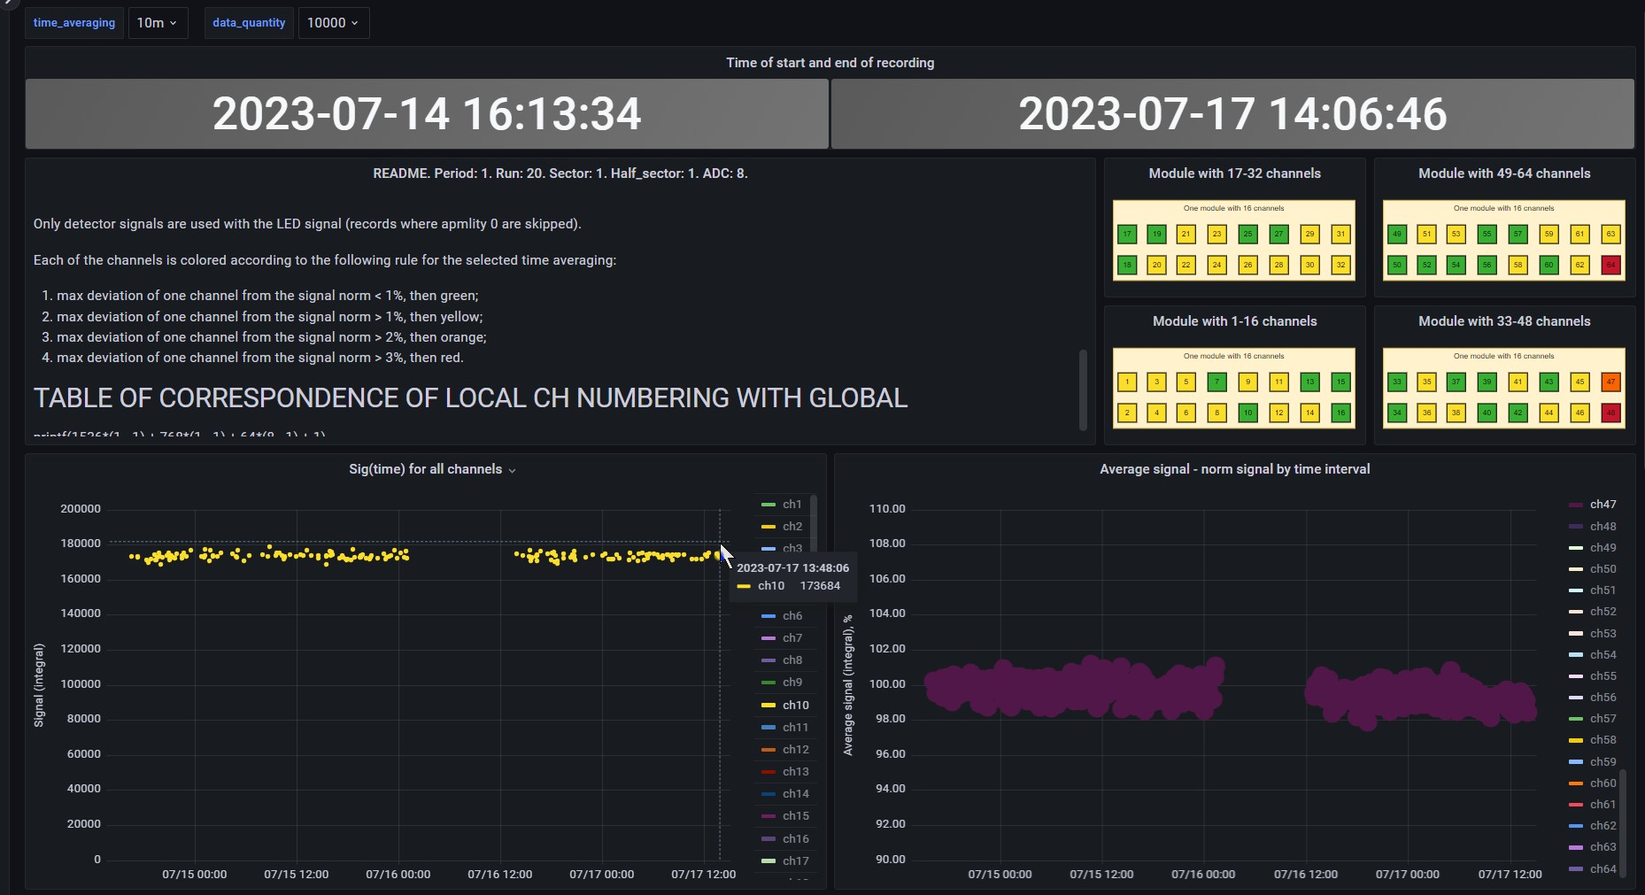

Slide 21

Conclusions:
First stage (64%) of ECal assembling is going well and will be completed in time (June 2024).
Work is started to build 400 more modules increasing ECal coverage in the barrel region up to 82%.
First assembled half sector is under long term tests. Stability of ECal operation demonstrated on the level of few % for 768 channels.
Possibility to use cosmic muons for the calibration of the assembled ECal is demonstrated.
ECal Slow Control and Stability Control software is under tests using assembled half sector.

Slide 22
There is a lot of interesting work ahead, both
on detector study, as well as on the
software development for this detector
We are inviting everybody, from students
to experienced physicists, to cooperate
in those exciting researches
Thank you for the attention!

