Slide 1


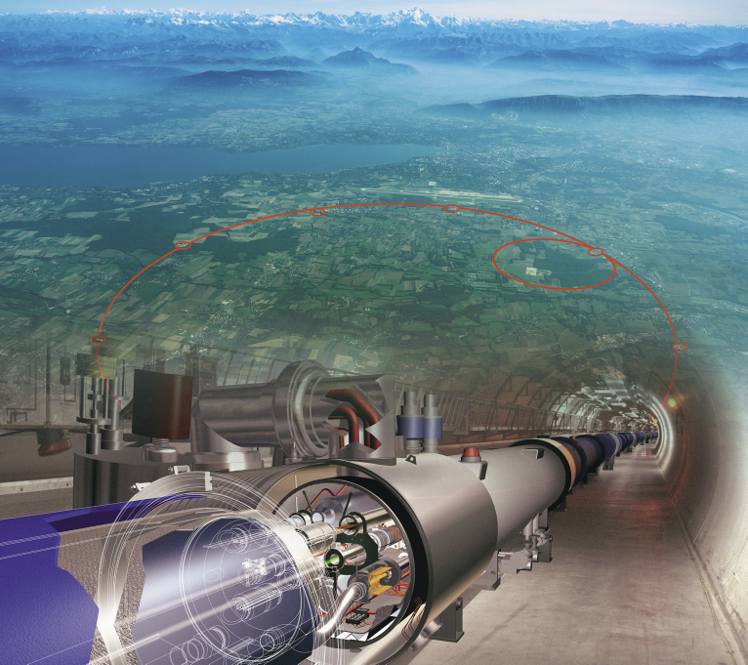
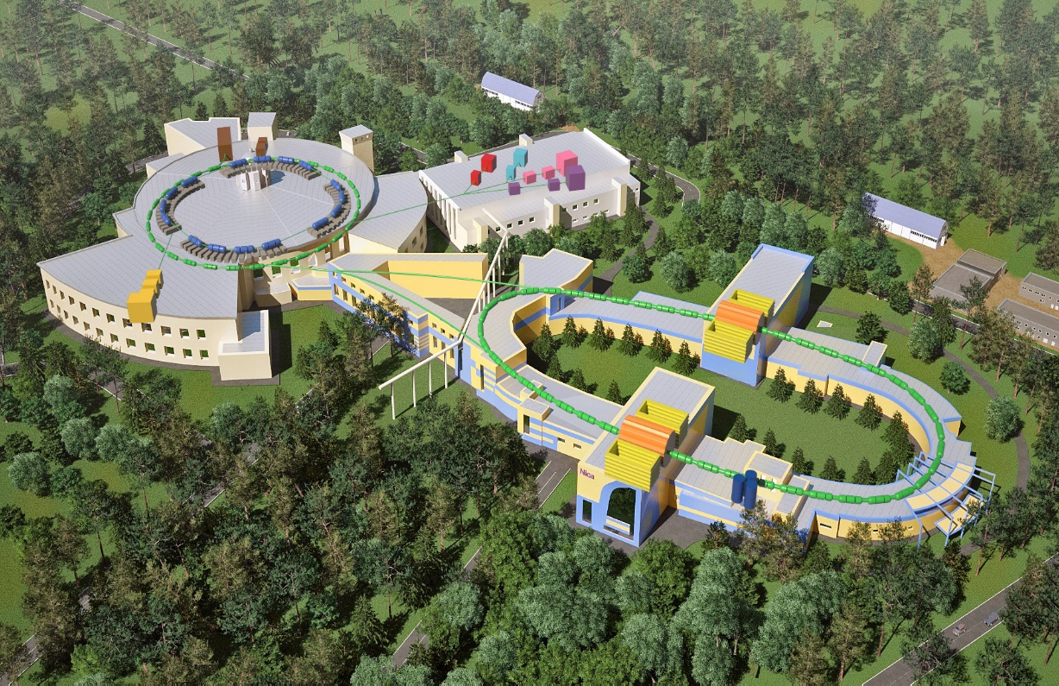
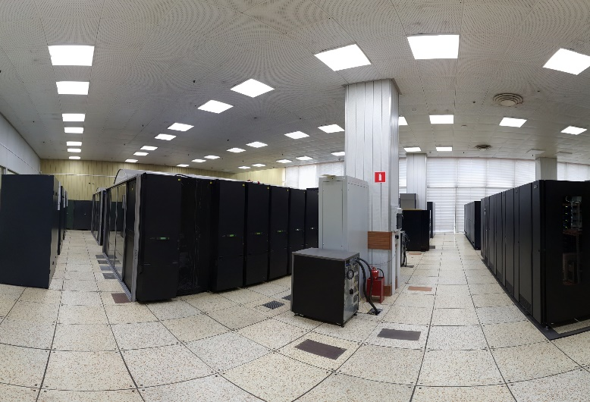
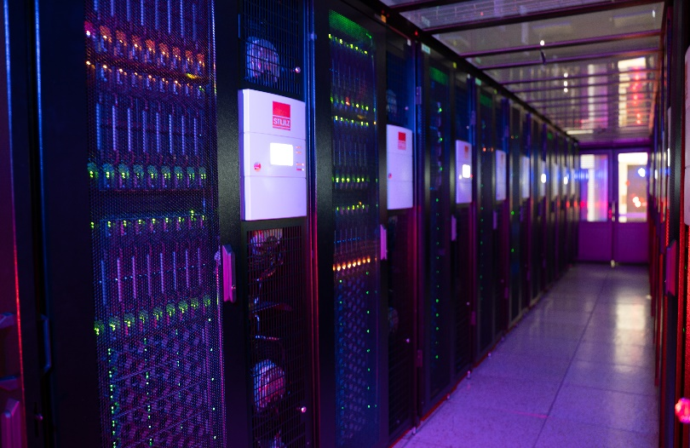
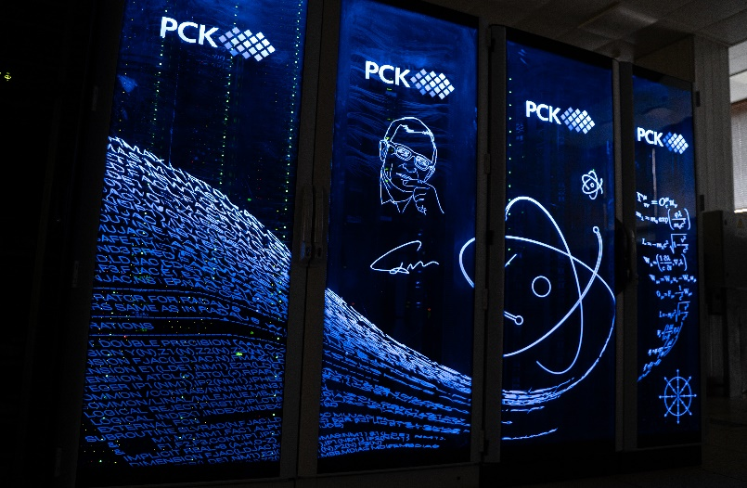
Computing in High Energy Physics
Sergei Shmatov (MLIT JINR, Dubna)
shmatov@jinr.ru shmatov@cern.ch
MLIT, JINR, Dubna
16-20 October, 2023
MLIT, JINR, Dubna
7 October, 2024
MLIT, JINR, Dubna
2 December, 2024

Slide 2
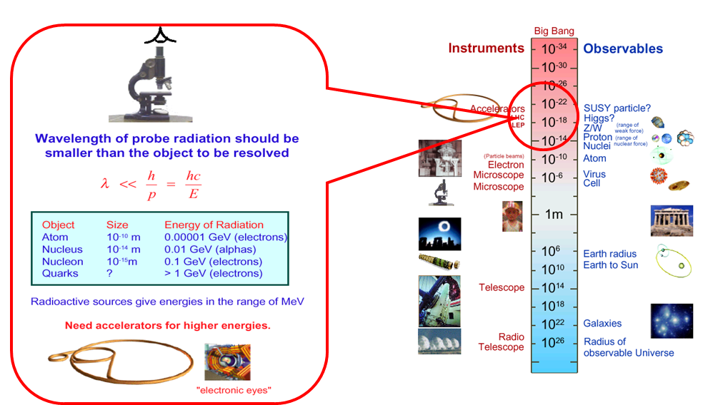
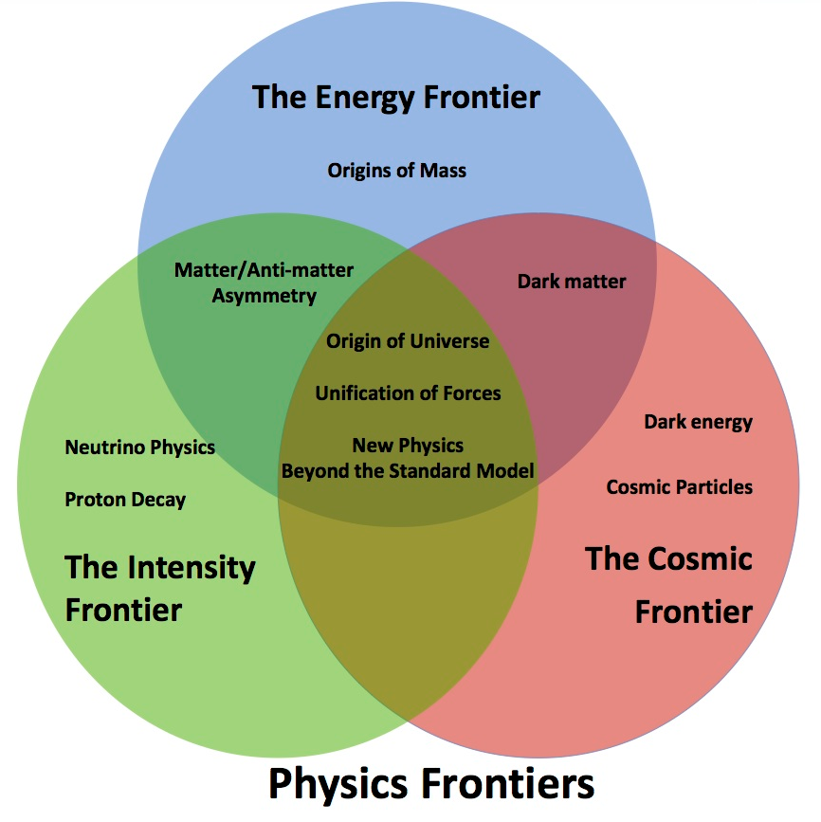
What Do Particle Physicists Do?
People have long asked,
  "What is the world made of?”
  "What holds it together?”
Physicists hope to fill in their answers to these questions through the analysis of data from High Energy Physics experiments
Some eternal questions
Particle physics have focused on the inner space frontier, pursuing the questions of the construction of matter and the fundamental forces at the smallest scale accessible.

Slide 3
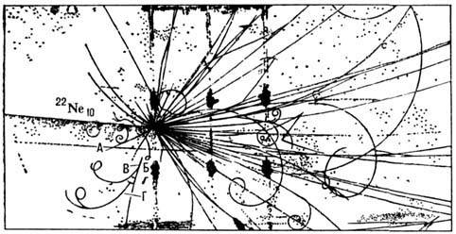
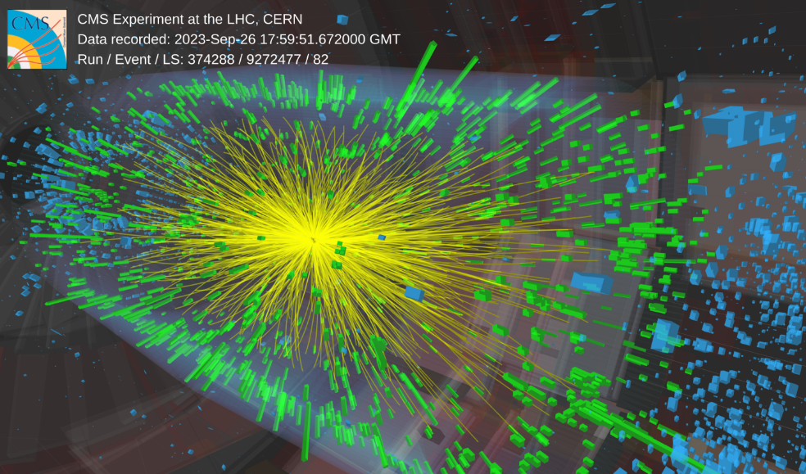
Do Physicists Really Need Computers?
Computing is any goal-oriented activity requiring, benefiting from, or creating computing machinery (c) Wiki
  general-purposed devices (computers/laptops/mobile..) and software
  dedicated tools
Bubble chamber, Synchrophasotron (JINR),
²²Ne (p=92,4 ГэВ/с) + Та
  50 particles
  only one photo per second
CMS @ LHC, PbPb (5,5 TeV), RUN3
thousands particles
140 million electronic channels
3-dimensional “camera” able to shot 40 million “pictures” per second

Slide 4
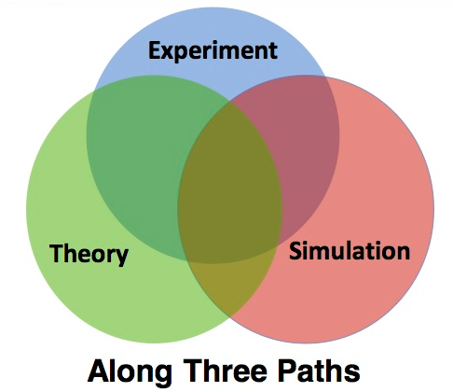
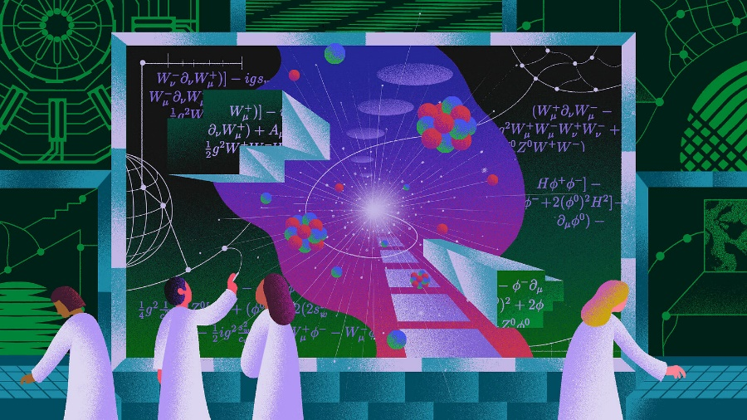
Particle Physics Tools
Particle physics or high energy physics is the study of fundamental particles and forces that constitute matter (c) Wiki
Where can I get elementary particles?
  in Nature (cosmic sources, earth sources, i.e. natural radioactivity)
  man-made sources (reactors, accelerators)
How can you catch particles ⇒ detector facilities
What is needed for data processing?
  algorithms and software for reconstruction of
  physics objects and processes
What is needed for data analysis?
  Theory
  Monte Carlo Tools
  Statistics Tools
Information Technologies

Slide 5
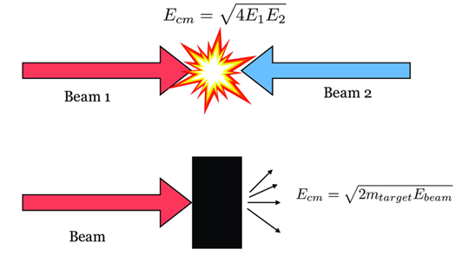
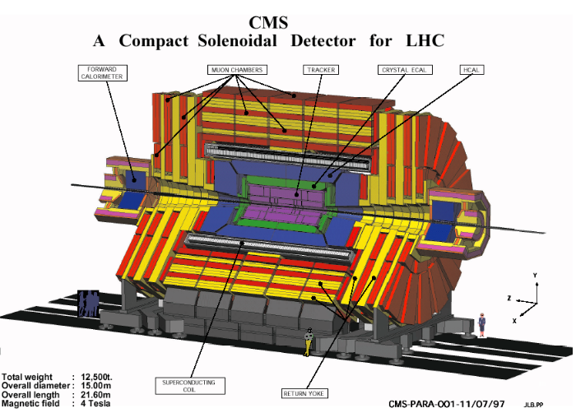
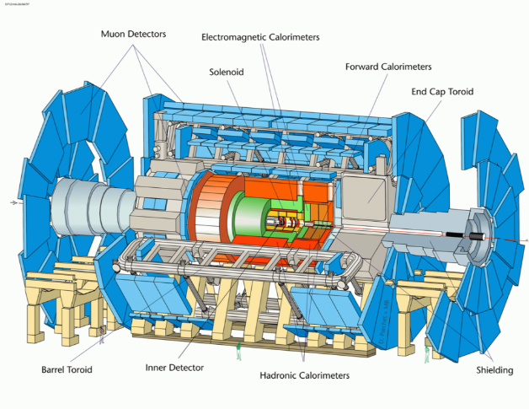
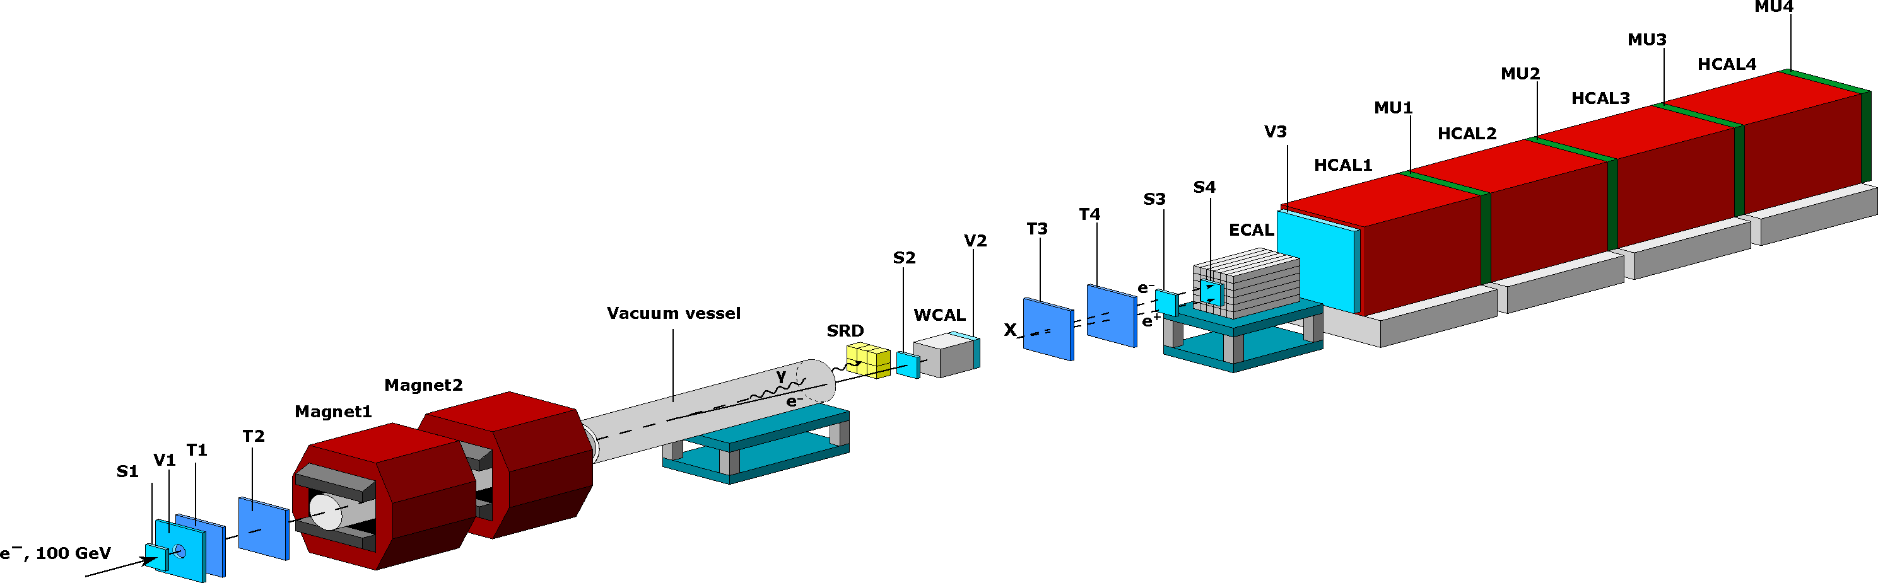
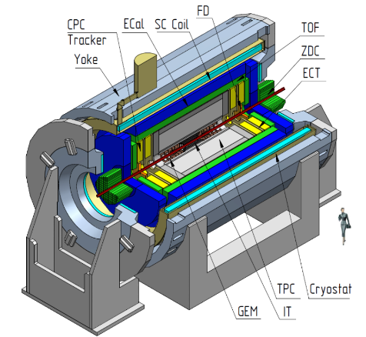
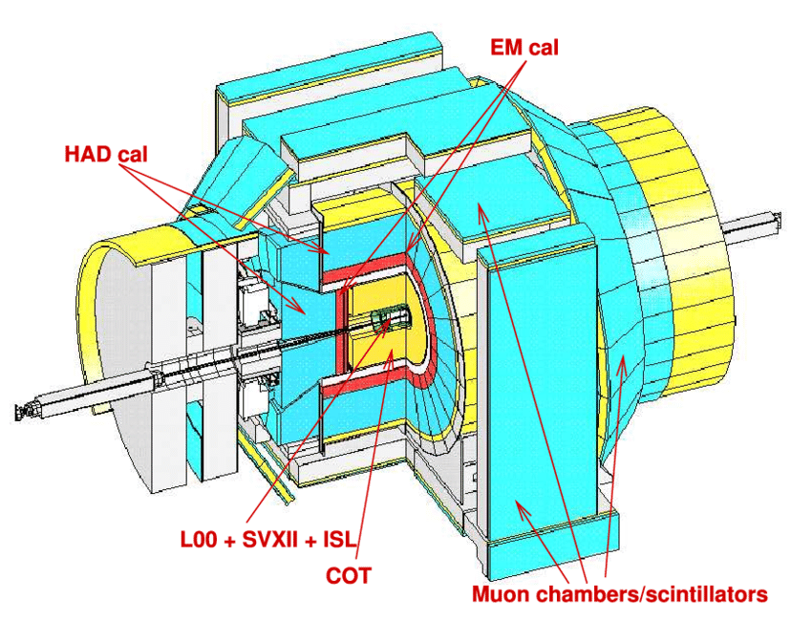
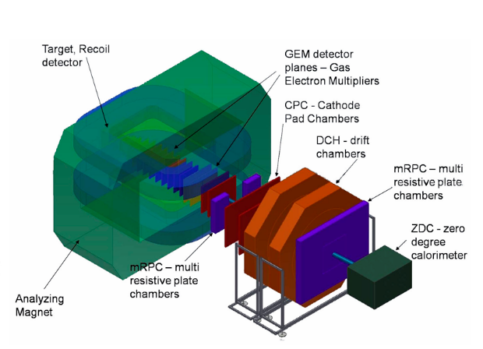
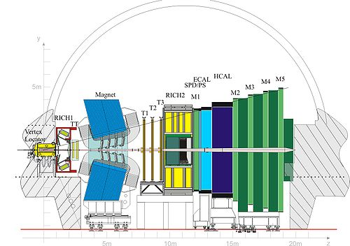
Examples of Experimental Facilities
CMS (LHC, CERN)
ATLAS (LHC, CERN)
NA64 (SPS, CERN)
MPD (NICA, JINR)
CDF (Tevatron, FLab)
BM@N (NICA, JINR)
LHC-B (LHC, CERN)
Scale without preservation of proportions

Slide 6
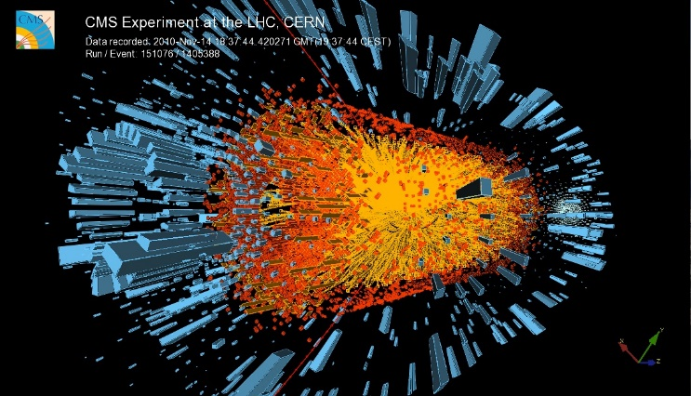
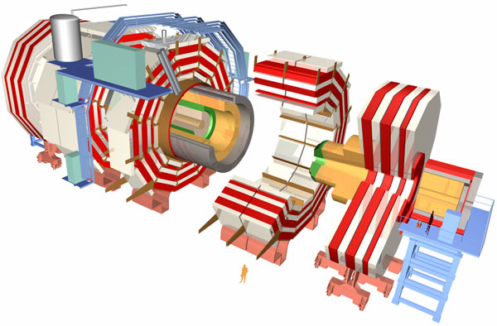
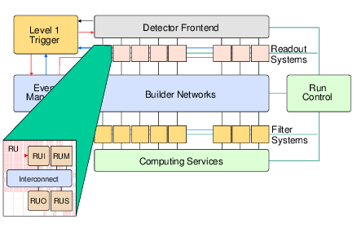
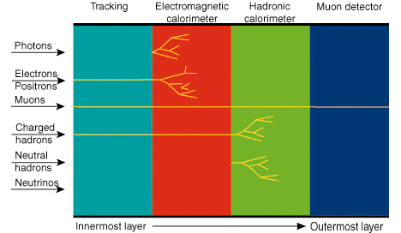
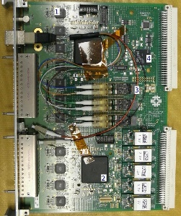
Workflow in Detectors
LHC Collisions
Interactions with
detector elements
Readout of detector electronics

Slide 7

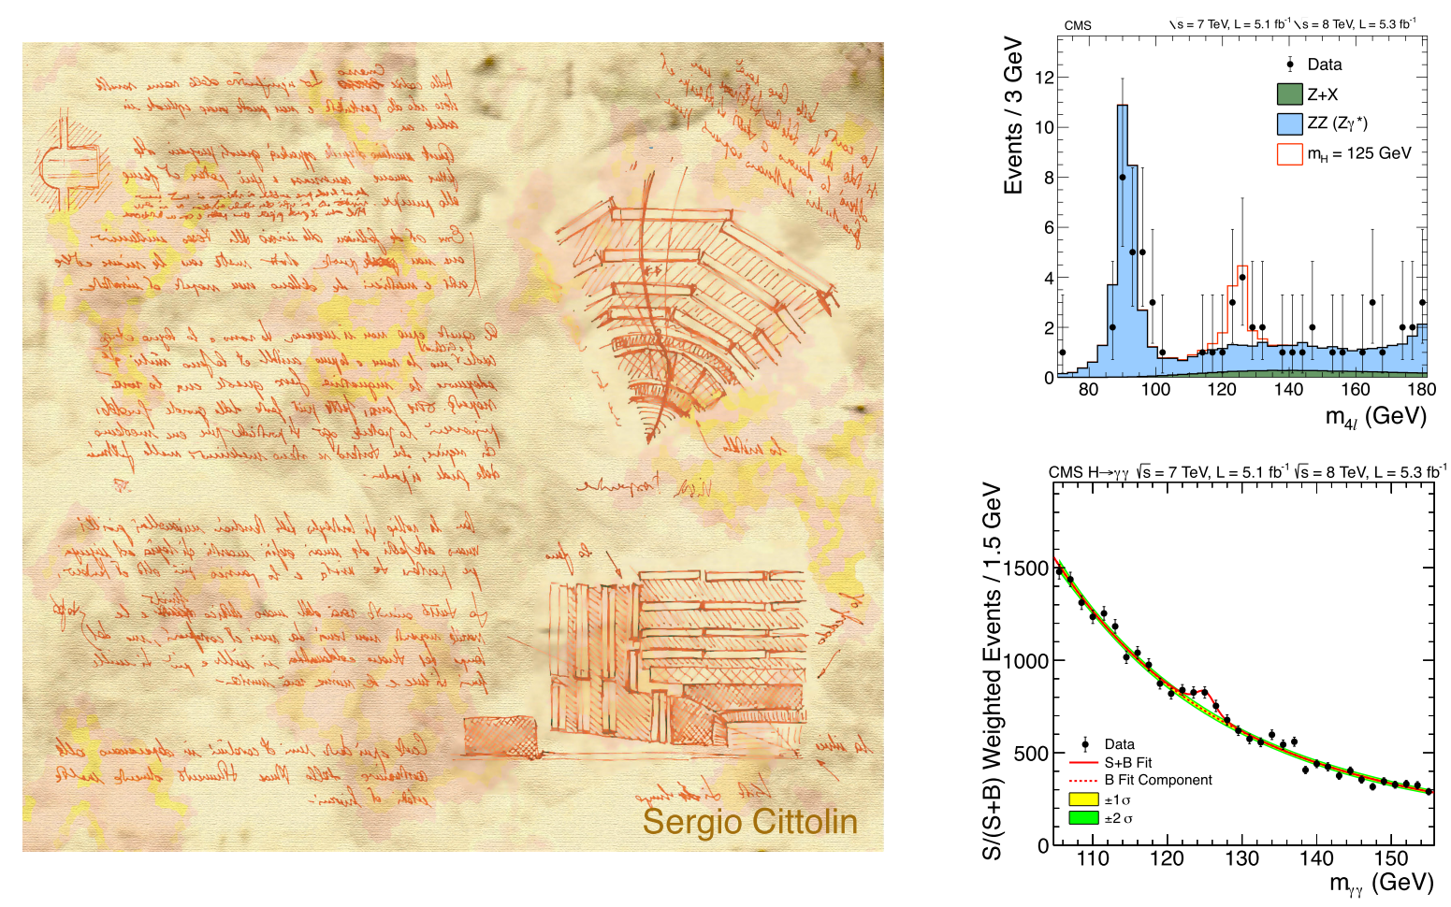
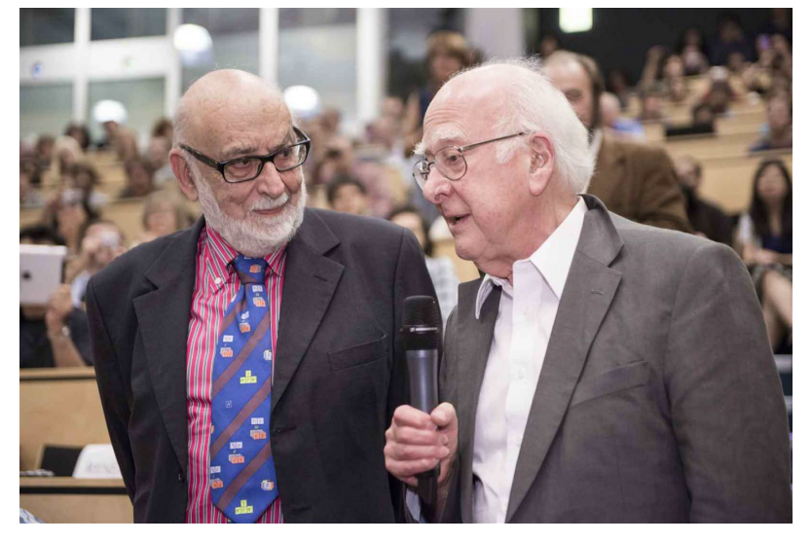
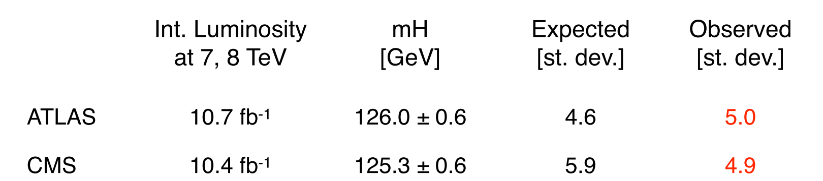
What do physicist want to see?
Higss Boson
From design
to discovery
4 July 2012
Higgs announcement at CERN

Slide 8
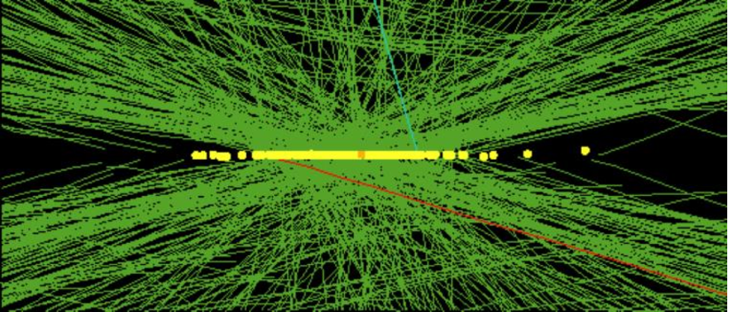
What do they actually see?
Real CMS Event with High Pile-up
High pileup event with 78 reconstructed vertices taken in 2012 by CMS

Slide 9

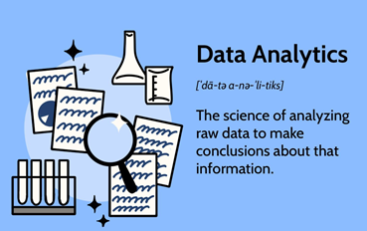
What is happening and and what we can do about it…
Physics objects
Event Selection
Reconstruction and Processing
Data Analysis

Slide 10
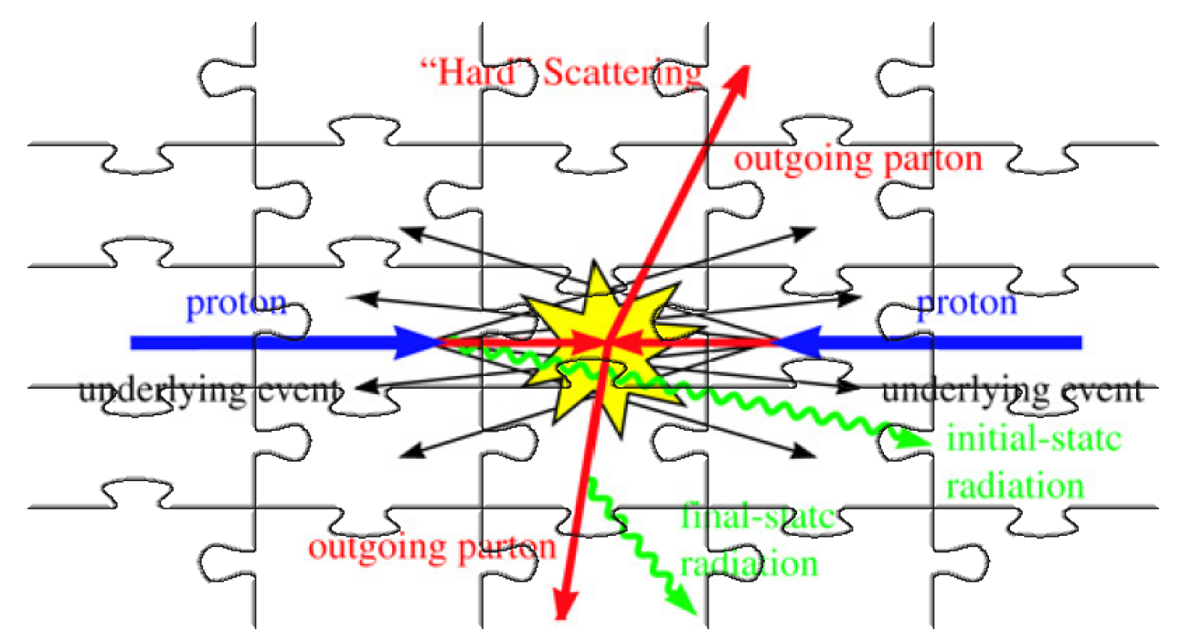
Mosaic of Collisions

Slide 11
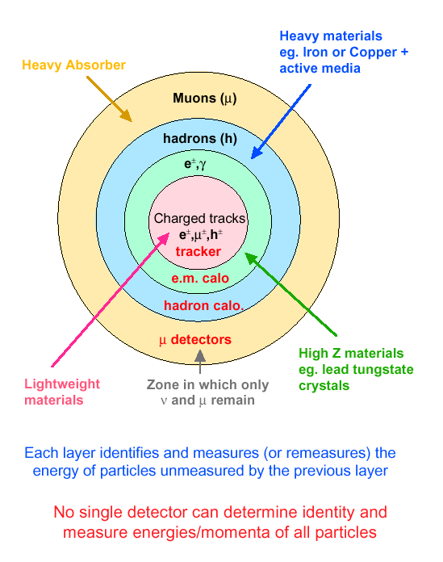
Modus Operandi for Experiments
Onion structure of detector layers placed in B-field

Slide 12

Event Selection and Data Flow

Slide 13
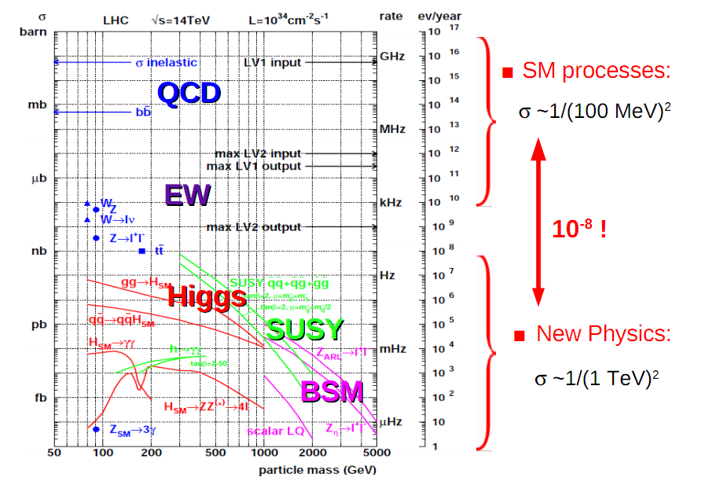
Physics Processes at LHC

Slide 14
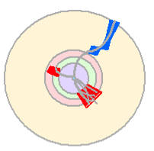

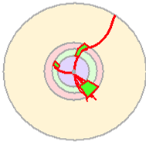
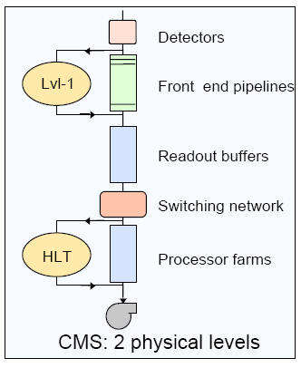
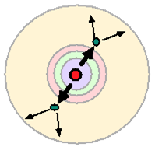
Multi-Layer Selection and Triggering
Level-1:
Hardware selection is comprised
of custom electronics that process
data from detectors, rough cutoffs
High Level Trigger:
Software selection based on
reconstruction of physics objects,
event topology

Slide 15
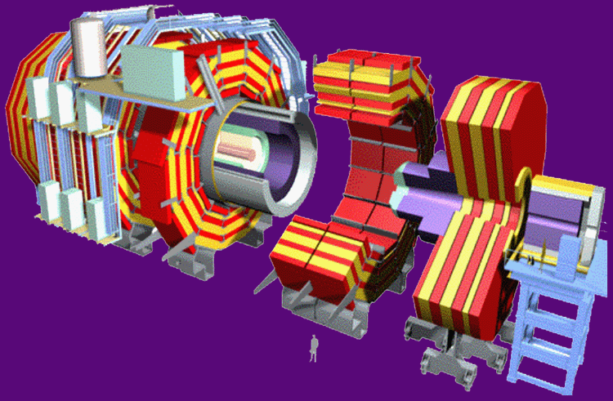
Trigger Rates
40 MHz (1000 TB/sec)
Level 1 - Special Hardware
75 KHz (75 GB/sec)
Level 2 - Embedded Processors
5 KHz (5 GB/sec)
Level 3 – Farm of commodity CPUs
100 Hz (100 MB/sec)
Data Recording &
Offline Analysis

Slide 16
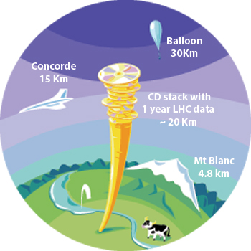
Data Flows
~ 3PB/year
~ 3PB/year
Big Data/GRID Computing

Slide 17
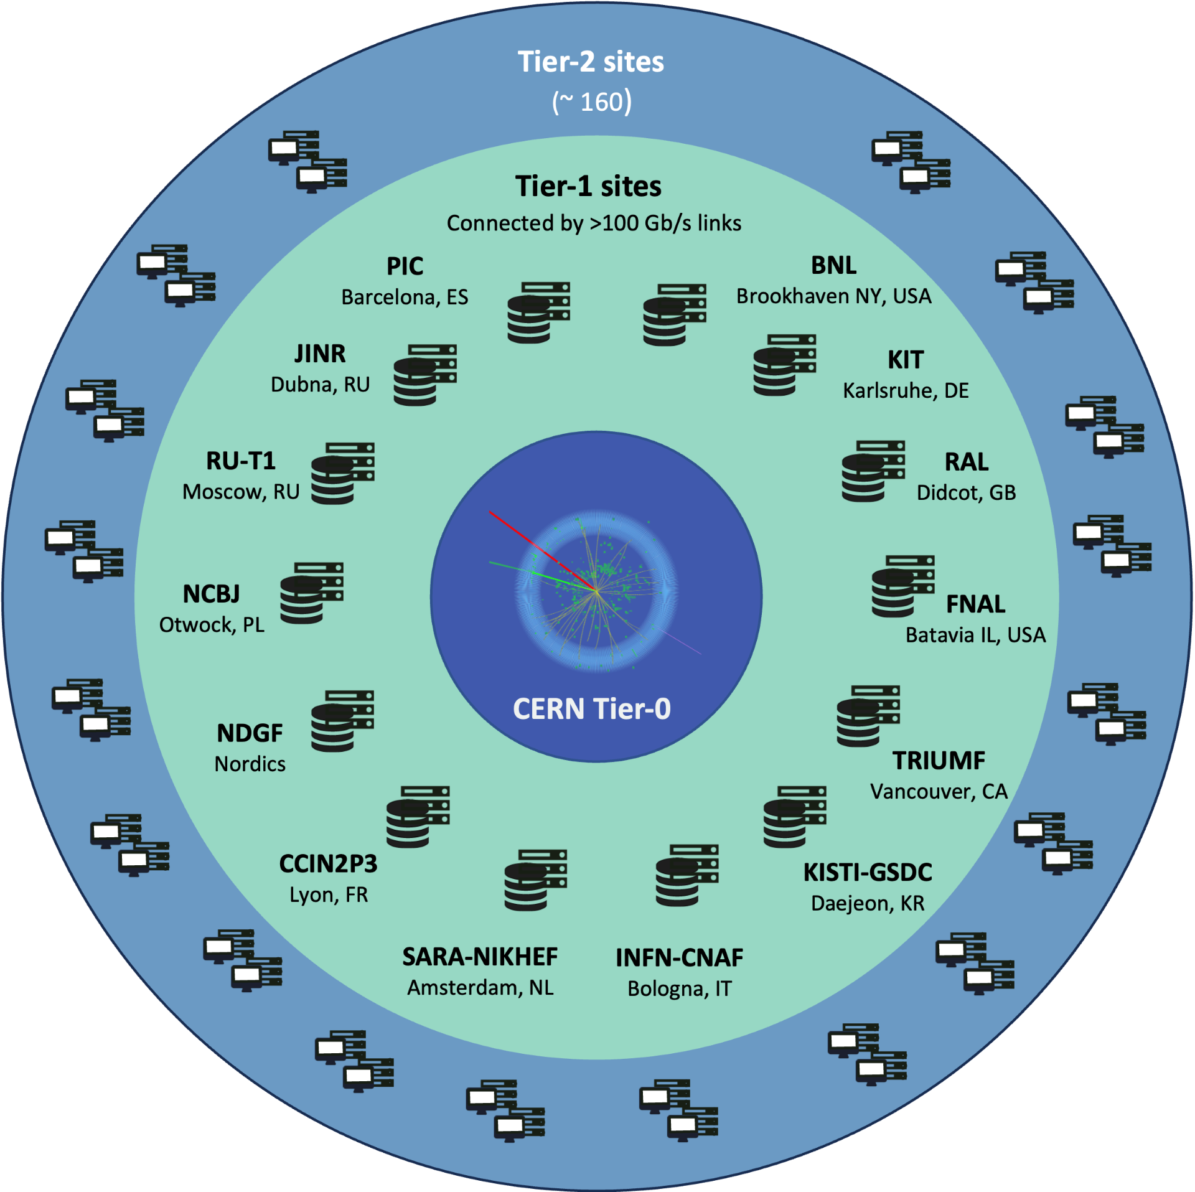
The Worldwide LHC Computing Grid
WLCG is an International collaboration to distribute and analyze LHC data. Integrates computer centers worldwide that provide computing and storage resource into a single infrastructure accessible by all LHC physicists
The mission of the WLCG project is to provide global computing resources to store, distribute and analyze the ~50-70 Petabytes of data expected every year of operations from the Large Hadron Collider.
WLCG computing enabled physicists to announce the discovery of the Higgs Boson.
Workshop on Information Technology in Natural Science
17

Slide 18
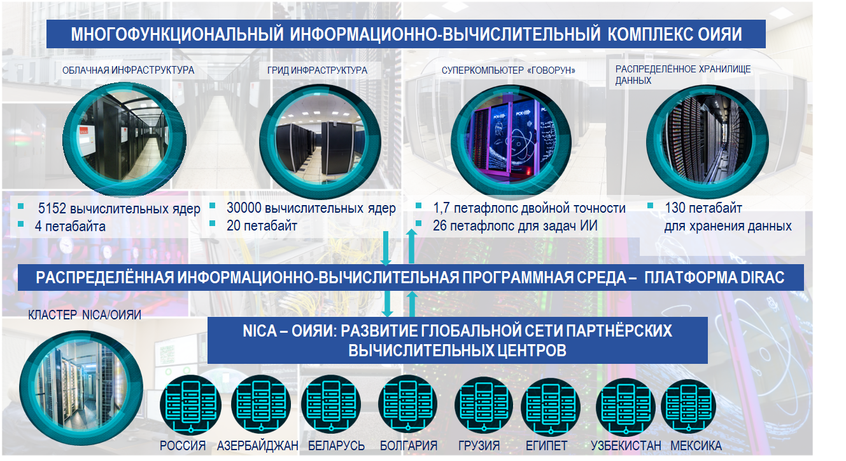
Multifunctional Information and Computing Complex in LIT JINR

Slide 19
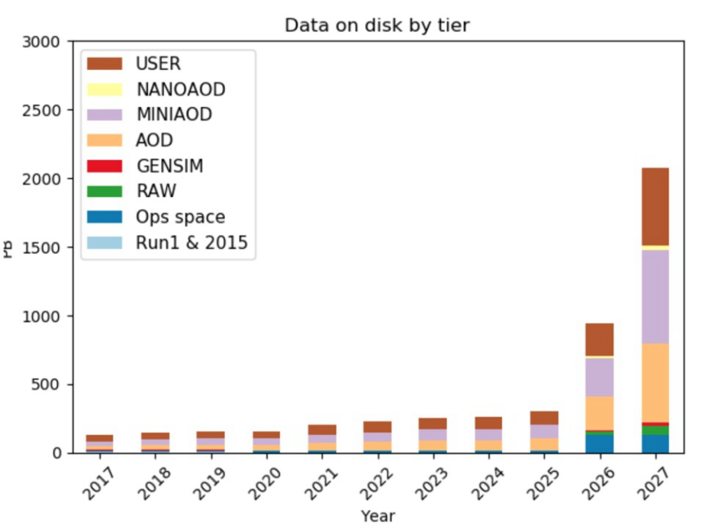
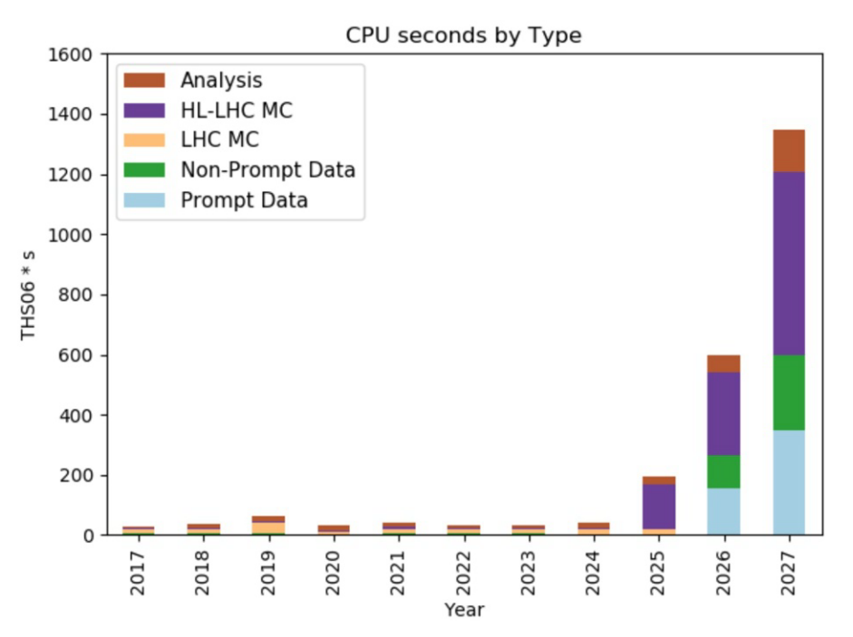
What Do We Expect?
CMS @ LHC Example
  Facing up to the exabyte (10¹⁸ bytes) era ⇒ required computing capacity is roughly 10 times higher than today
  an improvement of around a factor 10 in processing capabilities

Slide 20
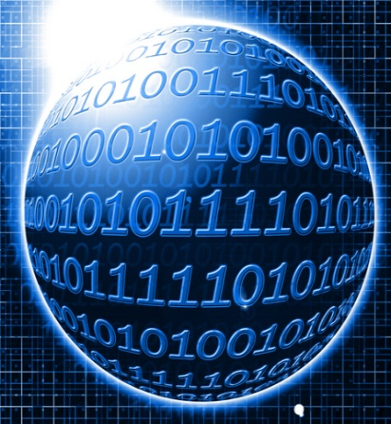
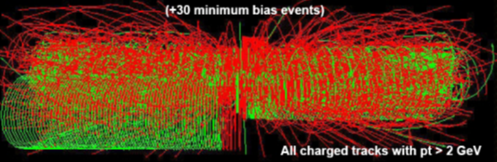
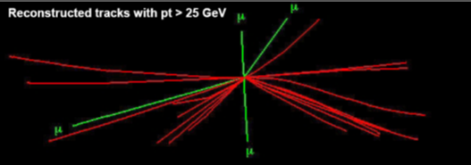

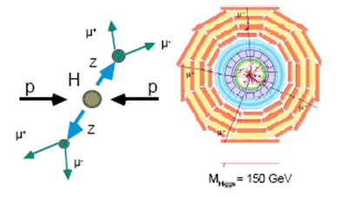
Data Processing and Analysis
RAW Data
Reconstruction
Event Selection
Theory/
Monte Carlo Simulation
Detector Response
Simulation
Calibration/Condition/etc
Data Bases

Slide 21
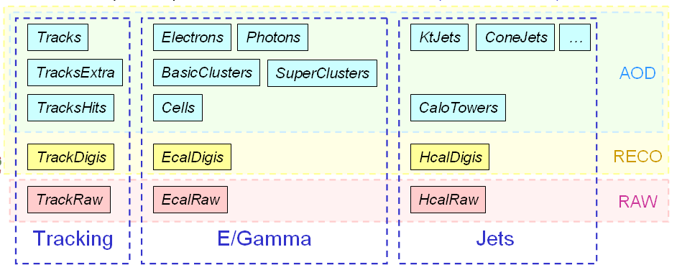
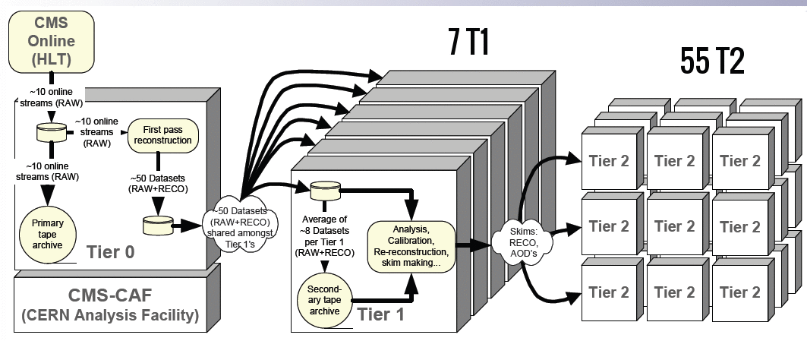
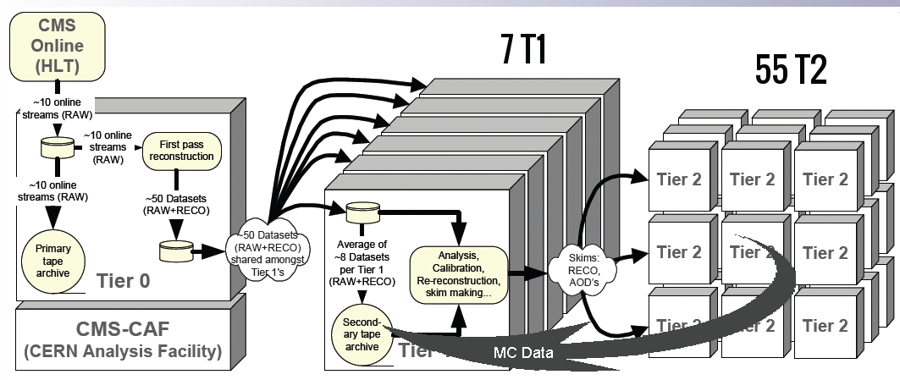
Data Model and Data Flow through Tiers
T0 ⇒ T1
scheduled, time-critical, will be continuous during data-taking periods
reliable transfer needed for fast access to new data, and to ensure that data is stored safely
T1 ⇒ T1:
redistributing data, generally after reprocessing (e.g. processing with improved algorithms)
T1 ⇒ T2:
Data for analysis at Tier-2s

Slide 22
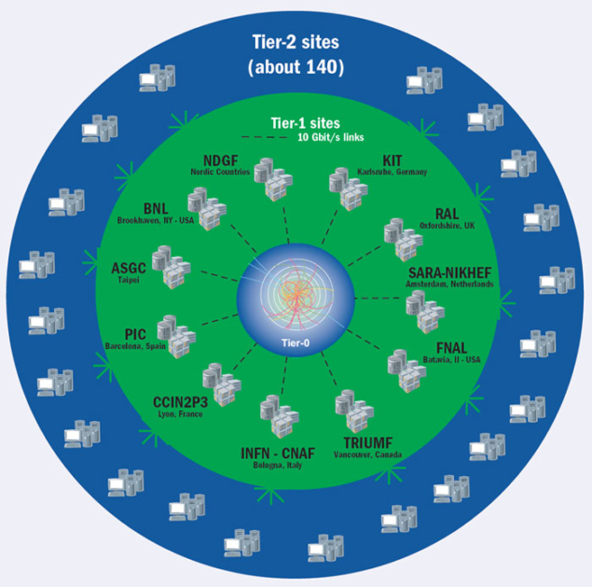

Event Reconstruction
Reconstruction (mathematical methods/algorithms/SW)
  physics objects - stable particles (e, μ, γ), clusters of particles (energy), vertexes, etc
  unstable particles/ physics processes
Data Processing

Slide 23

Particles in Detectors
Electromagnetic Calorimeter
Muon Spectrometer
Hadron Calorimeter
Inner Tracker
Magnet
Return flux

Slide 24





Muon Track and Dumuons Reconstruction
CMS Muon System shows a excellent performance to detect different resonances
Dec 2010
https://twiki.cern.ch/twiki/bin/view/CMSPublic/PhysicsResultsMUO

Slide 25

Jet Finding

Slide 26

Global Event Reconstruction
Using all information of the detector together for optimal measurement

Slide 27




Machine Learning

Slide 28

Example of h → ZZ → 2e 2μ

Slide 29

Example of h → 2γ

Slide 30


Challenge to the Detector/SW (Example)

Slide 31


Data Analysis
Data vs Theory ⇒ which theories you believe vs. reject
Significance of final results ⇒ do you trust your analysis or not?

Slide 32

Data Analysis:
Theory and Modeling (Monte Carlo Simulation)
Three main goals
  experiment planning
  algorithm's training
  data/MC comparison
Digital Twin of Experiments
  physics in a collision point
  models of detector systems
  response from detectors including digitization
  processing of MC data (simulation of data flow)

Slide 33

Chain of Simulation
LHE Data
RAW Data
Physics Processes
(Event Generators)
Detector Response
(tracing a particle through matter)
Reconstruction

Slide 34

Theory of Collisions

Slide 35

Event Generators
35

Slide 36



Detector Modeling
GEANT4
36

Slide 37

Data Analysis: Statistics
There are three kinds of lies: lies, damned lies, and statistics (с) Benjamin Disraeli

Slide 38


Significance of Discovery
The probability that an observed excess was a statistical fluctuation of the background (p-value)
Notable values for an excess in particle physics are 3σ, or p-value = 0.0013; and 5σ, or p-value = 2.87 x 10⁻⁷. When we have an excess of 3σ we talk about an evidence, and when we have an excess of 5σ, we are facing a discovery.

Slide 39

… and as a result…

Slide 40

Essential Parts of the Success
Accelerators : powerful machines that accelerate particles to extremely high energies and bring them into collision with other particles
Detectors : gigantic instruments that record the resulting particles as they “stream” out from the point of collision.
Computing : to collect, store, distribute and analyse the vast amount of data produced by these detectors
It's been a global effort, a global success. It has only been possible because of the extraordinary achievements of the experiments, infrastructure and the grid computing“ (c) Rolf Heuer, the Director General of CERN, when the discovery of the Higgs
Collaborative Science on Worldwide scale : thousands of scientists, engineers, technicians and support staff to design, build and operate these complex “machines”.

Slide 41

THANK YOU FOR YOUR ATTENTION!

Slide 42





Physics Objects
Muons (transverse momentum p_{T})
Electrons (energy and tr. momentum p_{T})
Photons (energy)
Jets (energy and coordinates )
…..
Missing energy and p_{T}
  vectorial sum of all transverse momentum
Kinematic Variables
Transverse momentum p_{T} (energy)
  particles that escape detection have p_{T}=0
  total visible p_{T} = 0
p
p_{T}
θ
Longitudinal momentum p_{Z} and energy E_{Z}
  particles that escape detection have p_{T}=0
  visible p_{Z} is not conserved (not so usefull variable)
Angles
  azimuthal and polar angles
  polar angle θ is not Lorenz invariant ⇒
  rapidity y
  or (or m=0) pseudorapidity η
4π-experiments cover
360⁰ over φ and large
pseudorapidity range,
|η| ≤ 5.0 (0.8⁰)

Slide 43

Hit-and-miss Monte Carlo
43

Slide 44





Статистический анализ
Событие (результат) называется “статистическими значимым”, если оно вряд
ли произошло случайно
p-valuе - вероятность получить результат, такой как наблюдается (или выше)
в предположении, что нуль-гипотеза верна
⇒ в нашем случае вероятность, того, что флуктуация фона достигли (или превысили) наблюденное значение
Нуль-гипотеза – основная проверяемая гипотеза (фон)
⇒ Нулевая гипотеза отвергается, когда значение p-value
меньше уровня стат. значимости α (по соглашению <0.05)
Масштабный фактор (strength factor)
σ_{SM} – сечение бозона Хиггса в CM, σ - гипотетическое сечение бозона Хиггса

Slide 45





Story at Higgs Discovery

Slide 46





What does Brazilian Flag mean?
Dimuon example
Extended gauge models
Models of low-energy gravity (RS1-type scenario of ED)
SM predictions
BSM predictions
SM predictions
Mass limit
Model-independent limits on cross section (in narrow width approximation, NWA)

Slide 47




Observation of Gravitational Waves

Slide 48


JINR in Particle Frontiers
JINR LONG-TERM DEVELOPMENT STRATEGIC PLAN UP TO 2030 AND BEYOND
RELATIVISTIC HEAVY-ION PHYSICS AT NICA
JINR PARTICIPATION IN FOREFRONT EXTERNAL EXPERIMENTS OFF-SITE
  LHC, SPS, RHIC, and at facilities under construction, as for example the FAIR facility
NICA SPIN PHYSICS
PARTICLE PHYSICS AT THE LHC AND BEYOND
  Accelerator-based research and frontier accelerator technologies (LHC, SPS, NICA, FAIR, etc)
  Neutrino physics and astroparticle physics (Baikal-GVD, JUNO, NOvA, DUNE, etc)
  Multi-messenger astronomy including gravitational wave detection (Baikal-GVD, TAIGA, VIRGO, etc)

Slide 49

What do we know today about the Standard Model from LHC?

