Slide 1
National Research Nuclear University MEPhI
Institute of Nuclear Physics and Engineering
Department of "Elementary Particle Physics" №40
Application of artificial intelligence methods for particle identification in the FARICH SPD detector
Supervisor: Zhemchugov A.S.
Student: Massalov K.Yu.
Moscow 2024

Slide 2
Introduction
inclusive production of charmonia
open charm
prompt photons
Decay modes of D-meson:

Slide 3
Goal
Creation of neural network methods for reconstructing signals from the FARICH detector
Studying their characteristics and comparing them with classical approaches

Slide 4
Reconstruction methods
Method name | Pros | Cons
Separation of particles by second moments | Simplicity Speed | Requires preliminary clustering Low noise resistance
Iterative method | Automatic matching of track with ring | Requires additional information Speed
Mask method | Simplicity | Requires preliminary clustering Low noise resistance Speed

Slide 5
Reconstruction methods
Method name | Pros | Cons
Fuzzy clustering | Simplicity Speed | Requires additional information Low noise resistance Speed
Gradient methods for minimizing the loss function | Resistance to initial estimates | Requires preliminary clustering Speed

Slide 6
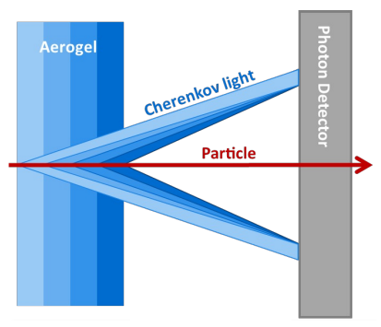
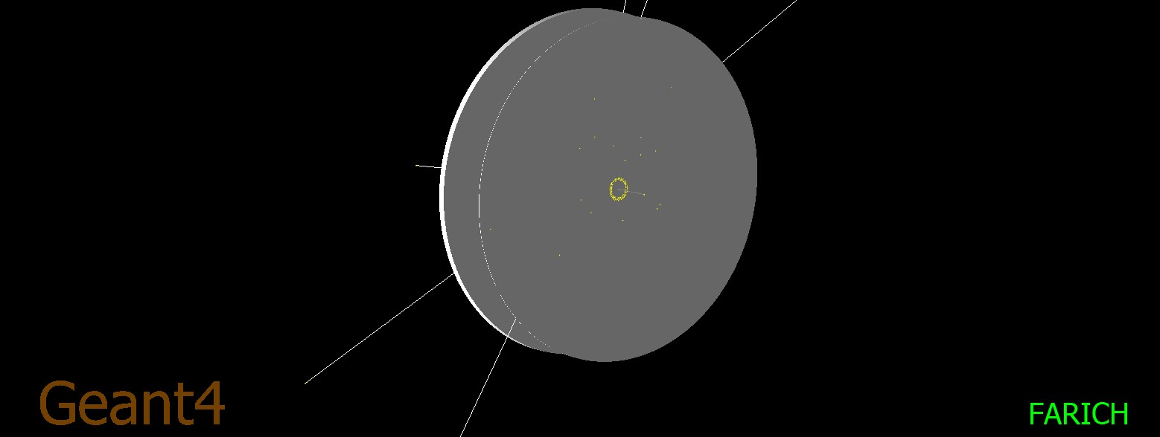
Modeling of the FARICH detector
n=1.047
n=1.041
n=1.037
n=1.043
7
9
10
10
164

Slide 7
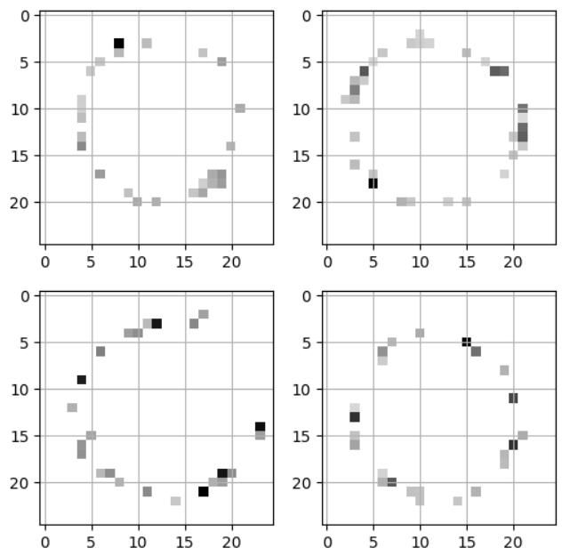
Example of input

Slide 8
Speed prediction (1v)
Conv
5x5
Pool
3x3
Conv
5x5
Conv
5x5
FC
25x10
FC
10x1
v
25x1x1
10x3x3
10x7x7
10x21x21
1x25x25

Slide 9
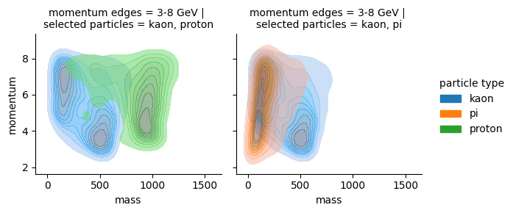
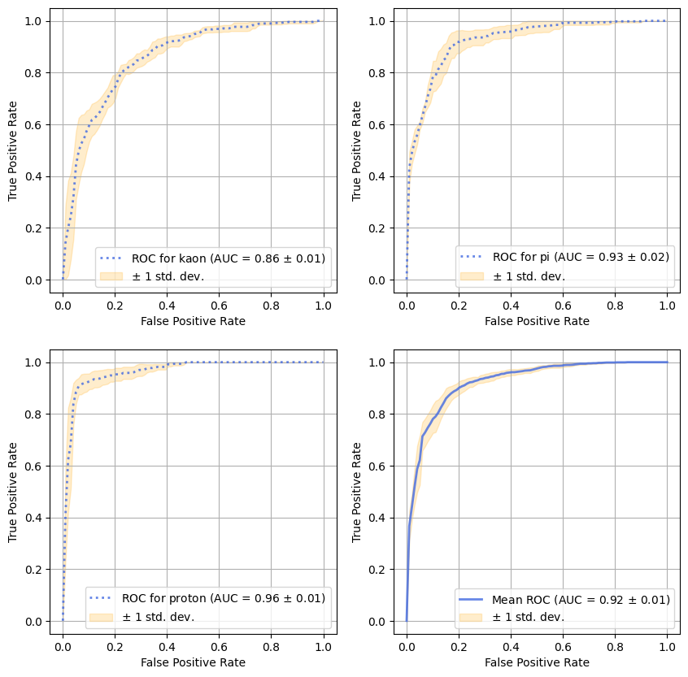
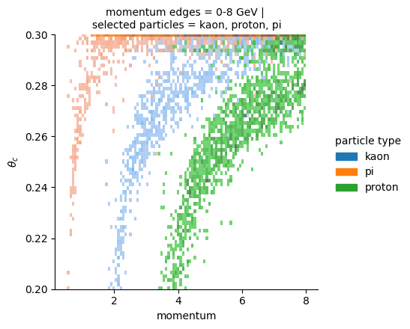
Speed prediction (1v)

Slide 10
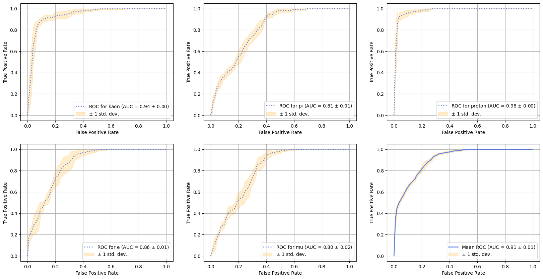
Speed prediction (1v)

Slide 11
Speed prediction (1v)
Conv
5x5
Inc
Pool
3x3
Inc
Pool
2x2
Conv
4x4
FC
20x10
FC
10x1
v
3x4x4
20x1x1
3x8x8
3x8x8
1x25x25
3x25x25
3x25x25

Slide 12
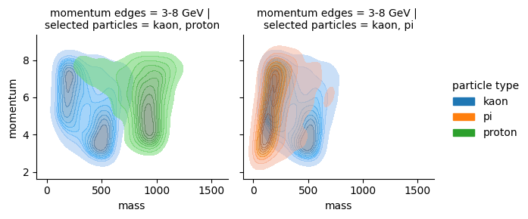
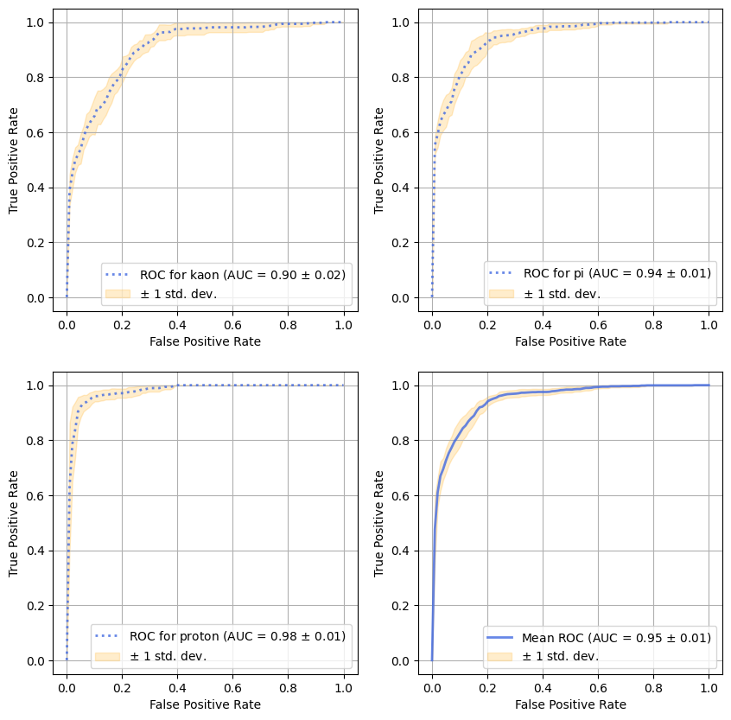
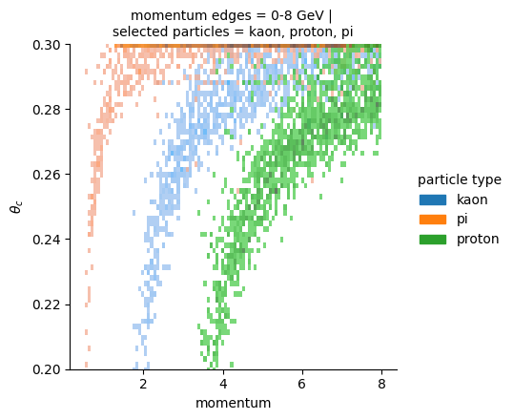
Speed prediction (2v)

Slide 13
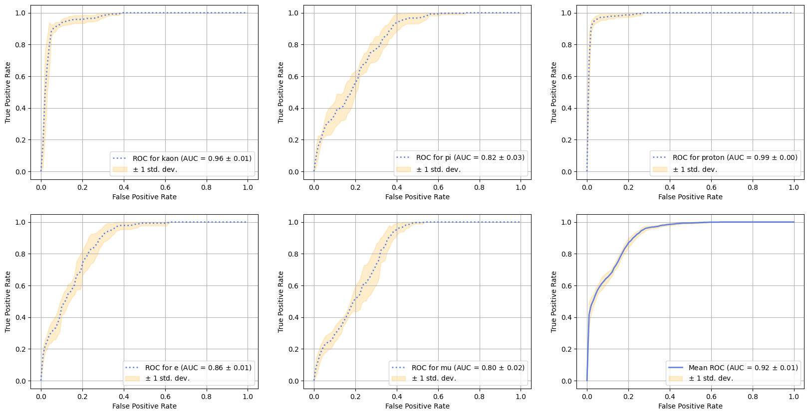
Speed prediction (2v)

Slide 14
Apex angle prediction
Conv
5x5
Pool
3x3
Conv
5x5
Conv
5x5
FC
25x10
FC
10x1
25x1x1
10x3x3
10x7x7
10x21x21
1x25x25

Slide 15
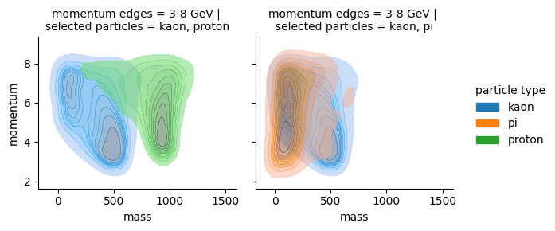
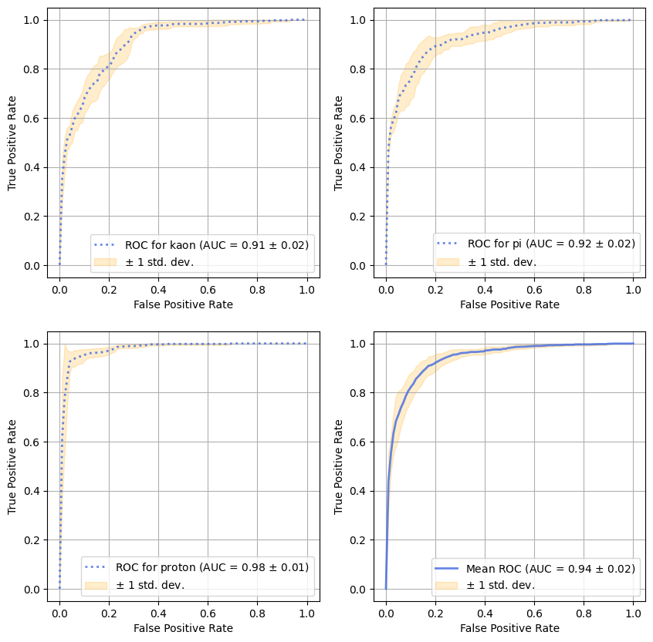
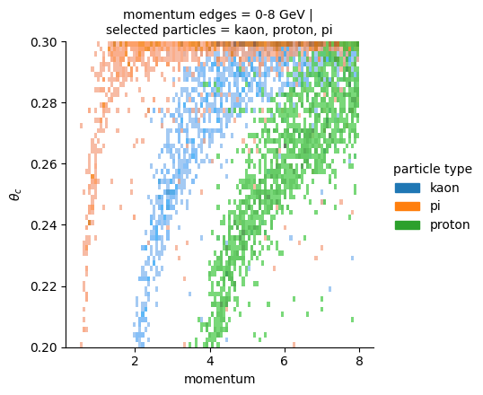
Apex angle prediction

Slide 16
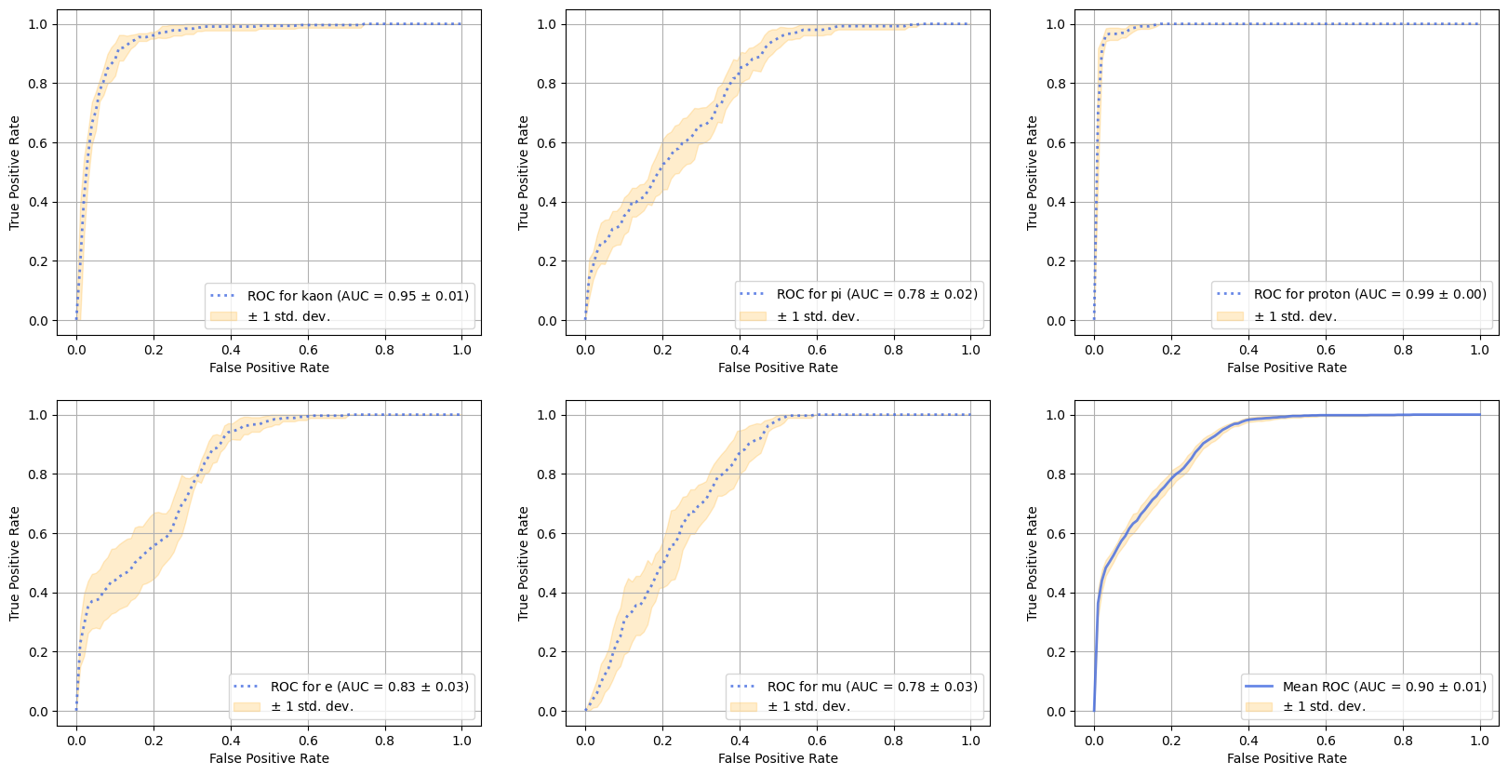
Apex angle prediction

Slide 17
Probability prediction
momentum
Conv
5x5
Pool
3x3
Conv
5x5
Conv
5x5
FC
25x10
FC
10x1
24x1x1
10x3x3
10x7x7
10x21x21
1x25x25

Slide 18
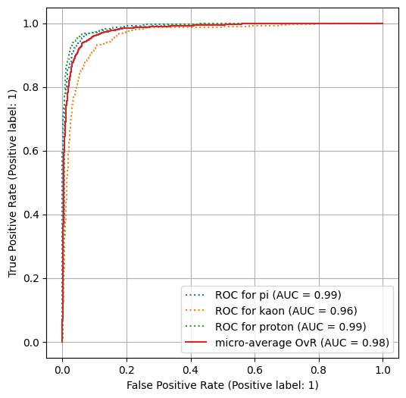
Classification without intermediate predictions

Slide 19
Conclusion
Using the GEANT4 software package, the events of the passage of different particles at different momentums through the FARICH detector were simulated. A neural network has been created to process single rings.
In the future it is planned:
to compare NN models with classic methods
increase accuracy by create a model for noise cleaning
build the pipeline for particle identification.

Slide 20
Thank you for
your attention

Slide 21
Backup slides

Slide 22
Head
(1,H,W)
(C,H,W)
…
Softmax
Sum

Slide 23
Inc
MLP
Normalization layer
Normalization layer
Heads
…

