Slide 1
Analysis of multi-channel links using the examples
of the JINR Data Center
A. Baginyan, A. Balandin, A. Dolbilov
Joint Institute for Nuclear Research, Dubna, Russia
bag@jinr.ru t.me/baginyan

Slide 2
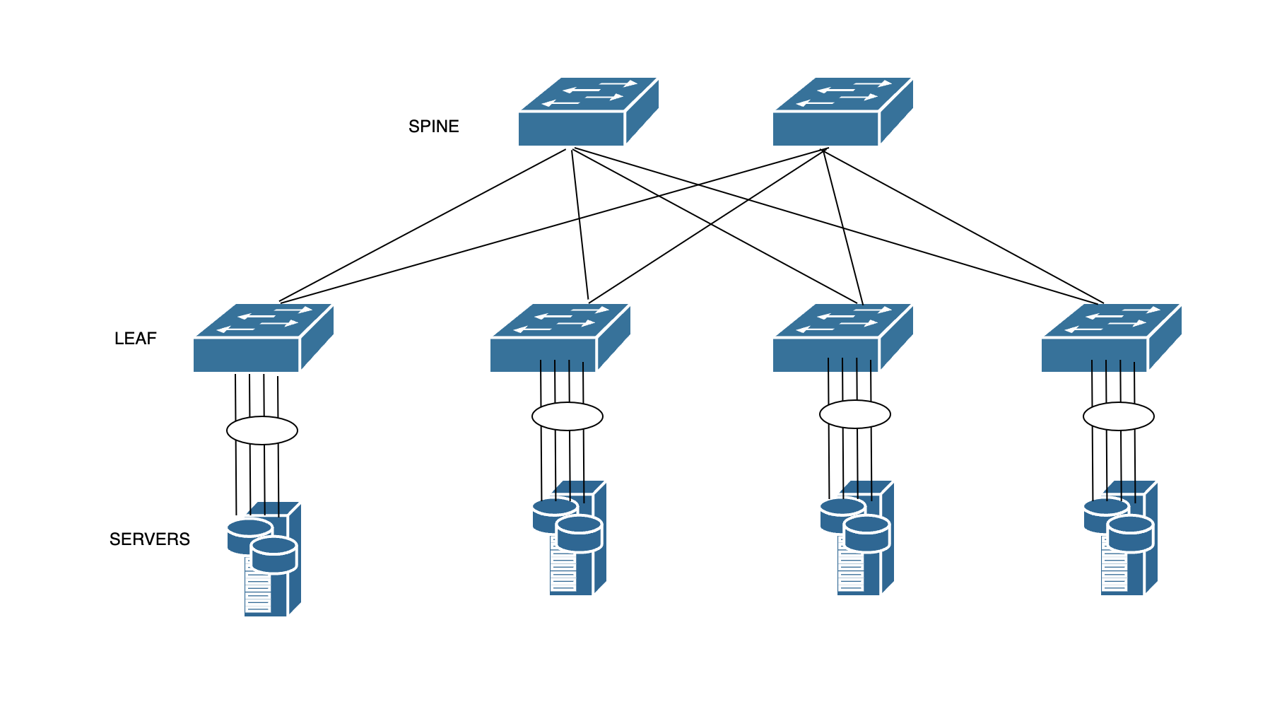
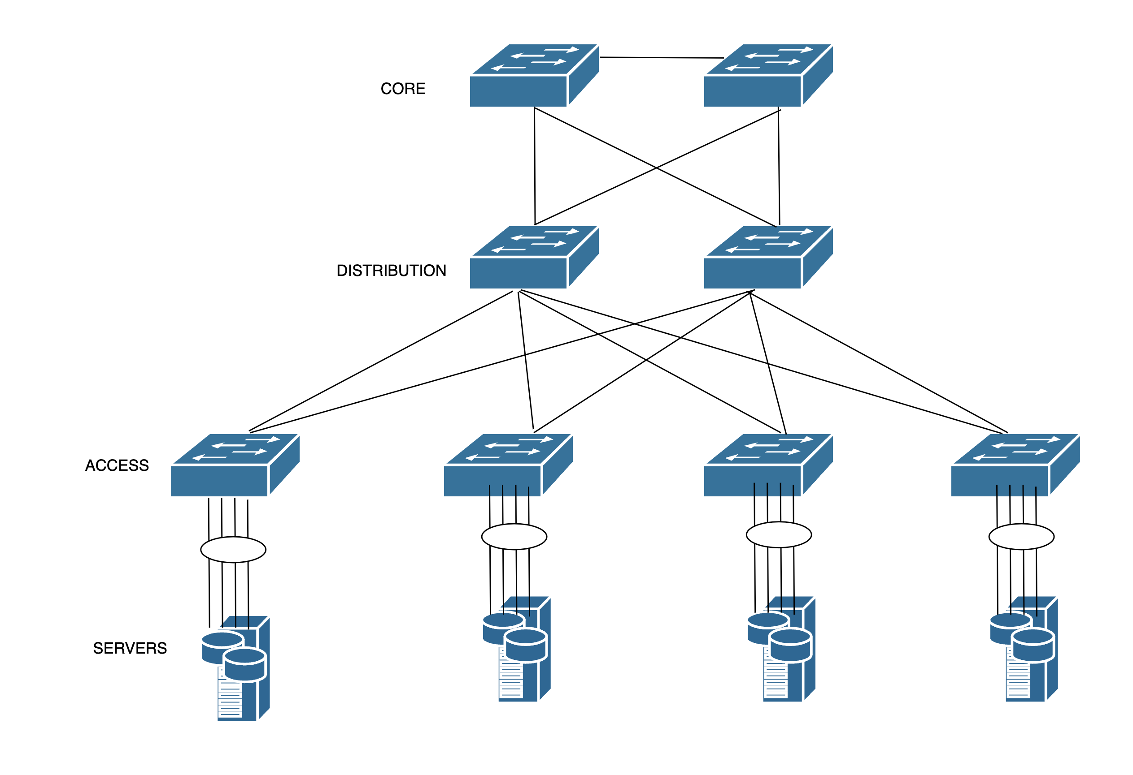
Leaf-Spine Architecture
Leaf-Spine architecture
Three-tier architecture

Slide 3
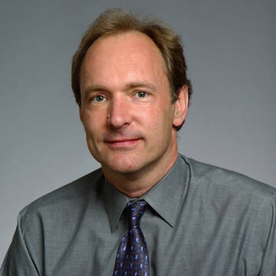
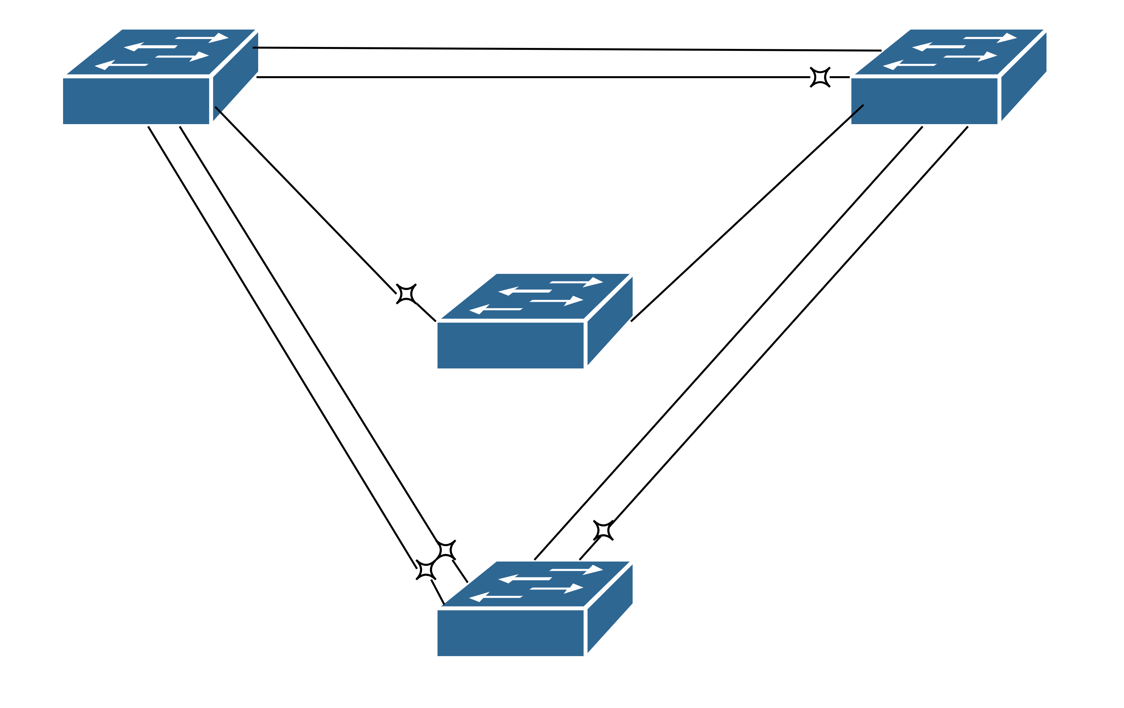
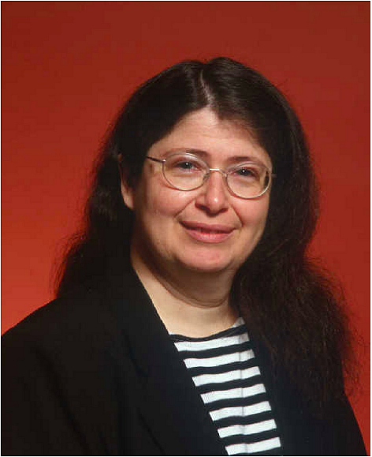
Spanning tree protocol
Tim Berners-Lee URL, HTTP, HTML
Radia Joy Perlman
1985 - Spanning tree
1992 - IS-IS
2010 - Transparent Interconnection
of Lots of Links

Slide 4
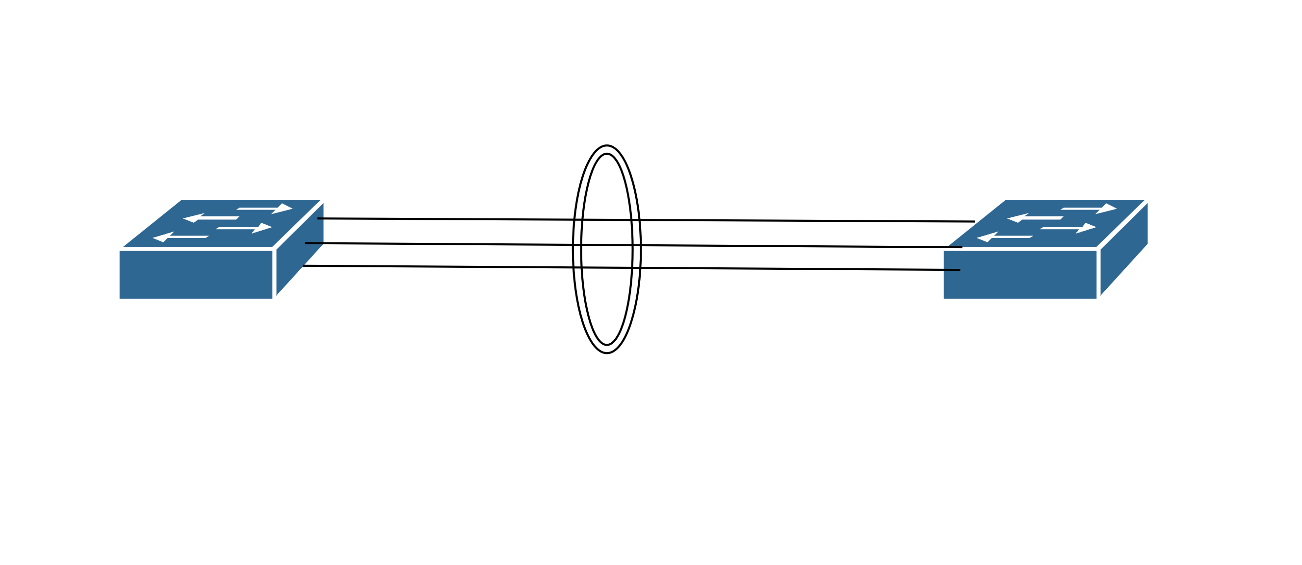
Link aggregation

Slide 5
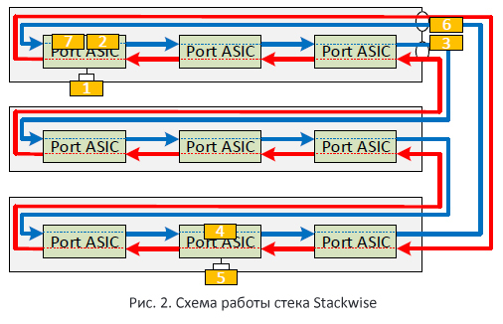
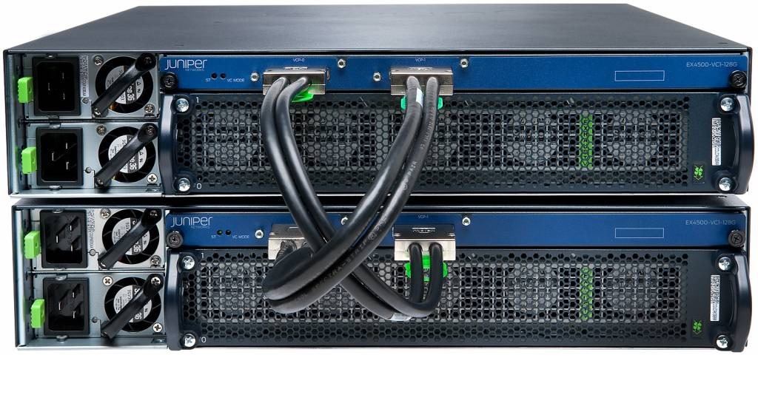
Stack
Stack [Online]. Available: https://habr.com/ru/companies/cbs/articles/269529/ 5.06.2024

Slide 6
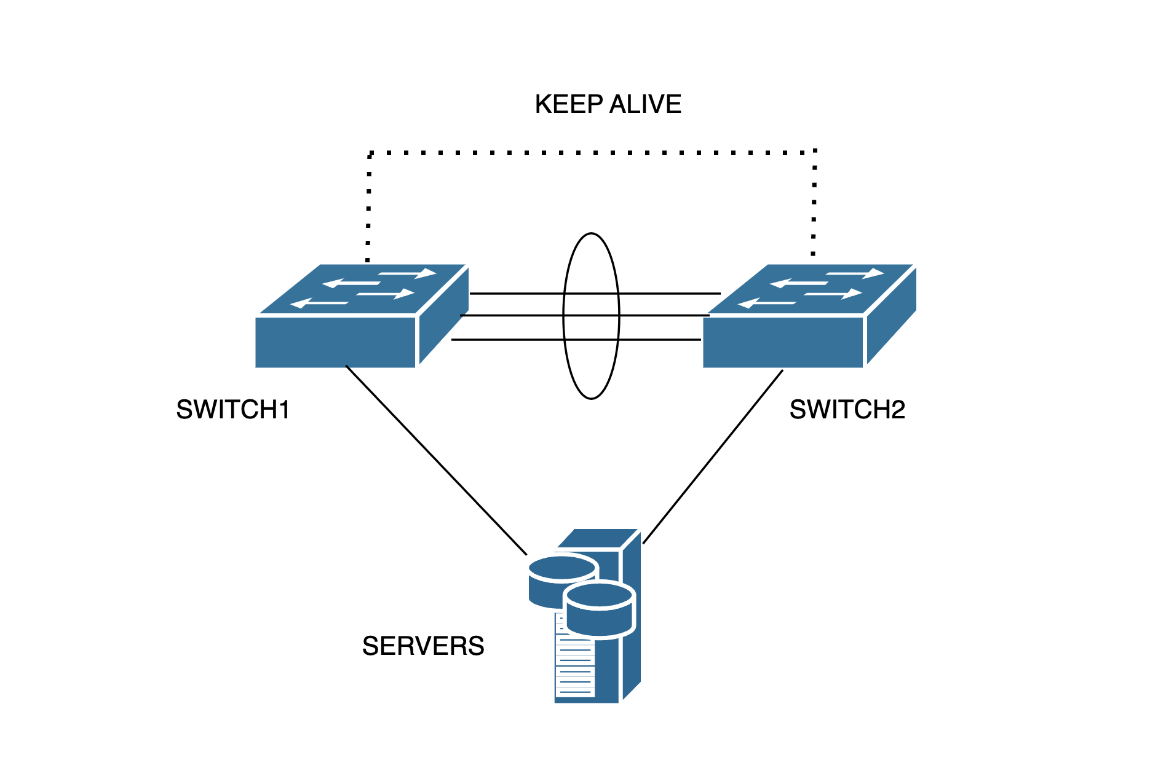
Virtual Port Channels

Slide 7
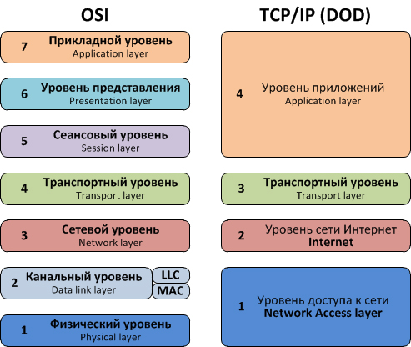
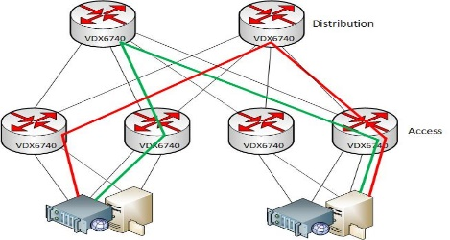
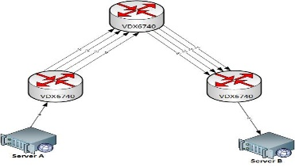
SPF protocol and TRILL
Unblocked network architecture (two of the eight possible paths are shown)
Similar data communication paths between two networks nodes.

Slide 8
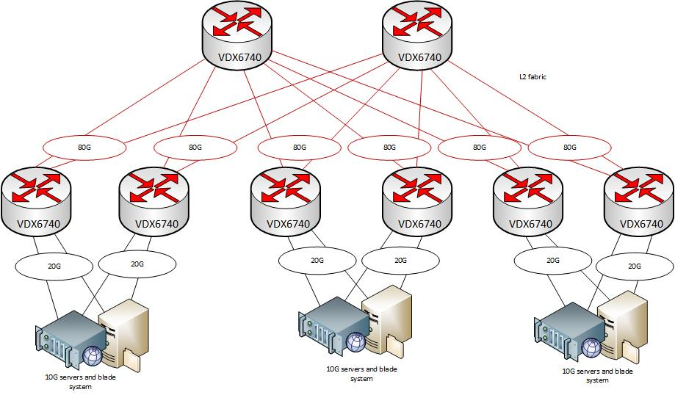

Slide 9
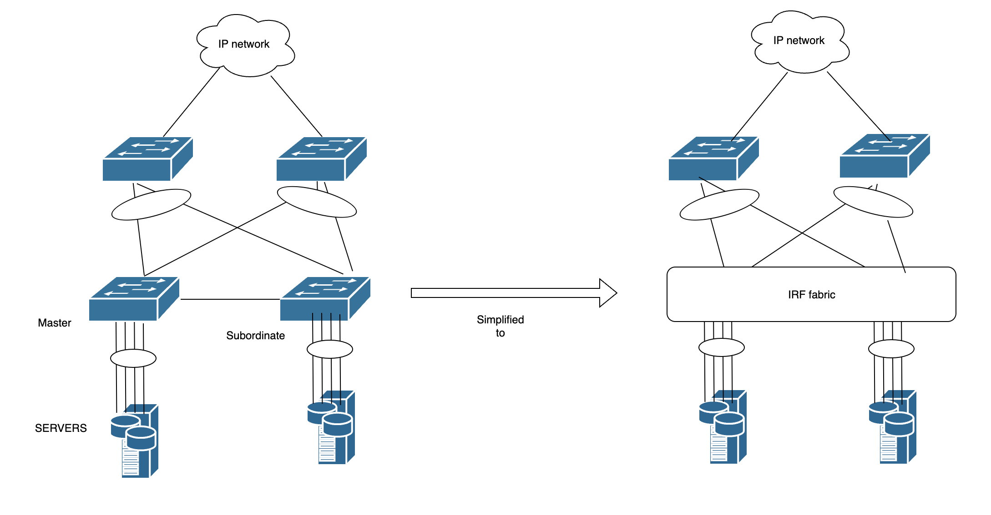
Intelligent Resilient Framework (IRF) technology

Slide 10
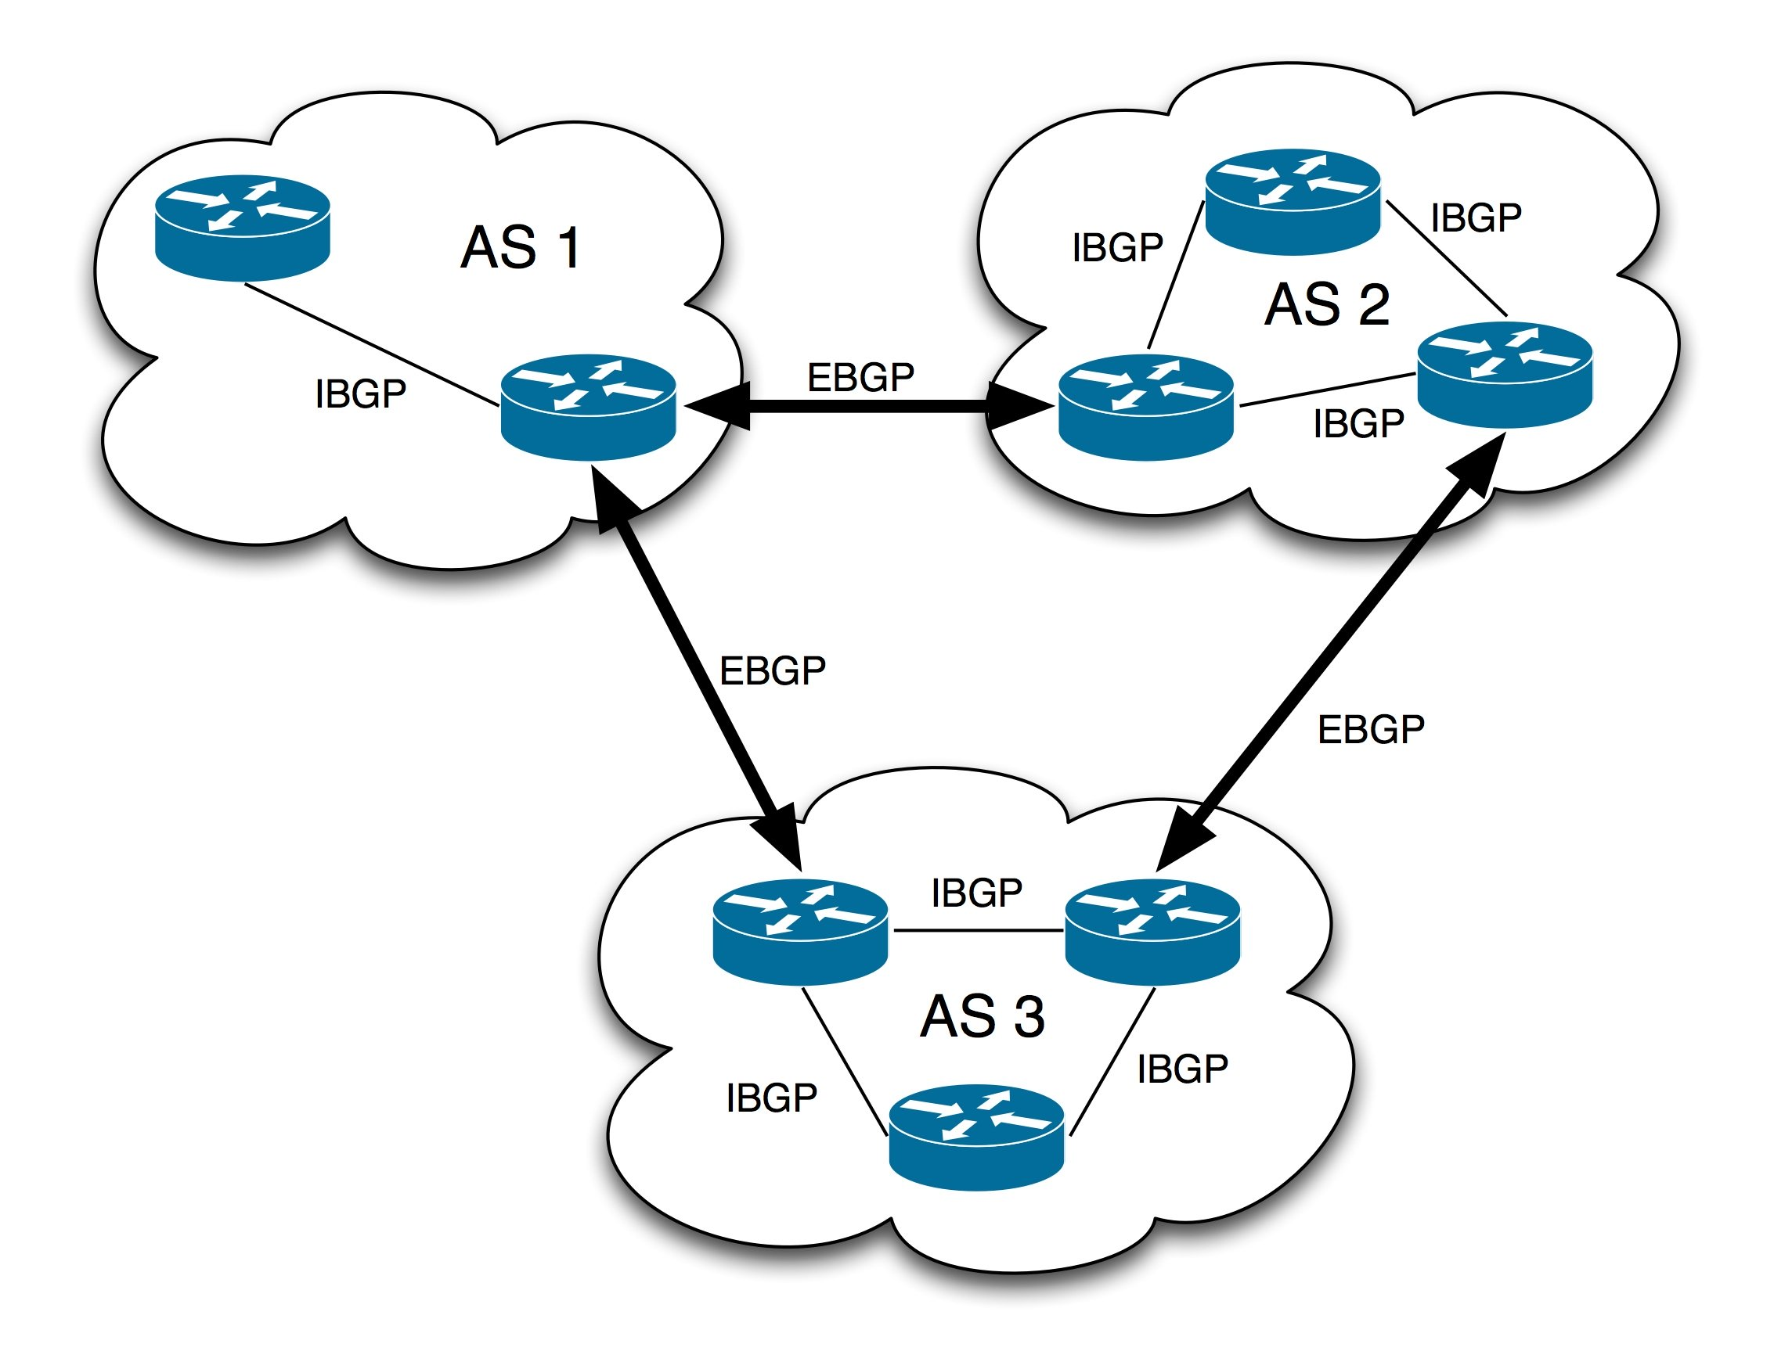
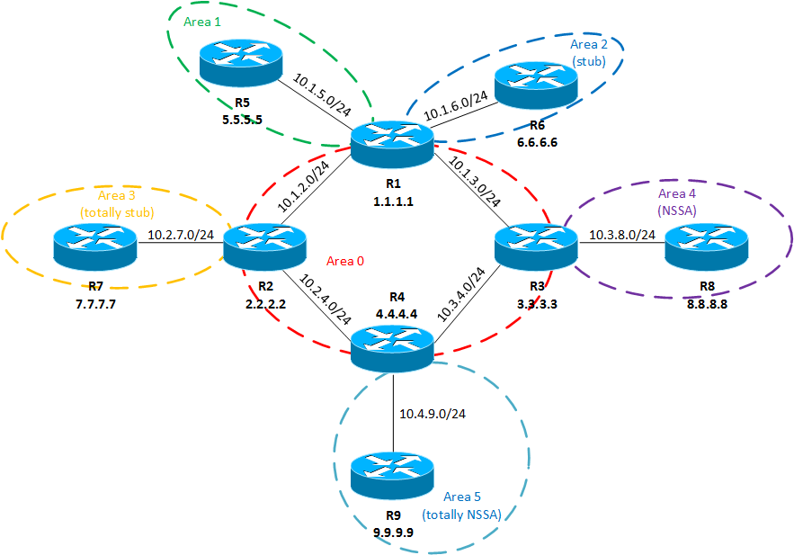
Border Gateway Protocol
Open Shortest Path First

Slide 11
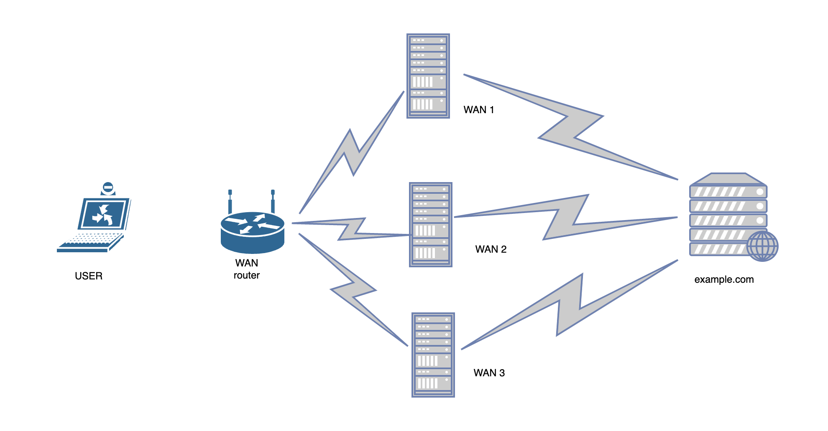
True Internet Channel Aggregation – OpenMPTCPRouter
Balancing at the IP connection level

Slide 12
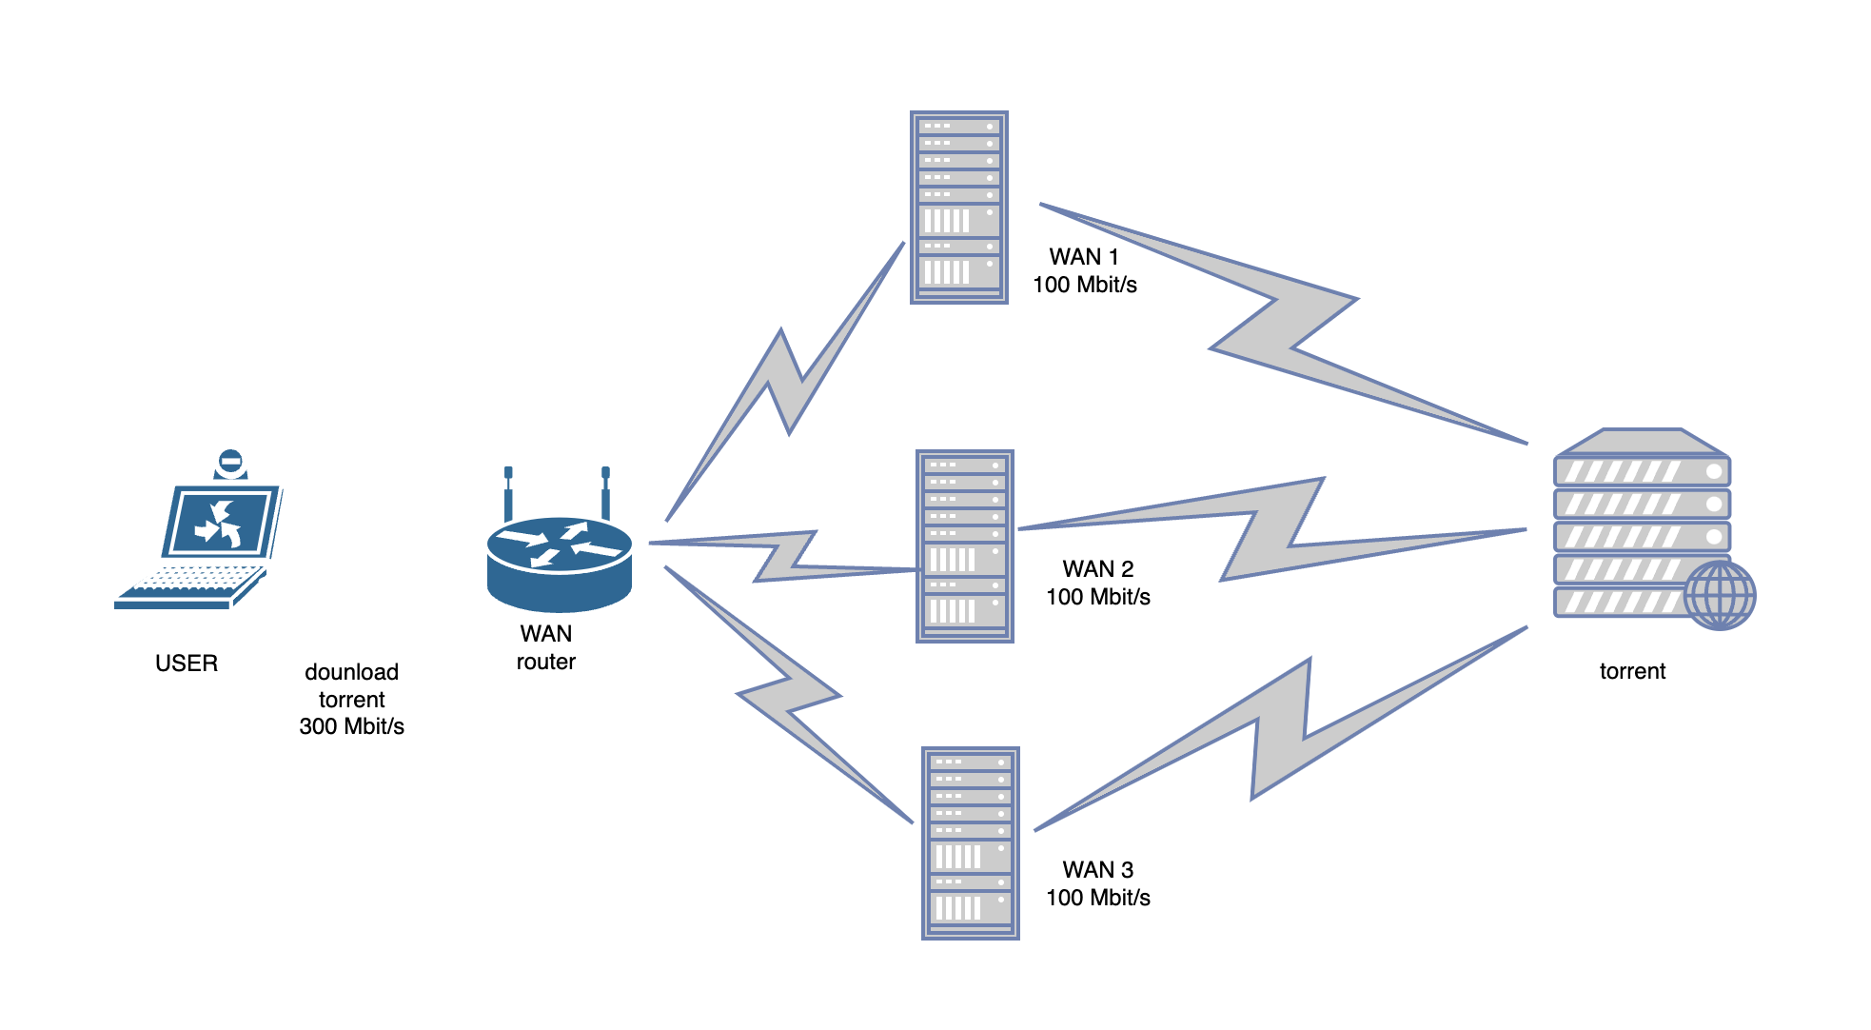
Aggregation server

Slide 13
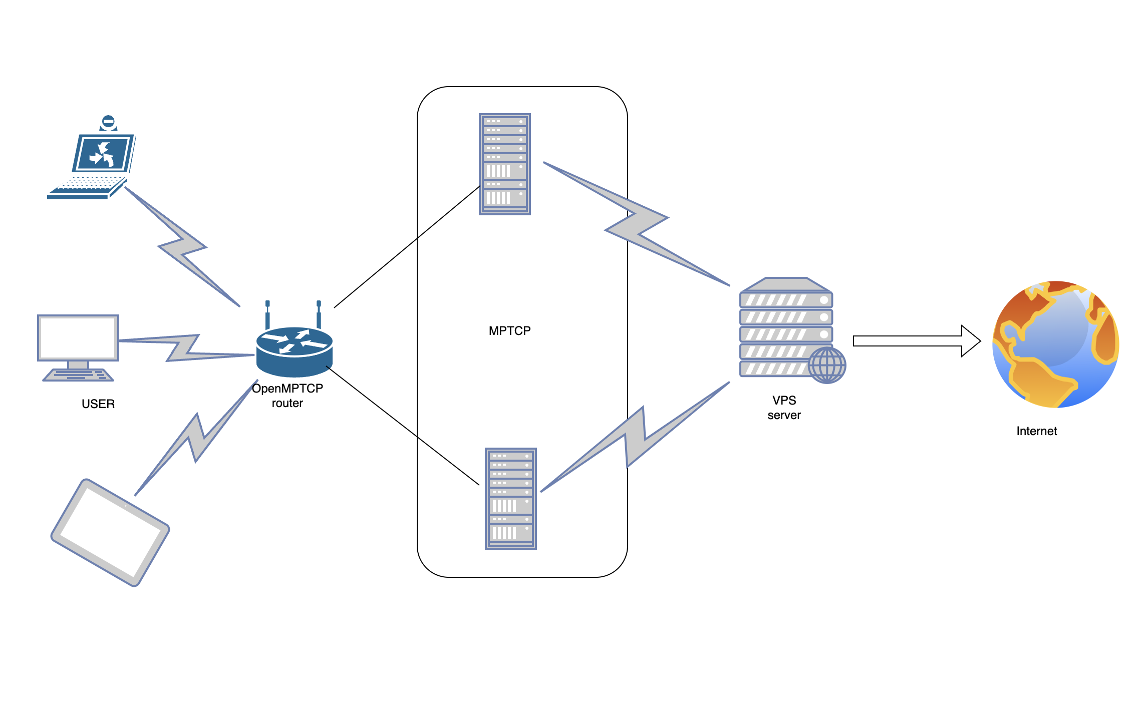
Setting up a summarizing server

Slide 14
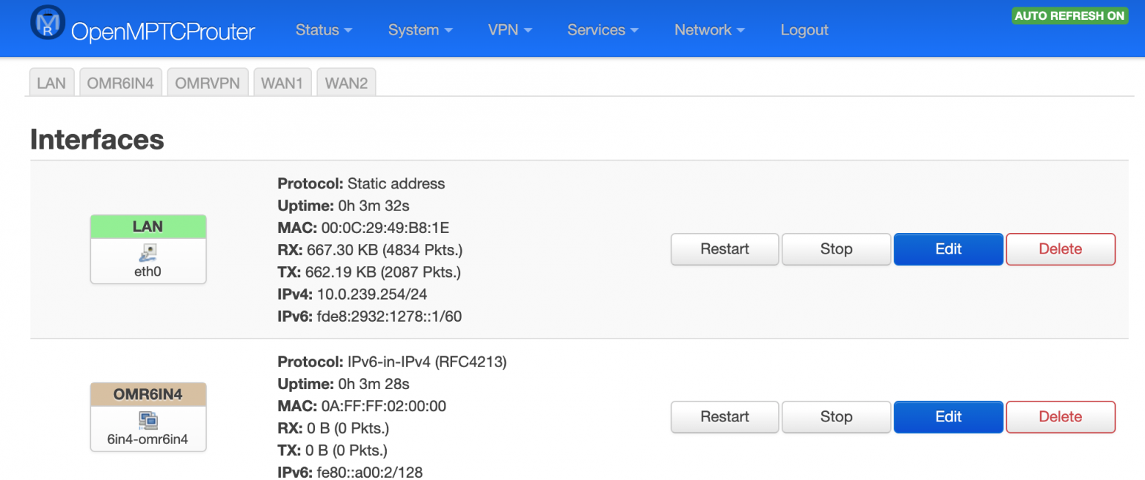
LAN settings

Slide 15
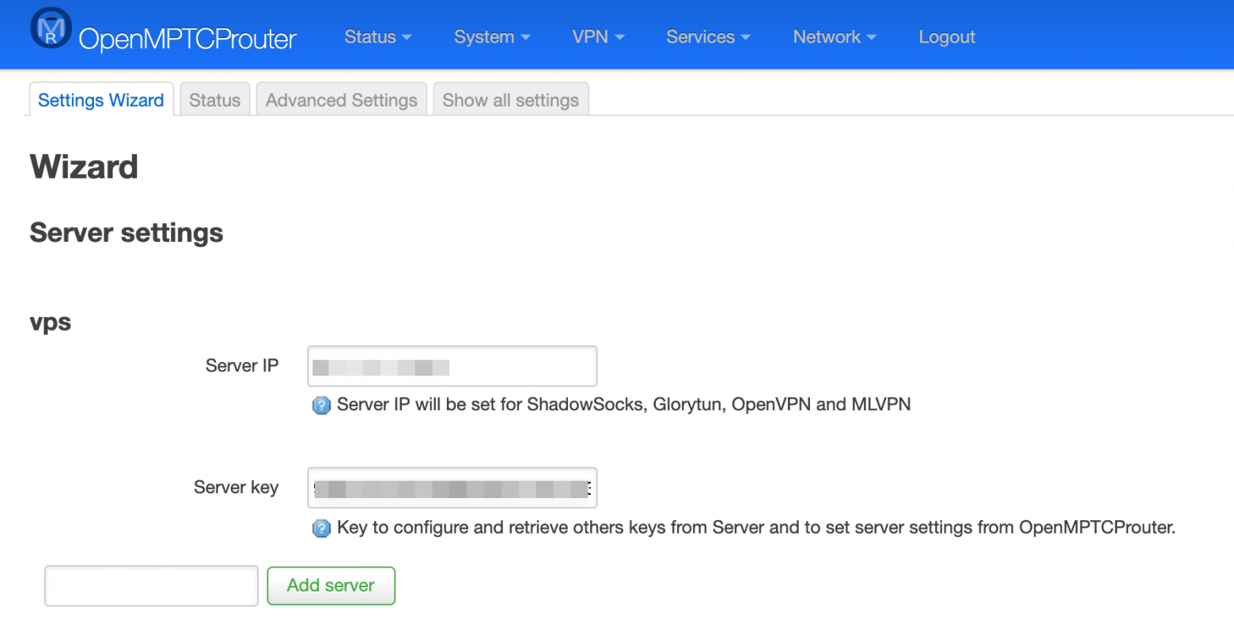

Slide 16
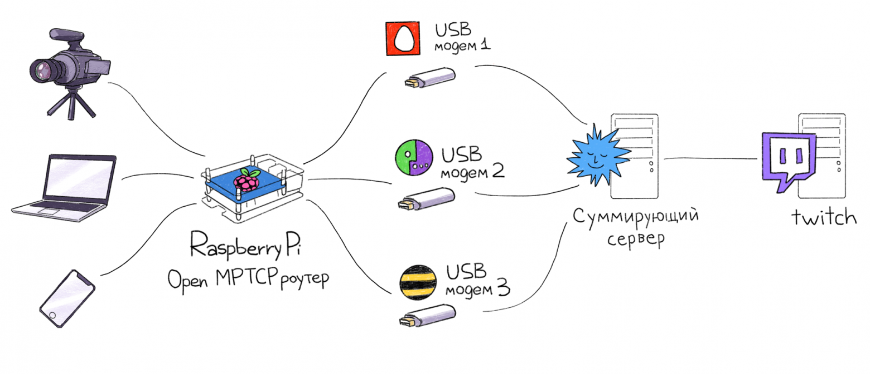
Conclusion
Многоканальная передача данных потребует перестройки всего Интернета?
https://habr.com/ru/companies/vdsina/articles/479026/

