Slide 1



Development of fast cycling superconducting magnet at IMP
Presented by Yuquan Chen
September 26, 2024
Magnet group, IMP

Slide 2
Outline
Requirements for HIAF-BRing magnet
Status of a 1.8T fast cycling magnet at IMP
Development of a 4T fast cycling magnet prototype (2T/s)
Collaboration on development of 4T fast cycling magnet (4T/s)
Summary

Slide 3
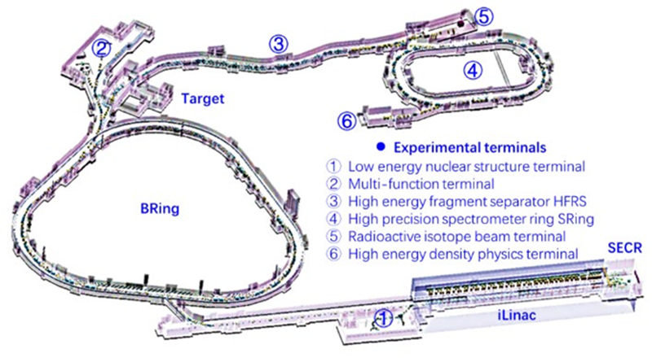
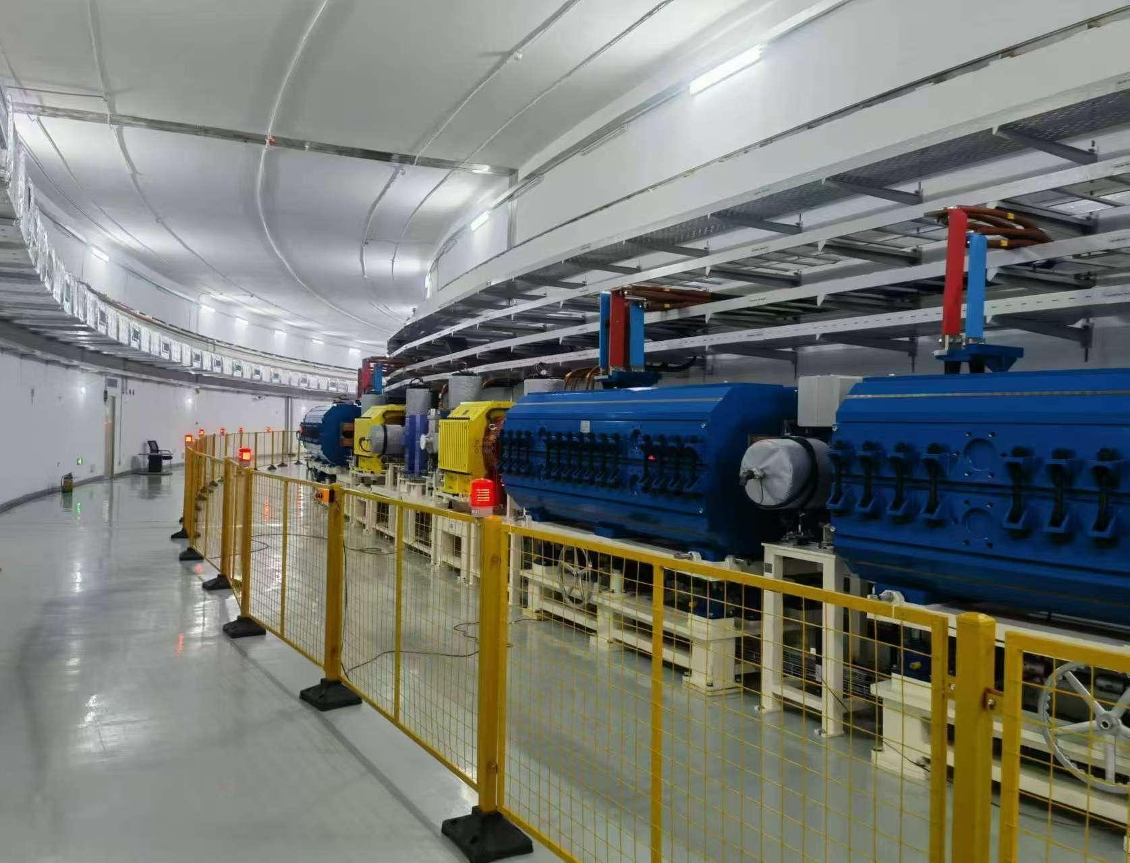
Requirements for HIAF-BRing magnet
Conventional magnets are manufactured and installed for the HIAF-BRing (started in 2018) due to our lack of expertise in fast cycling SC magnet technology. The dipole magnet has a maximum central field of 1.58 T and a maximum ramping rate of 12T/s.
Preliminary upgrade plan for BRing: add another ring in the same tunnel using SC magnets with a central field of 4T and a ramping rate of 4T/s.
BRing
Layout of HIAF
HIAF-BRing magnets in tunnel on 2024.09
Notes:
Introduce HIAF. Most of magnets are conventional. Reserved space.

Slide 4
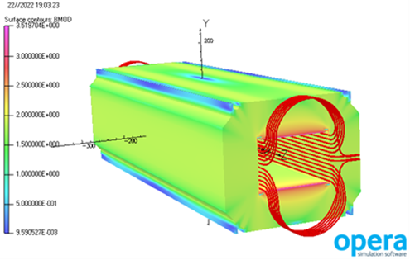
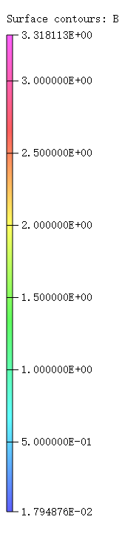
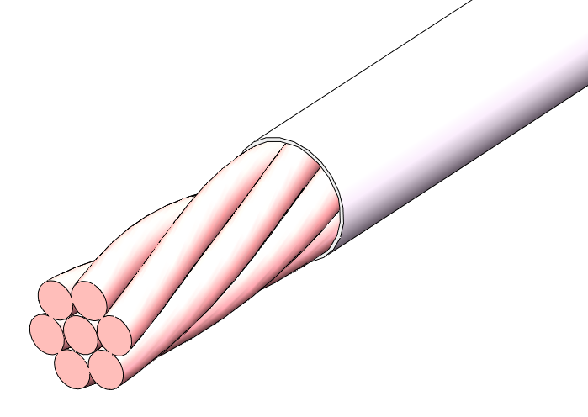
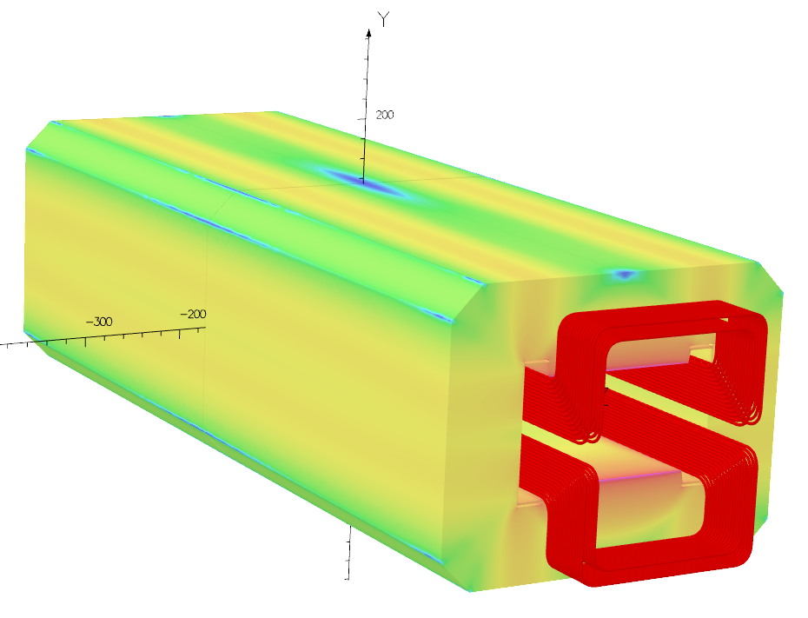
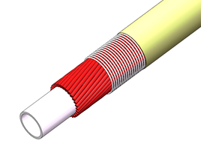
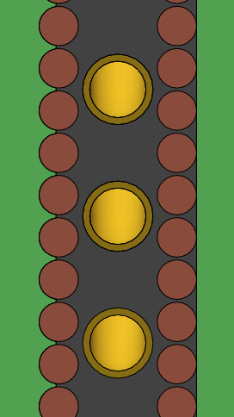
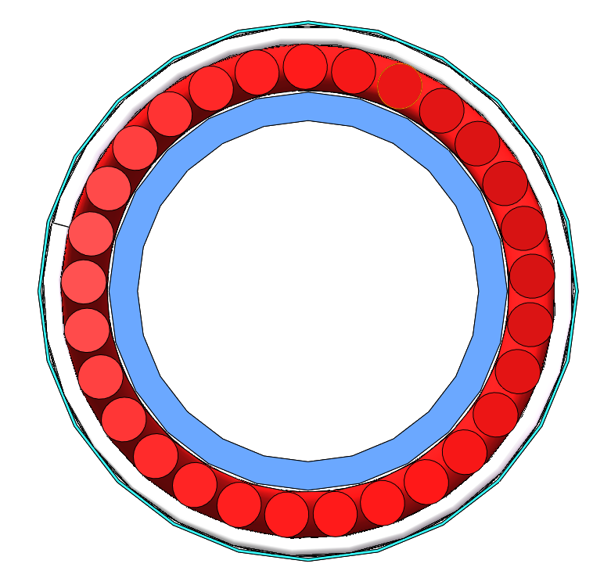
Nuclotron type magnet and other option
Nuclotron type（JINR）
7-strand type（IMP）
LHe pipe
液氦
Nuclotron-type cable
SC wires around LHe pipe
Operating current: ~10kA
One layer coil with serval turns
10kA pulsed power supply
7-strand cable with six wire surround one
Cooled by Lhe flowing through adjacent pipe
Operating current: ~3kA
Two layers, more turns
3kA/100V power supply
Notes:
effectively

Slide 5
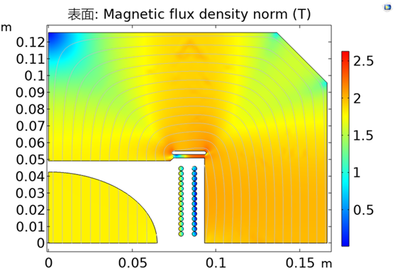
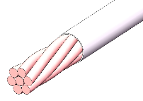
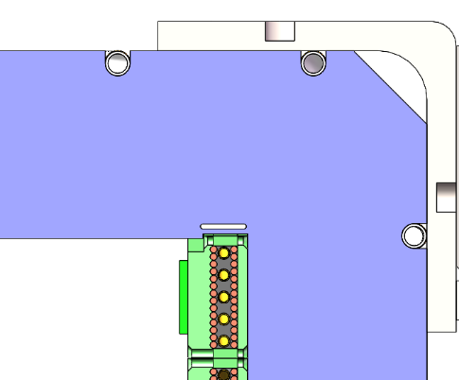
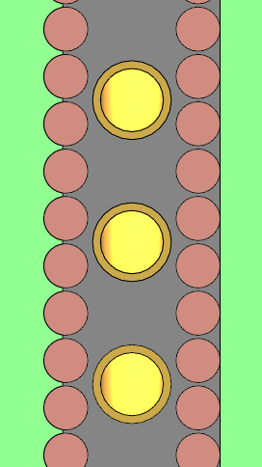
FRDM Design based on a 7-strand cable at IMP
7-strands cable is employed for FRDM with an operating current of 2670 A.
The coil is cooled by two-phase helium flowing through adjacent pipes.
Design parameters
Parameters | values
Gap | 98 mm
Turns per pole | 28 (two layers)
Operating current | 2670 A @1.8T 280 A @ 0.2T
Loading line factor | 55% @ 4.5K
iron yoke length | 960 mm
Cross section iron yoke | 350mm×270mm
Shared temperature | 6.8 K
Stored energy | 23.4 kJ
2D EM design
3D EM design
Lhe pipe
cables
G10 former
Cross section of coil

Slide 6
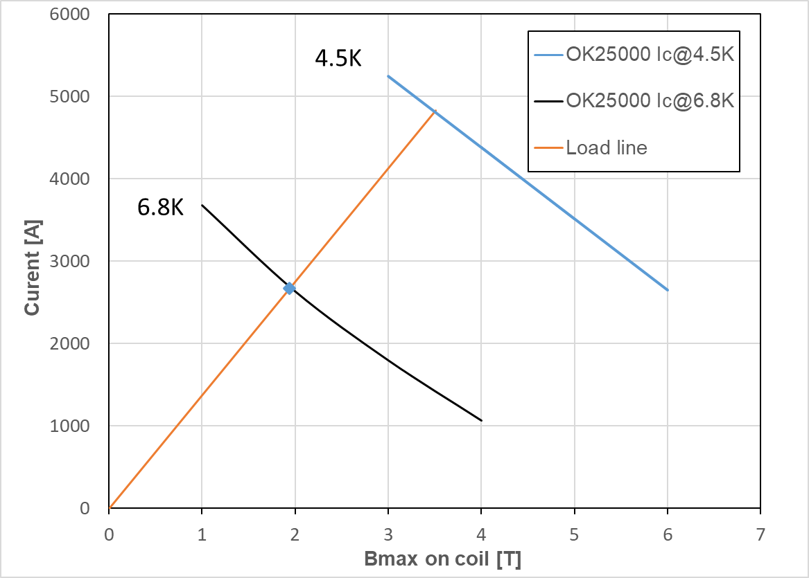
Load line
Low loss SC wire | Luvata-OK25000
Diameter of SC wire | 0.8 mm
Filament size | 3.2 um
Number of filament | 24490
Matrix material | Cu/CuMn0.5
Matrix:SC | 1.4
Twist pitch | 7 mm
Critical current @ 4.2K | 1000A @2T 850A @3T 700A @4T
Work point
The loading factor is 55% @4.5K, which is relatively moderate.
The shared temperature is 6.8K.
Notes:
CuMn around filaments embedded in OFC Matrix. manganese nickel

Slide 7
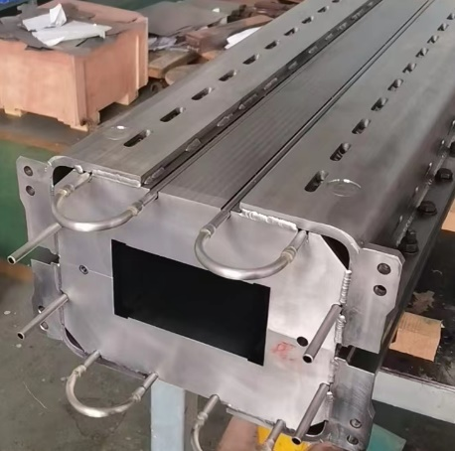
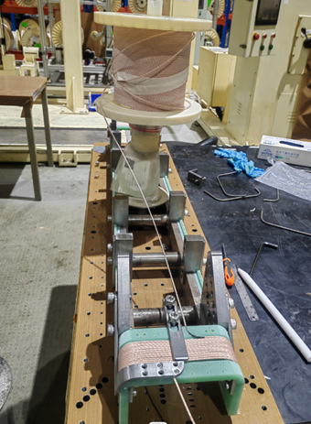
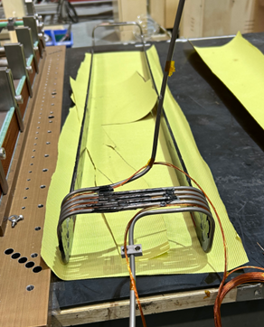
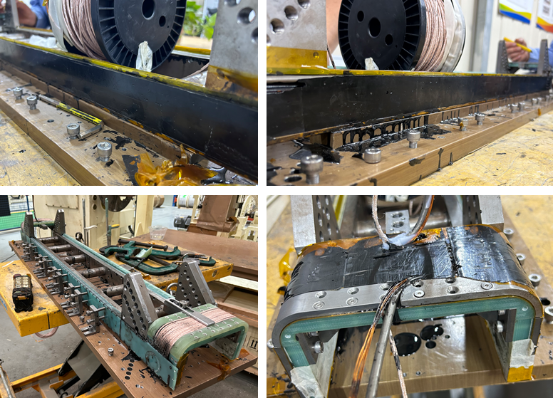
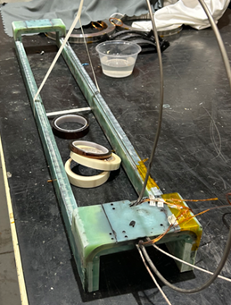
Manufacturing of FRDM at IMP
The iron yoke has been manufactured by lamination.
One of the two coils has been fabricated and is preparing for cryogenic test.
Another coil is being manufactured in factory and will be completed on October.
Iron yoke
Winding process
Cooling pipe
Filling Stycast 250
Finished winding

Slide 8
FRDM magnet testing plan
Manufacturing and assembly of IMP-type FRDM magnet prototype will be completed in late October, 2024.
IMP-type FRDM magnet prototype will be tested on November by using the testing bench currently under construction.

Slide 9
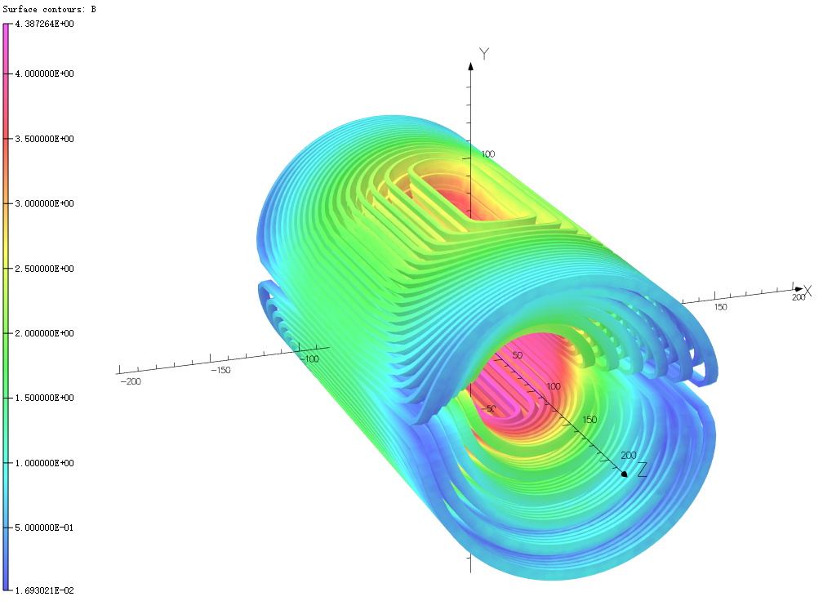
Development of a 4T fast cycling magnet prototype
Coil-dominated dipole magnet prototype with a maiximum field of 4T and ramping rate of 2T/s has been developed and tested.
Features: Discrete Cos Theta (DCT) type coil, helium bath cooling, 7-strand rope conductor, G10 former with grooves.
Maximum central field | 4 T
Operating current | 2040 A
Inner diameter of coil | 34 mm
Coil former layers | 6
Total turns | 168
Interval between layers | 1.4 mm
Coil length | 330 mm
Stored energy | 17.6 kJ
Inductance | 8.5 mH
cable consumption | 220 m
EM calculation: maximum field on coil is 4.38T
Notes:
The solenoids were also wired and tested. The magnetization test showed best center magnetic field exceed 7T.

Slide 10
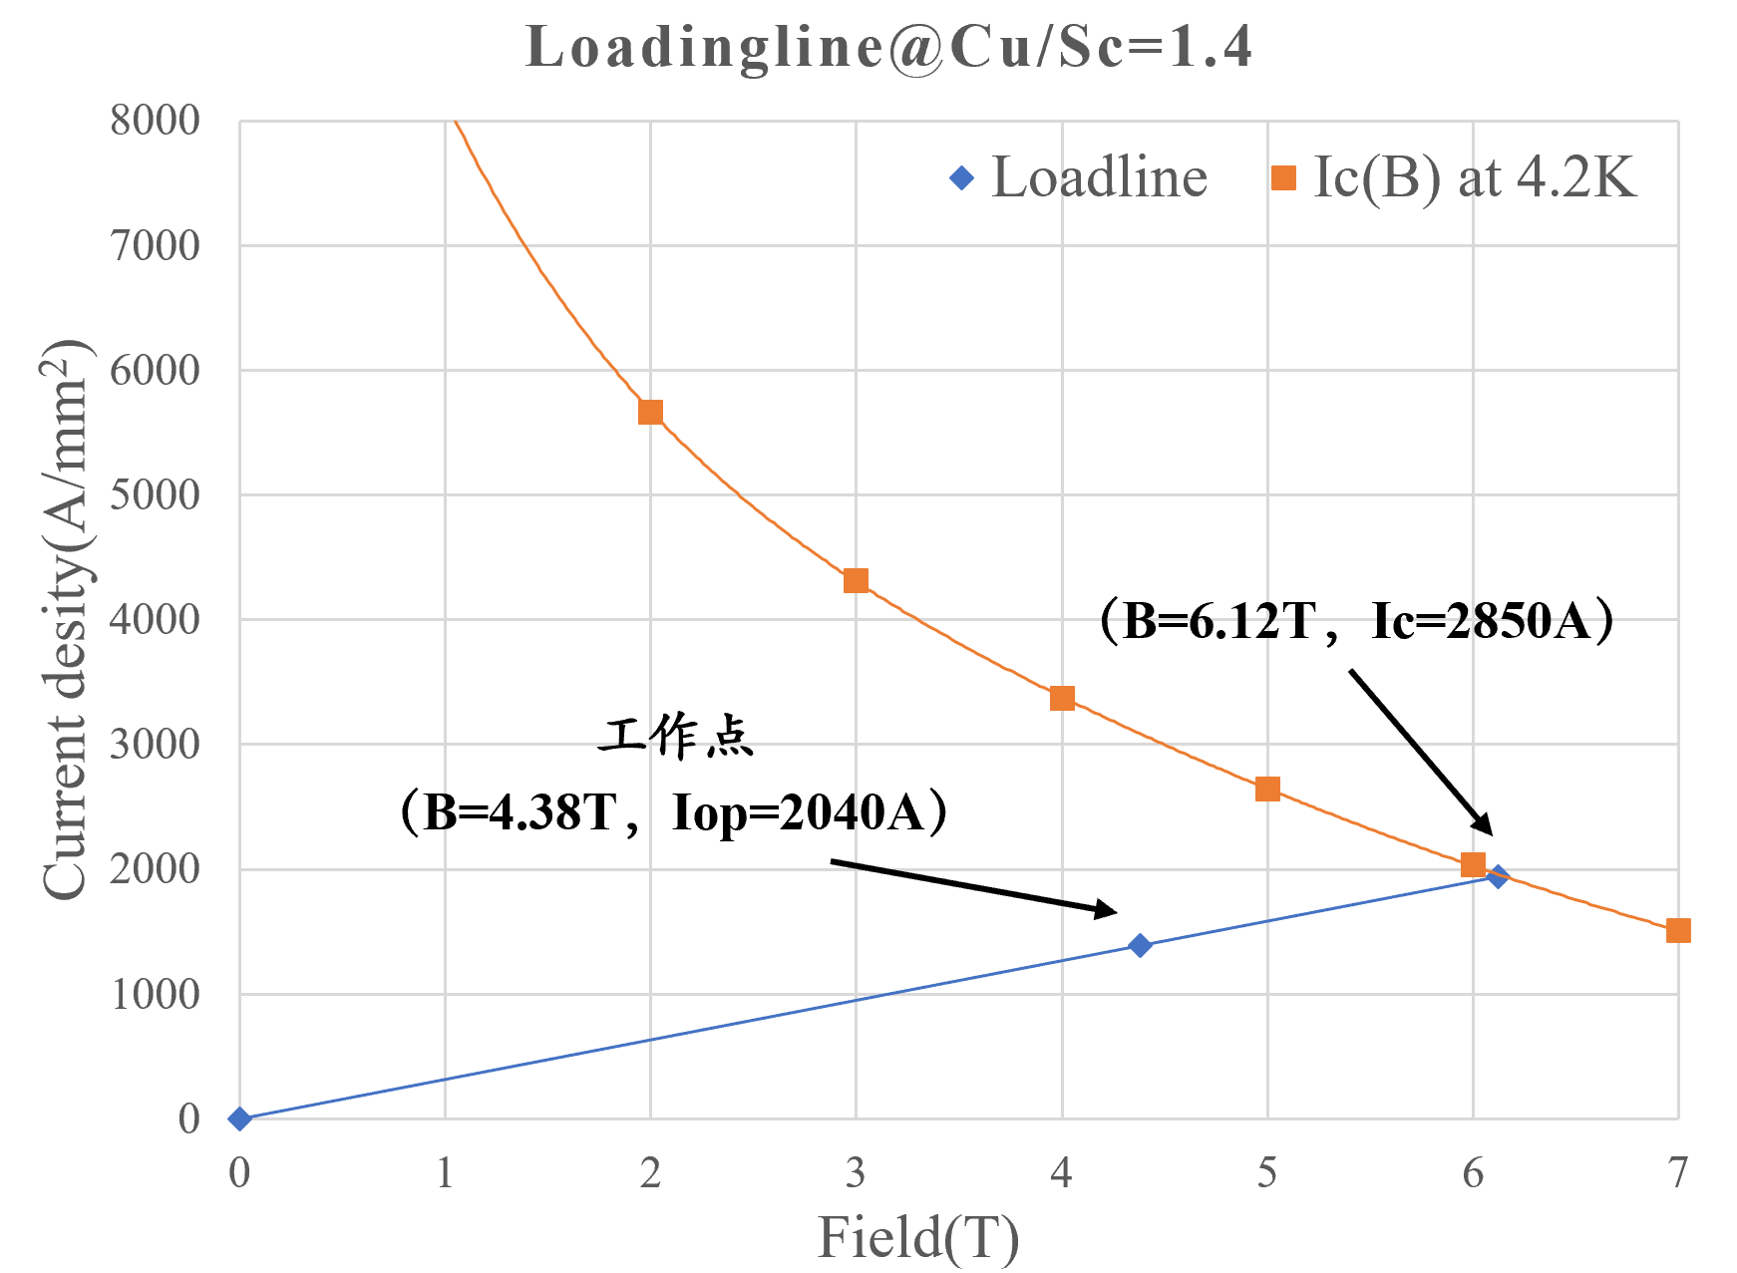
superconducting wire
The OK25000 wire produced by Luvata is employed for its low loss.
The loading factor is 72% with the operating current of 2040A. Temperature margin is 1.6 K.
Low loss SC wire | Luvata-OK25000
Diameter of SC wire | 0.8 mm
Filament size | 3.2 um
Number of filament | 24490
Matrix material | Cu/CuMn0.5
Matrix:SC | 1.4
Twist pitch | 7 mm
Critical current @ 4.2K | 1000A @2T 850A @3T 700A @4T
Working point
Notes:
CuMn around filaments embedded in OFC Matrix. manganese nickel

Slide 11
Displacement and stress
The maximum displacement is 0.3mm during cool down and 0.09mm after being energization.
Compared to the displacement generated by thermal contraction, it is smaller than that caused by EM force.
Displacements of the magnet under different conditions: a) cool down; b) electromagnetic force; c) cool down and EM force

Slide 12
Displacement and stress
The Von-Mises stress on the coil is below 80MPa while it is below 100MPa on the former.
Von-Mises stresses on the coil and former after cool down and energization
Notes:
Stress concentration

Slide 13

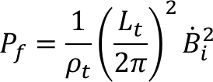
AC losses calculation
Calculated AC loss power by formula
Hysteresis loss power per cable length: 13.7 mW/m
Inter-filament coupling loss power per cable length: 0.88 mW/m
Total AC loss power per cable length: 14.6 mW/m
Total AC loss power: 3.21 W
B/T
4
2
4
8
t/s
Hysteresis loss:
Coupling loss:

Slide 14
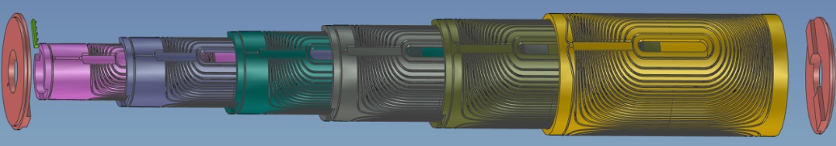
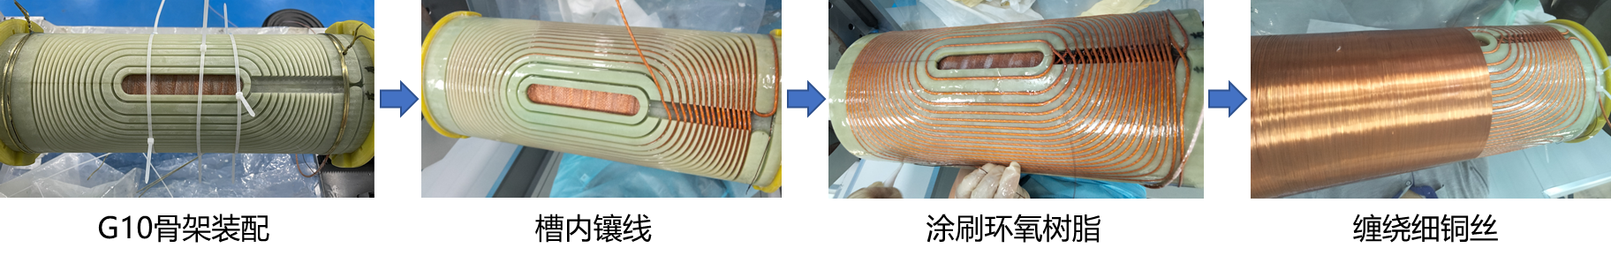
Fabrication
The magnet prototype consists of six formers assembled together. Each former is divided into two halves for easy assembly.
After winding one layer of coil, the next layer former is assembled, followed by winding that layer.
Diagram of formers and their assembley relationship
Assembling the former
Position the cable into the channel
Brush epoxy resin
winding thin copper wires

Slide 15
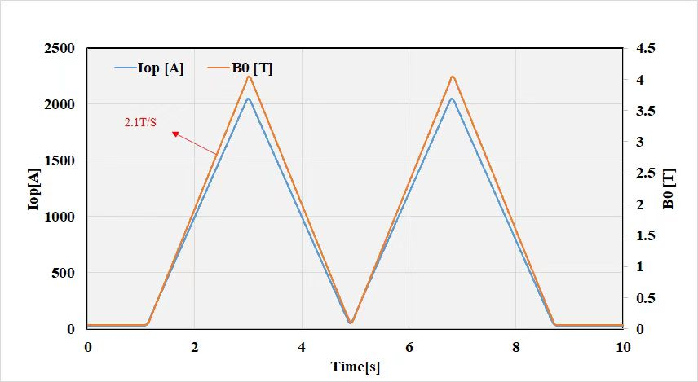
Cryogenic test
The magnetic field reached 4T after one quench and achieved the ramping rate of 2T/s with the energization rate of 1050A/s.
Only two cycles were tested, more cycles are required for testing.
Magnetic field
Notes:
Test from low ramping rate to high.

Slide 16
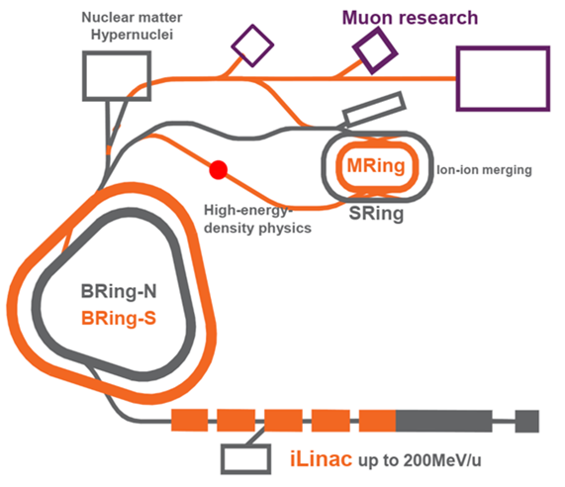
Collaboration of 4T FCDM with ramping rate of 4T/s
The demand for high beam intensities of the future high intensity heavy ion synchrotron accelerators HIAF (High Intensity heavy-ion Accelerator Facility), leads to requirement for higher field fast-cycling superconducting magnets.
Parameters | Unit | Value
Bmax | T | 4
Bmin | T | 0.4
dB/dt | T/s | 4~6
Leff | m | 1.4
Aperture | mm | 100
Field quality |  | ±3×10⁻⁴
Schematic of HIAF upgrade
Notes:
specifications

Slide 17
Collaboration of 4T FCDM with ramping rate of 4T/s
IMP and JINR will continue to collabrate on the fast cycling superconducting magnet.
For the first stage:
JINR and IMP will jointly conduct the magnet design including cable design, 2D/3D eletromagnetic design, structural analysis, thermal analysis, assessment of dynamic energy losses, quench simulation.
JINR provides the mechanical and engineering drawing of the FSDM prototype assemblies including iron yoke, coil winding and assembly for the magnet;
JINR provides the development and manufacturing of unique tooling and accessories for assembling the FSDM prototype;

Slide 18
Collaboration of 4T FCDM with ramping rate of 4T/s
For the second stage:
JINR and IMP jointly do the manufacture of the FSDM including cable, iron yoke, winding and assembling of the FSDM prototype cold mass;
JINR and IMP jointly provide the design and build the test bench for testing of assemblies and prototype of the FSDM (power supply, cryogenics, measurement equipment et. set.);
JINR is responsible for carrying out tests and magnetic measurements at room temperature;
JINR takes the cryogenics tests of the FSDM including magnet cooling, measurement of the quality of the magnetic field and obtain the performance characteristics of the magnet. Tests will be realized on the JINR site using a cryostat by JINR;
IMP staffs participate in the work of installing and testing the magnet on the JINR site;
Finally, the FSDM prototype device should be delivered to IMP after cryogenic tests;
JINR and IMP bear the expenses together for the development and manufacture of the fast-cycling superconducting magnet.

Slide 19
Summary
  We are developing a type of fast cycling superconducting magnet based on 7-strand cable, which still has a lot of work to be done.
  A 4T fast cycling magnet prototype has been designed, fabricated and tested, but more cycles are required for testing.
  It is a huge challenge to develop the FCDM with a magnetic file of 4T and a ramping rate of 4T/s, we need to closely collaborate with you.

Slide 20
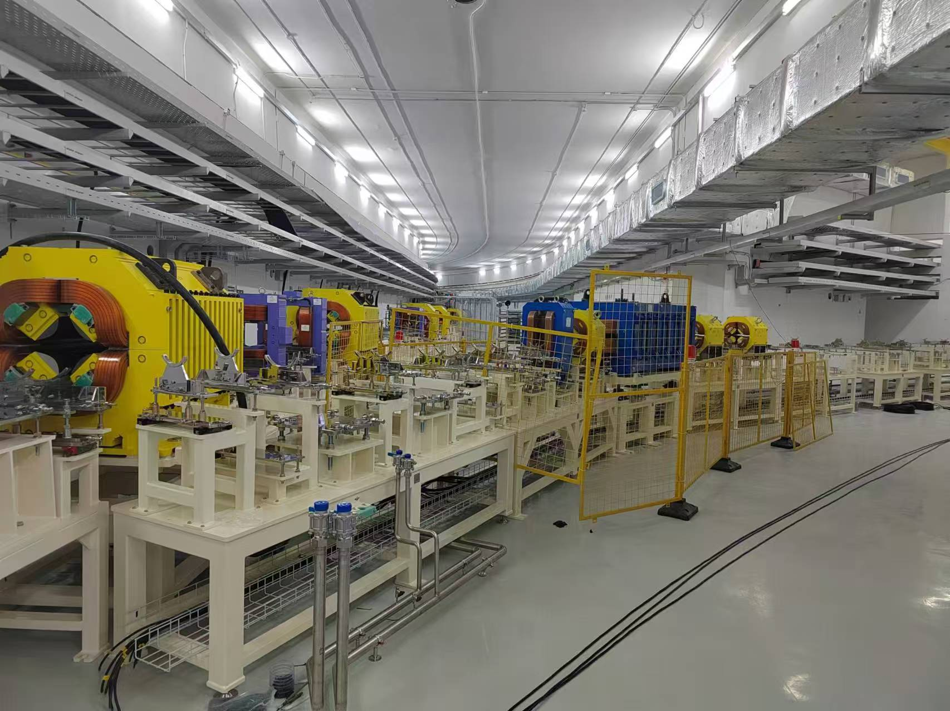
Thank you for your attention！
HIAF 2024.09

