Slide 1



Status of the gas-filled separator SHANS2
Zaiguo Gan
Institute of Modern Physics, Chinese Academy of Sciences
Lanzhou, China

Slide 2
Outline
Gas-filled recoil separators at IMP
Cold fusion reactions at SHANS2
New isotopes at SHANS2
Recent plans

Slide 3
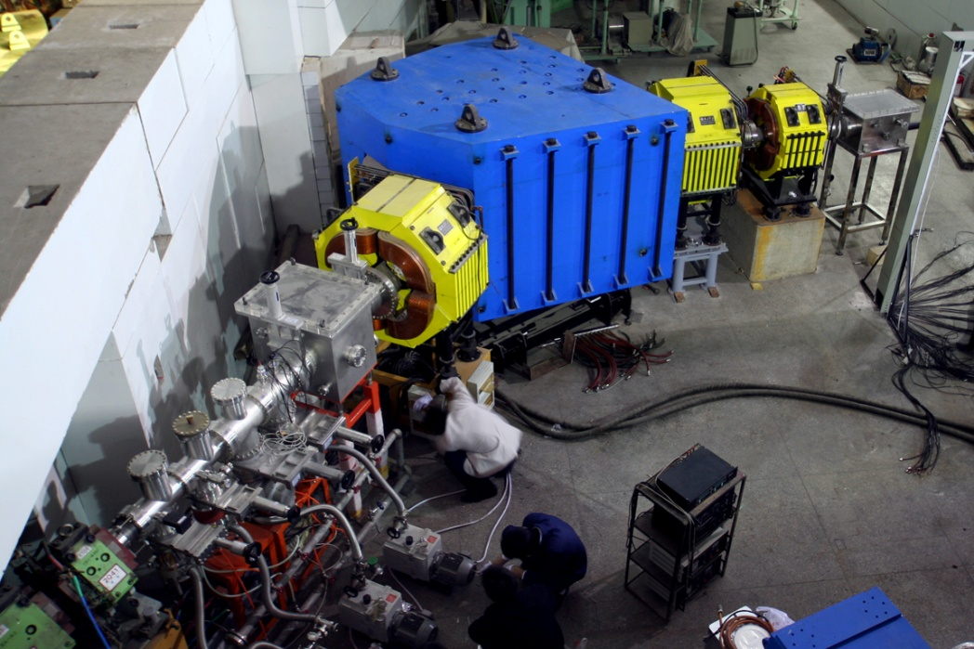
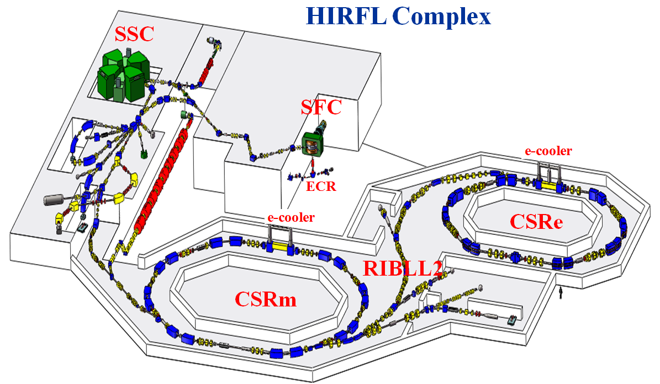
HIRFL +SHANS
Linac
SHANS
Spectrometer for Heavy Atoms and Nuclear Structure (SHANS)
RIBLL
Mode: ECR/SECR + SFC
Ions: Ar, Ca, Ne, Mg, Ni, Kr, …
Energy: ~ 5 MeV/u
Typical Intensity: ~500 pnA (^{36,40}Ar)
200~500 pnA (⁴⁰Ca)
Heavy Ion Research Facility in Lanzhou (HIRFL), China

Slide 4
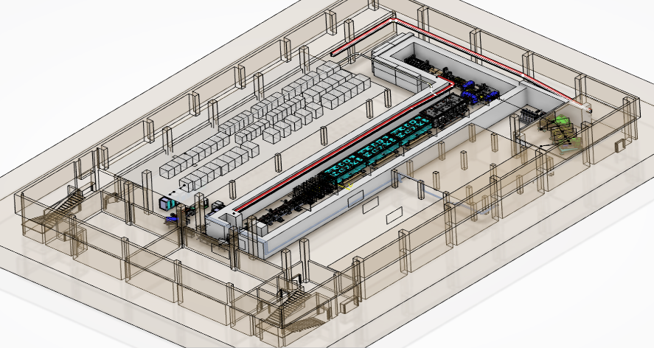
CAFE2+SHANS2
China Accelerator Facility for Superheavy Elements (CAFE2)
中国超重元素研究加速器装置
ECR
LEBT
RFQ
MEBT
CW - linac
HEBT
Designed parameters | Goal
Ions | Ca～Fe
A/Q | 3
Beam energy | 4.5-7 MeV/u
Beam current | 3～5 puA
Running mode | CW
SHANS2

Slide 5
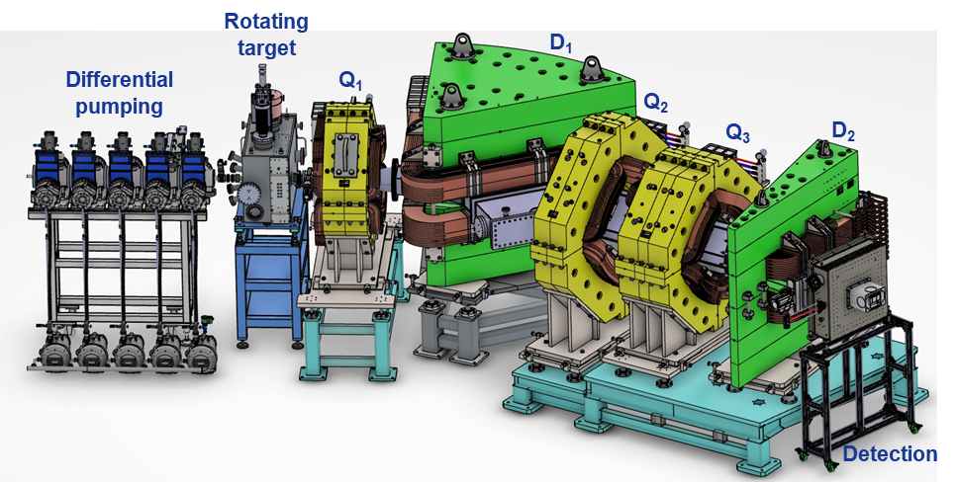
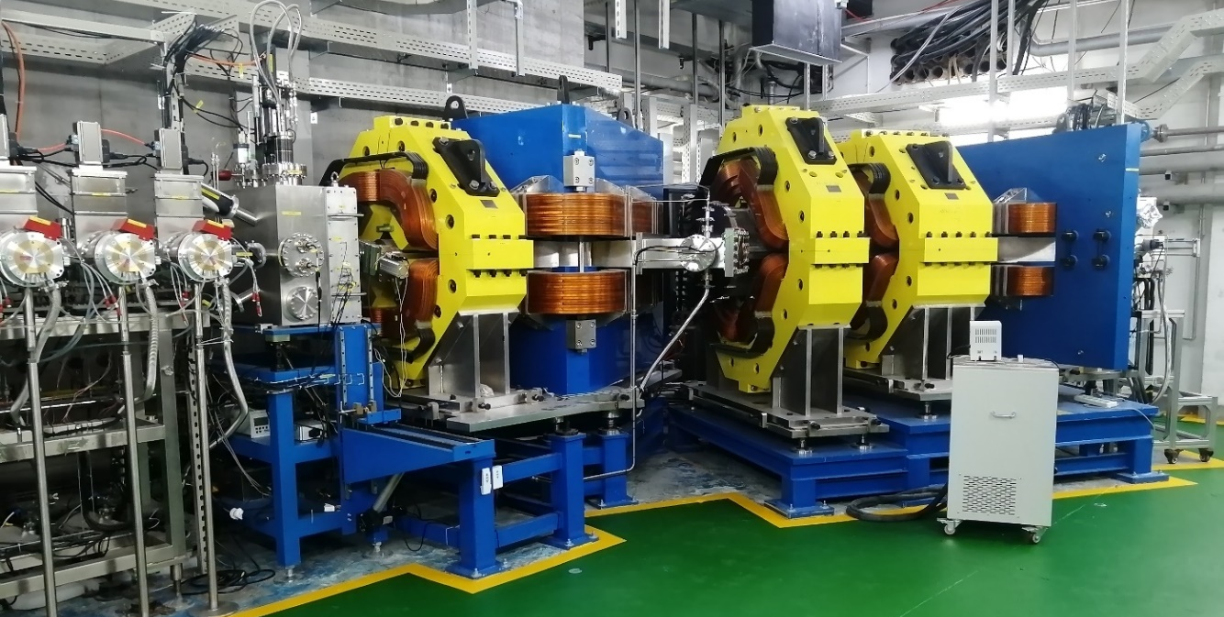
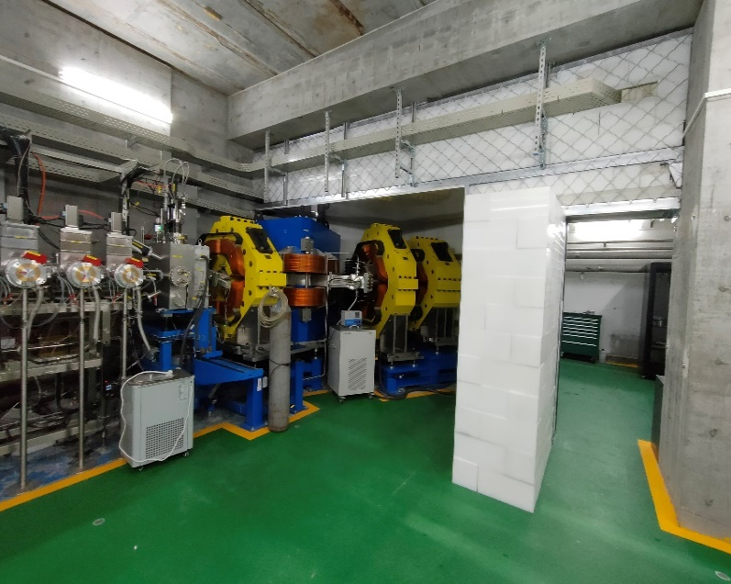
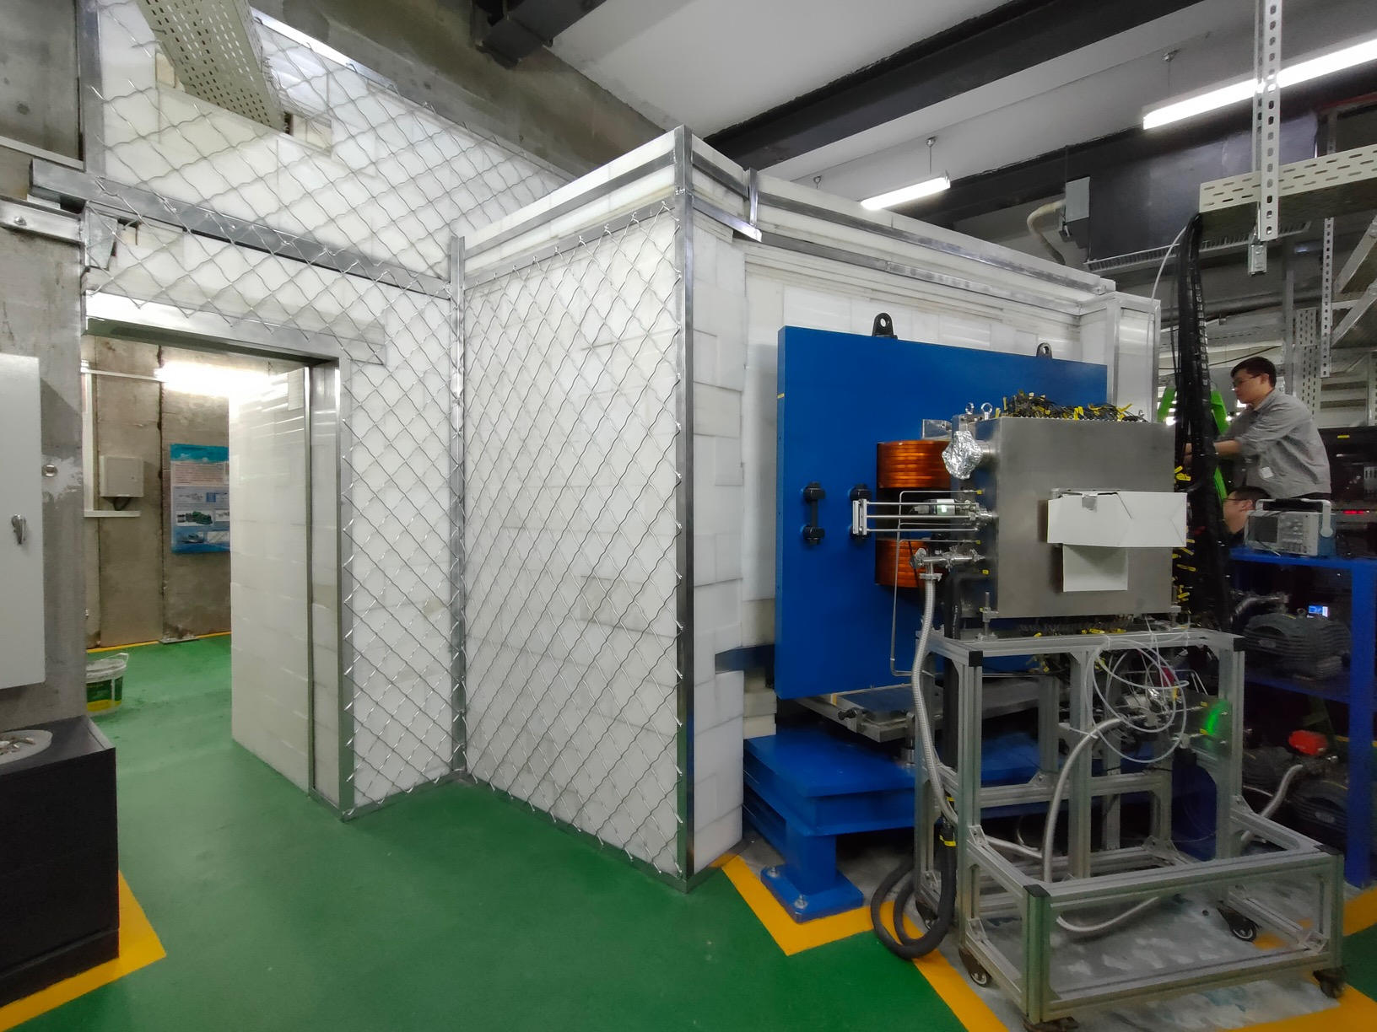
New gas-filled separator SHANS2
SHANS2

Slide 6
New gas-filled separator SHANS2
Separator | DGFRS | DGFRS-II | GARIS | GARIS-II | RITU | BGS | TASCA | SHANS | SHANS2
Location | FLNR Dubna Russia | FLNR Dubna Russia | RIKEN Wako Japan | RIKEN Wako Japan | JYFL Jyväskylä Finland | LBNL Berkeley USA | GSI Darmstadt Germany | IMP Lanzhou China | IMP Lanzhou China
Configuration | DQ_{h}Q_{v} | Q_{v}DQ_{h}Q_{v}D | DQ_{h}Q_{v}D | Q_{v}DQ_{h}Q_{v}D | Q_{v}DQ_{h}Q_{v} | Q_{v}D_{h}D | DQ_{h}Q_{v} | Q_{v}DQ_{v}Q_{h} | Q_{v}DQ_{h}Q_{v}D
Deflection angle | 23º | 30º+10º | 45º+10º | 30º+7º | 25º | 25°+45º | 30º | 52º | 30º+10º
Bρ (max/T∙m) | 3.1 | 3.2 | 2.04 | 2.46 | 2.2 | 2.5 | 2.4 | 2.88 | 2.5
Length (m) | 4 | 7.1 | 5.76 | 5.06 | 4.8 | 4.6 | 3.5 | 6.5 | 5.85
Dispersion (mm/% Bρ) | 7.5 |  | 9.7 | 19.3 | 10 | 20 | 9 | 7.3 | (22)

Slide 7
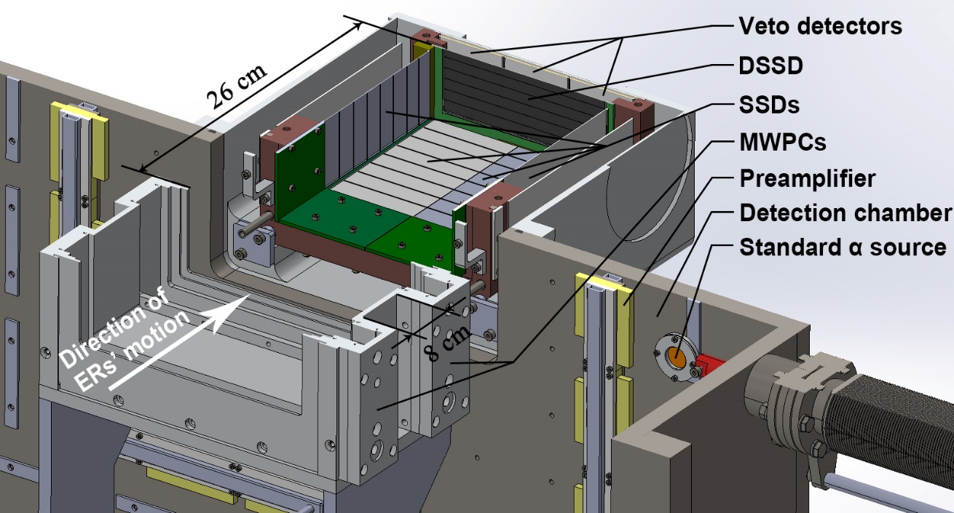
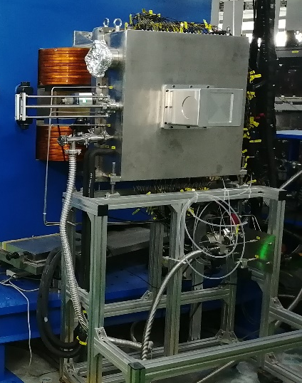
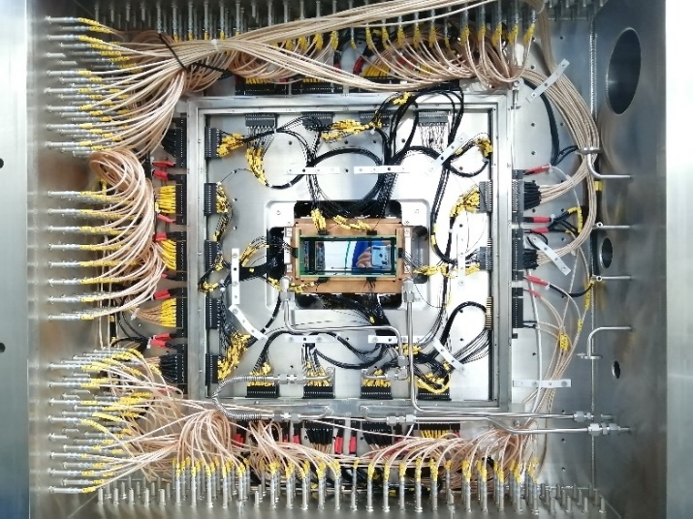
Detection system
 | DSSD (BB17) | SSD (W4) | VETO (MSX25)
Sensitive area | 128×48 mm² | 65×120 mm² | 50×50 mm²
Junction side | 48 strips | 8 strips | No strips
Ohmic side | 128 strips | No strips | No strips
Strip width | 1 mm | 15 mm
Thickness | 300±20 μm | 500±10 μm | 300 μm
Thickness of dead layer | 100 nm | 100 nm | 100 nm
Depletion bias voltage | 40 V | 30 V | 30 V
Energy resolution (FWHM) | 20~30 keV | ~50 keV
Multi-Wire Proportional Counter（MWPC）
Sensitive area | 180×80 mm²
Working gas | Isobutane
Pressure | ~300 Pa
Wire material | Tungsten plated with gold
Diameter of wires | Cathode：20μm Anode：15μm
Distance between wires | Cathode：1 mm Anode：2 mm
Voltage of anode | +500 V
Voltage of cathode | -150 V

Slide 8
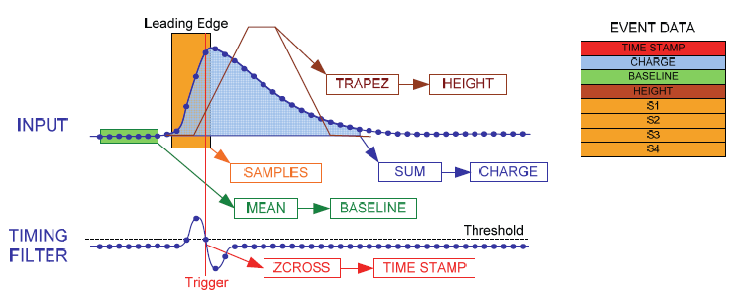
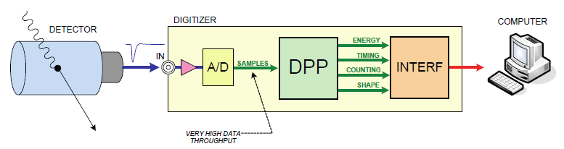
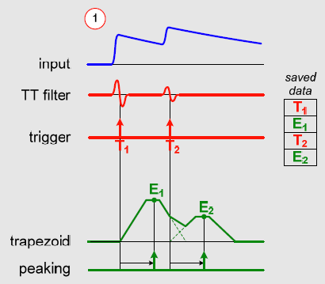
DAQ with digital electronics
Data acquisition system
Charge sensitive preamplifier directly connected to the digitizer
Provides pulse height, time stamp (10 ns) and waveform
Suited for high resolution spectroscopy (HPGe and Silicon detectors)
Dead time free => beneficial for short-lived isotopes
CAEN S.p.A : http://www.caen.it/csite

Slide 9
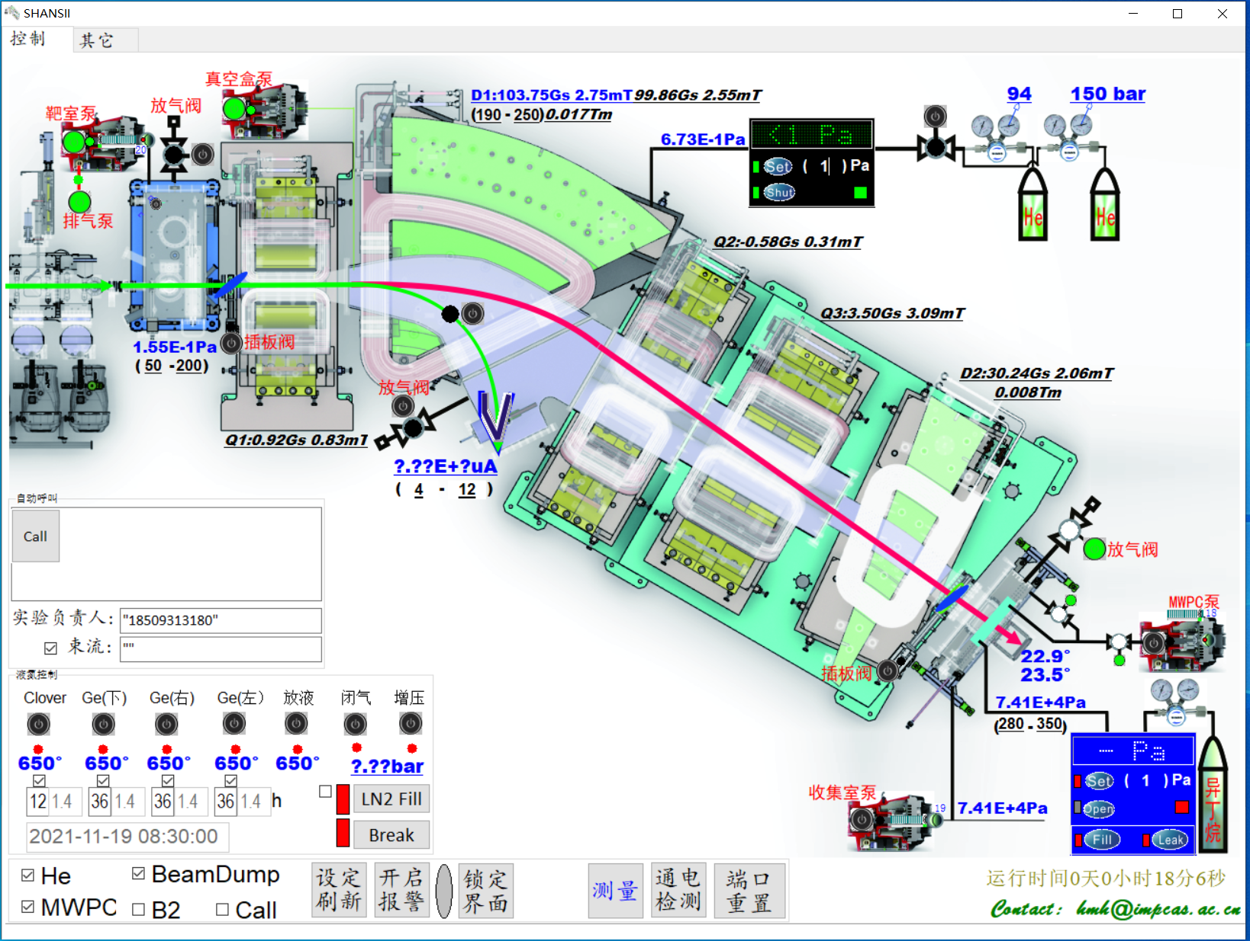
Monitor system

Slide 10
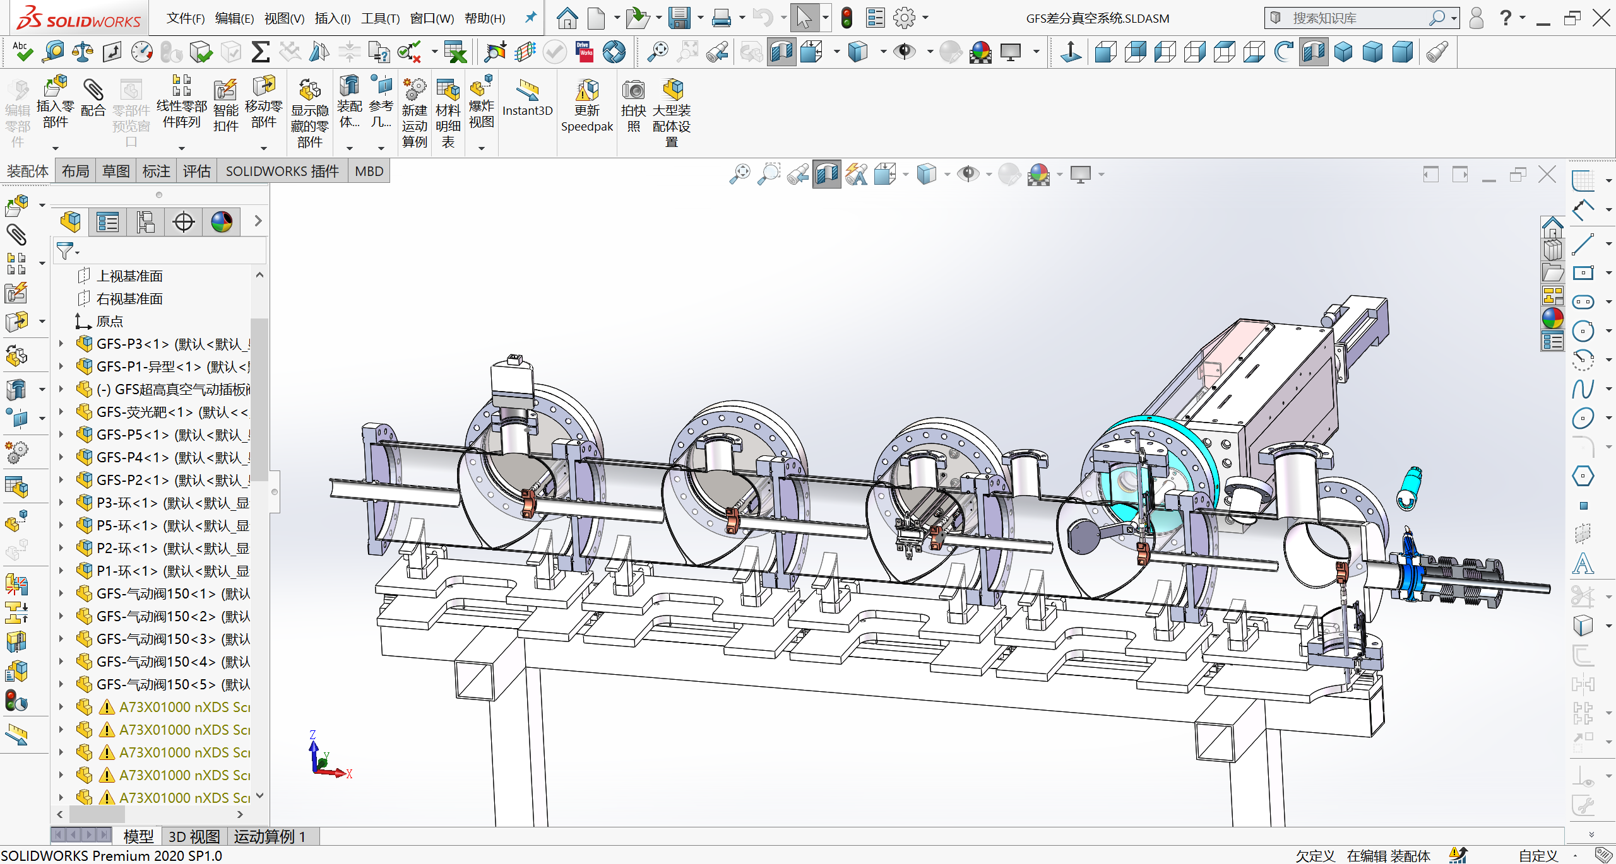
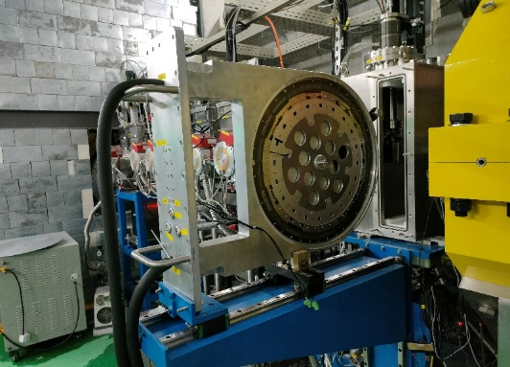
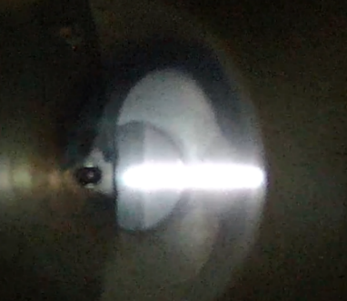
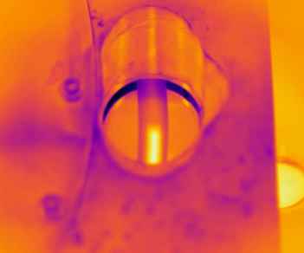
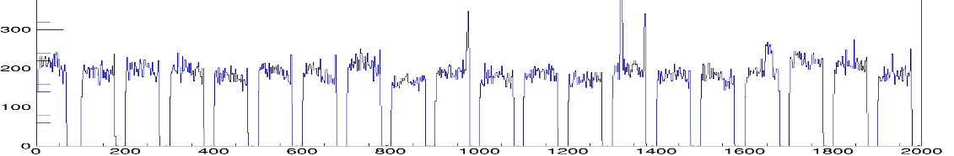
Differential pumping & Rotating target
Rotating target:
Target wheel with a diameter of 50 cm for 20 segments
¹⁷⁵Lu and ¹⁶⁹Tm targets have been used under beams with the intensity up to 3 pμA
Differential pumping:
Helium gas filled in separator (P<300 Pa)
High vacuum pressure before differential pumping (P<5×10⁻⁶ Pa)

Slide 11
Outline
Gas-filled recoil separators at IMP
Cold fusion reactions at SHANS2
New isotopes at SHANS2
Recent plans

Slide 12
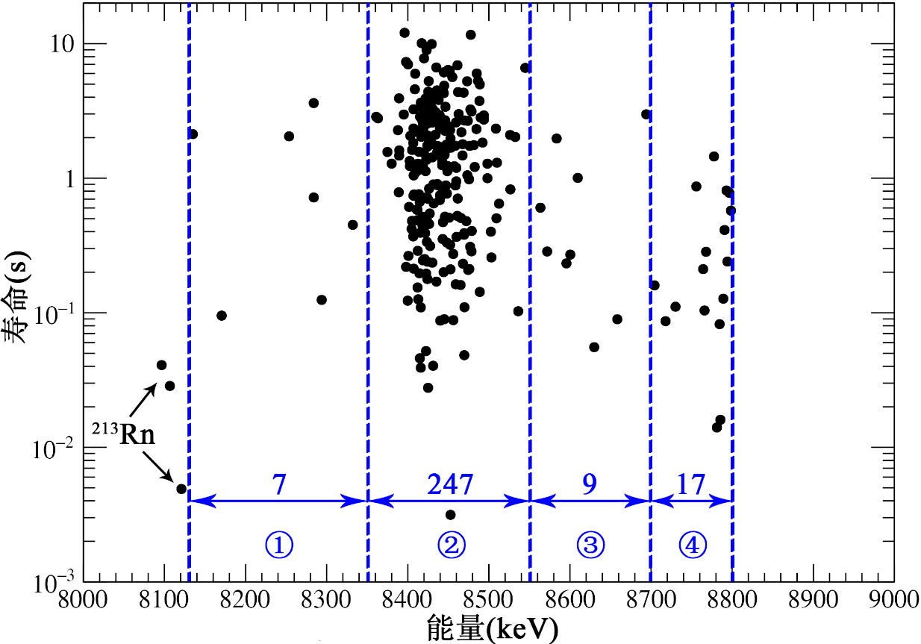
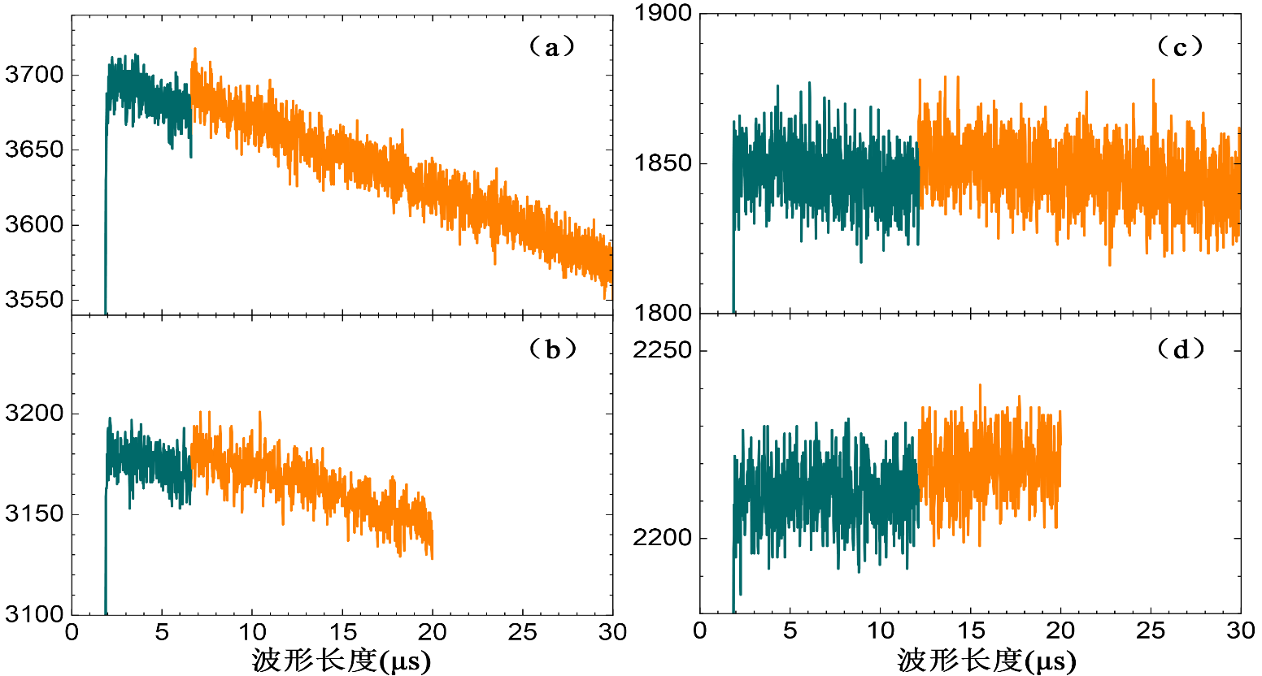
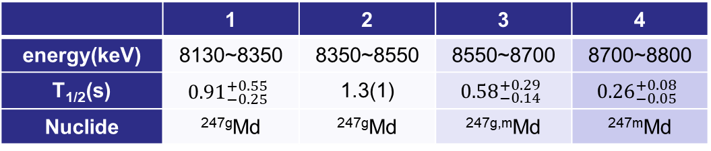
²⁰⁹Bi(⁴⁰Ar, 2n)²⁴⁷Md
Bρ(T·m) | Beam (eμA) | time(h) | Time(h)
2.064 | 4.6 | 1.9 | 1.5
1.958 | 6.2 | 0.6 | 0.5
2.000 | 5.9 | 7.8 | 6.0
1.980 | 11.3 | 20.9 | 16.1
 | 1 | 2 | 3 | 4
energy(keV) | 8130~8350 | 8350~8550 | 8550~8700 | 8700~8800
T_{1/2}(s) | $${0.91}_{−0.25}^{+0.55}$$ | 1.3(1) | $${0.58}_{−0.14}^{+0.29}$$ | $${0.26}_{−0.05}^{+0.08}$$
Nuclide | ^{247g}Md | ^{247g}Md | ^{247g,m}Md | ^{247m}Md

Slide 13
²⁰⁸Pb(⁴⁸Ca, 2n)²⁵⁴No
E=219.1MeV, Bρ=1.99Tm

Slide 14
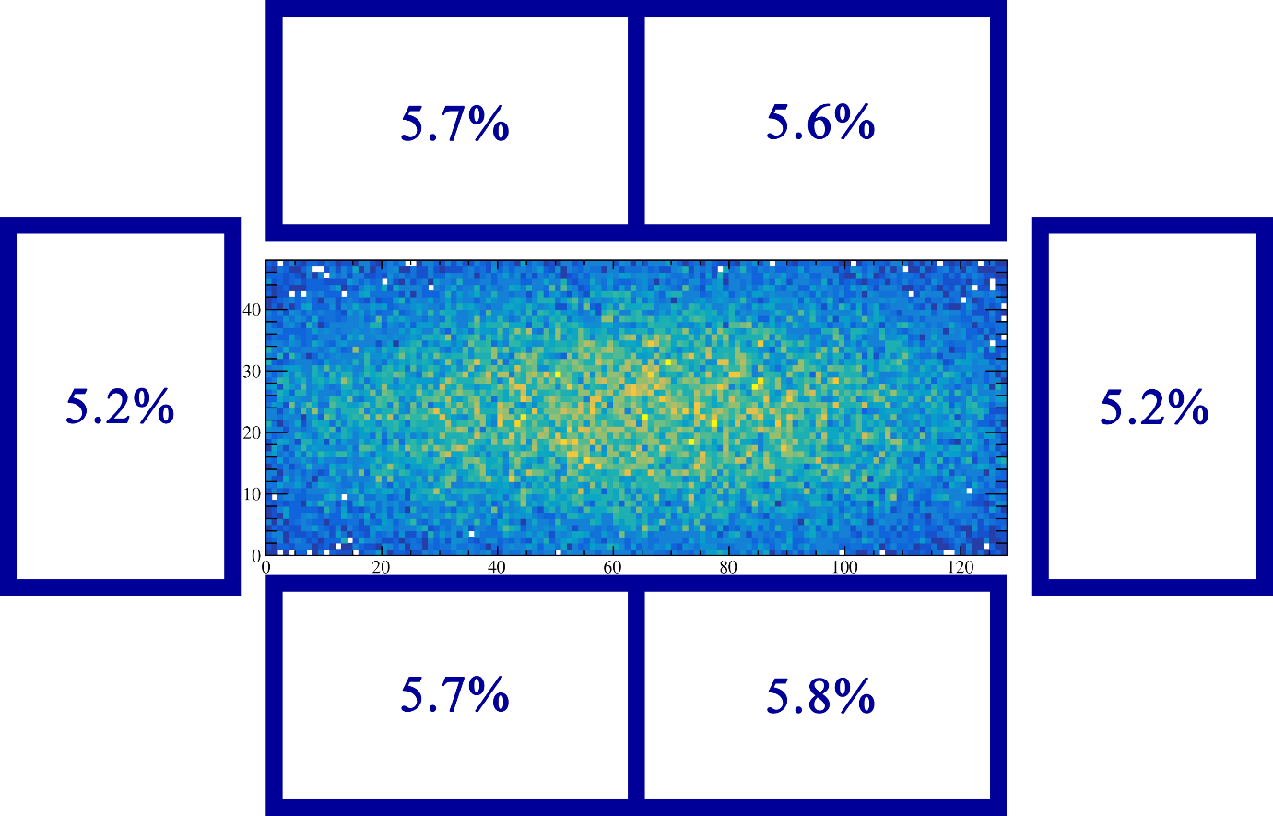
Simulation and measurement on detection efficiency
54% + 31.6% = 85.6%
54% + 33.2% = 87.2%
²⁰⁸Pb(⁴⁸Ca, 2n)²⁵⁴No
²⁰⁹Bi(⁴⁰Ar, 2n)²⁴⁷Md

Slide 15
Outline
Gas-filled recoil separators at IMP
Cold fusion reactions at SHANS2
New isotopes at SHANS2
Recent plans

Slide 16
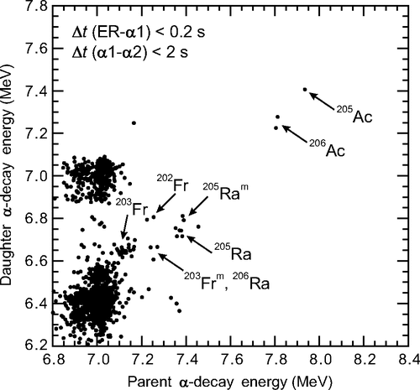
New isotopes ^{204,205}Ac
⁴⁰Ca +¹⁶⁹Tm (E_{lab}=198 MeV)
⁴⁰Ca +¹⁶⁹Tm (E_{lab}=200-214 MeV)
205
Ac
ER
α₁
7.935 MeV
29.1 ms
201
Fr
α₂
7.406 MeV
85.0 ms
197
At
α₃
6.997 MeV
2.08 s
193
Bi
Phys. Rev. C 89, 014308 (2014)
SHANS
SHANS2

Slide 17

New isotope ²⁰³Ac
¹⁶⁹Tm(⁴⁰Ca,6n)²⁰³Ac, 225 MeV, I_{beam}: ~1.5 pμA, max:3.0 pμA, 217 h, 7.3E18
  The Cross Section: ${0.13}_{−0.10}^{+0.30}$ pb
The Sp for ²⁰³Ac: -1214 keV.
No evidence for proton decay.
PLB, 850,138503 (2024)

Slide 18
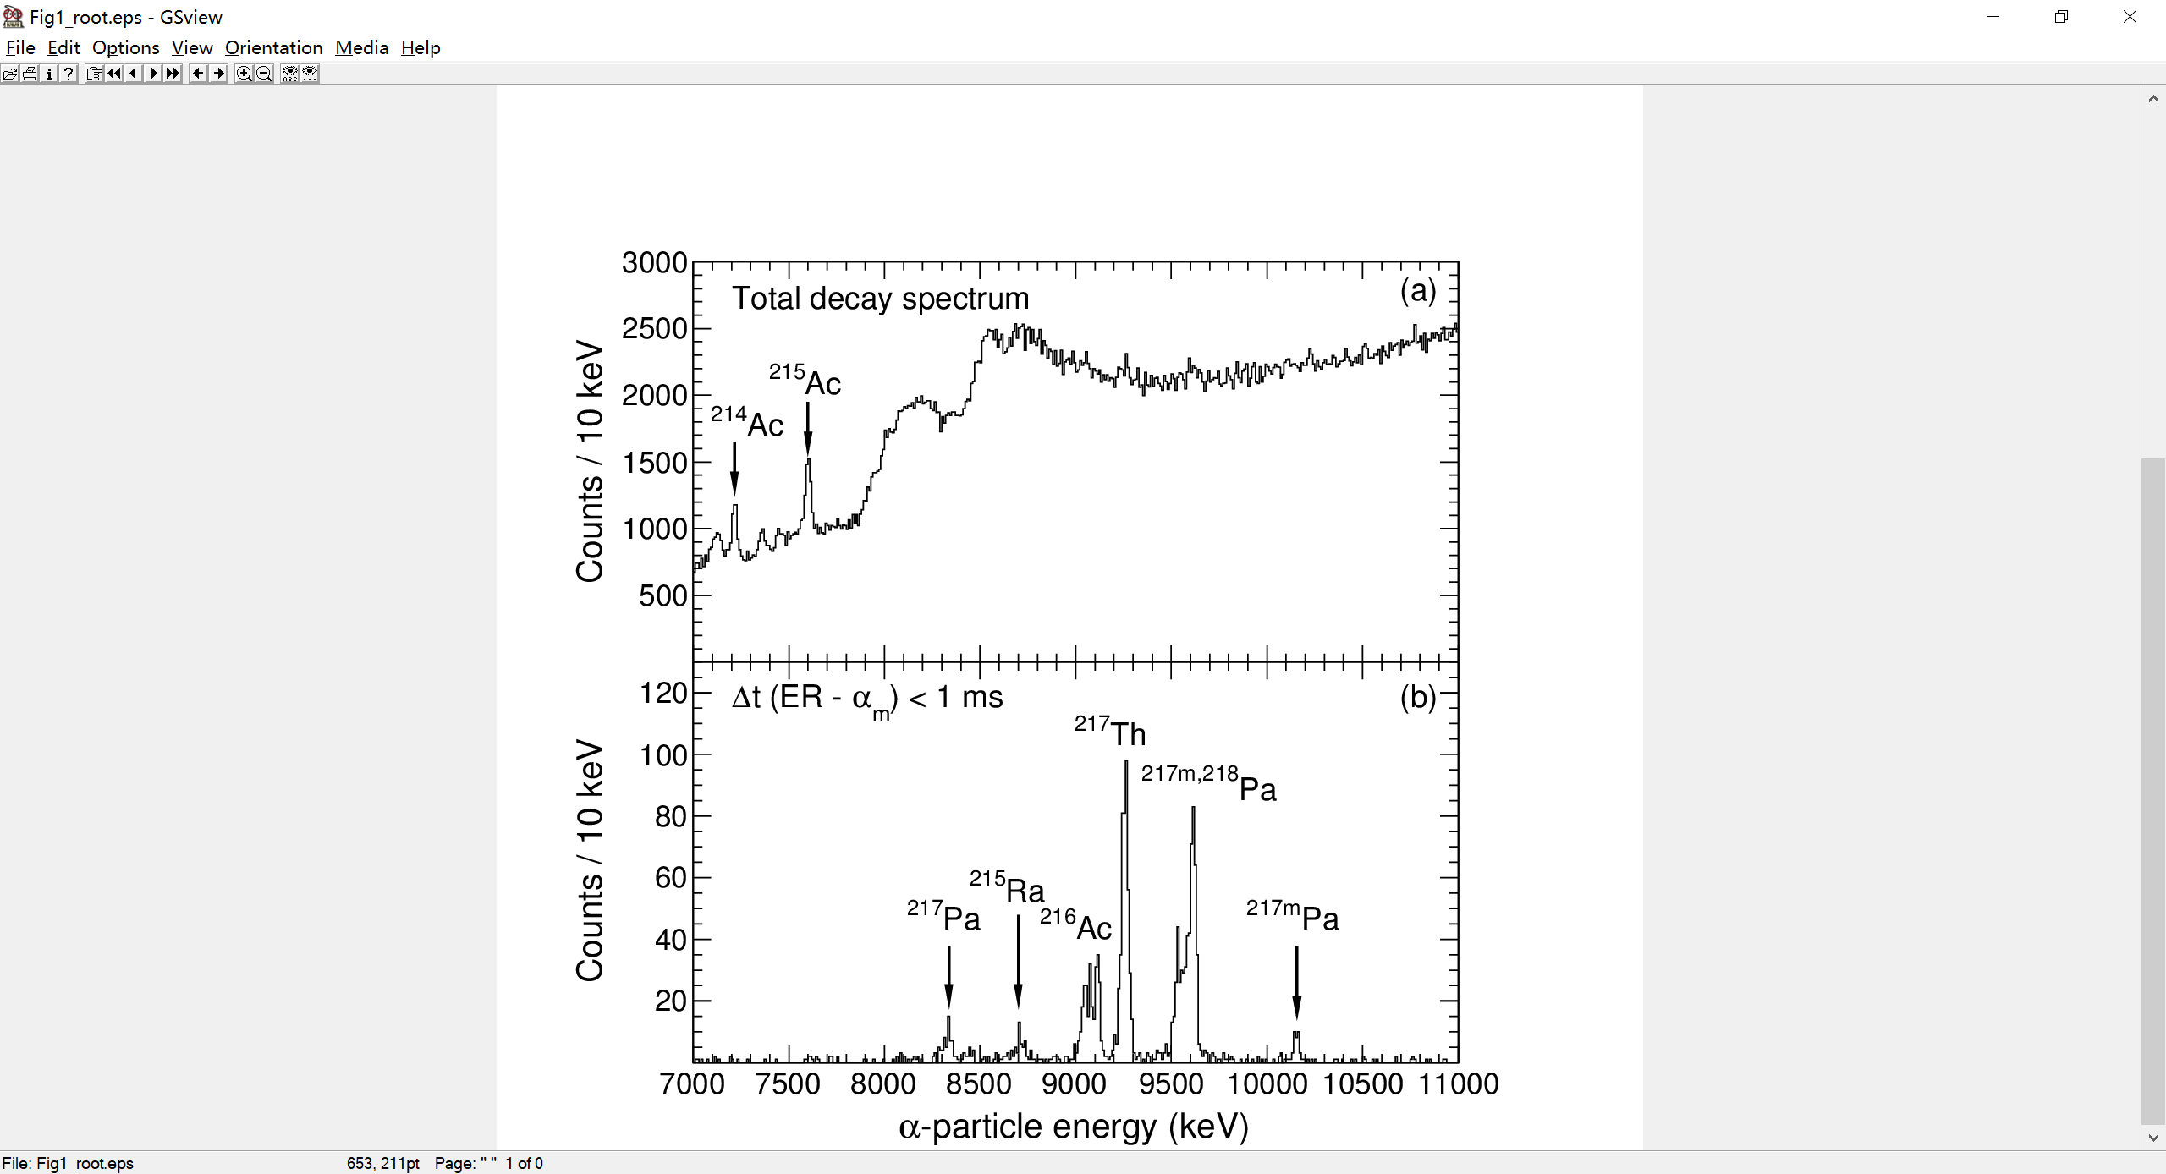
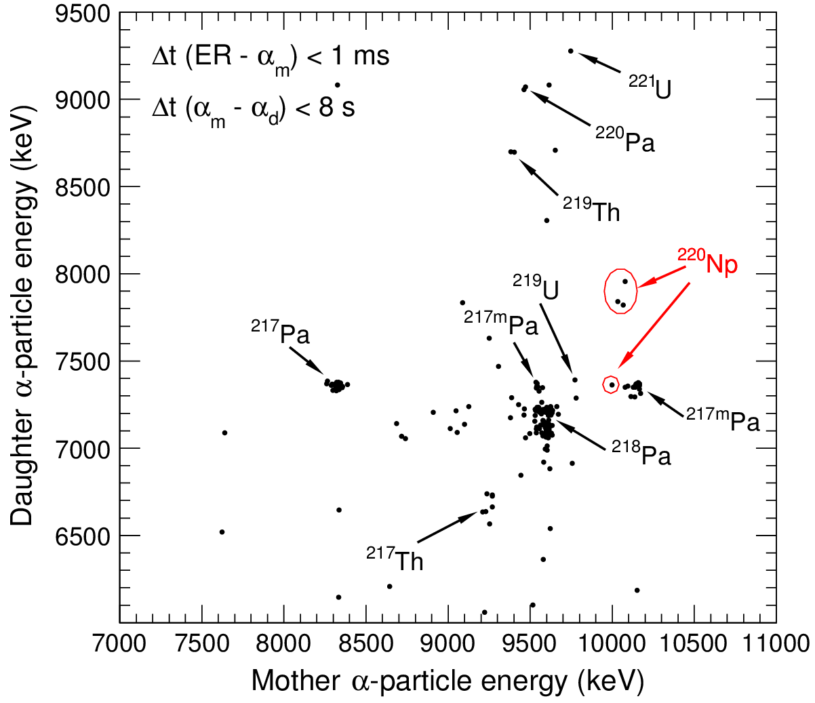
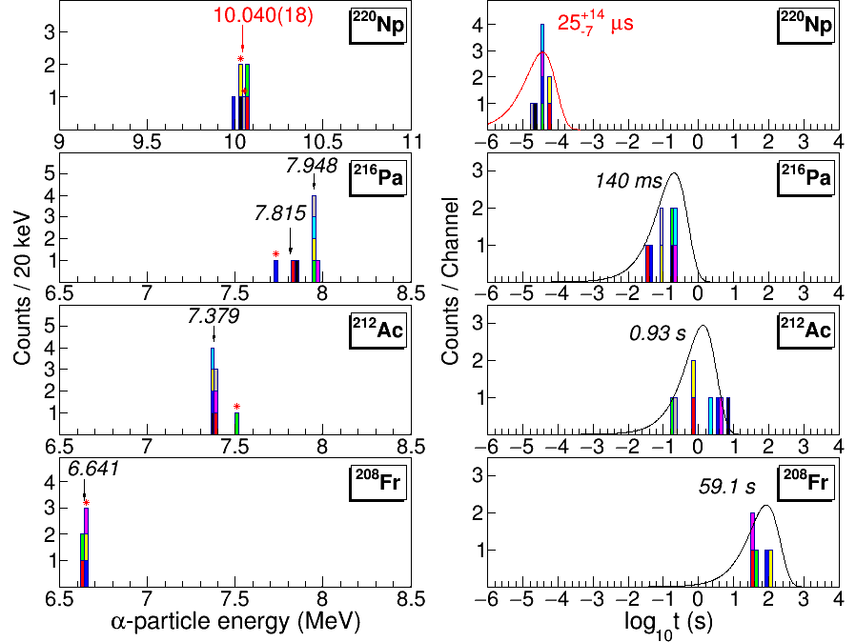
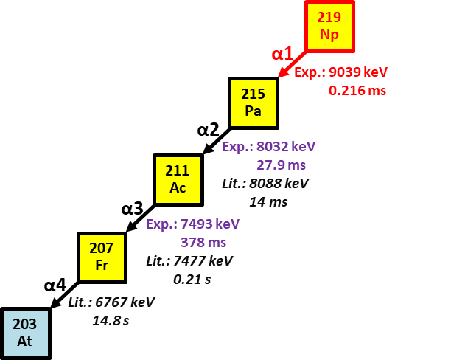
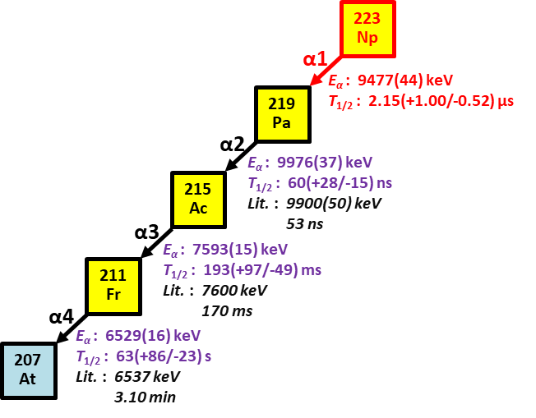
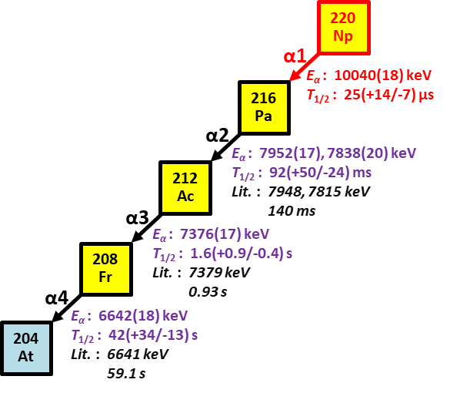
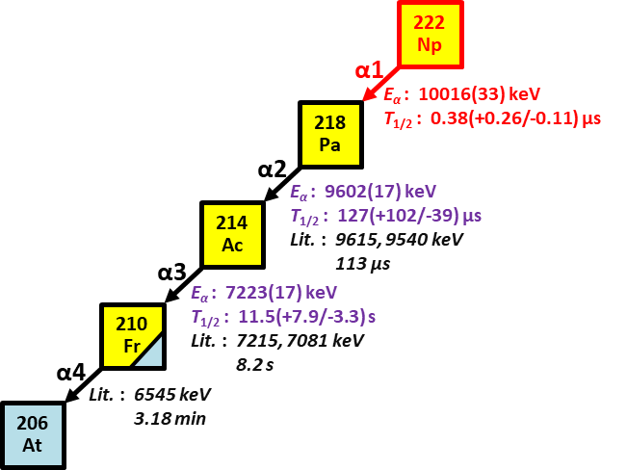
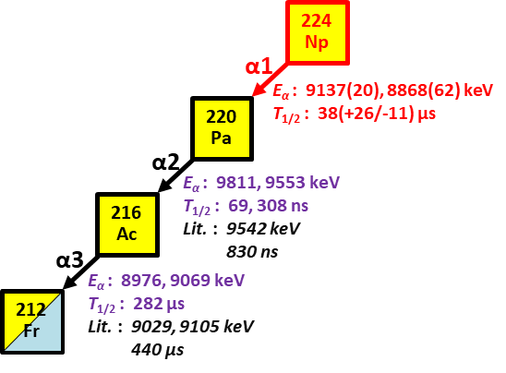
New isotopes of Np
⁴⁰Ar+¹⁸⁵Re→²²⁵Np* @ 200 MeV
H. B. Yang, et al., PLB 777, 212 (2018).
Z. Y. Zhang, et al., PRL 122, 192503 (2019).
L. Ma, et al., PRL 125, 032502 (2020).
M. D. Sun, et al., PLB 771, 303 (2017).
T. H. Huang, et al., PRC 98, 044302 (2018).

Slide 19
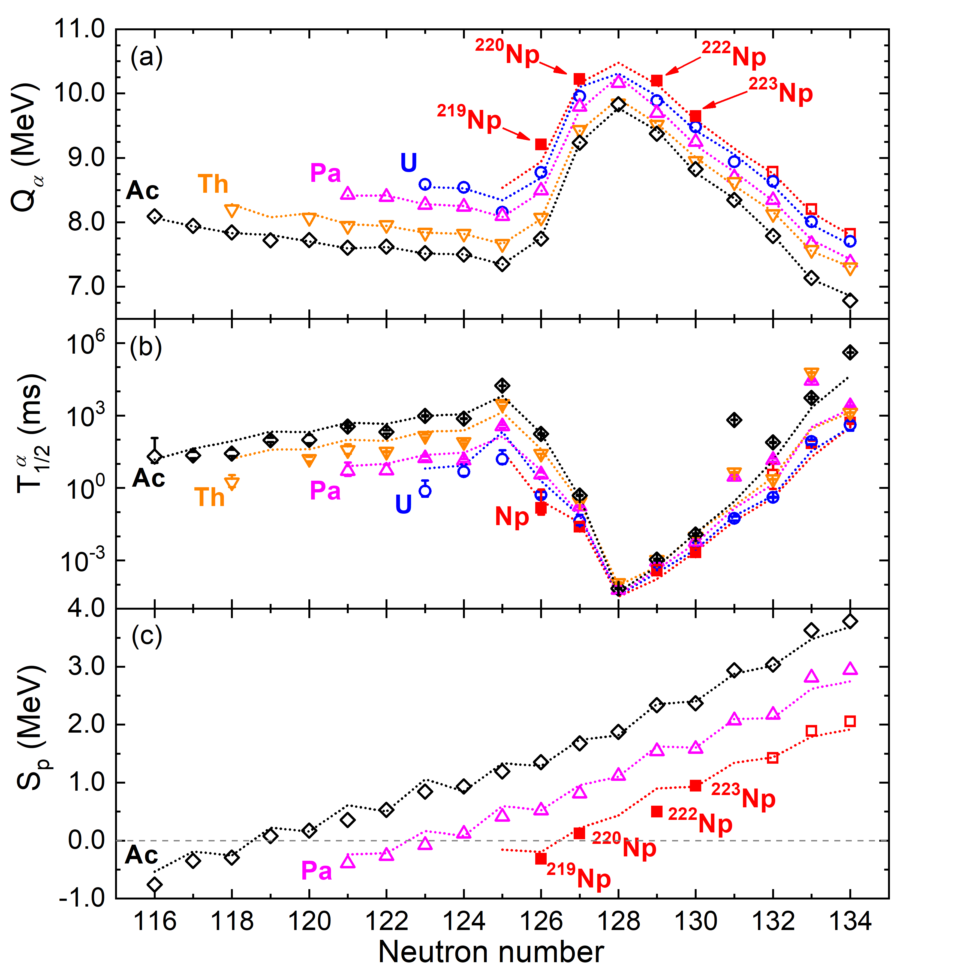
New isotopes of Np
N=126 shell
Proton drip line for Np
Z. Y. Zhang, et al., Phys. Rev. Lett. 122, 192503 (2019).

Slide 20
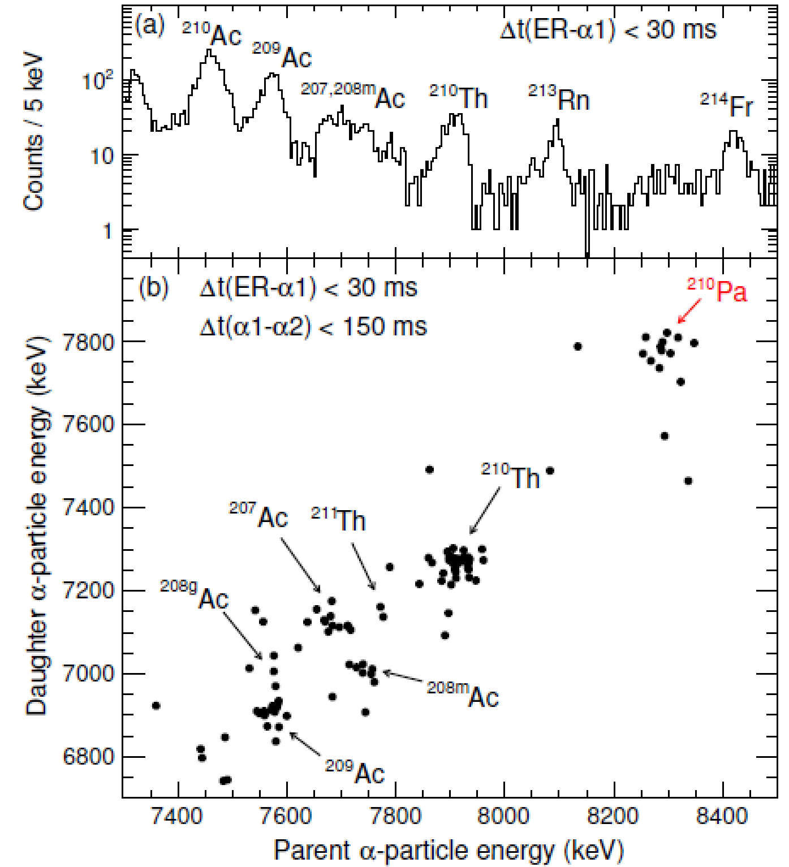
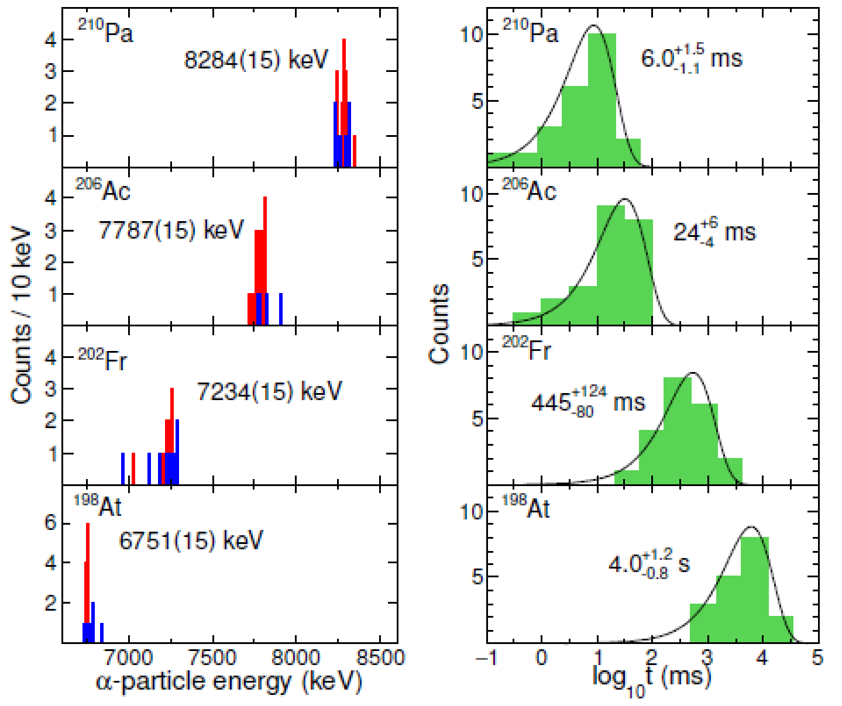
New isotope ²¹⁰Pa
¹⁷⁵Lu(⁴⁰Ca, 5n)²¹⁰Pa ,E_{lab}=212 MeV
α-decay properties of ²¹⁰Pa and its descendants
Submitted to Nature Communications
20

Slide 21
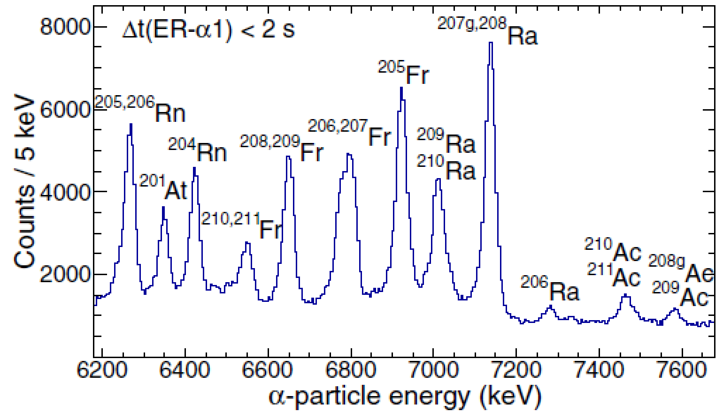
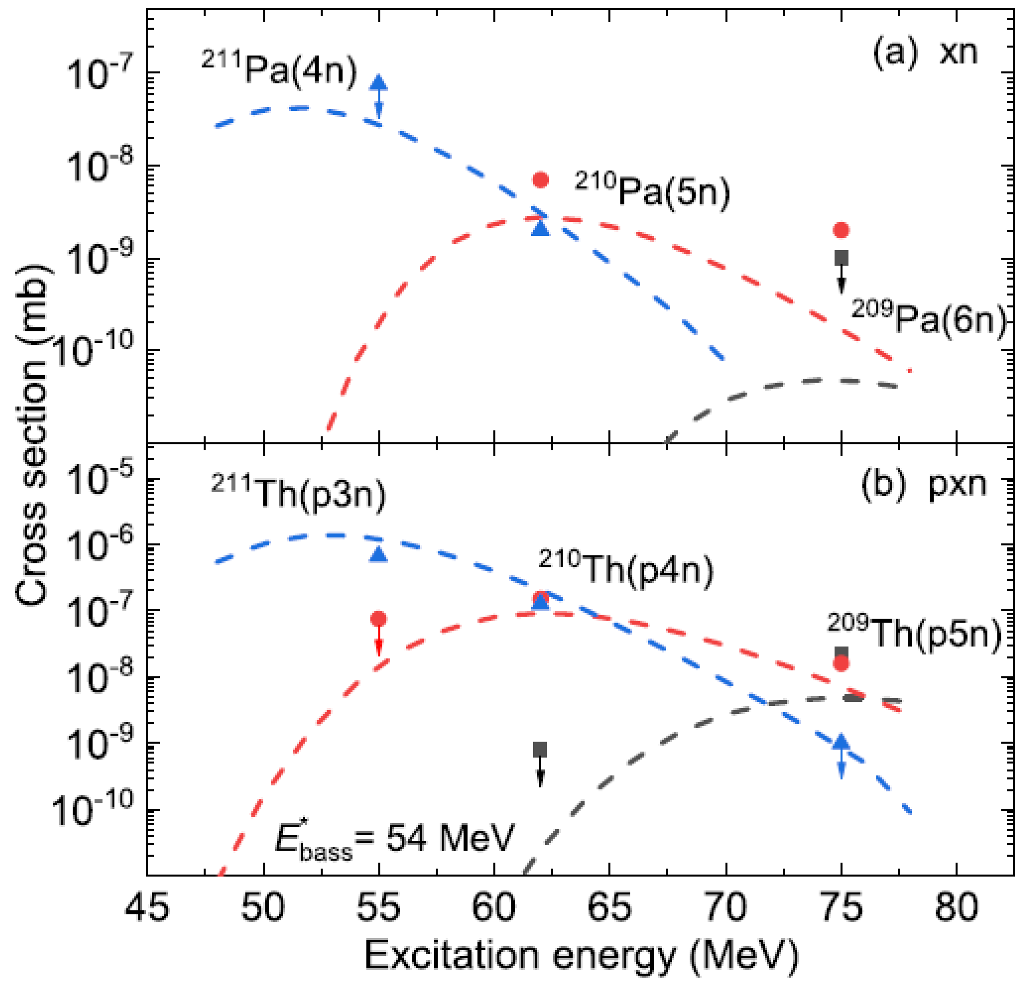
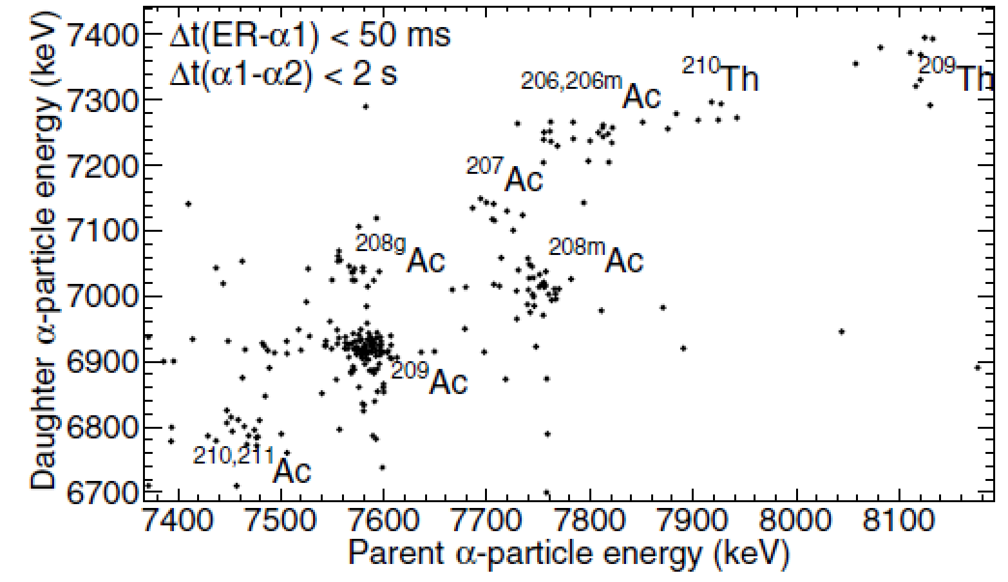
Search for ²⁰⁹Pa
Searching for new isotope ²⁰⁹Pa at Elab=228 MeV
Measured excitation functions of xn and pxn channels
No candidates are observed
21

Slide 22
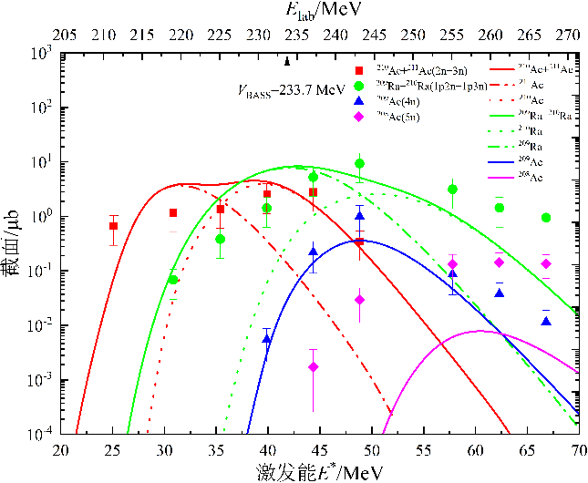
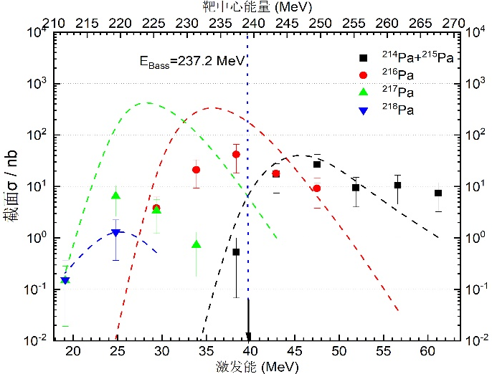
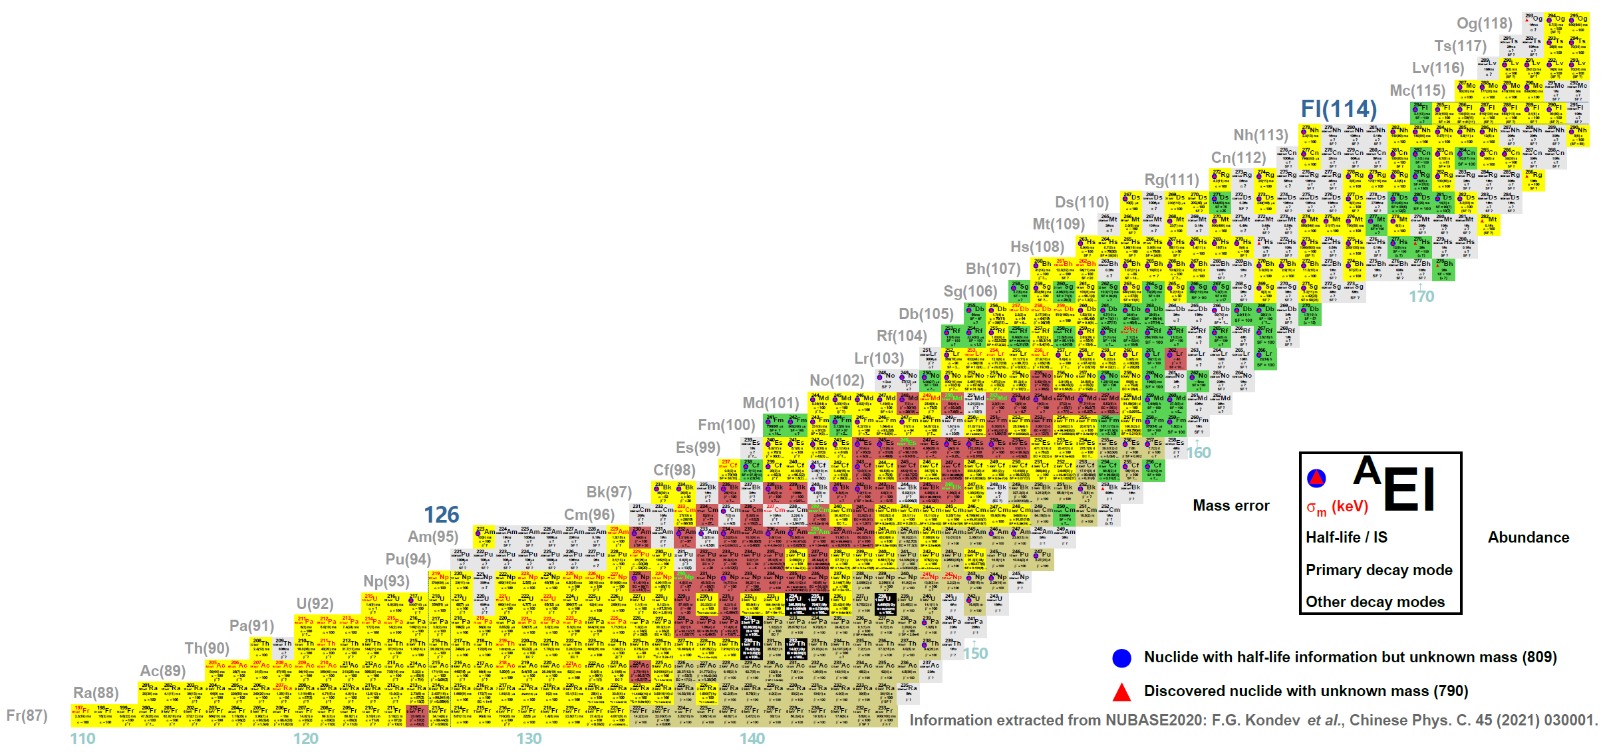
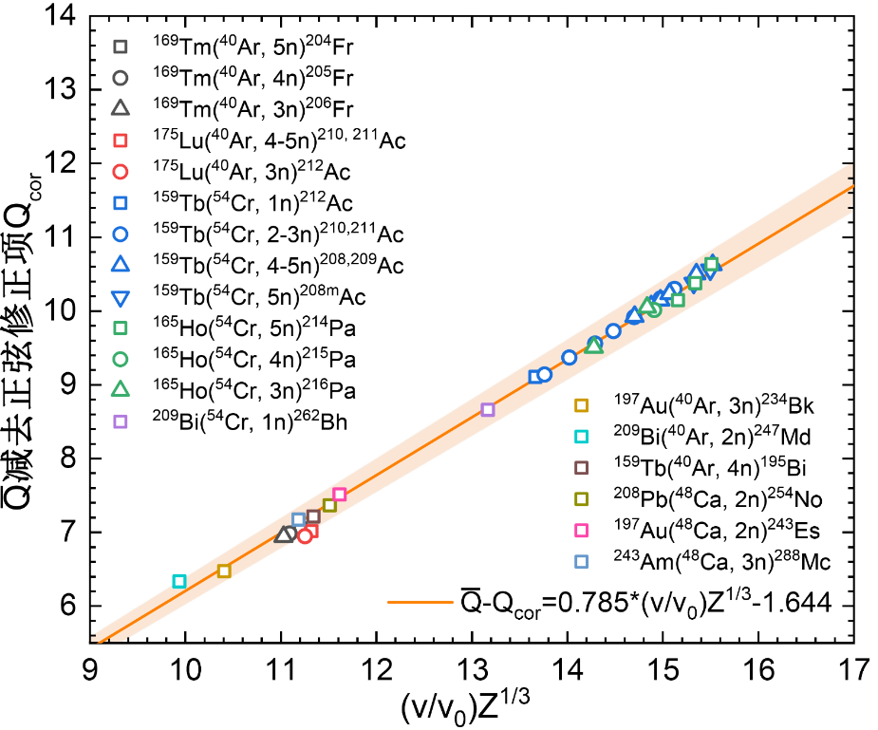
Experiments in 2023
⁵⁴Cr+¹⁵⁹Tb→²¹³Ac*
⁵⁴Cr+¹⁶⁵Ho→²¹⁹Pa*
Equilibrium charge state
magnetic rigidity
Cross section
⁵⁴Cr+²³⁸U→²⁹²Lv*
⁴⁸Ca+²⁴³Am→²⁹¹Mc*
⁵⁴Cr+²³²Th→²⁷⁶Fl*
2023.5
⁴⁰Ar+²³²Th→²⁷²Hs*
2023.3
⁵⁴Cr+²⁰⁹Bi→²⁶³Bh*
⁵⁴Cr+¹⁹⁷Au→²⁵¹Lr*
2023.4-5
⁴⁰Ar+²⁰⁹Bi→²⁴⁹Md*
2023.2
⁴⁰Ar+¹⁹⁷Au→²³⁷Bk*
⁵⁴Cr+¹⁸¹Ta→²³⁵Bk*
⁵⁴Cr+¹⁷⁵Lu→²²⁹Am*
⁵⁴Cr+¹⁶⁹Tm→²²³Np*
⁵⁴Cr+¹⁶⁵Ho→²¹⁹Pa*
⁵⁴Cr+¹⁵⁹Tb→²¹³Ac*

Slide 23
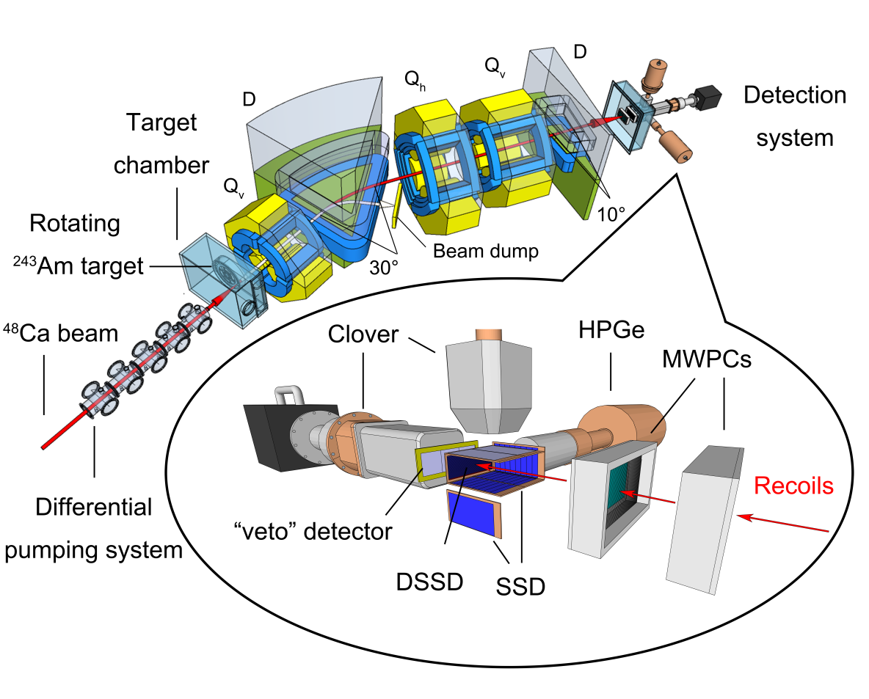
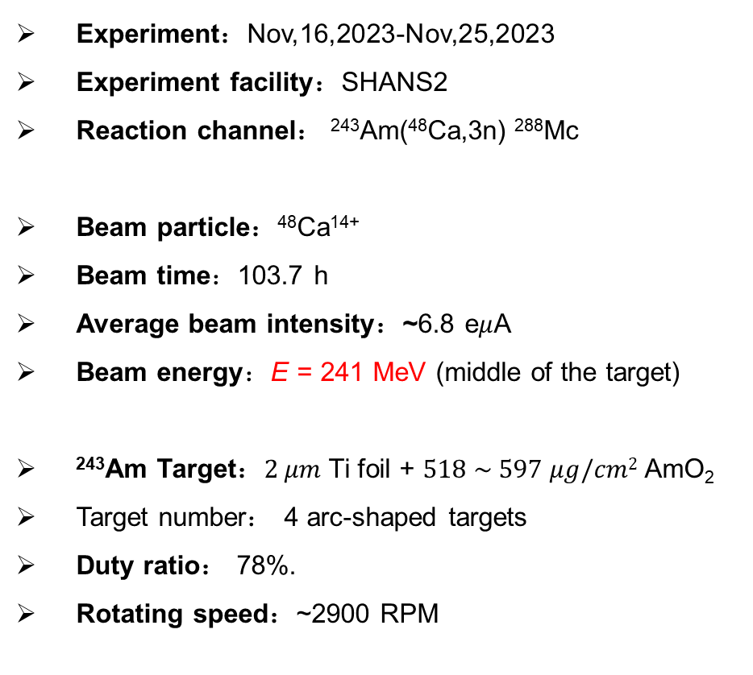
Re-investigation on ²⁸⁸Mc
Experiment：Nov,16,2023-Nov,25,2023
Experiment facility：SHANS2
Reaction channel： ²⁴³Am(⁴⁸Ca,3n) ²⁸⁸Mc
Beam particle：⁴⁸Ca¹⁴⁺
Beam time：103.7 h
Average beam intensity：~6.8 e$μ$A
Beam energy：E = 241 MeV (middle of the target)
²⁴³Am Target：$2 μm$ Ti foil + $518 \sim 597 μg/cm2$ AmO₂
Target number： 4 arc-shaped targets
Duty ratio： 78%.
Rotating speed：~2900 RPM

Slide 24
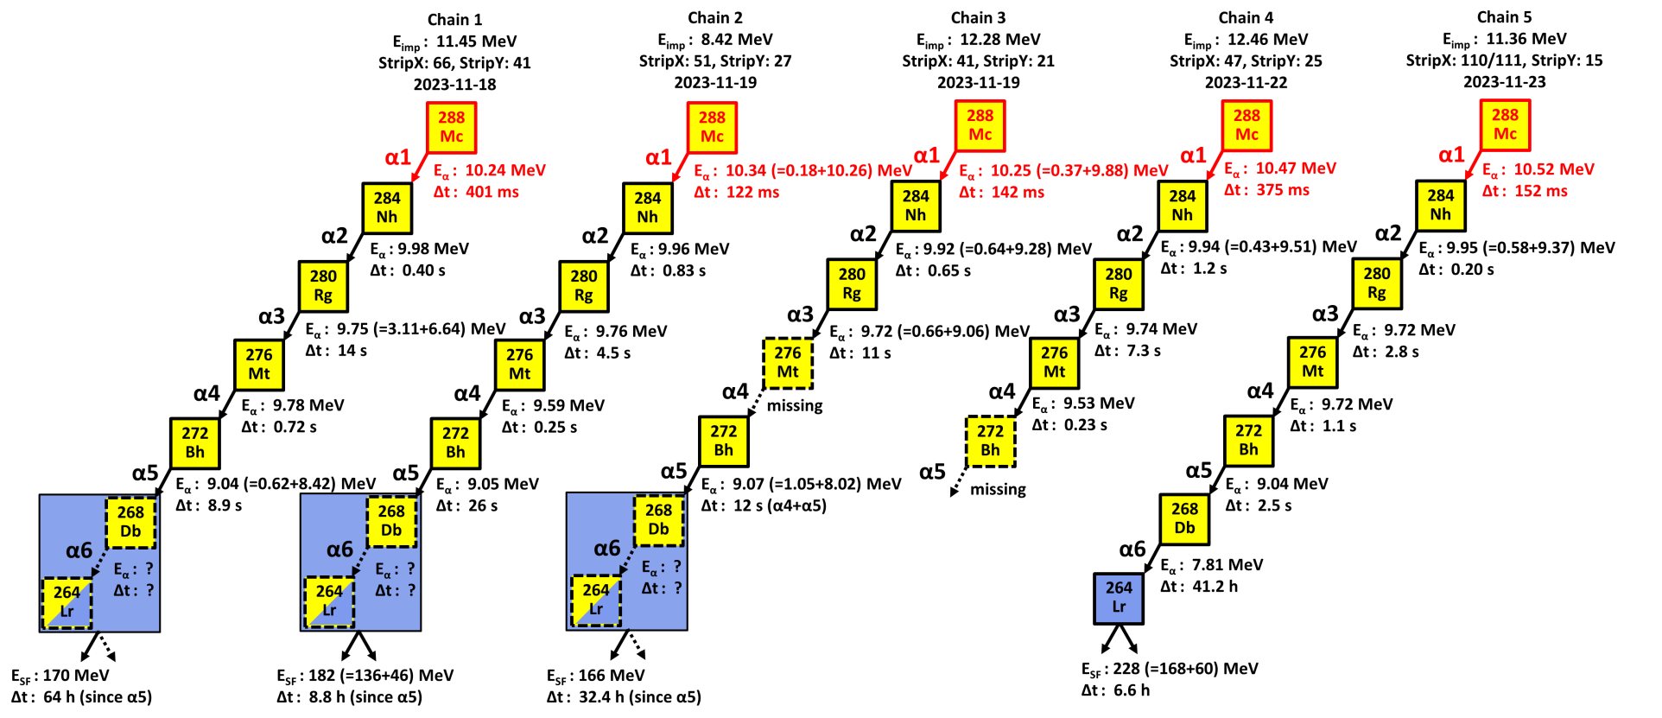
Re-investigation on ²⁸⁸Mc
Five $α$-decay chains, assigned to the decay of ²⁸⁸Mc, were detected.
The measured $α$-decay properties of ²⁸⁸Mc as well as its descendent nuclei are consistent with known data.

Slide 25
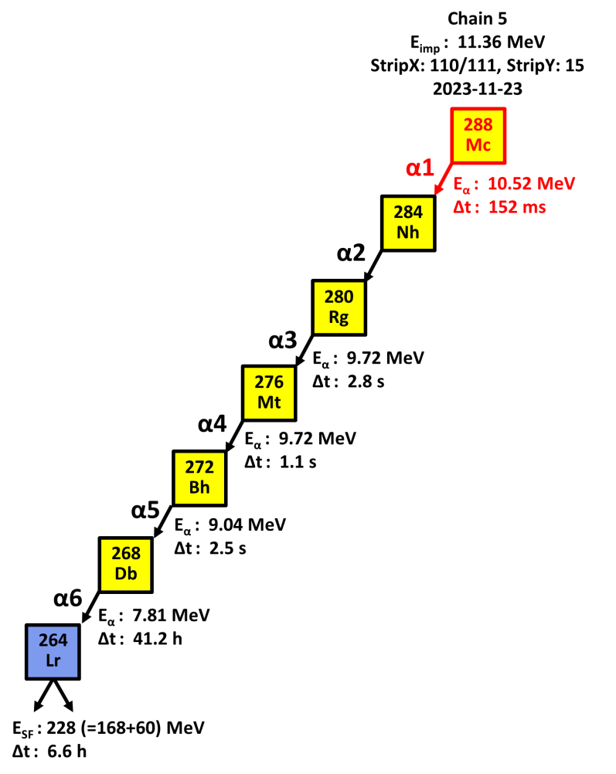
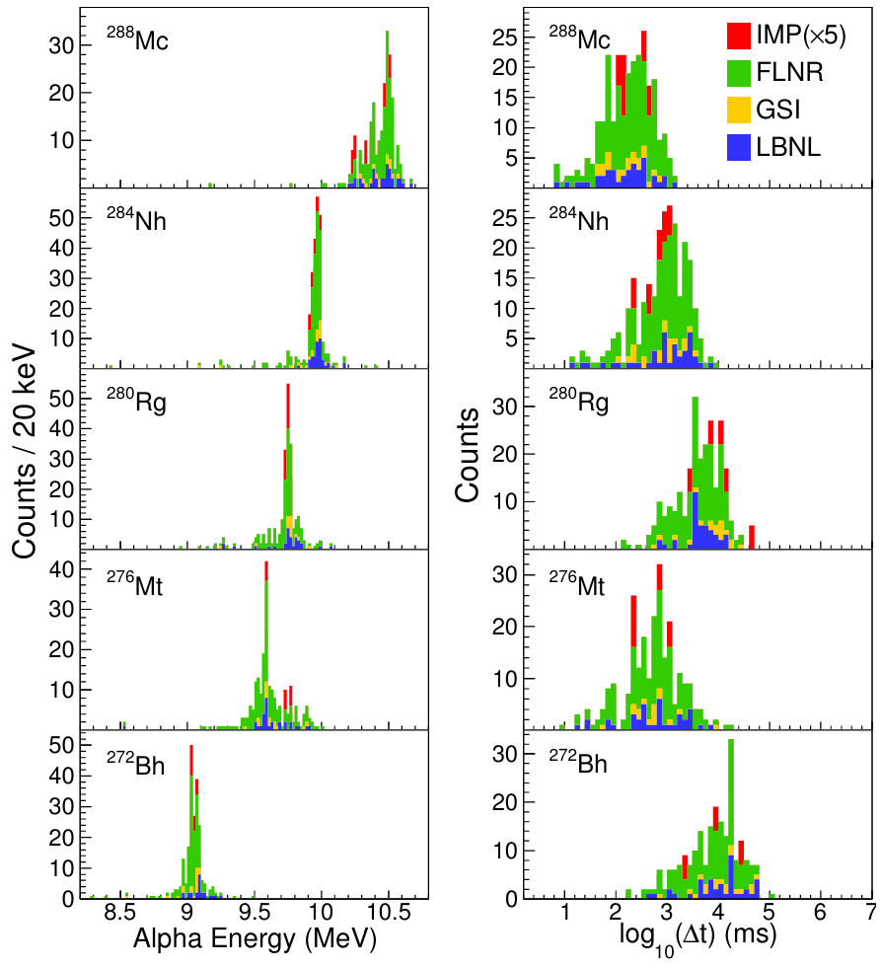
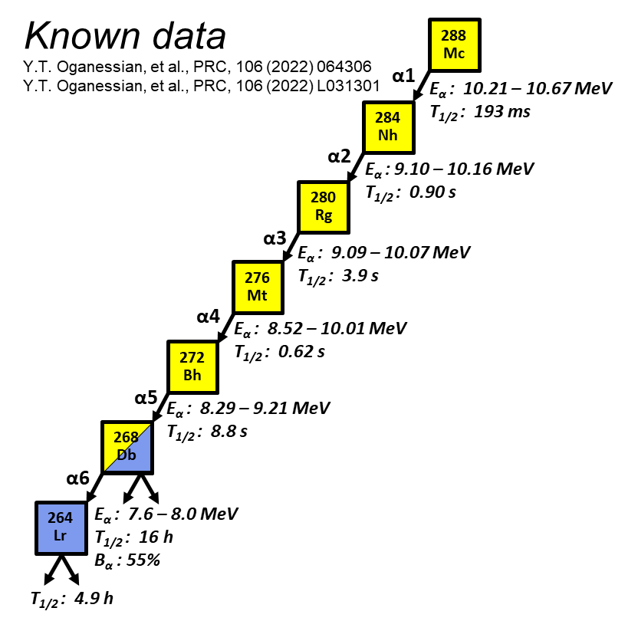

Re-investigation on ²⁸⁸Mc
$$Pran=0.0019$$
During the beam-stopped period, the$α$ decay of ²⁶⁸Db with an energy of 7.813(23) MeV and a lifetime of 41.2 h were unambiguously identified, which match well with the recent work.

Slide 26
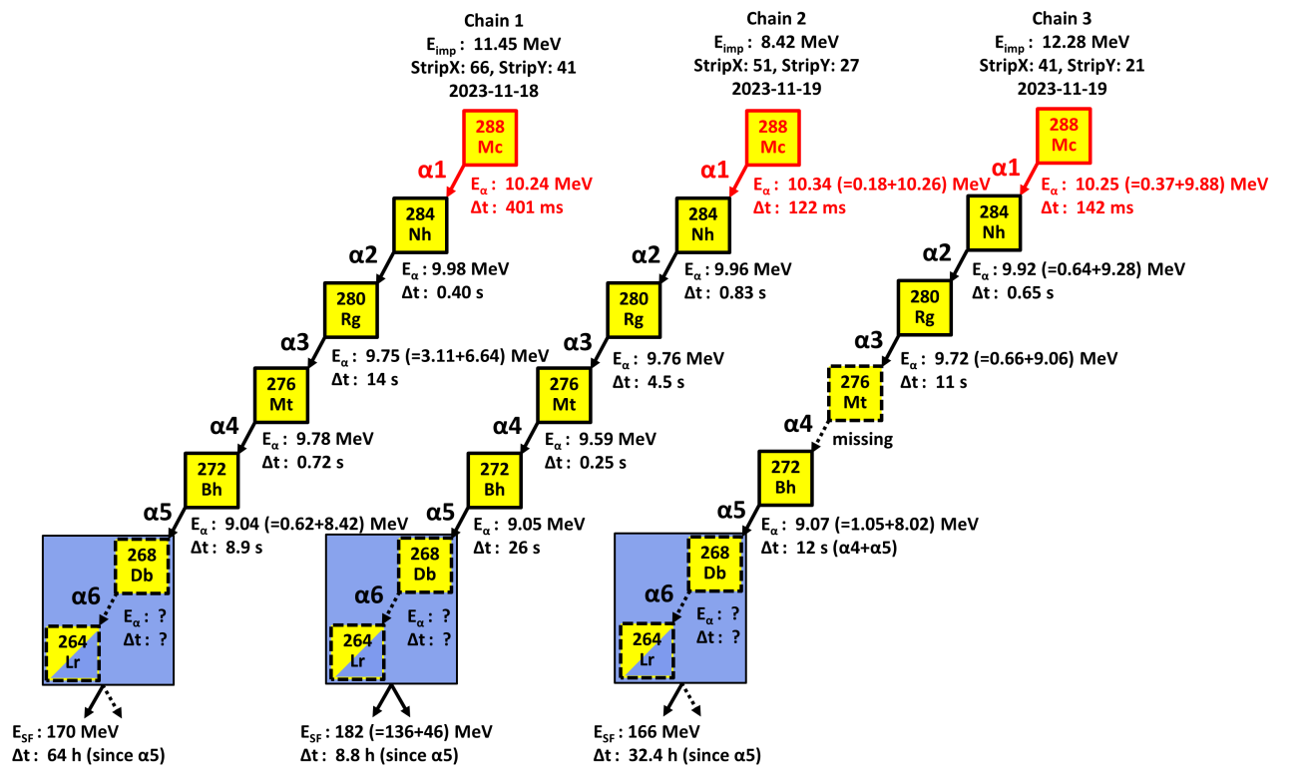
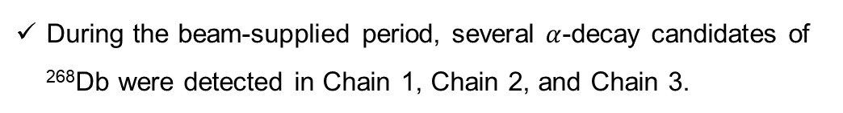

Re-investigation on ²⁸⁸Mc
Chain No. | E_{total} (MeV) | LifeTitme (h) | StripX | StripY | P_{ran}
1 | 7.888(45)^{ac} | 47.2 | 66 | 41 | 0,21
1 | 7.759(23)ª | 61.5 | 66 | 41 | 0.34
2 | 7.789(22)ª | 1.7 | 51 | 27 | 0.31
3 | 7.771(22)ª | 12.4 | 41 | 21 | 0.31
3 | 7.994(34)^{ac} | 13.1 | 41 | 21 | 0.15
5 | 7.831(23)^{b} | 41.2 | 110& 111 | 15 | 0.0019
a $α$ particle registered in beam-supplied period.
b $α$ particle registered in beam-stopped period.
c Event registered by both DSSD and SSD.
During the beam-supplied period, several $α$-decay candidates of ²⁶⁸Db were detected in Chain 1, Chain 2, and Chain 3.

Slide 27
α decay of ²⁶⁸Db and SF of ²⁶⁴Lr
SF(²⁶⁴Lr) registration time
α decay of ²⁶⁸Db
55% branching ratio
264Lr
4.9 h
268Db
16 h
7.6 – 8.0 MeV

Slide 28
Outline
Gas-filled recoil separators at IMP
Cold fusion reactions at SHANS2
New isotopes at SHANS2
Recent plans

Slide 29

HIAF
High-Intensity Heavy Ion Accelerator Facility-HIAF
HIAF is one of the major national science and technology infrastructure under construction with the support of both central and local governments
The total budget is 3.0 billion CNY
The campus locates in Huizhou City of Guangdong Province
The construction of project started at the end 2018, and the construction period is 7 years

Slide 30


New gas-filled separator at HIAF

Slide 31






New gas-filled separator at HIAF
 | Length | Angular acceptance | Transmission (at focal plane) | Focal size | Dispersion (cm/%)
①：D50+Q1+Q2 | 5.4 m | ±6.3°/±2.9° | 18.5% | σ_{x/y}=16.7/41.5 mm | Dx=2.5
②：S1+D50+Q1+Q2 | 7.8 m | ±6.3° | 91.2% | σ_{x/y}=12.3/38.8 mm | Dx=2.9
③：S1+D50+S2 | 8.2 m | ±7.5° | 98.3% | σ_{x/y}=6.9/6.0 mm | Dx/y=-0.2/0.07
①
②
③
S1
Superconducting Solenoid
S1
D50
D50
D50
Q1+Q2
S2
Q1+Q2
①
②
③

Slide 32

Search for New isotope of Pu,Am
Alpha
⁴⁰Ar+¹⁹²Os->²³²Pu*->²²⁷Pu+5n

Slide 33

N=82 and Z=82?

Slide 34




Collaboration
Thank you for all your attention!

Slide 36



叠加信号
4.8 μs
30 μs波形
20 μs波形
1.85 μs
预触发
高能侧几乎没有拖尾
²⁴³Es可能有μs量级的同核异能态
<2 μs
小幅的叠加信号可能湮没在高幅的α衰变信号中
>20 μs
寿命更长且幅度低于100 keV阈值的叠加信号未被记录

Slide 37



New isotope ²²⁷Pu
To probe the robustness of the N=126 shell closure in Pu, it is necessary to continue α-decay studies of ²²¹⁻²²⁶Pu.
⁴⁰Ar+¹⁹²Os->²³²Pu*->²²⁷Pu+5n
E_{α}=8191(28) keV
T_{1/2}=0.78(+0.39/-0.19) s

