Slide 1
50th anniversary of the discovery of cold fusion of massive nuclei
Status of accelerator based SHE Factory
Georgy Gulbekian
and factory group
FLNR JINR
National Academy of Science of Armenia
Nov.20-25, 2024, Yerevan. Int. Conference

Slide 2
History of the accelerator based discovery of transfermium elements
Element | Method of fusion | Years | Beams
102 -106 |  | 1967 – 1974 | ¹¹C, ¹²С , ¹³С, ¹⁵N, ¹⁸O, ²²Ne Stockholm, Berceley,Moscow,Dubna,Oak Ridge
107- 113 | cold | 1974 – 2012 | ⁴⁰Ar, ⁴⁴Ca, ⁴⁸Ca, ⁵⁰Ti, ⁵⁴Cr, ⁵¹V, ⁵⁵Mn, ⁵⁶Fe, 58Fe, ⁵⁹Co, ⁶⁴Ni Berceley,Dubna,Darmstadt,RIKEN
114-118 | hot | 1999- 2016 | ⁴⁸Ca Dubna, Darmstadt, Berceley,RIKEN

Slide 3
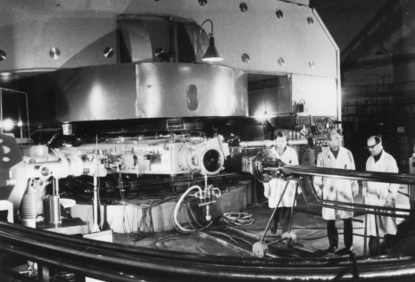
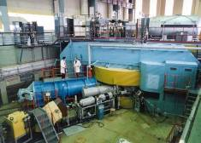
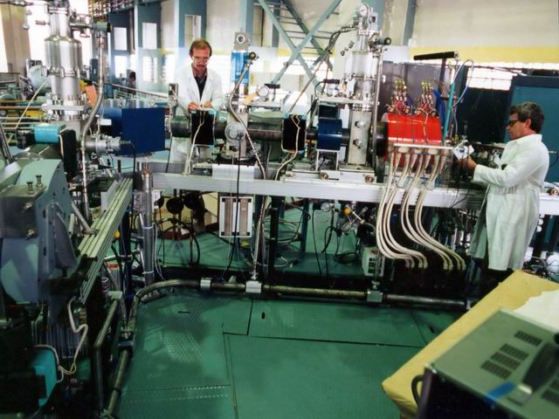
U400+ECR. First accelerated ⁴⁸Ca beam – November 1997.
The intensity of ⁴⁸Ca ion beam up to 1.4 pμA.
Cyclotron U300 +PIG i.s. Cyclotron U400+PIG i.s. 1978 - 1996
1961 -1989 +ECR i.s 1996-2024
12C,15N,18O,22Ne 12C,15N, 18O, Ne22,26Mg,36S,44Ca,48Ca,50Ti, 51V,54Cr, 55Mn,64 Ni

Slide 4
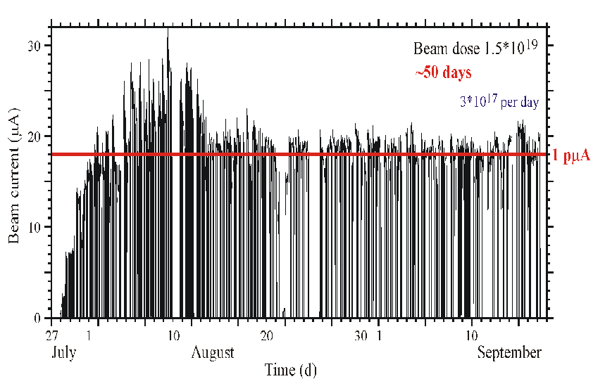
Cyclotron U-400. ⁴⁸Ca⁵⁺
1996 г.
PIG: I ~ 0.1 pμA,
48Ca consumption: 4 ÷ 15 mg/h
ECR: I ~ 10 pμA,
48Ca consumption 0.4 ÷ 0.5 mg/h
2010 г.
I ~ 1pμA
Transformation of 48Ca as working substance into the 48Ca beam on target is about 1% in routine operation.

Slide 5
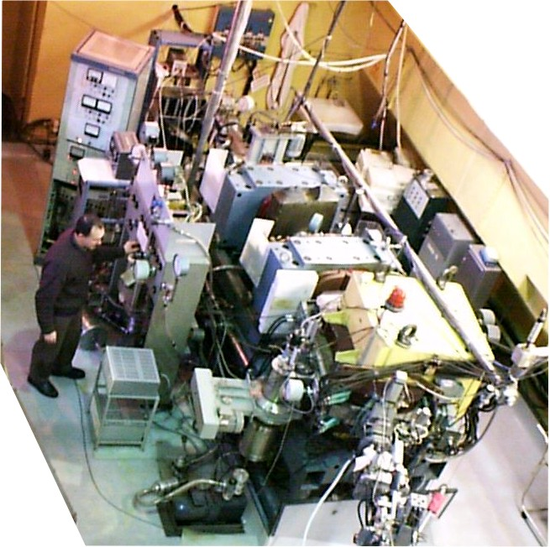
DUBNA Gas Filled Recoil Separator
Target Beam Isotopes
²³⁸U, ^{242,244}Pu, ²⁴³Am, ^{246,248}Cm, ²⁴⁹Cf + ⁴⁸Ca → 112 – 118
Ion beam energy: 5.00 – 5.75 MeV/A
Beam intensity: 6 - 8⋅10¹² pps
Consumption of ⁴⁸ Ca < 0.5 mg/h
Beam time: 2000 – 4000 hours per year
5

Slide 6
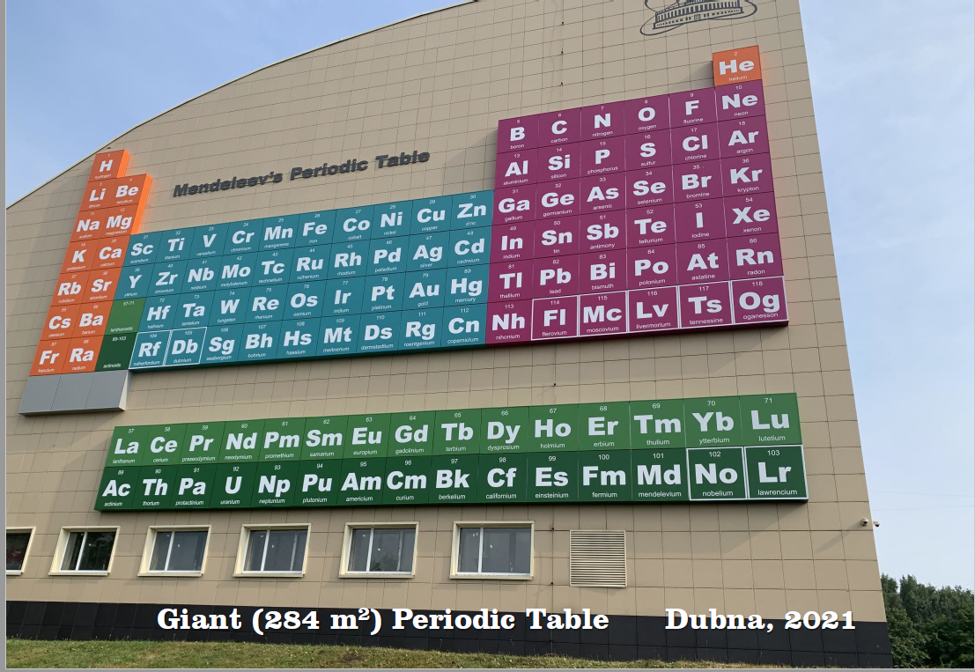
SH Islanders
daughter nuclides

Slide 7
2010-2012
NEW FLNR ACCELERATOR – CYCLOTRON DC280
In order to improve efficiency of the SHE experiments for the future it is necessary to obtain the accelerated ion beams
with following parameters.
Energy 4÷8 MeV/n
Masses 10÷238
Intensity (up to A=50) 10 p𝜇A
Intensity U beam 1 pµA
Beam emittance less 30 π mm·mrad
Efficiency of beam transfer >50%

Slide 8
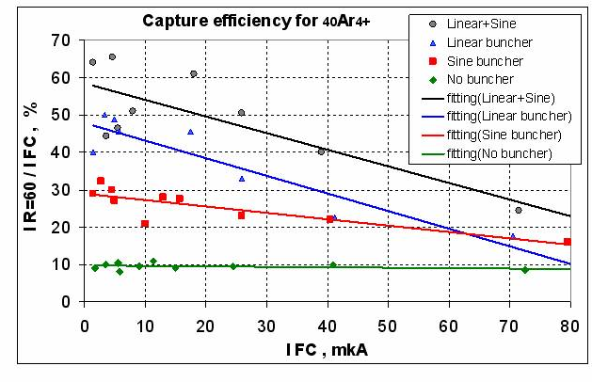
U400 ion beam transfer from 15 kV ECR ion sourse up to extraction
Kalagin I . Ivanenko I.

Slide 9
From 15 kV to 70 kV injection beam capture efficiency
U400 DC280

Slide 10
  DC280. Design parameters and expected results
 | DC280 Parameter | Goals
1. | High injecting beam energy (up to 100 kV) | Shift of space charge limits for factor 30
2. | High gap in the center | Space for long spiral inflector
3. | Low magnetic field | Large starting radius. High turns separation. Low deflector voltage
4. | High acceleration rate | High turns separation.
5. | Flat-top system | High beam capture. Single orbit extraction. Beam quality.

Slide 11
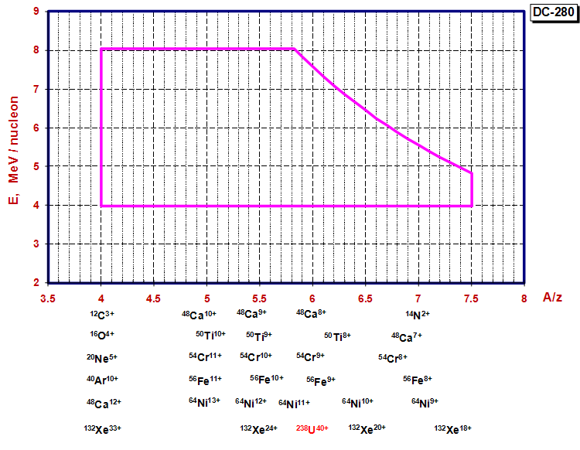
Working diagram of the DC-280
SHE synthesis

Slide 12

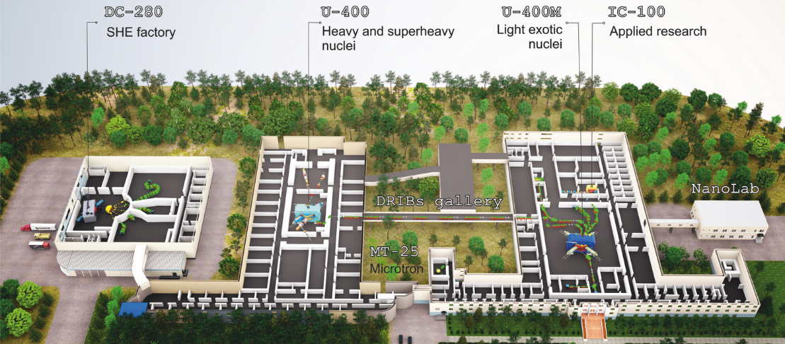
DRIBS-III ACCELERATOR COMPLEX
FLEROV LABORATORY OF NUCLEAR REACTIONS
FLNR’s basic directions of research:
Heavy and superheavy nuclei
Light exotic nuclei
Radiation effects and physical groundwork of nanotechnology
Accelerator technologies
Notes:
12
Beam intensity of Ca-48 up to 2.5 mkA
Ion energy variation on the target with factor 5
Cyclotron average magnetic field from 1.8 up to 0.8 T

Slide 13
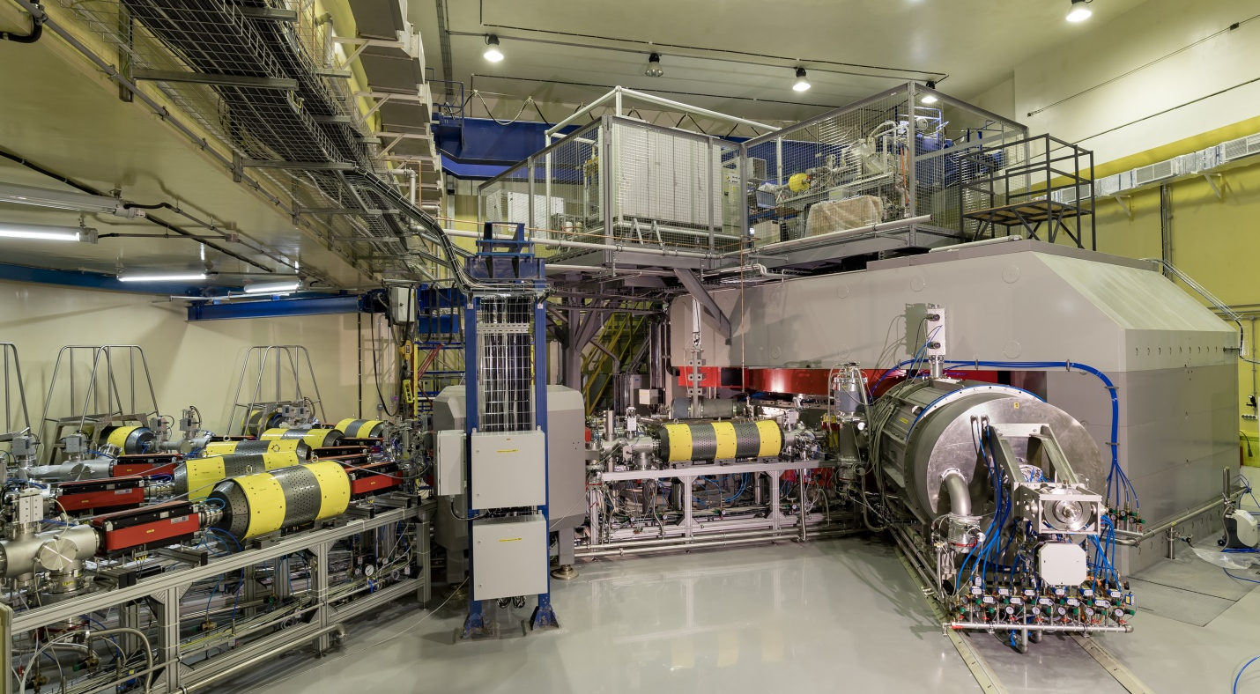
Cyclotron DC280
2
1
3
4
1- main magnet DC280, 2-ion source and axial injection system, 3- RF resonator, 4- 5 beam transport lines

Slide 14
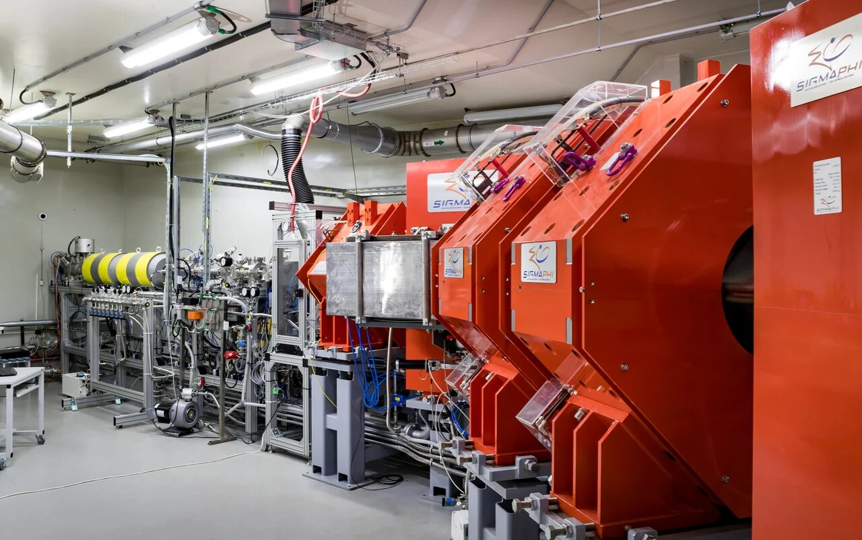
DGFRS-II separator

Slide 15
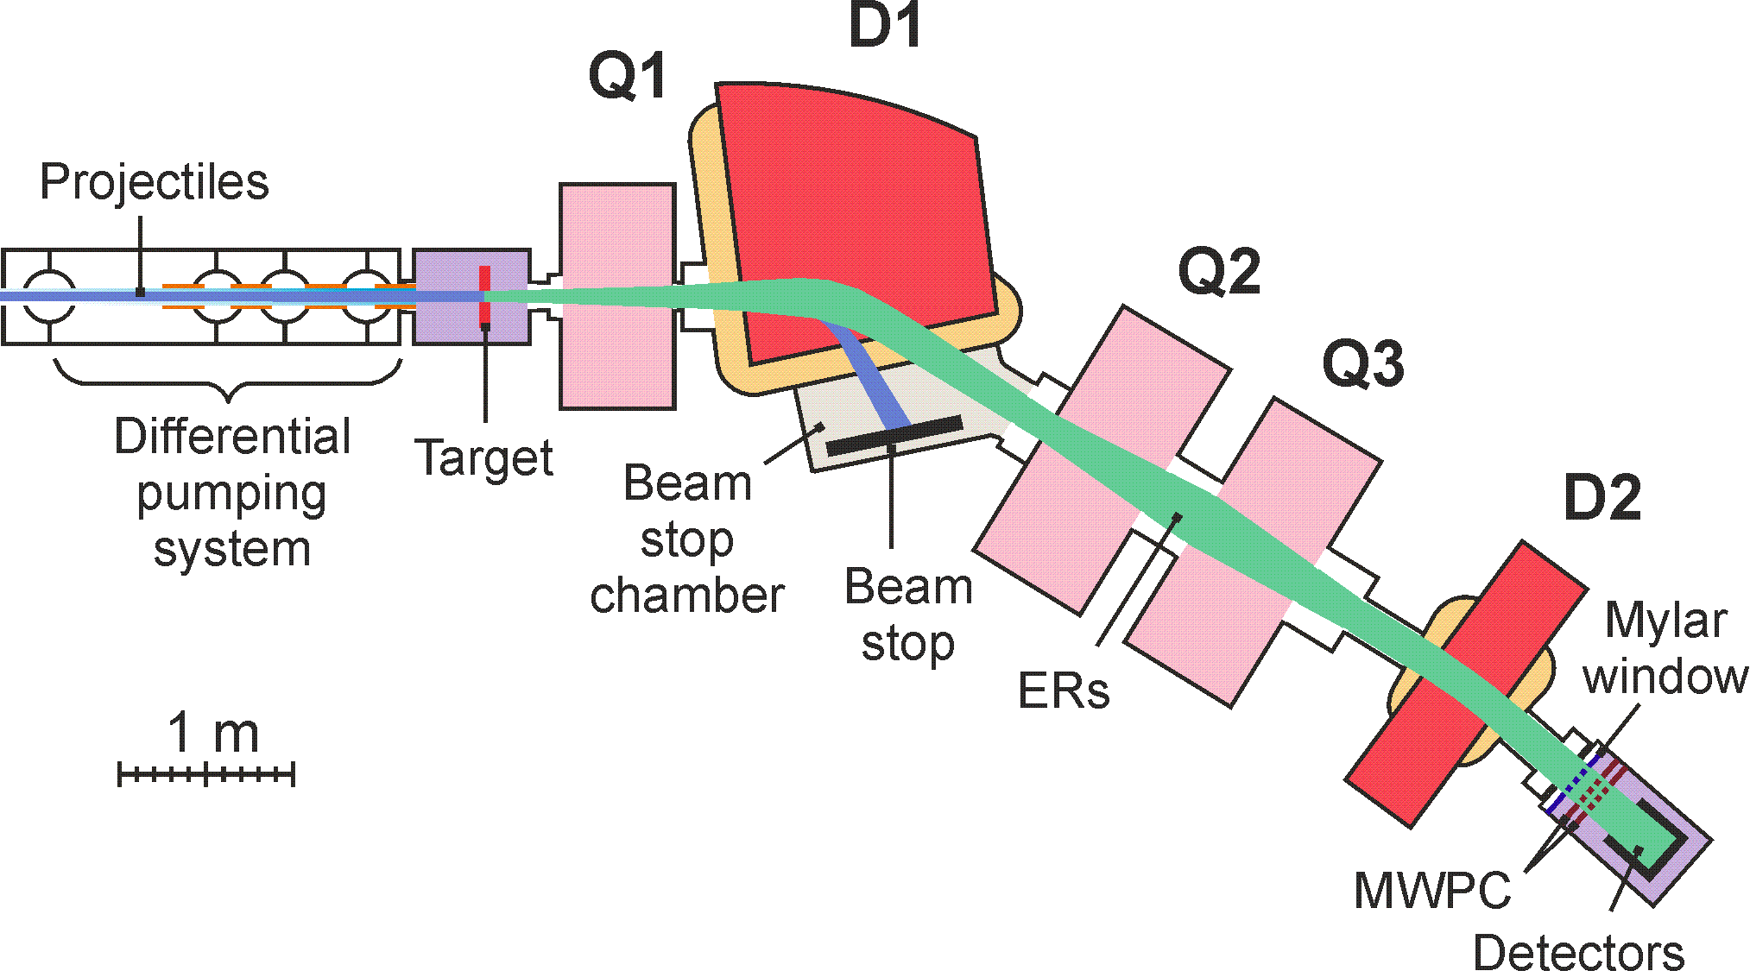
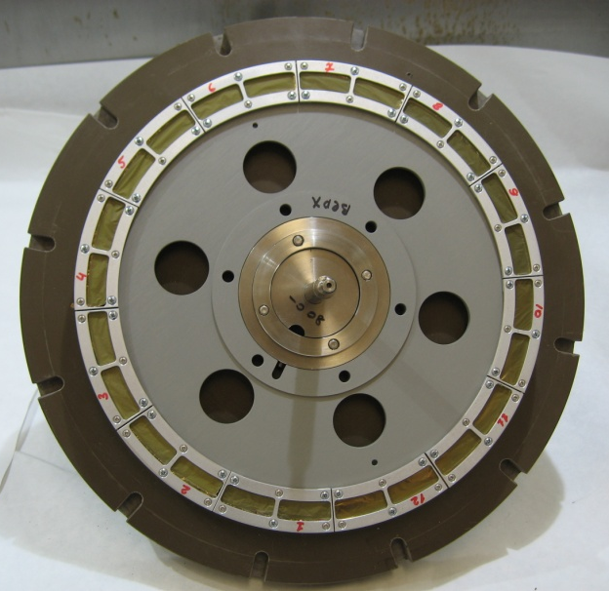
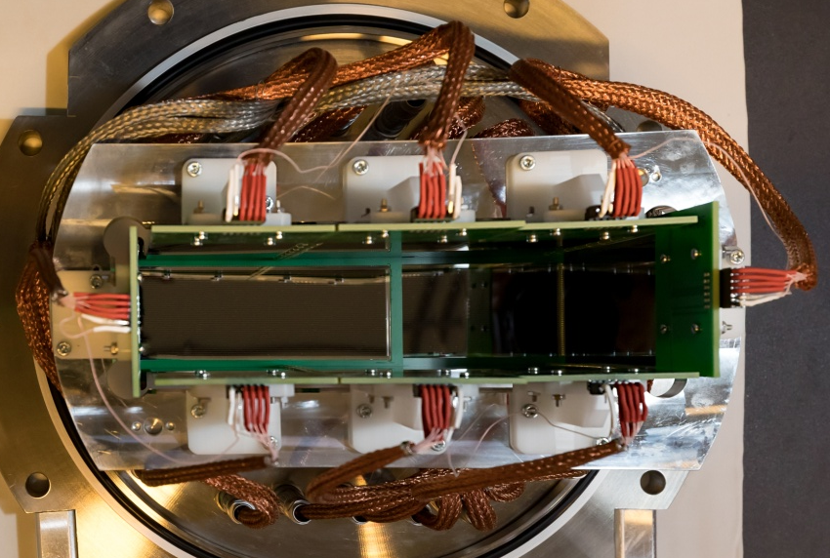
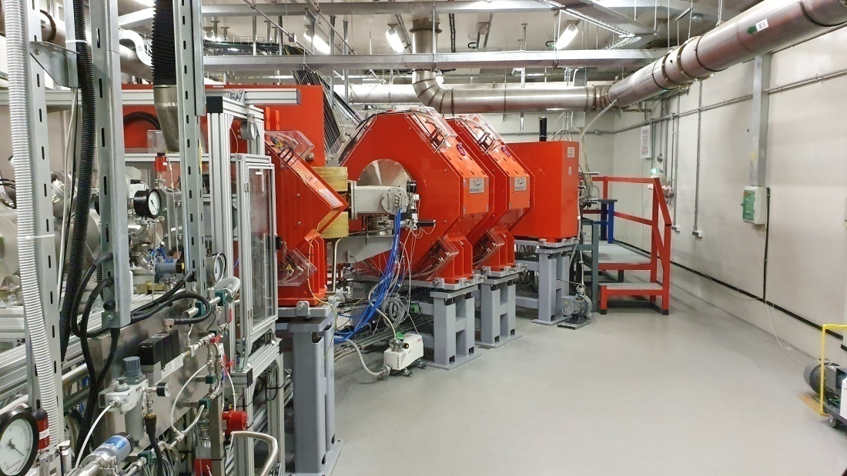
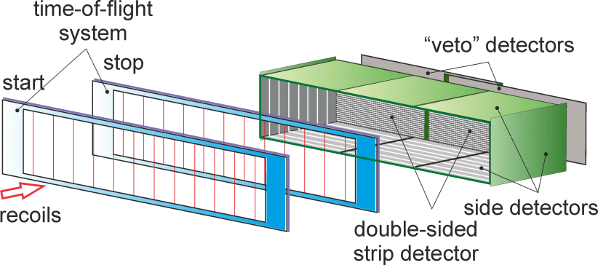
Dubna gas-filled recoil separator DGFRS-2
²⁴²Pu 24-cm target wheel , 12 sectors
Rotating target, magnets (Q1, D1, Q2, Q3, D2), beam-stop chamber, and detector chamber are shown.
48×220 DSSD & 60×120 SSSD
Digital and analog
electronics

Slide 16
Target matter losses vs ion flux density . Q<10¹⁸ ${cм}^{−2}$

Slide 17
Four type of DGFSs target wheels
ʃ max 3e19 5e19 8e19 1.5e20

Slide 18
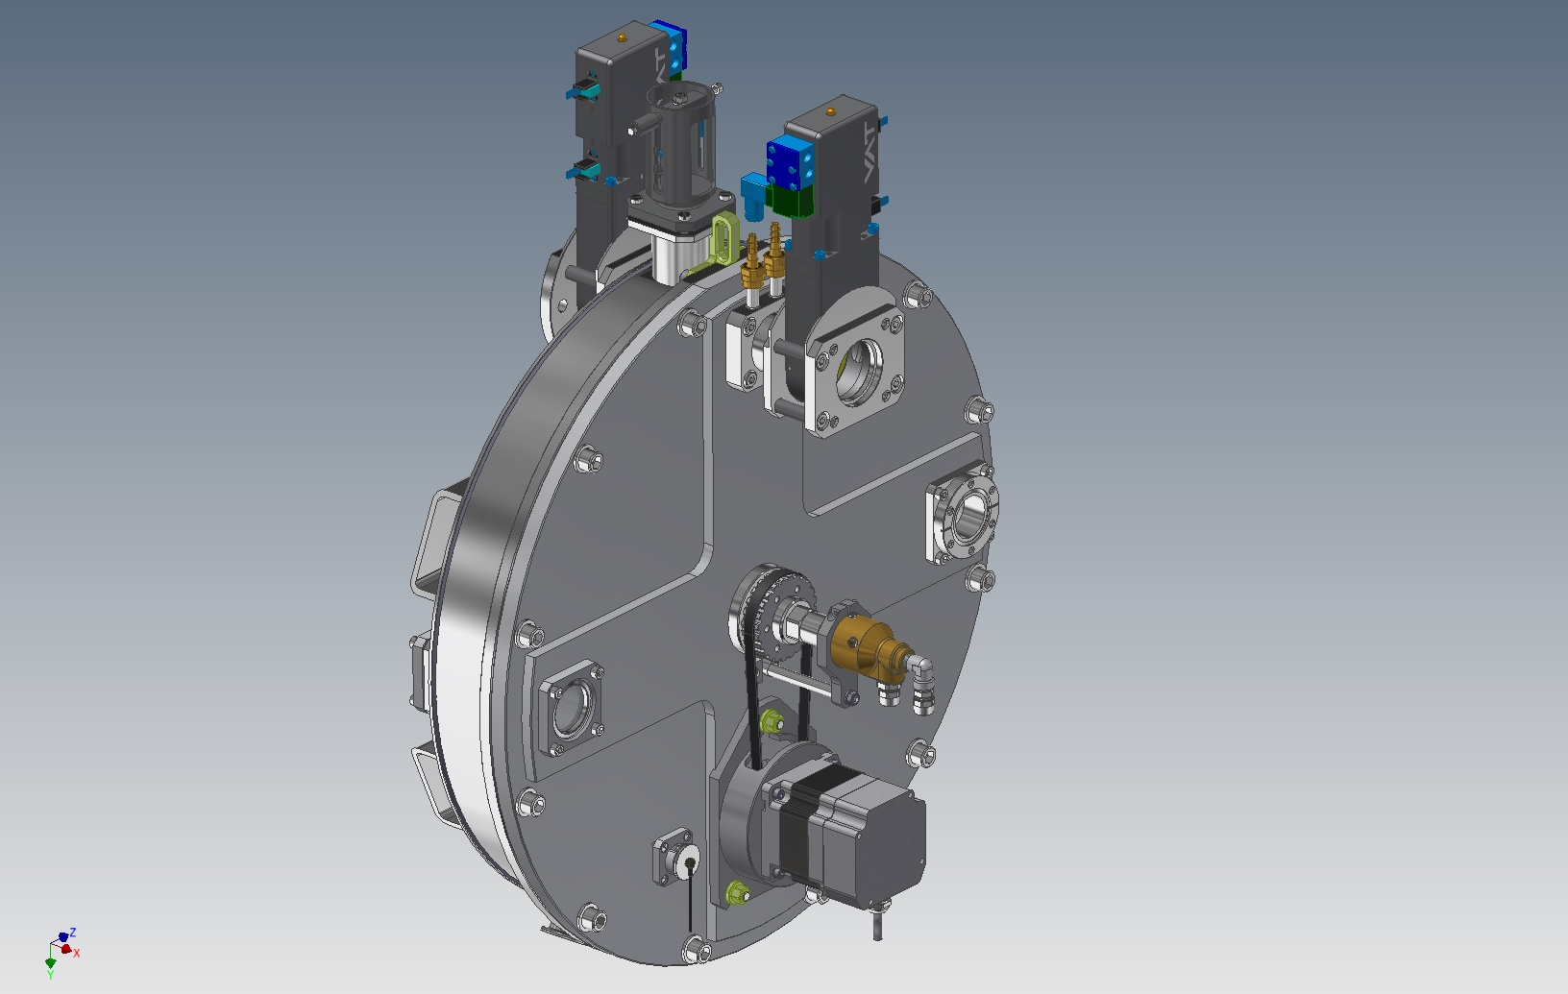
480 mm target wheel assembly design

Slide 19
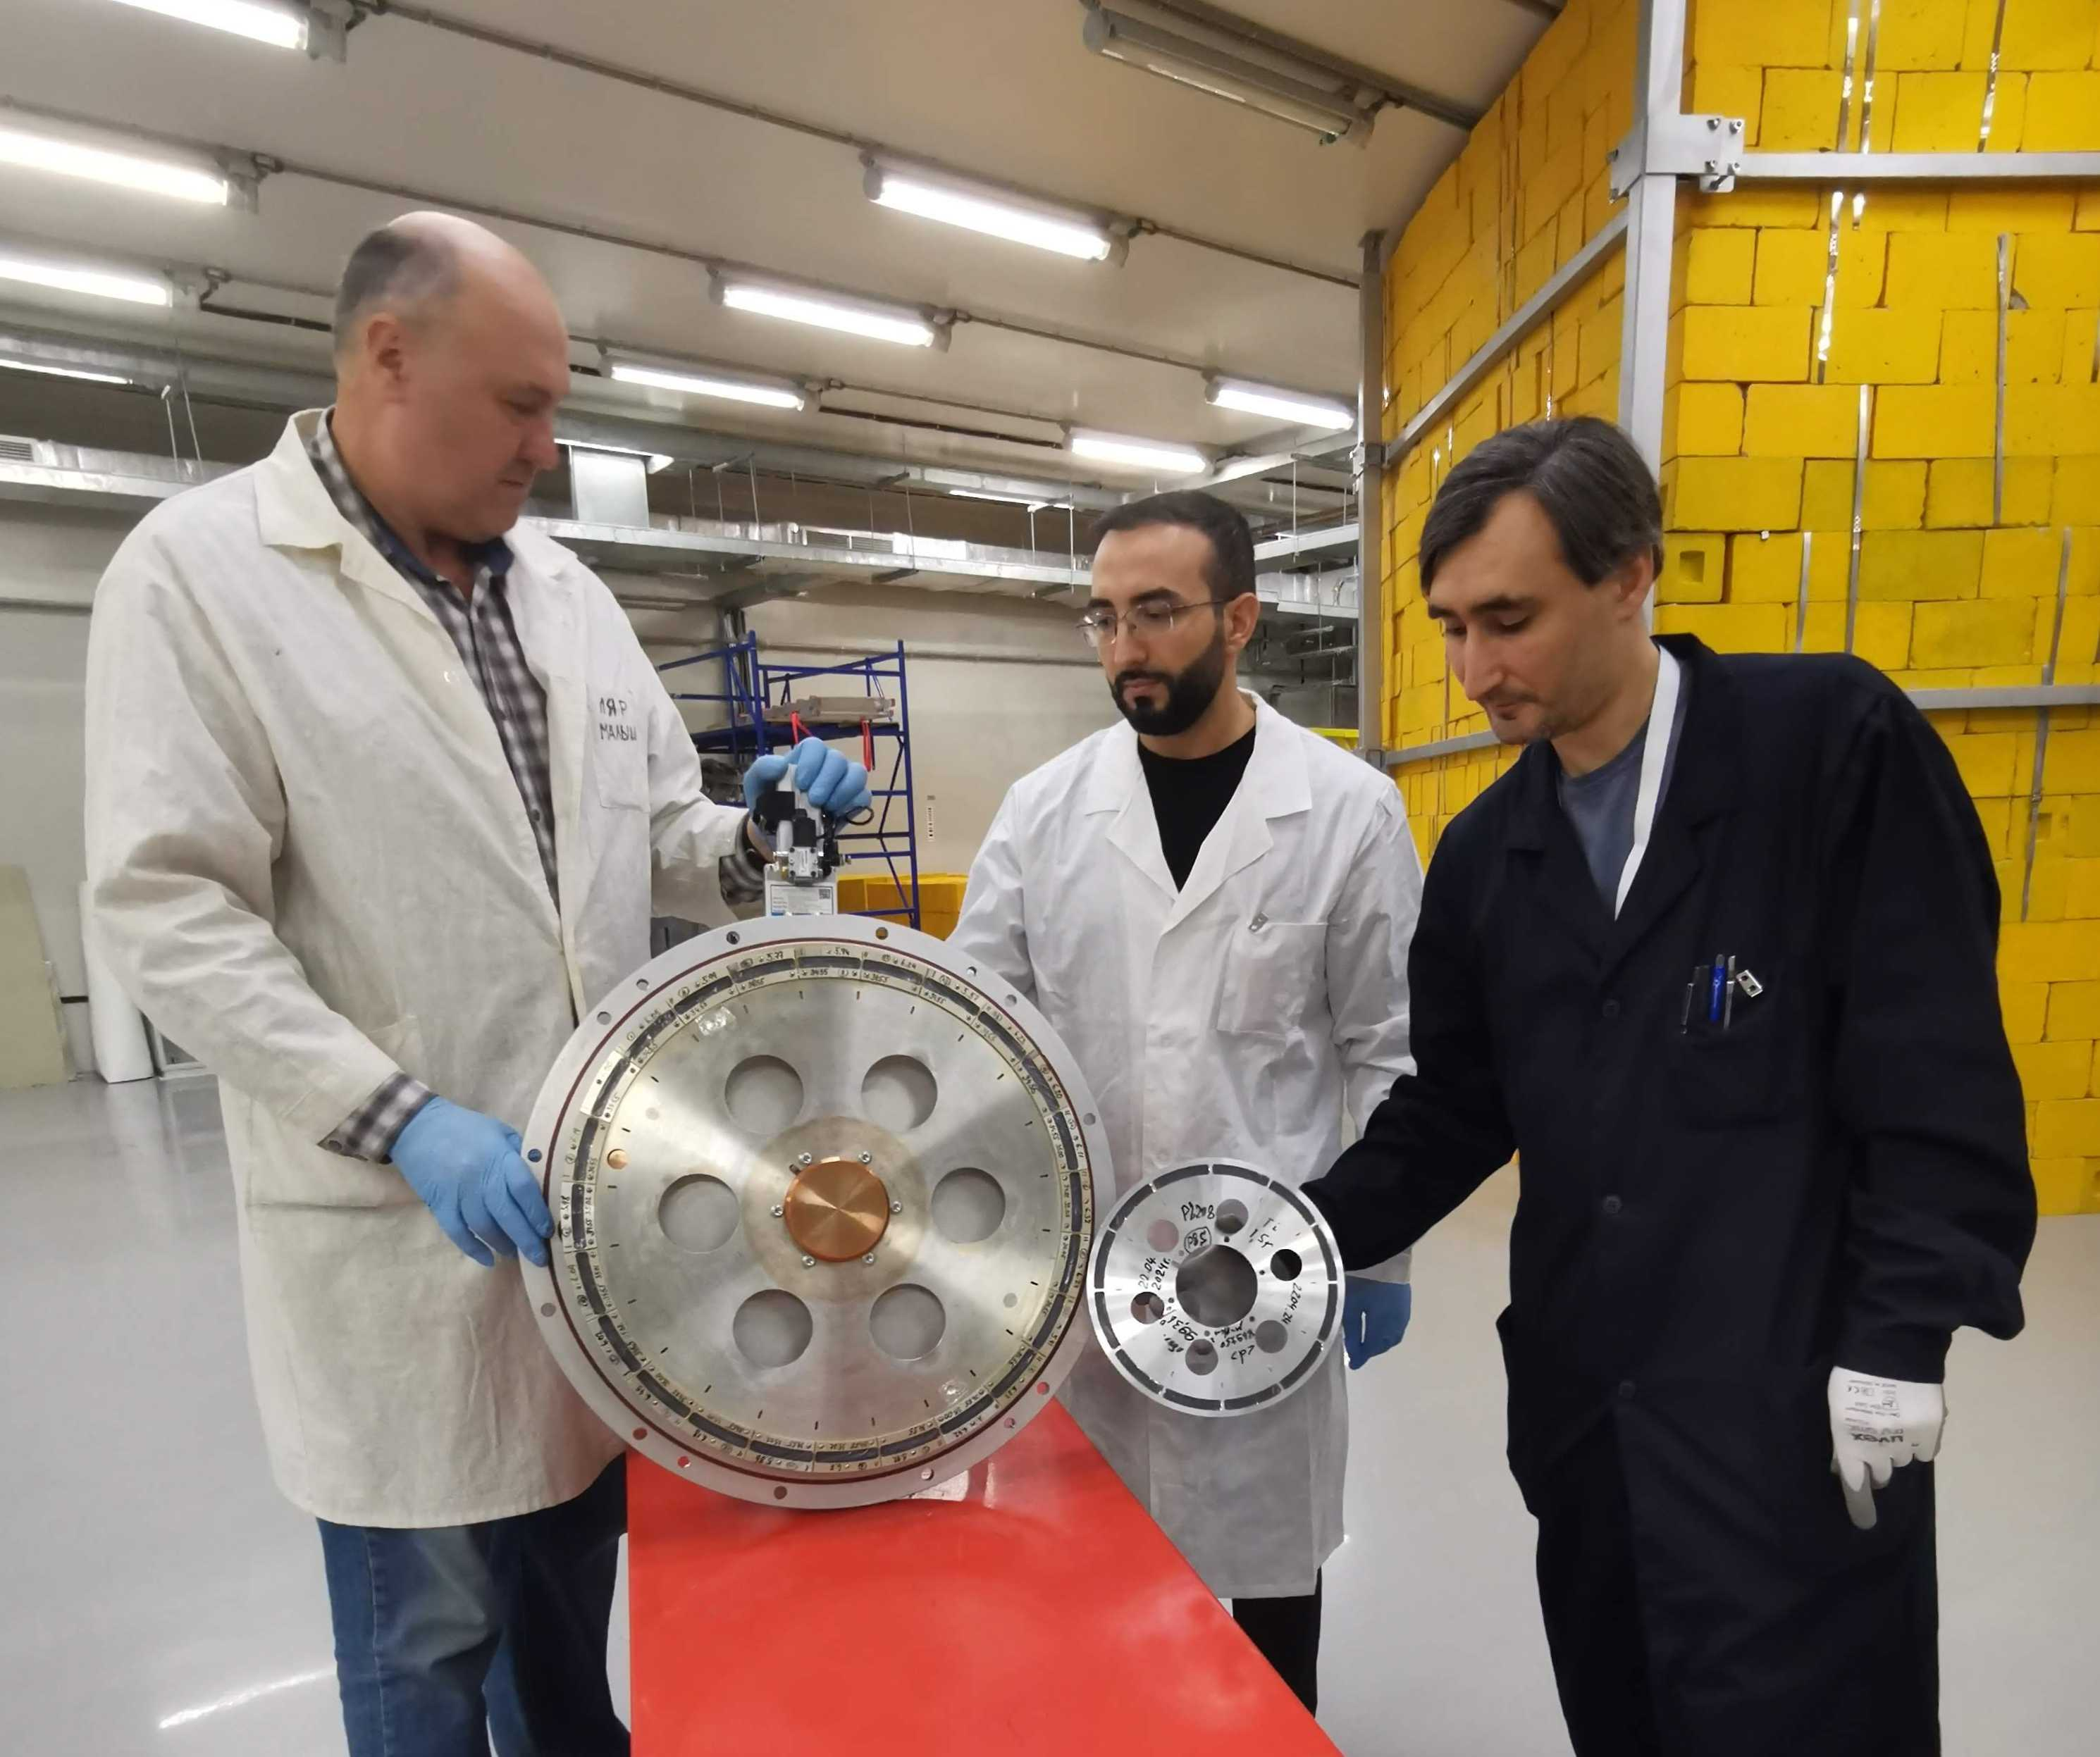
Target wheels with 240 and 480 mm diameter

Slide 21
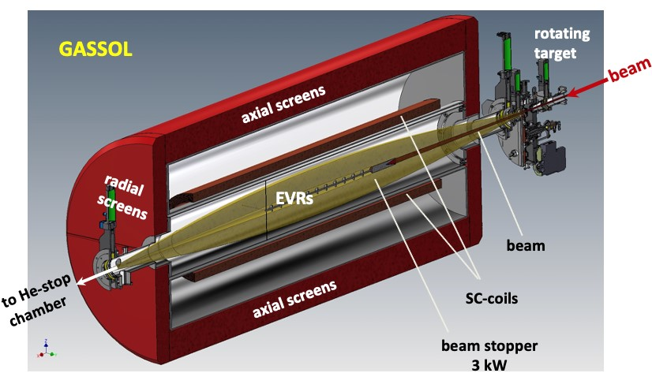
Δ(BR)/ BR = ± 5.7%
Stopping volume in gas 1-3 cm³
GASSOL. The FLNR JINR concept of the magnetic separator of SHE, which assumes the application of a superconducting solenoid. Solovyev D.

Slide 22


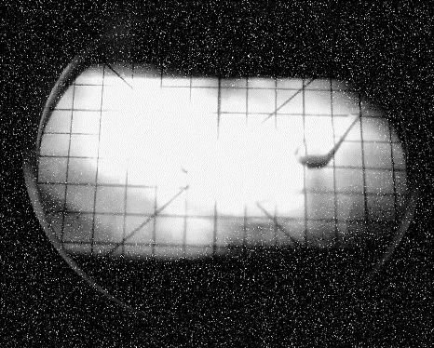
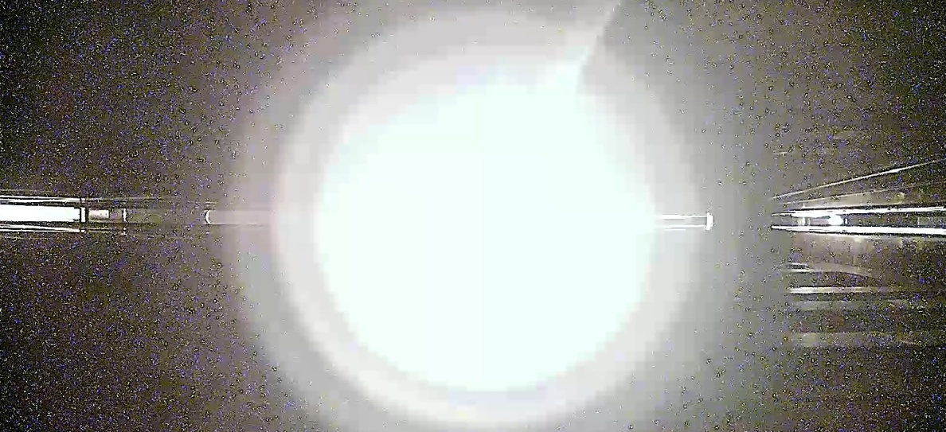
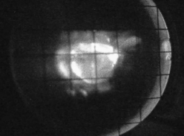
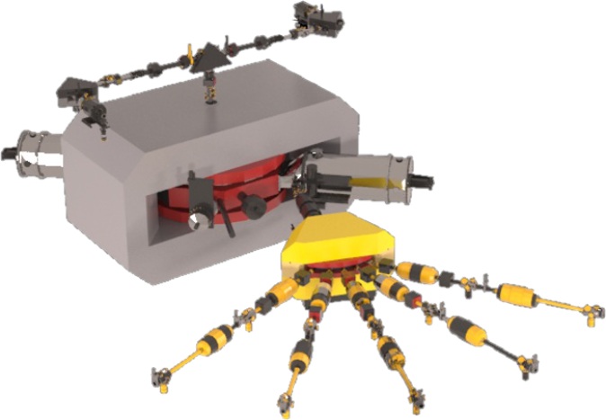
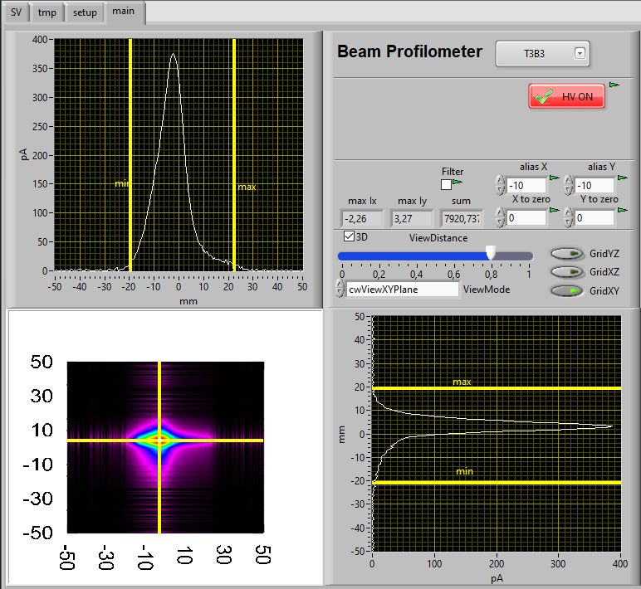
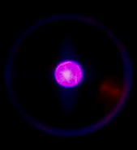
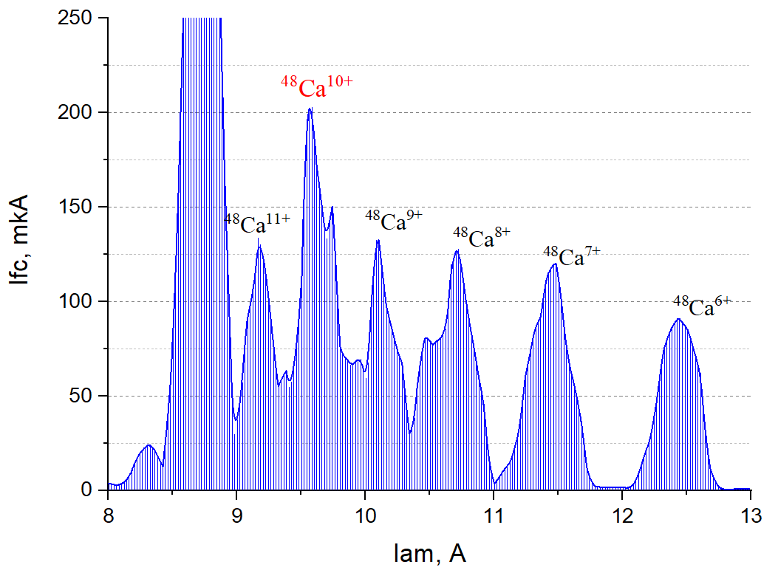
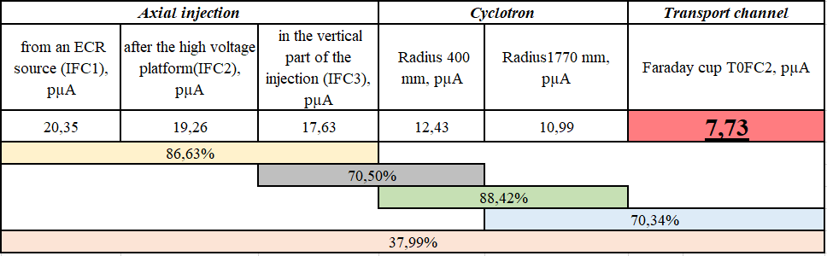
Production of high-intensity ion beams ⁴⁸Ca
Joint Institute
for Nuclear Research
Axial injection
Transport channel
Ion source
Transport channel
Glow of the preseptum plate of the deflector(~2300 °C)
Beam power 2,64 kW (7,73 pµA)
Spectrum of 48Ca ions optimized for ⁴⁸Ca¹⁰⁺

Slide 23
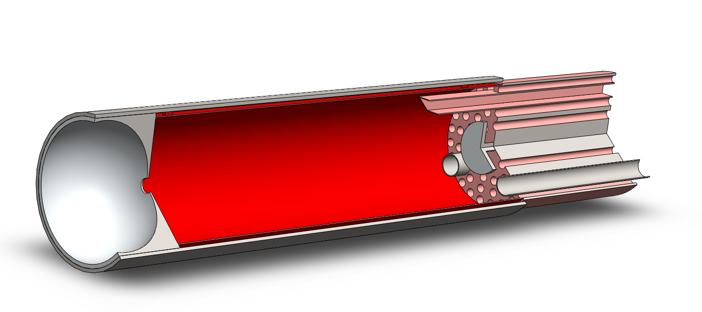
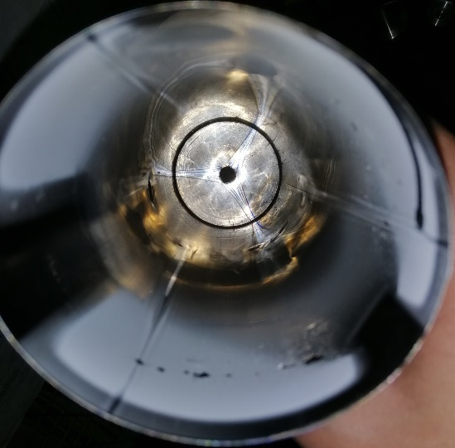
Calcium consumption

Slide 24
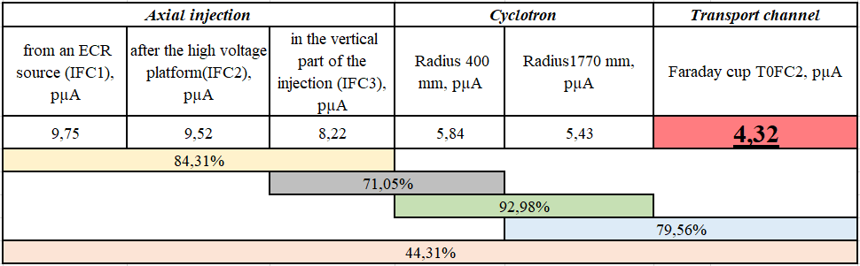

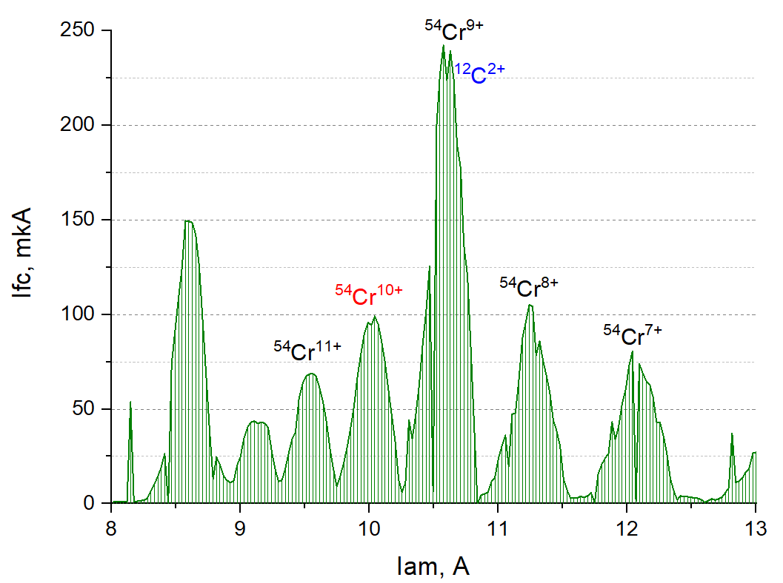
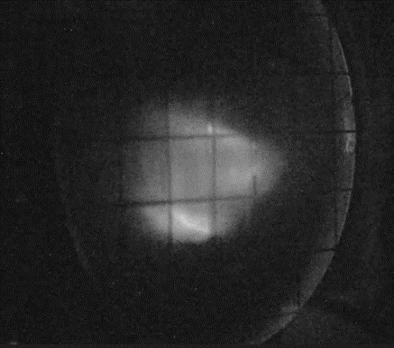
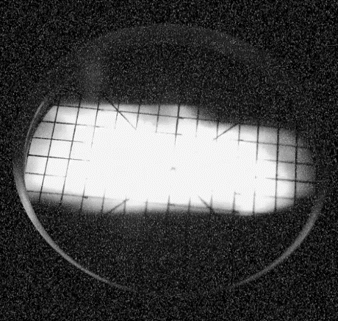
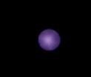

Joint Institute
for Nuclear Research
Axial injection
Transport channel
Ion source

Slide 25
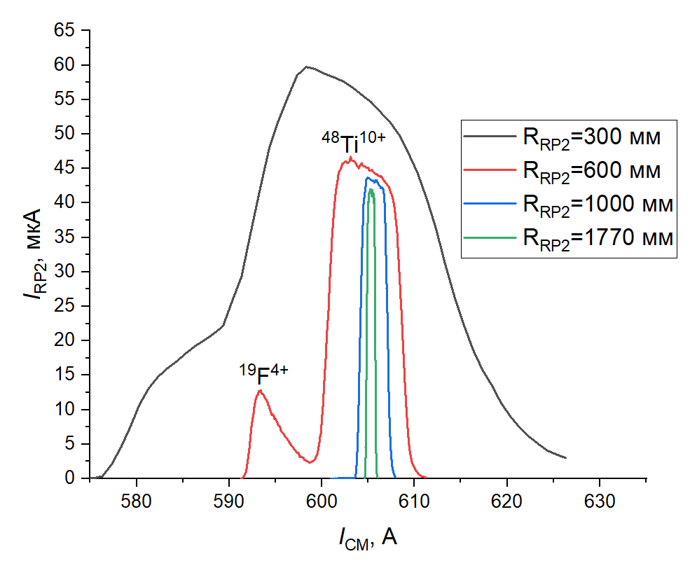

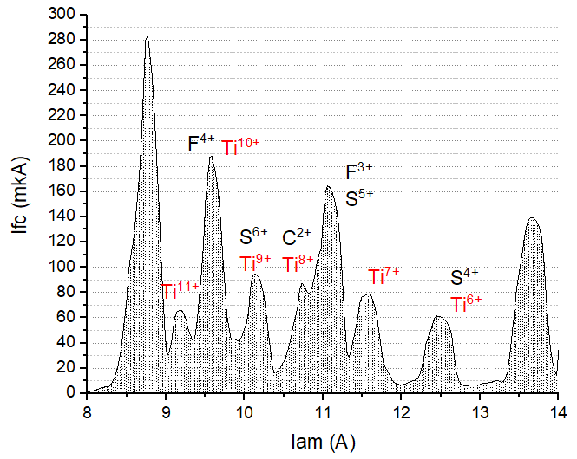

Production of high-intensity ion beams ⁴⁸Ti¹⁰⁺
Joint Institute
for Nuclear Research
UHF
He + SF₆
Ti foil

Slide 26
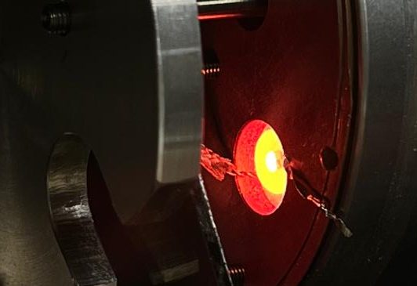
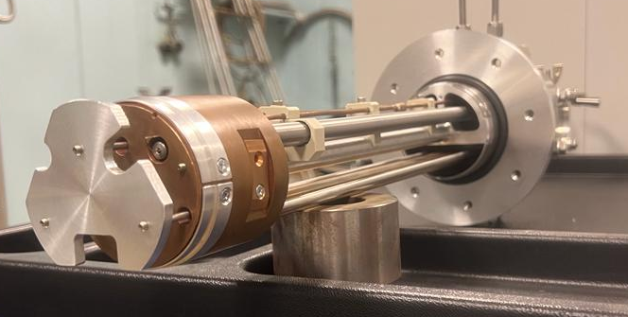
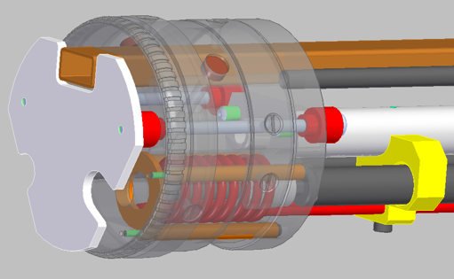
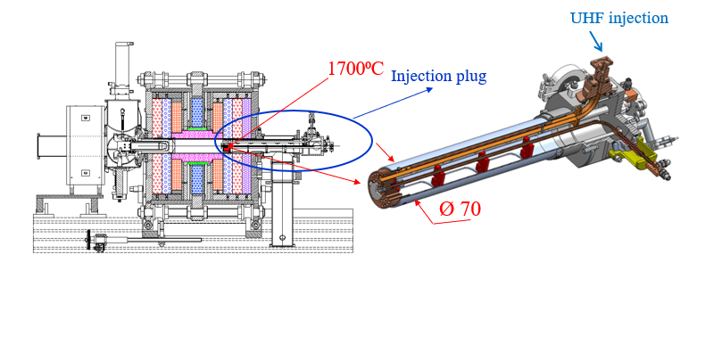
Cromimium & Titanium: HT oven development
FLNR inductive oven (off-line tests)
Thermocouple1500⁰С
Adaptation to DECRIS-PM
Outer surface of plug should be well cooled to avoid damage of permanent magnets!!

Slide 27
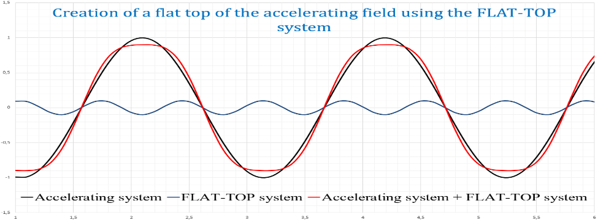
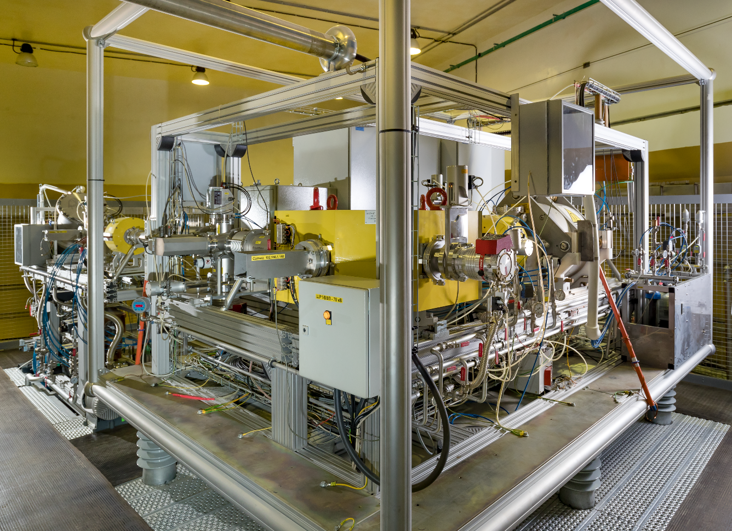
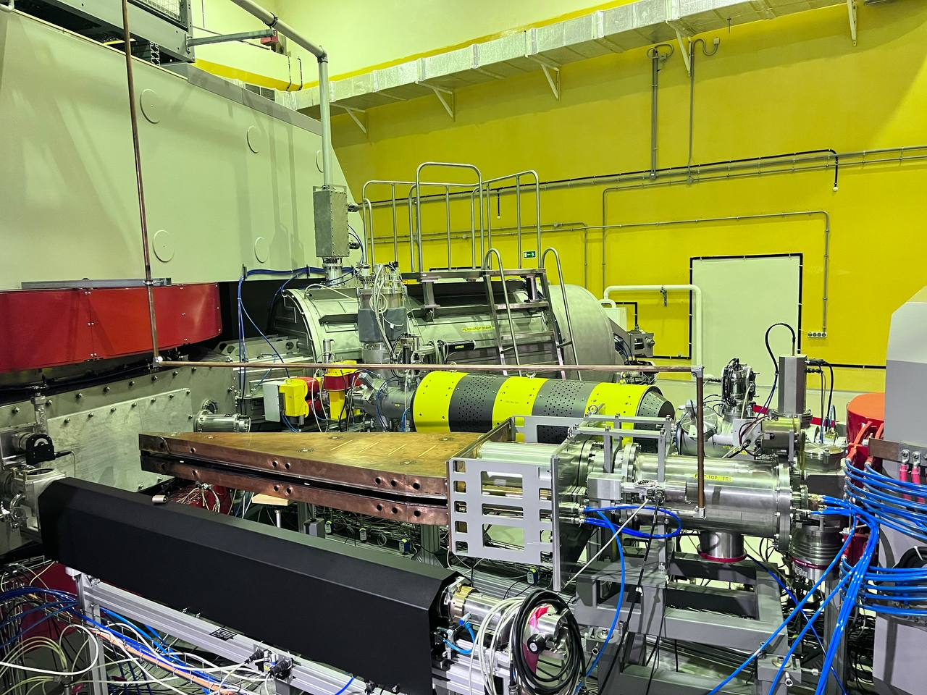
Features of the DC-280 cyclotron
Flat-top system:
Injection 21,96-31,14 MHz
U max 13kV
Potential up 70 kV
capture efficiency in acceleration ~75%

Slide 28




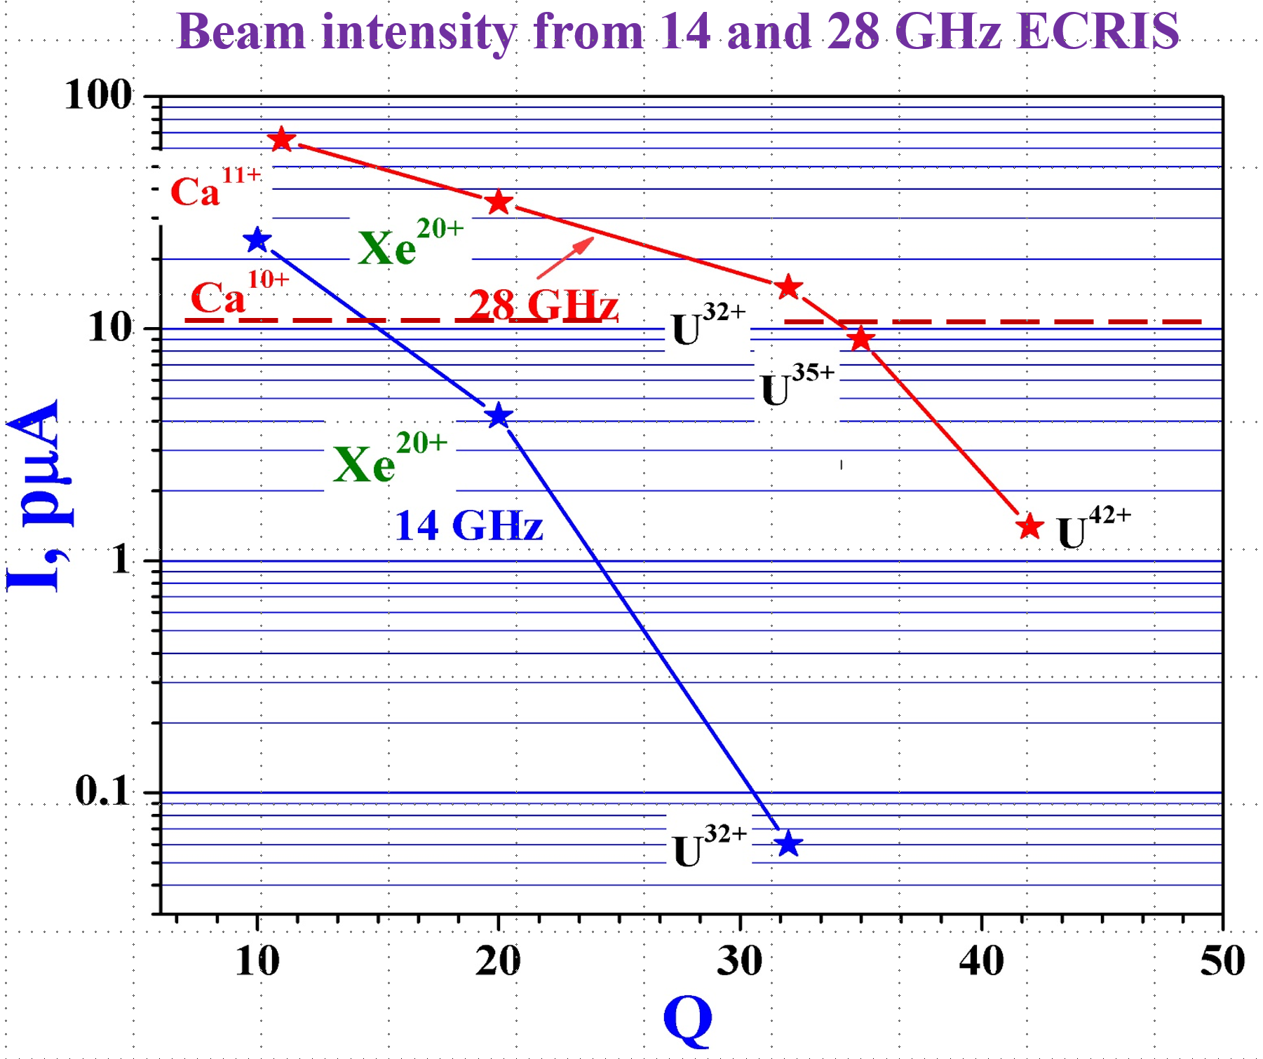
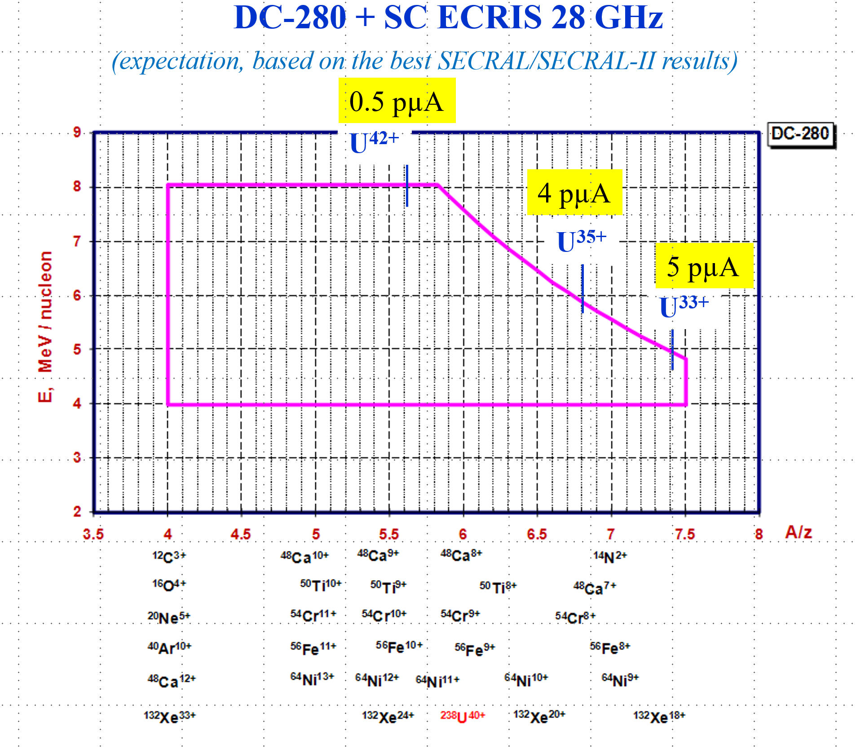
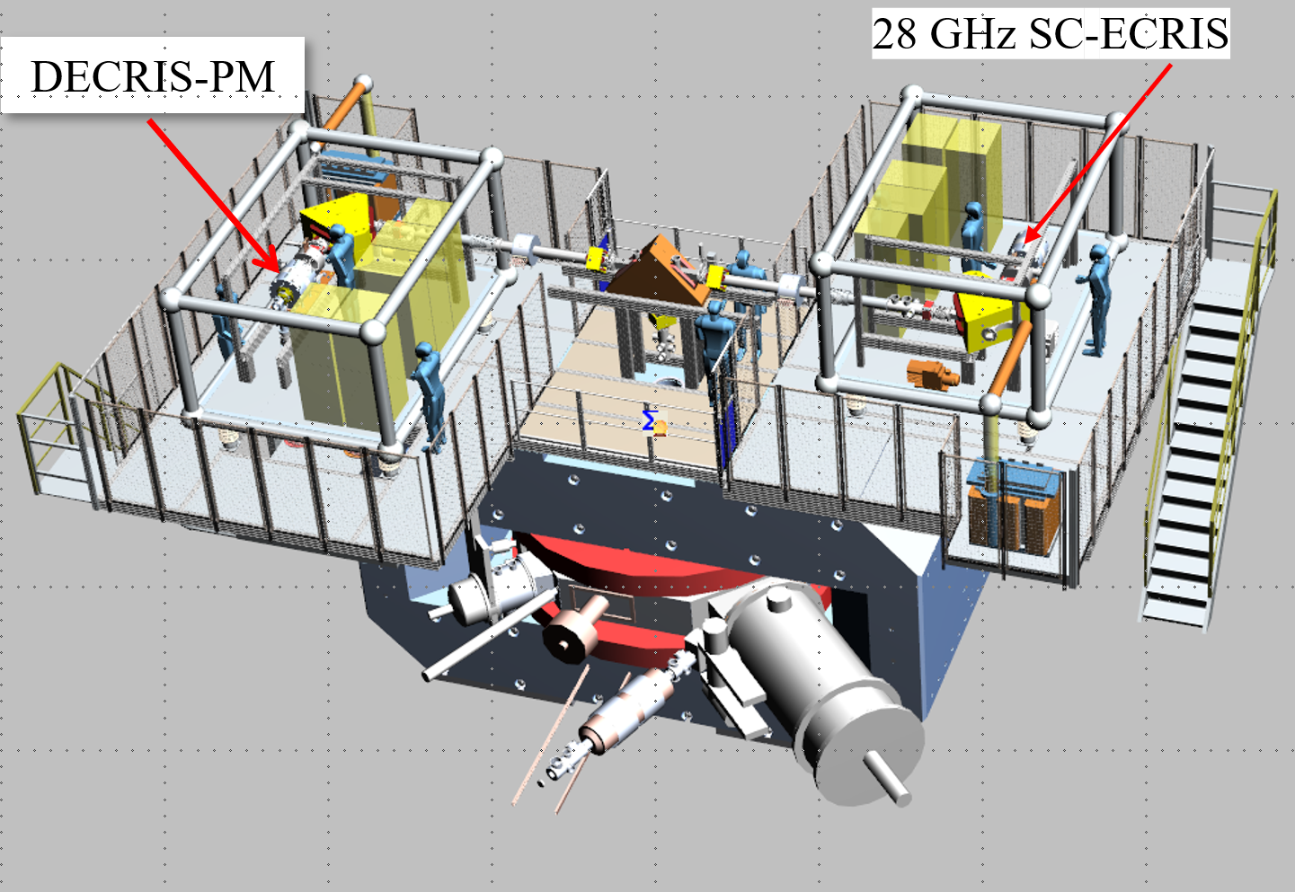
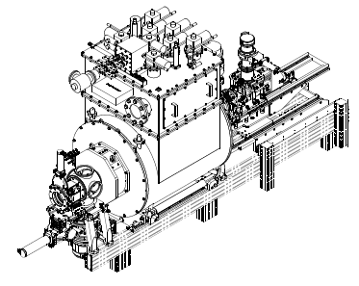
FUTURE DEVELOPMENT for SHE FACTORY

Slide 29
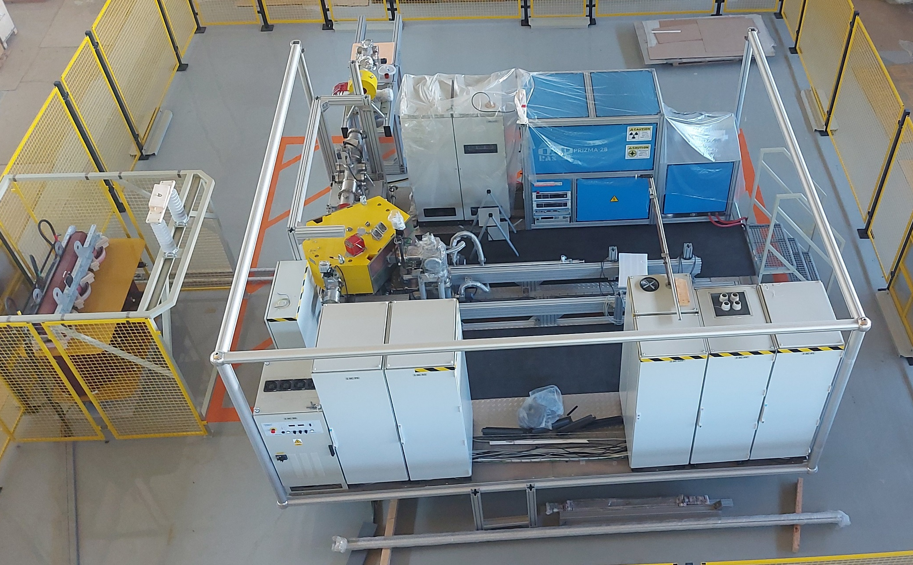
Assemblage of the injector in the test hall

Slide 30
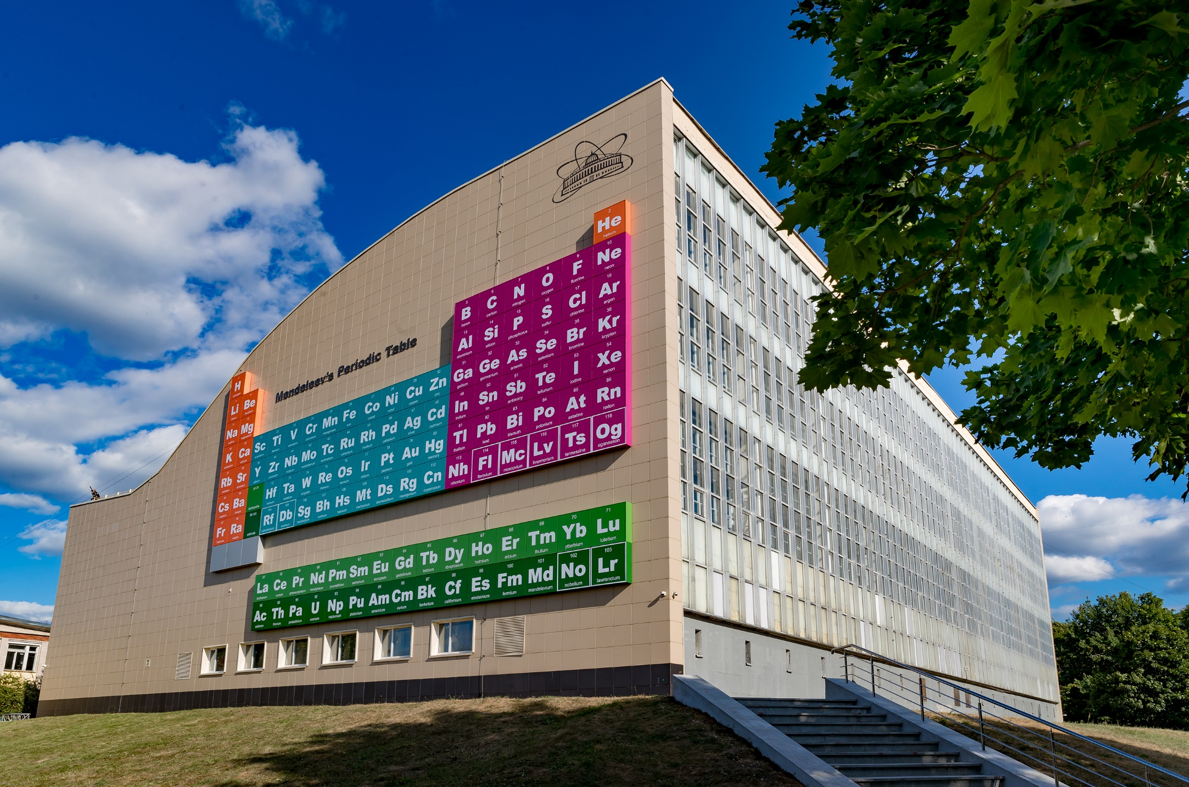
Thank you for attention!

Slide 31
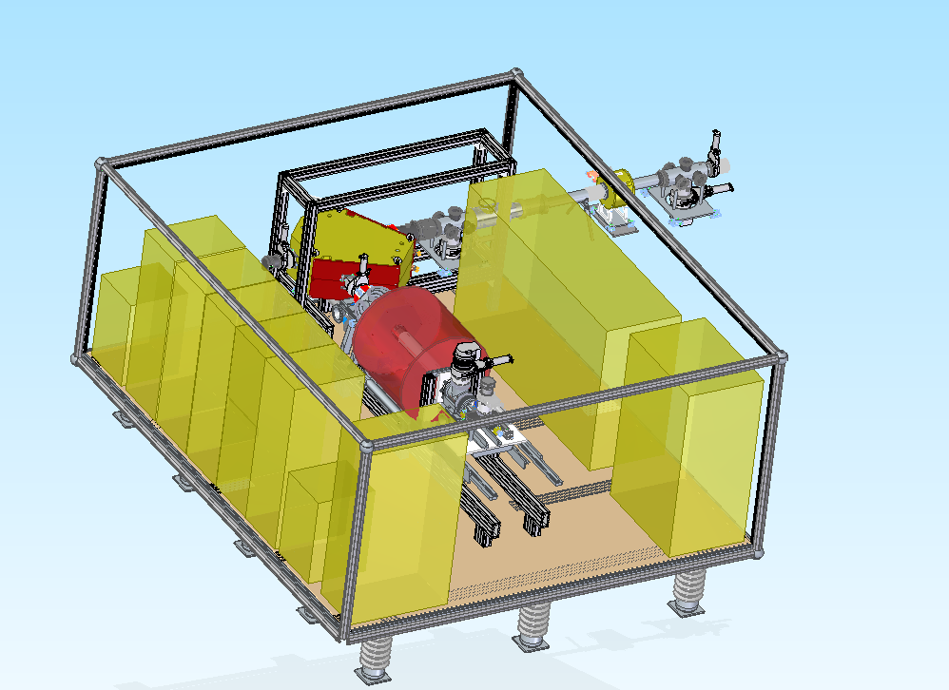

SC-ECRIS 28 GHz for DC-280 cyclotron
HV platform with SC-ECRIS 28 GHz
DC-280 with two injectors
DECRIS-PM (14 GHz)
SC-ECRIS (28 GHz)

Slide 32




Transverse beam density distribution inside the Cyclotron
Joint Institute
for Nuclear Research
Transverse beam density distribution inside the cyclotron without flat-top
Transverse beam density distribution inside the cyclotron with flat-top

Slide 33

Features of the DC-280 cyclotron
Flat-top system:
21,96-31,14 MHz
U max 13kV
Joint Institute
for Nuclear Research
HV platform:
Work potential up 70 kV
capture efficiency in acceleration ⁓ 75 %

Slide 34





Production of ⁴⁸Са ion beam at the DC-280 cyclotron
Hot screen (heated by microwaves)
Resistive oven
50
7

Slide 35



Titanium: MIVOC - (CH₃)₅C₅⁵⁰Ti (CH₃)₃
DECRIS-PM 14 GHz
May – June 2024, DC-280
Accelerated beam of
⁵⁰Ti⁹⁺ ≤ 2pµA at the target
~150 W
⁵⁰Ti 0.46 mg/h
Hydrogen ~ 6×10¹⁵ pps. Carbon ~ 1.5×10¹⁵ pps.
High drain current from the source pure transmission
In operation with Ca helium flow ~ 1.5 ÷ 3×10¹⁵ pps.
How to eliminate needless species?

Slide 36



Titanium foil after operation with SF₆ plasma
1)
S_{eff} ≈ 600 mm²
S_{eff} ≈ 4500 mm²
S_{total} ≈ 5100 mm²
2)
S = 707 mm²
S_{total} ≈ 254 mm²
Ti biased-electrode
Ø 30 mm
Ta screen
1): S_{total} ≈ 5100 mm²
Ti⁷⁺=80 eµA;
Ti¹¹⁺=70 eµA
2): S_{total} ≈ 254 mm²
Ti⁷⁺=40 eµA
Ti¹¹⁺=30 eµA
We need to find the right place and optimal surface area to ensure maximum results.
Deposition of ⁵⁰Ti to the substrate surface (?)
Notes:
After work, we determined that the working surface corresponds to 5000 mm2. Experience has shown that the technique works quite successfully and stably, thus, in the near future we hope to use this method to obtaining the isotope of titanium 50 as a working material. However, the problem is that it is necessary to ensure a more rational use of the area, since titanium will probably have to be used in the form of pressed plates.

Slide 37

The heaviest target for experiments on synthesis of superheavy elements in heavy-ion reactions is ²⁴⁹Cf, so further progress in the synthesis of elements with Z > 118 requires the production of intense beams of accelerated neutron-enriched isotopes, such as ⁵⁰Ti, ⁵⁴Cr, ⁵⁸Fe, ⁶⁴Ni, etc.
²⁴³Am
²⁴⁹Bk
²⁴⁹⁻²⁵¹Cf
²⁴⁸Cm
¹¹⁹
⁵⁰Ti
⁵⁴Cr
¹²⁰
Up to 5 pmkA

Slide 38

Progress at SHE-Factory
4.0
designed
3.5
Luminosity
(target 30 mg)
3.0
now at Factory
2.5
Luminosity (10³¹/cm²ˑs)
DC-280 + DGFRS-2
2.0
1.5
1.0
0.5
previous level
U-400 + DGFRS-1
0.0
2000
2020
2021
2022
year

Slide 39
Metallic ion beams production
Low temperature oven – Ca, Mg, Bi, etc.
Inductive/foil oven - Cr and Ti in near future
MIVOC – Cr, Ti, Al, Zr, Fe, etc.
Insertion into plasma – Al
Sputtering – Al, Ta, Cu
Up to 1000 ºC
More than 1000 ºC

Slide 40

U400 CYCLOTRON
stand-alone & post-accelerator
Ion | Ion energy [MeV/A] | Output intensity
⁴ He ¹⁺ | - | -
⁶ He ¹⁺ | 11 | 3⋅10⁷ pps
⁸ He ¹⁺ | 7.9 | -
¹⁶ O ²⁺ | 5.7; 7.9 | 5 pμA
¹⁸O³⁺ | 7.8; 10.5; 15.8 | 4.4 pμA
⁴⁰ Ar ⁴⁺ | 3.8; 5.1 * | 1.7 pμA
⁴⁸ Ca ⁵⁺ | 3.7; 5.3 * | 1.2 pμA
⁴⁸Ca⁹⁺ | 8.9; 11; 17.7 * | 1 pμA
⁵⁰ Ti ⁵⁺ | 3.6; 5.1 * | 0.4 pμA
⁵⁸ Fe ⁶⁺ | 3.8; 5.4 * | 0.7 pμA
⁸⁴Kr⁸⁺ | 3.1; 4.4 * | 0.3 pμA
¹³⁶Xe¹⁴⁺ | 3.3; 4.6; 6.9 * | 0.08 pμA
¹⁶⁰Gd¹⁹⁺ | 5.5 | 0.01 pμA
²⁰⁹Bi¹⁹⁺ | 3.4 | 0.01 pμA
New heavy isotopes
Fusion-fission
Nuclear spectroscopy
SHE chemistry
Multi nucleon transfer reactions;
Reactions with exotic nuclei
Structure of light exotic nuclei;
Notes:
40

Slide 41

PROGRESS
SHE
SHE-Factory

Slide 42



Calcium consumption
Old
New

Slide 43




Production of ⁴⁸Ca beam
Helium
Helium + Ca
Helium + Ca + UHF Power>300
Total working time, h | 12000
Average consumption, mg/h | 0.76
Average operating current of ⁴⁸Ca¹⁰⁺, pµA | 8
Global efficiency of the Ca ionization | 16%
The ⁴⁸Ca ion spectrum, optimized for Ca¹⁰⁺

Slide 44


Slide 45
DC280 . Intensity of some typical ion beams
20Ne | 1·10¹⁴ pps
48Ca | 6·10¹³ pps
50Ti | 3·10¹³ pps
70Zn | 2,5·10¹³ pps
86Kr | 3·10¹³ pps
100Mo | 2·10¹² pps
124Sn | 2·10¹² pps
136Xe | 2·10¹³ pps
208Pb | 1·10¹² pps
238U | 1·10¹¹ pps

Slide 46
Superheavy Elements (SHE) Factory – the Goals
Experiments at the extremely low (σ<100 fb) cross sections:
Synthesis of new SHE in reactions with ⁵⁰Ti, ⁵⁴Cr ...;
Synthesis of new isotopes of SHE;
Study of decay properties of SHE;
Experiments requiring high statistics:
Nuclear spectroscopy of SHE;
Study of chemical properties of SHE.

Slide 47
DC-280 CYCLOTRON- THE NEW FLNR ACCELERATOR
To satisfy the Goals, the DC-280 has to provide the following parameters of ion beams:
Ion energies (smooth variation) 4÷8 MeV/n
Ion masses 10÷238
Intensities (A~50) >10 pµA
Efficiency of beam transfer >50%

Slide 48


Slide 49

Flat-Top system
Net effect A₁Sin(ω_{rf} t) + A₂Sin(3ω_{rf} t)
A₂ ≈ 0.1⋅A₁
3F_{rf}
F_{rf}

Slide 50

Cyclotron DC280
Configuration of the DC280 cyclotron

Slide 51
DC280
Near and future development
2. a). 2-nd high voltage platform creation.
b). 2-nd ECR ion source creation with 28? – 52?
GHz plasma heating frequency.
c). 238U ion acceleration with energy range 4÷8
MeV/n and beam intensity ≥10¹² pps (≥2000 W)

Slide 52

DC280
Near and future development
Development of the rare isotopes matter supply system.
Ca48
 | Beam intensity | Consumption | Efficiency
U400 | 6·10¹² ¹/сек | ~ 1 ^{mg}/h (3,5·10¹⁵ ¹/сек) | ~ $\frac{1}{500}$
DC280 (project) | 6·10¹³ ¹/сек | ~ 2 ^{mg}/h (7·10¹⁵ ¹/сек) | ~ $\frac{1}{100}$
DC280 (development) | 10 ¹⁴/сек | ≤2 ^{mg}/h (7·10¹⁵ ¹/сек) | ~ $\frac{1}{60}$

Slide 53

Cyclotron DC280
DECRIS-PM ECR ion source at HV platform, where: 1- DECRIS-PM, 2- Focussing solenoid

Slide 54


22 mg of ²⁴⁹Bk
have been produced in HIFR ORNL
Target wheel
Notes:
54

Slide 55
Working diagram of the DC-280
First experiments at SHE factory

Slide 56



SHE Factory
SHE Factory Building
High-current cyclotron DC-280
New facilities:
New gas-filled separator
Preseparator
SHELS
Etc.
Notes:
The project of the SHE factory includes three principal components: i) high current accelerator, ii) new experimental hall and iii) a number of the next generation facilities.

Slide 57

Main parameters of DC-280 cyclotron
Joint Institute
for Nuclear Research
Parameter | design | realized
Power consumption | 550 kW
Ion source | DECRIS-PM – 14 GHz on HV platform (U_{max}=70kV)
Injection energy | to 100 keV×Z | to 76 keV×Z
A/Z | 4÷7.5 | 4,44÷6.86
Energy range | 4÷8 МeV/nucleon | 3,81÷7,46 МeV/nucleon
Ions (for DECRIS-PM) | 4-136 | 12(¹²С²⁺)-84(⁸⁴Kr¹⁴⁺)
Intensities | >10 pµA (for A⁓50) | 10.4 pµA(⁴⁰Ar⁷⁺); 7.73 pµA (⁴⁸Ca¹⁰⁺)
Magnetic field level | 0.6÷1.3 Т | 0.8÷1.23 Т
Dee voltage | 130 kV | 130 kV
flat-top dee voltage | 13 kV | 13 kV
Acceleration efficiency | >50% | 52,17% (⁴⁸Са 3.3 рµA)
Emittance | Less than 30 π mm‧mrad
Year | Total work time | Ions
2019 | 3377 | ¹²C, ⁴⁰Ar, ⁴⁸ Ca, ⁸⁴Kr
2020 | 3705 | ⁴⁰Ar, ⁴⁸ Ca, ⁴⁸Ti
2021 | 5357 | ⁴⁸ Ca, ⁴⁸Ti , ^{52,54}Cr
2022 | 5973 | ⁴⁰Ar, ⁴⁸Ca, ⁴⁸Ti , ^{52,54}Cr
2023 | 3643 | ⁴⁰Ar, ⁴⁸Ca, ⁴⁸Ti, ^{52,54}Cr, ²⁶Mg,⁵⁶Fe
57

Slide 58



Results
Joint Institute
for Nuclear Research
extraction system by 19.95%(from 144,6 W to 115,85 W)
Energy Spread Reduction from 1,12‧10⁻² (without flat-top system) to 4,8‧10⁻³ (with FLAT-TOP system)
Reducing the horizontal size ion beam
17 mm
13 mm
The horizontal size ion beam:
a) without flat-top system; b) with FLAT-TOP system
58

Slide 59
Production of high-intensity ion beams ^{52,54}Cr
Joint Institute
for Nuclear Research
Ion | method of obtaining | operating time, (h) | Result
2021
⁵²Сr¹⁰⁺ | MIVOC | 1270 | 2.6 pµA
⁵⁴Сr¹⁰⁺ | MIVOC | 216 | 2.55 pµA
2022
⁵²Сr¹⁰⁺ | MIVOC | 72 | 2.6 pµA
⁵⁴Сr¹⁰⁺ | MIVOC | 216 | 3.5 pµA
2023
⁵⁴Сr¹⁰⁺ | MIVOC | 96 | 4.32 pµA
⁵²Сr¹⁰⁺ | MIVOC | 408 | 2.3 pµA
Result: In the period from 2021 to 2023, the time of work to obtain high-intensity ^{52,54}Cr ion beams was ~2000 hours. Maximum peak intensity 4.32 pµA

Slide 60
Joint Institute
for Nuclear Research
Axial injection
Transport channel
Ion source

Slide 61

Joint Institute
for Nuclear Research
THANK YOU FOR YOUR ATTENTION!

Slide 62




H
atch
Chanel
n.1
Experimental
Hall n.115
Plan of the experimental building of FLNR. Hatch is the straight-through passage in the celling of the experimental hall 115.

Slide 63



450 euA of U³³⁺, 380 euA of U³⁴⁺,
310 euA of U³⁵⁺
60 euA of U⁴²⁺, 26 euA of U⁴⁶⁺, 9 euA of U⁵⁰⁺
SECRAL-II
IMP Lanzhou, inductive oven

Slide 64
Resistance Oven
Ion Species | Source | Rf Power (kW) | Operation Time | Ion Beam Intensity (euA)
²³⁸U³³⁺ | VENUS | 6.5+1.8 | ~10 hours | 440
²³⁸U³⁵⁺ | VENUS | 6.5+1.8 | ~10 hours | 300
²³⁸U³³⁺ | RIKEN-28 | 2.2-2.6 | - | ~225
²³⁸U³⁵⁺ | RIKEN-28 | 2.2-2.6 | - | ~200
²³⁸U³⁵⁺ | RIKEN-28 | - | ~1 month | 100-120
…
Background-Resistance Oven

Slide 65

RIKEN - sputtering

Slide 66
450 euA of U³³⁺, 380 euA of U³⁴⁺,
310 euA of U³⁵⁺
60 euA of U⁴²⁺, 26 euA of U⁴⁶⁺, 9 euA of U⁵⁰⁺
SECRAL-II
IMP Lanzhou, inductive oven

Slide 67
U400 - DC280
Overall (ion source - target) beam current
transferring efficiency versus injected beam current

Slide 68
Principles of the DC-280 design
 | Principle | Expected result
1. | High injection energy of ions (up to 80 keV/Z) | Strong decreasing of space charge effects and ion beam emittance. High efficiency of beam capture into acceleration .
2. | Low magnetic field (up to 1.3 Т) | High beam extraction efficiency. Lower power of the main magnet.
3. | High accelerating voltage (up to 130 kV) | Higher turns separation for effective extraction. Lower vacuum losses .
4. | Beam extraction by the electrostatic deflector together with the flat-top system | Effective ion extraction. Better beam quality.

Slide 70
Accelerating of ⁵⁴Cr
⁵⁴Cr¹⁰⁺
Faraday Cup | Current, eµA | Efficiency of beam transfer
I_{inj1} | 97.5 | 100.00%
I_{inj2} | 95.2 | 97.64%
I_{inj3} | 82.2 | 84.31%
I_{RP2-1} | 60.7 | 62.26%
I_{RP2-2} | 54.3 | 55.69%
I_{FCI} | 43.2 | 44.31%

Slide 71
Ti ion production using SF₆ plasma*
ECR ion source plasma chamber
UHF
He + SF₆
Ti foil
Ti + F TiF_{x}
Volatile compounds
*Production of multiply charged metallic ions by compact electron cyclotron
resonance ion source with SF₆ plasma Y. Saitoh et al.
REVIEW OF SCIENTIFIC INSTRUMENTS VOLUME 69, NUMBER 2 FEBRUARY 1998
*Recycling effect of germanium on ECR ion source P. Leherissier et al.
Nuclear Instruments and Methods in Physics Research B 211 (2003) 274–280

Slide 72


Necessary components for SHE synthesis
Ion source
(injector)
Targets: ²⁴⁴Pu, ²⁴³Am, ²⁴⁸Cm….
Accelerator
Separator & detectors
Working substance feed:
PIG, ECR, EBIS, LIS……
⁴⁸Ca, ⁵⁰Ti, ⁵⁴Cr………..²³⁸U

Slide 73


Super Heavy Element Factory
Injector DECRIS-PM
DC-280 CYCLOTRON
DGFRS-2
DC-280 has to provide the following parameters of ion beams:
Ion energy 4 ÷ 8 MeV/n
Ion masses 10 ÷ 238
Intensities (A~50) 5 ÷ 10 pµA
Beam emittance less than 30 π mm·mrad
Efficiency of beam transfer ≥ 50%
Required intensities from the source 10 ÷ 20 pµA
Charge states: 4⁺ ÷ 40⁺

