Slide 1
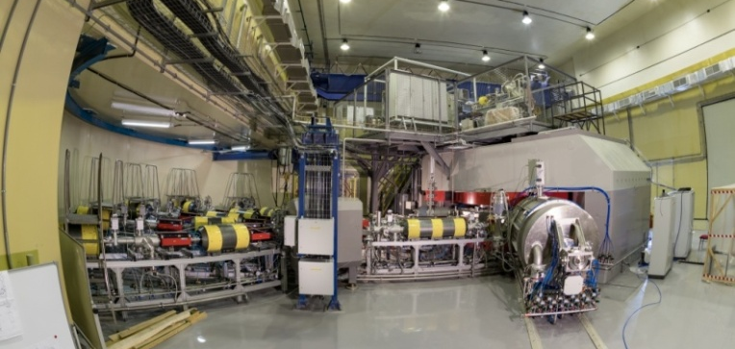
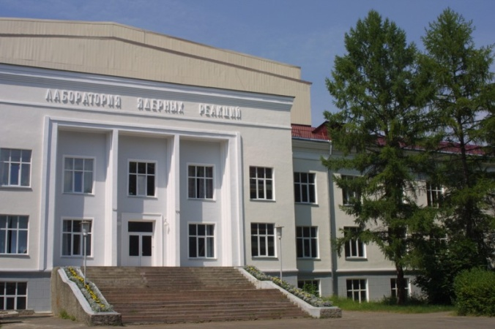
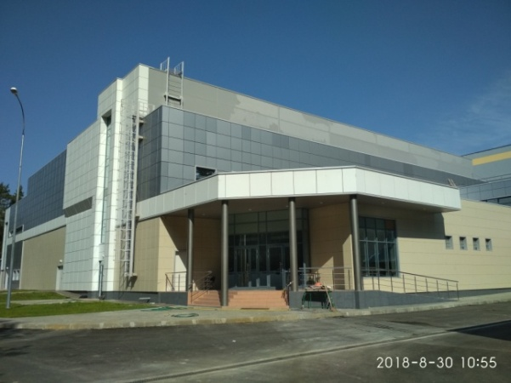
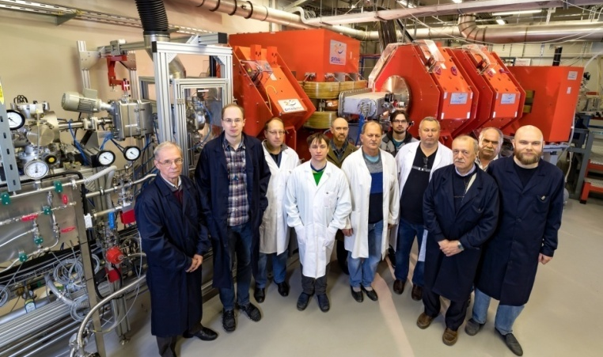
On the way to the synthesis of new elements: 119 and 120
N.D.Kovrizhnykh
Flerov Laboratory of Nuclear Reactions JINR
DC280
DGFRS-2
International conference
“50 years of cold fusion”

Slide 2
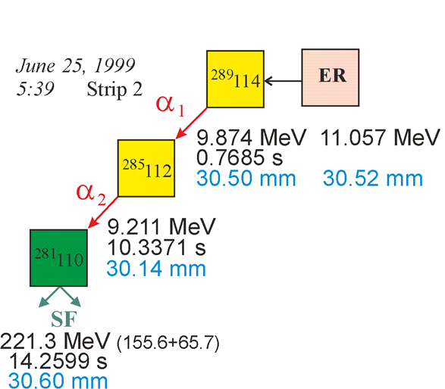
25 years of observation of first superheavy element decay chain

Slide 3
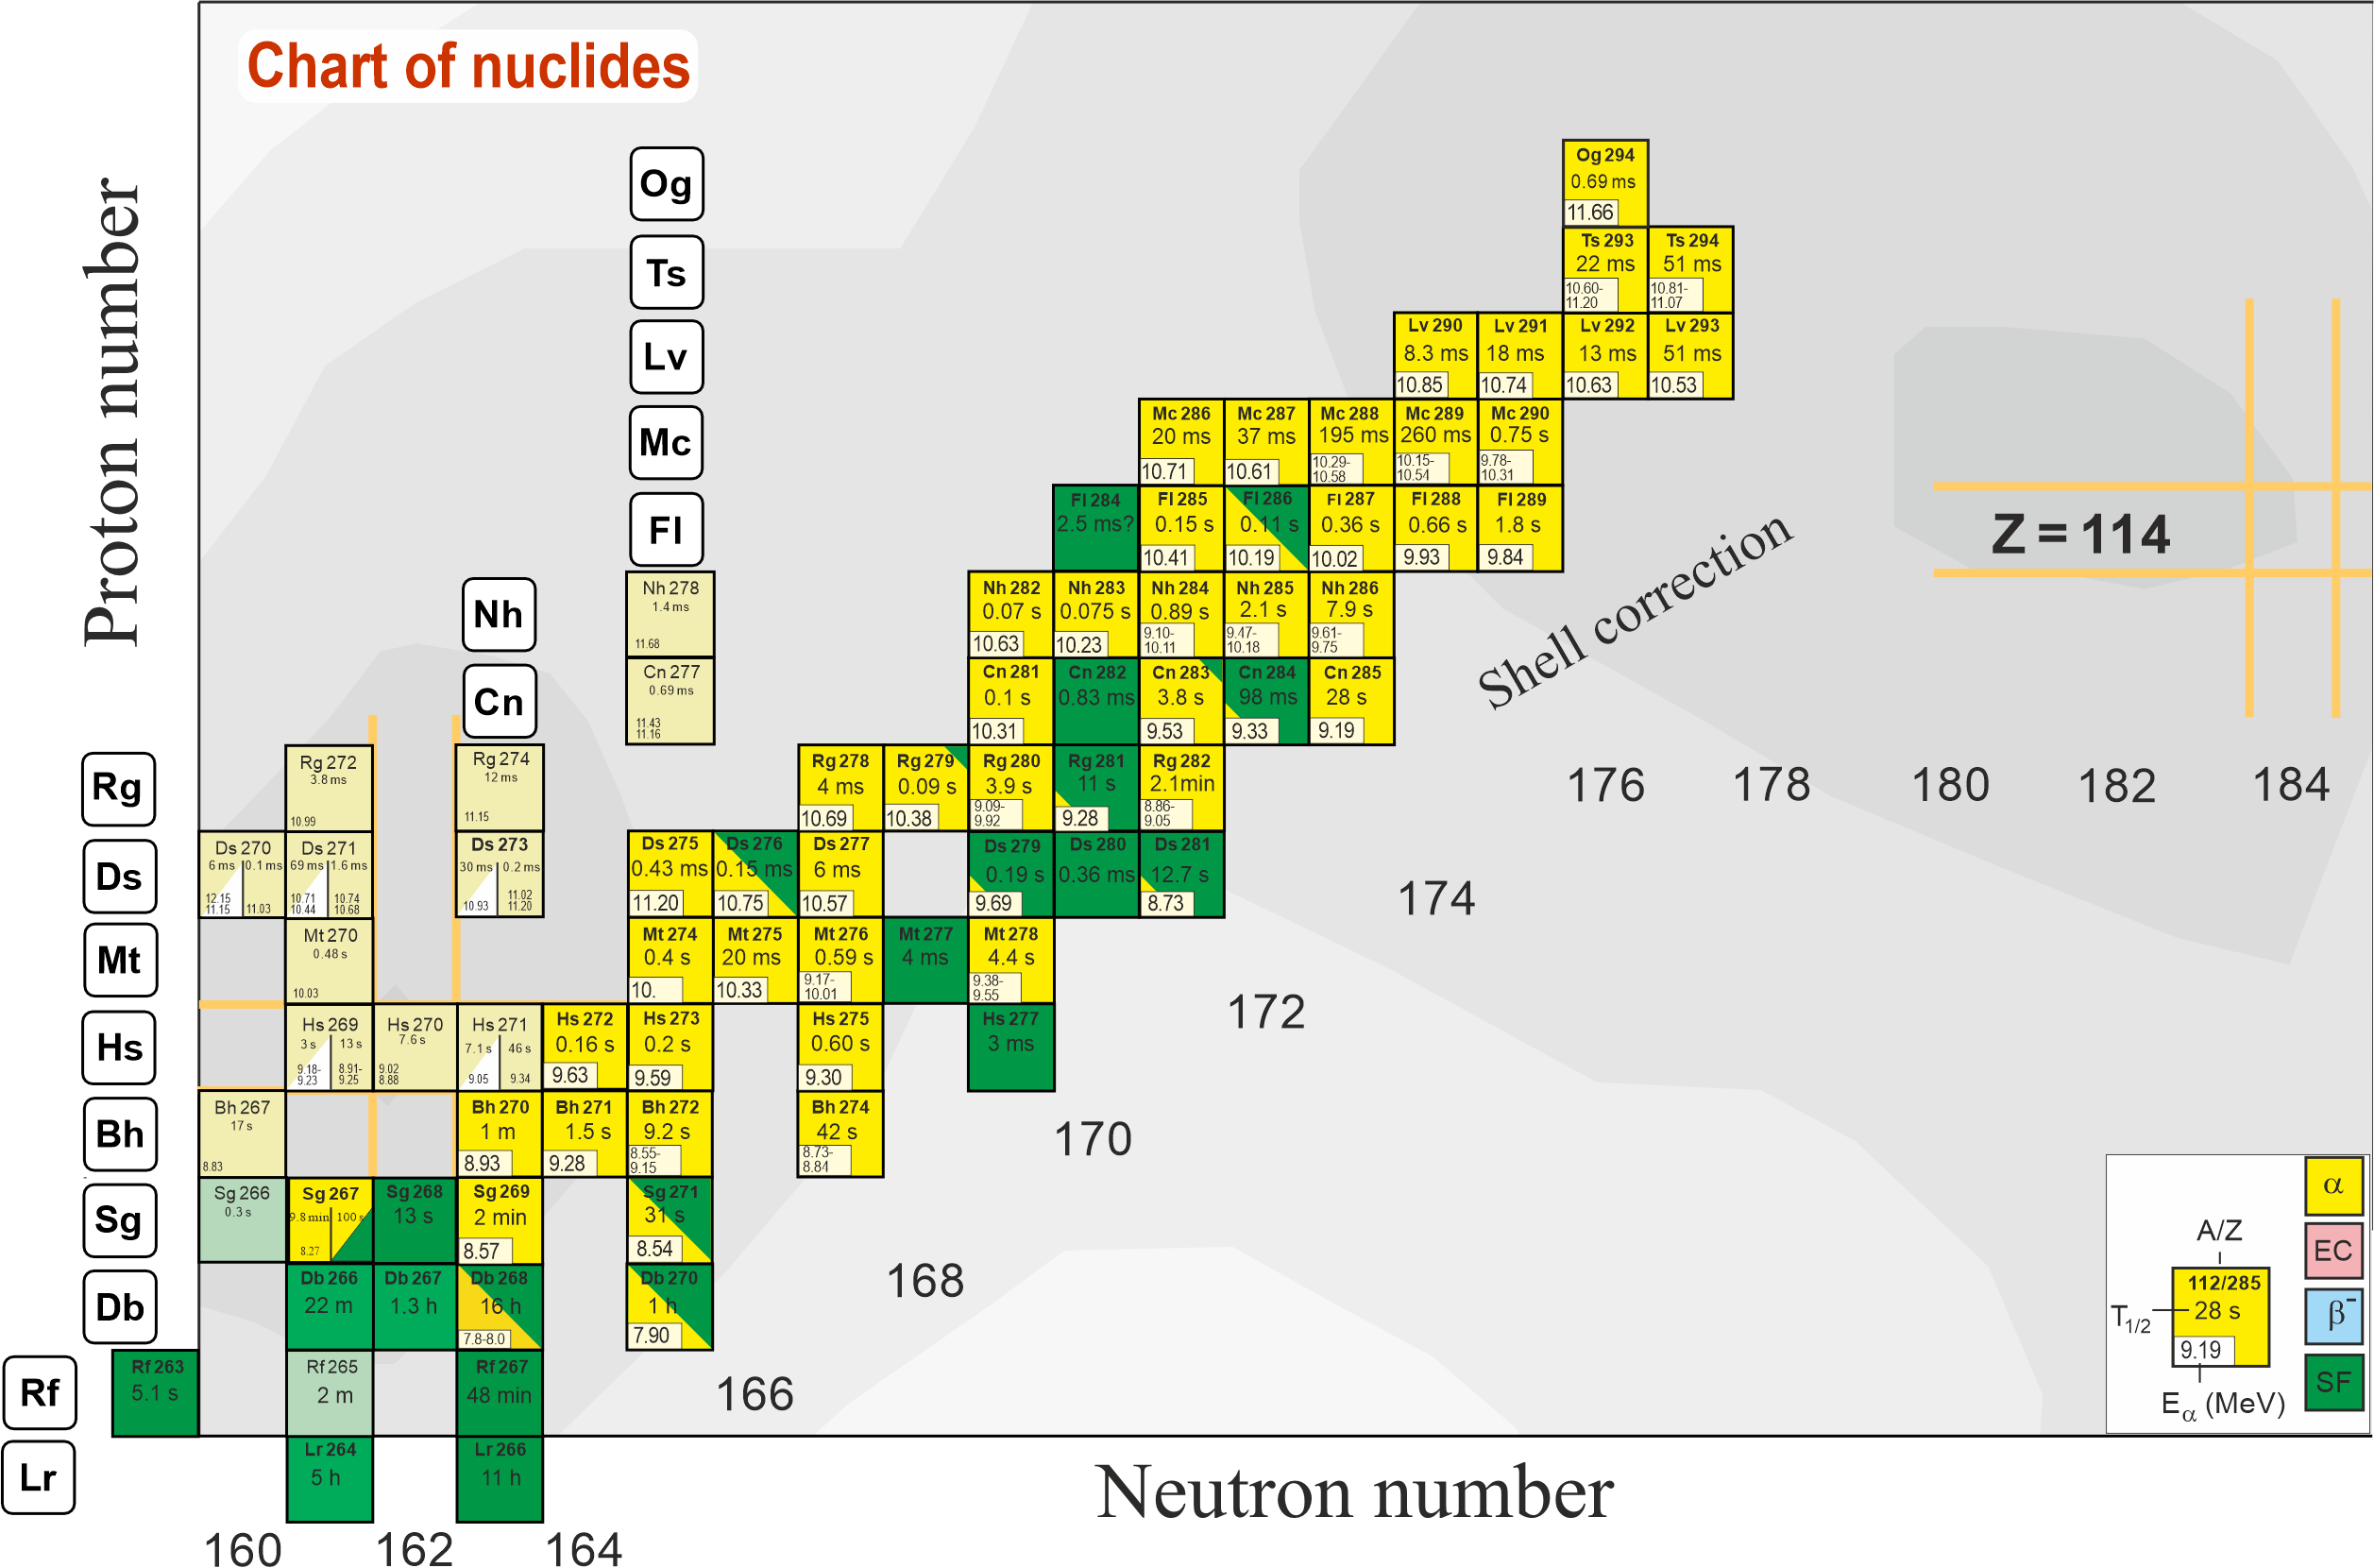
Area of known superheavy isotopes
Production of new isotopes and synthesis of new elements 119, 120…
⁵⁰Ti, ⁵⁴Cr…
²³⁸U – ²⁴⁹Cf + ⁴⁸Ca
Light isotopes
2n channel
Notes:
A new accelerator(CAFE2) and gas-filled recoil separator(SHANS2) have been built at IMP. The detectors and rotating target are shown.

Slide 4
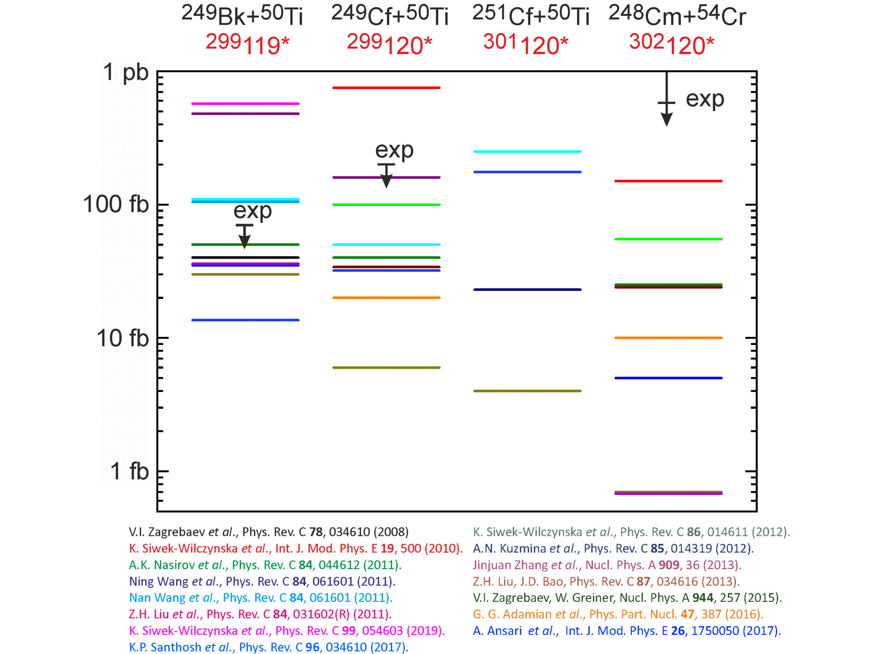
Predictions of production cross-sections of element 119 and 120 isotopes in ²⁴⁹Bk+⁵⁰Ti, ²⁴⁹⁻²⁵¹Cf+⁵⁰Ti , ²⁴⁸Cm+⁵⁴Cr reactions
(difference by 2-3 orders of magnitude)

Slide 5
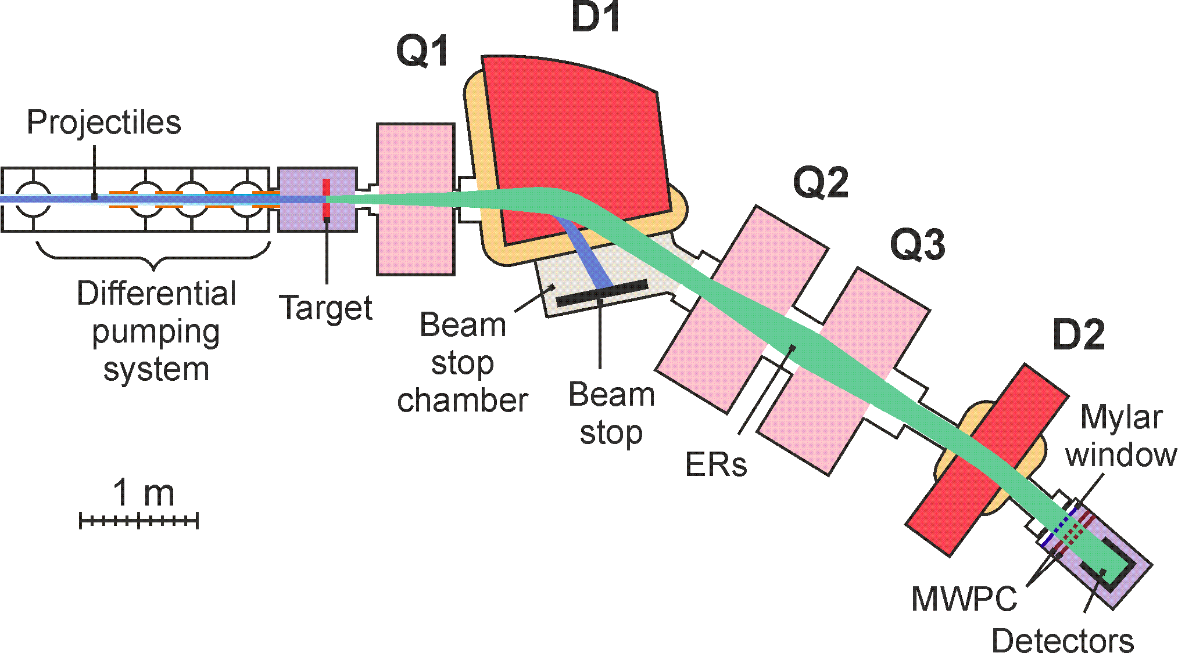
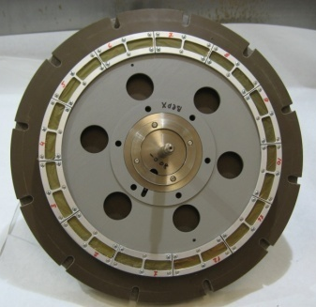
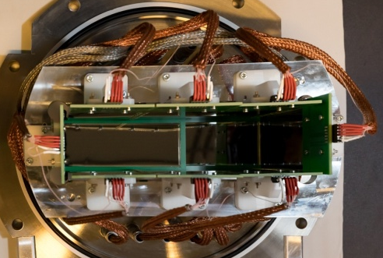
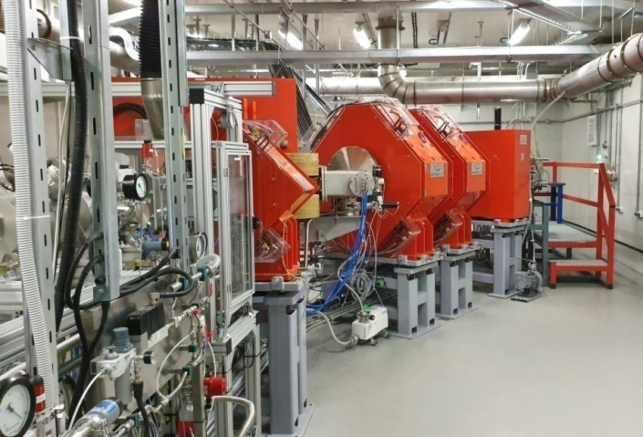
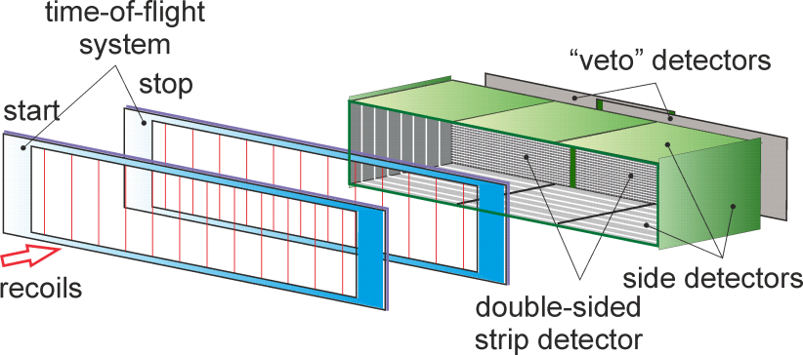
SHE Factory
Dubna Gas-Filled Recoil Separator DGFRS-2
24-sm target, 12 sectors
Rotating target, magnets (Q1, D1, Q2, Q3, D2), beamstopper, detector chamber.
48×220 DSSD & 60×120 SSSD
Digital and analog electronics

Slide 6
Experiment ²³⁸U + ⁵⁴Cr
Target ²³⁸U: 0.72 mg/cm²
Dose: 7.2 x 10¹⁹
Excitation energy: 42 MeV
For the first time:
Actinide + ⁵⁴Cr
New isotope ²⁸⁸Lv
Confirmation of ²⁸⁴Fl
Cross-section ~36 (12-82) fb
Notes:
For a more accurate estimation of the cross sections of reactions leading to the synthesis of new elements 119 and 120 in the fusion of 54Cr with Am and Cm isotopes, we performed a test experiment to obtain Lv nuclei in the 238U+54Cr reaction. The thickness of the target, the beam dose, the excitation energy and the distribution of the beam intensity over time are shown. The interval between the dates is one week. Two decay chains of 288Lv were registered, the alpha decay of which ended with spontaneous fission of the known isotope 284Fl. In the first chain, the energy and decay time of 288Lv corresponds well to the decay from the ground state to the ground state. In the second chain, the decay times in both cases are consistent with the times in the first chain. But the energy of the alpha particle is 1.45 MeV lower than in the first case. The data is preliminary. One of the reasons for the low energy may be incomplete registration of the particle, for example, the escape of alpha particle from the focal detector at a small angle to its surface or the nucleus got between the detector strips. Another reason may be the level structure of the nuclei. Data analysis continues.
Thus, for the first time in this experiment, a nucleus was obtained in the fusion reaction of a particle heavier than 48Ca with the nucleus of an actinide element, a new isotope was synthesized, and the decay properties of 284Fl were confirmed.
The reaction cross-section was 0.1 pb.

Slide 7
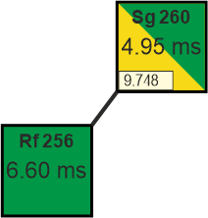
Experiment ²³⁸U + ⁵⁴Cr
Possible reasons: 4. It’s product of multi-transfer nucleon reactions:
Possible reasons: 1. Temporary change in the gain of the recording equipment - could not be confirmed or refuted. 2. α-particle deposited energy only in focal detector and escaped from it at the small angle.
3. Decay to excited state of ²⁸⁴Fl – seems very unlikely during large differences between α-decay energies and close decay times.

Slide 8
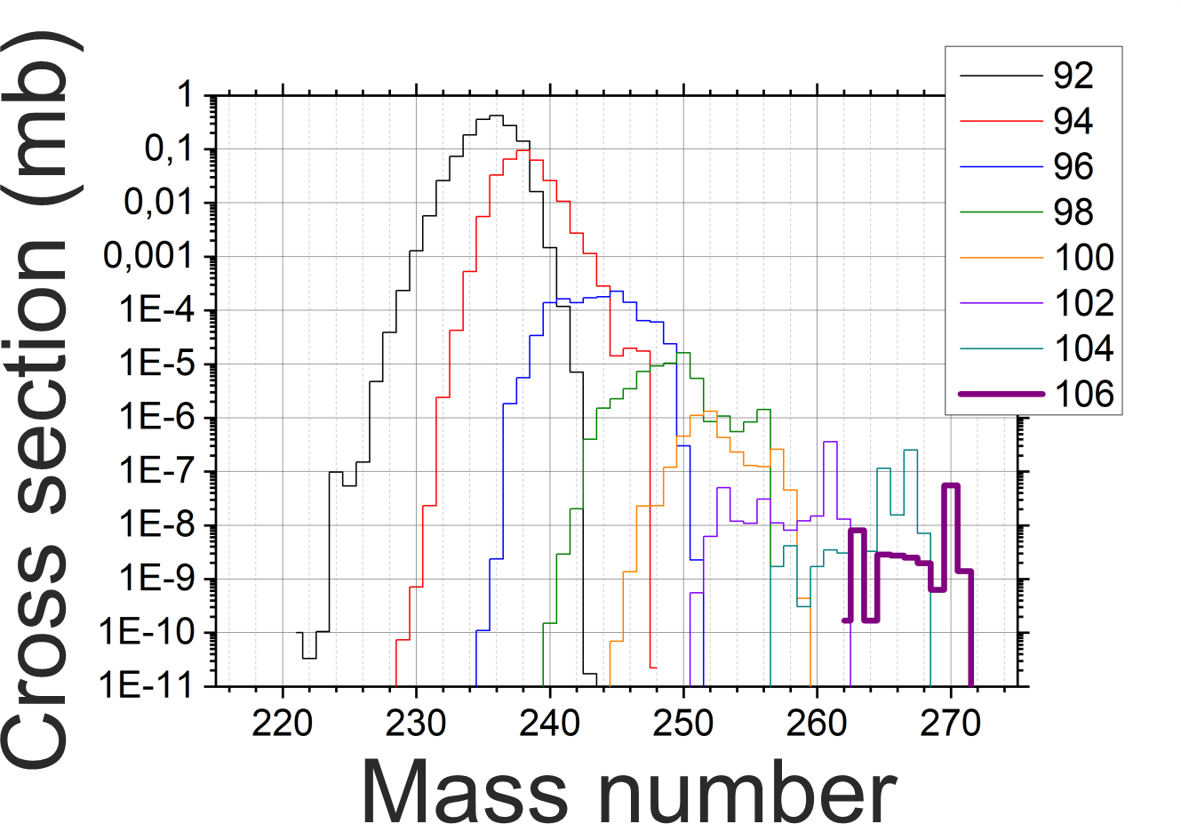
Yields for multi-nucleons transfer reaction products
Karpov, Saiko
Y (²⁶⁰Sg / ^{262,264,266,268,270}Sg) < 1/500

Slide 9
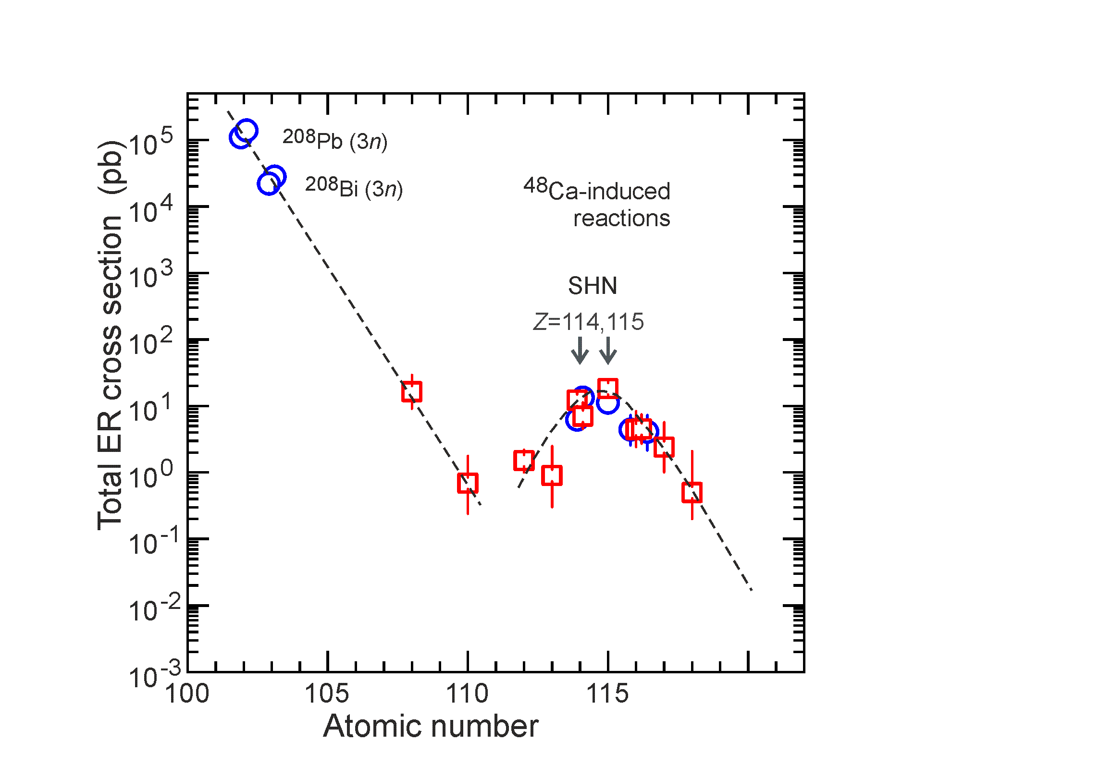
Next stage
Synthesis of new elements 119 and 120

Slide 10
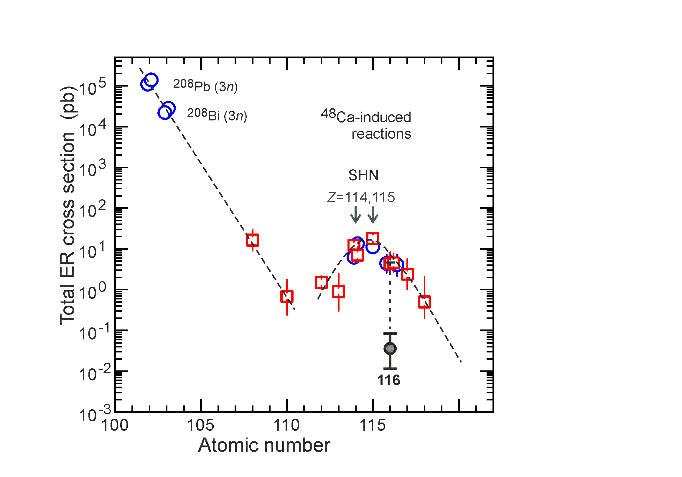
Next stage
Synthesis of new elements 119 and 120

Slide 11
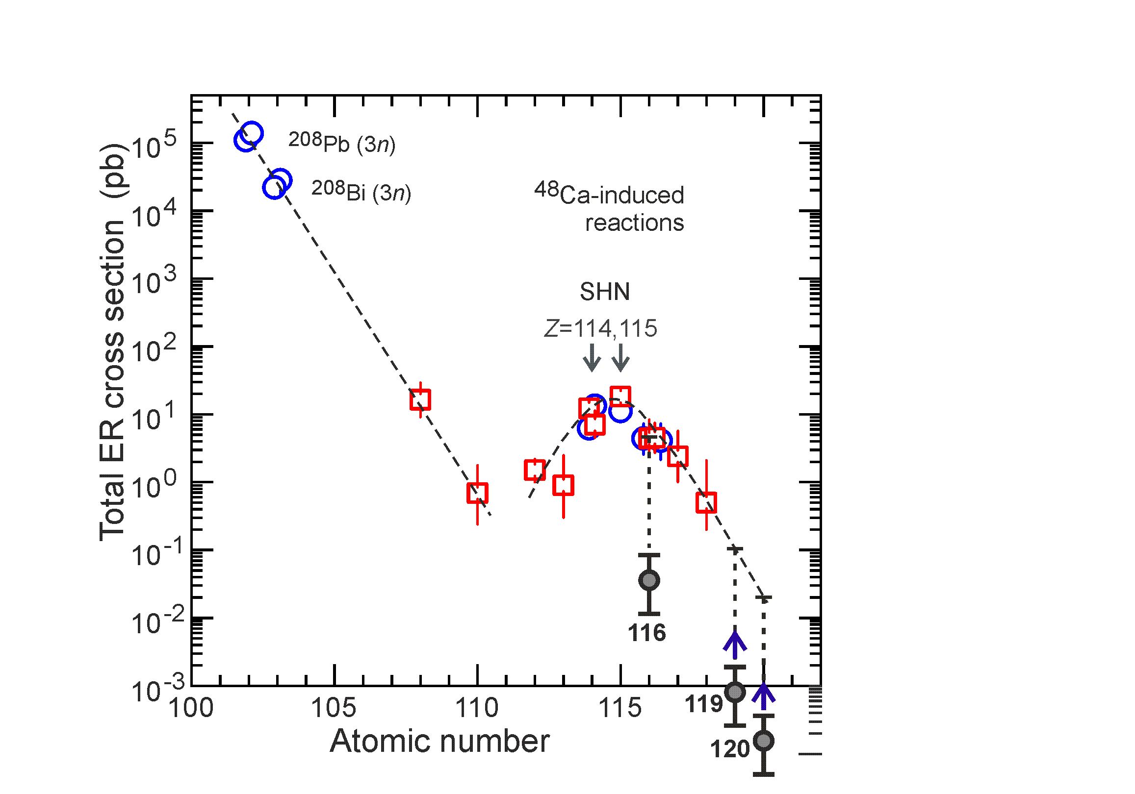
Next stage
Synthesis of new elements 119 and 120
σ=1 fb, h_{t}=0.7 mg/cm², I_{beam}=4 pμA → ≈1 / 3 year
Z_{mag} = 120 – 126?
119:
Cross section ~1 fb

Slide 12
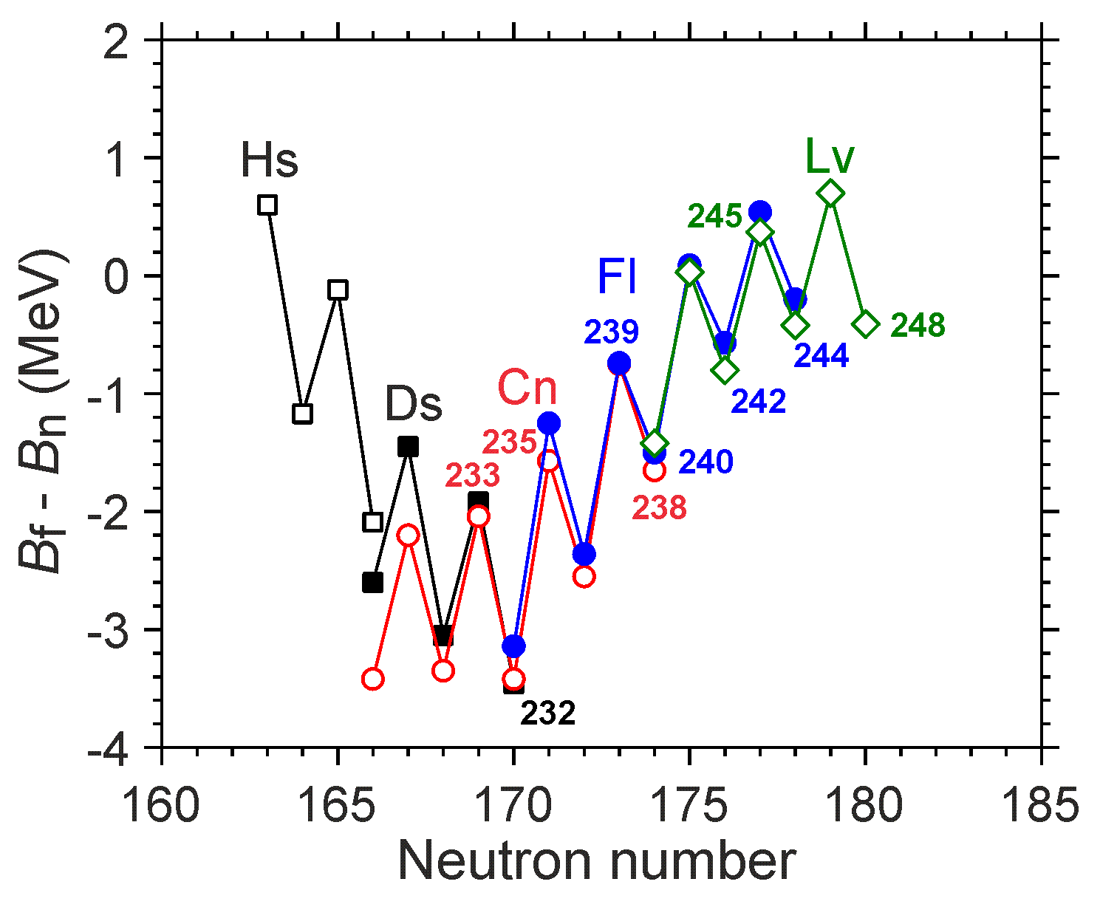
Next stage
Synthesis of new elements 119 and 120
σ=1 fb, h_{t}=0.7 mg/cm², I_{beam}=4 pμA → ≈1 / 3 year
119:
Cross section ~1 fb
Estimation accuracy:
experiment
²⁴⁸Cm + ⁴⁸Ca → ²⁹⁶Lv (N=180)
²⁴⁵Cm + ⁴⁸Ca → ²⁹³Lv (N=177)
²³⁸U + ⁵⁴Cr → ²⁹²Lv (N=176)
176
Less survivability –
Larger formation probability of compound nucleus
P. Jachimowicz et al., 2021

Slide 13
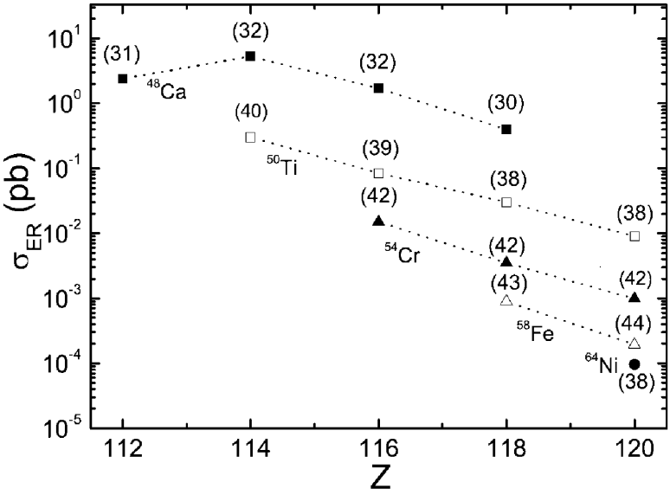
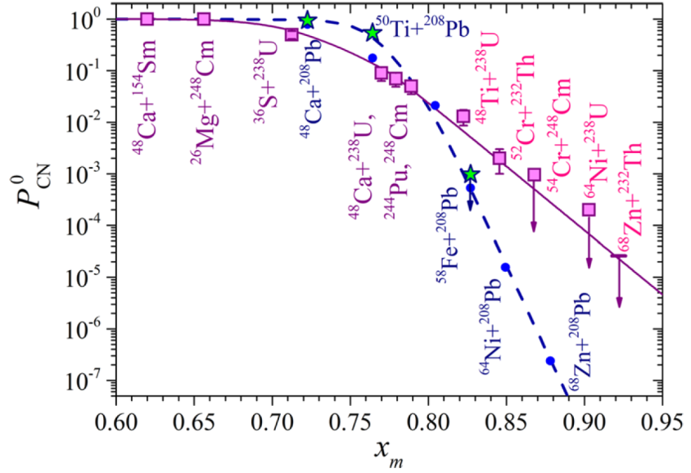
Next stage
Synthesis of new elements 119 and 120
⁴⁸Ca ⁵⁰Ti ⁵⁴Cr
²⁴⁵Cm + ⁴⁸Ca ²⁹³Lv*
²⁴²Pu + ⁵⁰Ti ²⁹²Lv*
²³⁸U + ⁵⁴Cr ²⁹²Lv*
~8
⁴⁸Ca
⁵⁰Ti
~4
⁵⁴Cr
~10
⁵⁸Fe
G.G. Adamian et al., PRC 101, 034301 (2020)
M.G. Itkis et al., EPJ A 58, 178 (2022)

Slide 14
Experiment ²⁴²Pu + ⁵⁰Ti
Target ²⁴²Pu: 0.72 mg/cm²
Beam dose: 1.5 x 10¹⁹
Excitation energy: 41 MeV
For the first time:
New isotope ²⁸⁰Cn
α-decay of ²⁸⁴Fl
Cross-section ~220 (70-490) fb

Slide 15
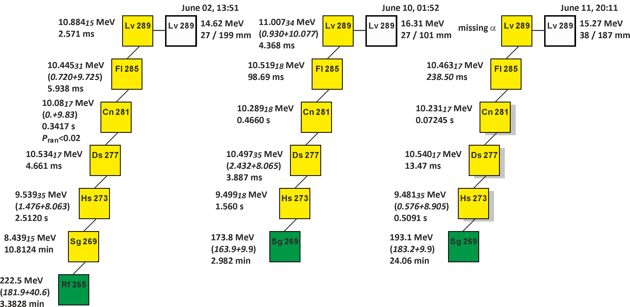
Experiment ²⁴²Pu + ⁵⁰Ti
Target ²⁴²Pu: 0.72 mg/cm²
Beam dose: 1.5 x 10¹⁹
Excitation energy: 41 MeV
For the first time:
New isotope ²⁸⁹Lv
Cross-section ~320 (140-660) fb

Slide 16
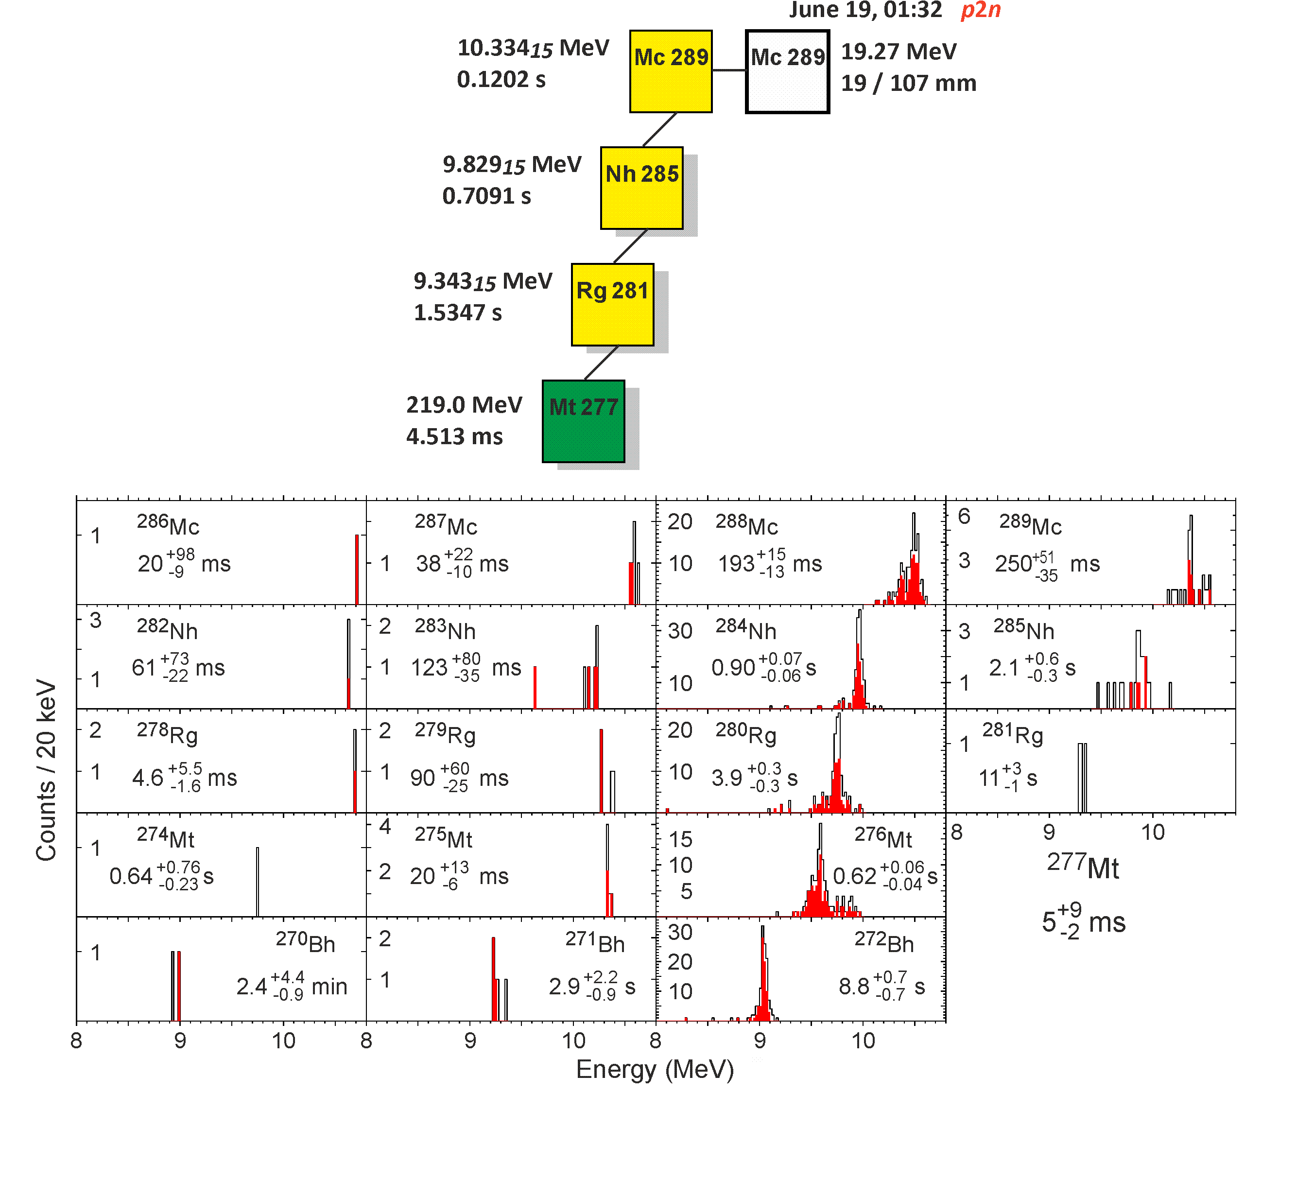
Experiment ²⁴²Pu + ⁵⁰Ti
Target ²⁴²Pu: 0.72 mg/cm²
Beam dose: 1.5 x 10¹⁹
Excitation energy: 41 MeV
For the first time:
pxn channel
Actinide + ⁴⁸Ca, ⁵⁰Ti, ⁵⁴Cr
Cross-section ~0.11 (0.02-0.37) pb

Slide 17
Decay properties of observed isotopes
Nucleus | Decay mode, branch (%) ^{a,b} | Half-life ^{b} | E_{a} (MeV) ^{c} | Q_{a} (MeV) ^{c} | T_{α} ^{b} | T_{SF} ^{b}
²⁸⁸Lv | α | 2.0$\begin{matrix}+2.3 \\ −0.7\end{matrix}$ ms | 11.084(15) | 11.240(15)
²⁸⁴Fl | SF: 76$\begin{matrix}+9 \\ −19\end{matrix}$; α | 2.5$\begin{matrix}+1.2 \\ −0.6\end{matrix}$ ms | 10.570(17) | 10.721(17) | 10.4$\begin{matrix}+8.4 \\ −5.4\end{matrix}$ ms | 3.2$\begin{matrix}+2.0 \\ −0.9\end{matrix}$ ms
²⁸⁰Cn | SF | 10$\begin{matrix}+18 \\ −4\end{matrix}$ ms
²⁸⁹Lv | α | 2.4$\begin{matrix}+4.4 \\ −0.9\end{matrix}$ ms | 10.904(15) | 11.057(15)
²⁸⁵Fl | α | 86$\begin{matrix}+43 \\ −21\end{matrix}$ ms | 10.450(17) | 10.600(17)
²⁸¹Cn | α | 0.16$\begin{matrix}+0.08 \\ −0.04\end{matrix}$ s | 10.270(17) | 10.418(17)
²⁷⁷Ds | α | 4.0$\begin{matrix}+1.8 \\ −1.0\end{matrix}$ ms | 10.538(17) | 10.692(17)
²⁷³Hs | α | 0.68$\begin{matrix}+0.30 \\ −0.16\end{matrix}$ s | 9.509(17) | 9.650(17)
²⁶⁹Sg | α: 87$\begin{matrix}+6 \\ −23\end{matrix}$ | 13$\begin{matrix}+6 \\ −4\end{matrix}$ min | 8.423(15) | 8.550(15) | 14$\begin{matrix}+9 \\ −3\end{matrix}$ min | 1.6$\begin{matrix}+1.9 \\ −1.1\end{matrix}$ h
²⁶⁵Rf | SF | 1.3$\begin{matrix}+0.8 \\ −0.3\end{matrix}$ min
ª Branch is given for the most probable decay mode (a or SF). The branching ratio is not listed when only one decay mode was observed.
^{b} Error bars correspond to 68%-confidence level.
^{c} Energy uncertainties (standard deviations) given in parentheses correspond to the data with the best energy resolution.

Slide 18
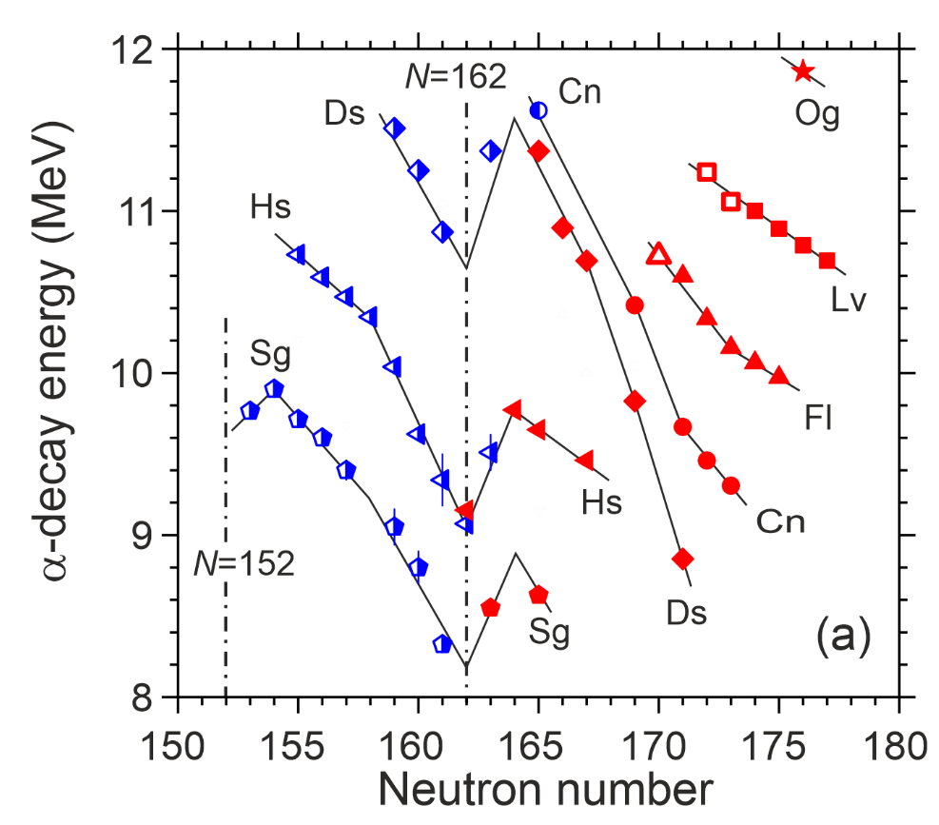
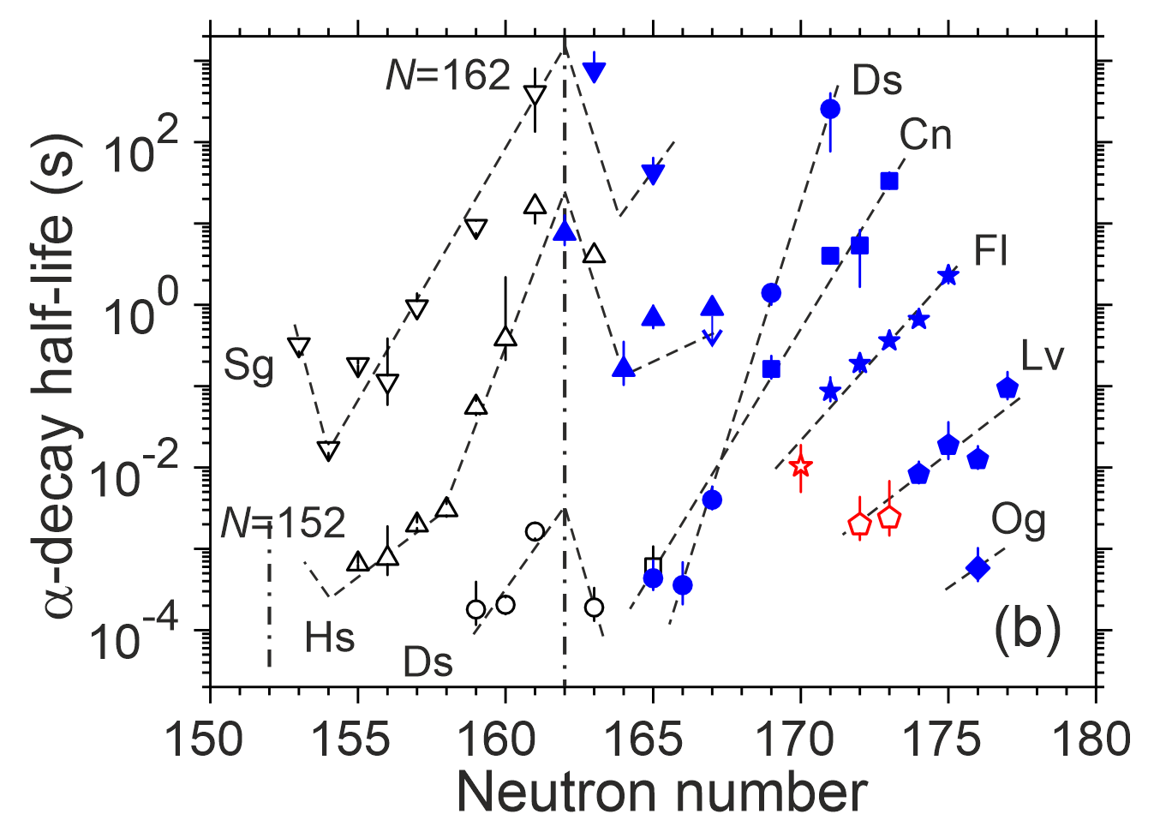
Decay properties of observed isotopes

Slide 19
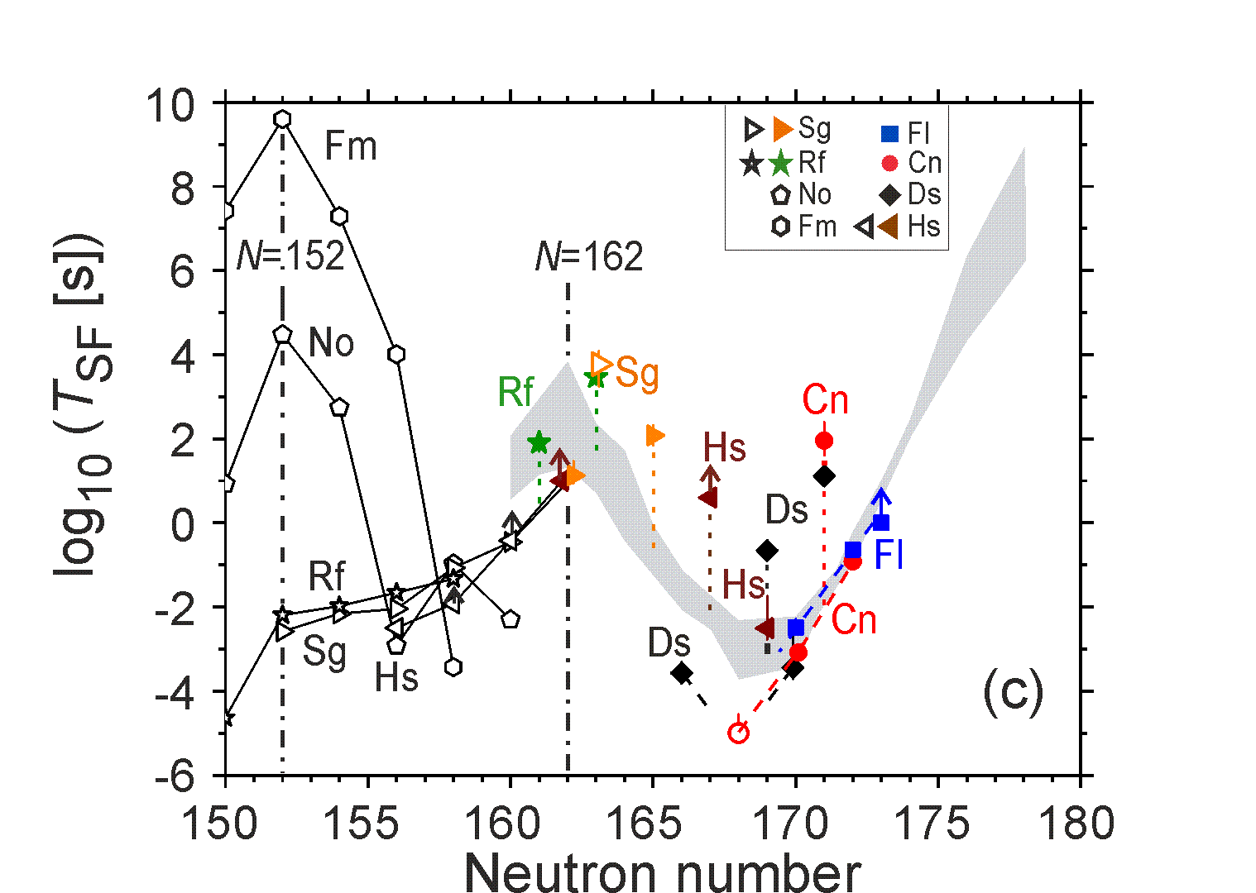
Decay properties of observed isotopes

Slide 20
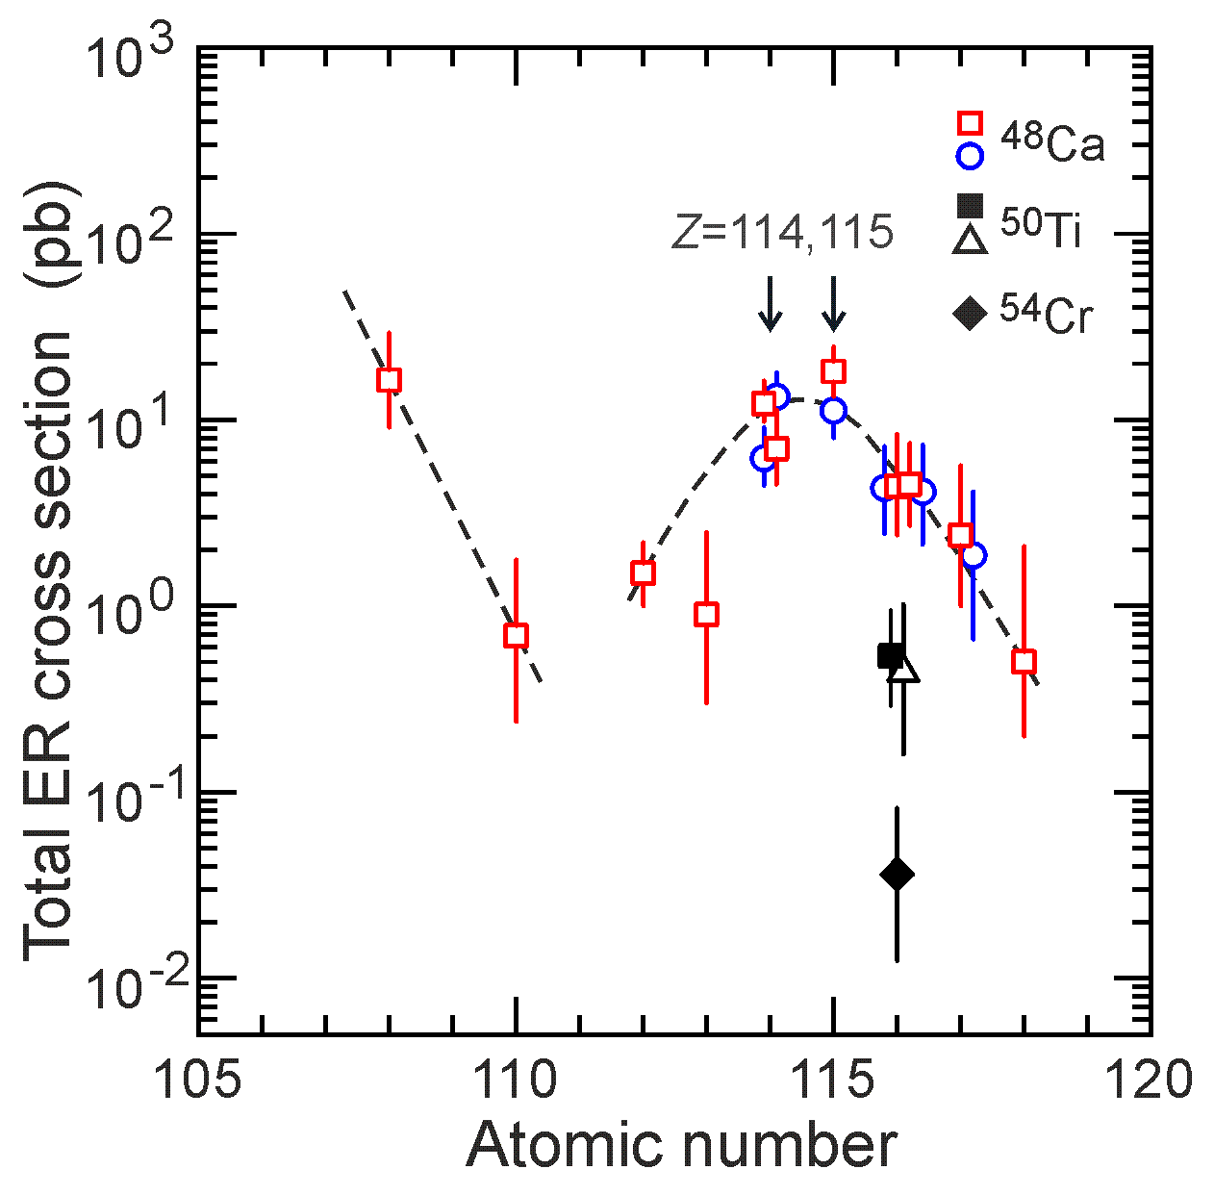
Production cross-sections of superheavy elements
⁵⁰Ti + ²⁴⁴Pu J.M. Gates et al.
PRL 133, 172502 (2024)

Slide 21
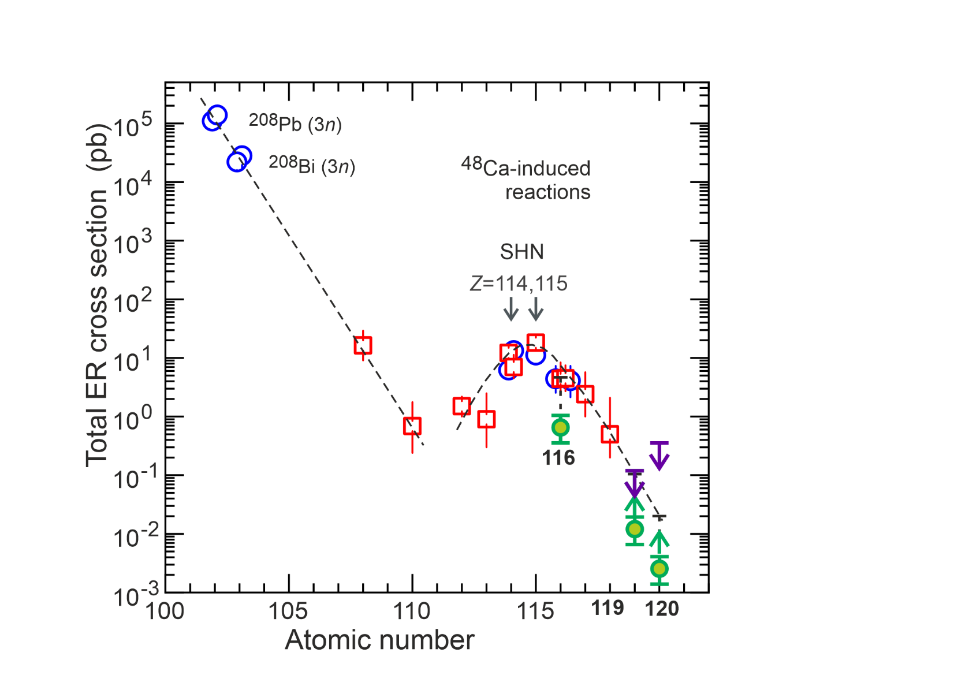
Production cross-sections of superheavy elements
119: ~10 fb
120: ~2.5 fb
Gates 2024: 25-50 fb Z=120
Khuyagbaatar 2024: 20 fb Z=119
6 fb Z=120

Slide 22
DGFRS-2: Results of experiments
²³⁸U+⁵⁴Cr
Cross section of the actinide + ⁵⁴Cr reaction (decrease by ~150)
Synthesis of new isotope ²⁸⁸Lv
Confirmation of ²⁸⁴Fl
²⁴²Pu+⁵⁰Ti
Cross section of reaction (decrease by ~10)
Synthesis of new isotopes ²⁸⁹Lv and ²⁸⁰Cn
α-decay of ²⁸⁴Fl
First observation of pxn-evaporation channel
Cross section of the reaction with ⁵⁰Ti is ~15 times larger than with ⁵⁴Cr
Discovery of new SHE 119 and 120 is within experimental reach!

Slide 23
Thank you for attention!

Slide 24
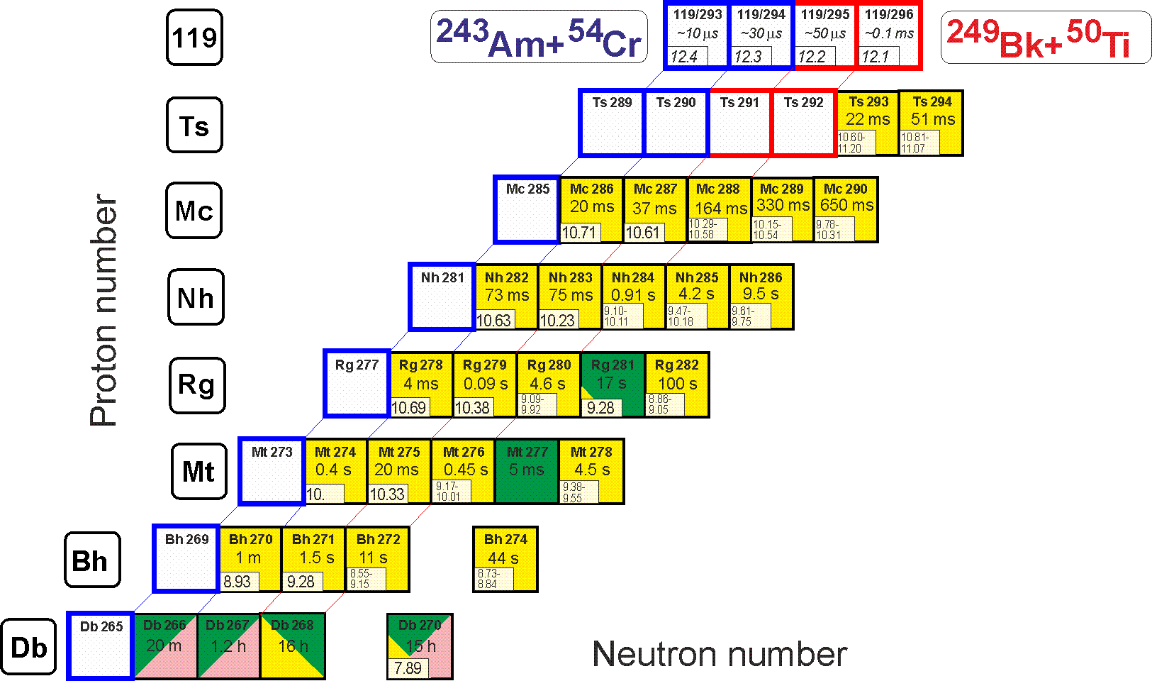
Perspectives
Synthesis of new element 119
²⁴³Am(⁵⁴Cr,3-4n)^{293,294}119 ²⁴⁹Bk(⁵⁰Ti,3-4n)^{295,296}119
²³⁷Np(⁴⁸Ca,3-4n)^{281,282}Nh
Identification by correlation method

Slide 25
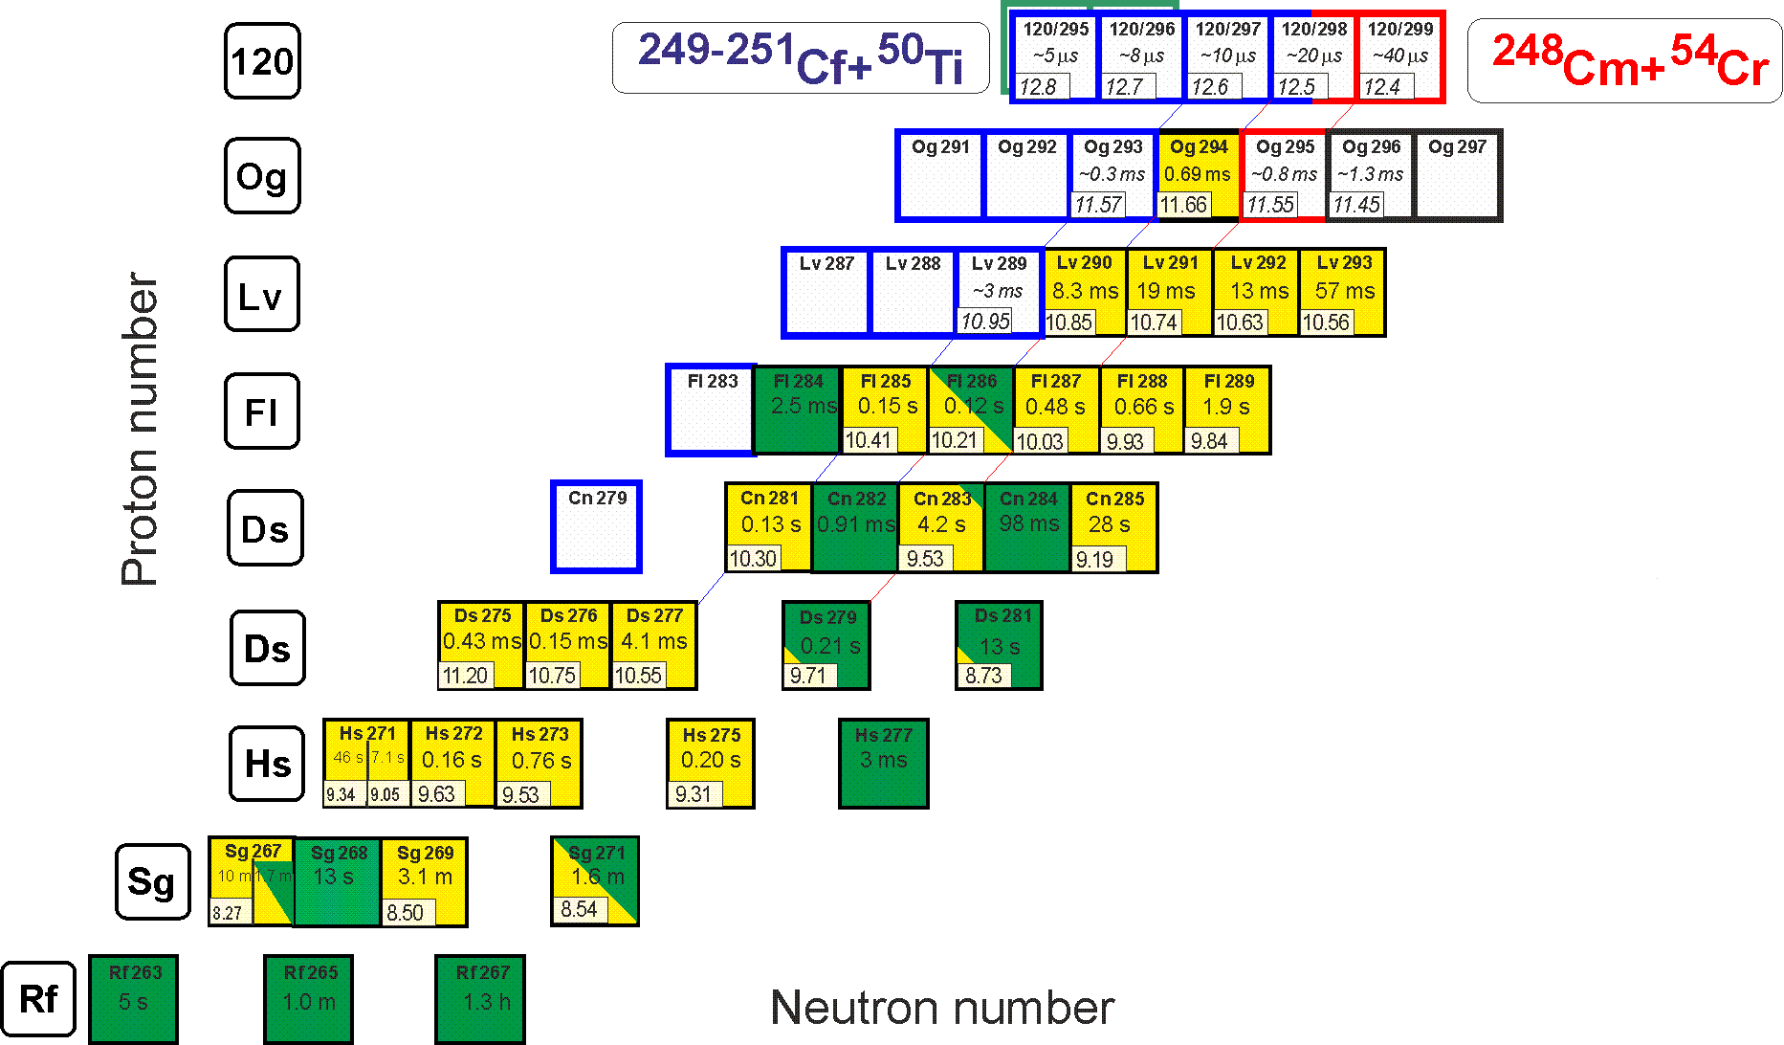
Perspectives
Synthesis of new element 120
²⁴⁹⁻²⁵¹Cf(⁵⁰Ti,3-4n)²⁹⁵⁻²⁹⁸120 ²⁴⁸Cm(⁵⁴Cr,3-4n)^{298,299}120
²⁴⁵Cm(⁵⁴Cr,3-4n)^{295,296}120
Known decay properties

