Slide 1



International Conference on 50th anniversary of cold fusion
Status of the Nihonium Chemistry at IMP
Zhi QIN
On behalf of the Nh collaboration
20th Nov. 2024 Armenia

Slide 2
Contents
01
Background
02
Development of the LEGEND system
03
Test experiments of short-lived Fr and Tl
04
First experiments of Nh at IMP
05
Future plan

Slide 3
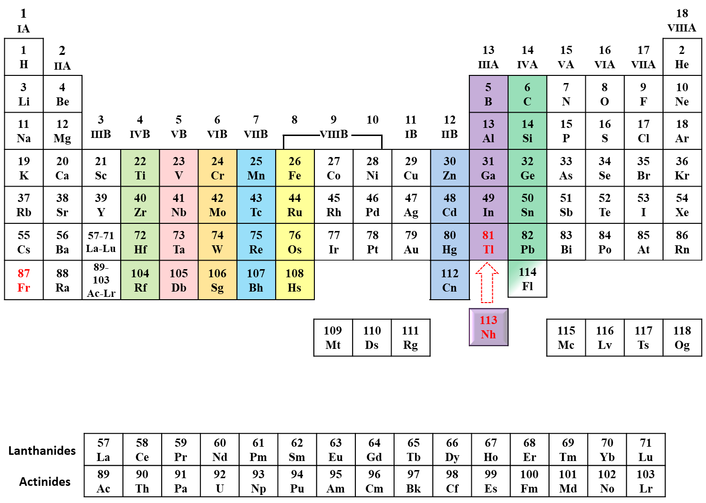
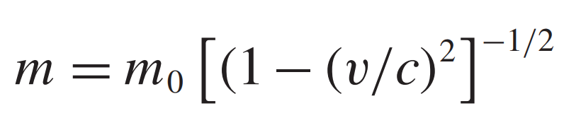
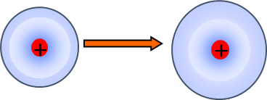
Chemistry of SHEs
Periodic Table of Elements
Relativistic effects on SHEs?

Slide 4
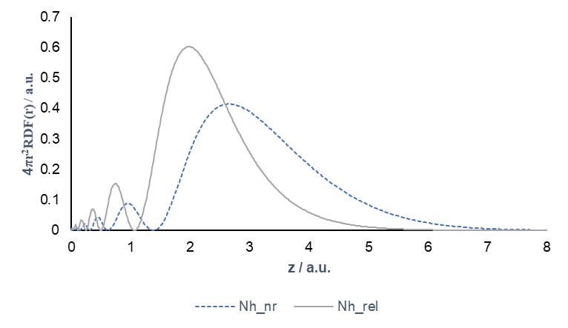
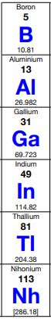
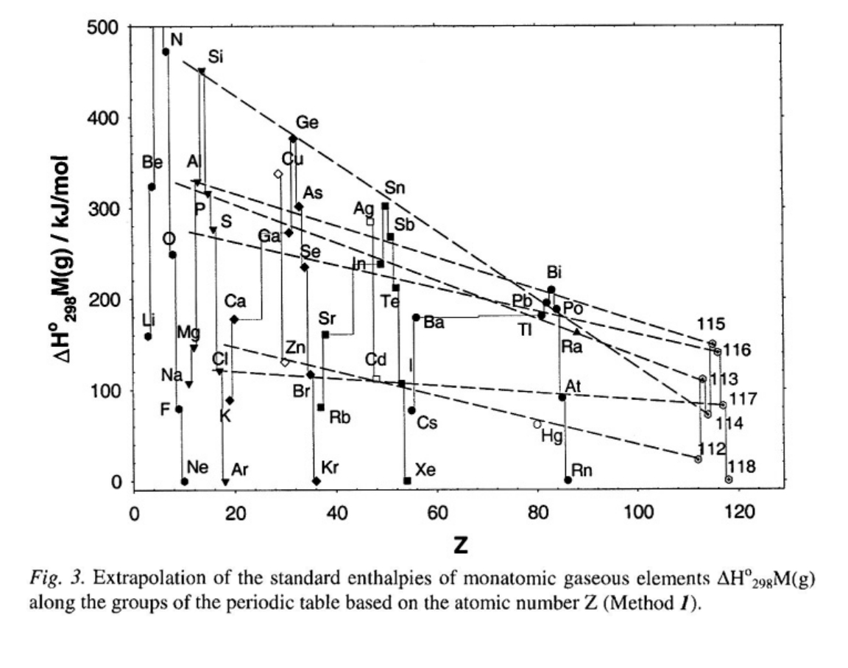
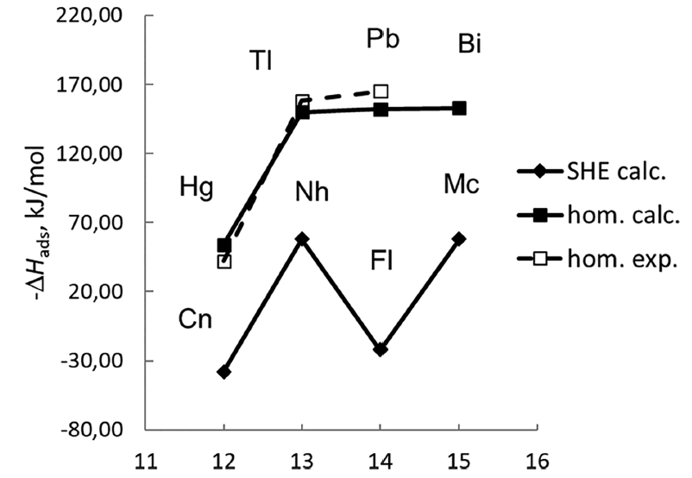
Chemical property of Nh (E113)
Periodic Law of Elements on Group 13
Relativistic Contraction of 7s-Orbital on Nh
+3 ions Stability
+1 ions Stability
Metallicity
Reactivity
Volatility
?
[Rn]5f¹⁴6d¹⁰7s²7p_{1/2}
Calculated Volatility of Nh
Theoretical predictions of -ΔH_{ads}(kJ/mol) on SiO₂
(V. Pershina, M. Iliaš, and A. Yakushev, Inorg.Chem.)

Slide 5

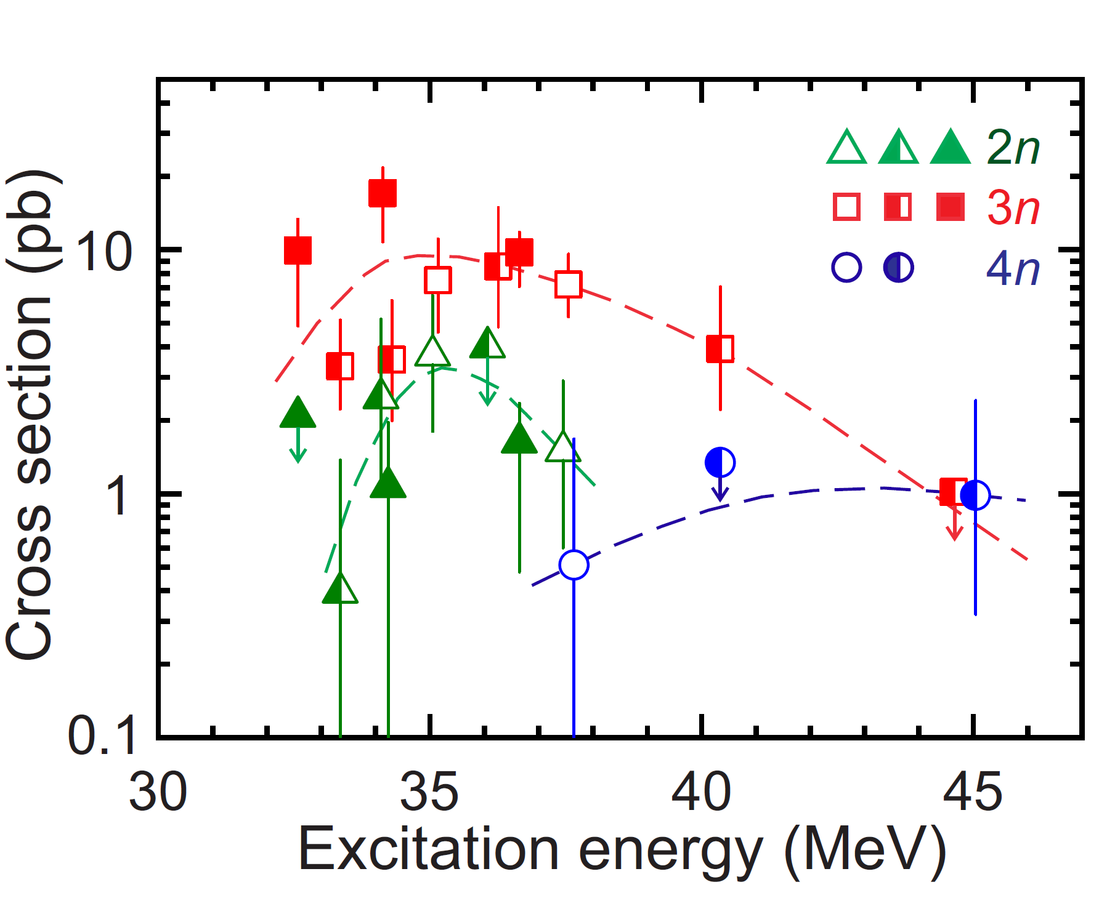
Production and identification of Nh
²⁴³Am(⁴⁸Ca,3n)²⁸⁸Mc
Neutron◊3
⁴⁸Ca
²⁴³Am
²⁹¹Mc
²⁸⁸Mc
α
288 ms
²⁸⁴Nh
α
0.77 s
Identification of Nh
²⁸⁰Rg
α
3.2 s
²⁷⁶Mt
α
0.51 s
²⁷²Bh
α
SF
7.2 s
²⁶⁸Db
28 h
α
16 h
σ ≈ 17 pb; T_{1/2} ≈ 0.77 s; α-α-α-α(E_{α} ≥ 9 MeV)
²⁸⁴Nh is suitable for the chemical experiment!
²⁶⁴Lr
SF
4.9 h
Y. Oganessian et al., PRC 106, L031301 (2022)

Slide 6
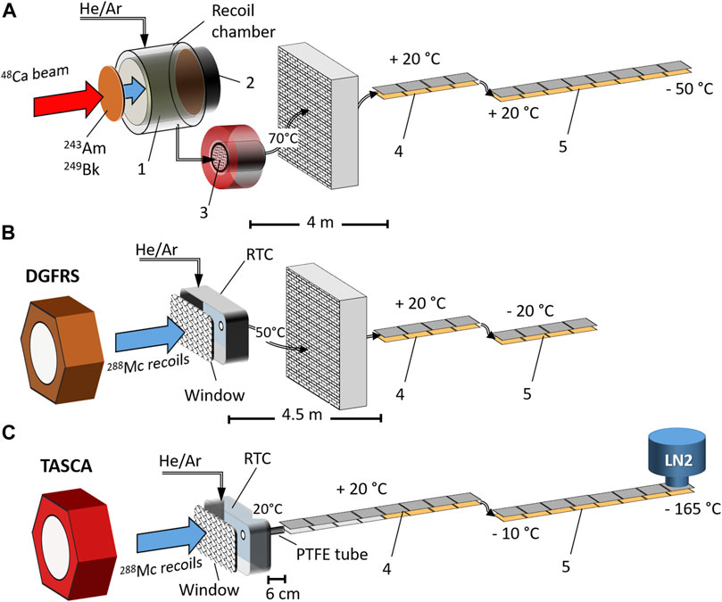
Previous chemical study with Nh
(I)：Dubna & GSI, 2014~2017
A. Dubna (Mendeleev Commun. 24, 2014)
⁴⁸Ca+²⁴³Am, U-400+RTC, 5 events
Confirmed the synthesis of E115 and E113 by ⁴⁸Ca+²⁴³Am
No physical pre-separation, high background
-ΔH > 60 kJ/mol
B. Dubna (Eur. Phys. J. A. 53, 2017)
⁴⁸Ca+²⁴³Am, U-400 + DGFRS + RTC，0 events
PTFE capillary (4.5 m)
-ΔH > 45 kJ/mol
C. GSI (Frontiers in Chemistry 9, 2016)
⁴⁸Ca+²⁴³Am, TASCA + RTC, 20 days，0 events
PTFE capillary (6 cm)
-ΔH > 50 kJ/mol

Slide 7
Previous chemical study with Nh
(II)： GSI, 2020~2024 (Frontiers in Chemistry 12, 2024)
No Teflon capillary！ 18 long decay chains of Nh within 6 weeks ≈ 40%

Slide 8
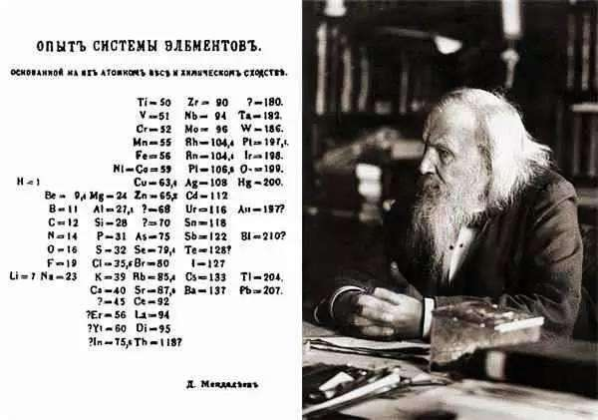
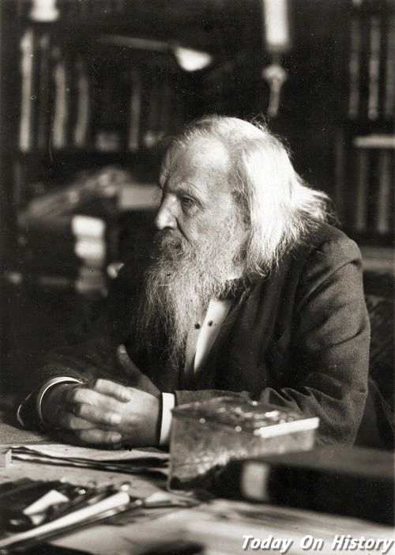
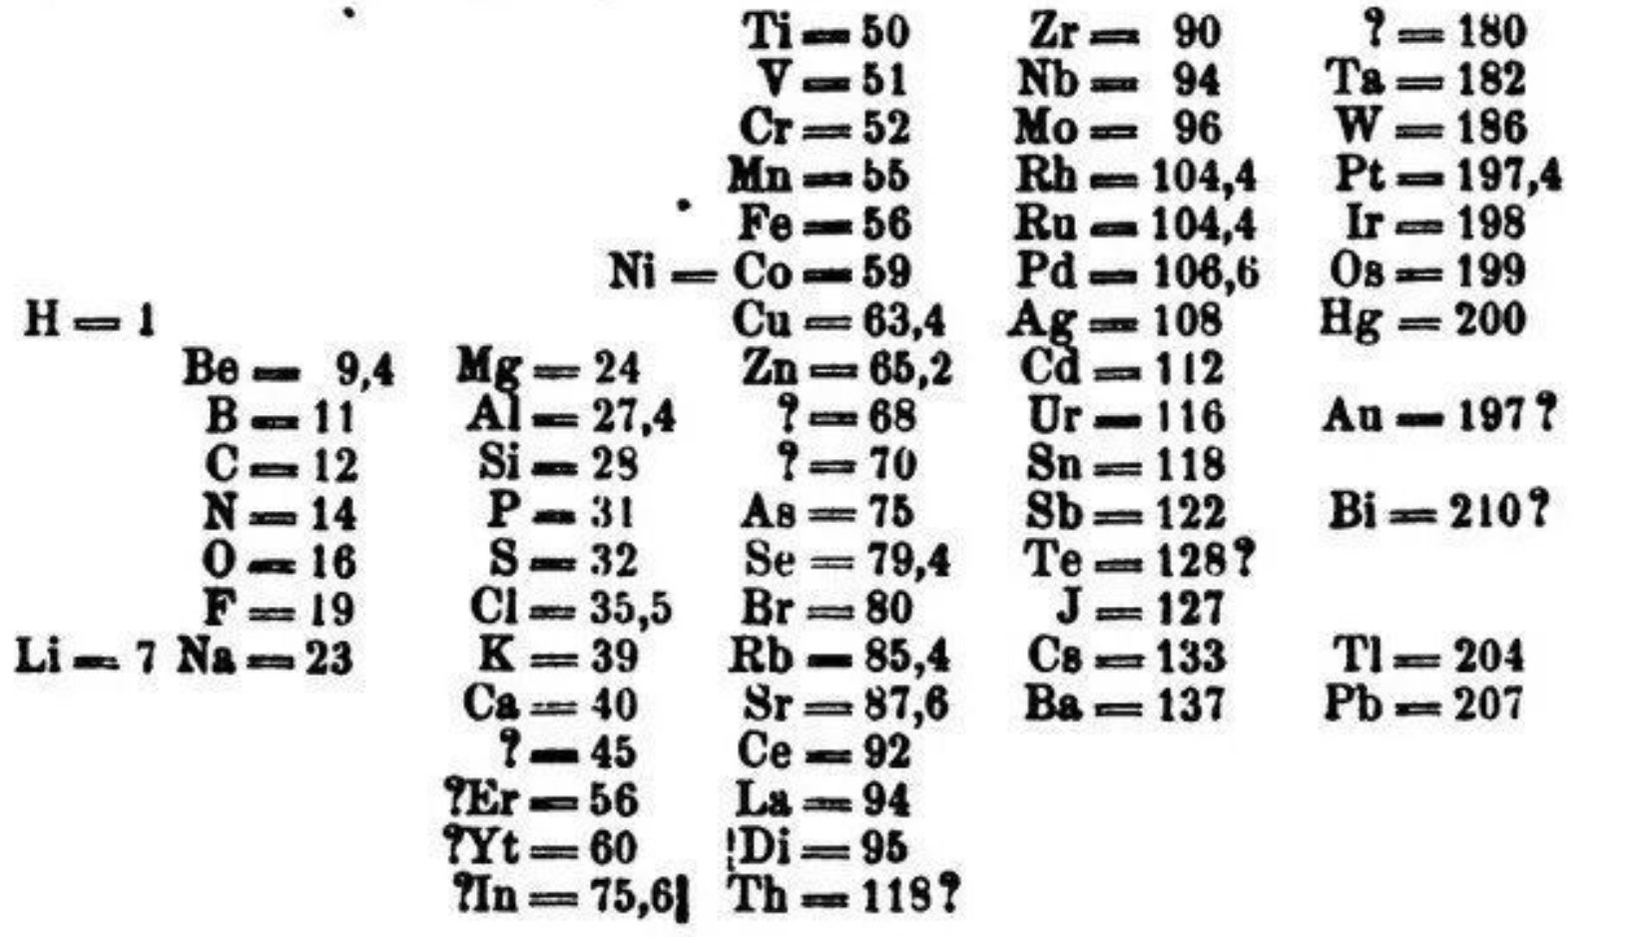
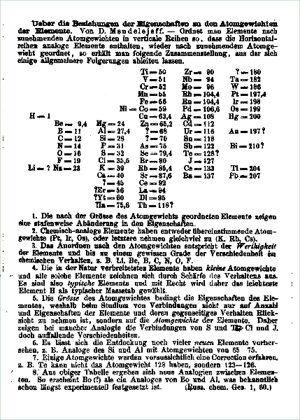
Background
Tl and Fr for the preparation of Nh study
Nh compared with Tl and Fr:
Physical and atomic properties
Valence shell electron configuration
Chemical reactivity
Why we choose Fr?
High chemical reactivity
Low transport efficiency
Non-volatile; lower limit for Nh
Suitable for on-line experiment:
  Produced by ⁴⁰Ar+¹⁶⁹Tm reaction
  Short-lived, T_{1/2} around 1 s
  α-α correlation
Atomic properties of Tl, Fr and Nh
 | m.p.(K) | b.p.(K) | R_{vdw}(Å) | AR(Å) | IP(eV) | EA(eV) | α(au) | Valence Electron Configuration | -ΔH_{ads}(kJ/mol)
 |  |  |  |  |  |  |  |  | Quartz | Teflon | Au
Tl | 577 | 1746 | 1.96 | 1.90 | 6.11 | 0.38 | 51 | 6p¹ | 153~172 | 20 | 250
Fr | 300 | 950 | 3.09 | n/a | 4.07 | 0.49 | 311.5 | 7s¹ | unknown | 21; 72(?) | 136
Nh | 700 | 1430 | 1.84 | 1.22 | 7.31 | 0.68 | 29.9 | 7p¹ | 58 | 14 | 120~180

Slide 9
Contents
01
Background
02
Development of the LEGEND system
03
Test experiments of short-lived Fr and Tl
04
First experiments of Nh at IMP
05
Future plan

Slide 10

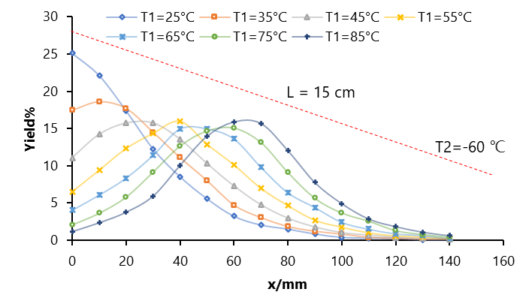
LEGEND system
T
MFC
Gas loop & purification
LEGEND Detector
SHANS2
Vacuum
Data acquisition system
Temperature indicator
甘肃敦煌飞天（LEGEND）
Legend with temperature gradient
Monte Carlo simulation [-ΔH_{ads}(Nh)=58 kJ/mol]
L
…
…
T1
T1
T2

Slide 11
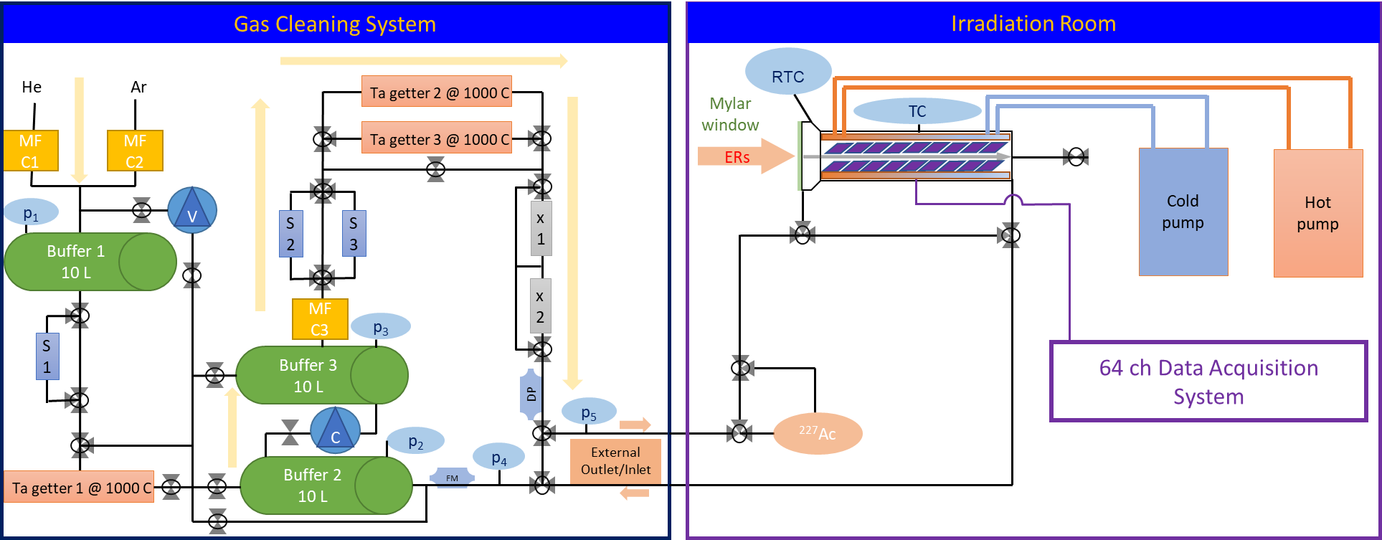
LEGEND system
1. Gas Cleaning system
Gas purification and circulation loop (remove H₂O, O₂, H₂……)
2. Vacuum Window
Mylar foils, honeycomb-hole grids (high transparency)
3. RTC
Small volume with high efficacy (short transport time)
4. TC
Direct connected with RTC (Si-detectors array with negative temperature gradient)

Slide 12
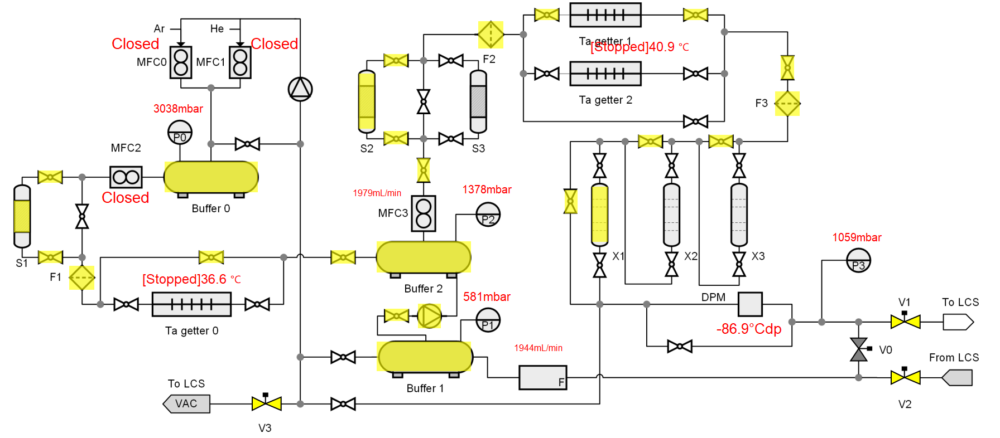
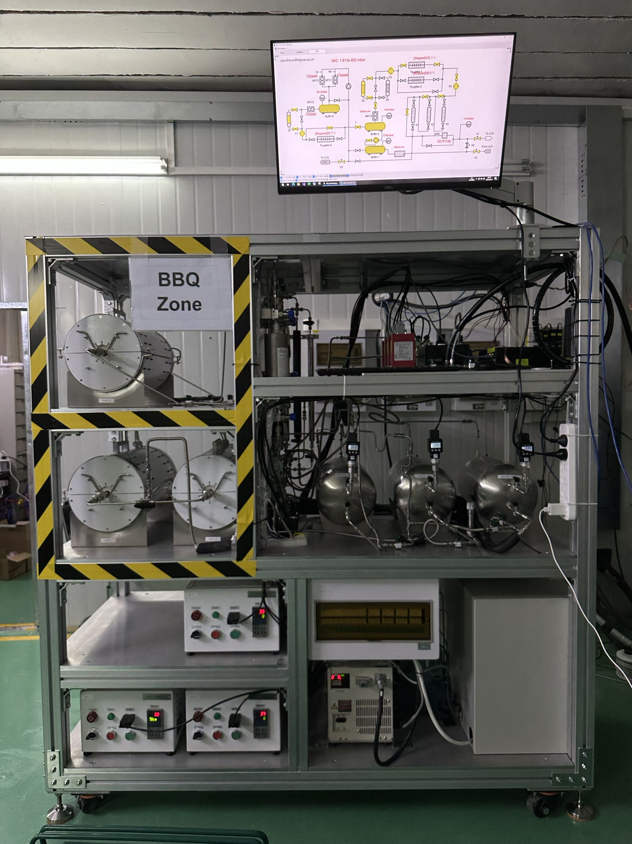
GCS (gas cleaning system)
20 L; 0.5~3 L/min (Ar/He); 0.5~2 bar
Buffer 1~3: 10 L tank (SUS316,EP-level clean)
S 1~3: Drying column (P₂O₅)
Ta getter 1~3: Ta metal @ 1000℃
X 1~3: GateKeeper® gas purifiers
(H₂O, O₂, CO, CO₂, H₂< 100 pptV; 1.5 nm filter)
DPM: -92.4℃, 60 ppbV (lower limit)
On-line operation and auto-control !

Slide 13
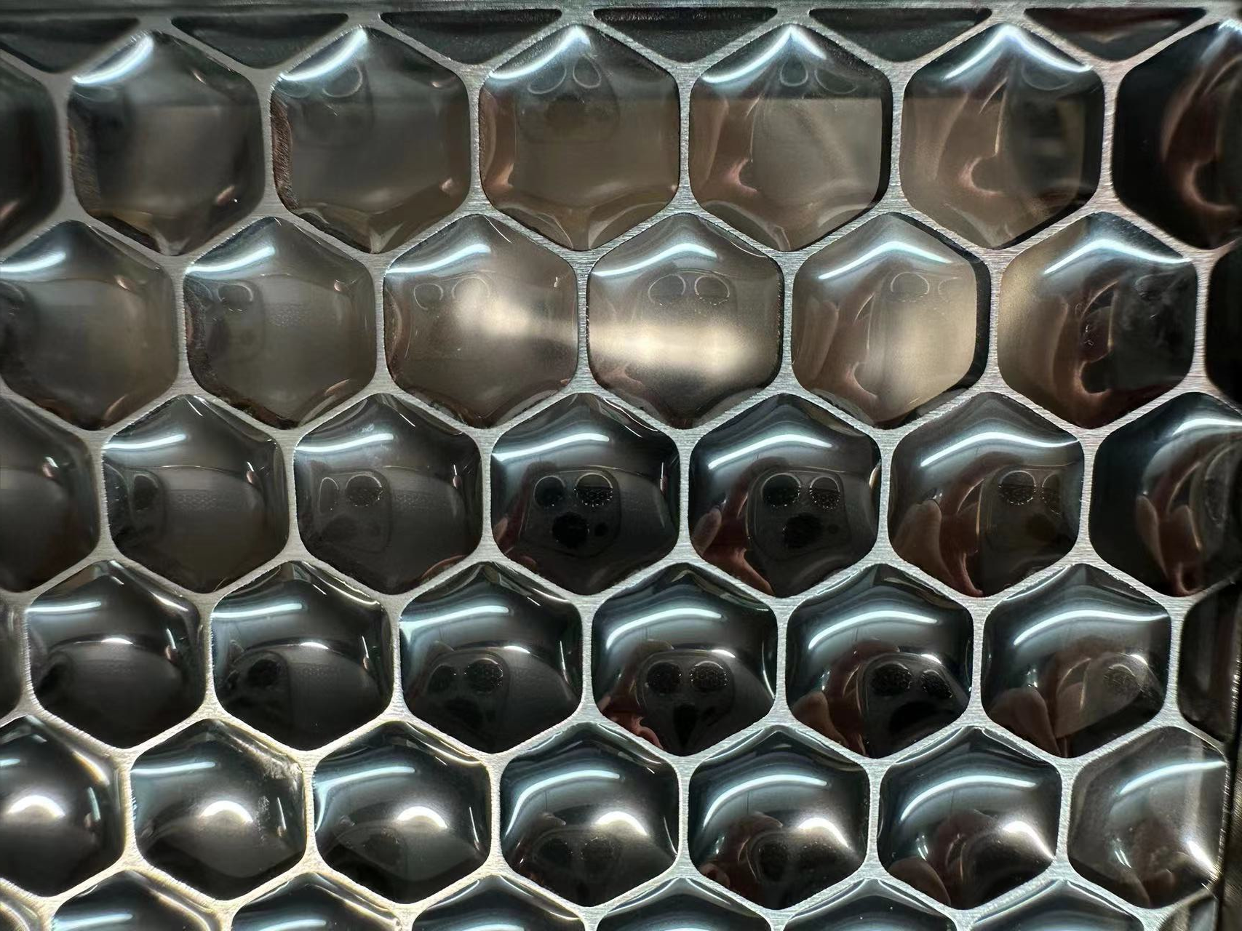
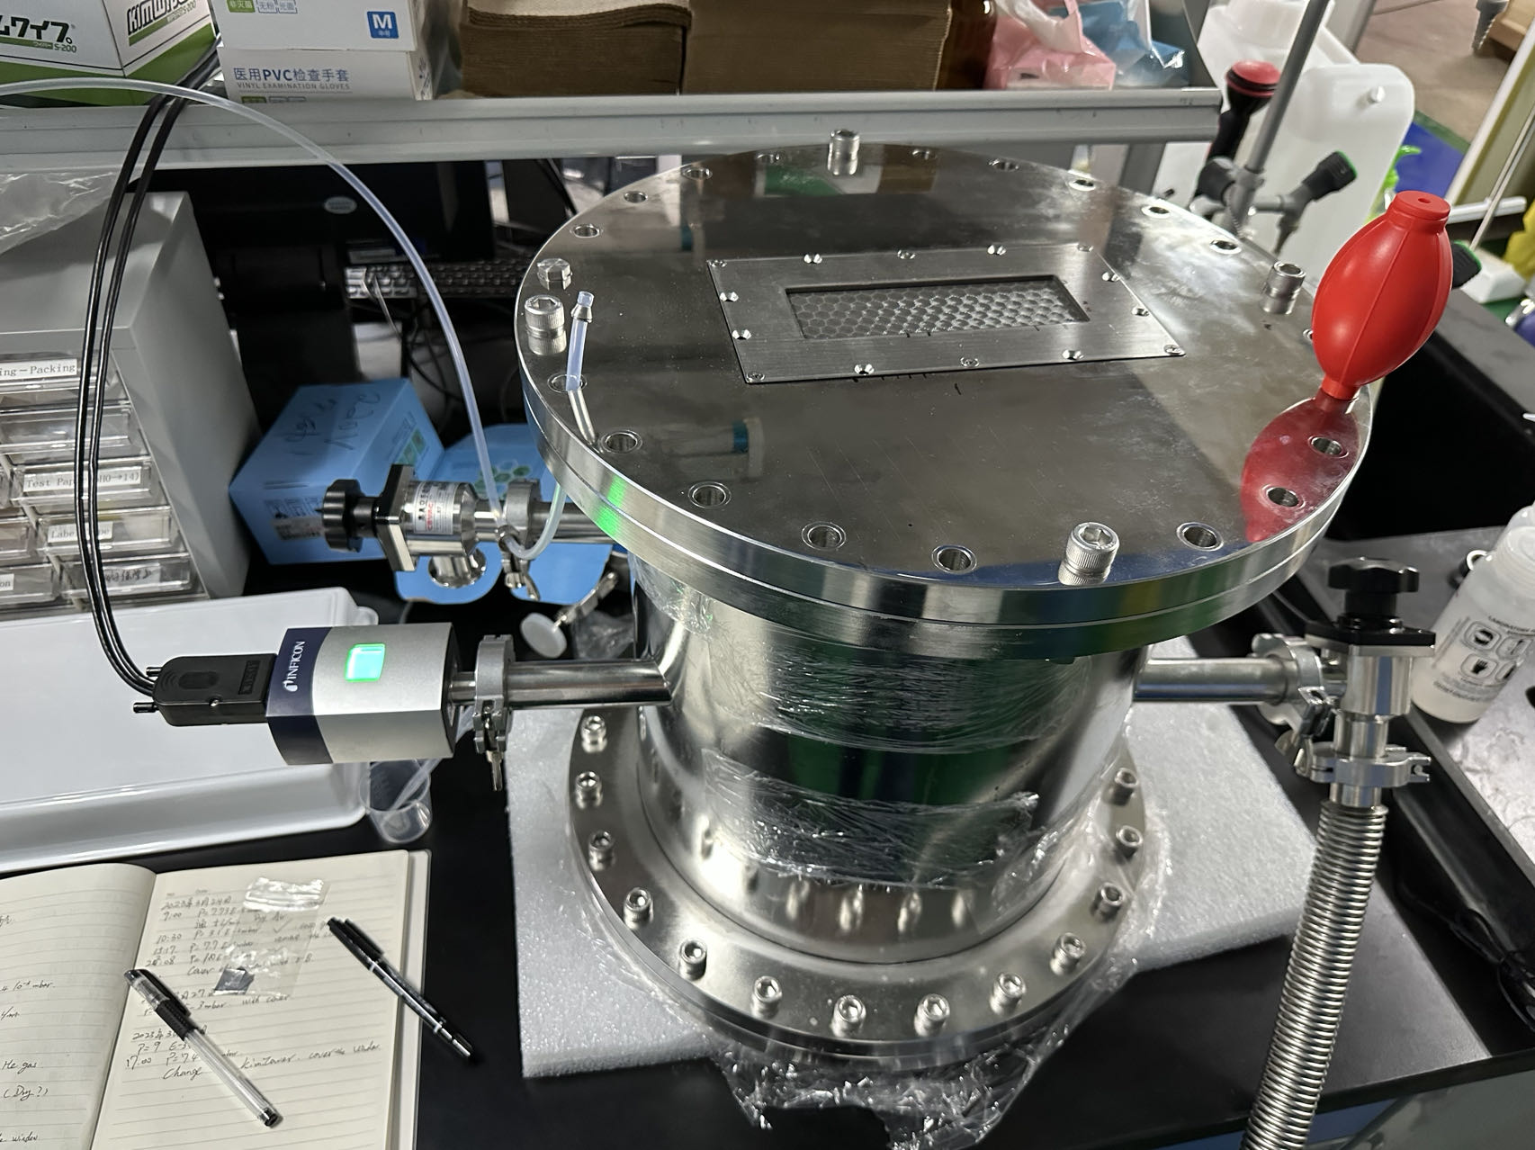
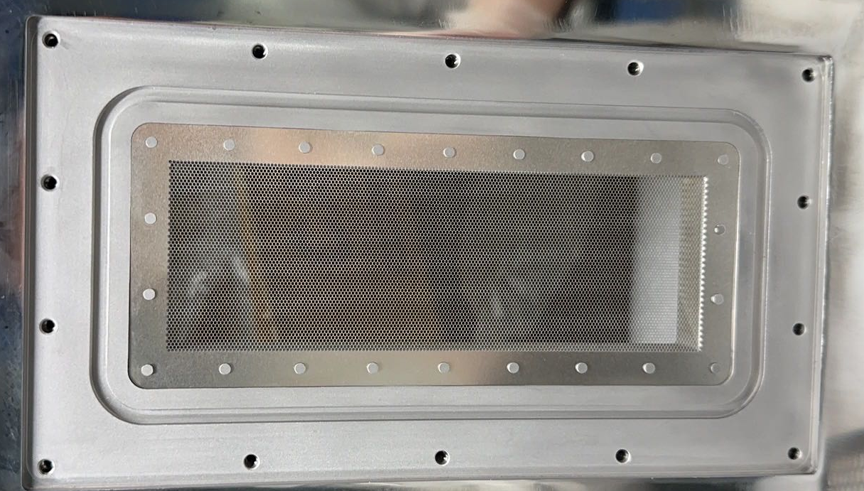
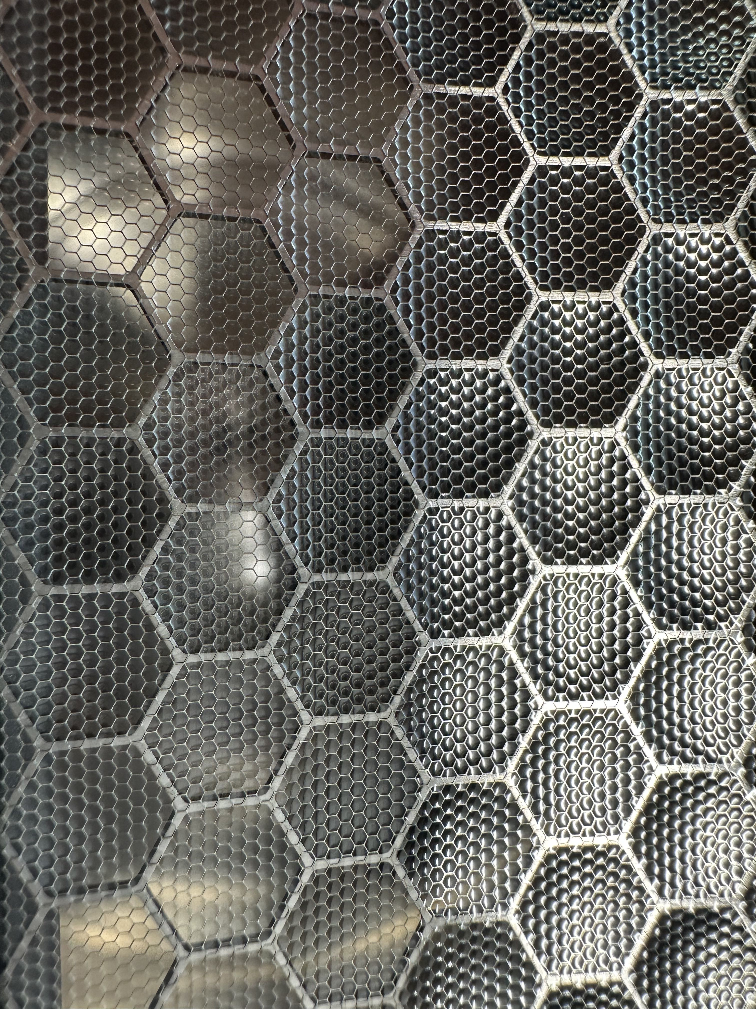
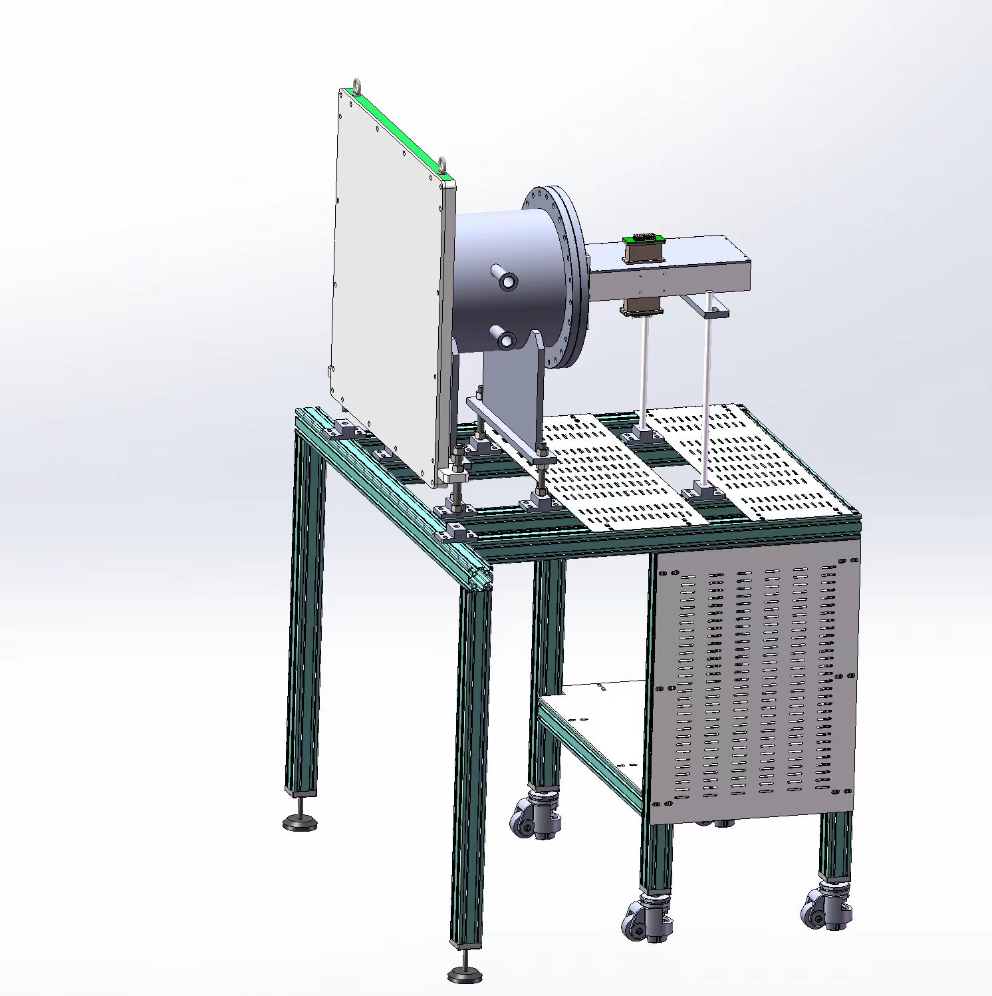
Vacuum window
Adapter with vacuum window (15×5 cm²)
Honeycomb grids: 2+0.1 mm-thick SUS
1 cm
Grid1: 88.7% (2.5~6 μm Mylar foils)
The adapter connects SHANS2 and RTC.
The window is located in the focal plane of SHANS2.
Grid1+2: 74.1% (0.7~2.5 μm Mylar foils)

Slide 14
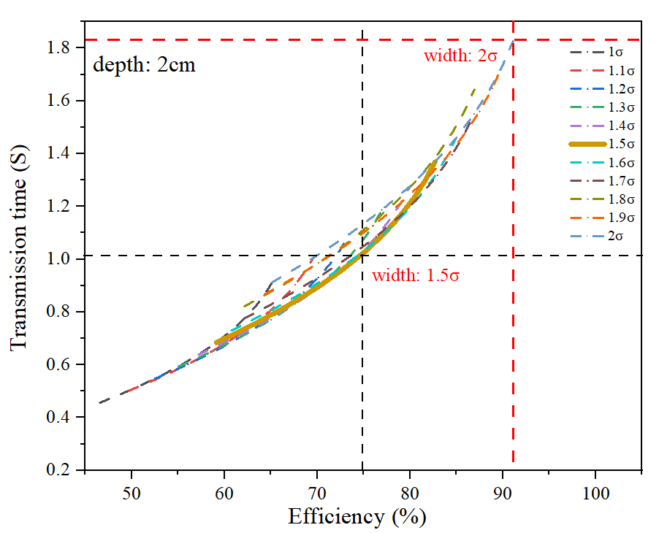
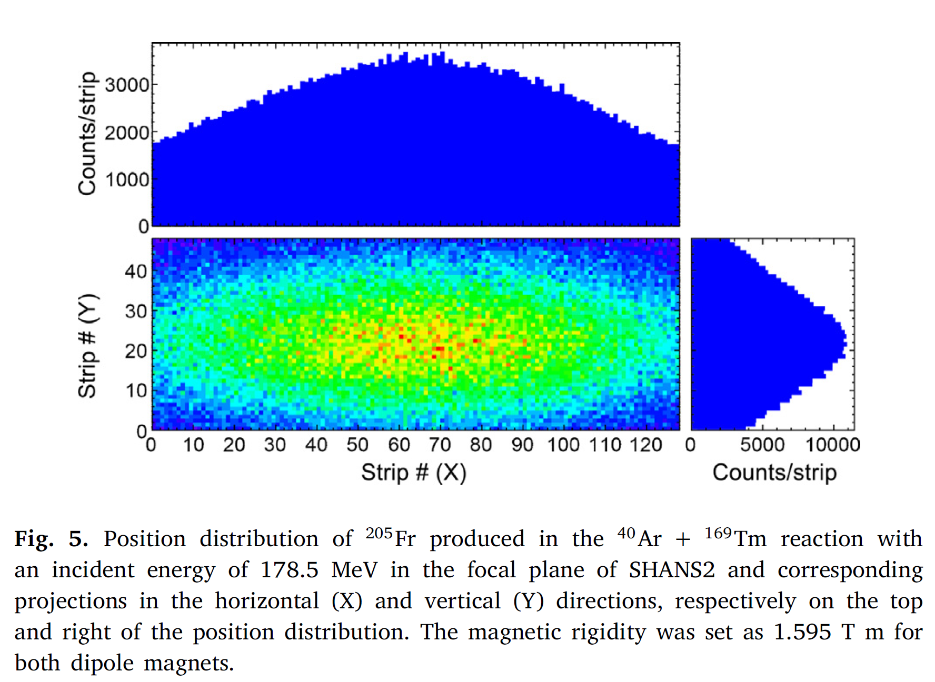
RTC (recoil transfer chamber)
Position distribution of ERs on the focal plane of SHANS2
Design of the RTC
RTC #1: 91% (2𝜎_{𝑥}◊2𝜎_{𝑦})
X=101.4 mm; Y=30 mm; D=20 mm
V=60.84 mL
Time=1.8 s (2 L/min Ar)
The standard deviations in the horizontal (𝜎_{𝑥}) and vertical (𝜎_{𝑦}) directions are 50.7 mm and 15.0 mm respectively.
RTC #2: 75% (1.5𝜎_{𝑥}◊1.5𝜎_{𝑦})
X=76.0 mm; Y=22.5 mm; D=20 mm
V=34.2 mL
Time=1.0 s (2 L/min Ar)
Nucl. Instrum. Methods A. 1050 (2023) 168113

Slide 15
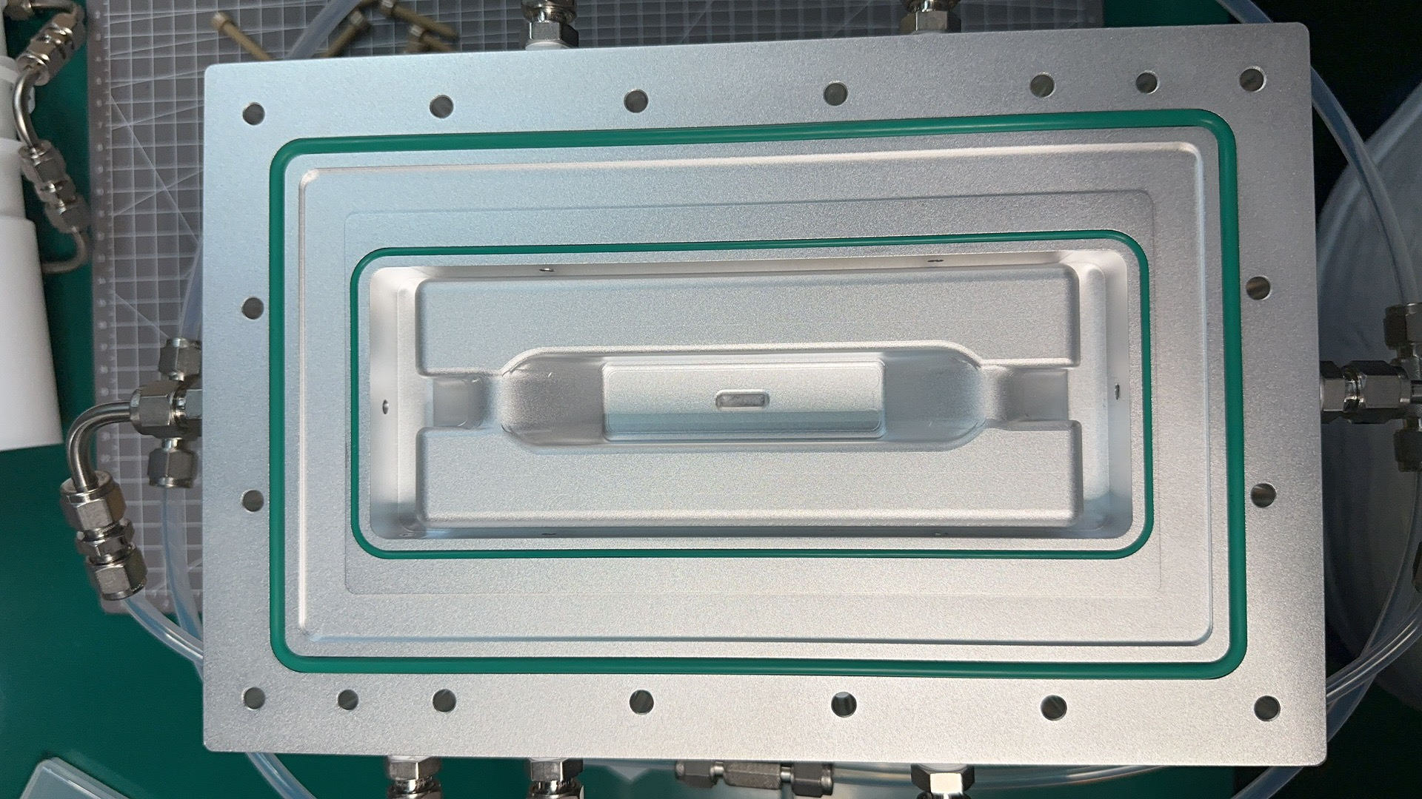
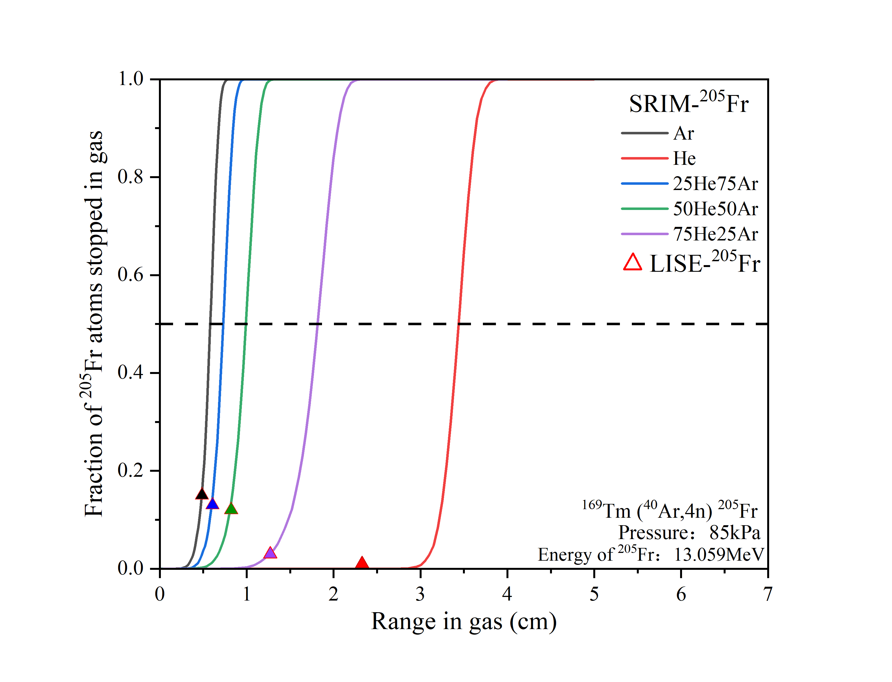
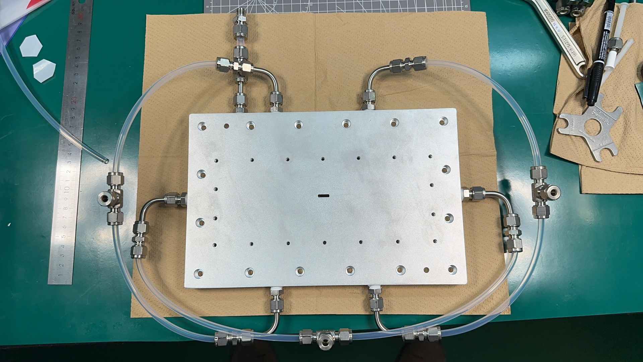
RTC
Stopping range of ²⁰⁵Fr in Ar/He (1:1)
RTC 3 with 6 inlets for Nh
Stopping range of the ERs can be varied by using Mylar foils with different thickness.
RTC #3: 75% (1.5𝜎_{𝑥}◊1.5𝜎_{𝑦})
X=76.0 mm; Y=22.5 mm; D=15 mm
V=25.6 mL
Time=0.8 s (2 L/min Ar)
²⁸⁴Nh T1/2= 0.77s

Slide 16


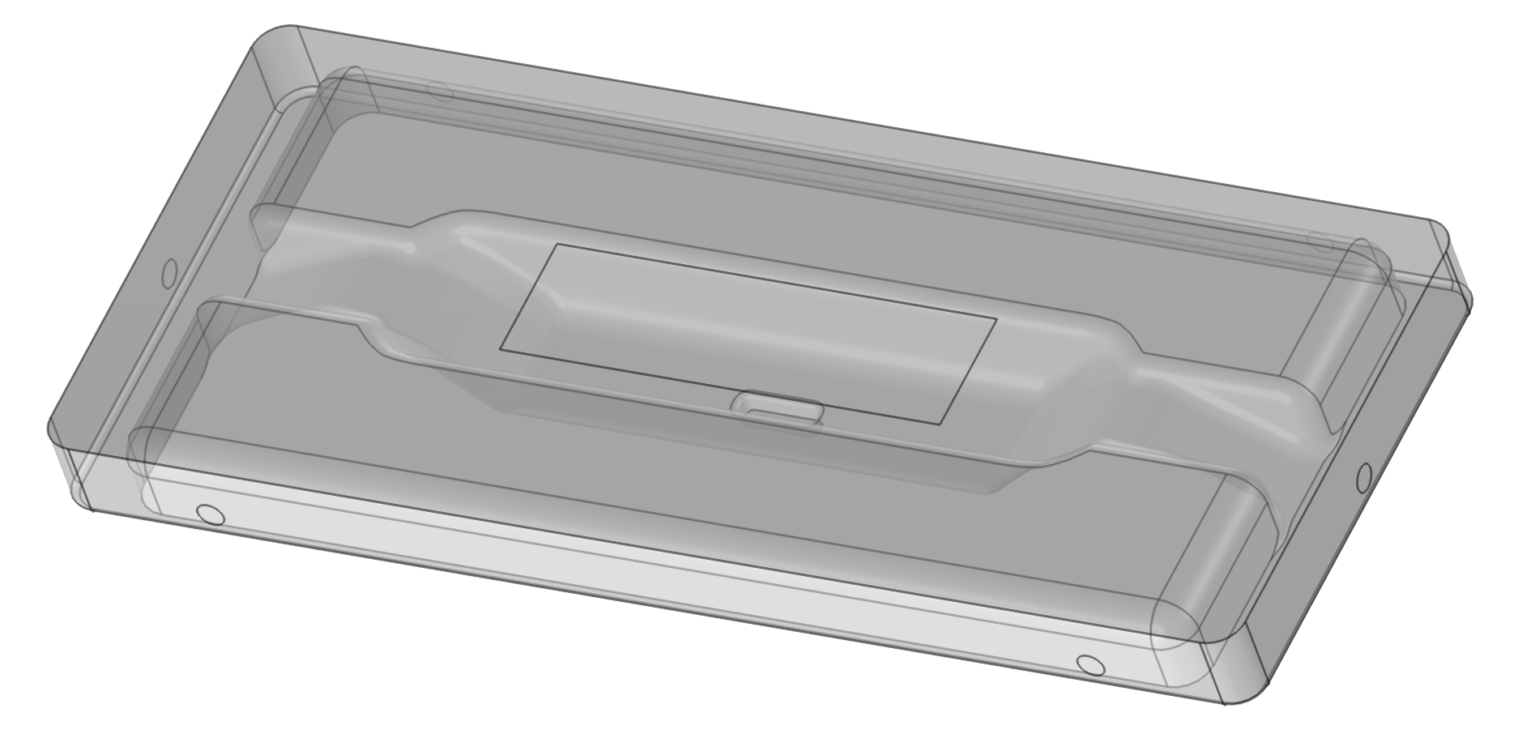
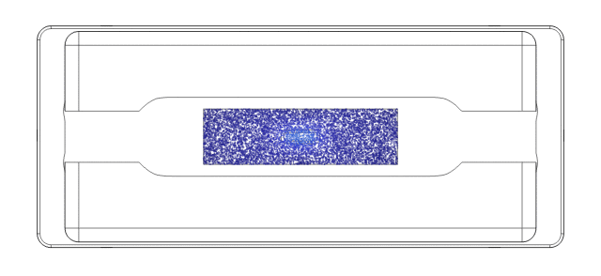
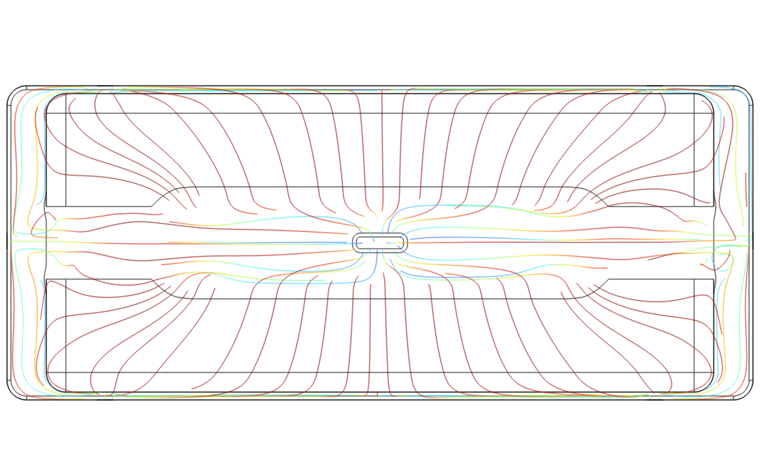
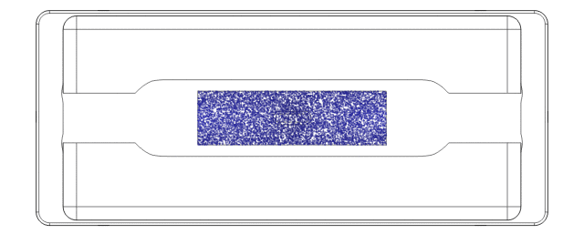
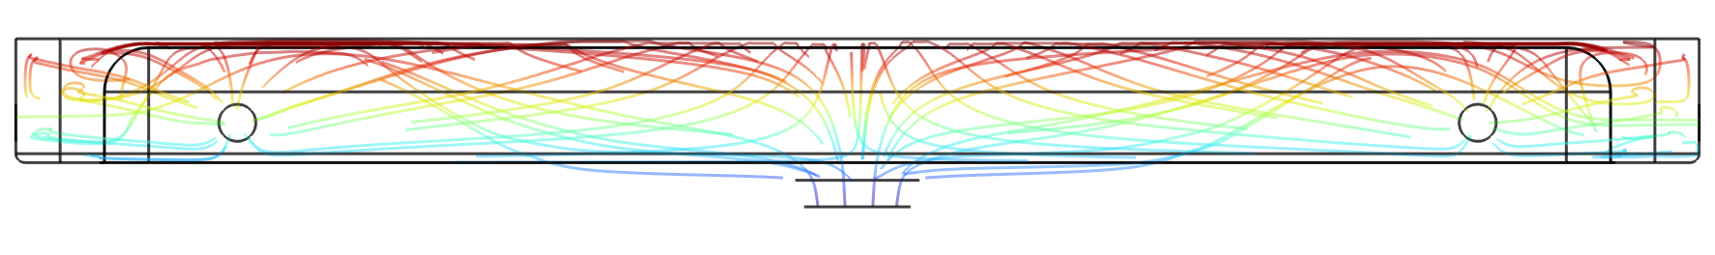
RTC
COMSOL simulations by Patrick Steinegger, PSI/ETHZ
Flushing-out behavior of RTC
13 mm from window
1 mm from window
Good flushing-out behavior
Gas flow through all six inlets should be the same! → Individual mass flow controllers will be used！

Slide 17
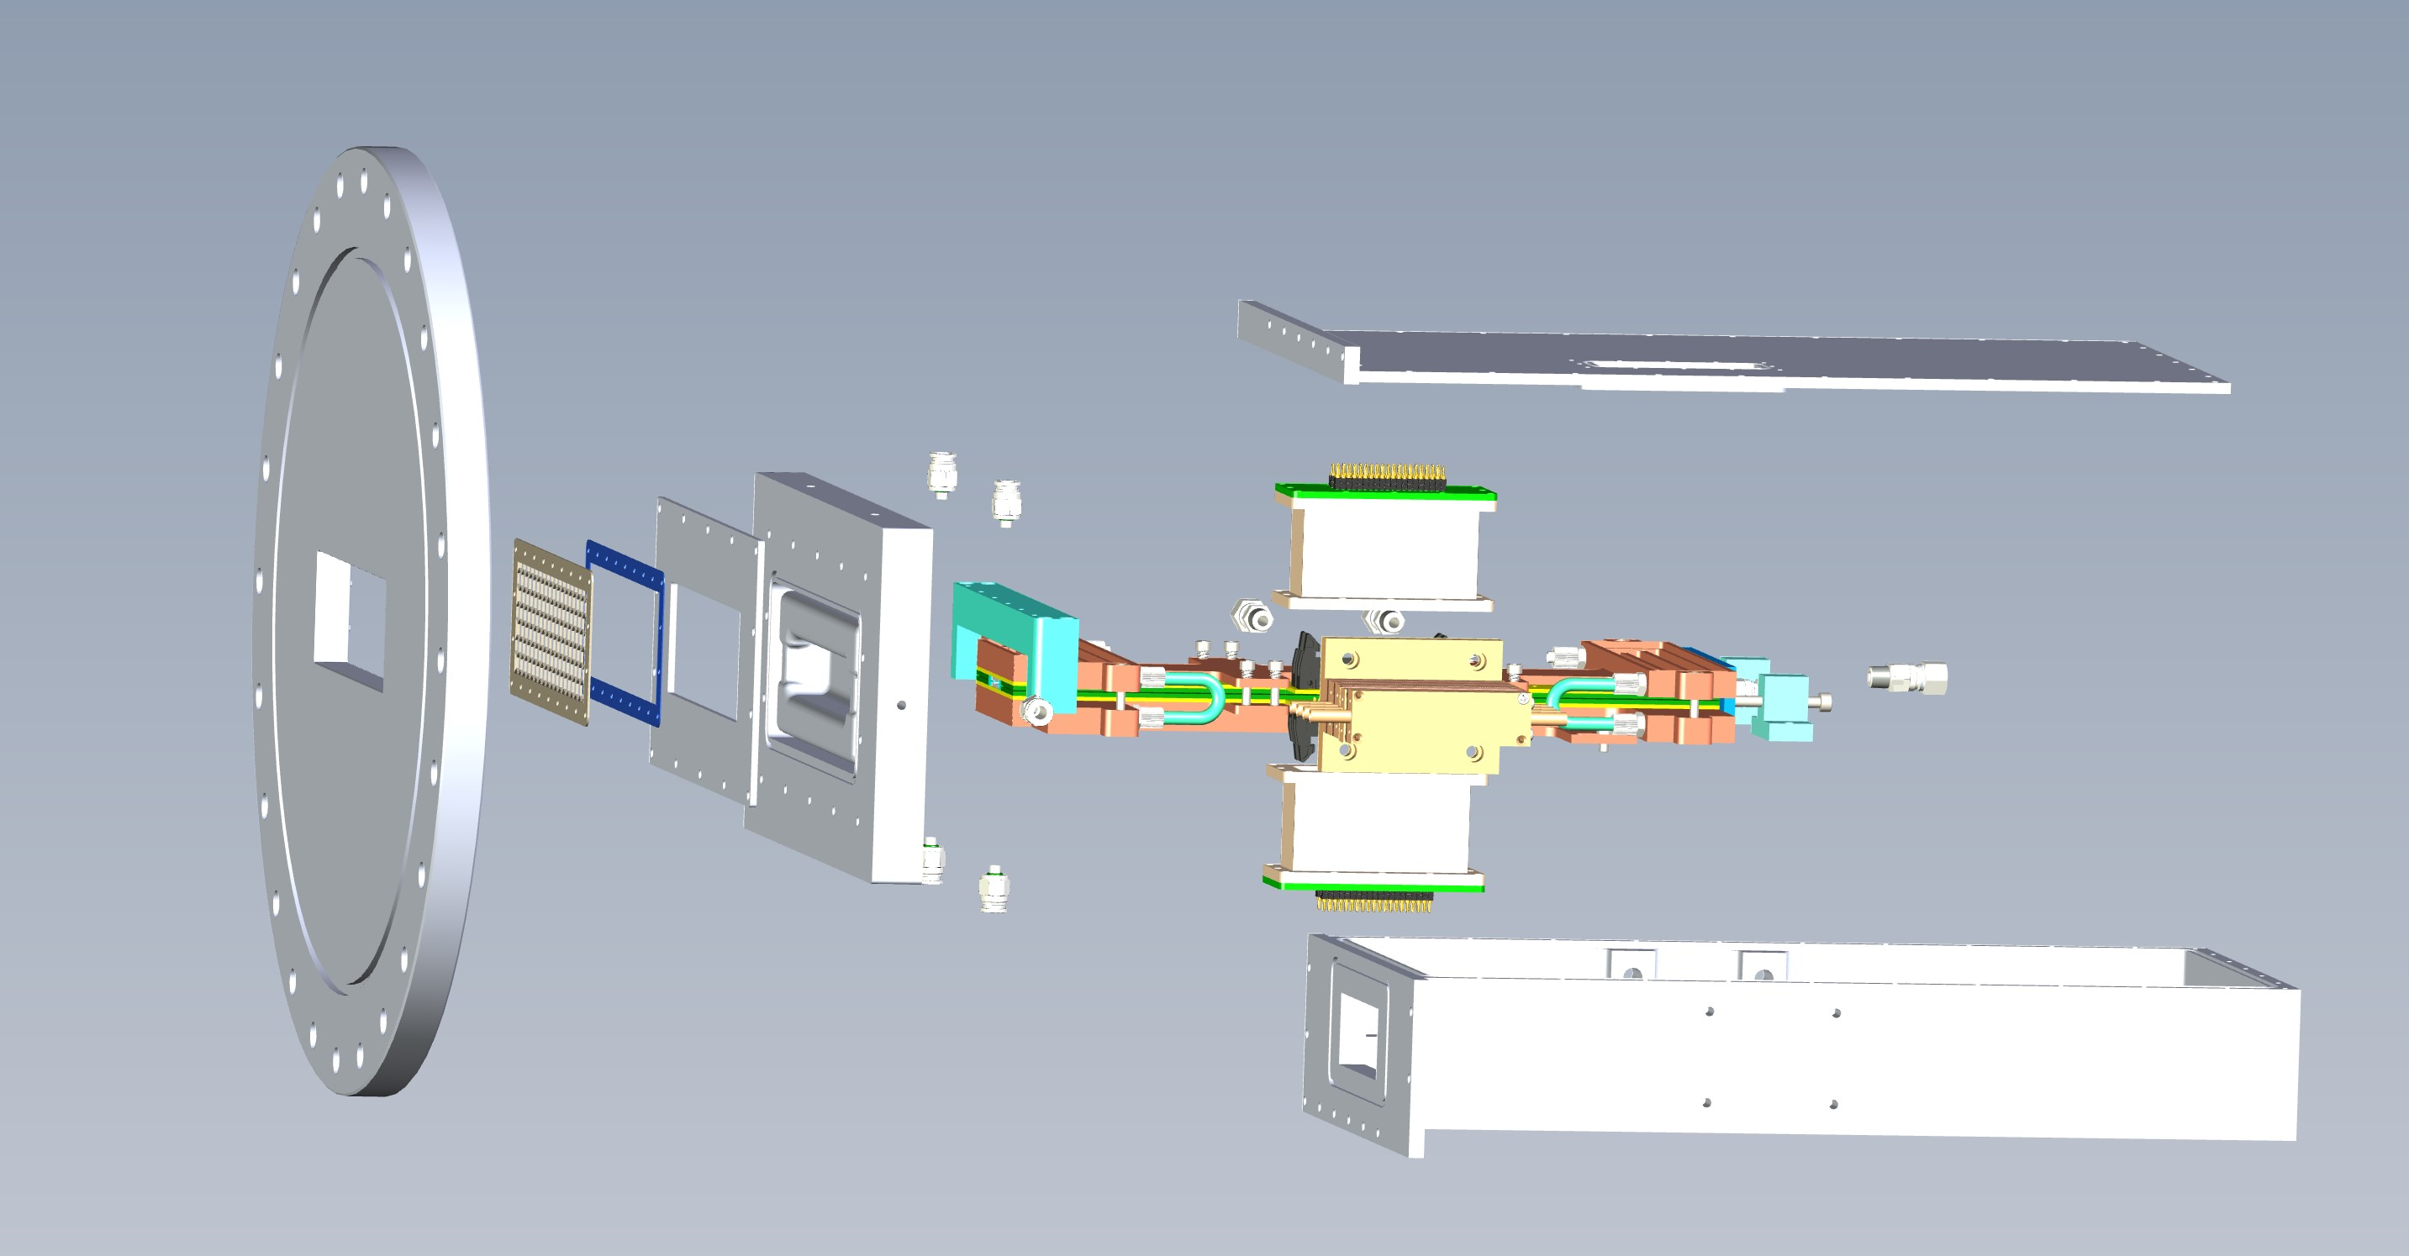
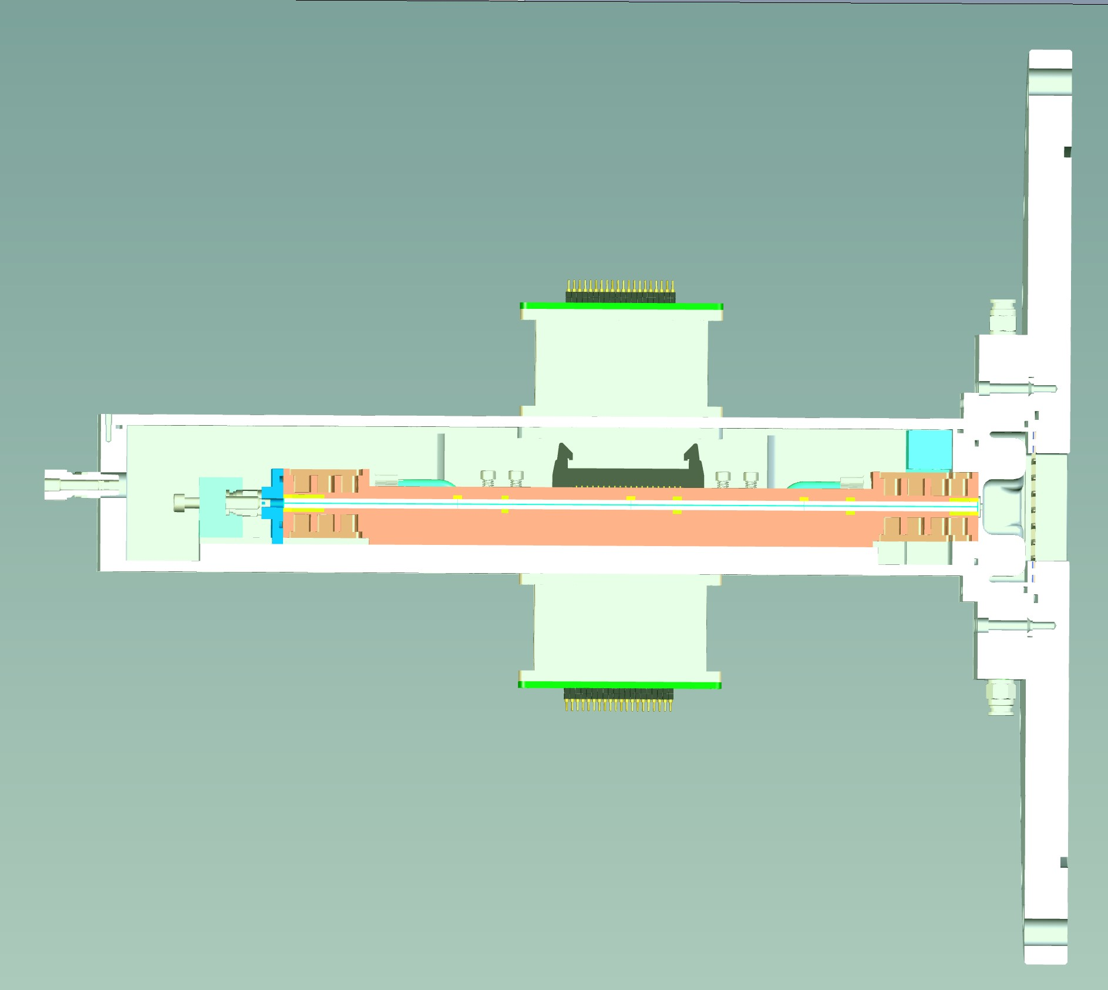
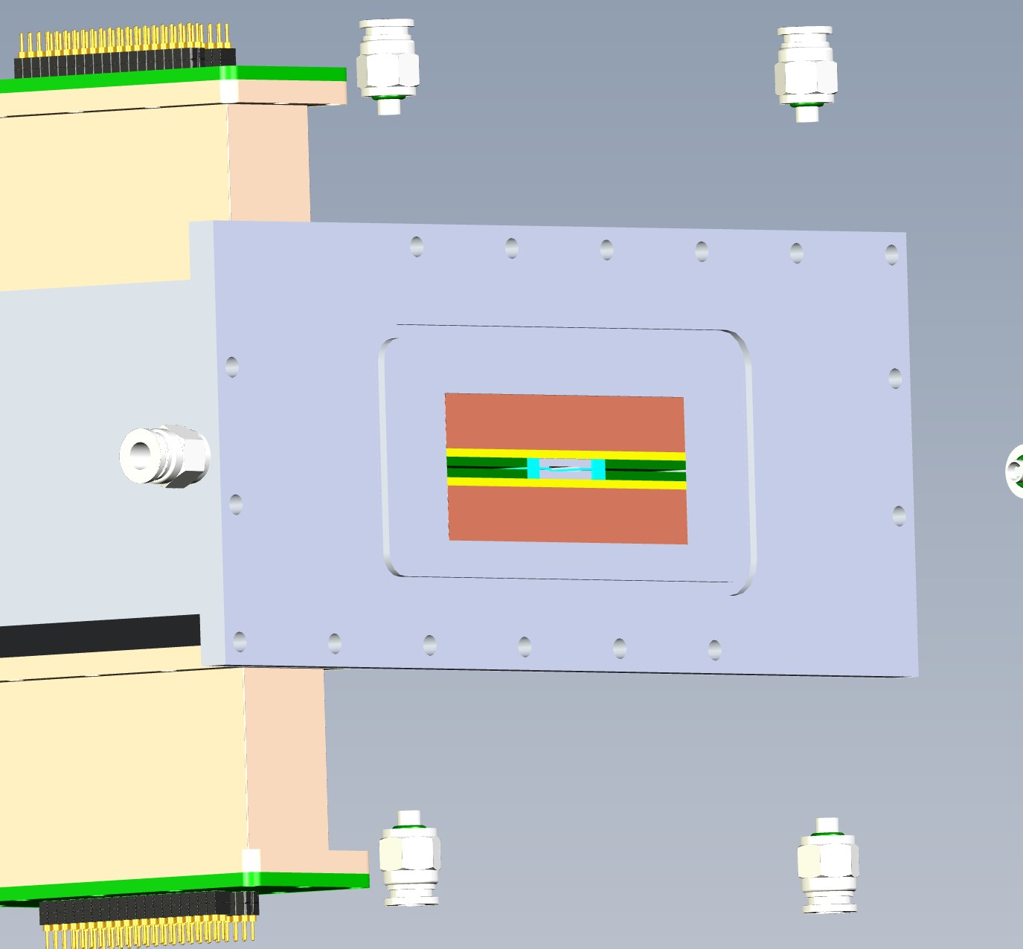
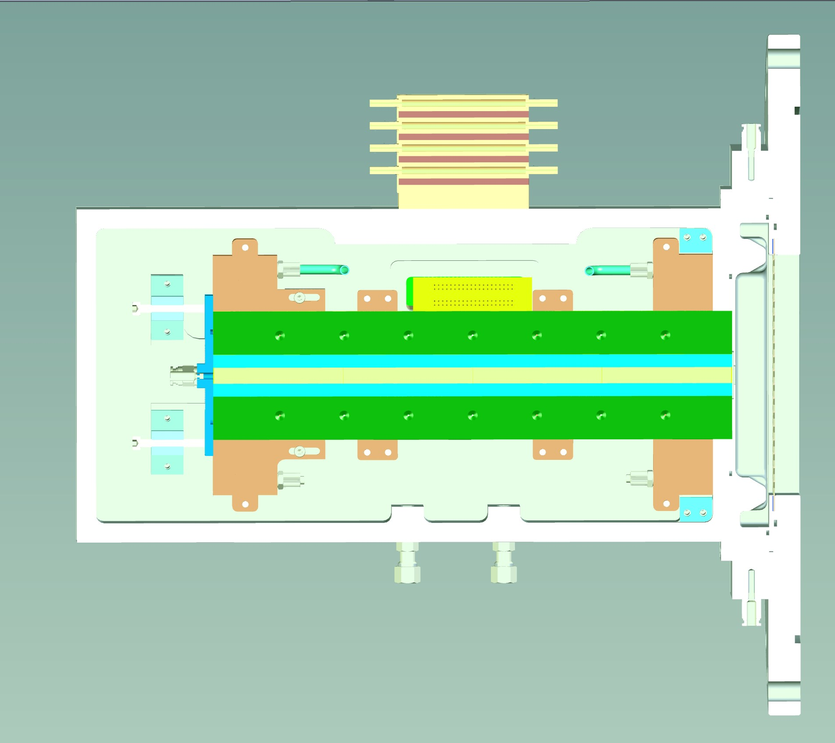
TC (Thermochromatography)
RTC
TC
Adapter flange
Vacuum box
Vacuum Window
Side view
Inlet
Top view

Slide 18
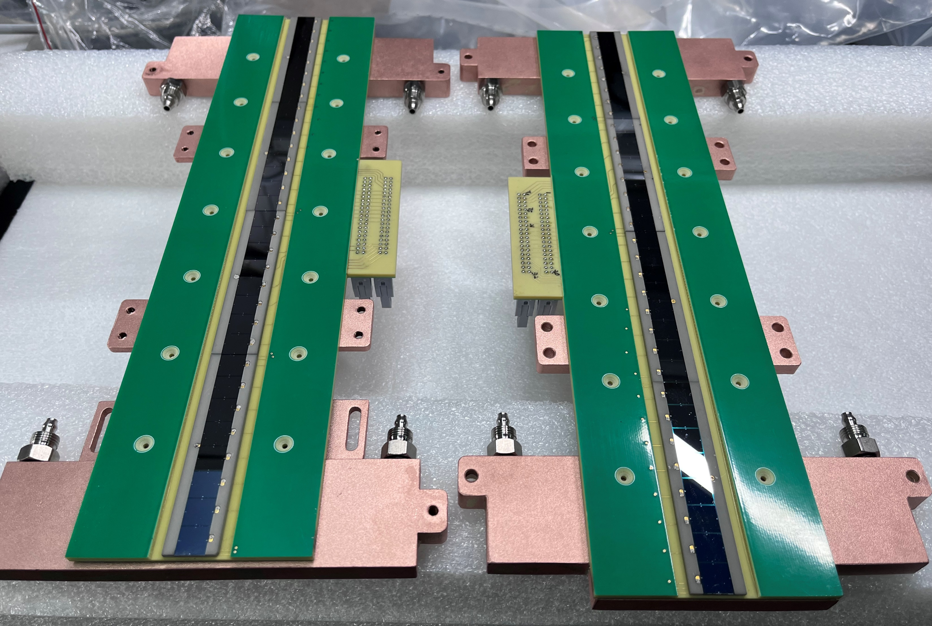
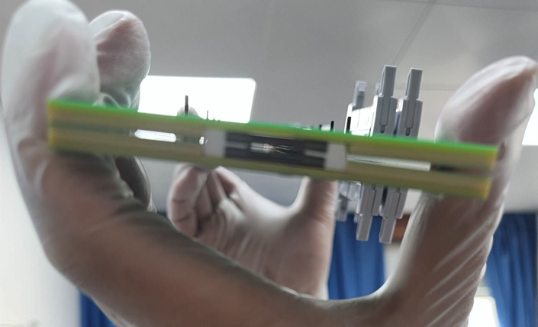
TC (Si-detector array)
32 (4◊8) pairs of Si-detectors—64 ch
8 Si chips on a ceramic plate (made @ IMP)
300 μm; 180 nm; 0.50% @ 5.486 MeV
9.6
10.04
in mm
9.6
10.04
80.32
18.04
Top
PTFE Spacer
0.8
Bottom
Length mm | Width mm | Height mm | Efficiency -α | Efficiency-SF
321.28 | 10.04 | 0.80 | 87.84% | 75.69%

Slide 19
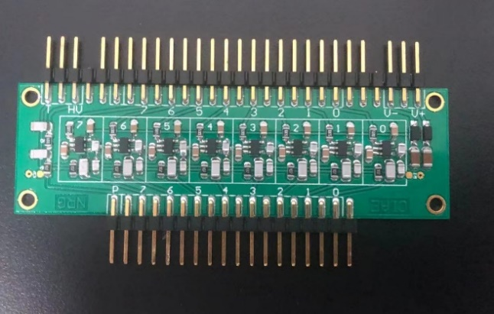
TC (Electronics)
8-ch preamplifier—SPA02-16
Power supply: ±6 V
Bias: up to ±500 V
Rise time < 6 ns
Noise < 1.5 keV at 0 pF
CAEN—V1724
Analog input
Channel: 8 ch
Input range: max ±6 V
Bandwidth: 40 MHz
ADC
14-bit
10 ns
100 MS/s

Slide 20
Contents
01
Background
02
Development of the LEGEND system
03
Test experiments of short-lived Fr and Tl
04
First experiments of Nh at IMP
05
Future plan

Slide 21
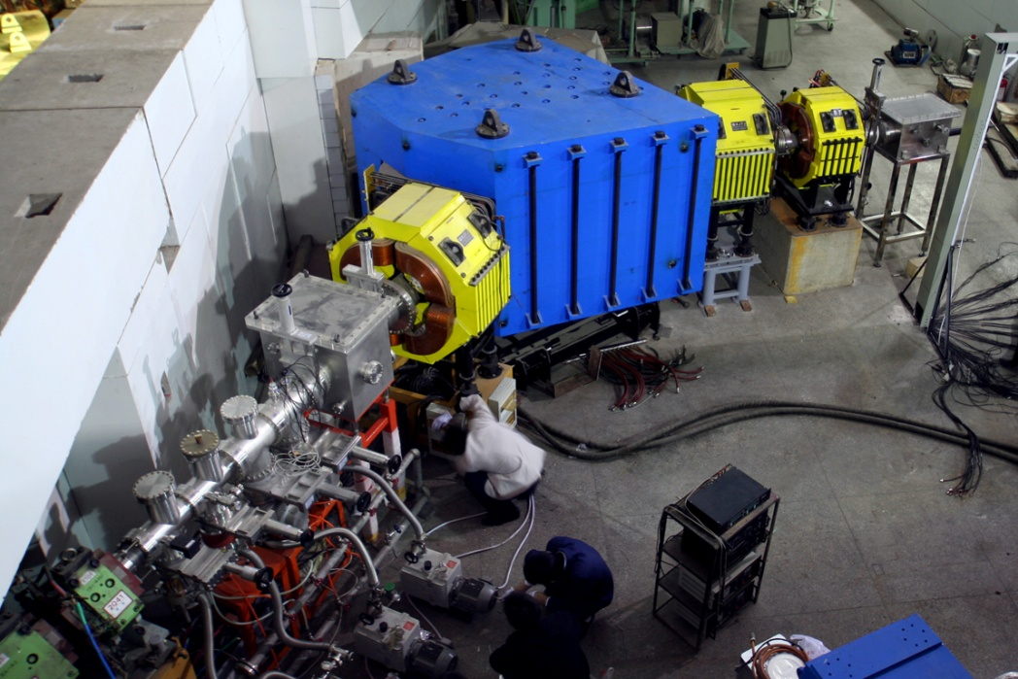
Test of LEGEND system with Fr and Tl at SHANS, IMP
SHANS @ IMP China (15th—30th July 2023)
QDQQ; He gas @ 60 Pa
Target chamber
Focal plane
Ion beam from SFC
Differential pumping

Slide 22
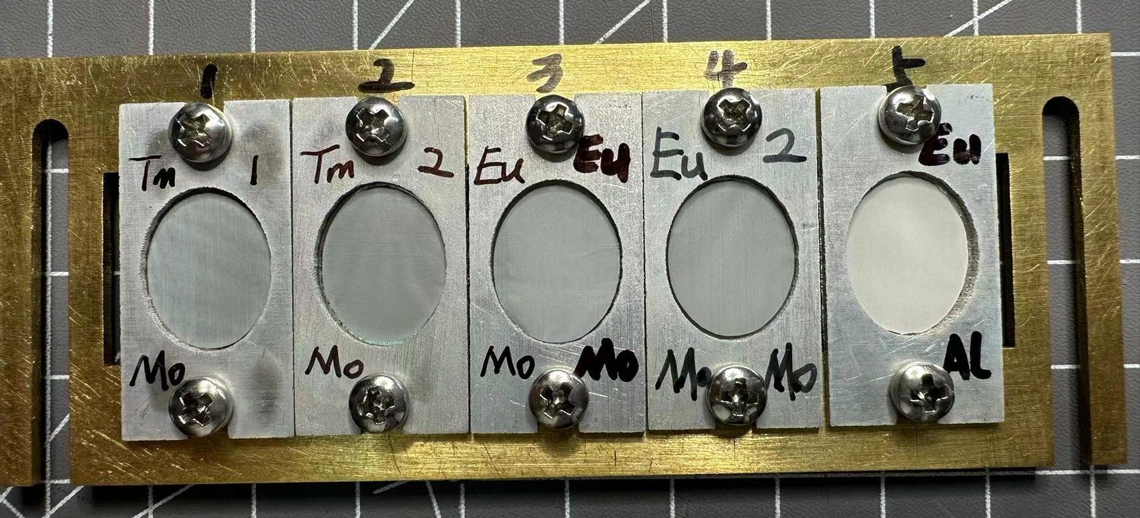
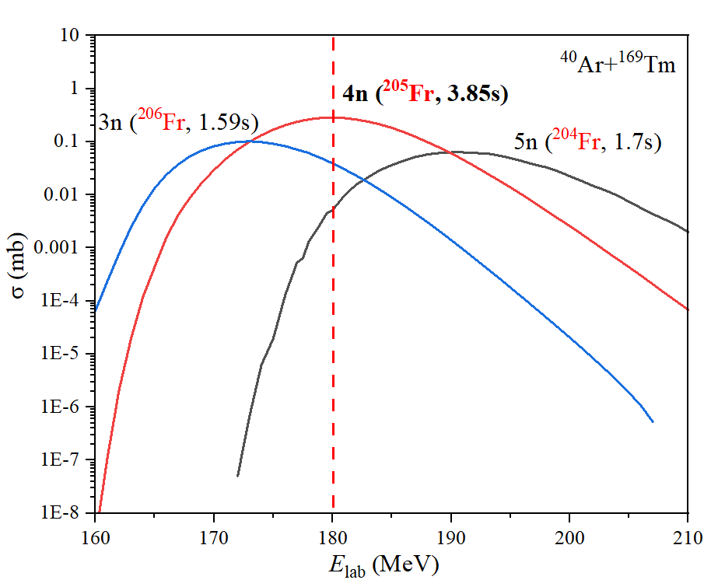
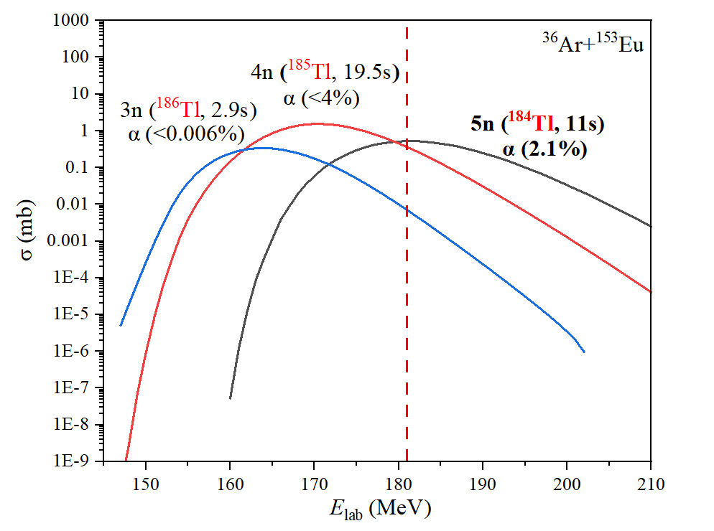
Synthesis of short-lived Fr and Tl isotopes
Tm and Eu targets
¹⁶⁹Tm(⁴⁰Ar,4n)²⁰⁵Fr @ 180 MeV & 0.7 pμA
Tm and Eu targets were prepared by molecular plating with the efficiency >99%.
¹⁵³Eu(³⁶Ar,5n)¹⁸⁴Tl @ 181 MeV & 0.8 pμA
1 | 2 | 3 | 4 | 5
¹⁶⁹Tm | ¹⁶⁹Tm | ^{151/153}Eu | ^{151/153}Eu | ^{151/153}Eu
Tm₂O₃ | Tm₂O₃ | Eu₂O₃ | Eu₂O₃ | Eu₂O₃
0.521 mg/cm² | 0.524 mg/cm² | 0.565 mg/cm² | 0.557 mg/cm² | 0.564 mg/cm²
Mo (2μm) | Mo (2μm) | Mo (2μm) | Mo (2μm) | Al (9μm)

Slide 23
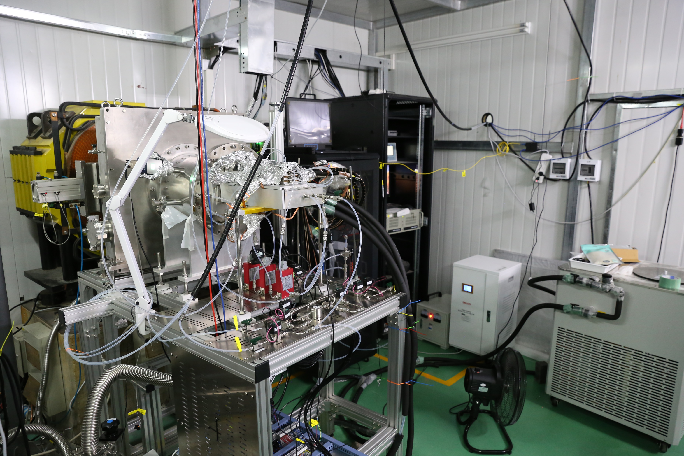
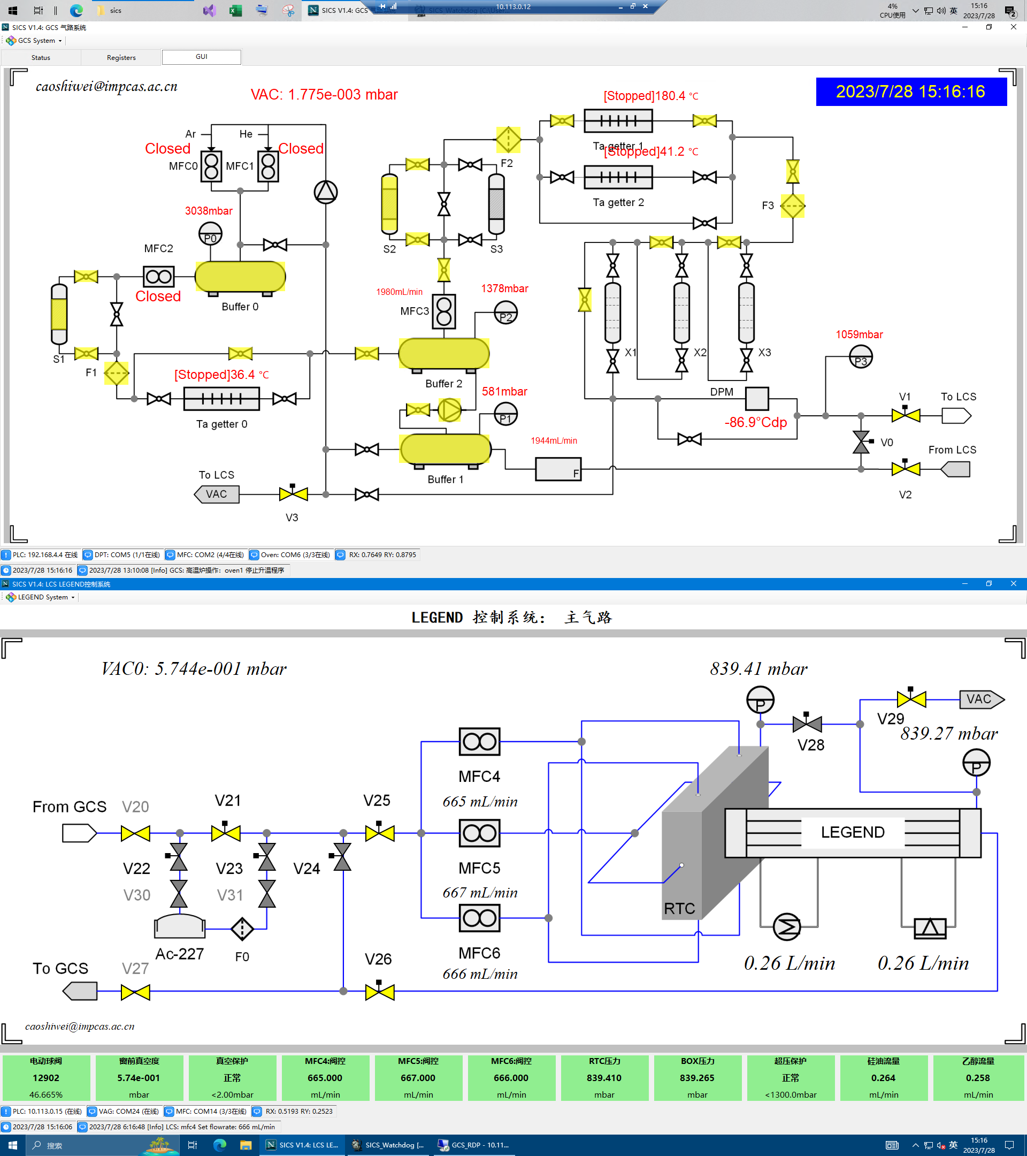
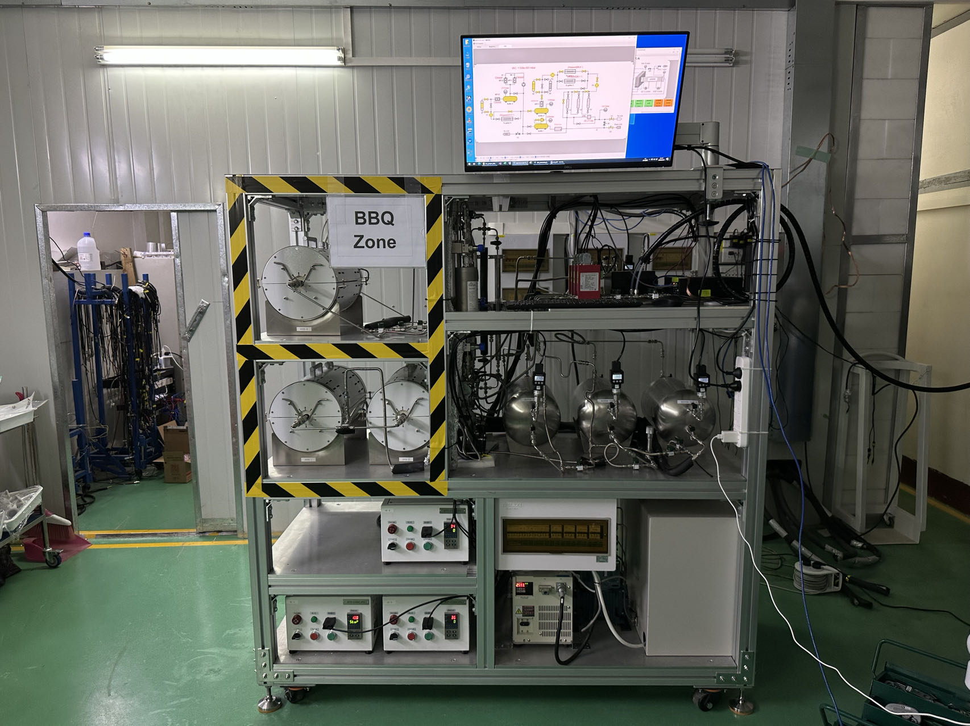
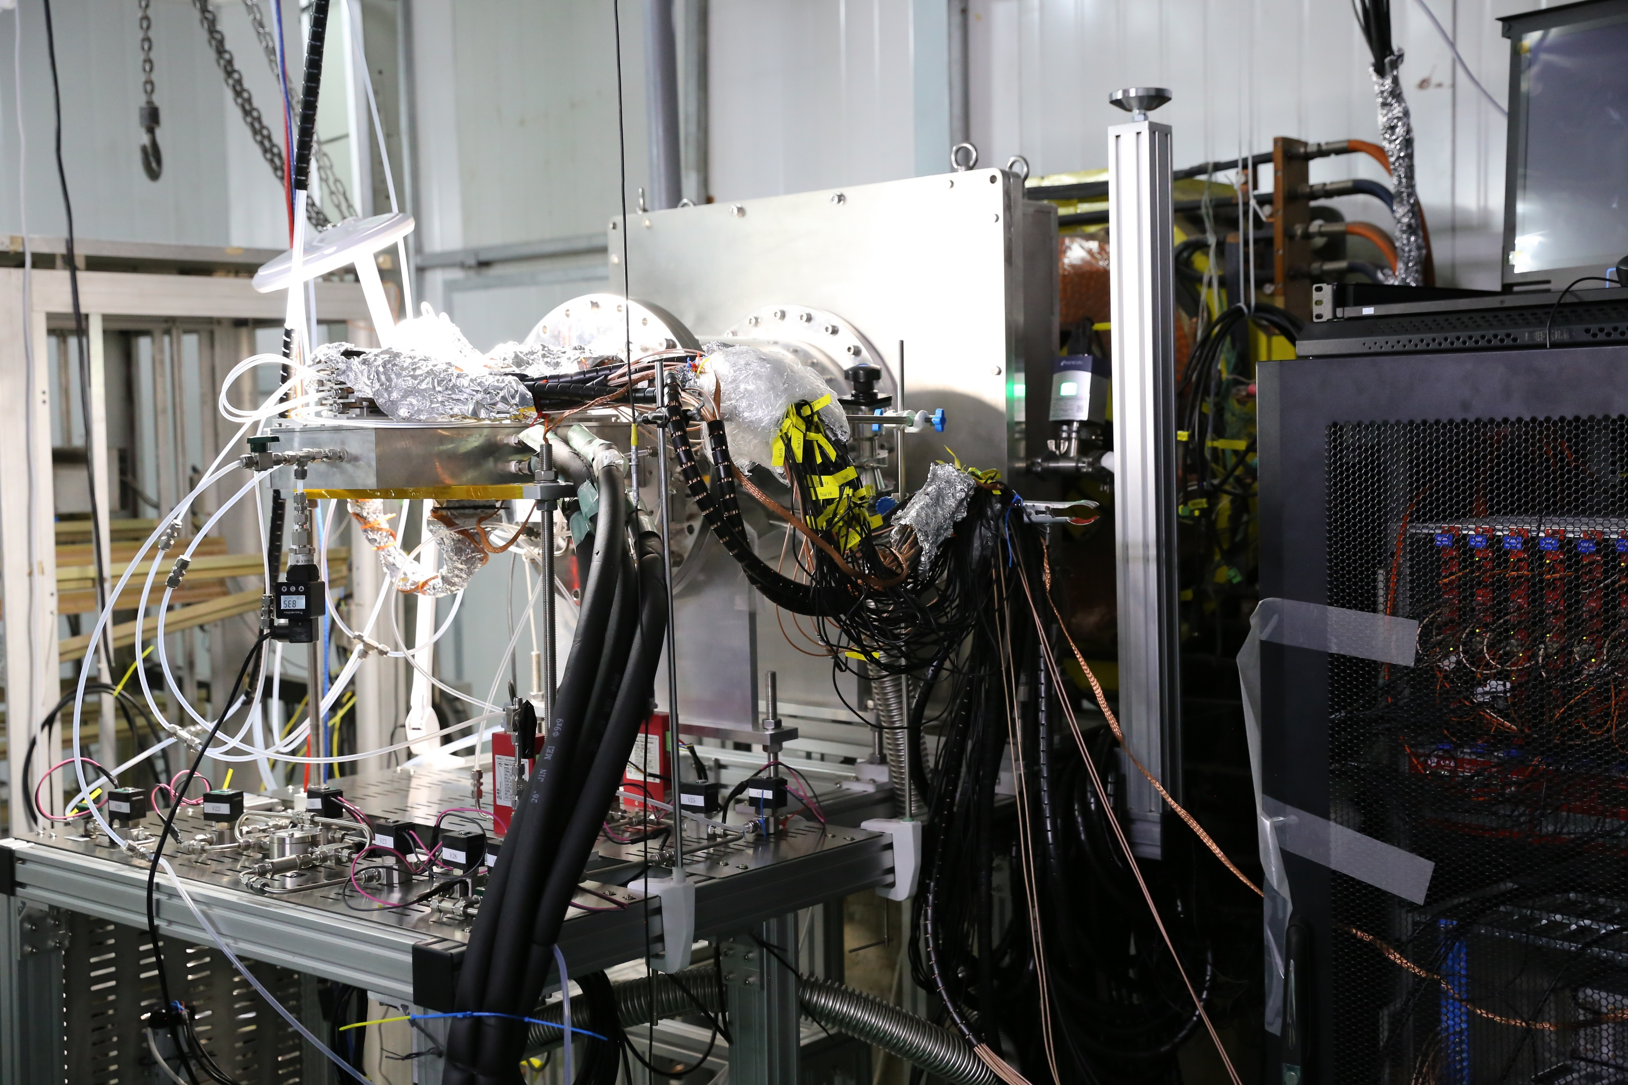
Irradiation room
LEGEND @ SHANS
LEGEND Control System
GCS
LCS
Remote control is available!

Slide 24
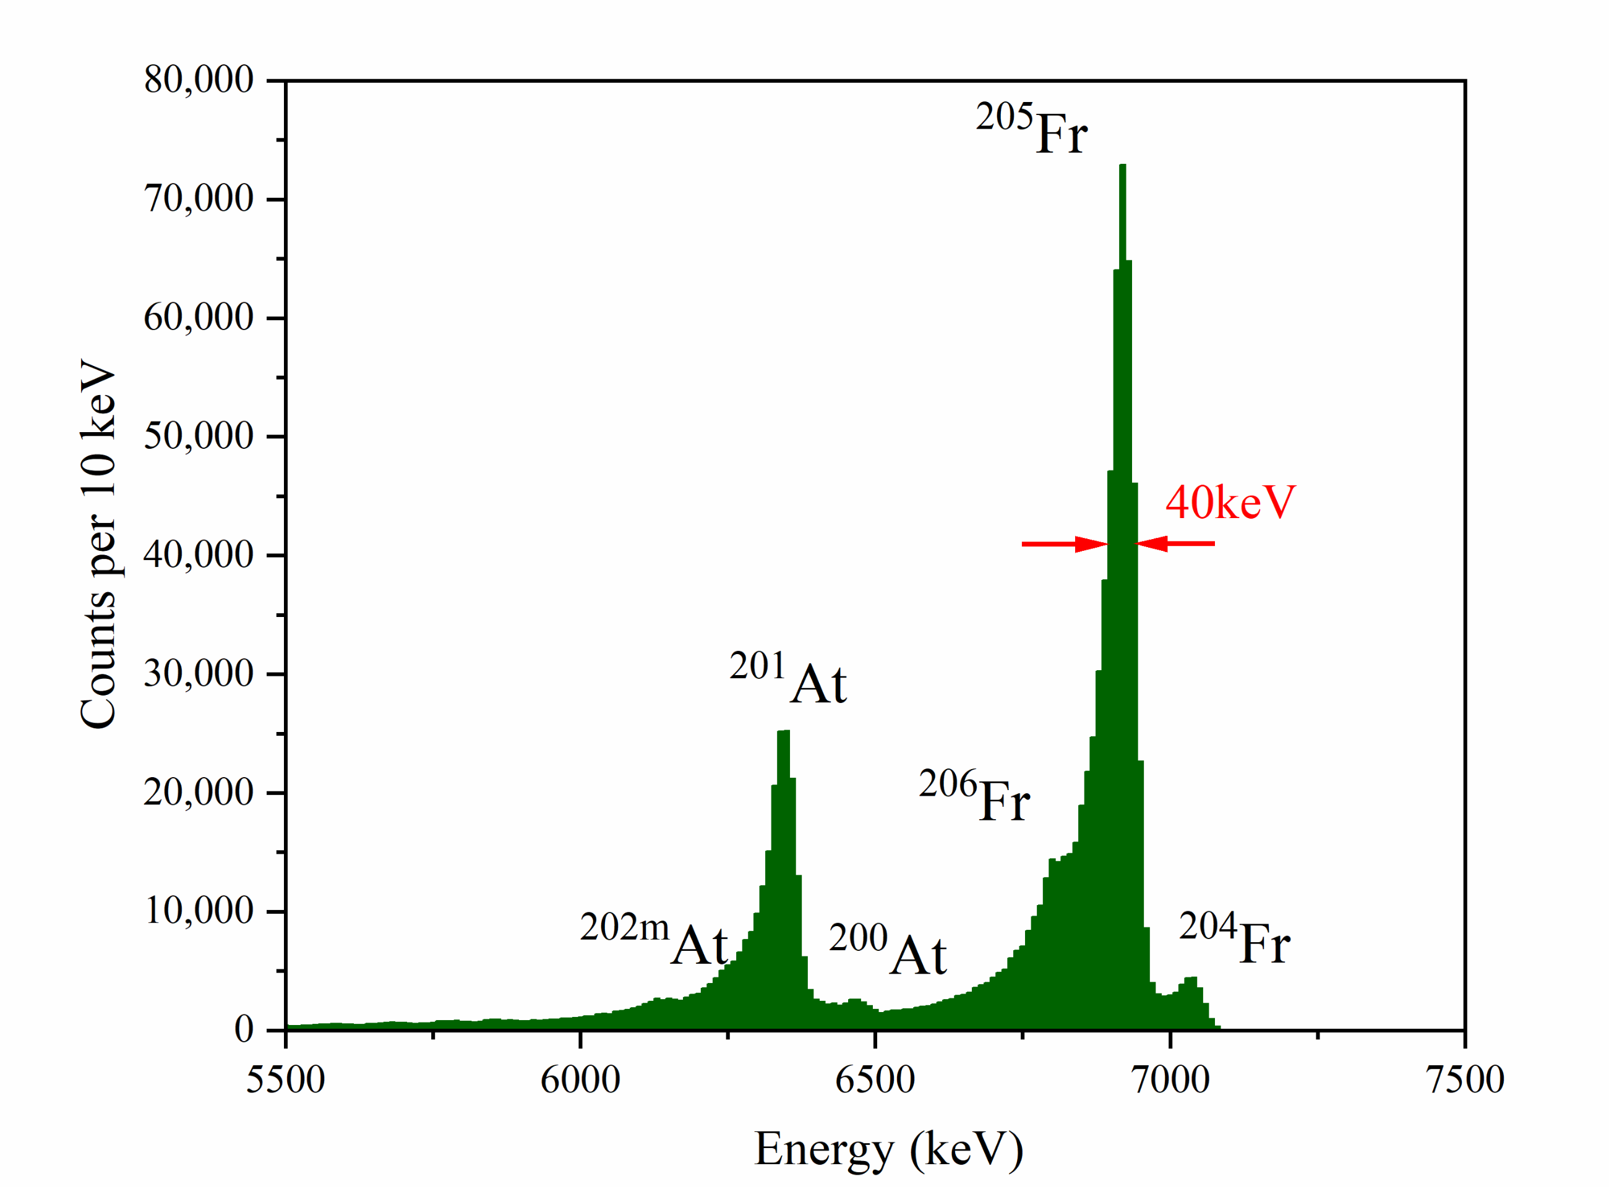
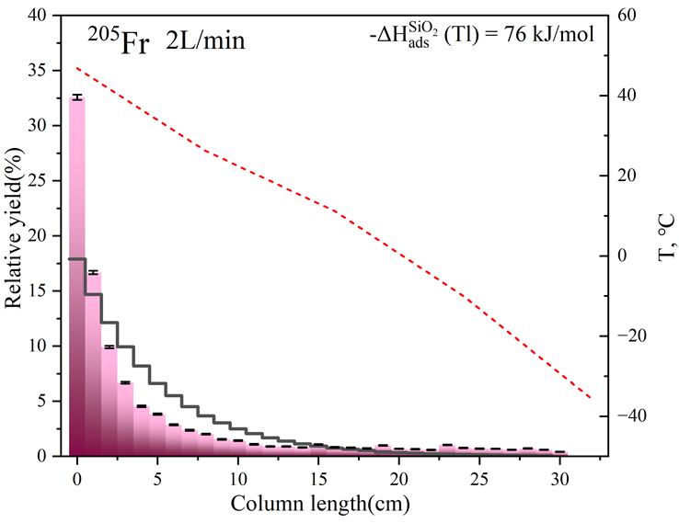
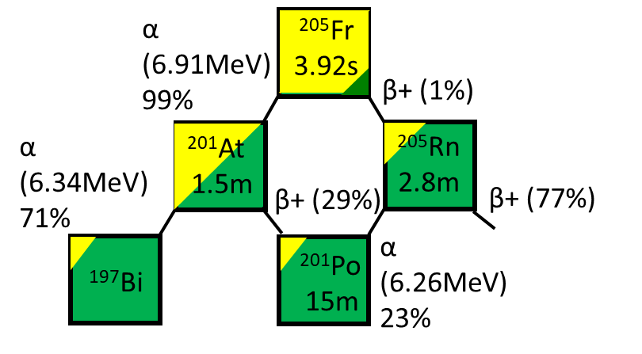


Results
¹⁶⁹Tm(⁴⁰Ar,xn)²⁰⁴⁻²⁰⁶Fr
Bottom #1
Upper limit: ΔH_{ads}(Fr) ≈ -76 kJ/mol
Distribution of Fr and At on SiO₂

Slide 25




Results
¹⁵³Eu(³⁶Ar,xn)¹⁸²⁻¹⁸⁵Tl
Bottom #1
Upper limit: ΔH_{ads}(Tl) ≈ -112 kJ/mol
8000s
Distribution of ¹⁸⁵Tl and ¹⁸⁵Hg

Slide 26




Test experiments of short-lived Fr and Tl
Results
Transport efficiency of RTC
Gas flow rate
RTC pressure
(3 μm Mylar foil)
Ar/He mixture
99%
99%
99%
97%
83%
69%
75%
66%
43%
Gas inlet type with RTC #3

Slide 27
Conclusions
The LEGEND system is very stable with good performance!
Suitable for Nh experiments with long beam time!
2. The best transport efficiency for RTC #3 appeared at using
2~2.5 L/min of pure Ar with 6 inlets gas flow at 85 kPa .
The RTC #3 is available for isotopes with a half-life around 1 s.
3. The temperature limit for Si-detector is about 45℃.
New type detectors are needed for working with higher temperature.

Slide 28






Test experiments of short-lived Fr and Tl
Counting room
On-line operation and monitoring
Meeting area
LEGEND
SHANS & beam
Working
Relaxing

Slide 29
Contents
01
Background
02
Development of the LEGEND system
03
Test experiments of short-lived Fr and Tl
04
First experiments of Nh at IMP
05
Future plan

Slide 30


Facilities for SHEs study @ IMP
China Accelerator Facility for Superheavy Elements (CAFE2)
Ions：Ca ~ Zn
A/Q：3
Energy：4.5 ~ 7 MeV/u
Intensity: 5 ~ 10 pμA
Spectrometer for Heavy Atoms and Nuclear Structure-2 (SHANS2)
Configuration: QvDQhQvD
Deflection angle: (30+10)°
Max. Bρ: 2.56 Tm
Length: 5.97 m
Efficiency：40%

Slide 31


Production of ²⁸⁸Mc @ IMP，CAFE2，SHANS2（Nov,16-Nov,25,2023）
Reaction channel： ²⁴³Am(⁴⁸Ca,3n) ²⁸⁸Mc
Beam particle：⁴⁸Ca¹⁴⁺
Beam time：103.7 h
Average beam intensity：~6.5e$μ$A
Beam energy：E_{cot} = 241.3 MeV
Target：$2 μm$ Ti foil + $518 \sim 597 μg/cm2$²⁴³Am (4 arc-shaped targets)
IMP is ready for the experimental study of Nh!

Slide 32




First Nh experiment at SHANS2, IMP, (23th Sep. -- 14th Oct. 2024)
SHANS2 @ CAFE2
Improved LEGEND system
²⁴³Am targets
⁴⁸Ca¹⁴⁺ beam from CAFE2
E_{cot} = 241.3 MeVσ (²⁸⁸Mc) ≈ 10 pb

Slide 33


²⁴³Am targets were prepared by molecular electrodeposition method
²⁴³Am targets
 | ug/cm2 | err
target 1 | 501.19 | 17.54
target 2 | 486.13 | 17.03
target 3 | 499.49 | 17.48
target 4 | 465.85 | 16.31
target 5 | 453.64 | 15.88
target 6 | 458.24 | 16.06
target 7 | 467.28 | 16.39
target 8 | 471.90 | 16.51
target 9 | 473.95 | 16.58
target 10 | 472.62 | 16.54
 | 475.03 | 15.19
10 sectors on a 20 cm wheel
²⁴³Am：475 μg/cm²
Ti foil： 2.28 μm

Slide 34





Improvement of LEGEND
Preamp box
Detector Box
GCS
All metallic connections：
Metal sealed MFC； flexible metallic tubes；reducing plastic surface in the gas loop.
High purity gas!
C_{(water)} < 60 ppmV
Well shielded and water cooling!
Temperature gradient:
+65 ~ -45 ℃

Slide 35



Improvement of LEGEND
RTC
76.0 mm (L); 22.5 mm (W); 15.0 mm (D)
Eff = 75%
SRIM calculation: 11 mm in Ar at 850 mbar
E_{recoil} (Mc) | Though half Target | Though SHANS2 | Though Mylar foil
40.2 MeV | 36.43 MeV | 32.75 MeV | 19.66 MeV

Slide 36



Improvement of LEGEND
Development of SiC detectors
Distribution of ²⁸⁴Nh on Si₃N₄ surface with the temperature gradient: +65 ~ -45 ℃
(MCS: -58 kJ/mol for Nh)
High performance SiC detectors are needed!
1.33% @ 5485 keV with 150 V at 65℃

Slide 37



Improvement of LEGEND
Upgrade of LEGEND detector array
Detector covered with Si₃N₄
4H-SiC Detectors
(+65~-20 ℃)
（First 24 pairs）
Thickness：450 um
Deadlayer：250 nm
Thickness of Si₃N₄
75 nm or 50 nm
SiC detector
Si detectors covered with Au
（-20~-45 ℃）
（8 pairs）
Thickness：300 um
Deadlayer：188 nm
Thickness of Au
50 nm
Resolution：~70keV
98 keV @ 7386 keV

Slide 38
Online experiment with ⁴⁸Ca beam and ²⁴³Am targets
²⁴³Am(⁴⁸Ca,3n)²⁸⁸Mc
Neutron◊3
⁴⁸Ca
²⁴³Am
²⁹¹Mc
²⁸⁸Mc
α
288 ms
²⁸⁴Nh
α
0.77 s
Identification of Nh
²⁸⁰Rg
Beam: ⁴⁸Ca¹⁴⁺
Energy (on the target): 258 MeV
Beam time : 9.24-9.27 Baking target
beam intensity : 4.5 euA
9.27-10.14 Nh experiment
Beam intensity : 11 euA
Total Beam dose : 6.95 × 10¹⁸
α
3.2 s
²⁷⁶Mt
α
0.51 s
²⁷²Bh
α
SF
7.2 s
²⁶⁸Db
28 h
α
16 h
SF
²⁶⁴Lr
4.9 h
Decay chains expected to be observed

Slide 39



On-line experiment with ⁴⁸Ca beam and ²⁴³Am targets
One ²⁸⁸Mc was Observed!
TOP-0 (65℃)
2024.9.29 0:06
Run85
Event ID：312
Beam dose: 9.39×10¹⁷
No events in next 15 days
Mc
Low background leading to low random probabilities of 4.9 × 10⁻⁷

Slide 40

First experiments of Nh
Distribution of ²⁸⁸Mc on the FPD of SHANS2
D1：Bρ = 2.091 / 2.100 Tm
⁈

Slide 41
Contents
01
Background
02
Development of the LEGEND system
03
Test experiments of short-lived Fr and Tl
04
First experiments of Nh at IMP
05
Future plan

Slide 42

Upgrade the detectors!
1. New RTC4 for LEGEND.
L=101 mm; W=30 mm; D=15 mm
V=45.45 mL
Time=1.36 s (2 L/min Ar)
2. R&D of high performance SiC detectors
Higher temperature may be needed for Mc and Nh chemistry study.

Slide 43


Upgrade the detectors!
3. The focal plane detector for LEGEND.
— Absolute efficiency of RTC is missing
4. More experiments will be performed in 2025 @ SHANS2 & CAFE2, IMP

Slide 44

Thank you for your attention!
Z. Qin, Y. Wang, S. Cao, X. Yin, Z. Jia, Y. Cui, Z. Gan, Z. Zhang, J. Wang, L. Ma
N. Aksenov, A. Madumarov, A. Bodrov, A. Goltsman, I. Chuprrakov, G. Bozhikov, A. Astakhov
R. Eichler, P. Steinegger, G. Tiebel, J. Wilson

Slide 45


Slide 46






CHE10 @ Dunhuang, China
Sep. 7—11, 2025

