Slide 1
SC-Recoil separator GASSOL. The first step of fast chemistry
Solovyev Dmitriy
FLNR JINR

Slide 2
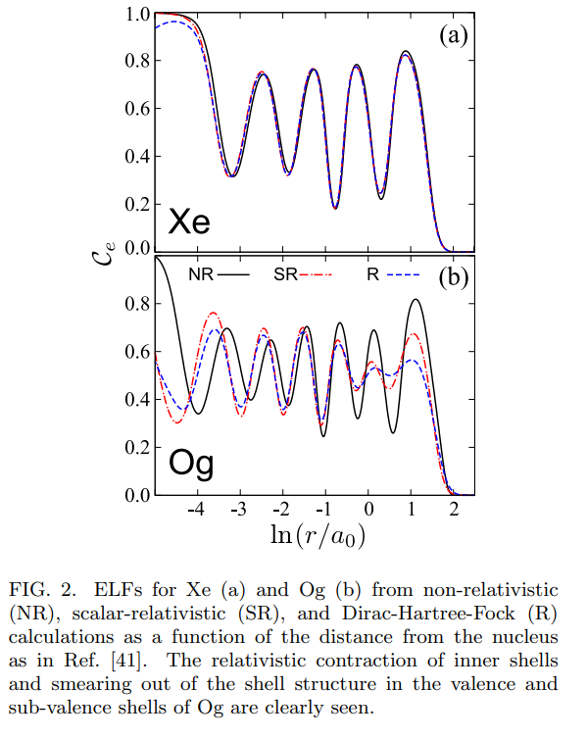
Purpose
Interesting aspect of SHE research – experimental study of chemical properties
Relativistic effects can significantly affect the chemical properties of superheavy elements
Theoretical calculations show that the volatility and chemical reactivity of SHEs can differ from the properties of the nearest light homologues
Experimental study of chemical properties is complicated – SHE have a very short half-lives
The most-used experimental method for studying the SHEs adsorption properties is gas chromatography
Jerabek, P., Schuetrumpf, B., Schwerdtfeger, P., Nazarewicz, W. 2017 Electron and Nucleon Localization Functions of Oganesson: Approaching the Thomas-Fermi Limit

Slide 3
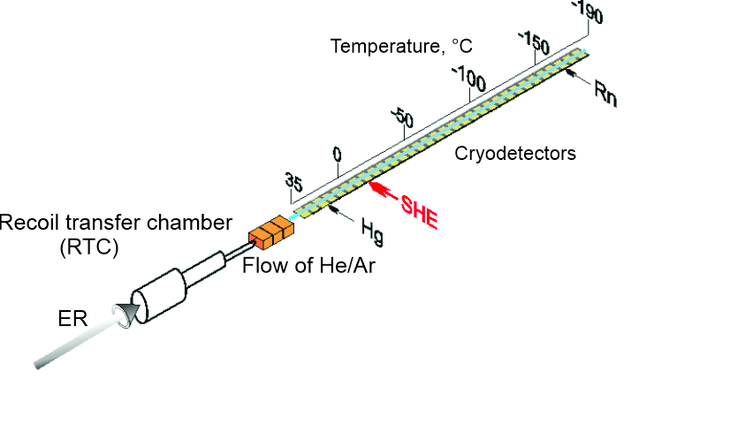
Purpose
We measure the adsorption properties of on the surfaces of various materials and compare with the adsorption properties of their lighter homologues at the same experimental conditions
Pre-separation is needed – high beam intensity or high background affect the quality of experiment
One of the most important things – time of transport
Time of transport depends on RTC size=> depend on image size of ER in focal plane of pre-separator
We need small image size – gas-filled solenoid seems like a good option!
Scheme of gas chromatography setup

Slide 4
GASSOL principle of work
Квантили радиального распределения пучка ⁴⁸Са с энергией 254 МэВ
Momentum of beam and ER are equal
Charge of beam in gas is 3 times higher
Beam focal length is shorter – put beam stopper there!

Slide 5
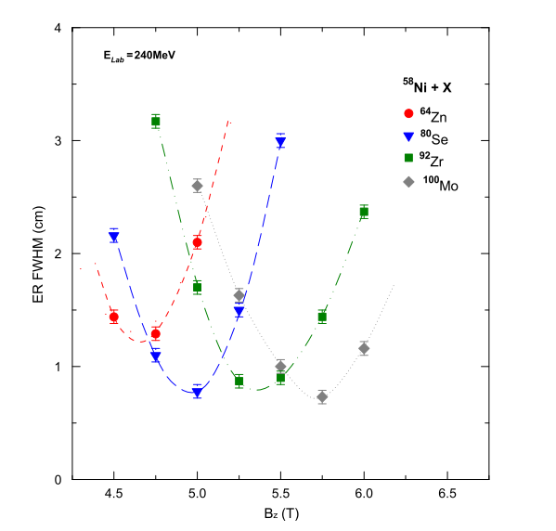
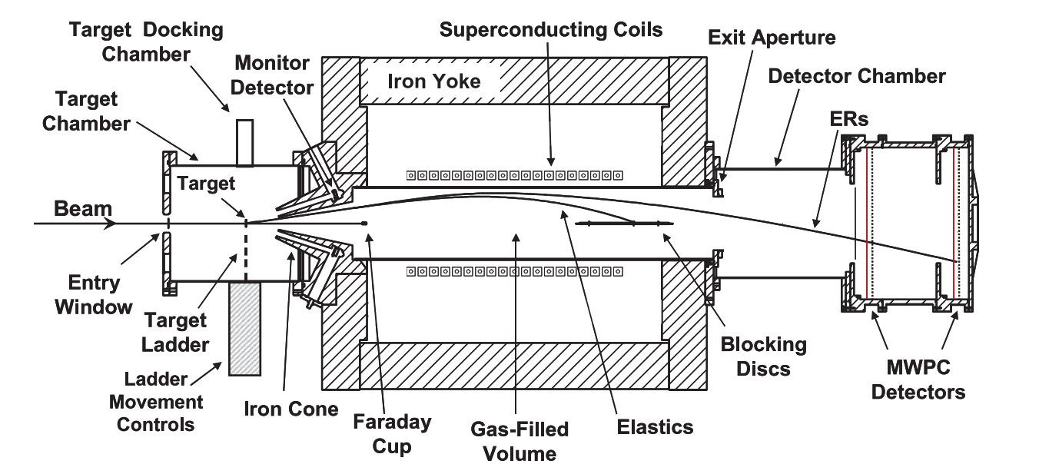
SOLITAIRE solenoid
Rodríguez, M. D., Brown et al, SOLITAIRE: A new generation solenoidal fusion product separator NIMA, 614(1)
Placed in ANU, Australia
Used for study of complete fusion reactions of heavy nuclei
Small image size: FWHM < 1 сm – from our experience we can expect something similar for SHE!

Slide 6
GASSOL simulation model
Created in Geant4 framework
Using the same method as in DGFRS-2 model
Multiple scattering, propagation in field, energy loss – Geant4 models
Also possible to use dE/dX tables of our own
Neutron evaporation – created a simple statistical model
Charge fluctuations in gas – created a model based on Gregorich idea
Gregorich, K. E. (2013). Simulation of recoil trajectories in gas-filled magnetic separators. Nuclear Instruments and Methods in Physics Research, Section A: Accelerators, Spectrometers, Detectors and Associated Equipment, 711, 47–59. https://doi.org/10.1016/j.nima.2013.01.020

Slide 7
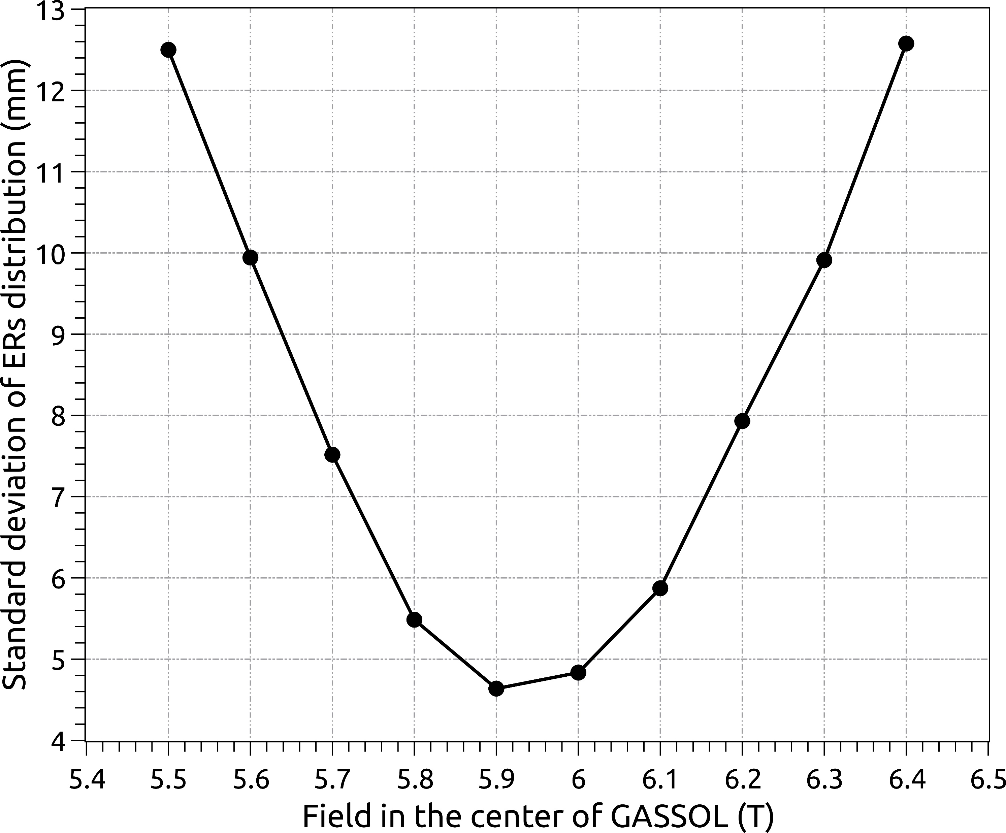
Results of simulation
Optimal field for SHE: 5.8-6.0 Tesla
ER image is symmetrical
In optimum one sigma is about 5 mm
Full transmission to focal plane is 58% (0.4 mg/cm² target) with 500 turbine mm и 40 mm diameter stopper
About 13% ER lost in vacuum chamber walls, 15% lost in stopper и 14% lost in turbine

Slide 8
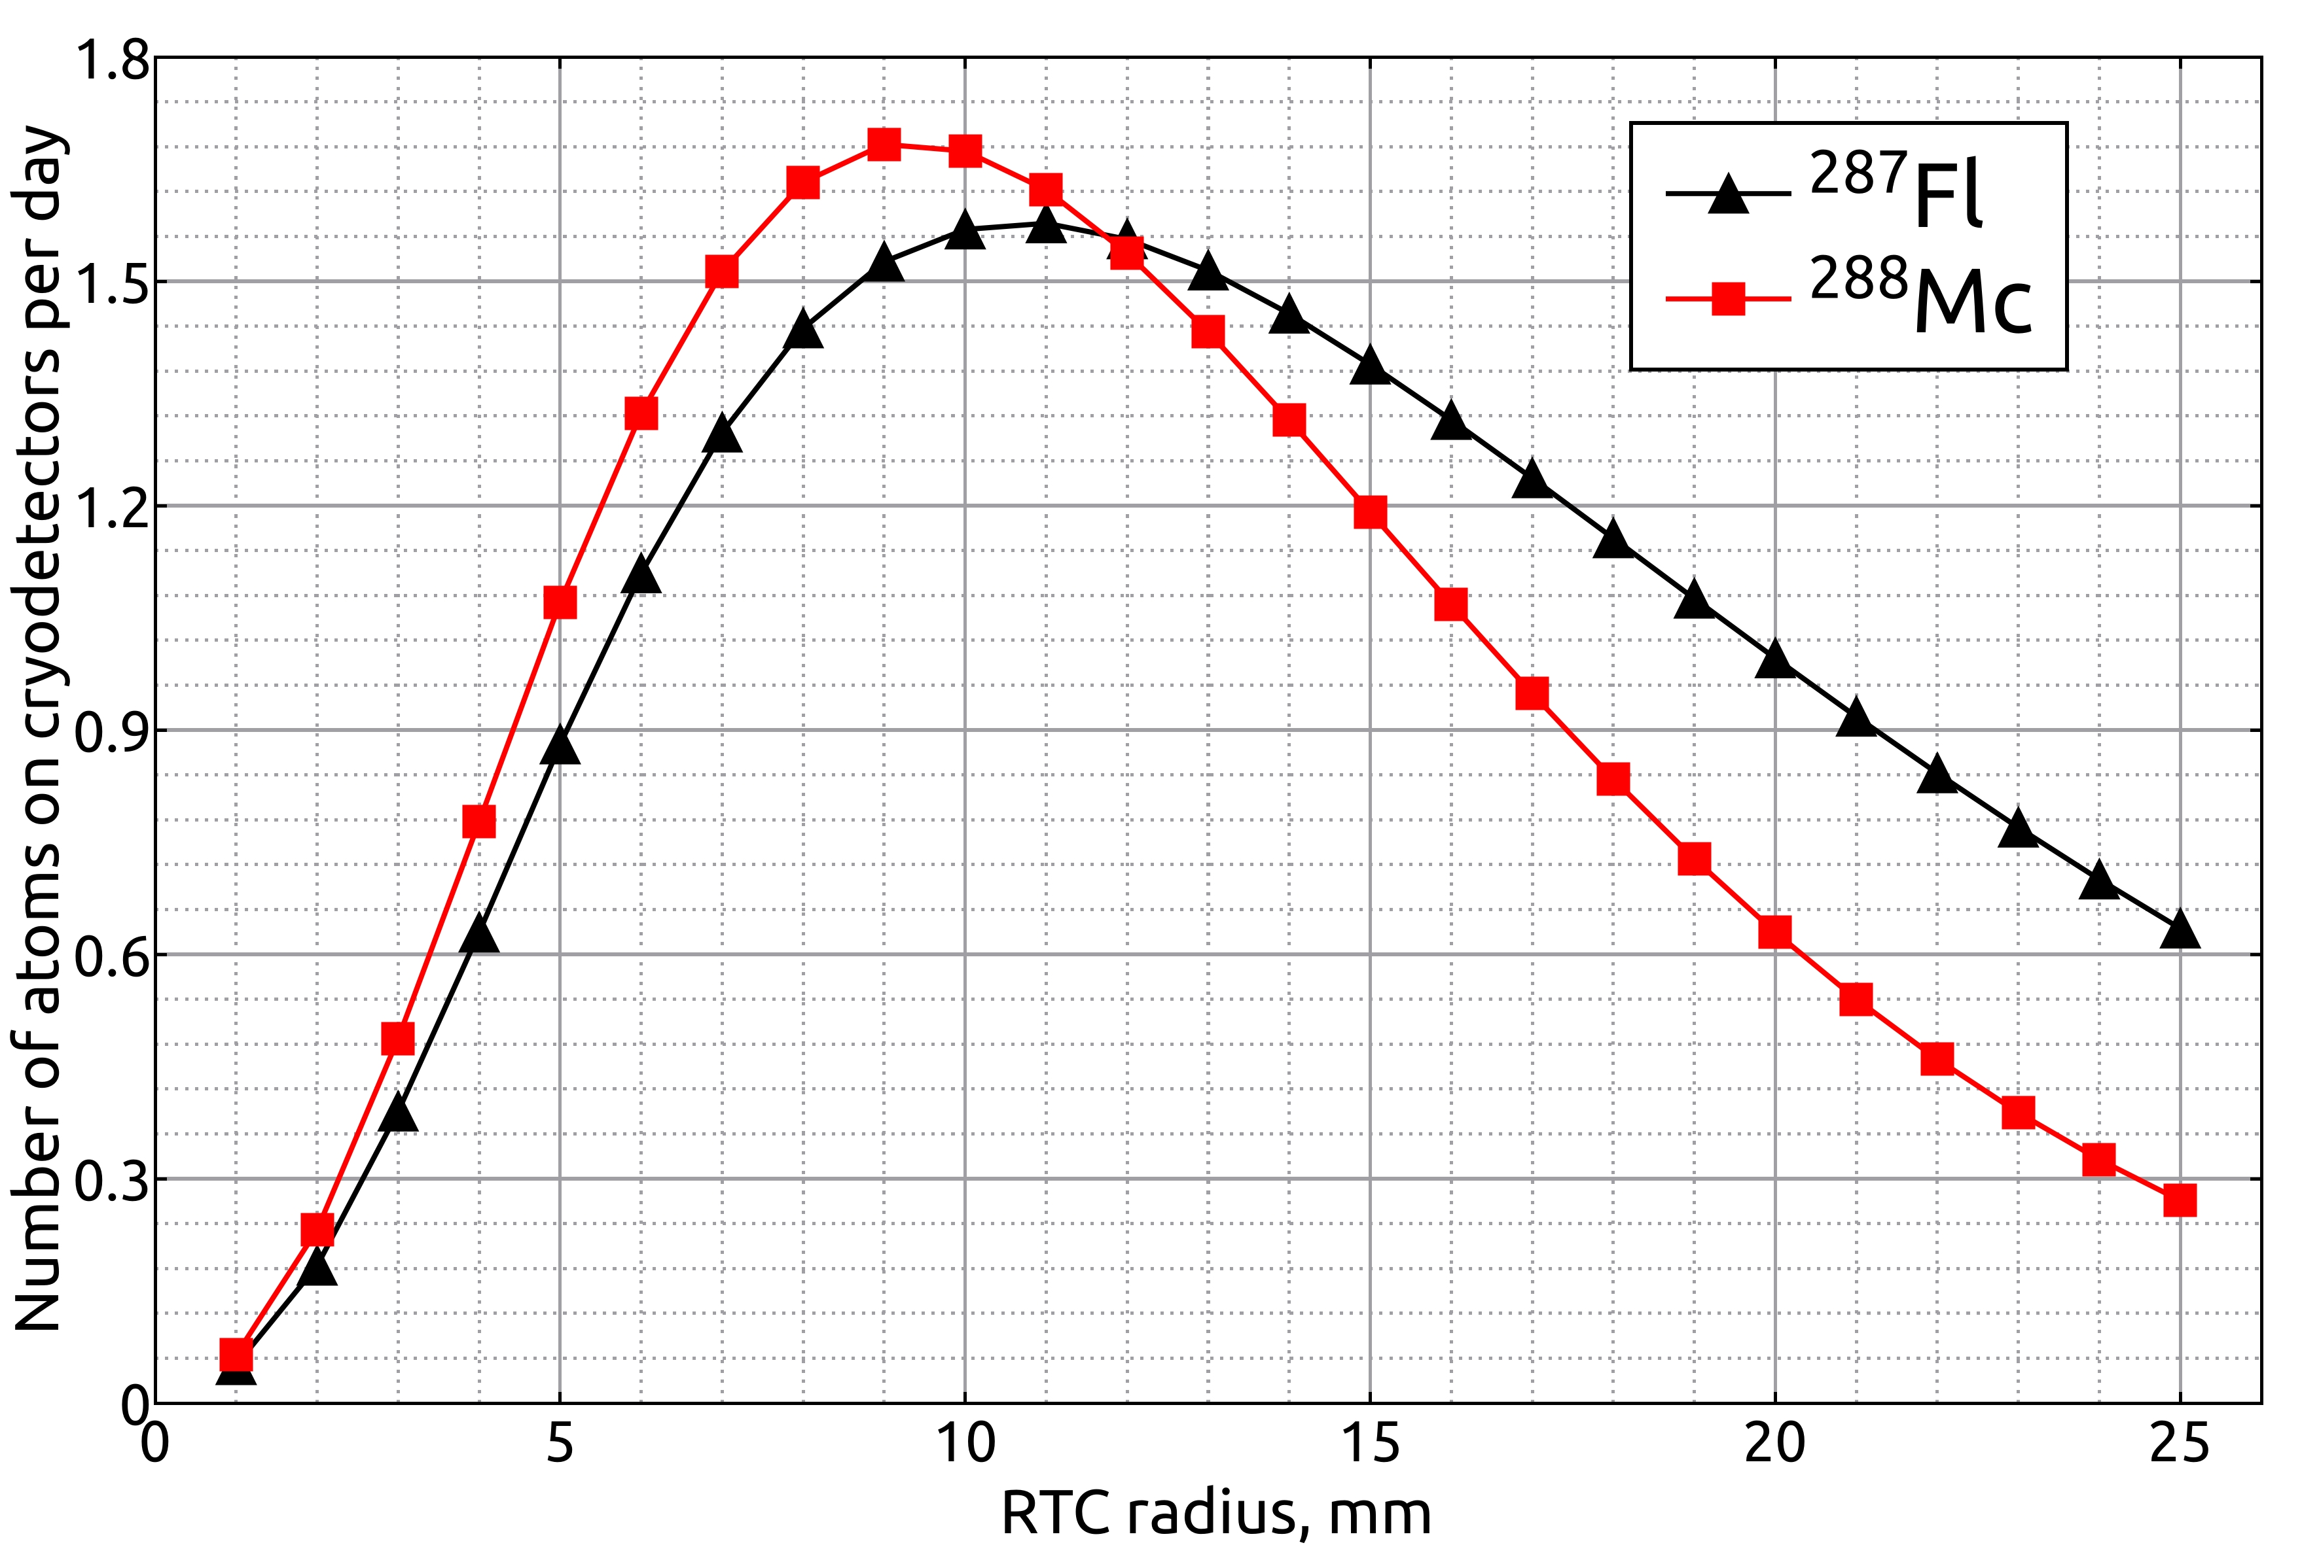
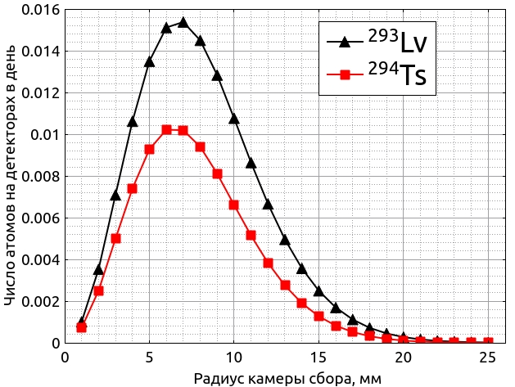
Results of simulation
Conditions:
Target 0.4 mg/сm²
Beam 1 puA
RTC: cylinder 1 cm in length
Gas flow 1.8 l/min
$$N_{det}= N_{cam}∗exp⁡(−\frac{ln2}{t_{1/2}}∗(t_{cam}+t_{cap}+t_{det}) )$$
We change RTC radius in search of optimum
Number of SHE atoms on cryodetectors is about 10 times higher
Small chamber volume: 4 cm³ Fl, 1 cm³ Ts
Large statistics is possible for Fl and Mc
Lv и Ts – we need large target and small detectors

Slide 9
Results of simulation
Element | ²⁸⁷Fl | ²⁸⁸Mc | ²⁹³Lv | ²⁹⁴Ts
Optimal chamber radius, mm | 11 | 9 | 7 | 6
Efficiency for the optimal chamber($ε_{tr}∗ε_{col})$ | 0.52 | 0.47 | 0.37 | 0.31
Volume, cm³ | 3.8 | 2.5 | 1.5 | 1.1
The RTC renewal time , s | 0.127 | 0.08 | 0.051 | 0.038
1 m capillary transportation time, s, s | 0.063 | 0.063 | 0.063 | 0.063
Time of flight in the detectors,s | 0.11 | 0.11 | 0.11 | 0.11
Full transportation time, s | 0.299 | 0.257 | 0.224 | 0.21
Half life, s | 0.360 | 0.193 | 0.051 | 0.057
Cross section, pb | 10 | 17 | 1.2 | 1.1
Atoms per day in RTC | 2.81 | 4.24 | 0.22 | 0.18
Atoms per day on the detectors | 1.58 | 1.68 | 0.015 | 0.010

Slide 10
Background problem
We can’t estimate the background – to many processes and to many uncertainties in them
Data from SOLITAIRE: reaction ³⁰Si+¹⁸⁶W, beam intensity 10⁸ ions/s, background is about 100 events/s in 1 cm radius of focal plane, mainly beam particles
Extrapolating to our beam intensity - 6*10¹³ ions/s (~ 10 ppA) we can expect about 6*10⁷ ions/s in 1 cm RTC.

Slide 11
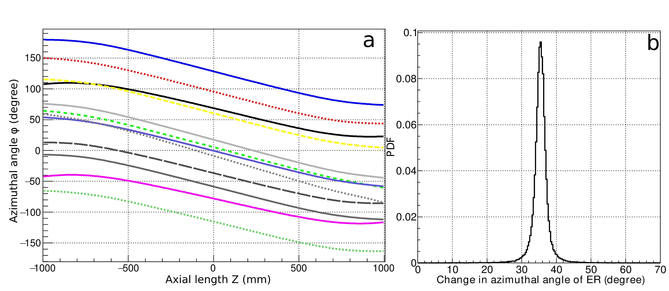
Additional suppression system
In solenoid field charged particles rotate around solenoid axes with frequency $ω = \frac{qB}{2m}$
Particles with same $Bρ$ will rotate on the same angle on some distance Z
Kumar, V. (2009). Understanding the focusing of charged particle beams in a solenoid magnetic field.
²⁸⁷Fl angular trajectories
$$φ=\frac{ωt}{2}= \frac{qBZ}{2mvcosθ}≈ \frac{qBZ}{2mv}=\frac{BZ}{2(Bρ)}$$
Based on this, we can create and additional suppression system and put it in the center of GASSOL
²⁸⁷Fl angle of rotation for Z = 500 mm

Slide 12
Static turbine

Slide 13
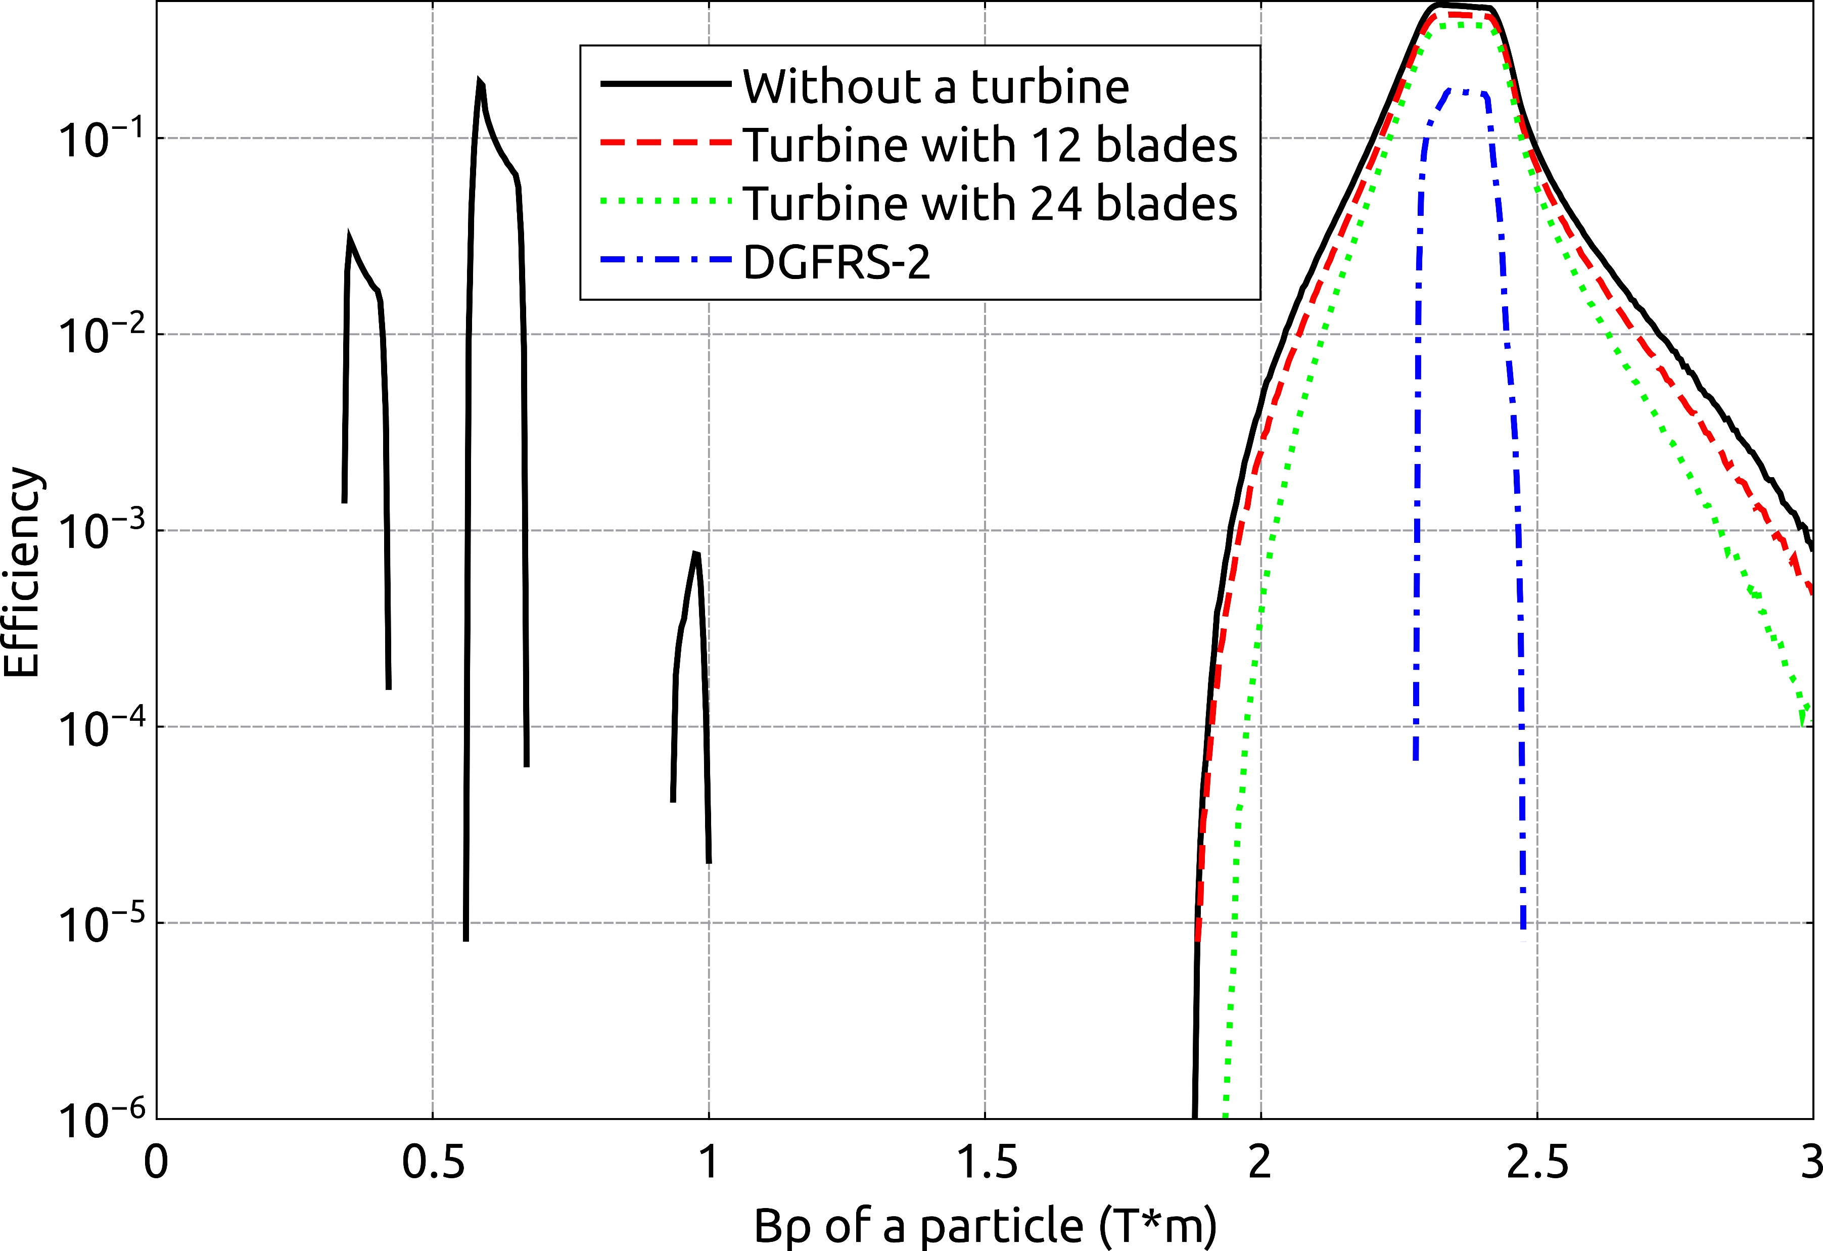
Background analysis
Field is 5.9 T – optimal for Fl
We change Bρ of particle from 0.005 до 3 Т*m: we want to understand which particles go in RTC
Similar calculation was done for DGFRS-2
Transmission peak $≈$2.4 Т*m still pretty wide
Additional transmission peaks removed
Only experiments will show is it enough
Simulation of 100 trajectories for Bρ = 0.6 T*м

Slide 14
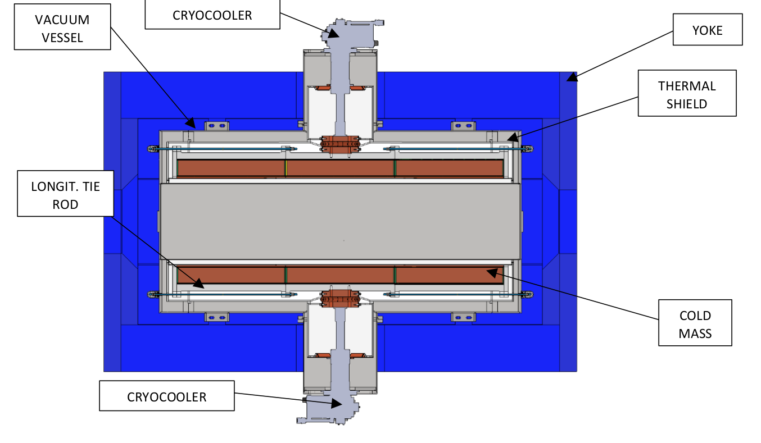
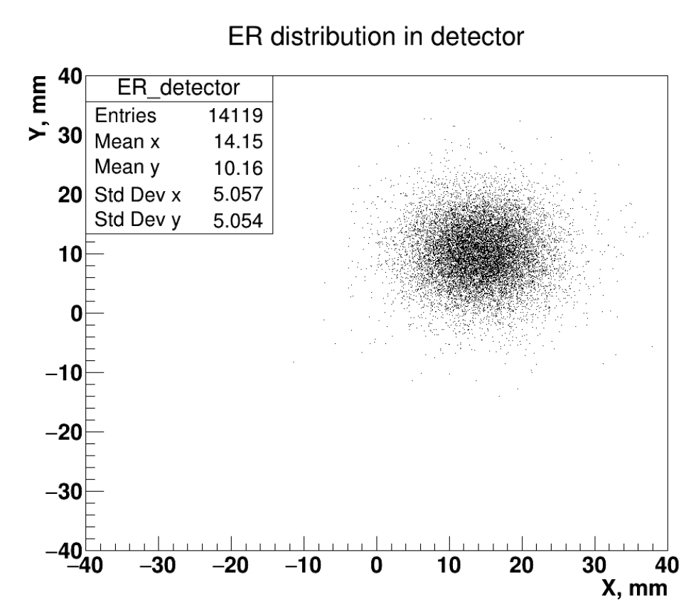
Cold mass misalignment problem
Cold mass will have some misalignment with iron yoke
This will lead to field direction displacement
As a consequence, ER will have some radial displacement on the focal plane
Will be first tuned by aligning tension in tie rods
Fine tuning – move magnet a bit around vacuum vessel!

Slide 15
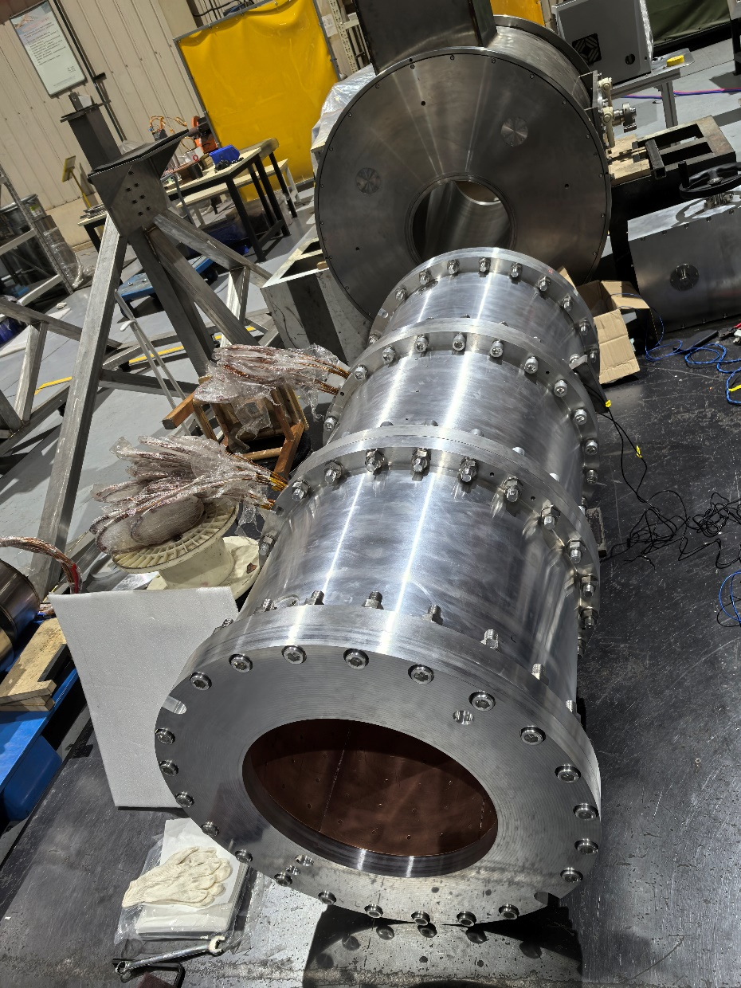
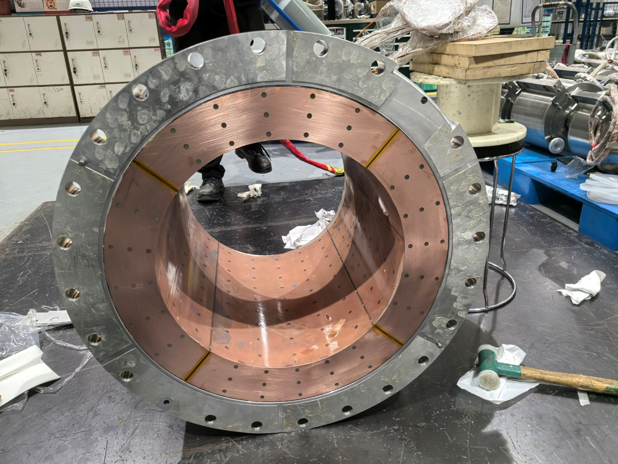
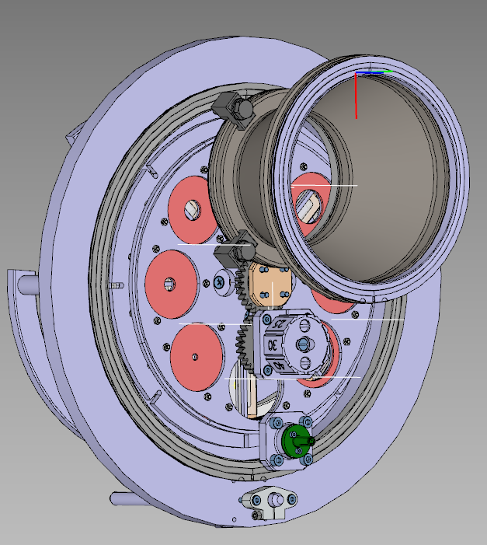
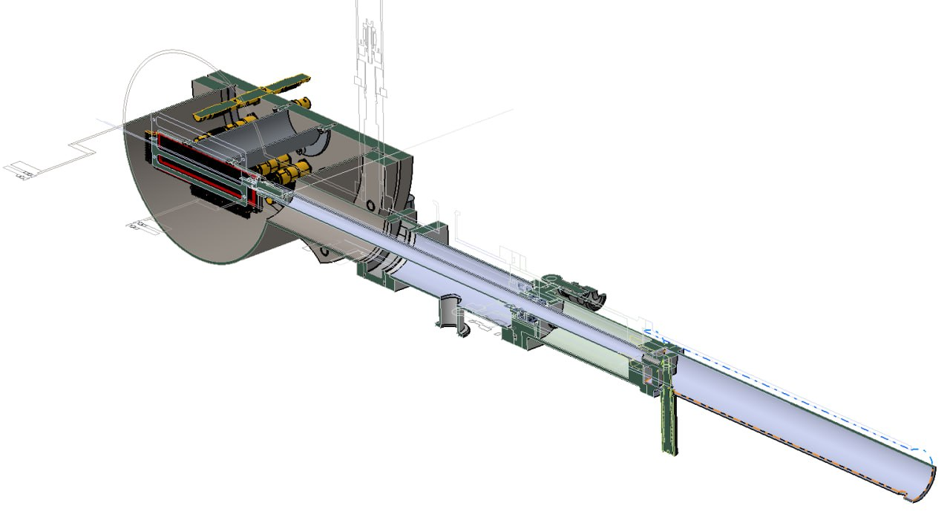
Status of GASSOL
Magnet is being produced by XSMT company in Xian
Cold mass has been assembled
Delivery is planned on July, 2025
Will be placed on DC-280 beam line
Technical systems are under construction
The testing procedure is developed and two detector assemblies are being produced
Autumn 2025 – optimistically we can start test experiments

Slide 16
Thank you for your attention

Slide 18
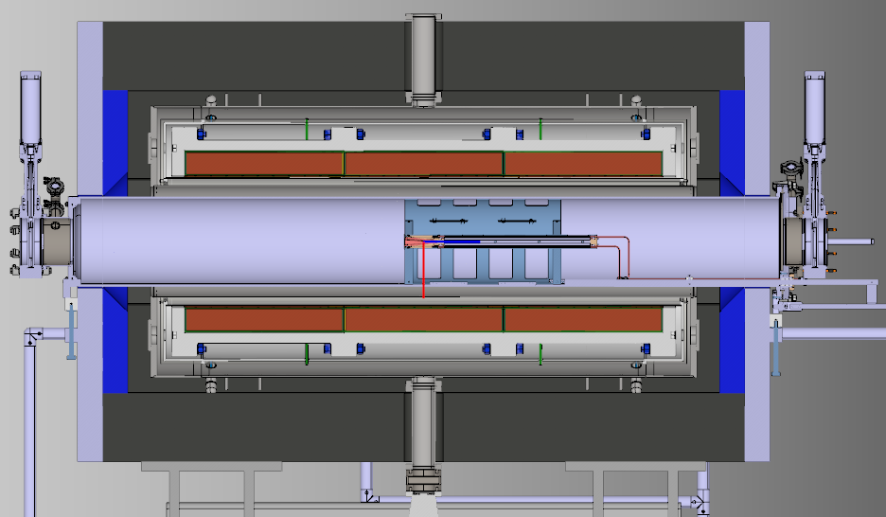

Slide 19
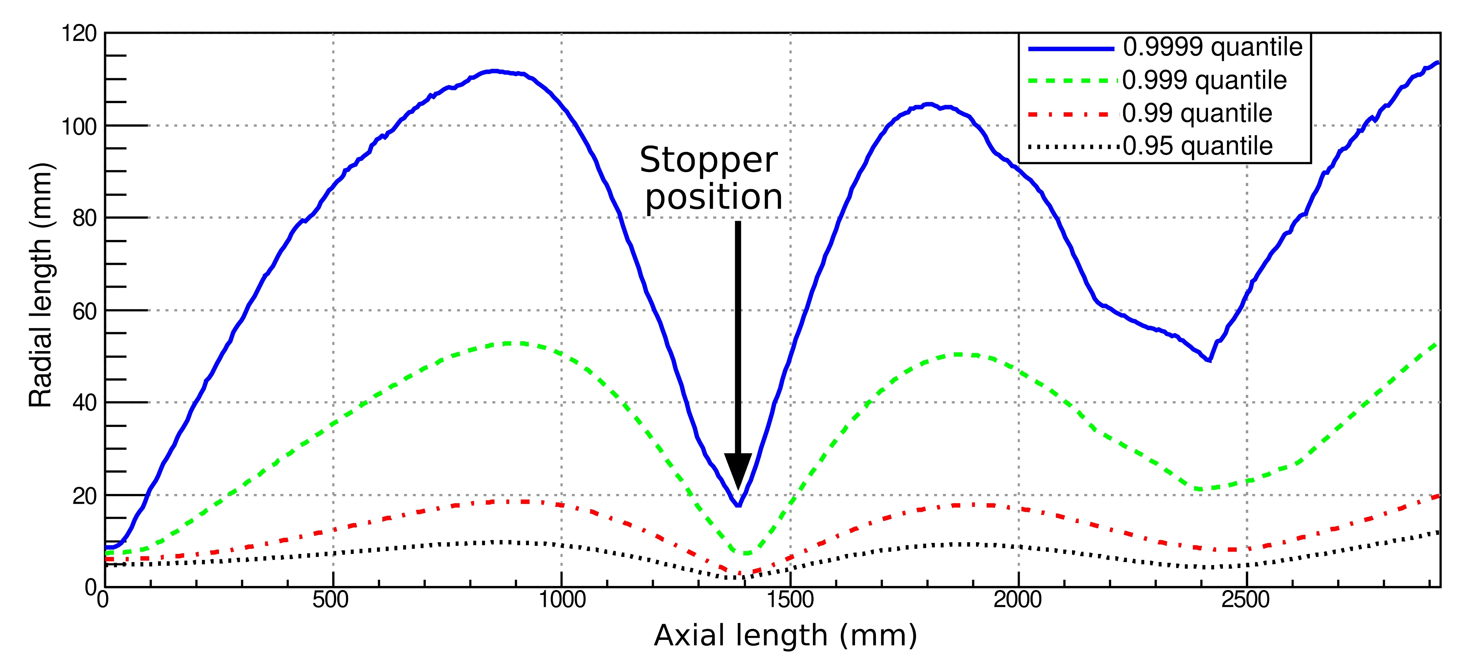
Results of simulation
⁴⁸Са, ≈ 5 Mev/amu
After target q = 17.6, σ = 1.38 [G. Schiwietz, P.L. Grande, Improved charge-state formulas]
For q = 17 in hydrogen:
σ_{capture} ≈ 4 *10⁻²⁰ см², σ_{loss} ≈ 5 *10⁻²⁰ см² [N.V. Novikov Empirical method evaluation of charge – Changing cross sections]
In 0.7 Torr of hydrogen λ ≈ 2 m, which only slightly change the charge distribution
Picture shows radial quantiles of beam distribution inside the solenoid
⁴⁸Ca, 254.2 MeV before target

Slide 20
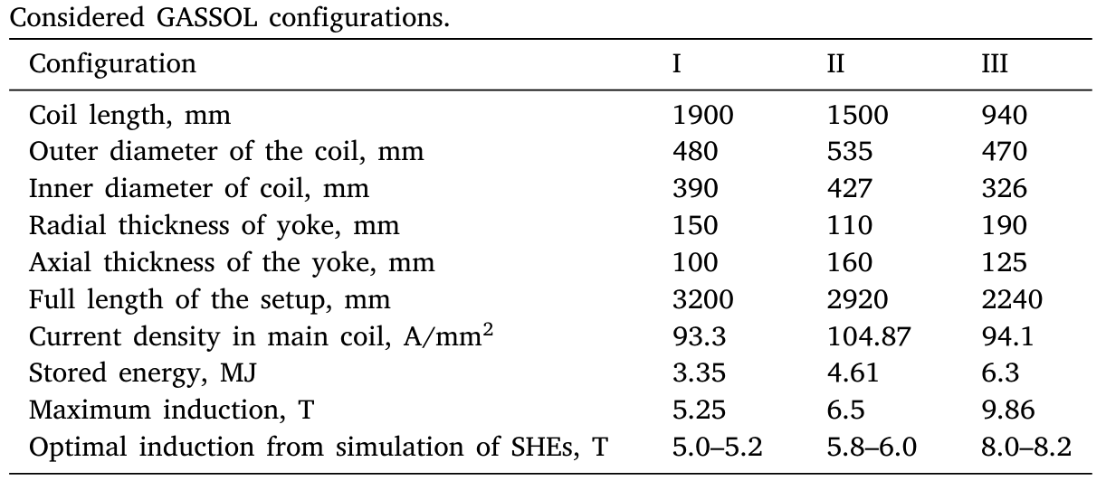
GASSOL configuration
Several solenoid configuration were analyzed in the model, II is used

Slide 21
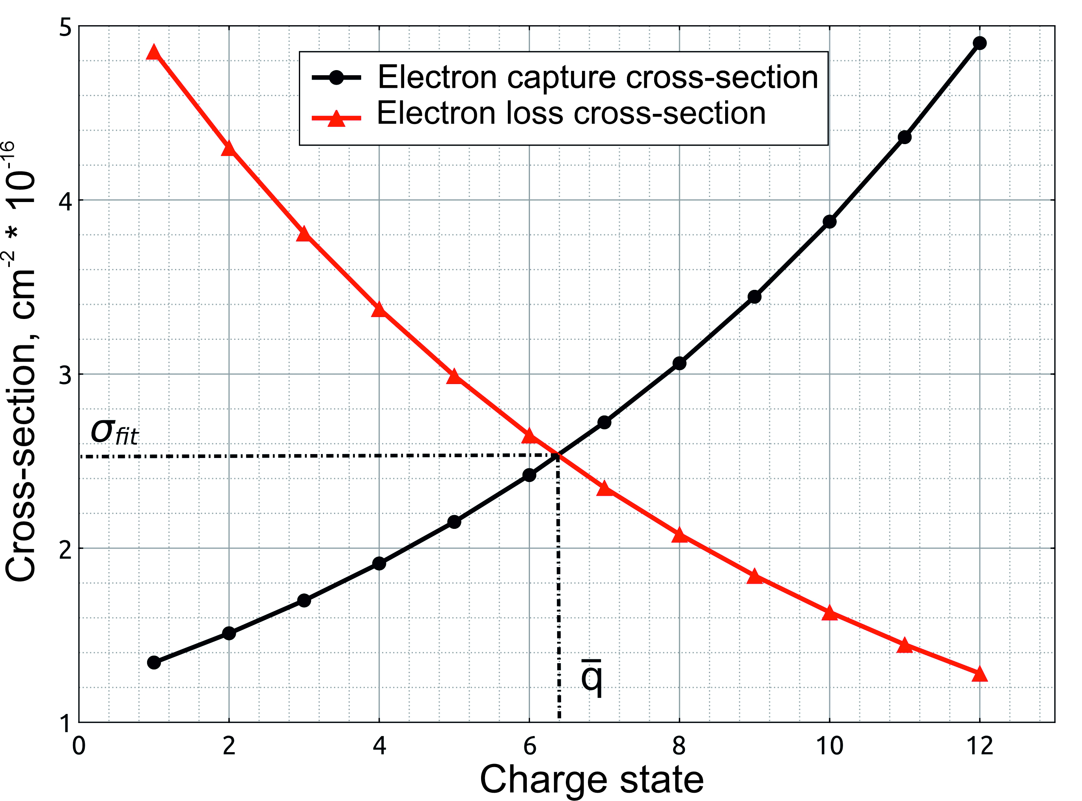
Recharge process
$$\overline{q} −from charge systematics$$
Electron capture cross section:
$$σ_{fit}=\text{8}\text{.}\text{77} \overline{q} ∗exp\left(\text{−}\text{0}\text{.}\text{0614} ∗\frac{\text{E}}{{\overline{q}}^{\frac{4}{7}}}\right)$$
Sagaidak, R. N. (2021). Empirical relations for heavy-ion equilibrated charges and charge-changing cross sections in diluted H2 with application. European Physical Journal D, 75(8).
For equilibrated charge electron capture cross section is equal to electron loss cross section – if we omit multielectron recharge

Slide 22
Recharge process
0.12 – from comparison of image sizes in different pressure on DGFRS-2
Calculation showed that this parameter highly affects the image size
0.12 – showed best agreement with experimental data

Slide 23
Verification of model
Comparison of experimental and simulated data on angular distribution:
(а) ¹⁴⁶Nd (¹¹B,7n)¹⁴⁹Tb, target thickness 89 um/cm², beam energy 104 МeV ,
(б) ¹⁴⁴Nd (¹²C,7n)¹⁴⁹Dy, 77 um/cm², МeV ,
(в) ¹⁹⁷Au (¹⁸O,5n)²¹⁰Fr, толщина мишени 150 мкг/см², энергия пучка 90 МэВ,
(г) ²⁰⁹Bi (¹²C,4n)²¹⁷Ac, толщина мишени 100 мкг/см², энергия пучка 80 МэВ

Slide 24
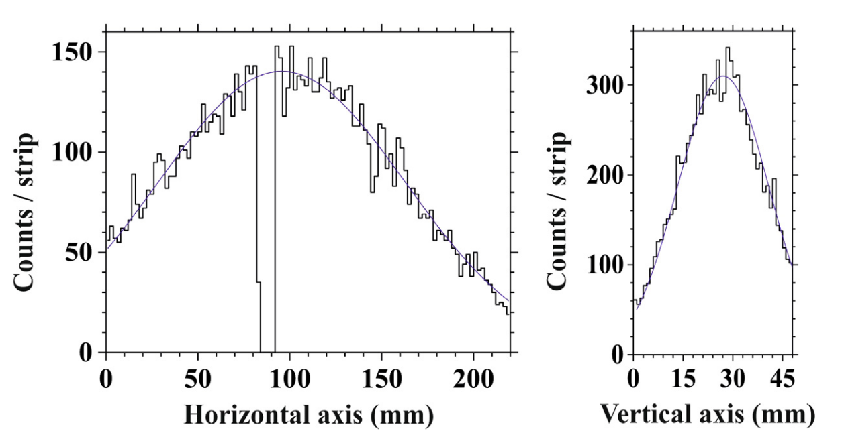
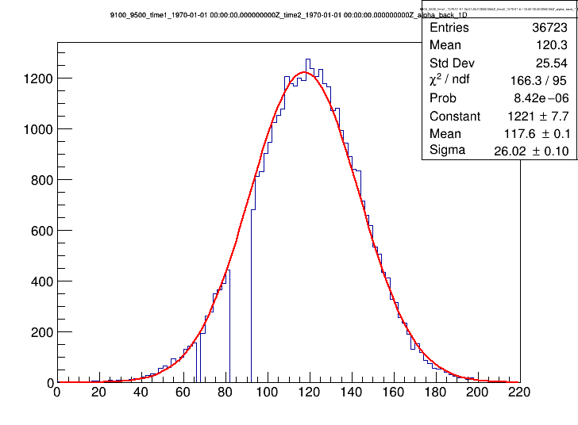
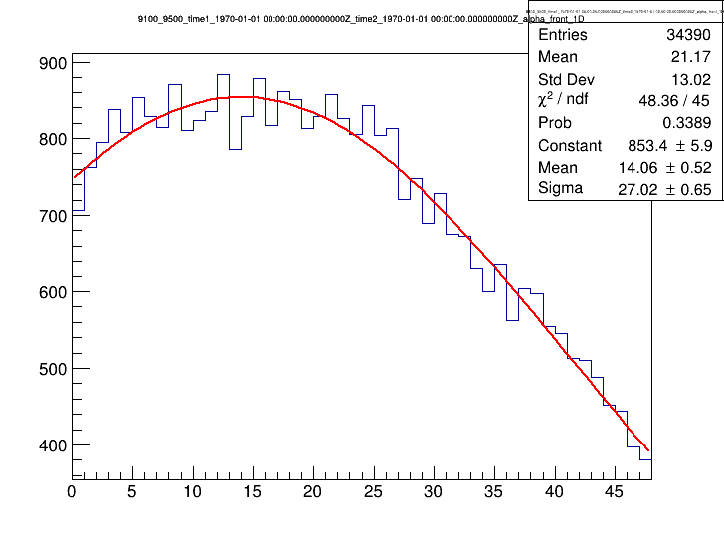
Image sizes on DGFRS-2
Reaction:²⁰⁶Pb(⁴⁸Са,2n)²⁵²No
Configuration: Q_{v}D_{h}Q_{h}Q_{v}D
Transmission: ≈ 60% for 0.4 mg/cm²
σ_{x} = 70.1 mm σ_{y} = 12.9 mm
Reaction: ¹⁷⁴Yb(⁴⁸Са,5n)²¹⁷Th
Configuration: Q_{v}D_{h}Q_{v}Q_{h}D
Transmission:≈ 40% for 0.4 mg/cm²
σ_{x} = 26.0 мм σ_{y} = 27.0 мм

Slide 25
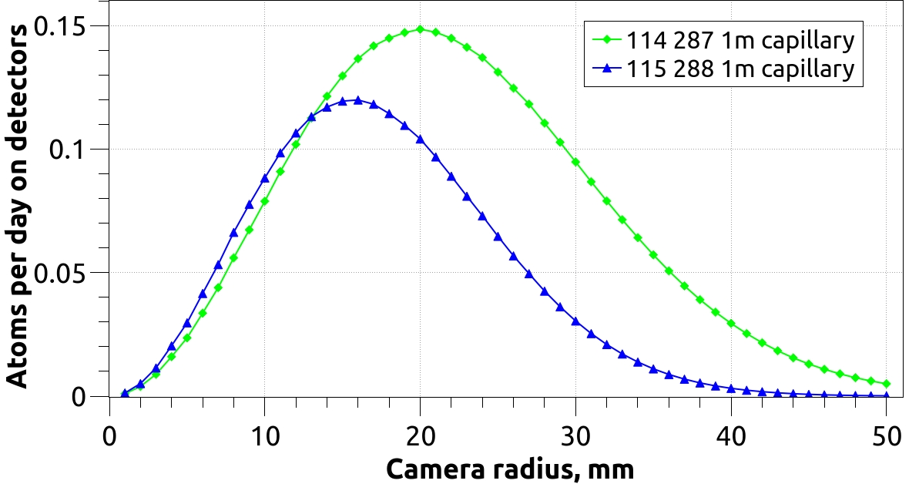
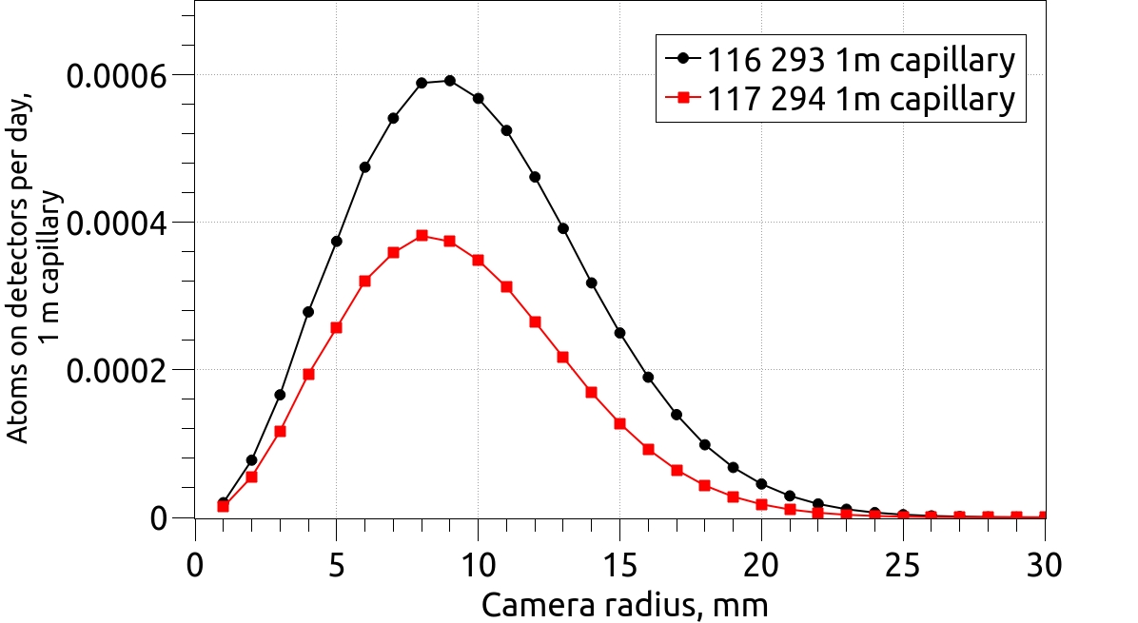
Image sizes on DGFRS-2
σx = 26.0 mm σy = 27.0 mm
- Transmission 40%
Target 0.4 mg/сm²
Beam 1 puA
RTC: cylinder 1 cm in length
Gas flow 1.8 l/min
Isotope | Cross-section, pb | Half life, ms
²⁸⁷Fl | 10 | 330
²⁸⁸Mc | 17 | 193
²⁹³Lv | 1.2 | 57
²⁹⁴Ts | 1.1 | 51

