Slide 1
Transport and adsorption modeling of a gas chromatography experiment of SHE
INTERNATIONAL CONFERENCE «50 YEARS OF COLD FUSION» YEREVAN, ARMENIA, NOVEMBER 20 – 23, 2024
Andrey Astakhov, Gospodin Bozhikov, Nikolay Aksenov
E-mail: astakhov@jinr.ru

Slide 2
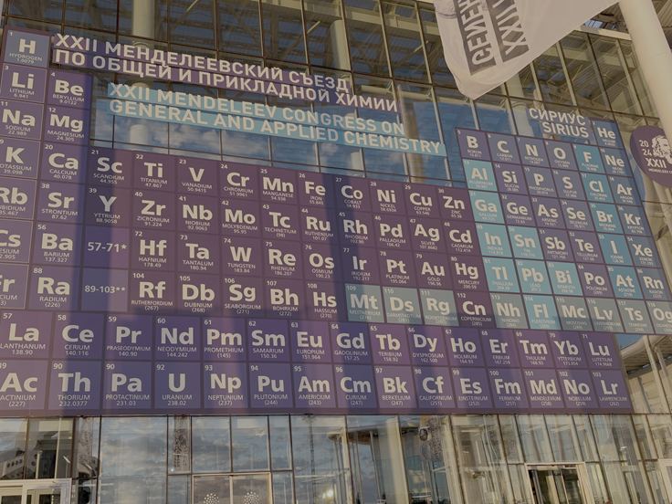
Planning the first chemistry experiment at the SHE Factory
Elements of interest:
SHE discovered in reactions with ⁴⁸Ca

Slide 3
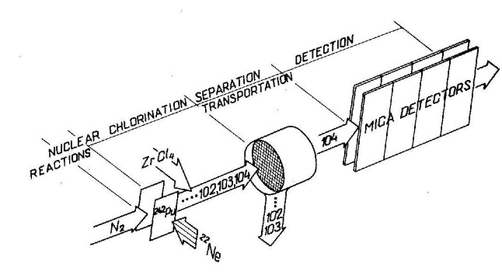
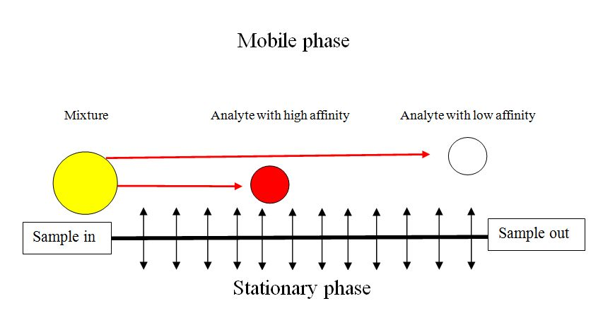
Gas adsorption (thermo-) cryo-chromatography
to study inert and volatile elements
Mobile phase – an inert carrier gas
Adsorption on metal surfaces
Mixture
High affinity
Low affinity
Stationary phase
Chromatographic separation due to interaction with surface
Volatility
Inert behavior
Elemental state
extrapolation of data (adsorption) to macroscopic quantities
using modeling and quantum chemistry

Slide 4
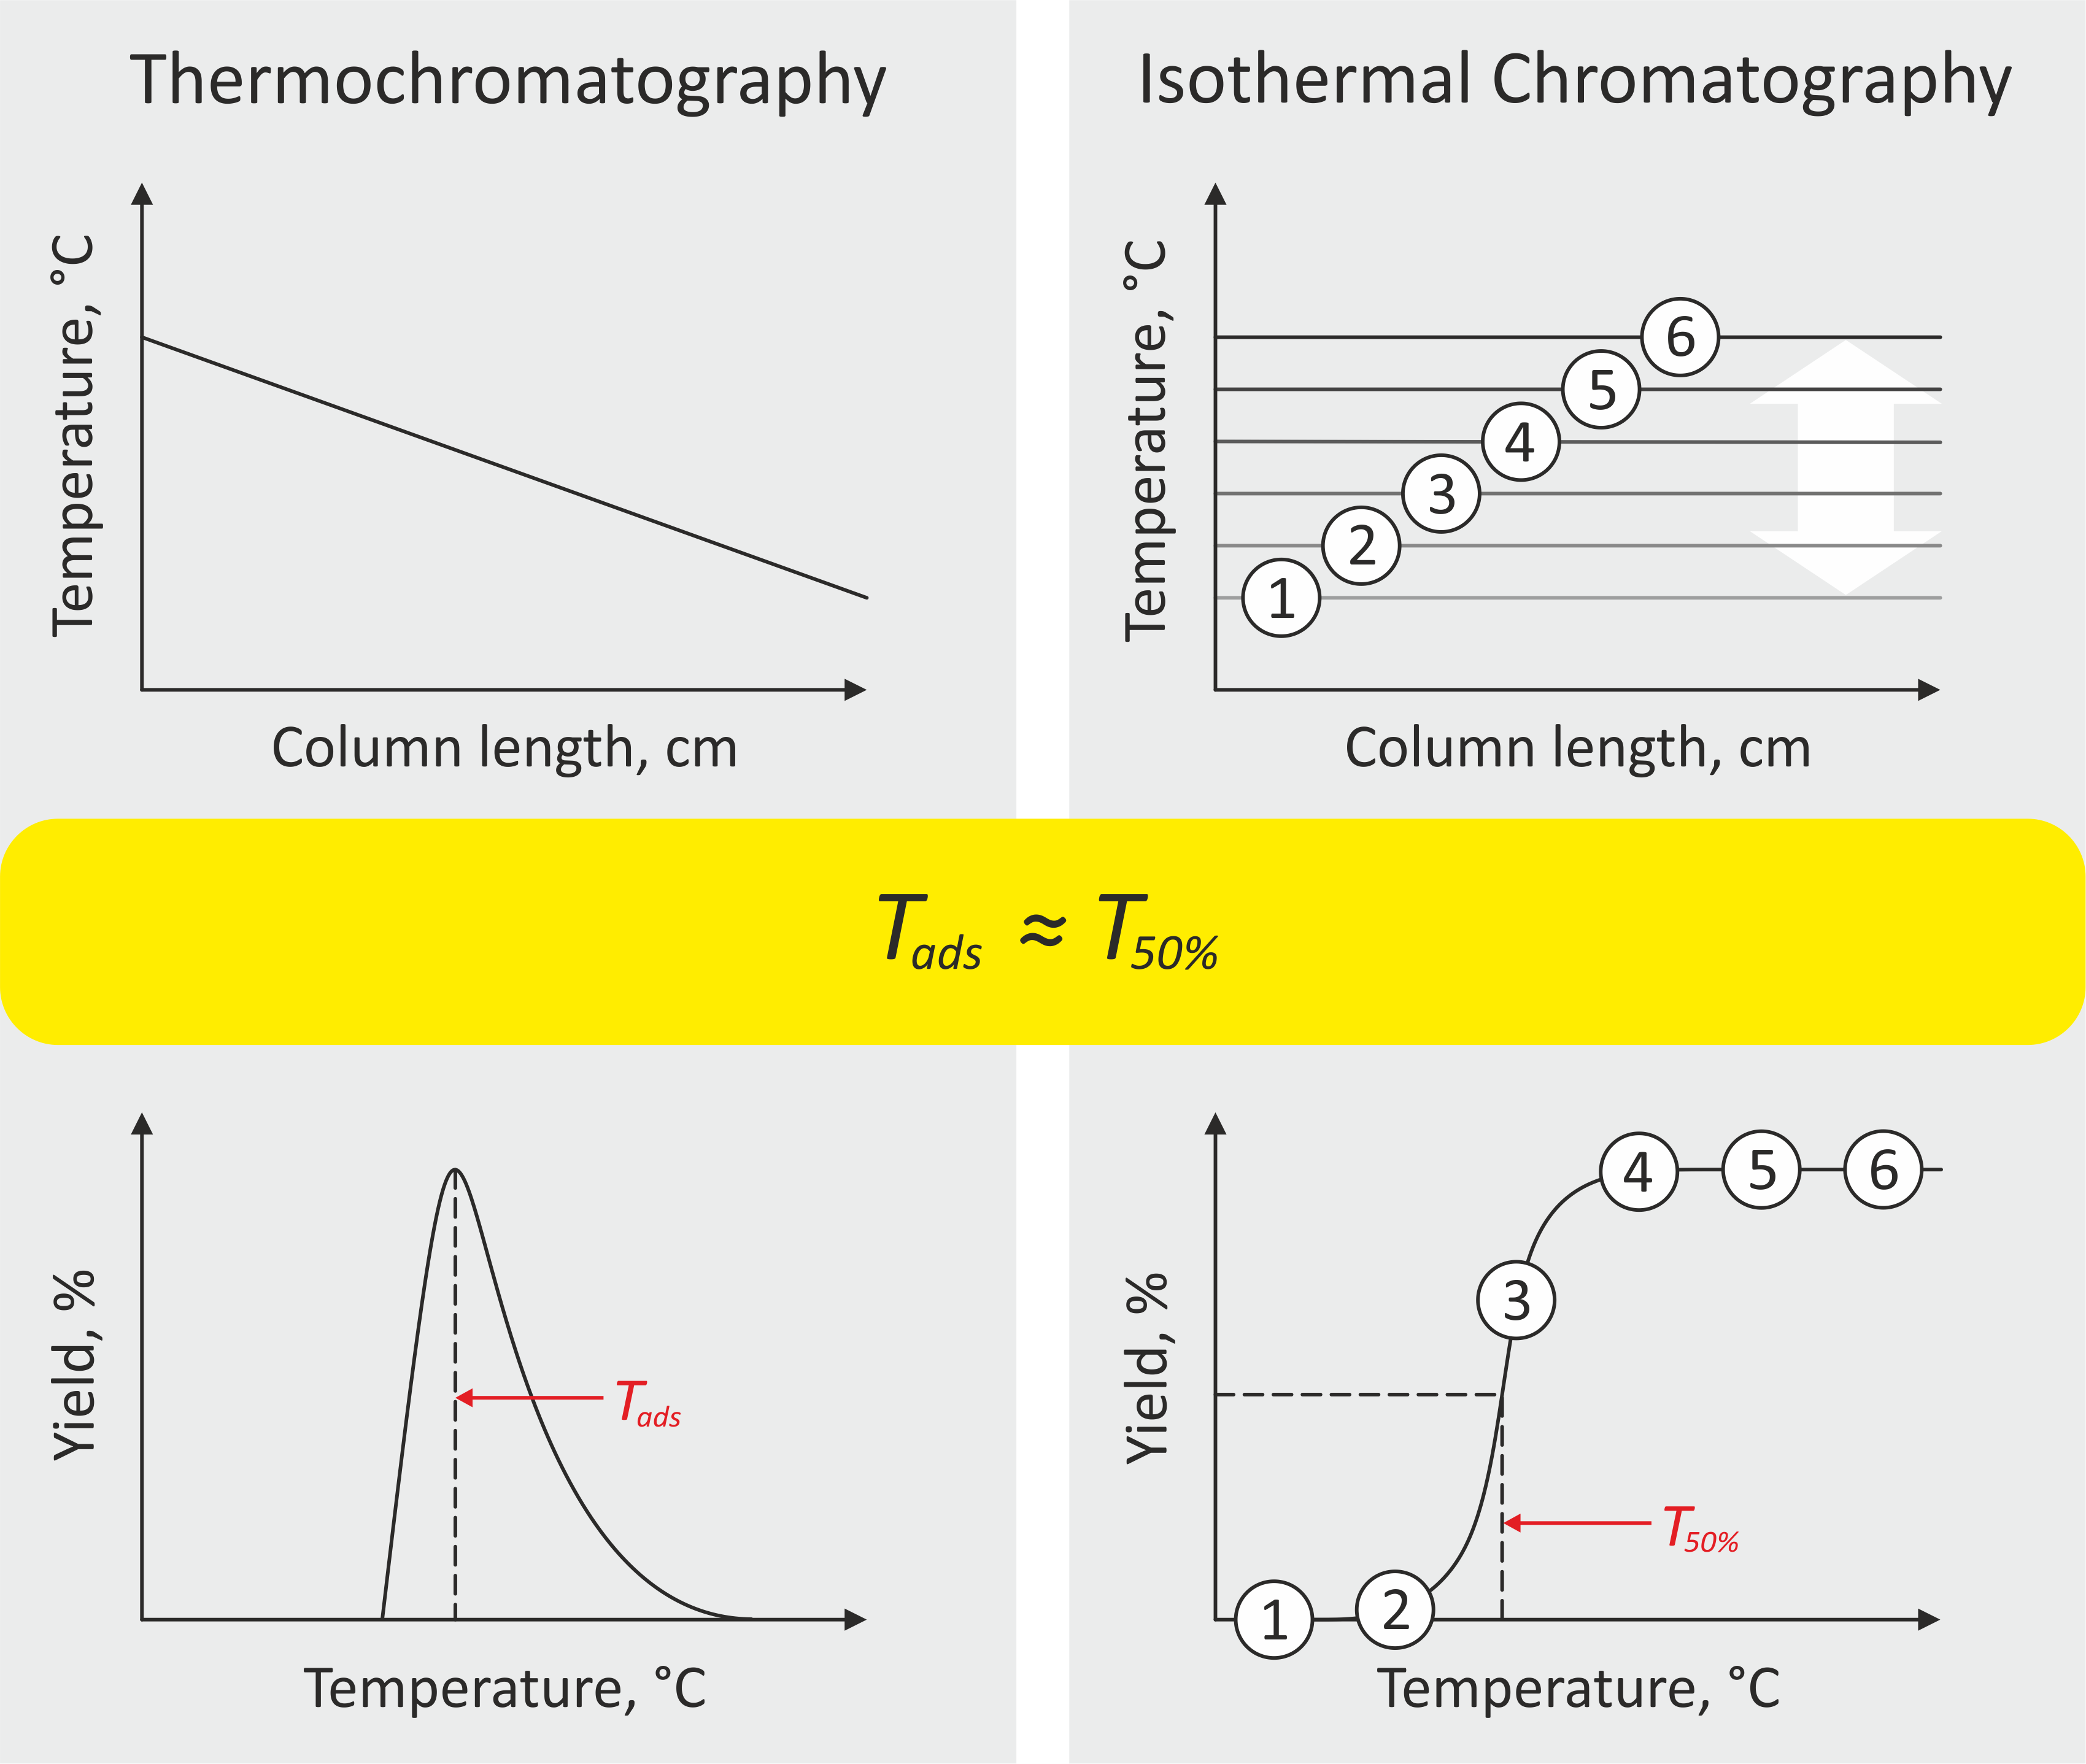
Chromatographic profiles characterize chemical interactions between adsorbate and adsorbent;
Small number of events does not allow to define chromatographic profiles experimentally for SHEs (Cn, Nh, Fl);
Experimental chromatographic profiles can be obtained in the off-line experiments with long-lived isotopes of light SHE’s homologs (Hg, Tl, Pb);
Comparing results of the Monte-Carlo simulations with experimental chromatographic profiles we can verify efficiency of theoretical model.
Does the mobile adsorption model explain all known results?

Slide 5
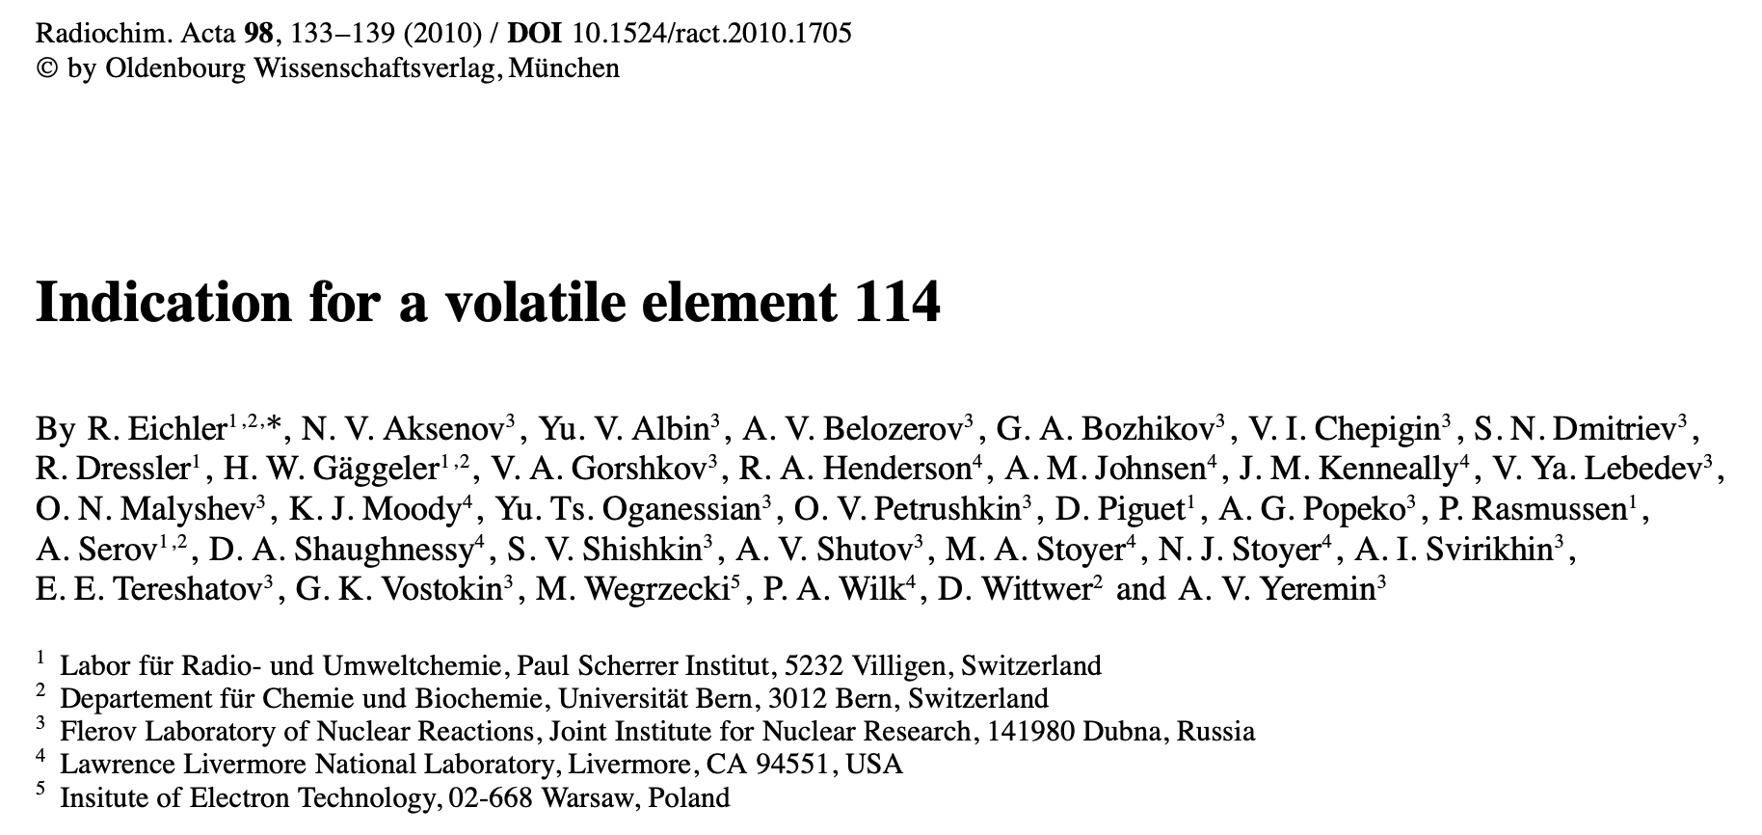
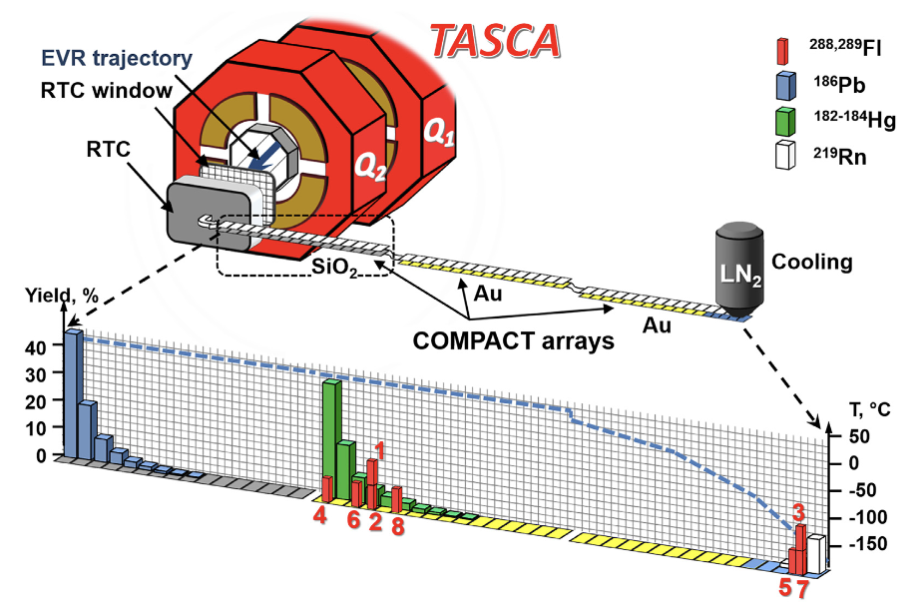
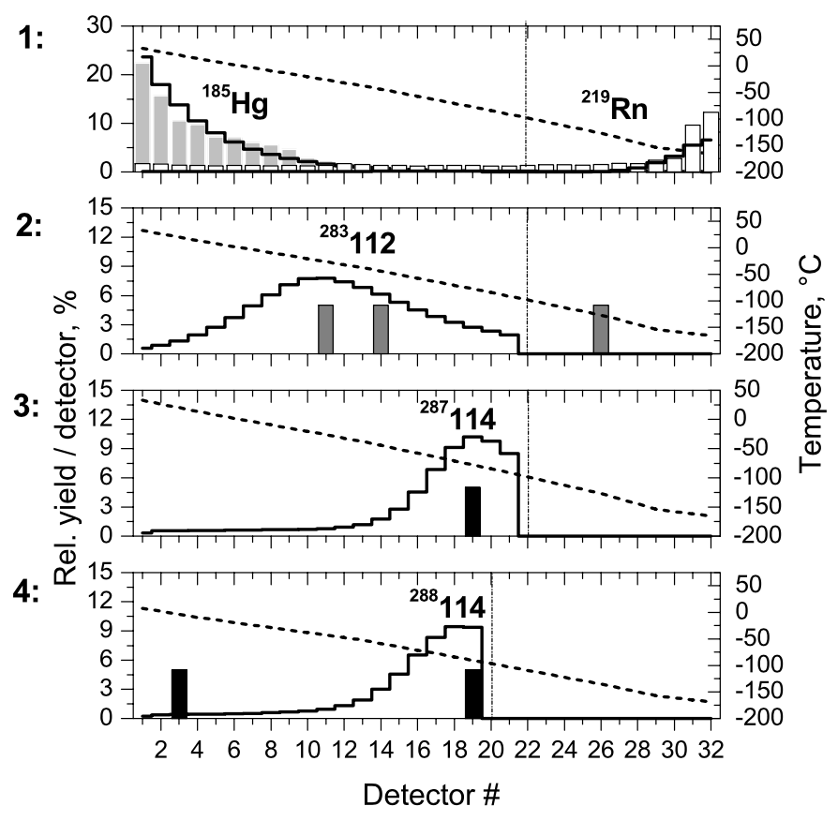
Fl chemistry
A. Yakushev et al.
TC on gold
2007-2008 PSI&FLNR
2009 TASCA GSI
2014-2015 TASCA GSI
Volatile inert metal or gas
Strong influence of relativistic effects
Behind TASCA separator (8 chains)
High volatility and metallic properties
Chemisorption on gold
Two deposition zones
Latest theoretical estimations:
Stability of FlO predicted
Mechanism of adsorption on gold is proposed
COLD: Behind the target + gas jet (3 chains)
High volatility and inert behavior
Physisorption on gold
Monte Carlo simulations can not describe the experimental result
Speciation study at the SHE Factory: Formation of two chemical species?

Slide 6
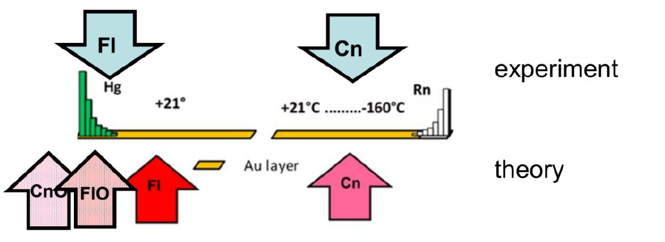
Fl adsorption on gold
Possible explanations of two peaks:
1) existence of two different adsorption mechanisms (for example, strongly bound and weakly bound states)
2) presence of two different chemical species of flerovium (Fl and FlO)
3) contamination of the gold surface
Theory
E_{ads}(Fl) = 0.92 eV
E_{ads}(FlO) = 1.88 eV
V. Pershina, M. Iliaš, Dalton Trans. 51, 7321 (2022)
The mobile adsorption model does not predict two peaks!
This can be a reason for revision and generalization of the existing model

Slide 7
Stages of chromatographic process (Monte-Carlo modeling)
Transport in the gas phase: interaction with carrier gas atoms;
Interaction with surface: scattering/adsorption;
Transport on the surface: migration, transition to a strongly bound state;
Desorption into the gas phase;
α-decay or spontaneous fission.
Mobile phase – an inert carrier gas
Mixture
High affinity
Low affinity
Stationary phase
Stationarity condition: given a time-constant carrier gas flow rate and a time-constant temperature gradient, a stationary field of macroscopic velocities u(r) and temperatures T(r) is established (laminar fluid flow);
Local thermodynamic equilibrium condition: in the presence of a temperature gradient, each small volume of gas can be considered as local canonical ensemble and satisfies the Boltzmann distribution:

Slide 8
1. Transport in a gas phase
Continuous model (stochastic dynamics)
Solution of the stochastic Langevin equation:
η(t) – stochastic force
D – diffusion coefficient
Discret model (rigid balls)
Mean free path for heavy atom
υ_{a} – atomic velocity, n_{g} – carrier gas concentration, – relative velocity, σ_{ag} – kinetic cross-section for atoms.
Real free paths of atoms are distributed by
$${\overline{υ}}_{rel}$$
Values of σ_{ag} и D are unknown for SHE and have to be estimated by other methods

Slide 9
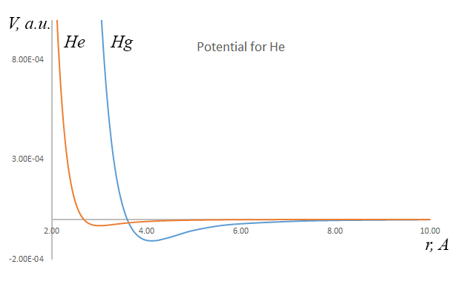
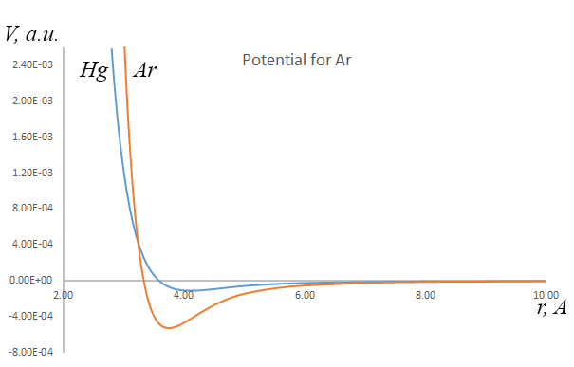
Evaluation of the diffusion coefficients by molecular dynamics
Relativistic coupled clusters calculations of interaction energies between pair of atoms (relCCSD(T)/aug-RPF-4Z)
Type of model potential:
Diffusion coefficients from the Cubo formula:
Trajectories length for simulation: 0.4 μs
Number of atoms in cell: 500
Number of cells in ensemble: 100

Slide 10
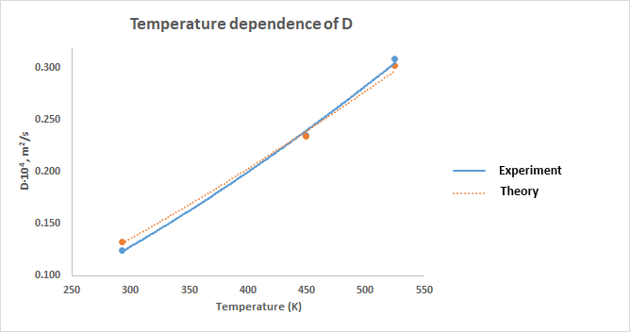
Results for Hg and Fl
 | D·10⁴, m²/s (273.2 К) | D·10⁴, m²/s (293.2 К) | D·10⁴, m²/s (449.2 К) | D·10⁴, m²/s (449.2 К)
He – He | 1.00 0.84 (exp.)
Ar – Ar | 0.13 0.16 (exp.)
Hg – He | 0.47 0.53 (exp.)
Hg – Ar | 0.114 0.109 (exp.) | 0.132 0.124 (exp.) | 0.234 0.235 (exp.) | 0.302 0.309 (exp.)
Fl – Ar |  | 0.116
$T_{0}$=273.15 K

Slide 11
2. Atom – surface interaction
(adsorption model by I. Zvara)
Mobile adsorption model (two free translational degrees of freedom per atom)
Harmonic vibration approximation (one vibrational degree of freedom per atom)
Average desorption time (Frenkel-Arrhenius equation):
In the simplest case for adsorption on gold t₀⁻¹=v_{max}(Au)= 3.34·10¹² s⁻¹
(I. Zvara. The Inorganic Radiochemistry of Heavy Elements. – Springer, 2008. – 225 p.)
Possible generalization
Adiabatic approximation in quantum chemistry
$$ε_{j}$$
- energies of nuclear states (vibrational and translational levels)

Slide 12
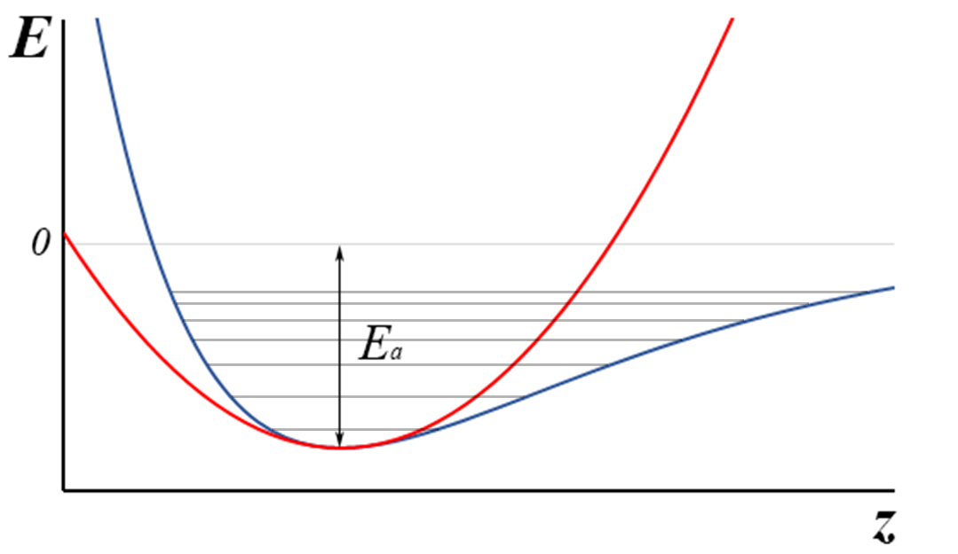
Adiabatic potential of periodic surface
Along a surface
Normal to a surface
Free states
Bound states
Occupation probability on i-th level for a given temperature T is
The mobile adsorption corresponds to E_{a} > V(x,y)
Adsorption/desorption are the transitions between free sates and bound states
Beyond the mobile adsorption model migration of atoms along a surface are hindered
Hamiltonian of total interacted system can be represented as a Hamiltonian of equilibrium system and time-periodic potential (can be taken into account as a time-depended perturbation using phonon dynamics)
H_{eq} corresponds to absence of thermal vibrations of surface atoms (the rigid surface model with fixed nuclei positions)
Adiabatic potential E(R) describes possible interactions between surface and atom

Slide 13
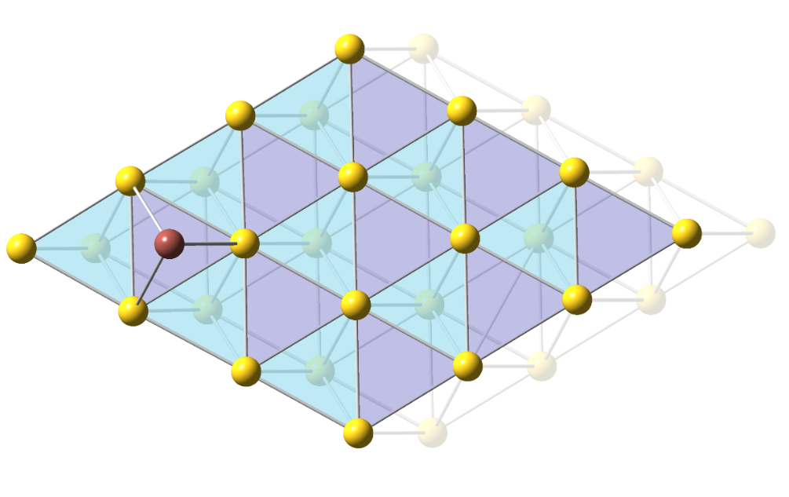
Quantum-chemical estimation of the adsorption energy
E_{a} = (E_{slab} + E_{atom}) – E_{slab+atom}
The most energetically stable surface is (111) for gold
(V. Pershina, M. Ilias, Chem. Phys. Letters 2018, 694, 107–111)
E_{a} is a stationary points on a adiabatic potential surface
How can we reconstruct total potential surface?
is a linear combination of cosine functions
2
1
3
- the Morse potential
In each stationary point i
- force constants

Slide 14
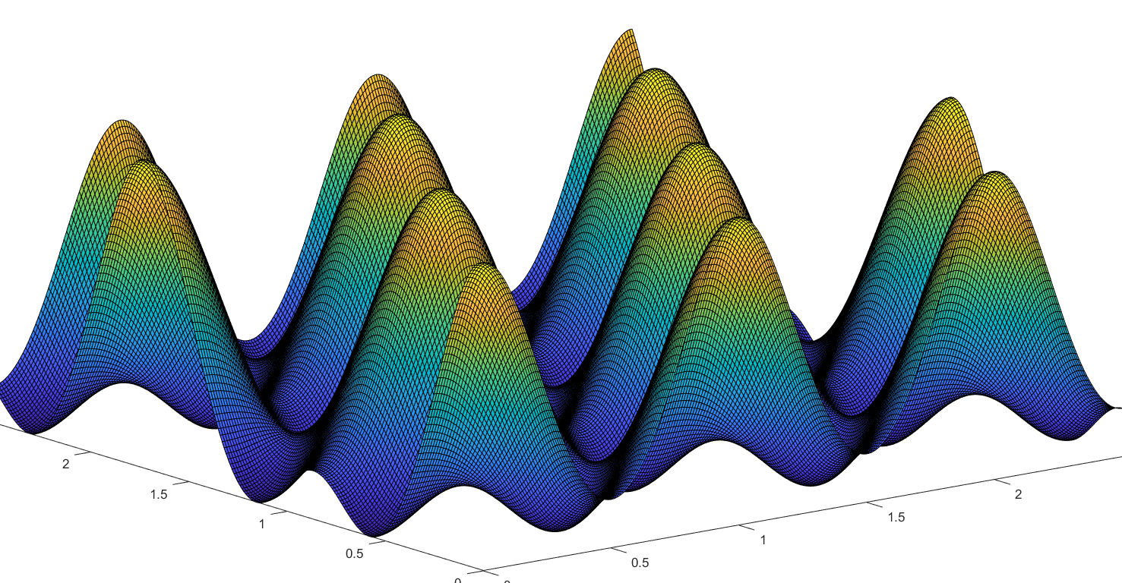
An example: adsorption of Tl (Nh homologue) atom on gold
2
1
3
CP2K + SIRIUS
DFT PBEsol/PP-PW
Pseudopotentials USPP for Au и Tl
ZORA + SO
Positions | E_{a}, kJ/mol | k_{x}, N/m | k_{y}, N/m | k_{z}, N/m | v_{x}·10¹² s⁻¹ | v_{y}·10¹² s⁻¹ | v_{z}·10¹² s⁻¹
Hollow-2 (1) | 221 | 6.49 | 6.01 | 60.0 | 0.697 | 0.670 | 2.12
Bridge (2) | 217 | -0.979 | 7.19 | 57.3 | 0.271i | 0.733 | 2.07
Top (3) | 203 ΔH_{a}=270±10 (exp.) | -3.43 | -4.45 | 75.6 | 0.507i | 0.577i | 2.38

Slide 15
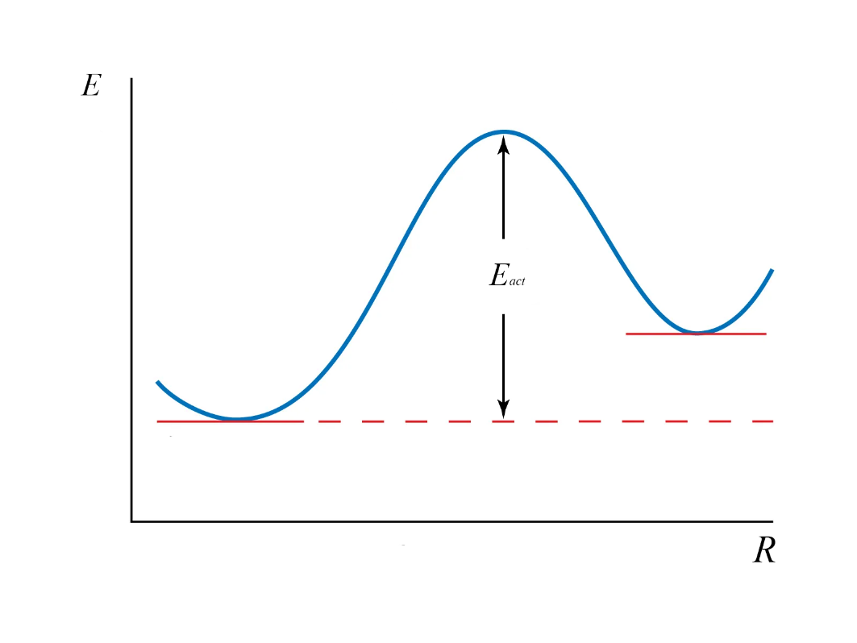
Diffusion on a surface: the activated diffusion
TS
2
1
2
1
Transport of adatom can be considered as a series of jumps between two neighboring adsorption sites (the activated diffusion);
There is an equilibrium for transitions between two neighboring states;
The surface diffusion velocity constant depends on population of vibrational levels at given temperature

Slide 16
Temperature dependence of Tl diffusion on gold
D corresponds to smooth ideal gold surface. Real diffusion coefficients will be smaller
The proposed model of activated diffusion can be in principle extended to the case of a non-ideal surface

Slide 17
Summary
We propose a way for theoretical estimating of transport and adsorption properties of heavy and superheavy elements;
Gas-transport parameters of SHE species such as diffusion coefficients can be effectively estimated by the molecular dynamic simulations;
Interactions between SHE atoms and surface and behavior of adsorbed atom on a surface can be predicted using simulations with model adiabatic potential surface, which is extracted from DFT calculations;
This work is the first step towards more strong and precise theoretical description of chromatography process (and possible explanation of two adsorption peaks of Fl).

