Slide 1
INTERNATIONAL CONFERENCE «50 YEARS OF COLD FUSION» 20-23 November, 2024 Republic of Armenia
Heavy nuclei from massive transfer I.V. Vorobiev¹, E.M. Kozulin¹, G.N. Knyazheva¹, A.V. Karpov¹, A.A. Bogachev¹, K.V. Novikov¹, I.M. Itkis¹, V.V. Saiko^{1,2}
¹Flerov Laboratory of Nuclear Reactions, Joint Institute for Nuclear Research (JINR), Dubna, Moscow oblast, 141980 Russia ²Institute of Nuclear Physics, 050032 Almaty, Kazakhstan
E-mail: rc_38@jinr.ru

Slide 2
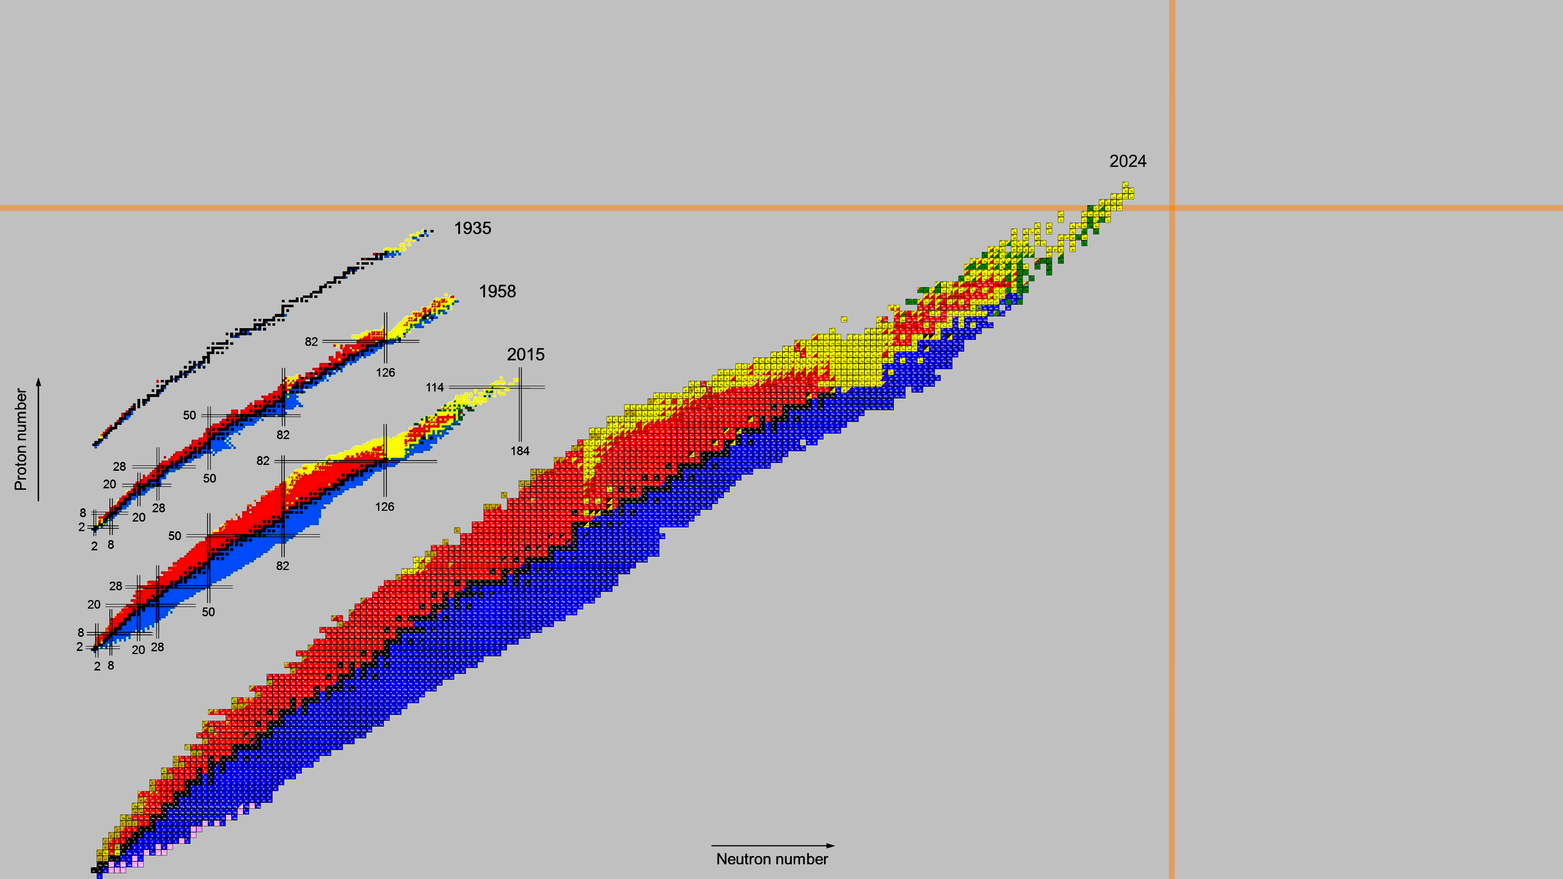
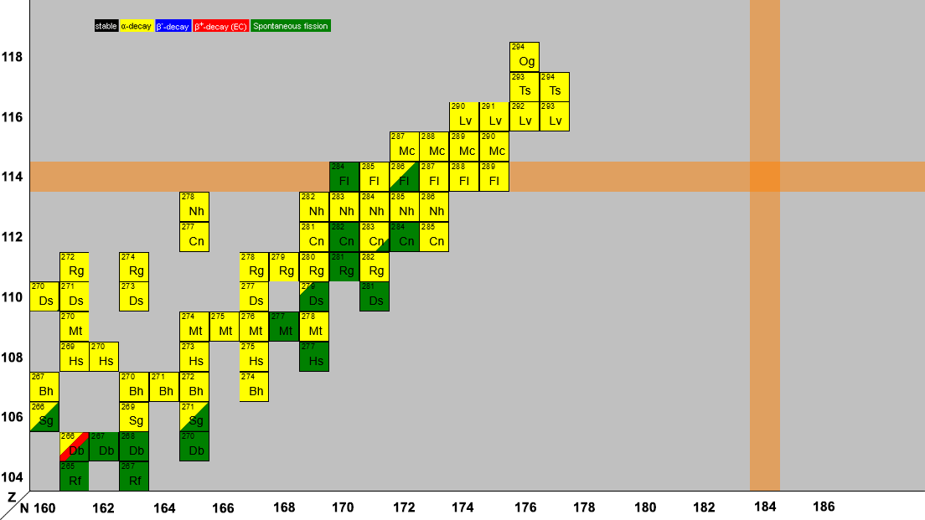
Synthesis of new nuclei
2
It’s necessary to produce new neutron-rich nuclei to reach the «Island of stability»
MultiNucleon Transfer reactions (MNT) are considered as a perspective way to produce and investigate heavy and superheavy nuclei!
G. G. Adamian et al., Eur. Phys. J. A (2020) 56:47 http://nrv.jinr.ru/nrv/webnrv/map/

Slide 3
MultiNucleon Transfer (MNT) reaction
3
V.V. Volkov, Phys. Rep. 44, 93 (1978)
Projectile
TLF
PLF
Target
Illustration of the formation and decay of the double nuclear system.
MNT reaction is conditioned by the formation of the double nuclear system (DNS) in the collision of two complex nuclei. MNT reaction is a binary process with full momentum transfer. Masses of projectile-like (PLF) and target-like (TLF) fragments are near masses of projectile and target nuclei respectively.

Slide 4
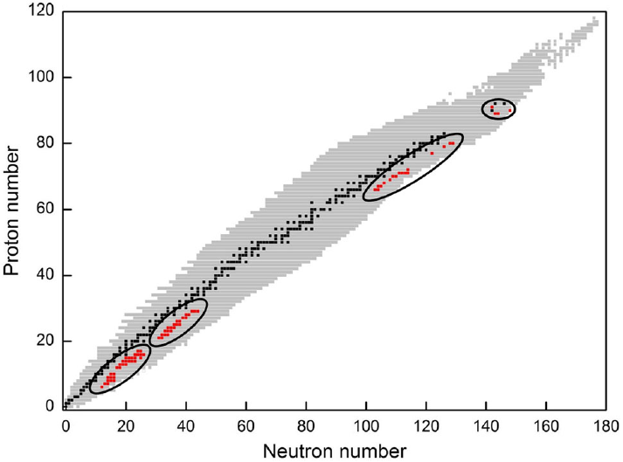
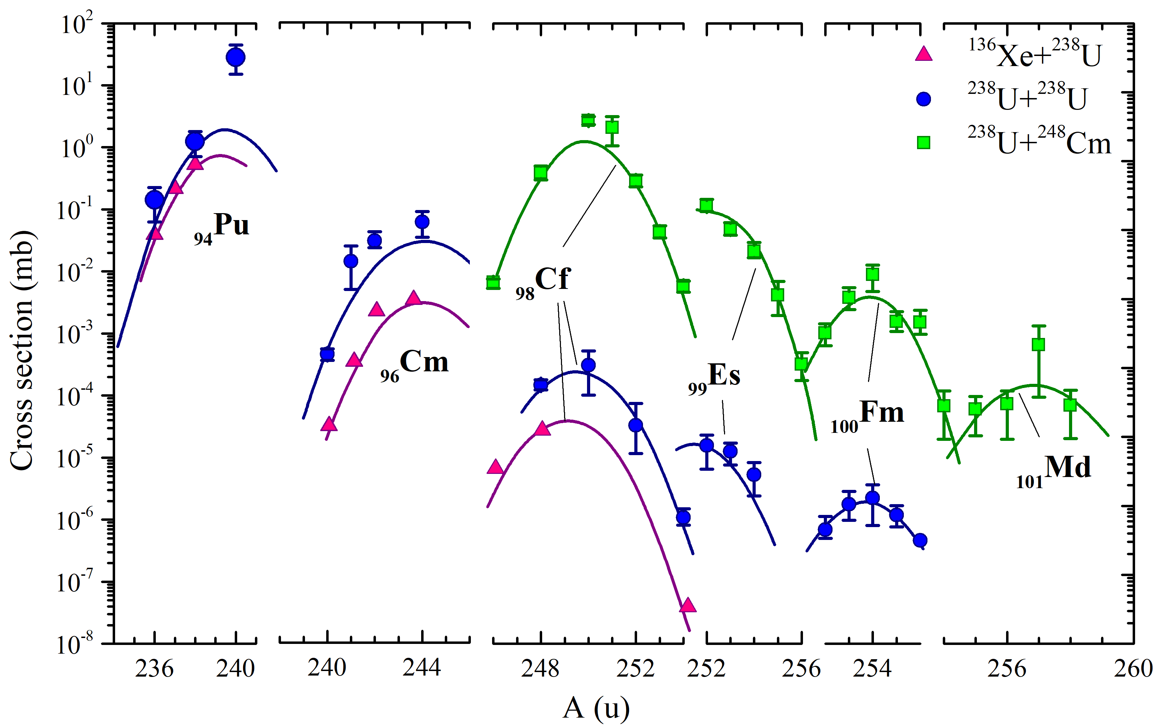
Nucleosynthesis in transfer reactions
4
G. G. Adamian et al., Eur. Phys. J. A (2020) 56:47
M. Schädel et al., Phys. Rev. Lett. 48 (1982) 852
Chart of nuclides with all presently known isotopes (2020). During the years 1969–1995 the 76 neutron-rich nuclides which were discovered in MNT reactions are marked in red.
Production cross sections of transuranium nuclei in the reactions ¹³⁶Xe+²³⁸U, ²³⁸U+²³⁸U and ²³⁸U+²⁴⁸Cm at the interaction energy E_{lab} ≤ 7.5 MeV/u.

Slide 5
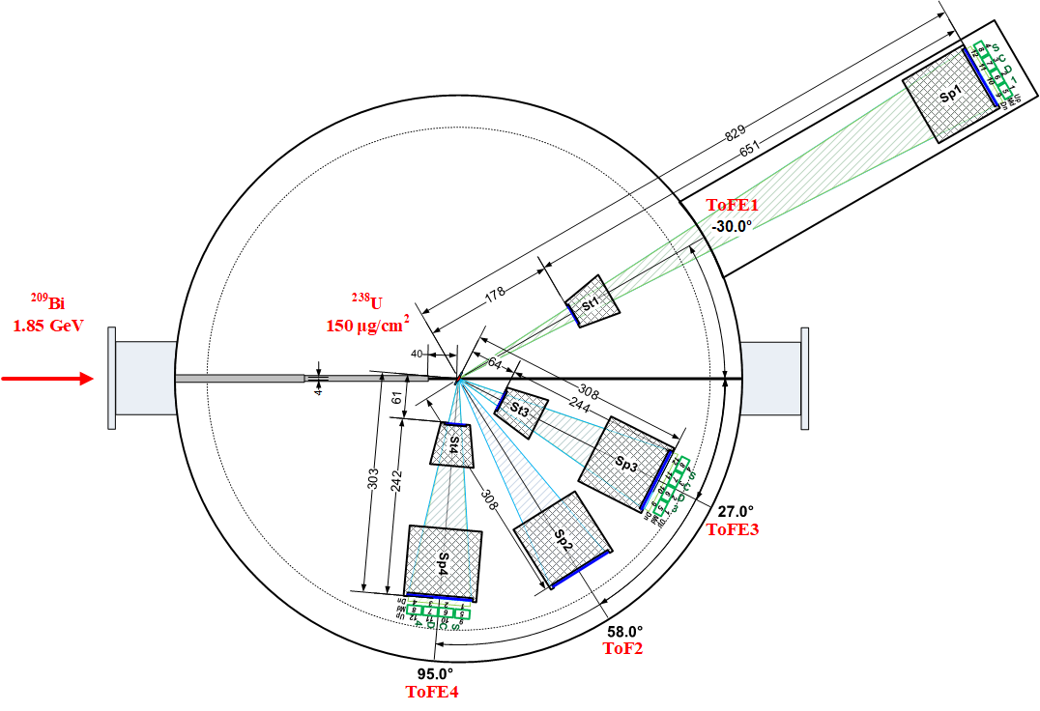
Experiments ¹³⁶Xe, ²⁰⁹Bi + ²³⁸U at energy ≈ 1.45 E_{Coulomb}
5
²⁰⁹Bi (1.85 GeV) + ²³⁸U
²⁰⁹Bi + ²³⁸U (150 μg/cm²)
E_{lab} | 1.85 GeV
E_{c.m.} | 985 MeV
E_{c.m.}/E_{Coulomb} | 1.42
Θ_{c.m.} grazing of ²⁰⁹Bi | 61°
Θ_{lab} grazing of ²⁰⁹Bi | 34°
Θ_{lab} grazing of ²³⁸U | 59.2°
CORSET setup, FLNR

Slide 6
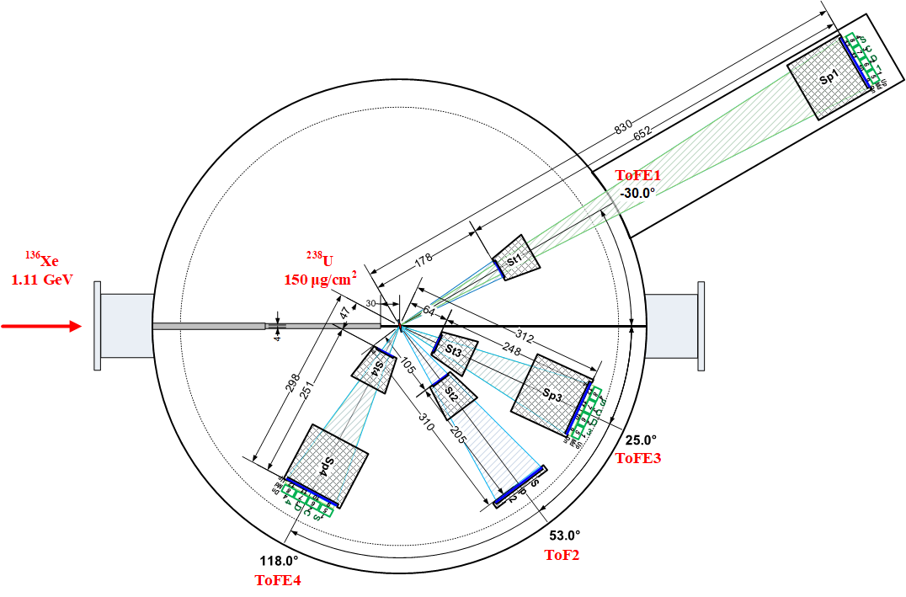
Experiments ¹³⁶Xe, ²⁰⁹Bi + ²³⁸U at energy ≈ 1.45 E_{Coulomb}
6
¹³⁶Xe (1.11 GeV) + ²³⁸U
¹³⁶Xe + ²³⁸U (150 μg/cm²)
E_{lab} | 1.11 GeV
E_{c.m.} | 706 MeV
E_{c.m.}/E_{Coulomb} | 1.48
Θ_{c.m.} grazing of ¹³⁶Xe | 57°
Θ_{lab} grazing of ¹³⁶Xe | 37°
Θ_{lab} grazing of ²³⁸U | 61.5°
CORSET setup, FLNR
E.M. Kozulin et al., Phys. Rev. C 109, 034616 (2024)

Slide 7
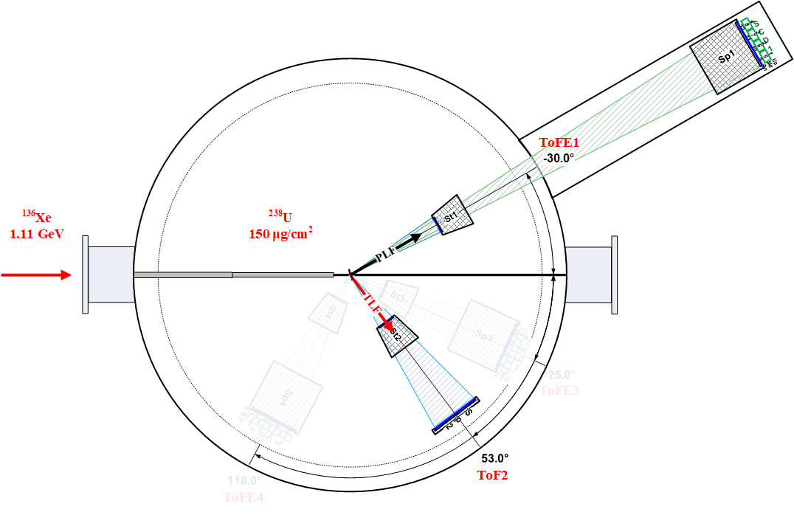
Experiments ¹³⁶Xe, ²⁰⁹Bi + ²³⁸U at energy ≈ 1.45 E_{Coulomb}
7
¹³⁶Xe (1.11 GeV) + ²³⁸U
¹³⁶Xe + ²³⁸U (150 μg/cm²)
ToFE1 acceptance angle | X: ±2.8° Y: ±2.1°
ToF2 acceptance angle | X: ±7.4° Y: ±5.5°
Time resolution | 150-200ps
CORSET setup, FLNR
E.M. Kozulin et al., Phys. Rev. C 109, 034616 (2024)

Slide 8
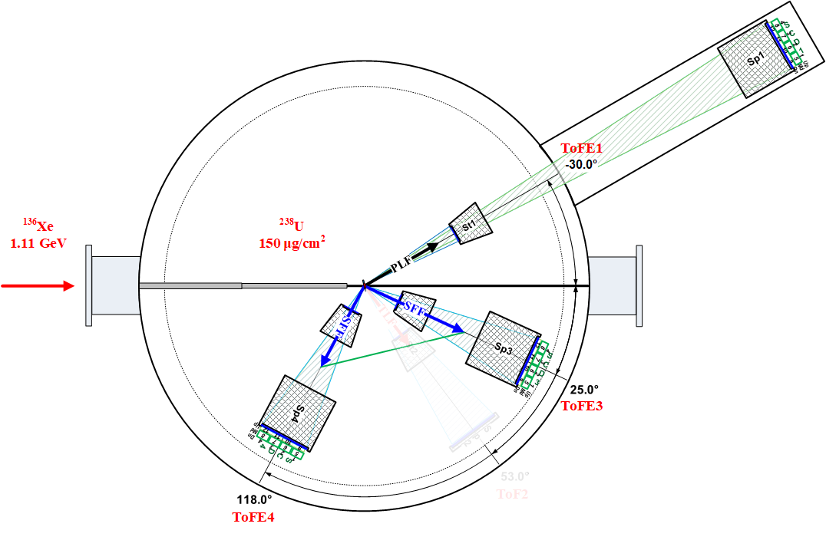
Experiments ¹³⁶Xe, ²⁰⁹Bi + ²³⁸U at energy ≈ 1.45 E_{Coulomb}
8
¹³⁶Xe (1.11 GeV) + ²³⁸U
¹³⁶Xe + ²³⁸U (150 μg/cm²)
ToFE1 acceptance angle | X: ±2.8° Y: ±2.1°
ToFE3 acceptance angle | X: ±7.3° Y: ±5.5°
ToFE4 acceptance angle | X: ±7.6° Y: ±5.7°
Time resolution | 150-200ps
CORSET setup, FLNR
E.M. Kozulin et al., Phys. Rev. C 109, 034616 (2024)

Slide 9
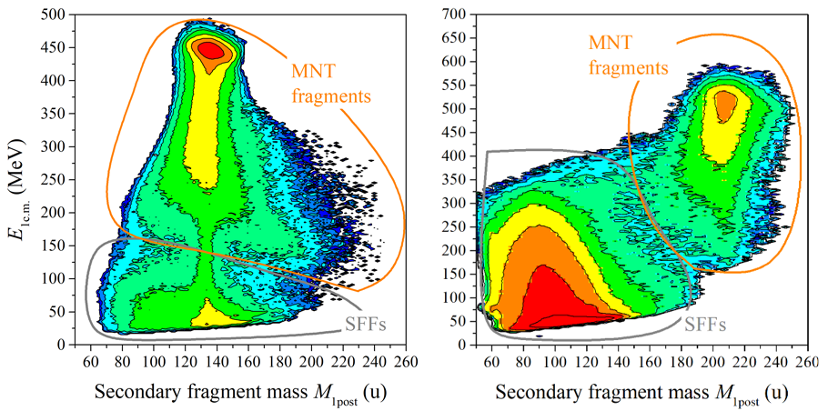
Mass-energy distributions of secondary PLFs
9
(after deexcitation process)
Θ_{lab} = 30° ± 2.8°
¹³⁶Xe (1.11 GeV) + ²³⁸U
²⁰⁹Bi (1.85 GeV) + ²³⁸U

Slide 10
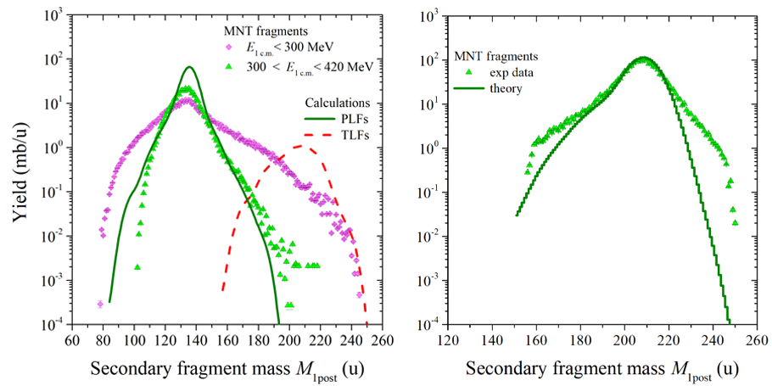
Mass distributions of secondary PLFs
10
¹³⁶Xe (1.11 GeV) + ²³⁸U
²⁰⁹Bi (1.85 GeV) + ²³⁸U
The theoretical calculations have been provided by V. Saiko and A. Karpov
The lightest secondary fragment mass found in the mass spectrum for secondary PLFs is 79 u.
The lightest secondary fragment mass found in the mass spectrum for secondary PLFs is 156 u.

Slide 11
Registration of survived PLF and TLF (ToF1-ToF2)
11
¹³⁶Xe (1.11 GeV) + ²³⁸U
CORSET setup, FLNR
E.M. Kozulin et al., Phys. Rev. C 109, 034616 (2024)

Slide 12
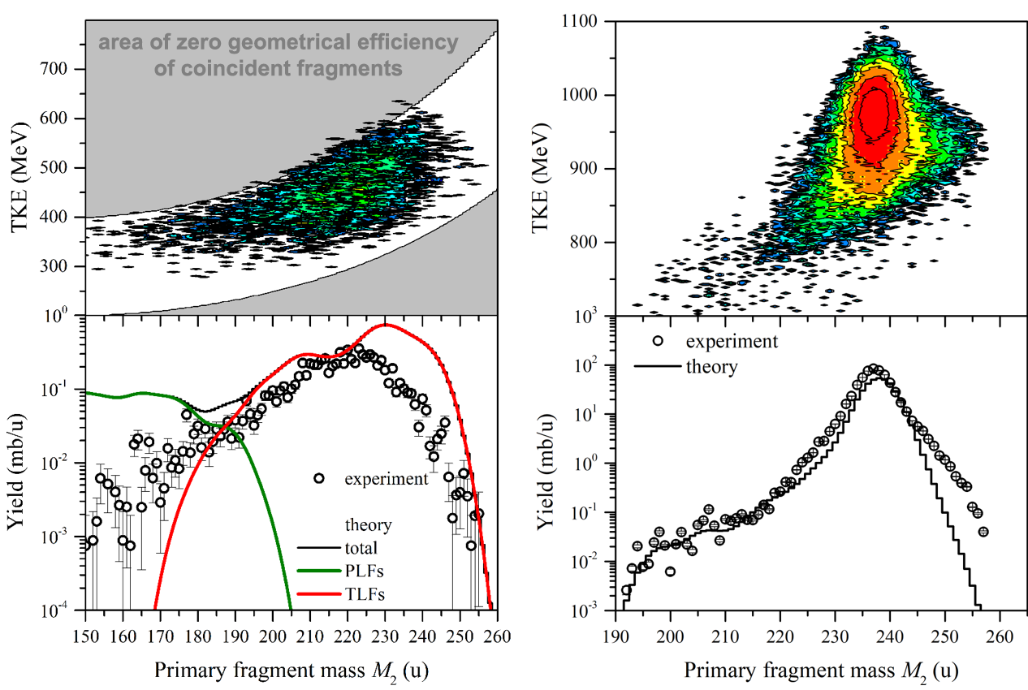
Mass-energy distributions of survived primary TLFs
12
(before deexcitation process)
¹³⁶Xe (1.11 GeV) + ²³⁸U
²⁰⁹Bi (1.85 GeV) + ²³⁸U
The heaviest primary fragment mass found in the mass distribution for survived primary TLFs is:
255 u (Z ≈ 99–100, Es–Fm isotopes)
with the cross section of about 2 μb!
257 u (Z ≈ 101, Fm–Md isotopes)
with the cross section of about 30 μb!

Slide 13
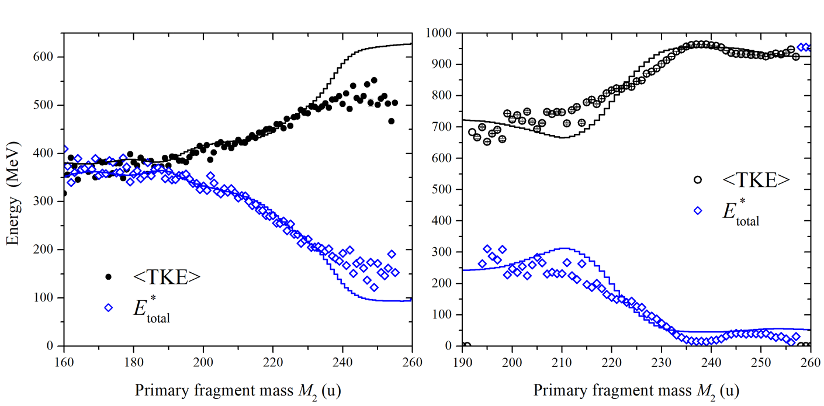
Total excitation energies for survived primary TLFs
13
¹³⁶Xe (1.11 GeV) + ²³⁸U
²⁰⁹Bi (1.85 GeV) + ²³⁸U
The total excitation energy may be estimated from TKE measurements:
For transuranium fragments the total excitation energies of composite nuclear systems for the reaction ²⁰⁹Bi (1.85 GeV) + ²³⁸U are less than 70 MeV => sufficiently good conditions for survival of such MNT fragments!

Slide 14
Registration of 3-body events (PLF and 2 SFFs of fissioning TLF)
14
¹³⁶Xe (1.11 GeV) + ²³⁸U
CORSET setup, FLNR
E.M. Kozulin et al., Phys. Rev. C 109, 034616 (2024)

Slide 15
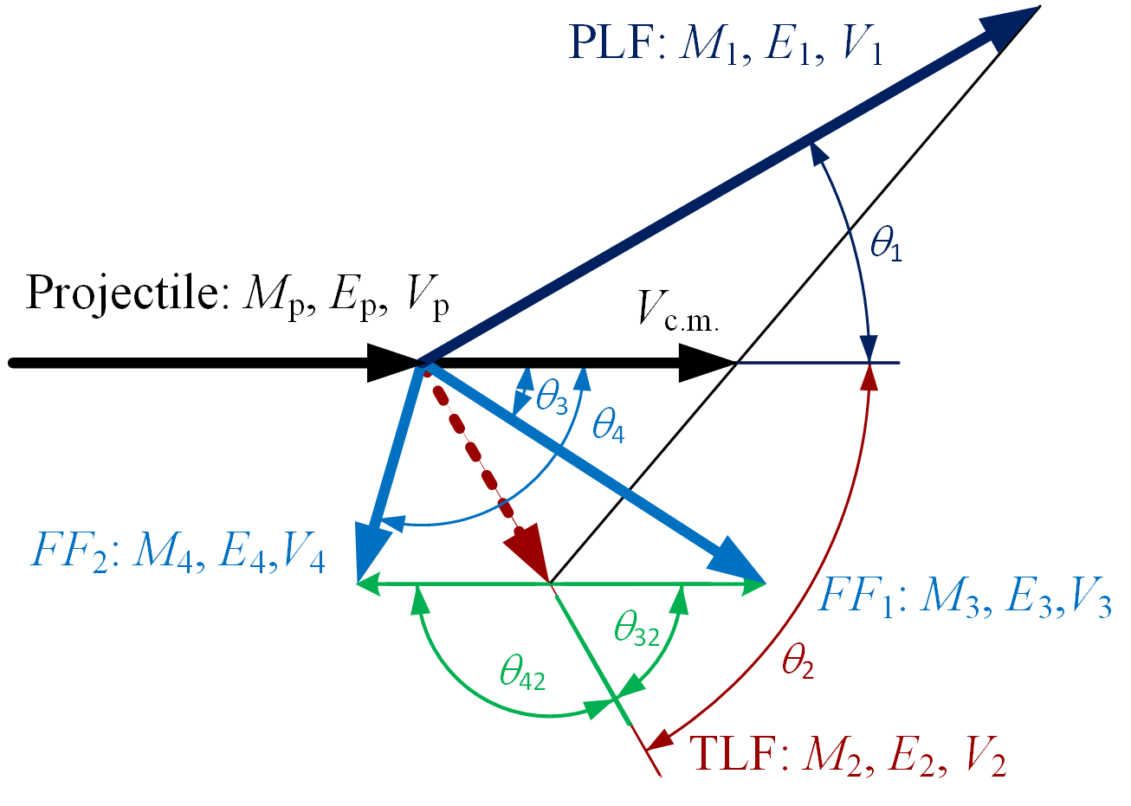
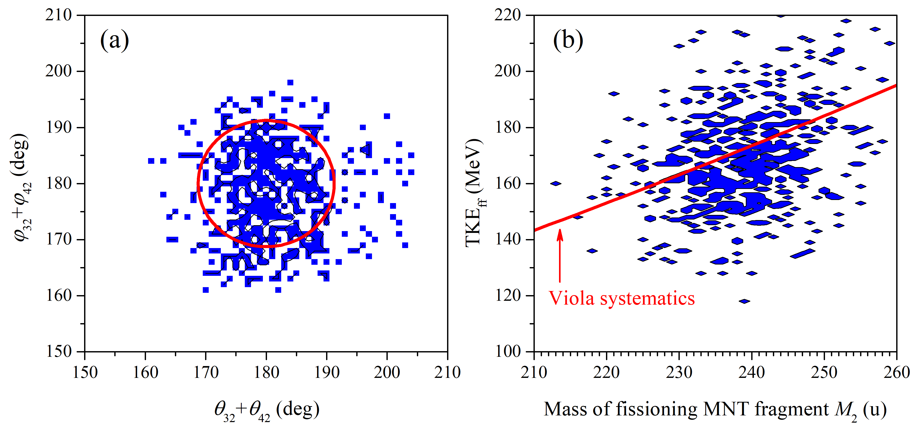
Sequential fission of excited TLF
15
¹³⁶Xe (1.11 GeV) + ²³⁸U
E.M. Kozulin et al., Phys. Rev. C 109, 034616 (2024)
The localization of folding angles around 180° and TKE_{ff} value close to the Viola systematics proves that the detected three-body events are formed as products of the two-stage process: the formation of 2 MNT fragments in the MNT reaction and further the sequential fission of the excited MNT fragment (TLF).

Slide 16
Sequential fission of excited TLF
16
An average mass loss <△m₁> for each mass of the PLFs fragment can be determined as:
M₁ – measured mass of the primary PLF (via ToF-ToF method),
M_{1post} – measured mass of the secondary PLF (via ToF-E method),
N is the number of fragments with given mass M₁ or/and TKE.
Mass of primary TLF can be found using the law of conservation of mass:
M₂ – estimated mass of the primary TLF,
M_{p} – the mass of the projectile,
M_{t} – the mass of the target.

Slide 17
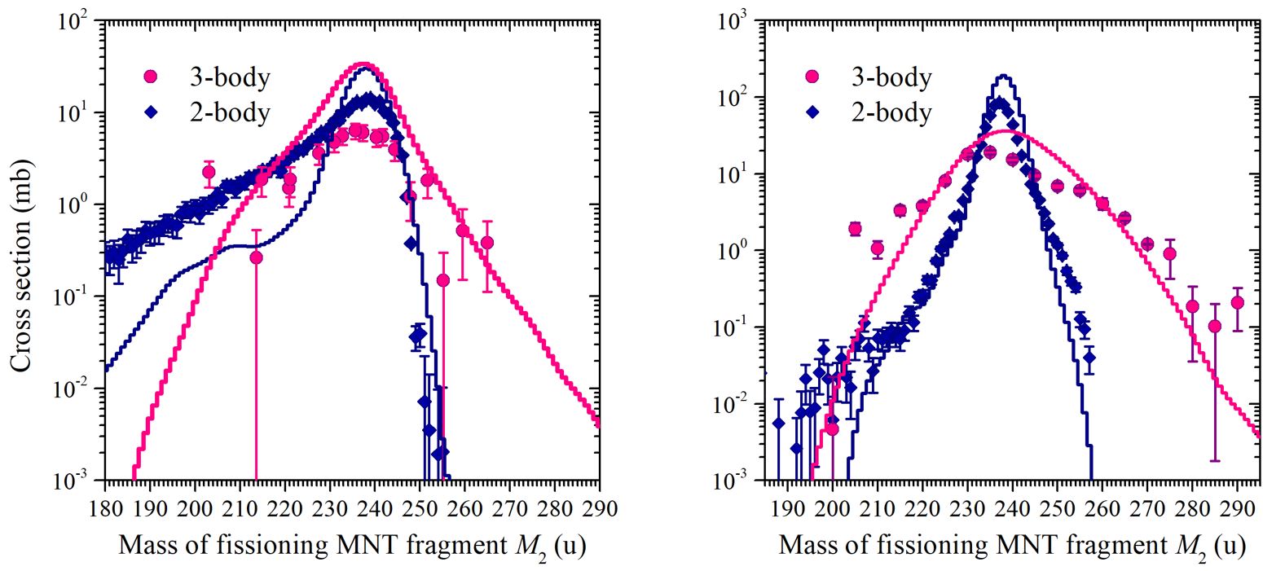
Mass distributions of primary TLFs for 2- and 3-body events
17
¹³⁶Xe (1.11 GeV) + ²³⁸U
²⁰⁹Bi (1.85 GeV) + ²³⁸U
The heaviest primary fragment mass found in the mass distribution for 3-body events for primary TLFs is:
265 u (Z ≈ 103, Lr isotopes)
with the cross section of a few hundred μb!
289 u (Z ≈ 113, Nh isotopes)
with the cross section of a few hundred μb!

Slide 18
Conclusion
18
In the investigation of MNT reactions as a possible tool to produce new isotopes of heavy and superheavy nuclei, the measurements of mass and energy distributions of fragments formed in the ¹³⁶Xe, ²⁰⁹Bi + ²³⁸U reactions at E_{lab}(¹³⁶Xe) = 1.11 GeV and E_{lab}(²⁰⁹Bi) = 1.85 GeV have been performed. For now modified CORSET setup allows studying binary processes, as well as 3-body events (projectile-like fragment + sequential fission of heavy MNT fragment).
The measurements of TKE of binary reaction fragments (via ToF-ToF method) allow to estimate the total excitation energy of composite system formed in the ¹³⁶Xe, ²⁰⁹Bi + ²³⁸U reactions. For survived transuranium elements formed in the ²⁰⁹Bi + ²³⁸U reaction the total excitation energy is less than 70 MeV. The heaviest survived observed primary fragments have mass around 255 u (Z ≈ 99-100, Es – Fm isotopes under the assumption of unchanged charge density of N/Z equilibration) formed in the ¹³⁶Xe + ²³⁸U reaction with the cross section of about 2 microbarns and 257 u (Z ≈ 101, Fm – Md isotopes) formed in the ²⁰⁹Bi + ²³⁸U reaction with the cross section of about 30 microbarns. It has been observed for the ¹³⁶Xe, ²⁰⁹Bi + ²³⁸U reactions MNT fragments heavier than around 250 u mainly undergo fission. Due to registration of 3-body events the heaviest fissioning TLFs have been observed, which have masses around 265 u (Z ≈ 103, Lr isotopes) formed in the ¹³⁶Xe + ²³⁸U reaction and 289 u (Z ≈ 113, Nh isotopes) formed in the ²⁰⁹Bi + ²³⁸U reaction with the cross sections of a few hundred microbarns, i.e. the massive nucleon transfers from projectile to target nucleus of about 27 u and 51 u respectively have been observed!

Slide 19
Thank you for your attention!
INTERNATIONAL CONFERENCE «50 YEARS OF COLD FUSION» 20-23 November, 2024 Republic of Armenia

