Slide 1
Transfermium nuclei expected from U+U interactions
V.V. Saiko and A.V. Karpov
Flerov Laboratory of Nuclear Reactions, JINR, Dubna, Russia

Slide 2
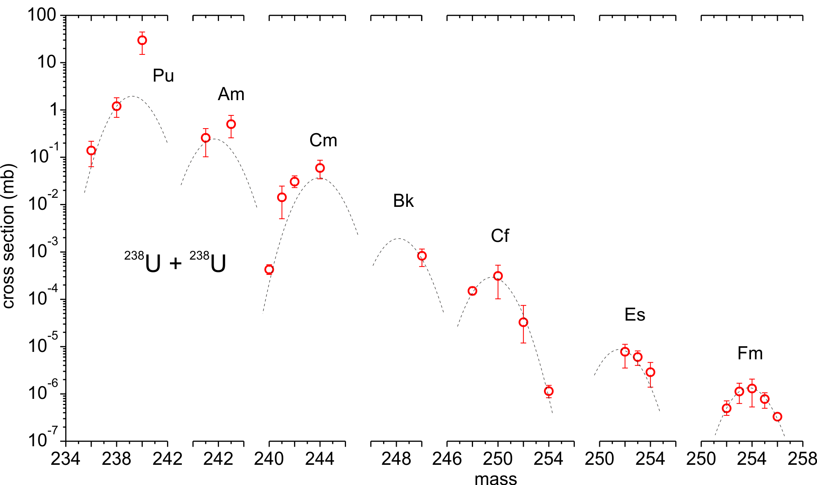
Motivation
Radiochemical identification of transuranic elements
in the ²³⁸U + ²³⁸U reaction (7.5 MeV/nucleon)
?
exp.: M. Schädel et al.,
Phys. Rev. Lett. 41, 469 (1978)
What can we
expect next

Slide 3
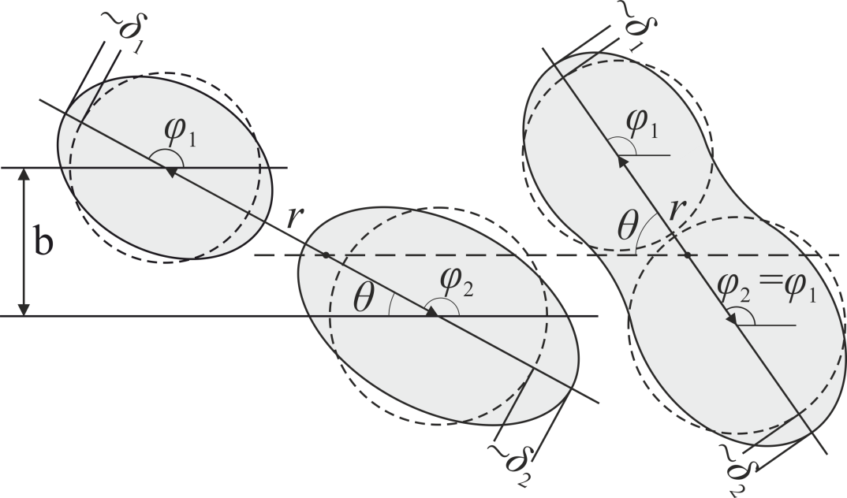
Model
A.V. Karpov and V.V. Saiko,
Phys. Rev. C 96, 024618 (2017)
Phys. Rev. C 99, 014613 (2019)
Eur. Phys. J. A 58, 41 (2022)
system of
Langevin equations
driving, friction and random forces
r – distance between centers of nuclei
δ_{1,2} – ellipsoidal deformations
η_{A} – mass asymmetry
η_{Z} – charge asymmetry
θ – angle between symmetry axis and beam direction
φ_{1,2} – angles of rotation of nuclei in the reaction plane
– mass tensor
– dissipation tensor
– amplitude of random force
– random value

Slide 4
Model
A.V. Karpov and V.V. Saiko,
Phys. Rev. C 96, 024618 (2017)
Phys. Rev. C 99, 014613 (2019)
Eur. Phys. J. A 58, 41 (2022)
a collision of ¹³⁶Xe + ²⁰⁸Pb
r
each trajectory of a collision provides:
Z and A of fragments,
scattering angle,
kinetic energy,
excitation energy,
reaction time,
…
δ
Final fragments are simulated by means of
statistical model of decay of heavy excited nuclei,
GEF code http://nrv.jinr.ru
http://www.khschmidts-nuclear-web.eu/GEF.html
mass
E_{rel}, MeV
differential reaction cross section:
interaction time, 10⁻²² s

Slide 5
Mutual orientation of colliding nuclei
V.V. Saiko and A.V. Karpov,
Phys. Rev. C 99, 014613 (2019)

Slide 6
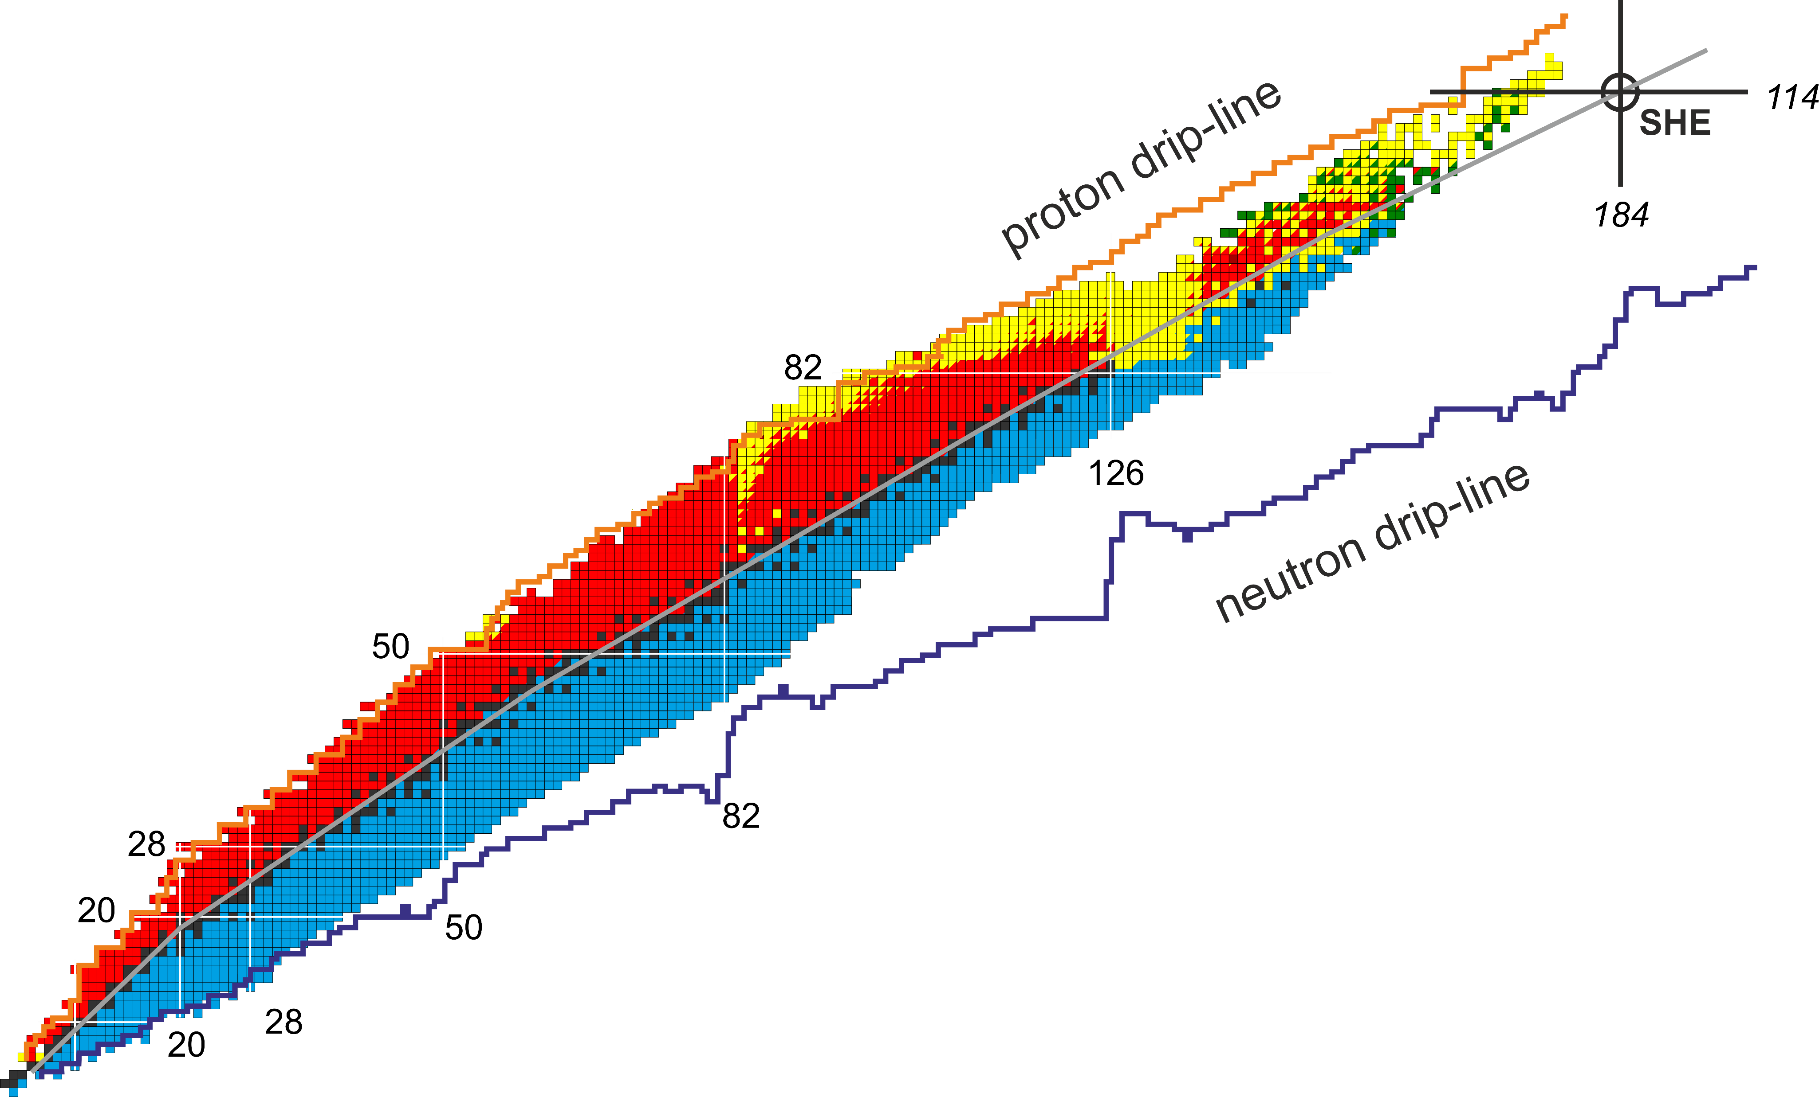
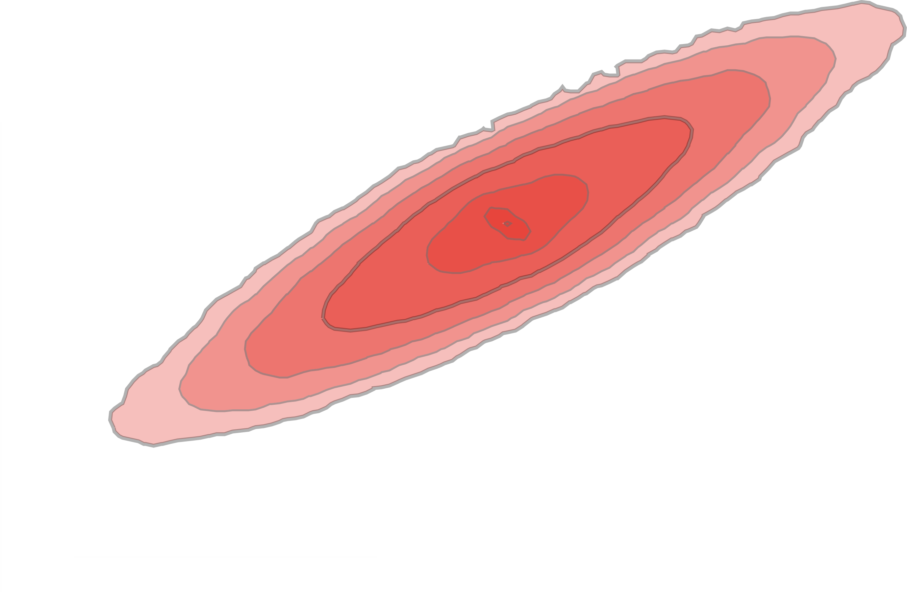
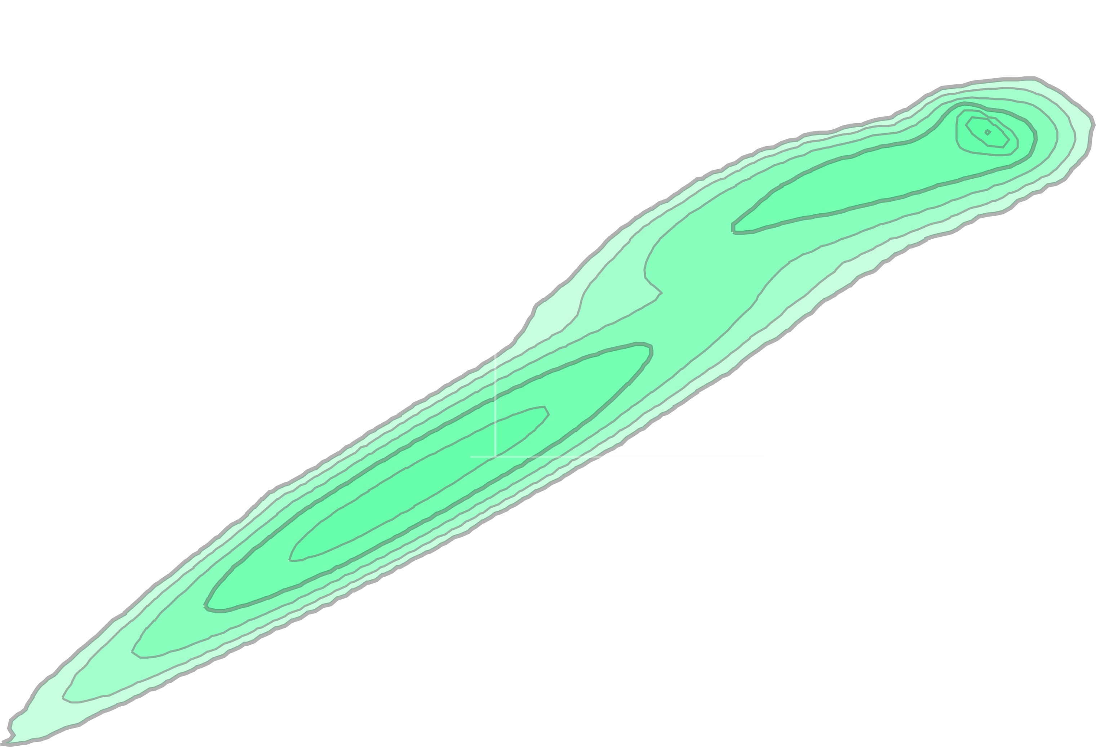
²³⁸U + ²³⁸U reaction
Primary (excited) products:
symmetric distribution
cover the “Island of stability”
1 µb
E = 8 MeV/nucleon
but
primary products heavier than uranium
mostly go through fission

Slide 7
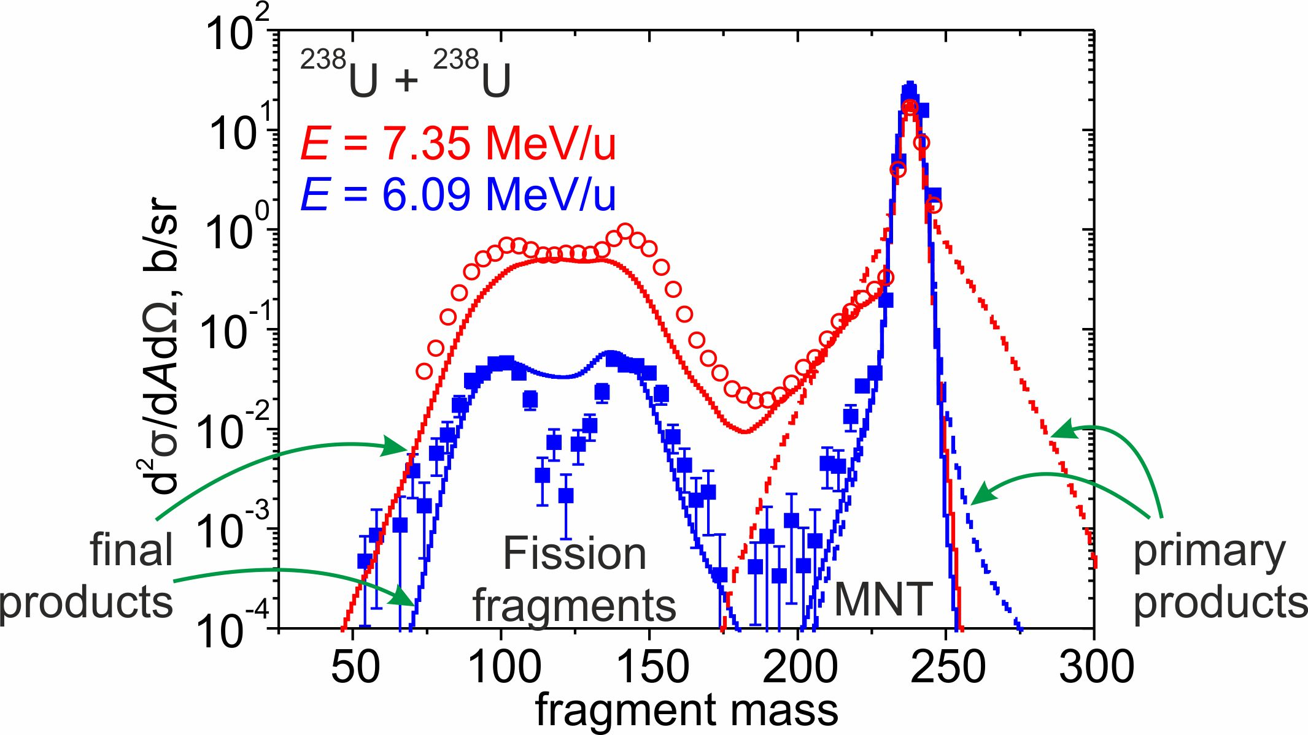
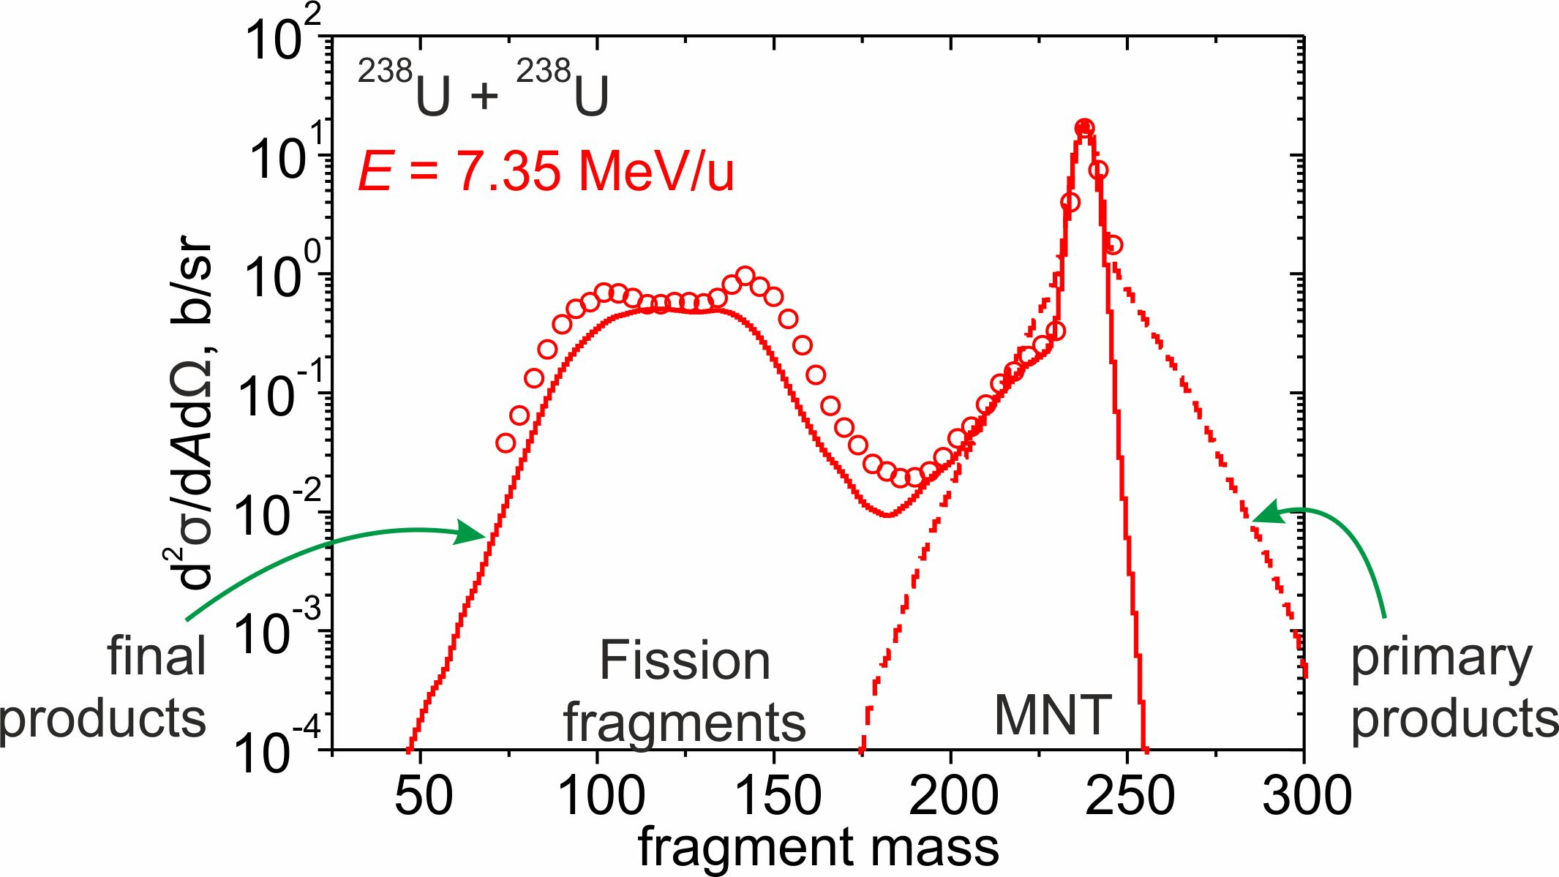
Mass distribution of products in the ²³⁸U + ²³⁸U reaction
exp.: C. Golabek et al., EPJA 43, 251 (2010)

Slide 8
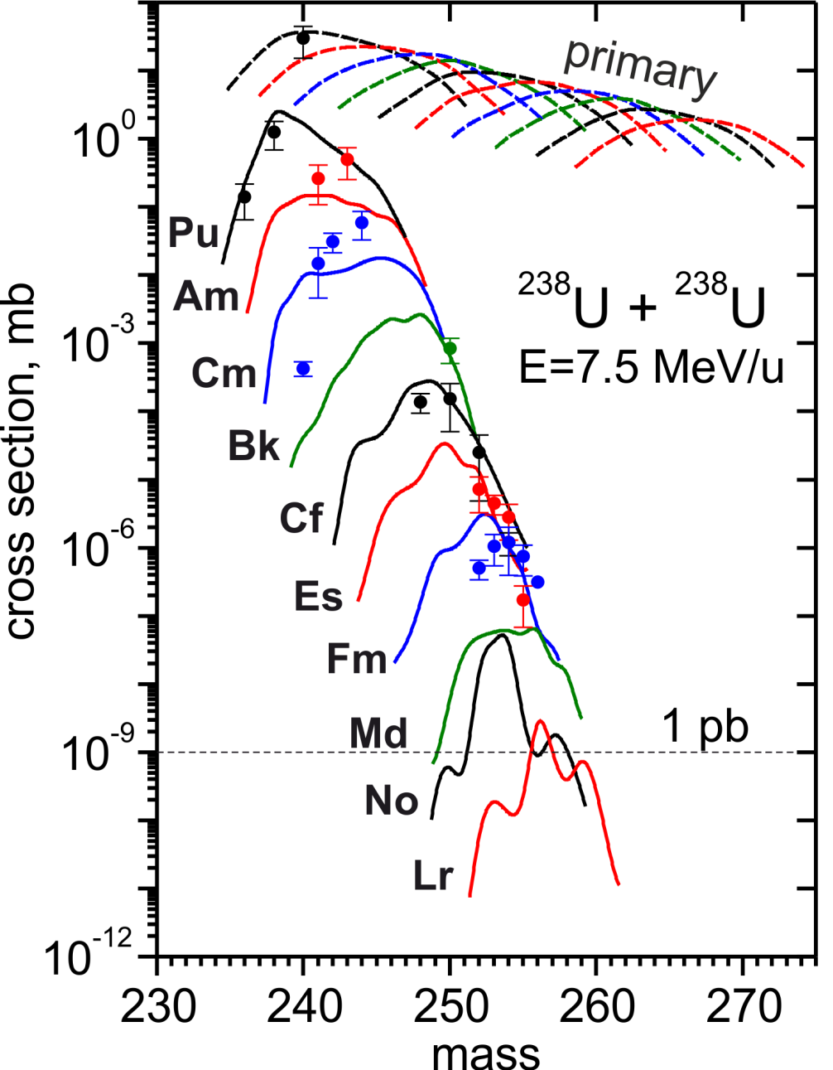
Production of transuranic elements in the U + U reaction
exponential decrease
of production cross sections
is preserved in the region
of tranfermium elements
exp.: M. Schädel et al., Phys. Rev. Lett. 41, 469 (1978)

Slide 9
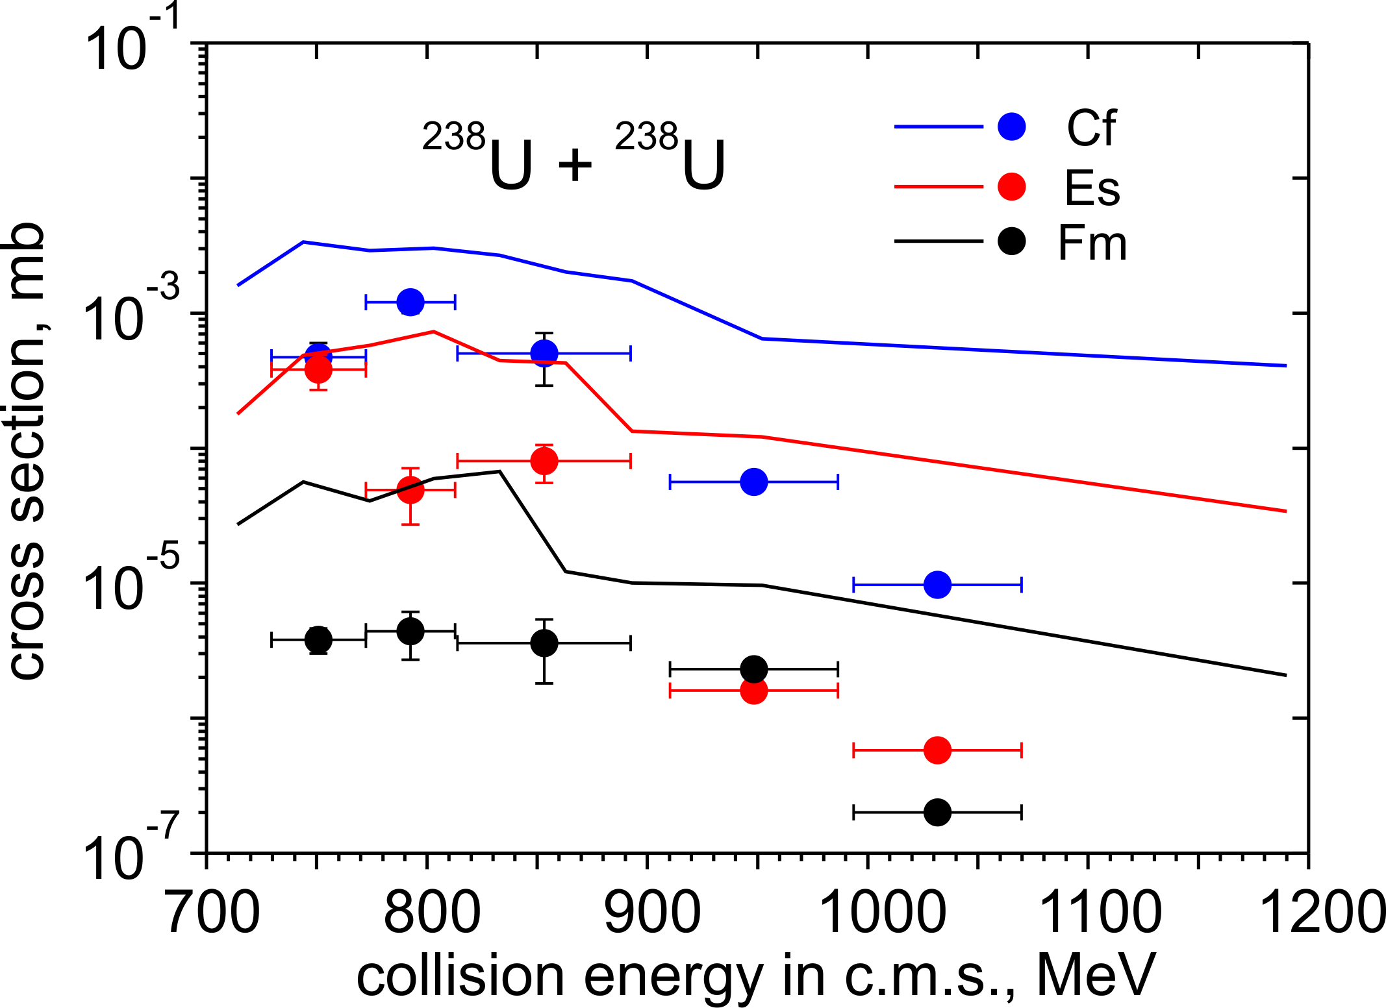
Optimal energy for transuranium elements
exp.: J.V. Kratz, et. al, Phys. Rev. C 88, 054615 (2013)

Slide 10
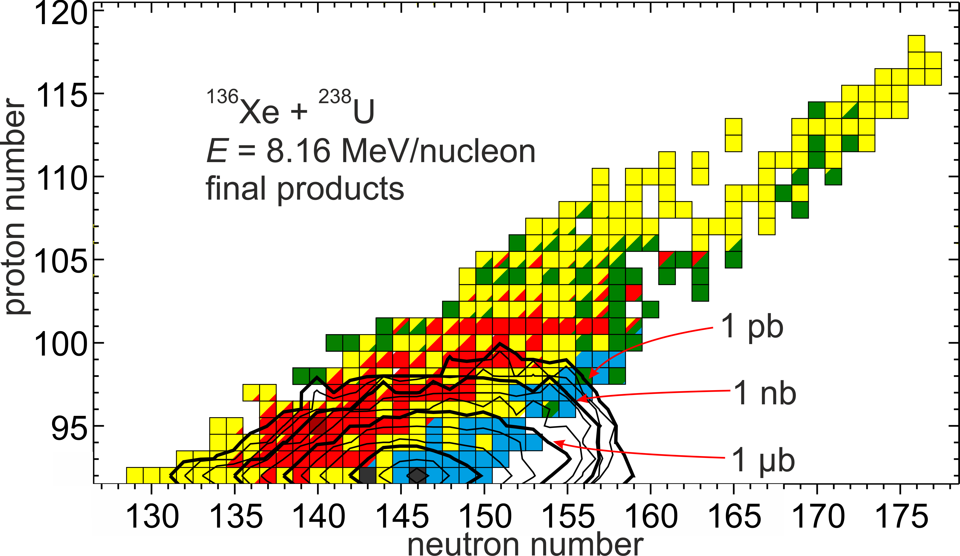
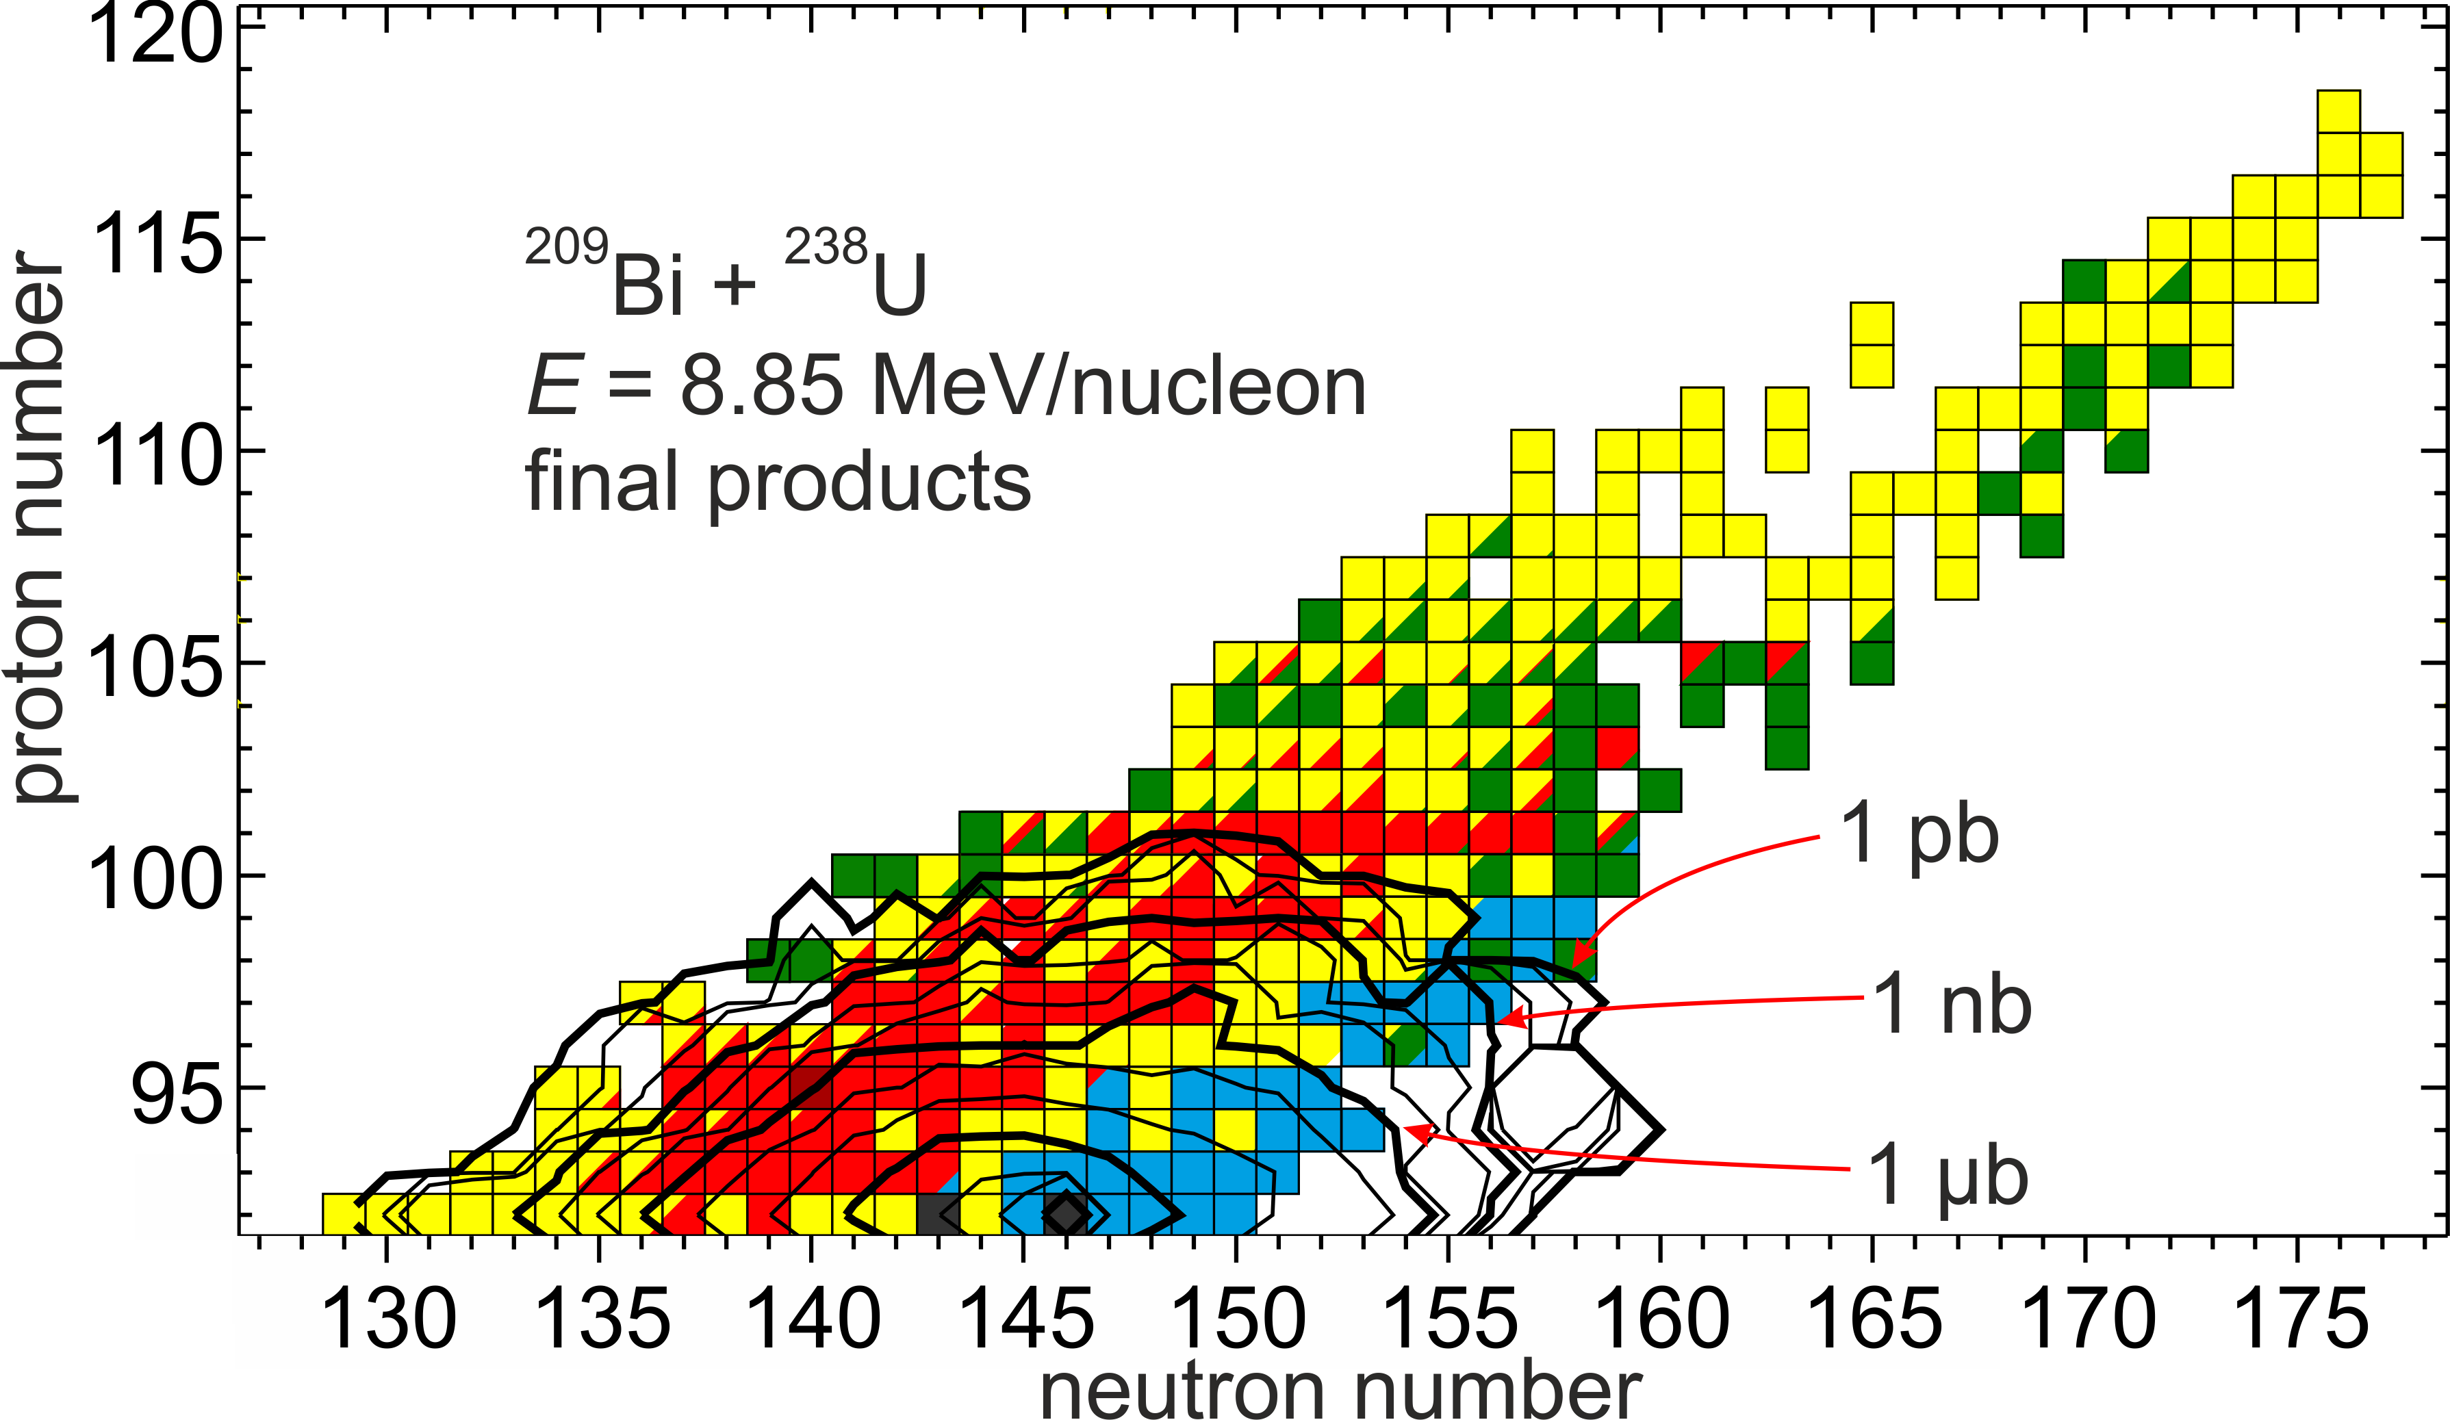
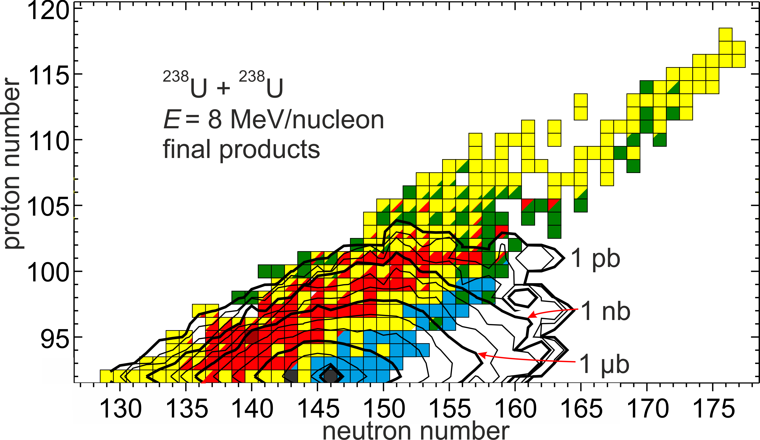
Other projectiles
¹³⁶Xe + ²³⁸U
E = 8.16 MeV/u
²⁰⁹Bi + ²³⁸U
E = 8.85 MeV/u
²³⁸U + ²³⁸U
E = 8 MeV/u
Distribution of final transuranium products becomes wider in reaction with a heavier projectile

Slide 11
Conclusions
Production cross sections of transuranic elements in the ²³⁸U + ²³⁸U reaction
continue to decrease exponentially with increasing their atomic number
in the area of transfermium nuclides;
Energy near Coulomb barrier provides highest production cross sections of
transuranic products in the ²³⁸U + ²³⁸U reaction;
²³⁸U projectile provides higher cross sections of transuranic nuclei than
the ¹³⁶Xe and ²⁰⁹Bi ones at comparable energies in MeV/nucleon;

