Slide 1
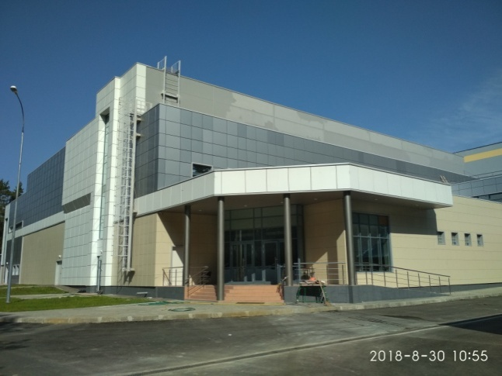
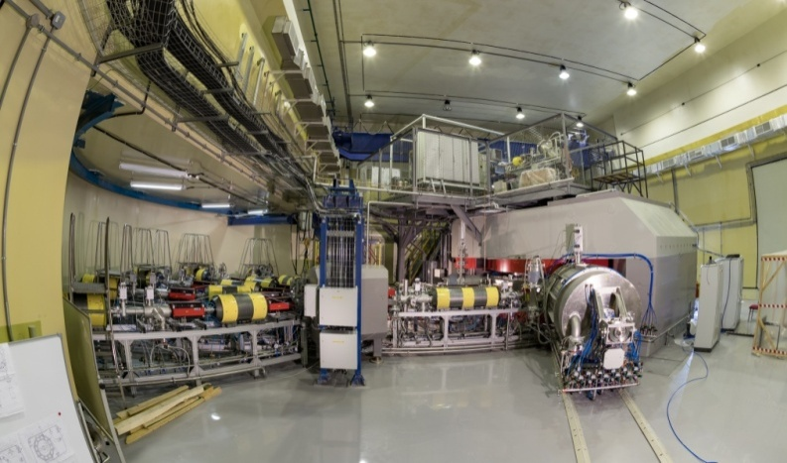
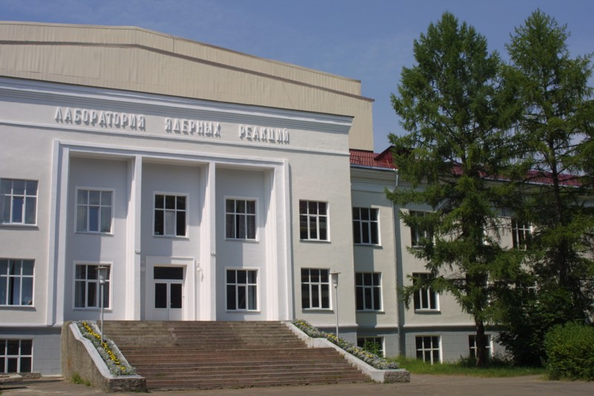
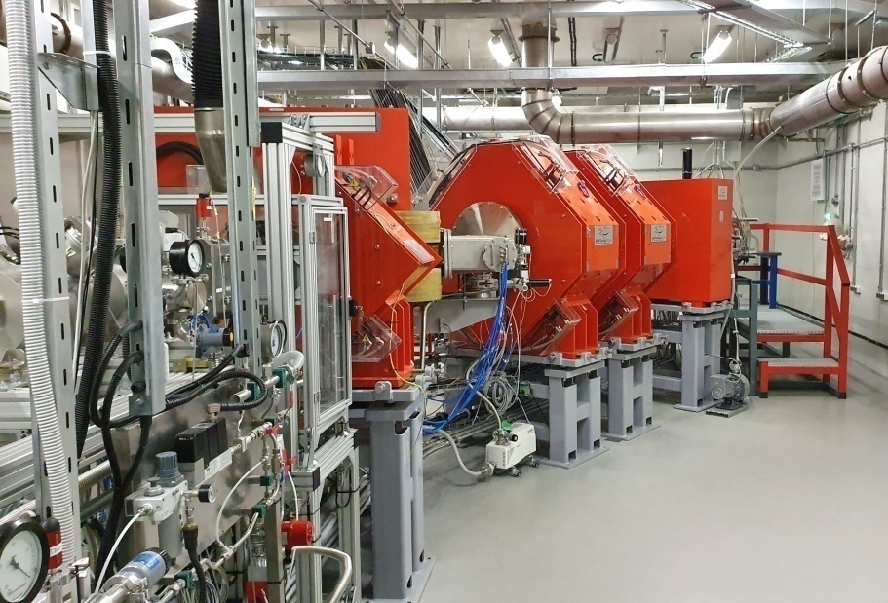
Synthesis and Decay Properties of Ds Isotopes (Z=110)
in ⁴⁰Ar and ⁴⁸Ca Induced Reactions
Maksim Shumeiko
JINR Flerov Laboratory of Nuclear Reactions, Russia
DC280
International Conference «50 Years of Cold Fusion»
Yerevan, Armenia, 2024
DGFRS-2

Slide 2
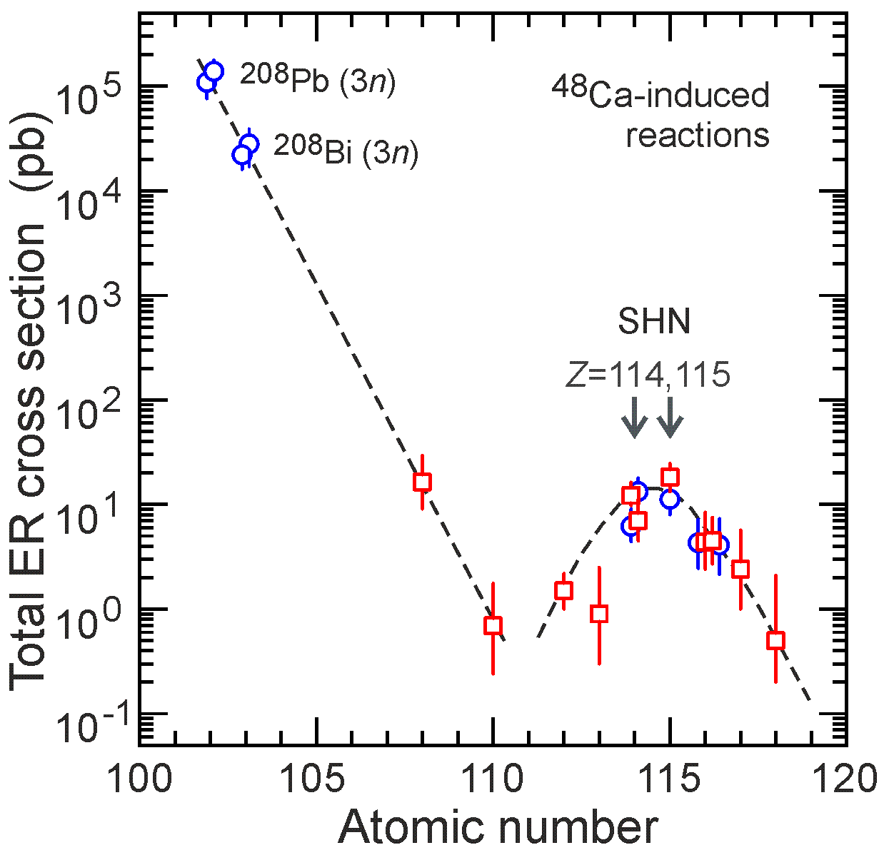
Nuclei at the minimum stability
²³²Th + ⁴⁸Ca -> ²⁸⁰Ds* ²³⁸U + ⁴⁰Ar -> ²⁷⁸Ds*
Production cross sections and decay properties of ^{273, 275, 276}Ds
?

Slide 3
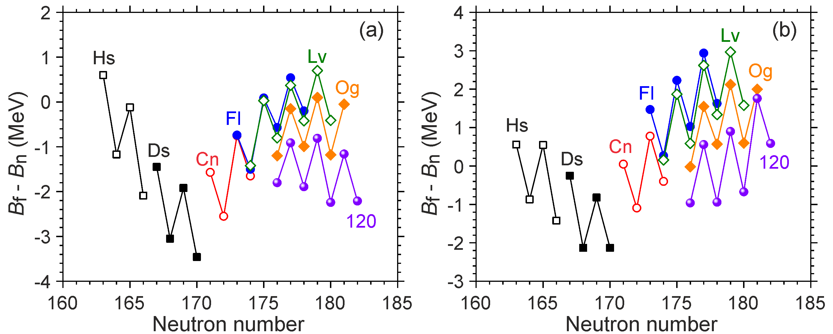
²³²Th + ⁴⁸Ca -> ²⁸⁰Ds* N = 170
Competition between neutron evaporation and fission reaction channels
Jachimowicz, Kowal, J. Skalski, ADNDT 138, 101393 (2021). Möller, Sierk, Ichikawa, Sagawa, ADNDT 109-110, 1 (2016).
Dependence (Bf – Bn) on the number of neutrons for isotopes from 108 (Hs) to 120, reaction products ²²⁶Ra, ²³²Th, ²³⁸U, ^{242,244}Pu, ^{245,248}Cm, ^{249,251}Cf + ⁴⁸Ca, ^{245,248}Cm + ⁵⁴Cr.

Slide 4
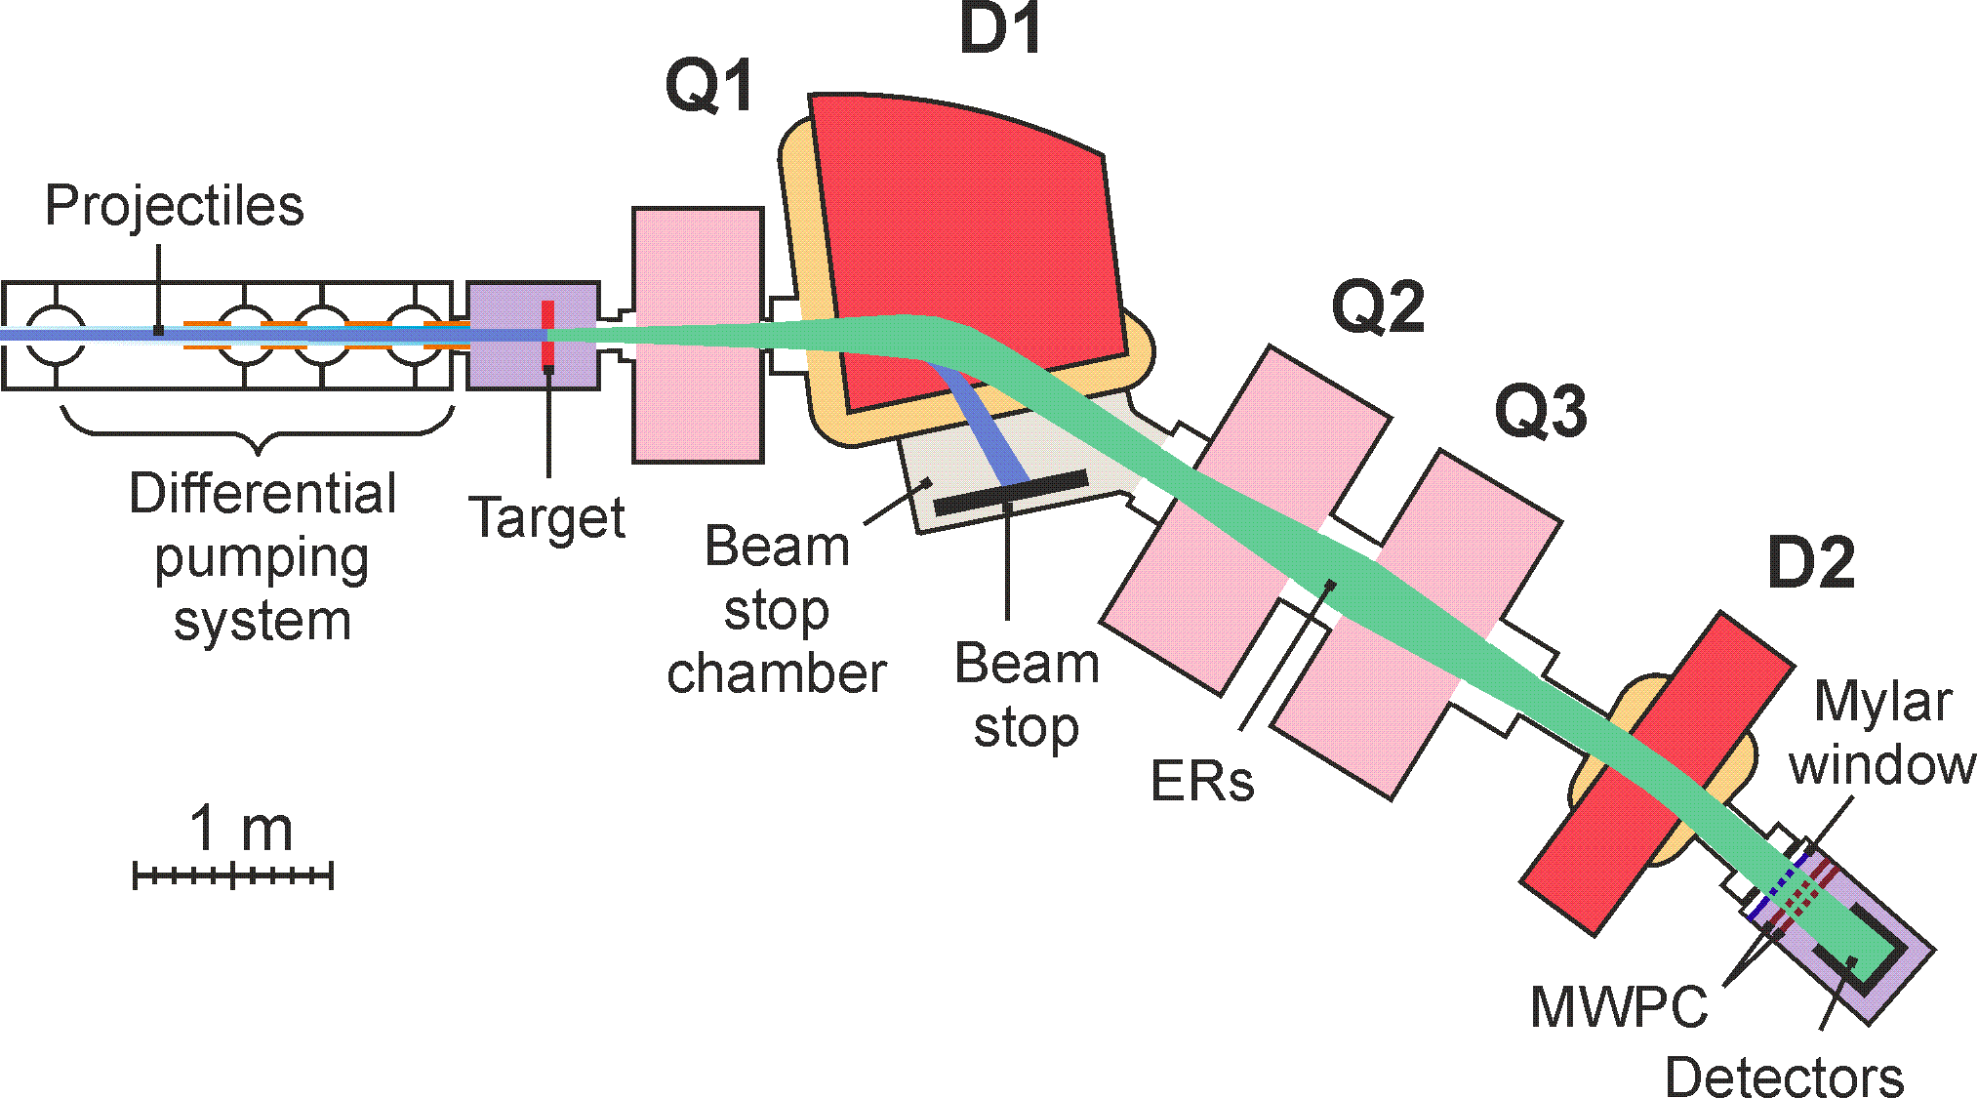
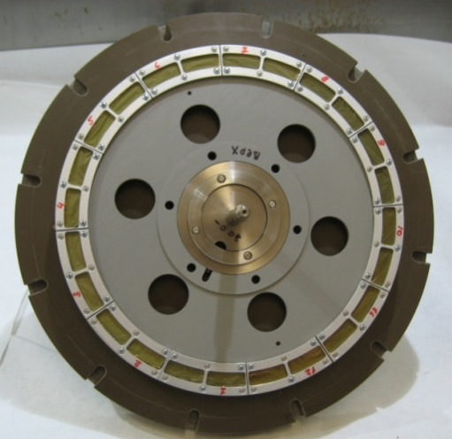
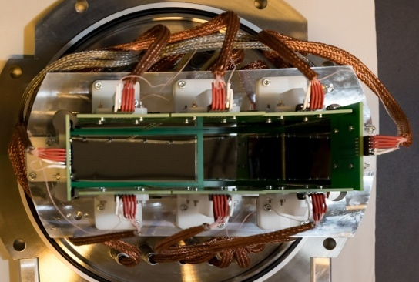
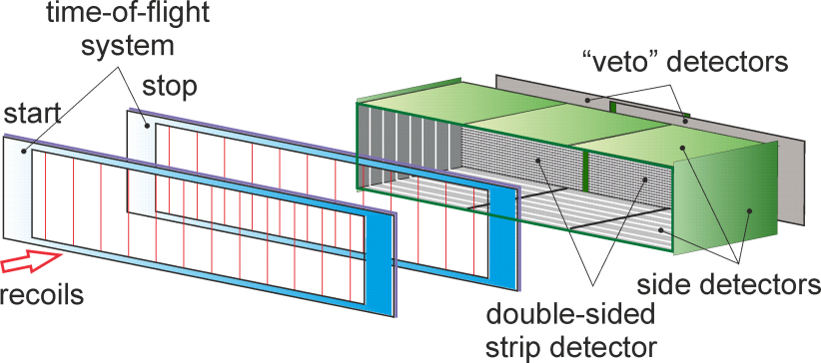
Dubna gas-filled recoil separator DGFRS-2
24-cm target wheel , 12 sectors
Rotating target, magnets (Q1, D1, Q2, Q3, D2), beam-stop chamber, and detector chamber are shown.
48x220mm DSSD
60x120mm SSSD
Digital and analog
electronics
MWPC

Slide 5
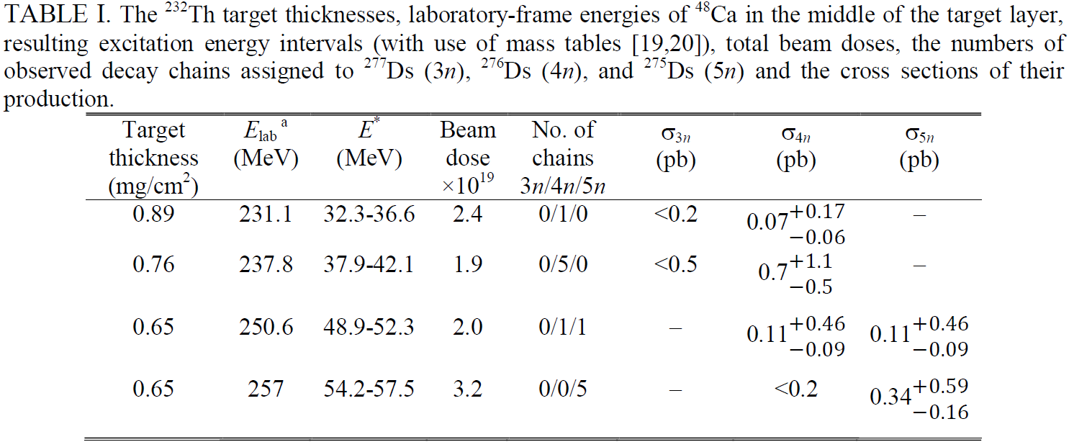
²³²Th + ⁴⁸Ca -> ²⁸⁰Ds*

Slide 6
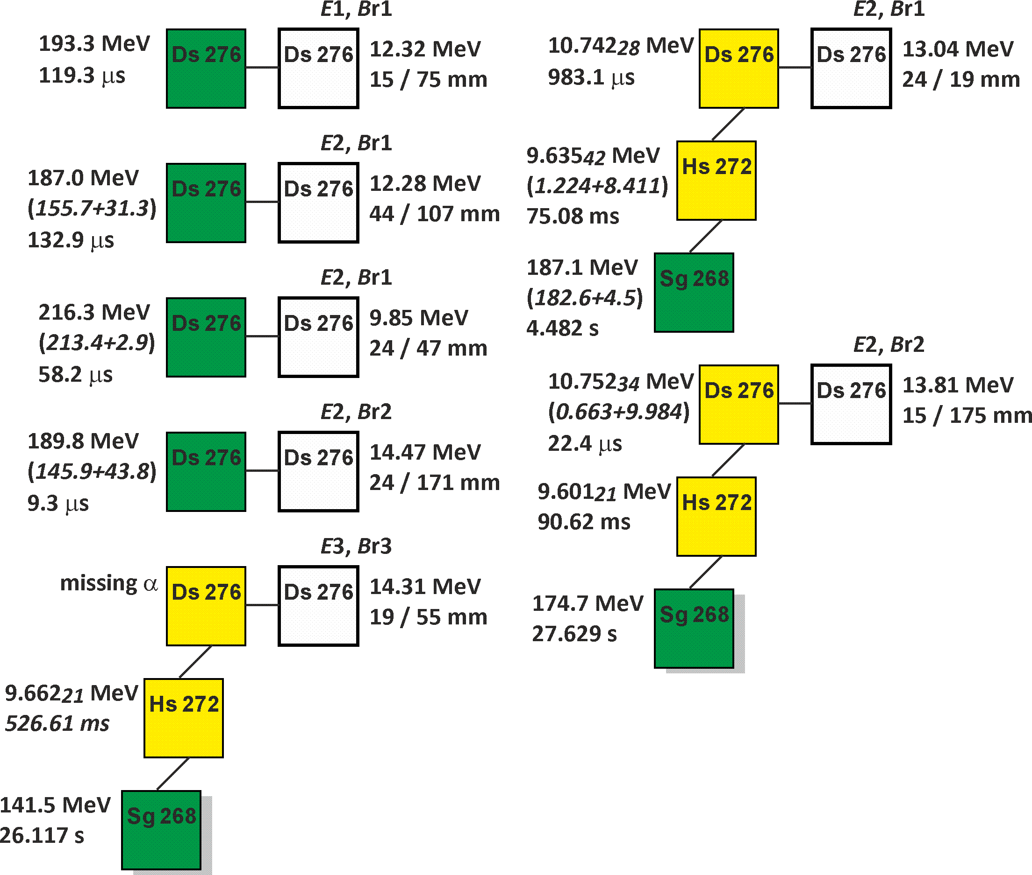
7 decay chains ²⁷⁶Ds
4n channel
²³²Th(⁴⁸Ca, 4n)²⁷⁶Ds
E₁ = 231 MeV
E₂ = 238 MeV
E₃ = 251 MeV

Slide 7
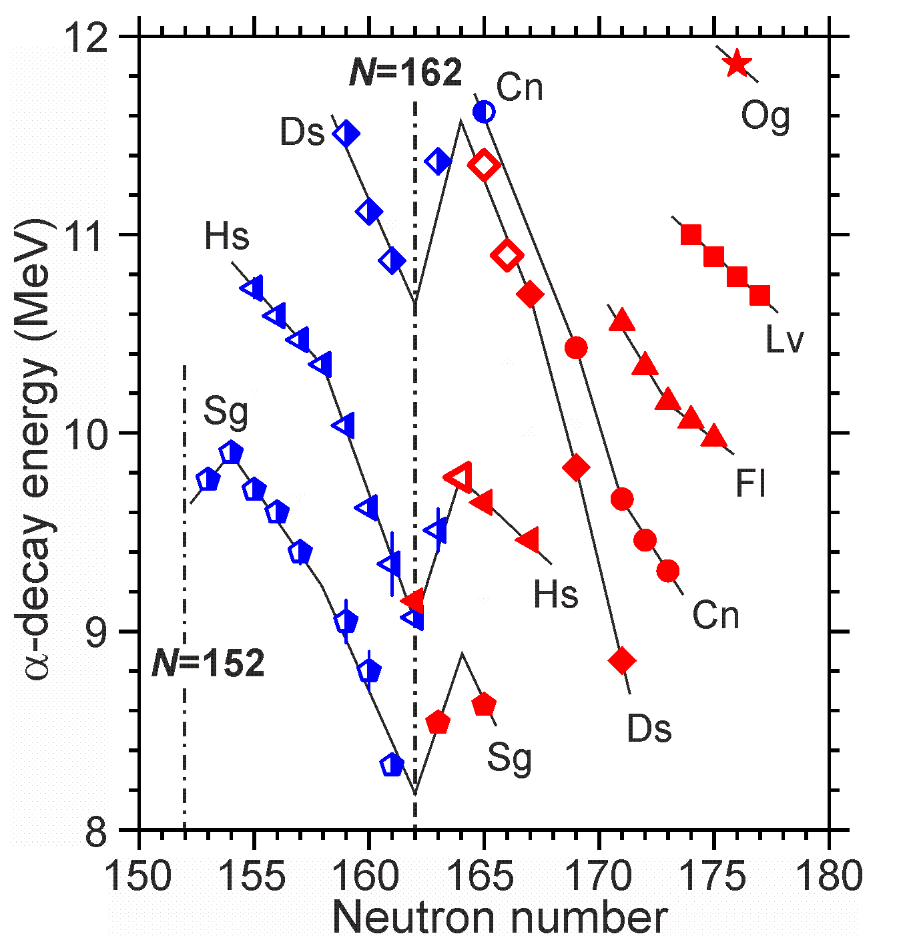
Identification: 9 decay chains (ER-α-α-SF)
Systematics of α-decay energy
α-decay energy vs neutron number for isotopes of elements Sg–Og.
Red symbols: nuclei observed in the Ra – Cf + ⁴⁸Ca reactions.
Open symbols: new data for ²⁷⁵Ds, ²⁷⁶Ds, and ²⁷²Hs.

Slide 8
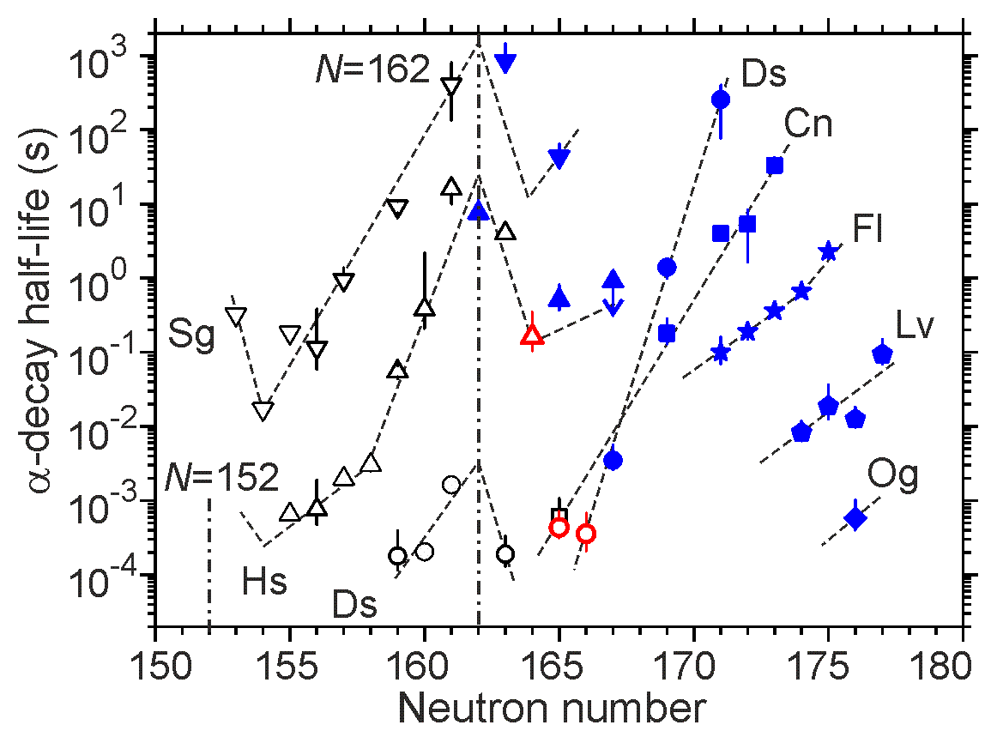
Identification: 4 decay chains (ER-α-α-SF)
Systematics of half-lives for α-decaying nuclei
Partial half-lives T_{α} vs neutron number for isotopes of elements with Z = 106–118.
Ra–Cf + ⁴⁸Ca reaction products are shown by blue symbols.
Data for ²⁷⁵Ds, ²⁷⁶Ds, and ²⁷²Hs are shown by red symbols.

Slide 9
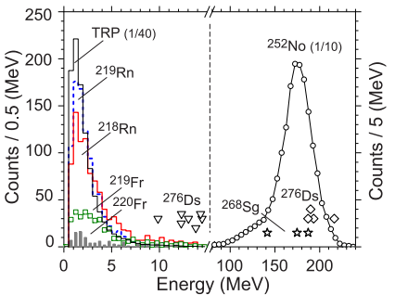
Identification: 4 decay chains (ER-SF) even isotopes
Energy spectra of recoils and fission fragments
.
.
Energy spectra of recoils (0–15 МэВ) and fission fragments (80–240 МэВ).
²¹⁹Rn, ²¹⁸Rn, ²¹⁹Fr и ²²⁰Fr – transfer-reaction products.
Energies of ²⁷⁶Ds recoils are shown by triangles.
Fission-fragment energies of ²⁷⁶Ds and ²⁶⁸Sg are shown by diamonds and stars.

Slide 10
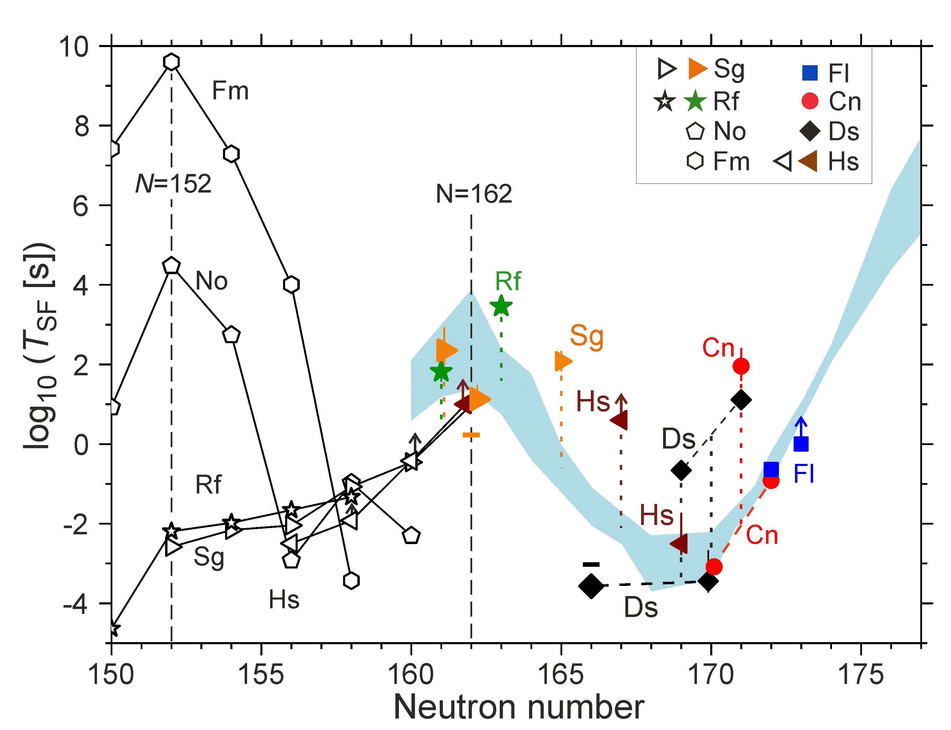
Identification: 13 decay chains (ER-SF and ER-α-α-SF)
Systematics of half-lives for spontaneously fissioning nuclei
Spontaneous-fission half-lives for even-even nuclei with Z= 100 – 108, N < 160 (open symbols) and
with Z = 104 – 114, N > 160 (closed symbols – ⁴⁸Ca-induced reactions).
The area of half-lives of even-even isotopes with Z=104−110, N=160–164 and Z=110–114, N=164–177
predicted by Z. Łojewski and A. Staszczak (1999) is highlighted in light blue.
Good agreement with predictions by Rogov, Adamian, Antonenko.

Slide 11
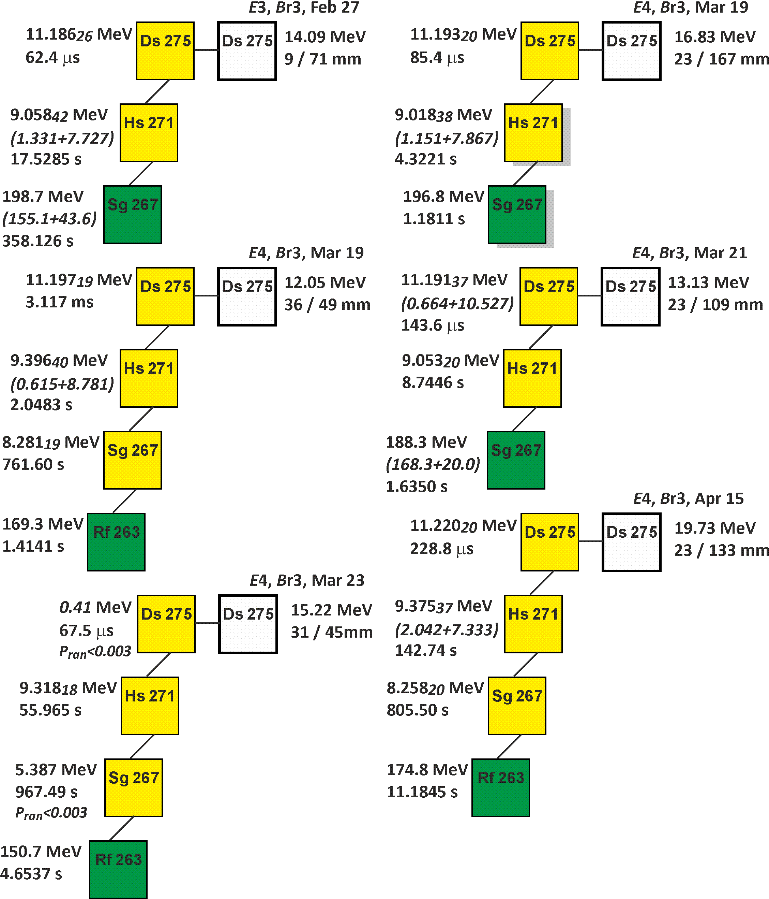
6 decay chains ²⁷⁵Ds
5n channel
²³²Th(⁴⁸Ca, 5n)²⁷⁵Ds
E₁ = 251 MeV
E₂ = 257 MeV

Slide 12
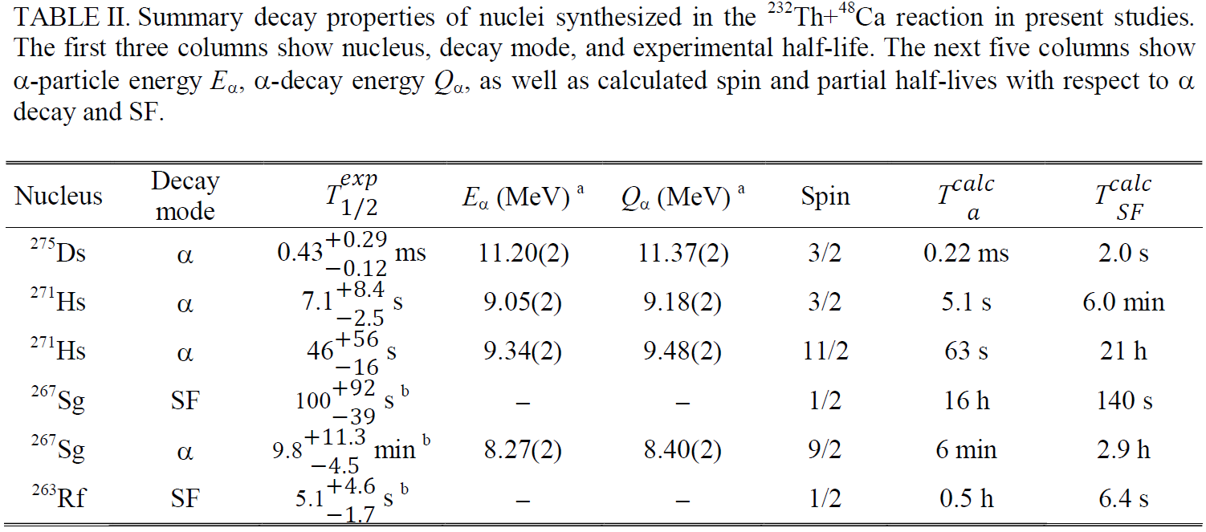
Level structure of odd-N nuclei
G. G. Adamian, I. S. Rogov

Slide 13
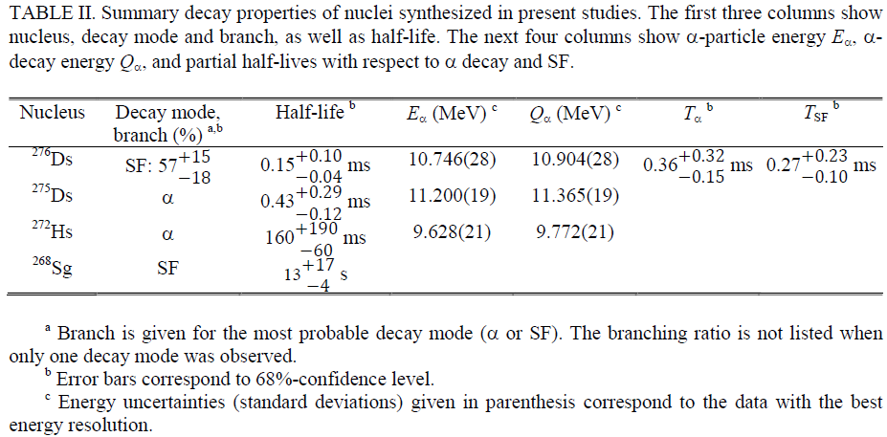
Decay properties of four isotopes are determined for the first time

Slide 14
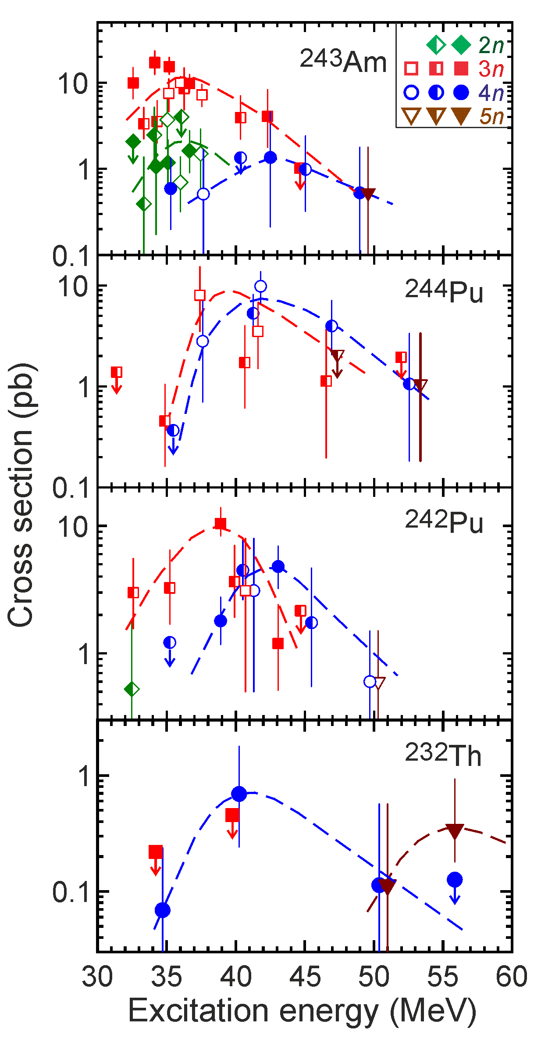
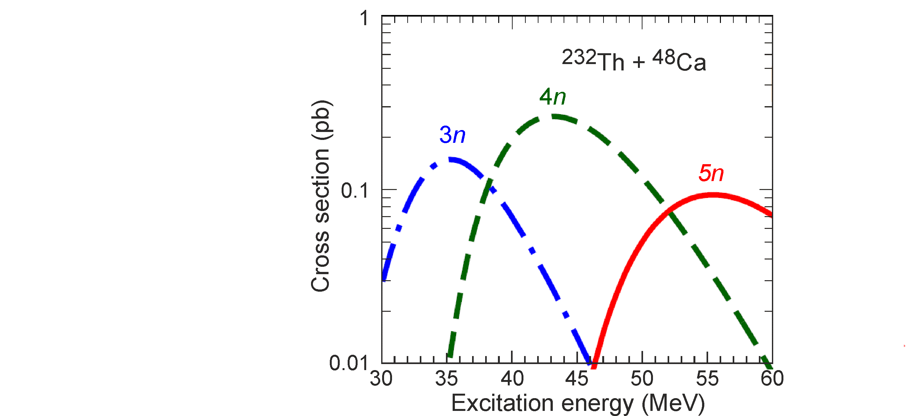
²³²Th(⁴⁸Ca, 4-5n)^{275,276}Ds
BGS
and others
DGFRS-1
DGFRS-2
5n -> 4n
cross section
drop factor
~ 3
~ 9
~ 8
~ 2
Relatively high cross-section values for the 5n channel indicates relatively high survivability of the nuclei ²⁸⁰Ds*
J. Hong, G. Adamian et al., PRC (2022)
G. Adamian, private communication

Slide 15
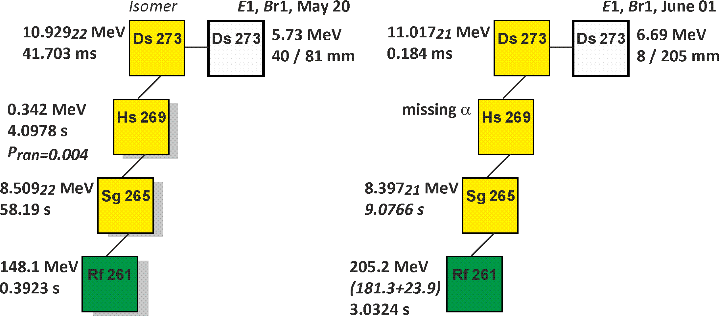
²³⁸U(⁴⁰Ar, 5n)²⁷³Ds

Slide 16
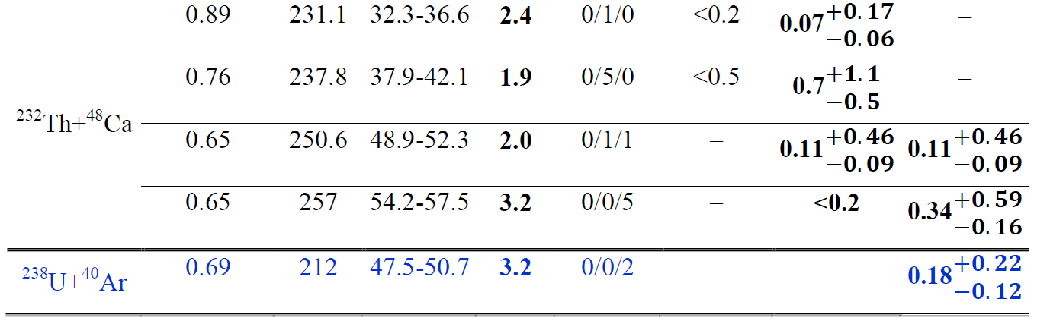
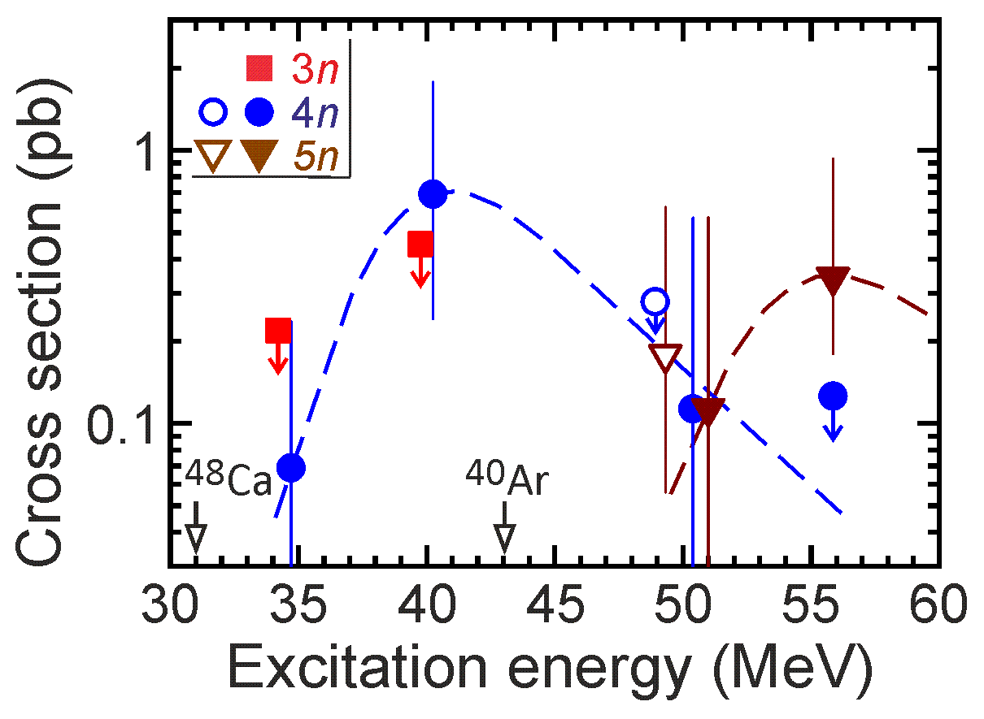
Nuclei at the minimum stability
²³⁸U + ⁴⁰Ar -> ²⁷⁸Ds*
Production cross sections and decay properties of ²⁷³Ds
²⁷⁵⁻²⁷⁷Ds
(2022)
(2023)
(2023)
²⁷³Ds

Slide 17
Summary
²³²Th + ⁴⁸Ca -> ²⁸⁰Ds*
4-5n 13 chains
New nuclei ²⁷⁶Ds, ²⁷²Hs, ²⁶⁸Sg
New isotope ²⁷⁵Ds, confirmation for ²⁷¹Hs, ²⁶⁷Sg, and ²⁶³Rf
Cross-section measured at the lowest stability
The structure of the levels of nuclei in the ²⁷⁵Ds decay chain
First observation of transition to the mainland
6 chains
7 chains
²⁷⁵Ds
5n
²⁷⁶Ds
4n
²⁷⁵Ds
new
²⁷⁶Ds
new
J. Dvorak et al., Observation of the 3n Evaporation Channel in the Complete Hot-Fusion Reaction ²⁶Mg + ²⁴⁸Cm Leading to the New Superheavy Nuclide ²⁷¹Hs,
Phys. Rev. Lett. 100, 132503 (2008).
²⁷¹Hs
conf
²⁷²Hs
new
²⁶⁷Sg
conf
²⁶⁸Sg
new
²³⁸U + ⁴⁰Ar -> ²⁷⁸Ds*
5n 2 chains
Cross-section measured at the lowest stability
The structure of the levels of nuclei in the ²⁷³Ds decay chain
²⁶³Rf
conf

Slide 18
Thank you for your attention!

Slide 19
New isotope ²⁷⁶Ds and its decay products ²⁷²Hs and ²⁶⁸Sg from the ²³²Th + ⁴⁸Ca reaction
Synthesis and decay properties of isotopes of element 110: ²⁷³Ds and ²⁷⁵Ds
Yu.Ts. Oganessian ¹, V.K. Utyonkov ¹, M.V. Shumeiko ¹, F. Sh. Abdullin ¹, G.G. Adamian ¹, S.N. Dmitriev ¹, D. Ibadullayev ^{1,2}, M.G. Itkis ¹, N.D. Kovrizhnykh ¹, D.A. Kuznetsov ¹, O.V. Petrushkin ¹, A.V. Podshibiakin ¹, A.N. Polyakov ¹, A.G. Popeko ¹, I.S. Rogov ¹, R.N. Sagaidak ¹, L. Schlattauer ^{1,3}, V.D. Shubin ¹, D.I. Solovyev ¹, Yu.S. Tsyganov ¹, A. A. Voinov ¹, V. G. Subbotin ¹, N.S. Bublikova ¹, M.G. Voronyuk ¹, A.V. Sabelnikov ¹, A.Yu. Bodrov ¹, N.V. Aksenov ¹, A.V. Khalkin ¹, Z.G. Gan ⁴, Z.Y. Zhang ⁴, M.H. Huang ⁴, and H.B. Yang ^{1,4}
¹Joint Institute for Nuclear Research, RU-141980 Dubna, Russian Federation
²L.N. Gumilyov Eurasian National University, 010000 Astana, Kazakhstan
³Palacky University Olomouc, Department of Experimental Physics, Faculty of Science, 771 46 Olomouc, Czech Republic
⁴Institute of Modern Physics, Chinese Academy of Sciences, Lanzhou 730000, China

Slide 20
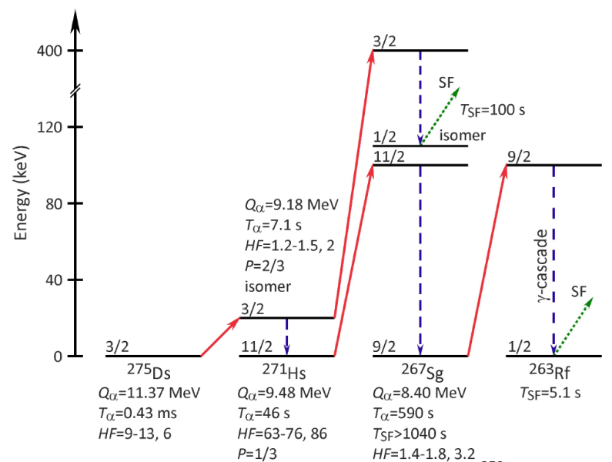
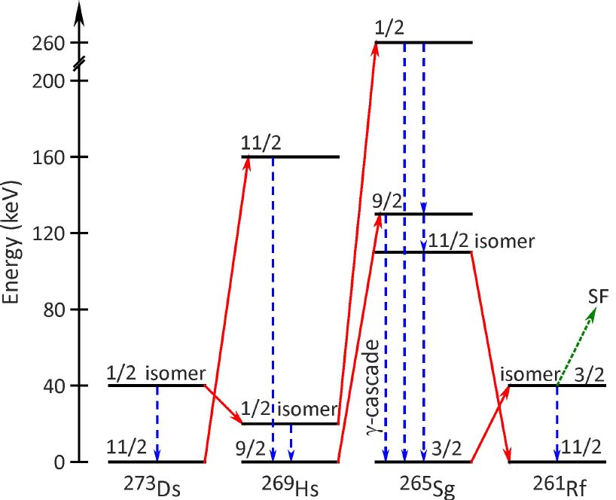
Level structure of odd-N nuclei
[23] I.S. Rogov, G.G. Adamian, and N.V. Antonenko, Dynamics of a dinuclear system in charge-asymmetry coordinates: α decay, cluster radioactivity, and spontaneous fission, Phys. Rev. C 100, 024606 (2019); Cluster approach to spontaneous fission of even-even isotopes of U, Pu, Cm, Cf, Fm, No, Rf, Sg, and Hs, ibid. 104, 034618 (2021).
[24] I.S. Rogov, G.G. Adamian, and N.V. Antonenko, Spontaneous fission hindrance in even-odd nuclei within a cluster approach, Phys. Rev. C 105, 034619 (2022).
²³²Th(⁴⁸Ca, 5n)²⁷⁵Ds
²³⁸U(⁴⁰Ar, 5n)²⁷³Ds

Slide 21
Nuclei at the minimum stability
²³²Th + ⁴⁸Ca -> ²⁸⁰Ds* ²³⁸U + ⁴⁰Ar -> ²⁷⁸Ds*
Production cross sections and decay properties of ^{273–277}Ds
?

