Slide 1
First In-Person coordination meeting of the
ITS-miniBeBe cooperation
WORK PERFORMED IN DUBNA Sep.-Oct. 2024
Electronics Team

Slide 2
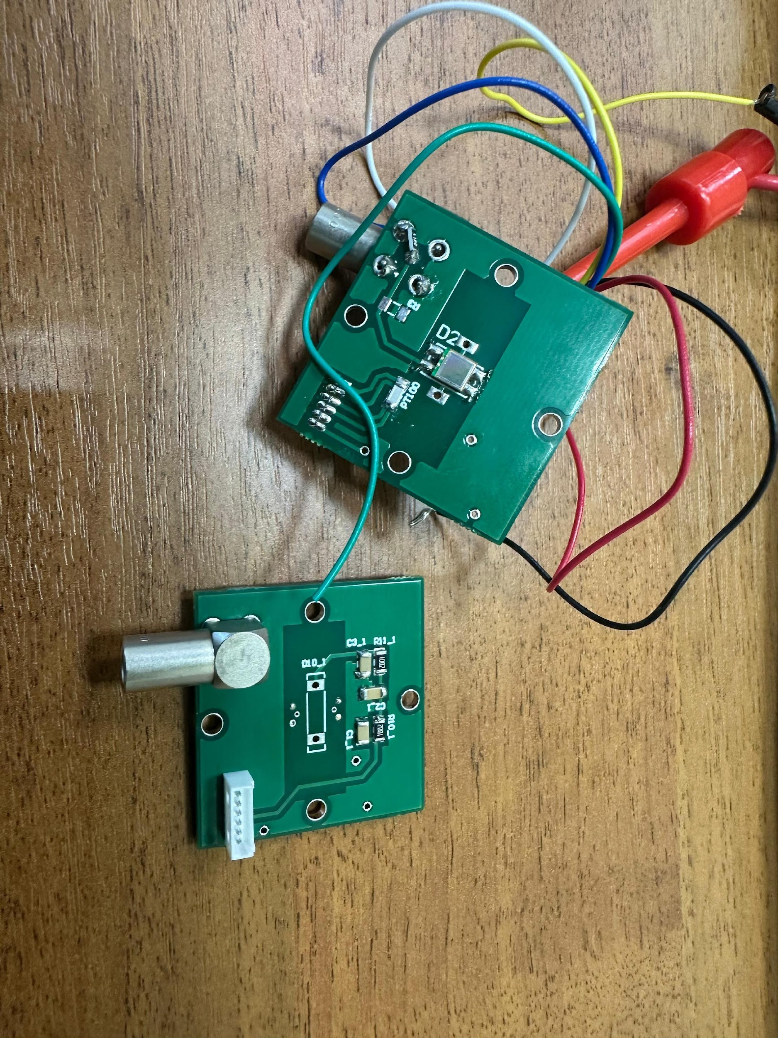
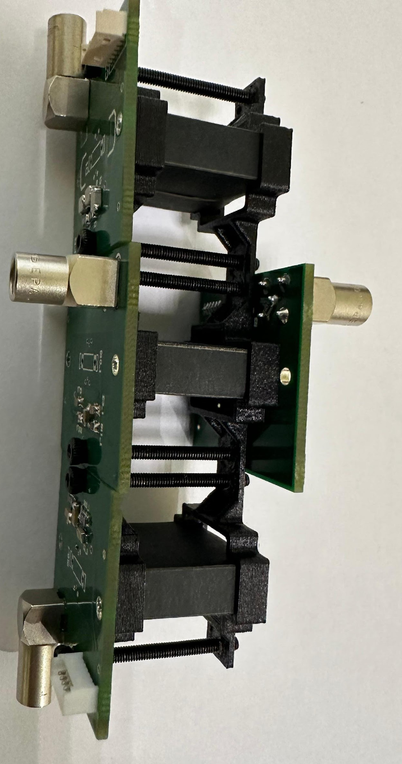
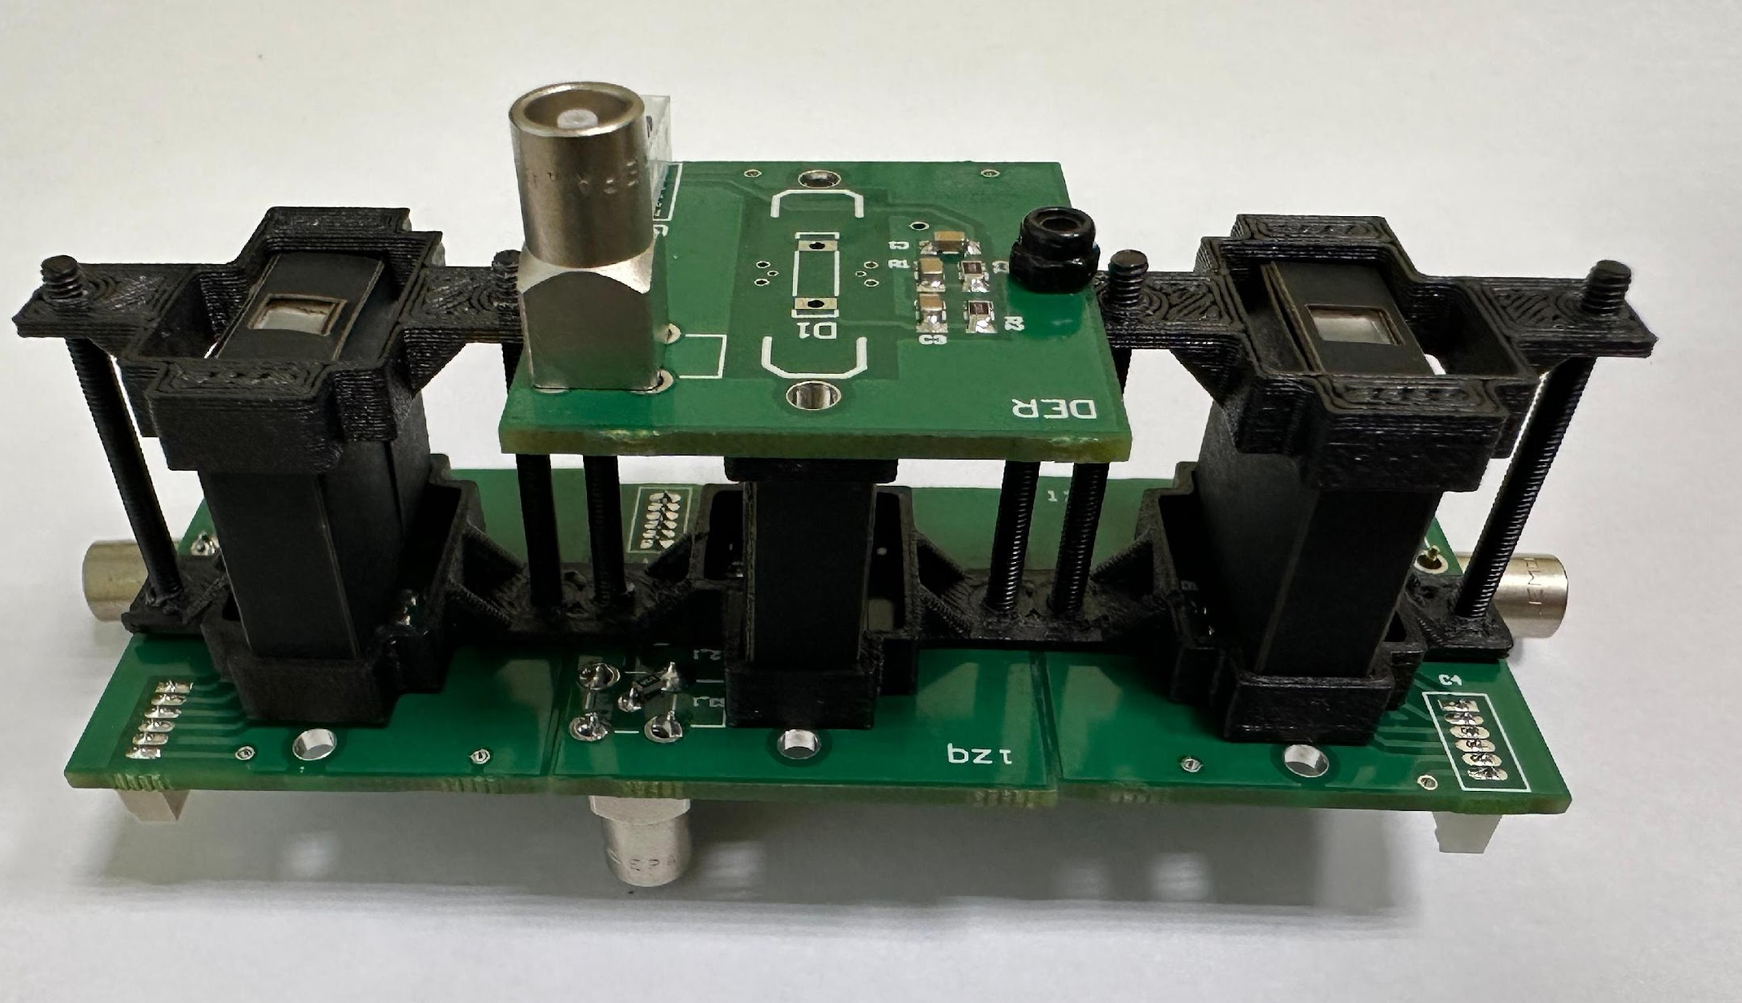
SiPMs, Individual Modules
In testing with Prof. Slava’s team
Awaiting date for beam test
Awaiting results to determine exact resolution time
👍

Slide 3
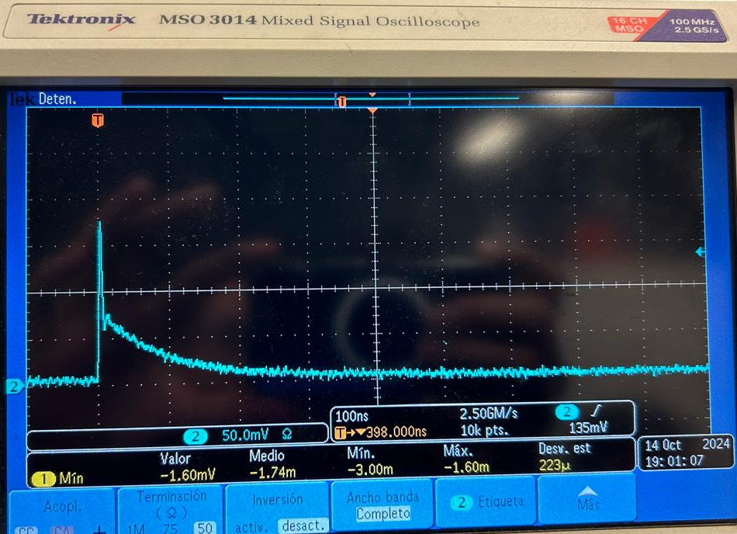
SiPMs, Power Supplies
Low noise, switched-mode voltage supply, 4 output channels, independently controlled output voltage from 3-58V, 1mA maximum current per channel, with current check, voltage and temperature measurement at the load; the supply is controlled via graphic interface and/or serial terminal by RS-232 or RS-485 UART port.
Slava's team is currently testing it, and will provide ideas to improve noise levels and protection systems.
low cost!! low cost!! low cost!!

Slide 4
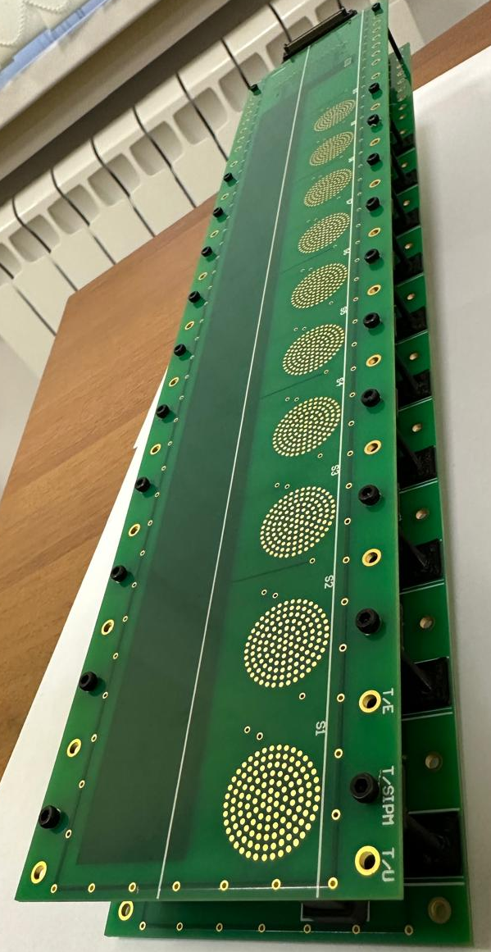
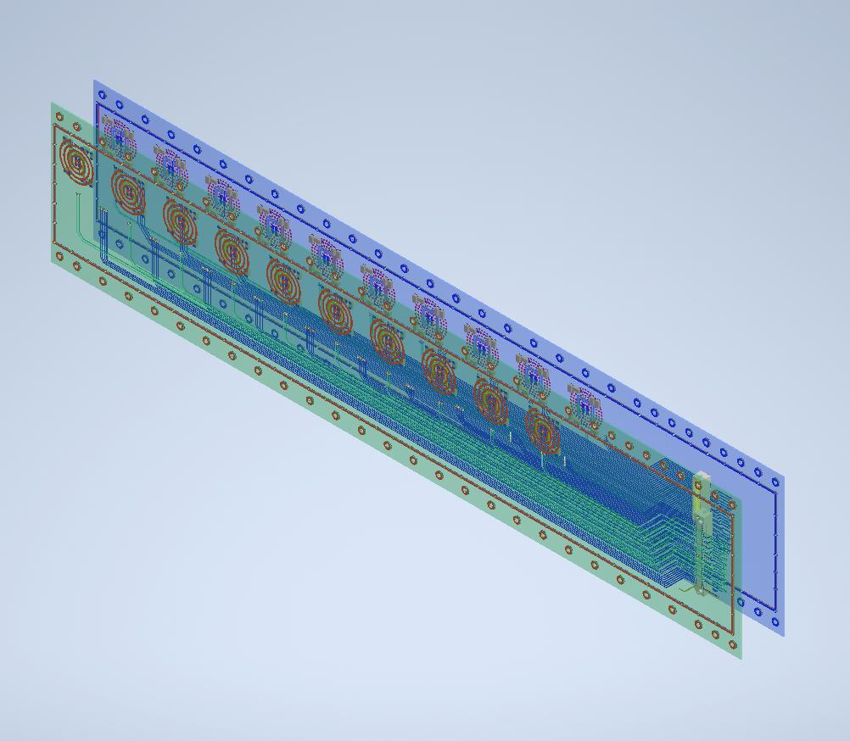
MiniBeBe, “H” single module
Actual model available here!
Available for testing
Scheduling test runs once devices are available
Thermography test coming soon
👍

Slide 5
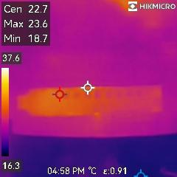
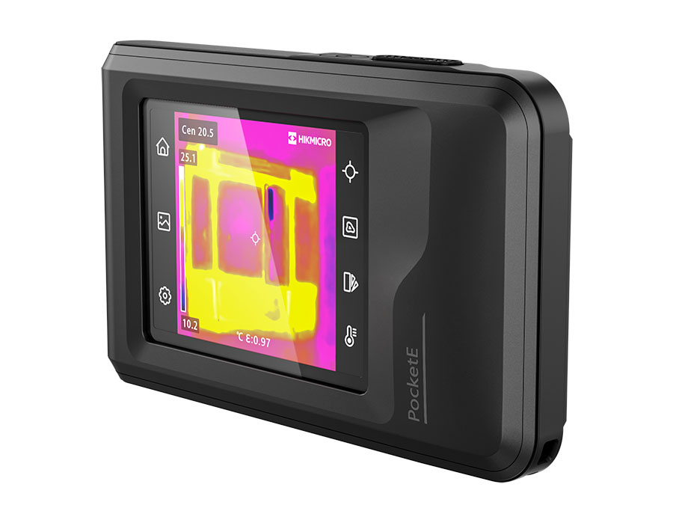
TEMPERATURE TEST
Both the matching module and the H module (with the left and right cards) require the same power supply. The priority these days is beam test, so the temperature tests are on hold.
thermal camera ready!!

Slide 6
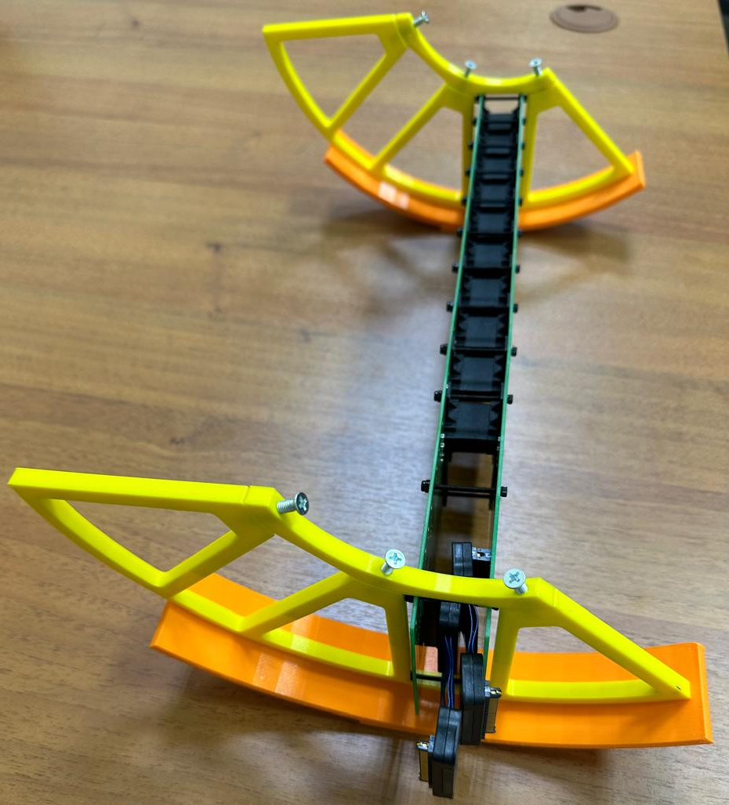
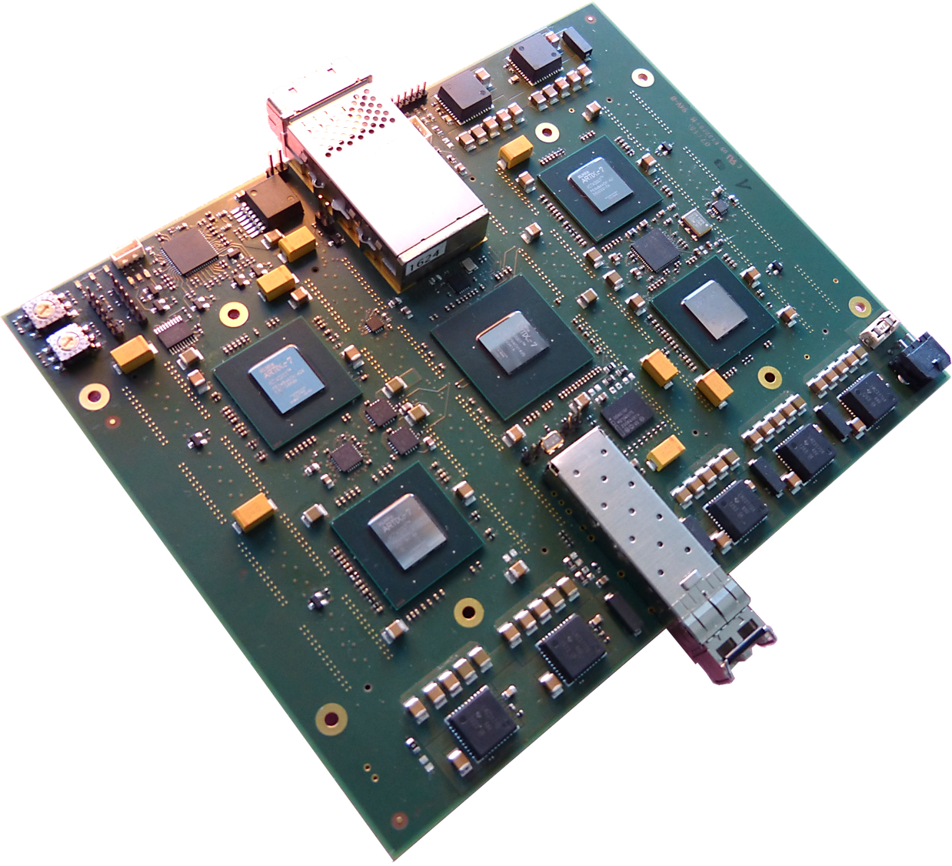
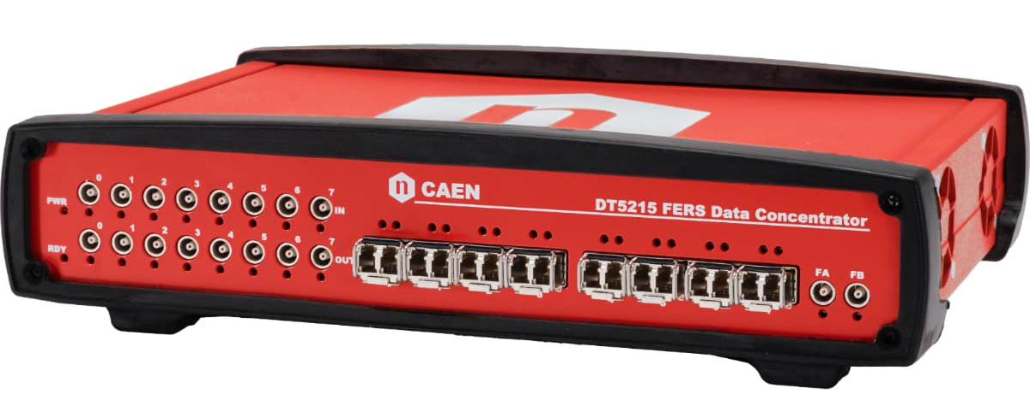
MINIBEBE
Mechanics
FrontEnd electronic boards
H-Module Power Supplies
CAEN FERS 5200 modules
CAEN Collector Module
SAMTEC CABLE
3 m.
SAMTEC CABLE
12 m.
Mechanical system and
H Modules
Trigger Modules
Data Collection System

Slide 7
MiniBeBe, Costs and Description
DESCRIPTION | QUANTITIES | COST
Mechanics of MiniBeBe The mechanical structure of the detector takes into account geometrical space constraints by sharing part of the mechanical structure with the ITS detector. The design considers 8 electronic modules, 4 in each half of the housing. The internal flanges, where the modules are placed, are fitted with covers to facilitate their insertion and removal. The materials used for their manufacture must not be ferromagnetic, so carbon fibre, aluminium and brass will be used. | 1 carbon fibre housing, 10 internal flanges + caps, 4 locking rings, 16 cable holders + pipes, 16 cooling plates 800mm long + accessories, 16 ruby spheres, 4 support flanges + accessories (similar to ITS flanges), 320 plastic scintillator holders, 16 electronic module holders, M2.5, M3 and M4 screws, plus glue. | In gathering information.
Modules H The electronics of the detector, consists of 8 longitudinal sections arranged in an H-shape with a length of 80 cm and a height of 8 cm, each divided into four sections of 40 cm long by 8 cm high joined by 10 plastic scintillators attached to both cards through a SiPM device on each side. | With a total of 32 PCBs, 320 SiPM Hamamatsu S13360-3050PE, 160 rectangular plastic scintillators of 2 by 2 cm and a height of 0.5 cm, 320 PT100 temperature sensors, 960 resistors and 640 capacitors. | In gathering information. .
H-Module Power Supplies Low noise switched-mode voltage source, 4 output channels, independently controlled output voltage 3-58V, 1mA maximum current per channel, with current, voltage and temperature measurement at the load; the source is controlled via graphical interface and/or serial terminal by UART RS-232 or RS-485 port. | 80 modules mainly built by, ATMEGA2560 microcontroller, LT3905 voltage supply, AD5696R D/A converter, REF2025 voltage references, LTC2497 A/D converter, REF200AU current source, ADG728 analogue switch. UNDER IMPROVEMENT | $400.00 USD per module $32,000.00 USD

Slide 8
4. Connector cables from H-modules to FrontEnd electronic boards (Data and Power) SAMTEC cables of two to three metres to interconnect the H modules and the FrontEnd electronics (DATA AND POWER SUPPLY). | 32 SAMTEC CABLES 64 connectors (DATA/FOOD) | 16,520.00 USD
5. FrontEnd electronic cards Electronic circuits and devices that are about 2 to 3 metres from the H modules and their function is to receive, discriminate, condition and process the signals generated by the detector so that they can be transmitted to the CAEN FERS modules. | IN THE PROCESS OF DESIGN | In gathering information.
6. Connection cables between FrontEnd electronic boards and CAEN FERS Modules (data) and power supply cables | PENDING FOR FRONTEND CARD DESIGN | In gathering information.
7. CAEN FERS 5200 modules Real-time data acquisition platform specifically designed to handle large numbers of readout channels, enabling tasks such as: Signal filtering. Feature extraction (amplitude, arrival time among others). Noise reduction. Discrimination and classification of events. Accurate synchronisation between modules, using standards such as White Rabbit | Due to the mechanical structure of the detector, they are required: 2 modules of 128 channels 2 modules of 64 channels Fibre optic interconnecting cables. | $41,000.00 Euros

Slide 9
8. CAEN Collector Module Distribution and communication interface between the different FERS modules and the main data acquisition system. It acts as a "hub" that consolidates the output of all modules into a single interface or communication channel, ensures time synchronisation with White Rabbit timing standards using fast interfaces such as Ethernet or USB. | DT5215 Collector Board for FERS-5200 | $9000.00 Euros
9. Trigger Modules Signal conditioning for Trigger. | AWAITING INFORMATION | In gathering information.
10. Data Collection System Dedicated PC | AWAITING INFORMATION | In gathering information.

