Slide 1
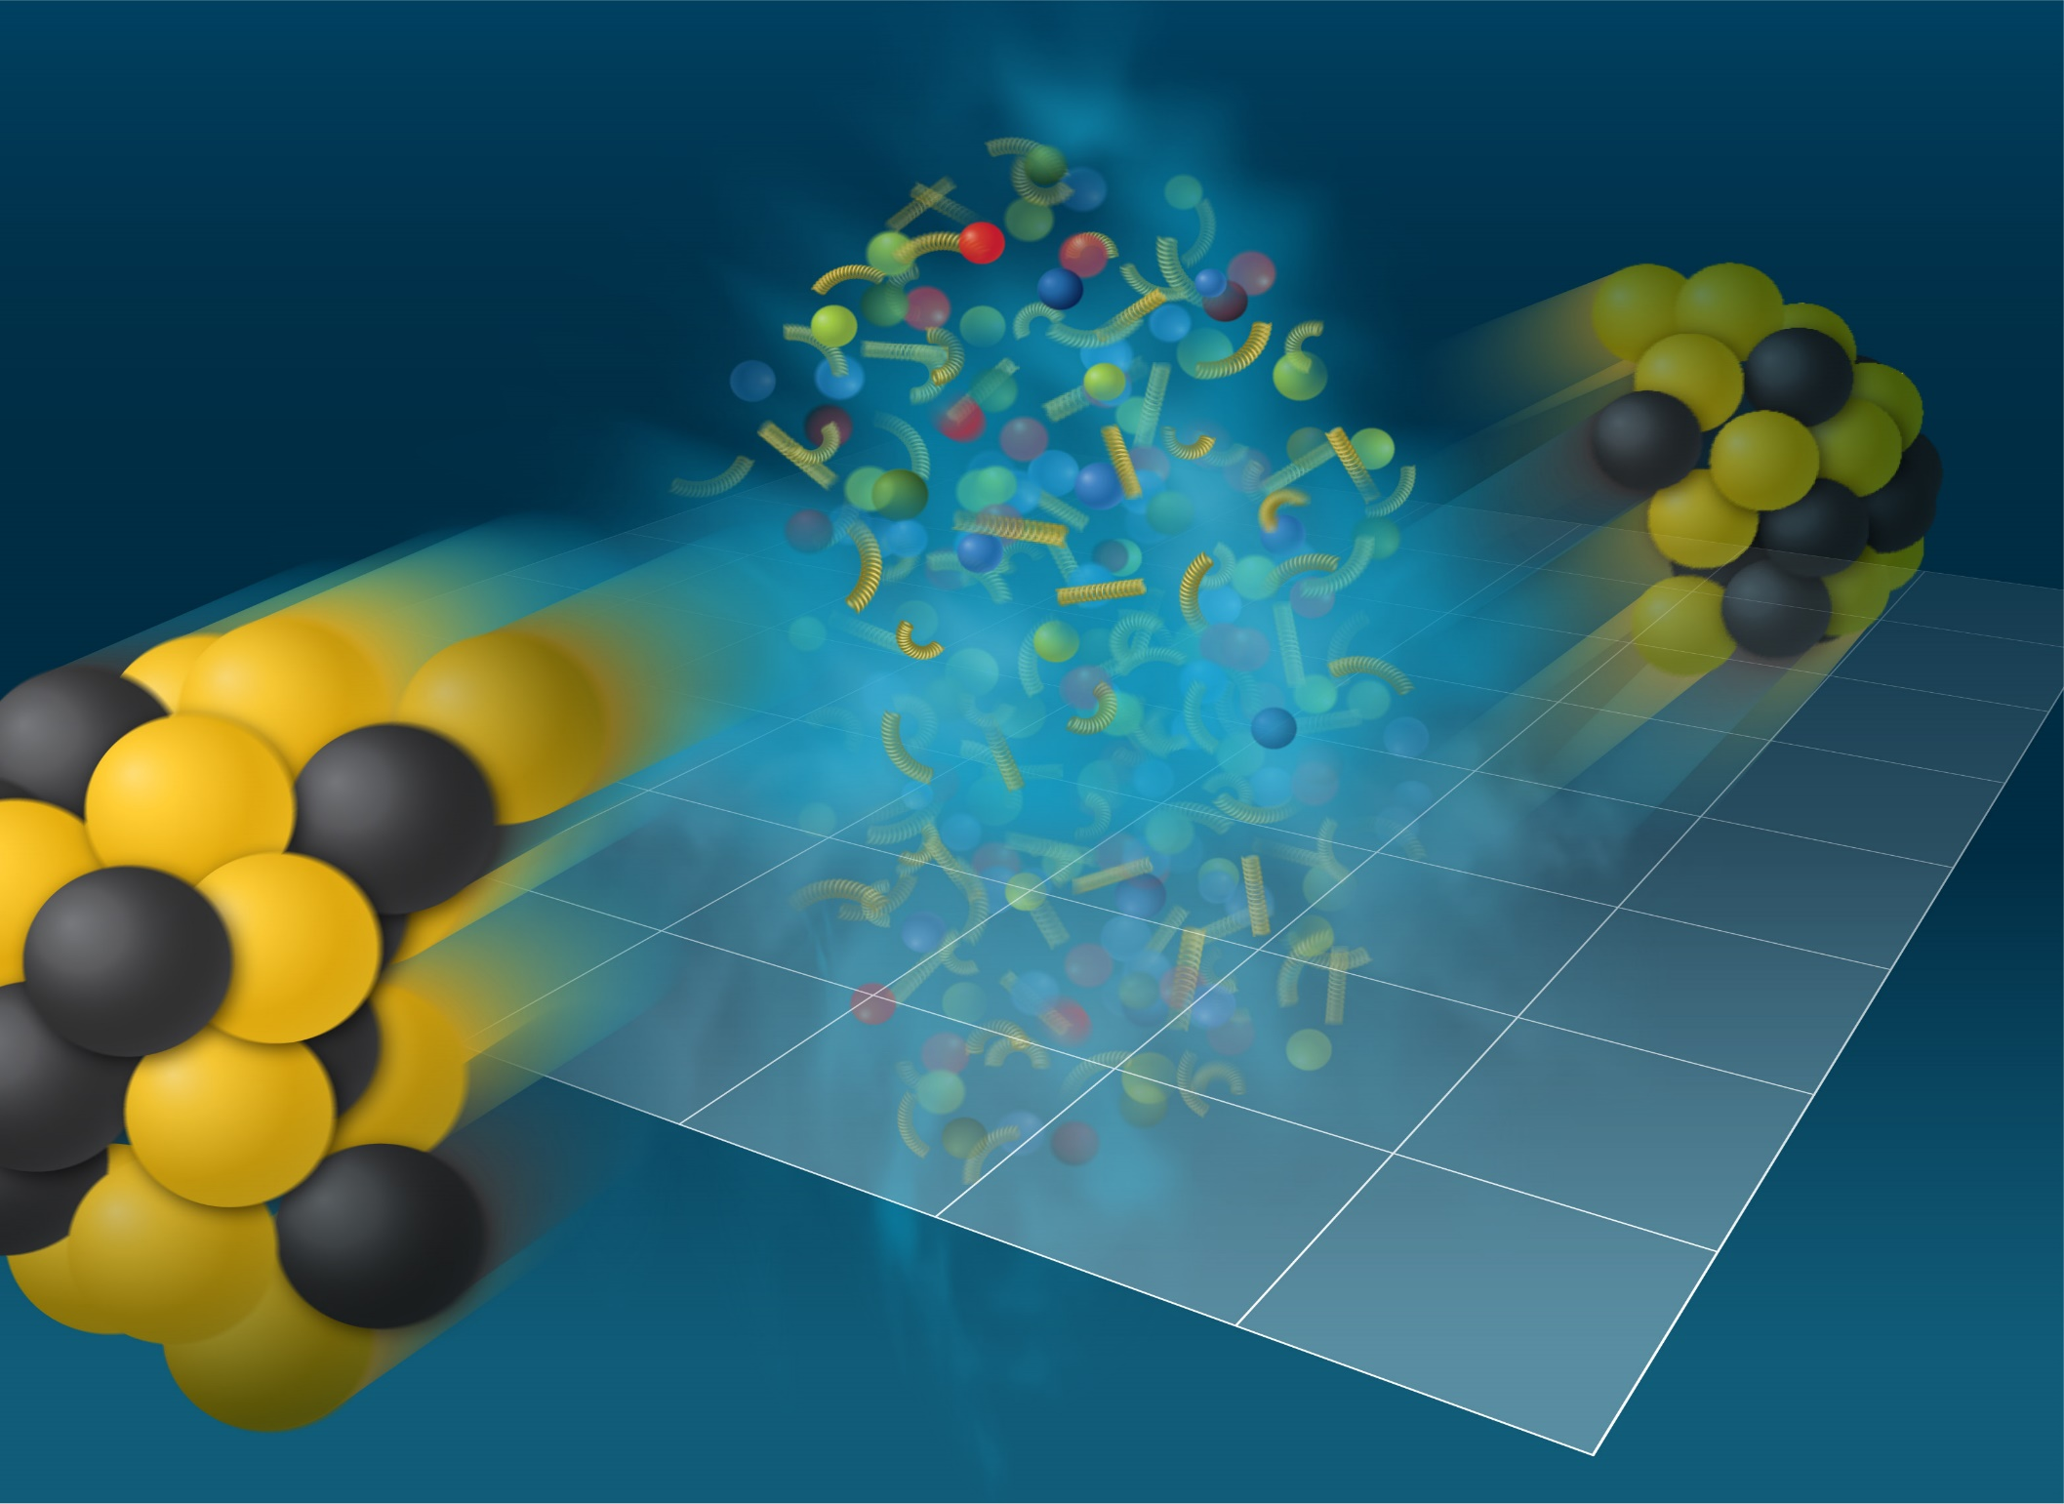
Изучение столкновений тяжелых ионов на NICA

Slide 2
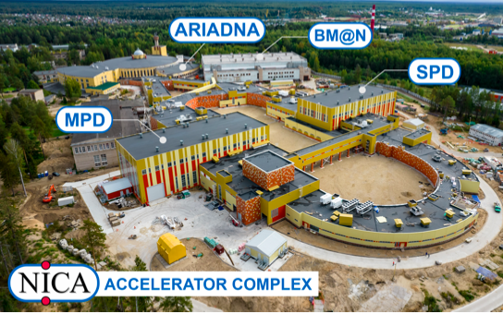
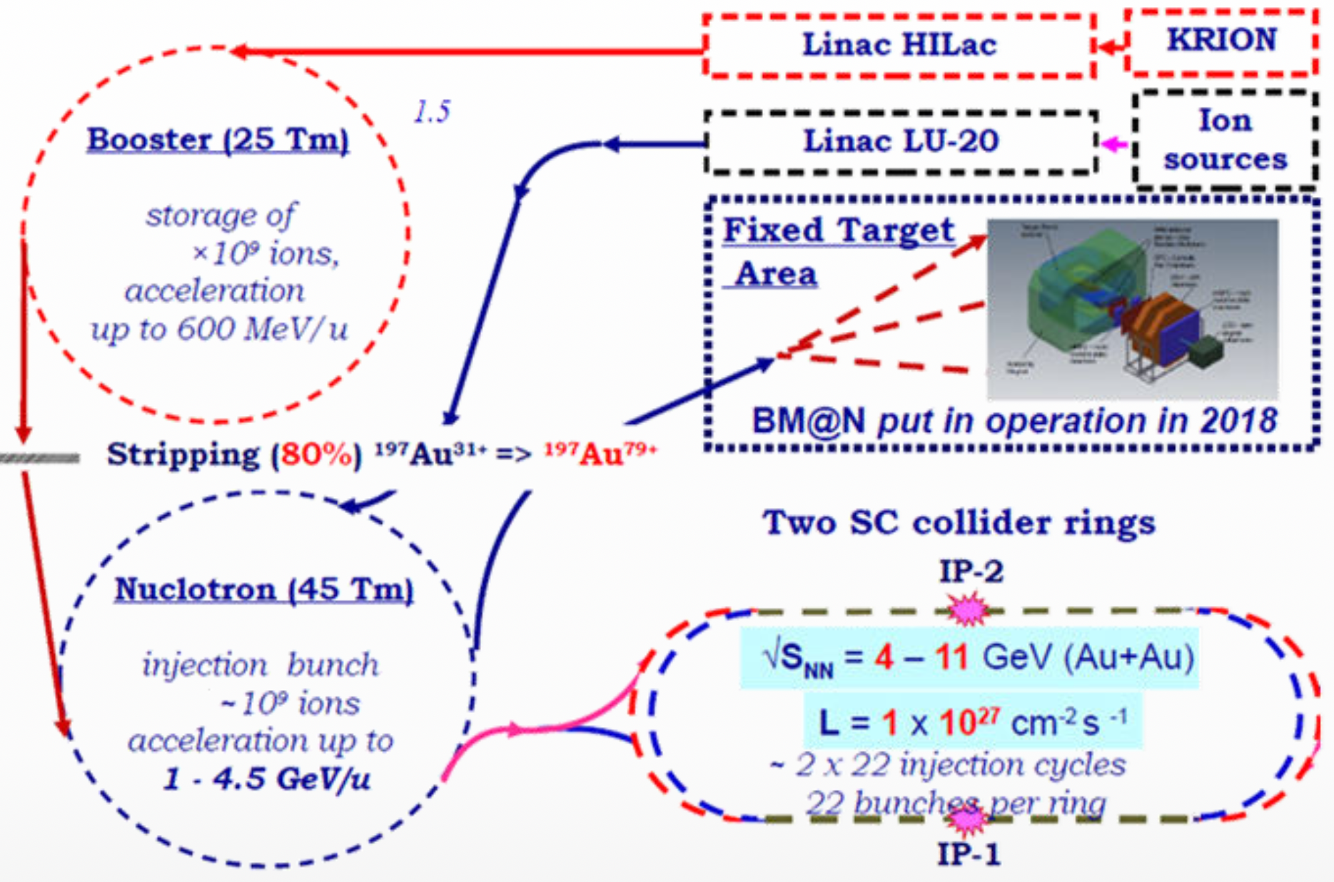
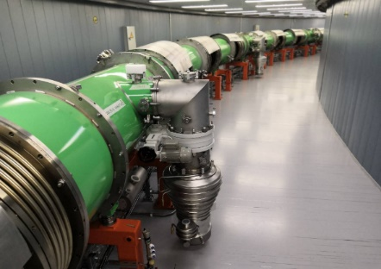
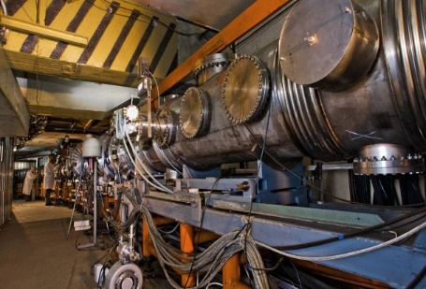
Ускорительный комплекс NICA (ЛФВЭ, ОИЯИ, Дубна)
Booster
Nuclotron
Мегапроект NICA (Nuclotron based Ion Collider fAcility) - сверхпроводящий коллайдер протонов и тяжёлых ионов, строящийся на базе Лаборатории физики высоких энергий (ЛФВЭ, ОИЯИ), окончание строительства: 2025
  BM@N (“Барионная материя на Нуклотроне “) – Nuclotron, c 2018 года
  MPD (“Многоцелевой Детектор“) - коллайдер NICA, 2025-2026 год
  SPD (“Детектор Спиновой Физики“) - коллайдер NICA, 2028-2030 год?

Slide 3
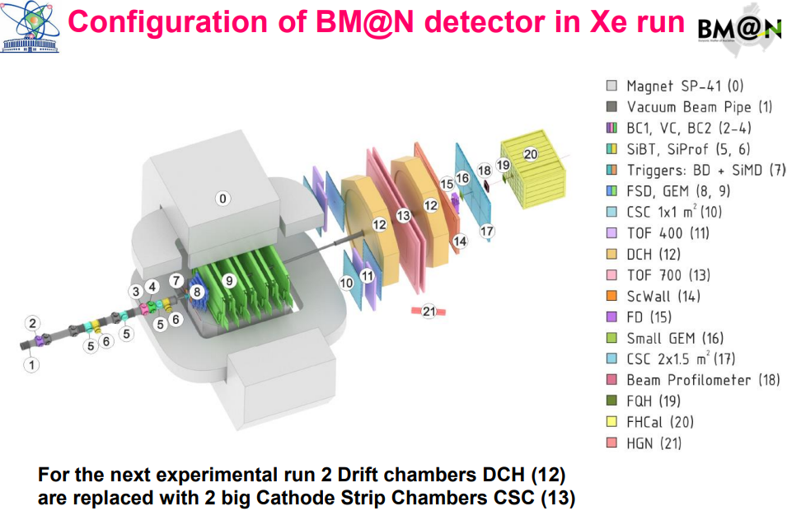
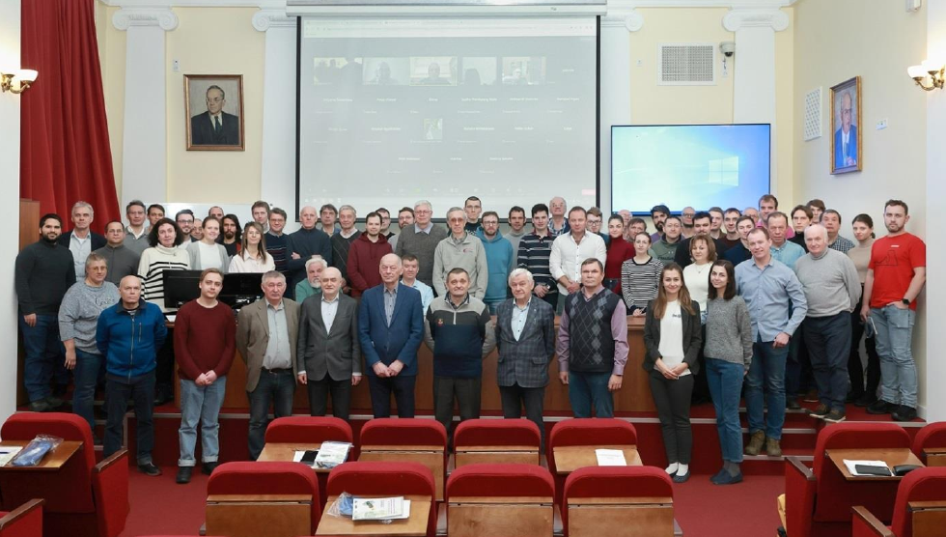
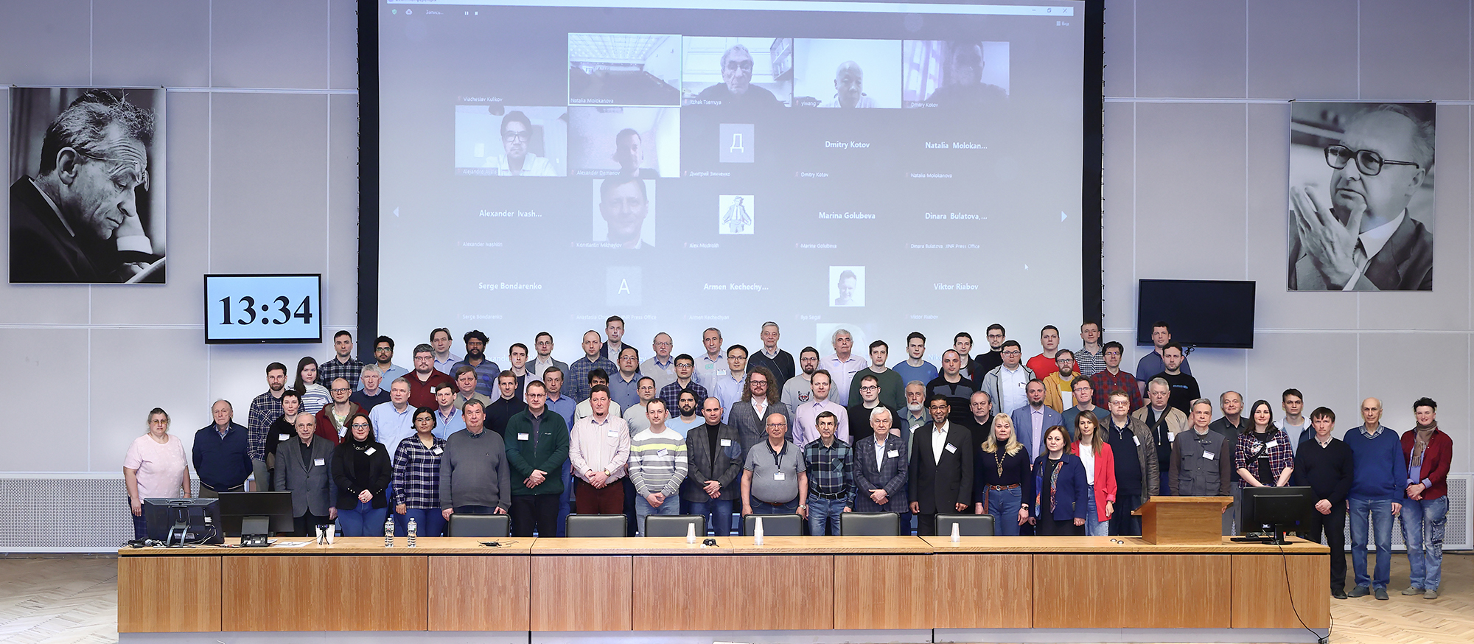
NICA: BM@N and MPD Collaborations
The BM@N spectrometer at the NICA accelerator complex
Nucl.Instrum.Meth.A 1965 (2024) 169352
Status and initial physics performance studies of the MPD experiment at NICA , Eur.Phys.J.A 58 (2022) 7, 140
BM@N: ~214 participants из 13 institutes, 5 countries
MPD: ~500 participants из 38 institutes, 12 countries

Slide 4
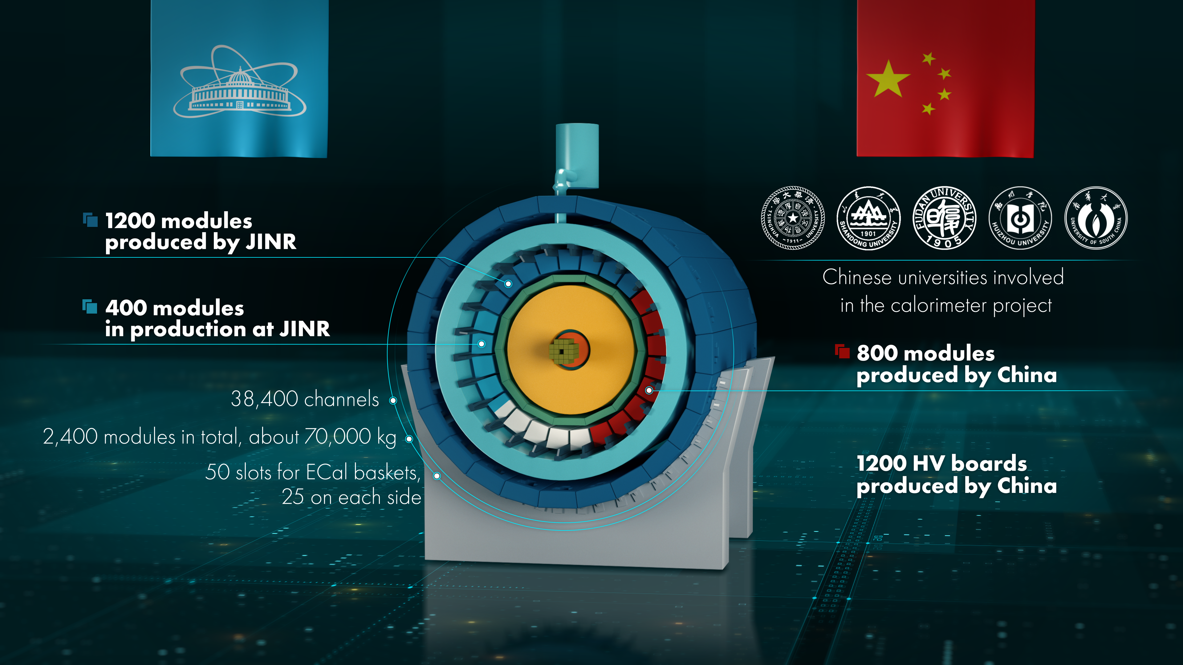

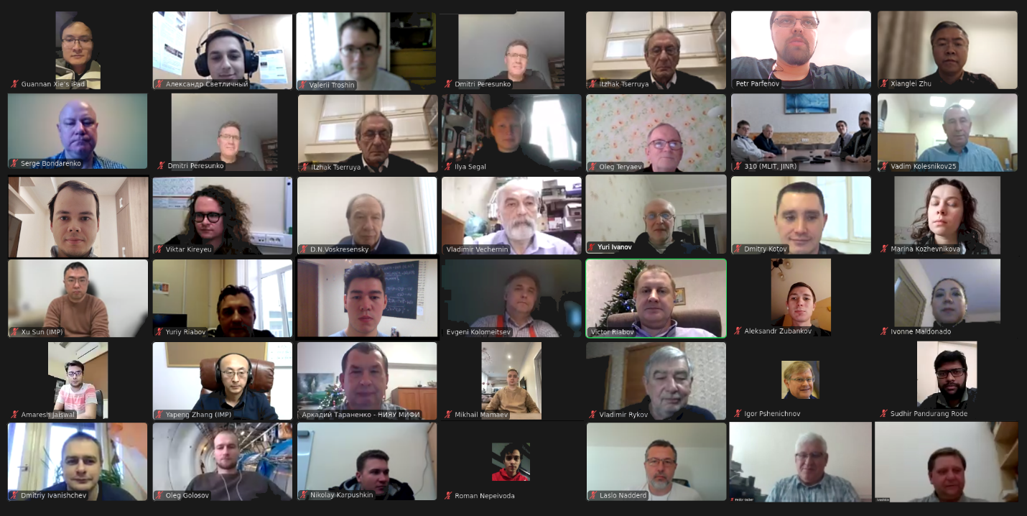
MPD collaboration (NICA)
2nd China-Russia Joint Workshop on NICA Facility
indico.jinr.ru/event/4642
International Workshop on physics performance studies at NICA-2024 (November 25-27,2024)
https://indico.jinr.ru/event/4973/overview

Slide 5

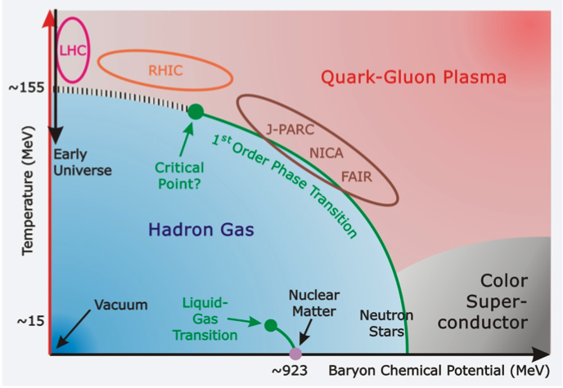
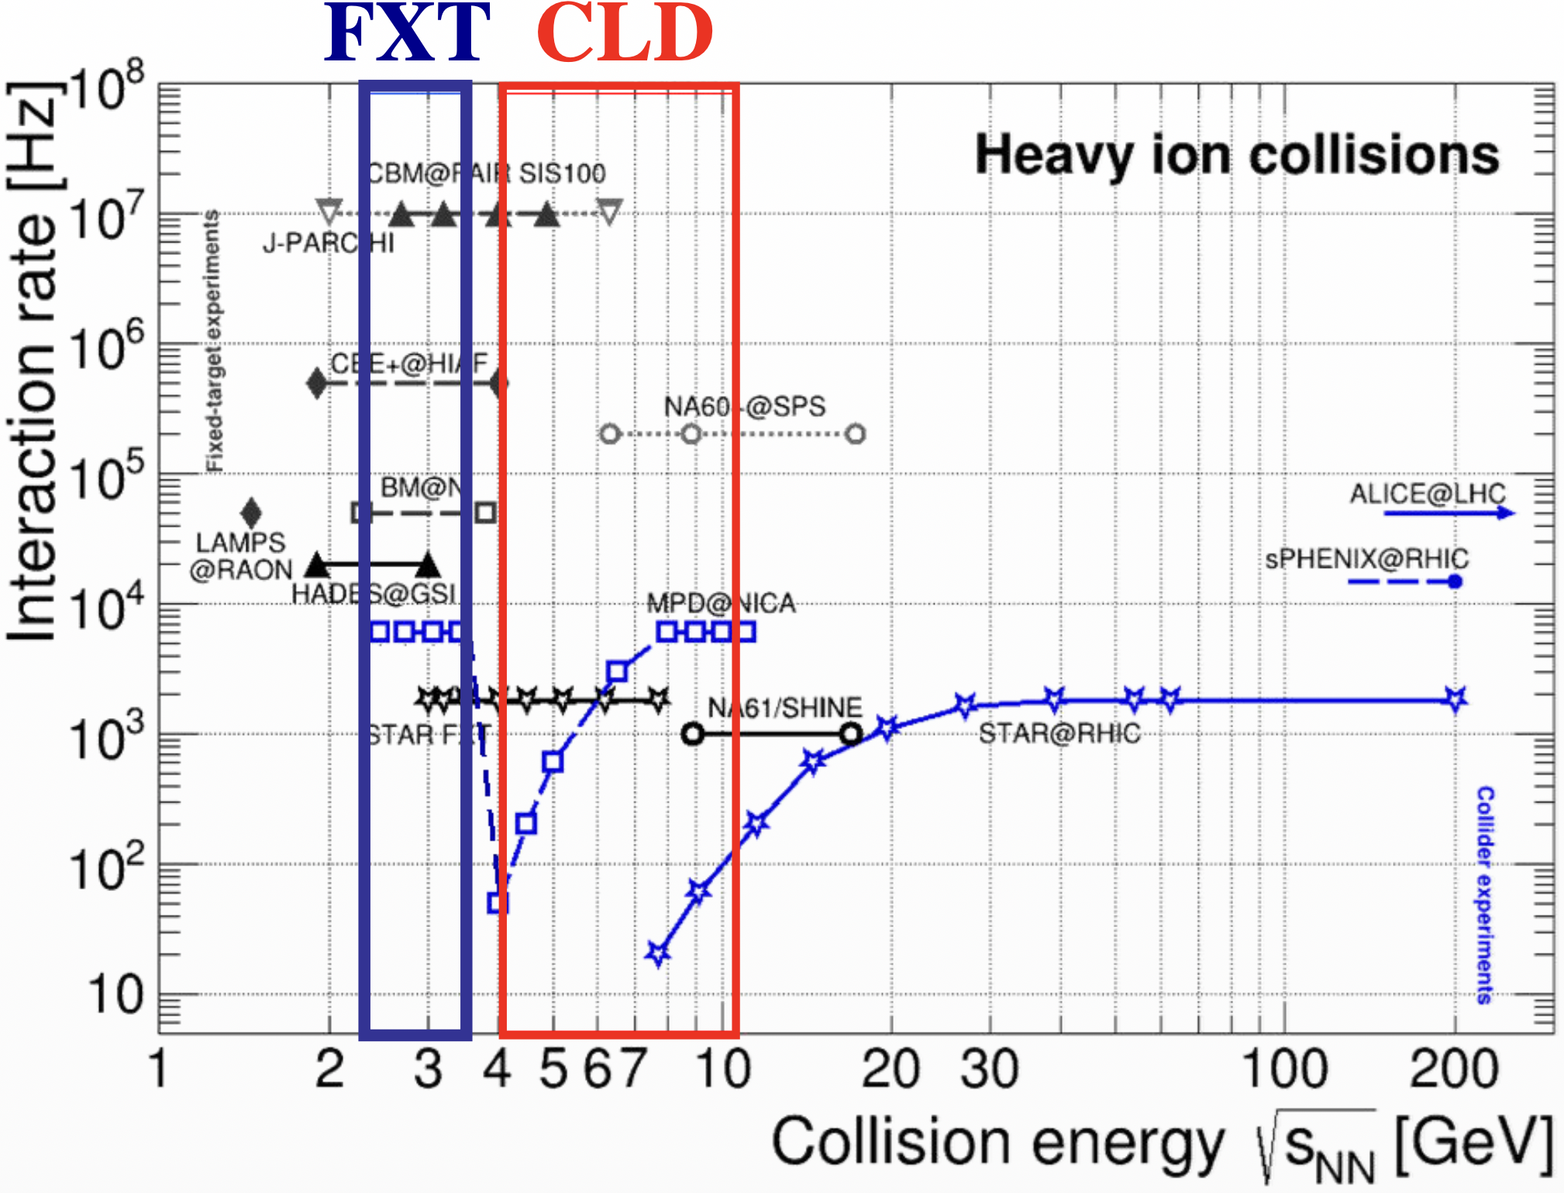
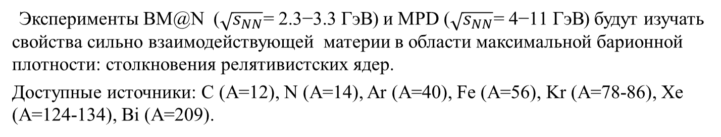
Experiments: BM@N and MPD
Эксперименты BM@N ($\sqrt{s_{NN}}\text{= }\text{2.3}\text{−}\text{3.3} \text{ГэВ}$) и MPD ($\sqrt{s_{NN}}\text{= 4−11 }\text{ГэВ}$) будут изучать свойства сильно взаимодействующей материи в области максимальной барионной плотности: столкновения релятивистских ядер.
Доступные источники: C (A=12), N (A=14), Ar (A=40), Fe (A=56), Kr (A=78-86), Xe (A=124-134), Bi (A=209).

Slide 6
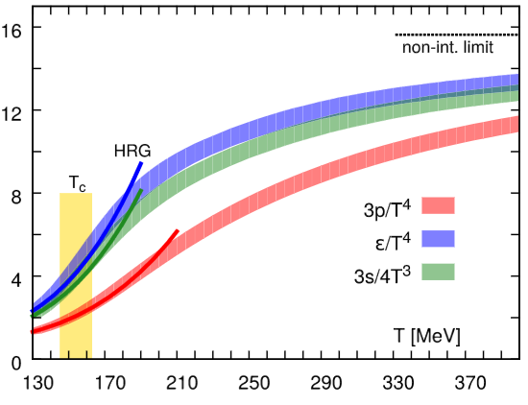
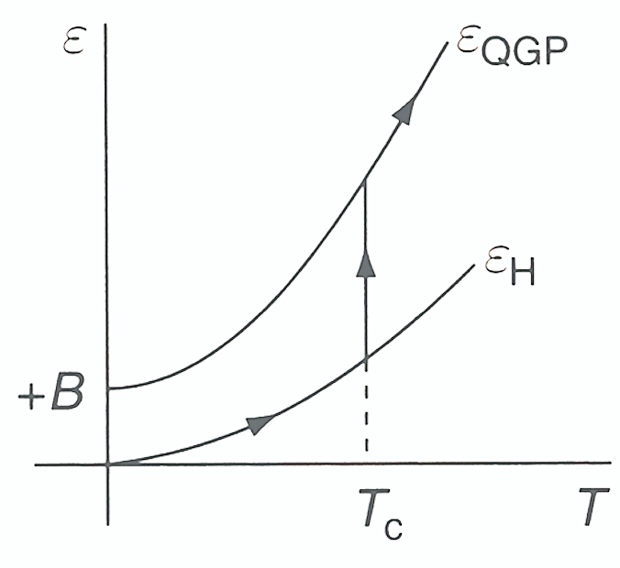
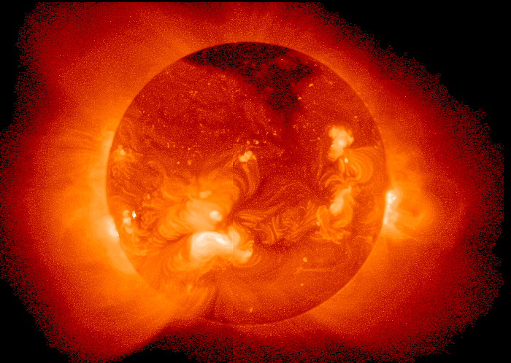
Phase transition in Lattice QCD
T_{c} ≈ 156 +/- 9 MeV
Steep rise in thermodynamic quantities due to change in number of degrees of freedom → phase transition from hadronic to partonic degrees of freedom.
[PRD 90 094503 (2014)]
Energy density ε
Pressure p
Entropy density s
Smooth crossover for a system with net-baryon content equal 0. For a first order phase transition, the behavior would be not continuous.
For comparison:
T=156 MeV ≙ 1.8∙10¹² K
Sun core: 1.5 ∙ 10⁷ K
Sun surface: 5778 K

Slide 7
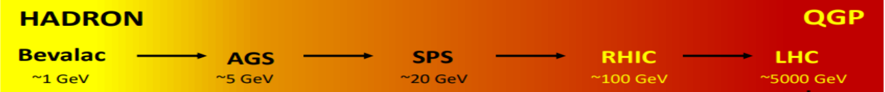
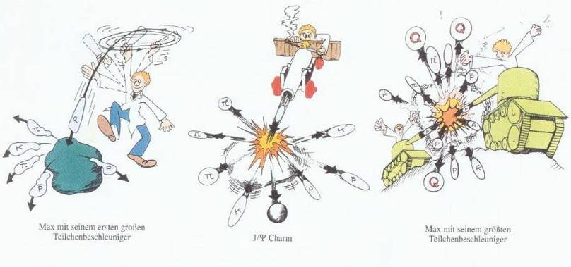
Increasing the beam energy over the last decades…
..from early fixed target experiments at GSI/Bevalac/JINR and SPS to collider experiments at RHIC and LHC.
Brookhaven → RHIC √s_{NN}~3-200 GeV (BES)
CERN → LHC √s_{NN} = 5.02 TeV
SPS, CERN,√s_{NN}~6-20 GeV
SIS, GSI Darmstadt,√s_{NN}~2.4 GeV

Slide 8
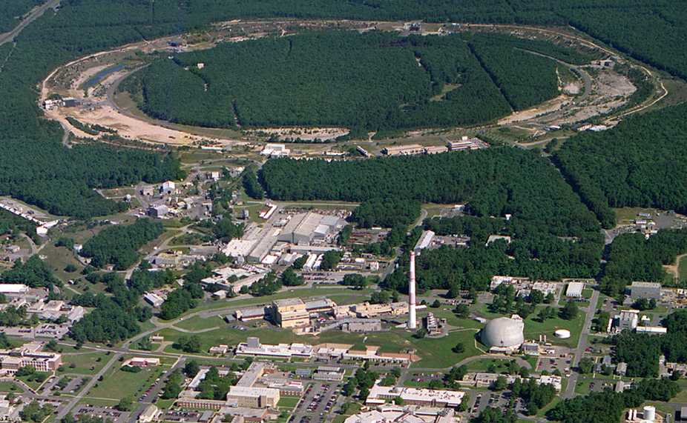

2005: Quark-Gluon Plasma is a “perfect liquid”
Relativistic Heavy-Ion Collider (BNL), Upton, NY (USA)
PHOBOS
BRAHMS
RHIC
PHENIX
STAR
v = 0.99995⋅c = 186,000 miles/sec
Au + Au at 200 GeV
AGS
TANDEMS

Slide 9
The good QCD matter probes should be:
vacuum
Well understood in “p+p collisions”
hadronic
matter
Affected by hadronic matter,
in a well understood way,
which can be accounted for
QGP
Strongly affected by the dense and
deconfined QCD medium...

Slide 10
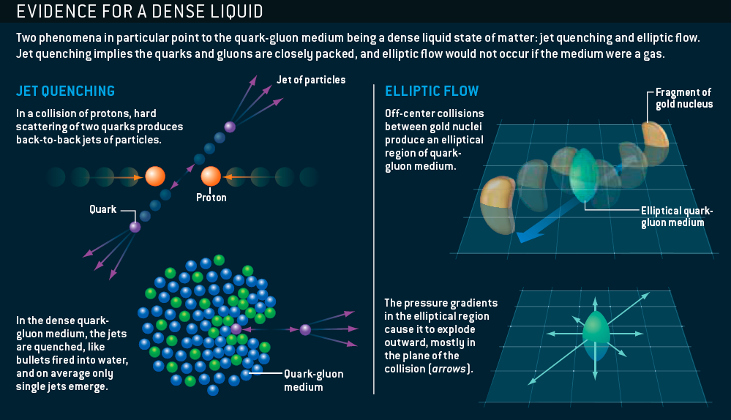
The sQGP Discovered at RHIC: 2005
M. Roirdan and W. Zajc,
Scientific American, May 2006

Slide 11
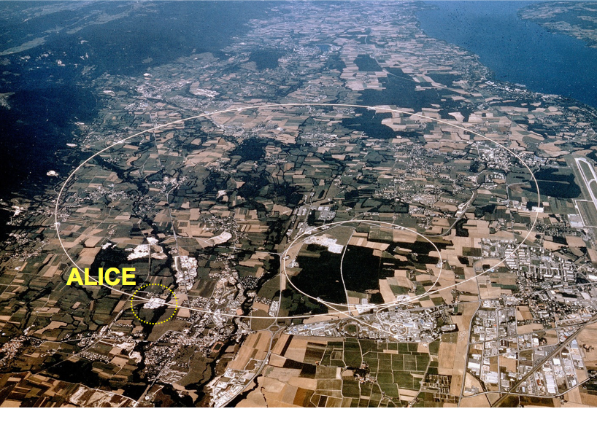
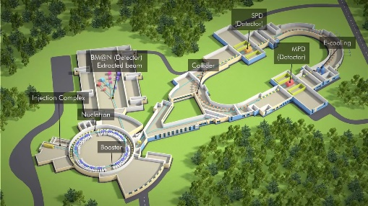
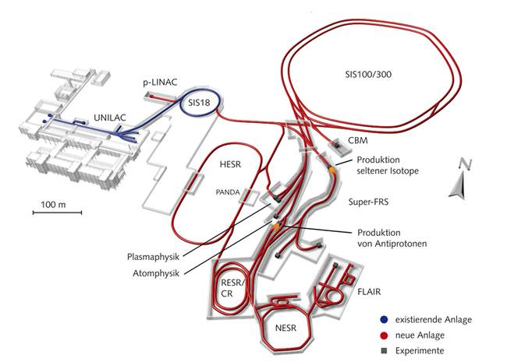
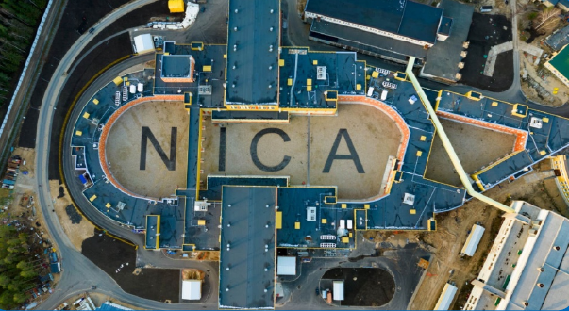
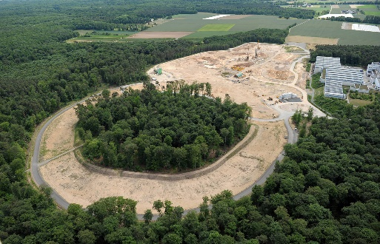
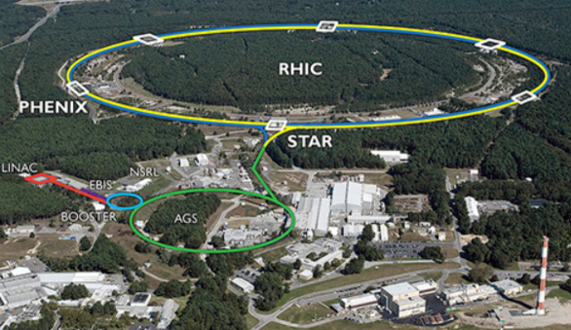
Relativistic Heavy-Ion Experiments
Low energy frontier: RHIC (BES), SPS
→ future facilities: FAIR (GSI), NICA
High energy frontier: LHC
CMS
NA-61
LHCb
FAIR
ATLAS
→ By now all major LHC experiments have a heavy-ion program: LHCb took Pb-Pb data for the first time in November 2015.
RHIC

Slide 12
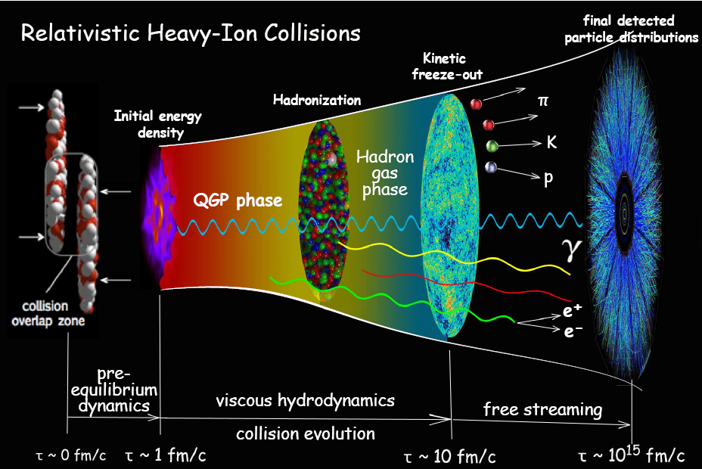
Evolution of the system created in RHIC
Fireball is ~10⁻¹⁵ meters across and lives for 5*10⁻²³ seconds
Initial state
QGP as a relativistic
fluid
Pre-equilibrium
dynamics
Hadronization
Transport/Freezeout
~400 nucleons in 10⁻²² seconds = 1000-30000 hadrons

Slide 13
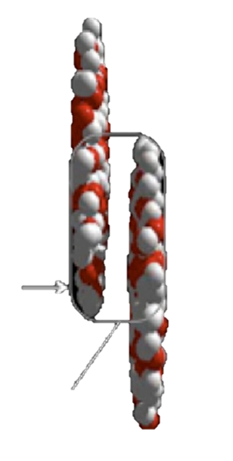
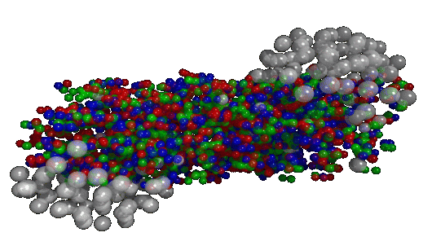
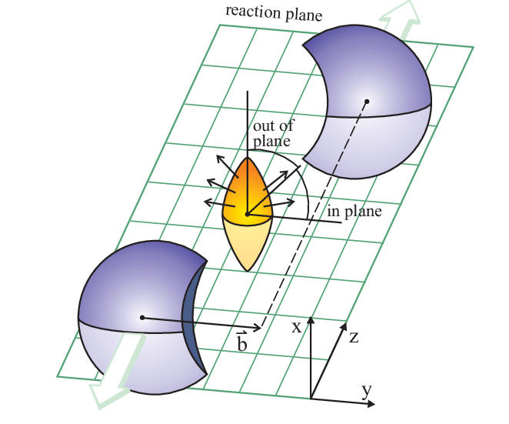
Characterising a heavy-ion collision
We can control a posteriori the geometry of the collision by selecting in centrality.
Centrality = fraction of the total hadronic cross section of a nucleus-nucleus collision, typically expressed in percentile, and related to the impact parameter (b)
spectators
b
Z- beam axis
Collision overlap zone
participants
𝜑 - Ψ_{RP}

Slide 14
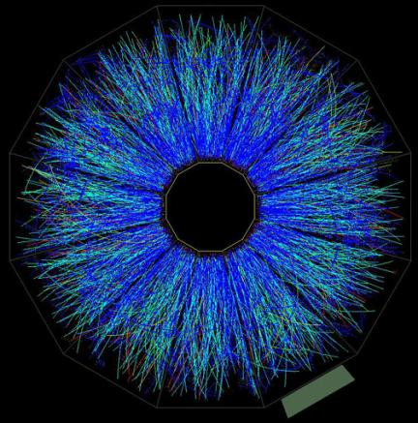
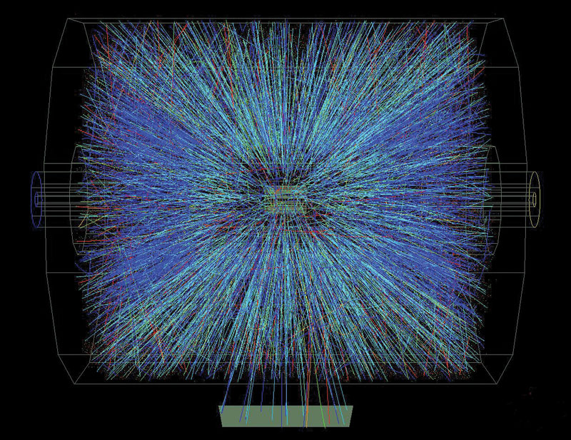
Definition of kinematical variables
Momentum , azimuthal angle φ and pseudo-rapidity (η) of the emitted particles
y
θ
φ
x
z
φ
η
p_{T} is generated in the collision (while p_{z} is already present “before the collision”)

Slide 15
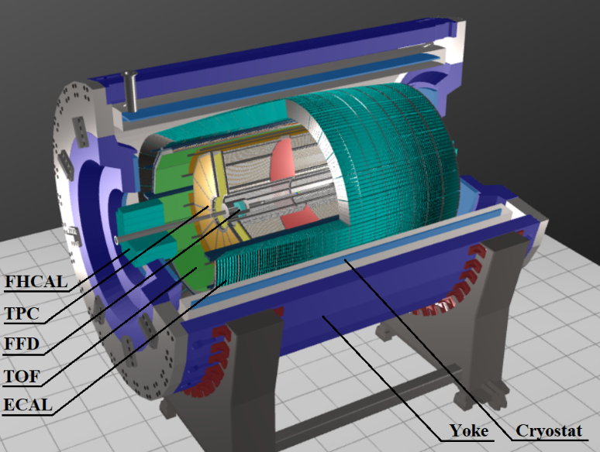
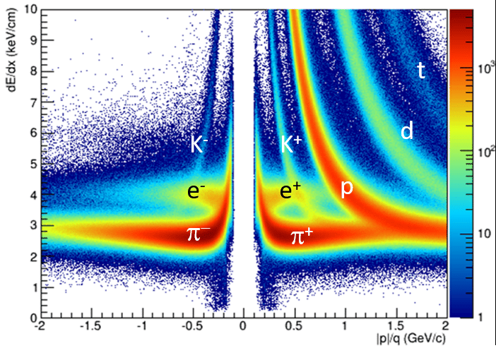
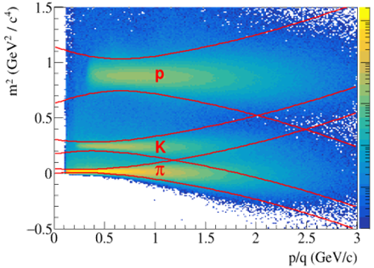
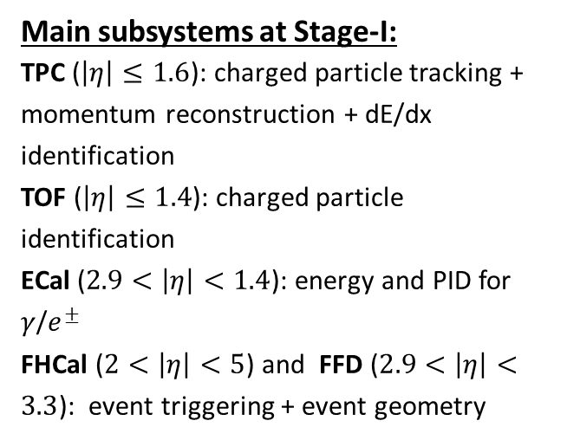
MPD experiment at NICA
Main subsystems at Stage-I:
TPC ($\left|η\right|≤1.6$): charged particle tracking + momentum reconstruction + dE/dx identification
TOF ($\left|η\right|≤1.4$): charged particle identification
ECal ($2.9<\left|η\right|<1.4$): energy and PID for $γ$/$e^{±}$
FHCal ($2<\left|η\right|<5$) and FFD ($2.9<\left|η\right|<3.3$): event triggering + event geometry

Slide 16
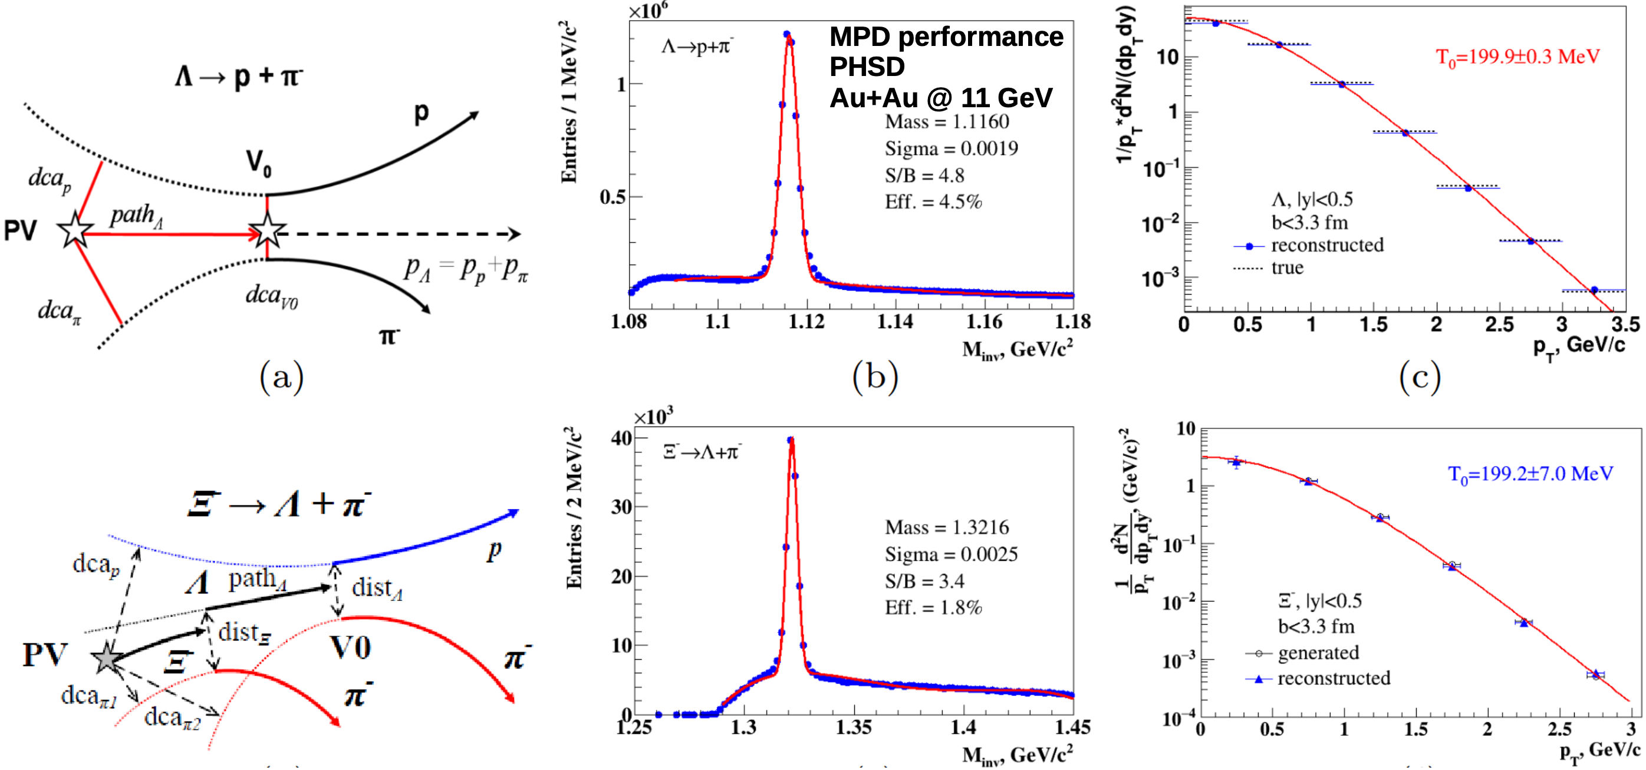
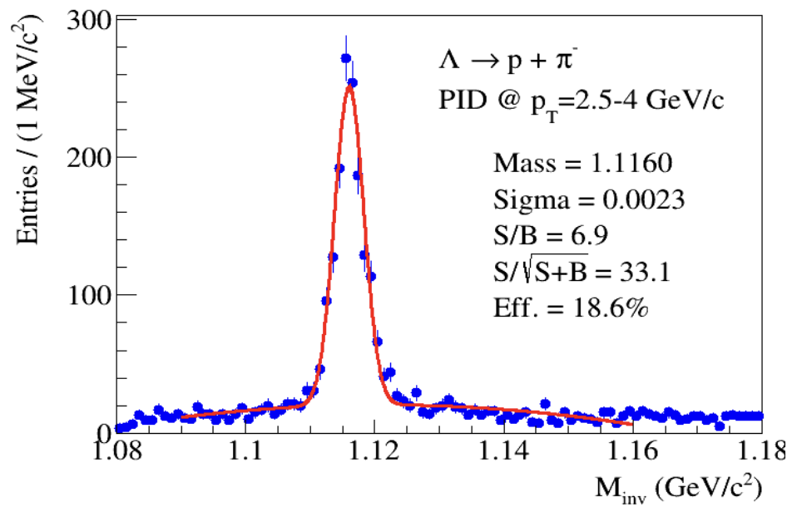
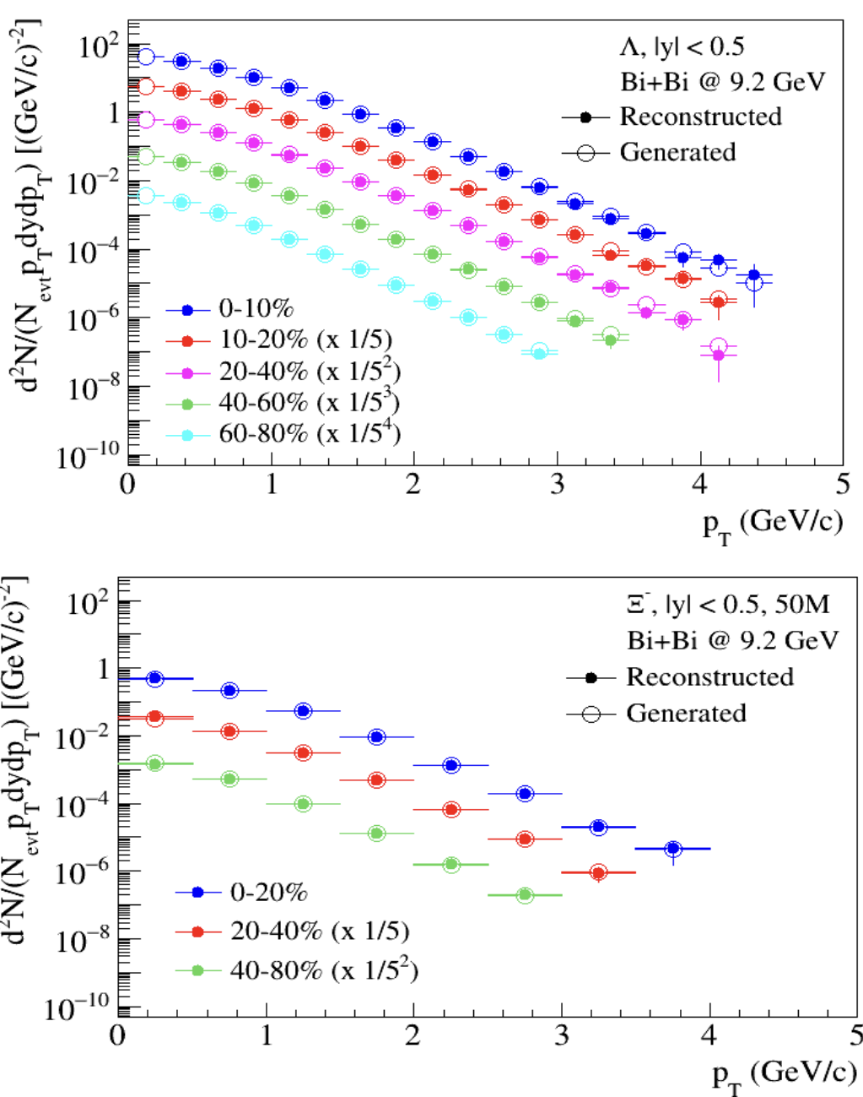

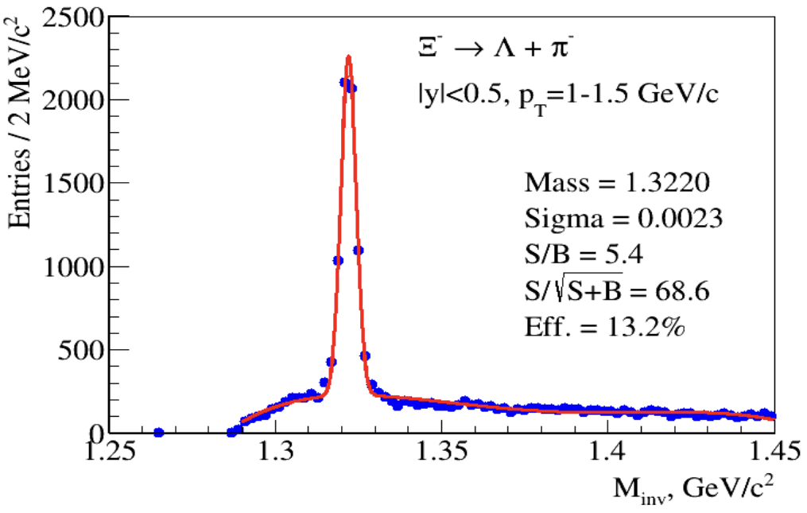
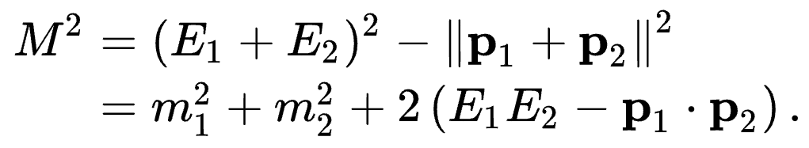
PID via Topology and Invariant Mass

Slide 17
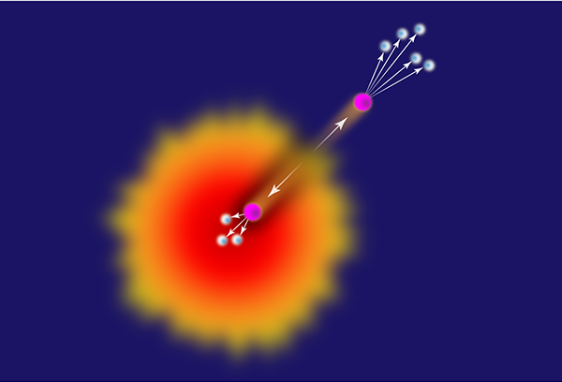
Jet quenching
medium is opaque
Jet quenching

Slide 18
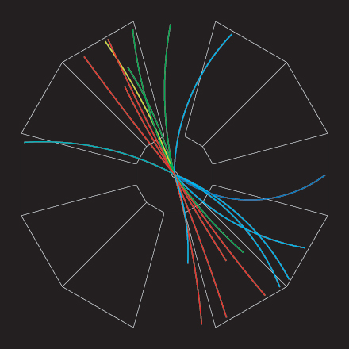
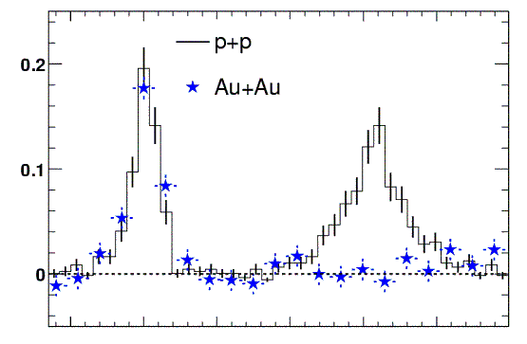
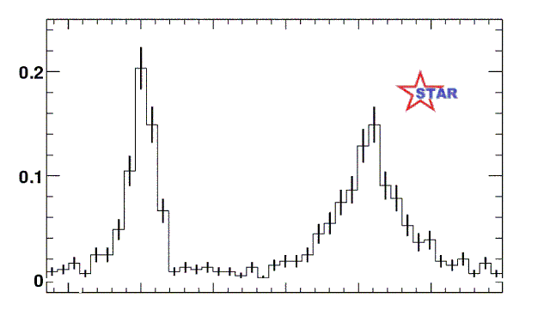
RHIC Experiment: “Jet quenching”
proton-proton jet event
Analyze by measuring (azimuthal) angle between pairs of particles
Number of pairs
0º
180º
Angle between high energy particles
In Au-Au collisions we see only one “jet” at a time !
How can this happen ?
Jet quenching!
q
q

Slide 19
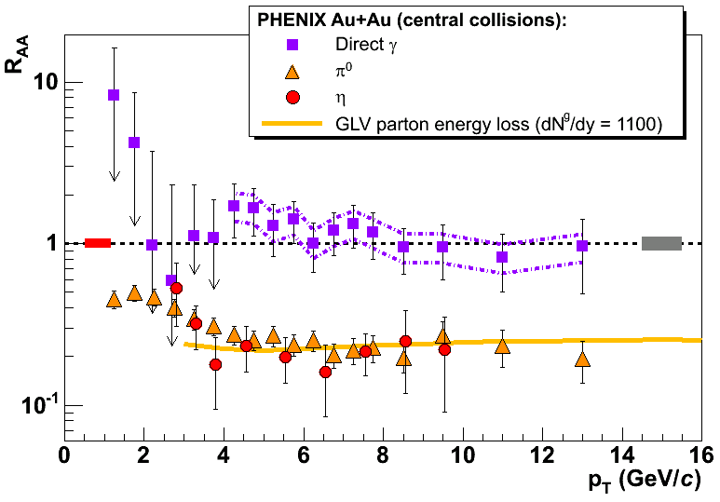
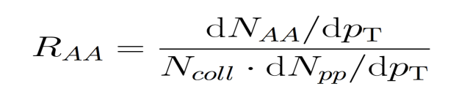
The nuclear modification factor: R_{AA}
If R_{AA}< 1 at high p_{T}
→ the medium is opaque to the passage of partons
→ parton-medium final state interactions, energy loss, modification of fragmentation in the medium
R_{AA} = 1 at high p_{T}
→ the medium is transparent to the passage of partons
reference process
photons
The meson yield in central Au-Au is 5 times lower than expected from
pp collisions
the direct photons are not affected by the dense medium

Slide 20
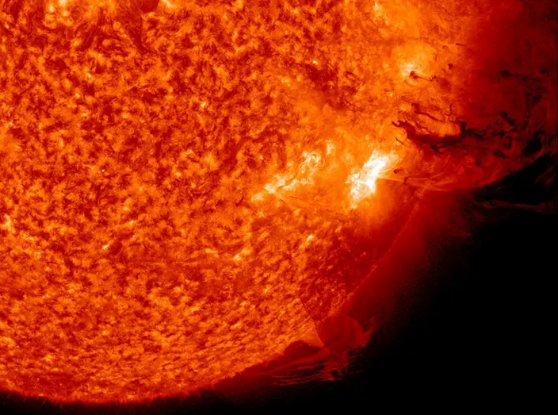
Medium is hot
Hundreds of thousands of times hotter than the Sun !
Image credit : NASA
Notes:
4 (RHIC) and 5.5 (LHC) Trillion degrees Celsius (250k (RHIC) 300 k (LHC) times hotter than the core of sun)

Slide 21
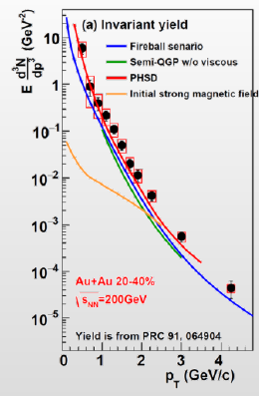
Thermal photons in A+A collisions
PoS CPOD 2017 079 (2018)
Measure the spectrum of thermal photons (non-interacting) emitted from the source.
The spectrum will display the average temperature over the full lifetime of the partonic source.
Determining the initial temperature requires modeling.
p_{T} slope ⇒ Temperature
PHENIX: T = 221±19±19 MeV
Critical condition for QGP satisfied.

Slide 22
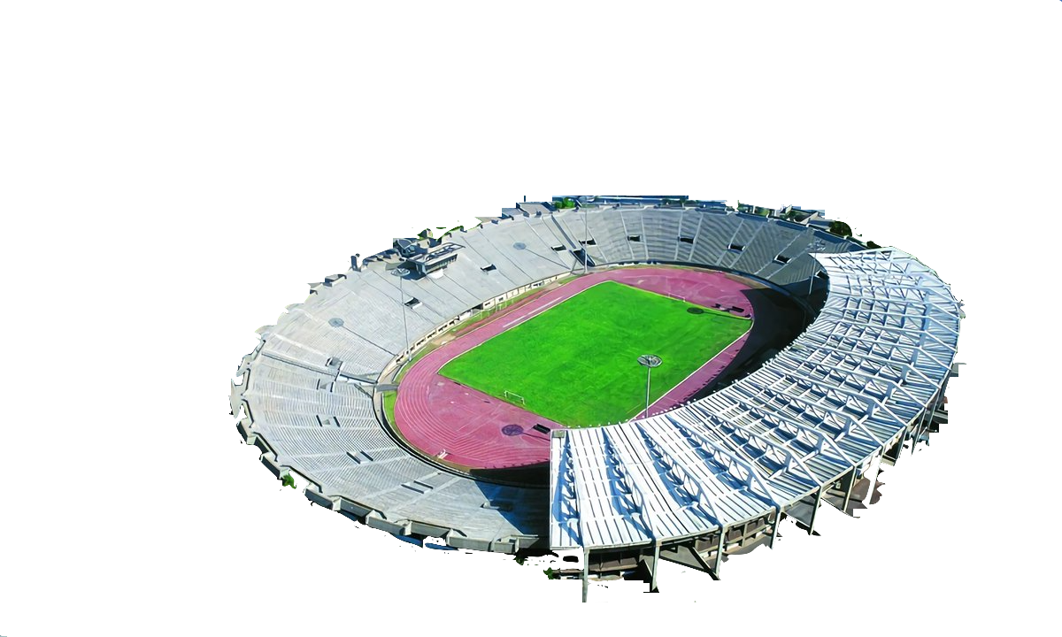

Medium is dense
Pack the entire Earth inside a stadium !

Slide 23


Energy Density
Critical condition for QGP satisfied.

Slide 24
Chemical and Thermal Equilibrium?
Particle yields freeze
STAR, NPA 757 102 (2005)
Particle ratios described very well by statistical model assuming thermal and chemical equilibrium

Slide 25


Chemical freeze-out temperature - LHC
Nature volume 561, pages 321–330 (2018)
Production of (most) light-flavour hadrons (and anti-nuclei) is described (χ²/ndf ~ 2) by thermal models with a single chemical freeze-out temperature, T_{ch} ≈ 156 MeV
→ Approaches the critical temperature roof from lattice QCD: limiting temperature for hadrons!
→ the success of the model in fitting yields over 10 orders of magnitude supports the picture of a system in local thermodynamical equilibrium

Slide 26

It’s perfect liquid
Lowest viscosity possible !
Image credit : SmileTemplates

Slide 27



Azimuthal distributions at RHIC
b ≈ 6.5 fm
b ≈ 4 fm
“central” collisions
STAR, PRL90 032301 (2003)
midcentral collisions

Slide 28

2005 - Elliptic Flow at RHIC
Z
Reaction plane
Y
X
P_{y}
P_{z}
The initial spatial anisotropy evolves (via interactions and density gradients ) →
Momentum-space anisotropy
P_{x}

Slide 29


Elliptic Flow: ultra-cold Fermi-Gas
Li-atoms released from an optical (laser) trap exhibit elliptic flow analogous to what is observed in ultra-relativistic heavy-ion collisions
Interaction strength among the atoms can be tuned with an exteranl magnetic field (Feshbach res)
Elliptic flow is a general feature of strongly interacting systems?

Slide 30


Perfect Liquid at RHIC
Hydrodynamic
STAR
PHOBOS
RQMD
R. Lacey , A. Taranenko, PRL 98 092301 (2007)
Shear Viscosity – resistance to deformation, flow
Data approaching Hydro for central collisions
viscosity extracted close to the lowest value set by quantum limit.

Slide 31

Elliptic Flow at RHIC/SPS

Slide 32






Bjoern Schenke
Hydrodynamic simulation (SONIC from Paul Romatschke) run with
η/s = 0.08 ~ 1/4π and ζ/s = 0.01

Slide 33







Anisotropic Flow at RHIC-LHC
Gale, Jeon, et al., Phys. Rev. Lett. 110, 012302
Phys. Rev. Lett. 122 (2019) 172301

Slide 34

It’s partons unchained?
Partonic degree of freedom at work ?
Image credit : BNL

Slide 35





Anisotropic Flow at RHIC – partonic?
= m_{T} – m
n=2 for mesons and
n=3 for baryons
R. Lacey , A. Taranenko
PoS 2006 (2006) 021

Slide 36

It’s swirling fast
Most vortical fluid !
Image credit : BNL

Slide 37


QGP Under Rotation
Nuclear
fragments
Quark-gluon
plasma
Reaction Plane
Nuclear
fragments
B$\sim {10}^{18} Gauss$
$$L \sim {10}^{3}−{10}^{7}ℏ$$

Slide 38





Λ Global Polarization
$$P_{∧}≈\frac{1}{2}\frac{ω}{T}+\frac{μ_{∧}B}{T}$$
$$P_{\overline{∧}}≈\frac{1}{2}\frac{ω}{T}−\frac{μ_{∧}B}{T}$$
$$ω=\left(P_{∧}+P_{\overline{∧}}\right)k_{B}T/ℏ∼{10}^{22}s^{−1}$$
RHIC : ω ~ 10²² s⁻¹
Most vortical fluid !
STAR, Nature 548 62 (2017)

Slide 39


Slide 40







System size scan at top RHIC energy ($\sqrt{s_{NN}}$= 200 GeV)
Au+Au
200 GeV
2001-2005
Ψ₀
Ψ₀
2005-2011
2011-2012
40

Slide 41



2011-2016
Nucleon substructure matters
2020-2022
41

Slide 42

42

Slide 43



43

Slide 44


Relativistic Heavy-Ion Collisions and QCD Phase Diagram

Slide 45

45

Slide 46

STAR BES-I and BES-II Data Sets

Slide 47



Beam Energy Dependence of Elliptic Flow (v₂)
Strong energy dependence of v₂ at √s_{NN} = 3-11 GeV
  v₂≈0 at √s_{NN} = 3.3 GeV and negative below

Slide 48


Beam Energy Dependence of Elliptic Flow (v₂)
Passage time: 2R/(β_{cm}γ_{cm})
Expansion time: R/c_{s} c_{s}=c√dp/dε - speed of sound

Slide 49


$v_{1,2}\left(y\right)$in Au+Au $\sqrt{s_{NN}}$=3 GeV: models vs. STAR data
A. Sorensen et. al., Prog.Part.Nucl.Phys. 134 (2024) 104080
Model description of $v_{n}$:
Good overall agreement for $v_{n}$ of protons
$v_{n}$ of light nuclei is not described
$v_{n}$ of 𝛬 is not well described
  nucleon-hyperon and hyperon-hyperon interactions
Light mesons (𝜋,K) are not described
  No mean-field for mesons
Models have a huge room for improvement in terms of describing $v_{n}$

Slide 50







EOS for high baryon density matter
The binding energy per nucleon:
Isospin asymmetry:
Symmetric matter
Symmetry energy
A. Sorensen et. al., Prog.Part.Nucl.Phys. 134 (2024) 104080
New data is needed to further constrain transport models with hadronic d.o.f.

Slide 51





Sensitivity of the collective flow to the EOS
P. Danielewicz, R. Lacey, W.G. Lynch, Science 298 (2002) 1592
Mean field usually can be defined using Skyrme potential with:
$$U\left(n_{B}\right)=A\left(\frac{n_{B}}{n_{0}}\right)+B{\left(\frac{n_{B}}{n_{0}}\right)}^{τ}$$
Discrepancy in the interpretation:
$v_{1}$ suggests soft EoS
$v_{2}$ suggests hard EoS
New measurements using new data and modern analysis techniques will address this discrepancy
More detailed model study should be done to address $n_{B}$-dependence of incompressibility $K_{0}$
MPD-FXT
BM@N
MPD
MPD-FXT
BM@N
MPD
Soft EOS
Hard EOS
$$v_{2}≡\left\langle \cos\left(2\left(φ−Ψ_{RP}\right)\right)\right\rangle$$
Additional measurements are essential to clarify the previous measurements

Slide 52

dv₁/dy|_{y=0} for protons vs. collision energy
Xe + CsI,
E_{kin} = 3.8 AGeV
Slope of v₁ is in good agreement with the world data
See Mikhail Mamaev talk at AYSS2024

Slide 53
MPD physics program
G. Feofilov, P. Parfenov
V. Kolesnikov, Xianglei Zhu
K. Mikhailov, A. Taranenko
Global observables
Total event multiplicity
Total event energy
Centrality determination
Total cross-section measurement
Event plane measurement at all rapidities
Spectator measurement
Spectra of light flavor and hypernuclei
Light flavor spectra
Hyperons and hypernuclei
Total particle yields and yield ratios
Kinematic and chemical properties of the event
Mapping QCD Phase Diag.
Correlations and Fluctuations
Collective flow for hadrons
Vorticity, Λ polarization
E-by-E fluctuation of
multiplicity, momentum and
conserved quantities
Femtoscopy
Forward-Backward corr.
Jet-like correlations
D. Peresunko, Chi Yang
Wangmei Zha, A. Zinchenko
Electromagnetic probes
Electromagnetic calorimeter meas.
Photons in ECAL and central barrel
Low mass dilepton spectra in-medium modification of resonances and intermediate mass region
Heavy flavor
Study of open charm production
Charmonium with ECAL and central barrel
Charmed meson through secondary vertices in ITS and HF electrons
Explore production at charm threshold

Slide 54

High-energy heavy-ion reaction data
Galactic Cosmic Rays composed of nuclei (protons, … up to Fe) and E/A up to 50 GeV
These high-energy particles create cascades of hundreds of secondary, etc. particles
Cosmic rays are a serious concern to astronauts, electronics, and spacecraft.
The damage is proportional to Z², therefore the component due to ions is important
Damage from secondary production of p, d, t, ³He, and ⁴He is also significant
Need input information for transport codes for shielding applications (Geant-4, Fluka, PHITS, etc.):
  total, elastic/reaction cross section
  particle multiplicities and coellecense parameters
  outgoing particle distributions: d²N/dEdΩ
Notes:
54
54
54
54

Slide 55



High energy heavy ion reaction data
NICA can deliver different ion beam species and energies:
  Targets of interest (C = astronaut, Si = electronics, Al = spacecraft) + He, C, O, Si, Fe, etc.
No data exist for projectile energies > 3 GeV/n
dE/dx vs momentum in TPC
m² vs. momentum in TOF
MPD has excellent light fragment identification capabilities in a wide rapidity range → unique capability of the MPD in the NICA energy range
Notes:
55
55
55
55

Slide 56

Summary
NICA open unique opportunities for the exploration of the properties of dense nuclear matter. Complementary energy range, large discovery potential.
Preparation of the MPD detector and experimental program is ongoing, all activities are continued
All components of the MPD 1-st stage detector are in advanced state of production
Commissioning of the MPD Stage-I detector is expected in 2025-2026
BM@N first physics run with Xe+CsI - finished – good data
Further program will be driven by the physics demands and NICA capabilities

Slide 57




Optimal collision energy for realizing high baryon-density matter
H. Taya, A. Jinno, M. Kitazawa, Y. Nara https://arxiv.org/abs/2409.07685
Dense region disappears more quickly for larger $\sqrt{s_{NN}}$
$\sqrt{s_{NN}}$dependence of the maximum volume max[V3] (solid) and the lifetime τ (dashed)
The optimal energy is around $\sqrt{s_{NN}}$=3−5 GeV, where a baryon density ρ/$ρ_{0}$ = 3 nuclear density is realized with a substantially large space-time volume. Higher and lower energies are disfavored due to short lifetime and low density

Slide 58


Multi-Purpose Detector (MPD) Collaboration
MPD International Collaboration was established in 2018
to construct, commission and operate the detector
10 Countries, >450 participants, 31 Institutes and JINR
Organization
Acting Spokesperson: Victor Riabov
Deputy Spokesperson: Zebo Tang
Institutional Board Chair: Alejandro Ayala
Project Manager: Slava Golovatyuk
Joint Institute for Nuclear Research;
AANL, Yerevan, Armenia;
University of Plovdiv, Bulgaria;
Tsinghua University, Beijing, China;
USTC, Hefei, China;
Huzhou University, Huizhou, China;
Institute of Nuclear and Applied Physics, CAS, Shanghai, China;
Central China Normal University, China;
Shandong University, Shandong, China;
IHEP, Beijing, China;
University of South China, China;
Three Gorges University, China;
Institute of Modern Physics of CAS, Lanzhou, China;
Tbilisi State University, Tbilisi, Georgia;
FCFM-BUAP (Heber Zepeda) Puebla, Mexico;
FC-UCOL (Maria Elena Tejeda), Colima, Mexico;
FCFM-UAS (Isabel Dominguez), Culiacán, Mexico;
ICN-UNAM (Alejandro Ayala), Mexico City, Mexico;
Institute of Applied Physics, Chisinev, Moldova;
Institute of Physics and Technology, Mongolia;
Belgorod National Research University, Russia;
INR RAS, Moscow, Russia;
MEPhI, Moscow, Russia;
Moscow Institute of Science and Technology, Russia;
North Osetian State University, Russia;
NRC Kurchatov Institute, ITEP, Russia;
Kurchatov Institute, Moscow, Russia;
St. Petersburg State University, Russia;
SINP, Moscow, Russia;
PNPI, Gatchina, Russia;
Vinča Institute of Nuclear Sciences, Serbia;
Pavol Jozef Šafárik University, Košice, Slovakia

