Slide 1
The International Workshop on “Problems of the Modern
Mathematical Physics – PMMP’25, Dubna, 2025.02.10-14
Interior Dynamics of Hairy Black Holes
Rong-Gen Cai
Institute of Theoretical Physics
Chinese Academy of Sciences
Ningbo University
Refs: RGC, L.Li and R.Q. Yang, arXiv: 2009.05520; JHEP 03 (2021) 263
RGC, C. Ge, L.Li and R.Q. Yang, arXiv:2112.04206; JHEP 02 (2022) 139
R.Q. Yang, L. Li and RGC, arXiv: 2104.03012; CQG 39 (2022) 035005
RGC, M. N. Duan, L. Li and F.G. Yang, arXiv:2312.11131, JHEP 02(2024)169
RGC, M. N. Duan, L. Li and F.G. Yang, arXiv:2408. 06122

Slide 2
1、Introduction: Black hole is one of predictions of GR
Oct 6, 2020

Slide 3
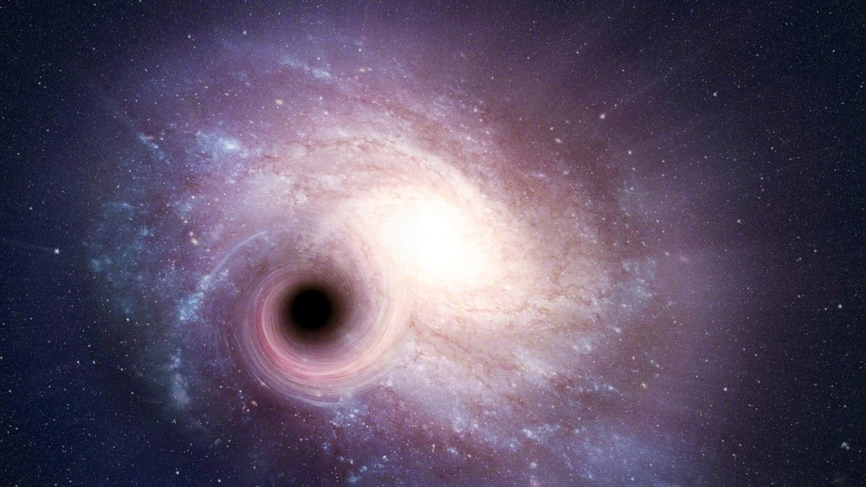
Questions:
“The discoveries of this year’s Laureates have broken new ground in the study of compact and supermassive objects. But these exotic objects still pose many questions that beg for answers and motivate future research. Not only questions about their inner structure, but also questions about how to test our theory of gravity under the extreme conditions in the immediate vicinity of a black hole”, says David Haviland, chair of the Nobel Committee for Physics in 2020.

Slide 4
Uniqueness theorem (no hair theorem) of BH in GR:
The most general stationary black hole in Einstein-Maxwell Theory is Kerr-Newman black hole, which is described by three parameters: M, J and Q .
Behind the event horizon, there is a spacelike singularity
for Schwarzschild black hole.
On the other hand, for Reissner-Nordstrom, Kerr, Kerr-
Newman black holes, there is a timelike singularity and
a Cauchy (inner) horizon behind the event horizon.

Slide 5
Some questions arise naturally:
1) The observed black holes are the ones predicted by GR?
2) The singularity inside black holes is a generic feature?
if yes, spacelike, nulllike, or timelike?
3) Cauchy horizon is stable or unstable? its fate?
mass inflation, A. Ori (1991)
back reaction of quantum fields
This talk will focus on the internal structure of black holes
with various hairs.

Slide 6
Outline:
No inner horizon theorem for charged black hole with
scalar hairs
No inner horizon theorem
Singularity
Hyperbolic black hole with inner horizon
2. Towards classifying the interior dynamics of charged
black holes with scalar hair
3. The case for black hole with vector hair
4. The number of black hole horizons with energy condition
5. Conclusions

Slide 7
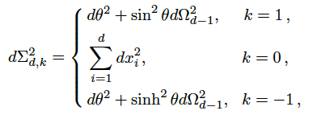
1. No inner horizon theorem for charged black hole with scalar
The model: we consider a (d+2)-dimensional gravity theory
coupled with a Maxwell field and a charged scalar field:
The black hole solution ansatz:

Slide 8
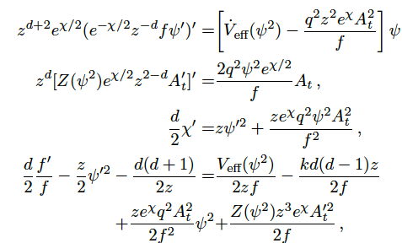
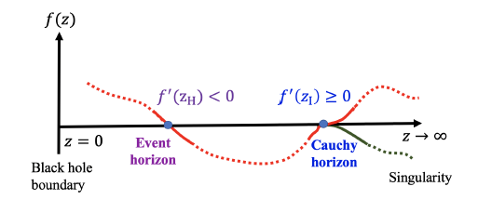
The equations of motion:

Slide 9
The key observation: the existence of the conserved quantity
Namely,
Let us evaluate this quantity both at two horizons

Slide 10
(1) When k=0 or k=1: the lhs <0, while the rhs >=0;
(2) When k=-1, the both sides have the same sign:
counter partner exists, see later. But there only exists
at most one inner horizon with non zero surface gravity.

Slide 11
The proof is as follows:
The horizon z_I must be a single root, otherwise we must
have f”(z_I) <=0
This is not consistent with Q’(z)=0! Thus z_i should be a
single root with f’(z_I) >0.
(ii) Suppose there exists a second inner horizon z_II

Slide 12
The lhs is positive, while the rhs is negative, therefore the
second inner horizon is impossible.

Slide 13
Singularity
For simplicity, consider Z=1 and the kinetic term of the scalar
field dominates. In that case, the potential can be neglected.
In that case,
The charge approaches to a constant at the singularity，
Namely, the spacelike singularity must be charged.

Slide 14
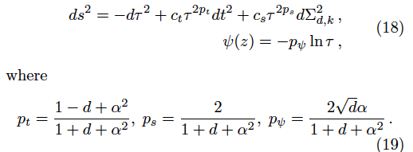
Introduce the proper time
We have
The metric has a (generalized) Kasner form!

Slide 15
In the above, the following constraint must be obeyed:
which allows the potential V to be arbitrary algebraic function,
including polynomial function, for example, V= m^2 \phi^2.
Some examples: we define
Note that for Kasner geometry, they are constants when

Slide 16
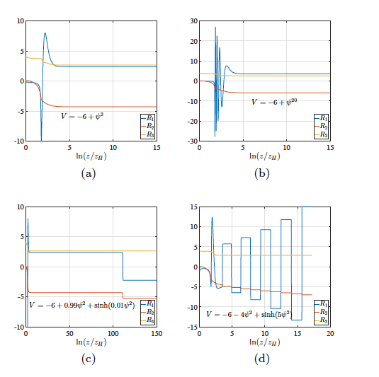

Slide 17
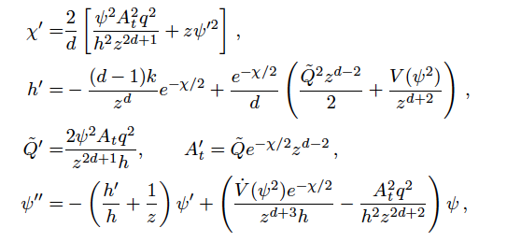
Hyperbolic black hole with inner horizon
Consider a model in four dimensions:
The equations of motion:

Slide 18
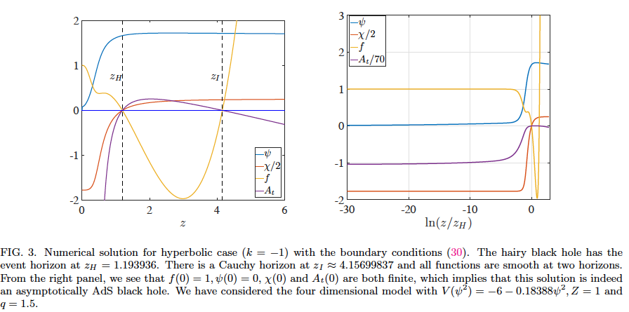
Take the parameter and initial conditions:

Slide 19
Further discussions:
No scalar-haired Cauchy horizon theorem in Einstein- Maxwell-Horndeski theories
by D. Devecioglu and Mu-In Park ( arXiv: 2101.10116)
No Cauchy horizon theorem for nonlinear electrodynamics black holes with charged scalar hairs by Y. S. An et al, arXiv: 2106.01069【 for the hyperbolic horizon case, the Cauchy horizon is ruled out by NED.
Black hole singularity across phase transitions by Y. Liu et al, 2108.04554
Inside an asymptotically flat hairy black hole by O. Dias et al, 2110.06225
Kasner geometries inside holographic superconductors by L. Sword and D. Vegh,2112.14177
The final kasner regime inside black holes with scalar or vector hairs by M. Henneaux, 2202.04155
Interior of helical black holes by Y. Liu and H. Lyu, 2205.14803
AdS black holes with a bouncing interior by S. Hartnoll, 2209.12999
Insights and guidelines on the Cauchy horizon theorem by X.Y. Chew et al, 2308.09225
Internal structure of hairy rotating black holes in three dimensions, L. L. Gao et al,
2310.15781……..
Vector hair, tensor hair?
Gravity theories with high curvature terms (e.g., GB theory)?....

Slide 20
2. Classifying the interior dynamics of black holes with scalar
The setup
The hairy black hole solution takes the form:
denotes the line element of unit sphere (k=1),
planar (k=0) or hyperbolic sphere (k=-1) in d-1 dim

Slide 21
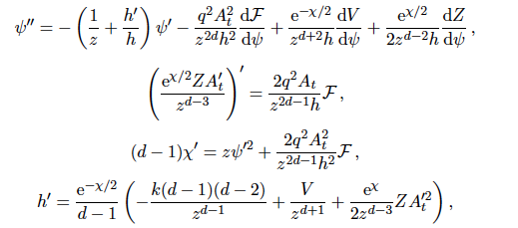
We take theta=0 without loss generality, then
In this coordinate, the boundary is at z=0, while the singularity would be
at z-> infinity. And the associated thermodynamics
Note that

Slide 22
Kasner Epoch:
In this case, the contributions from F and V are negligible. At large z limit
One has the solution:

Slide 23
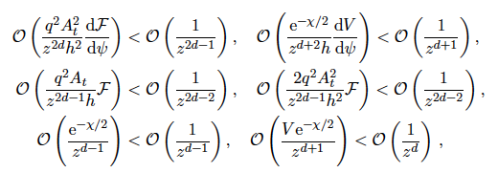
Introducing the proper time:
The (generalized)
Kasner geometry
These constants are all determined by alpha, called Kasner exponent. It is
easy to check that the solution makes sense if
this allows V and F to be arbitrary
algebraic functions, including
polynomial functions. Namely once
these conditions are obeyed, the
neglected terms in EOMs will not
change the solutions.

Slide 24
Kasner Inversion:
Once the above assumption is invalid, the solution will become unstable.
A particularly simple case is triggered by the h’/h term. Interestingly,
this alternation caused by the non-integrability of h’ will make itself come
back to be integrable and will enter a new stable Kasner epoch. This is
called Kasner Inversion.
Inside the event horizon, one has h<0, while
To have a stable Kasner epoch down to the singularity, the integral
of h’ should be finite, otherwise the new dynamics will come into play.
The breakdown of the integrability of h’:

Slide 25
In this case, the background becomes unstable and the term h’/h cannot
be dropped. Then the dynamics is determined by the equations
Here h’ is determined by the kinetic term of the gauge field.
Take the form:

Slide 26
The two exponent alpha for the Kasner epoch before and after the Kasner
inversion are the roots:
These two roots obey
Here alpha is the one before the inversion,
while alpha_I is the one after the inversion
Suppose there is a Kasner epoch with
There will be a new Kasner epoch with

Slide 27
Kasner Transition:
When one considers the coupling function F with an exponential form
The background solution will be destroyed and a new Kasner
transformation process will appear.
One can see when
The term with dF/d$ψ$ cannot be dropped. In this case, one has

Slide 28
One has the transformation law for the Kasner transition
Suppose there is a Kasner epoch with
This transformation law shows that the Kasner transition
process will decrease the amplitude of alpha until the
condition is destroyed.
In addition, the transformation not only depends on the
dimension, but also the parameter kappa.

Slide 29
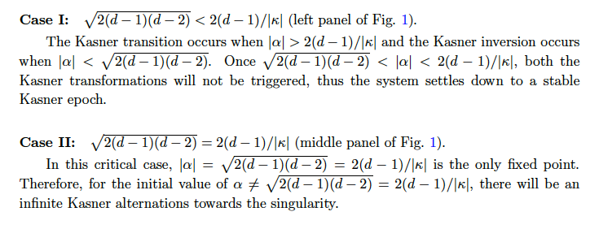
Classification of Kasner Alternation:
As we have seen that the Kasner transition causes alpha to decreases
while the Kasner inversion makes alpha increase. When these two
processes are triggered alternately, it could lead to an infinite chaotic
oscillation of Kasner epochs.

Slide 30
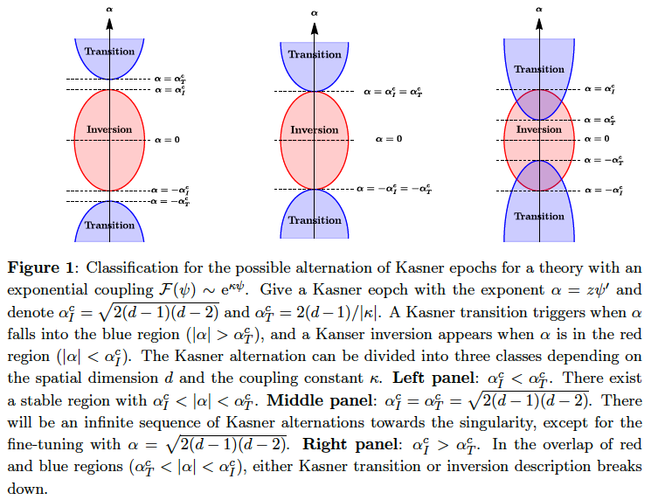

Slide 31
Numerical verification:
Consider a 5-dimensional model:
At the AdS boundary:
Kasner inversion:
Kasner transition:
here “+ ”for positive alpha
while“ – ”for negative alpha

Slide 32
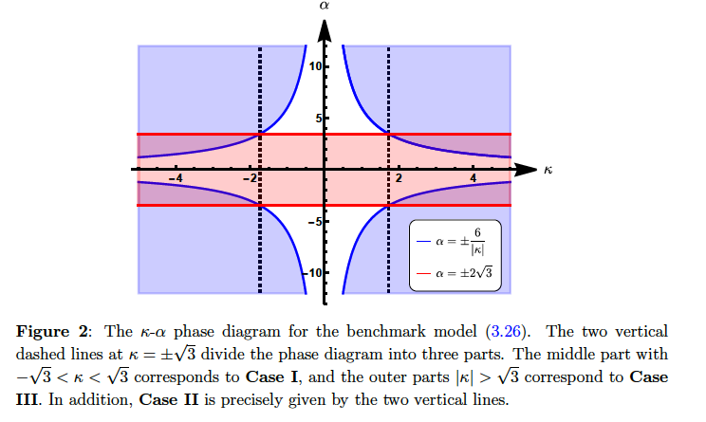

Slide 33
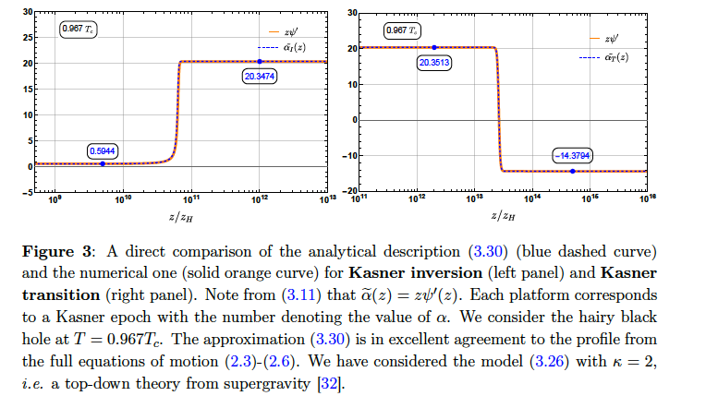
1) The case of （ ）
Note that there is an overlapping region:
Outside the overlapping region, the alternation between adjacent
Kasner epochs is described by the transformation laws. Inside the
overlapping region, however…

Slide 34
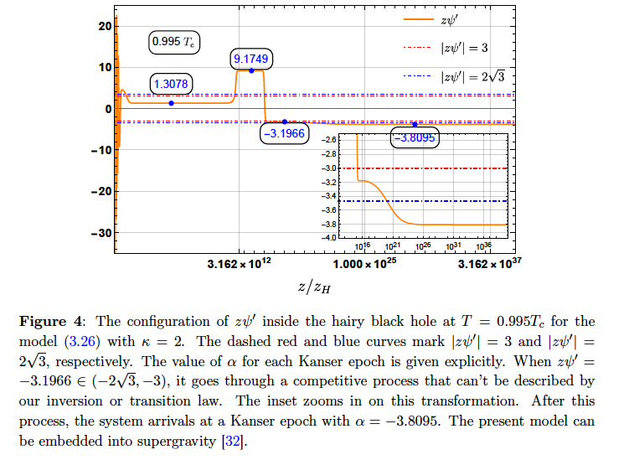
Here is the case for T=0.995T_c. After the ER collapse and scalar
oscillation, one has a Kasner epoch with alpha=1.3078, then after a Kasner inversion and a transition, the resulting epoch has alpha=-3.1966
which is within the overlapping region:： .

Slide 35
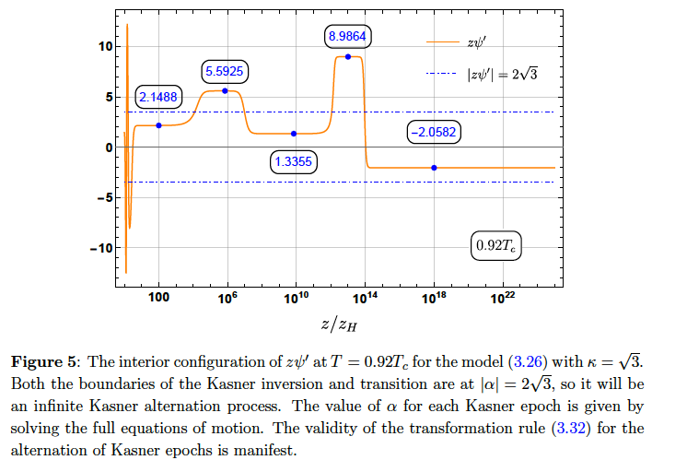
2） The case of : （belongs to Case II）
There will be generically a never-ending chaotic alternation of Kasner
epochs towards the singularity.
KI
KT

Slide 36
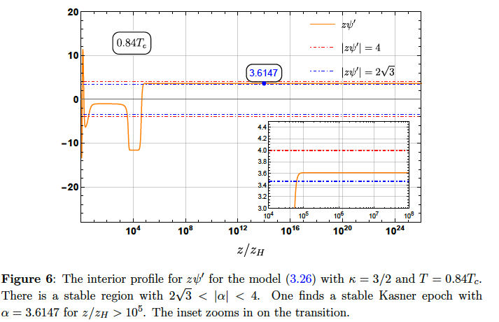
3) The case of : （belongs to Case I）
In this case there exists a stable region:
Once a Kasner epoch falls into this region, it will stay at this Kasner
epoch towards the singularity：After a Kasner transition around z/z_H=
10^5, the system jumps to a Kasner epoch with alpha=3.6147 within the
stable region.

Slide 37
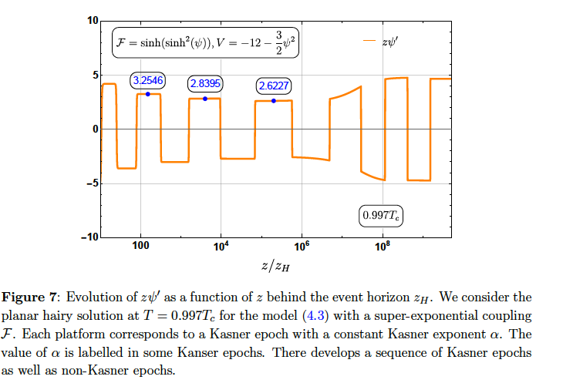
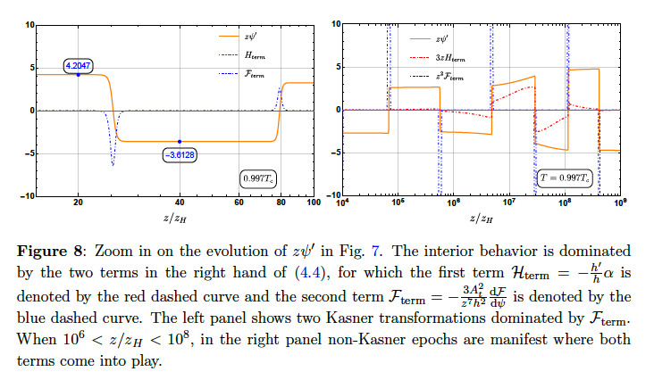
The case with general coupling F, while V neglected
Consider a 5-dimensional model with

Slide 38
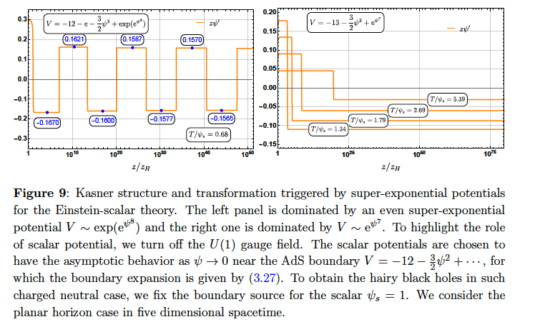
The case with general potential V
When the scalar potential dominates

Slide 39
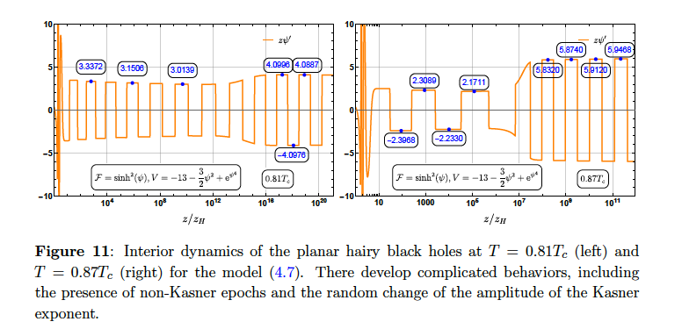
The case with both F and V

Slide 40
3、Inside anisotropic black holes with vector hairs
The model we are considering:
(R. G. Cai et al, arXiv:1309.4877, a holographic p-wave model)
The ansatz for metric and matter field:
Here β (r) can be set to zero as a gauge choice.

Slide 41
The effective action:
The key observation: there is a scaling symmetry
There is an associated conserved charge:

Slide 42
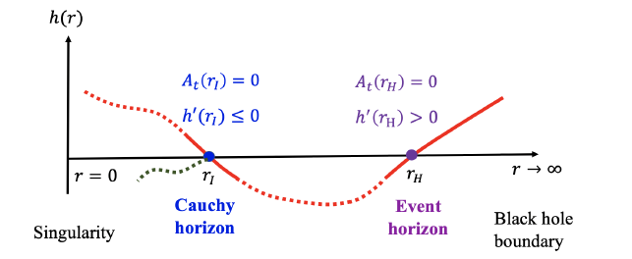
No Cauchy horizon:
No solution
No inner horizon

Slide 43
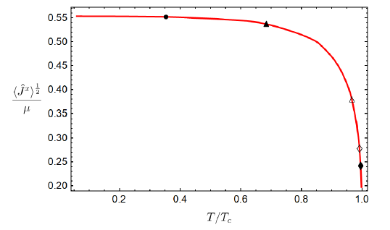
Anisotropic black hole: p-wave superconductor
Near z=0:

Slide 44
Dynamical epochs inside: Anisotropic Kasner cosmology
In this coordinate, the AdS boundary is at z=0,while the
singularity is assumed at z=\infty. Near the singularity,
one has (neglecting the contribution of matter fields)
The solution:

Slide 46
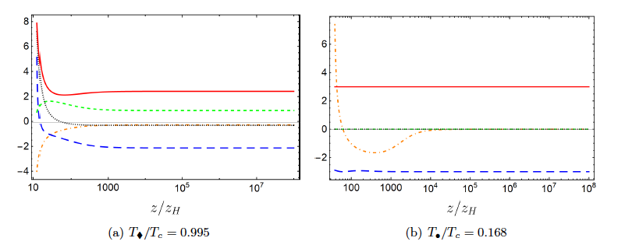
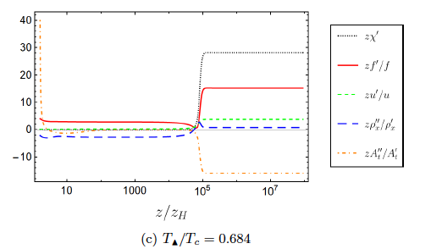
Numeric examples with

Slide 47
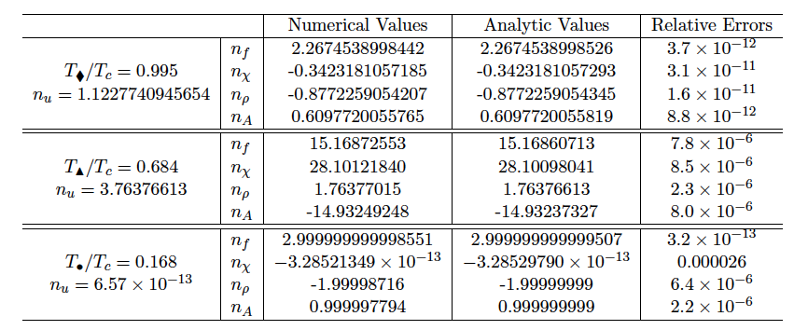
Analytic and numeric comparison:

Slide 48
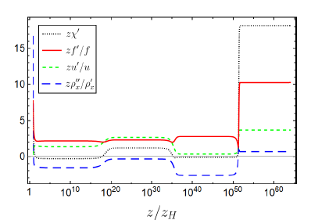
M. Henneaux,
arXiv: 2202.04155
Kanser alternation and flipping of powers
We find that the interior geometry near singularity does not
experience only one Kasner epoch, but several ones as
z-> \infty, and one has:
Numerical values:

Slide 49
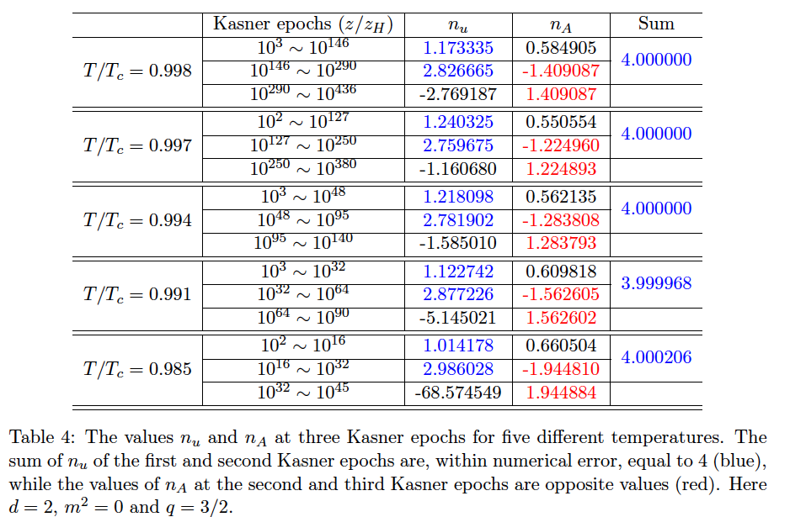
Five more examples:

Slide 50
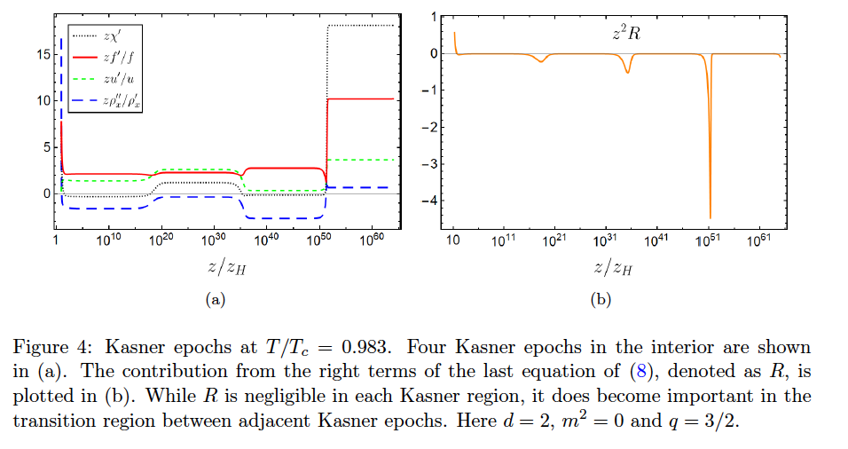
Never-ending Kasner alternations:

Slide 51
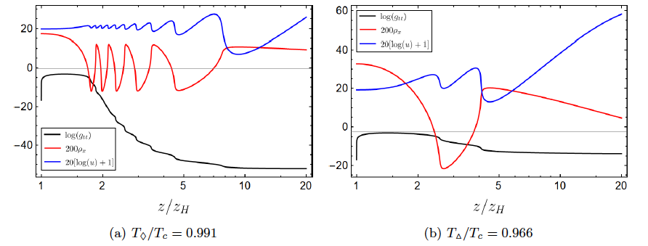
Collapse of ER bridge and Josephson oscillations:
When T is above T_c, the solution is the RN-AdS black hole,
when T is slightly less than T_c, the Cauchy horizon will
disappear. The geometry near the would-be inner horizon:
The anisotropic factor u(z) also oscillates with a half period of the vector condensate. When T decreases, the non-linear dynamics become less dramatic.

Slide 52
Further considerations: No Cauchy horizon
(1) The case one:
(2) The case two:

Slide 53
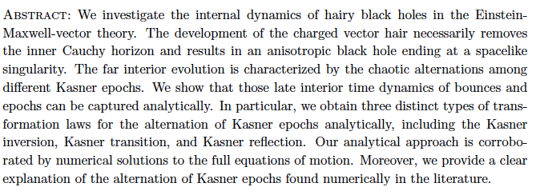
Clarifying Kasner dynamics inside anisotropic black hole with
vector hair
2408.06122

Slide 54
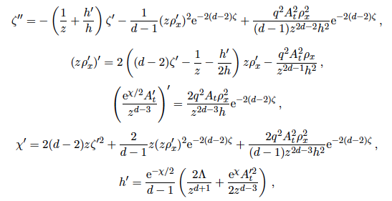
The model:
The ansatz:
The equations of motion:

Slide 55
The Kasner solution:

Slide 56
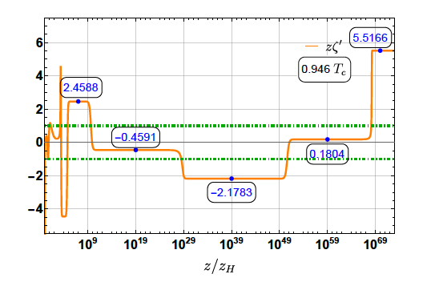
The Laws of Kasner Transformation:
d=3
KT
KI

Slide 57
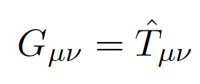
5. Constraining the number of horizons with energy condition
Einstein’s equation in (d + 1)dimensional spacetime
In the classical level the matter should satisfy some constraints named “energy conditions” which crudely describe properties common to all (or almost all) states of matter that are well-established in physics but are sufficiently strong to rule out many unphysical “solutions” of the Einstein’s equation.
The original singularity theorems of Penrose and Hawking were proved for matter obeying the null energy condition (NEC) or strong energy condition (SEC), respectively.

Slide 58
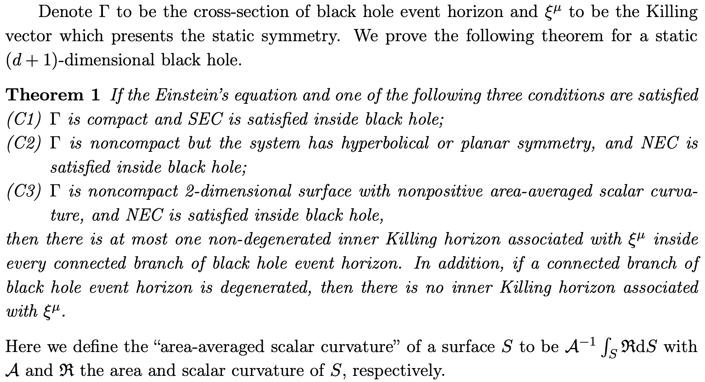
4. Constraining the number of horizons with energy condition
arXiv: 2104.03012 [gr-qc]

Slide 59
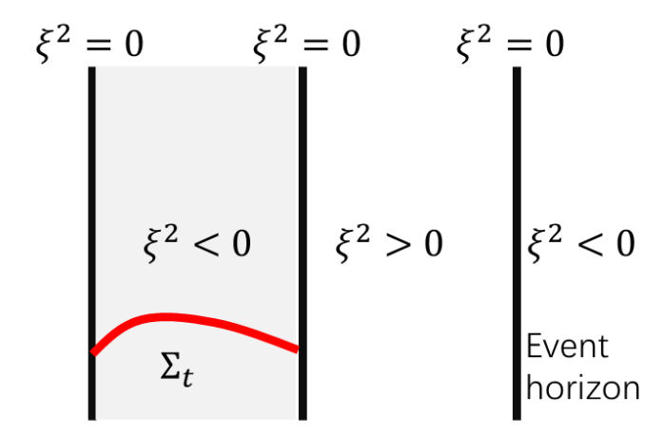
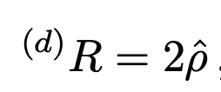
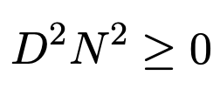
Proof of C1:
Assume that behind the event horizon there is an connected spacetime
region V inside which the Killing vector \xi is timelike
Einstein’s equation:
SEC:
Maximum Principle: the maximum of N^2 must be at the boundaries:
which is contradictory to the assumption that \xi is timelike !

Slide 60
For the stationary case:
In an axisymmetric stationary spacetime, there are two linear
independent Killing vectors, is timelike outside EH, and
a spacelike vector field, , representing the rotating symmetry.
On the EH:

Slide 61
Let us assume that: (A) there are more than two inner Killing
horizons when EH is nongenerated, or (B) there is an inner
Killing horizon when the EH is degenerated. Then there must
be a spacetime region V, where the N^2>0 inside V and N=0 at
One can make an ADM decomposition on the spacetime V
by a series of equal-t surface denoted by The induced metric
Then the Hamiltonian constraint
and the momentum constraint:

Slide 62
On the other hand,
due to stationary, the evolution equation of extrinsic curvature
and induced metric read
With the equations of motion, we are able to show

Slide 63
Then we see that inside , with the SED,

Slide 64
5. Conclusions
We establish a no inner-horizon theorem for black holes with charged scalar hair.
The hairy black holes approach a spacelike singularity at late interior time, independent of the form of scalar potentials and the asymptotic boundary of spacetimes.
The geometry near the singularity takes a universal Kasner form when the kinetic term of the scalar hair dominates, while novel behaviors different from Kasner form are uncovered when the scalar potential becomes important to the background.
All these features are also valid for the Einstein gravity coupled with neutral scalars.
No Cauchy horizon for (charged) black holes with vector hairs, including GB case. Some
Interesting features appear inside the black holes, for example, never-ending Kasner epochs.
We try a classification of the interior structure of black holes with scalar hairs, and the
transformation laws for Kasner inversion and Kasner transition are presented.
With quite general conditions, we find that the number of horizons is highly constrained by energy conditions of matter.

Slide 65
thanks!

