Slide 1
NATIONAL UNIVERSITY OF SCIENCE AND TECHNOLOGY MISIS
for
SPD Collaboration (JINR, Dubna)
17/10/2024

Slide 2
NATIONAL UNIVERSITY OF SCIENCE AND TECHNOLOGY MISIS
NUST MISIS is leading university in the field of materials science, materials engineering and technologies.
~ 15 000 students
9 Colleges:
College of Technologies !
College of Advanced Materials !
College of Economics & Management
College of Computer Sciences !
College of Mining
College of Basic Professional Studies
College of Biomedical Engineering
College of Physics and Quantum Engineering !
College of Lifelong Learning

Slide 3
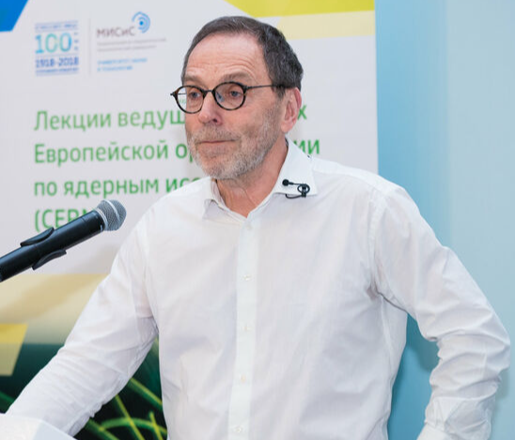
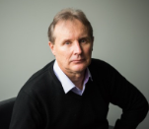
NATIONAL UNIVERSITY OF SCIENCE AND TECHNOLOGY MISIS
Since 2014, NUST MISIS has been participating in the research at the Large Hadron Collider in the SHiP and LHCb experiments.
The center of MegaScience was created to join the researchers from different groups to develop promising technologies and materials for the MegaScience experiments.
https://misis.ru/university/struktura-universiteta/centre/95/
More than 30 employees are involved in the project.
Scientific supervisor - Andrey Golutvin
Director of the center for MegaScience – Mikhail Dubinin
As part of the Priority 2030 program, it is implementing a research program: “New technologies and engineering solutions for large installations and service systems”
This is the fifth year that the educational program has been conducted jointly with CERN (more than 100 students)"New solutions for searching for new physics“
Several PhD students with strong physics background were taken to the center after graduating the program.

Slide 4
NATIONAL UNIVERSITY OF SCIENCE AND TECHNOLOGY MISIS
Since 2014, NUST MISIS has been participating in the research at the Large Hadron Collider in the SHiP and LHCb experiments.
Since 2021, NUST MISIS has been participating SND@LHC collaboration.
SHIP collaboration – 14 people
Tasks: Magnetic systems, Calorimeter, Simulation (GEANT4), Neutrino emulsion detectors.
LHCb collaboration – 24 people
Tasks: Calorimeter, Simulation (GEANT4), Radiation hard detectors, Sensors for UTI treackers, Data analysis.
SND@LHC collaboration – 2 people
Tasks: Emulsion detectors, Data analysis.

Slide 5
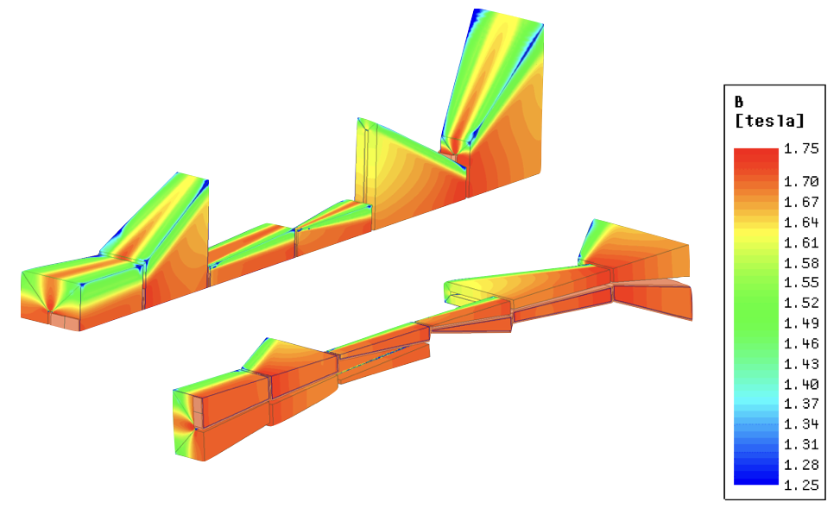
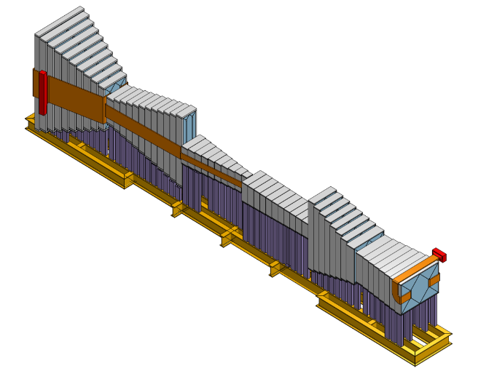
SHIP collaboration
Magnetic muon shield
The prototype with 4 welded joints has been successfully produced using EBW technology. Magnetic properties of the prototype reveal just small degradation of the magnetic properties. The properties particularly recovered after a heat treatment.
Coil parameters of all the sections have been calculated. The parameters seems to be realistic.
The conception of assembly of whole the construction and supporting structures has been proposed.
Magnetic field map has been calculated using developed simulation model for highly anisotropic materials
Design & Construction
Magnetic fields calculations

Slide 6
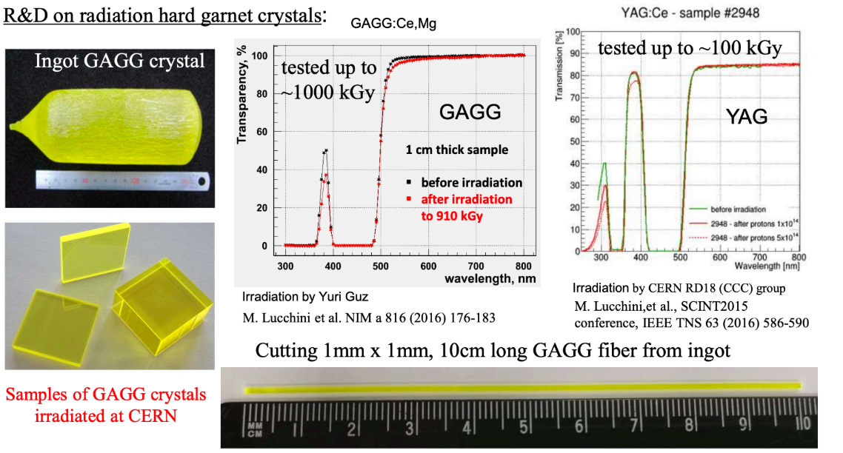
LHCb collaboration
Modeling the energy resolution of the spaghetti type calorimeter (GEANT4).
Study of light collection inhomogeneity for different photomultiplier geometries, assessment of the influence of light collection inhomogeneity on the energy resolution of the calorimeter(GEANT4)
Optimization of absorber material, contribution from lead additives to improvemechanical characteristics of the alloy
Manufacturing of a prototype absorber by casting
General module design
Modeling of residual activity of various materials under Run4 and Run5 conditions(ActiWiz)
Development of equipment for modernization of SHASHLIK-type modules - replacement of fibers and replacing scintillation plates
Infrastructure issues: preparation for installation of modules in the LHCb shaft

Slide 7
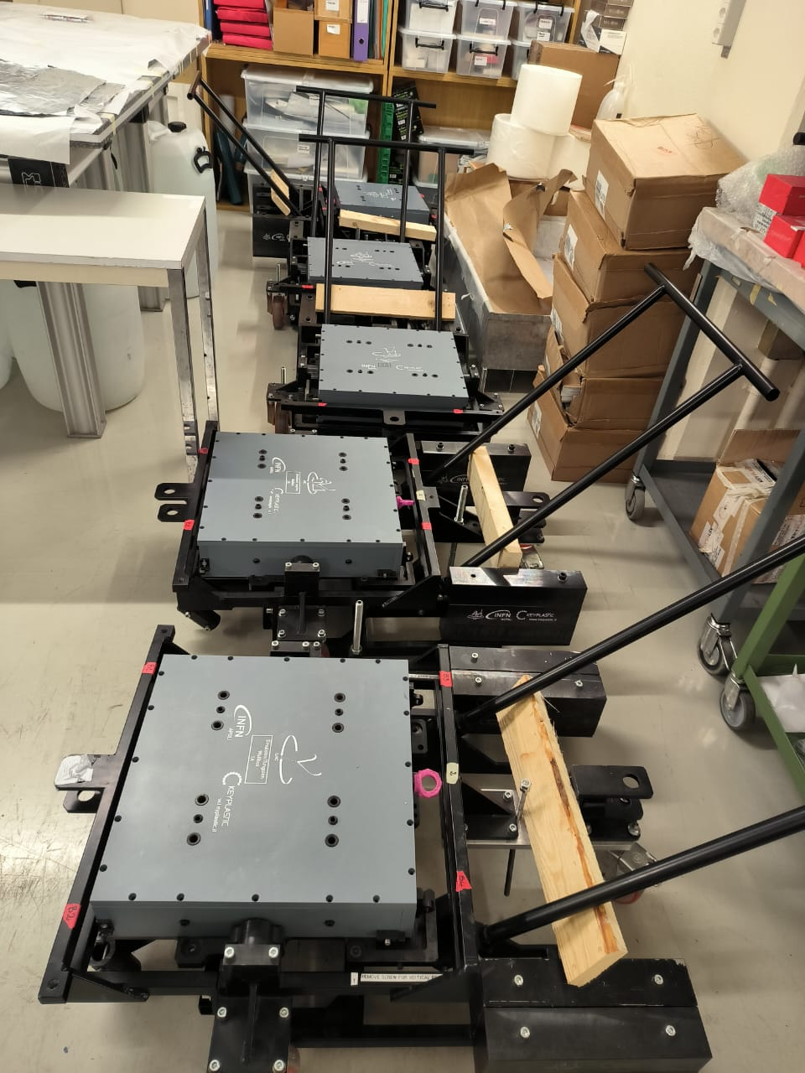
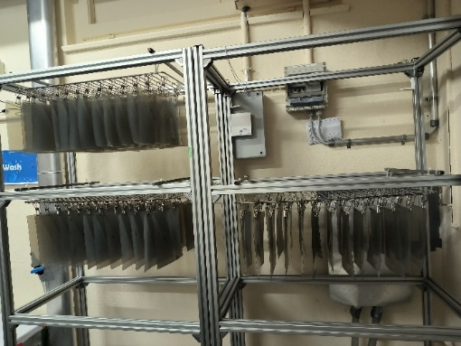
SND@LHC collaboration
Emulsion detectors development
Data analisys

Slide 8
MISIS team for SPD collaboration (JINR, Dubna)
Proposed team from NUST“MISIS” at SPD (NICA) JINR, Dubna
For engineering tasks:
Gorshenkov Mikhail Vladimirovich, Ph.D., senior researcher (Team Leader)
Dergachev Pavel Andreevich, Ph.D., leading expert
Shmanin Evgeniy Vladimirovich, Ph.D., senior researcher
Fortuna Anastasia Sergeevna, Postgraduate student
Vazhinsky Nikita Mikhailovich, Master student
Nechaev Konstantin Sergeevich, Master student

Slide 9
For physical tasks:
At the MISIS there is a group, which participates in physics analysis groups of the LHCb and SHiP experiments at CERN.
It consists of physicists, students and PhD students, graduated from, in particularly, MSU and MIPT.
At the moment, there is a discussion with PNPI, Gatchina group concerning common research on simulations for production of exotic multiquark hadronic resonances for SPD setup.
Proposed team for SPD collaboration:
Anna Anokhina, PhD, senior researcher
Vasilisa Guliyeva, PhD student
… PhD students with strong physical background

Slide 10
Engineering tasks for SPD collaboration
Calculation of a magnetic field map in complex electromagnetic systems, taking into account nonlinear and anisotropic materials
Verification calculations of the stress-strain state of electromagnetic systems and associated structures
Calculation of the thermal state of structural elements and systems taking into account convective heat transfer
Development of technical specifications, programs and methods for input and output control of elements of electromagnetic and associated systems
Control tests of witness samples for the manufacture of electromagnetic systems and associated structures

