Slide 1
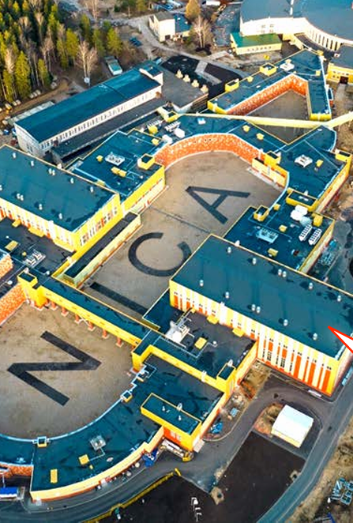
IX SPD collaboration meeting
Yerevan 2025
(12-16 may)

Slide 2
VISA information
https://www.mfa.am/en/visa/

Slide 3
Currency exchange information
Information about the current exchange rate in exchange points and banks in Armenia is always available here:
Daily exchange rates, Banks - Rate.am
VTB Armenia ATMs Serve MIR Cards
and you can get it directly in AMD (Armenian Dram)

Slide 4
Hotel recommendations
Olympia Garden Hotel Erevan, 64 Barbusse st. (2.5 km)
Hotel Orbeli, 65/2 Maeshal Baghramyan ave. (3.6 km)
Blur Inn Gallery, 11 Barbusse st. (3.2 km)
Deluxe hotel, 32/1 Komitas Ave. (4 km)
Hotel Grig, 47 Maeshal Baghramyan ave. (3.9 km)
Ani Plaza Hotel, 19 Sayat-Nova Ave. (6.3 km)
ibis Yerevan, 5/1 Northern Ave. (6.5 km)
AYGESTAN PLAZA, 65/1 Mikhail Chailakhyan (7.6 km)
Ani Grand Hotel, 65 Hanrapetutyan st. (6.8 km)

Slide 5
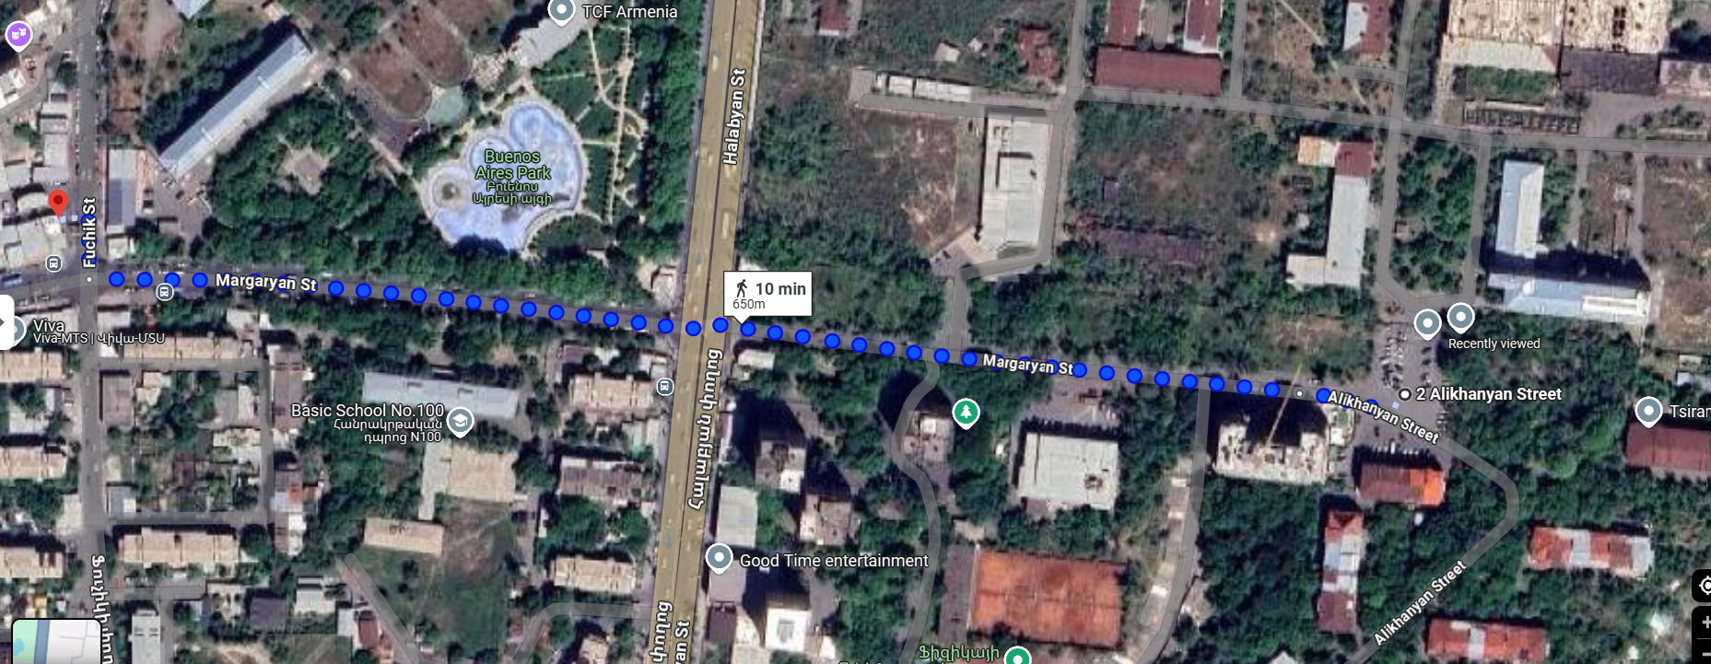
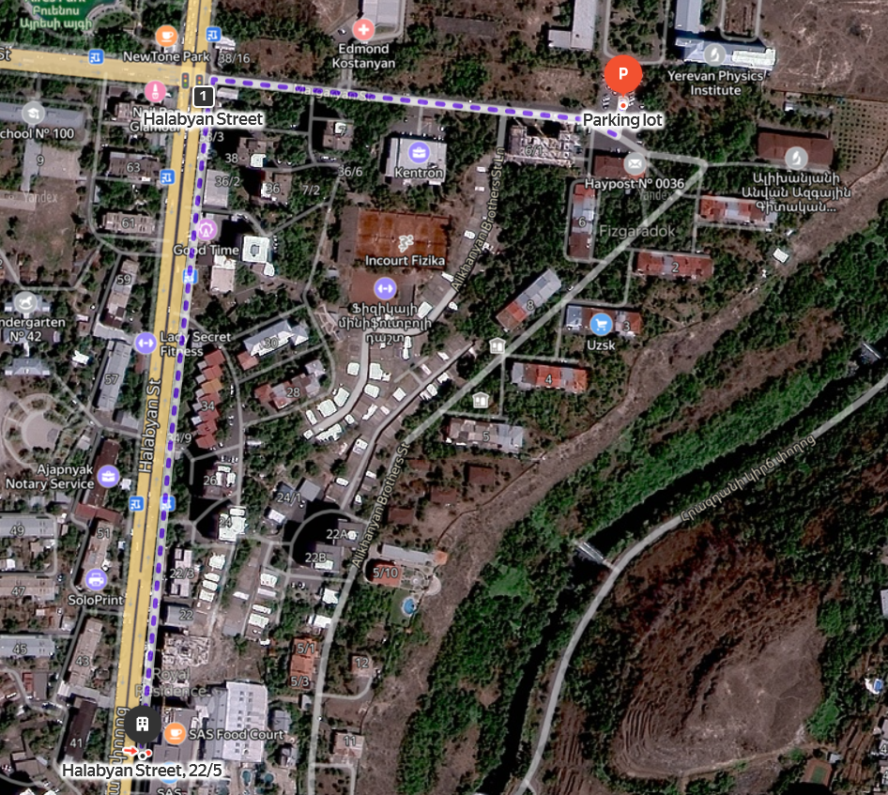
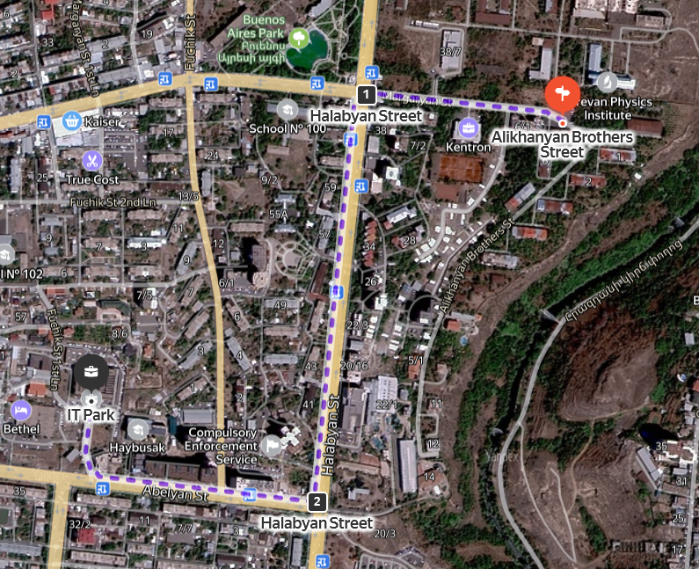
Lunch
From AANL(YerPhi)
Tumanyan Shaurma ~650 m
SAS FoodCourt ~850 m
ArtLunch (IT Park) ~1.5 km
NewTone ~350 m

Slide 6
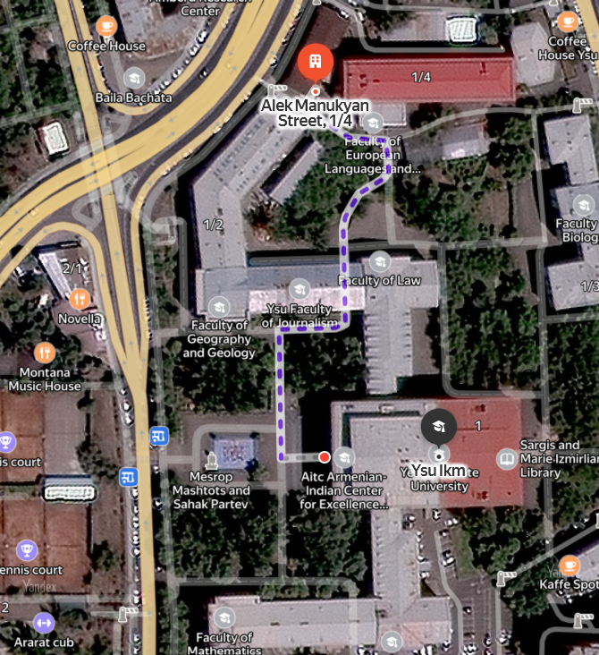
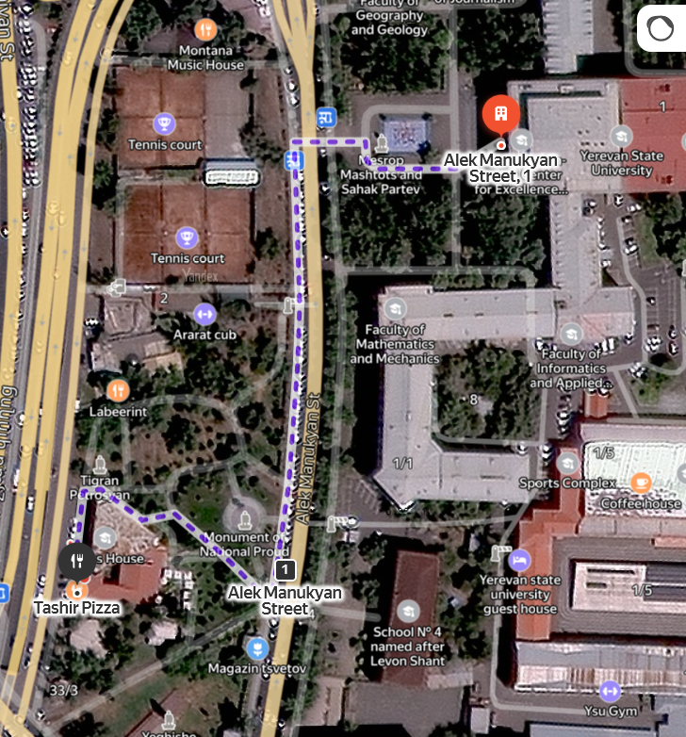
Lunch
From YSU
YSU Lunch (Romano) ~150 m
ArtLunch (Radio) ~300 m
Tashir Pizza ~250m

Slide 7
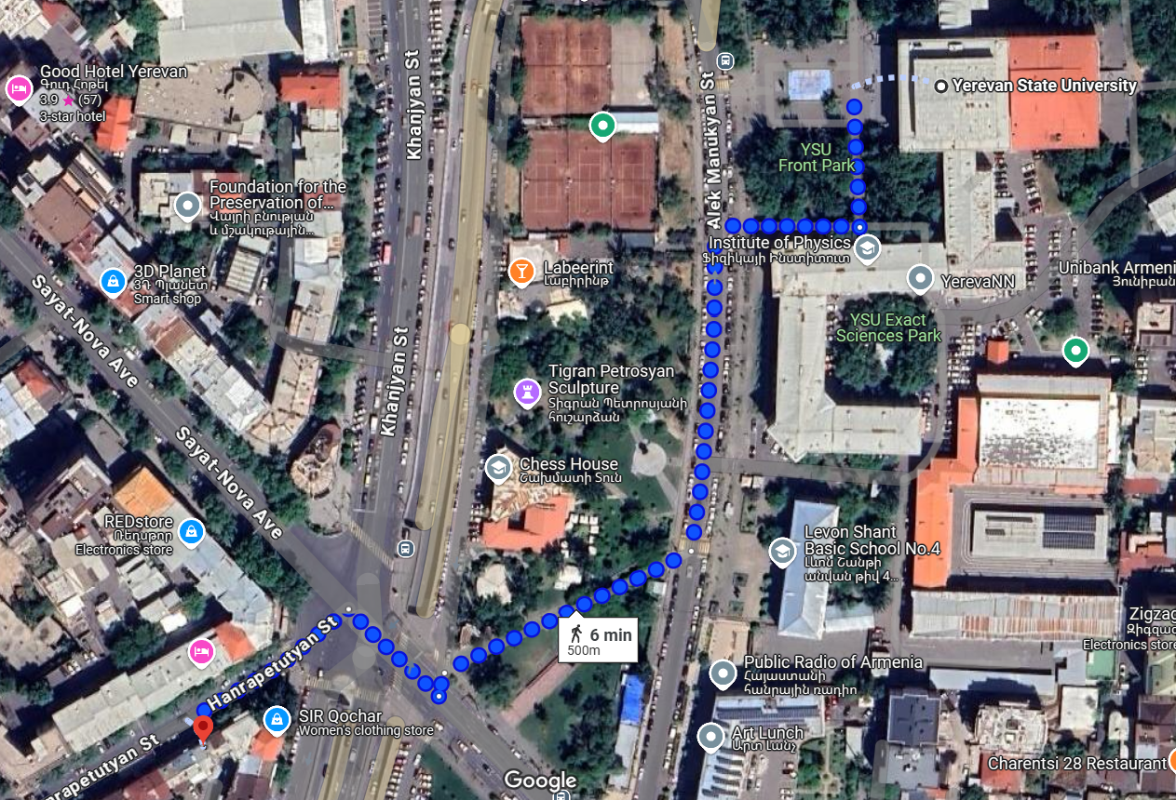
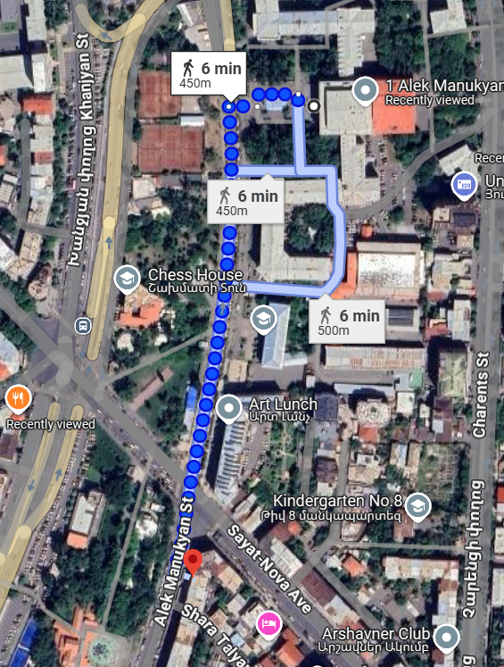
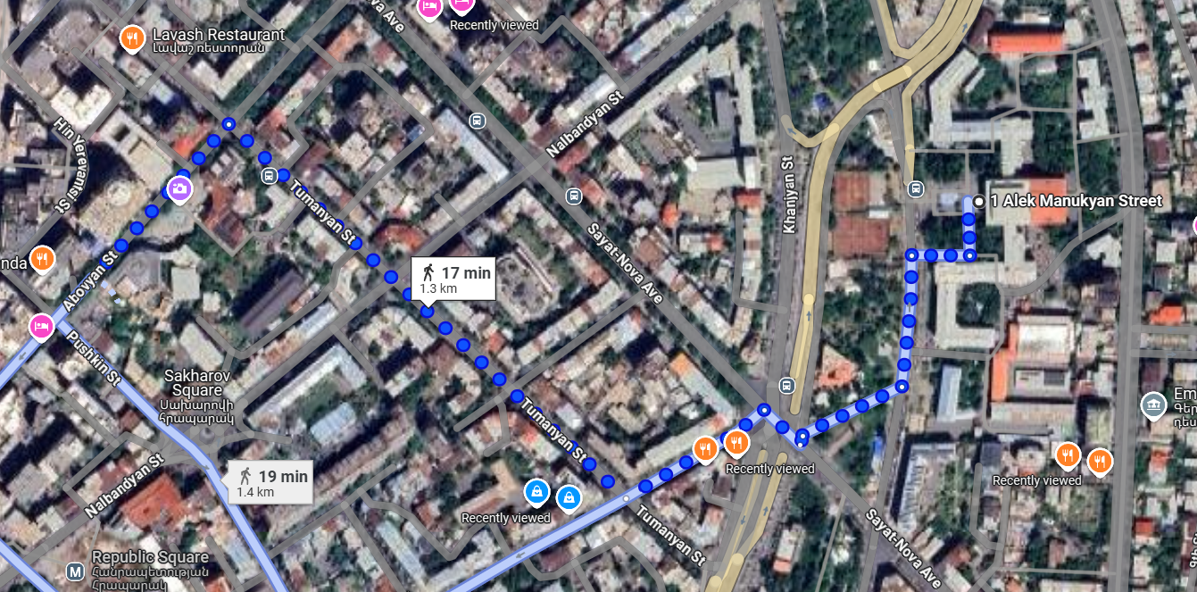
Lunch
Caucasus tavern ~ 500 m
From YSU
Old Marani Tavern ~ 450 m
Dalan Art Gallery and Restaurant ~ 1.3 km

Slide 8
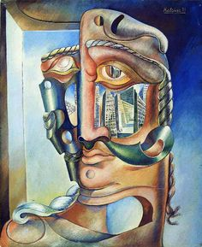
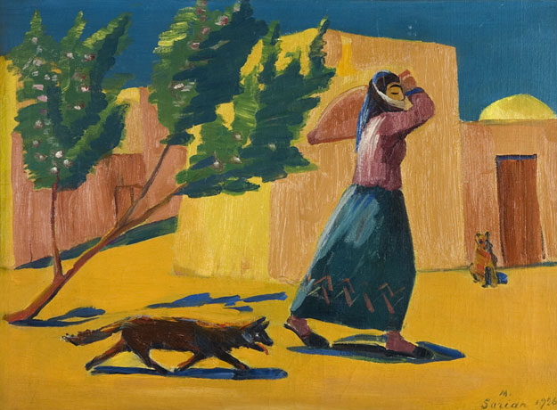
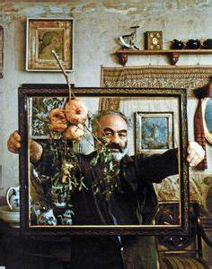
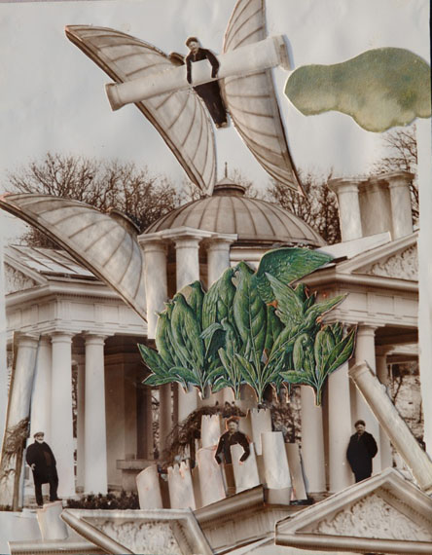
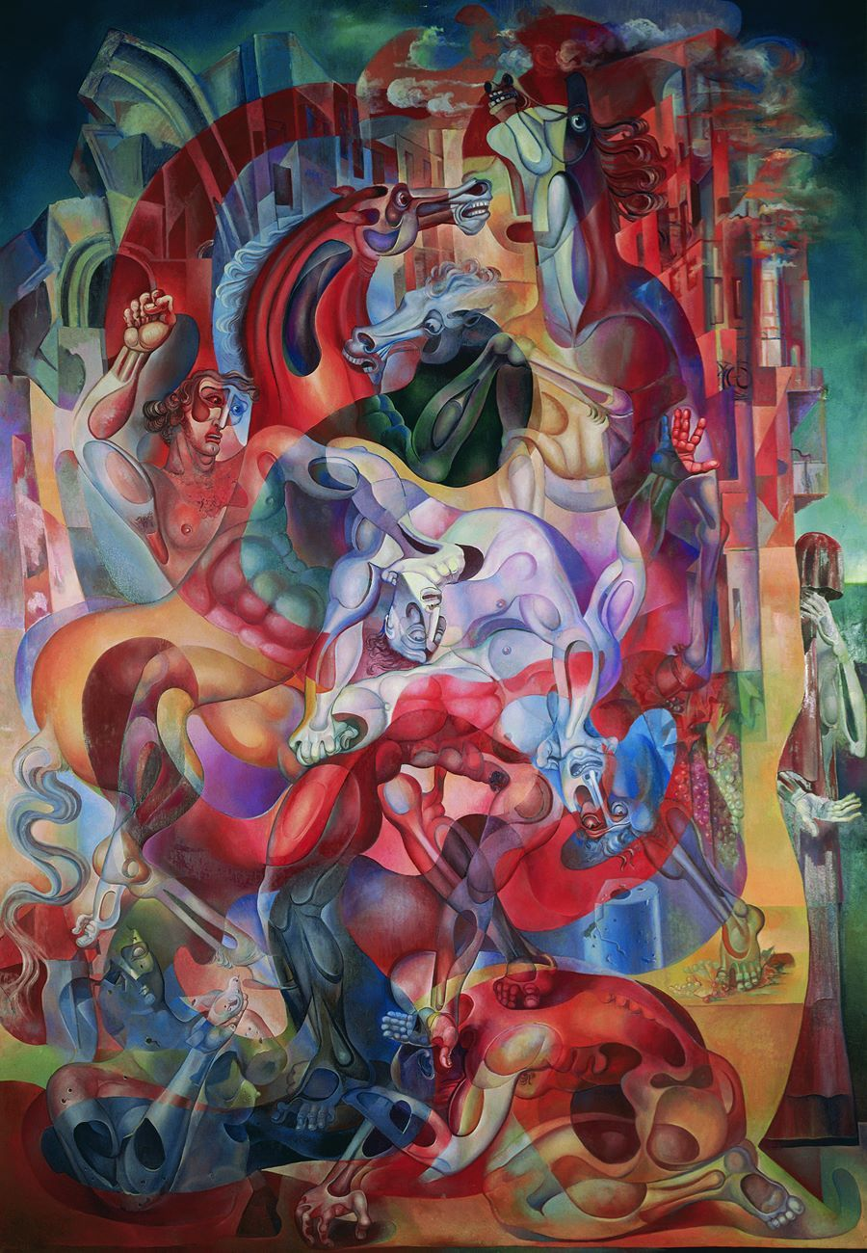
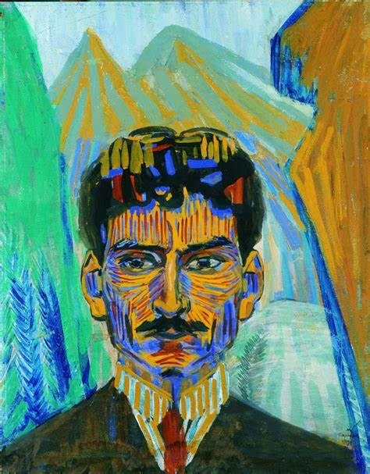
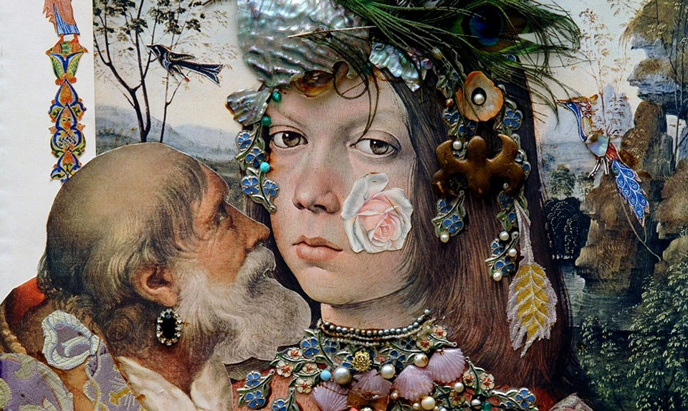
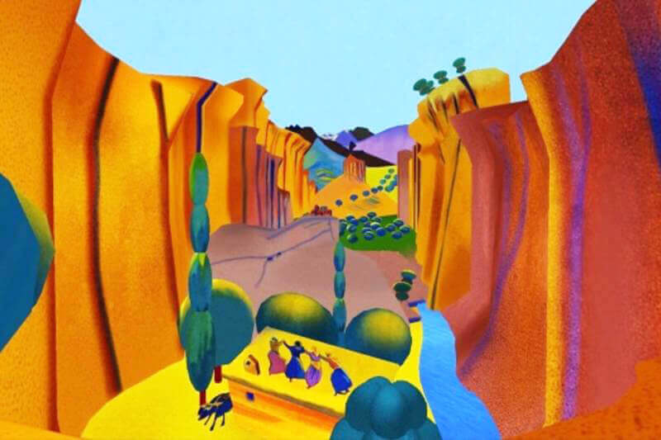
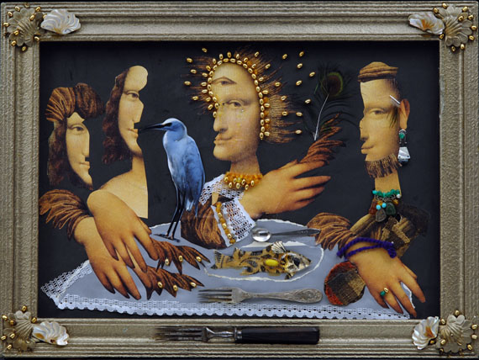
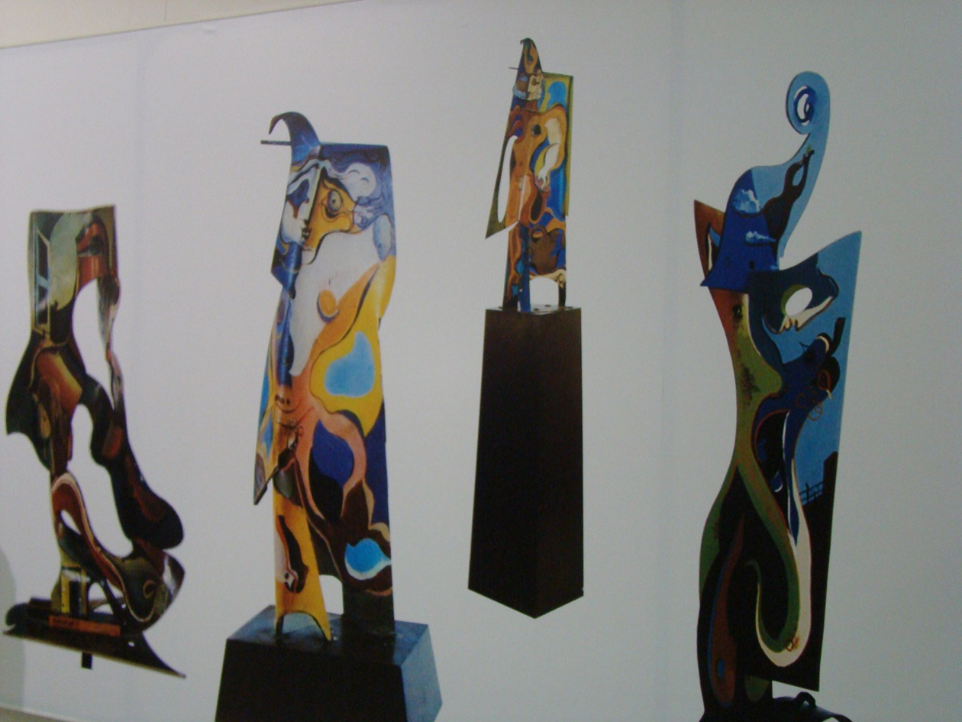
Travel
museum of the film director and collagist
museum of the painter and sculptor
museum of the painter
Ervand Kochar – 39 Mashtoc Ave.
Martiros Saryan – 3 Saryan st.
Sergei Parajanov - 15/1 Israyelyan st.

Slide 9
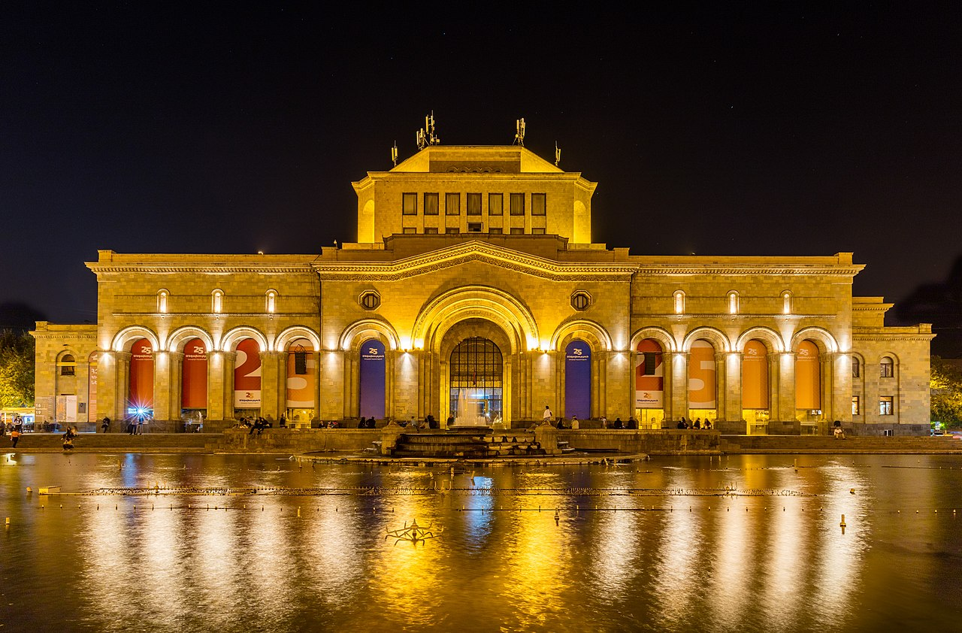
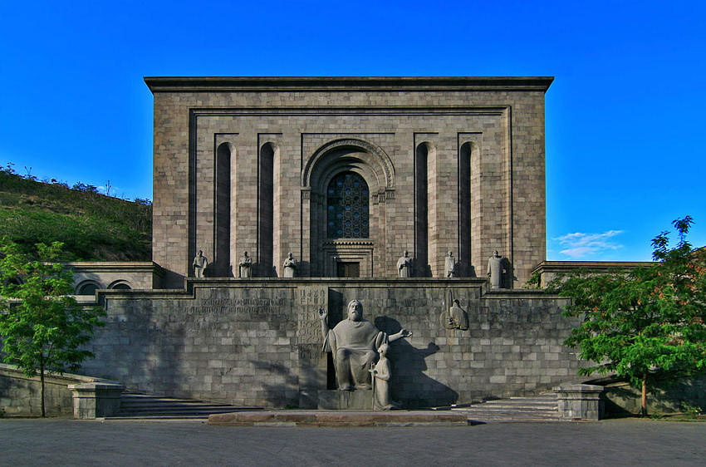
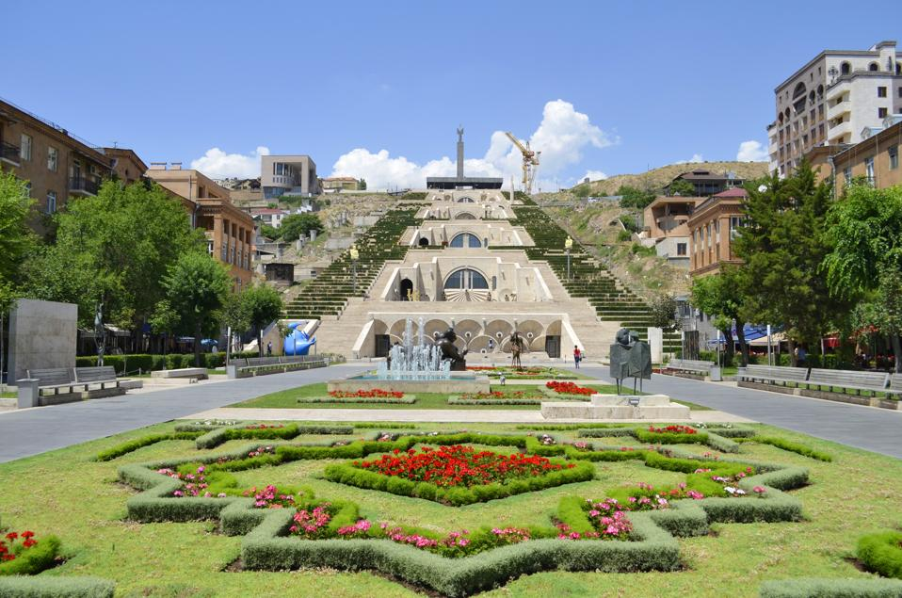
Travel
National Gallery of Armenia
Matenadaran
Cascade
HMA – History Museum of Armenia
The Museum of Ancient Manuscripts
Cafesjian Art Center. Museum

Slide 10
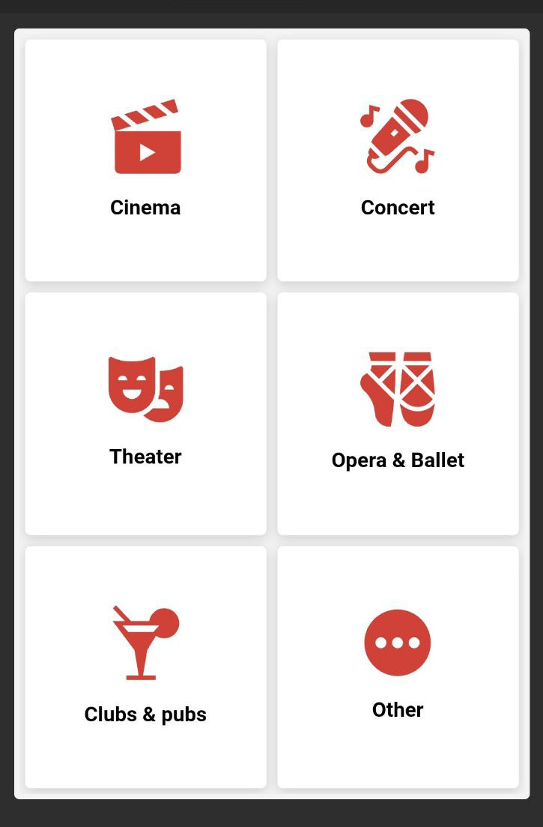
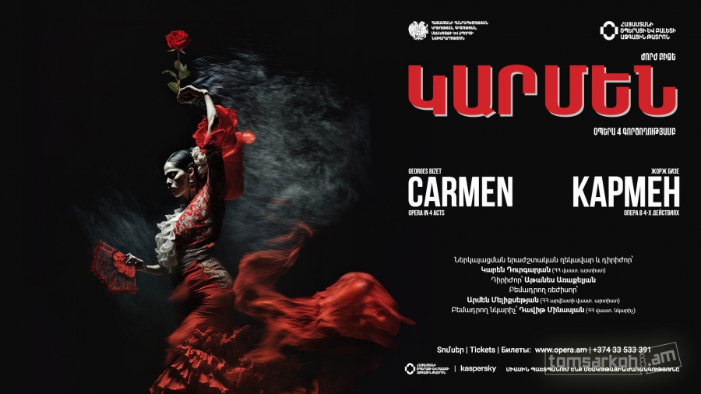
All events in Yerevan

Slide 11
Thank you for your attention
09 APR. 2025

