Slide 1
Recent progress of aerogel Cherenkov radiators production in Novosibirsk
Aleksandr A. Kattsinª (A.A.Kattsin@inp.nsk.su)
A.Yu. Barnyakovª, E.A. Kravchenkoª, A.F. Danilyuk^{b}, A.Yu. Predein^{b}.
ªBudker Institute of Nuclear Physics of SB RAS
^{b}Boreskov Institute of Catalysis SB RAS

Slide 2
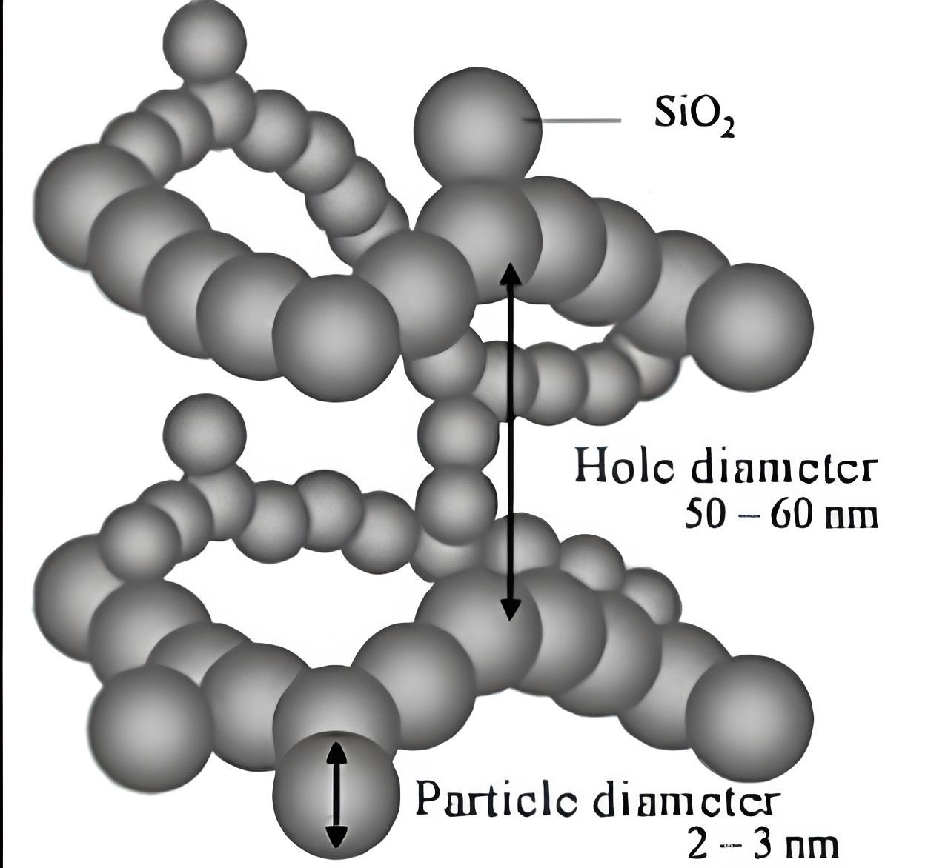
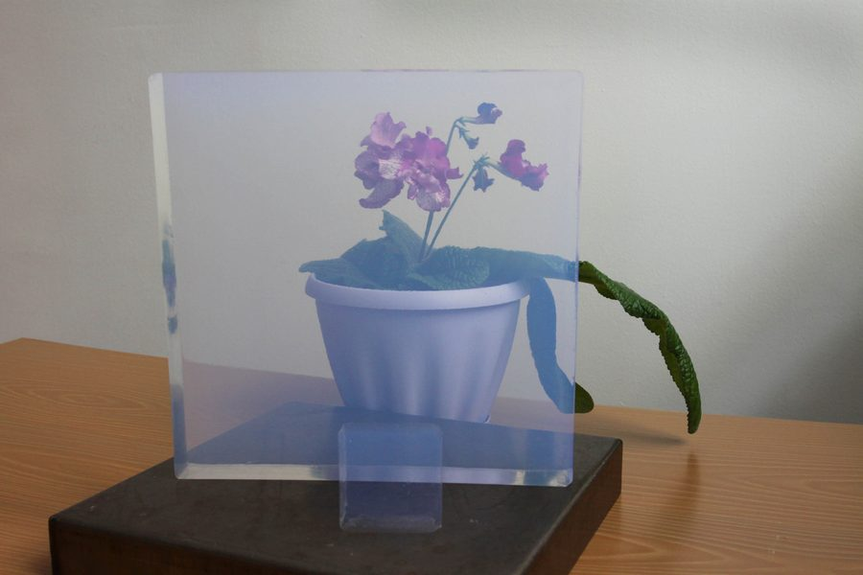
Silica aerogel
quartz
SiO₂
Silica aerogel - porous material with pore dimension less than visible light wavelength. 3D network of SiO₂ nanometer sized pellets and 50-100 nm pores.
Hole diameter
50-60 nm
Lightest solids. Close the nature’s gap in refractive index between gases (n-1≲10⁻³) and liquids/solids (n≳1.3).
Particle diameter
2-3 nm
$$n=\sqrt{1+0.438×ρ}$$
Aerogel is a light, fragile material with strong Rayleigh scattering of light which easily absorb gases and vapours.

Slide 3
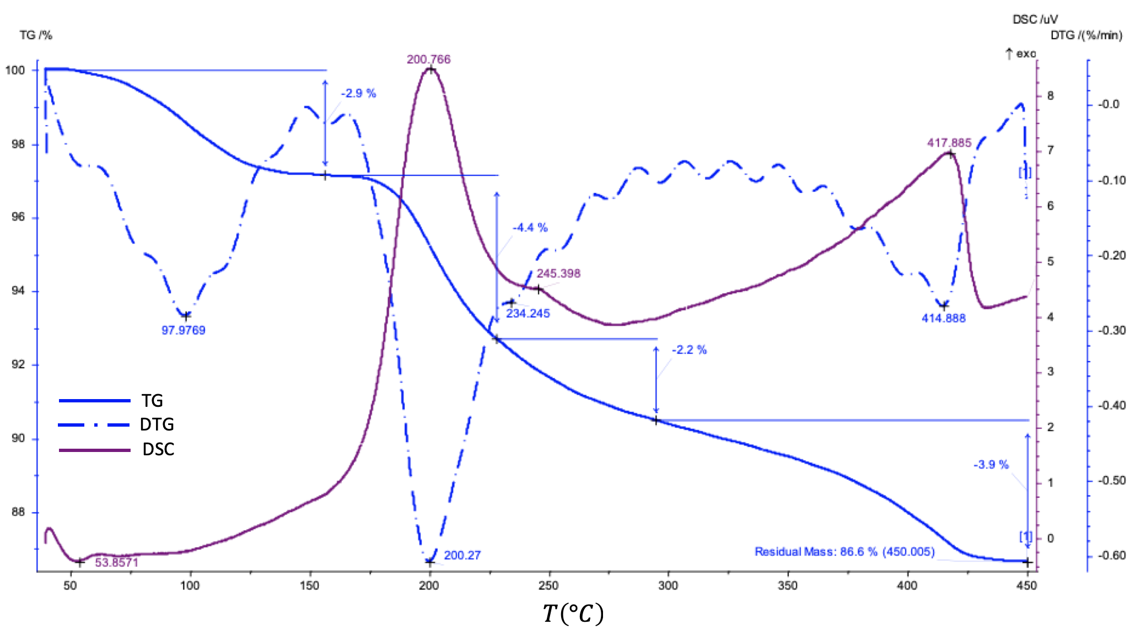
Aerogel primary annealing protocol
Thermogravimetric and differential scanning calorimetry analysis
Up to about 120 ℃, the annealing process involves heat absorption (desorption of water and organic matter).
Starting from 170 ℃, heat generation begins to increase and mass decreases – organic matter burns out.
Heat release at 417 ℃ is presumably the afterburning of organic matter.
heat flow
derivative mass
$$!$$
After changing
the primary annealing procedure, its efficiency was almost 100%: 100% of the large aerogel blocks do not crack.
aerogel mass lost
In 2023, the procedure for primary annealing aerogel in an air atmosphere was changed so that the blocks would not crack. The process of heating to the organic burnout temperature (approximately 170 ℃) has become smoother (taking longer), and the aerogel annealing stage is also included in this cycle without raising the temperature for several hours at 170 ℃, so that the organic matter contained in the aerogel burns out without destroying the source block.

Slide 4
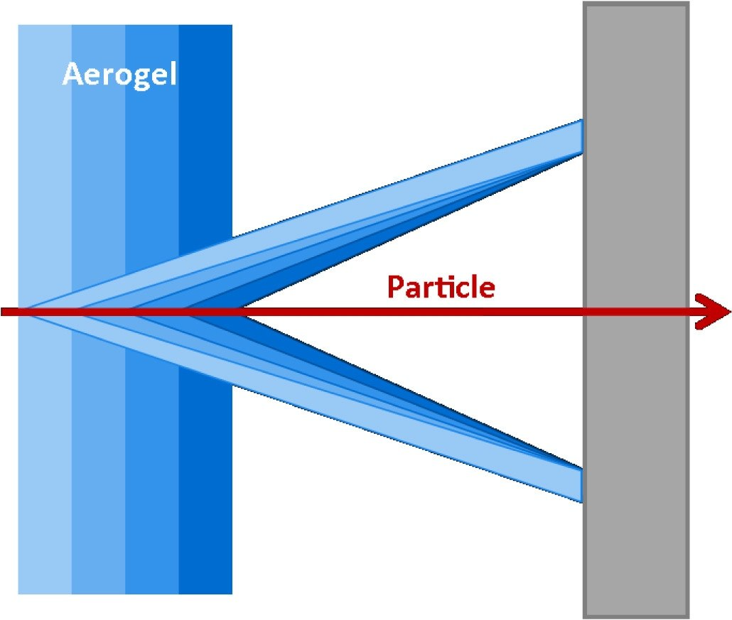
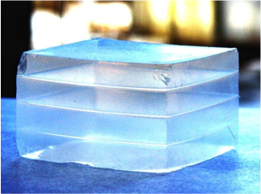
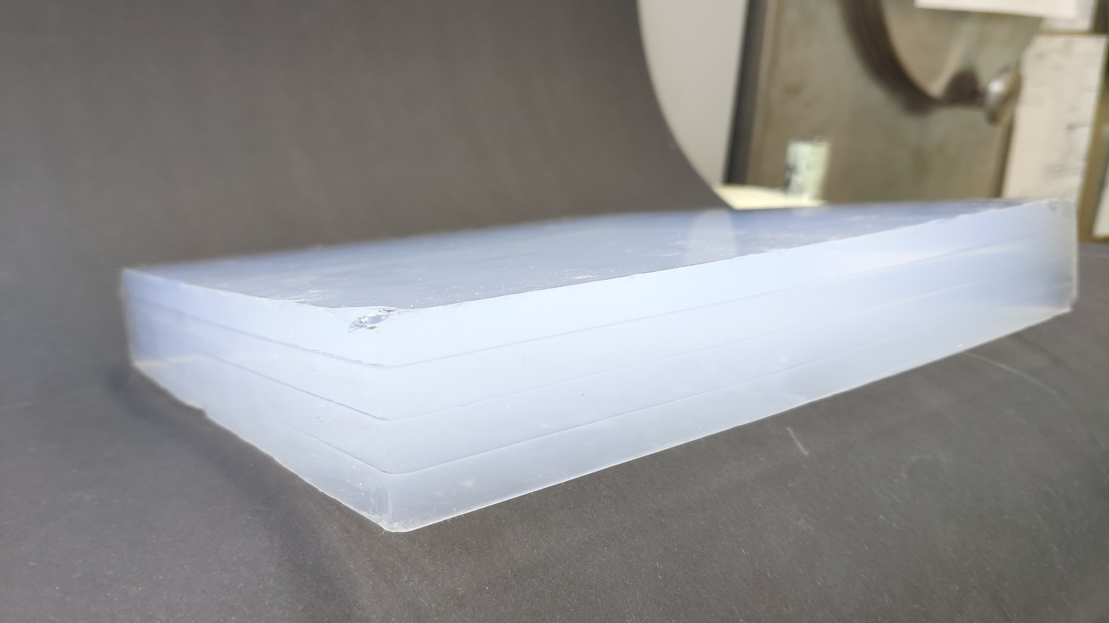
Focusing Aerogel RICH - FARICH
first four-layer monolithic sample
first four-layer monolithic sample
Refractive index profile is measured by means of X-ray setup at the BINP
50 mm
50 mm
Photon Detector
n=1,030 6,0 мм
Cherenkov light
n=1,027 6,3 мм
n=1,024 6,7 мм
n=1,022 7,0 мм
The four-layer focusing aerogel sample with 230x230x35 mm size and with correct parameters for refractive index and transparency.
2004
19 years of R&Ds
Thicknesses and refractive indexes in each layer are adjusted in such way that Cherenkov rings from each layer overlap in the same region of the position-sensitive photon detector.
The number of detected Cherenkov photons increases due to increase of the thickness without degradation of Cherenkov angle resolution due to uncertainties of photon emission point.
230 mm
230 mm
n=1,046 8,5 mm
n=1,043 8,5 mm
35 mm
n=1,040 9,0 mm
n=1,039 9,0 mm
$$L_{sc}=60.52±0,83 mm$$
2023
T.Iijima et al., NIM A548 (2005) 383 and A.Yu.Barnyakov et al., NIM A553 (2005) 70

Slide 5
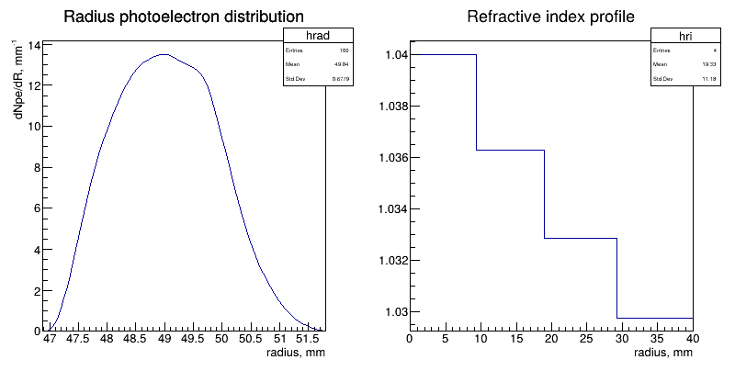
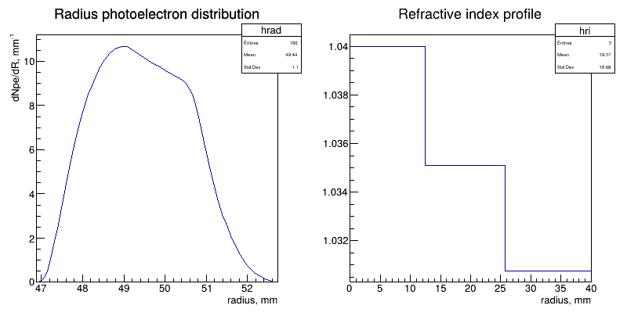
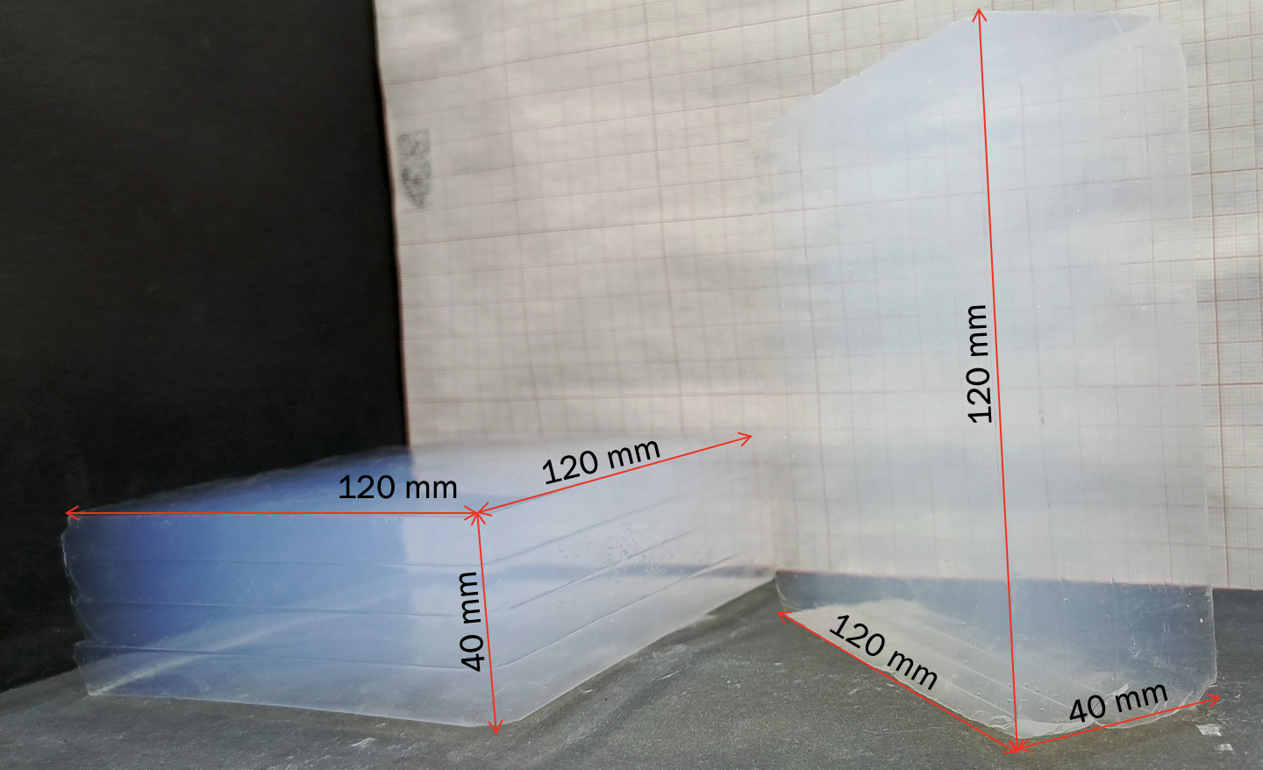
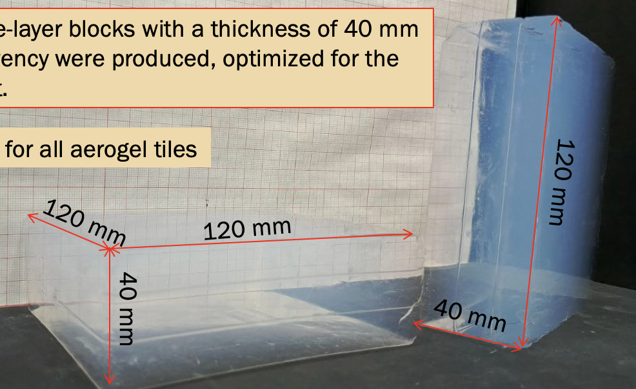
Aerogel optimization for 6$×$6 mm pixels according SPD FARICH concept and status of production
four-layer aerogel with n_{max}=1.04 and t_{tot}=40 mm
• PDE for H12700 and pixel 6$×$6 mm
• N_{pe}≈34
• $σ_{tr}^{θc}≈1.7$mrad
• π/K–separation at 6 GeV/c – $6.5 σ$
• “New4”
• Material budget ~ 2.7%X₀
three-layer aerogel with n_{max}=1.04 and t_{tot}=40 mm
• PDE for H12700 and pixel 6$×$6 mm
• N_{pe}≈35
• $σ_{tr}^{θc}≈1.8$mrad
• π/K–separation at 6 GeV/c – $6.1 σ$
• “New3”
• Material budget ~ 2.7%X₀
at 6 GeV/c – $6.5 σ$
at 6 GeV/c – $6.1 σ$
$L_{sc}≥60 mm$for all aerogel tiles
Material budget ~ 2.7%X₀
$L_{sc}≥60 mm$for all aerogel tiles

Slide 6
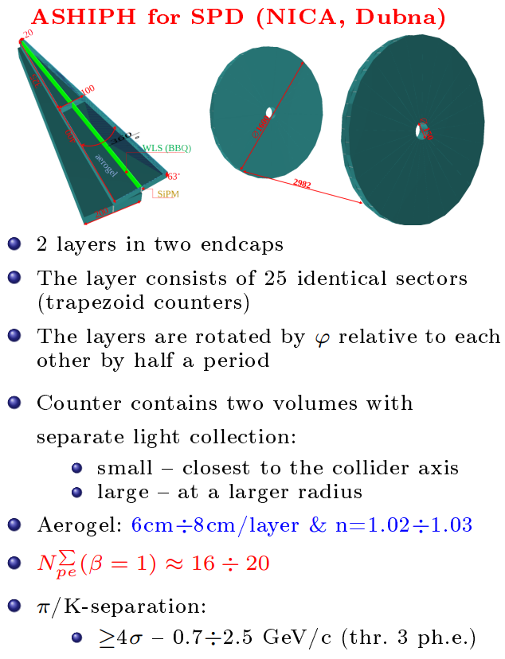
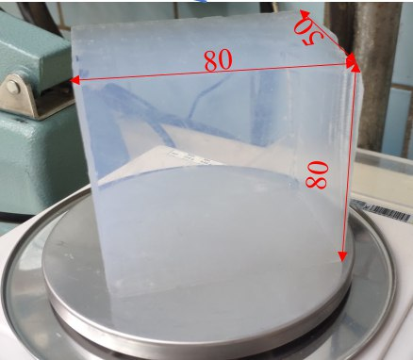
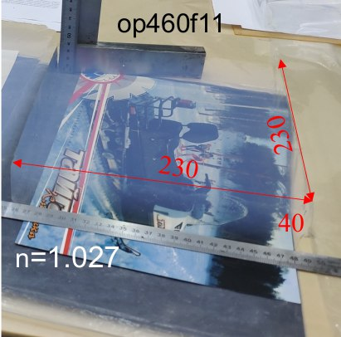
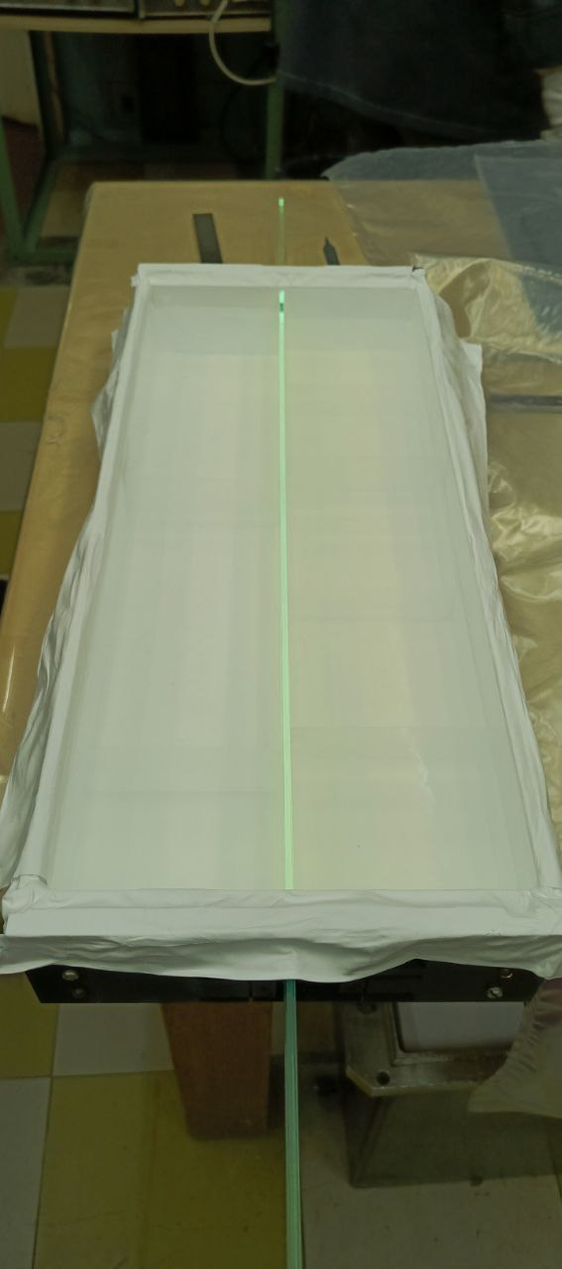
Thick aerogel radiator made of large single-layer tiles for threshold counters or for focusing with lenses
Cutting of aerogel
n=1.027
New samples of transparent thick large single-layer tiles aerogel radiators were manufactured in Novosibirsk for ASHIPH prototype.
Considered as an option!

Slide 7
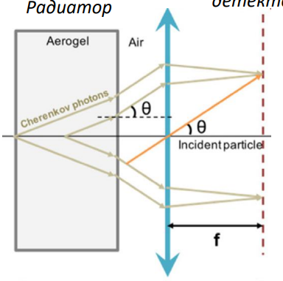
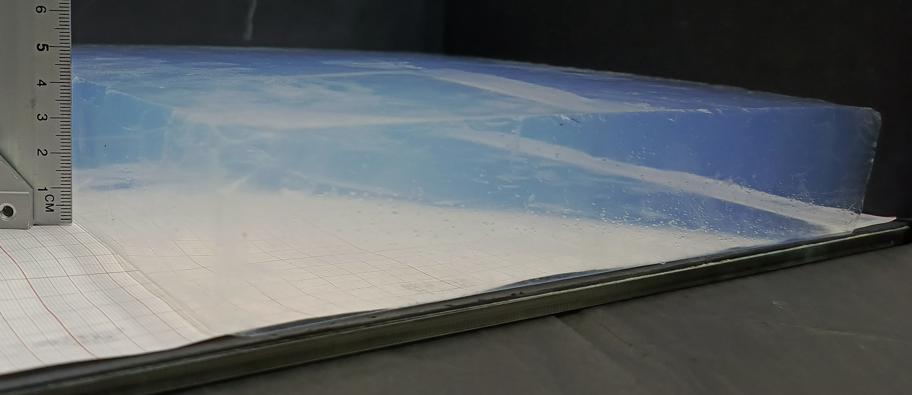
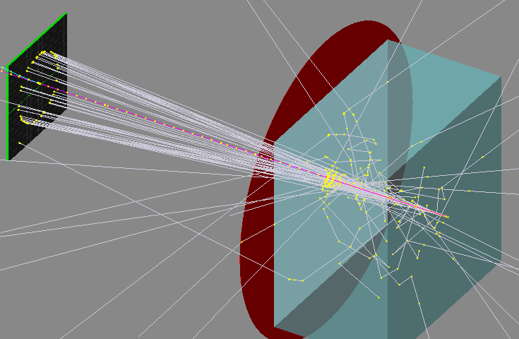
Thick aerogel radiator made of large single-layer tiles for threshold counters or for focusing with lenses
n=1.03
$$L_{sc}=60 cm$$
May 2025
Photon Detector
240 mm
240 mm
40 mm
Fresnel Lens
Aerogel RICH with Fresnel Lens: Ring image is shifted toward the central region on the photon detector
BINP test beam (pixel 6$×$6 mm):8 mrad for track
$=>$ can expect π/K–separation at 5 GeV/c – $3 σ$
BINP test beam hitmap
BINP sim

Slide 8
Ultralight aerogel
R&D on aerogel with n=1.008 is carrying out for high-momenta separation:
$$P_{μ_{thr}}=1.1{GeV}/c;$$
$$P_{π_{thr}}=1.2{GeV}/c;$$
$$P_{K_{thr}}=3.7{GeV}/c$$
50 mm
May 2025
produced
Aerogel $n=1.004$
22 mm
$$n=1.0036$$
n=1.0036
50 mm
50 mm
50 mm
22 mm
2025
FARICH based: aerogel n₁=1.0068 (20 mm) +
aerogel n₂=1.008 (20 mm)
pixel 6$×$6 mm: π/K–separation at 10 GeV/c;
𝜇/π–separation at 2 GeV/c.
pixel 3$×$3 mm: π/K–separation at 13 GeV/c;
𝜇/π–separation at 2.6 GeV/c.
$$L_{sc}=46 cm$$
2005
can think about

Slide 9
Summary
The primary annealing procedure was changed. Its efficiency is almost 100%. 100% of the large thick aerogel blocks remain intact.
Refractive index of multilayer focusing aerogel Cherenkov radiators were optimized for pixel 6×6 mm.
In Novosibirsk three-layer and four-layer aerogel optimized for pixel 6×6 mm was produced in 2025.
Large and highly transparent aerogel tiles with n=1.03 (230x230x40 & 50mm size) were produced for ASHIPH prototype options.
Ultralight aerogels (n_{max}=1.008) were produced for R&D on high-momenta separation ($>\text{10 }\text{GeV}\text{/}\text{c}$) by FARICH method.

Slide 10
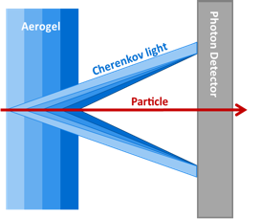
FARICH motivation
$σ_{C}^{tr}=1/{\sqrt{N_{pe}}}∙\sqrt{{\left(\frac{Δ_{pix}∙\cos{θ_{C}}}{L∙\sqrt{12}}\right)}^{2}+{\left(\frac{σ_{n}}{n∙\tan{θ_{C}}}\right)}^{2}+{\left(\frac{t∙\sin{θ_{C}}}{L∙\sqrt{12}}\right)}^{2}}$~ $\sqrt{t}$
$N_{pe}(β=1)$~ $500∙\frac{n^{2}−1}{n^{2}}∙t∙QE$
To get $\left\langle N_{pe}\right\rangle ≫5$ from aerogel with n=1.05 & thickness 1 cm is too hard practice task!!!
Thicknesses and refractive indexes in each layer are adjusted in such way that Cherenkov rings from each layer overlap in the same region of the position-sensitive photon detector.
The number of detected Cherenkov photons increases due to increase of the thickness without degradation of Cherenkov angle resolution due to uncertainties of photon emission point.
T. Iijima et al., NIM A548 (2005) 383 and A.Yu. Barnyakov et al., NIM A553 (2005) 70

Slide 11
Focusing Aerogel RICH beam test results
Pixel 6x6 mm
Geom.Eff. ~ 80%
Pixel 3x3 mm
Geom.Eff. ~ 20%
Main results:
• N_{pe} $≈$16 (~ 0.8 of Ring)
• $σ_{θ}^{1pe}≈13.5 mrad$($∎$ 6mm)
• $σ_{θ}^{1pe}≈ 7.0 mrad$ ($∎$ 3mm)

Slide 12
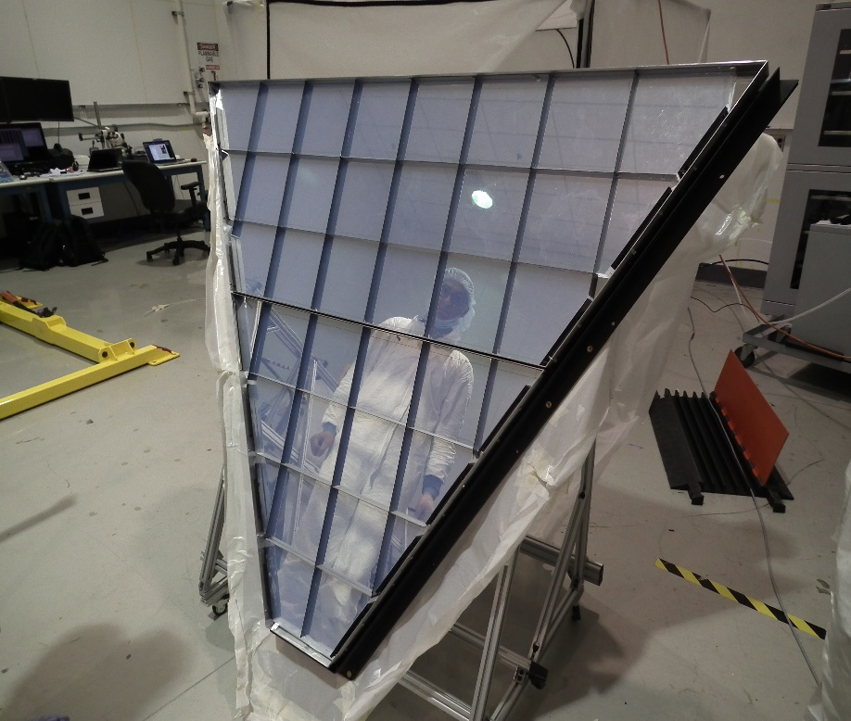
History of aerogel radiators in Novosibirsk
The history of the Novosibirsk aerogel begins in 1986.
KEDR ASHIPH system (VEPP-4М – BINP):
𝜋/K-separation in the momentum range 0,6÷1,5 GeV/с.
Aerogel $n=1,05$ (V~1000 L).
SND ASHIPH system (VEPP-2000 – BINP):
𝜋/K-separation in the momentum range 300÷870 MeV/с.
Aerogel $n=1,13$ (V~9 L).
DIRAC-II (PS – CERN):
𝜋/K-separation in the momentum range 5,5÷8,0 GeV/с.
Aerogel $n=1,008$ (V~9 L).
AMS-02 aerogel RICH (ISS):
Search for antimatter, study of cosmic rays.
Aerogel $n=1,05$ (S~1 m²).
LHCb aerogel RICH (LHC – CERN):
𝜋/K-separation in the momentum range 5,5÷8,0 GeV/с.
Aerogel $n=1,03$ (S~0,5 m²), aerogel tile 20х20х5 см³.
CLAS-12 aerogel RICH (J-Lab):
𝜋/K- & K/p-separation at level 4𝜎 with several momentum GeV/с.
Aerogel $n=1,05$ (S~6 m²), aerogel tile 20х20х2-3 см³.
Aerogel RICH for CLAS12

