Slide 1
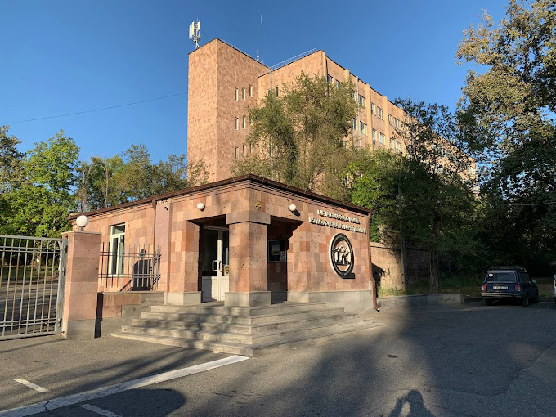
SPD ECAL Status Report
IX SPD collaboration meeting
Erevan, May 13 of 2025 Oleg Gavrishuk, Laboratory of High Energy Physics, Dubna

Slide 2
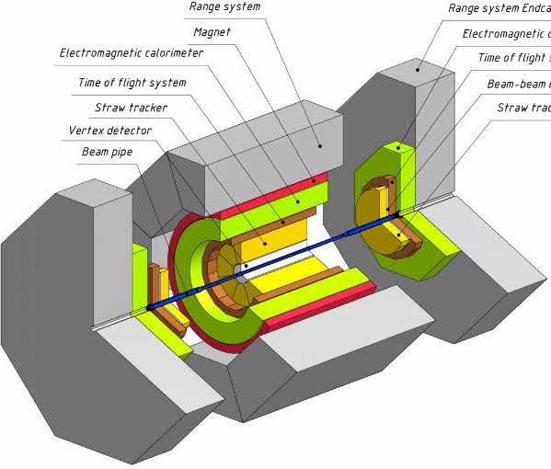
Overview of the SPD ECAL
The calorimeter placed inside of Cryostat (Red) and shown in layout Green color.
The calorimeter is designed for efficient registration of electrons and gamma quanta in the energy range up to 10 GeV.
The transverse size of the calorimeter cell should be on the order of the effective Moliere radius of the calorimeter medium: ~58 mm.
The cells in the End-Cup part of the calorimeter have a rectangular shape 40x40 mm².
The cells in the barrel part of the calorimeter have a trapezoidal shape in the azimuthal direction with vertex angle of the trapezoid equals 1.87 and 40 mm in beam direction.
07.05.2025
Oleg Gavrishchuk
2
Notes:
2
2

Slide 3
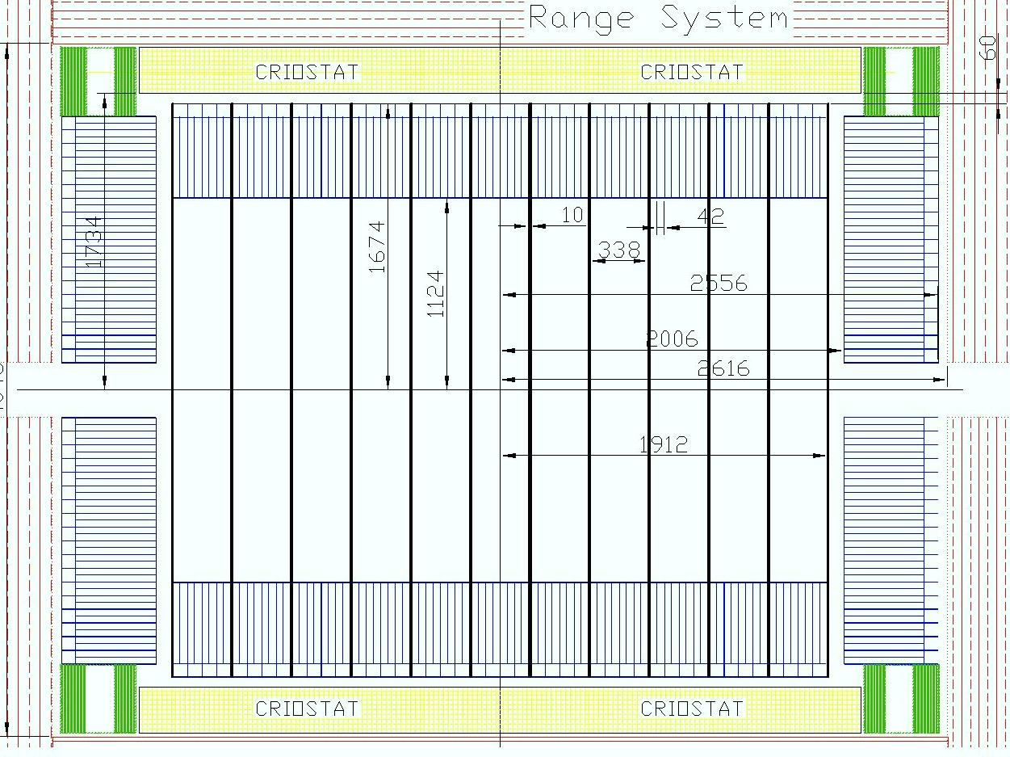
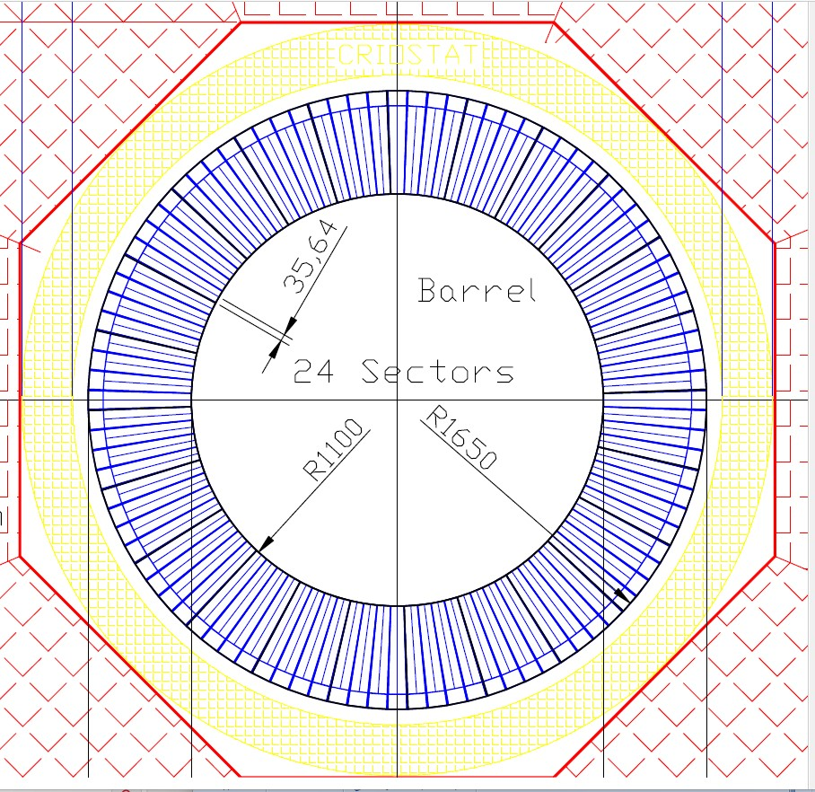
Schematic view of a calorimeter placed inside of cryostat.
Criostat
Barrel
End-Cup
Barrel
Criostat
07.05.2025
Oleg Gavrishchuk
3
Notes:
3
3

Slide 4
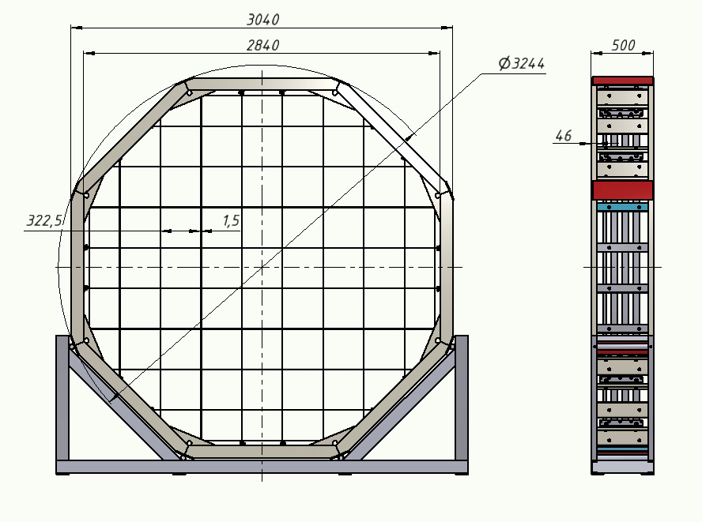
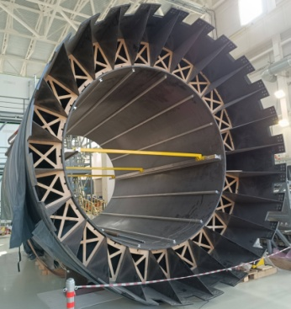
End-Cup calorimeter support.
Frame design – option One
ECAL frame mounted inside of Barrel support
MPD
Barrel support
Stainless strips for ECAL support
1.5 mm thick.
Stand for ECAL assembling in the assembly room

Slide 5
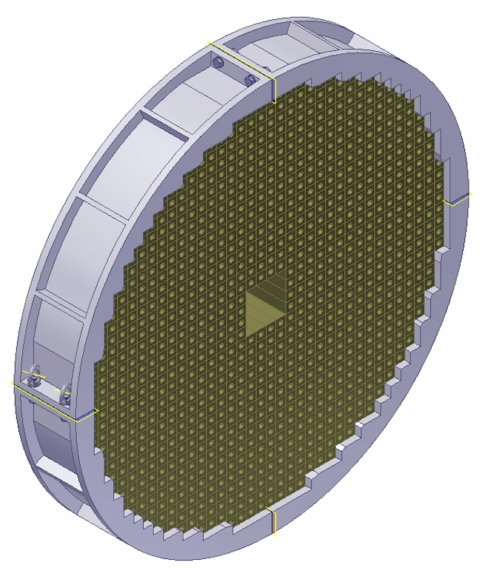
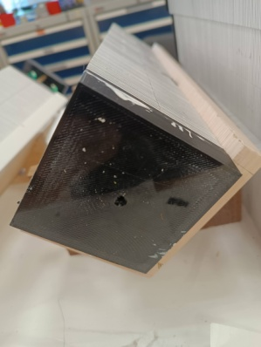
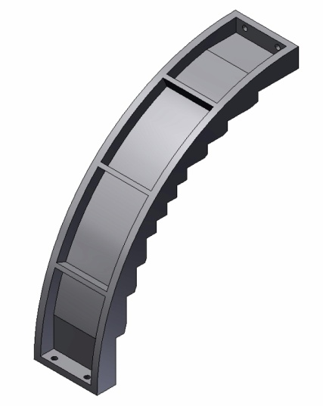
End-Cup calorimeter support.
Frame design – option Two.
ECAL’s modules placed inside of frame
ECAL module 80x80
From 2x2 cells 40x40
Aluminum frame composed from 4 details made by casting into a mold

Slide 6
Calorimeters cell composition
Shashlik type calorimeter has been selected with the sampling structure of 200 layers of 1.5-mm polystyrene scintillator and 0.5-mm lead, the length of the active part 400 mm, which corresponds to ~18X0.
The Cells in the End-Cup part of the calorimeter have a rectangular shape 40x40 mm².
4 calorimeter cells are assembled into a Module, where four 40x40 mm scintillators cells are joint by a common 80x80 mm lead plate.
200 Polystyrene scintillator plates with 1.5% P-terphenyl and 0.05% POPOP is used.
199 Lead plates 0.5 mm: alloy Cca with 0.5% antimony is used as an absorber.
16 WLS fibers (1 mm diam.) collect light onto the SiPm of 6x6 mm² with 15 micron pith size. Its corresponded to 160.000 pixels.
SiPm EQR15 11-6060D-S - it is a novel China design of NDL technology. NDL SiPM employs intrinsic epitaxial layer as the quenching resistors
07.05.2025
Oleg Gavrishchuk
6
Notes:
6
6

Slide 7
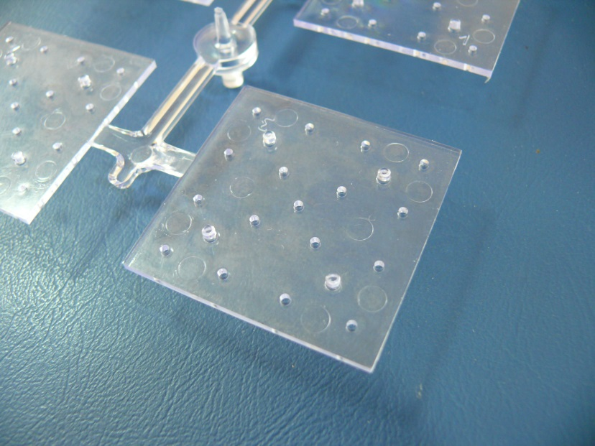
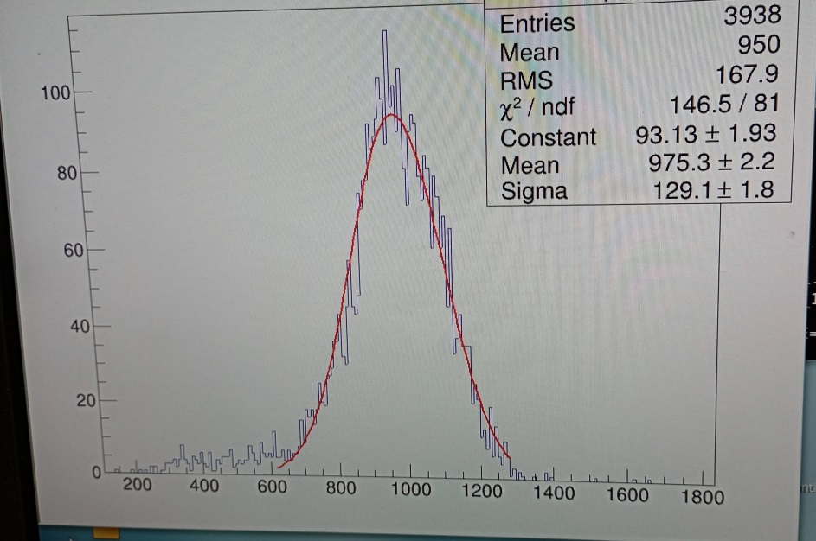
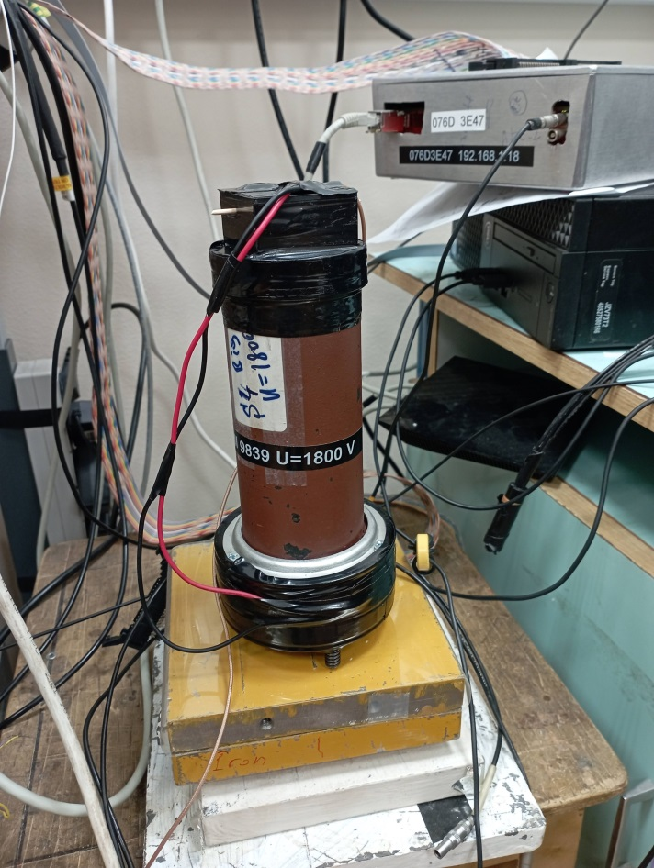
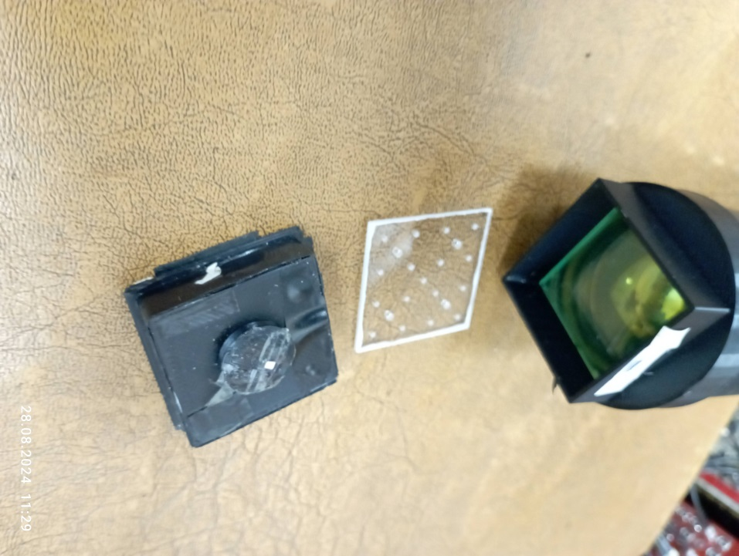
160000 scintillator Cells 40x40x1.5 mm³
produced in Vladimir at February 2024
Spectra from
α-source
4 scintillators plates after injection molding machine
Scintillator plate:
40x40 mm² , t=1.5 mm
WLS and PM
Setup for scintillators test

Slide 8
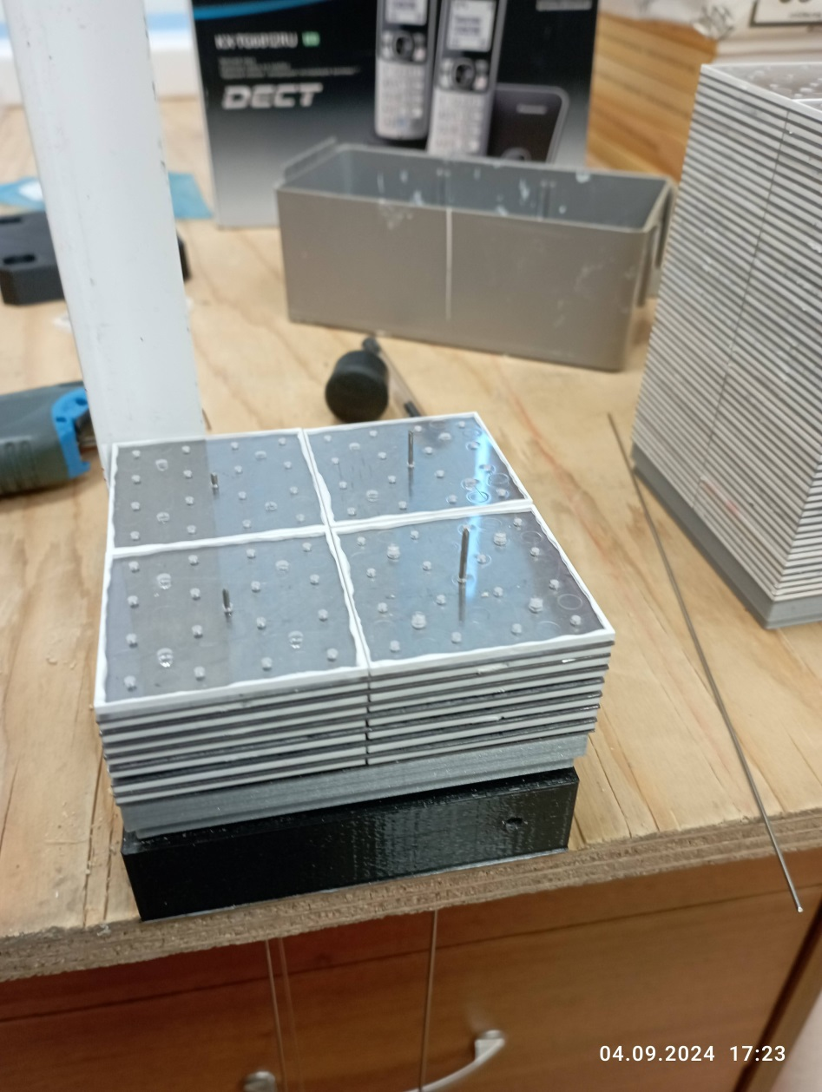
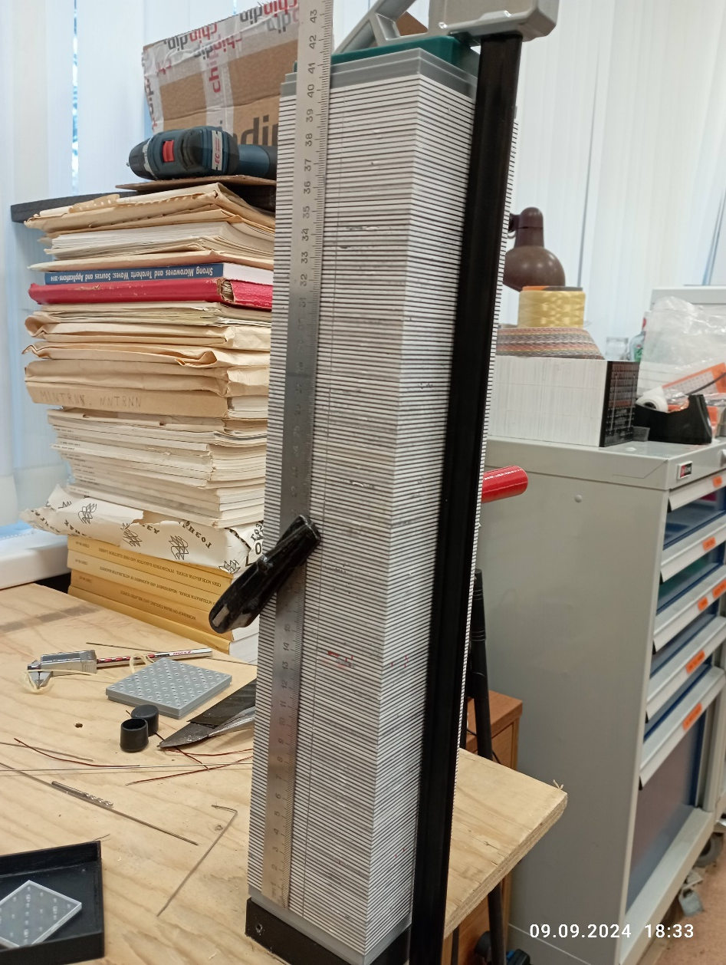
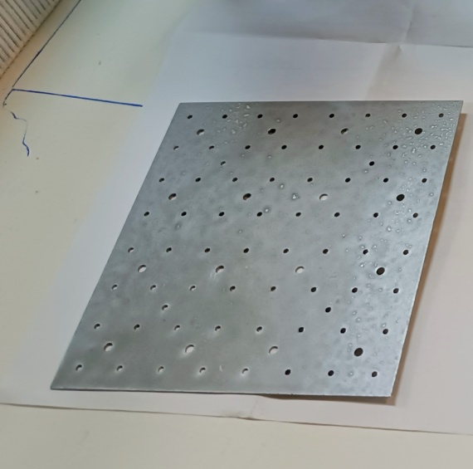
Module assembling – first setup
4-cells module assembling - in beginning stage.
Final stage of module stacking with 200 layers of 1.5+0.5 mm scintillators
And Led plates. The length of Active volume is equal 403 mm , that corresponded to the estimated period 2.02 mm
Led plate 80x80 mm² to joint 4 Scintillator plates
40x40 mm².

Slide 9
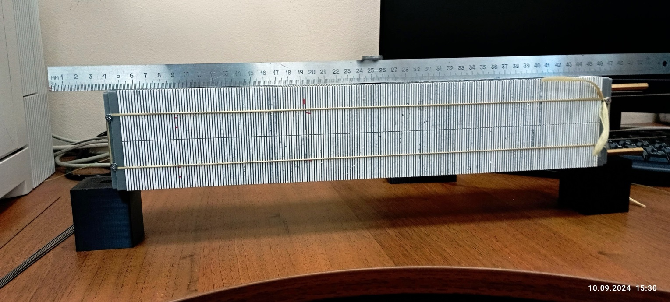
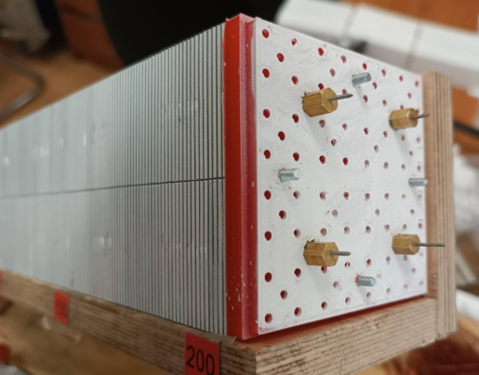
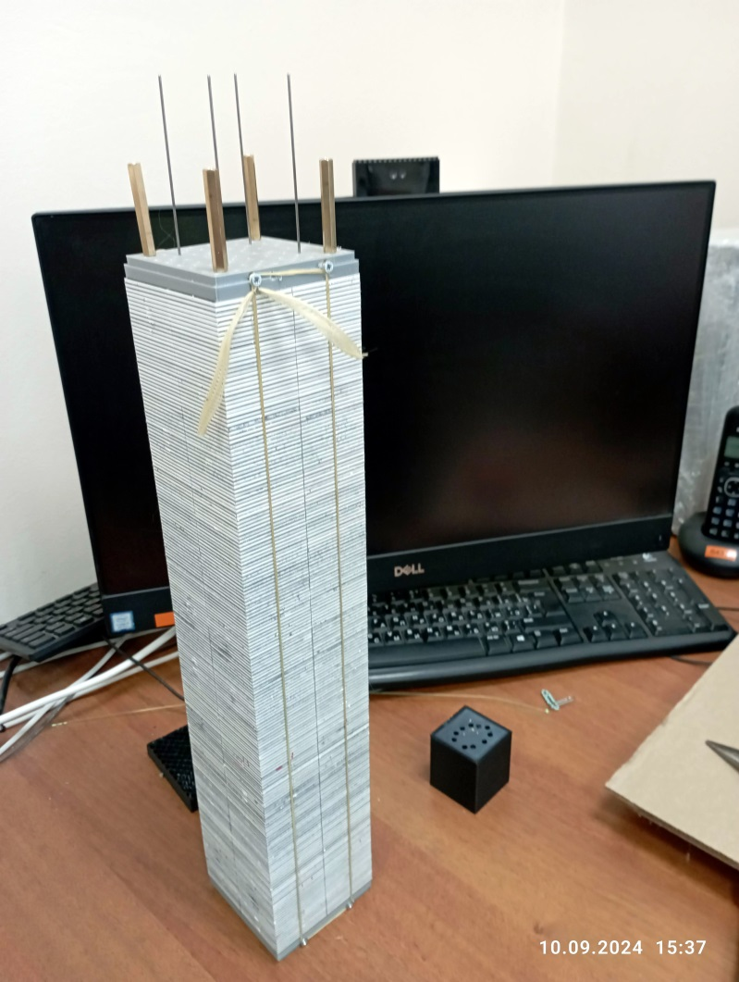
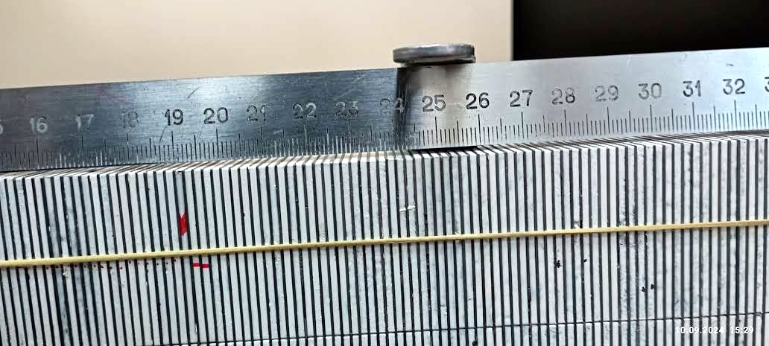
Module assembling and stress test setup
4-cells module assembled and tied with a Kevlar rope. It was first example to fix 200 layers stack .
The next stack fixation will be done by 4 stainless rods.
Stress test setup
Center part Zoom

Slide 10
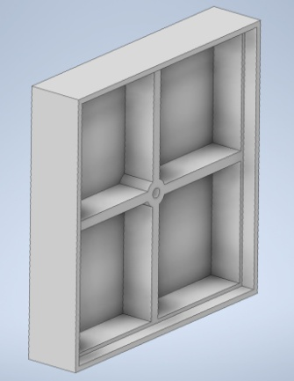
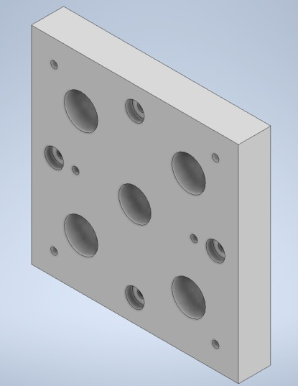
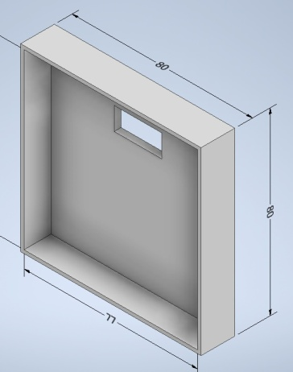
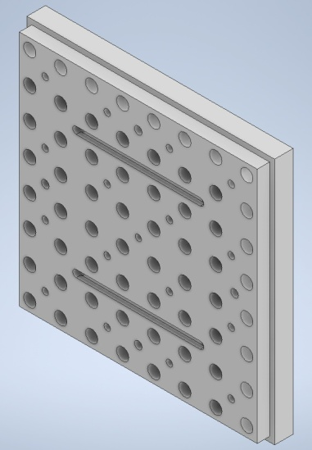
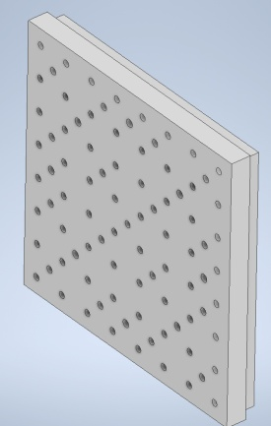
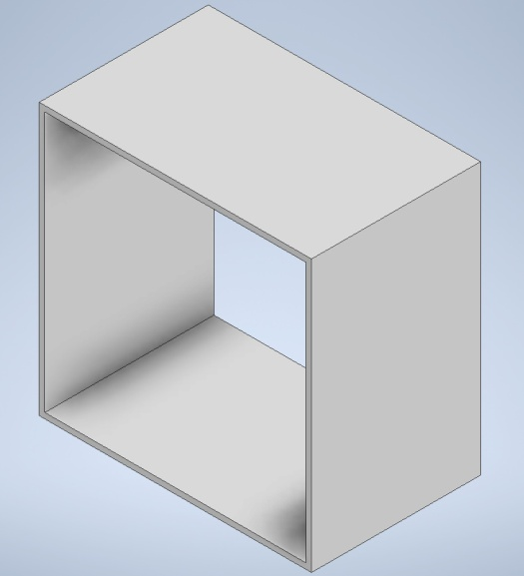
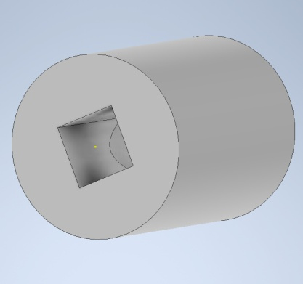
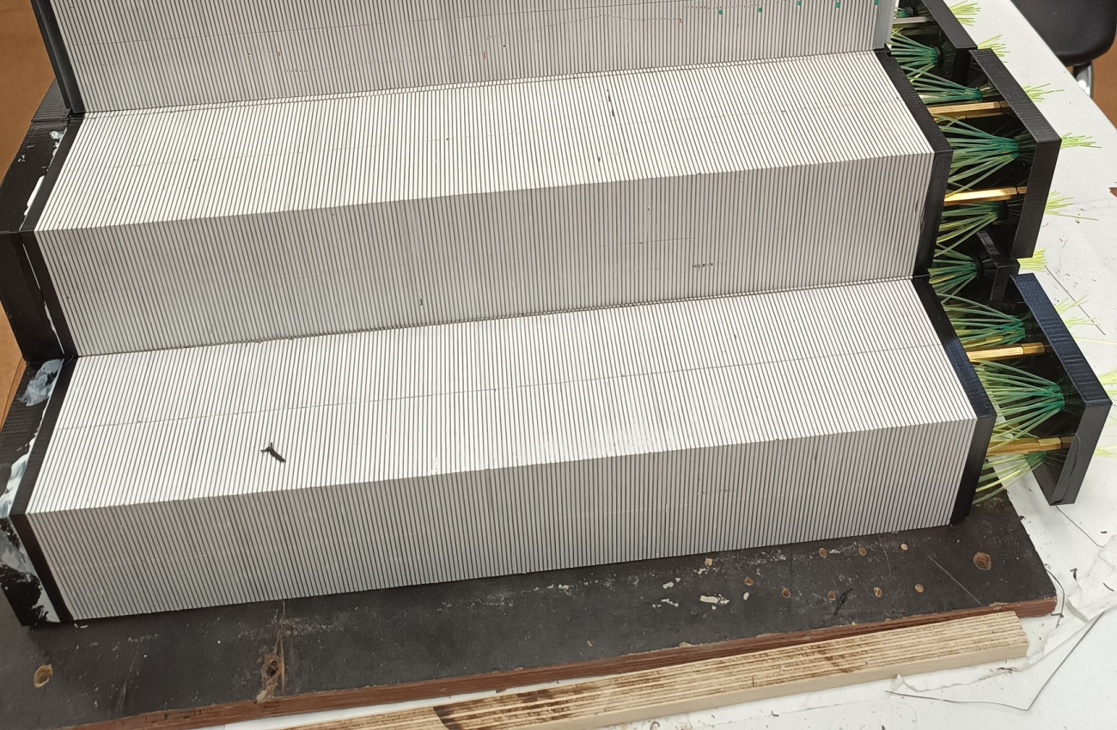
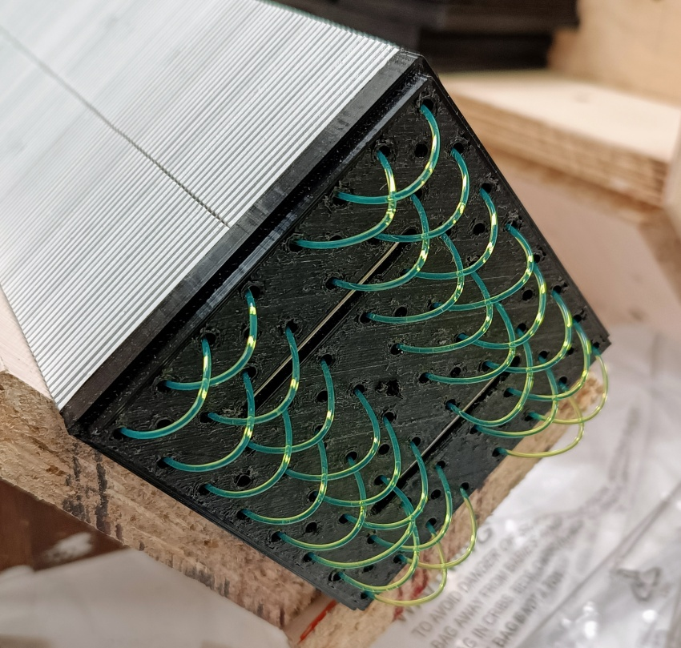
Assembling Details

Slide 11
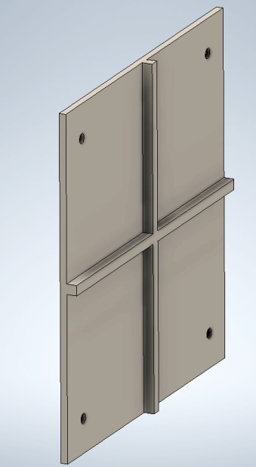
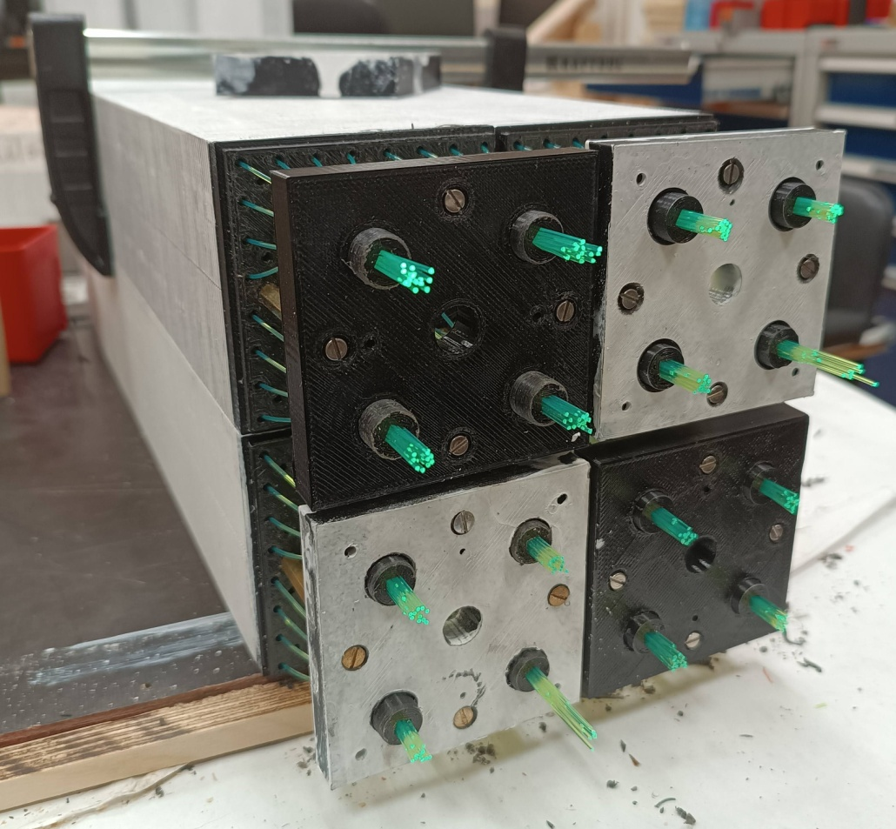
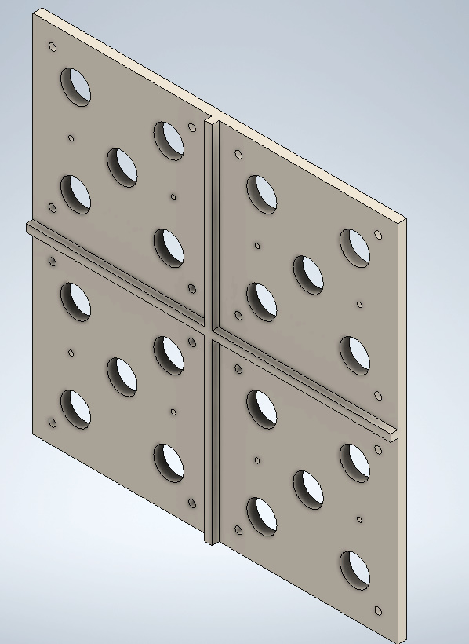
Cluster of 4 Modules (16 cells 40x40) design
Joint Front Plate
Sleeve for 16 fibers
Cluster = 4 Modules Setup of 16-ch
Joint Back Plate

Slide 12
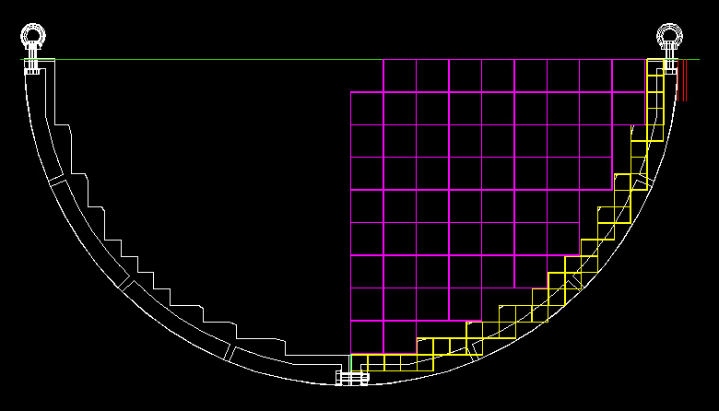
End Cup and 16-ch Clusters design:
End Cup Quarters consist from 58 Clusters composing from 232 Modules as 2x2 Cells.
Total End Cup consist from 928 Modules or 3712 cells of 40x40 mm2.
16 Ch cluster selected to have associate with Front End card and ADC board.

Slide 13
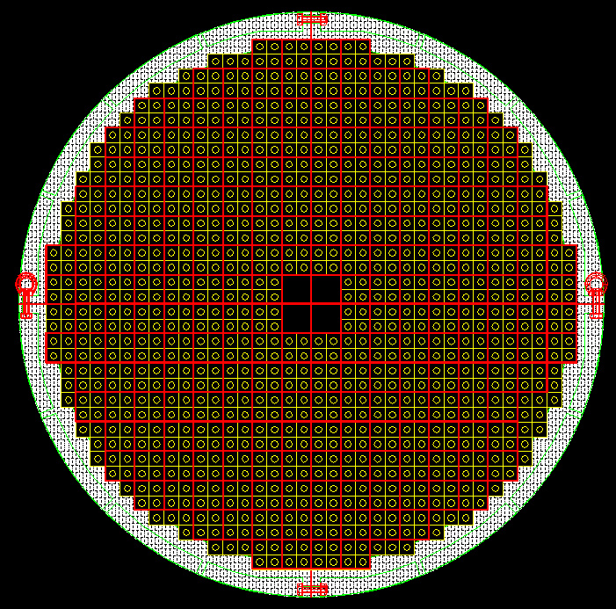
End-Cup calorimeter
in support frame
This End-Cup support for 928 Modules (3712 cells 40x40 mm²) – proposed by Valey Shvetcov.
Frame composed from 4 tiles – manufacturing from molded Aluminum.
The frame with ECAL modules should be inserted in Barrel support after their assembling.
Total End-Cup weight is equal ~10 tons.

Slide 14
Was done up to Now in 2025:
Scintillator tiles production in Vladimir (Uniplast) started since 2024.
Plan: plates 40x40x0.5 mm³ for one End-Cup , ~1000 modules, ~4000 cells:
Ready for 200 Modules - 160.000 plates – in 2025
In progress for 500 Modules - 400.000 plates – should be ready in 2026
Lead absorber plates 80x80x0.5 mm³ :
Ready for 200 Modules - 40.000 plates – 2 tons Lead in 2025
In progress for 500 100.00 plates – 5 tons Lead – plan for 2025-2026
Lead plate blanks (85x168 mm²) are produced in JINR and their stamping is done in Vladimir to obtain size 80x80 mm² with 64 holes for WLS.
Modules assembling:
200 – JINR VBLHE – 2025 – assembling procedure in progress.
500 – Vladimir (Uniplast) – assembling will started in 2025 will ready in 2026.
Modules assembling in Vladimir should be made complete with WLS .
WLS test was done in LNP – Results and report: Baranov V. - Kuraray-OSL8-BC
MC – Zimin Iliya report – WLS att. length influence on E-resolution.
WLS Fiber preparation – Not solved – polishing – painted – Used Loop option.
ADC and Frontend – status approximately is defined – Anfimov N. , Kreslo I.
5/7/2025
Oleg Gavrishuk, JINR, Dubna , Russia
14

Slide 15
End of Report
Thanks for attention to All
5/7/2025
Oleg Gavrishuk, JINR, Dubna , Russia
15

