Slide 1

Cryogenic system of SPD
Speaker: Yurii Bespalov
1

Slide 2

Outline
Elements of the cryogenic system
Placement of cryogenic equipment
3. Cryogenic liquid tanks and related work
4. Steps of creation
5. Conclusions
2

Slide 3
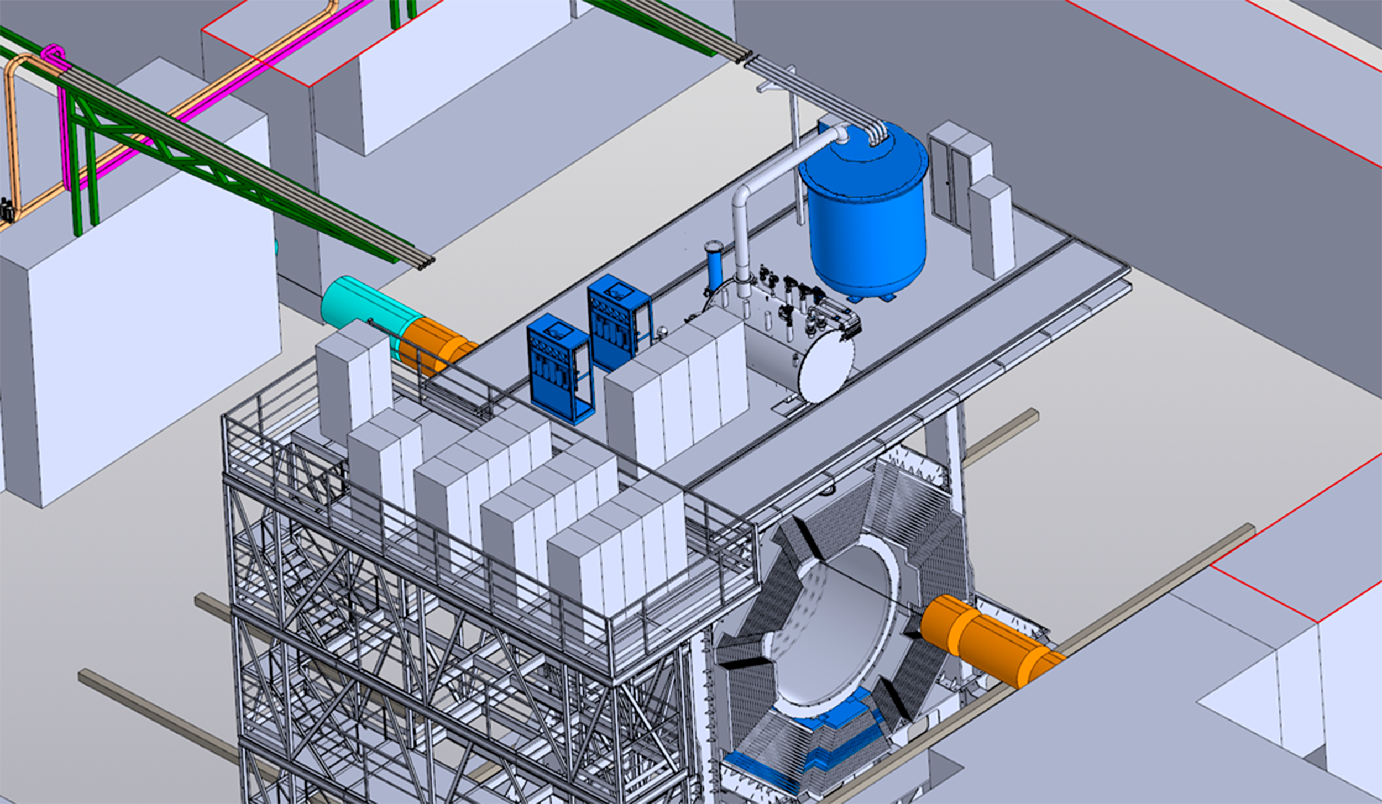
Cryogenic system
Helium and Nitrogen pipelines
Liquefier plant
Control cryostat
SPD
The model has been developed by Andrey Ponomarev

Slide 4
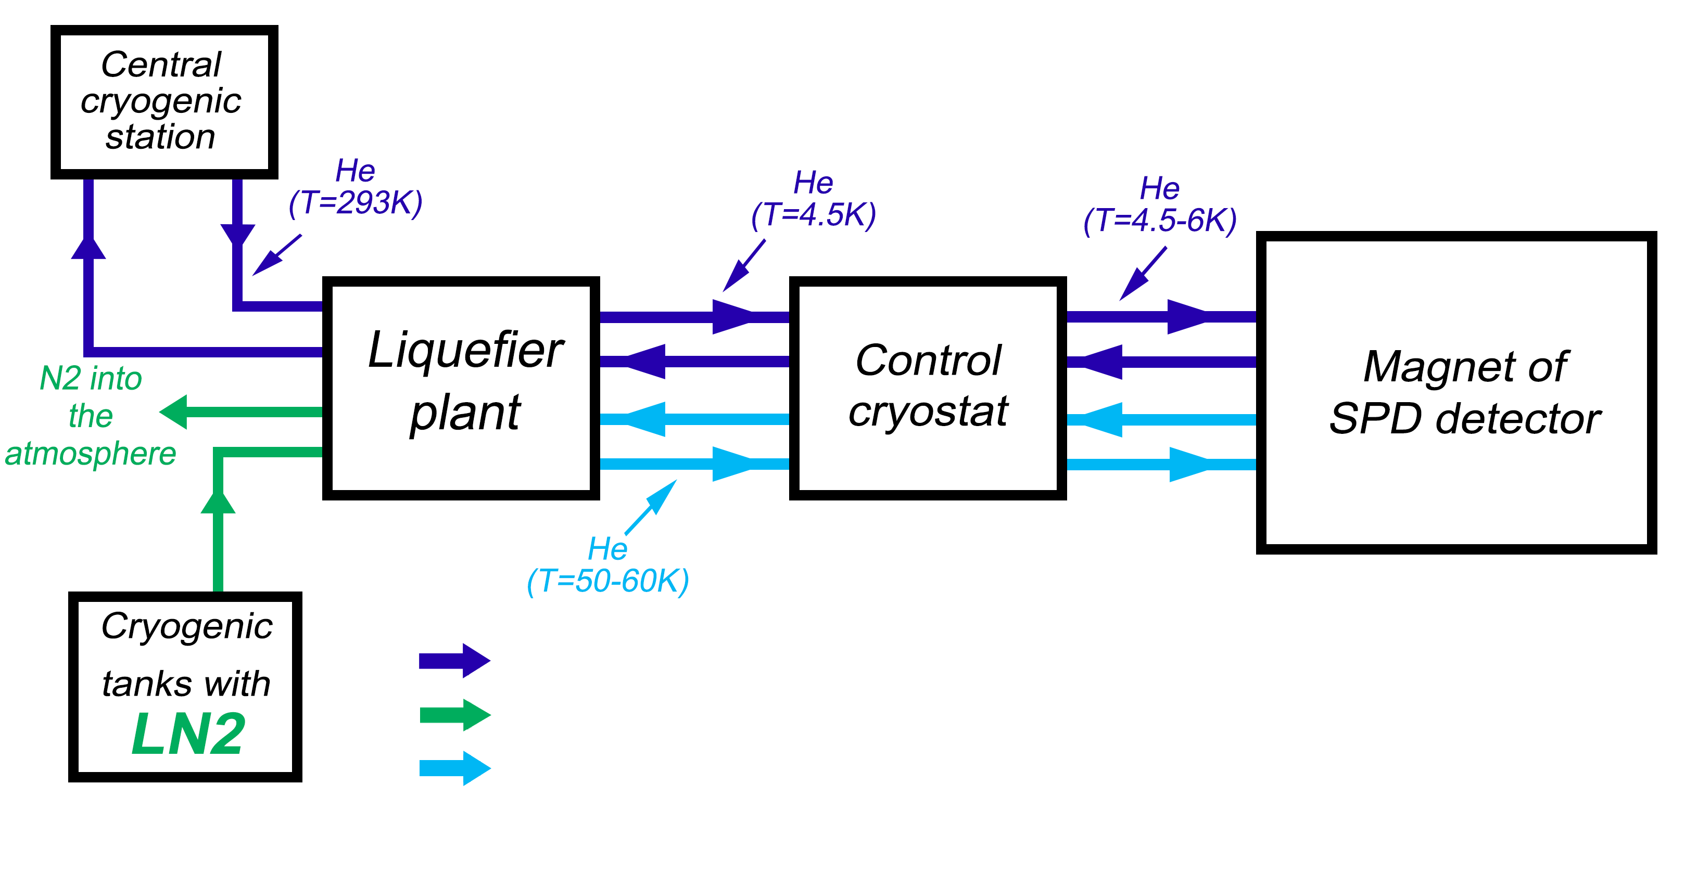
Cryogenic system
Diagram of cryogenic flows
He flow for cooling magnet of SPD detector (4.5-6К)
N2 flow for cooling cryogenic plant (~77К)
He line for cooling thermal shields and Cu part of current leads (~50К)
4

Slide 5
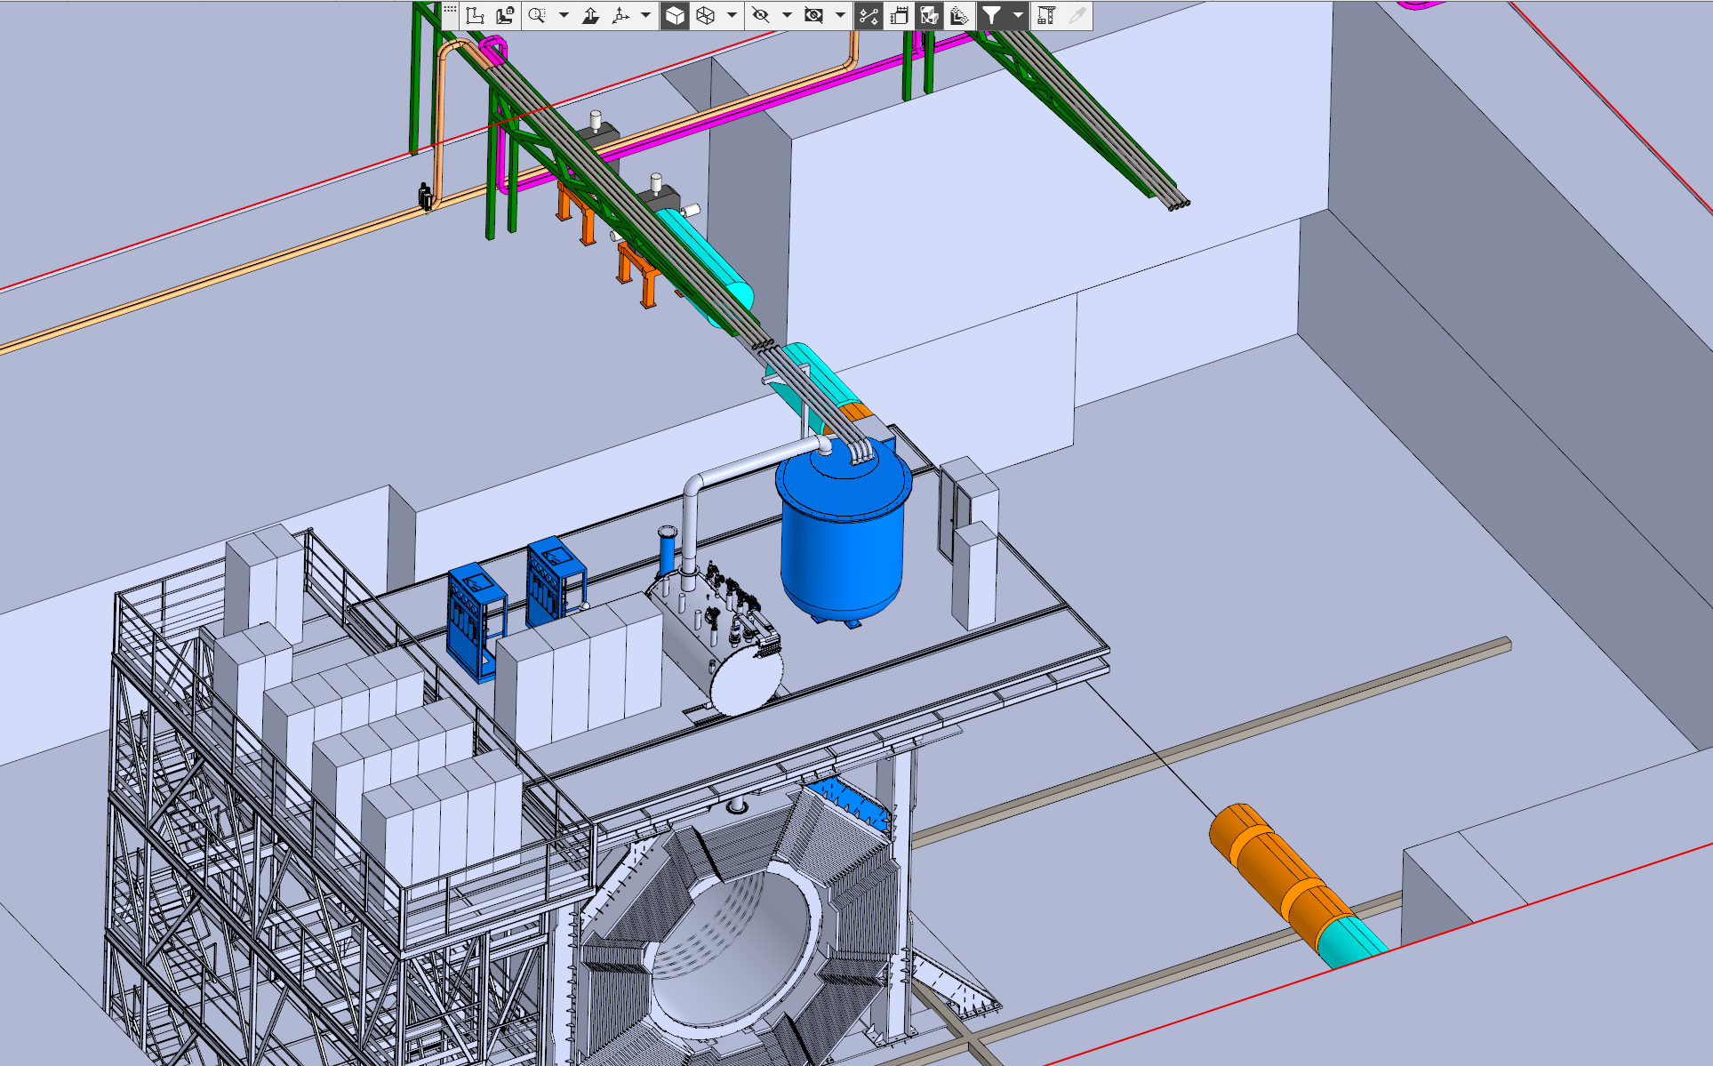
Cryogenic system service position
Working position
Service position
5

Slide 6
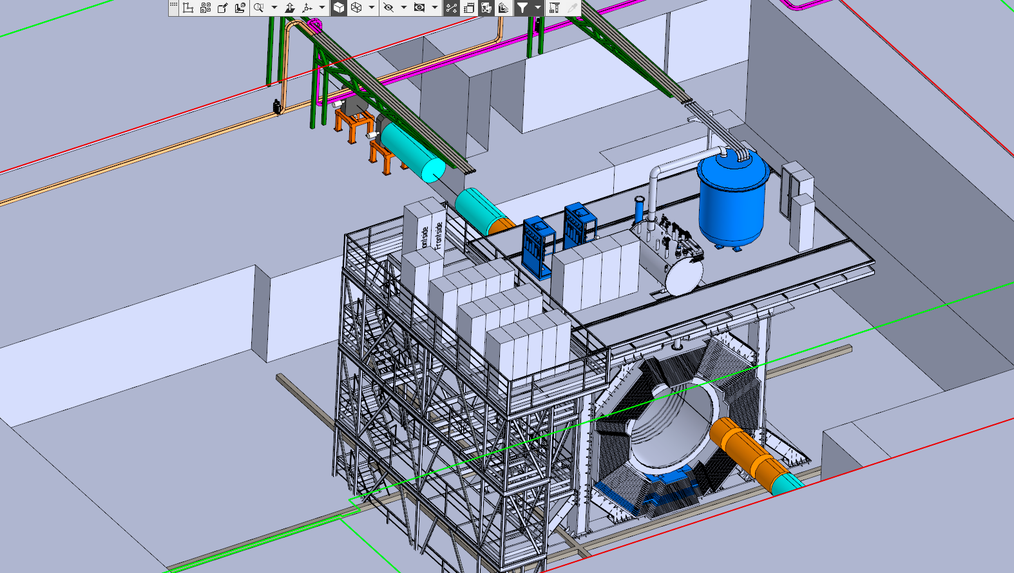
Cryogenic system working position
Working position
Service position
6

Slide 7
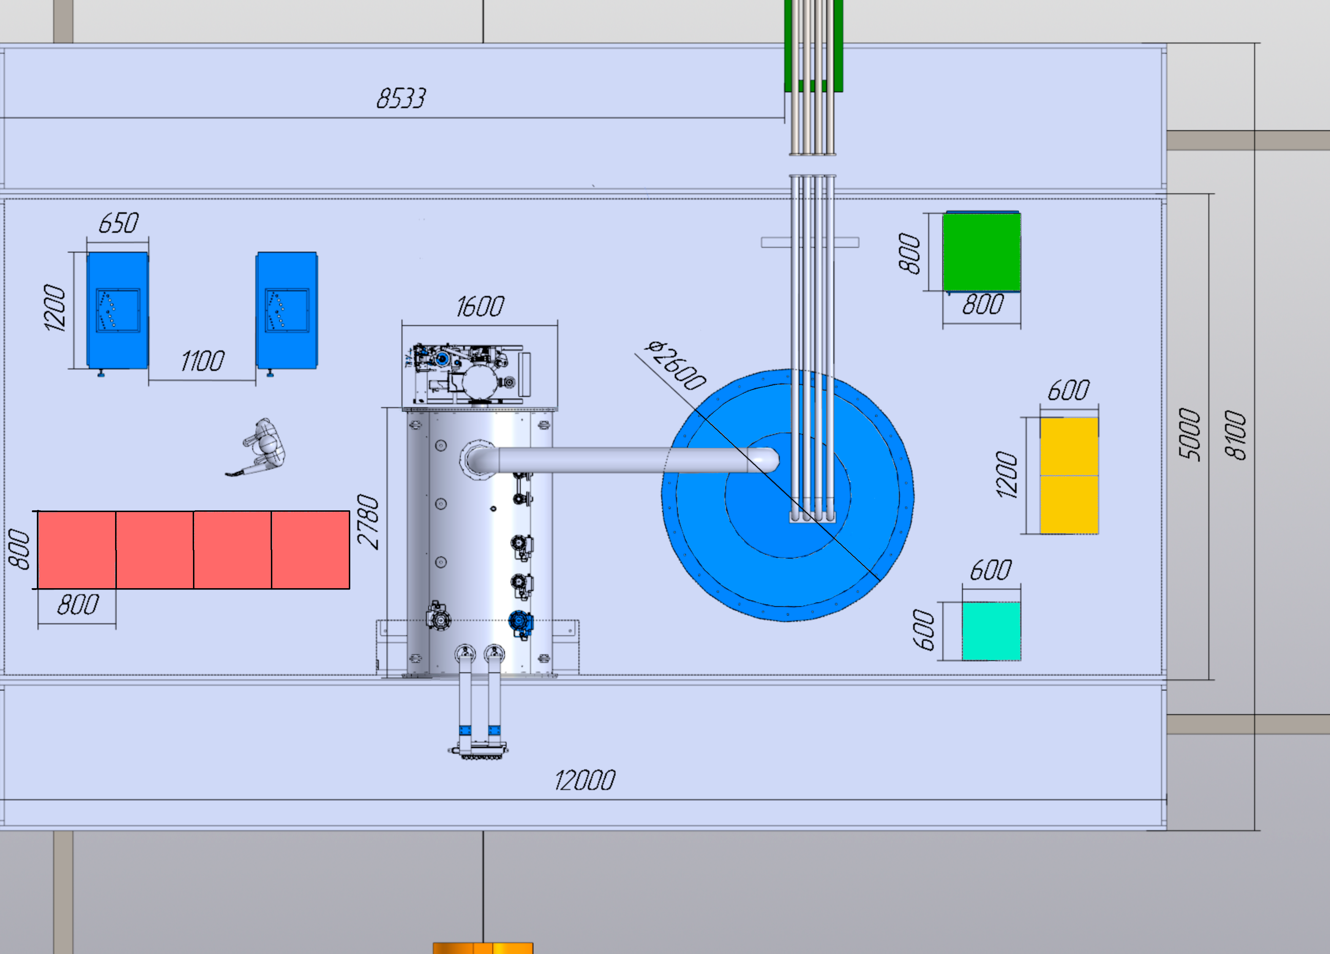
Cryogenic system
Measuring cabinet
Power supply cabinet
Protection system cabinet
Thermometry system cabinet
Vacuum cabinet
7

Slide 8
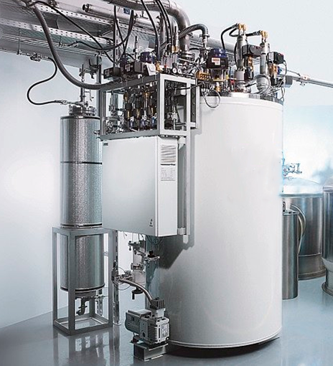
Helium system
 | Operating parameters | Unit
1 | Cooling capacity (for 4.5 K) | 100 - 130 l/h
2 | Cooling capacity (for 50 K) | 150 W
3 | Temperature of outlet flow from the SPD | 4.3 K (1.05 bar)
4 | Temperature of inlet flow from the SPD | 4.5 К (1.15 bar)
5 | Hydraulic resistance of the SC coil | 0.1 bar
6 | Cold weight | 5200 kg
7 | Maximum pressure in coil | 5 MPa
8 | Heat load | 60 – 80 W
9 | Equipment Requirement | Maximum reliability, energy efficiency, compactness, automatic mode
10 | Interval of repair/regulatory work of the plant | Not more than once a year
8

Slide 9
Cryogenic system control
Cryogenic system control
Helium pipeline
Vacuum system
Pneumatic system
Cryogenic plant
Nitrogen system
SC coil system control
9

Slide 10
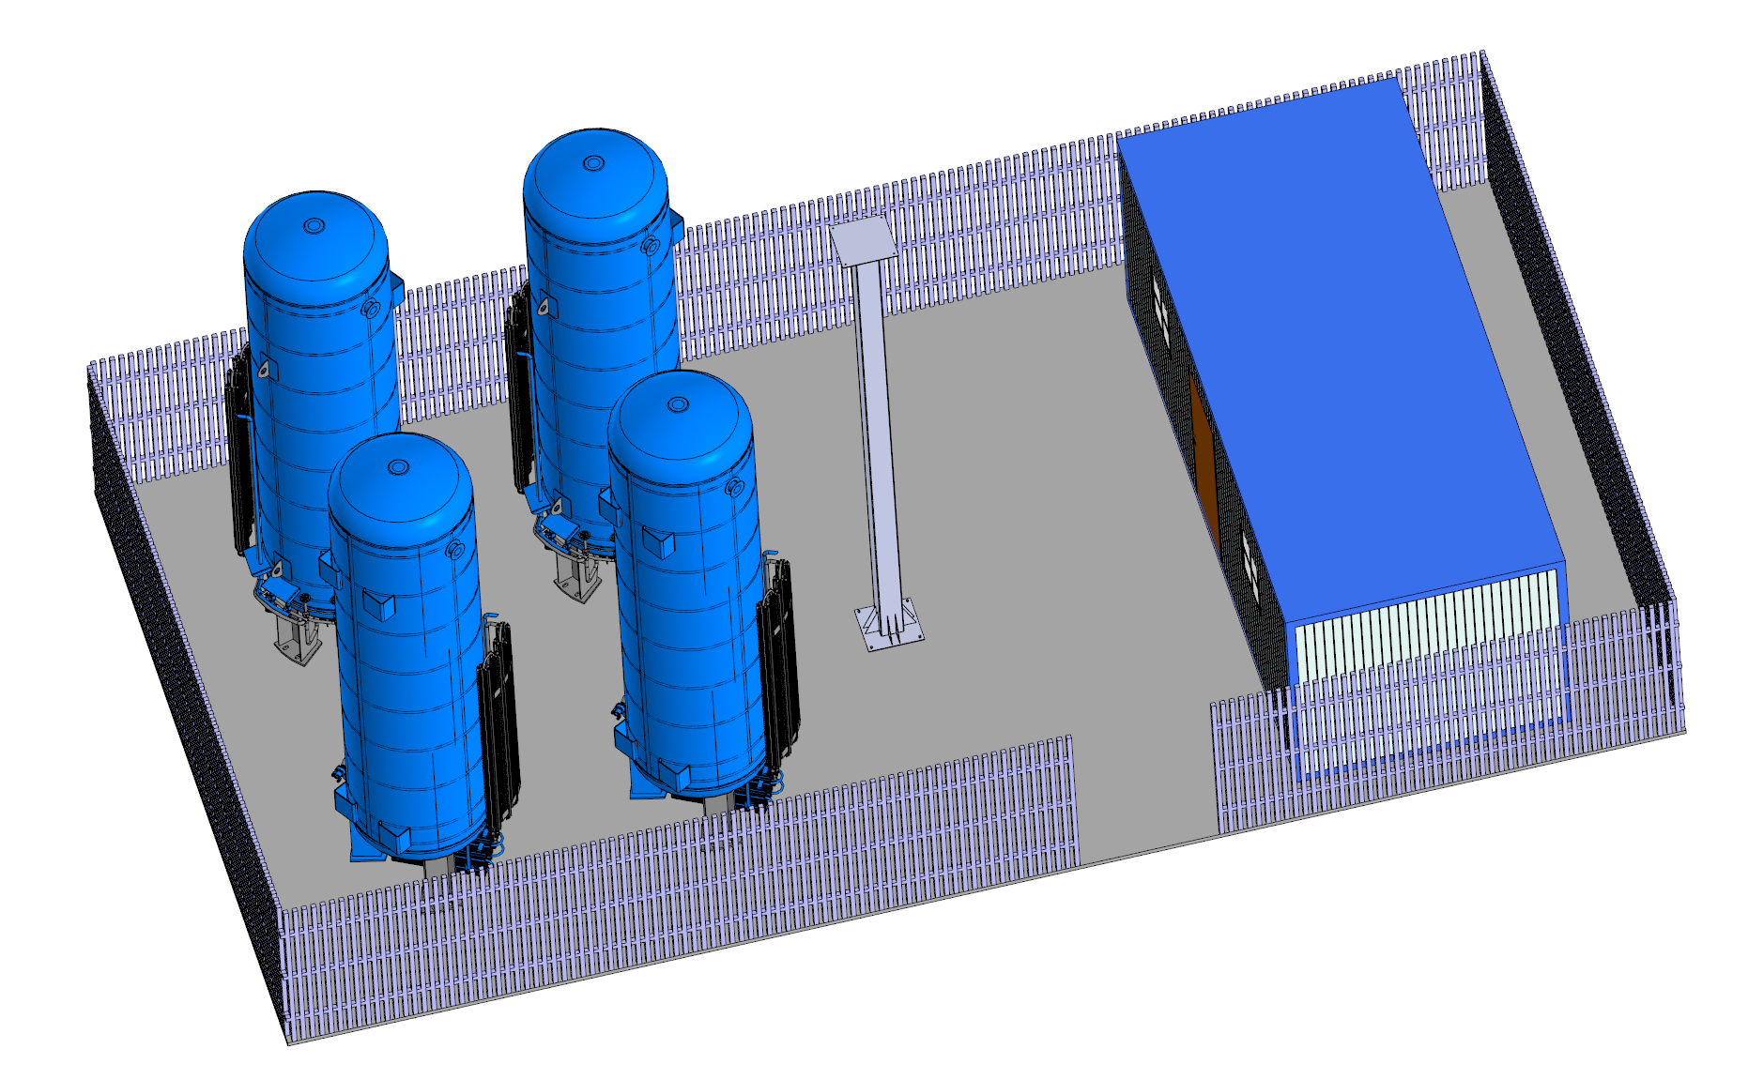
Cryogenic tanks platform
1
1
Pipelines
4
2
3
Cryogenic line:
LN2 – 150 m (rigid tube)
Warm line:
Ar – 120 m (rigid tube)
N2 – 120 m (rigid tube)
CO2 – 120 m (rigid tube)
1 – Two storage tanks for LN2;
2 – Storage tank for LAr;
3 – Storage tank for LCO2;
4 – Technical room
10

Slide 11
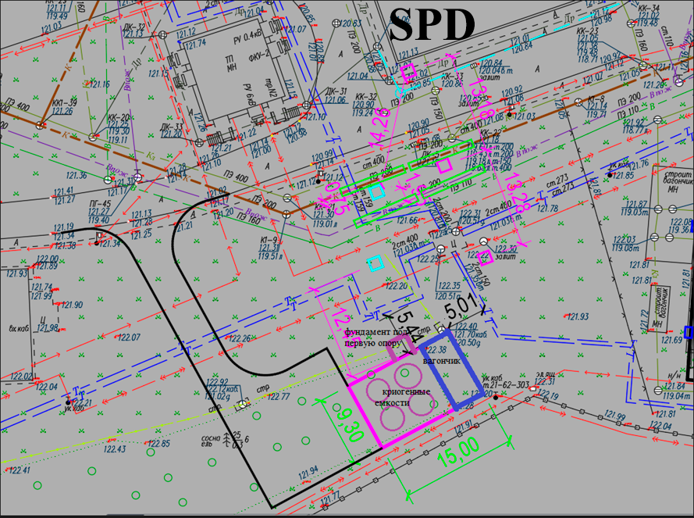
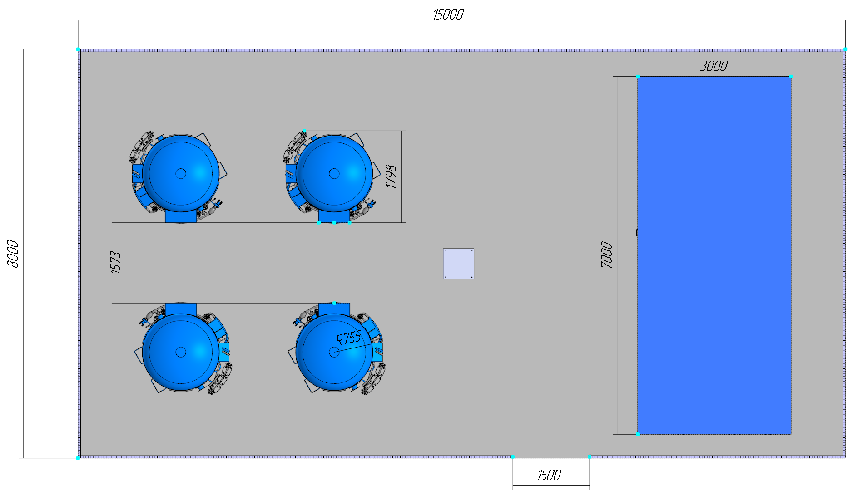
Cryogenic tanks platform
Cryogenics tanks:
20 000 liters of nitrogen will be spent in 1 month of work;
Refueling of nitrogen tanks can be carried out without stopping the experiment;
10 000 liters of Ar will be spent in 2.6 months of work;
10 000 liters of CO₂ will be spent in 4.7 month of work;
Isobutane will be stored in ballons volume of 20 m³(one ballon – 2.5 month of work.
11

Slide 12
Steps of creation
Steps of creation
SPD | 2024 |  |  |  | 2025 |  |  |  | 2026 |  |  |  | 2027 |  |  |  | 2028
 | I | II | III | IV | I | II | III | IV | I | II | III | IV | I | II | III | IV | I | II | III | IV
Cryogenic plant
Helium pipeline
Nitrogen system
Vacuum system
Pneumatic system
Cryogenic system control
Cryogenic tests
 |  |  | Technical design |  |  | Technical task |  |  |  |  | Contract execution |  |  |  |  |  | Assembly & Test |  |  |  |  | Commissioning
13

Slide 13
Conclusions:
The new location of cryogenic equipment on the technical platform has been approved.
The new location of cryogenic tanks platform has been determined.
A technical project was developed for the construction of a foundation for cryogenic tanks, including a platform for the arrival of a refueling machine.
The development of technical task for the manufacture of cryogenic tanks is in an active phase.
14

Slide 14
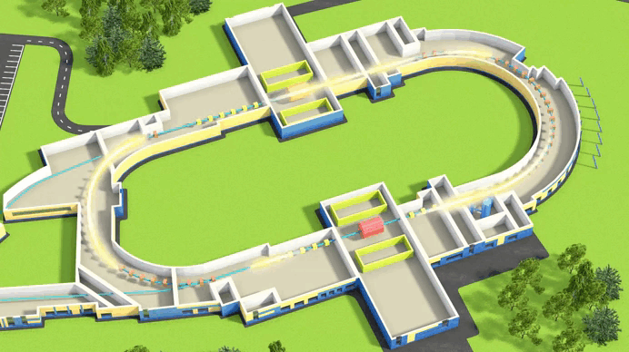
Thank you for your attention!

