Slide 1
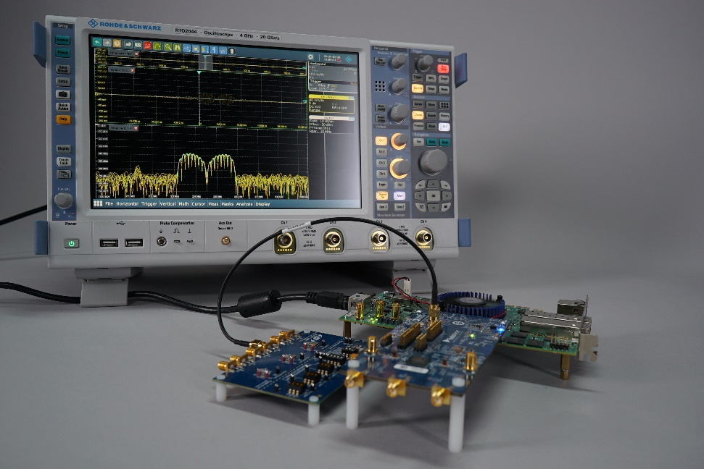
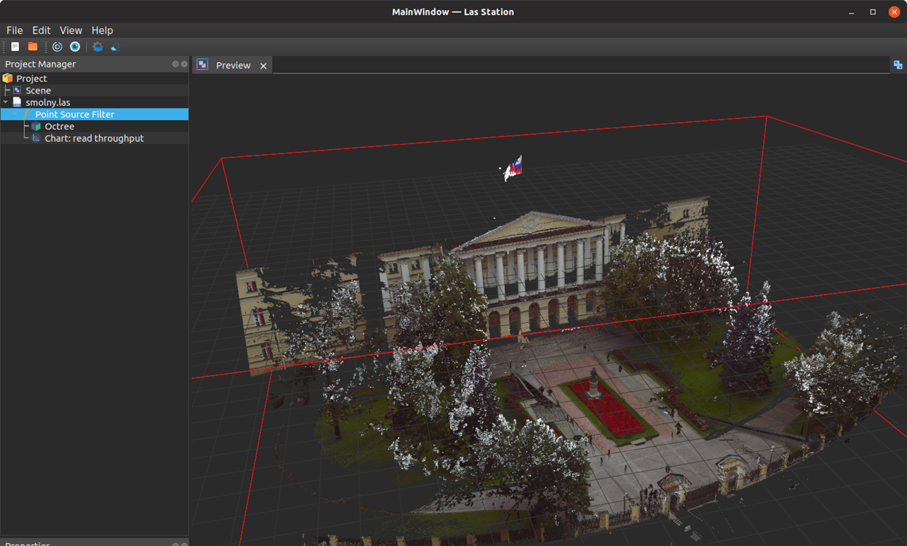
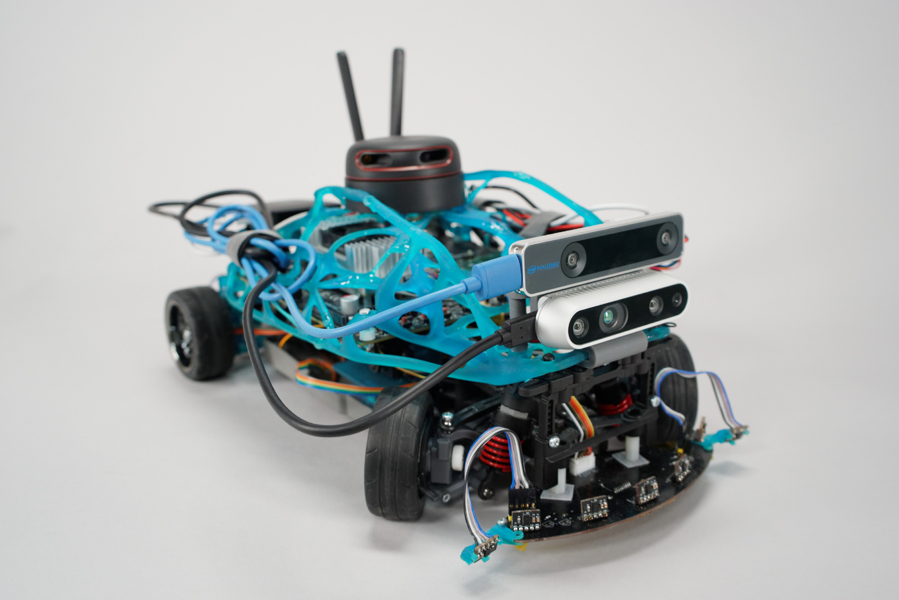
Current status of TSS development. White Rabbit calibration automatization and modeling of TSS network Daniil Kozyrev, Technician Industrial Systems for Streaming Data Processing Laboratory, “Digital Engineering” Advanced Engineering School, SPbPU
SPD-meeting
___________________________________
May 12th 2025

Slide 2
Presentation brief
Refresher on TSS subsystem, precision and accuracy requirements
White Rabbit calibration procedure comparison
White Rabbit calibration automatization adjustments
Network communication modeling
Current development work and prospects

Slide 3
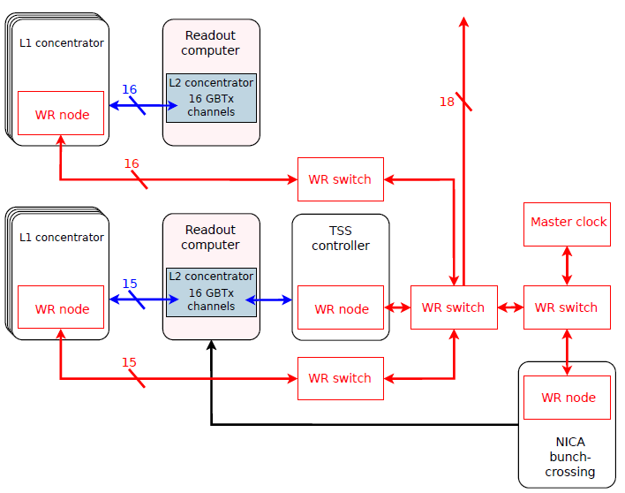
Time Synchronization Subsystem (TSS) with White Rabbit
1. Provides the global clock and time for the SPD DAQ
WhiteRabbit PTP (high accuracy profile of the IEEE1588-2019) – standard open protocol developed and maintained by CERN
Expected accuracy is better than 1 ns
2. Generates and distributes synchronous commands to mark data frames and slices
Run Control sends Start/Restart, Stop and Abort commands to TSS controller
The TSS controller generates a schedule
TSS nodes (at L1) receive this schedule and generate synchronous commands to front-end electronics
Notes:
The Time Synchronization Subsystem TSS has two main tasks. The first one is to provide a global clock and time for the SPD DAQ. For this purpose the TSS design employs the standard White Rabbit technology. White Rabbit nodes will be placed at TSS controller and at each L1 concentrator, and, if necessary, will be connected to White Rabbit at NICA site. The TSS network infrastructure will need just two levels of White Rabbit switches. And all the nodes in the network will be connected by a regular Ethernet over fiber optic cables.
The second task of the TSS is to broadcast a schedule that coordinates the run data partition across all distributed front ends at DAQ. Such synchronous commands will define when the run starts and stops and when are the boundaries of frames and slices in data.
Both White Rabbit nodes and a TSS protocol are currently under development at our lab.

Slide 4
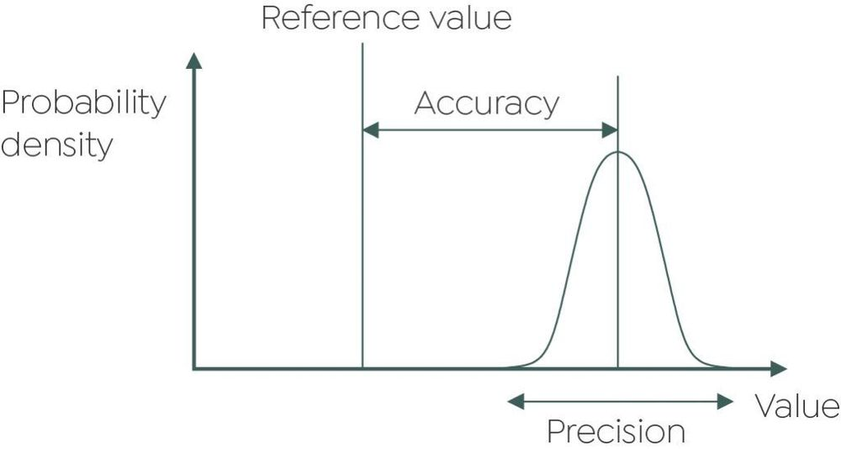
What is accuracy and precision
After initial synchronization WR node tracks the global clock and maintains the equal frequency of the local clock.
Accuracy as average clock skew:
Precision as relative rms jitter:
SPD
requires:
$$\overline{Δt}=\frac{1}{M}\sum_{i=1}^{M}{\left(t_{ref}−t\right)}$$
< 1 ns
$$σ_{N}=\sqrt{\frac{1}{M−1}\sum_{i=1}^{M}{{\left(Δt_{i}−\overline{Δt}\right)}^{2}}}$$
< 50 ps
Sub-nanosecond accuracy can be achieved after calibration.
Jitter depends on the hardware and environment.
Notes:
IEEE 181-2011
What White Rabbit does is it detects the clock frequency from the incoming Ethernet link and then constantly keeps track of the clock phase. The quality of synchronization can be defined by the clock accuracy and its precision. The clock accuracy is a skew of the clock in reference to a grandmaster clock. And precision is a relative clk jitter. The SPD experiment requires that each local clock will have accuracy better than 1 ns and precision better than 50 ps.
Our task was to estimate accuracy and precision limits achievable with particular devices and network topology of the TSS.

Slide 5
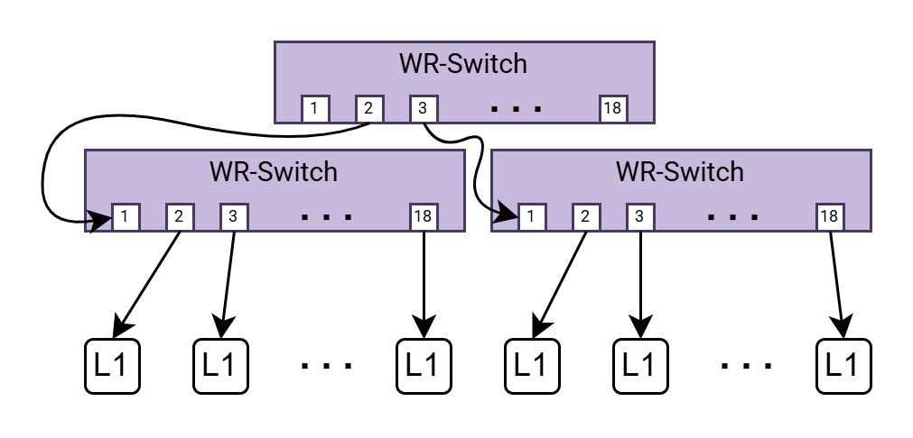
Calibration
Significant calibration time decrease
comparing to previously used procedure
Configuration | Before | Now
2Sw, 17 Nodes | 9h 0min | 14h 29min
3Sw, 34 Nodes | 18h 0min | 14h 47min
4Sw, 51 Nodes | 27h 0min | 15h 5min
5Sw, 68 Nodes | 36h 0min | 15h 23min
*** | *** | ***
17Sw, 272 Nodes | 144h 0min | 18h 59min
Independent of the SFP modules
Independent of Switch master port
Independent from the optical fiber cabel
Up to 4 SFP module pairs in L1s’ coefficient groups
Up to 10 SFP module pairs in switches’ coefficient groups
(length < 100 m)
Notes:
The key to high accuracy in White Rabbit is calibration. We have performed calibration for a test setup with three levels of White Rabbit switches. Both switches and nodes are from SyncTechnology and will be used in the first TSS prototypes.
During calibration each different network port should be measured against an already calibrated device and results are saved to its internal configuration file. For this task we used high-definition, high-precision oscilloscope and used internal oscillator in the top level switch as a grand-master clock.

Slide 6
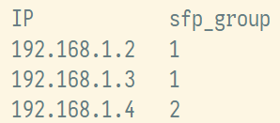
Calibration procedure automation
Derived device calibration is fully automated
Switches take now significantly longer time to calibrate
Procedure implies repetitive duplication of coefficients
9 hours for 18 ports
5 hours for 10 SFPs
for both switches and end nodes
The tables contain information on:
Coefficient groups of each end-node (max 4 per group)
SFPs composing each group
based on “White Rabbit. Good Practice Guide”
Motivation: calibration of one end point is a repetitive manual process, takes around 30 min
Method: automated RX and TX calibration presets refinement.
Requires:
manual oscilloscope probes connection (RTO2044)
remote LAN connection to oscilloscope
remote LAN connection to end node
Python script performs:
automated measurement of the current relative PPS skew
repetitive PTP restart
estimation of the required delay correction
remote end node’s delays reconfiguration
verification of calibration
Notes:
With this simplification only ports need to be calibrated. The calibration of one new White Rabbit port takes about 30 minutes. It is a repetitive process, where you have to manually take several measurements, reset the device each time, then put the results into a spreadsheet and change the device configurations based on calculations. We have created and tested a software program to automate this process. It has a command line interface. Here at the bottom of the slide is an example of its execution results. A node has been re-calibrated from 18 ps accuracy to 4 ps accuracy.

Slide 7
Delay mitigation
Devices not covered by TSS synchronization impose internal delay
Grand
Master
TSS (WR)
network
L1
WR node
L1
sync out
FE
sync in
FE
detector
uncovered delay $ẟ$
Calibrated with desired accuracy +- 70ps between resynchronization
+
Delay on non-TSS route could be mean-mitigated
$$skew_{PPS}→−ẟ$$
300 ps accuracy budget due to environmental effects
Notes:
In conclusion, we have done some simplification and automation of White Rabbit calibration. We have tested our method on SyncTechnology devices, which will be used both at the early TSS prototyping and during the system deployment. During our experiments we have determined the limits of accuracy and precision for White Rabbit devices. All measurements showed that numbers are well beyond the specified requirements and leave a generous margin in a total skew and jitter budget, which should definitely be estimated for the SPD installation in the future.

Slide 8
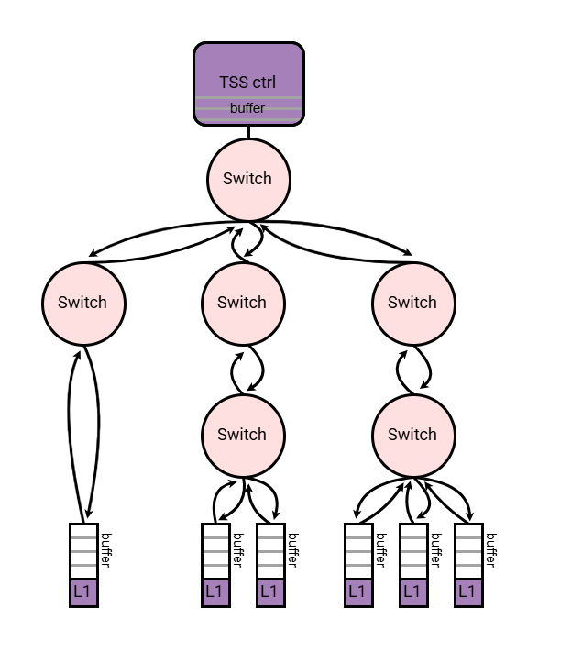
Network communication modeling
Mathematical model
PTP
Diagnostics
TSS UDP
The loading of communication channels
Input buffer sizes
Diagnostic OK-reply period
Imitational model complies non-TSS traffic to analyze TSS devices behavior
Could verify not only the device “as-is”, but the behavior of the system itself
Connection of non-TSS devices
Device access denials
L1 synchronization loss
Notes:
With this simplification only ports need to be calibrated. The calibration of one new White Rabbit port takes about 30 minutes. It is a repetitive process, where you have to manually take several measurements, reset the device each time, then put the results into a spreadsheet and change the device configurations based on calculations. We have created and tested a software program to automate this process. It has a command line interface. Here at the bottom of the slide is an example of its execution results. A node has been re-calibrated from 18 ps accuracy to 4 ps accuracy.

Slide 9
Reports on calibration methodology, and accuracy and precision evaluation
This work got support from Russian Ministry of Education and Science, state assignment for fundamental research (code FSEG-2025-0009)
IP:
“WR-NODE Calibration Refinement Program”
Conference publications:
D. Ryabikov et al. «White Rabbit Technology in the SPD Experiment», на SAEC-2024
D. Kozyrev et al. “White Rabbit Technology Evaluation for the SPD Experiment”, at PIERE-2024 (IEEE)
D. Kozyrev et al. “Automated Calibration Procedure of White Rabbit Nodes for Deployment and Maintenance of the Time Synchronization System for the SPD Experiment”, at SEDM-2025
Workshop presentation:
N. Makarevich “Allan Deviation Calculation Problem in White Rabbit Network”, at workshop “Development of digital data acquisition systems” - 2024
Notes:
This part of our work is supported by a state assignment. Some of our results already have been reported and published, and the rest is planned to be published by the end of the year.

Slide 10
TSS development roadmap
2025
2026
2027
TSS controller prototype implementation
Preliminary integration and testing with DAQ L1 elements
New! Evaluation of WR implementation based on PangoMicro FPGA
Preliminary TSS testing
New! Mathematical and imitational modelling of network communication
TSS calibration automation
TSS diagnostic tools implementation
Project porting for Cyclone 10
WR network deployment and configuration for TSS network segments
TSS controller production
Continuous support and refinement of TSS

Slide 11
Team

