Slide 1
Set up for RUNO chip project. First experience and next steps.
Е.Усенко (ИЯИ РАН, ОИЯИ),
М.Буряков (ОИЯИ),
В.Чмиль (ОИЯИ).

Slide 2
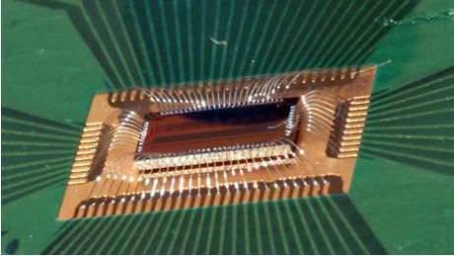
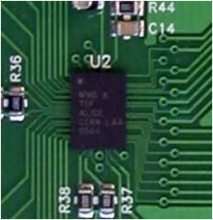
Main prototype - NINO ASIC's for RPC detectors.
A NINO CHIP: FIRST ASIC FOR TIME-OF-FLIGHT APPLICATIONS
NINO ASIC based on the CMOS 0.25 um technology from the IBM process.
8-channels smart amplifier-discriminators
differential transimpedance input stage
preamplifier G=30, discriminator G=5x5x5x5=625
TOT method
Stretcher for TOT function
Hysteresis adjustment
NINO chip bounded on test board
76-pin TAPP package

Slide 3
RUNO ASIC set up.
It is important to take 20-years experience of NINO ASIC application.
Only NINO ASIC was successful use in a variety of applications
8-channels smart amplifier-discriminators structure? – OK
differential transimpedance input stage? – Need modify
NINO designed for PAD readout. But RUNO ASIC for STRIP readout.
For reduce signal losses (two side STRIP termination) and simplified design.
amplification factor preamplifier G=60– Need modify
TOT method – Need modify
Modify for reduce errors and extend application
Stretcher – OK
OR function – Need modify
Add OR input

Slide 4
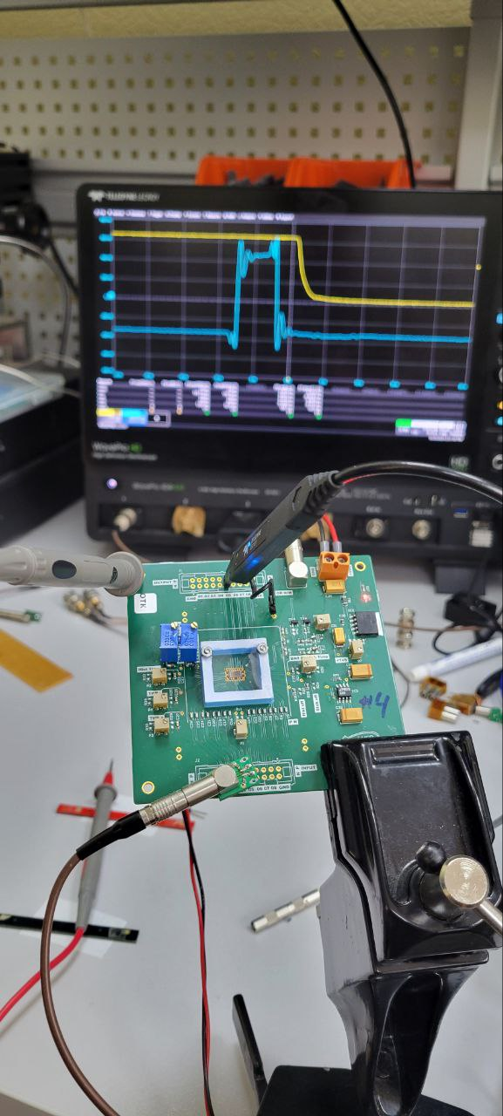
RUNO ASIC first step.
First version – technology test.
Jitter 10ps

Slide 5
RUNO ASIC continue.
First version – 0.18 um CMOS “Micron” Zilenograd.
First especial version – repeat NINO ASIC structure for “Micron” technology testing.
half – successful result – need correct technology or project ????
Two possible ways:
Modify RUNO ASIC project for “Micron” technology requirements.
Cost and time? In process
Is it possible?
2. Start completely new project for change production factory.
Cost and time?

