Slide 1
On some proposals to SPD spin physics program
A.Gribovsky^{1,2}
E.Kokoulina²
M.Levchuk^{3,1}
R.Shulyakovsky¹
¹IAP NASB, Minsk
²JINR, Dubna
³B.I.Stepanov Institute of Physics NASB, Minsk

Slide 2
ABSTRACT
Some possible physical tasks in context of SPD experiment are proposed. Among them are the following: Gerasimov–Drell–Hearn sum rule for deuteron are discussed; possibility of QCD-instanton-induced effects manifestation is considered; contribution of two-photon mechanism of lepton pairs production is estimated. Also some results of modeling of detector magnet geometry are presented.

Slide 3
Gerasimov–Drell–Hearn sum rule for deuteron
QCD-instanton-induced effects
Two-photon mechanism of lepton pairs production
Modeling of detector magnet geometry

Slide 4
ON GERASIMOV–DRELL–HEARN (GDH) SUM RULE FOR THE DEUTERON
preliminary

Slide 5
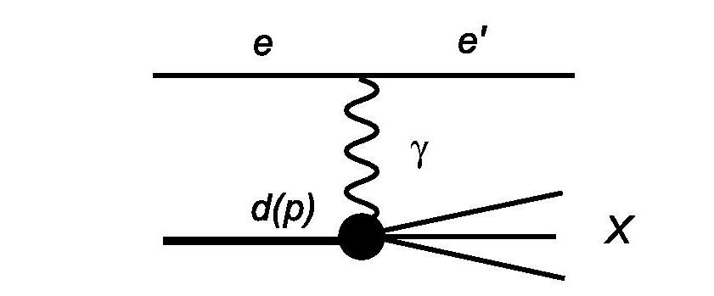

Slide 6
The famous GDH sum rule gives an integral relation between anomalous magnetic moment k of a spin-S particle and the difference of the total photoabsorption cross sections with parallel and antiparallel photon and target spin alignments
Eγ is the photon laboratory energy
m is the particle mass
S. B. Gerasimov, Yadern. Fiz., 598 (1965) [Sov. J. Nucl. Phys., 430 (1966)].
S. D. Drell and A. C. Hearn, Phys. Rev. Lett., 908 (1966).

Slide 7
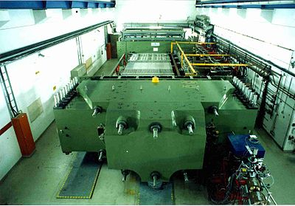
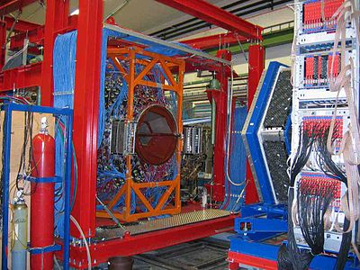
For more than a decade, the GDH and A2 collaborations (INP, Mainz, Germany) have been carrying out intense experimental studies aimed at the verification of this sum rule.
K. Helbing, Progr. Part. Nucl.Phys., 405 (2006).

Slide 8
The lhs of above equation for the proton is 205 µb. The integrand in the rhs of the equation at energies from 0.2 to 2.9 GeV was determined by the GDH and A2 collaborations in a series of experiments with circularly polarized photons and longitudinally polarized protons. Involving theoretical predictions from threshold to 0.2 GeV and above 2.9 GeV, the GDH group obtained for the rhs of the equation 212±6(stat)±16(syst) µb, which is in good agreement with the GDH sum rule prediction.

Slide 9
What about GDH for the deuteron?
The anomalous magnetic moment k_{d} = – 0.143.
The lhs of GDH for the deuteron is 0.65 µb, which is more than two orders smaller than the nucleon values.
An analysis of different channels (deuteron photodisintegration, single and double-pion production as well as from single-η production) in the deuteron GDH integral is 27 µb.
[H. Arenhövel, A. Fix, and M. Schwamb, Phys. Rev. Lett., 202301 (2004)
M.I. Levchuk, Phys. Rev., C82, 044002 (2010)]
The maximal Eγ in the calculations was about 2 GeV.

Slide 10
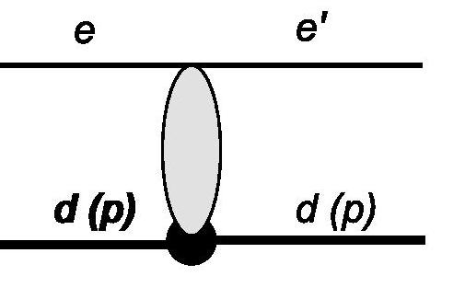
Another task: deuteron and nucleon form factors
The diagram that contributes to deuteron and nucleon form factors

Slide 11
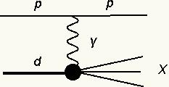
Аdditional difficulties…

Slide 12
QCD-instanton-induced effects
Instantons are nontrivial solutions of Euclidean equations of motion with finite action

Slide 13
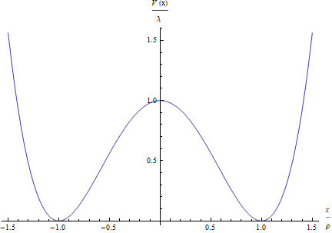
Quantum mechanical example

Slide 14
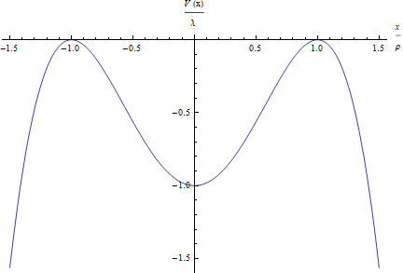
After Wick rotation we get inverted potential

Slide 15
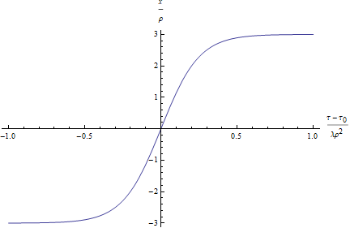
In this model, there is exact analytical Euclidean solution of the following form

Slide 16
BPST-instanton
Instantons were found in 1975 [1]:
[A. Belavin, A. Polyakov, A. Schwarz, and Yu. Tyupkin, Phys. Lett. 59B, 85 (1975).]

Slide 17
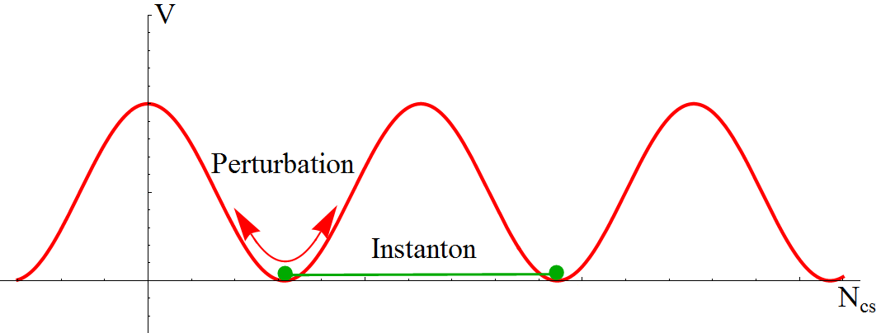
Vacuum QCD
[R. Jackiw, C. Rebbi, Phys. Lett. 37, 172 (1976)]

Slide 18
Instantons in QFT
In quantum field theory instantons describe tunneling processes between classical degenerated vacua (if formalism of Feynman path integral used)

Slide 19
Instantons in QFT
In leading approximation

Slide 20
Relationship between amplitude and energy
Ringwald showed that the amplitude can exponentially grow with the energy:
[A. Ringwald, Nucl. Phys. B 330, 1 (1990)]

Slide 26
Chiral symmetry breaking

Slide 27
Resonance tunneling
[V.I. Kuvshinov, A.V. Kuzmin, R.G. Shulyakovsky. Chaos assisted instanton tunnelling in one dimensional perturbed periodic potential. Phys. Rev. E67 (2003) 015201-1 - 015201-4]
[Р.Г. Шуляковский. Аналитические инстантонные решения в 2-мерных полевых моделях. Письма в ЭЧАЯ №5, 2008, 704-708]
Footprints of QCD-instantons in high energy collisions
[A. Ringwald, Nucl. Phys. B 330, 1 (1990)]
[V.I. Kashkan, V.I. Kuvshinov, R.G. Shulyakovsky. Effect of Hadronization on the Form of Correlation Moments for Instanton Processes and Possibility of Discovering Them Experimentally. Physics of Atomic Nuclei, Vol. 65, No. 5 (2002) 925–928]
Contribution into spin structure function (instanton liquid model)
[T. Schaefe, E. Shuryak. Instantons in QCD. Rev. Mod. Phys. 70:323-426,1998]
[A.E.Dorokhov. Instanton effects in high energy processes. Czech.J.Phys.53:B59-B68, 2003]
[N.I. Kochelev. Instantons and Spin-Flavor effects in Hadron Physics.: arXiv:0809.4773]
Instantons at high temperature and high density
[V. A. Rubakov, M. E. Shaposhnikov. Electroweak baryon number non-conservation in the early Universe and in high-energy collisions UFN, 166:5 (1996), 493–537]

Slide 28
Resonance tunneling
[V.I. Kuvshinov, A.V. Kuzmin, R.G. Shulyakovsky. Chaos assisted instanton tunnelling in one dimensional perturbed periodic potential. Phys. Rev. E67 (2003) 015201-1 - 015201-4]
[Р.Г. Шуляковский. Аналитические инстантонные решения в 2-мерных полевых моделях. Письма в ЭЧАЯ №5, 2008, 704-708]
Footprints of QCD-instantons in high energy collisions
[A. Ringwald, Nucl. Phys. B 330, 1 (1990)]
[V.I. Kashkan, V.I. Kuvshinov, R.G. Shulyakovsky. Effect of Hadronization on the Form of Correlation Moments for Instanton Processes and Possibility of Discovering Them Experimentally. Physics of Atomic Nuclei, Vol. 65, No. 5 (2002) 925–928]
Contribution into spin structure function (instanton liquid model)
[T. Schaefe, E. Shuryak. Instantons in QCD. Rev. Mod. Phys. 70:323-426,1998]
[A.E.Dorokhov. Instanton effects in high energy processes. Czech.J.Phys.53:B59-B68, 2003]
[N.I. Kochelev. Instantons and Spin-Flavor effects in Hadron Physics.: arXiv:0809.4773]
Instantons at high temperature and high density
[V. A. Rubakov, M. E. Shaposhnikov. Electroweak baryon number non-conservation in the early Universe and in high-energy collisions UFN, 166:5 (1996), 493–537]

Slide 29
Three magnetic systems ─ a comparison
Gribowsky A.
Ivanov A.
Kovalenko A.
Perepelkin E.

Slide 30
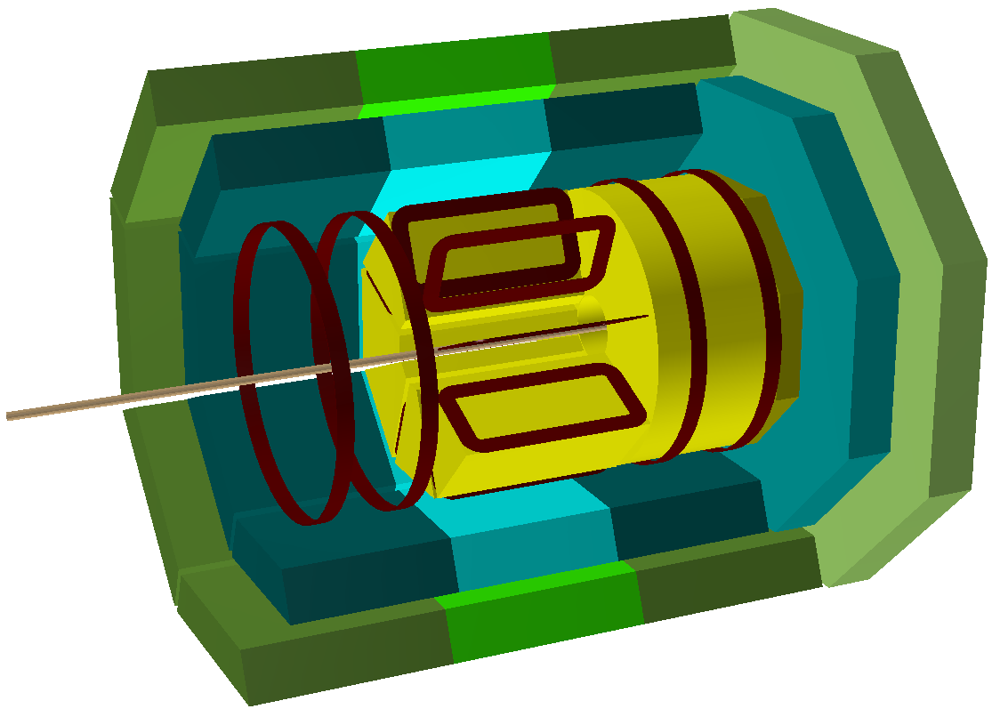
Settings
Data: Hybrid Solenoidal and Toroidal SPD set-up with one million events; p – p collision with √s = 26 GeV.
Minimum bias
RS
ECAL
TS
MAGNET

Slide 31
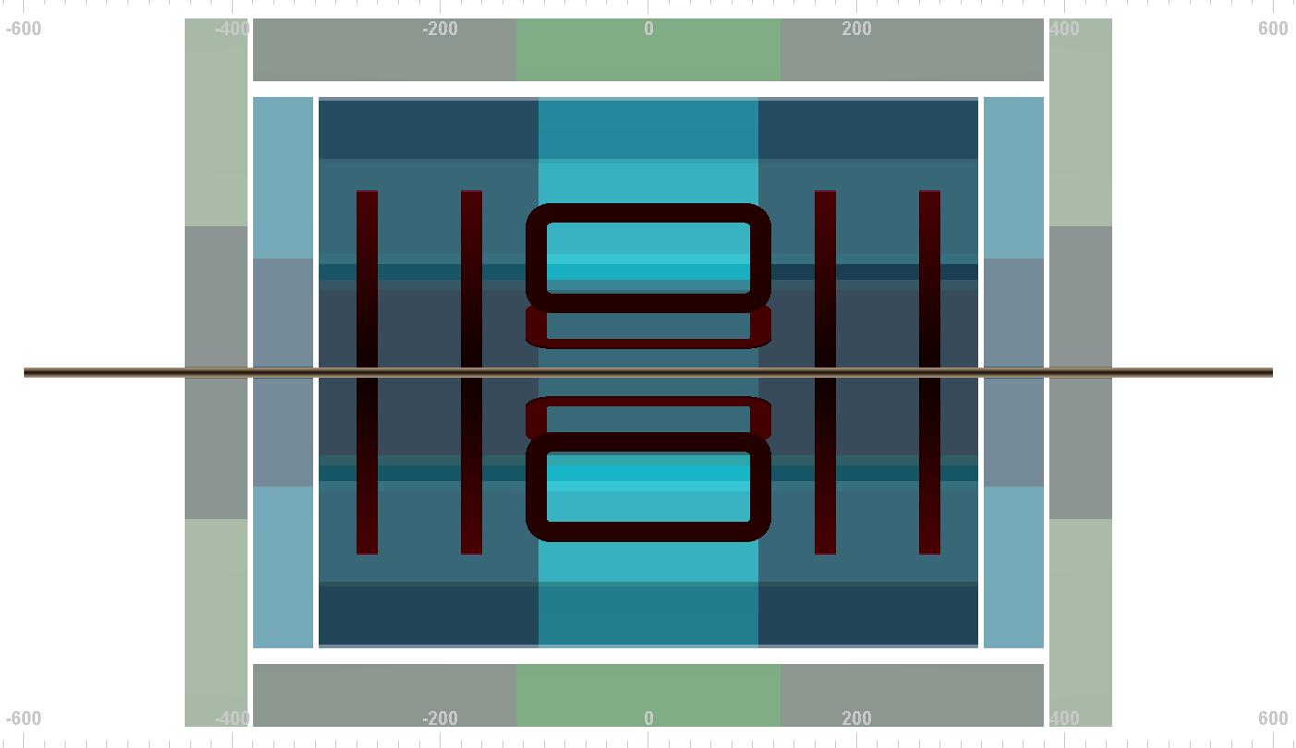
Geometry: Rho-Z
New composition
RS
ECAL
MAGNET

Slide 32
Geometry: R-Phi
Solenoidal part
Toroidal part
RS
ECAL
TS
MAGNET

Slide 33
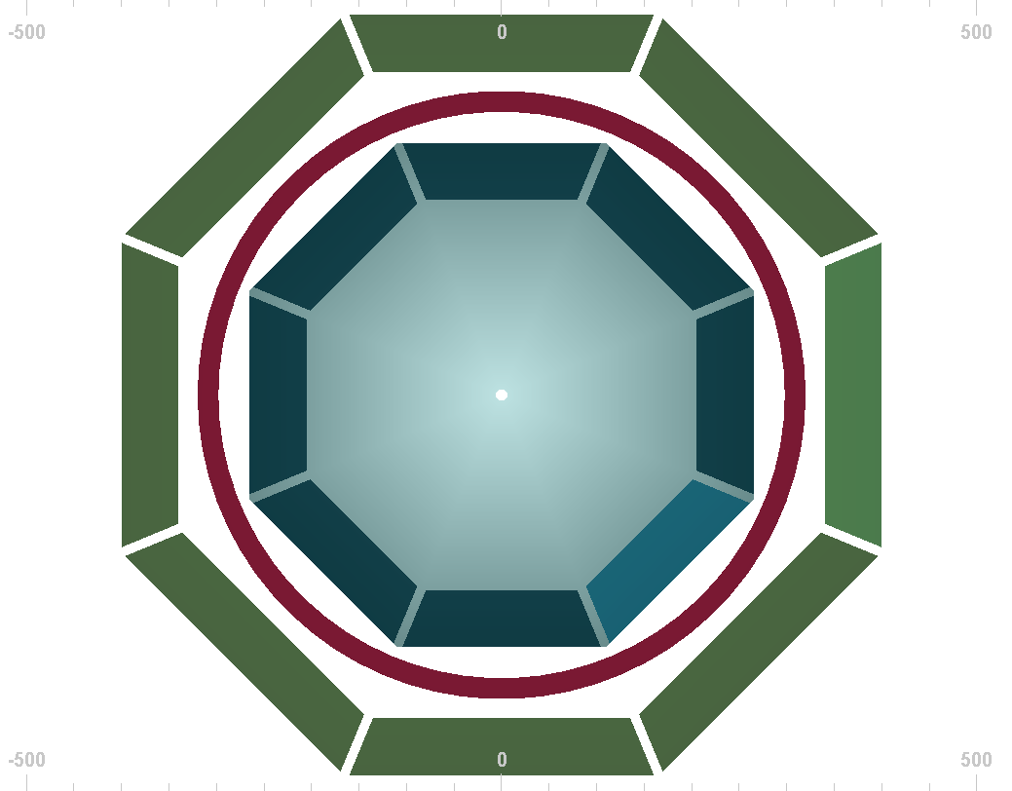
Solenoid geometry: R-Phi
Solenoid
RS
ECAL
MAGNET

Slide 34
Momentum: γ from initial vertex
p
p_{T}
 | Solenoid | Toroid | Hybrid
ECAL | 93% | 84% | 91%

Slide 35
Angles: γ from initial vertex
θ
φ
 | Solenoid | Toroid | Hybrid
ECAL | 93% | 84% | 91%

Slide 36
Momentum: π⁰ → γγ
p
p_{T}
 | Solenoid | Toroid | Hybrid
ECAL | 86% | 71% | 83%

Slide 37
Angles: π⁰ → γγ
θ
φ
 | Solenoid | Toroid | Hybrid
ECAL | 86% | 71% | 83%

Slide 38
Particles | Solenoid % | Toroid % | Hybrid %
γ | 93 (ECAL) | 84 (ECAL) | 91 (ECAL)
π⁰ → γγ | 86 (ECAL) | 71 (ECAL) | 83 (ECAL)
p | 80.5 (ECAL) | 68.4 (ECAL) | 80.1 (ECAL)
n | 81.3 (ECAL) | 69.6 (ECAL) | 81.1 (ECAL)
π⁺ | 76 (ECAL) | 73 (ECAL) | 80 (ECAL)
K⁺ | 56 (ECAL) | 53 (ECAL) | 57 (ECAL)
K⁰→π⁺π⁻ | 48 (ECAL) | 47 (ECAL) | 60 (ECAL)
Λ → pπ⁻ | 59 (ECAL) | 41 (ECAL) | 62 (ECAL)

Slide 39
The design of the SPD for NICA complex is at the stage of the magnetic system development. Magnets allow using a convenient method to measure the momentum of charged particles by analyzing their paths curvature. So, it is important to choose field that wouldn’t be difficult to work with.
At this stage, several options are proposed. The simplest option for further tracking is a solenoid, which creates a uniform field. However, to study spin effects it is desirable to have a transverse field component. Such a field can be obtained using a toroidal magnet. Also during the discussion, a hybrid version of a magnet with solenoidal and toroidal parts was proposed (A. Kovalenko). However, the hybrid magnet has a non-trivial field, which would considerably burden further tracking. In addition, in the hybrid system toroidal central part of the magnet can be replaced by solenoid. That would give greater flexibility to the detector and expand its capabilities.

Slide 40
The simulation program is based on FairRoot framework and uses Pythia6 as events generator and Geant4 for the simulation of the passage of particles through matter. In addition to magnet, geometry of the model also includes electromagnetic calorimeter and muon chamber, both composed of barrel and two end caps. Barrels are built of trapezoidal blocks with spaces between them. Internal geometry of these parts are not decided yet. Geometry of electromagnetic calorimeter for all three option of detector is the same, so only form of magnet would affect results.
One million minimum biased events of pp collision with were selected. Simulation indicated that solenoidal geometry shows the best acceptance of all three magnets. It is understandable because in this case the magnet is located behind the calorimeter. The toroidal magnet showed the worst results. Because of its geometry, rings of toroidal magnet reflect and stop particles going at small angles to beam, where most of the particles fly. Such a results are expected, but still they will be taken in account when final decision will be made.

Slide 41
This work is supported by Belarusian Republican Foundation for Fundamental Research under Grant No. FФ18D-010

Slide 42
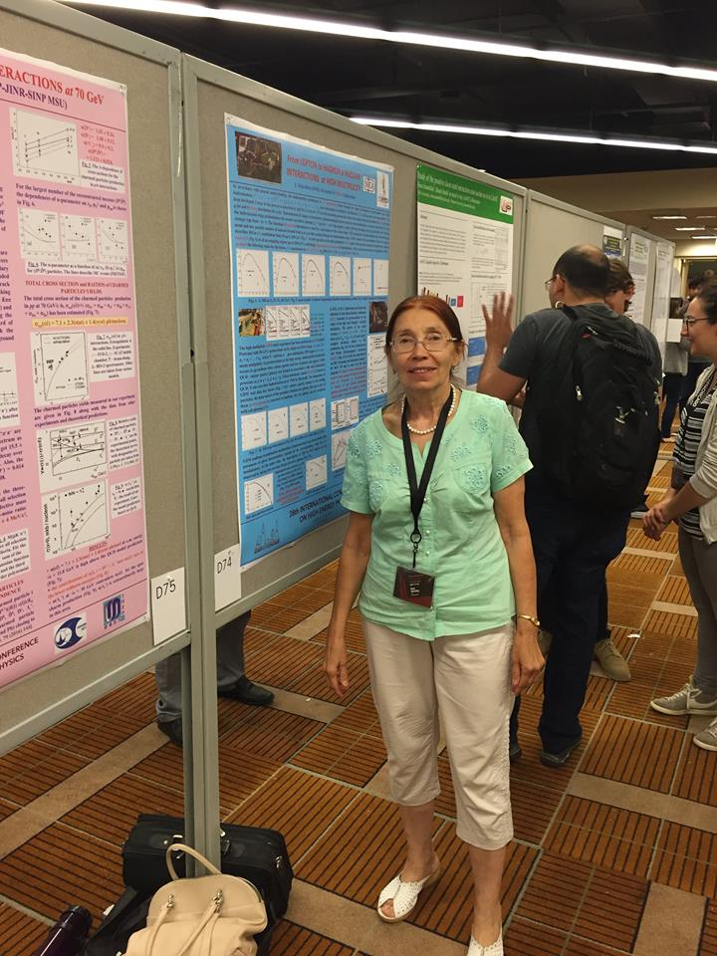
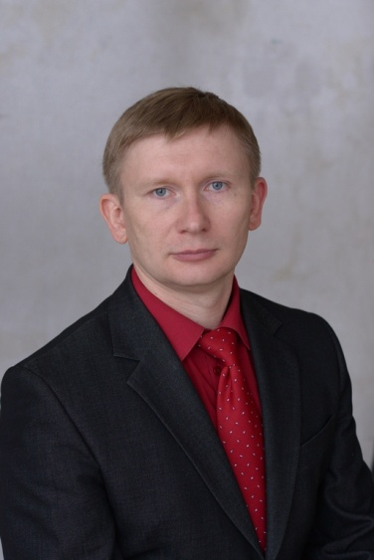
Prof. Mikhail LEVCHUK
Dr. Elena KOKOULINA
Alexander GRIBOWSKY
Alexei SHAPLOV
Dr. Alexander GARKUN
Maxim Nevmerzhitskii

Slide 43
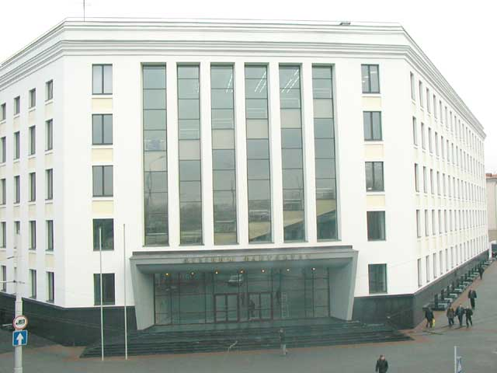
Belarus State University Physical Faculty

Slide 44
Thank you for attention!

