Slide 1
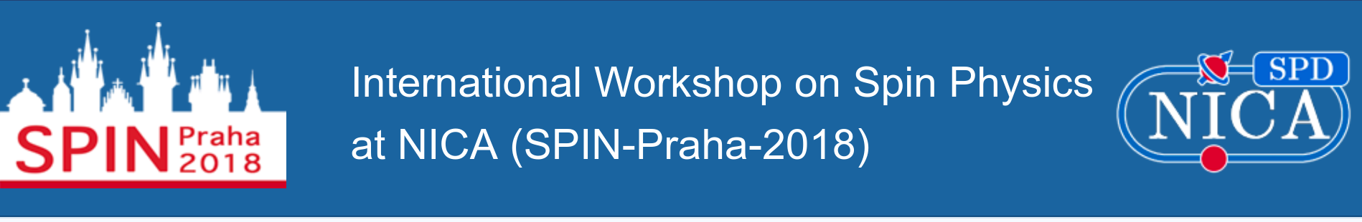
SPD silicon inner tracker
S.Khabarov, O.Tarasov, N.Zamyatin, E.Zubarev
JINR, Dubna
SPIN-Praha-2018 11.07.2018

Slide 2
Outline
Region of IT on SPD
Main parameters of IT
Specification for Si sensors
Design of Vertex planes for BM@N experiment
Conclusion

Slide 3
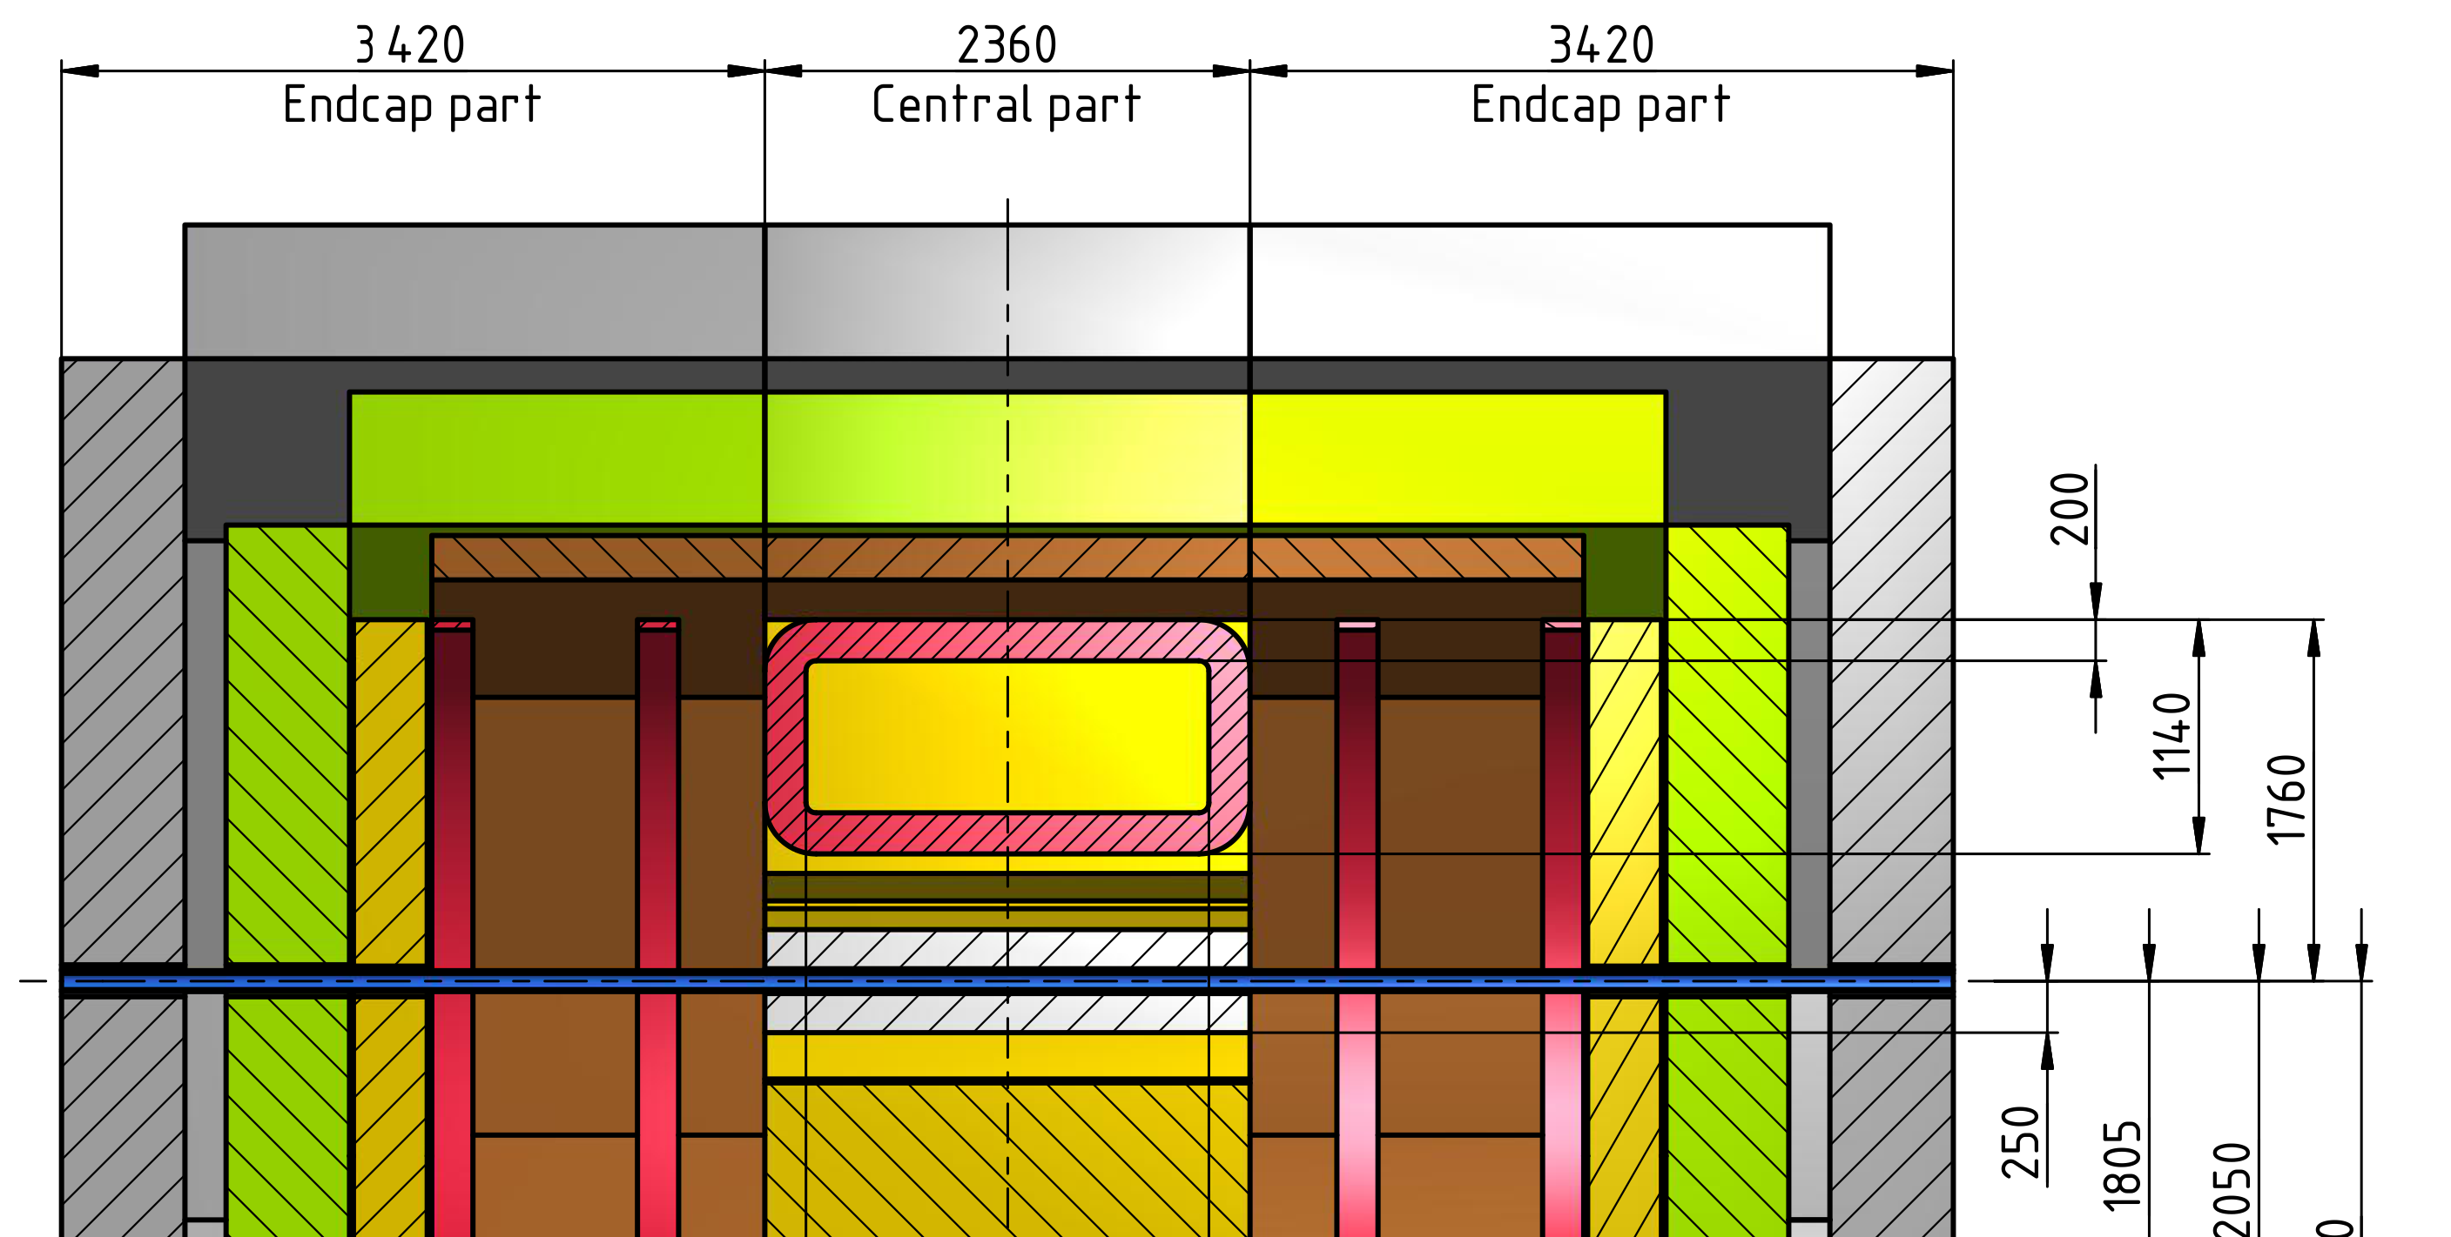
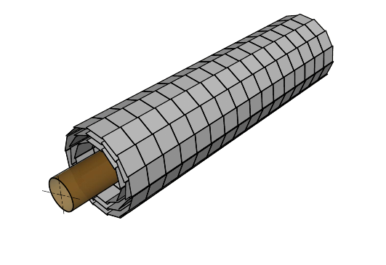
Space region barrel IT
Length = 2360
Diameter = 500

Slide 4
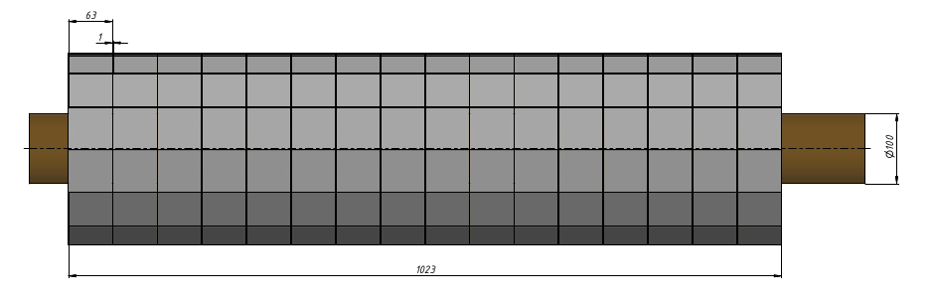
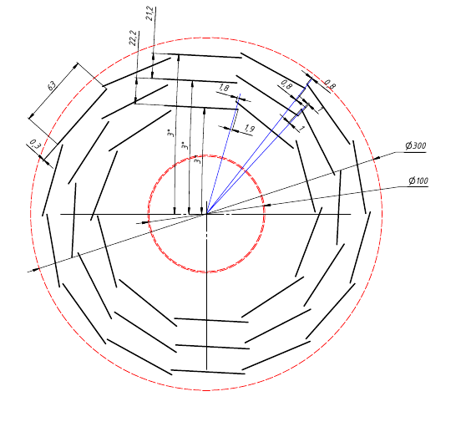
View of prototype barrel IT, length =1m and three Si layers
(without FEE and cables )

Slide 5
Version #0 (for discussion):
Detectors module consist of two Si-sensors
Topology of Si-sensor are double side strips
640 strips per each side of sensors
 | Size of Si detectors, mm² | Si det., pcs | Area, m² | Number of FEE, ch (two sensors connected strip to strip)
1 layer | 63x63 | 10x32=320 | 1,3 | (320:2)x640x2=204 800
2 layer | 63x63 | 12x32=384 | 1,6 | (384:2)x640x2=245 760
3 layer | 63x63 | 14x32=448 | 1,8 | (448:2)x640x2=286 720
4 layer | 63x63 | 16x32=512 | 2,1 | (512:2)x640x2=327 680
5 layer | 63x63 | 18x32=576 | 2,3 | (576:2)x640x2=368 640
 |  | Total = 2268 | Total = 9,1 | Total= 1 433 600
Comments: Total numbers of FE chips = 11340 Total power FEE chips~2mW/ch. × 1,44*10⁶ = 3 kW

Slide 6
About connection Si-sensors with FEE
OR???
126
kaptons cable (640x2) ch
FEE
(640x2) ch
FEE
FEE
(640x2) ch
FEE
63
FEE
(640x2) ch
FEE
FEE
FEE
(+) Power of FEE separates from Si- sensors
(+) Min budget of “dead” materials on IT -space
(-) Big length of the kaptons cables (60-100 cm) (capacitance; noise)
(+) No long cables
(-) Power of FEE heat of Si
(-) FEE –”dead” materials take place on IT -space

Slide 7
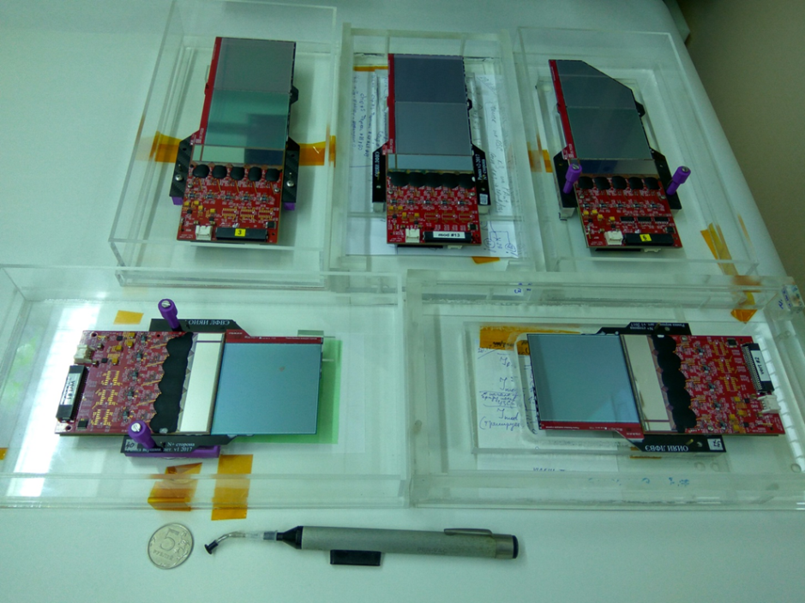
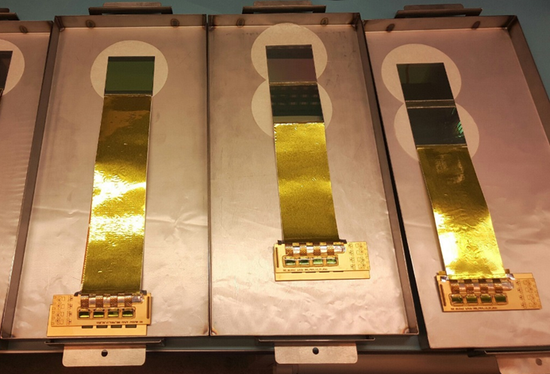
kaptone cable (640x2) ch
FEE
(640x2) ch
FEE
FEE
(640x2) ch
FEE
FEE
(640x2) ch
FEE
FEE
FEE
N.Zamyatin, MPD and BM@N meeting
12.04.2018 (BM@N design)
Yu. Murin, SPD meeting
03.07.2018 (CBM design)

Slide 8
Specification for Si sensors version #0 (for discussion):
Size: 63x63mm² (on 4” – Si wafers)
Topology: double side microstrip (DSSD) (DC or AC coupling)
Pitch: 95mkm – p⁺ strips and 103mkm – n⁺ strips
Stereo angle between p⁺/n+ strips: 2,5⁰÷10⁰
Number of strips: 640x640 (640=128ch × 5 chips)
Si wafers:
  Material: FZ-Si
  Diameter: 4” or 6”
  Surface: DSP (double side polished)
  Thickness: 300mkm
  Resistivity: ρ>5kOm*cm
  Conductivity: n-type (doping by phosphorous)
  Life time carrier: >1ms
Full depletion voltage: ≤60 V
Dark current per sensor: ≤1,5 µA/120 V/+20⁰C
Break down voltage: ≥200 V

Slide 9
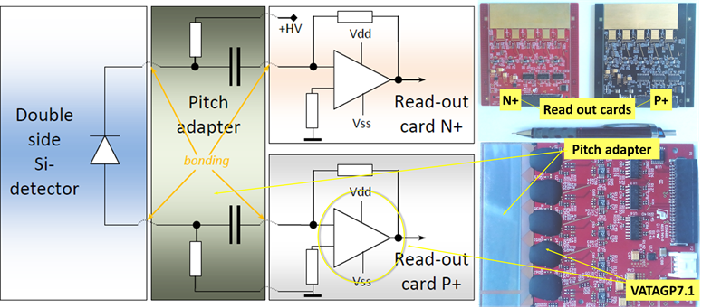
The functional scheme of BM@N detectors module and appearance of two electronic boards
DSSD with DC topology don’t contain integral resistors and capacitors (RC), therefore external R, C are required to supply bias voltage to each strip and to electrically decouple the DC current from the electronic inputs. This role is performed by Pitch Adapter (PA) with a topology of two types for p+ and n+ sides of the detector. In addition, PA has topology of contact pads similar to chips located on the side of electronic chips. PA modules are made on sapphire plates with an epitaxial layer of silicon (SOI). Integrated poly silicon bias resistors have a value of 0.7 – 1.0 MΩ, decoupled capacitors have a value of 140 pF. PA is assembled together with read-out ASICs on the read-out card. Positive polarity signals come from detectors to P+ read-out card (black PCB) while negative signals come to N+ read-out card (red PCB).

Slide 10
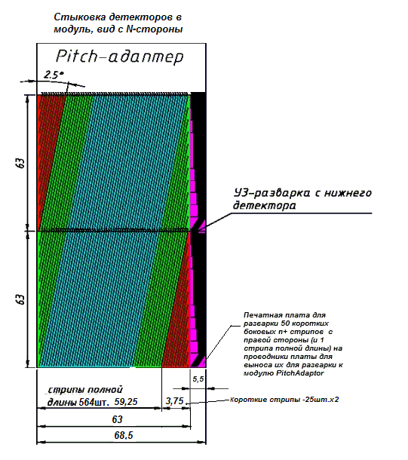
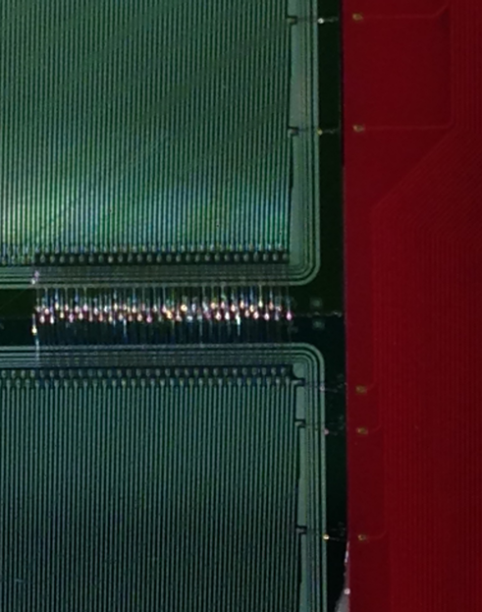
Ultrasonic bonding of the strip to strip
between two DS-Si-sensors on module

Slide 11
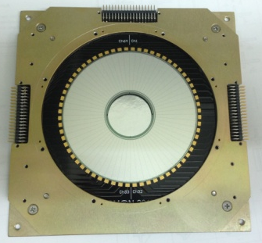
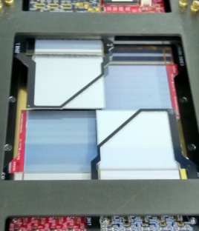
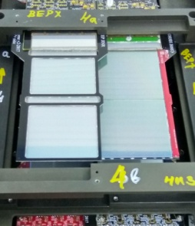
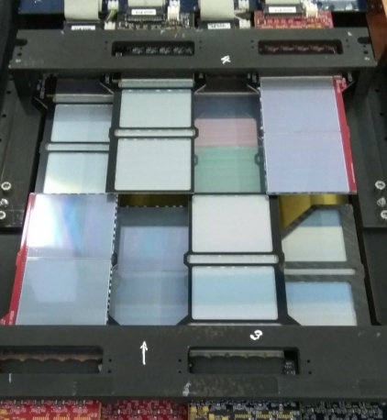
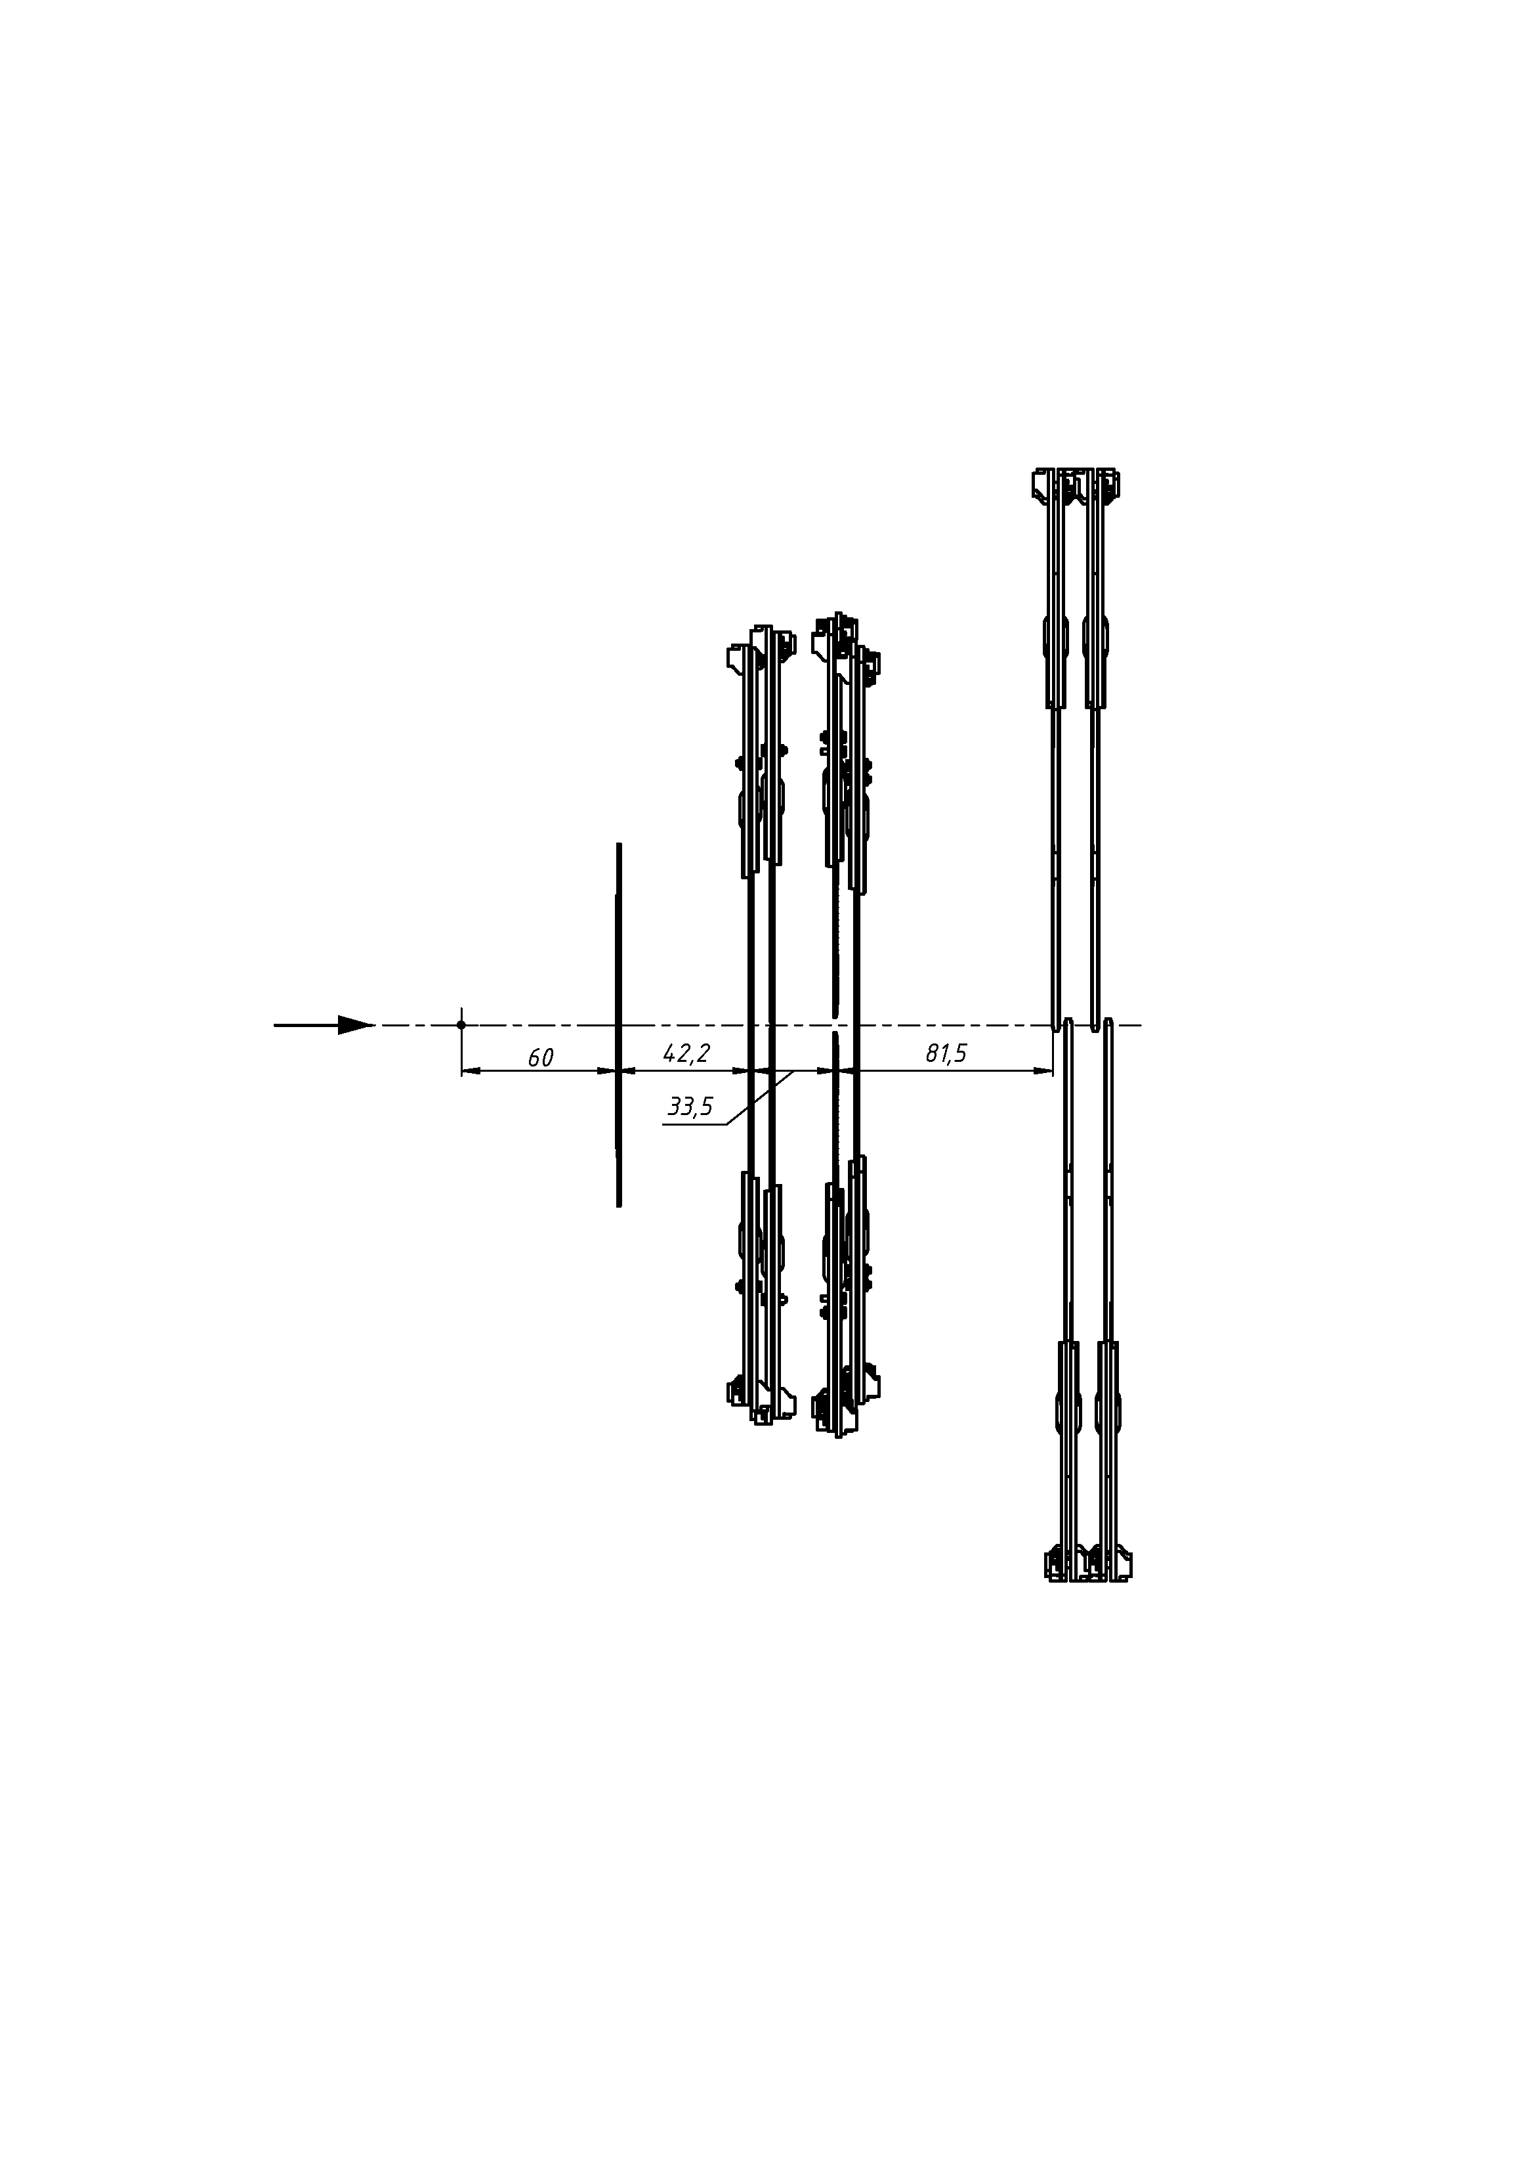
Design and position of Si-planes on the beam-channel BM@N, Session #55 (February-April’18)
Si-multiplicity detector
Si-Vertex plane-1
Si-Vertex plane-2
Si-Forward plane
Si-Forward plane consist of two-coordinate Si sensors X-X’(±2.5º) with strip pitch of 95/103 μm, sensitivity area 25 x 25 cm² , 10240 strips
target
Vertex plane-1 consist of 4 modules with sensitivity area 12,5×12,5cm², 5120 strips
Vertex plane-2 consist of 2 modules with sensitivity area 12,5×12,5cm², 2560 strips
beam

Slide 12
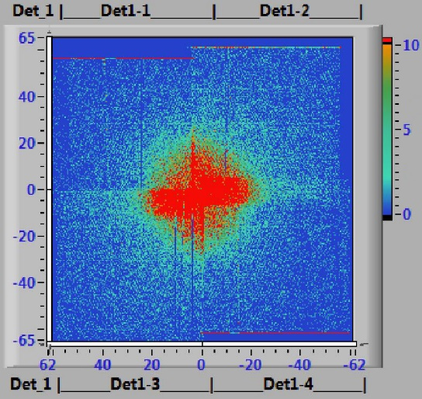
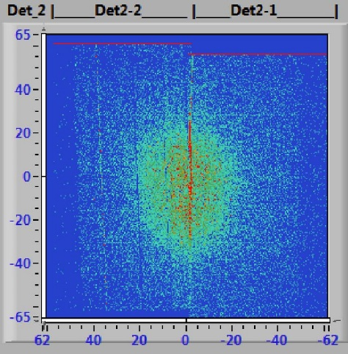
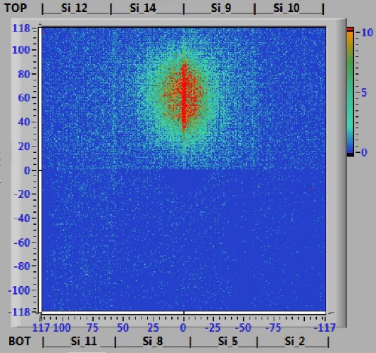
Carbon beam position in Si-planes for SRC-setup
Run 3467:
Beam-C, no target
Beam duration: 2.5 sec. Flux: 25k, MF=107.6 mv, 100K events, Air Empty, BC2-prime 1640 V
target
beam
12

Slide 13
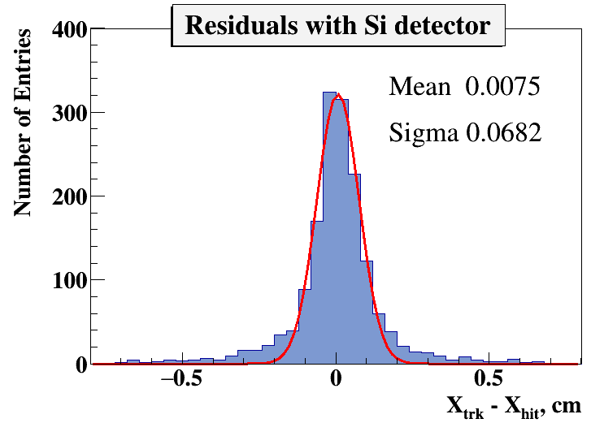
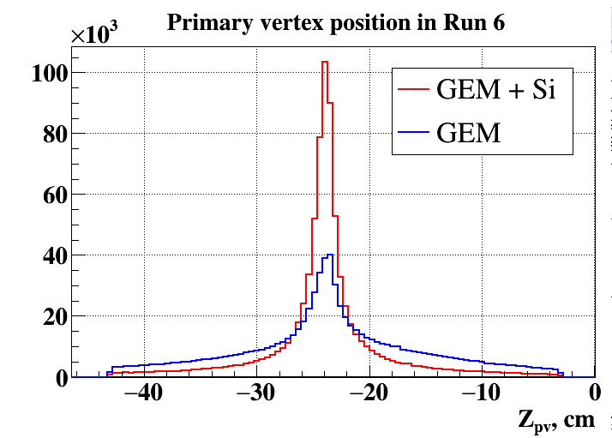
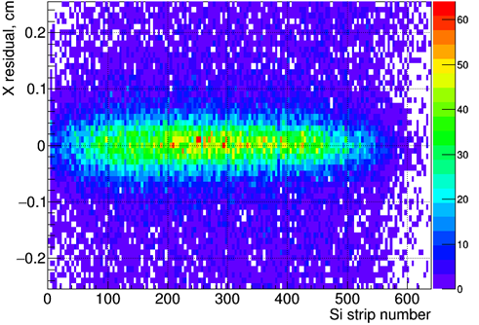
Slide from M. Kapishin
Primary Vertex with Si detector vs without Si detector
Carbon run, March 2017
Residuals of Si hits to GEM tracks. Carbon run, March 2017 → accuracy is defined by GEM track resolution

Slide 14
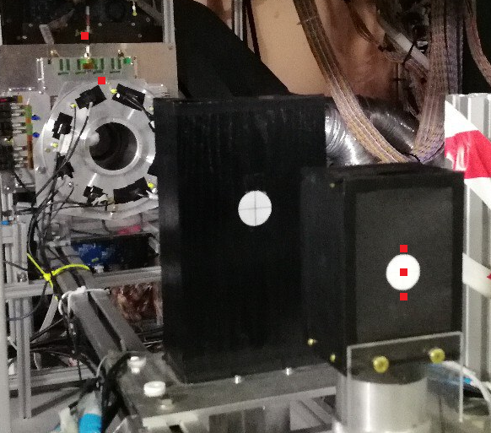
Position of Si-monitors for measurements of radiation background on beam area BM@N (integral of Ar + Kr is 5×10⁹ ions)
3
5
2
1
# Si-monitor | Position | Equal neutrons Ф<1MeV>, cm⁻²
#1 | Center of BC1 | 4,19×10¹⁰
#2 | Top BC1 | 2,44×10⁸
#3 | FE-PCB Forward-Si | 3,35×10⁹
#4 | Bottom of BC1 | 4,72×10⁹
#5 | Si-multiplicity trigger (top part) | 1,25×10⁹
4

Slide 15
Conclusion
Three Si-coordinate planes based on double side Si detectors were developed and manufactured (DUBNA Si-group) for the BM@N experiment (this design can be acceptable for End Cup part of SPD IT)
You need to create a international community for R&D and final design IT SPD

