Slide 1

Status of New Low Energy Polarimeter at the Nuclotron
R.A. Kuzyakin, V.V. Fimushkin, M.V. Kulikov, L.V. Kutuzova, Yu.V. Prokofichev, A.M. Shumkov, A.V. Averyanov, D.O. Krivenkov
Joint Institute for Nuclear Research, Dubna
Notes:
Good afternoon dear colleagues. The report I’m present to you is devoted to polarimetry at JINR acceleration complex. Nowadays it is Nuclotron - the only in Europe and Asia superconducting accelerator of nuclei and heavy ions. And The international mega-science project “NICA (Nuclotron based Ion collider facility) complex” which is aimed in the study of the properties of nuclear matter in the region of the maximum baryonic density.
Conceptual design of a new universal low energy polarimeter at Nuclotron is presented. It is proposed to install the new polarimeter behind linear accelerator LU-20 instead of old low energy polarimeter (LEP). The ³He target of this setup allows to measure both the vector polarization of protons and the vector and tensor polarization of deuterons. It is assumed that new design of polarimeter will make it possible to measure vector and tensor polarization of deuterons at the same time. The dipole magnet will be used to remove H₂⁺ component in deuteron beam. Fabrication of the basic parts of the modern polarimeter is in progress now.

Slide 2
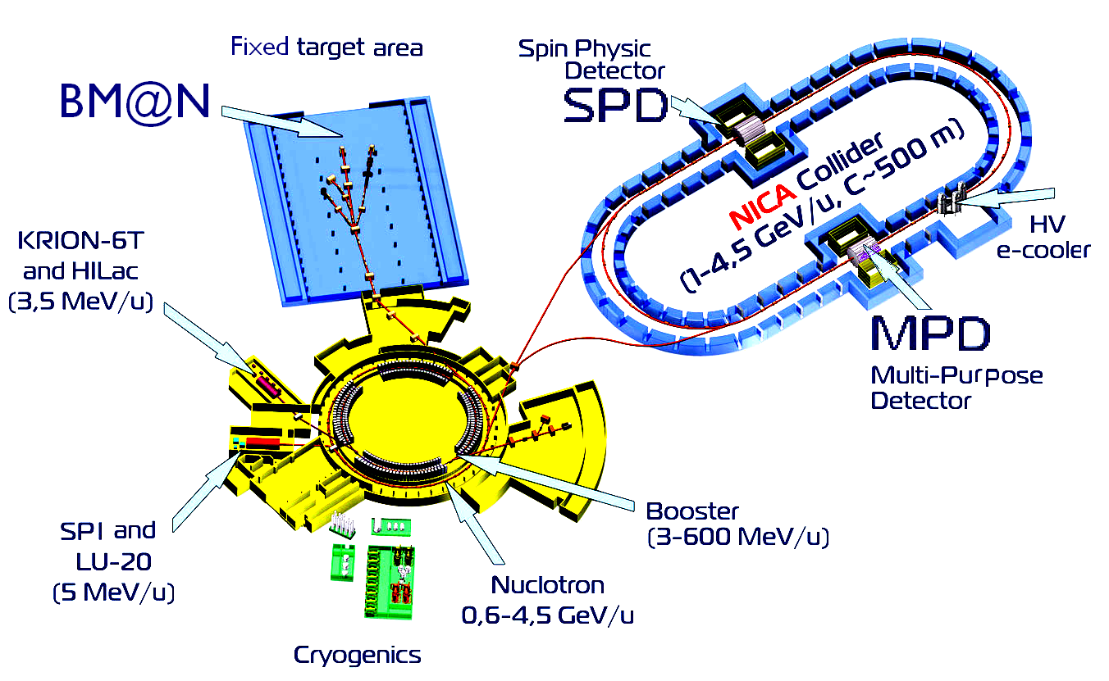
General view of the NICA facility
Physics with polarized light ion beams is considered as an important part of the NICA program.

Slide 3
NICA operation in Polarized Mode
Polarized dd – collisions:
SPI→ LU-20 → Nuclotron → Collider
Polarized pp – collisions:
SPI→ LU-20 → Nuclotron → Collider

Slide 4
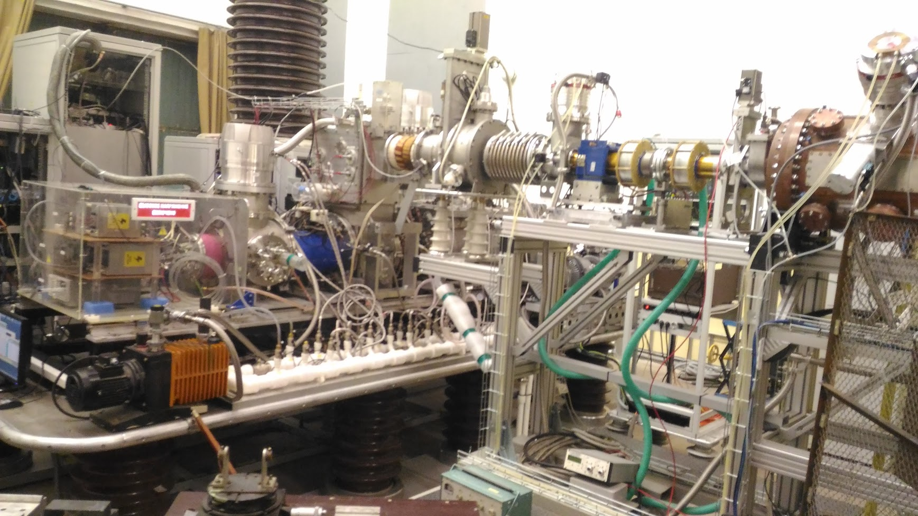
Source of Polarized Ions (SPI) for the JINR accelerator complex (Nuclotron, NICA)
Low Energy Beam
Transfer (LEBT)
SPI
Radio Frequency
Quadrupole (RFQ)
SPI will be used for the NICA-project scientific program implementation
Notes:
Development of the new Source of Polarized Ions (SPI) and the acceleration of polarized beam at JINR accelerator complex made it necessary to measure the polarization of the beam in order to configure and optimize the source systems. Further the SPI will be used for the NICA-project scientific program implementation.

Slide 5
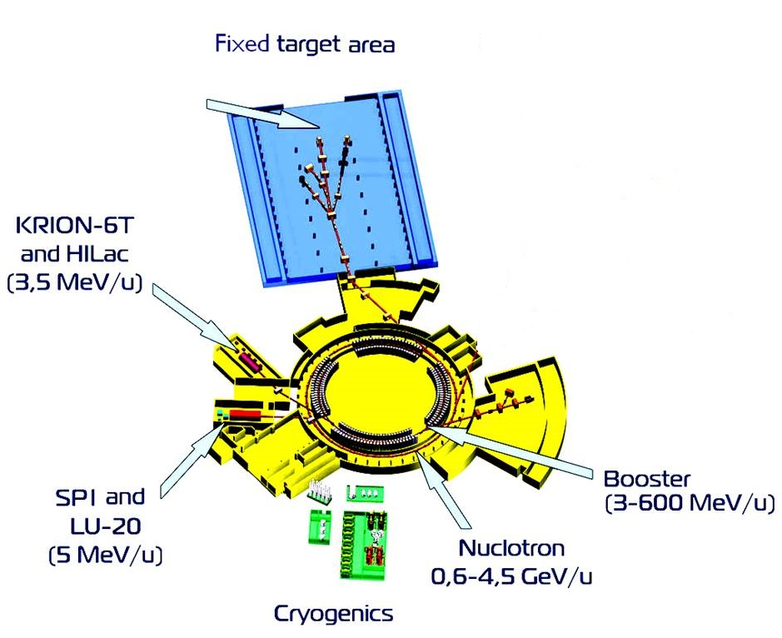
Implementation of polarization program
F3-polarimeter
LEP at LU-20
Polarimeter at Nuclotron ring

Slide 6
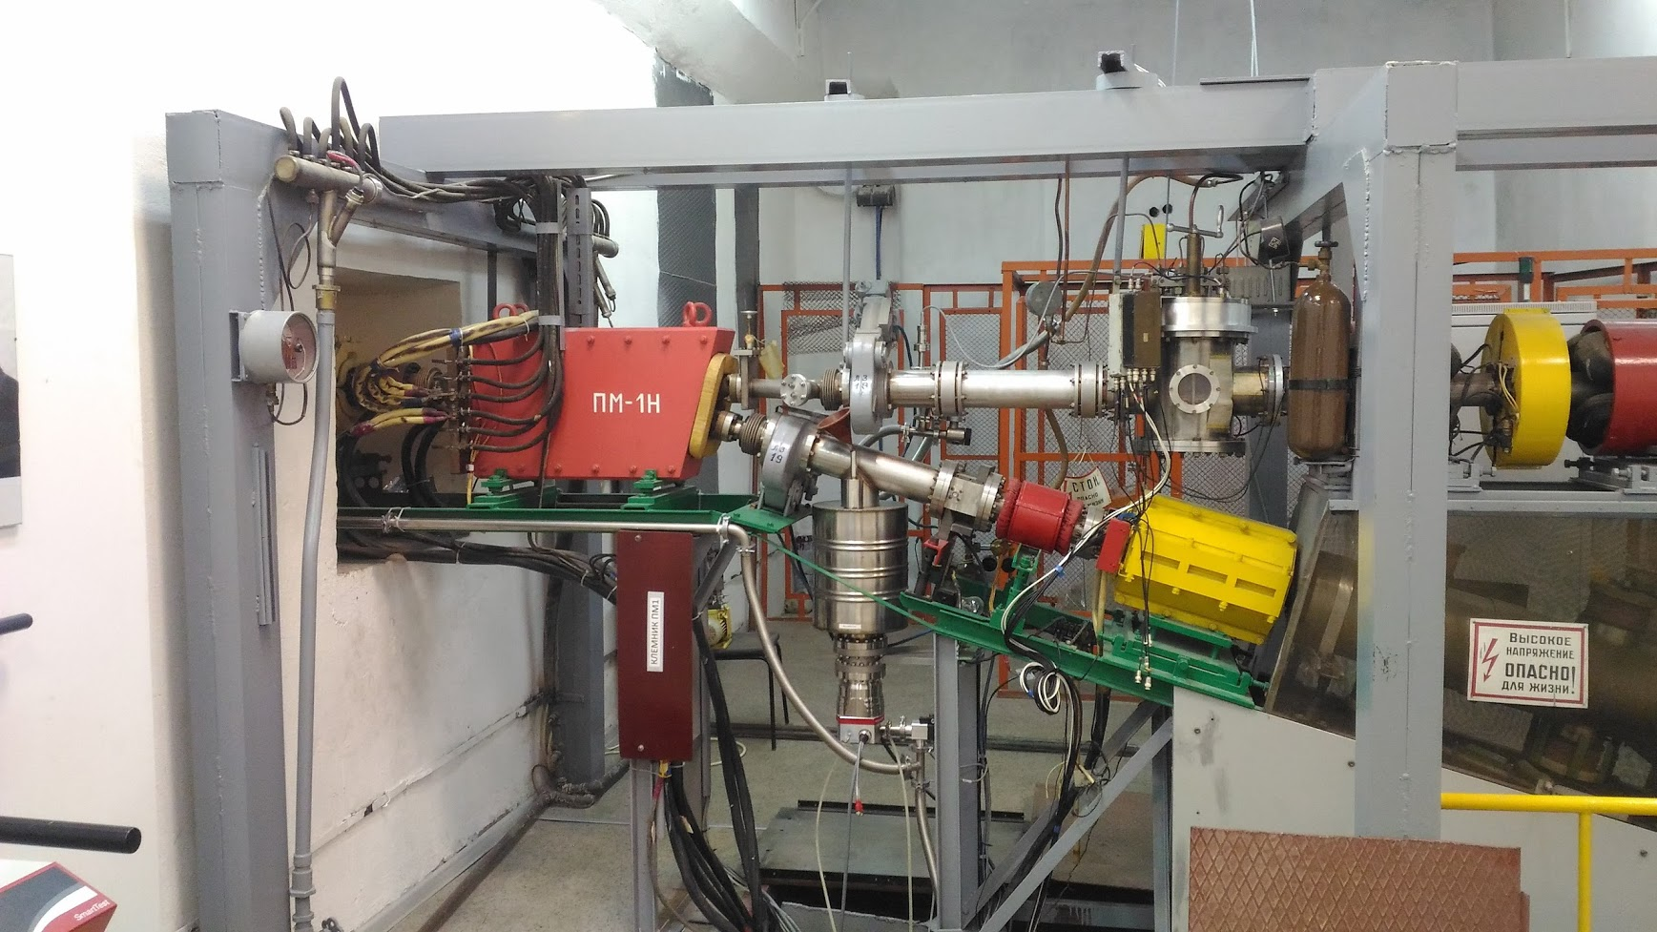
Bending Magnet and Old LEP
Bending
Magnet
Old LEP
From
LU-20
Beam Transfer
to the Nuclotron
Notes:
After it The bending magnet rotates the beam to the Nuclotron. If the magnet is turned off, the beam goes to the Low Energy Polarimeter (LEP) which is located here.

Slide 7
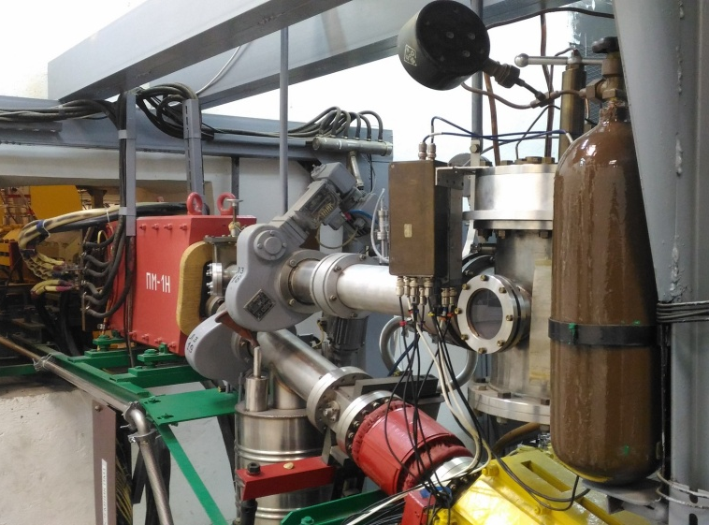
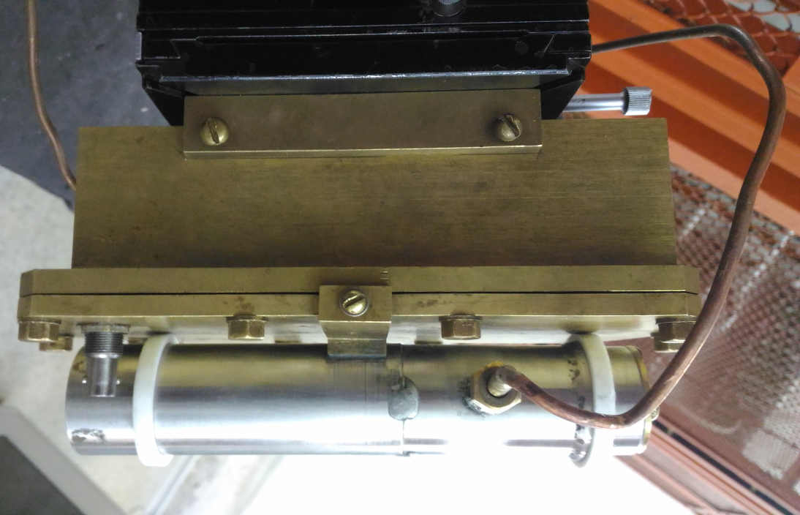
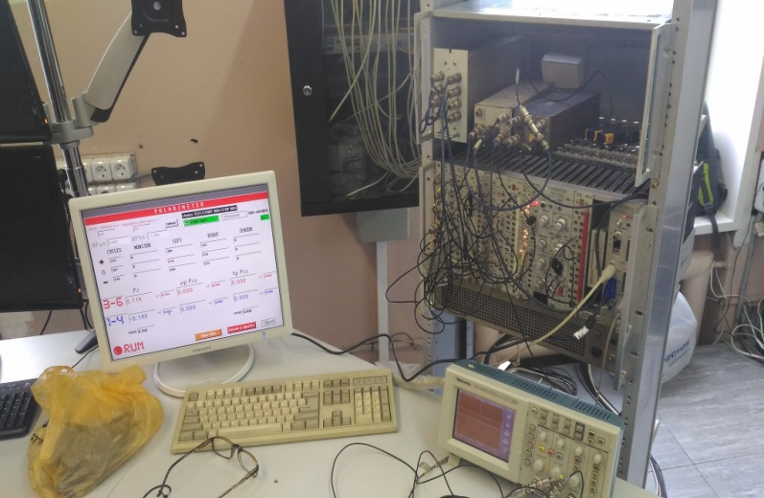
Old Low Energy Polarimeter (LEP) Details
Vector part
Polarimeter Vacuum chamber
Tensor part
Two independent parts of polarimeter
Electronics and DAQ
Notes:
So, let’s consider the low energy polarimeter which is consist of two independent parts. The first is using for the vector polarization measurements. The second one is for tensor mode. Unfortunately the parts can not work together in the same time. But they can replace each other. Here you can see polarimeter vacuum chamber and electronics and daq system.

Slide 8
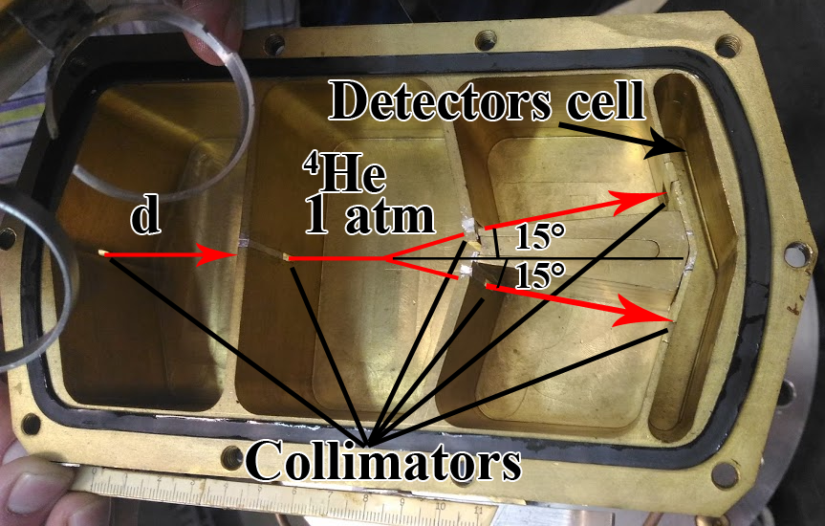
Scheme of the Old LEP for the Vector
Polarization Mode
LEP for the vector polarization measurements (left – outline, right – photo).1 – ion transfer; 2 – bellows; 3, 4 – Mylar windows; 5 – vacuum chamber; 6 – movable hermetic volume with collimators A,B,C,D; 7 – silicon detectors (Thickness - 55 μm).
Sizes of collimators: А, В – 1,3 × 7,4 [mm]; С – 1,3 × 12,5 [mm]; D – 2,5 × 12,7 [mm].
Notes:
Photo of opened LEP for the vector polarization measurements is here. Also there are ion transfer, bellows, Maylar windows, vacuum chamber, movable hermetic volume with the collimators A,B,C,D and silicon detectors.

Slide 9
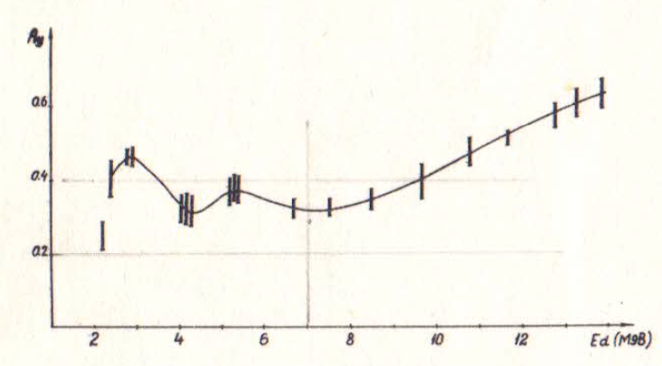

Old LEP Details
The reaction using for the vector polarization measurements is
Primary beam energy ~ 10 MeV
Energy after Mylar windows ~ 6.9 MeV
Energy of scattered (15°) deuterons ~ 6.7 MeV
Energy of recoil (15°) α-particles ~ 5.7 MeV
Deuteron energy on the detectors ~ 6.5 MeV
α-particle energy on the detectors ~ 4.5 MeV
$$P_{z}=2.4\frac{N_{L}−N_{R}}{N_{L}+N_{R}}$$
E_{d} ~ 6.7 MeV
A_{y} = 0.28
Analyzing power of the reaction at the deuterons scattering angle θ_{cms} = 150⁰
Notes:
The reaction using for the vector polarization measurements is here. Analyzing power of this reaction at the deuterons scattering angle θ_{cms} = 150⁰ is quite big and weakly depends on the energy E_{d} = 2 to 14 MeV. There are also several energy values of deuterons and α-particles at different stages of the reaction. The asymmetry in the number of deuterons on the left and right detectors gives us the polarization value.

Slide 10
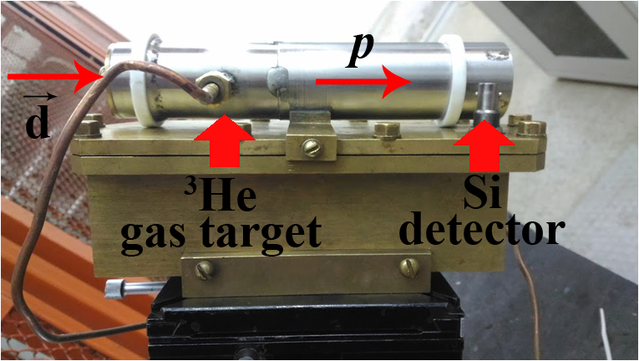
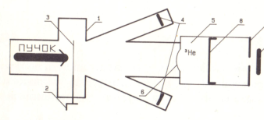
Old LEP for Tensor Polarization Mode
E_{p} = 20 MeV
Beam
LEP for tensor polarization mode (left – photo , right – outline).
Notes:
LEP for Tensor Mode Polarization is shown here and based on this reaction. T₂₀ component energy dependence of the analyzing power matrix for this reaction is here. T₂₀ component at the registered deuterons energy 6 Mev is about -1.3. The cross-section of the reaction depends of the tensor polarization value. To get this value the numbers of samples in the Si detector, normalized to the intensity of the beam, are compared in two cases: when the beam has tensor polarization and without polarization.

Slide 11
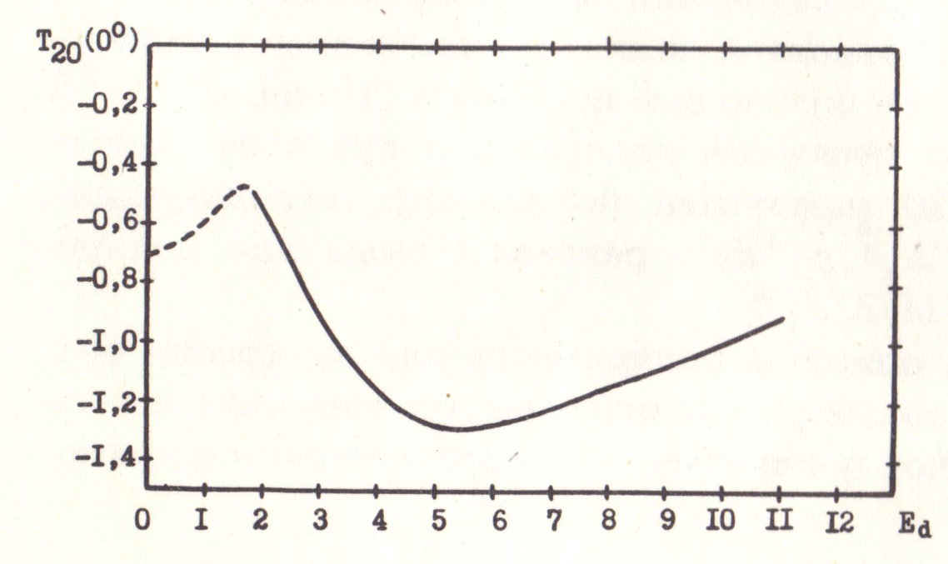

Old LEP for Tensor Polarization Mode
Tensor polarization measurements are based on the following reaction:
E_{p} = 20 MeV
$$P_{zz}=\frac{N_{P}−N_{0}}{0.46N_{0}}$$
E_{d} ≈ 6 MeV
T₂₀ ≈ -1.3
T₂₀ component energy dependence of the analyzing power matrix.
Notes:
LEP for Tensor Mode Polarization is shown here and based on this reaction. T₂₀ component energy dependence of the analyzing power matrix for this reaction is here. T₂₀ component at the registered deuterons energy 6 Mev is about -1.3. The cross-section of the reaction depends of the tensor polarization value. To get this value the numbers of samples in the Si detector, normalized to the intensity of the beam, are compared in two cases: when the beam has tensor polarization and without polarization.

Slide 12

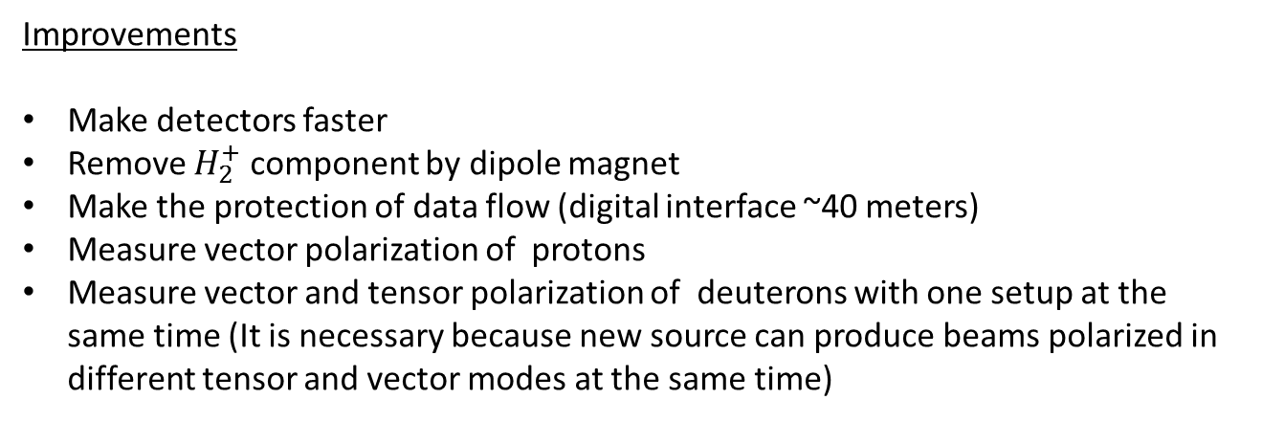
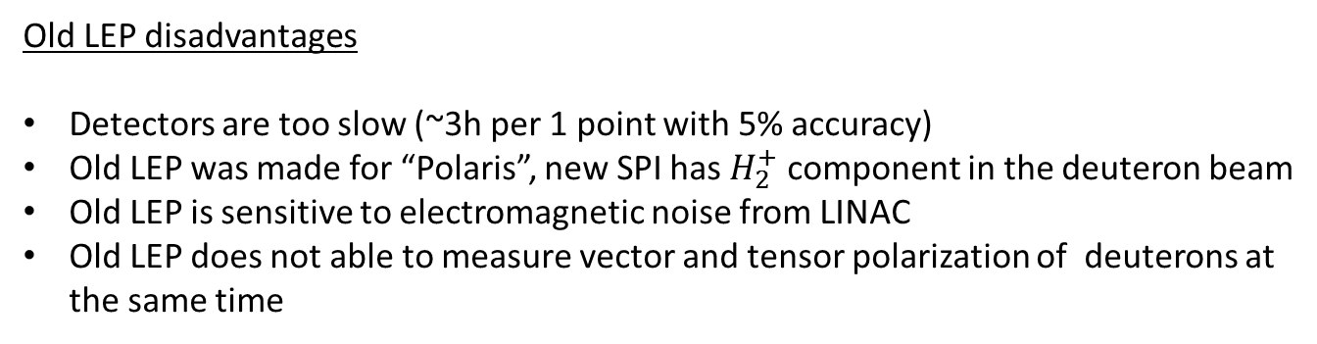
Motivation for New LEP
Old LEP disadvantages
Detectors are too slow (~3h per 1 point with 5% accuracy)
Old LEP was made for “Polaris”, new SPI has $H_{2}^{+}$ component in the deuteron beam
Old LEP is sensitive to electromagnetic noise from LINAC
Old LEP does not able to measure vector and tensor polarization of deuterons at the same time
Improvements
Make detectors faster
Remove $H_{2}^{+}$ component by dipole magnet
Make the protection of data flow (digital interface ~40 meters)
Measure vector polarization of protons
Measure vector and tensor polarization of deuterons with one setup at the same time (It is necessary because new source can produce beams polarized in different tensor and vector modes at the same time)
Notes:
Обдирочная мишень – strip target

Slide 13


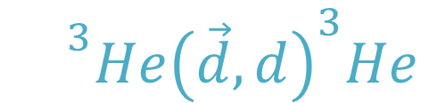
Proposed Scheme of New Low Energy Polarimeter
Vector Mode
$${}^{3}Hⅇ{\left(\vec{d},d\right)}^{3}He$$
θ_{cms} = 150º
A_{y} = 0.3
D1
$$\vec{d}$$
³He
15°
112°
D2
Recoil ³He
deuteron 10 MeV
Notes:
Система отсчета – reference system

Slide 14
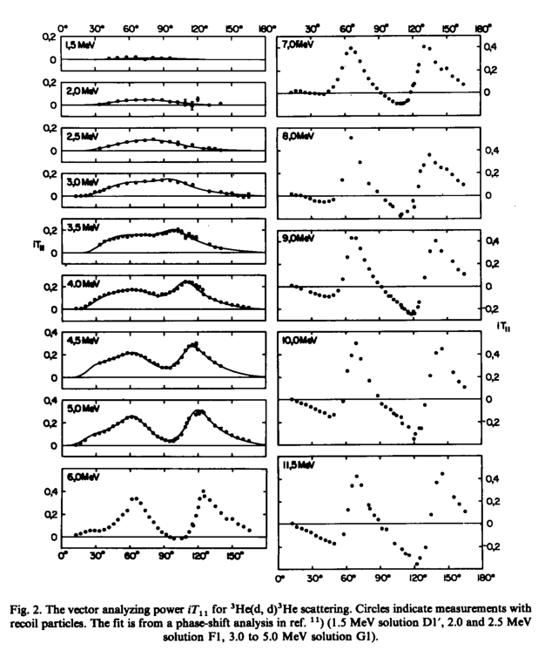
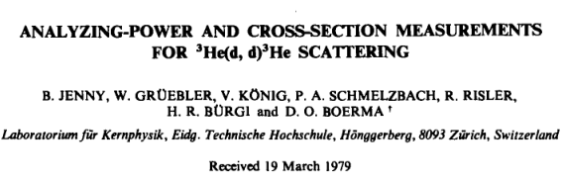
Notes:
Система отсчета – reference system

Slide 15
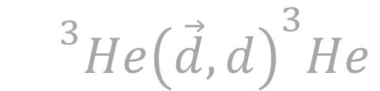
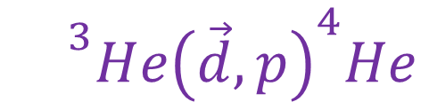
Proposed Scheme of New Low Energy Polarimeter
Vector Mode
Tensor Mode
$${}^{3}Hⅇ{\left(\vec{d},d\right)}^{3}He$$
θ_{cms} = 150º
A_{y} = 0.3
$${}^{3}Hⅇ{\left(\vec{d},p\right)}^{4}He$$
θ = 0º
Т₂₀ = -1.2
D1
$$\vec{d}$$
³He
15°
T
112°
D2
Recoil ³He
deuteron 10 MeV
daughter proton 20 MeV
Notes:
Система отсчета – reference system
estimate – оценивать
steel plate – стальная пластина
copper plate – медная пластина

Slide 16
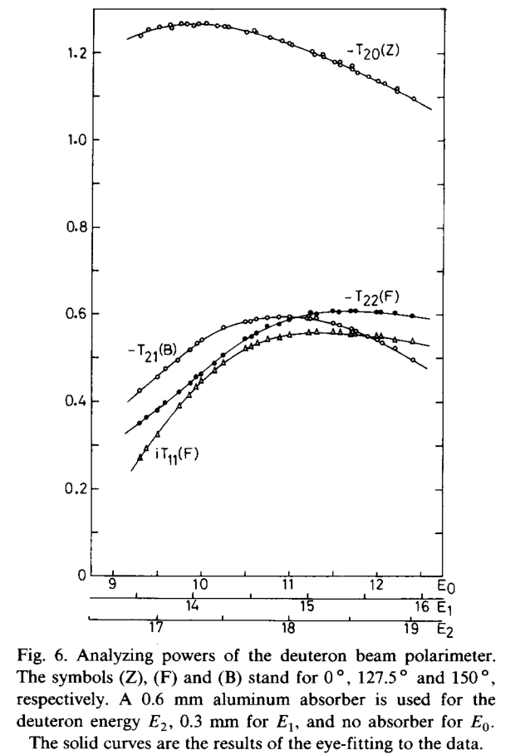
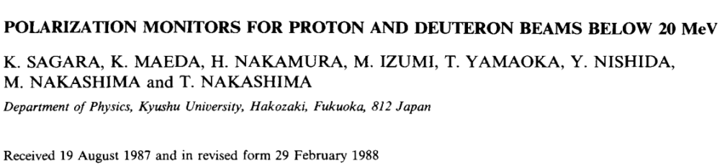
Notes:
Система отсчета – reference system

Slide 17


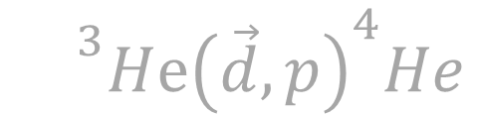

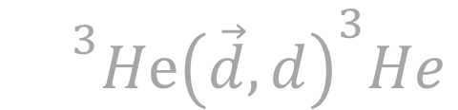
Proposed Scheme of New Low Energy Polarimeter
Vector Mode
Tensor Mode
$${}^{3}Hⅇ{\left(\vec{d},d\right)}^{3}He$$
θ_{cms} = 150º
A_{y} = 0.3
$${}^{3}Hⅇ{\left(\vec{d},p\right)}^{4}He$$
$${}^{3}Hⅇ{\left(\vec{p},p\right)}^{3}He$$
θ = 0º
Т₂₀ = -1.2
θ_{cms} = 80º
A_{y} = 0.3
P1
D1
³He
63°
$$\vec{d}$$
15°
15°
T
$$\vec{p}$$
50°
112°
112°
D2
Recoil ³He
deuteron 10 MeV
P2
proton 5 MeV
daughter proton 20 MeV
Notes:
Система отсчета – reference system

Slide 18
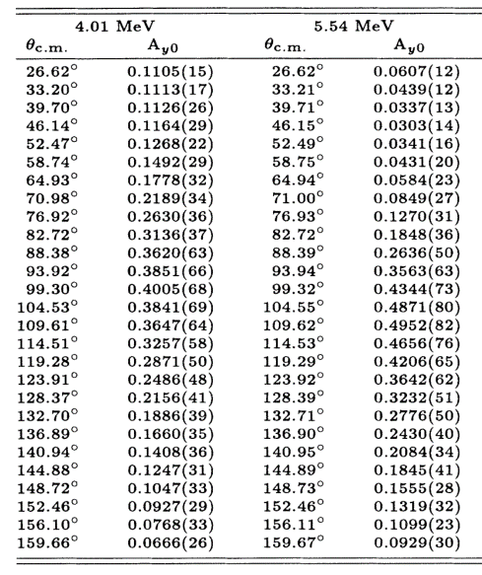
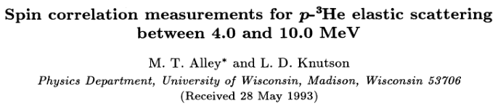
Notes:
Система отсчета – reference system

Slide 19





Proposed Scheme of New Low Energy Polarimeter
$${}_{}^{3}{He(\vec{d},d){}_{}^{3}{He}}$$
P1
$${}_{}^{3}{He(\vec{d},p){}_{}^{4}{He}}$$
D1
$${}_{}^{3}{He(\vec{p},p){}_{}^{3}{He}}$$
³He
63°
$$\vec{d}$$
15°
T
$$\vec{p}$$
50°
112°
D2
P2
Recoil ³He
deuteron 10 MeV
proton 5 MeV
daughter proton 20 MeV
Notes:
Система отсчета – reference system

Slide 20
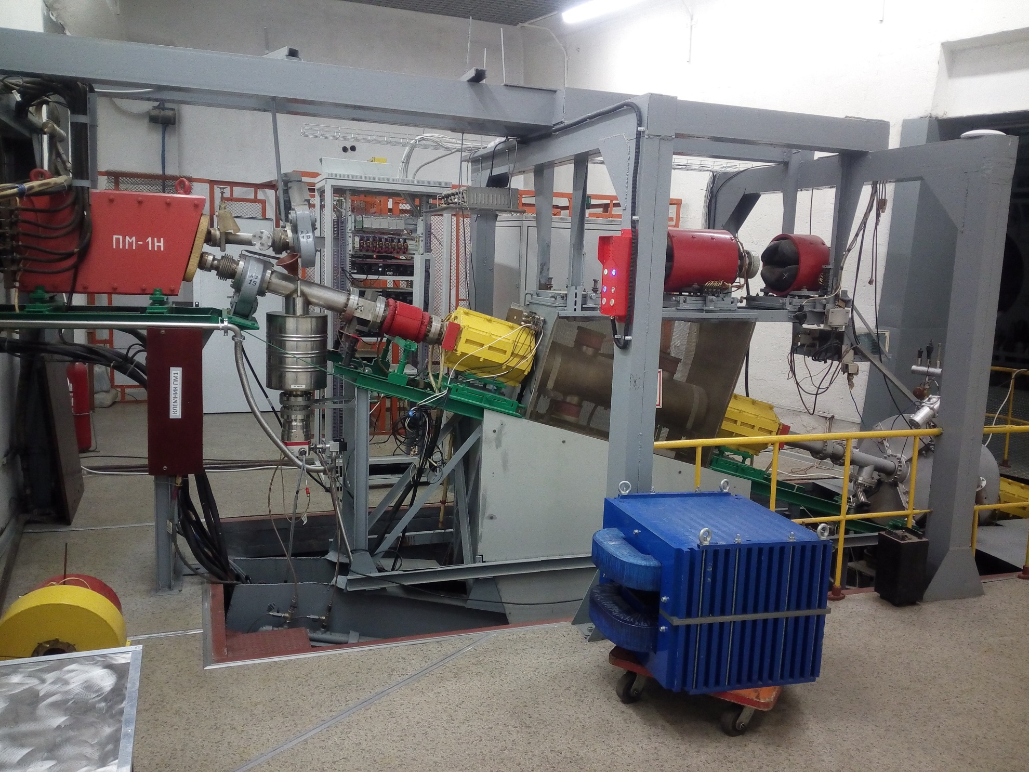
New Low Energy Polarimeter Location
Bending
Magnet
Transfer to Booster
From
LU-20
Transfer to Nuclotron
Dipole
Magnet
Notes:
After it The bending magnet rotates the beam to the Nuclotron. If the magnet is turned off, the beam goes to the Low Energy Polarimeter (LEP) which is located here.
stairs – лестница, fastening – крепление, plane – плоскость

Slide 21
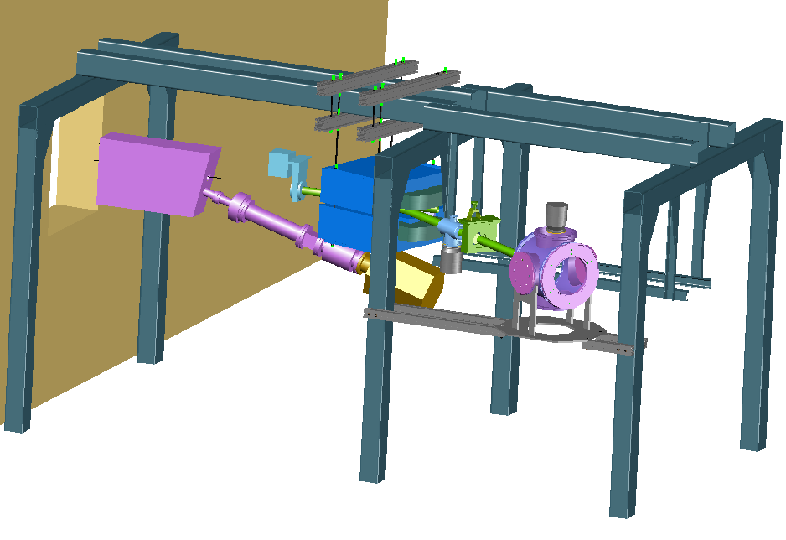

View of New Low Energy Polarimeter
DM Fastening
Cross
Faraday cup
TM Pump
Vacuum Gate
$\vec{p}$, $\vec{d}$ beam
Dipole Magnet
TM Pump
VC Fastening
Vacuum Chamber
Notes:
stairs – лестница
fastening – крепление
plane – плоскость

Slide 22
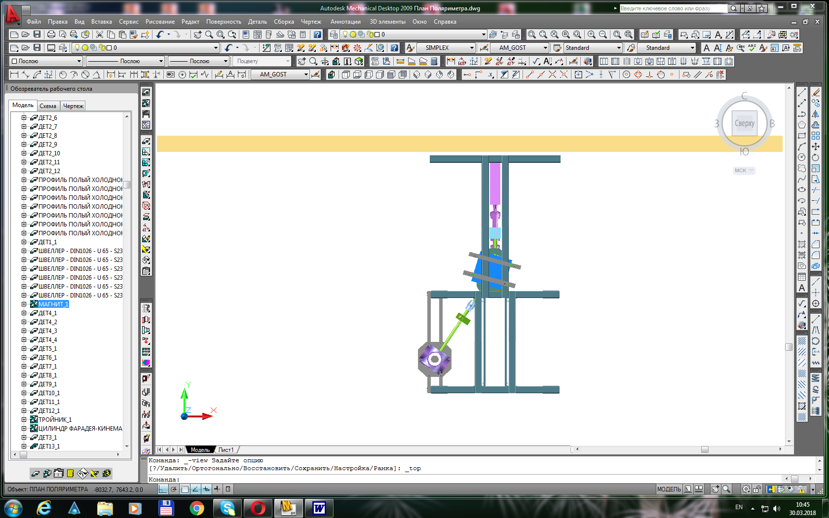
View of New Low Energy Polarimeter
From LU-20
To Booster
17°
34°
To Vacuum Chamber
Notes:
stairs – лестница turn – поворот
fastening – крепление
plane – плоскость

Slide 23
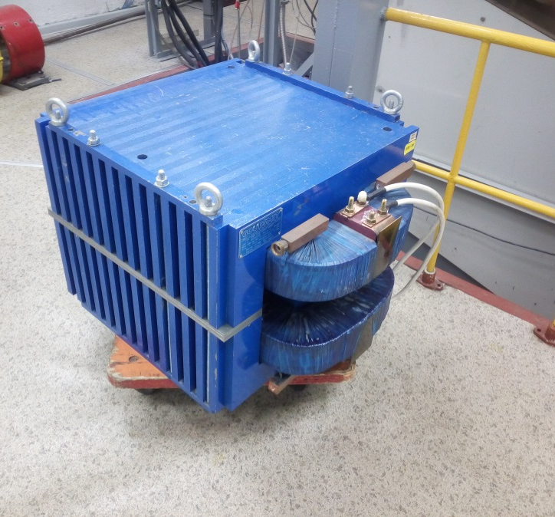
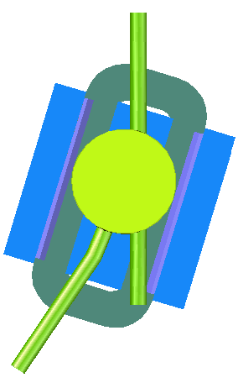
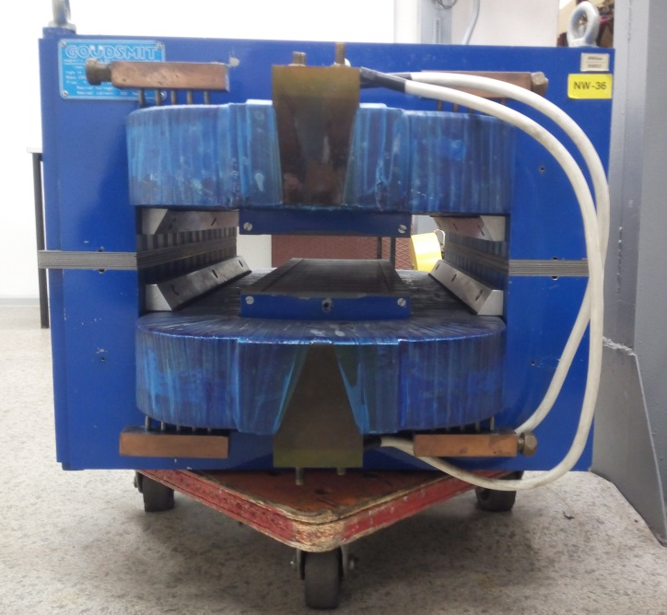
View of Dipole Magnet
Coils
56 mm
Dipole Magnet
 346 mm
22°
34°
Vacuum Chamber
of Dipole Magnet
Notes:
set – набор
yoke - ярмо

Slide 24

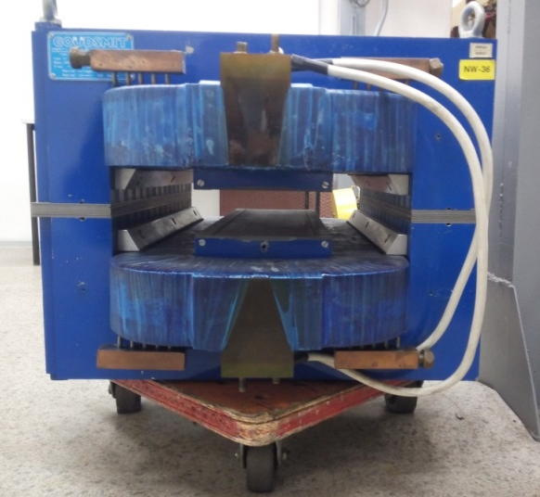
View of Dipole Magnet
Magnetic field for different particle energies
Energy per nucleon E, MeV/nucleon | Particle | Magnetic field (theory) B_{т}, G | Magnetic field (modeling/ experiment) B_{м}, G | Coils current I_{м}, А | Turn radius (theory) R_{т}, mm
5 | p | 2905 | 2800 / 2830 | 124 | 1112
5 | d | 5808 | 5615 / 5700 | 249 | 1112
7 | p | 3437 | 3319 / 3350 | 147 | 1112
7 | d | 6872 | 6648 / | 296 | 1112
13 | p | 4684 | 4538 / 4600 | 201 | 1112
Notes:
set - набор

Slide 25
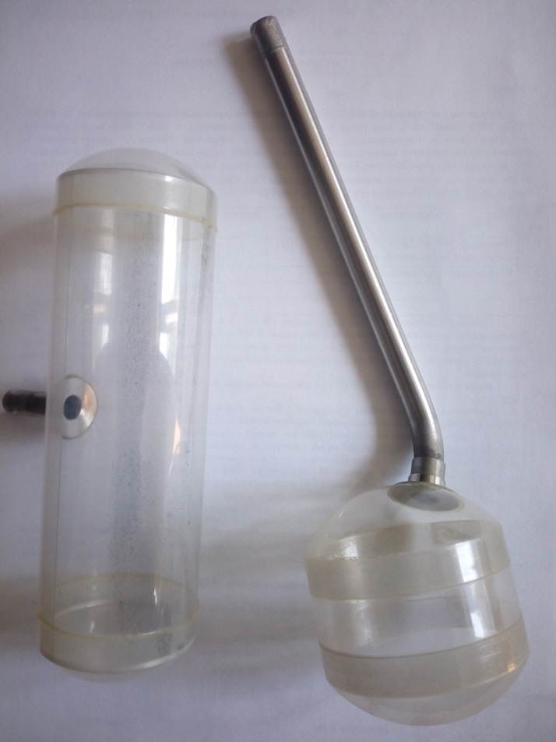
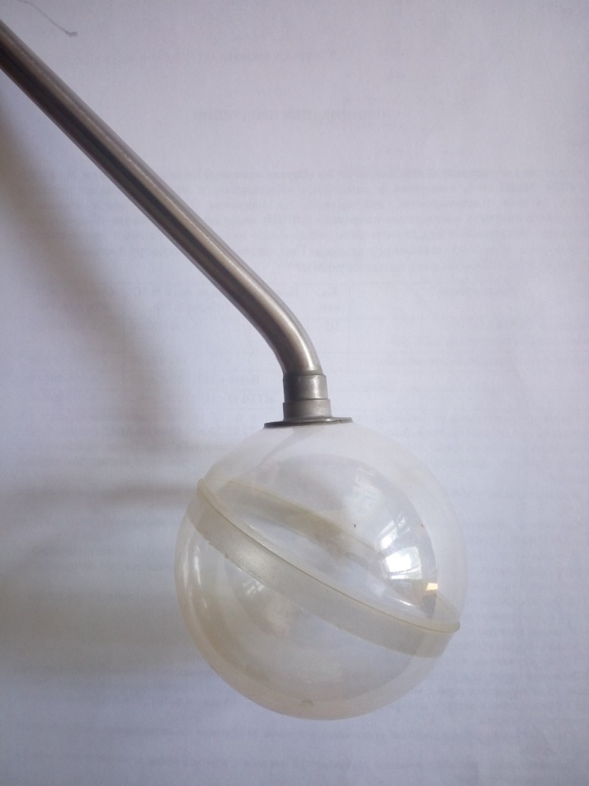
View of Polarimeter Target
Spherical mylar vessel
Cylindrical mylar vessel
³He
³He
³He
Radius – 50 mm
Radius – 50 mm, Height – 70 mm
Notes:
glue – клеить
join (connect, unite) – соединять

Slide 26
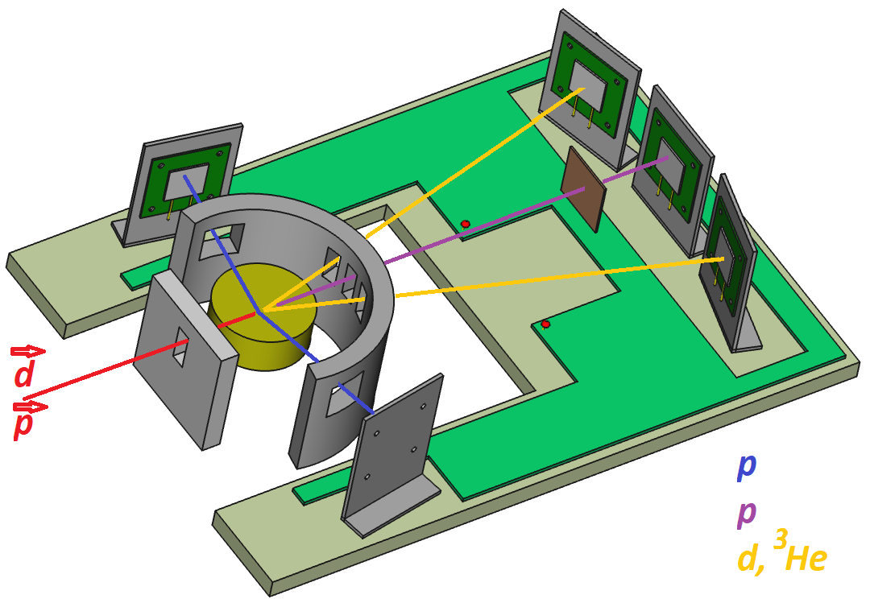
View of New Low Energy Polarimeter
Detector
Collimators
Plate
Detectors
³He
Collimator
Detector
Target
Notes:
estimate – оценивать, event – событие
steel plate – стальная пластина
copper plate – медная пластина

Slide 27

Current Status
Old low energy polarimeter was removed
Fabrication and ordering of basic parts of new polarimeter is in progress
Test runs are possible since next year (it’s not necessary to run Nuclotron cryogenic system to get beam on the LINAC output)
It is suggested to use usual silicon and pixel detectors
The use of solid target – deuterated titanium – is also considered

Slide 28

Thanks for your attention!

Slide 29
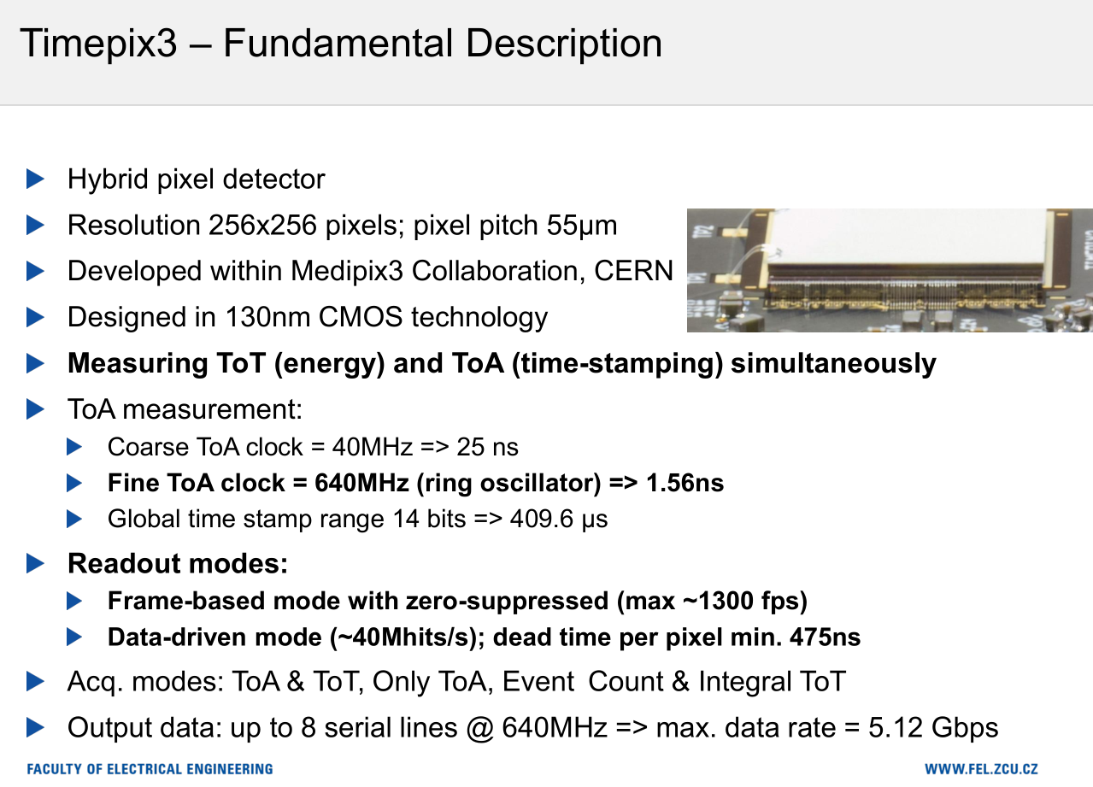

Slide 30
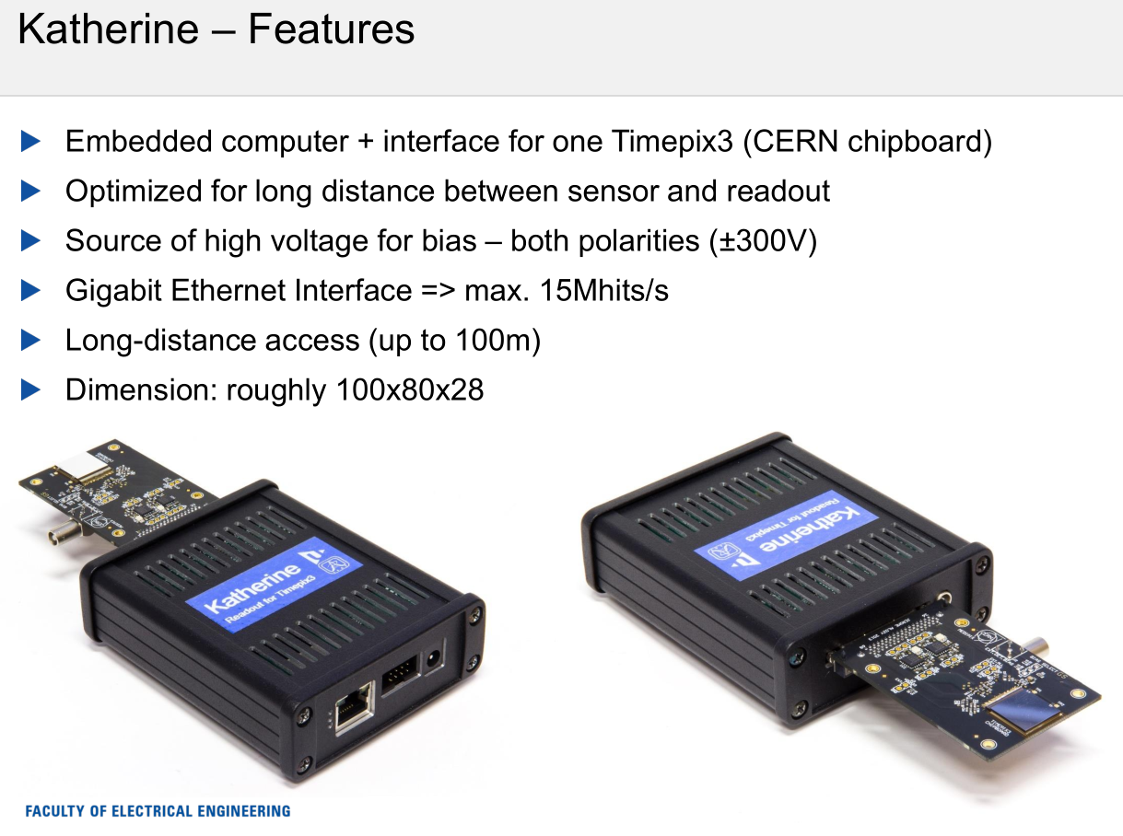

Slide 31
