Slide 1




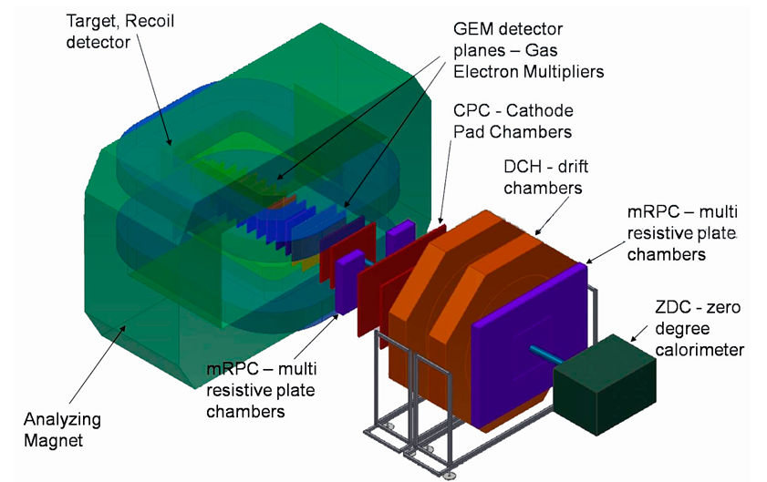
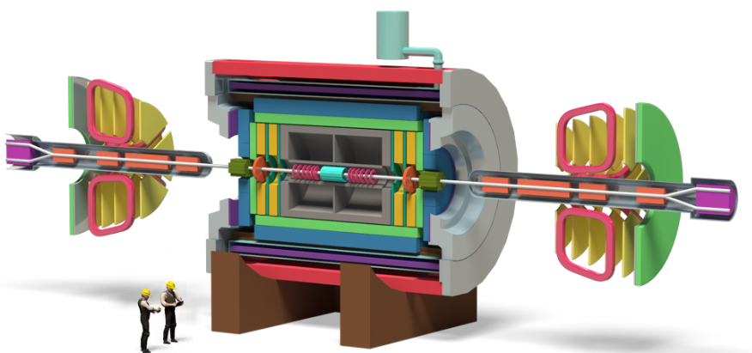
Silicon Tracking Systems for BM@N and MPD experiments at NICA
D.Dementev, Yu. Murin
for JINR STS team
JINR LHEP
SPIN-Praha-2018
Charles University, Faculty of Mathematics and Physics

Slide 2
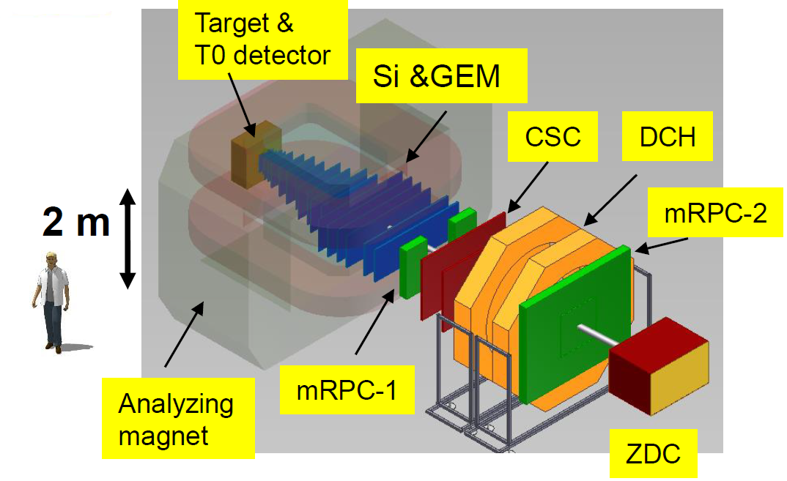
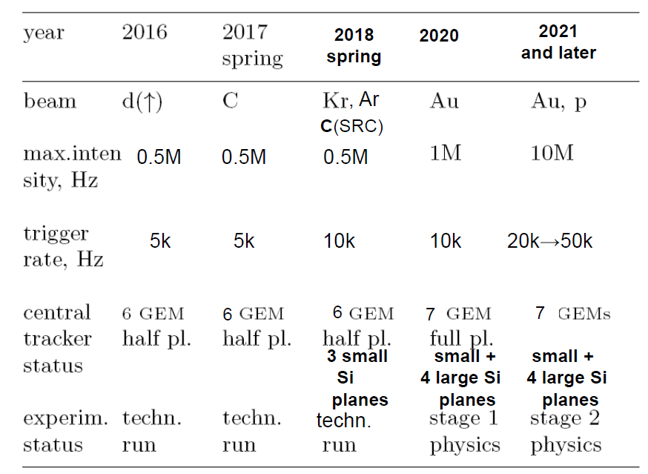
BM@N (Baryonic Matter at Nuclotron)
Beam parameters and setup at different stages of the experiment
BM@N advantage: large aperture magnet
(~1 m gap between poles)
→ fill aperture with coordinate detectors
which sustain high multiplicities of particles
→ divide detectors for particle
identification to “near to magnet” and “far
from magnet” to measure particles with low
as well as high momentum (p > 1-2 GeV/c)
→ fill distance between magnet and “far”
detectors with coordinate detectors

Slide 3
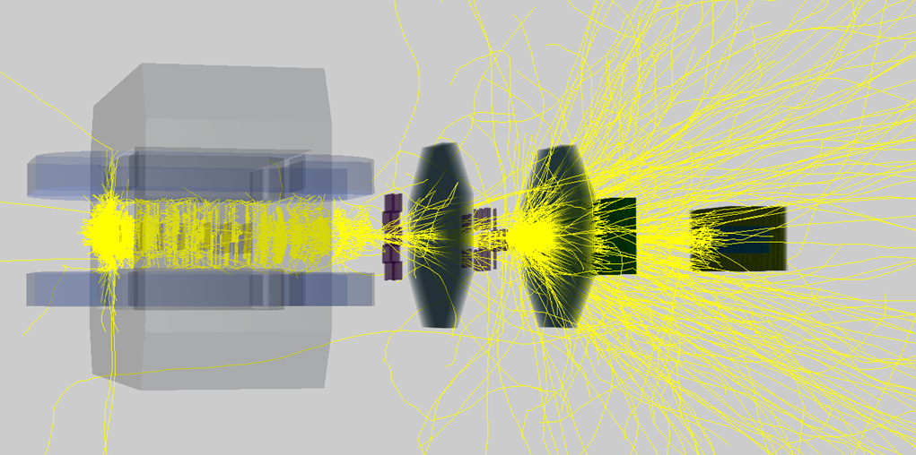
BM@N 2020: stage 1
Major BM@N plans for Au+Au to start in 2020:
Upgrade of the BM@N beam line: implement beam pipe instead of air gaps existing, implement instruments to limit beam size and spread at the target
Implement vacuum / helium beam pipe through BM@N setup
Collaborate with CBM to produce and install large aperture STS silicon detectors in front of GEM setup
Extend GEM central tracker and CSC outer tracker to full configuration
Install MPD / CBM type of hadron ZDC calorimeter
Talk by M. Kapishin, BM@N DAC meeting, Jun. 2018:
Status of BM@N project
Talk by P. Zenger, The third Mini-Work Meeting "Making-up a Work Plan for building hybrid DSSD-GEM Tracking System for the BM@N-2" Jul. 2018:
BM@N upgrade for high intensity Au beams
One single Au ion at 5A GeV, no beam pipe, BMNroot + GEANT3

Slide 4
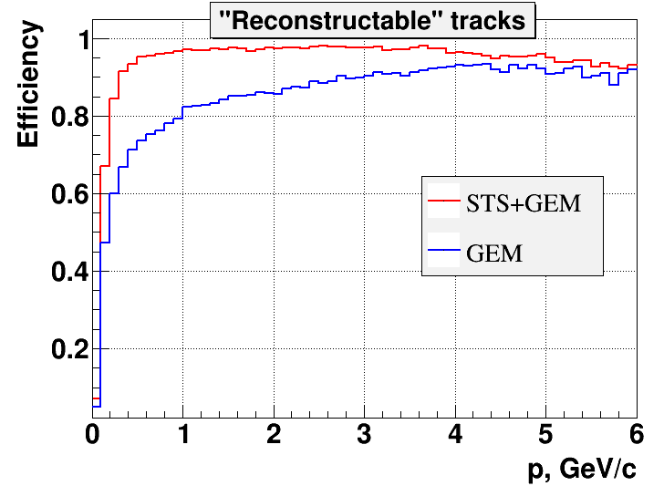
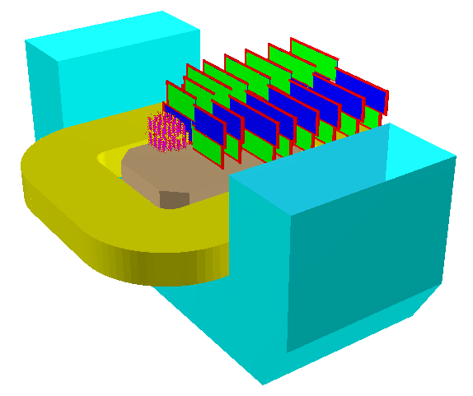
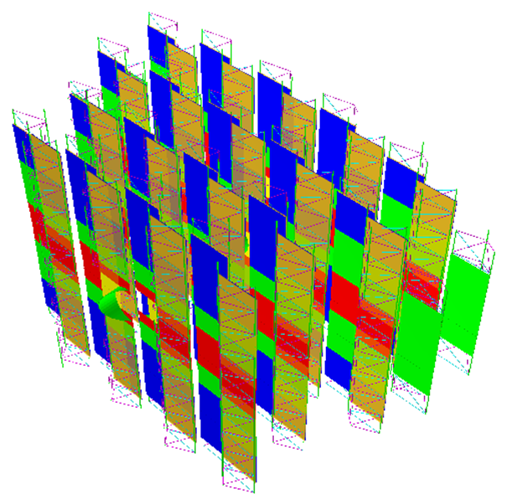
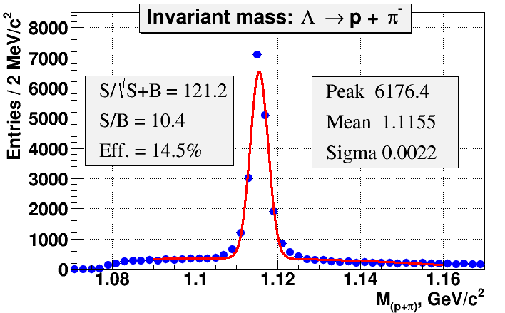
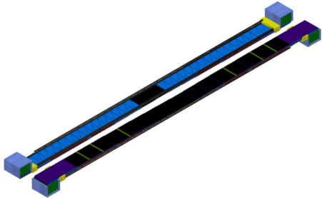
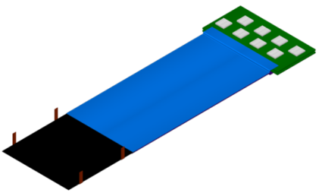
Hybrid DSSD-GEM Tracking System
Mutual interest by CBM groups from Germany and Russia to install, commission and use
4 CBM-like Silicon Tracking Stations in BM@N in 2020.
dipole magnet
STS
GEM
Δp/p ≈ 1%
25 µm single-hit spatial resolution
material budget per station ~1% X0
344 Modules
40 Ladders
~700 k Channels

Slide 5
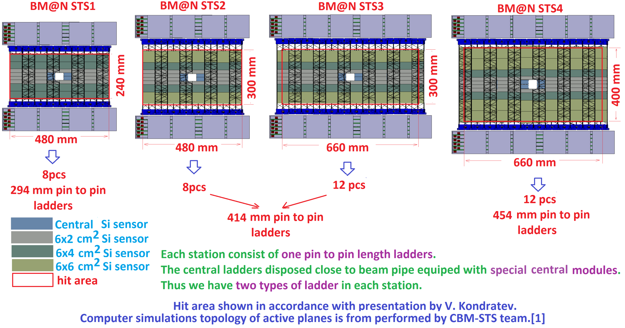
Preliminary layout of BM@N STS
Total:
40 ladders
344 modules
~700 k channels
Talk by V.Elsha, The third Mini-Work Meeting "Making-up a Work Plan for building hybrid DSSD-GEM Tracking System for the BM@N-2" Jul. 2018: Tentative Layout of the DSSD Stations with Number of Requested Components

Slide 6
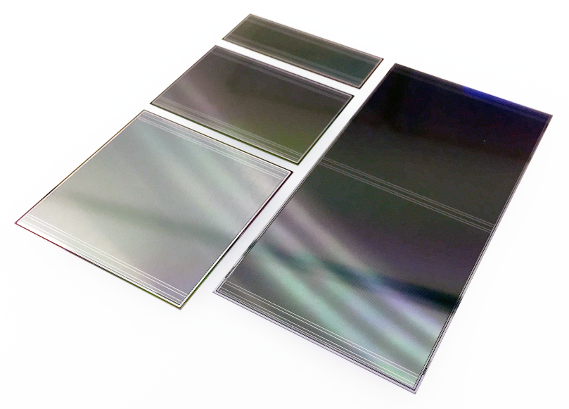
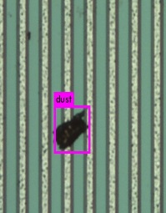
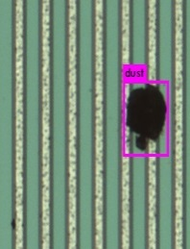
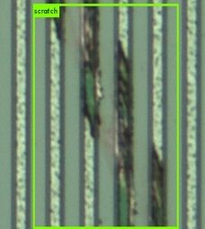
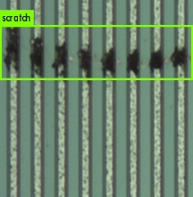
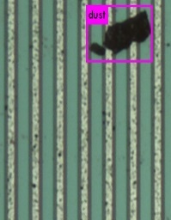
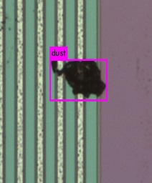
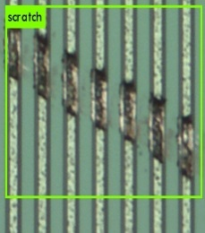
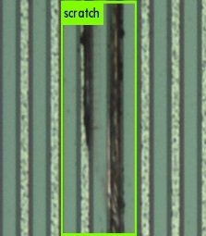
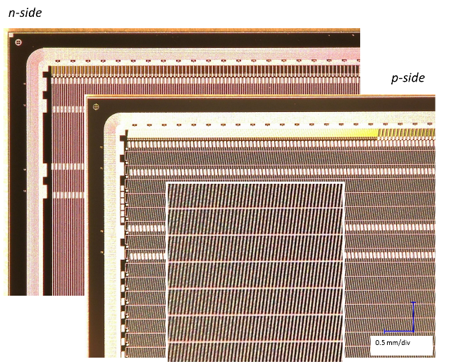
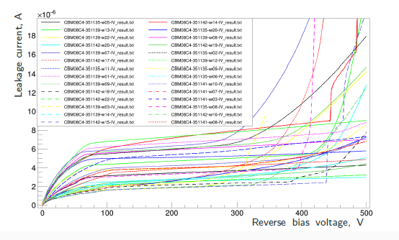
Double sided microstrip silicon sensors
CiS
Quality assurance of the sensors
Final product inspection at the vendors: detailed data
Quality inspection at JINR has been advanced:
  full inspection during prototyping, sample tests during series production
  sophisticated optical and electrical methods established
  charge collection tests before/after irradiation, S/N determination
6.2 x 2.2 cm²
6.2 x 4.2 cm²
6.2 x 6.2 cm²
Hamamatsu
Thickness: 300 μm
Pitch: 58 μm
Stereo angle: 7.5°
400 sensors are already ordered and arrived at JINR

Slide 7
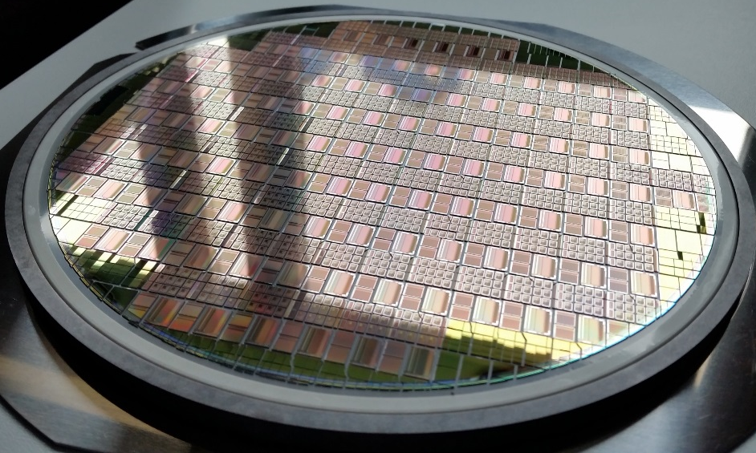

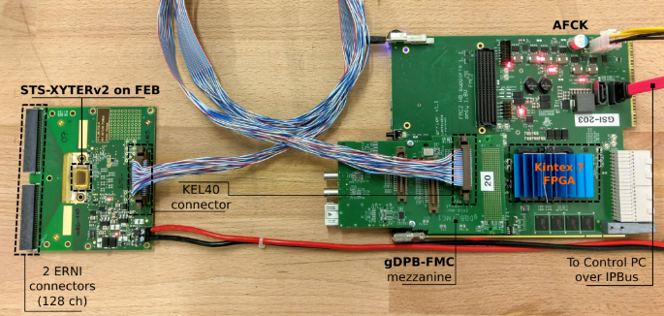
STS/MUCHXYTER ASIC
produced in 9/2016
128 channels+ 2 test channels
Self triggered architecture
Maximum data rate: 250 kHz/channel
5-bit amplitude measurement
  - shaper_{slow}+ ADC
  10 bit DAC for effective slow path threshold setting (~200 e resolution)
  time stamp measurement
  - shaper_{fast} + discriminator
  Dynamic range: 16 fQ at STS mode
  Noise performance for slow shaper: 1000 enc at 30 pF input
  Time stamp resolution: 1 ns
Test bench for characterization
of the ASIC
Test socket for the ASIC-tab-bonds
CBM STS-XYTER 2.1 and SPADIC 2.2 Submission Review (15.03.2018)

Slide 8
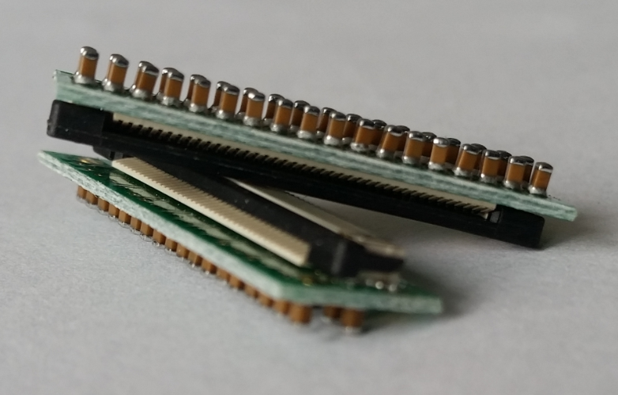
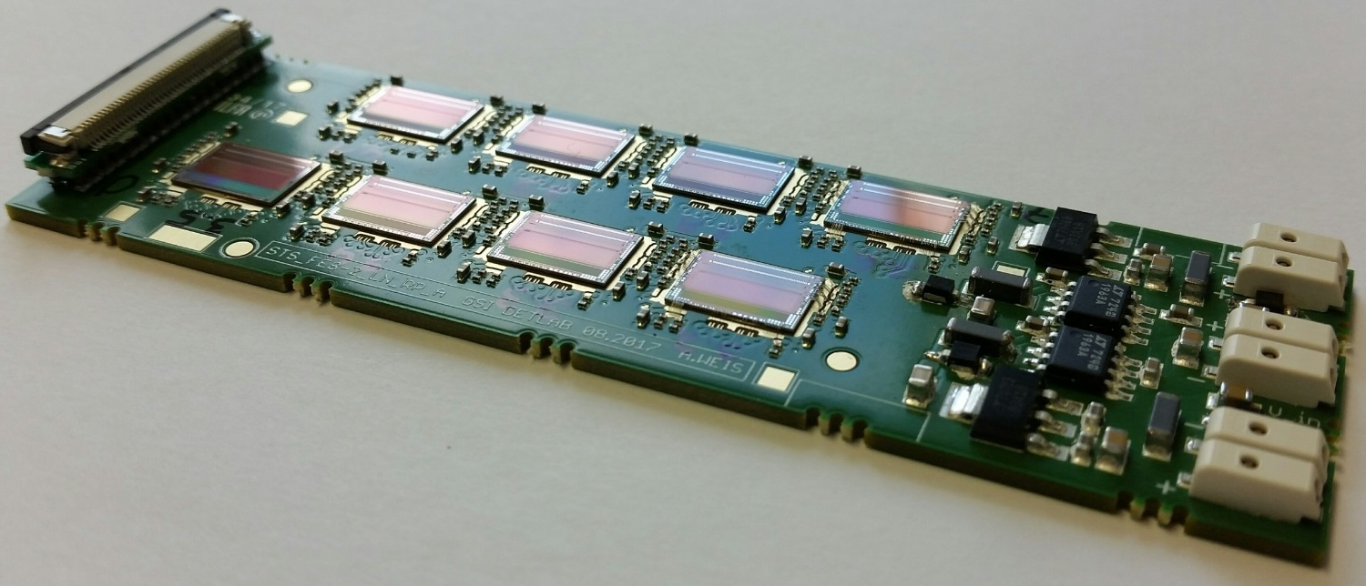
Front-end Boards with 8 STSXYTERS (FEB-8)
Size very much determined through available space: 101.5mm x 30.6mm
Digital signal coupling, crossing ~500V DC sensor bias
Powering: low drop skimming regulators (dedicated development SCL Chandigarh)
ZIF-digital signal connector – for 5, 2 and 1 uplink per chip
10-layer board allows routing of 2 uplinks per chip
5 uplinks per chip may be feasible with 14 layers
Production at AGH-Krakow
Development activities at AGH-Krakow (Lukas Mik) and GSI

Slide 9
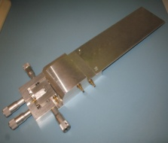
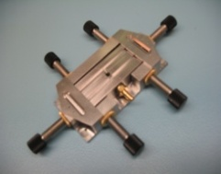
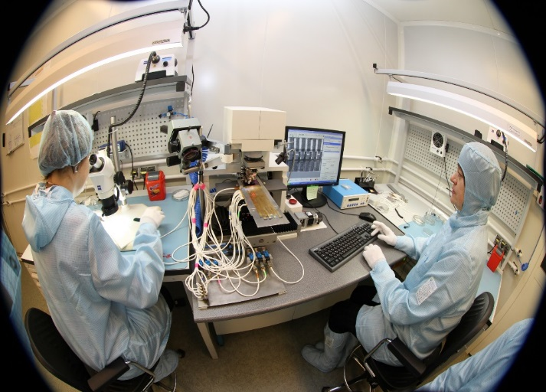
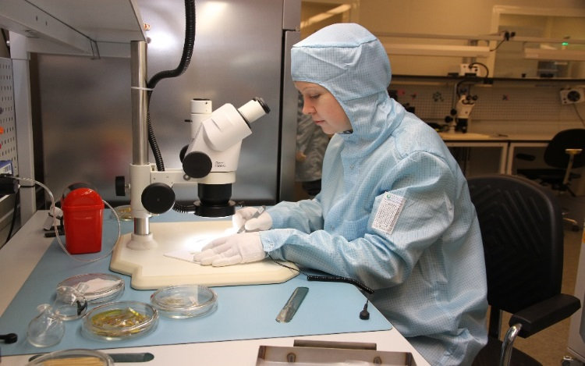
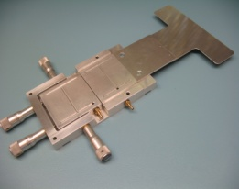
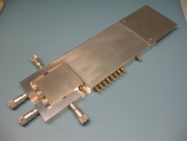
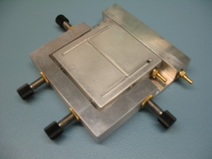
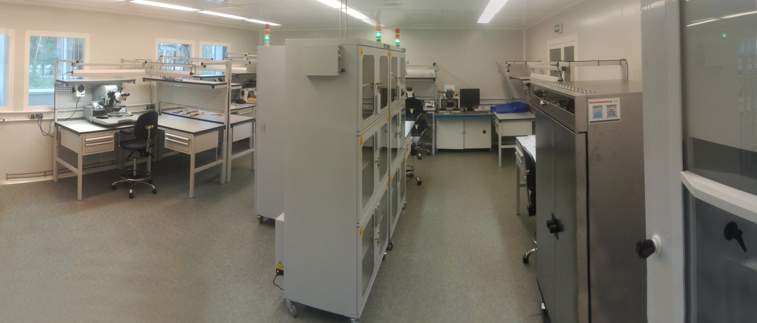
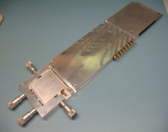
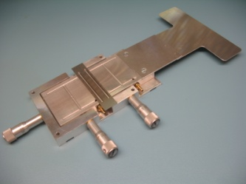
Module assembly site at JINR LHEP
The main room (90m² ) is class 7 ISO (less than 10 000 p/ft³ < 0.5 mkm)
4 technicians are currently involved in module assembling
jigs for the module assembling

Slide 10
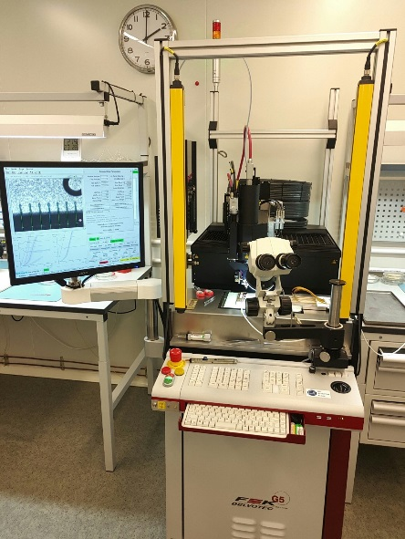
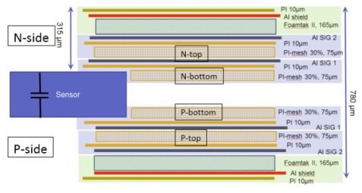
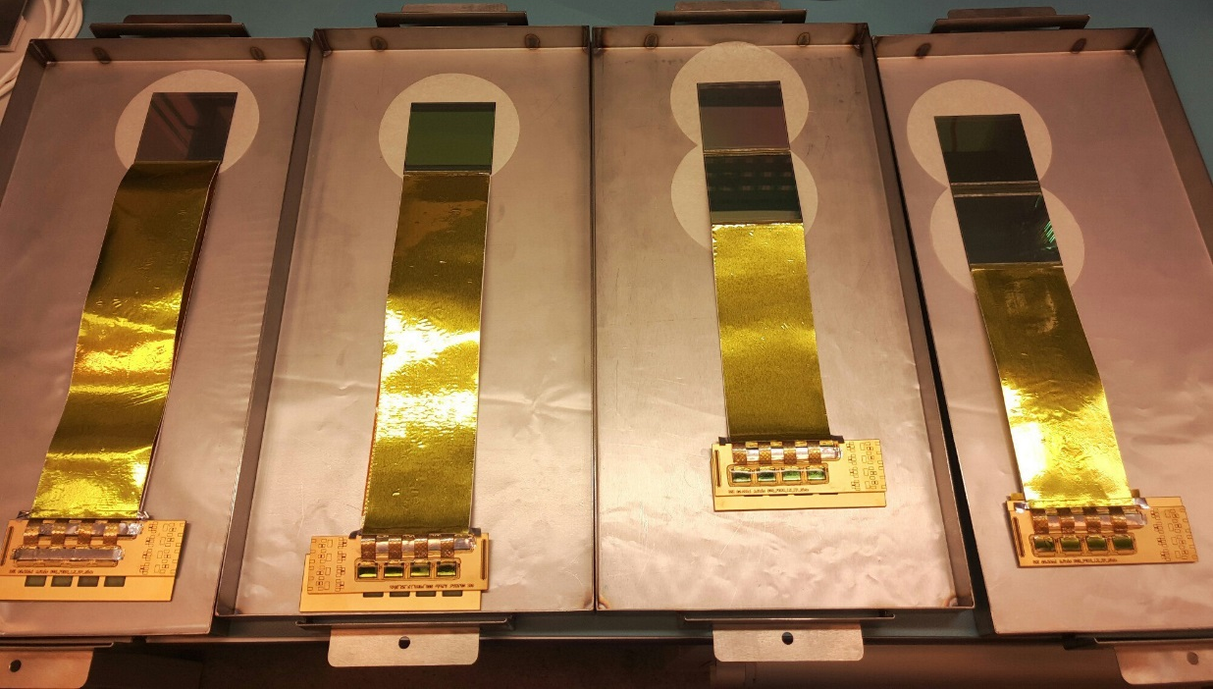
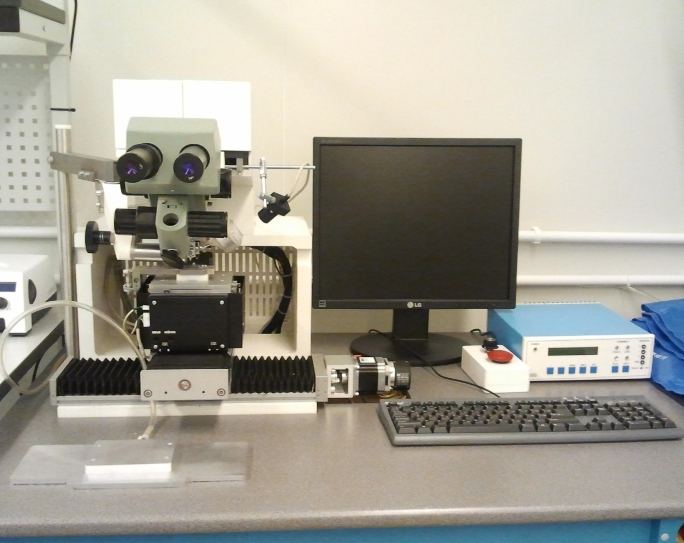

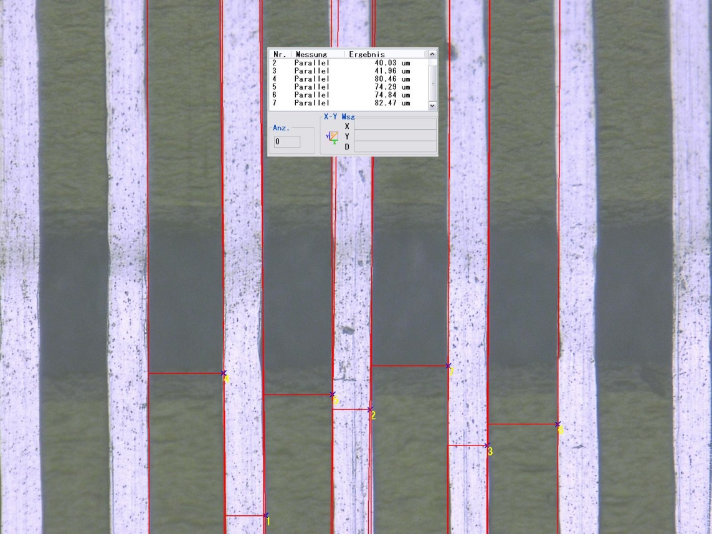
Modules
Microcables from Al-polyimide
Wirebonder F&K Delvotec G5
Measurement:
C_line = 0.38pF/cm
Mockups of the STS modules
About 420 components are in assembly process at different stages
TabBonder Planar EM-437
distance between traces varies from 74 to 82 µm

Slide 11
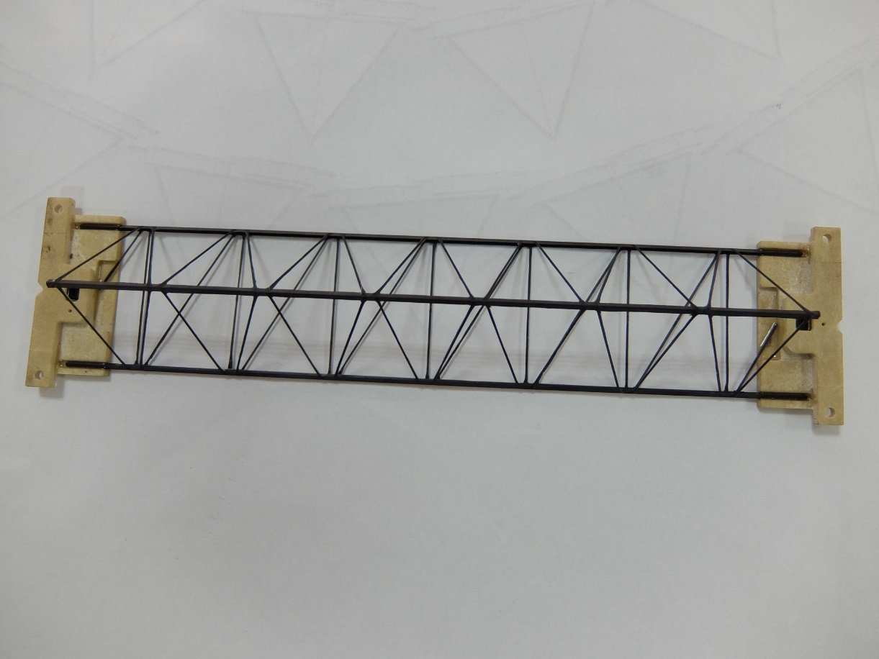
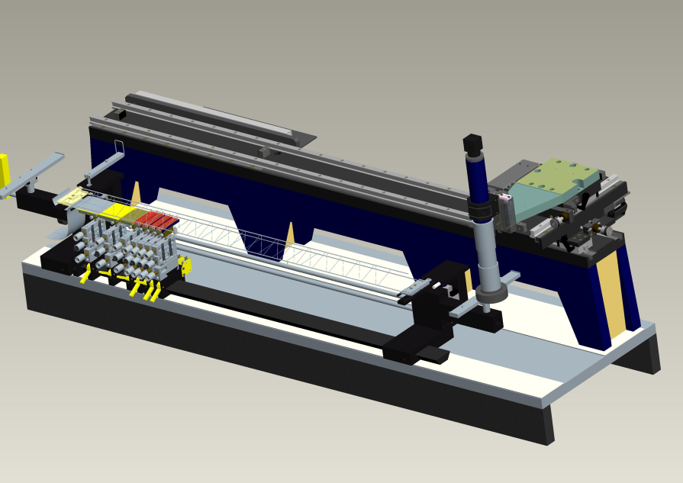
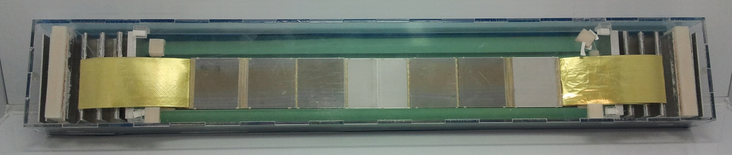
Ladder assembly
Design by S. Igolkin (CERN)
Material: CF prepreg M55J/ 334EU
Modulus of composite 32800Gpa
Total weight: 10,4 g/m
Ladder assembly device
40 CF frames were already produced (this is already enough for BM@N,
production for the CBM@FAIR is under discussion)
The precision of the sensor orientation:
X coordinate ±50 mkm
Y coordinate ±15 mkm on 1200 mm base
±12 mkm on 180 mm base
Z coordinate ±50 mkm
FEB box
Si sensors
FEB box
Mockup of the ladder

Slide 12
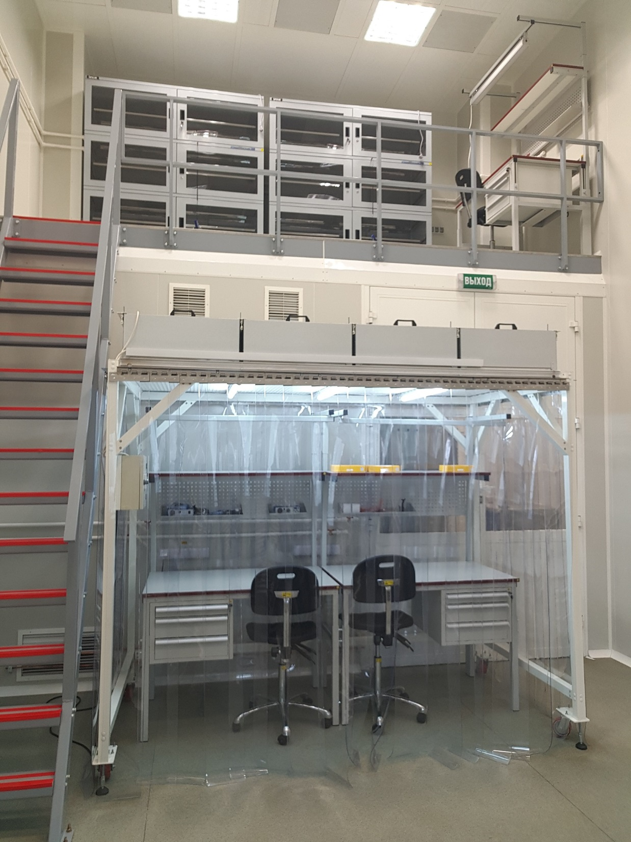
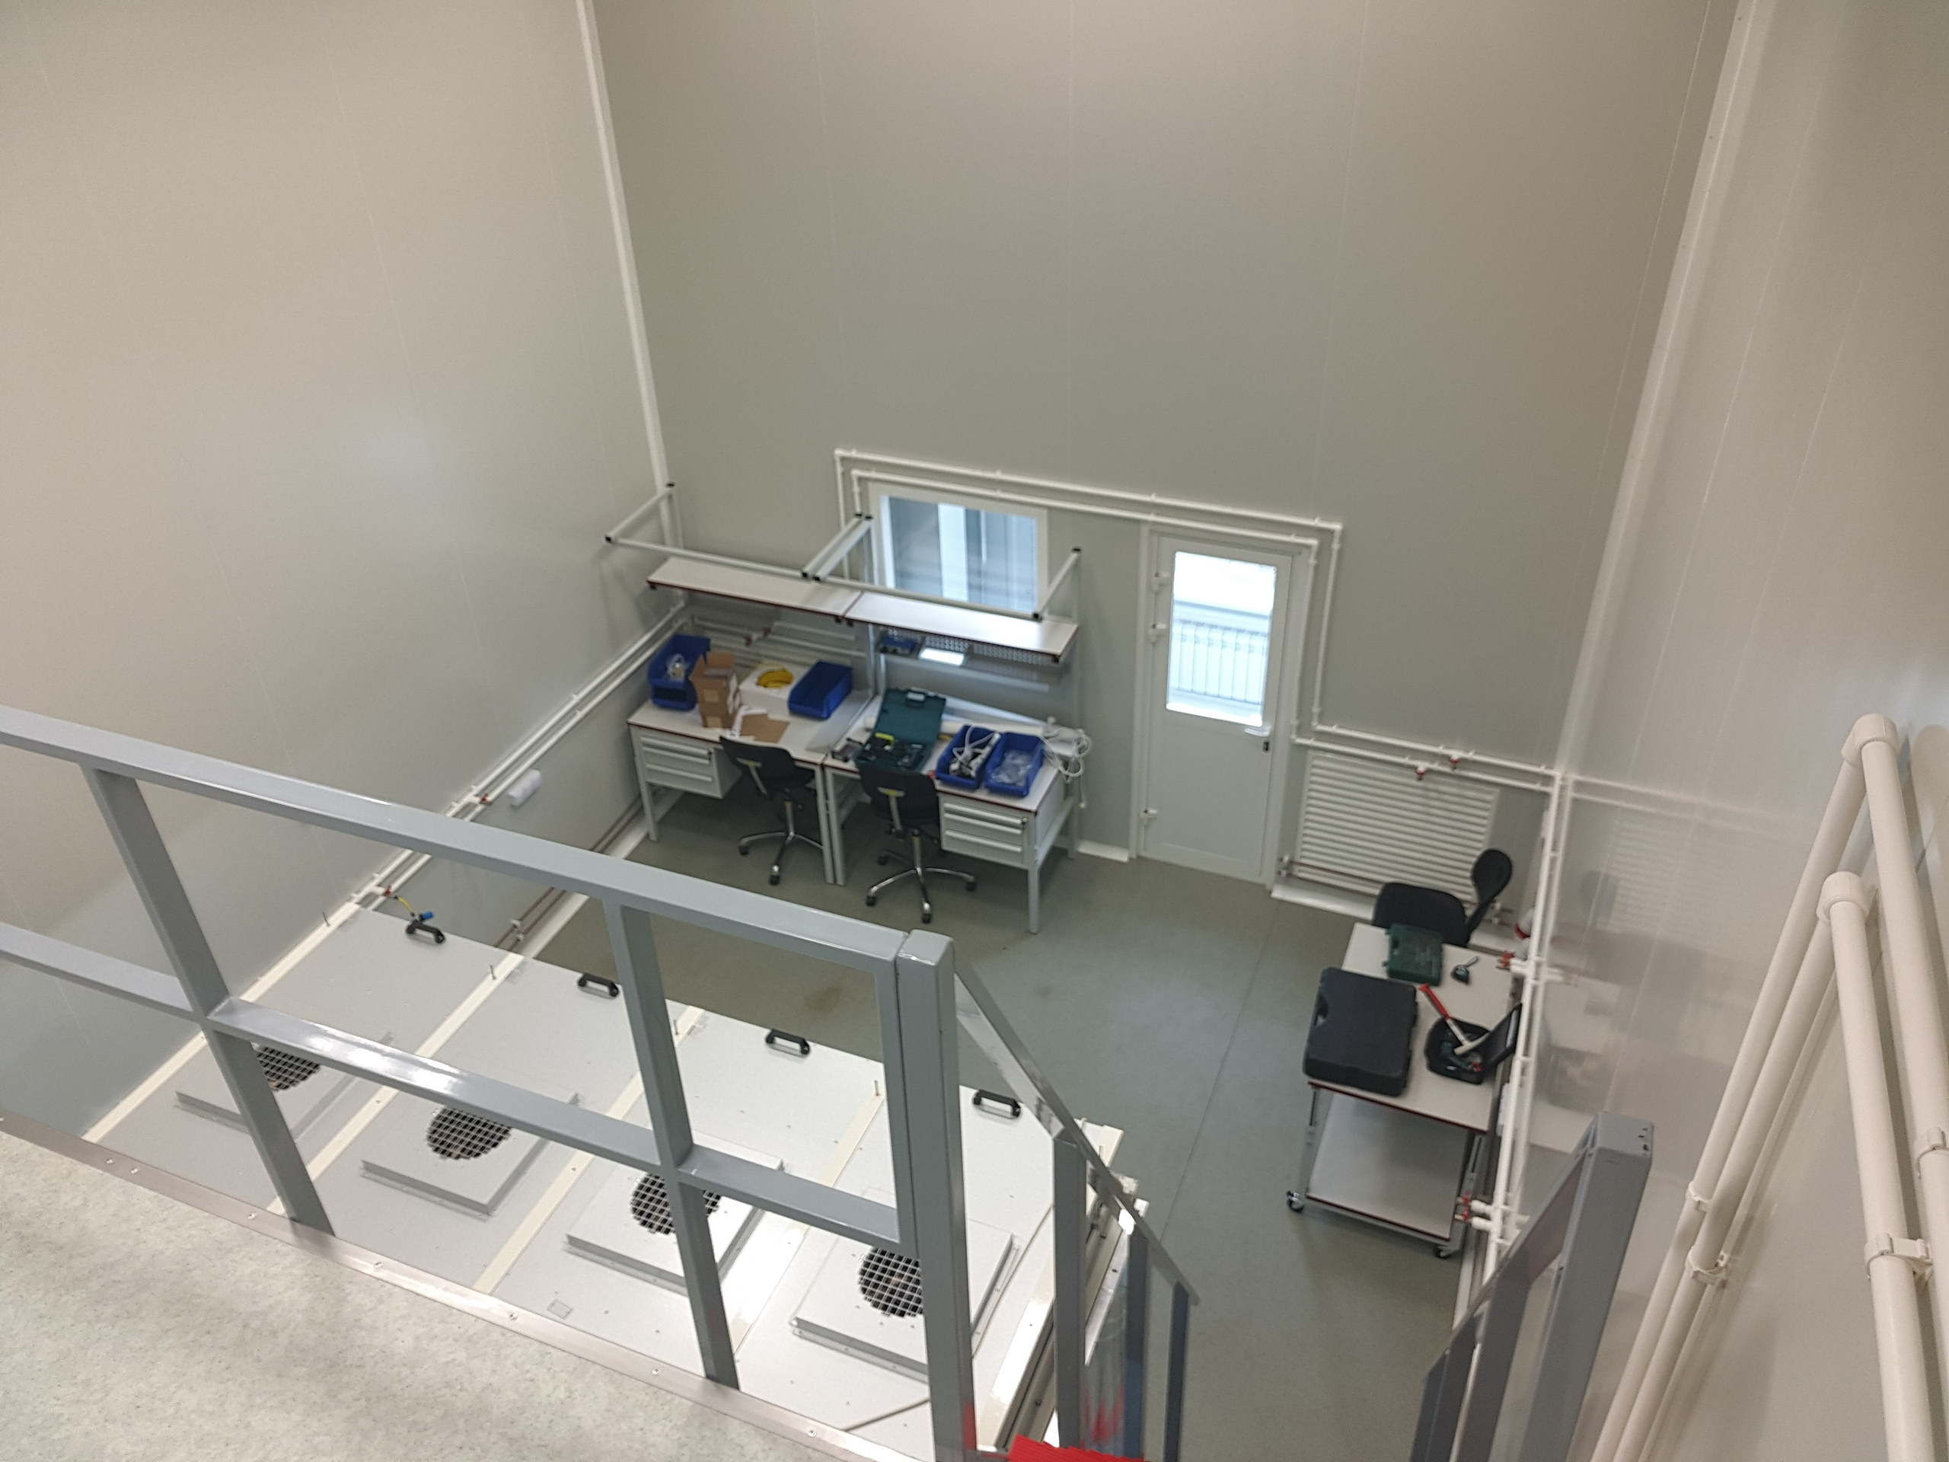
Ladder assembly site

Slide 13
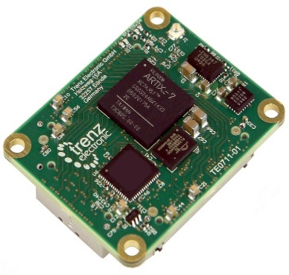
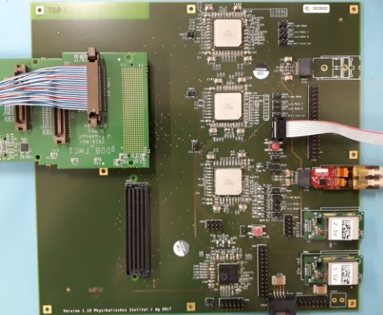
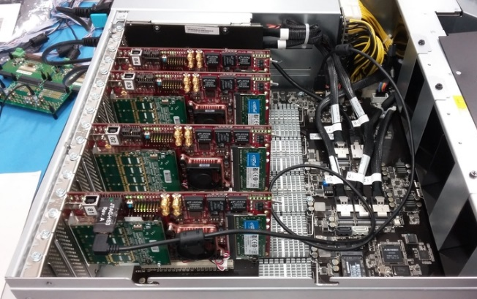

Detector readout chain
STS modules
8 STS-XYTER v2.0 on FEB-8
Common GBTx Readout Board
based on radiation hard GBT and Versatile Link components developed at CERN
→ all components purchased
fully featured prototype currently being tested and commissioned (CROB - larger than final board)
FLES IN node with FLIBs
GBTx ASIC military graded by IBM!
Banned for export to Russia
Copper
link
Longer cables (~5 m)
80 Mbit/s per link instead of 320 Mbit/s
Optical link
Xilinx Artix 7 FPGA board
on detector
off detector

Slide 14


HighRose Digital Signal Cable FH41
Signal transmission tested (GSI-Team)
20 differential pairs, shielded 0.5mm pitch HighRose cable
ZIF-connector – 80cm differential pair – ZIF-connector
Beautiful Eye-Pattern at 800 MHz suggest : 1600 Mbit/s feasible → targeted 80 Mbit/s no problem!
Line to line pickup investigated: no visible crosstalk
1.25ns

Slide 15



Integration to the BM@N DAQ
Timing system of BM@N experiment is based on White Rabbit network. Supported frequencies are 125 MHz and 125/3 MHz. There is no 40 MHz clock, which is used in CBM. Two different options for STS were suggested:
To run at 125 MHz and link speed of 5 Gb/s instead of 4.8 Gb/s (still problems with PPS)
To install additional time receiver and create a time base with 40 MHz
GPS CLOCK Antenna
Time receiver
Current bandwidth of the BM@N DAQ is 1-5 GB/s. SSD storage network has much higher bandwidth, but capacity is limited.
Probability of using a ring buffer for the data storage before receiving of a trigger decision is suggested. Alternative solution is to use embedded computers for that.
WR switch
WR switch
slaves
slaves

Slide 16



In-beam tests: COSY 2018
Achieved noise level: 1.2 ke
Silicon sensor online monitor

Slide 17

In-beam tests: mCBM
Activities towards prototype station assembly, construction of mSTS for mCBM@SIS18
(GSI, 2018)
Small scale pilot version of the detector involving pre-final components – before BM@N and CBM.
Very important project requiring joint effort of all groups involved.
JINR team will provide 2 detector layers with ladders from JINR production, for runs in 2019.
mSTS system mechanical design, fully detailed

Slide 18




In-beam test: Linac-200 JINR FLNP
beam
STS 0
STS 1
STS 2
S 0
S 1
2 m
uTCA crate
with DPB
boards
Checking of the mapping with Ra-226 alpha source
STS 0: Test station with baby sensor
STS 1: Test station with baby sensor
STS 2: Test station with STS module
S 0, S 1: Scintillator counters
Model of the test station with half-module
Test station with “baby” sensor

Slide 19

ITS for MPD experiment
Stage 2: 2022-2023
Installation of ITS and thin wall Be beam pipe
JINR appeals for the Know-How transfer to build 5-layer ITS of the ALICE ITS Upgrade type with increased length of ladders to fit the NICA/MPD Interaction diamond parameters
MoU was signed
Radiation length for the IB ~ 0.3% X0
for the OB~0.8% X0

Slide 20





ALPIDE – Monolithic Active Pixel Sensor
One machine is already installed
in a clean room
130,000 pixels / cm² O(30x30x30 μm³)
Max particle rate: 100 MHz / cm²
fake-hit rate: < 10⁻¹⁰ pixel / event

Slide 21


ITS for MPD experiment
Pointing resolution
Simulations by Valery Kondratiev, SpBSU, SpB
Reconstructed Λ-hyperon invariant mass spectrum (p_{t}<0.6 Gev)
A. Zinchenko et al
5 Layers of ITS with a beam pipe diameter less than 40 mm
will allow identification of open charm particles
MPD ITS based on ALICE type staves
.

Slide 22
ITS in a nutshall
IB stave
OB stave

Slide 23
Work plan
To transfer Know-How on MAPS ITS from CERN to NICA
To design the ITS out of new ALICE ITS components with minimum changes and need for additional R&D
To build the outer layer(s) with all mainframe and installation mechanics completed by the time of the MPD commissioning (2022)
To complete MPD ITS by 2025-26 and install it during NICA LS1 together with Be-pipe of reduced diameter

Slide 24
Plans for 2018
To sign the Protocol on Agreement CERN -JINR
To send 3 key assembly persons to CERN
To write & sign Addendum for CERN delivery of ALPIDE,SAMPA, etc. and transfer the money to CERN to be able to start assembling of HICs OB at LHEP in 2019
To write the Technical Proposal for MPD/ITS : (1) mechanical sketch design including jigs for ITS installation; (2) ITS optimization through computer simulations
To procure/install the basic equipment for assembly of HIC (ALICIA-8)

Slide 25

Thank you for your attention!

Slide 26

Motivation for study of charm production at NICA
  Heavy charm quarks are produced at the very initial stage of the collision of the heavy ions to witness the CBM(NICA,FAIR) or QGP (RHIC,CERN) . C-quarks re-scattering by CBM is the right way to study CBM at NICA
  C-quarks interaction with cold nuclear matter has an exciting perspective at NICA since the estimated yields for the production of the hypothetical light supernuclei _{c}Hе³ and _{c}Hе⁴ indicated feasibility of the experimental search at NICA and not anywhere else at the moment
      From the experimental point of view production of open-charm particles in the energy range of NICA is a complete terra incognita

Slide 27

Physics motivation for a study of charm in cold nuclear matter
J. Steinheimer, A. Botvina, M. Bleicher arXiv:1605.03439v1
Dubna model and coalescense by late K.Gudima

Slide 28


Expected yields of the C-probes
K⁻
D⁺
π⁺
π⁺
At the highest energies NICA luminosity will reach values of L=10²⁷ cm²s⁻¹ and the gold-gold collision rate of 5 kHz with the estimates for the number of registered open-charm particles in a two-week run of NICA/MPD as follows
Decay | Multiplicity | сτ, μ | BR,% | Eff,% | Number of events
D⁰->K⁺π- | 0,1 | 123 | 4 | 2 | 48 10³
Dbar⁰->K⁻π+ | 0,1 | 123 | 4 | 2 | 48 10³
D⁺->K⁺ π-π+ | 0,1 | 312 | 7 | 1,5 | 63,5 10³
D⁻->K⁻ π-π+ | 0,1 | 312 | 7 | 1,5 | 63,5 10³
D⁺_{s}-> K⁺ K⁻ π+ | 0,1 | 150 | 3 | 1,5 | 27,2 10³
Λ⁺_{c}-> pK⁺ π- | 10⁻³ | 60 | 6 | 0,1 | 363
Λbar⁺_{c}-> pbarK⁻ π+ | 10⁻³ | 60 | 6 | 0,1 | 363
_{c}Hе³-> d+pK⁺ π- | 10⁻⁴ | 60? | ? | ? | 3,6 (?)
_{c}Hе⁴-> t+pK⁺ π- | 10⁻⁵ | 60? | ? | ? | 0,36 (?)

Slide 29

ALICE Monolithic Pixel Detector
CMOS Pixel Sensor using 0.18μm CMOS Imaging Process
N_{A} ~ 10¹⁶
N_{A} ~ 10¹³
N_{A} ~ 10¹³
N_{A} ~ 10¹⁸
N_{A} ~ 10¹⁸
SEM picture of ALPIDE cross section
High-resistivity (> 1kΩ cm) p-type epitaxial layer (25μm) on p-type substrate
Small n-well diode (2 μm diameter), ~100 times smaller than pixel => low capacitance (~fF)
Reverse bias voltage (-6V < V_{BB} < 0V) to substrate (contact from the top) to increase depletion zone around NWELL collection diode
Deep PWELL shields NWELL of PMOS transistors
➔ full CMOS circuitry within active area

Slide 30
ALPIDE – ALice PIxel DEtector
1024 pixel columns
AMP
COMP
THR
130,000 pixels / cm² O(30x30x30 μm³)
spatial resolution: ~ 5 μm (3-D)
Max particle rate: 100 MHz / cm²
fake-hit rate: < 10⁻¹⁰ pixel / event
Power : ~ 300 nW /pixel
zero suppression
zero suppression
zero suppression
zero suppression
512 rows
continuous
or
external trigger
Bias, Data Buffering, Interface
Spatial Resolution & Cluster Size
50μm thick
pads over matrix

Slide 31
The status of the MPD-ITS
J. Steinheimer, A. Botvina, M. Bleicher arXiv:1605.03439v1

Slide 32
Work Plan for 2018
To sign the Protocol on Agreement CERN -JINR
To send 3 key assembly persons to CERN
To send 3 key assembly persons to CERN
To write & sign Addendum for CERN delivery of ALPIDE,SAMPA, etc. and transfer the money to CERN
to be able to start assembling of HICs OB at LHEP in 2019
To write the Technical Proposal for MPD/ITS : (1) mechanical sketch design including jigs for ITS installation; (2) ITS optimization through computer simulations
To procure/install the basic equipment for assembly of HIC (ALICIA-8)

Slide 33
Towards Technical Proposal
Pre-design!

Slide 34
Strange hyperons identification ( Λ₀)
Towards Technical Proposal: Simulations
J. Steinheimer, A. Botvina, M. Bleicher arXiv:1605.03439v1

Slide 35
Cascades hyperons identification (Ξ⁻)
Towards Technical Proposal: Simulations
J. Steinheimer, A. Botvina, M. Bleicher arXiv:1605.03439v1

Slide 36
Strange hyperons identification Λ⁺_{c}
Towards Technical Proposal: Simulations
J. Steinheimer, A. Botvina, M. Bleicher arXiv:1605.03439v1

Slide 37

Towards Technical Proposal: General Mechanical Layout
Sketch design by S.N.Igolkin will start September 2018
Key task: To design of the
mainframe and jigs for its
integration with TPC and BP within a year and tune the flow of components for assembly OB at JINR

Slide 38

Towards Technical Proposal: Interfaces
In TPC
?
Proposed for MPD
As done in ALICE

Slide 39
Critical issues of the MPD/ITS project and ways for remedy
Absense of 3 “leutenants” in the fields pointed by Musa
Decision of JINR Director to overcome the standard flow of procurement and transfer the money without delay to CERN
Getting an export license on ALPIDE (SAMPA?)
Finding a Deputy for me of a rank of “a captain” to carry on the project after my retirement

Slide 40
Perspectives for Internationalization
Italy, China, Germany, Poland, UK
Hiring foreign postdocs with salary from CREMLIN+ (starting 2019)

Slide 41



MPD/ITS physics case is well justified and has a potential of discovery of super nuclei
After signing the Protocol with CERN the project got a ground for a start
Strategic plan is worked and agreed with CERN
However, the general status to the moment is “just started”
THANK YOU FOR YOUR ATTENTION!

